Slide 1
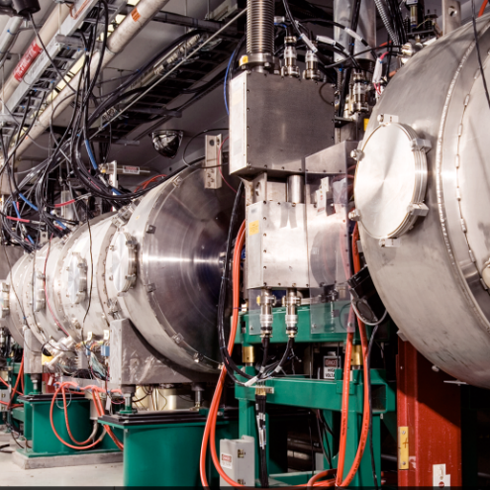
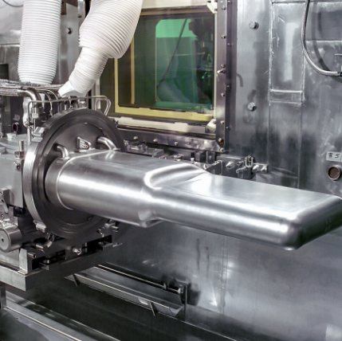
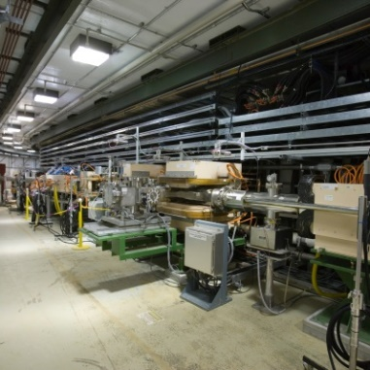

P.05.10.02 FTS Safety
DOE/SC Independent Project Review of the Proton Power Upgrade Project.
Jacob Platfoot
Level 4 for FTS Safety
September 14 - 17, 2021

Slide 2
Outline
Scope
Organization
Status
Progress since CD-2/3
Challenges
Responses to recommendations
12-month look-ahead
Summary

Slide 3
Scope
Charge: 1
Develop accelerator safety documentation to support FTS upgrades associated with PPU
  Evaluate potential hazards associated with upgrades to mercury target gas injection
  Evaluate potential hazards associated with o/p catalytic converter modules in the moderator cryogenic system
  Evaluate the effects of increased proton beam energy on FTS systems
  Develop performance requirements to support design of the Beam Power Limiting System

Slide 4
Accelerator and Target Advisory Committee
Stuart Henderson, Chair
Neutron Sciences Directorate
Associate Laboratory Director Ken Andersen
Proton Power Upgrade Project
Director – John Galambos
Project Manager – Mark Champion Project Controls Lead – Wayne Steffey Partner Lab Senior Team Lead – Ed Daly Technical Director – Sang-Ho Kim
Controls Integration Manager – Karen White
ESH&Q – Sam McKenzie
Sr. Administrative Assistant – Angie Woody
Management Advisory Committee
Les Price, Carl Strawbridge
Project Management Mark Champion
SCL Systems
Matt Howell
RF Systems
John Moss
Ring Systems
Nick Evans
First Target Station
Bernie Riemer
Conventional Facilities Mark Connell
R & D
Nick Evans
Pre-Ops
Glen Johns
Project Support Wayne Steffey ESH& Q
Sam McKenzie
Cavities
John Mammosser
Cryomodules Ed Daly Cryogenics Brian Degraff Utility Systems Chris Stone
System Integration John Mammosser SCL Controls Karen White
SCL HPRF
John Moss
NCL HPRF
John Moss
LLRF
Mark Crofford Existing Linac Modulators Chris Pappas
New Linac Modulators David E. Anderson Utilities
Greg Norman RF Controls Karen White Global Controls
Karen White
Injection Region Robert Saethre Injection Dump Charlotte Barbier Extraction Region Robert Saethre Utilities
Greg Norman
Ring Control Systems
Karen White RTBT Stub Nick Evans
Accelerator Physics
Nick Evans
Neutronics Franz Gallmeier Mercury Process Makayla Edwards
Moderator Cryogenic Systems
Bernie Riemer(Interim) Vessel and Shielding Systems
Oscar Martinez
Target Utility Erica Ahlschwede Instrument Systems
Oscar Martinez
MOTS
Greg Stephens 2 MW Target Kevin Johns
Safety, Controls and Operations
Charlotte Barbier Gas Injection Development Charlotte Barbier
Building Modifications
Mark Connell
Gas Injection Development Charlotte Barbier Foil Development Nick Evans
Commissioning Glen Johns Regulatory Compliance Glen Johns

Slide 5
Status of P.5 Safety Items
Charge: 3
All HAR topics analysis complete ready for FSAD-NF
  Increased beam particle energy effect on target spallation product inventory (HAR Section 2)
  Increased beam particle energy effect on core vessel component heat distribution (HAR Section 3)
  Helium injection inside target module up to 20 L/min (HAR Section 5)
  Addition of catalytic converter to each cryogenic moderator loop (HAR Section 6)
    Increased hydrogen inventory
    Potential activation of catalyst media
FTS analysis and design input for Beam Power Limiting System is complete

Slide 6
Progress since CD-2/3
Charge: 1
CD-2/3 Look Ahead
Off-Normal analysis for gas injection + Mercury Loop
  Need to address any action items
  Finalize alarms response
Accomplishments
Completed Off-normal analysis for PPU gas injection
  Included helium supply, mercury loop, MOTS, and recirculation
Mercury process interlock review
Revision of BPLS requirement document to support SRD
B2-7 - Ahlschwede
B4-7 - Bong

Slide 7
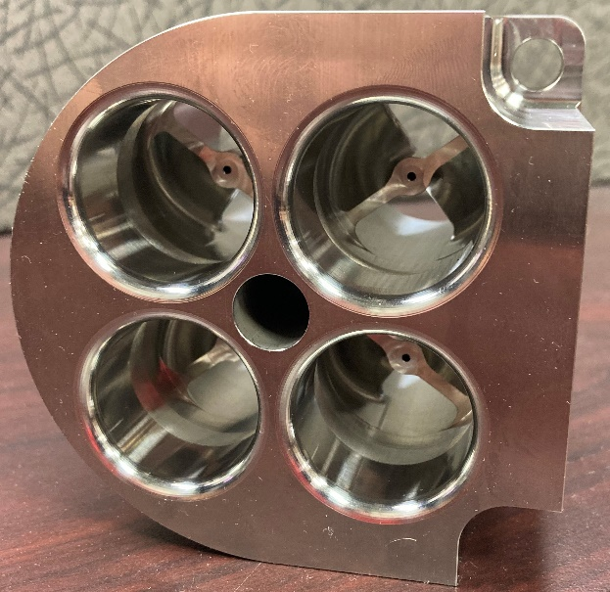
Safety Analysis Supporting PPU Target Gas Injection is Complete and Ready for Incorporation into FSAD-NF.
Central documentation is Section 5 of HAR for CD-2/3
All hazards and scenarios identified as part of Target Gas Injection Initial Implementation (GI3) have been addressed
One additional scenario requiring a
credited control was identified
Off-normal (HAZOP)
Path Forward
USIE for swirl bubbler design will be completed
prior to operation of PPU Test Target #1 (Jan-22)
Incorporate into FSAD-NF and ASE to support Pre-beam ARR for Target Gas Injection (Jul-23)

Slide 8
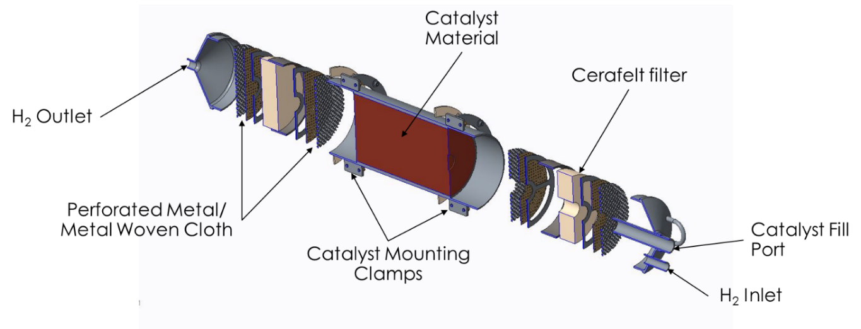
Safety Analysis Supporting CMS Modification for o/p conversion is Complete and Ready for Incorporation into FSAD-NF.
B2-6 – Riemer
Central documentation is Section 6 of HAR for CD-2/3
Two changes identified to have significant effect on safety Both have been addressed
Credited retention element in o/p catalyst modules incorporated using an ACL
Path Forward
Incorporate into FSAD-NF and
ASE to support ARR (Q1 FY24)

Slide 9
Safety Analysis Supporting Effect of 1.3 GeV Particle Energy is Complete and Ready for Incorporation into FSAD-NF.
Central documentation is Sections 2 and 3 of HAR for CD-2/3
Two changes identified to have significant effect on safety Both have been addressed
No further action needed
Path Forward
Incorporate into FSAD-NF to
support ARR (Q1 FY24)

Slide 10
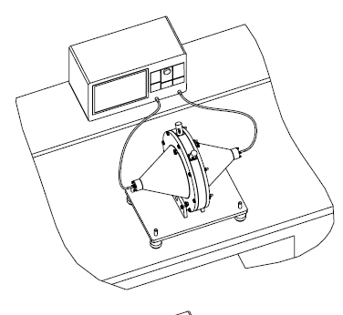
FTS Requirement Document supporting design of Beam Power Limiting System has been incorporated into System Req’t Doc.
B4-7 - Bong
Need for BPLS is described in Section 7 of HAR for CD-2/3
FTS analysis was performed to verify that FTS components, particularly CECs, are protected in bounding case allowed by BPLS
Drafted wording for Operations Envelope to be consistent with BPLS capability and FTS analysis
Path Forward
Stay up to date with BPLS design progress

Slide 11
Other Safety Effort
FTS mercury process interlock review
  Comprehensive review of process interlocks being used in the mercury process and related systems
  Ensure unified approach and prevent conflicting actions
Radiation Safety Committee review of MOTS PPU
  Evaluate source term and dose rate estimates for MOTS components outside the Service Bay after PPU modifications complete
B2-7 - Ahlschwede
B2-8 - Stephens

Slide 12


Challenges
Achieving consensus approval of FSAD-NF revision in time
  Support a timely update of the FSAD-NF prior to PPU update to resolve non-PPU related issues
  As appropriate, subdivide into documents that address specific PPU aspects so that stakeholder consensus can be obtained incrementally as material is ready

Slide 13
Risk Register
Charge: 1
Risk ID | Status | L3 WBS | Risk Title | Expiration Date | Pre-Mitigation Rank | Post Mitigation Rank
T-P.5-015 | Open | P.05.03; P.05.09; P.05.10 | Mercury loop safety basis concerns | 8/1/2023 | 12 | 6
T-P.5-024 | Open | P.05.10 | Analysis reveals additional controls and/or protection system requirements for 2 MW target. | 11/1/2022 | 12 | 6
T-P.5-016 | Open | P.05.10 | Failed certification for safety or controls during last outage | 12/1/2023 | 12 | 4
Three active risks identified
  No risks retired
  Pre-mitigated ranking: 3 Medium
  Post-mitigated ranking: 1 Low, 2 Medium
High Risks
  No high risks identified
Key risk categories analyzed
  Controls requirements
  Safety
Risks are reviewed on a regular basis

Slide 14
Responses to Recommendations
No recommendations from the CD-2/3 review

Slide 15

12-Month Look-Ahead
Complete USI Evaluation of swirl bubbler operation in PPU Test Target #1
Work with P.5.3 (CMS) and QA to ensure proper implementation of CEC requirements in procurement and fabrication of catalyst modules
Final design completion of BPLS
  Incorporation of BPLS design requirement into FSAD-PF

Slide 16
Summary
FTS Safety analysis is complete
Implementation of conclusions from safety analysis is underway
Translation of safety analysis into operational documentation is beginning.

