Slide 1




P.3.8 Linac RF Controls
P.3.9 Linac Global Controls
DOE/SC Independent Project Review of the Proton Power Upgrade Project
Alan Justice
Level 4 Manager for RF and Global Controls
September 14-17, 2021

Slide 2
Outline
Scope
Organization
Progress since CD-2/3
Challenges
Final design status
Installation plans
Cost and schedule
Labor profile
Risk register
Responses to recommendations
ESH&Q and COVID-19 impacts
12-month look-ahead
Summary

Slide 3
Scope
Charge: 1, 2
P.3.8/P.10.3.8 RF Controls
  Integrate new HPRF and LLRF into existing SNS EPICS based Control System to support 7 additional Cryomodules
  P.3.8.2 Linac HPRF Controls
    Controls support for 3 new Modulators and 5 new Transmitters
  P.3.8.2 Linac LLRF Controls
    Controls support for 28 LLRF MicroTCA Systems
SNS Controls EPICS environment
B3-3 Crofford

Slide 4
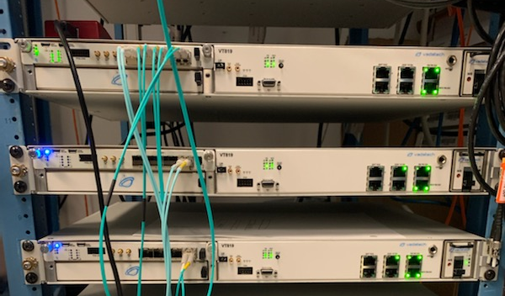
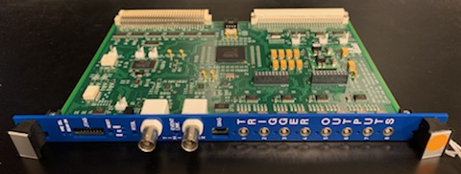
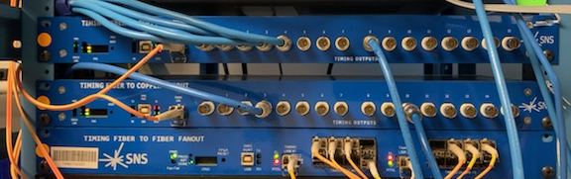
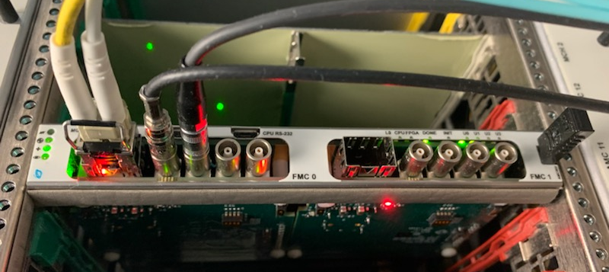
Scope
Charge: 1, 4
MPS Fast Protect Nodes
P.3.9/P.10.3.9 RF/SCL Global Controls
  P.3.9.2 Linac/SCL Timing/Machine Protection System(MPS)
    Extension of SNS Timing and MPS to devices added for PPU
    Total of 17 Timing Receiver Cards, 4 Timing Fanouts and 3 MPS Nodes
VME Timing Receiver
Timing Fanouts
MicroTCA Timing Receiver

Slide 5
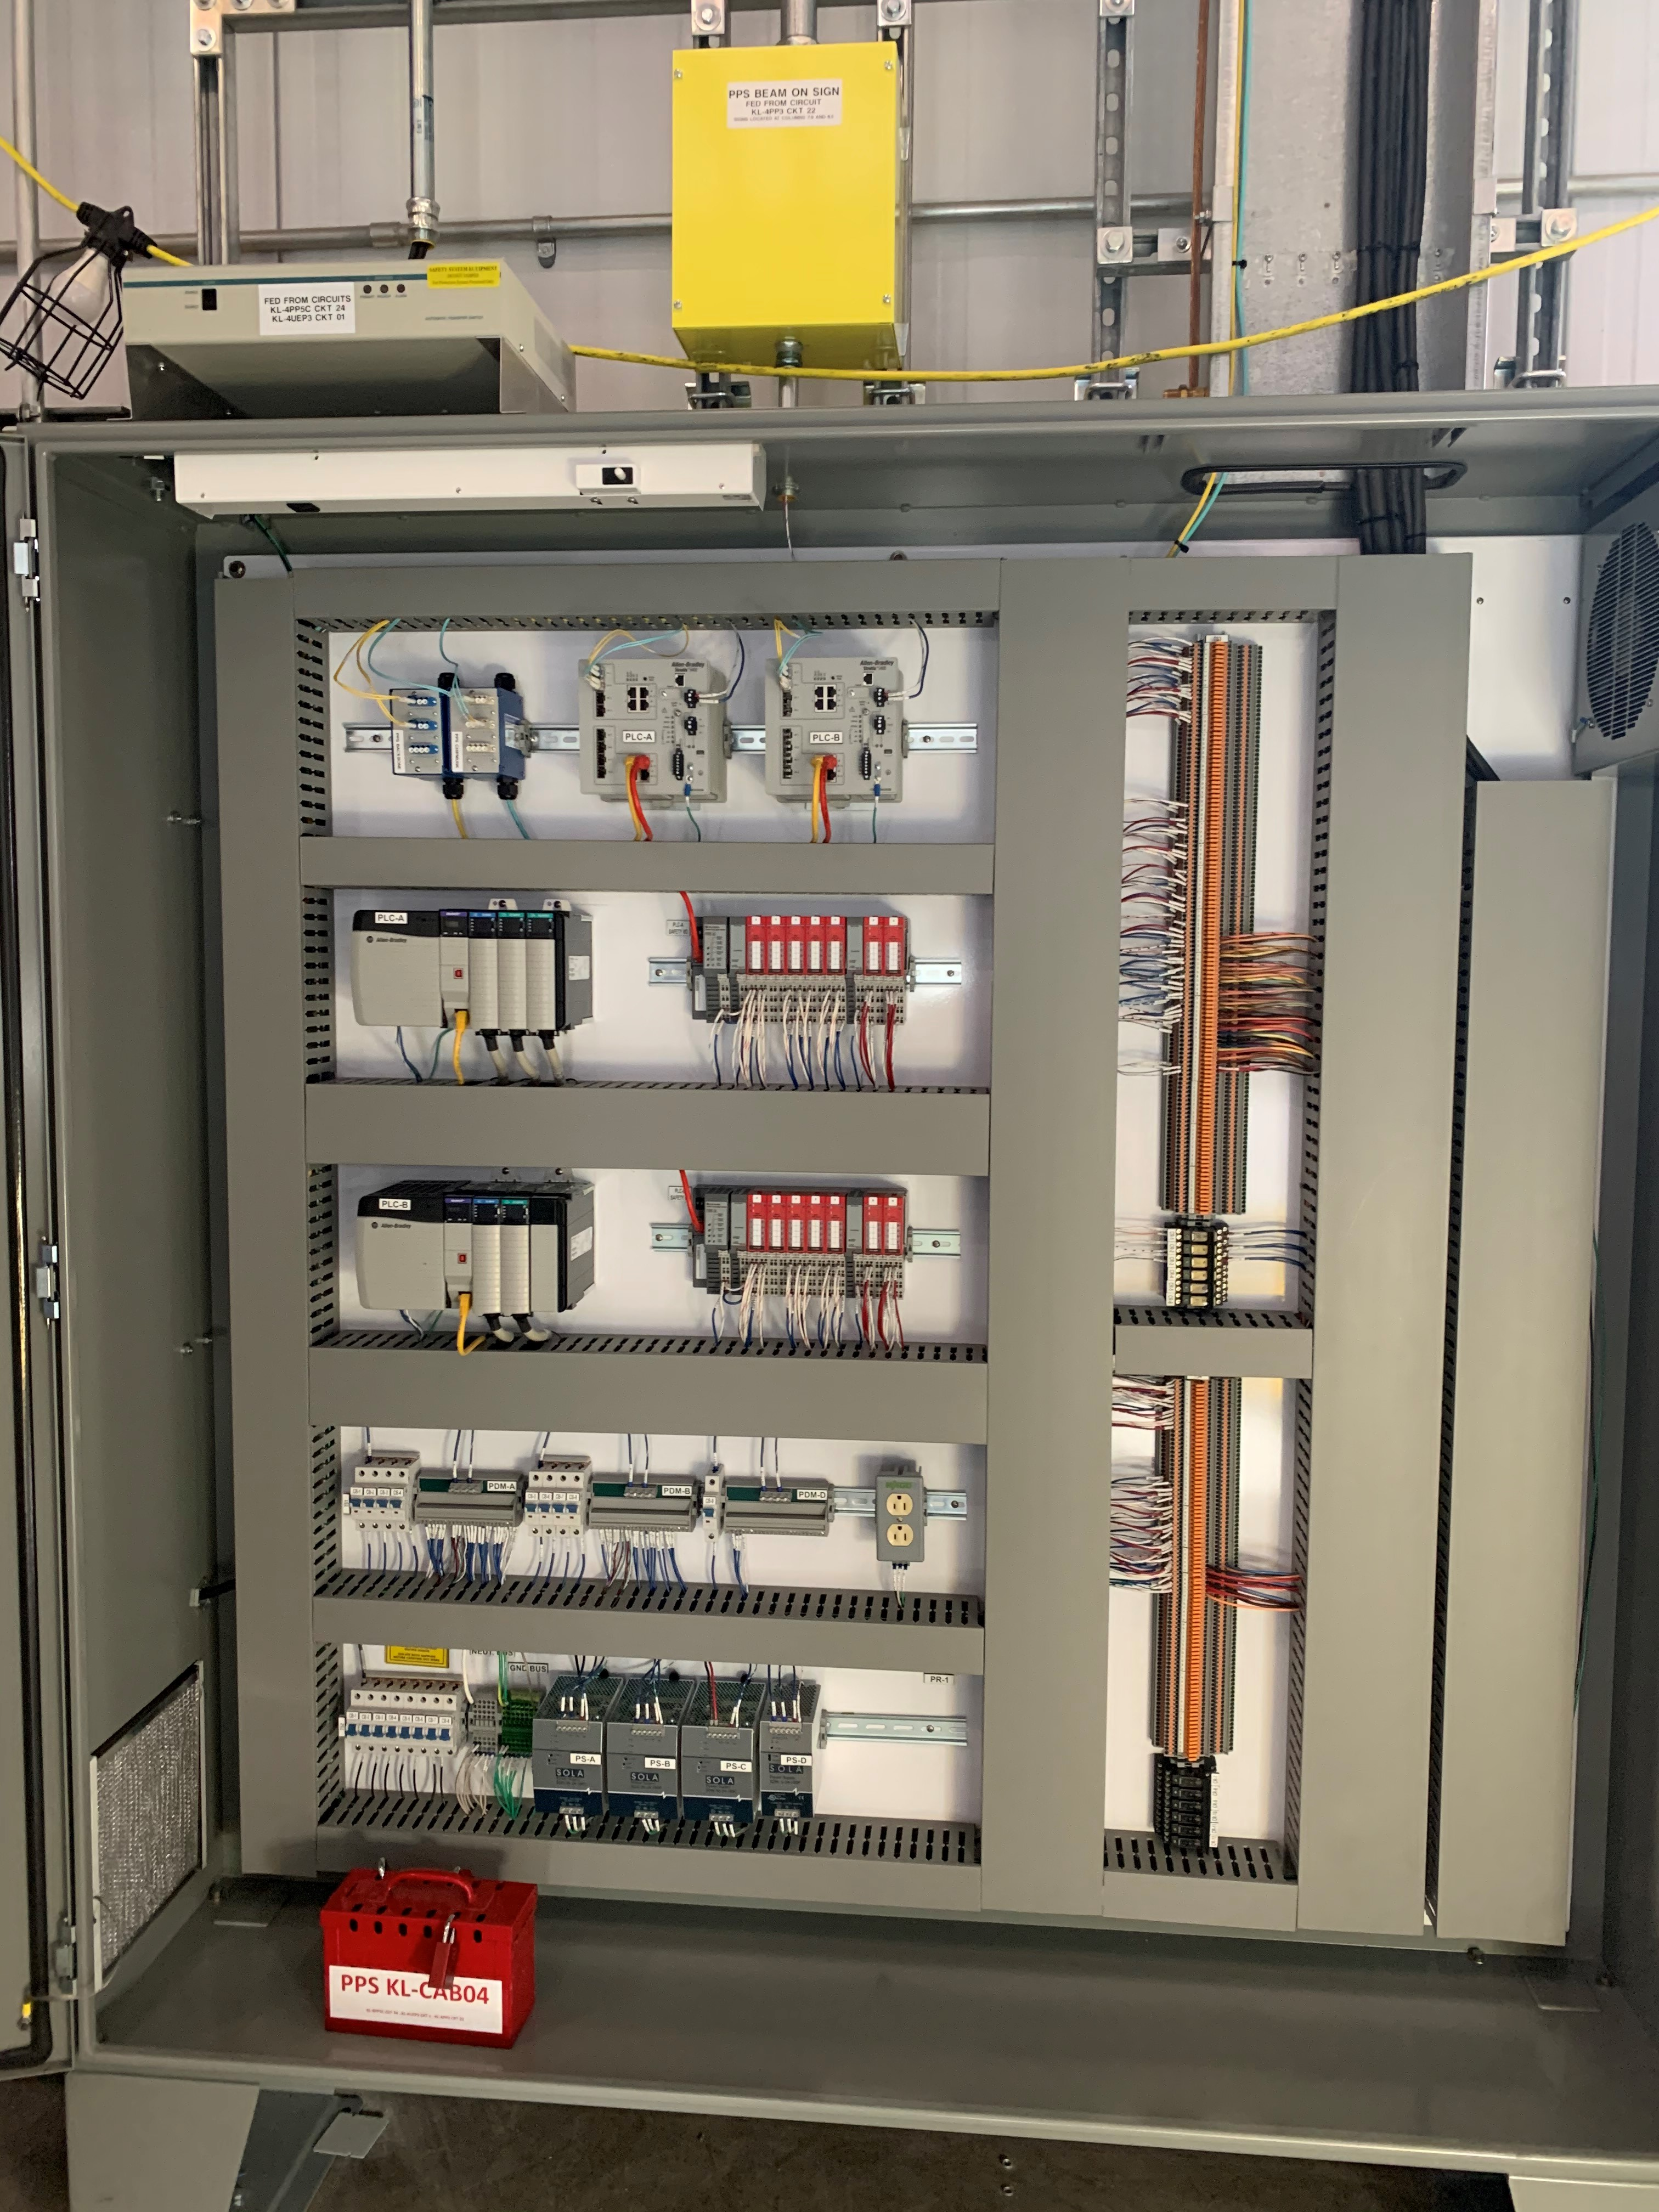
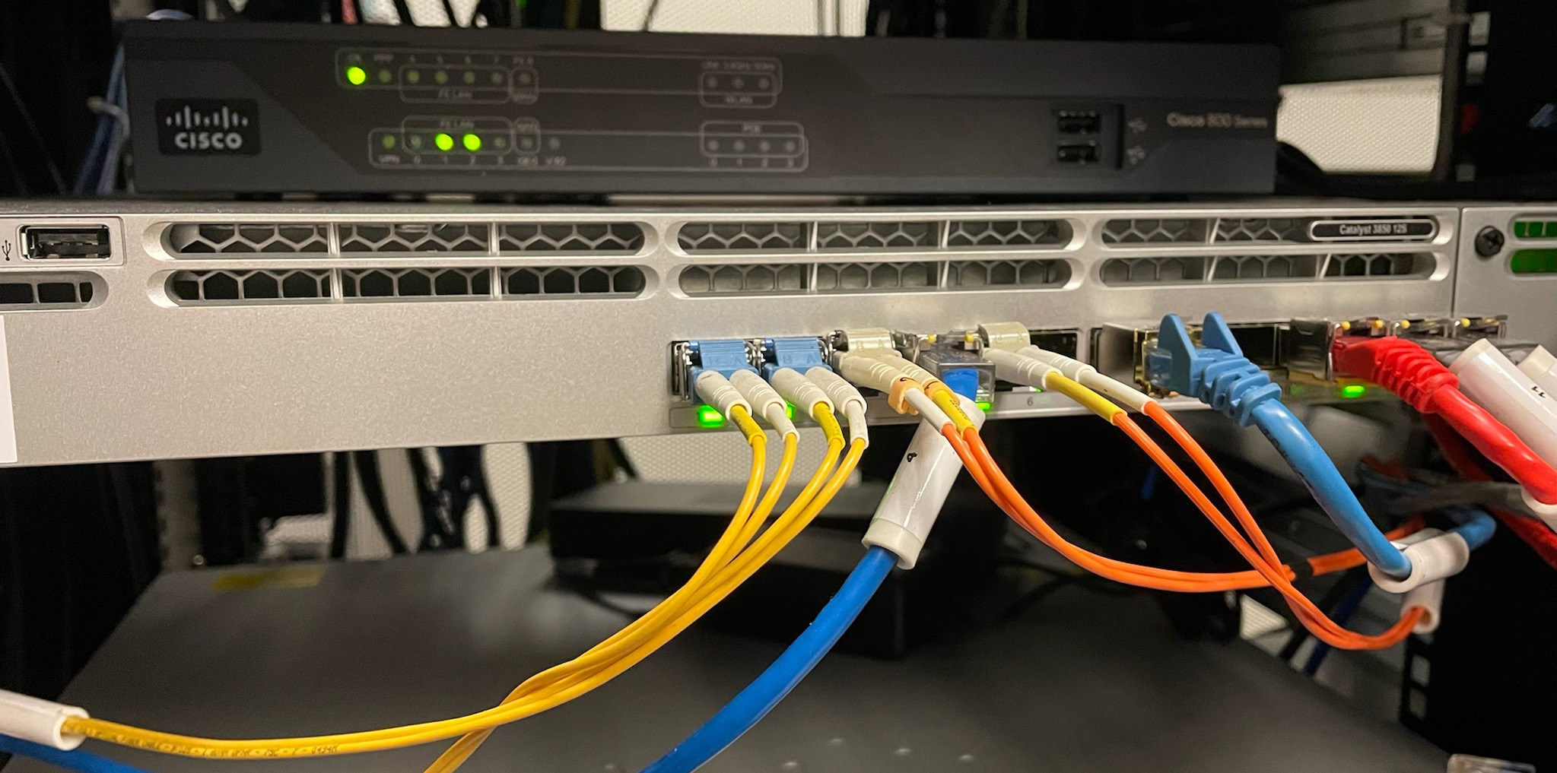
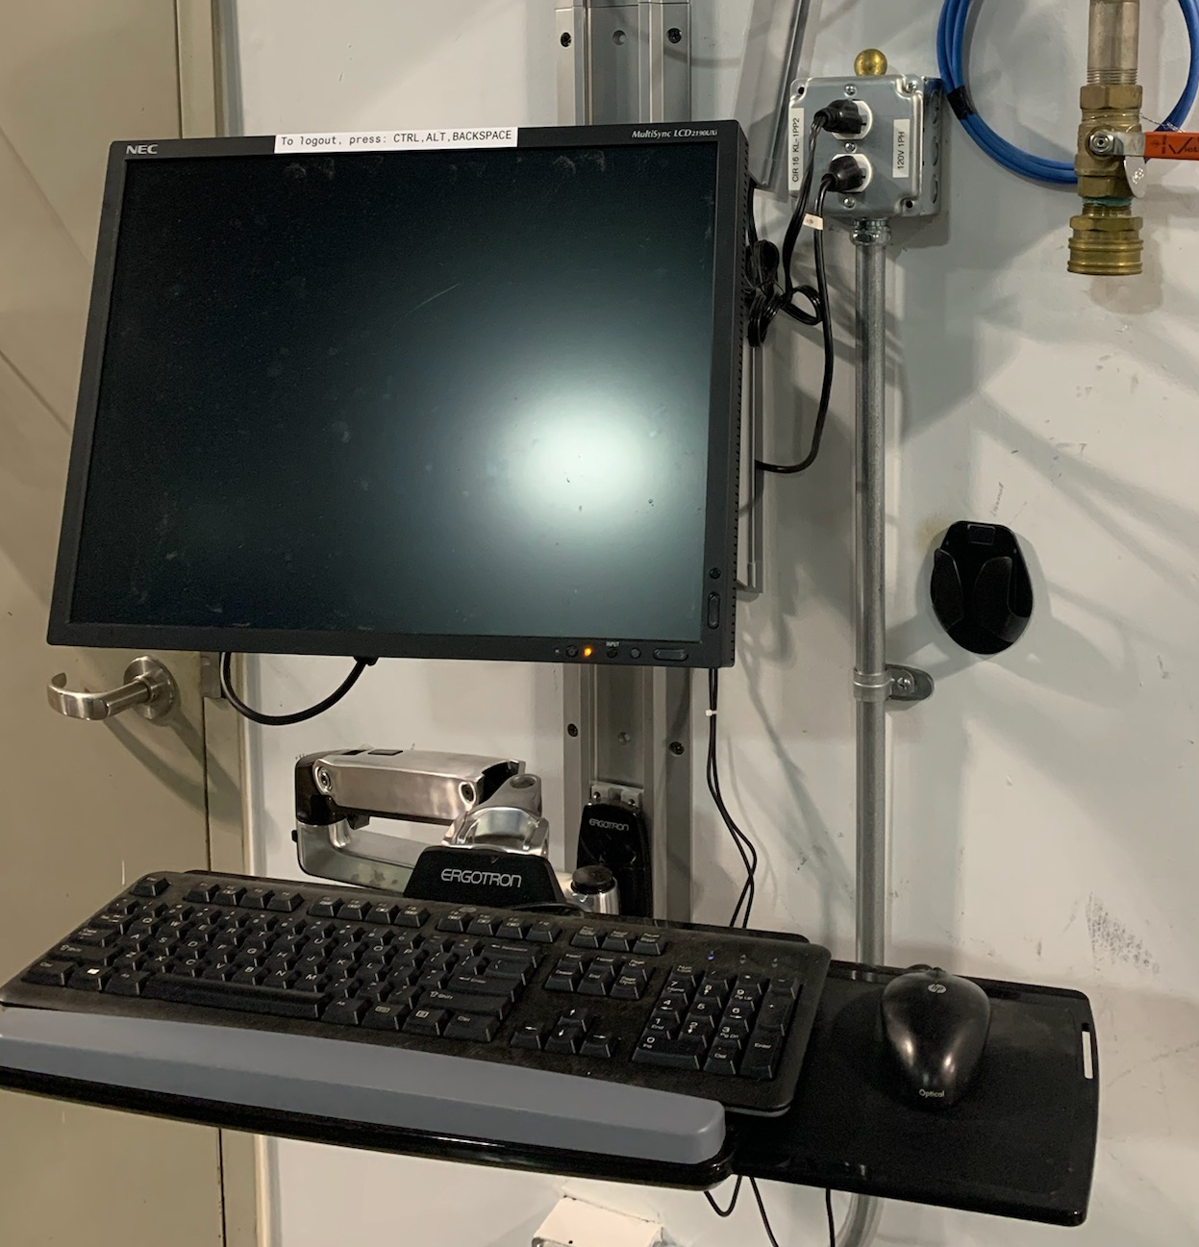
Scope
Charge: 1, 4
P.3.9 RF/SCL Global Controls
  P.3.9.3 Linac/SCL Personnel Protection
    Extension of SNS Accelerator PPS to devices added for PPU
  P.3.9.4 Linac/SCL Networking and Computing Infrastructure
    Extension of network and computing infrastructure to devices added for PPU
Network switches
PPS KL Cab04
Klystron Gallery User Terminal

Slide 6















































Organization
Charge: 5
P.3 – RF Systems
John Moss
P.3.1
Management and System Integration John Moss
P.3.2 SCL HPRF
John Moss
P.3.3 NCL HPRF
John Moss
P.3.5 Existing Linac
Modulators
Chris Pappas
P.3.6 New Linac
Modulators
David Anderson
P.3.8 RF Controls Karen White
P.3.9 Global Controls Karen White
P.3.4 LLRF
Mark Crofford
P.3.7 Utilities
Greg Norman
P.3.1.1
Management and System Integration
John Moss
P.3.2.1
Management and System Integration
John Moss
P.3.3.1
Management and System Integration
John Moss
P.3.4.1
Management and System Integration
Mark Crofford
P.3.5.1
Management and System Integration
Chris Pappas
P.3.6.1
Management and System Integration
David Anderson
P.3.7.1
Management and System Integration
Greg Norman
P.3.8.1
Management and System Integration
Alan Justice
P.3.9.1
Management and System Integration
Alan Justice
P.3.2.2
Transmitters
John Moss
P.3.3.2
Transmitters
John Moss
P.3.4.2 LLRF System
Mark Crofford
P.3.5.2 Modulator System
Chris Pappas
P.3.6.2
Transformer
David Anderson
P.3.7.2 Water Utilities, New Cold
Linac SCL RF
Greg Norman
P.3.8.2 Linac RF Controls
Alan Justice
P.3.9.2 Linac/SCL Timing/MPS Alan Justice
P.3.2.3 Klystrons
John Moss
P.3.3.3 Klystrons
John Moss
P.3.4.3 Arc Detectors
Mark Crofford
P.3.5.3 Modulator Control System Mark Wezensky
P.3.6.3 SCR System
David Anderson
P.3.7.3 Water Utilites, Modify
Existing RFQ/DTL
Greg Norman
P.3.8.3 Linac Water System
Controls
Derrick Williams
P.3.9.3 Linac/SCL Protection System
Kelly Mahoney
P.3.2.5 Circulators
John Moss
P.3.3.4 Circulators
Sung-Woo Lee
P.3.4.4 Reference Line
Chip Piller
P.3.5.4 Modulator SystemTest
Article
Chris Pappas
P.3.6.4 Modulator System
David Anderson
P.3.7.7 Electrical
Wm Barnett
P.3.9.4 Linac/SCL Networking and
Computing
Alan Justice
P.3.3.5 Glycol/ Water Loads Sung-Woo Lee
P.3.5.5 Warm Linac Test HVCM
Chris Pappas
P.3.6.5 Modulator Control System Mark Wezensky
P.3.5.6 Upgrade RFQ-Mod1 Chris Pappas
P.3.6.6 Integrated System
David Anderson

Slide 7
Progress since CD-2/3
Charge: 1, 4
12 Month Look ahead from CD-2/3 Review
  P.3.8.2 HPRF
    Document the software configuration information
    Define software interlocks used by other systems
  P.3.8.2 LLRF
    Continue software support for the firmware development of the FCM and HPM
    Document the software configuration information
    Define software interlocks used by other systems
    Support cavity testing in the Linac

Slide 8
Progress since CD-2/3
Charge: 1,2,4
12 Month Look ahead from CD-2/3 Review
  P.3.9.2 Linac/SCL Timing/MPS
    Document the software configuration information
    Define software interlocks used by other systems
  P.3.9.3 Linac/SCL Protection System
    Complete CD-3B procurements
  P.3.9.4 Linac/SCL networking and computing infrastructure
    Review installation documentation

Slide 9
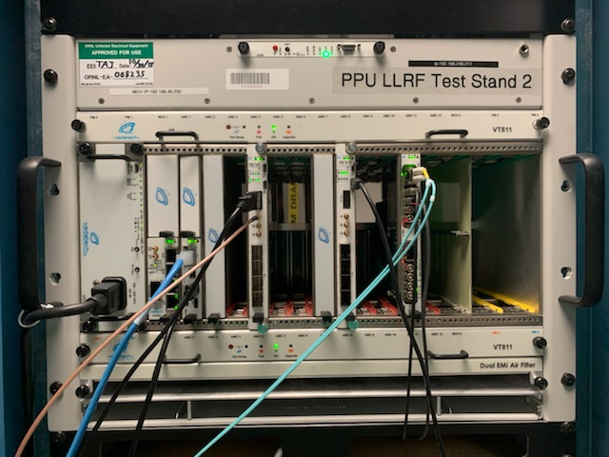
Progress since CD-2/3
Charge: 1,2,4
Accomplishments
  P.3.8.2/P.10.3.8.2 HPRF
    Reviewed existing HPRF Transmitter PLC code
    Developed plan to extend PLC and EPICS software support for factory acceptance testing and production deployment.
  P.3.8.2 LLRF
    Continued software support for LLRF platform updates
    Designed and completed procurement for LLRF Timing Interface cards
    Completed procurement for LLRF MicroTCA Processors
PPU LLRF MicroTCA platform
B3-3 Crofford

Slide 10
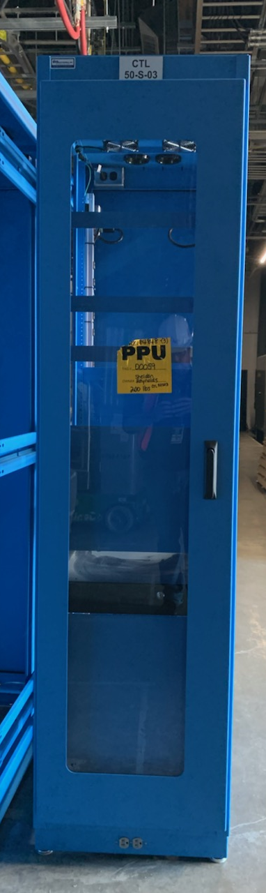
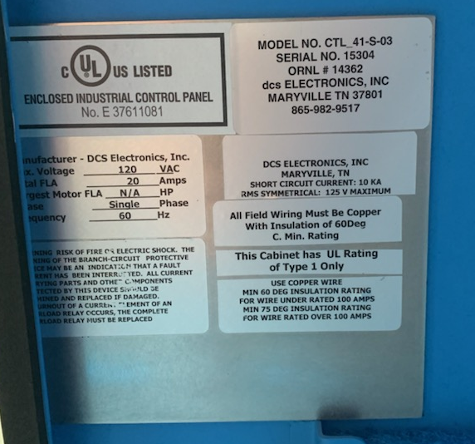
Progress since CD-2/3
Charge: 1,2,4
Accomplishments
  P.3.9.2 Linac/SCL Timing/MPS
    Completed Procurement and Received all Hardware and Cabling
    Received, Inspected and Accepted Controls Racks
    Finalized Installation Plans and Drawings
    Tested all Timing Fanouts, Timing Receivers, and MPS Hardware
Rack UL Inspection
Controls Rack 50-S-03

Slide 11
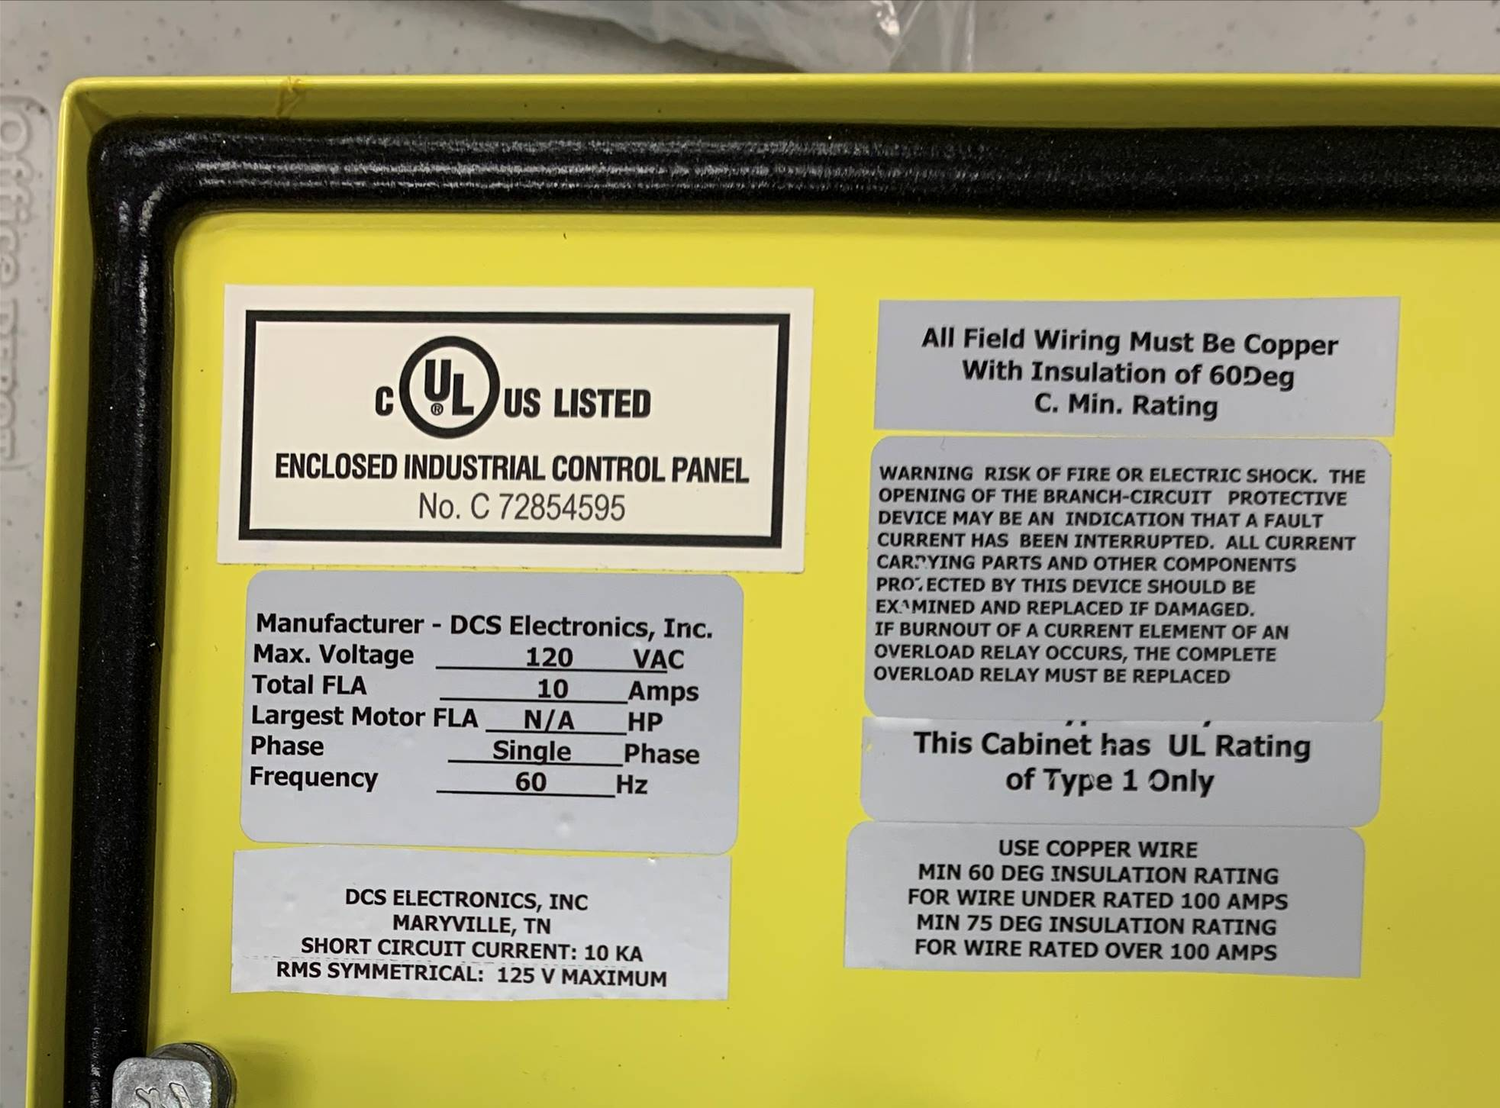
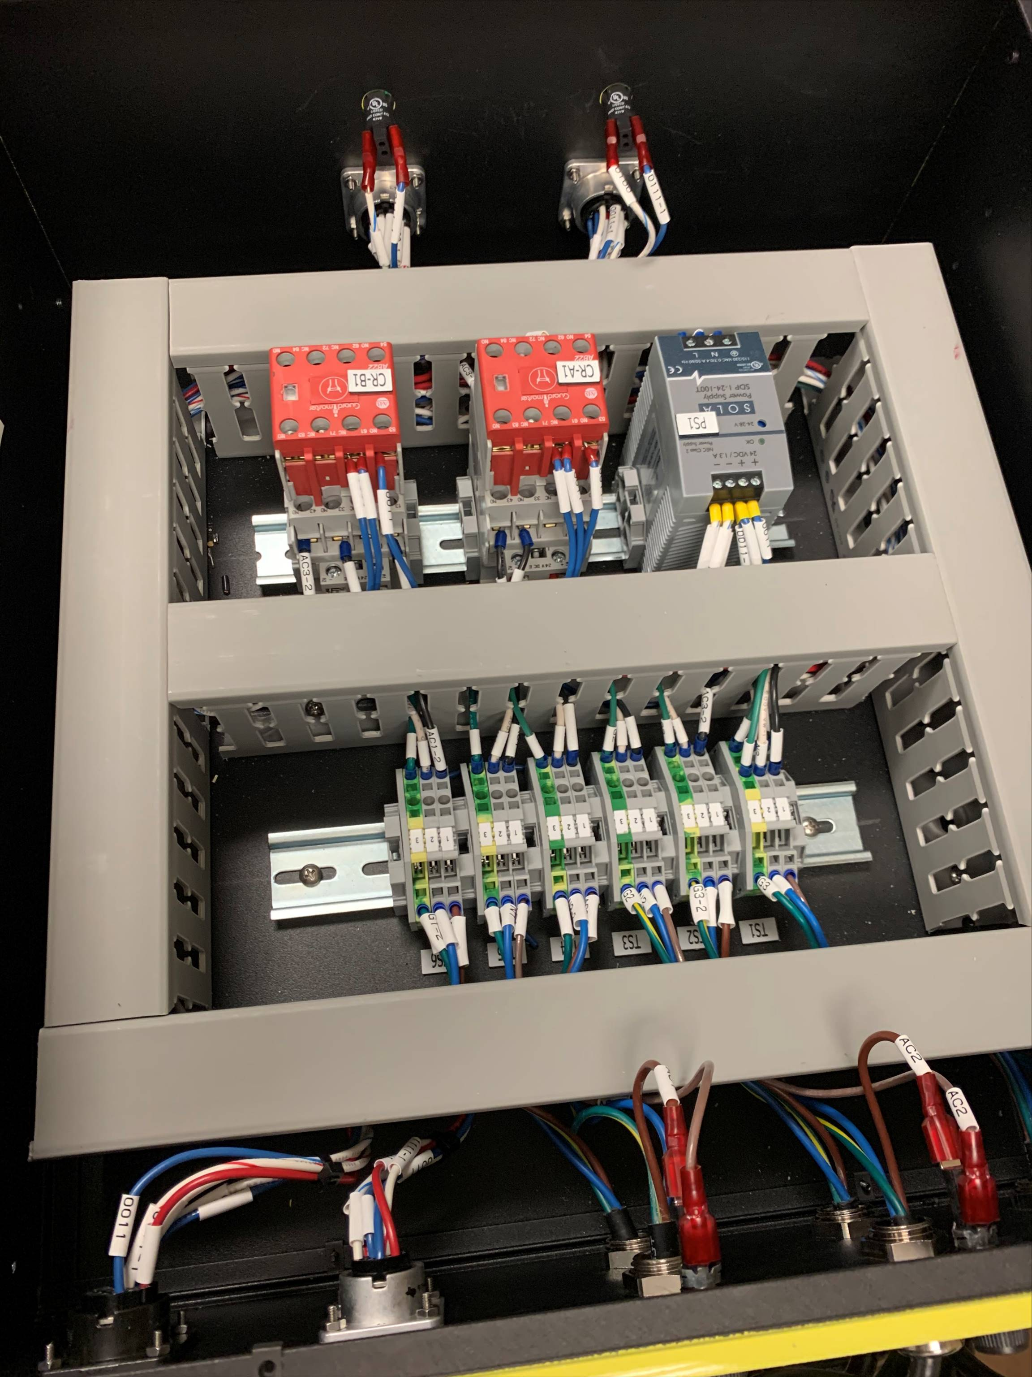
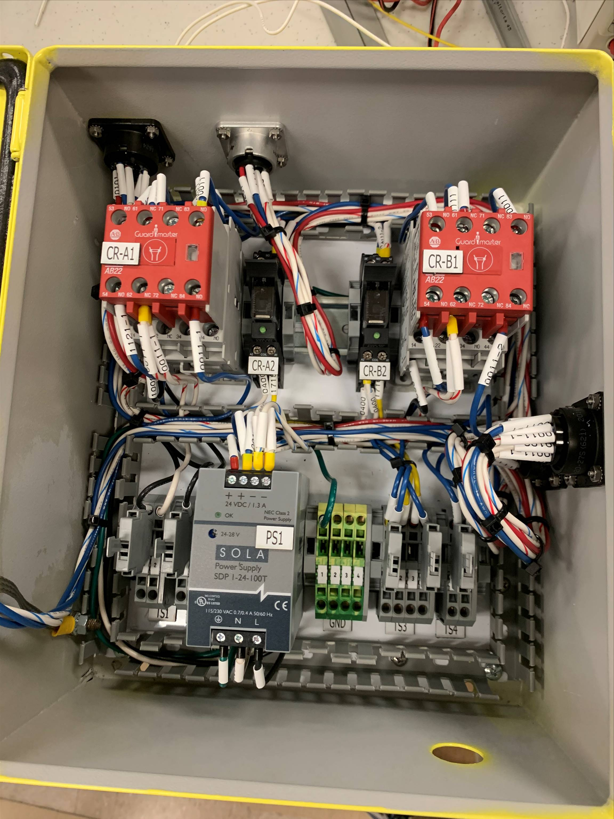
Progress since CD-2/3
Charge: 1,2,4
Accomplishments
  P.3.9.3 Linac/SCL Protection System
    Procured, received, tested, and installed KLCab04
    Procured, received and tested RF Transmitter and Modulators interfaces
    Procured all cabling and connectors for Interfaces
  P.3.9.4 Linac/SCL networking and computing infrastructure
    Completed Procurement of all Hardware and Cabling
PPS Interface chassis

Slide 12
Challenges
Charge: 2,4,5
Long Lead Times
  Issue
    Global shortage of Integrated Circuits (ICs) and bare printed circuit board(PCB) materials
  Mitigation
    Moved procurements up on the schedule
Personnel Resources
  Issue
    In the Last 12 months lost a field engineer and technician
  Mitigations
    Posting the technician job and hiring someone as soon as possible
    ORNL Reimagining provided access to a second technician that is being trained and will be utilized for PPU installation

Slide 13
Final Design Status – P.3.8.2
Charge: 1, 2
Charge: 2
HPRF design is final
  Hardware and software are already in use for production systems
LLRF is a new platform but has received final design review approval
  Software supports basic functionality and progress is ongoing for advanced functionality
  Support for production cavity field testing has been successful
B3-3 Crofford

Slide 14
Final Design Status – P.3.9.2, P.3.9.3, P.3.9.4
Charge: 1, 2
Timing, Networking and PPS designs are final
  Designs are complete and already utilized for production
MPS Fast Protect System(FPS) is based on a new design that is being completed through an Accelerator Improvement Project
  The final design has been approved and the hardware is finalized
  Firmware and Software are in final stages of development
  Firmware and software will be completed in the next 4 months
Concerns
  New MPS FPS will not be ready for PPU Deployment
  Mitigation will be to use existing Legacy MPS FPS hardware

Slide 15
Installation Plans
Charge: 2
Charge: 2
Racks
  Controls Racks will be installed by construction contractors and oversight by SNS Electrical engineers
Cabling
  Cabling will be pulled by contractors or SNS craft
  Cabling will be terminated by SNS Craft or Controls technicians
  PPS Cabling will be terminated by PPS technicians
MPS, Timing and Network Hardware
  MPS, Timing and Network Hardware will be installed by Controls technicians
PPS Interface
  PPS Interfaces will be installed by PPS technicians

Slide 16
Installation Plans
Charge: 2,5
Install Controls Racks
Install Timing and Network
Install MPS

Slide 17
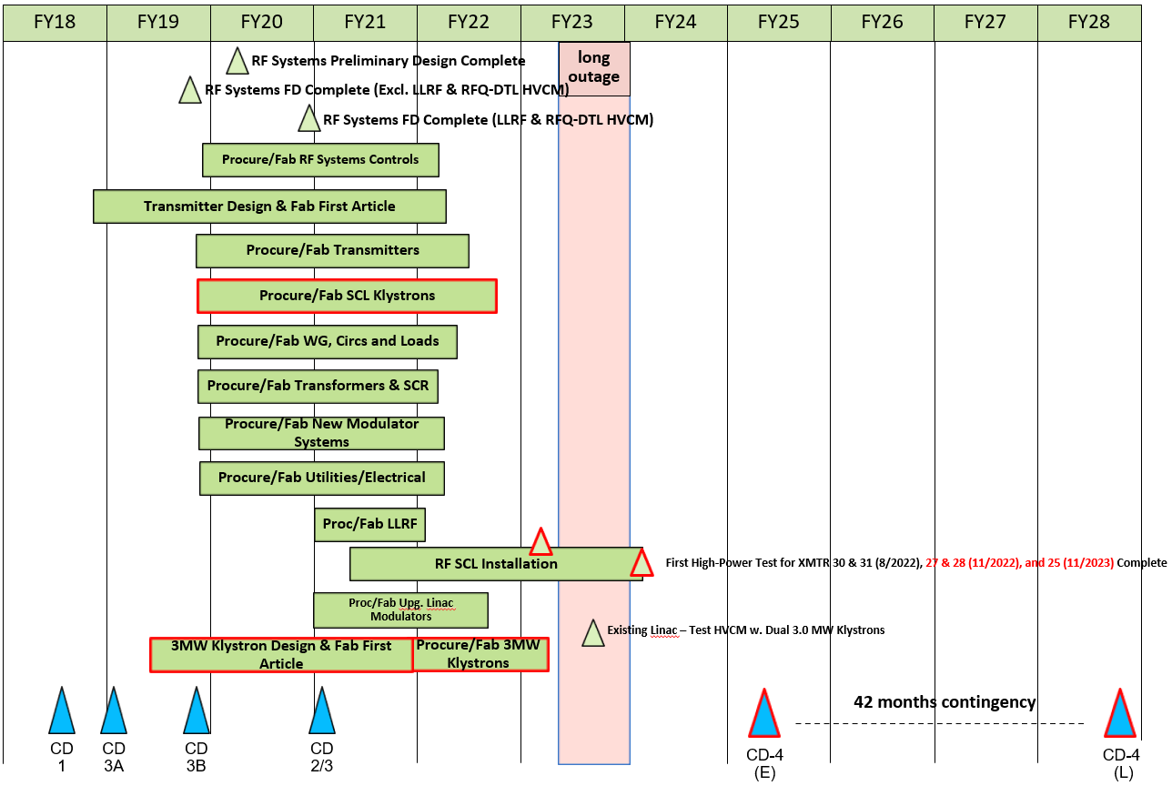
Schedule
Charge: 2

Slide 18
Cost and Schedule
Charge: 2
Changes Since CD – 2/3
P03.08 at 57%
P03.09 at 57%

Slide 19
Cost and Schedule
Charge: 2
ETC is well understood and achievable for all 3 WBS

Slide 20
Estimate to Complete by FY
Charge: 2

Slide 21
Estimate to Complete by FY
Charge: 2

Slide 22
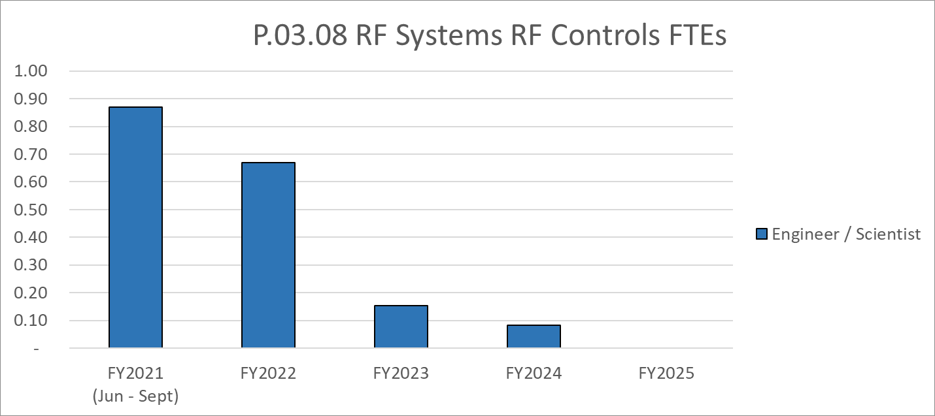
Labor Profile
Charge: 5
RF Controls is composed of Software, Hardware and Process Control Engineer for the duration of remaining work.

Slide 23
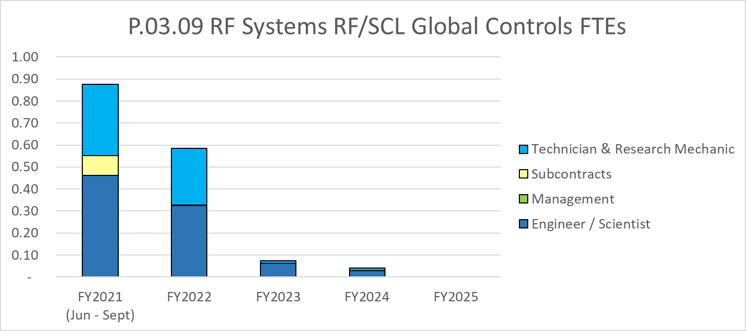
Labor Profile
Charge: 5
FY2021 is divided between subcontract, Technician/RM and Engineer support.
FY2022, FY2023, and FY2024 is split between Technician/RM and Engineer Support

Slide 24
Risk Register
Charge: 2, 5
Risk ID | L3 WBS | Risk Title | Expiration Date | Mitigation | Pre-Mitigation Rank | Post Mitigation Rank
T-P.3-012 | P.03.08 | Controls Software Requirements | 7/31/2021 | Carefully monitor development of requirements to push completion prior to software development. Perform requirements reviews for complex areas. | 12 | 4
One active risk identified
  One retired risk
  Pre-mitigated ranking: 1 Medium
  Post-mitigated ranking: 1 Low
High Risks
  No high risks identified
Key risk categories analyzed
  Requirements
  Staff availability
Risks are reviewed on a regular basis

Slide 25
Responses to Recommendations
Charge: 6
No Recommendations from CD-2/3 Review

Slide 26
ESH&Q and COVID-19 Impacts
Charge: 3
ESH&Q
  No issues or concerns
  Racks and PPS Chassis are already UL certified
Covid-19 impacts
  No major impacts to the PPU schedule
  Delay from MicroTCA Vendor
    MicroTCA Processor Cards delayed 4 months
    Still can achieve installation schedule
  Quarantine issues
    Working remotely has allowed the team to stay on track despite several quarantines at all levels

Slide 27
12-month look ahead
Charge: 1,4
P.3.8.2 HPRF
  Support Factory Acceptance Testing of Transmitters
  Integrate controls for Transmitter 30 and 31
  Integrate controls for Modulator 30
P.3.8.2 LLRF
  Support final software development for new LLRF platform
  Integrate new Timing Receiver card
  Support continued production cavity testing
B3-3 Crofford

Slide 28
12-month look ahead
Charge: 1,4
P.3.9.2 Linac/SCL Timing/MPS
  Complete Rack installation in the Klystron Gallery Buildout
  Install Timing infrastructure and fanouts in Klystron Communication Room 6 and new LLRF and Controls Racks
  Install fiber patch panels and fiber for Timing, MPS and Network
P.3.9.3 Linac/SCL Protection System
  Prepare PPU KL-Cab04 software modifications
P.3.9.4 Linac/SCL networking and computing infrastructure
  Install networking hardware in Klystron Communication Room 6 and PPU racks
  Install wall mounted PC in the Klystron Gallery Buildout

Slide 29
Summary
All RF and Global Controls are on schedule
Controls hardware designs are well established
  Timing, Network and PPS hardware is already in production use
  MPS hardware has final design approval
Firmware and Software designs are in final stages
  HPRF PLC code and Software are well defined and extensions of existing systems
  LLRF Software has made good progress and is a high priority
  MPS firmware and software are in final stages and targeted to be completed before being needed for PPU

