Slide 1




P.04.02 Injection Region
P.04.04 Extraction Region
DOE/SC Independent Project Review of the Proton Power Upgrade Project
Robert Saethre
Level 3 Manager for Injection and
Extraction Regions
September 14-17, 2021

Slide 2
Outline
Scope
Organization
Progress since CD-2/3
Challenges
Final design status
Installation plans
Cost and schedule
Labor profile
Risk register
Responses to recommendations
ESH&Q and COVID-19 impacts
12-month look-ahead
Summary

Slide 3
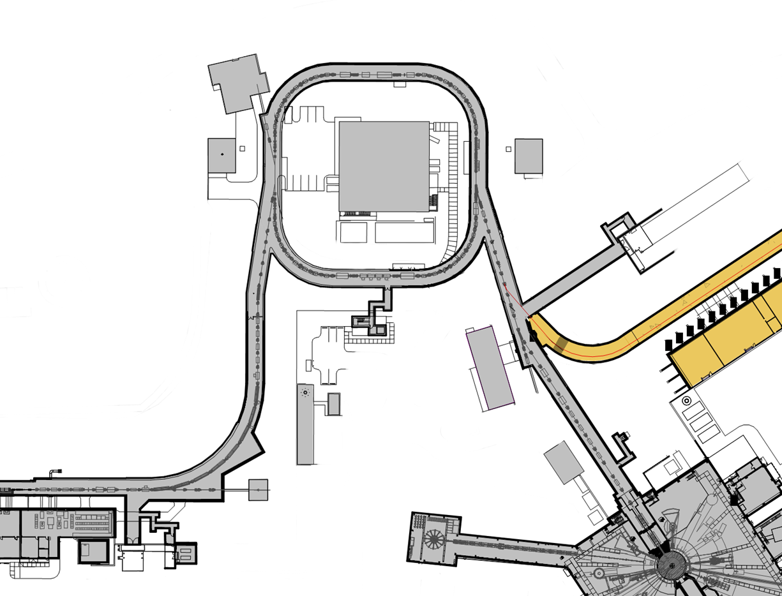
PPU-Ring Technical scope
Charge: 1
Re-evaluate injection dump power limit
Install view screen
  Upgrade charging power supplies to 45kV
  Replace shims in extraction septum magnet
Ring
Service
Building
Replace two chicane magnets
Upgrade injection kicker power supplies
Replace injection dump septum magnet
Move chicane mag. #1 upstream
Add quad magnet to IDmp beamline
Add diag. to IDmp beamline
2D Pyrometer for foil temperature measurements*
  Neutronics and shielding calculations for RTBT tunnel stub
  PPS for stub
  Power limit system
  2 MW
  Upgrade water cooling system for the power supplies in the Ring service building
  Cooling fan kit for the main ring dipoles substation power transformers
  Install air conditioning in PFN Room

Slide 4

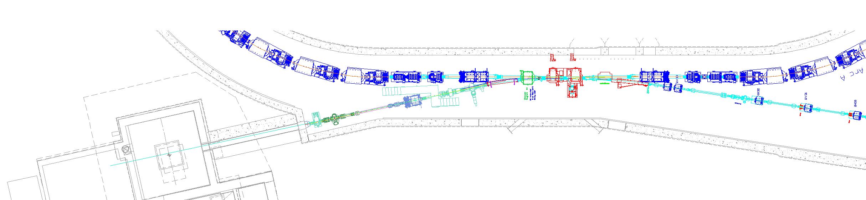
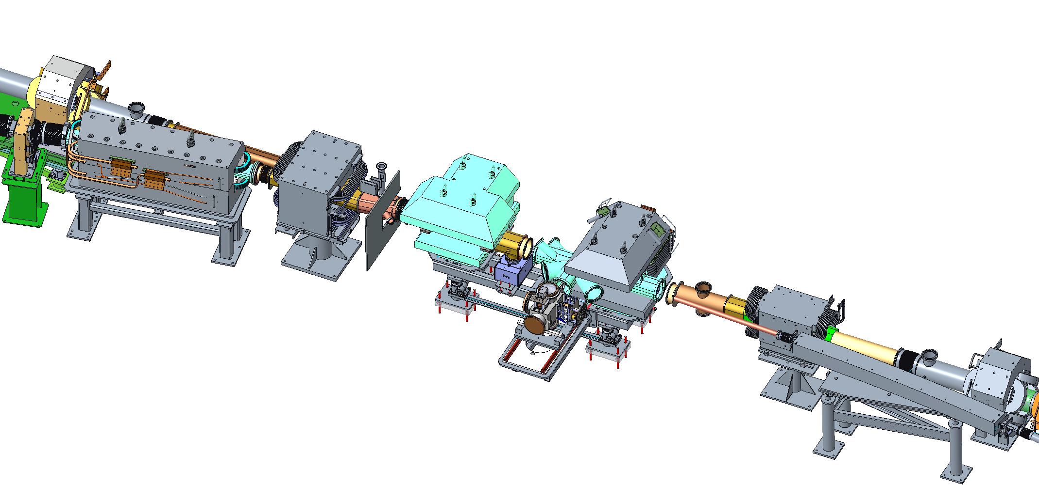
Ring Injection Region Scope detail (WBS P.4.2)
P.4.2.3 Upgrade injection kicker power supplies (8 total)
P.4.2.2 Add injection dump quadrupole magnet and power supply
P.4.2.2 New injection dump septum magnet designed by FNAL (Harding)
Beam direction
P.4.2.2 Two new magnets designed by FNAL
Chicane #3 and Chicane #2 (Harding)
P.4.2.2 Move chicane #1 ~30 cm upstream
Chicane #4 does not change
P.4.2.5 Primary and Secondary Foil Strippers
(Charlotte Barbier)
P.4.2.4 New vacuum chambers, TiN coating of adapters, ion pumps, and gauges
(Charlotte Barbier)

Slide 5
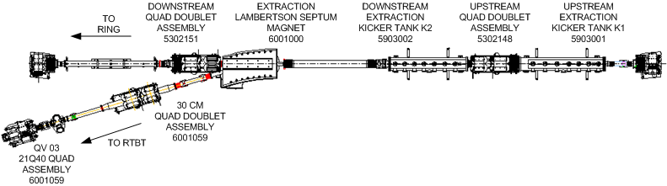
Ring Extraction Region Scope Detail (WBS P.4.4)
Beam direction
  Upgrade existing PFNs to Higher Current
  Replace shims in extraction septum magnet

Slide 6
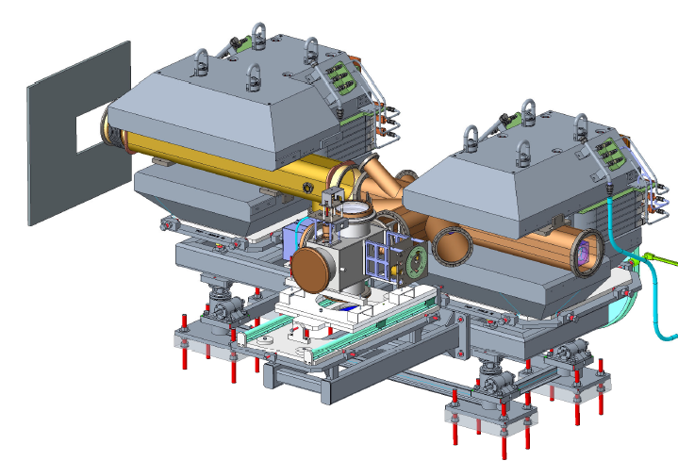
Latest Chicane 2 & 3 Design
Magnet design at FNAL
  Design Complete
  FNAL contract for manufacture of the chicane and injection dump septum magnets released
Field clamp
Chicane 2 and 3
with foil changer

Slide 7
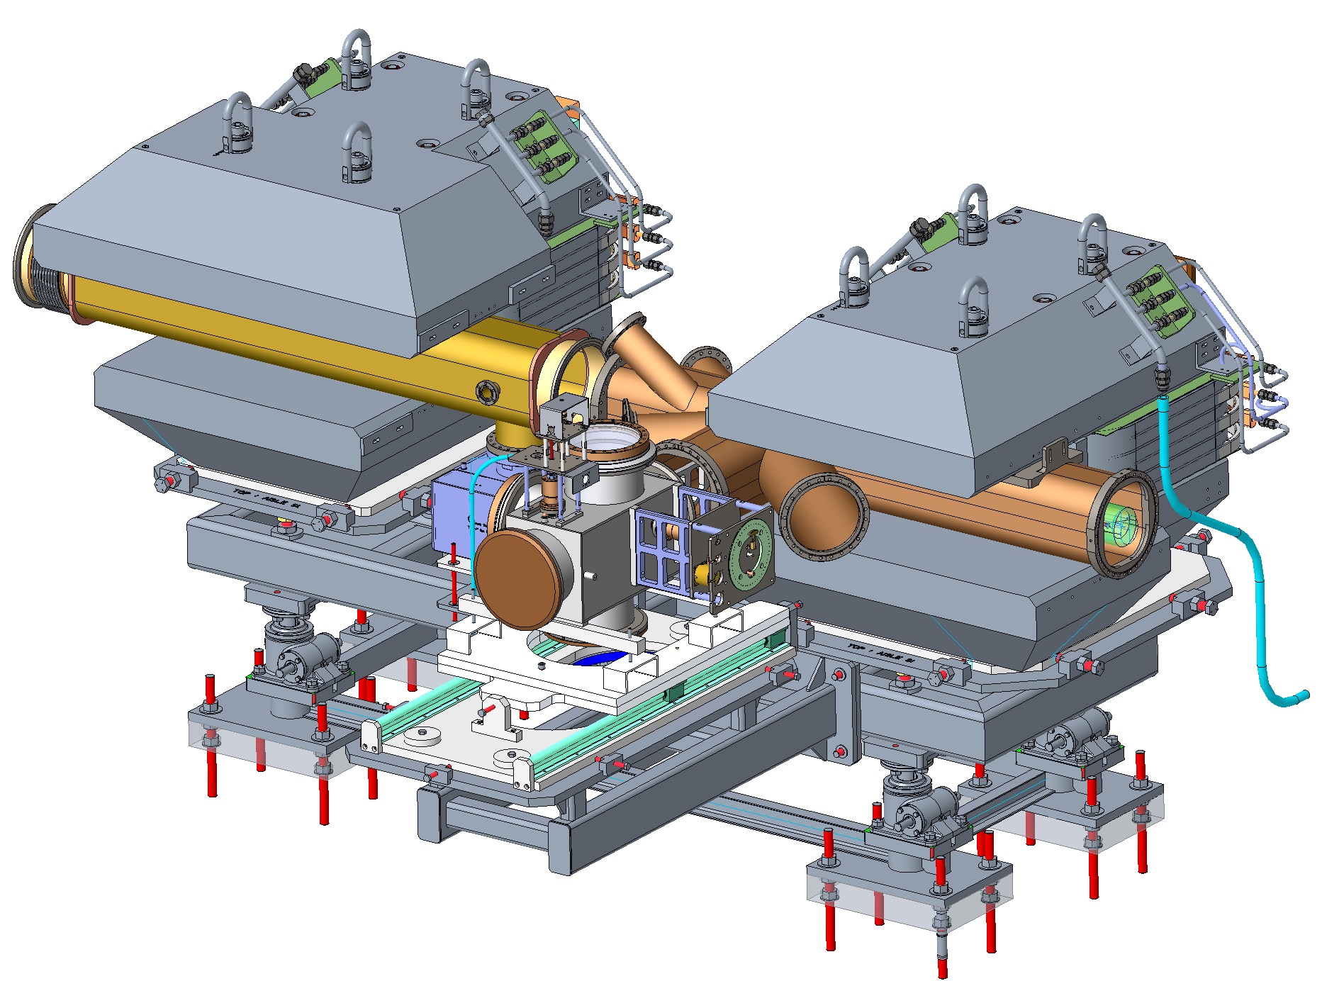
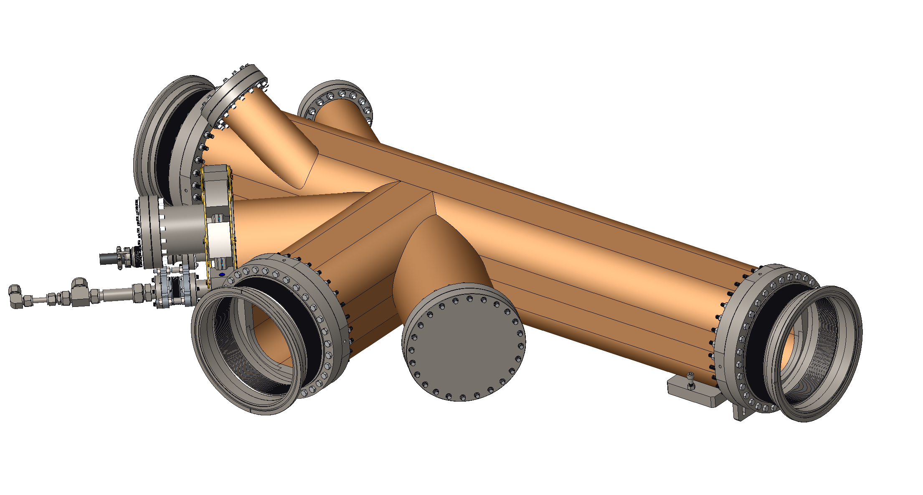
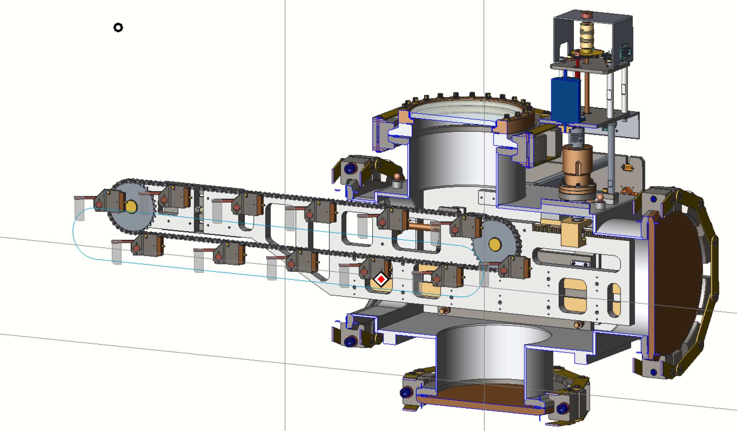
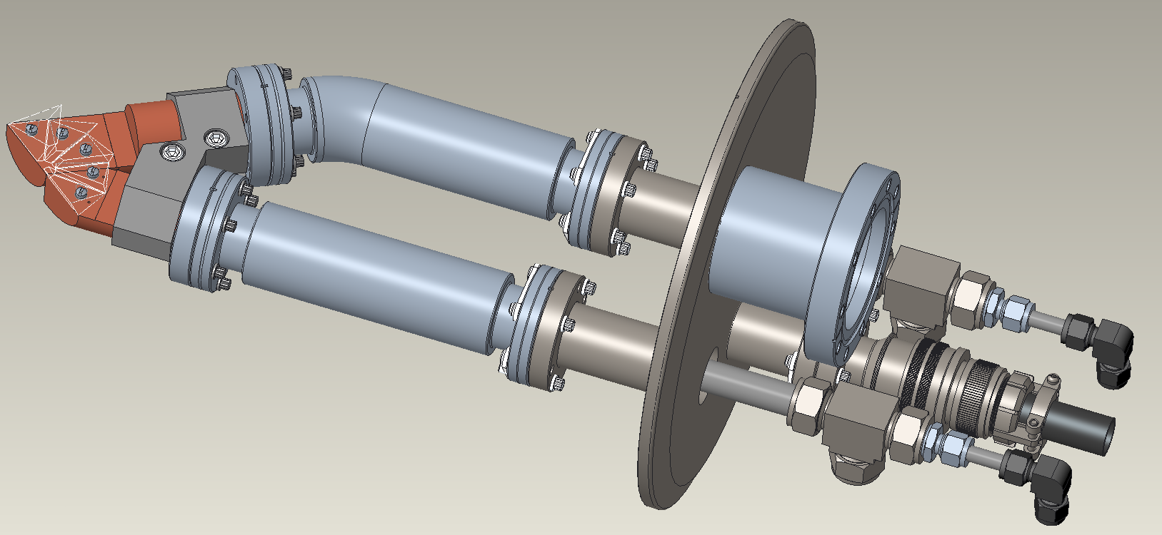
Injection Region Vacuum Chambers
Titanium-Nitride Coating/Installation of new vacuum vessels and vacuum hardware
Adjustable and replaceable electron catcher
Features improved lighting and larger view ports for the e-catcher and foils
COVID-19 and staff loss has impacted this scope
Chicane 2 and 3
Chicane 2 vacuum chamber
Adjustable/replaceable e-catcher
Foil changer
Graphics by D. Pomella

Slide 8
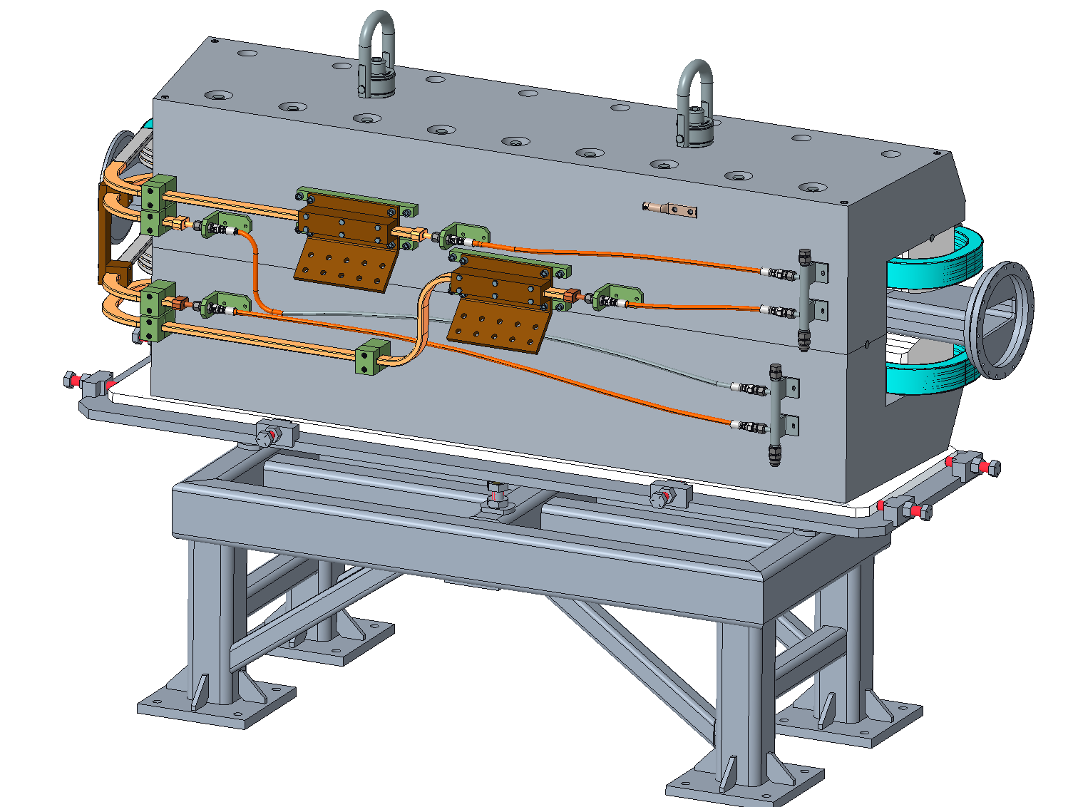
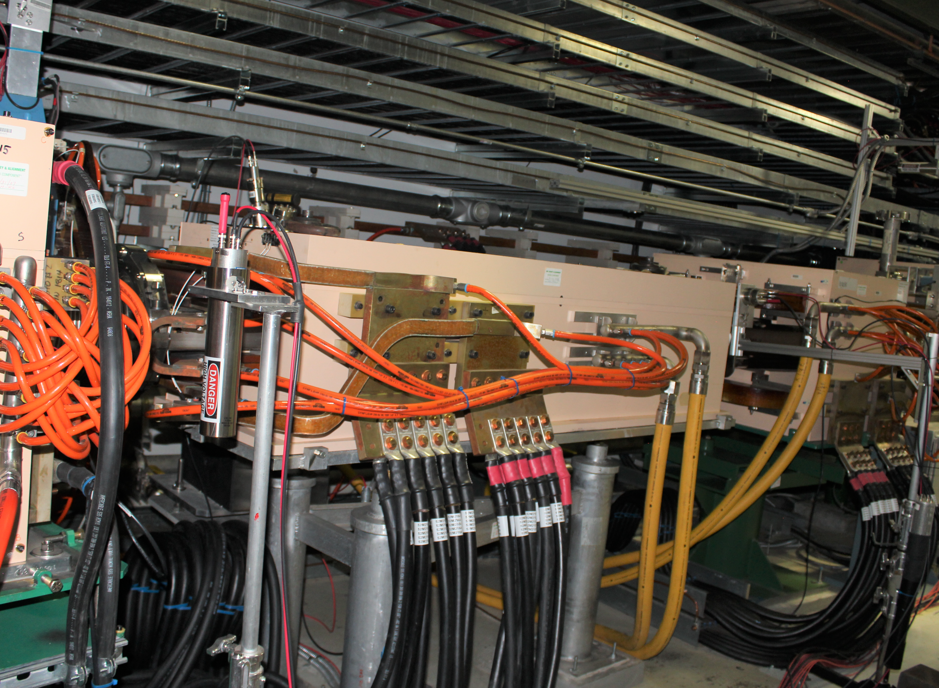
Injection dump septum magnet
The new magnet will use the existing 5000 A power supply
Design complete
Contract for manufacture released
New Injection Dump Septum
New Injection Dump Septum with
Red outline of existing magnet
Existing Injection Dump Septum in tunnel

Slide 9
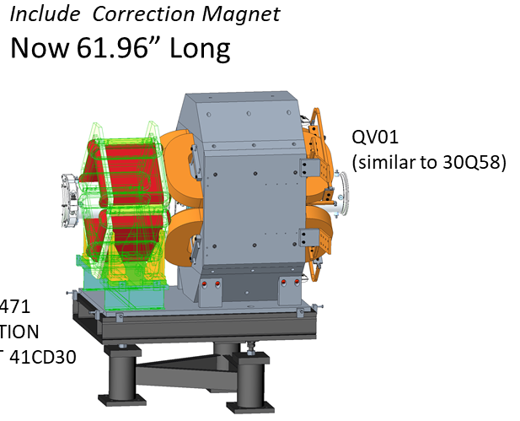
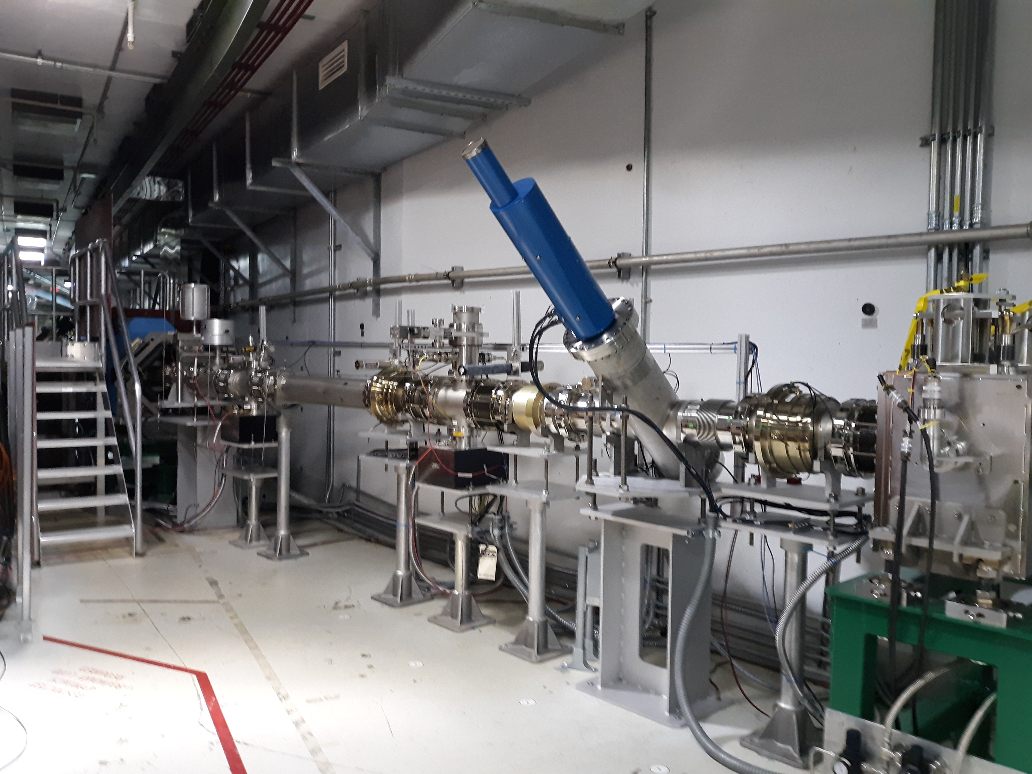
Injection Dump Quadrupole Magnet and Power Supply (P.4.2.2 and P.4.2.3)
Provides additional control of beam distribution at injection dump
Add new wire scanner to improve ability to extrapolate beam size at dump
B4-1 - Evans
Existing QV01
New QH01
Quadrupole Magnet 30Q58
New unipolar PS 120A/10V to be installed in RSB
PO 4000190477 Placed

Slide 10









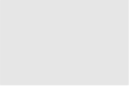
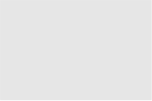
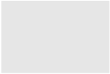
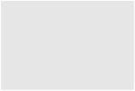




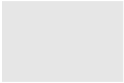
















Organization
Charge: 5
P.4 Ring
Nick Evans
P.4.1
Management and System Integration Nick Evans
P.4.2 Injection Region
Robert Saethre
P.4.3 Injection Dump
Charlotte Barbier
P.4.4
Extraction Region Robert Saethre
P.4.6 Ring Control Systems Karen White
P.4.7 RTBT Stub
Nick Evans
P.4.8
Accelerator Physics Nick Evans
P.4.5 Utilities
Greg Norman
P.4.1.1
Management and System Integration
Nick Evans
P.4.2.1
Management and System Integration Robert Saethre
P.4.3.1
Management and System Integration
Dave Willis
P.4.4.1
Management and System Integration Robert Saethre
P.4.5.1
Management and System Integration
Greg Norman
P.4.6.1
Management and System Integration Derrick Williams
P.4.7.2 RTBT Stub Temporary Shielding
Nick Evans
P.4.8.1 Accelerator Physics
Nick Evans
P.4.1.2
Design
Nick Evans
P.4.2.2 Magnets
Robert Saethre
P.4.3.2 Injection Dump Imaging
Dave Willis
P.4.4.2 Magnets
Robert Saethre
P.4.5.2 Main Ring Dipole XFMR
Upgrade
Greg Norman
P.4.6.2 Beam Power Limit
Systems
Patrick Bong
P.4.7.3 RTBT Stub Earth Berm Shielding
Nick Evans
P.4.2.3 Power Supplies
Robert Saethre
P.4.3.3 Injection
P.4.4.3 Power Supplies
Robert Saethre
P.4.5.3 RN-03 DIW
Cooling Upgrade
Greg Norman
P.4.6.3 Personnel Protection System
Kelly Mahoney
Dump Engineering
Review
Melissa Harvey
P.4.2.4 Vacuum Systems
Charlotte Barbier
P.4.5.4
PFN Room HVAC
Greg Norman
P.4.6.4 Ring Injection Section
Controls
Derrick Williams
P.4.2.5 Primary and Secondary
Stripper Foil
Charlotte Barbier
P.4.6.5 Ring Extraction Section
Controls
Derrick Williams

Slide 11
CD 2/3 Review’s in July 2020 12-Month Look-Ahead
Charge: 6
Complete Ring Systems Final Design Review
  Chicane and Septum Magnet FDR October 2020
Begin Procurement of Injection region Vacuum systems, Magnets and Power Supplies
  Vacuum Systems
    Contract Awards scheduled for early 2022
  Injection Dump Quad Power Supplies
    Ametek 500A/20V Quad PS PO 4000188195 due June 2021
    Danfysik 7000 PO 4000188927 due October 2021
  Injection region Chicane 2, 3, and Septum magnets with FermiLab
    PO 4000186990 for Chicanes due December 2022
    PO 4000186923 for Septum due September 2022
  Injection Kicker (Bump) Magnet Power Supply Upgrade
    Completed January 2021

Slide 12
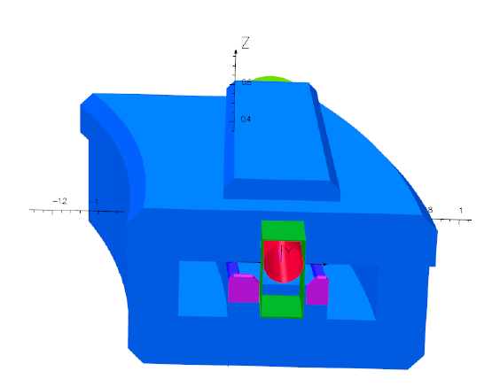
CD 2/3 Review’s in July 2020 12-Month Look-Ahead cont.
Complete Extraction Septum shim analysis and design if necessary
  Analysis confirmed necessity of shims
  Solid design model complete and ready for detailed drawings
Existing pole shims require splitting magnet to replace
new shims install on front face of magnet yoke
Upstream end of Extraction Lambertson in SNS tunnel, and FNAL simulation

Slide 13
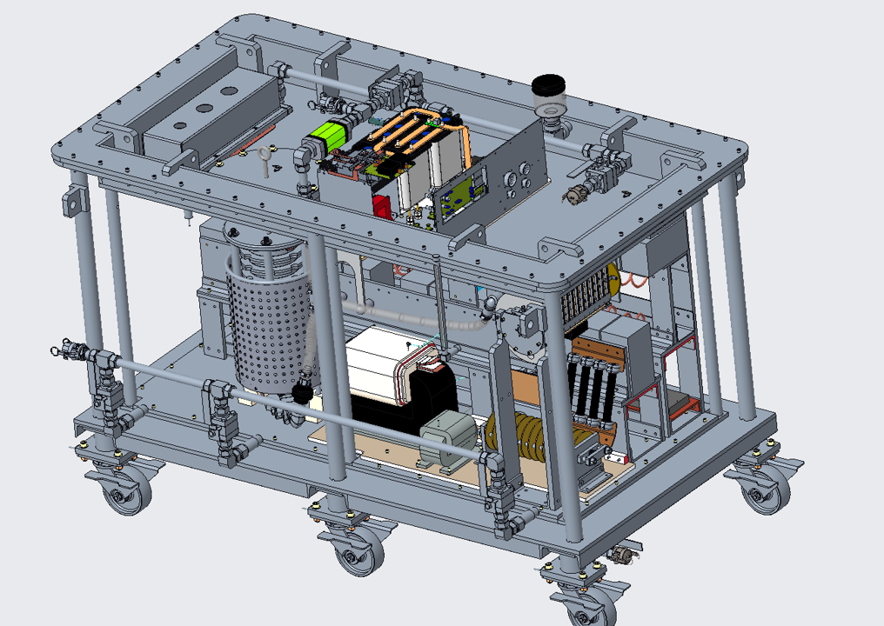
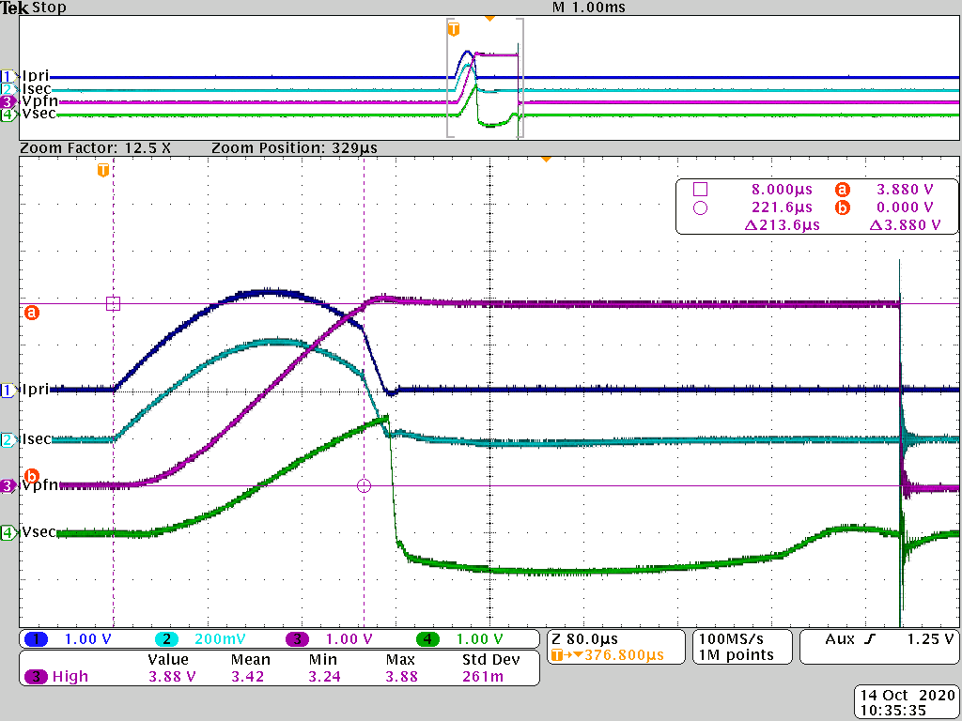
CD 2/3 Review’s in July 2020 12-Month Look-Ahead cont.
Complete Extraction Kicker Power Supply 30-day test
  Successfully completed 30-day test and extended run
PFN
RCPS
Primary Current
PFN Voltage
Secondary Current
Secondary Voltage
Transformer

Slide 14
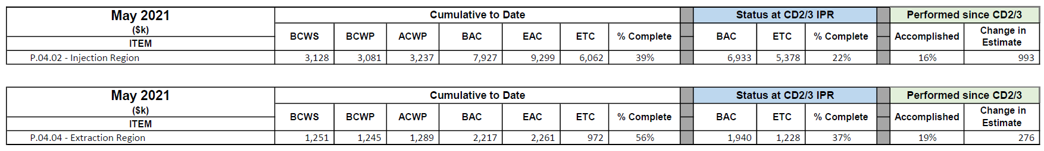
PPU Changes since CD-2/3
Charge: 4
We are at 39% complete in Injection and 56% in extraction
There was an increase in BAC of $993k for Injection and $276k for Extraction

Slide 15
Project Change Requests since CD-2/3
Charge: 5
$495k from P4.2 and $257 from P4.4
These are the PCRs associated with the change to budgets
Injection region portion of $1.8M is $495k (from update pricing)
Extraction region portion of $1.8M is $257k(from update pricing)

Slide 16
Challenges
Back filling resources due to staff loss
  Scope of foil changer has been reduced
  Loss of key engineer severely set us back on vacuum chamber, electron catcher, foil changers (currently no impact on installation plans)
  Electron catcher – new design simplifies vacuum chambers, decouples catcher from chamber
Fabrication of Chicane and Injection Dump Septum magnets may be delayed
  Our weekly video teleconferences were very effective during COVID-19
  We are increasing our oversight with onsite visits
  Reduced the development time for magnet measurement system
  Delays will consume our contingency and may impact the long outage installation plans
B4-1 Evans

Slide 17
Challenges cont.
Vacuum chamber fabrication will also be tight – design is not complete – COVID-19 impact
  Could delay long outage activities
  Contractor enlisted to help with chamber design and analysis, evaluating best procurement strategy
Primary/Secondary Foil changer designs behind schedule
  Could delay long outage activities
  Reduction of scope, additional engineering resource enlisted

Slide 18
Final Design Status
Charge: 1
Final design is complete, except for the Vacuum Chambers and Foil Changer design
  Stripper Foil Changers
  Vacuum Systems
  Injection Dump Quad Power Supplies
  Injection region Chicane 2, 3, and Septum magnets with FNAL
  Injection Kicker (Bump) Magnet Power Supply Upgrade
  Extraction Kicker Power Supply
  Extraction Septum shim

Slide 19
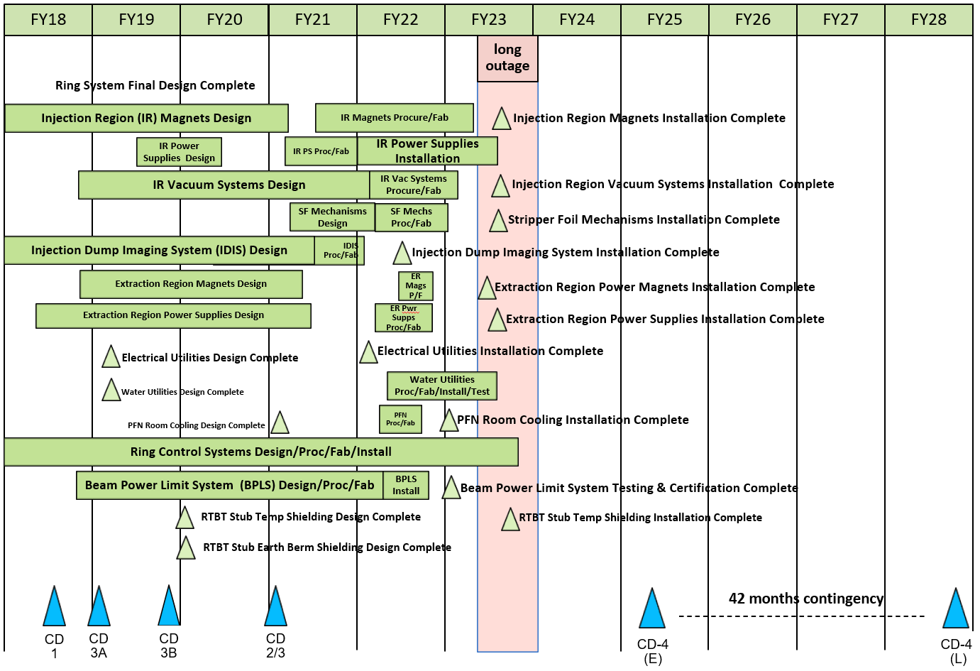
P.4 – Ring Systems May 2021 Status Summary Schedule
Inj. Region Magnets delivery close to beginning of long outage
Installation starts 60 days after start of outage

Slide 20
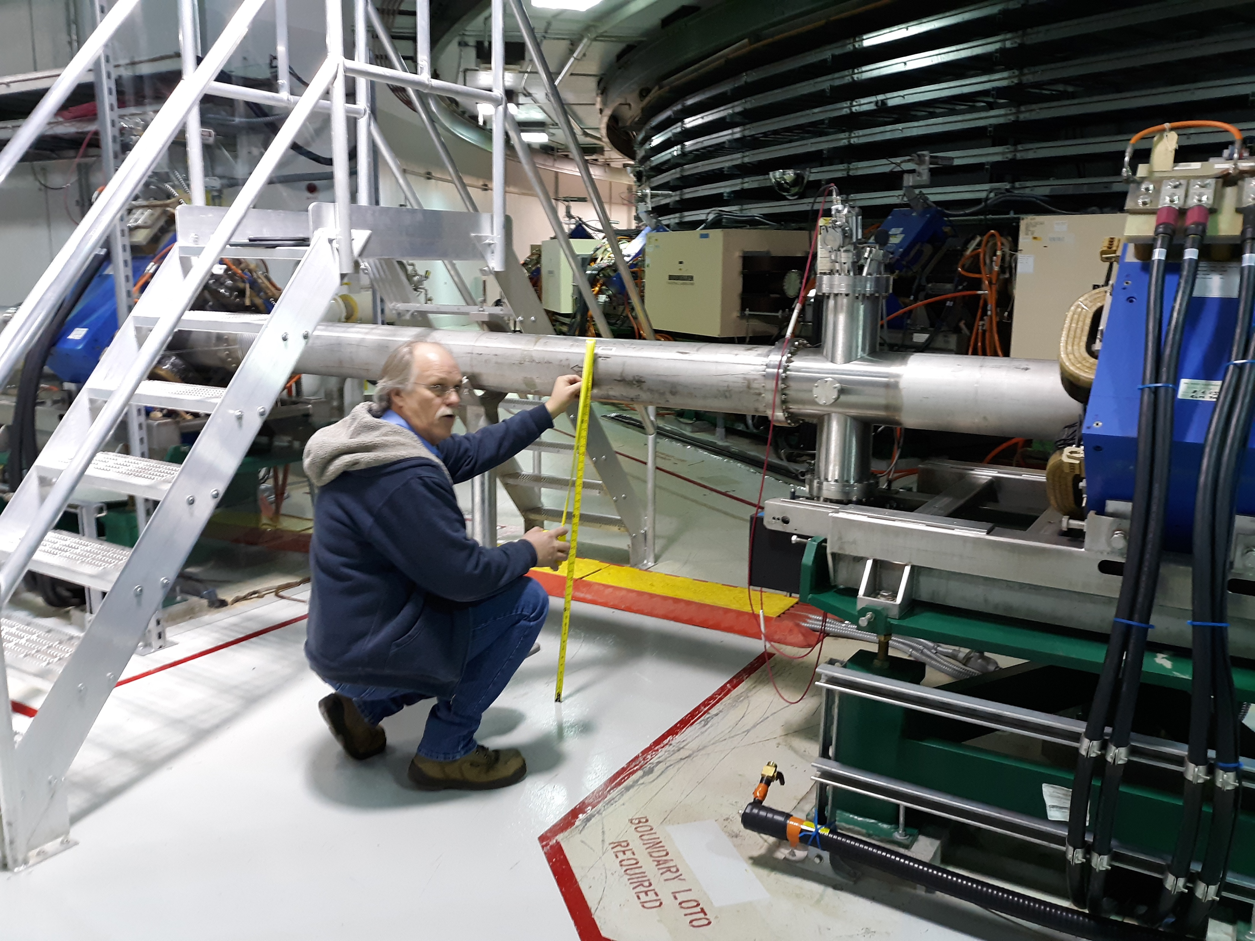
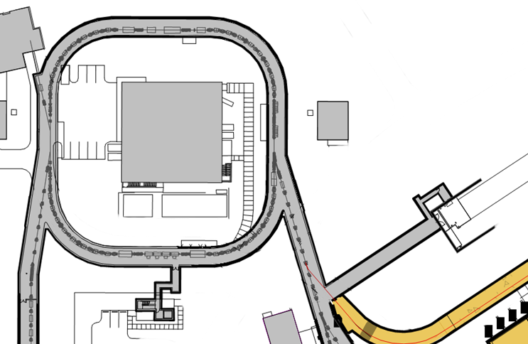
Injection Region Magnets Removal and Installation Plan during Long Outage
Transport Chicanes (—) through south arcs of Ring
Remove sections of beam pipe to pass from HEBT and through RTBT (if crane not certified)
New Quad (—) will be transported in through North arcs
Will coordinate with RTBT Stub schedule to ensure we aren’t clashing with Stub penetration work

Slide 21
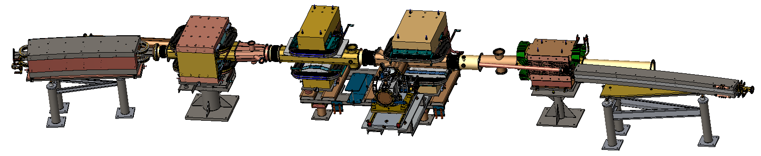
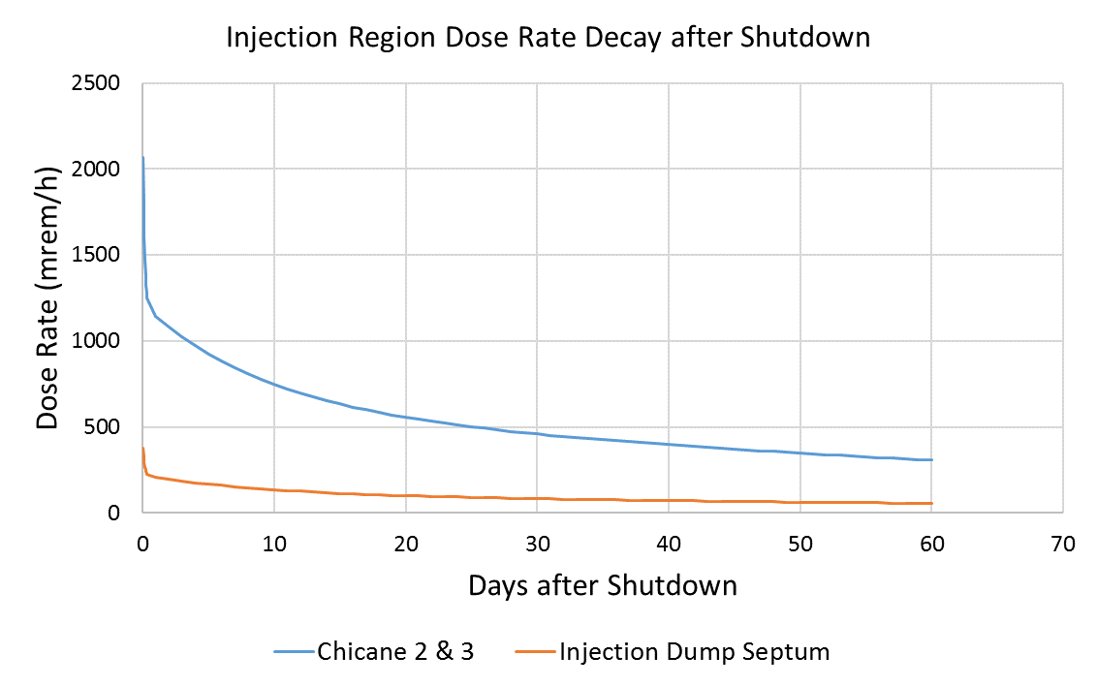
Injection Region Magnet Installation ES&H
Charge: 6
June 1, 2021
Creating a detailed ALARA Plan
5 Days are scheduled
Assume 10% of “hands on” work in HR area
Stripper Foil and Chicane 2 have highest levels
Remove high radiation items first
  Chicane 2 & 3
Before removing
  Inj. Dump Septum, Chicane 1
1.4 MW, 1011 MeV

Slide 22
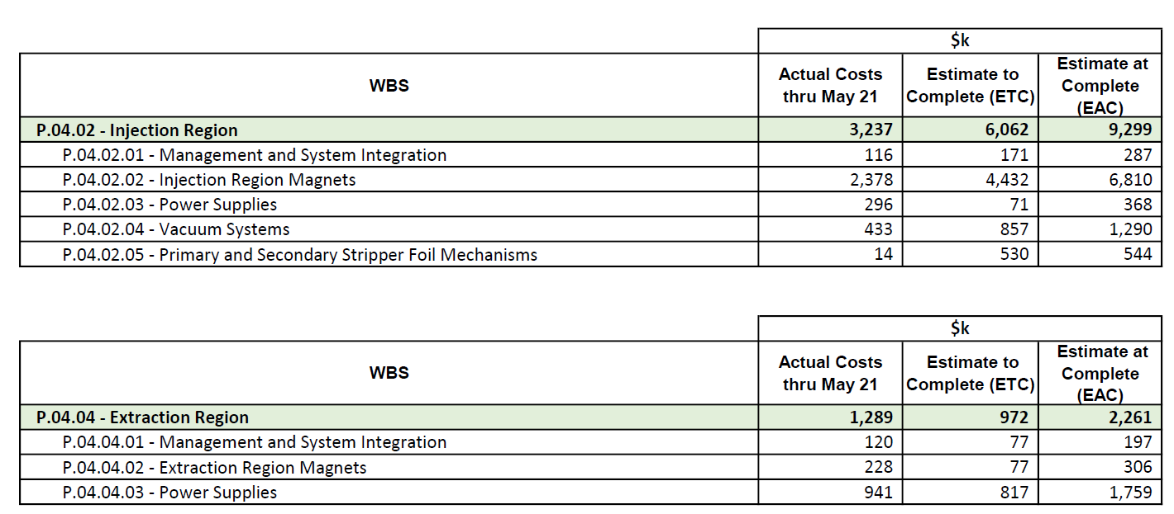
Budget and Estimate to Complete
Charge: 5
We are at 39% complete in Injection and 56% in extraction
Mostly procurement and installation is left
Some design for Vacuum and Foil changers remains

Slide 23
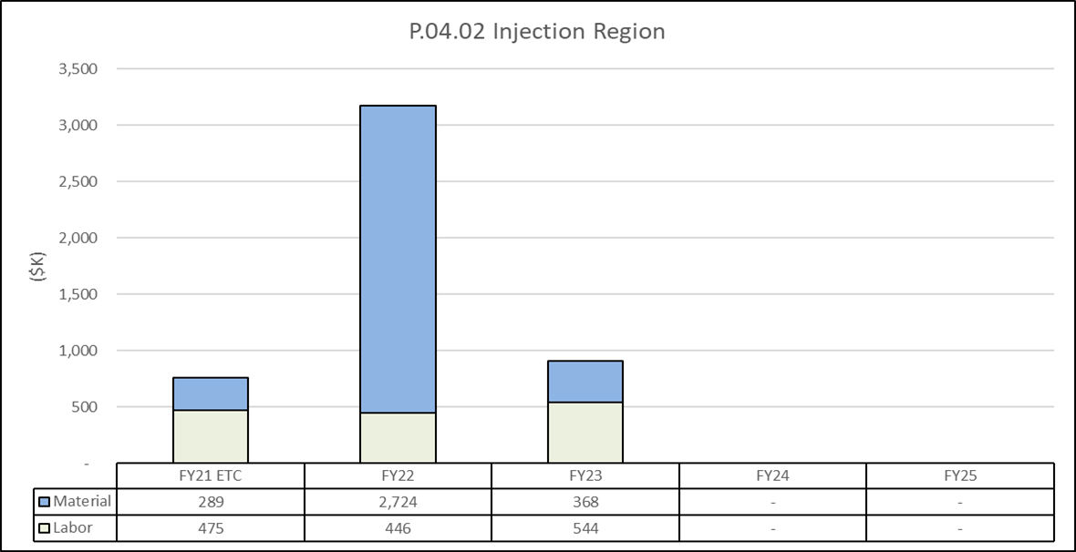
Estimate to Complete by FY
Majority cost is Material in FY22

Slide 24
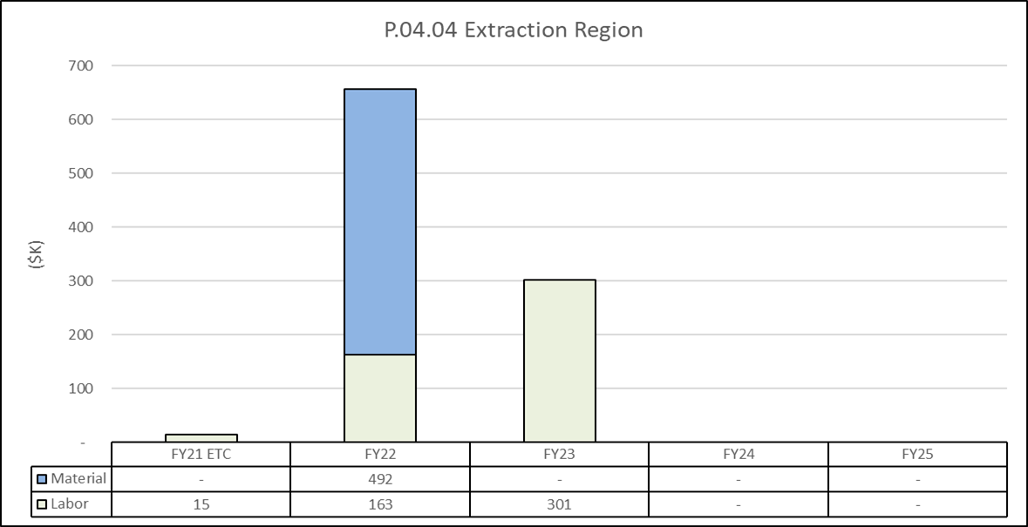
Estimate to Complete by FY
Majority cost is Material in FY22

Slide 25
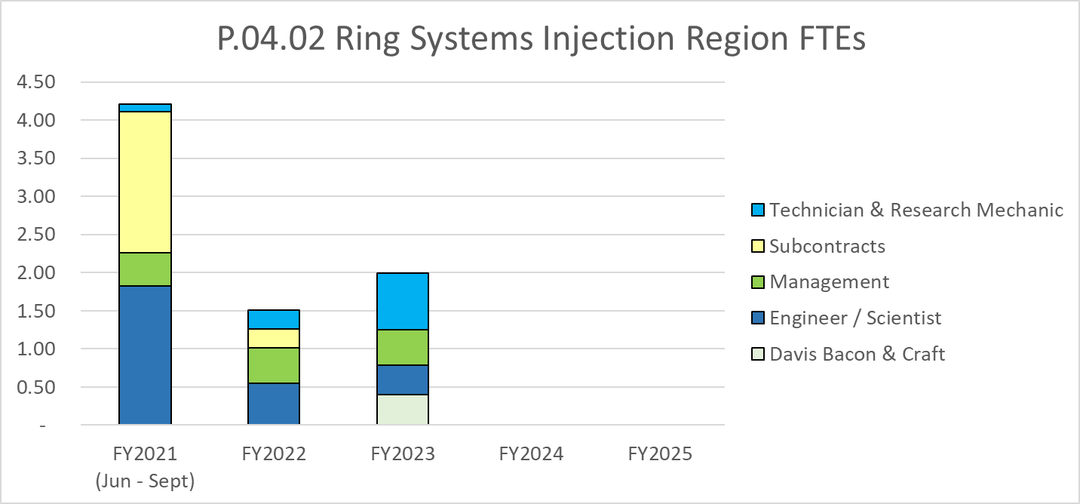
Labor Profile
Four FTEs
Subs are designers in Vacuum and Foil Changers

Slide 26
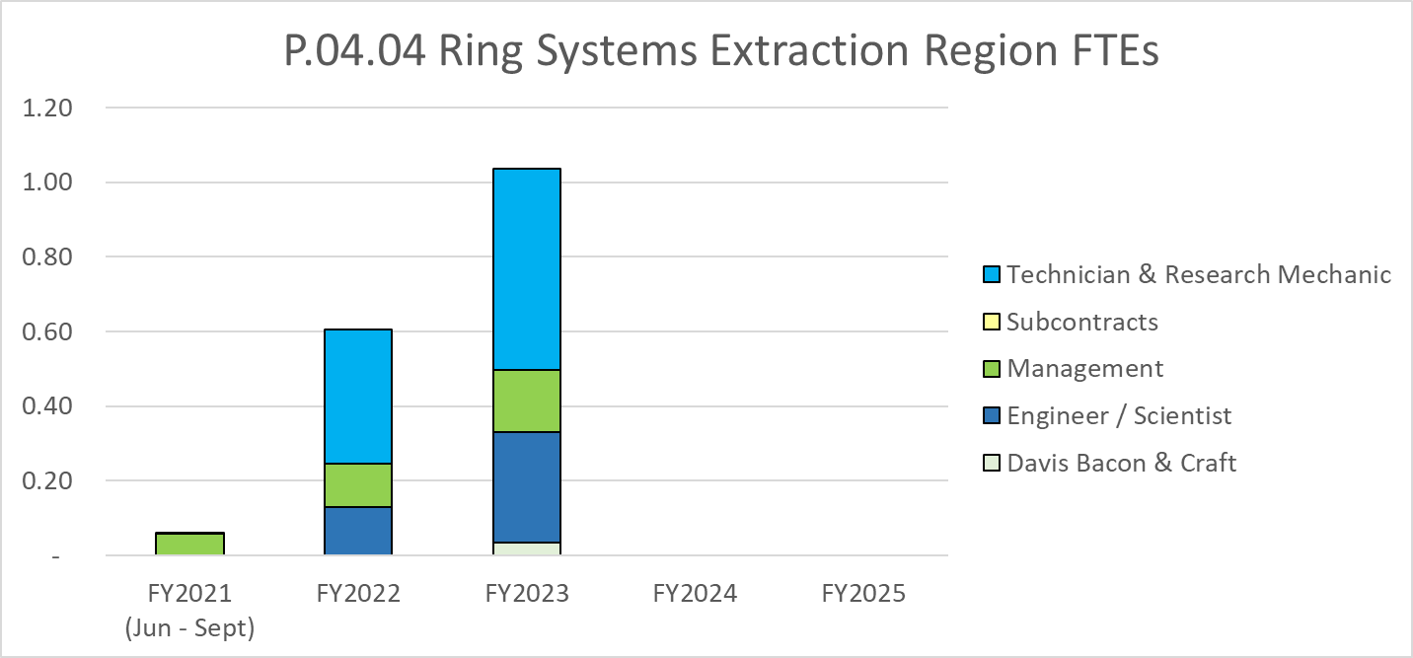
Labor Profile
One FTE
Procurement and installation in FY23

Slide 27
P.04.02 Injection Region Risk Register
Risk ID | L3 WBS | Risk Title | Expiration Date | Mitigation | Pre-Mitigation Rank | Post Mitigation Rank
T-P.4-013 | P.04.02 | Fermilab has competing projects or resource issues | 6/30/2022 | Maintain good communication between PPU and Fermilab so that schedule challenges can be discovered early and mitigated. Engage project management and Fermilab management as needed to ensure this work receives adequate priority. Perform periodic visits to Fermilab to assess progress. | 16 | 16
T-P.4-005 | P.04.02 | Ring Vacuum Vessel Fabrication Complications | 3/31/2022 | Stringent management of the fabrication of the vessels including a fabrication plan, fabrication schedule, fabrication milestones, scheduled meetings, and vendor visits. | 8 | 2
T-P.4-010 | P.04.02 | Equipment is damaged during removal/installation of new magnets | 6/30/2023 | Carefully plan and document the removal/installation work in advance of the long PPU outage. Use mockups where appropriate to validate plans. Access the injection area during maintenance periods to validate understanding of existing systems. | 2 | 2
Three active risks identified
  Five risks retired
  Pre-mitigated ranking: 1 Low, 1 Medium, 1 High
  Post-mitigated ranking: 2 Low, 1 High
High Risks
  One high risk identified
Key risk categories analyzed
  Fabrication
  Partner Laboratory
  Staff availability
Risks are reviewed on a regular basis

Slide 28
P.04.04 Extraction Region Risk Register
No active risks identified
  Two risks retired, 1 risk realized
High Risks
  No high risks identified
Key risk categories analyzed
  Magnet shim requirements
Risks are reviewed on a regular basis

Slide 29
Responses to Recommendations
Charge: 6
No recommendations from the CD-2/3 review
Recommendations from prior DOE reviews are closed

Slide 30
ESH&Q and COVID-19 Impacts
Charge: 3
ESH&Q considerations or impacts this scope of work
  Removal and installation of injection region equipment radiation decay well known but are still being monitored for any additional impact
COVID-19 impacts to scope
  No vendor delays
  Quarantines had limited impact, virtual meetings were effective
  Key staff member disabled by COVID-19
  Reduced scope for foil changers
  Shifted responsibilities to another engineer
  No impact on installation schedule (yet)

Slide 31
12-Month Look-Ahead
Charge: 4
Receive Extraction Kicker RCPS parts and begin assembly and testing
Receive Injection Dump Quad Power Supplies
Release Injection Dump Quad magnet PO
Receive Injection Dump Quadrupole Magnet
Contract oversight at FNAL
Dump Dipole Production Readiness Review
Chicane Magnet - Measure First Chicane Magnet
Complete Vacuum chamber design and start procurement

Slide 32
Summary
Final Designs are complete, except for vacuum, electron catcher, and foil changer
Completed Injection Kicker power supply upgrade early
Still on track to support power ramp up
Purchase orders on schedule
Concerns about delivery of Injection Chicanes, and Dump Septum
Overall, in good shape for cost

Slide 33
Backup

Slide 35
December 2016 Radiation Survey Data
Dec. 2016
1.2 MW, 972 MeV

