Slide 1




P.04.6 Ring/RTBT Controls
DOE/SC Independent Project Review of the Proton Power Upgrade Project
Kelly Mahoney
Level 4 Manager for Protection Systems
September 14-17, 2021

Slide 2
Outline
Scope
Organization
Progress since CD-2/3
Challenges
Final design status
Installation plans
Cost and schedule
Labor profile
Responses to recommendations
12-month look-ahead
Summary

Slide 3
Ring Controls Scope of Work
P.4.6.1 Management and System Integration for WBS P.4.6 Ring Control Systems
P.4.6.2 Beam Power Limit System (BPLS): Design, Install, and certify a credited control to detect excessive beam power to the First Target Station (FTS) and to shut off the proton beam if the power exceeds a pre-determined limit
P.4.6.3 Personnel Protection System (PPS): Modify the RTBT PPS to assure continued radiological protection during and after the RTBT stub construction
P.4.6.4 Injection Controls: Modify Injection stripper foil, power supply, vacuum, and cooling controls to be compatible with increased beam energy requirements
P.4.6.5 Extraction Controls: Modify Extraction power supply, vacuum, and cooling controls to be compatible with increased beam energy requirements. Add controls for additional extraction kicker power supplies
B4-7 - Bong

Slide 4
Controls are based on existing EPICS architecture
B3-7 - Justice
Architecture remains the same for PPU
Adding more network nodes, IOCs, PLCs
Modifying systems to support additional hardware for RING controls
EPICS architecture is scalable and extensible

Slide 5


































WBS P.4.6 Organization
Charge: 5
P.4 Ring
Nick Evans
P.4.1
Management and System Integration Nick Evans
P.4.2 Injection Region
Robert Saethre
P.4.3 Injection Dump
Charlotte Barbier
P.4.4
Extraction Region Robert Saethre
P.4.6 Ring Control Systems Karen White
P.4.7 RTBT Stub
Nick Evans
P.4.8
Accelerator Physics Nick Evans
P.4.5 Utilities
Greg Norman
P.4.1.1
Management and System Integration
Nick Evans
P.4.2.1
Management and System Integration Robert Saethre
P.4.3.1
Management and System Integration
Dave Willis
P.4.4.1
Management and System Integration Robert Saethre
P.4.5.1
Management and System Integration
Greg Norman
P.4.6.1
Management and System Integration Derrick Williams
P.4.7.2 RTBT Stub Temporary Shielding
Nick Evans
P.4.8.1 Accelerator Physics
Nick Evans
P.4.1.2
Design
Nick Evans
P.4.2.2 Magnets
Robert Saethre
P.4.3.2 Injection Dump Imaging
Dave Willis
P.4.4.2 Magnets
Robert Saethre
P.4.5.2 Main Ring Dipole XFMR
Upgrade
Greg Norman
P.4.6.2 Beam Power Limit
Systems
Craig Deibele
P.4.7.3 RTBT Stub Earth Berm Shielding
Nick Evans
P.4.2.3 Power Supplies
Robert Saethre
P.4.3.3 Injection
P.4.4.3 Power Supplies
Robert Saethre
P.4.5.3 RN-03 DIW
Cooling Upgrade
Greg Norman
P.4.6.3 Personnel Protection System
Kelly Mahoney
Dump Engineering
Review
Melissa Harvey
P.4.2.4 Vacuum Systems
Charlotte Barbier
P.4.5.4
PFN Room HVAC
Greg Norman
P.4.6.4 Ring Injection Section
Controls
Derrick Williams
P.4.2.5 Primary and Secondary
Stripper Foil
Charlotte Barbier
P.4.6.5 Ring Extraction Section
Controls
Derrick Williams

Slide 6
P.4.6.2 Beam Power Limit System (BPLS)
B4-7 - Bong
Accelerator Safety Envelope (ASE) max power to first target is 2MW
PPU Upgrade has potential for 2.8MW to the first target
A credited control is required to limit power to < the Accelerator Safety Envelope value
The BPLS will be a credited system to calculate pulse energy and trip the PPS if it exceeds 2MW-s.
The normal PPS computers (PLCs) are not powerful enough to make these calculations pulse to pulse
  The BPLS signal processor will be FPGA-based in a high-reliability μTCA design
  First digital credited control at SNS

Slide 7
P.4.6.2 Beam Power Limit System (BPLS) Scope
B4-7 - Bong
Design a credited system to shut off proton beam if beam power exceeds 2MW
Redundantly measure beam energy and calculate trip threshold using safety PLC based controls
Redundantly measure beam charge using fast current transformers and FPGA based signal processors
Generate PPS trip if power exceeds limit for one minute
Generate MPS trip if power exceeds limit for ten seconds
Incorporate extensive self-test and diagnostics
Generate extensive design basis and design documentation
Extensively test system in FY22 before ‘certifying’ as a credited control

Slide 8
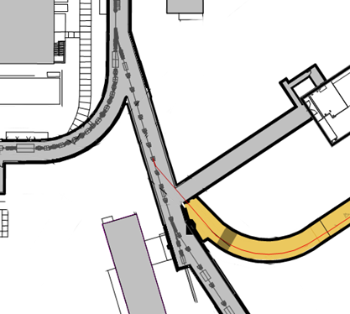
P.4.6.3 Ring Personnel Protection System (PPS) PPU Scope
Upgrade PPS equipment to certified safety hardware
Install one beam shutdown station (BSS) in the RTBT Stub
Install new radiation monitor on the downstream side of the RTBT stub shield wall
Install temporary cable for the RTBT Truck Ramp radiation monitor*
Integrate a beam power limit system (BPLS) trip
Update and certify RTBT PPS logic to accommodate the above
Update EPICS screens to reflect added components
* removal and reinstallation of buried conduit is in CF scope
Beam Shutdown Station
Reroute cable to this radiation monitor
New Radiation Monitor
BPLS Current XDR

Slide 9
Ring/RTBT PPS system design is based on replication of standard functions
Enforce a search and secure pattern that includes the new RTBT stub
Provide ESTOP capability in the RTST stub
Provide interlocked radiation monitoring at the downstream side of the RTBT/RTST shield wall. Monitor shall trip the PPS if prompt ionizing radiation exceeds 5 mrem/hr for 15 minutes or instantaneously for >100 mrem/hr.
Shut off the proton beam on a BPLS trip (same action as radiation monitor trip)
Updated RTBT PPS Rack Design Complete

Slide 10
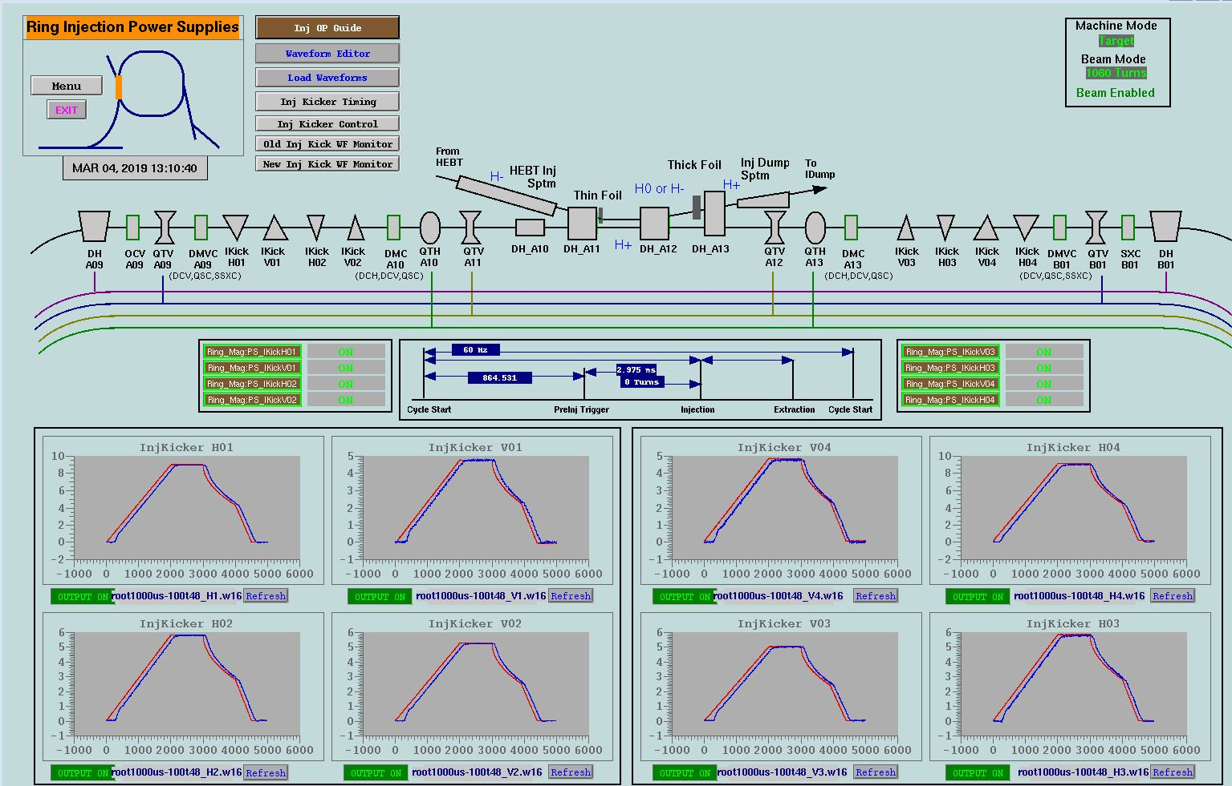
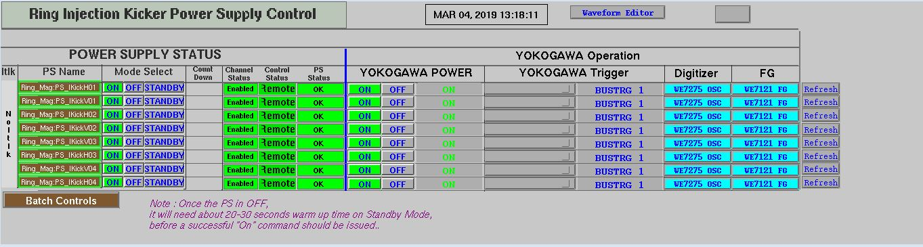
P.4.6.4 Ring Injection Section – Power Supply Controls
WBS P.4.6.4 Ring Injection Devices
  Injection Kicker power supplies will be upgraded using existing controller hardware
  Replacement Chicane/Septum magnets will use existing power supplies and controllers
  Add Controls for new IDump quad
  Control software scaling changes are complete
    Ampl_{p-p} 20V =1600A
    Monitor scaling 10V = 1600A
B4-2 - Saethre

Slide 11
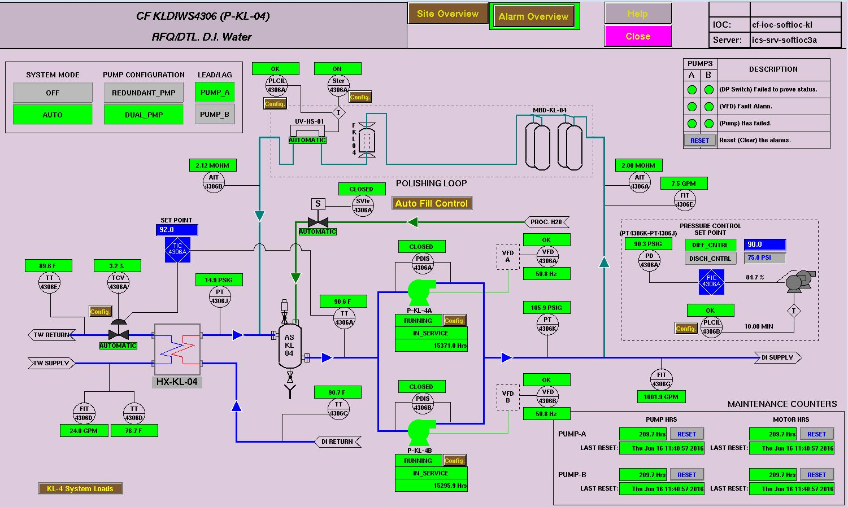
P.4.6.4 Ring RN03 Power Supply DI Water Controls
B4-4 - Norman
RN03 DI Water System includes:
  Hardware design drawings
  New PLC system (Allen-Bradley Control Logix)
  I/O enclosure
  PLC and EPICS Software
  Instrumentation setup
  VFD configuration
  New diagnostic sensors
  Integration and commissioning
Design Basis: Nearly identical to existing DI Water System

Slide 12
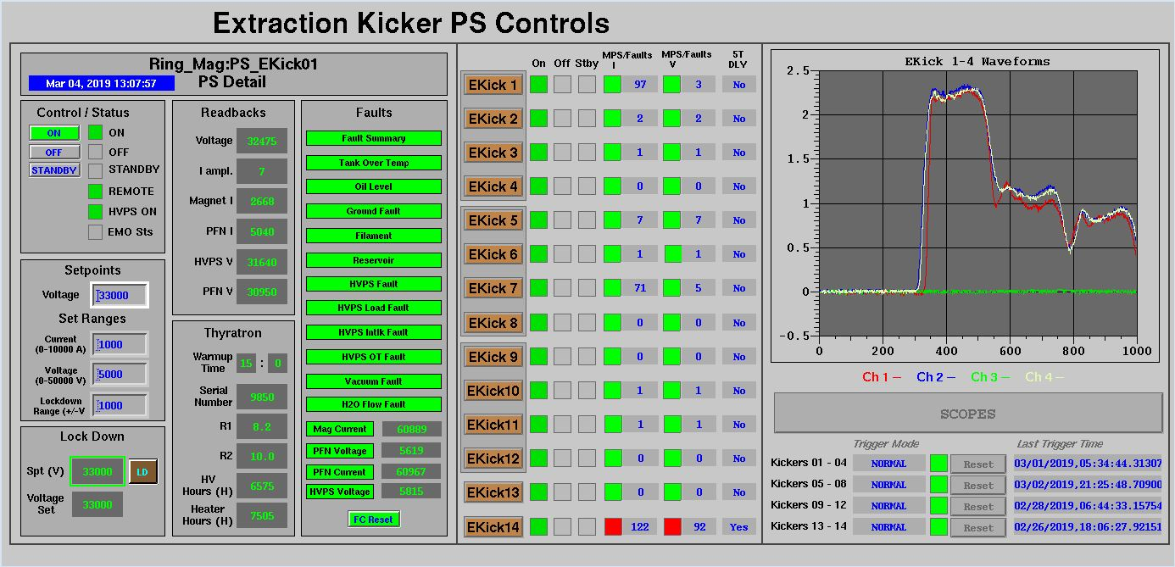
P.4.6.5 Ring Extraction Section – Power Supply Controls
Existing Design
Increase current for the existing kicker power supply
  Control software changes are minimal and will only require adjusting scaling tables
Adding additional resonant charging power supplies for kickers
  Add channels to the existing PLC and modify EPICS interface
B4-2 - Saethre
Extraction kicker PS controls are duplicated and scaled for 1.3 GeV beam energy.

Slide 13
Progress since CD2/3 Review July 2020…
Charge 1
P.4.6.2 BPLS
  Complete preliminary design
P.4.6.3 PPS
  Complete final design
  Final Design Review
  Cabinets on order
P.4.6.4 Injection controls
  Complete final hardware design for dump quad power supply controls
  Complete final hardware design for RN03 DI Water controls
P.4.6.5 Extraction controls
  Complete final design for extraction power supply controls
    Software – not needed until FY23 Q3
B4-7 - Bong

Slide 14
Challenges
P.4.6.3 – P.4.6.5 are based on existing systems and technology – no issues.
P.4.6.2 BPLS is technically challenging, but challenges are understood and being addressed
  International shortage of computer chips extending procurement time of microTCA cards by 4-6x
    Purchasing Long Lead/High Tech components ahead of schedule
Personnel Resources
  Lost mid-career PPS engineer to STS
    Matrixed to BPLS for FY21-22
  Posting opened and actively recruiting
  Hired contract engineering support
B4-7 - Bong

Slide 15
P.4.6 Final Design Status
WBS | Documentation | Final Design Review Complete | Purchase Equipment | Install
P4.6.2 BPLS | 60% | FY22 Q1 | FY21 Q3 - FY22 Q2 | FY22 Q3
P.4.6.3 PPS | 100% | FY21 Q3 | FY21 Q3 - FY22 Q2 | FY22 Q1-FY23 Q3
P.4.6.4 Injection Controls | 100% | FY21 Q4 | FY22 Q2-Q3 | FY22 Q3
P.4.6.5 Extraction Controls | 50% | FY23 Q2 | NA | FY23 Q2

Slide 16
P4.6 Installation Plans
Charge 5
4.6.2 Commission BPLS System
4.6.3 Install RTBT PPS Rack Upgrade
4.6.4 Install Injection Kicker control HW
4.6.2 Install BPLS Test System
4.6.2 Certify BPLS System
4.6.4 Install Injection Controls
4.6.5 Install Extraction Controls
4.6.3 Integrate Stub PPS Components
https://ns-staff.ornl.gov/operations/Schedules/DraftLong.pdf. Accessed 14 July, 2021

Slide 17
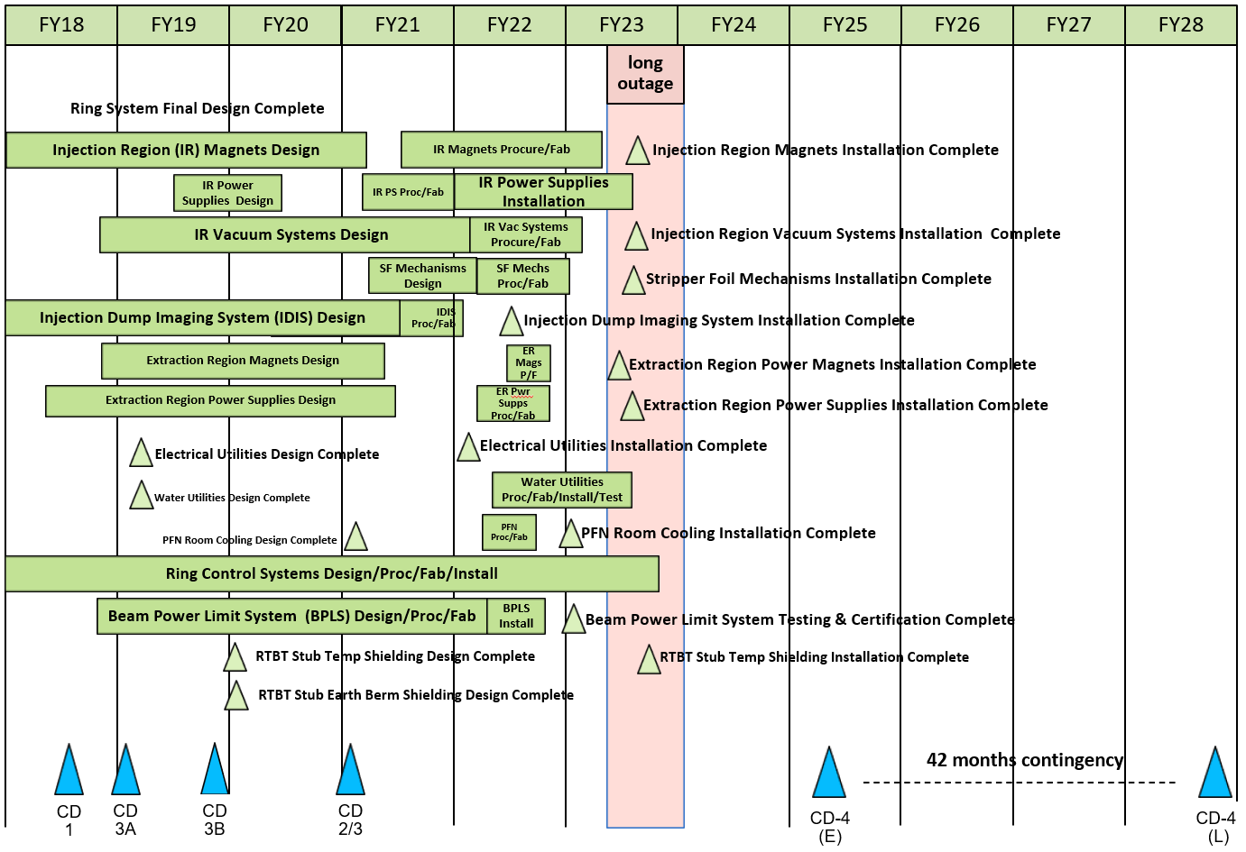
P.4 – Ring Systems May 2021 Status Summary Schedule
Charge 4
P.4.6 Scope
P.4.6 Dependent

Slide 18
PPU Changes since CD-2/3
Charge 4
Ring Controls is 49% complete with 2.5 FY remaining
Change in ETC since CD2/3
P.4.6.2 BPLS:
    Per preliminary design review recommendations:
    Purchased development equipment and software to mitigate technical risk
    Designed and fabricated special test fixtures needed for calibration
    Added additional contract FPGA design and V&V engineering experts
    Early purchase of equipment impacted by COVID-19
P.4.6.3 PPS:
Incorporated PPU scope of the RTBT PPS Rack Upgrade
    Engineering and design labor
    Materials
Ref: PCR PP-2021-01
B4-7 Bong

Slide 19
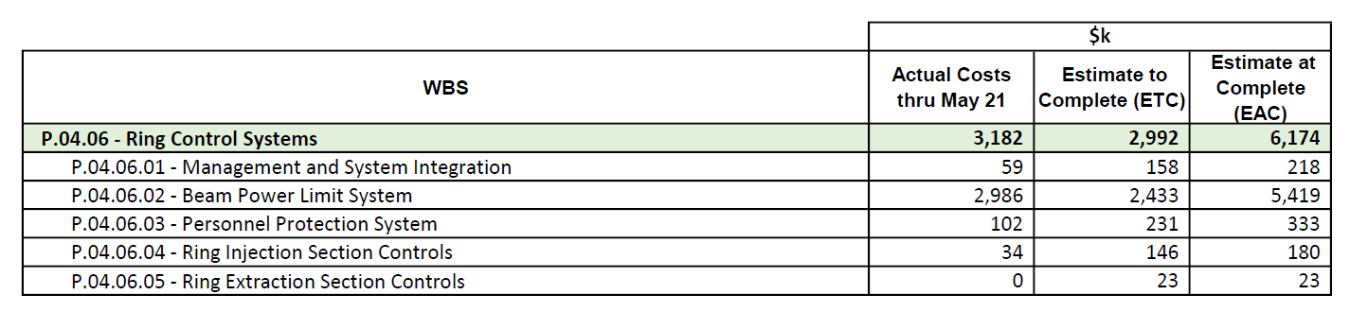
Budget and Estimate to Complete
Charges: 4, 5
ETC is understood and achievable

Slide 20
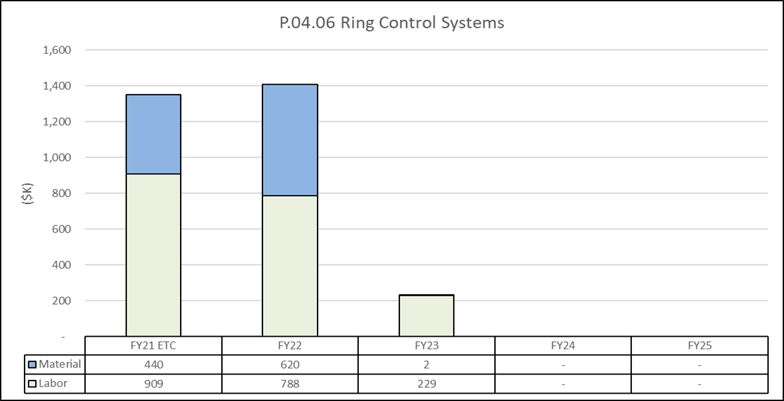
Estimate to Complete by FY
Charge 4
FY21 Design and long lead procurements. FY22 Procurement, fabrication and installation. FY23 Commissioning and clean up

Slide 21
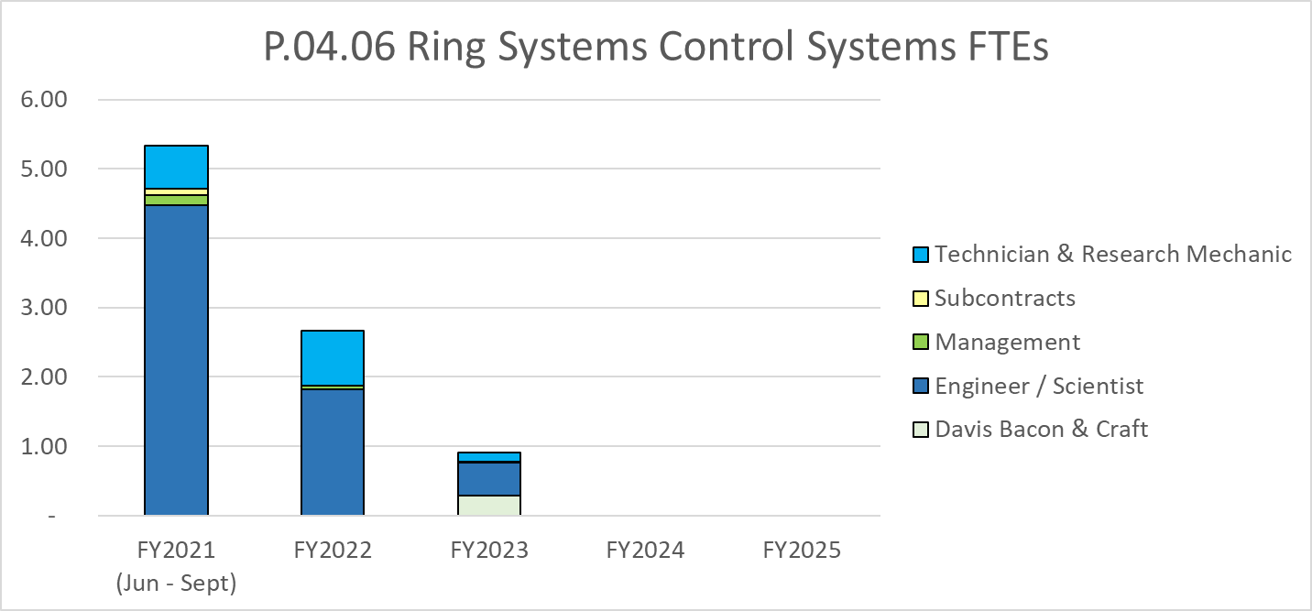
Labor Profile
Charge 5
BPLS requires significant labor support because it is a credited control

Slide 22
Responses to Recommendations
Charge: 6
  CD 2/3 - Added BPLS to Risk Registry
    Low Risk to achieving power ramp up
  no recommendations from prior reviews
B4-1 Evans

Slide 23
One Year Look-Ahead
Charges: 1, 2
P.4.6.2 BPLS
  Complete final design and final design review
  Install test system in FY22B Outage
P.4.6.3 PPS
  Complete RTBT PPS Rack Upgrade to certified safety hardware
P.4.6.4 Injection controls
  Procure and fabricate injection region water skid control cabinets
P.4.6.5 Extraction controls
  No activity planned until FY23 2Q

Slide 24
EHS&Q fully integrated into P.4.6
Charge 3
  EH&S in an integral part of the design and work planning process
  Designs like PPS power distribution minimize hazards like AC voltage
  Material handling considered in rack design
  Preparing work packages, which address safety, is included in the schedule
  Workspaces have Research Safety Summaries (RSS) – personnel required to read and acknowledge
  March 2020 to present ORNL has been operating under DOE approved COVID restrictions
  P.4.6 work not significantly impacted by restrictions
  Quality representatives included in P.4.6 from the beginning

Slide 25
Ring Controls are Ready to Support PPU KPPs
Charges: 1, 2, 4, 5, 6
The preliminary technical design for the BPLS (P.4.6.2) is complete and final design progressing
  Preliminary design review recommendations are being addressed
The final technical design for the PPS (P.4.6.3) and Injection Controls (4.6.4) are complete
The Final technical design and implementation for Extraction Controls (P4.6.5) – software only – is scheduled for FY23 Q2
Equipment potentially affected by COVID-19 procured early and are are progressing
P.4.6 Ring Controls cost and schedule are well understood and integrated into overall SNS operating schedule
Thank you for your time!

