Slide 1




P.04.6 Beam Power Limit System
DOE/SC Independent Project Review of the Proton Power Upgrade Project
Patrick Bong
Level 4 Manager for BPLS
September 14-17, 2021

Slide 2
Outline
Scope
Organization
Progress since CD-2/3
Challenges
Final design status
Installation plans
Cost and schedule
Labor profile
Risk register
Responses to recommendations
ESH&Q and COVID-19 impacts
12-month look-ahead
Summary

Slide 3
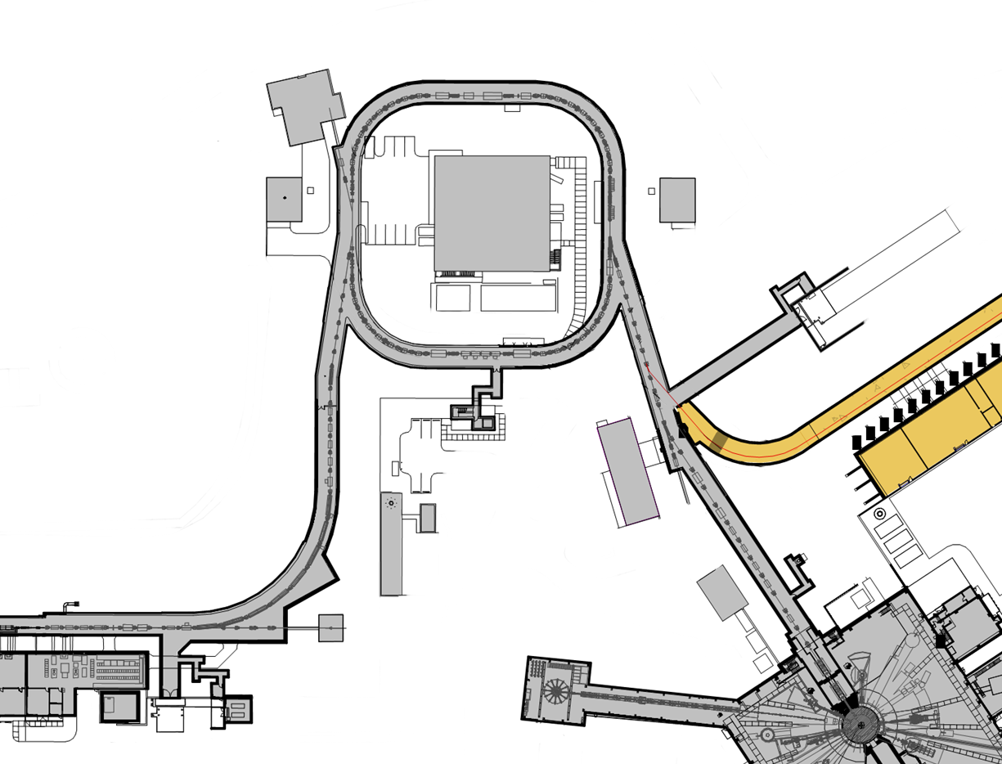
PPU-Ring Technical scope
Charge: 1
Re-evaluate injection dump power limit
Install view screen
  Upgrade charging power supplies to 45kV
  Replace shims in extraction septum magnet
Replace two chicane magnets
Upgrade injection kicker power supplies
Replace injection dump septum magnet
Move chicane magnet #1 upstream ~32 cm
Add quad magnet to IDmp beamline
Add diag. to IDmp beamline
2D Pyrometer for foil temperature measurements*
  Neutronics and shielding calculations for RTBT to RTST tunnel stub
  PPS for stub
This scope had no CD-3B Long Lead Procurements
  Power limit system
  2 MW
  Upgrade water cooling system for the power supplies in the Ring service building
  Cooling fan kit for the main ring dipoles substation power transformers

Slide 4
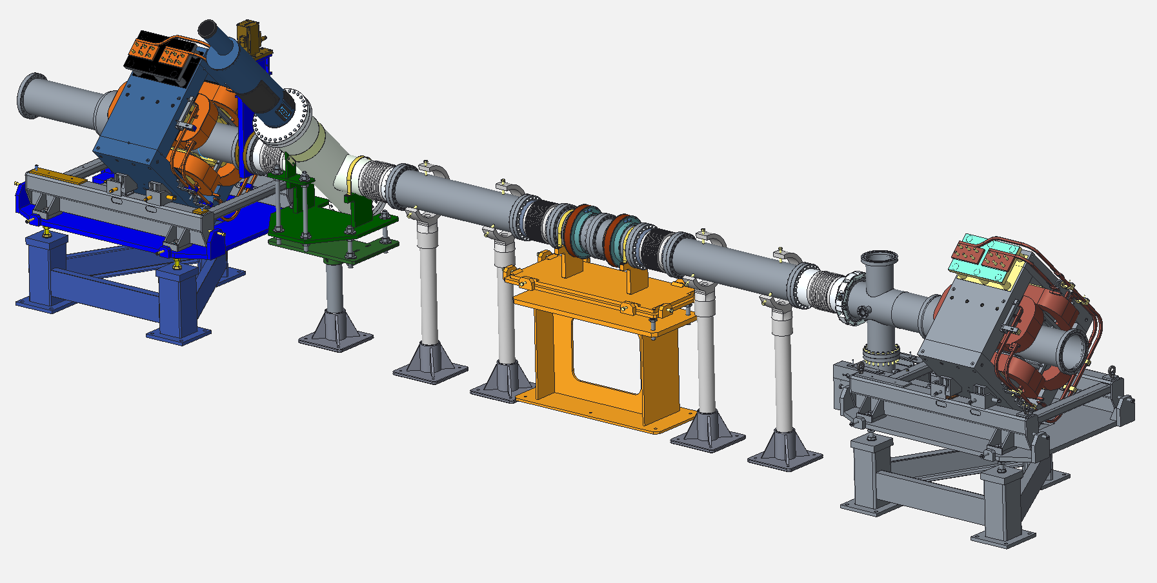
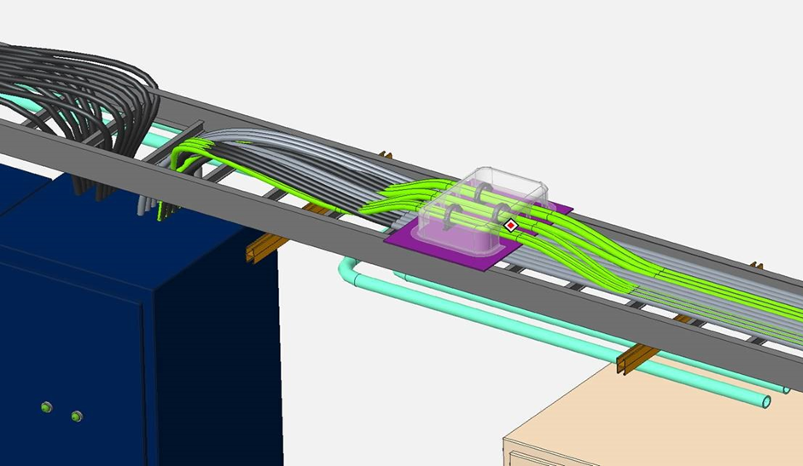
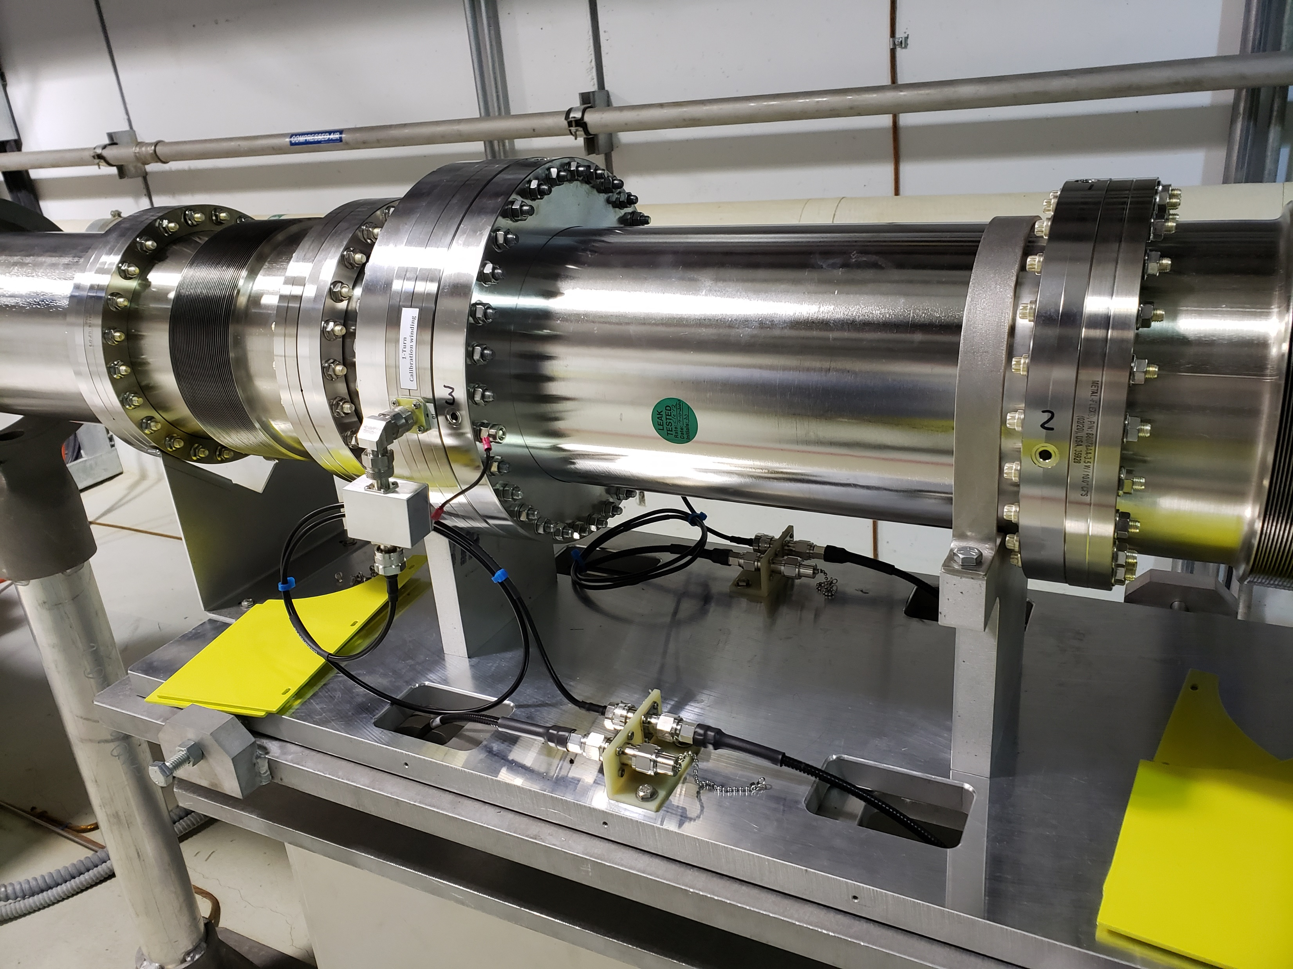
Scope
Charge: 1
P.4.6.2 Beam Power Limit System: Design, Install, and certify a credited control to detect excessive beam power to the First Target Station (FTS) and to shut off the proton beam if the power exceeds a pre-determined limit

Slide 5


































Charge: 4
P.4 Ring
Nick Evans
P.4.1
Management and System Integration Nick Evans
P.4.2 Injection Region
Robert Saethre
P.4.3 Injection Dump
Charlotte Barbier
P.4.4
Extraction Region Robert Saethre
P.4.6 Ring Control Systems Karen White
P.4.7 RTBT Stub
Nick Evans
P.4.8
Accelerator Physics Nick Evans
P.4.5 Utilities
Greg Norman
P.4.1.1
Management and System Integration
Nick Evans
P.4.2.1
Management and System Integration Robert Saethre
P.4.3.1
Management and System Integration
Dave Willis
P.4.4.1
Management and System Integration Robert Saethre
P.4.5.1
Management and System Integration
Greg Norman
P.4.6.1
Management and System Integration Derrick Williams
P.4.7.2 RTBT Stub Temporary Shielding
Nick Evans
P.4.8.1 Accelerator Physics
Nick Evans
P.4.1.2
Design
Nick Evans
P.4.2.2 Magnets
Robert Saethre
P.4.3.2 Injection Dump Imaging
Dave Willis
P.4.4.2 Magnets
Robert Saethre
P.4.5.2 Main Ring Dipole XFMR
Upgrade
Greg Norman
P.4.6.2 Beam Power Limit
Systems
Patrick Bong
P.4.7.3 RTBT Stub Earth Berm Shielding
Nick Evans
P.4.2.3 Power Supplies
Robert Saethre
P.4.3.3 Injection
P.4.4.3 Power Supplies
Robert Saethre
P.4.5.3 RN-03 DIW
Cooling Upgrade
Greg Norman
P.4.6.3 Personnel Protection System
Kelly Mahoney
Dump Engineering
Review
Melissa Harvey
P.4.2.4 Vacuum Systems
Charlotte Barbier
P.4.5.4
PFN Room HVAC
Greg Norman
P.4.6.4 Ring Injection Section
Controls
Derrick Williams
P.4.2.5 Primary and Secondary
Stripper Foil
Charlotte Barbier
P.4.6.5 Ring Extraction Section
Controls
Derrick Williams

Slide 6

P.4.6.2 Beam Power Limit System (BPLS) is new scope since CD1
Accelerator Safety Envelope max power to first target is 2MW
PPU Upgrade has potential for 2.8MW to the first target
A credited control is required to limit power to < the Accelerator Safety Envelope (ASE) value
The normal PPS computers (PLCs) are not powerful enough to make these calculations pulse to pulse
  The BPLS signal processor will be FPGA-based in a high-reliability μTCA design coupled with Safety PLCs
  First custom digital FPGA credited control at SNS
Charge: 1

Slide 7
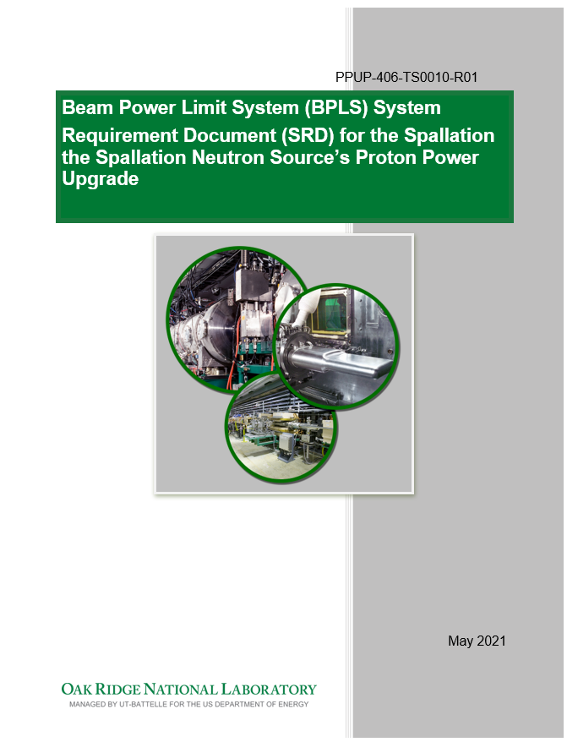
P.4.6.2 BPLS High Level Requirements
Charge: 1
Calculate beam pulse energy based on measurements of magnet dipole current PPU-406-CA001
Calculate beam charge based on measurement of beam current PPU-406-CA0003
Trip the proton beam if power exceeds 2.145MW-s over 60 sec period with credited control PPU-500-TS0001
Pedigree and reliability consistent with Safety Integrity Level (SIL) 2

Slide 8
Progress since CD-2/3
Charge: 1
System Requirement Documentation at Final maturity.
  21 Documents
Subsystem documentation at Preliminary maturity
  10 Documents
Held PDR in March 2021
  Mini-PDR for the digital subsystem in August 2021
Tested Fast Current Transformer
Long Lead, Low Risk Procurements underway
  Fast Current Transformer procurement awarded July 2021
  MicroTCA crate and cards ordered in June 2021

Slide 9
PPU Changes since CD-2/3

Slide 10
Challenges
Schedule is tight. Schedule was revised to account for missing elements
Project is in preliminary design. FDR is in February 2022
BPLS is required for power ramp-up
Error budget is tight. Trip thresholds are 2.5% away from operating power

Slide 11
Final Design Status
Charge: 1, 3
System is at Preliminary Design
Mini-PDR for the digital design components in August 2021
  Presented path forward to committee for the Mini-PDR
Final Design Review in February 2022
  Added digital designers with experience in safety systems
  Leveraging vendor support for design of DCCT
  Reduced dependencies on thermal variation.
Requirements tracking software is being populated
Beamline hardware is complete

Slide 12
Installation Plans
Charge: 4
Test Stand is populated with Safety PLC and MicroTCA hardware
Install the FCT Summer 2022. Receipt is mid December 2021
  Cabling infrastructure is installed
  Mechanical covers are installed
  Extra spool pieces are on-hand
Install racks upon receipt
  Racks are air conditioned and make tests before system is installed
  Looking at options currently
Install components in racks after FDR
  Perform individual tests and system tests

Slide 13
Budget and Estimate to Complete

Slide 14
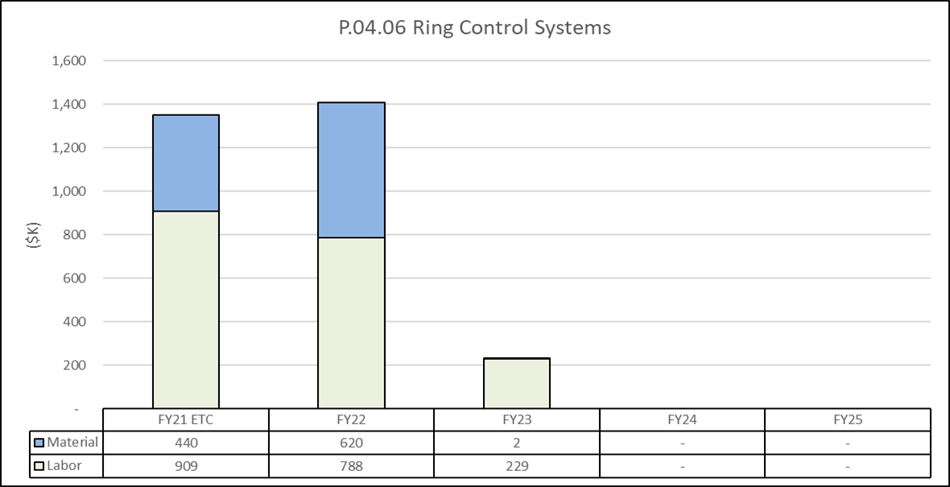
Estimate to Complete

Slide 15
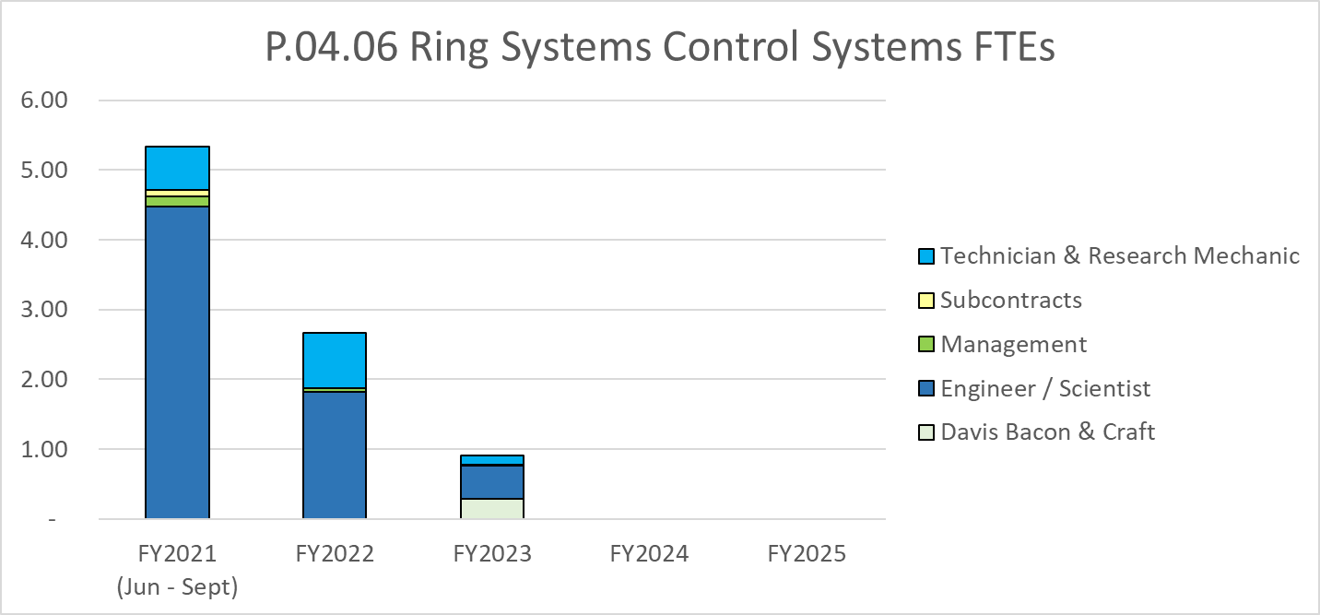
Labor Profile

Slide 16
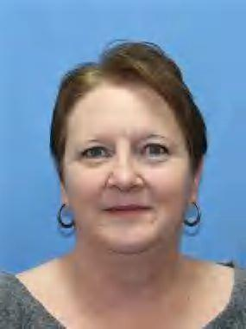
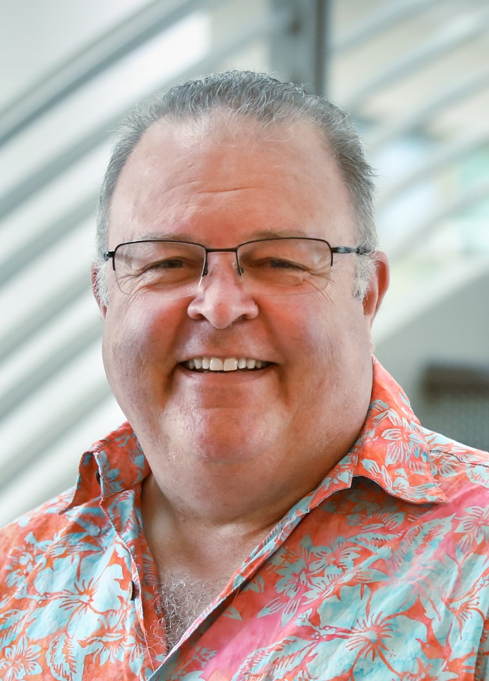
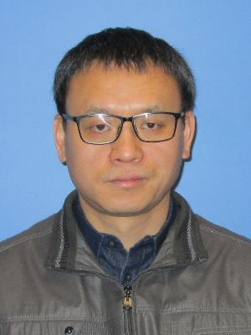
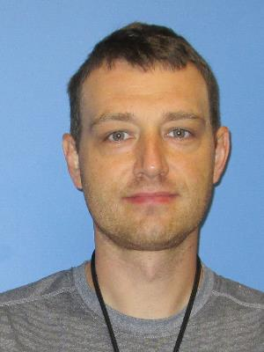
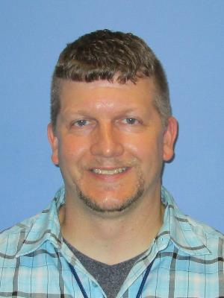
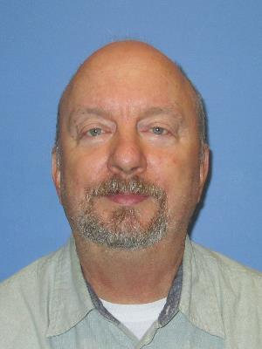
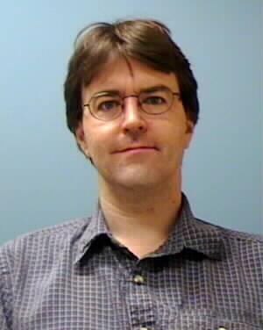
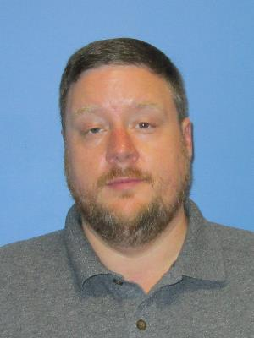
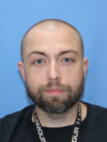
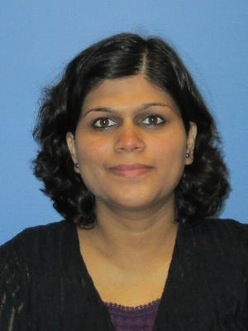
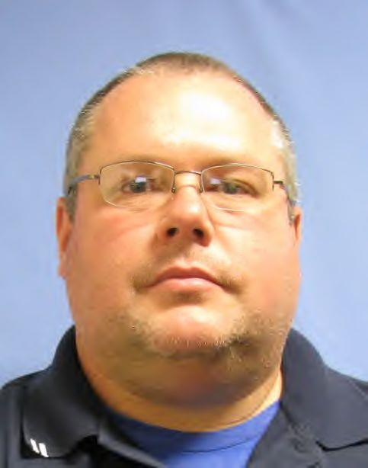
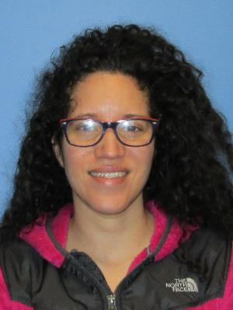
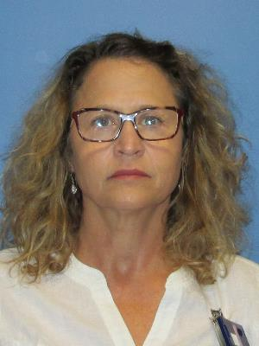
Labor Profile
Accelerator Physics
L2 Manager
Analysis
Device Location
Safety Basis
Guidance
Credited Control Evaluation
ASE/SAD Update
Nick Evans
Quality Assurance
Reliability Support
Quality Planning
David Freeman
Lisa Turvin
Controls Section Leader
L3 Manager
Resource Planning
Bryan Robertson
Jake
Platfoot
Karen White
Contract/Matrix
Controls System Engineer
System Integration
CT and AFE Design
Controls System Engineer
L4 Manager
Oversight
System Requirements/Spec
System Integration
CT and AFE Design
Project Management
System
Modeling
FPGA V&V
FPGA Design
2 Contractors
1 Full time ORNL staff
Rest are part time
Milko
Bobbrek
John
Jones
Trent
Allison
Tommy
Michaelides
Patrick Bong
Craig
Deibele
Yugang
Tan
Mechanical Engineering
Mechanical Analysis
FCT Stand Design
DCCT Housing
Controls Integration
Electronics Design
Firmware Support
Drivers
EPICS Software
Screens
Protection Systems Group
System Owner
Beam Energy Calculation
PPS Interface
Rack Layout and Power
Reqtracer
PLC V&V
Tom Roseberry
Klemen Vodopivec
Kelly Mahoney
Trent Allison
Tim
Lessard
Dave
Willis
Eric
Breeding
Chuck Roberts
Kay
Kasemir
Trent
Allison
Alan
Justice
Shaun
Cooper
Ashwini
Aher
Bryan
Moss
Gabriela
Sabin
Melanie
Smith

Slide 17
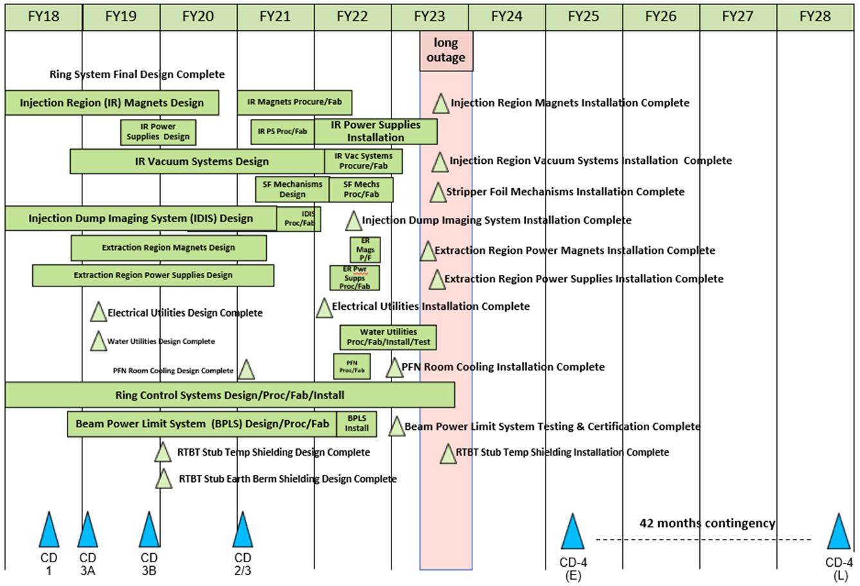
P.4 – Ring Systems May 2021 Status Summary Schedule

Slide 18
Risks are Identified and Monitored
Charge: 2
One active risk identified
  Two risks retired
  Pre-mitigated ranking: 1 Medium
  Post-mitigated ranking: 1 Medium
High Risks
  No high risks identified
Key risk categories analyzed
  Fabrication
  Requirements
Risks are reviewed on a regular basis

Slide 19
Responses to Recommendations
Charge: 6
No recommendations from the 2020 Directors Review
One from the CD 2/3 review:
  By the next DOE IPR, evaluate adding a Risk Registry entry for the Beam Power Limit System
  Management and technical team evaluated schedule and cost impact of slip in BPLS schedule, mitigation, included in risk register
  Risk to project is low, mitigation is administrative, could impact power ramp up
  Contingently planning is in progress

Slide 20
ESH&Q and COVID-19 Impacts
Charge: 2, 3, 5
Delay in production of test article FCT
  Used surrogate personnel for acceptance testing
  Had issues with required documentation
Circuit Board house availability reduced from COVID
  Vendor has unique requirements for MicroTCA
  Limited availability for board house caused delays
  Re-tooled ordering components to stay on track for installation

Slide 21
12-Month Look-Ahead
Charge: 1
Final Design Review, February 2022
System installation following FDR
  Test individual subcomponents with beam
  Test integrated systems with beam
  Test integrated system with PPS
Finalize all documentation August 2022
ARR in September 2022

Slide 22
Summary
Charge: x
BPLS schedule was updated during a project change request
BPLS has long lead procurements underway
  Fast Current Transformer
  MicroTCA hardware
BPLS has developed a test stand for system testing / development
BPLS has
  Mini PDR in August
  FDR in February 2022

