Slide 1
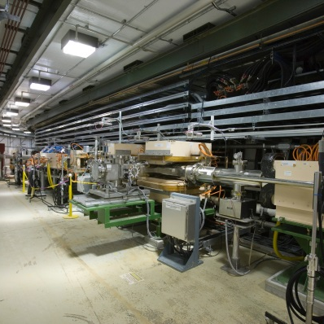
P.03.07 RF System Utilities
DOE/SC Independent Project Review of the Proton Power Upgrade Project
Greg Norman
Level 3 Manager for RF System Utilities
September 14-17, 2021

Slide 2
Outline
Scope
Organization
Progress since CD 2/3
Challenges
Final design status
Installation plans
Cost and schedule
Labor profile
Risk register
Responses to recommendations
ESH&Q and COVID-19 impacts
12-month look-ahead
Summary

Slide 3
Scope
Charge: 1
P.3.7 RF Utilities
P.3.7.1 Management and system integration
P.3.7.2 New SCL DI Water Cooling System (KL-06)
P.3.7.3 Upgrade existing DTL DI Water RF Cooling System (KL-04)
P.3.7.7 New SCL RF Electrical Utilities

Slide 4
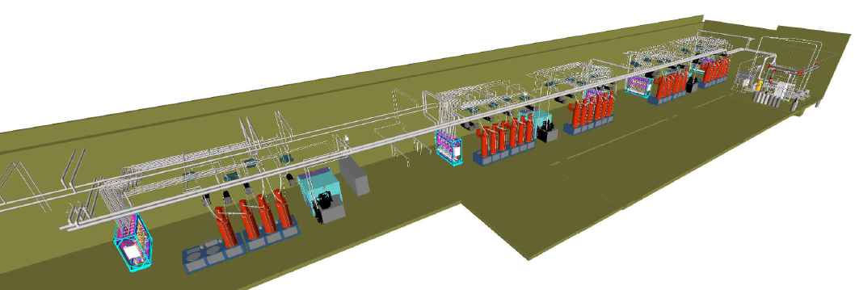
Scope
Charge: 1
P.3.7.2 New SCL RF Cooling System (KL-06)
New KL-06 SCL DI water cooling system will be provided to cool the 28 new SCL klystrons, the associated RF equipment, and 3 HVCM’s to be added to the klystron gallery
The 3.7.2 WBS scope includes the following:
Design the new pump room and DI water distribution system - complete
Purchase Pump room major equipment (pumps & heat exchanger) - complete
Provide RF equipment piping tie-in’s
XMTR 30 AREA
XMTR 31 AREA
XMTR 28 AREA
PUMP ROOM
XMTR 27 AREA
XMTR 25 AREA
TRCC
KLYSTRONS
HVCM

Slide 5
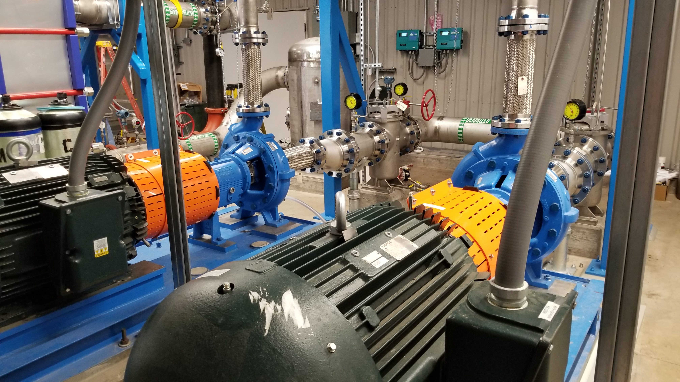
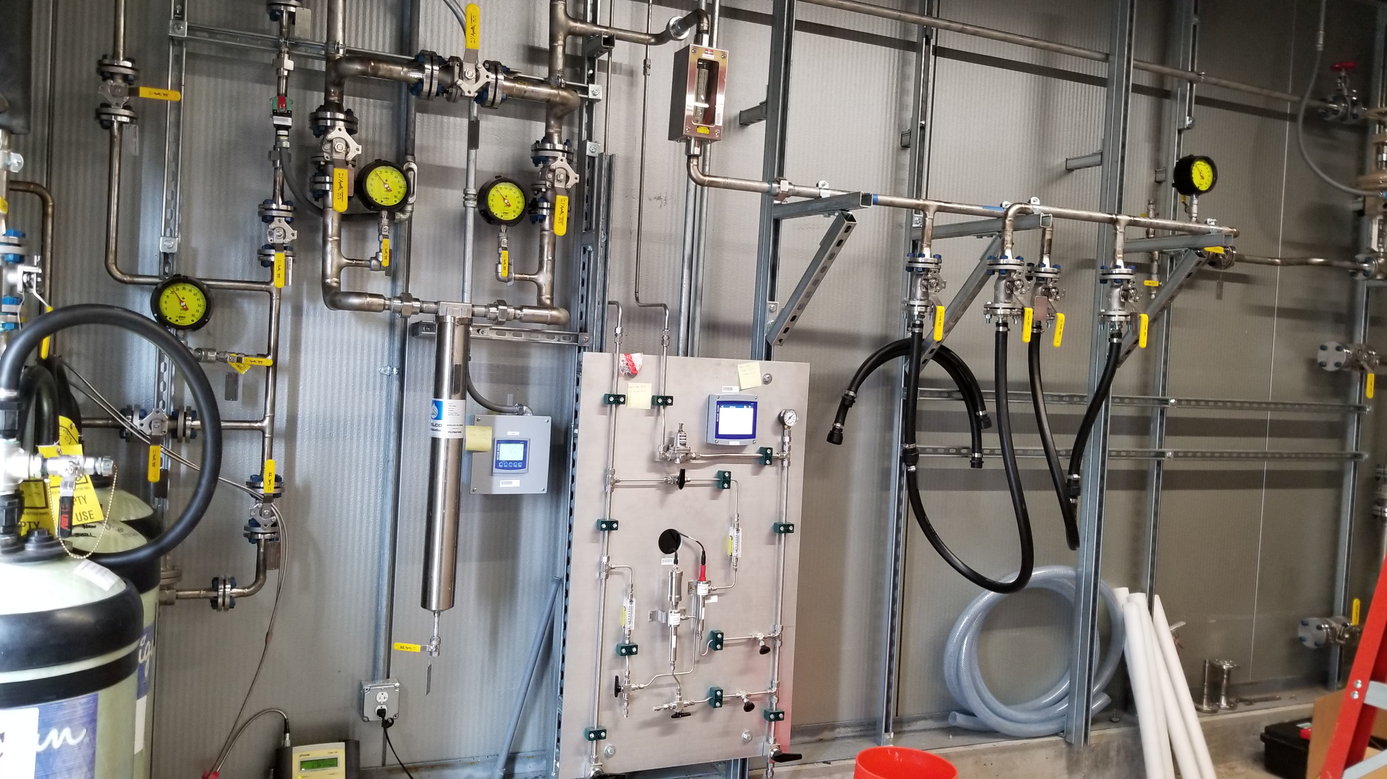
Scope
Charge: 1
P.3.7.2 New SCL RF Cooling System (KL-06) – cont.
KL-06 system construction scope is under conventional facilities WBS P10.6.2.1
Construction was completed April 2021
B5-2 Santee

Slide 6
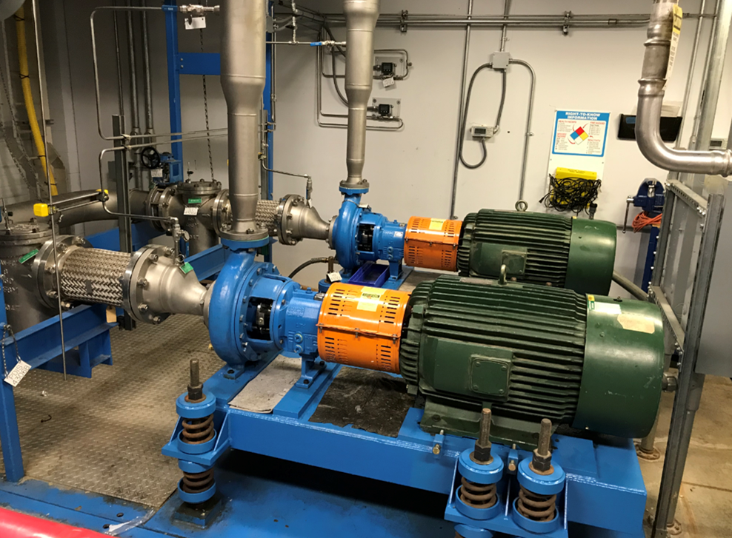
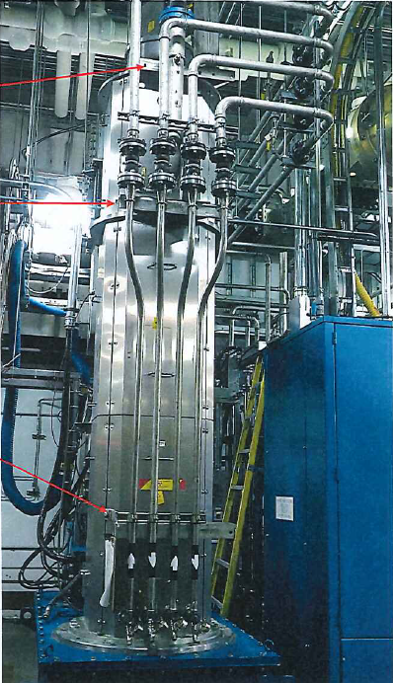
Scope
Charge: 1
P.3.7.3 Modify DTL & FEB RF Cooling System (KL-04)
Modify existing KL-04 DTL & FEB DI water cooling system to meet increased loads from the new 3.0 MW klystrons being added. The pumps are already overloaded with existing equipment requirements. The project will increase the size of the two DI water cooling pumps, and all associated electrical feed equipment
Provide the new DI water cooling tie in piping for the 3.0 MW Klystrons
KL-04 DI Water Pumps
Klystron Piping

Slide 7
Scope
Charge: 1
P.3.7.7 SCL RF Electrical Utilities
The WBS 3.7.7 scope:
Provide all technical equipment racks
Provide electrical service cables to technical equipment racks and systems from the AC distribution panels (Interface is the circuit breaker)
Provide all control cabling from technical equipment racks to the equipment, including the cryomodules in the LINAC
Provide grounding plane for all technical equipment
Install all waveguides, circulators, and loads
Conventional facilities CD 3B scope:
Provide the primary AC distribution equipment including all power panels and transformers - complete
Provide all primary raceway such as the main wire-way and cable-tray for all cable types - complete
Provide the 80kVA UPS and distribution panel - complete
B5-2 Santee

Slide 8
Charge: 5
Organization
P.3 – RF Systems
John Moss
P.3.1
Management and System Integration John Moss
P.3.2 SCL HPRF
John Moss
P.3.3 NCL HPRF
John Moss
P.3.5 Existing Linac
Modulators
Chris Pappas
P.3.6 New Linac
Modulators
David Anderson
P.3.8 RF Controls Karen White
P.3.9 Global Controls Karen White
P.3.4 LLRF
Mark Crofford
P.3.7 Utilities
Greg Norman
P.3.1.1
Management and System Integration
John Moss
P.3.2.1
Management and System Integration
John Moss
P.3.3.1
Management and System Integration
John Moss
P.3.4.1
Management and System Integration
Mark Crofford
P.3.5.1
Management and System Integration
Chris Pappas
P.3.6.1
Management and System Integration
David Anderson
P.3.7.1
Management and System Integration
Greg Norman
P.3.8.1
Management and System Integration
Alan Justice
P.3.9.1
Management and System Integration
Alan Justice
P.3.2.2
Transmitters
John Moss
P.3.3.2
Transmitters
John Moss
P.3.4.2 LLRF System
Mark Crofford
P.3.5.2 Modulator System
Chris Pappas
P.3.6.2
Transformer
David Anderson
P.3.7.2 Water Utilities, New Cold
Linac SCL RF
Greg Norman
P.3.8.2 Linac RF Controls
Alan Justice
P.3.9.2 Linac/SCL Timing/MPS Alan Justice
P.3.2.3 Klystrons
John Moss
P.3.3.3 Klystrons
John Moss
P.3.4.3 Arc Detectors
Mark Crofford
P.3.5.3 Modulator Control System Mark Wezensky
P.3.6.3 SCR System
David Anderson
P.3.7.3 Water Utilites, Modify
Existing RFQ/DTL
Greg Norman
P.3.8.3 Linac Water System
Controls
Derrick Williams
P.3.9.3 Linac/SCL Protection System
Kelly Mahoney
P.3.2.5 Circulators
John Moss
P.3.3.4 Circulators
Sung-Woo Lee
P.3.4.4 Reference Line
Chip Piller
P.3.5.4 Modulator SystemTest
Article
Chris Pappas
P.3.6.4 Modulator System
David Anderson
P.3.7.7 Electrical
Greg Norman
P.3.9.4 Linac/SCL Networking and
Computing
Alan Justice
P.3.3.5 Glycol/ Water Loads Sung-Woo Lee
P.3.5.5 Warm Linac Test HVCM
Chris Pappas
P.3.6.5 Modulator Control System Mark Wezensky
John Kristy
(Installation Coordinator)
William Barnett
(Electrical SME)
David Carlson
(Elect. Installation Coord.)
P.3.5.6 Upgrade RFQ-Mod1 Chris Pappas
P.3.6.6 Integrated System
David Anderson

Slide 9
Progress since CD 2/3
Charge: 1,2
P.3.7.2 New KL-06 SCL DI Water Cooling System
CD 2/3 12 Month Look-Ahead
“Construction is scheduled to be completed in January 2021 (CD 3B scope), except for piping tie ins to the RF equipment after it is installed later in 2021/2022”
Progress:
Construction was completed in April 2021 for the Klystron Gallery Bldg. SCL expansion which included the KL-06 pump room, equipment, instruments, and all piping
The KL-06 DI water cooling system pump room equipment and instruments have been fully tested, and controls programming has been completed and tested
Remaining work includes installation of the RF Transmitter Cooling Carts (TRCC) and water connections to the RF Equipment once installed in the Klystron Gallery
KL-06 Commissioning Completion Milestone date is April 2023

Slide 10
Progress since CD 2/3
Charge: 1,2
P.3.7.4 Modify KL-04 DTL DI Water Cooling System
CD-2/3 12 Month Look-Ahead
“All design and construction documents are complete and approved and ready for start of construction in June 2021”
Progress:
Construction was moved back to Oct-21 (Outage FY22A)after a more fully developed installation schedule showed more outage days were required
The new pumps, motors, and Variable Frequency Drives are on order and scheduled to be received in September 2021
The installation contract has been awarded

Slide 11
Progress since CD 2/3
Charge: 1,2
P.3.7.7 Klystron Gallery SCL Electrical Utilities
CD-2/3 12 Month Look-Ahead
“Remainder of cable, racks, and hardware necessary for completion of PHASE 1 (CM31 & CM32) will be purchased and received and the PHASE 1 installation will begin”
Progress:
All cable, racks, and hardware for Phase 1 installation have been purchased. All have been received with the following exceptions:
CRYO Marshalling, Tuner and CRYO Control racks [Obsolescence of specified components]
~ ½ the vacuum connectors. Beam Line and Insulating [Availability]
Specialized cables delivery has been delayed [Availability]
Installation of the ground plane for the racks and equipment involved with Phase 1 is underway
All racks that have been received for Phase 1 are installed
Waterfall cable tray to technical racks is complete for rack rows 53,52,51 and 50
2100 VAC OKONITE cable pulls from PPU Substations to corresponding HVCM SCR locations are complete
13.8 KV AC feeds to the PPU substations are complete
Cable pull lists for the October Outage are complete for LLRF, CRYO and Beam Line & Insulating Vacuum Systems
Cable pulls for AC service to rack rows 53, 52, 51, 50 and 49 is underway

Slide 12
Progress since CD 2/3
Charge: 4
16% of the scheduled work has been completed with an increase of $613K in BAC since CD 2/3

Slide 13
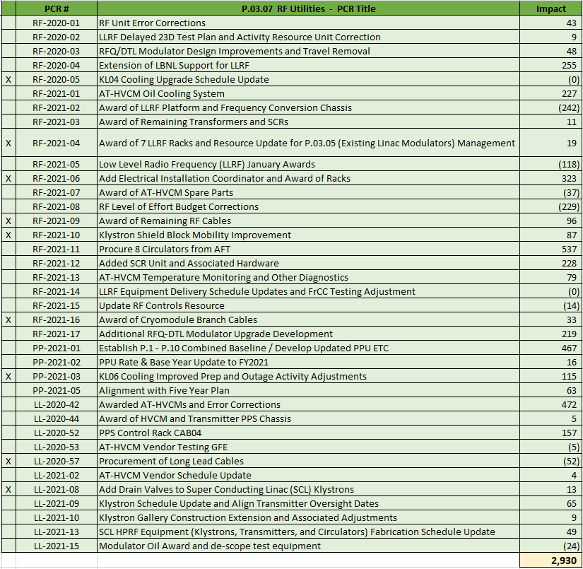
Project Change Requests since CD 2/3
Charge: 4

Slide 14
Challenges
Charge: 1,2
P.3.7.2 New KL-06 SCL DI Water Cooling System
No current challenges
P.3.7.4 Modify KL-04 DTL DI Water Cooling System
No current challenges

Slide 15
Challenges (cont)
Charge: 1,2
P.3.7.7 Klystron Gallery SCL Electrical Utilities
Late completion of Klystron Gallery SCL area construction delayed the utilities installation start date
Availability of Davis-Bacon craft personnel is compromised
Technical equipment delivery delays
Availability or obsolescence of specified parts, [cable, connectors, system components
A PCR was processed in June which has updated the baseline based on all of the above

Slide 16
Final Design Status
Charge: 6
All RF Utilities Final Design Reviews are complete with no outstanding recommendations

Slide 17
Installation Plans - DI Water Systems
Charge: 4,5
Remaining KL-06 DI Cooling System installation of TRCC carts and final connections to RF equipment is not outage dependent
3 Phase approach
Phase 1 – Install TRCC carts 30 & 31, cooling connections to SCR/HVCM 30, and cooling connections to the 1st 10 Klystrons, Circulators and RF Loads
Phase 2 – Install TRCC carts 27 & 28, cooling connections to SCR/HVCM 28, and cooling connections to the 2nd set of 10 Klystrons, Circulators, and RF Loads
Phase 3 – Install TRCC cart 25, cooling connections to SCR/HVCM 25, and cooling connections to the 3rd set of 8 Klystrons, Circulators, and RF Loads
KL-04 DI Cooling Pump Upgrades are scheduled to be completed during Outage FY22A in October 2021

Slide 18
Installation Plans – SCL RF Electrical Utilities
Charge: 4,5
SCL Electrical Utilities installation occurs in 3 phases
Phase 1 Activities (Klystron Gallery – non outage work)
Transmitter 30 & 31 racks and all associated racks, 10 klystron tanks, and TRCC carts, SCR/HVCM 30 and 1st 10 Klystrons. All cable tray, ground plane, wiring, and terminations for the above. Waveguide, RF Circulators, and RF Loads
Phase 1 Activities (LINAC – outage work)
All Phase 1 cables from the KG to the LINAC and terminations [CM32 & 31]
Phase 2 Activities (Klystron Gallery – non outage work)
Transmitter 27 & 28 racks and all associated racks, 10 klystron tanks, and TRCC carts, SCR/HVCM 28 and 2nd 10 Klystrons. All cable tray, ground plane, wiring, and terminations for the above. Waveguide, RF Circulators, and RF Loads
Phase 2 Activities (LINAC – outage work)
All Phase 2 cables from the KG to the LINAC and terminations [CM30, 29, & 28]
Phase 3 Activities (Klystron Gallery – non outage work)
Transmitter 25 racks and all associated racks, 8 klystron tanks, and TRCC carts, SCR/HVCM 25 and final 8 Klystrons. All cable tray, ground plane, wiring, and terminations for the above. Waveguide, RF Circulators, and RF Loads
Phase 3 Activities (LINAC – outage work)
All Phase 3 cables from the KG to the LINAC and terminations [CM27 & 25]

Slide 19
Installation Layout by Phase – RF Electrical Utilities
PHASE 3
PHASE 2
PHASE 1

Slide 20
RF Summary Schedule Editable Diagram
FY18
FY19
FY20
FY21
FY22
FY23
FY24
FY25
FY26
FY27
FY28
Charge: 4
RF Systems Preliminary Design Complete
long outage
RF Systems FD Complete (Excl. LLRF & RFQ-DTL HVCM)
RF Systems FD Complete (LLRF & RFQ-DTL HVCM)
Procure/Fab RF Systems Controls
Transmitter Design & Fab First Article
Procure/Fab Transmitters
Procure/Fab SCL Klystrons
Procure/Fab WG, Circs and Loads
Procure/Fab Transformers & SCR
Procure/Fab New Modulator Systems
Procure/Fab Utilities/Electrical
Proc/Fab LLRF
RF SCL Installation
First High-Power Test for XMTR 30 & 31 (8/2022), 27 & 28 (11/2022), and 25 (11/2023) Complete
Proc/Fab Upg. Linac Modulators
Existing Linac – Test HVCM w. Dual 3.0 MW Klystrons
3MW Klystron Design & Fab First Article
Procure/Fab 3MW Klystrons
42 months contingency
CD
1
CD
3A
CD
3B
CD
2/3
CD-4
(E)
CD-4
(L)

Slide 21
Budget and Estimate to Complete
Charge: 4
We are 29% complete in RF Utilities (Design’s and major procurements)
Installation is remaining

Slide 22
Cost Estimate by FY
Charge: 4
- Labor is mostly Davis-Bacon Craft (Electrical Utilities)
- FY21/22 materials are primarily the receipt of Phase 2 & 3 electrical items

Slide 23
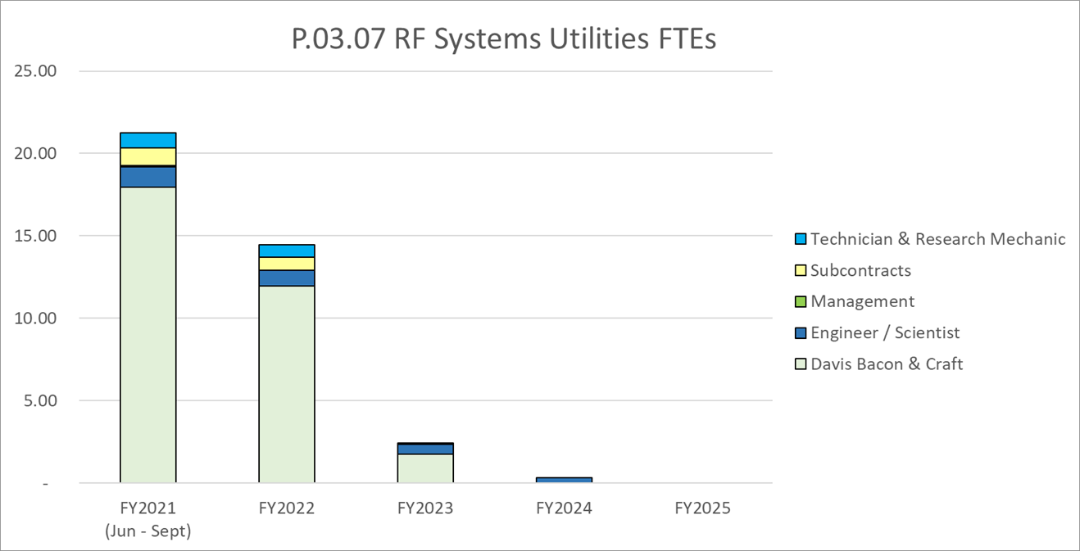
Labor Profile
Charge: 4
The majority of the labor is for RF Electrical Utilities Installation
June PCR changes this distribution

Slide 24
P.03.07 Utilities Risk Register
Charge: 5
Risk ID | L3 WBS | Risk Title | Expiration Date | Mitigation | Pre-Mitigation Rank | Post Mitigation Rank
T-P.3-031 | P.03.07 | Availability of Davis-Bacon craft personnel is compromised | 10/1/2021 | Work with the PPU installation coordinator, who also manages the GEM Technologies contract, to ensure needed craft resources are available when needed. Consider premium payments and/or overtime to compete with other local projects, e.g., UPF | 6 | 6
T-P.3-030 | P.03.07 | Installation does not match 3D model | 9/1/2022 | Ensure adequate Quality Controls Oversight | 6 | 2
Two active risks identified
No risks retired
Pre-mitigated ranking: 2 Medium
Post-mitigated ranking: 1 Low, 1 Medium
High Risks
No high risks identified
Key risk categories analyzed
Vendor skill
Craft availability
Risks are reviewed on a regular basis
T-P.3-031 mitigation:
Utilizing internal resources to supplement D-B craft
Retaining Electrical SME
Schedule has been adjusted to redistribute the manpower.

Slide 25
Responses to Recommendations
Charge: 6
No recommendations from the CD 2/3 review
Recommendations from prior DOE reviews are closed

Slide 26
ESH&Q and COVID-19 Impacts
Charge: 3,5
ESH&Q impacts
One procurement non-conformance: KL-06 pump motor amps are higher than the manufacturers published values
COVID-19 impacts
Quarantines during CF construction (5 weeks)
Technical equipment fabrication and delivery delays

Slide 27
12-Month Look-Ahead
Charge: 4,5
P.3.7.2 KL-06 SCL DI Water Cooling System
Install TRCC carts 30 & 31, cooling connections to SCR/HVCM 30, and cooling connections to the 1st 10 Klystrons, Circulators and RF Loads
Phase 1 Piping Complete in April 2022
Install TRCC carts 27 & 28, cooling connections to SCR/HVCM 28, and cooling connections to the 2nd 10 Klystrons, Circulators and RF Loads
Phase 2 Piping Complete in August 2022
Phase 1 1st High Power Test (Xmtr 30&31) in July 2022
P.3.7.4 Modify KL-04 DTL DI Water Cooling System
Receive pumps and VFD’s in September 2021
Installation is scheduled to be completed during Outage FY22A (October 2021)

Slide 28
12-Month Look-Ahead
Charge: 4,5
P.3.7.7 Klystron Gallery SCL Electrical Utilities
Phase 1 Activities (Klystron Gallery – non outage work)
Transmitter 30 & 31 racks and all associated racks, klystron tanks, and TRCC carts, SCR/HVCM 30 and 1st 10 Klystrons. All cable tray, ground plane, wiring, and terminations for the above. Waveguide, RF Circulators, and RF Loads
Phase 1 Activities (LINAC – outage work)
All Phase 1 cables from the KG to the LINAC [Outage FY22A – October 2021]
Terminate all Phase 1 cables in the LINAC [Outage FY22B – March 2022]
1st High Power Test (Phase 1 - Xmtr 30&31) in July 2022
Phase 2 Activities (Klystron Gallery – non outage work)
Transmitter 27 & 28 racks and all associated racks, klystron tanks, and TRCC carts, SCR/HVCM 28 and 2nd 10 Klystrons. All cable tray, ground plane, wiring, and terminations for the above. Waveguide, RF Circulators, and RF Loads
Note: Dates shown are based on the PCR processed in June 2021

Slide 29
Summary
All designs and FDRs are complete for the Klystron Gallery RF Utilities WBS’s
There are no outstanding recommendations from previous reviews
The KL-06 SCL DI Water Cooling System equipment, instrument, and piping installation has been completed and fully tested, and the tie ins to the RF equipment and HVCM’s are on schedule and will occur for Phase 1 & 2 in the next 12 months
The KL-04 DTL DI Water System modifications are scheduled for October 2021 [Outage FY22A]
The SCL RF Electrical Utilities installation ramped up slower than scheduled but has now recovered
Risk # T-P.3-031 “Availability of Davis-Bacon craft personnel is compromised” was realized
PCR to modify schedule dates was approved in June, before any large variances ocurred
Detailed planning and installation coordination is ongoing so installation efficiency should improve over time and result in schedule benefits to offset some of the slip from initial manpower limitations

