Slide 1
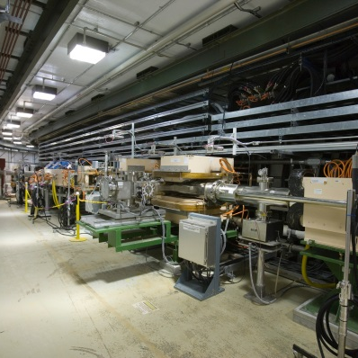
P.04.05 Ring Systems - Utilities
DOE/SC Independent Project Review of the Proton Power Upgrade Project
Greg Norman
Level 3 Manager for Ring Systems - Utilities September 14-17, 2021

Slide 2
Outline
Scope
Organization
Progress since CD 2/3
Challenges
Final design status
Installation plans
Cost and schedule
Labor profile
Risk register
Responses to recommendations
ESH&Q and COVID-19 impacts
12-month look-ahead
Summary

Slide 3
Scope
Charge: 1
P.4.5 Ring Utilities
P.4.5.1 Management and System Integration
P.4.5.2 Main Ring Dipole Transformer Cooling Upgrade
P.4.5.3 RN-03 Magnet Power Supply DI Cooling Water Upgrade
P.4.5.4 PFN Room HVAC

Slide 4
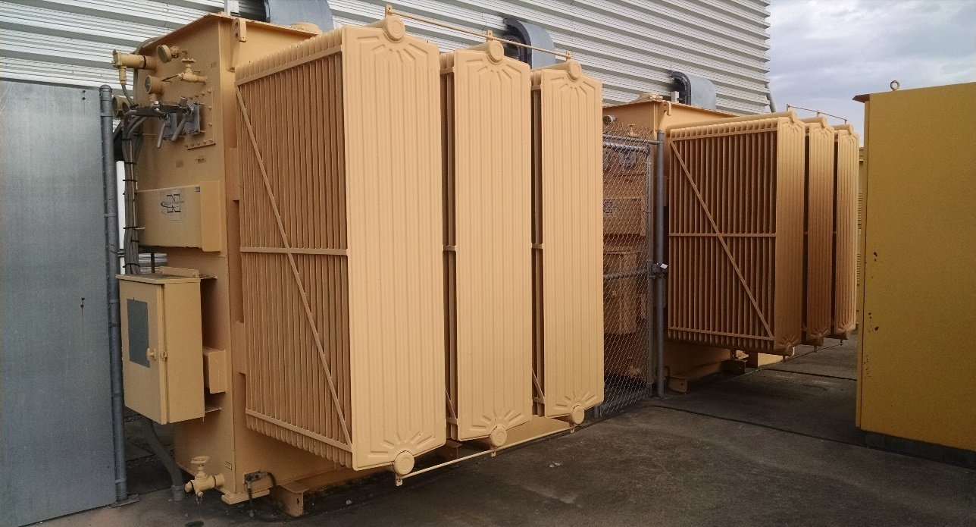
Scope
Charge: 1
P.4.5.2 Main Ring Dipole Transformer Cooling Upgrade
2 Cooling Fans per Transformer (Typical)
Add transformer cooling fan kits to existing 1500 kVa (4681 amp) transformers to increase capacity to 1725 kVa (5384 amps)

Slide 5
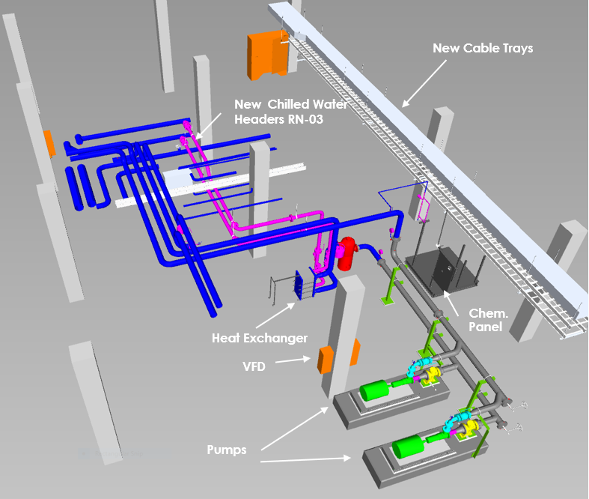
Scope
Charge: 1
P.4.5.3 RN-03 Magnet Power Supply DI Water Cooling Upgrade
Replace the 3 existing smaller capacity pumps with 2 larger pumps (1 installed spare)
Goulds 3196 (475 GPM @ 230 FT)
Add additional heat transfer area (plates) to the existing heat exchanger and change cooling media from Tower Water to Chilled Water
Alfa Laval M10-BFG (550 kW/h)
Decommission existing RF Power Supply chilled water trim cooler on the main floor
Install Water Chemistry Panel and Flow Control Valve to automate system resistivity control
Add instrumentation for improved system monitoring and control

Slide 6
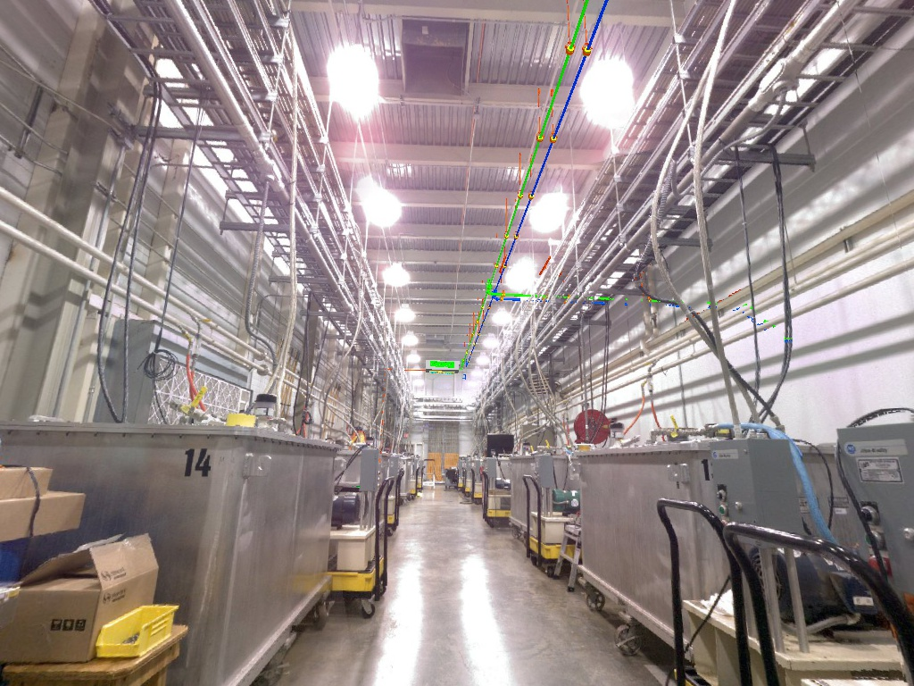
Scope
Charge: 1
P.4.5.4 PFN Room HVAC
Install two Liebert Mini-Mate air handling units suspended from the roof structure; 12 tons total capacity (72 F @ 50-55% RH)
Utilize existing facility Chilled Water and Heating Water Systems
Humidification and dehumidification control
BACnet compatibility for controls connection to EPICS
Supply ductwork along the center of the room with air distribution grilles
Remove existing roof-mounted fans and use those penetrations for outside air intake Remove, seal and insulate the existing wall-mounted filter louver intake openings and seal the partition wall at the roof deck

Slide 7
Charge: 5
P.4 Ring
Nick Evans
P.4.1
Management and System Integration Nick Evans
P.4.2 Injection Region
Robert Saethre
P.4.3 Injection Dump
Charlotte Barbier
P.4.4
Extraction Region Robert Saethre
P.4.6 Ring Control Systems Karen White
P.4.7 RTBT Stub
Nick Evans
P.4.8
Accelerator Physics Nick Evans
P.4.5 Utilities
Greg Norman
P.4.1.1
Management and System Integration
Nick Evans
P.4.2.1
Management and System Integration Robert Saethre
P.4.3.1
Management and System Integration
Dave Willis
P.4.4.1
Management and System Integration Robert Saethre
P.4.5.1
Management and System Integration
Greg Norman
P.4.6.1
Management and System Integration Derrick Williams
P.4.7.2 RTBT Stub Temporary Shielding
Nick Evans
P.4.8.1 Accelerator Physics
Nick Evans
P.4.1.2
Design
Nick Evans
P.4.2.2 Magnets
Robert Saethre
P.4.3.2 Injection Dump Imaging
Dave Willis
P.4.4.2 Magnets
Robert Saethre
P.4.5.2 Main Ring Dipole XFMR
Upgrade
Greg Norman
P.4.6.2 Beam Power Limit
Systems
Patrick Bong
P.4.7.3 RTBT Stub Earth Berm Shielding
Nick Evans
P.4.2.3 Power Supplies
Robert Saethre
P.4.3.3 Injection
P.4.4.3 Power Supplies
Robert Saethre
P.4.5.3 RN-03 DIW
Cooling Upgrade
Greg Norman
P.4.6.3 Personnel Protection System
Kelly Mahoney
Dump Engineering
Review
Melissa Harvey
P.4.2.4 Vacuum Systems
Charlotte Barbier
P.4.5.4
PFN Room HVAC
Greg Norman
P.4.6.4 Ring Injection Section
Controls
Derrick Williams
P.4.2.5 Primary and Secondary
Stripper Foil
Charlotte Barbier
P.4.6.5 Ring Extraction Section
Controls
Derrick Williams

Slide 8
Progress since CD 2/3
Charge: 1,2
P.4.5.2 Main Ring Dipole Transformer Upgrade
Main Ring Dipole Transformer Fan kits have been ordered
Installation scheduled for October 21 (Outage FY22A)
P.4.5.3 RN-03 Magnet Power Supply DI Cooling Water Upgrade
FDR was completed and there are no open recommendations
P.4.5.4 PFN Room HVAC
FDR was completed and there are no open recommendations

Slide 9
Progress since CD-2/3
Charge: 4
Ring Utilities is 25% complete with only a slight increase (+$25K) in the BAC since CD 2/3

Slide 10
Project Change Requests since CD 2/3
Charge: 4
Ring Utilities = $18K

Slide 11
Challenges
Charge: 1,2
No current challenges

Slide 12
Final Design Status
Charge: 6
All Ring Utilities Final Design Reviews are complete
No open recommendations

Slide 13
Installation Plans
Charge: 4,5
P.4.5.2 Main Ring Dipole Transformer Upgrade
Installation scheduled for October 21 (Outage FY22A)
Pre-work: Install conduit / wiring from PP to transformers
Outage: Install fan kits and controls
P.4.5.3 RN-03 Magnet Power Supply DI Cooling Water Upgrade
Pre-outage construction scheduled to start in November 22
Pump foundations and pumps
Piping fabrication
Cable tray & conduit installation
Outage construction scheduled for February 23 (Outage FY23A)
Piping demo and make the tie ins to the new pumps
Install additional heat exchanger plates
Install Instrumentation and wiring
P.4.5.4 PFN Room HVAC
PCR processed in August has shifted installation forward to March 22

Slide 14
Estimate to Complete
Charge: 4
We are 25% complete in Ring Utilities (Design and PM)
Procurement and installation is remaining

Slide 15
Estimate to Complete by FY
Charge: 4
FY22 labor is Main Ring Dipole Transformer Upgrade
FY23 labor & material is PFN HVAC and RN-03 Pump Upgrades
PFN HVAC and RN-03 are turnkey subcontracts

Slide 16
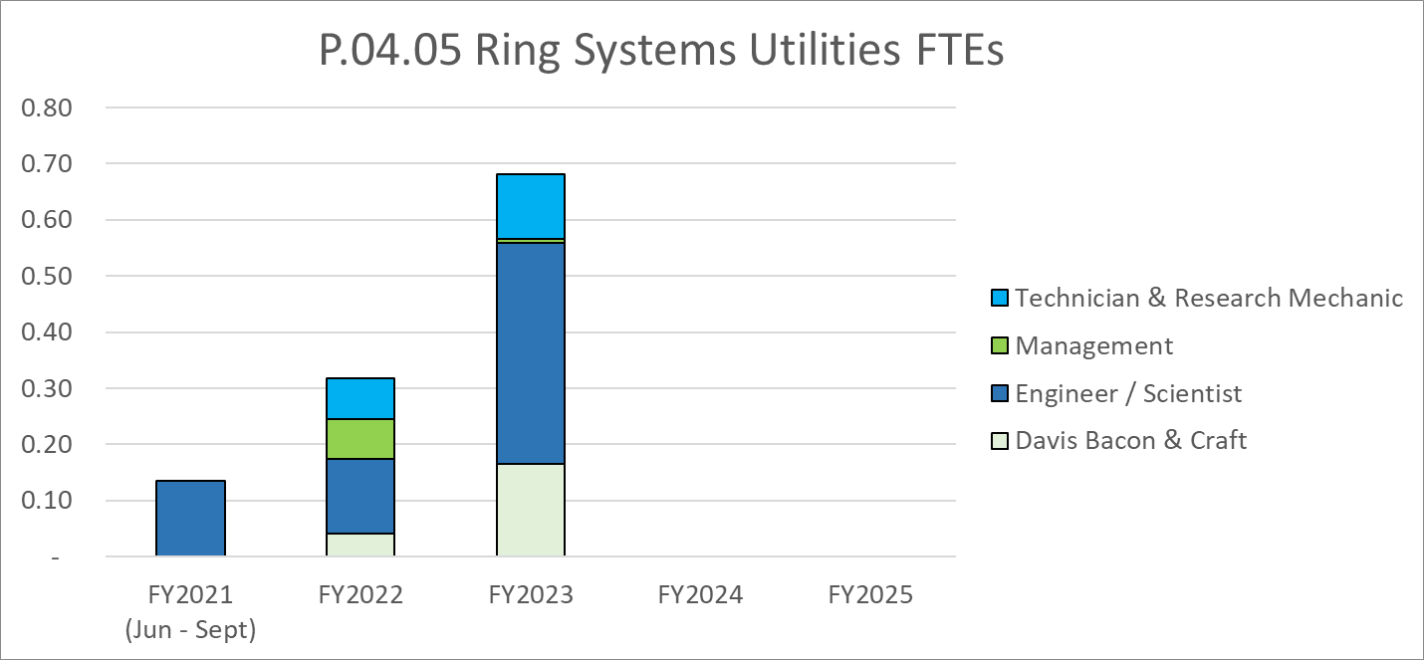
Labor Profile
Charge: 4
Labor is largely support of turnkey installations (PFN HVAC and RN-03)
FY22 is primarily Main Ring Dipole Transformer Upgrade
FY23 is PFN HVAC & RN-03 Pump Upgrades

Slide 17
P.4 Ring May 2021 Status Summary Schedule
Charge: 4

Slide 18
P.04.05 Utilities Risk Register
Charge: 5
No active risks identified
No risks retired
High Risks
No high risks identified
Risks are reviewed on a regular basis

Slide 19
Responses to Recommendations
Charge: 6
No recommendations from the CD 2/3 review
Recommendations from prior DOE reviews are closed

Slide 20
ESH&Q and COVID-19 Impacts
Charge: 3,5
ESH&Q impacts
None
COVID-19 impacts
None

Slide 21
12-Month Look-Ahead
Charge: 4,5
P.4.5.2 Main Ring Dipole Transformer Upgrade
Installation scheduled for October 21 (Outage FY22A)
P.4.5.3 RN-03 Magnet Power Supply DI Cooling Water Upgrade
Prepare SOW and Tech Spec for Water Cooling Components in April 22
Procurement Readiness Review for Water Cooling Components in May 22
Review and award installation contract August 22
Installation scheduled to start November 22
P.4.5.4 PFN Room HVAC
Prepare SOW for PFN Room Cooling HVAC installation October 21
PRR for PFN Room Cooling HVAC installation November 21
Procure PFN HVAC Units as GFE in November 21
Review and award installation contract January 22
Install PFN HVAC Units March 22 (Outage FY22B)

Slide 22
Summary
P.4.5.2 Main Ring Dipole Transformer Upgrade
Fan kits are on order with installation scheduled for October 21 (Outage FY22A)
No foreseen issues
P.4.5.3 RN-03 Magnet Power Supply DI Cooling Water Upgrade
Design is complete with installation contract PRR scheduled in May 22
Installation scheduled to start in November 22
No foreseen issues
P.4.5.4 PFN Room HVAC
Design is complete with HVAC procurement scheduled for November 21
Installation scheduled for March 22
No foreseen issues

