Slide 1
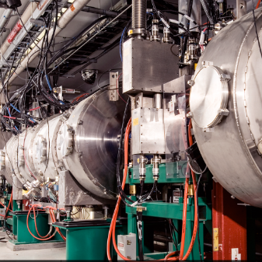
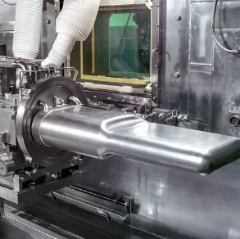
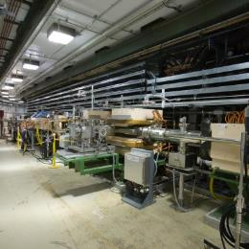

P.2.2- Cavities
DOE/SC Independent Project Review of the Proton Power Upgrade Project
John Mammosser
Level 3 Manager P.2.2
September 14-17, 2021

Slide 2
Outline
Scope
Organization
Progress since CD-2/3
Challenges
Final design status
Installation plans
Cost and schedule
Labor profile
Risk register
Responses to recommendations
ESH&Q and COVID-19 impacts
12-month look-ahead
Summary

Slide 3
Scope
Charge: 1
P02.02.02 Cavity procurement
  Manage the procurement of 32 new PPU SRF cavities for the 8 new cryomodules (CD 3a Scope)
    Implement a QA plan that reduces the risk of not achieving the design gradient performance from the vendor’s production
    Develop shipping and testing hardware that meets qualification testing needs at the partner lab Jefferson Lab
    Provide support to the cavity vendor for development of processes
  Perform three cavity-coupler integrated RF tests with HTA
    These are to aid production if needed
P02.02.04 Cavity Reprocessing
  Provide funding and oversight for cavities identified as needing full chemistry at the partner lab

Slide 4
Scope Cont’d
Charge: 1
P02.02.04 Coupler Acquisition
  Manage the procurement of 32 new PPU RF couplers (CD 3a scope)
  Perform assembly, baking and conditioning of the new RF couplers
  Deliver RF couplers to Jefferson Lab to meet the string production schedule
P02.02.07 HTA Testing
  Prepare Horizontal Test Apparatus (HTA) for the PPU cavity
  Perform up to three cavity and coupler integrated cryogenic tests
    Verifies cavity coupler integrated performance
    Tests used to diagnose production issues
P02.02.08 Coupler Waveguide Transition
  Procure 30 sets of installation hardware
    This hardware connects the HPRF waveguide to the cryomodule
    Perform incoming inspection

Slide 5
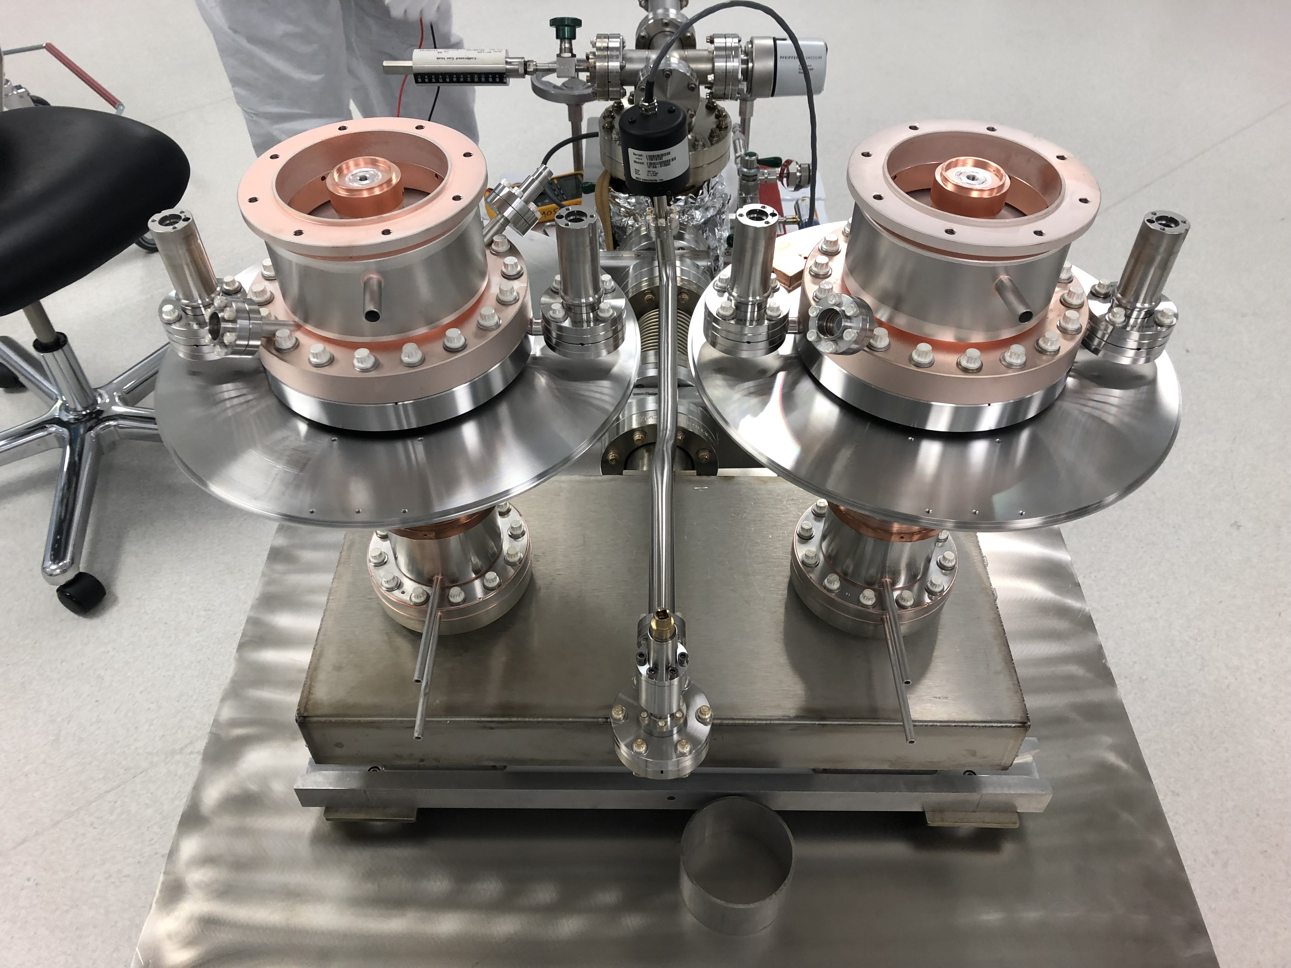
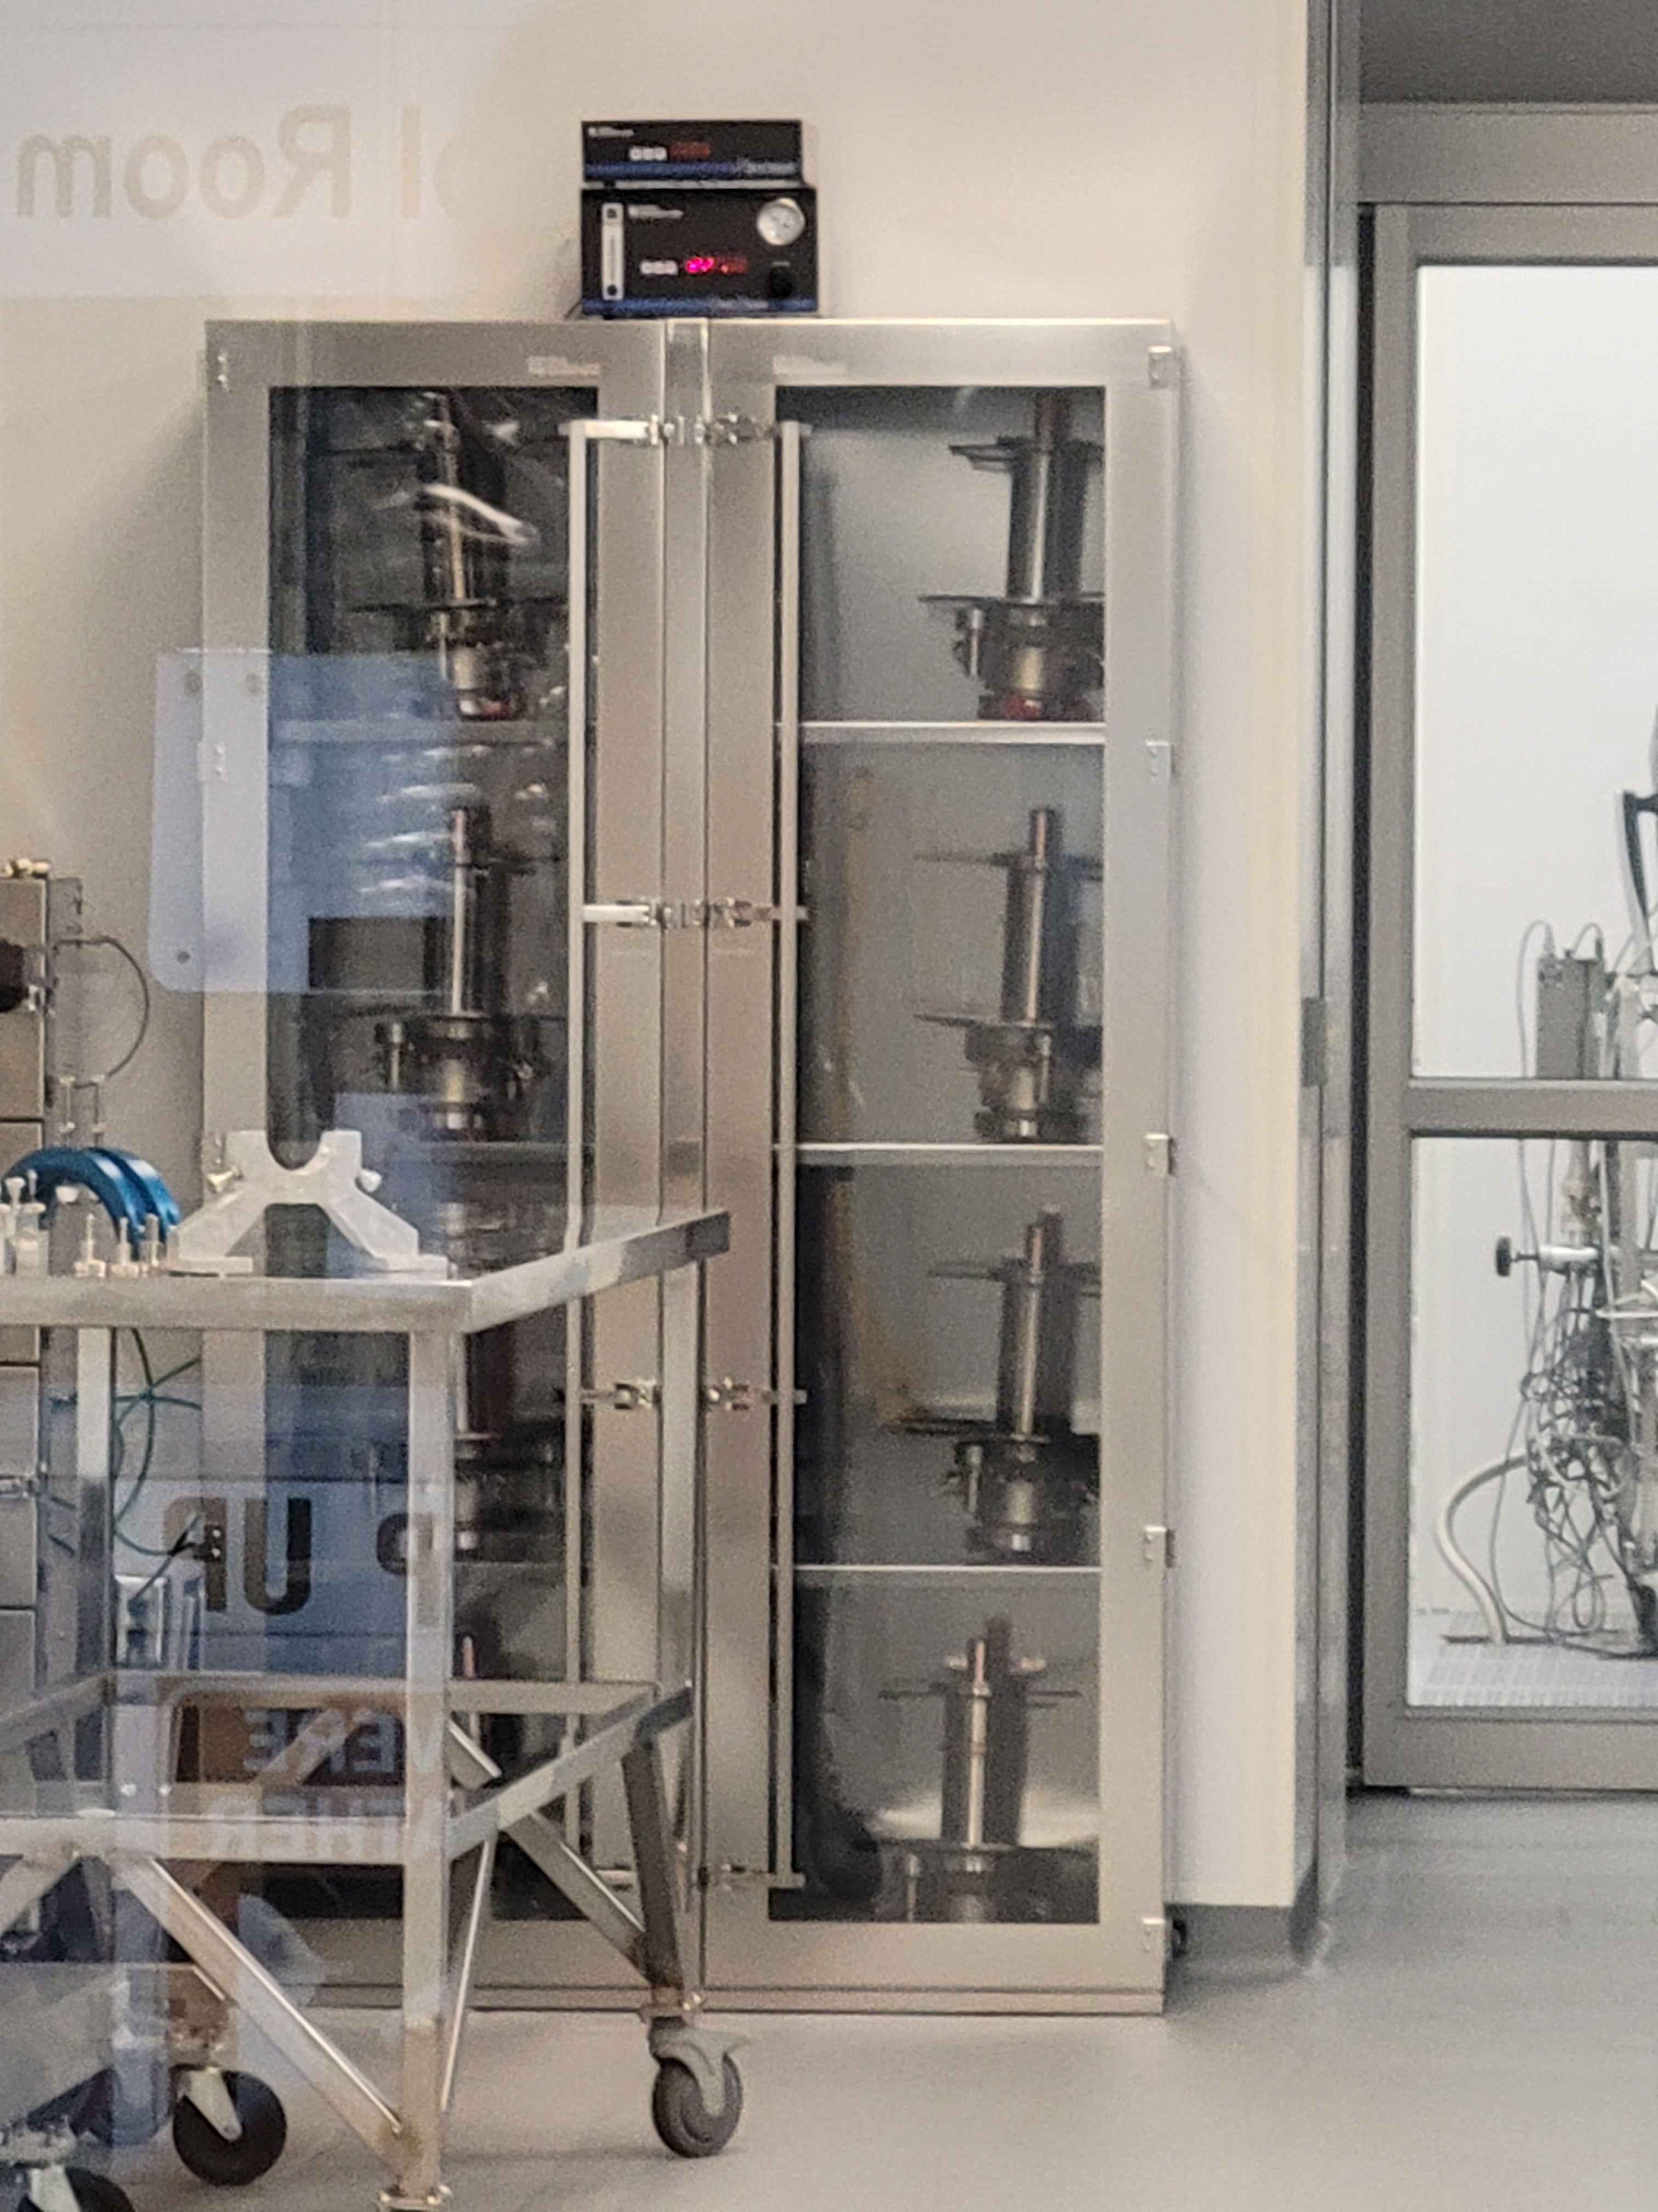
Hardware - RF Couplers
Couplers at JLab waiting on string assembly
Coupler Assembly in Cleanroom

Slide 6
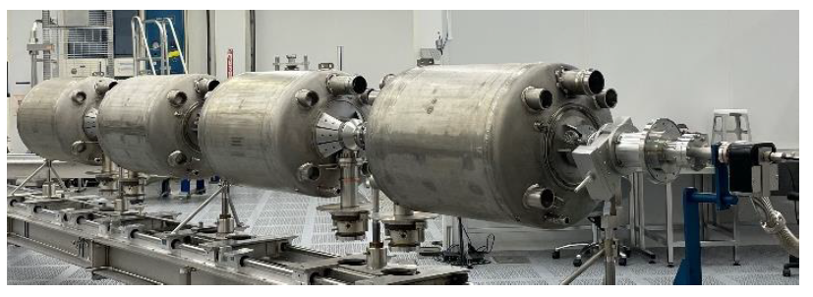
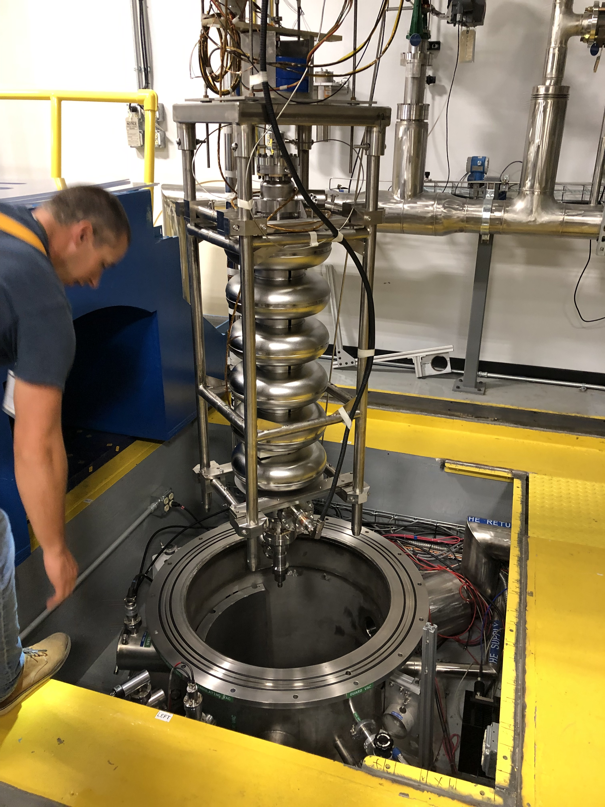
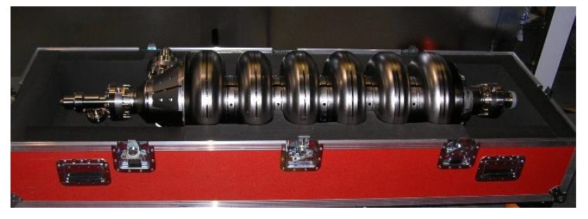
Hardware - Cavities
Quality Assurance Steps
Vertical Test in support of RI process development at SNS
String assembly at JLab
PPU Cavity Shipped From RI

Slide 7
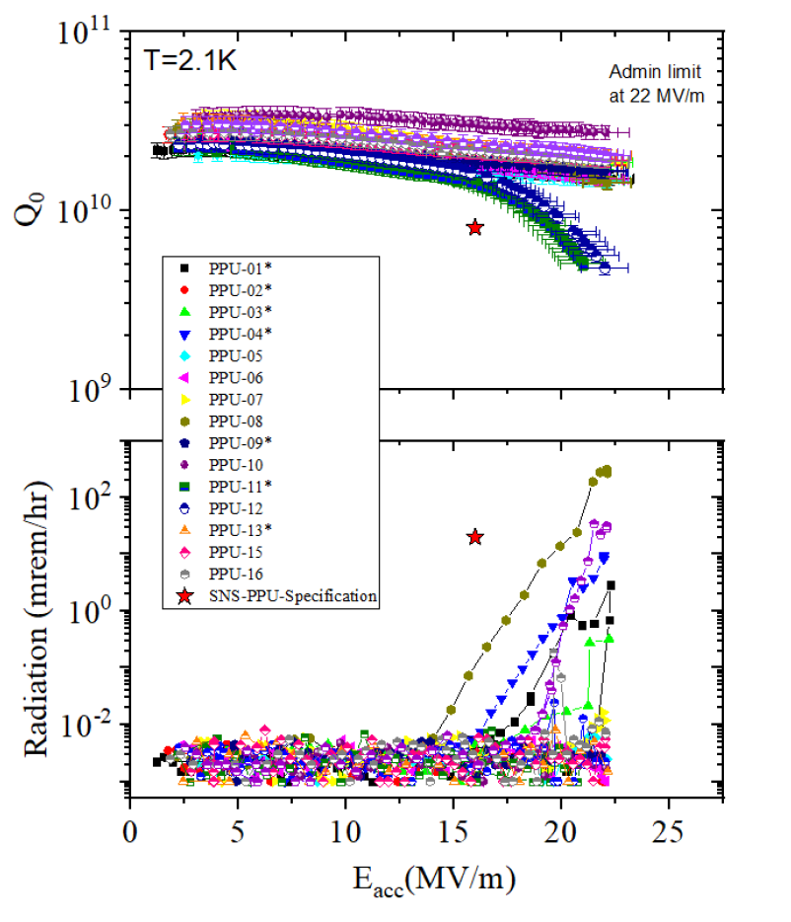
Cavity Performance
Vertical Test Data from JLab
All 32 cavities have been received at JLab from Research Instruments Company
19 cavities have been qualified
17 cavities dressed in helium tanks
2 cryomodule strings were assembled
Charge: 2

Slide 8
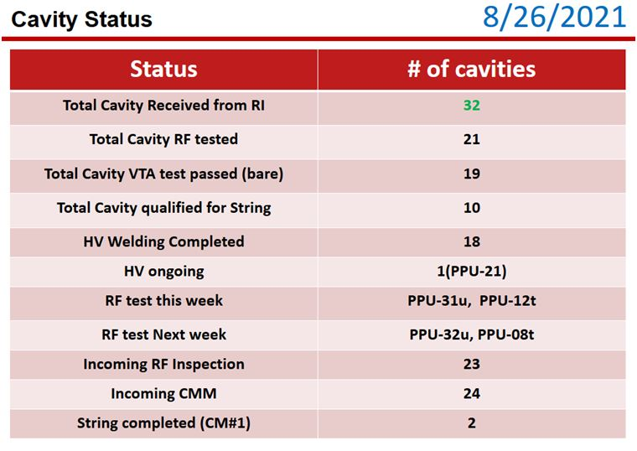

Slide 9


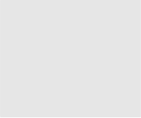


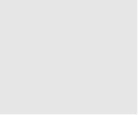


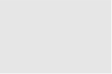
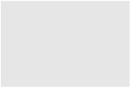


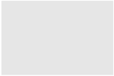

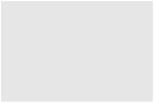
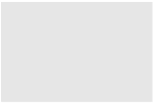











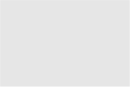




Organization
P.2 – SCL
Matt Howell
P.2.1
Management and System Integration Matt Howell
P.2.2 Cavities
John Mammosser
P.2.3
Cryomodules Integration Ed Daly
P.2.4
Cryogenics
Brian DeGraff
P.2.5 Utility Systems Chris Stone
P.2.6 System Integration
John Mammosser
P.2.7 SCL Controls Karen White
P.2.1.1
Management and System Integration
Matt Howell
P.2.2.1
Management and System Integration
John Mammosser
Partner Lab
P.2.4.1
Management and System Integration
Brian Degraff
P.2.5.1
Management and System Integration
Chris Stone
P.2.6.1
Management and System Integration
John Mammosser
P.2.7.1
Management and System Integration
Aaron Coleman
P.2.2.2 Cavity Procurement
John Mammosser
P.2.4.2 Cryogenic Components Brian Degraff
P.2.5.2 Beamline Vacuum
Chris Stone
P.2.6.2 Completed Cryomodule
Testing
John Mammosser
P.2.7.2 Linac Beamline Vacuum
Controls
Derrick Williams
P.2.2.4 Cavity Reprocessing
John Mammosser
P.2.4.3 Cryogenics System Testing
Brian Degraff
P.2.5.3 Insulating Vacuum System
Chris Stone
P.2.6.3
Cryomodule in Tunnel
John Mammosser
P.2.7.3 Linac Insulating Vacuum System Controls
Derrick Williams
P.2.2.5 Coupler Acquisition Yoon Kang
P.2.5.4 Water Systems Klent Pope
P.2.6.4
Cryomodule Testing in Tunnel John Mammosser
P.2.7.4
Cryomodule Controls Aaron Coleman
P.2.2.7 HTA Testing
Brian Degraff
P.2.6.5 Plasma Process MB Cryo. John Mammosser
P.2.2.8 Coupler Waveguide Transition Yoon Kang

Slide 10
Progress since CD-2/3
Charge: 1, 2
Cavity quality assurance plan was successfully implemented
Research Instruments has delivered all 32 cavities to Jefferson Lab
Jefferson Lab has qualified 19 of the 32 cavities to date
  RF performance significantly exceeds PPU requirements in vertical test
RF Coupler production is underway with
  24 RF couplers delivered to Jefferson Lab
  On schedule to complete effort at the end of this year

Slide 11
Challenges
Charge: 1
  Due to Covid concerns, Partner Lab onsite visits were minimized and has made addressing production concerns more difficult

Slide 12
Final Design Status
Charge: 1
Cavities, RF couplers and Airside Components have all completed their final design reviews and procurement of all components were awarded
  RF coupler contracts are complete
  Cavity contract is near complete
  Airside components are starting the fabrication phase

Slide 13
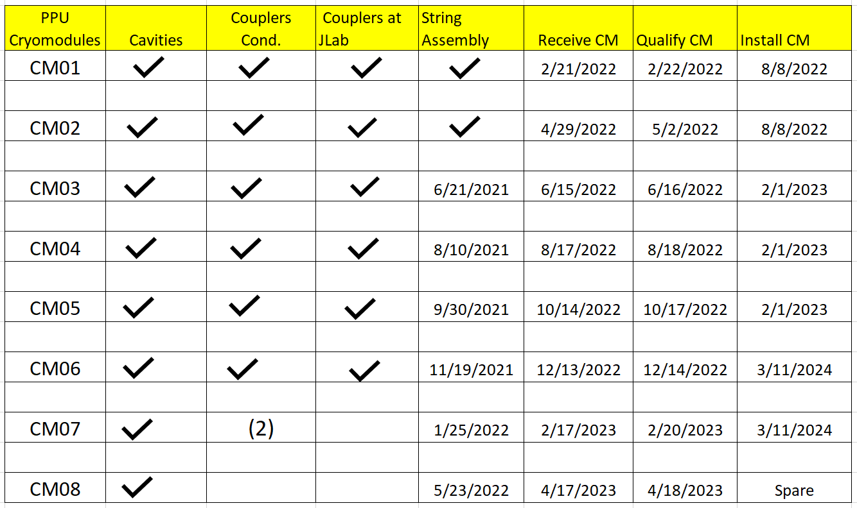
Installation Plans & more
Charge: 4

Slide 14
PPU Changes since CD 2/3
Charge: 4
Nearing completion for the long lead procurements

Slide 15
Budget and Estimate to Complete
Charge: 4
Budget break down of P.02.02

Slide 16
Budget and Estimate to Complete
Charge: 4
The specific long lead procurements for this portion of the WBS are identified in the red box

Slide 17
Cost Estimate by FY
Charge: 4
Working through the most active time of this WBS now through next year

Slide 18
Cost Estimate by FY
Charge: 4
Essentially complete LLPs this fiscal year

Slide 19
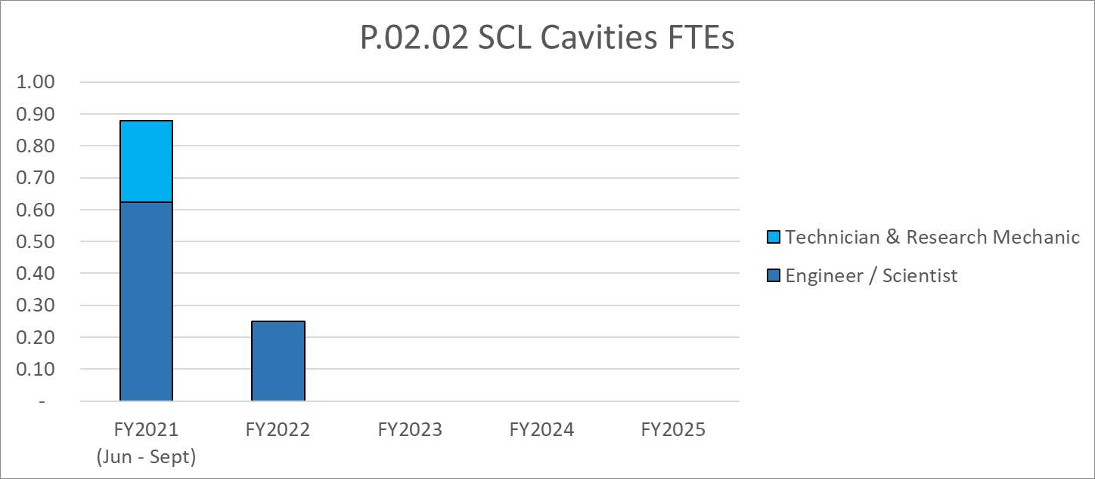
Labor Profile
Charge: 4
Highest labor demand in FY21 and then it reduces to a small effort in FY22

Slide 20
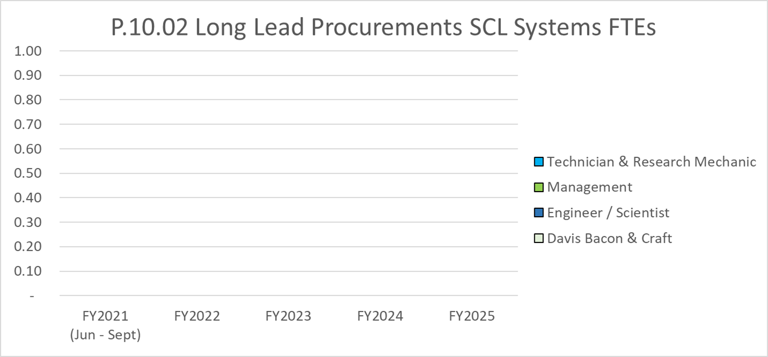
Labor Profile
Charge: 4
No labor remaining for LLPs

Slide 21
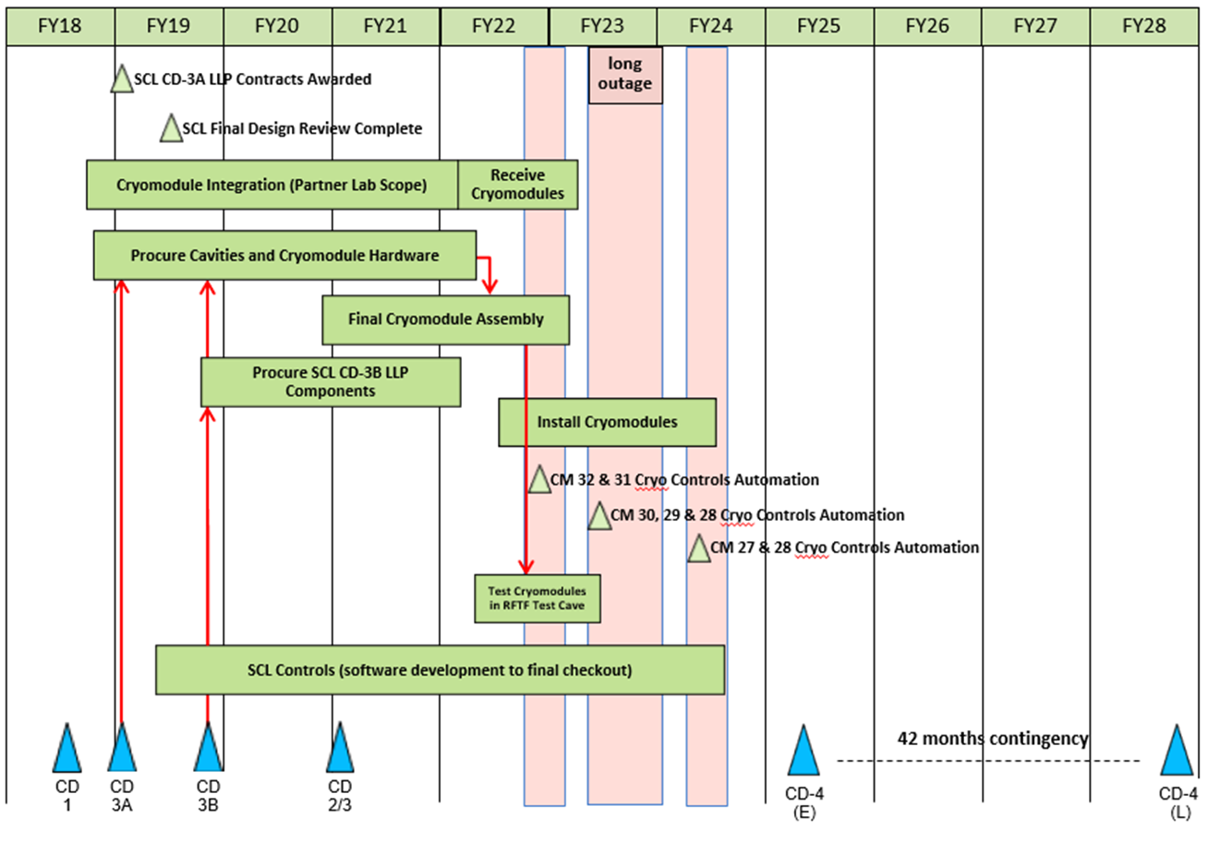
P.02 & P.10.02 – SCL May 2021 Status Summary Schedule
Charge: 4

Slide 22
P.02.02 Cavities Risk Register
Charge: 1, 4
No active risks identified
  Twelve retired, one realized
High Risks
  No high risks identified
Key risk categories analyzed
  Performance of cavities and couplers in similar projects
  Management of vendors from similar projects
  Overcoming technical issues previously experienced at SNS
Risks are reviewed on a regular basis

Slide 23
Responses to Recommendations
Charge: 6
2021 Directors Review recommendation: Develop a backup plan if a production cavity fails, no current spares due to the 8th cryomodule
We are developing a plan for the case of 1-2 PPU cavity failures in qualification:
  The first step is to try full reprocessing which the plan already includes 3 cycles of full chemistry and assembly, all still available
  The backup to this is to utilize the 2 reference cavities which already meet PPU requirements, helium vessels would have to be welded to be used and vertical test

Slide 24
ESH&Q and COVID-19 Impacts
Charge: 3
  A key COVID impact to this scope of work was onsite support of partner lab activities
  We are always monitoring vendor supply chains for delays
    Local consultant hired to monitor progress at cavity vendor

Slide 25
12-Month Look-Ahead
Charge: 1
In the next year we will have completed delivery of all RF couplers to Jefferson Lab and they will have assembled all 8 cryomodule cavity strings
We should receive all the airside components for installation of cryomodules in the accelerator

Slide 26
Summary
All 32 RF Couplers were received and 14 were successfully conditioned and delivered to JLab
30 Cavities were delivered to JLab for qualification and string assembly
Performance testing of ½ the PPU cavities was completed, and performance in vertical test all exceed PPU criteria
The first string was assembled at JLab
All airside components were procured

