Slide 1
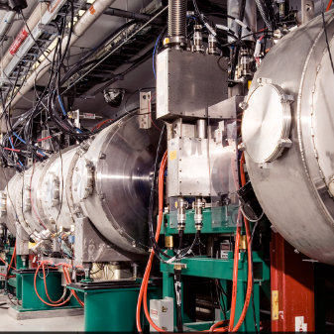
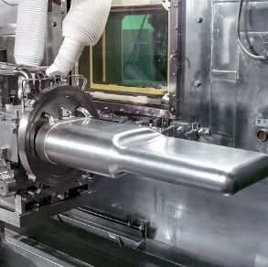
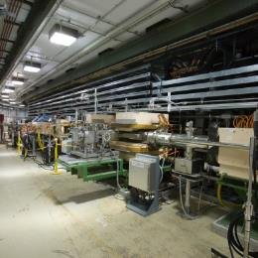
P.6 Klystron Gallery Construction
DOE/SC Independent Project Review of the Proton Power Upgrade Project
Luke Santee
Construction Manager for Klystron Gallery Construction
September 14-17, 2021

Slide 2
Outline
Scope
Organization
Progress since CD-2/3
Challenges
Final design status
Installation plans
Cost and schedule
Labor profile
Risk register
Responses to recommendations
ESH&Q and COVID-19 impacts
12-month look-ahead
Lessons Learned
Summary

Slide 3
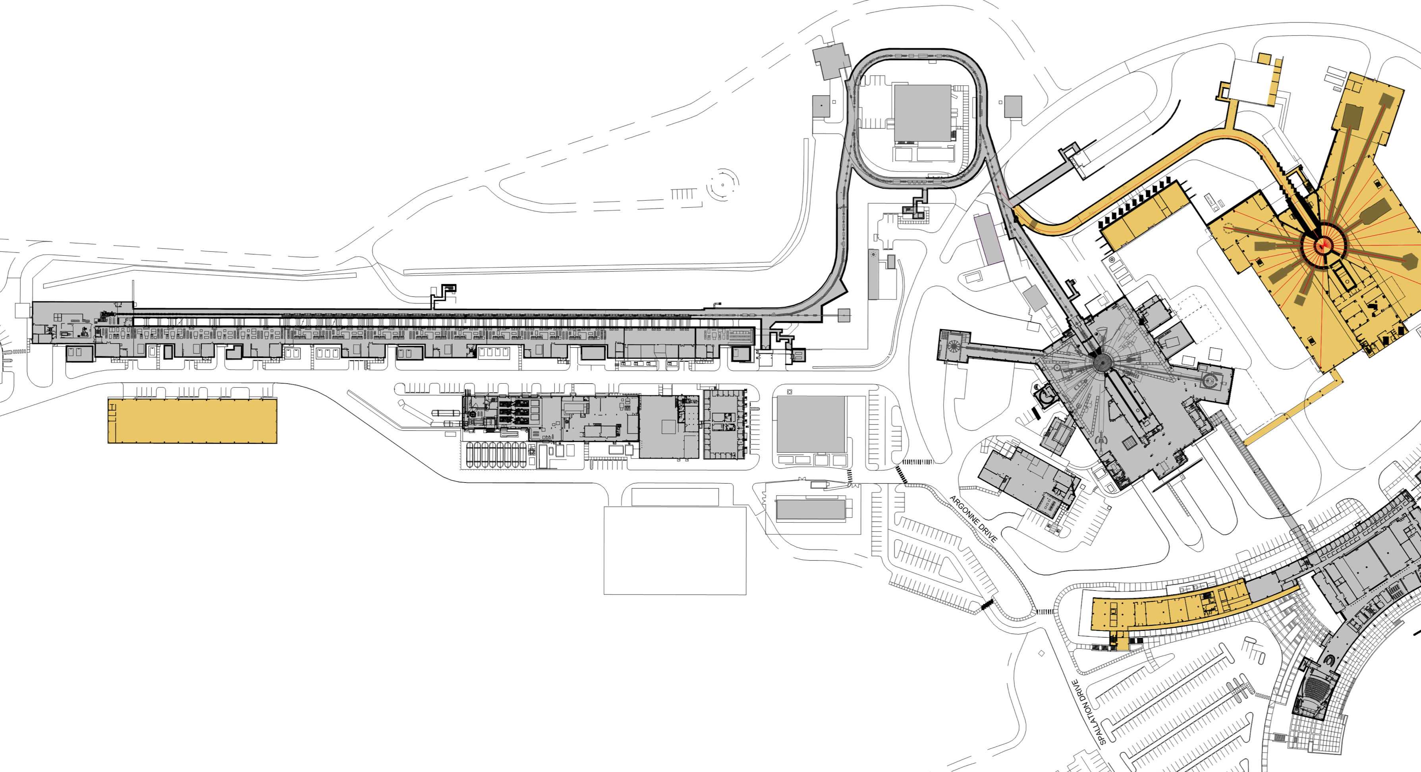
Scope – Klystron Gallery Construction
Charge: 1, 5
Scope this Presentation
Klystron Gallery – CD-3B
P.10.6.2.1
P.6.1 Conventional Facilities (CF) Management
P.6.2 Conventional Facilities Building Modifications
P.6.2.1 moved to P10.6 Klystron Gallery Building Modifications
P.6.2.2 Ring-to-Target Beam Transport (RTBT) Modifications
P.6.2.3 Heating, Ventilation and Air Conditioning (HVAC) Controls
P10.6 Long Lead Procurement Klystron Gallery Building Modifications
B5-1 Connell
B5-3 Connell
B5-4 Williams
Notes:
I am Luke Santee, Construction Field Rep for Conventional Facilities. I am going to go through PPU Klystron Gallery Construction Progress following the Marks Level 2, some of the components were covered in the Level 2 presentation.

Slide 4
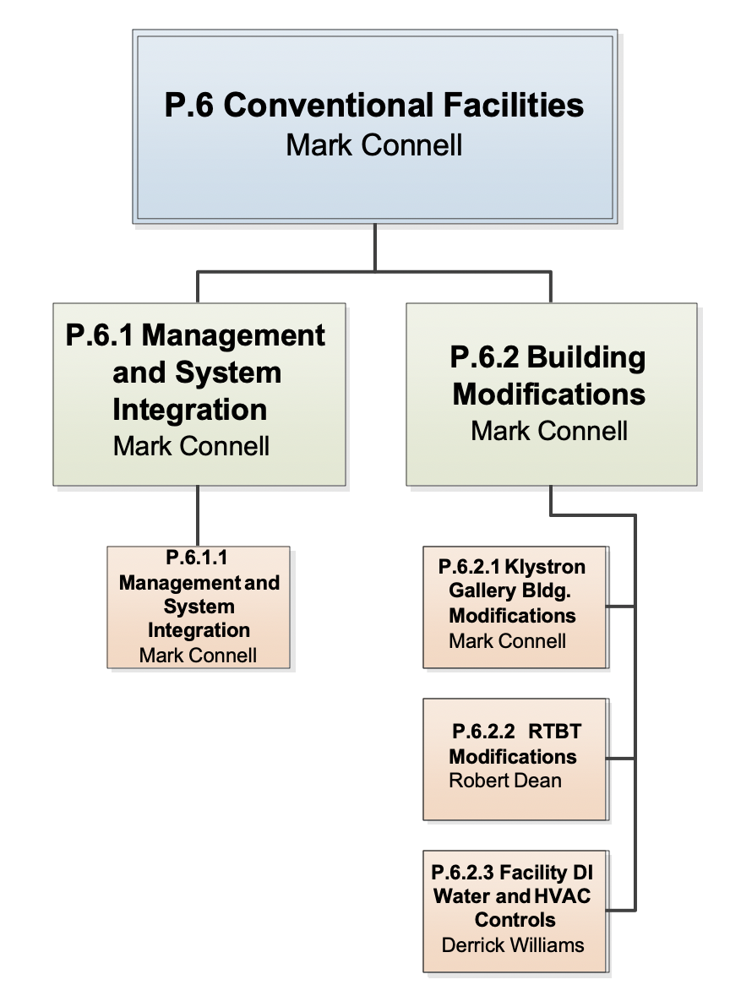
Scope - Work Breakdown Structure
Charge: 5
Moved to P.10.6.2.1 LONG LEAD PROCUREMENT (LLP)
Luke Santee
Moved to P.10.6.2.3
(LLP)
Notes:
The scope of my presntation is thown in the Blue Box below. I am shown in the next box down, because this scope will be transitioning to me , with R. Deans impeding retirement. Note: In the Work Breakdown Structure, the scope I will be covering today has been moved to P.10.6.2.1 Long Lead Procurements for cost and schedule purposes,

Slide 5
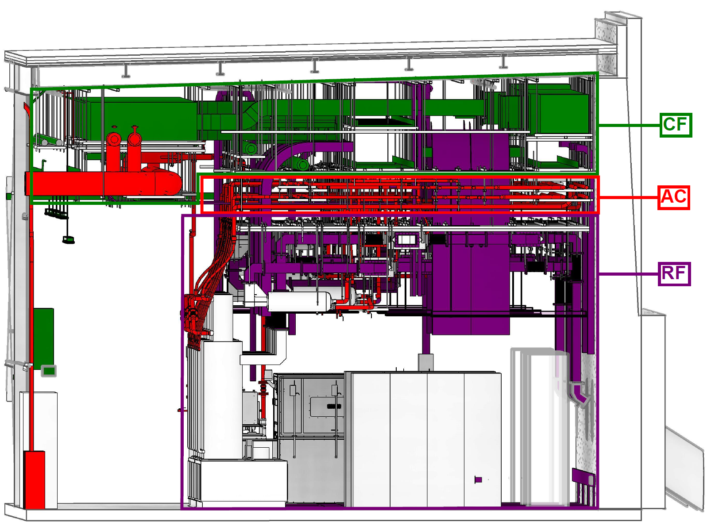
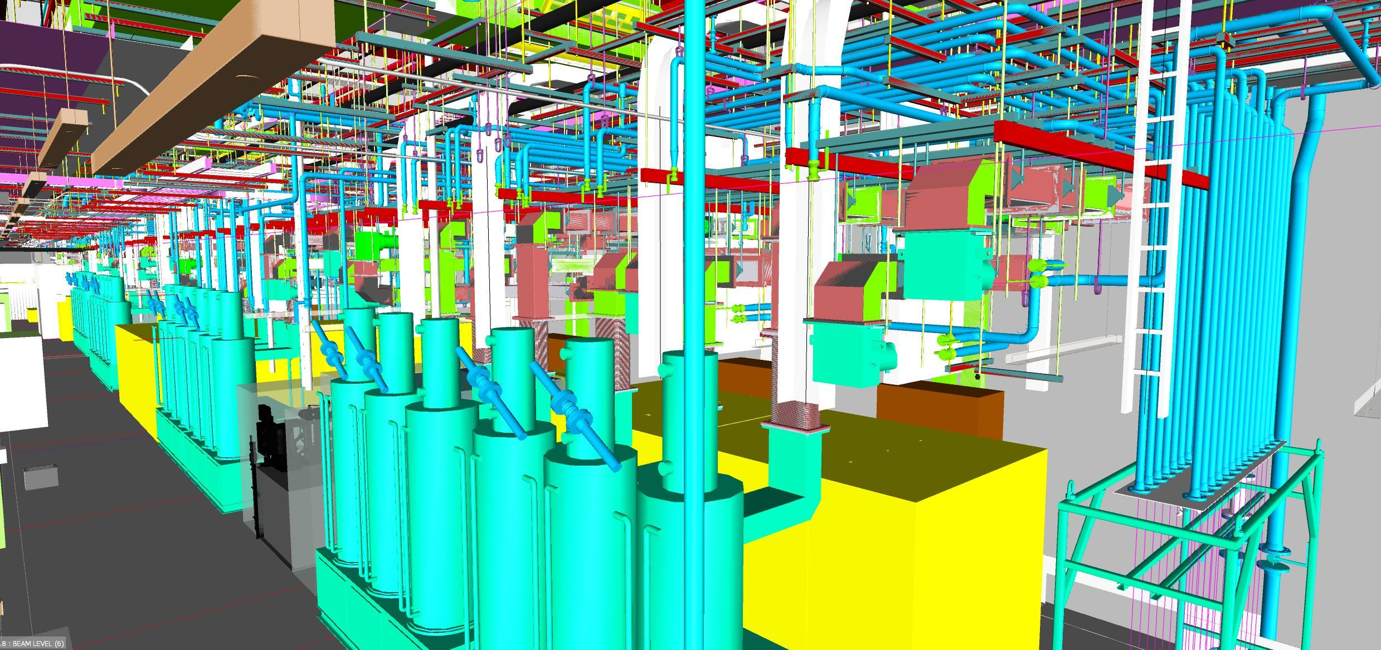
Scope – Klystron Gallery Construction (cont’d)
Charge: 1
B3-6 Norman
Conventional Facilities (CF)
New Rooftop HVAC Unit, piping , and Ductwork
New Pump Room
13.8 kV Switchgear and Building Electrical Services
Fire protection and detection (VESDA) expanded
Accelerator Cooling (AC)
(2 ea) 150 HP pumps, pump bases and header piping installed to (5 ea) Transmitter Rack Cooling Carts (TRCC)
DI Water polishing loop
Branch piping from TRCC’s to technical equipment hose connections
Hydrostatic testing, flushing and drying of piping
Controls (CT)
DI water system controls
HVAC system controls
Radio Frequency (RF)
Installed hanger grid system down to ~14’ above finished floor
B5-4 Williams
Notes:
Rooftop HVAC unit added for space conditioning (100-ton cooling, 30,000 cfm).
KL-06 Pump Room
Maximum Capacity:
(1,650 gpm @ 250 ft, removes 3.2 MW of Heat)

Slide 6
Organization – Level 3
Charge: 5

Slide 7
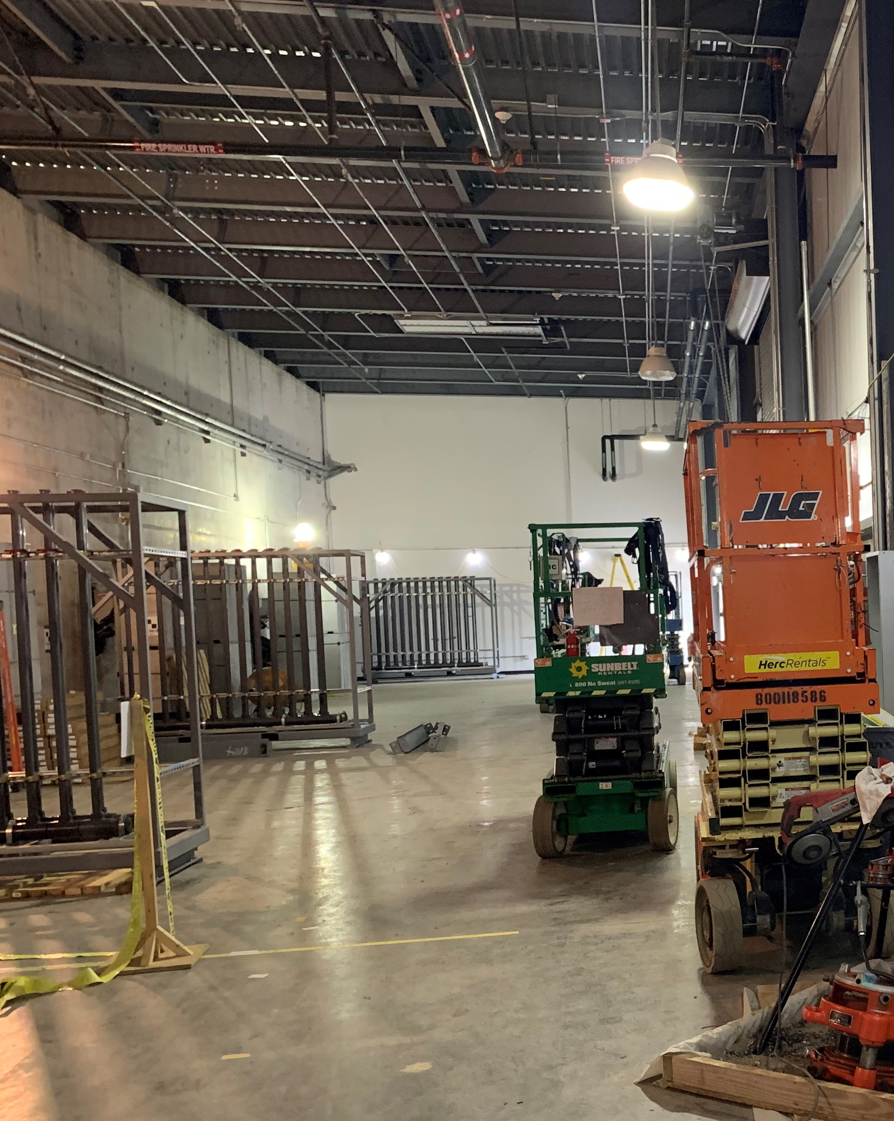
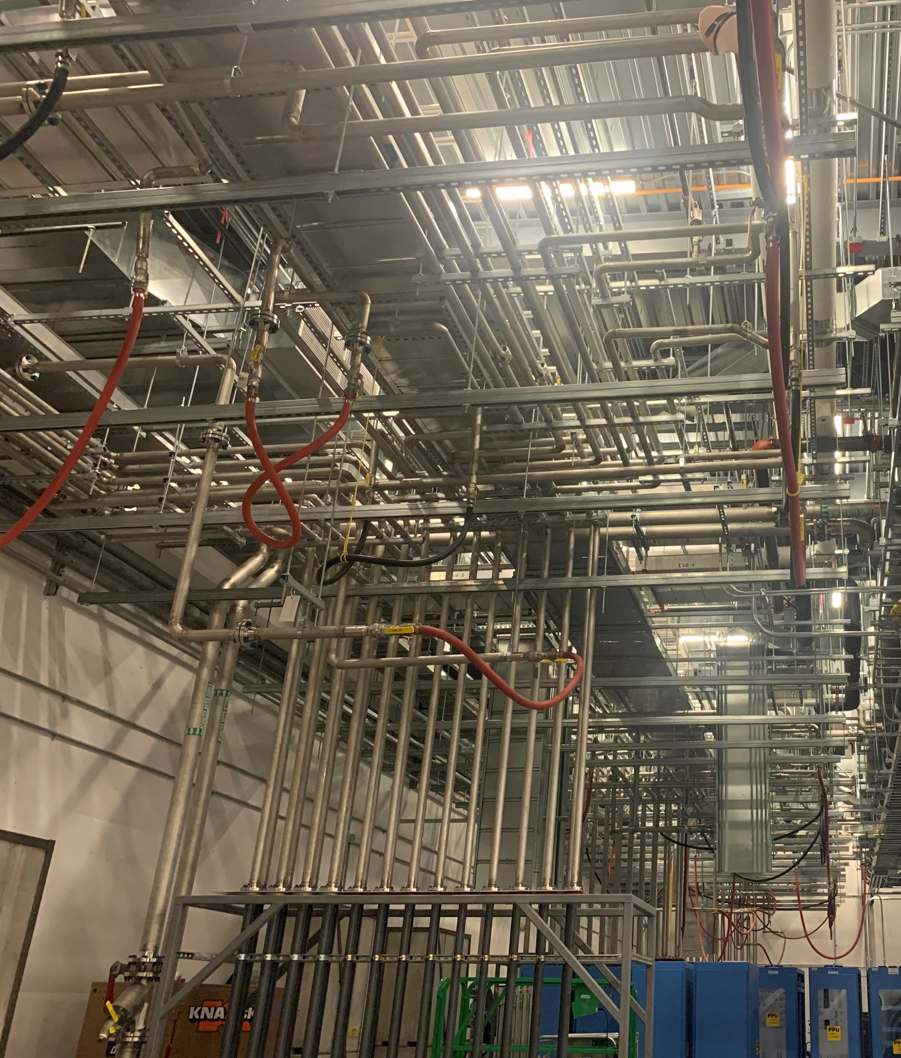
Progress since CD-2/3
Charge: 4
Klystron Gallery
Klystron Gallery Construction complete and released for installation of technical equipment. DOE Klystron Gallery ready for installation milestone met with Substantial Completion April 6, 2021.
As built drawings and project close-out in progress
Notes:
I am going to share with you the work achieved since Construction mobilization. In the last year, 2020-2021, our contractor and subtier contractors put a 58,000 man-hour effort forward, during a pandemic, to deliver their scope for a timely turnover to the next phase of the PPU effort.

Slide 8
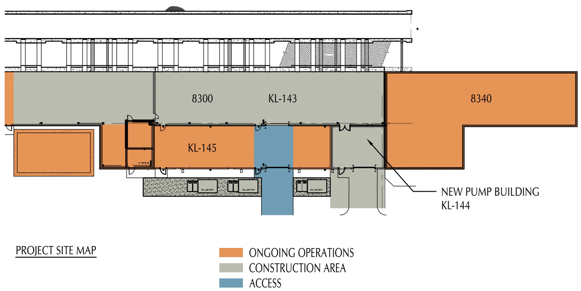
Progress since CD-2/3 (cont’d)
Charge: 4,5
Coordination with Operations
Protected existing operating equipment from damage, temperature swings, or excessive dust
Coordinated operations access and HVCM movements through construction area throughout project
Allowed ongoing access to PPS equipment
Coordinated Fire Detection outages throughout welding operations
Coordinated utility tie-ins requiring SNS system shutdown
Coordinated road closures as necessary
Zero lost beamtime resulting from project execution

Slide 9
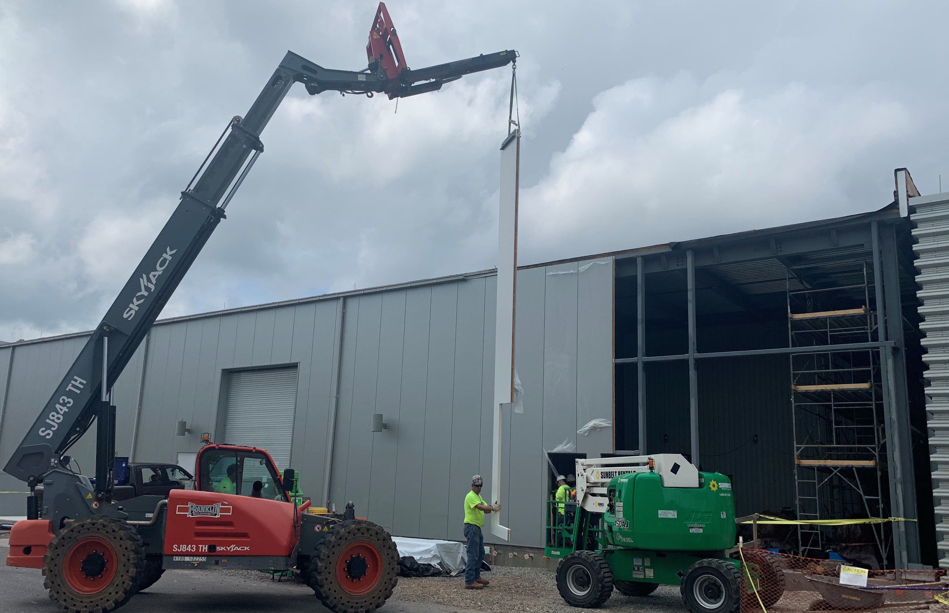
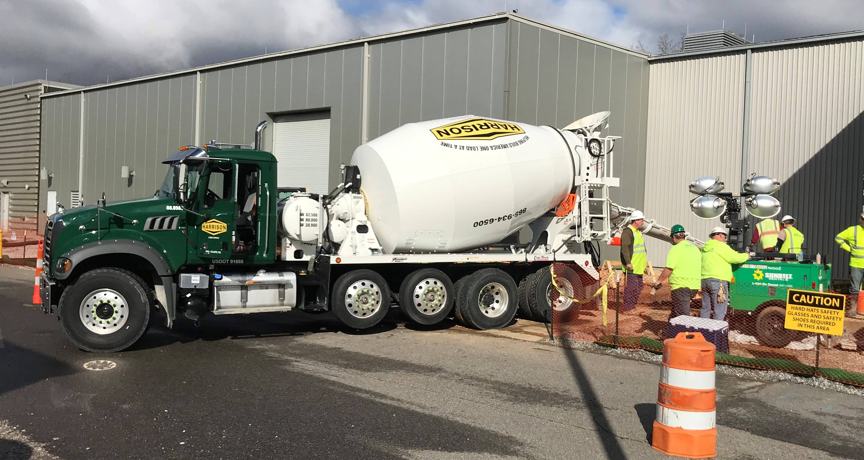
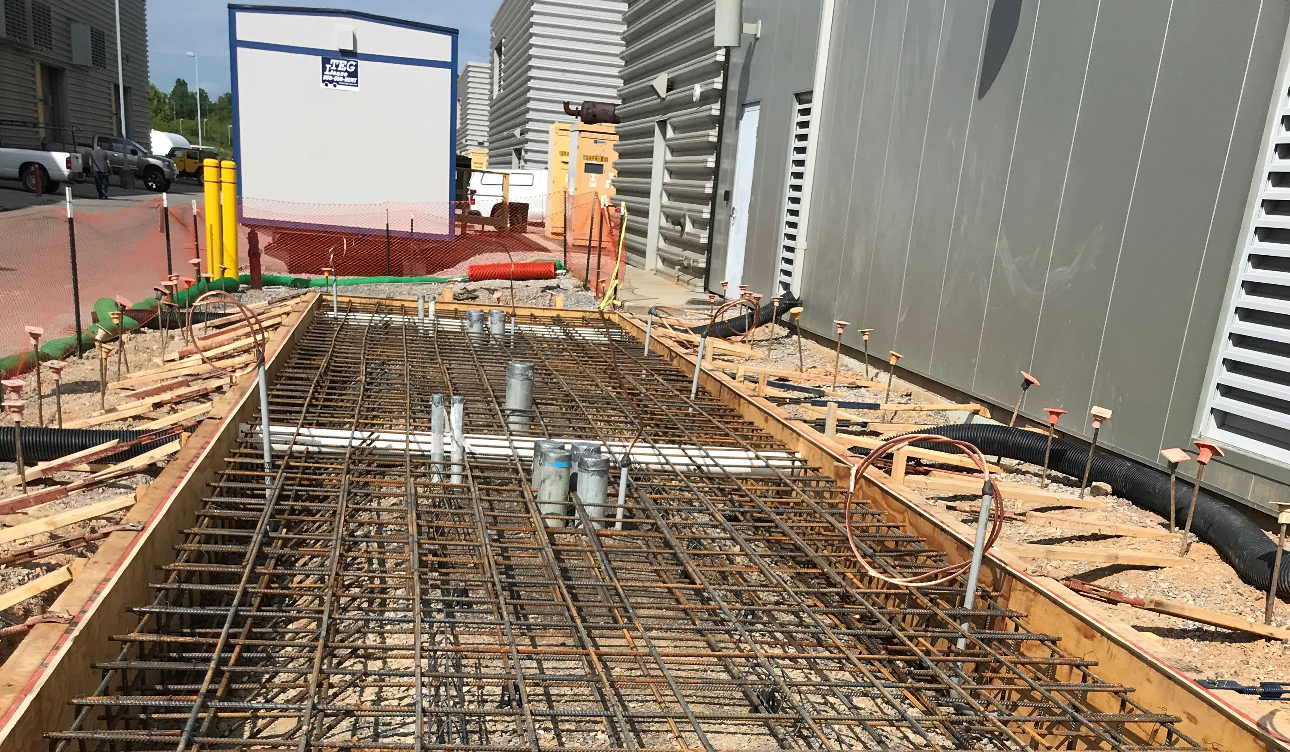
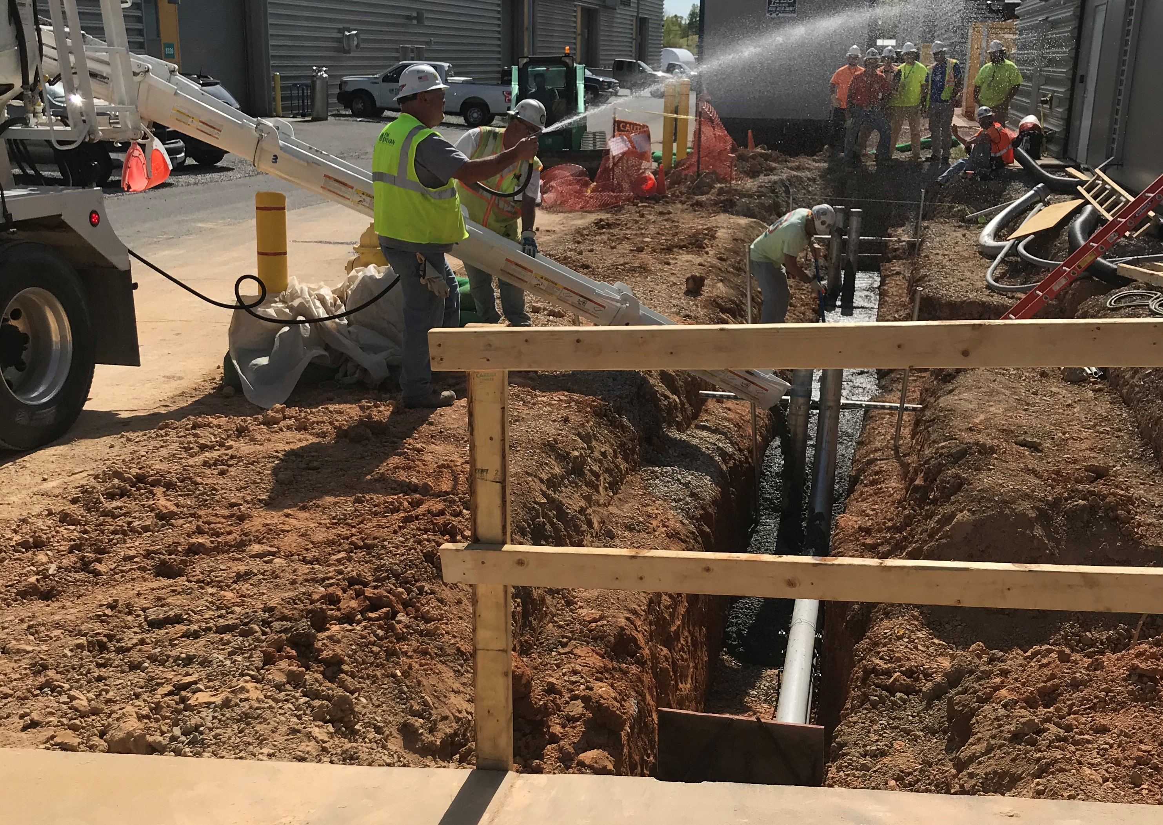
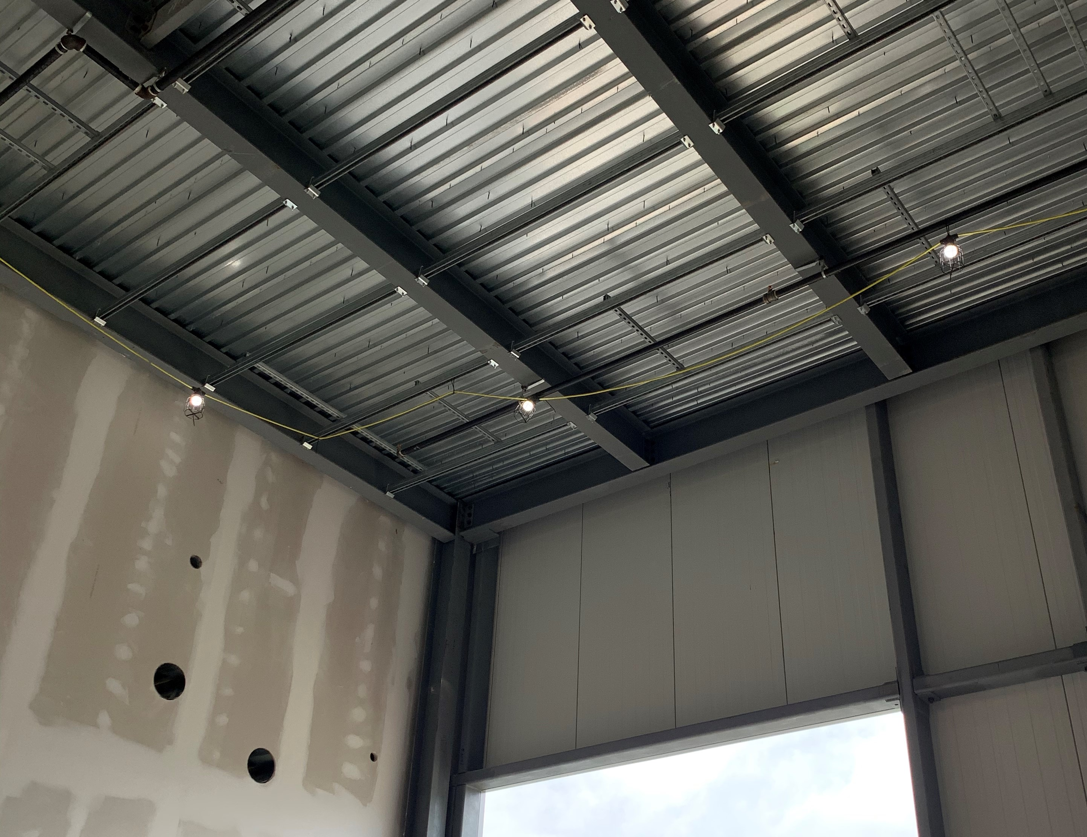
Progress since CD-2/3 (cont’d)
Charge: 4
Civil / Structural Scope
September 1, 2020
September 17, 2020
Notes:
Construction inspection and quality control
Transformer Pads backfill monitoring and testing; reinforcing steel inspections and concrete placement inspections complete
Pump bases, sump walls and pump building floor have been placed including underground piping, floor drains, isolation board, reinforcing steel, waterstop, insulation and control joints
Supplemental structural steel at HVAC unit installation complete
Pump room structural steel complete
Architect/Engineer (AE) design model and BIM subcontractor model includes support structure for duct, cable tray, piping and independent waveguide

Slide 10
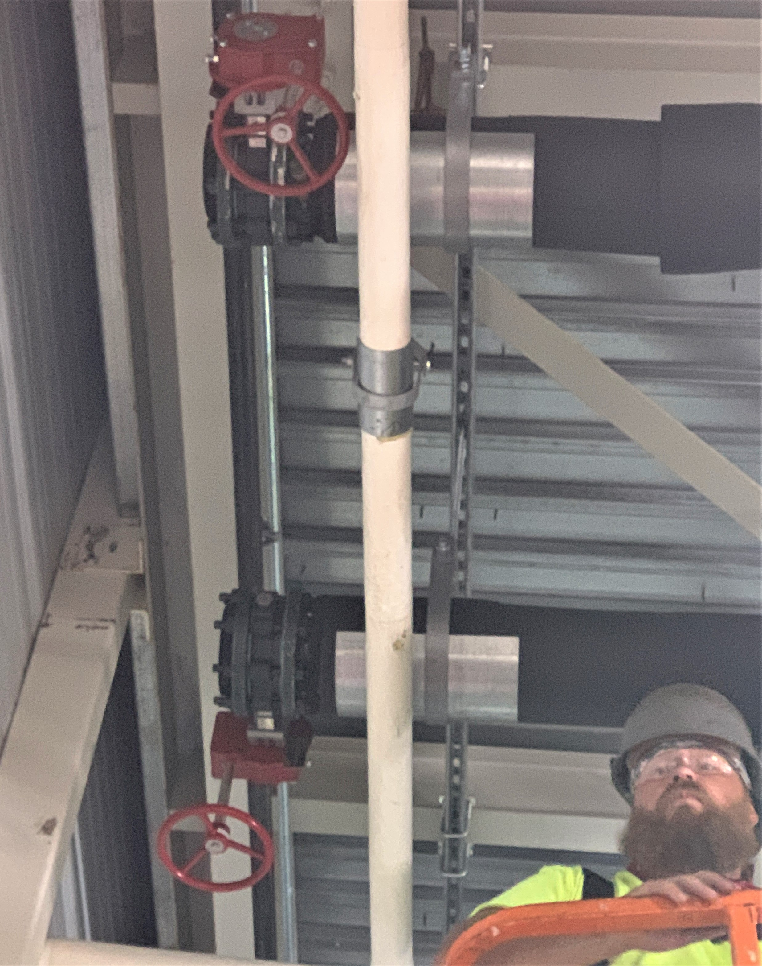
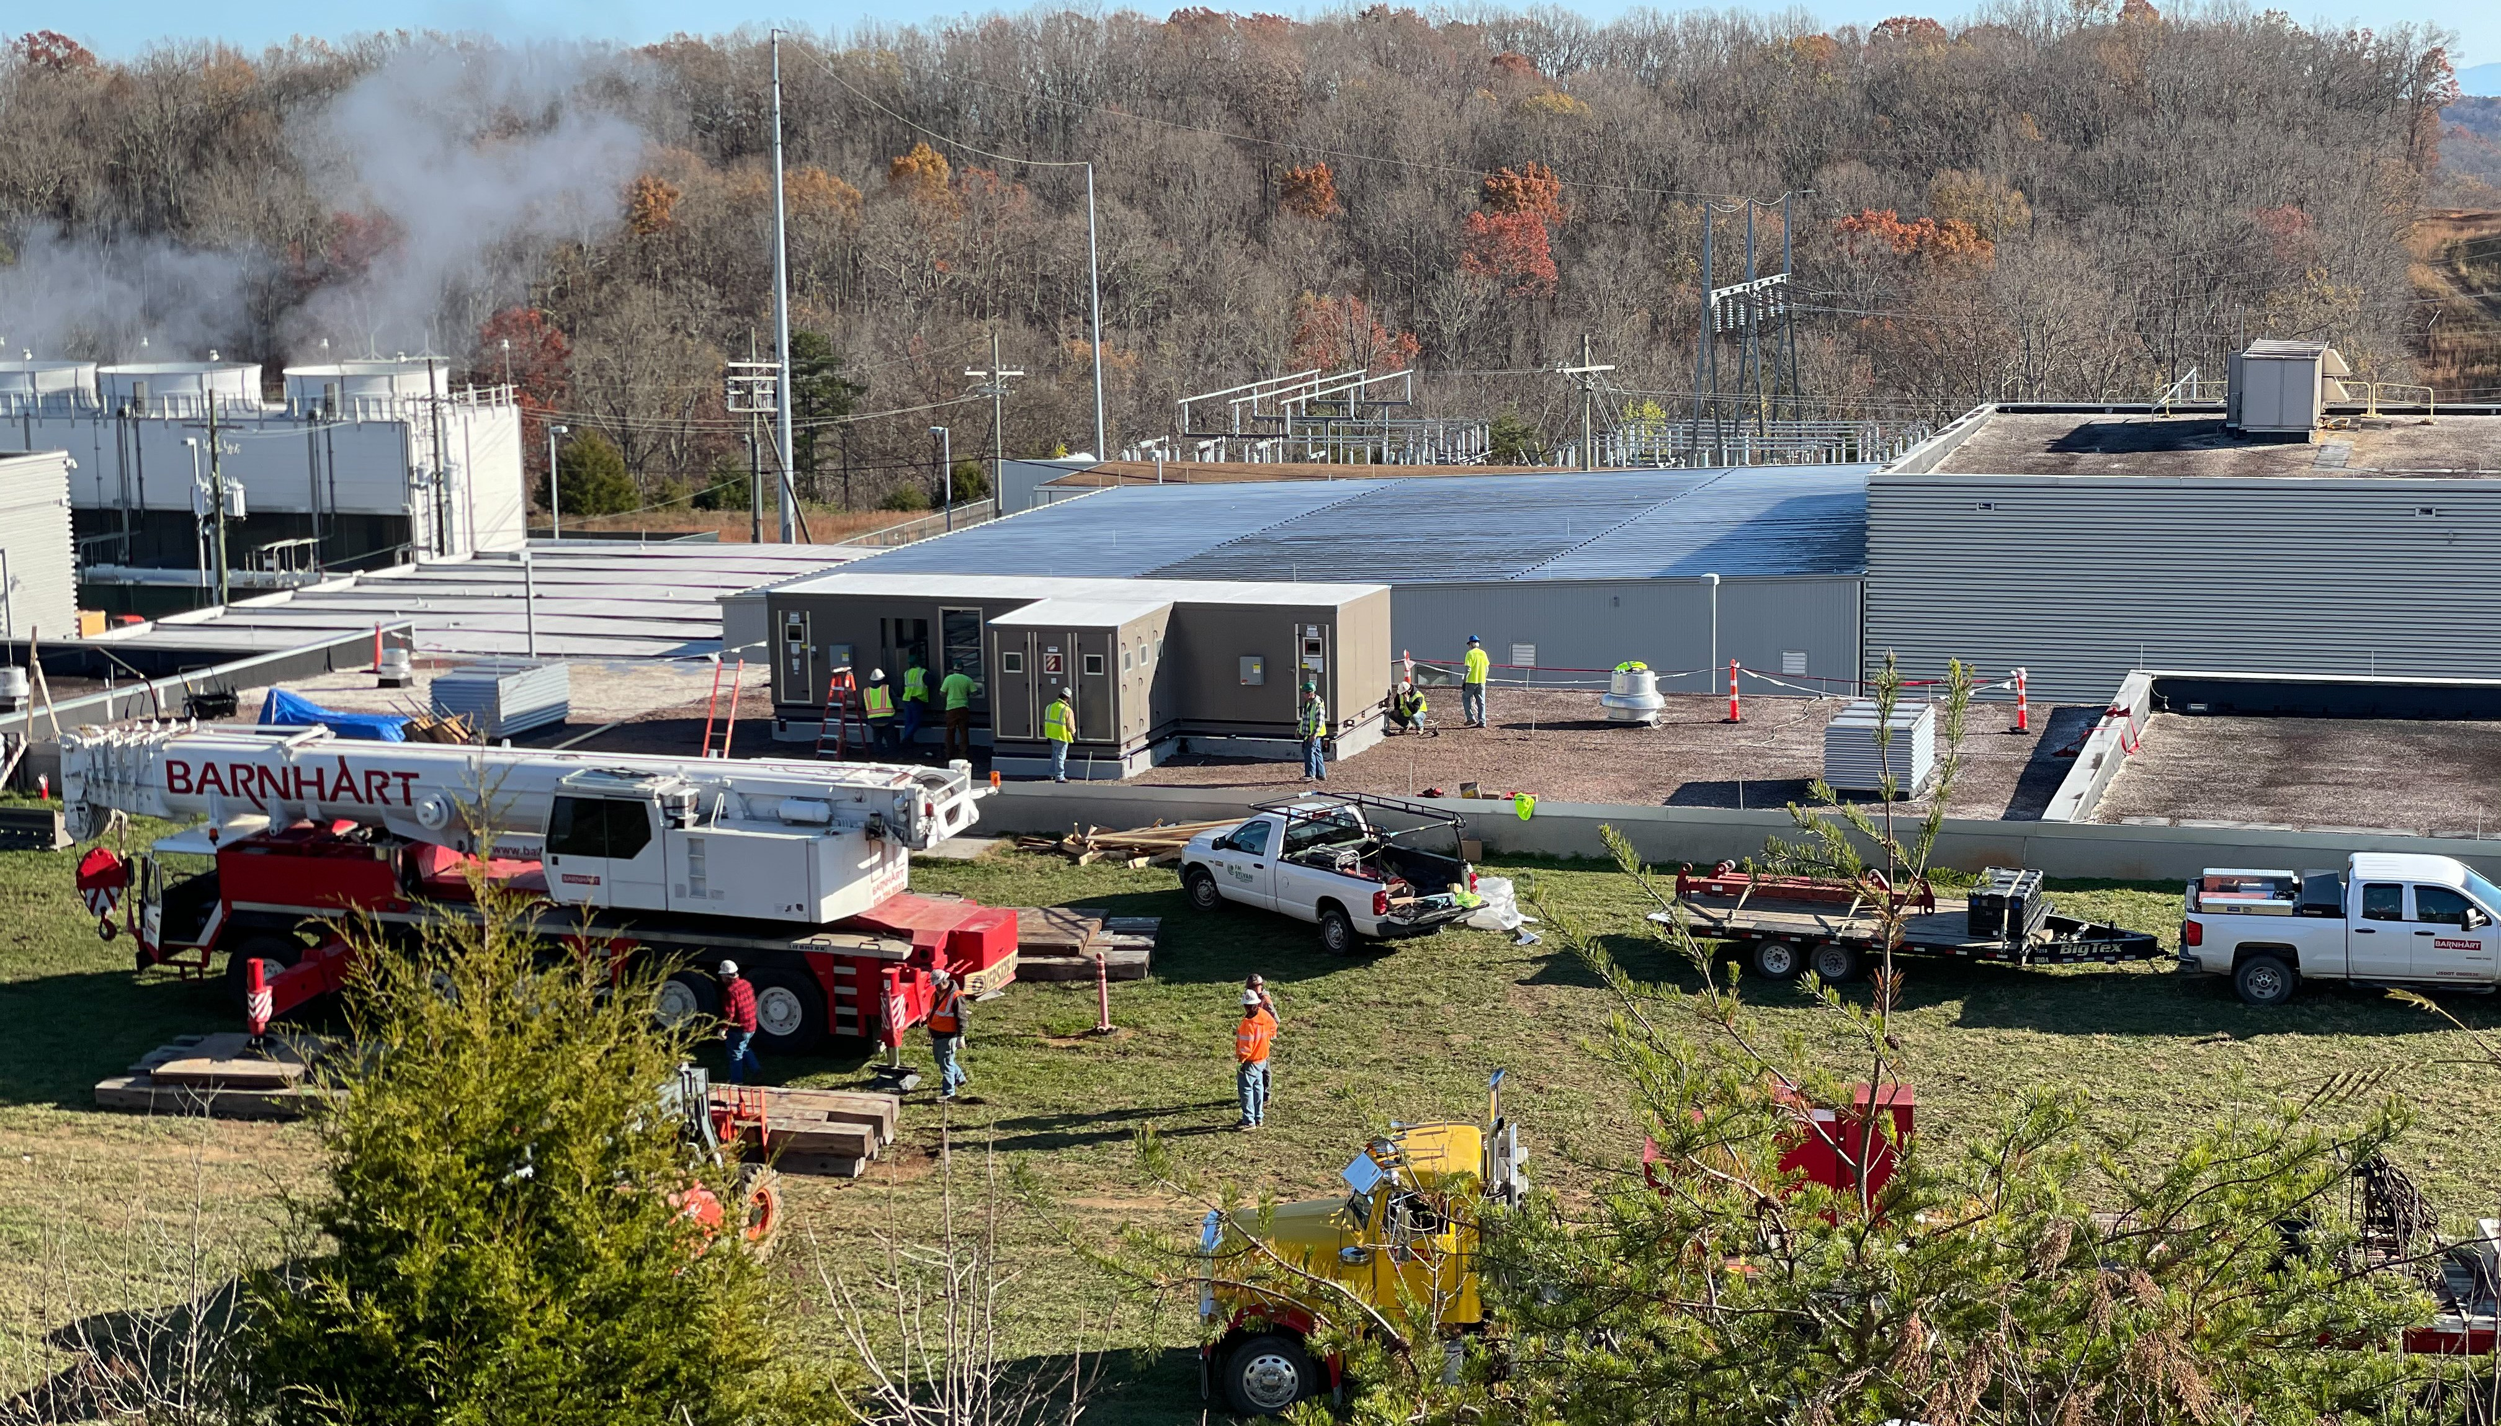
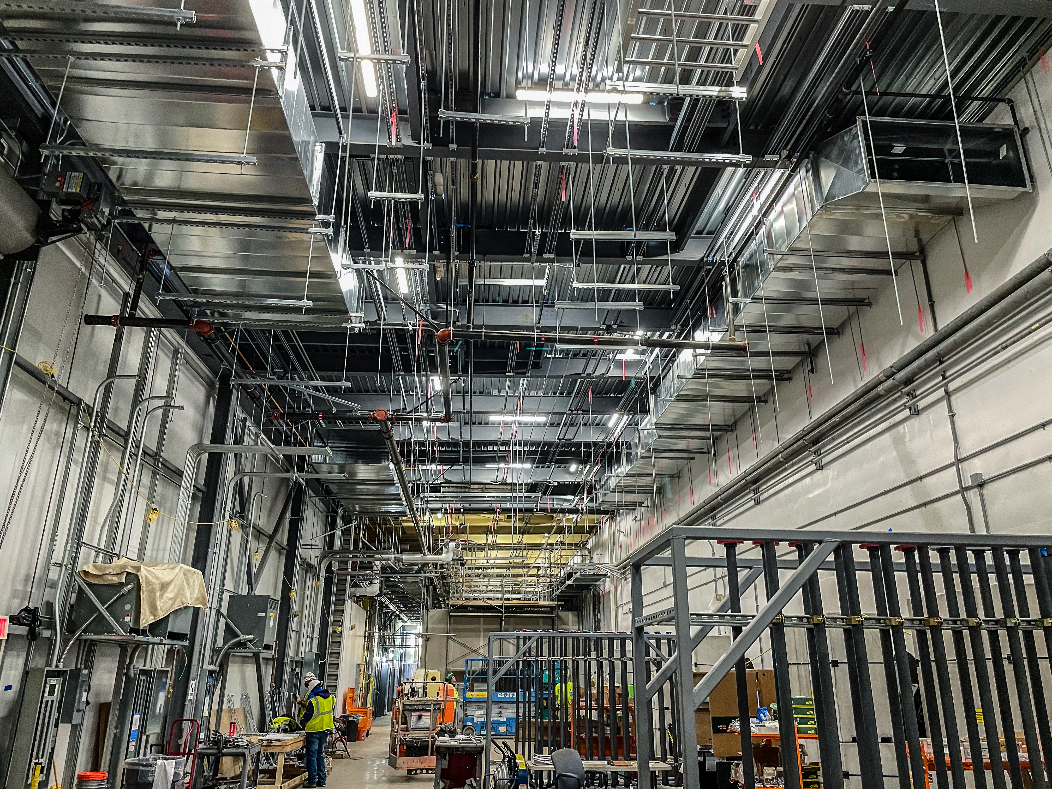
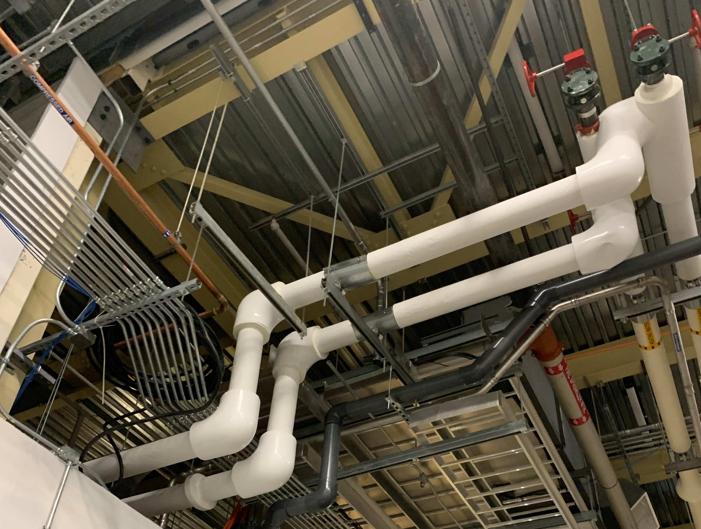
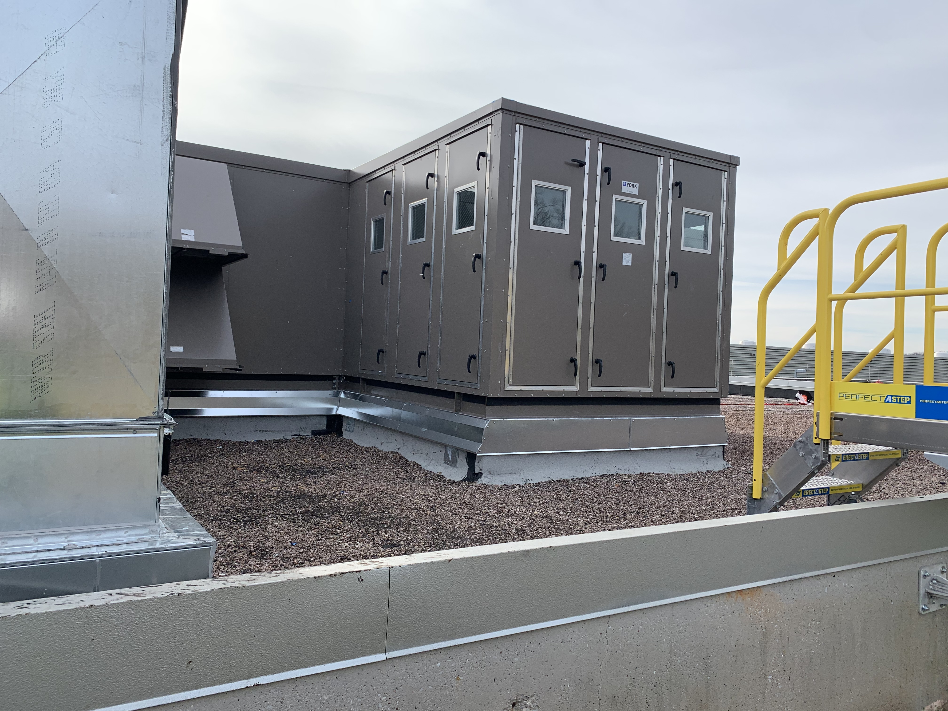
Progress since CD-2/3 (cont’d)
Charge: 4
Mechanical – CF (HVAC, Makeup, Fire Protection, and Process Waste)
Installation of Ductwork Nov 2020
Installation of Rooftop Unit (HVAC)Nov 2020
Heating and Cooling Water Tie In Aug 2020
Notes:
Rooftop HVAC unit added for space conditioning (100-ton cooling, 30,000 cfm). Air distributed by supply ductwork along the south wall and returned by return ductwork along the north wall.
3” heating water supply and return connect to existing piping mains
4” chilled water supply and return connect to existing
New pump building ventilated by exhaust fans and intake louvers and heated by an electric unit heater.
Process water lines for makeup water to pump room
Condensate from rooftop HVAC unit routed to storm drain
New drain from sump in pump room routed to High Energy Beam Transport (HEBT) service building
New automatic sprinklers in Pump Building
New fire alarm components in Pump Building
Modification to existing fire alarm components in Klystron Gallery Gap (KL-143)
New Vesda smoke detection in new Pump Building (KL-144)
Means of egress from new and existing structures in accordance with the Life Safety Code (LSC), current edition.
Addition of sprinkler heads under duct wider than 4’-0”

Slide 11
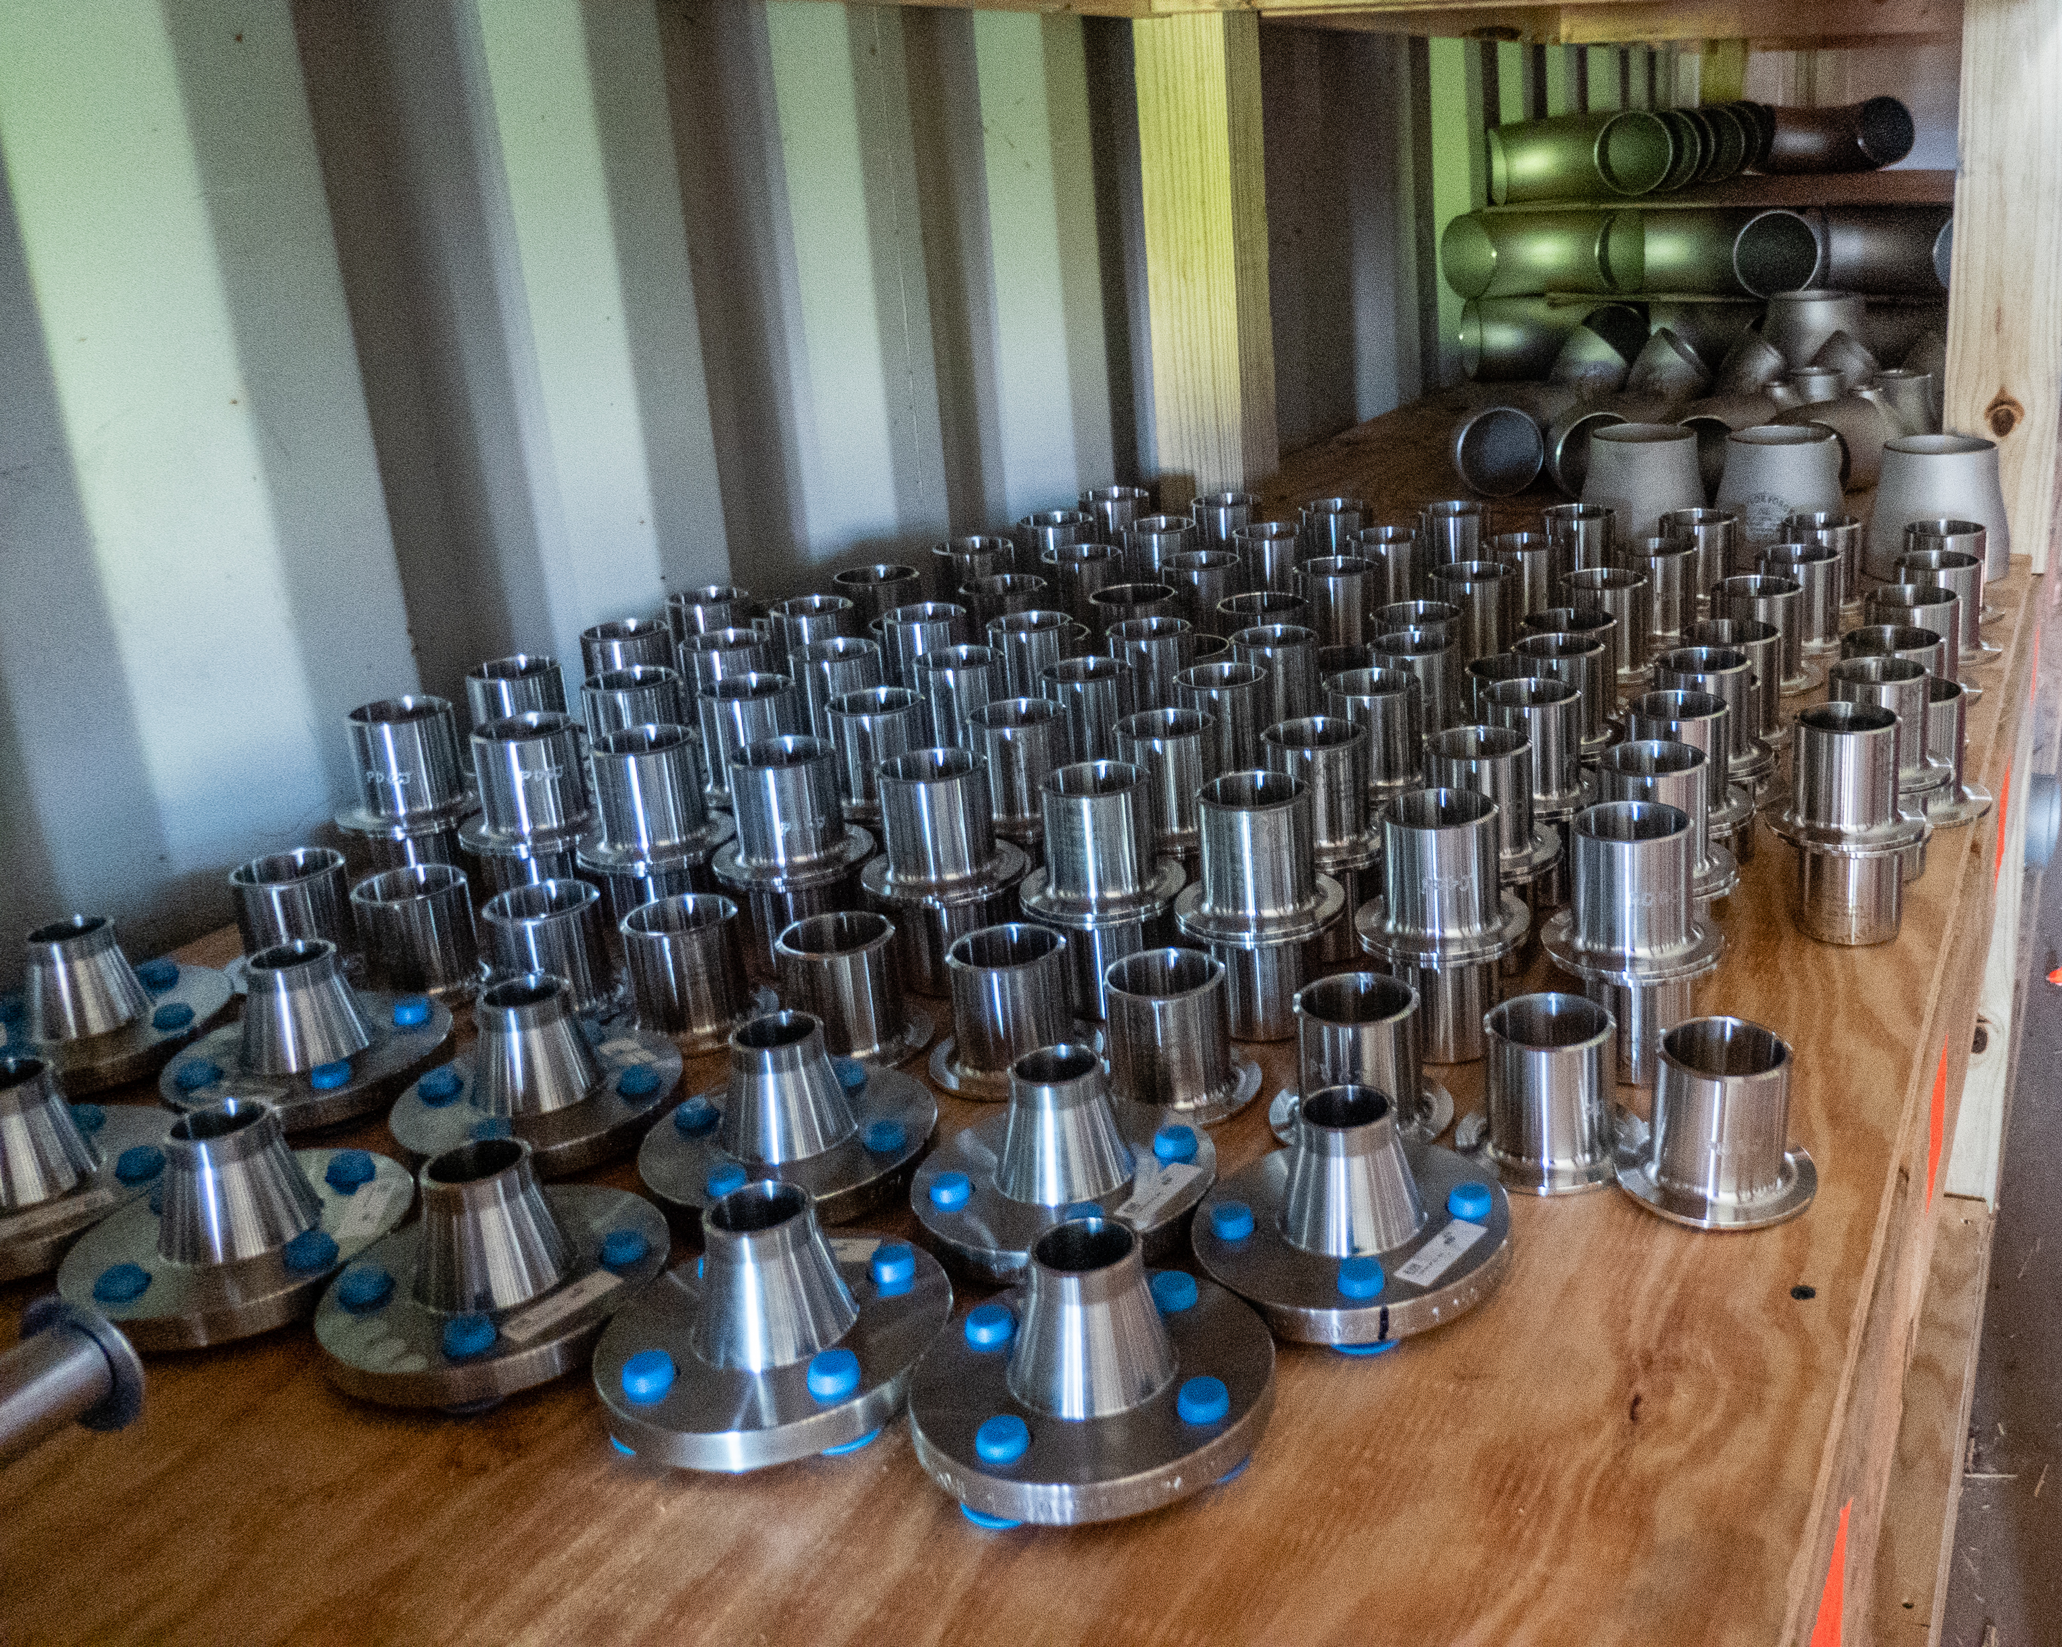
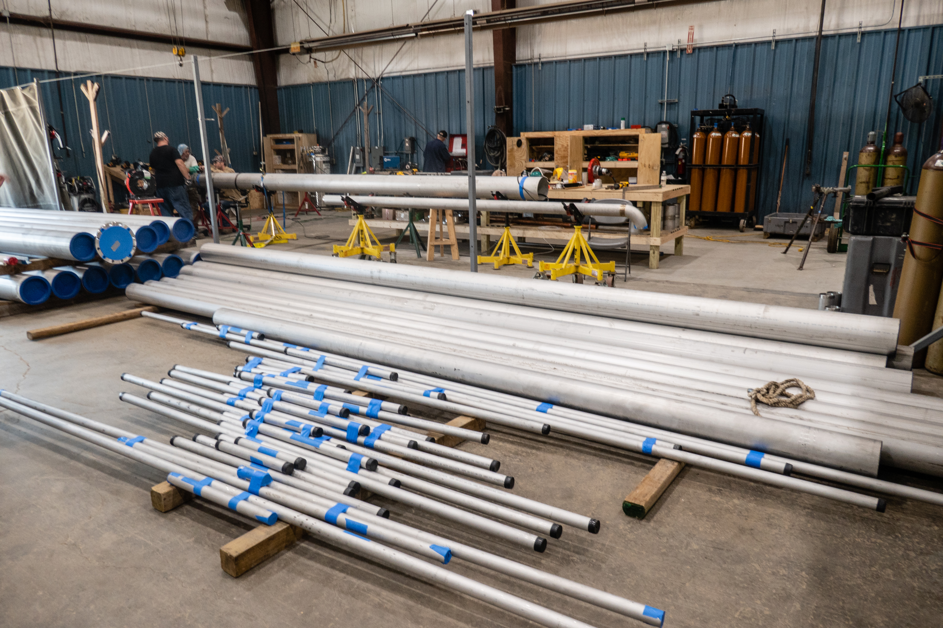
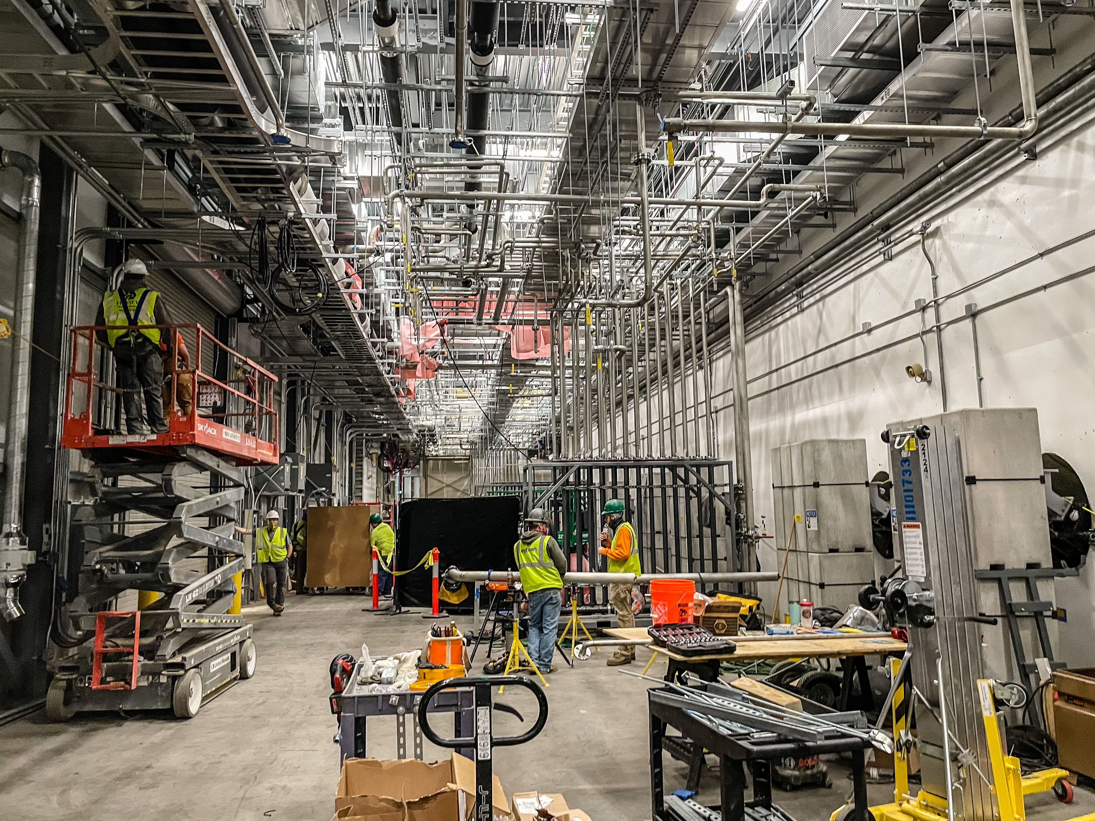
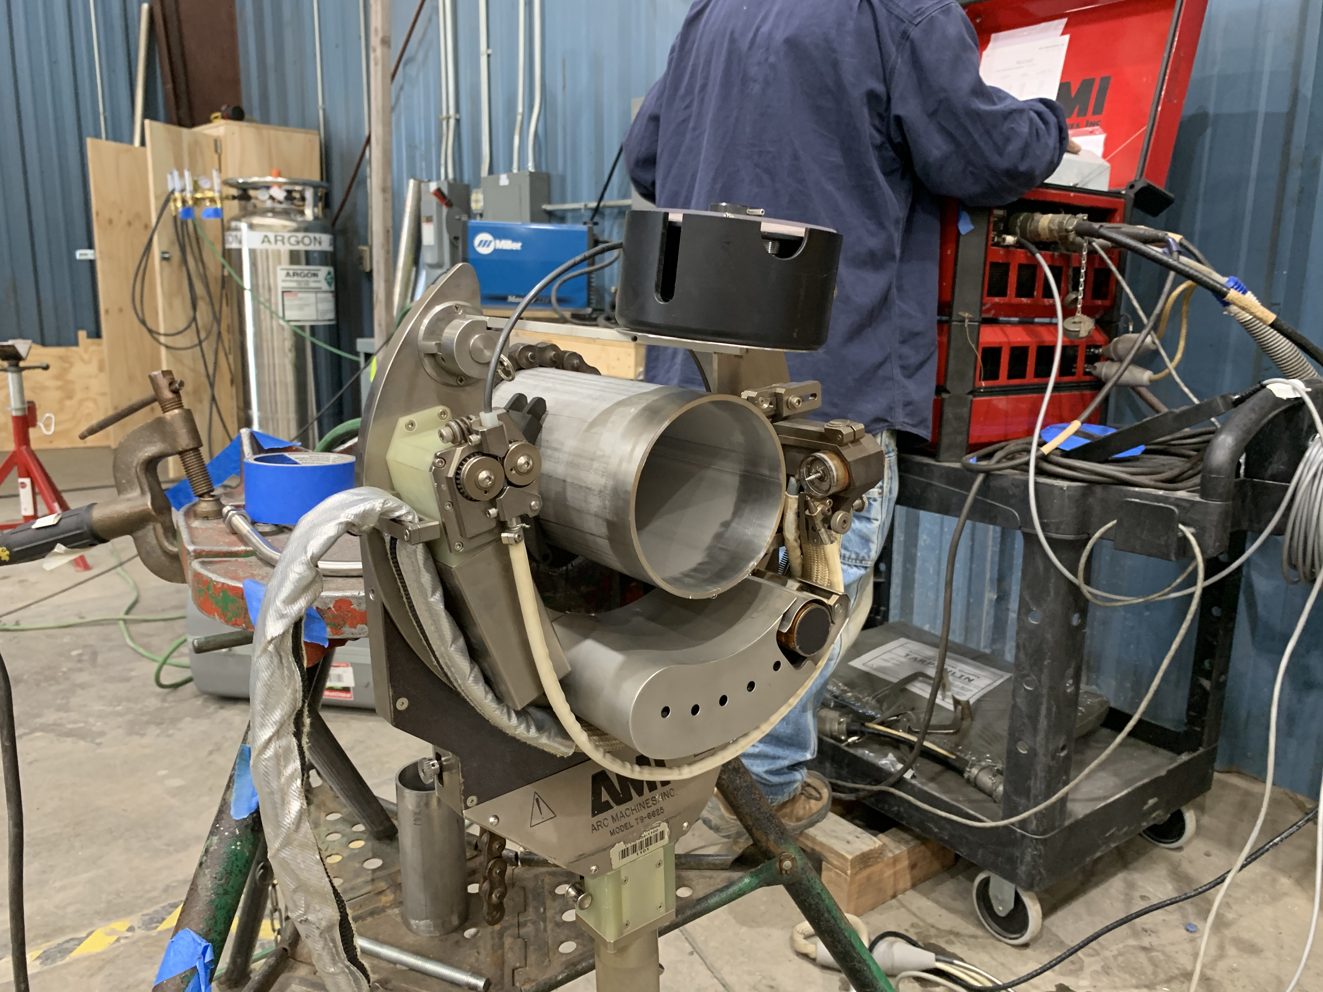
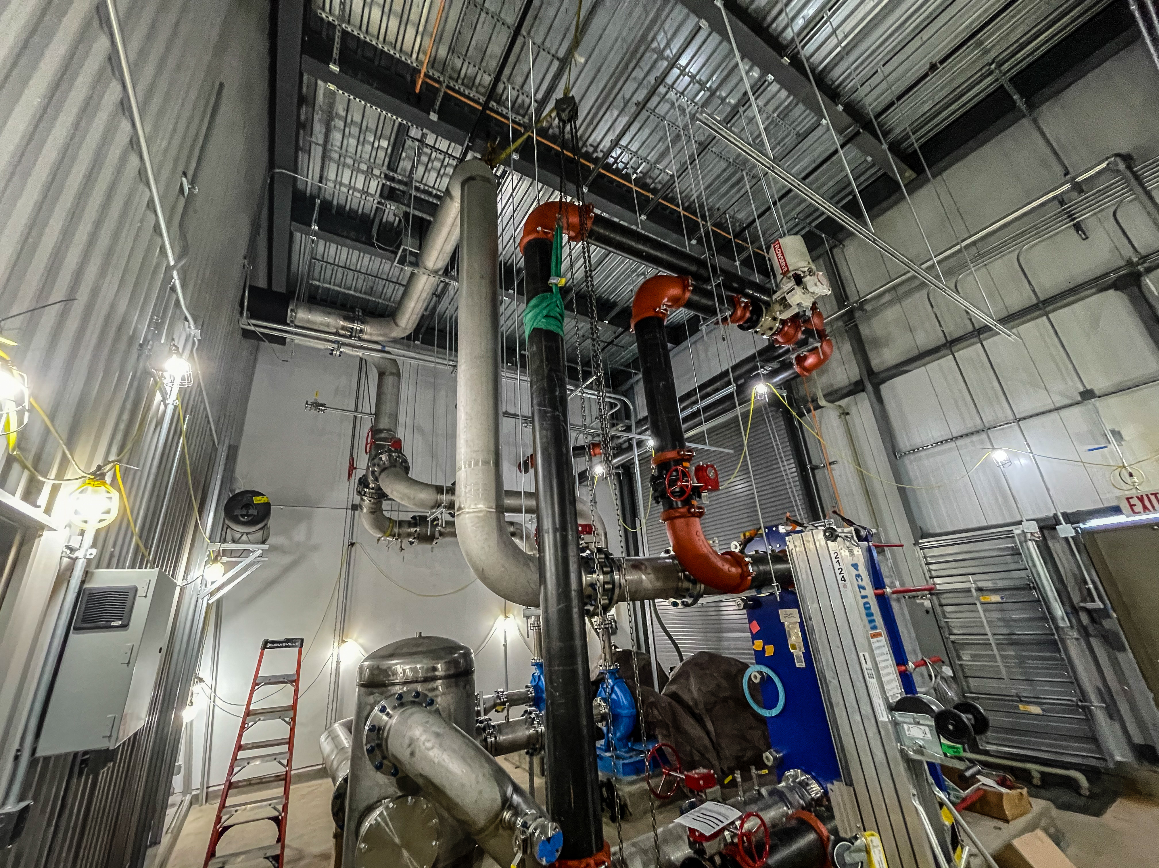
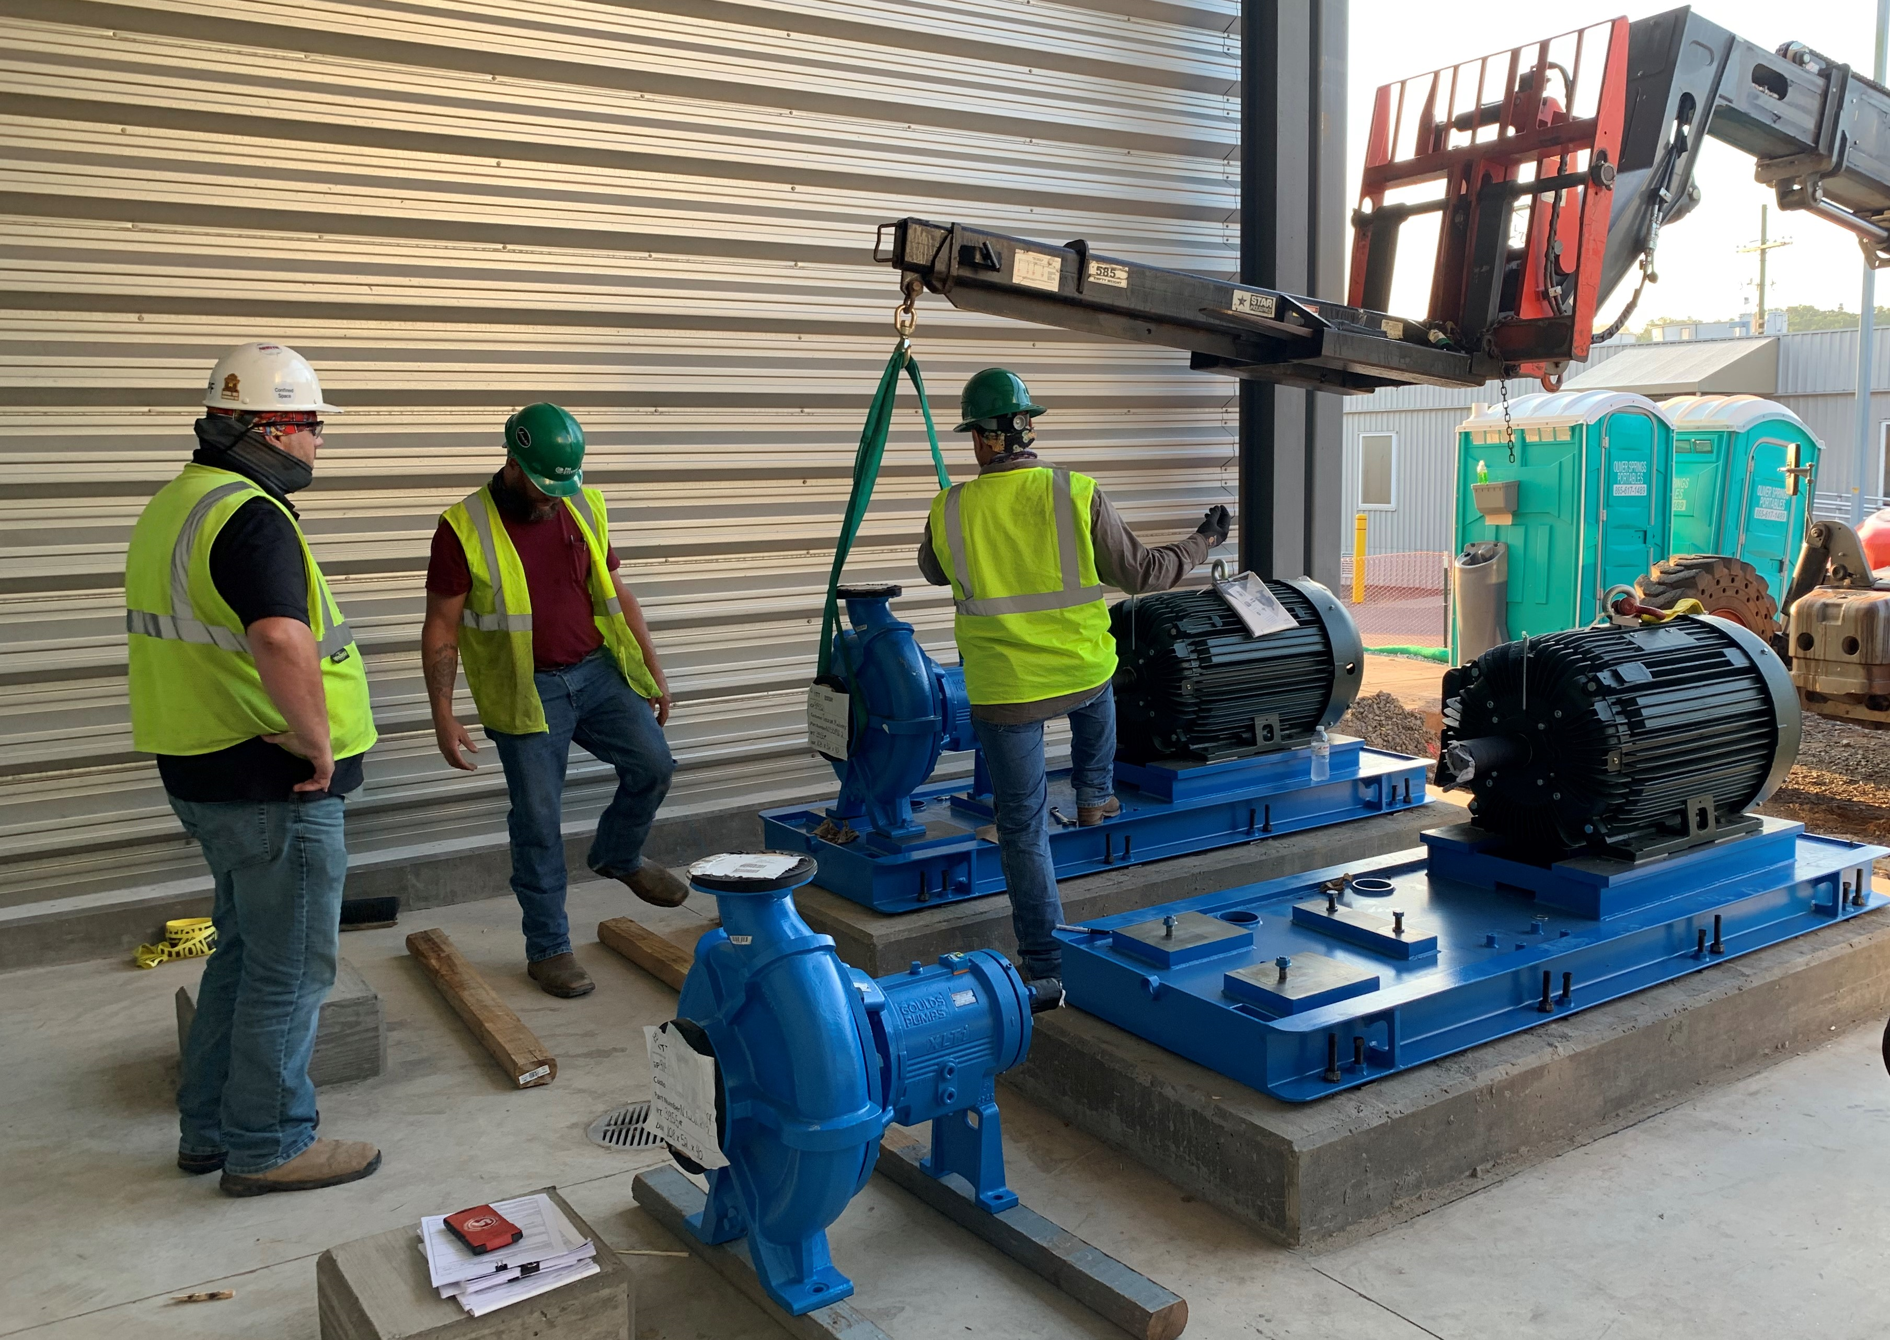
Progress since CD-2/3 (cont’d)
Charge: 4
Mechanical Scope – AC (Utilities - DI Cooling Water)
B3-6 Norman
Feb 2021 – Klystron Gallery
Notes:
New Deionized (DI) water cooling system KL-06. Provides cooling of additional RF equipment in klystron gallery build out
DI water cooling to 28 new klystrons, circulators, loads, 3 new High Voltage Convertor Modulators (HVCM) and new SCR cabinets
The KL-06 system equipment is near identical to existing SCL cooling systems
FPSC scope for AC system included roughly 1-3/4 mile of welded stainless piping in a concgested work areapiping to final equipment connection valves. Much of the piping was shop fabricated, utilizing orbital welding technology. Field welds were also performed orbitally, ensuting the highest quality.
Cleaning, flushing and system testing is included
Gallery piping supported from the roof steel above RF Wave Guides
Total of 142 piping circuits to the RF equipment
5 mock-up TRCC Carts (26 circuits each)
3 HVCM’s (2 circuits each)
3 SCR’s (2 circuits each)

Slide 12
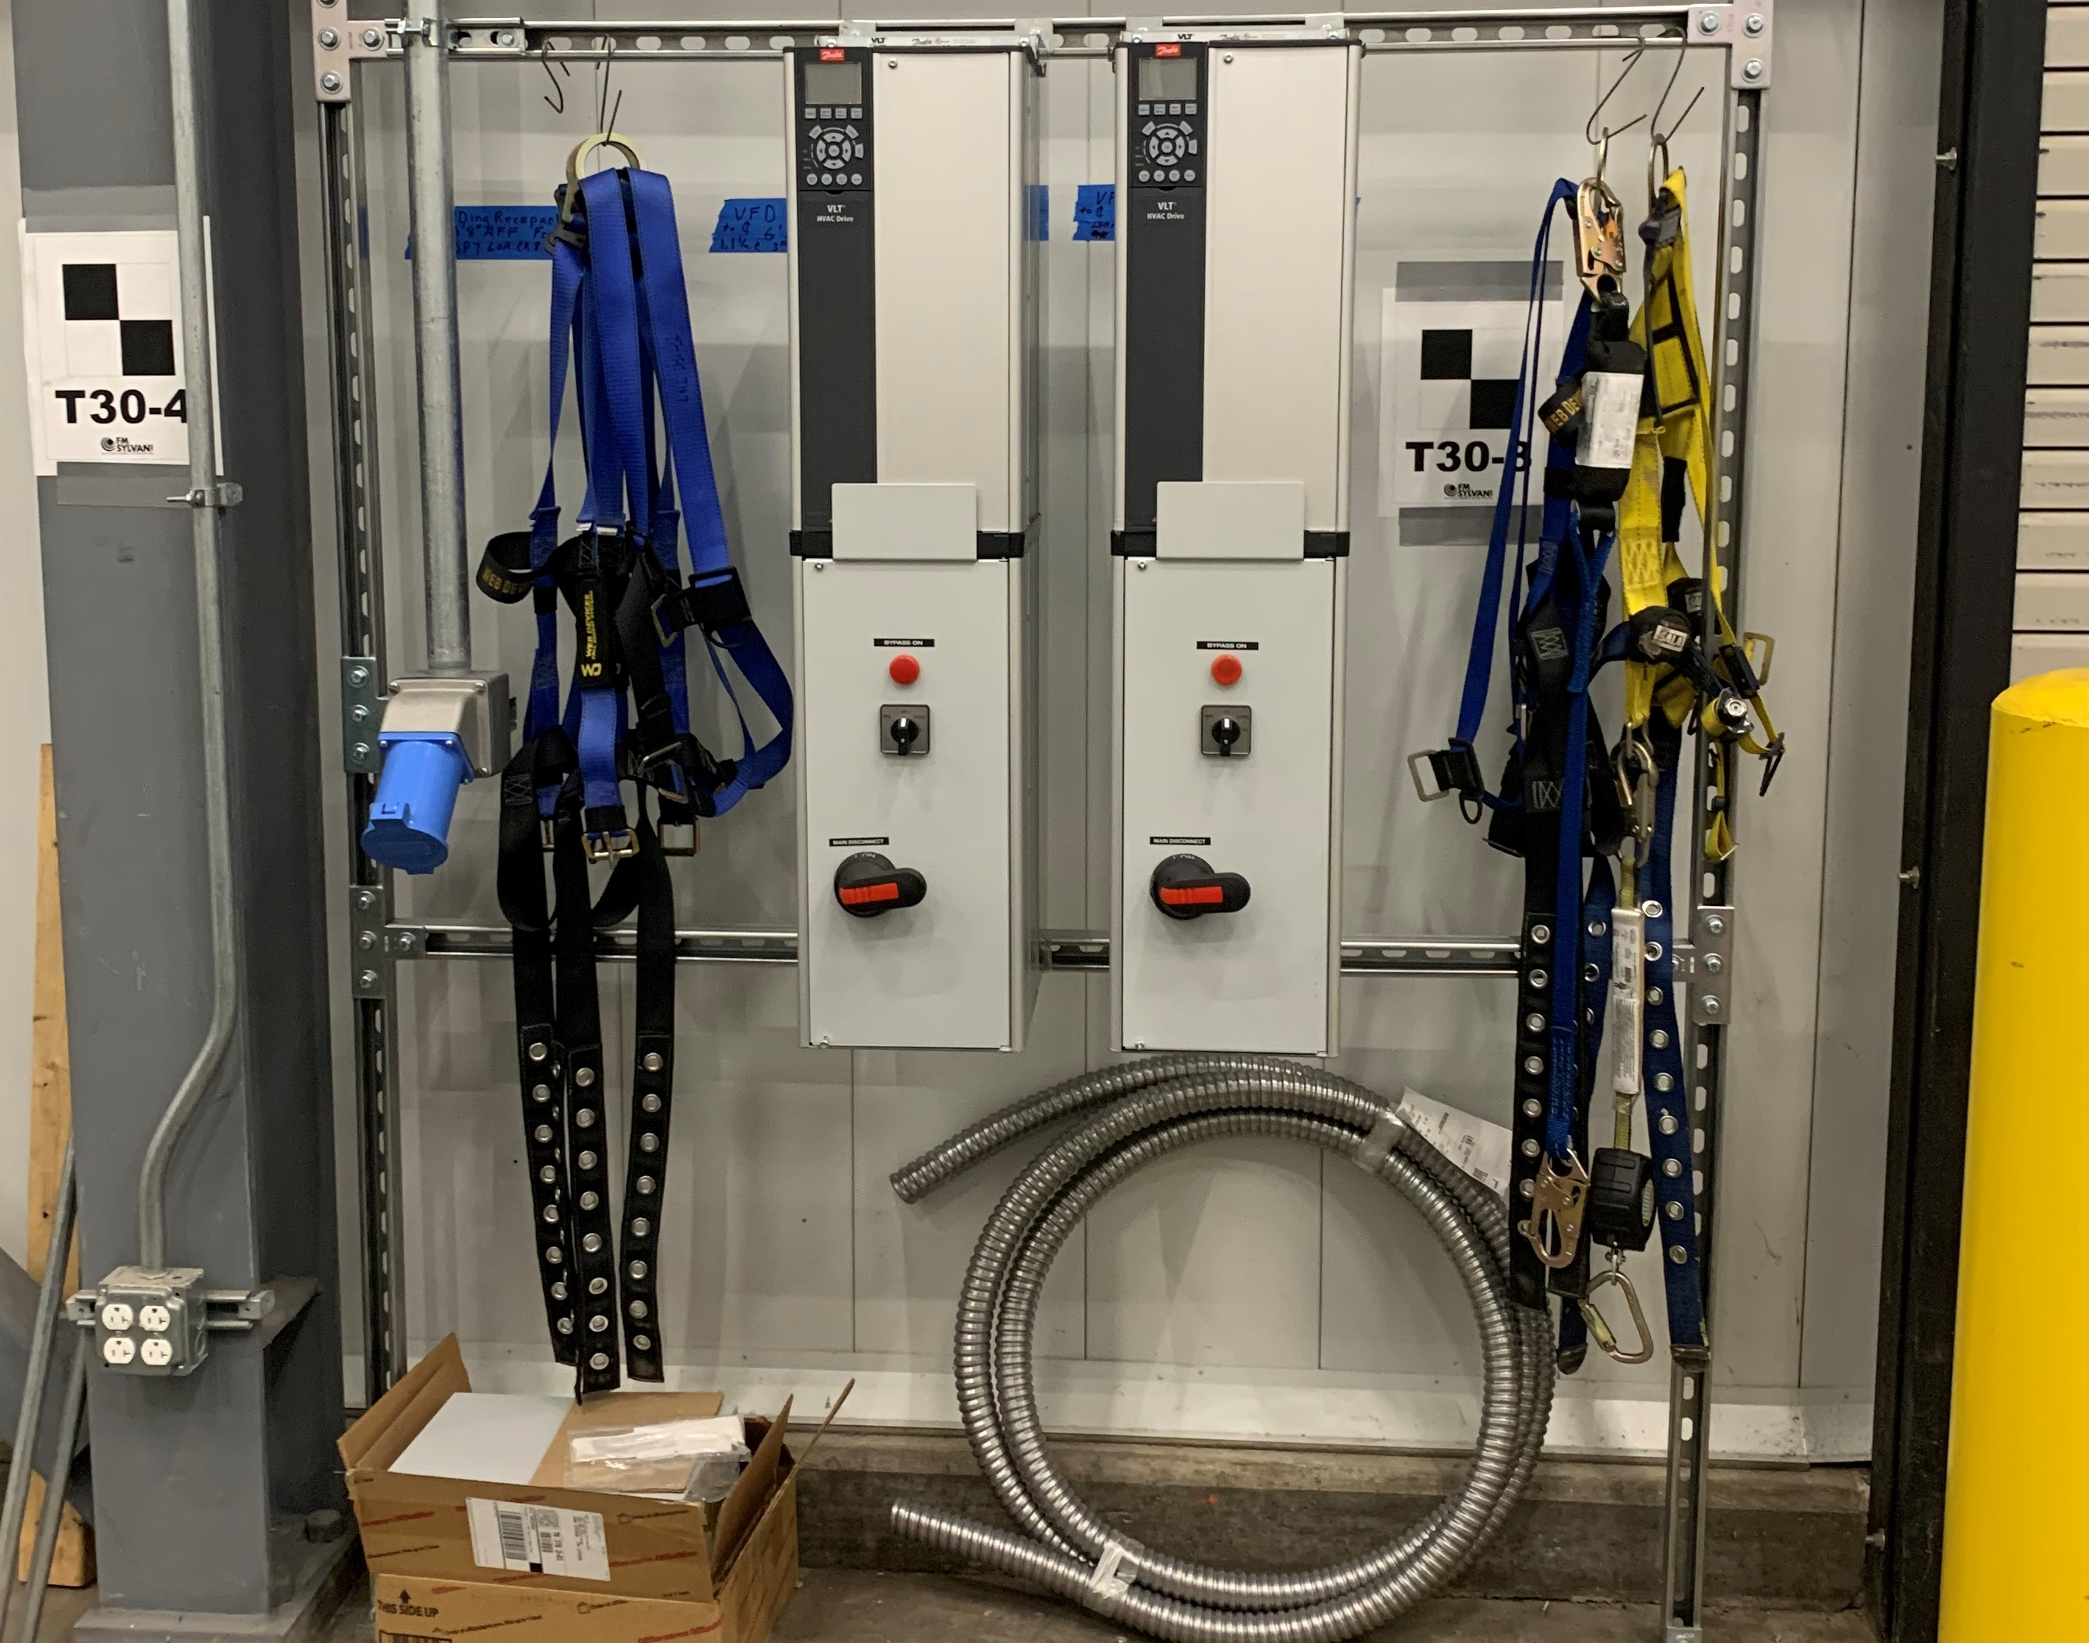
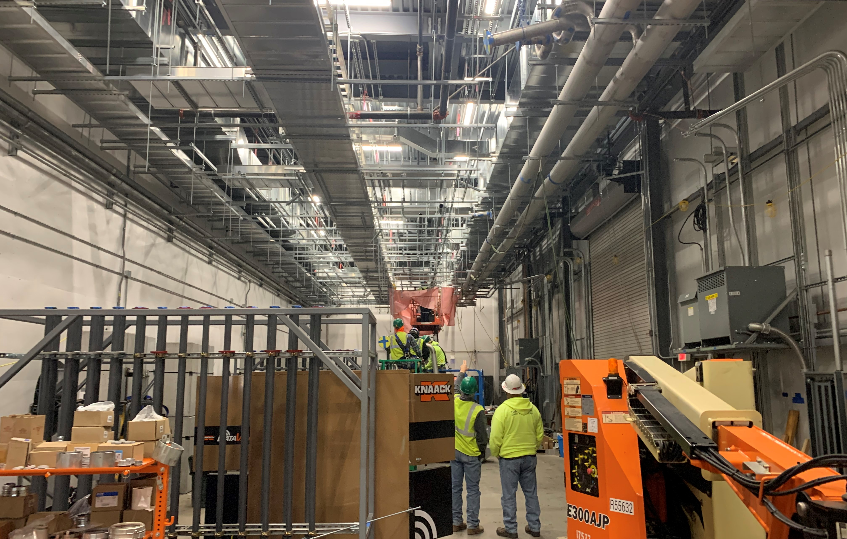
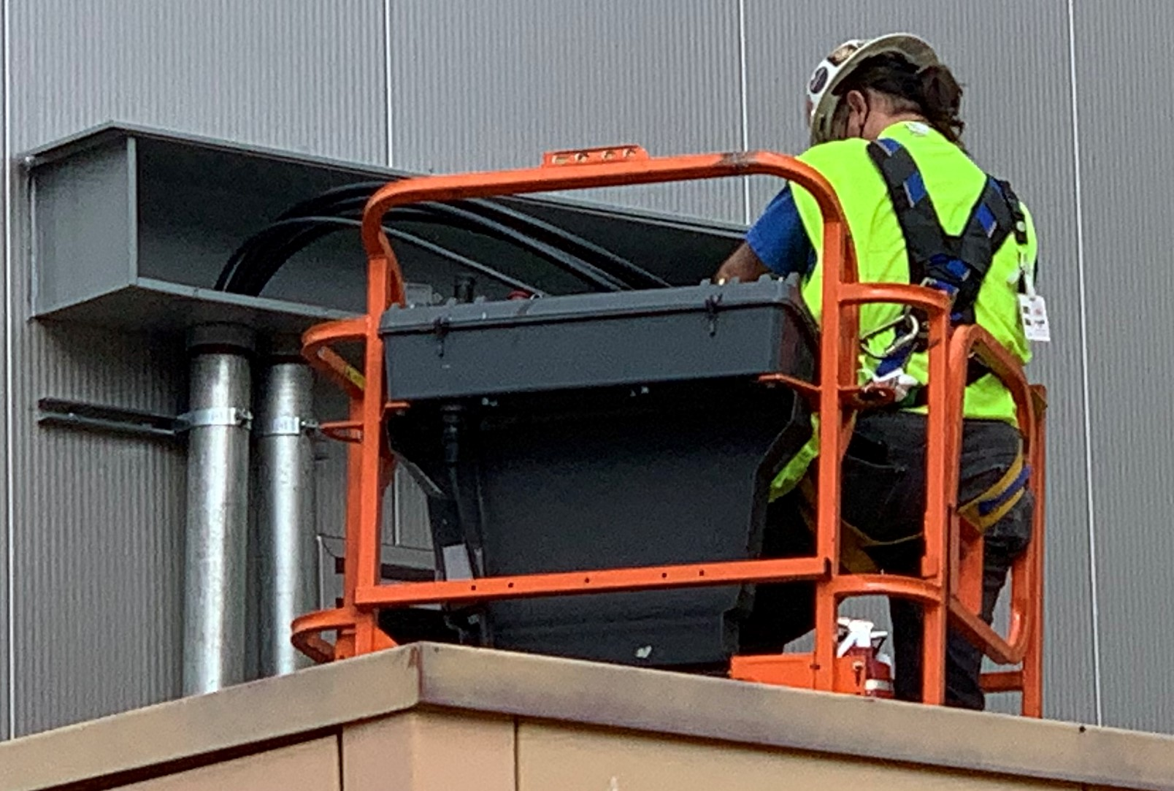
Progress since CD-2/3 (cont’d)
Charge: 4
CF Electrical Equipment / Cable, Raceway, and Terms
Variable Frequency Drive Installation Aug 2020
Cable Pulls Jan 2021 - Feeder from SS4
Notes:
Transformer motor-operated 13.8kV primary switch by CF will be supplied from the HEBT Substation by extending the 13.8 kV feeder underground through Manhole MH-20 outside of HEBT
Underground conduits and transformer pads installation complete. Government Furnished Equipment (GFE) switches delivered and installed
Cable trays inside buildings by CF. Secondary cabling by RF
480 Volt power to be supplied from Substation KL-SS4. 480V panels, transformers, 208-120V panels and UPS were installed , tested, and tied-in in KG to provide power to CF and technical equipment
Existing lighting was relaced with high-efficiency LED lighting

Slide 13
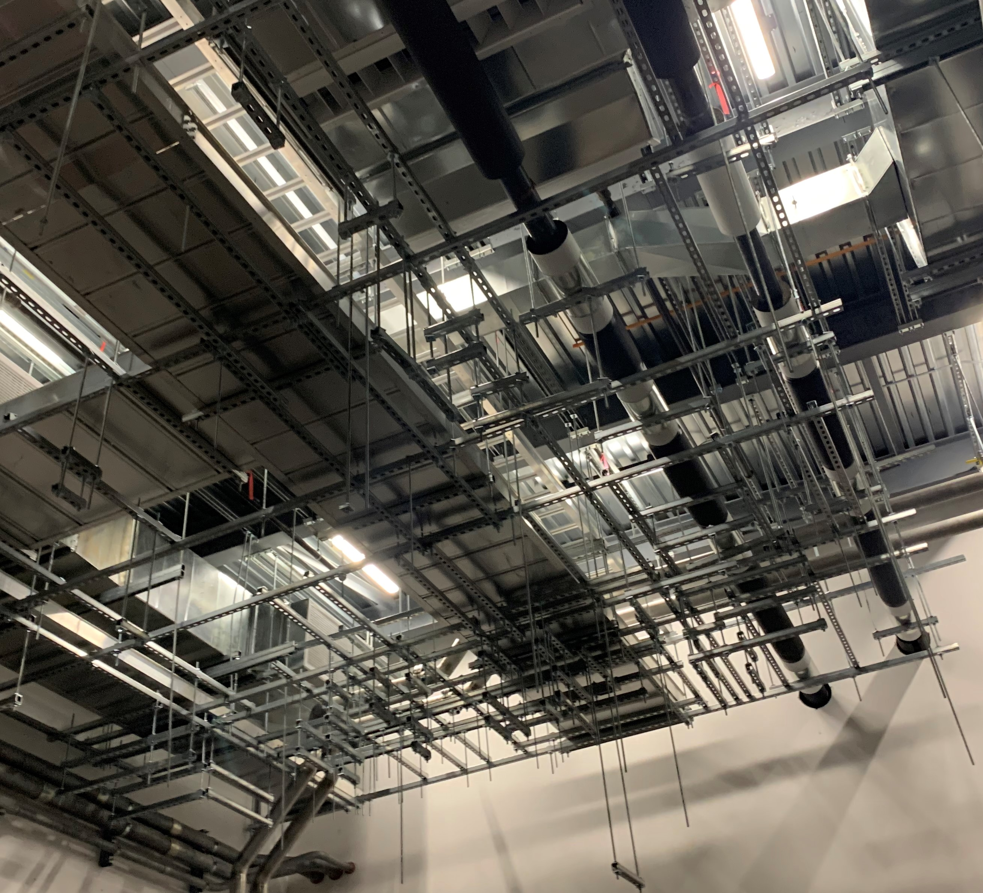
Progress since CD-2/3 (cont’d)
Charge: 4
Structural Scope – RF (Independent RF supports)
B3-6 Norman
Independent RF Support Grid Jan 2020
Notes:
Upper independent grid and rods were installed to support RF installation scope. Note the pink flags.

Slide 14
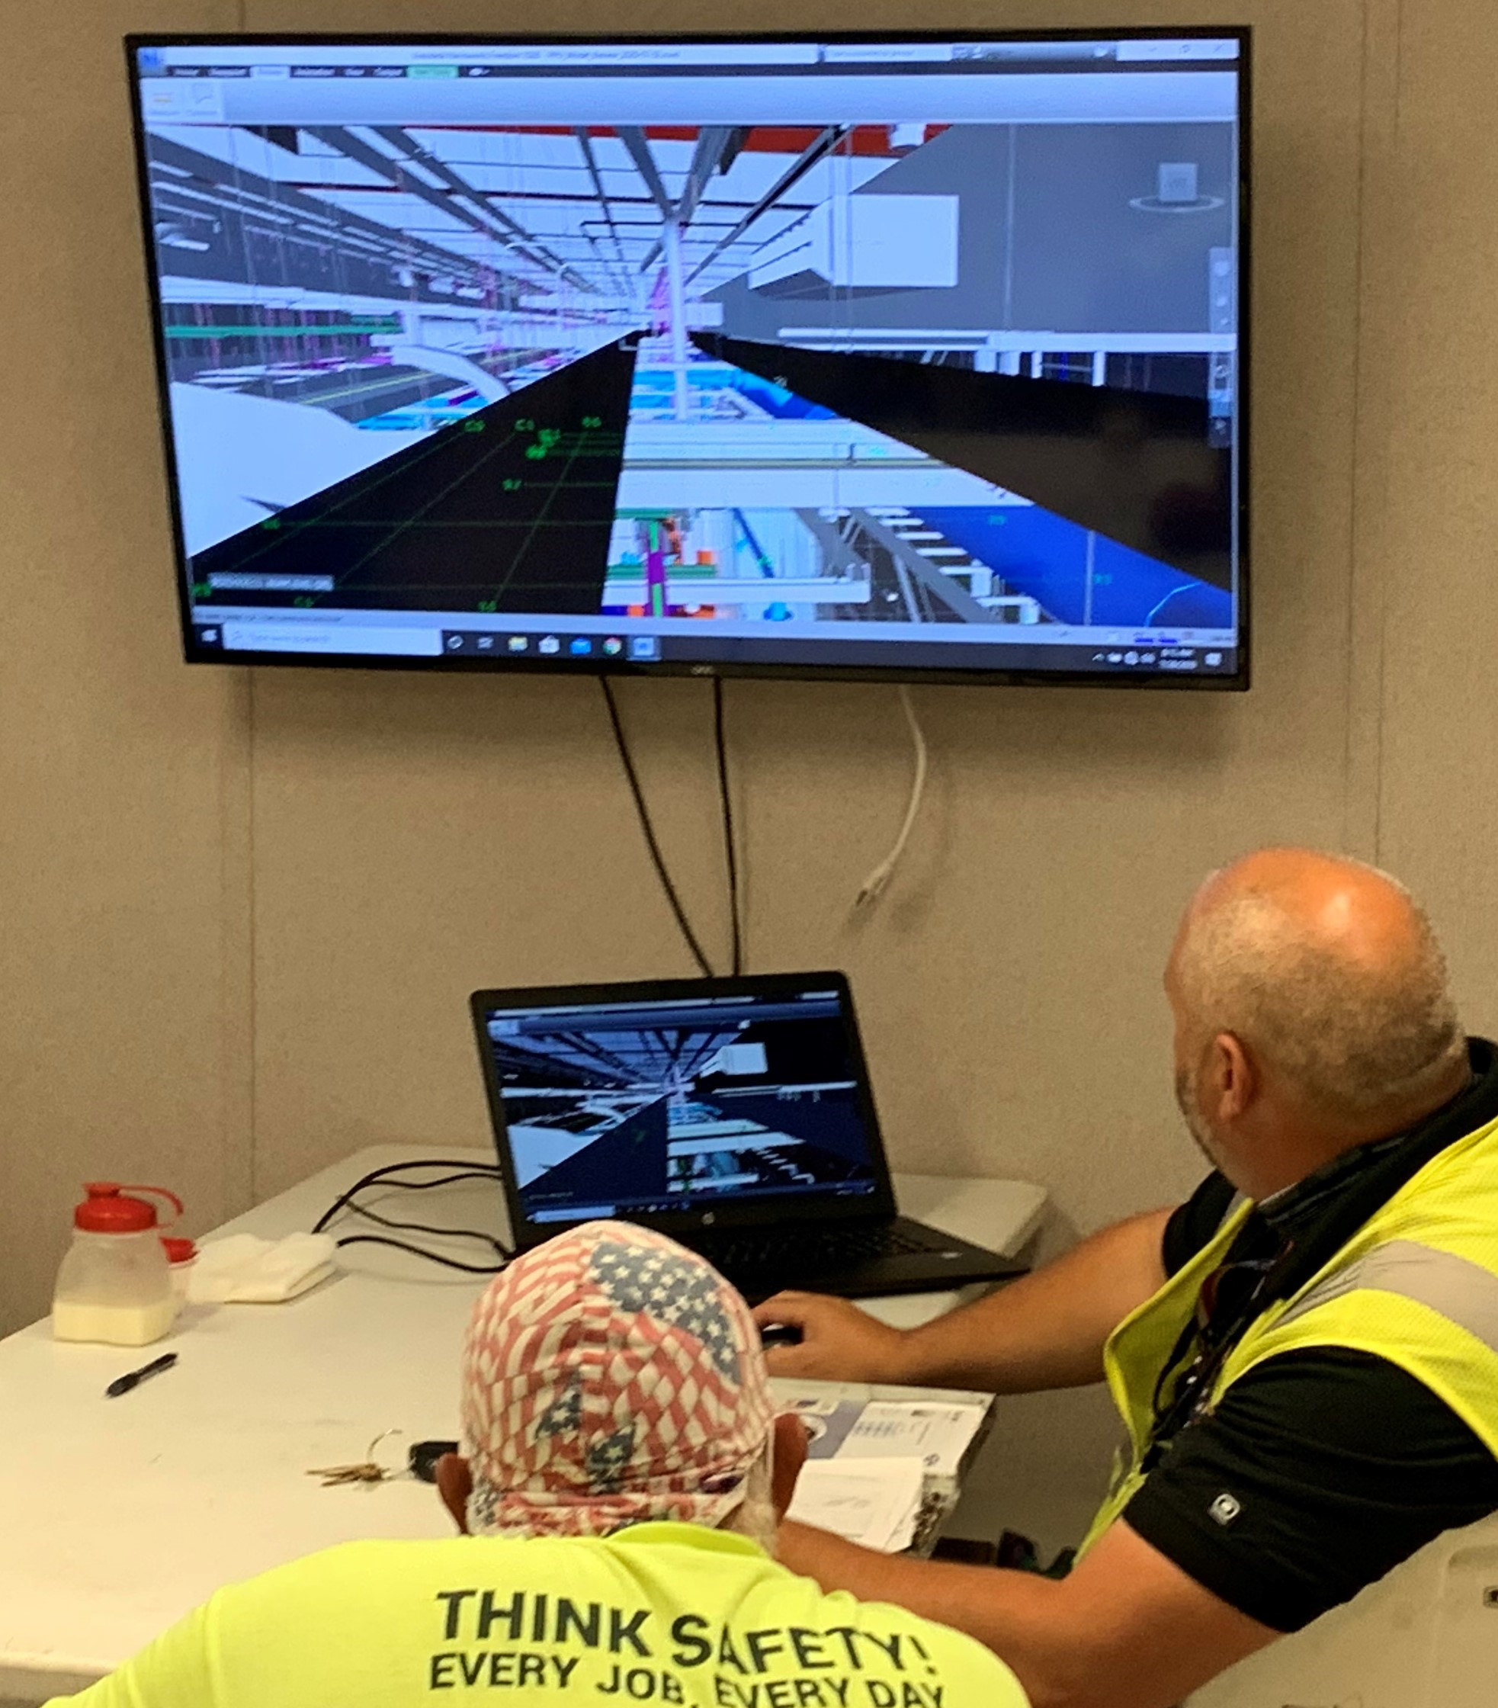
Challenges
Charge: 5
Schedule milestones met despite multiple Covid-19 impacts
Managing multiple scopes for design and construction
FPSC experience with Building Information Modeling for coordination with sub-tier contractors for first major construction project at SNS

Slide 15
Final Design Status
Charge: 1
Final design for Klystron Gallery Construction is complete
Notes:
As builts are underway. Model has been submitted.

Slide 16
Transition to RF Installation
Charge: 1,4
Construction complete, no further installation associated with this WBS
RF installation is underway by Installation Subcontractor
Mock up TRCC carts and pipe layout templates were used in installation to assist in fit-up, flushing, and testing of system.
Identical templates were sent to TRCC cart vendor for alignment.
B3-6 Norman
Notes:
Next phase is underway.

Slide 17
Cost and Schedule
Charge: 4
Cost and Schedule covered in Level 2 Manager Presentation for this WBS
B5-1 Connell

Slide 18
Labor Profile
Charge: 4
Labor Profile covered in Level 2 Manager Presentation for this WBS
B5-1 Connell

Slide 19
Risk Register
Charge: 5
No active risks in Risk Register
Covered in Level 2 presentation

Slide 20
ES&Q and Covid-19 Impacts
Charge: 3
No ES&Q delays
Subcontractor performed 58,300 hours without a recordable
COVID-19 Impacts
FPSC Construction delayed 35 workdays. Impact was to field and shop production as team members were quarantined due to COVID due to varied offsite circumstances;
Remote management by FPSC and subs and UTB staff contributed to moderate coordination/performance issues and minor schedule delays.
Construction overlapped with Installation Subcontract without incurring delays to delivering either scope

Slide 21
12-Month Look-Ahead
Charge: 4
Closeout activities (including as-built drawings)
Share Lessons Learned with FPSC, internal stakeholders, and Second Target Station CF management

Slide 22
Lessons Learned
Charge: 1
Design
Avoid multiple drawing and/or specification packages in single contract. Divergent customer group expectations and approaches and unnecessary redundancies in specifications and drawings. BIM exacerbates these differences.
Building Information Modeling (BIM)
BIM successfully assisted in optimization of the existing space for RF equipment and wave guide supports for constructability and maintenance.
BIM worked very well for piping shop fabrication; pipe spools required minimum field rework.
The expectations/alignment of the purpose and scope of using BIM was not adequately established during FPSC contract formation/award.
Designers(AE) should have scanned existing space and incorporated existing utilities.
FPSC should have validated existing site before starting model, through scanning.
Notes:
Would like to take some time to share some things the team learned along the way.

Slide 23
Lessons Learned (cont’d)
Charge: 1
Limited Bidding Competition
Local construction market highly competitive due to work availability
Use of BIM thought to have limited contractor interest

Slide 24
Summary
KG Construction completed supporting project objectives
Met DOE project milestones despite COVID impacts
Constructed quality infrastructure to support RF equipment
Delivered 58,300 craft hours without a recordable incident.
Overlapped RF installation with FPSC to support schedule
Use of BIM in SNS construction project delivered benefits in shop fabrication of piping and RF waveguide supports.
Templates for TRCC Cart Piping installation assisted in timely fit-up flushing and testing of system.

