Slide 1
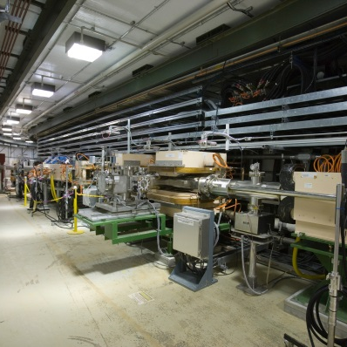
Target 1.4 MW Operational Experience
DOE/SC Independent Project Review of the Proton Power Upgrade Project
Drew Winder
Source Development and Engineering Group Leader
September 14-17, 2021
Thanks and credit to David McClintock, Hao Jiang, and Kevin Johns for figures

Slide 2
Outline
Operational update since CD-2/3
Performance from recent targets
Gas injection benefit and observations
Coordination between operations and PPU project
Operational improvements and progress
Notes:
1.4 MW operation highlights
- Since CD-2-3 in July 14, 2020
- T25 completed successful operation

Slide 3
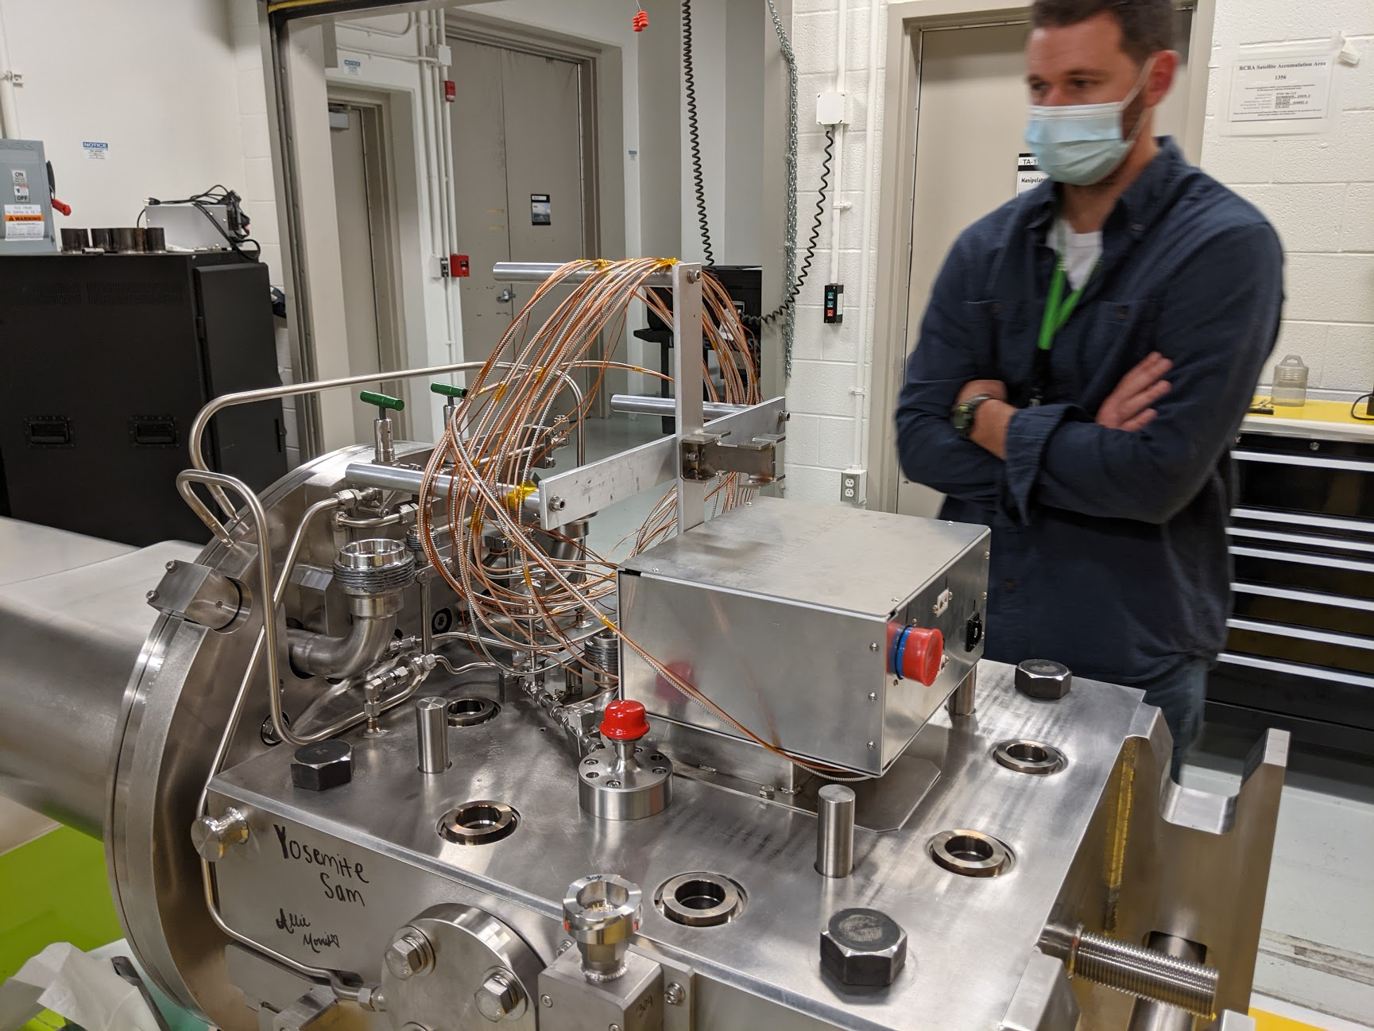
Four targets have operated at 1.4 MW since CD-2/3
Operated established original and jet-flow designs
Brief period of 1.0 MW operation occurred at the beginning of the COVID-19 pandemic
Increased to 1.4 MW when COVID experiments that could benefit from the added flux began
Positive post-irradiation examination results led to consideration of longer target lifetimes
T27 developed a leak in service
High power operation continued throughout COVID-19 pandemic

Slide 4
T27 leaked after 1,537 hours at 1.4 MW
Leak occurred on May 2nd
Beam delivered to new target on May 11th
Less hours than T24 (2,050) and T26 (1,654)
No signs of imminent failure in targets after removal
No signs of issues with the beam or gas injection system
Jet-flow
Jet-flow
Original
Jet-flow
Blue
Original
Gas Injection
Jet-flow
Jet-flow
Original
Original
Original

Slide 5
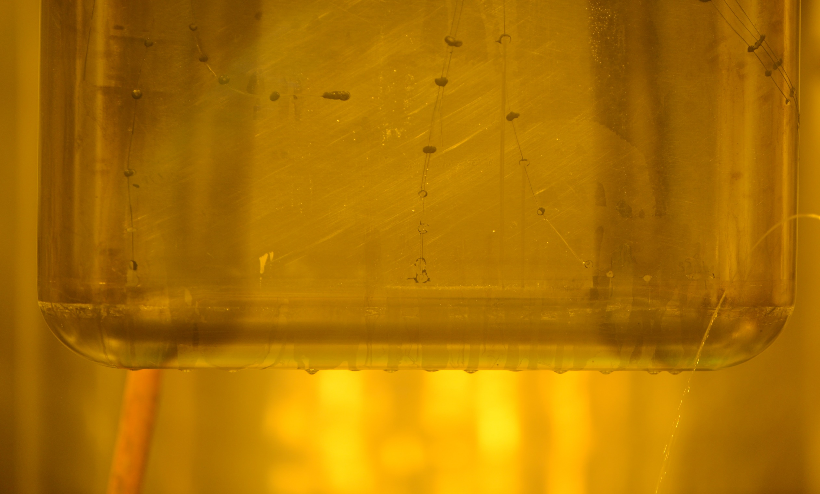
Cause of leak was same as previous T22
T22 was a different design
Crack initiated at an internal sharp corner
Corner had been present in previous designs
Analysis review indicated that the new design had increased stress at corner
Modifications were not made to jet-flow designs like T27
Modifications to jet-flow targets under fabrication are being reconsidered
Crack started at internal corner (above), and propagated through inner layer until reaching a connecting rib, where it then expanded to the outer surface causing a leak (below)

Slide 6
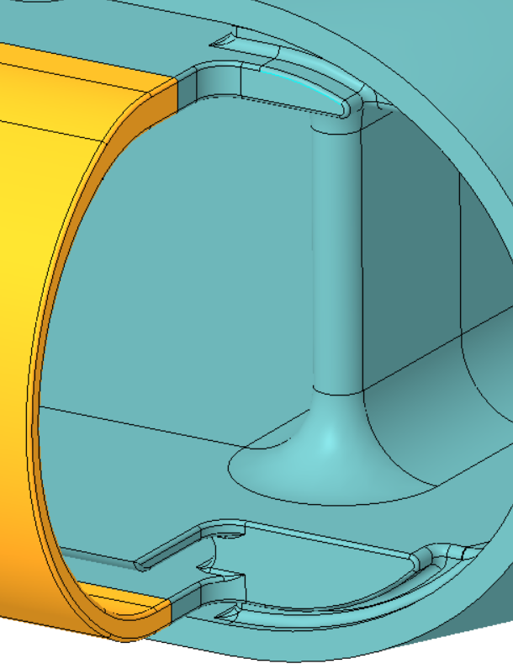
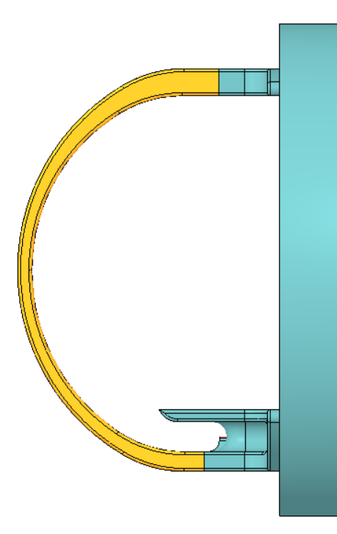
2MW Targets and PPU Test Targets Design Addressed T22
Shifted plane, added radius
Charge: 1
3x R=0.1875”
(4.76mm)
Offset: 0.1”
(2.54mm)

Slide 7
No operational issues with current gas injection levels
No mercury flow or level instabilities observed
Gas causes mercury level to rise
Volume displaced increased linearly with gas injection rates
Current configuration has 57 L of available head space
Theoretically allows for >16 slpm of gas injection
PPU overflow tank will add additional head space
Charge: 1

Slide 8
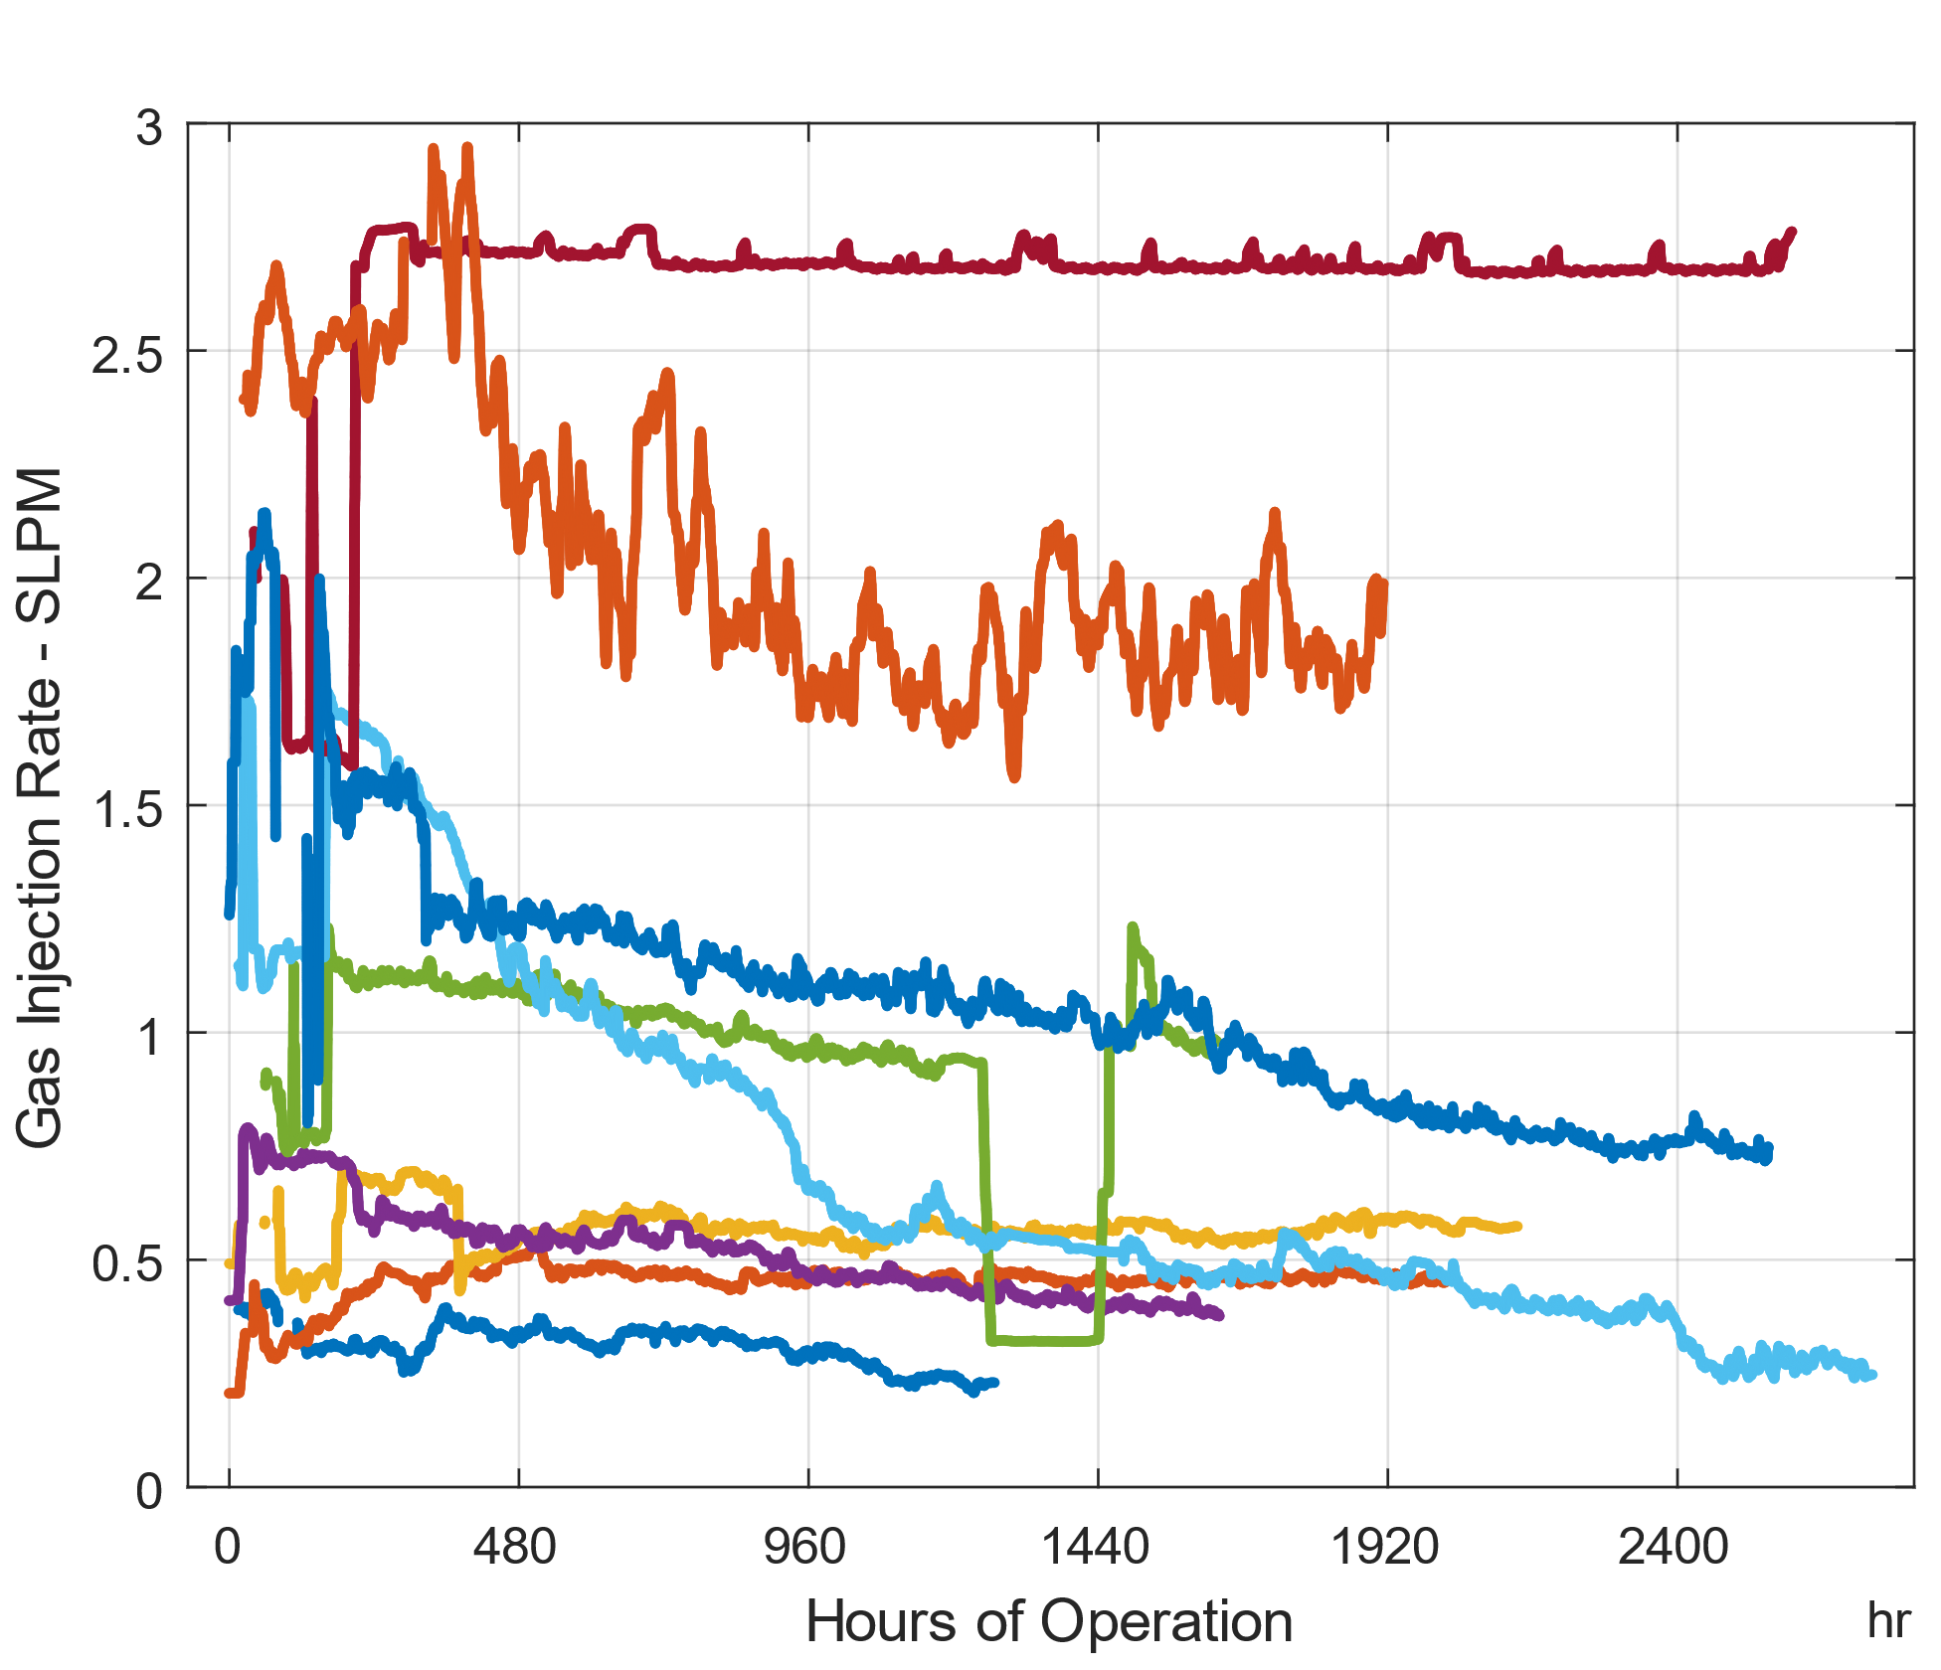
Continue to have clogging with current bubblers
Only exception of T25, which had a broken internal tube
Clogging problem is slowing hoped for increases in operational gas injection rates
Operations very much looks forward to swirl bubble operation starting with PPU Test Target #1
T25
T27
T22
T26
T20
T21
T19
T24
T18
Gas injection rates for targets operated to date

Slide 9
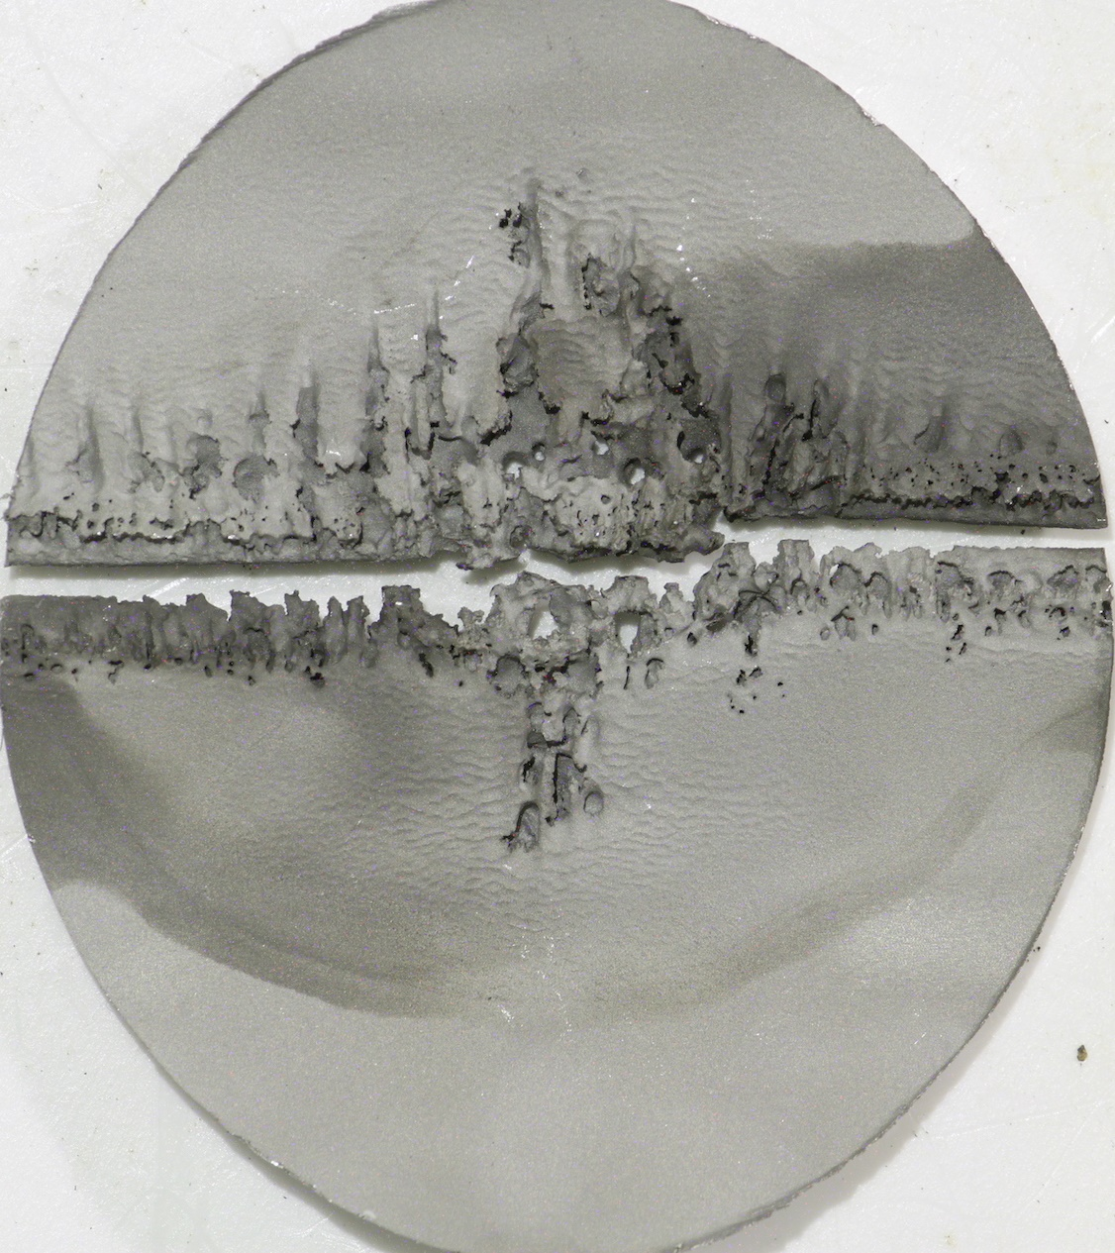
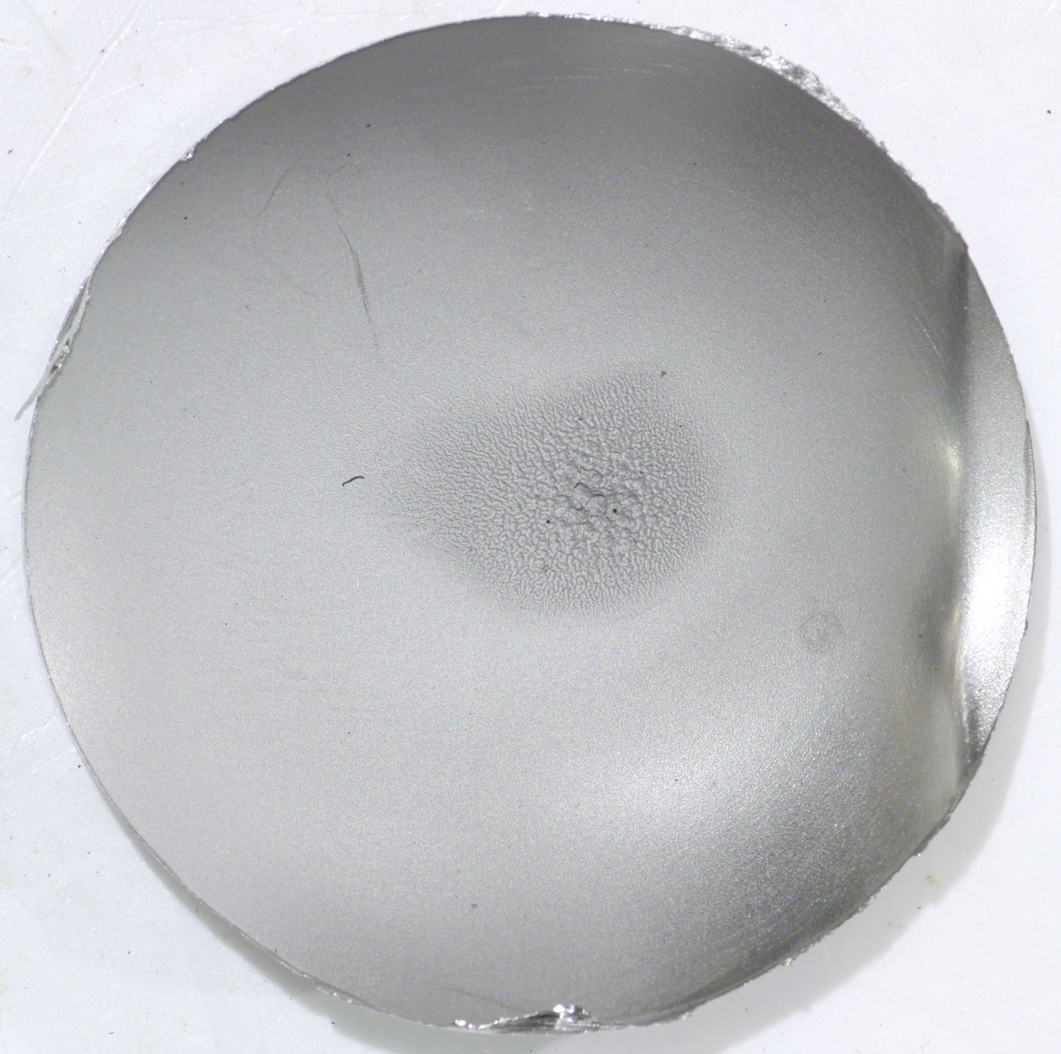
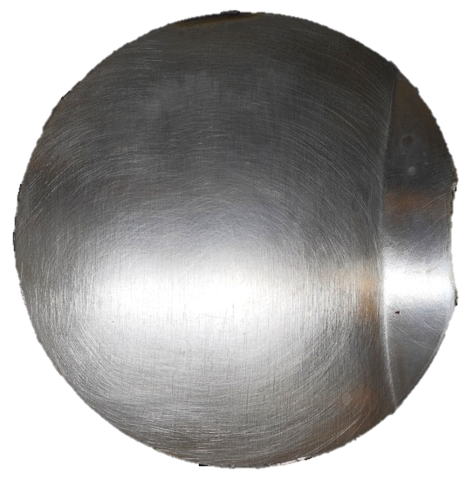
Gas injection continues to show cavitation reduction
Cavitation damage throughout the target continues to be reduced with gas injection
Reduction at the center of the target has been dramatic →
Damage outside of the beam also reduced significantly ↓
Reductions roughly equivalent to what would be expected with 2/3 the actual beam power
Charge: 1
T17
1,600 hours at 1.2 MW max, no gas
T27
1,600 hours at 1.4 MW max, with gas
T17
T27

Slide 10
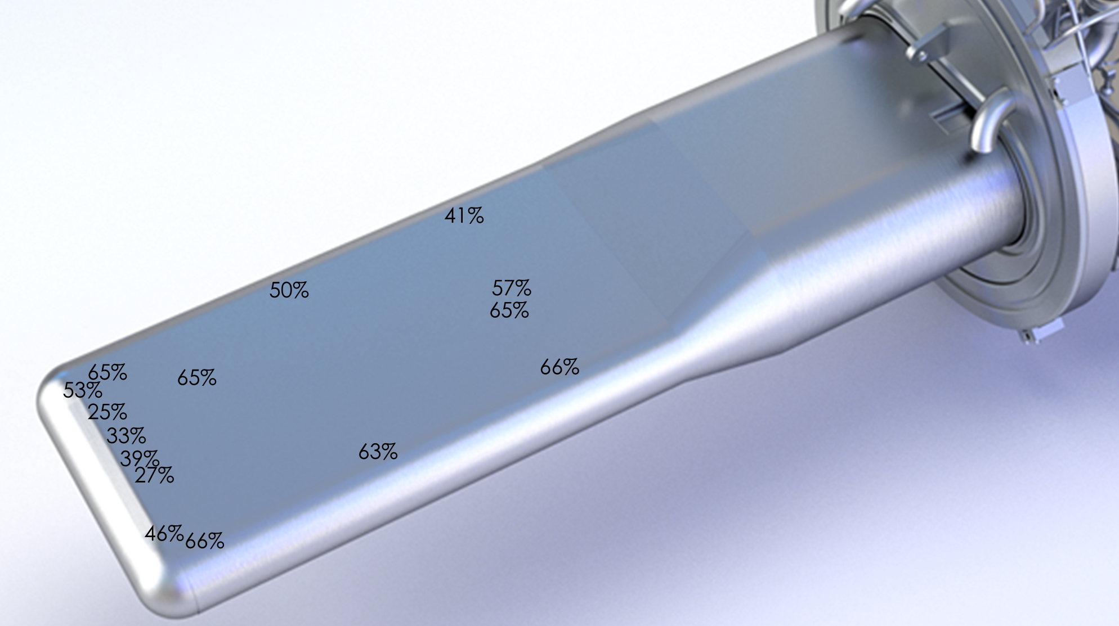
Gas injection continues to reduce strain levels
Charge: 1
T27 at ~1.3 slpm
Measured strain reductions continue to increase with higher gas injection rates
Rate of decrease is less than linear
Values observed are good compared to desired reductions
Generally higher strain away from beam location
2nd gas supply will provide additional benefits in this area
T27 at ~3.1 slpm
Values are % reduction in strain range / kW beam power.
Larger numbers are better.
Example measured strain reduction at 1.4 MW as a function of gas injection rate

Slide 11
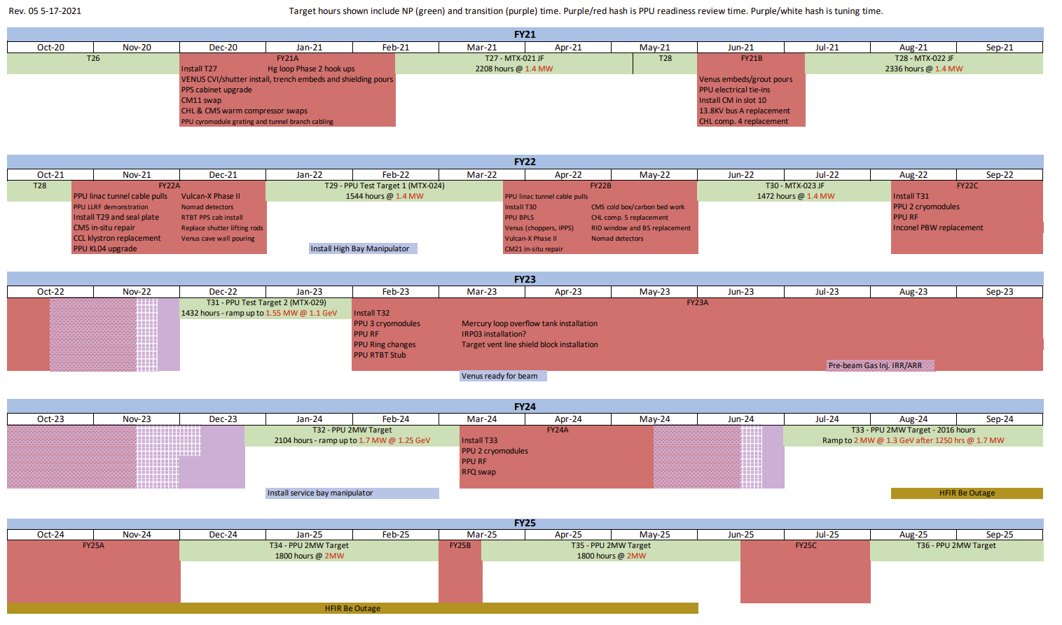
Coordination between PPU and Operations continues
Target management plan revised in November 2020
Plan scope continues past PPU finish
Planned for earlier installation of PPU Test Target #1 made possible by excellent fabrication performance
Planning for ~3 target per year consumption rate
New revision in draft
5-year operational plan issued in conjunction with PPU
Charge: 5
Recently issued 5-year plan

Slide 12
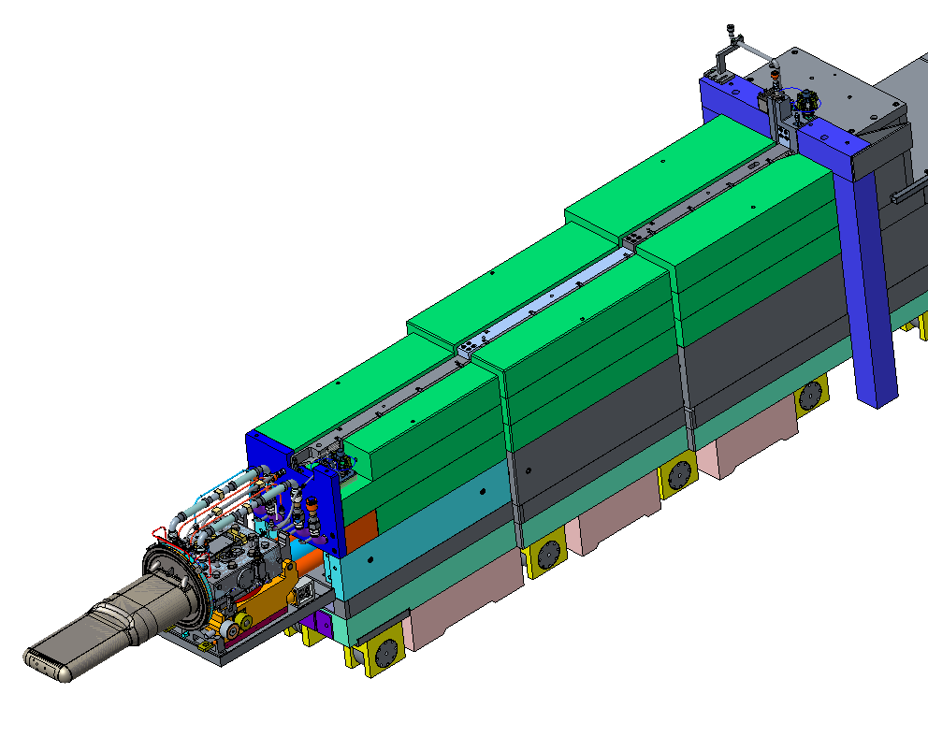
Work continues on reliability and improvements
Charge: 5
Completed final upgrades in response to 2019 mercury fill event
Included pulling additional gas hoses to support PPU project
Working on changes to speed target changes
Improved procedures
Increased trained staff
Development efforts to improve simulations
Joint research with other ORNL divisions
Reviews of 1.4 MW designs at higher powers
Fabrication of equipment needed for PPU project underway
B2-5 Edwards

Slide 13
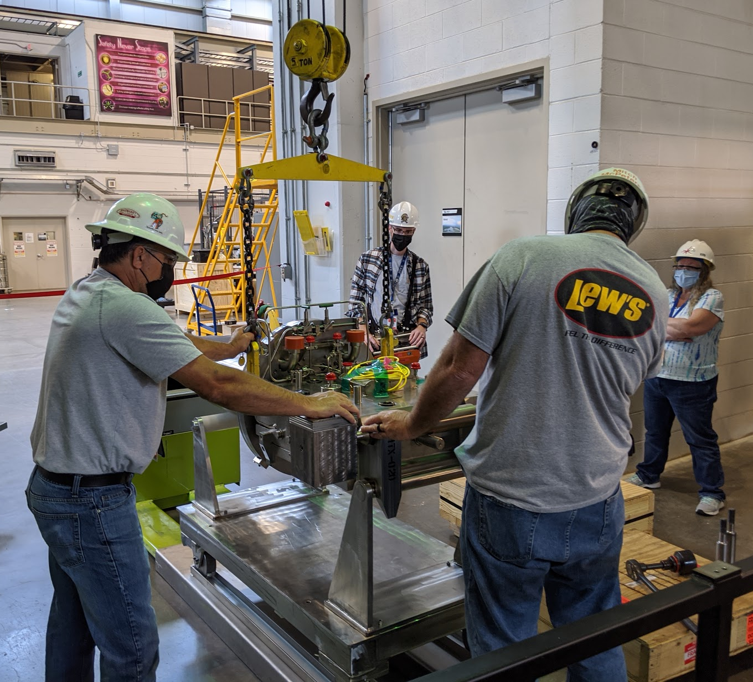
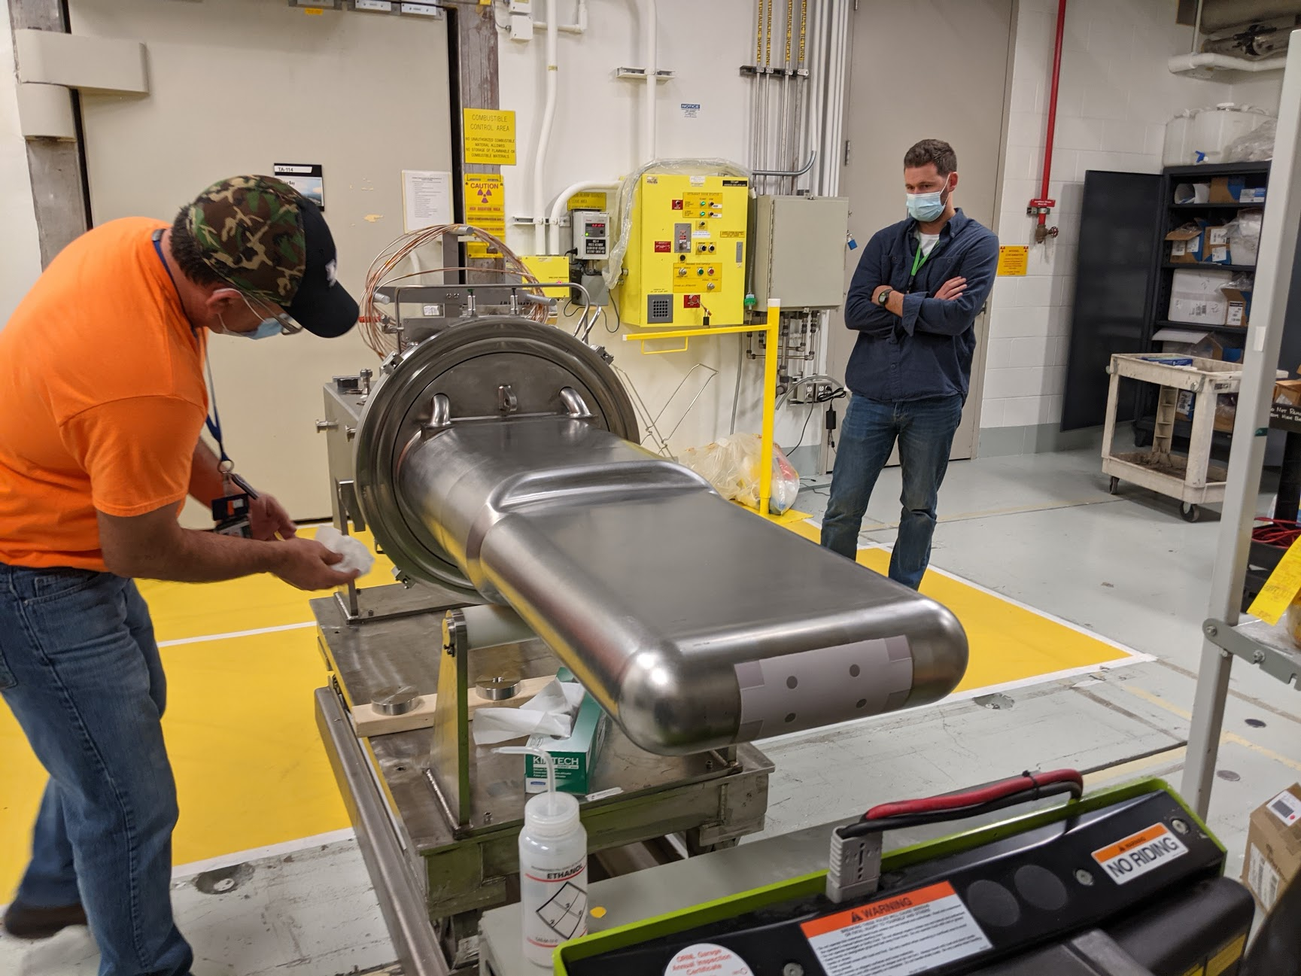
On track for PPU finish and beyond
Charge: 5
Completed multiple outages with COVID-19 controls
1.4 MW target fabrications trending ahead of schedule
Primary vendor working well, beating schedule estimates
Stopped work at secondary vendor
ORNL advanced fabrication facility progressing
Will provide fabrication alternative
Operations supporting 2MW target design package updates for upcoming additional fabrications

Slide 14
Summary
Charge: 1, 5
Since CD-2/3, one target has leaked in service after nearly 7,000 hours of reliable 1.4 MW operation
Leak cause has already been addressed in PPU target designs
Gas injection shows continued cavitation and strain reduction
Operational experience supports path chosen by PPU
Coordination continues between operations and PPU
5-year plan issued
Target Management Plan coordinates efforts
Multiple outages completed with COVID-19 controls
SNS operations stands ready to support PPU completion and continued 2MW operation beyond

