Slide 1
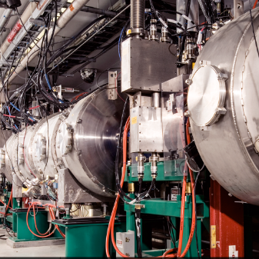
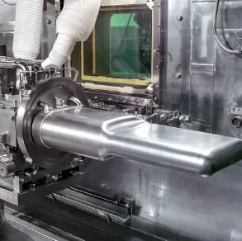
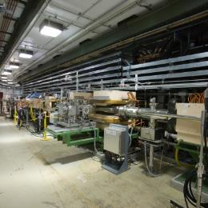

PPU Project Management
DOE/SC Independent Project Review of the Proton Power Upgrade Project
John Galambos
Director
September 14-17, 2021

Slide 2
Integrated Project Team
Harriet Kung
Linda Horton
Kurt Fisher
Linda Horton
Hannibal Joma
(Ed Stevens previously)
Johnny Moore
Wendy Cain
(James Barnard previously)
Thomas Zacharia
John Galambos
Mark Champion
Sang-Ho Kim
Wayne Steffey

Slide 3
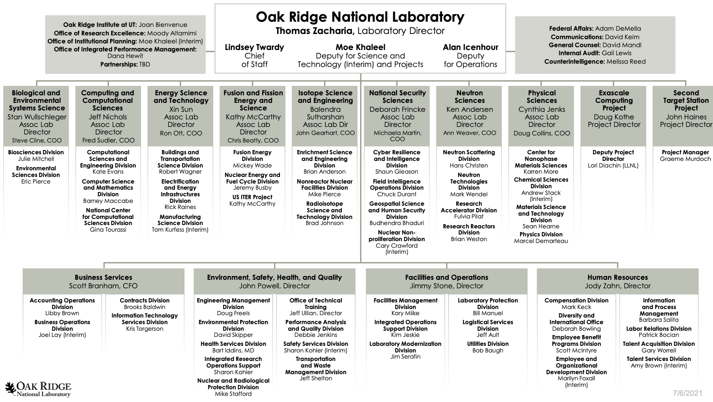
ORNL Organization
big projects

Slide 4
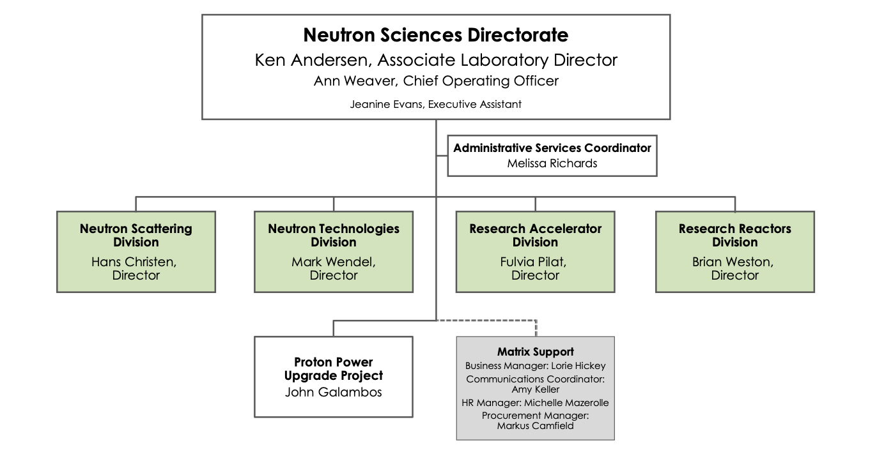
NScD organization
new

Slide 5
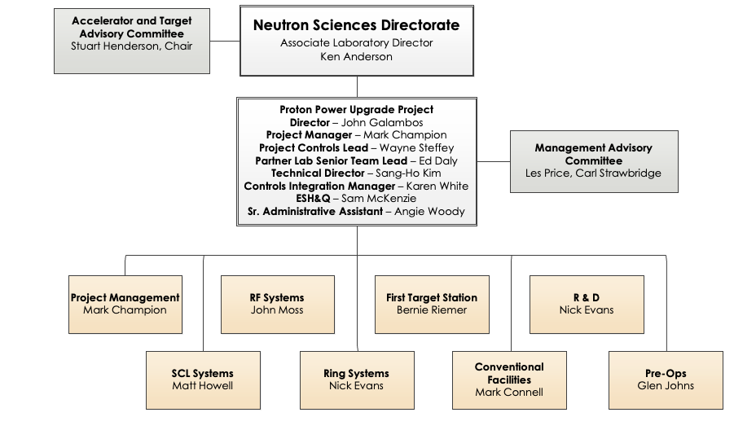
PPU project organization is largely stable
Currently being reconstituted
Ken Andersen replaced Paul Langan
Nick Evans replaced Charlotte Barbier

Slide 6
PPU interaction with NScD/ORNL leadership
Charge 5
I direct report to Ken Andersen(NScD ALD)
  Weekly 1-on-1 meetings
NScD leadership: daily VC meetings
Bi-monthly NScD cabinet meetings
Monthly meeting with ORNL “projects of distinction”
Bi-weekly mtg. with RAD director on operational issues and matrix staff

Slide 7
DOE communications
Bi-weekly meetings with Wendy Cain (FPD) + participation in weekly L2 meetings + monthly project metrics meetings
Regular bi-monthly meetings with sponsor
  Monthly IPT project conference call
  Mid-month call with BES project manager (Hannibal Joma) + Wendy Cain
Brief update on PPU progress communicated to BES by Ken Andersen weekly
Monthly progress report to BES
COVID impact to OPA monthly

Slide 8
ORNL Reorganization
ORNL underwent a “re-imagining” reorganization over the past year
  Adding a “section” management layer between divisions and groups
  PPU matrixed functions are generally retained through the new division structures
Some impact to PPU
    E.g., W. Steffey and C. Barbier are now group leaders
    ESH&Q staff are part of lab organizations
We are working with NScD on the PPU staff ramp-down plan
  Have benchmarked SNS accelerator staff levels with other facilities to get a better handle on target level
  Will be subject of 2022 BES triennial operations review

Slide 9
JLab collaboration is going well
There are many JLab interactions / communication channels
  PPU L2 weekly mtg.,
  SCL weekly mtg.,
  Weekly update report to PPU project office
  Monthly status reports
The collaboration is based on an established history of successfully working together
  Helped during COVID with limited travel possibilities
B8-6 Daly

Slide 10
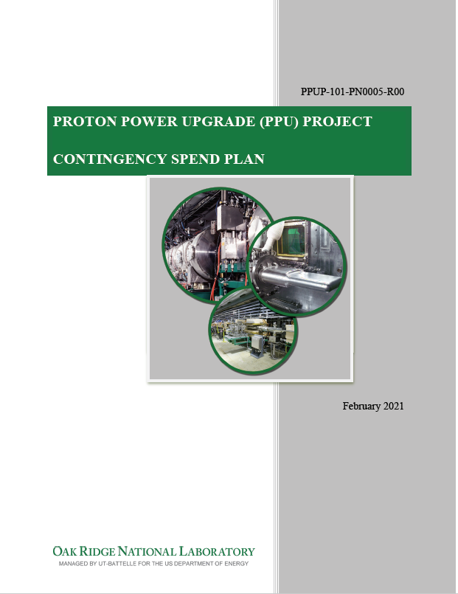
PPU has a well defined contingency spend process
Defines the process for how we pick contingency spend choices
  Project office proposes (FPD approves) when to release contingency
    Consider remaining risks, budget authorization, “opportunity” for leveraging ongoing procurements, …
  Choice of spending based on input from project + NScD
  Decision is communicated to BES
  Exercised this process for the spare cryomodule
See review website “Contingency spend plan” under project documents

Slide 11
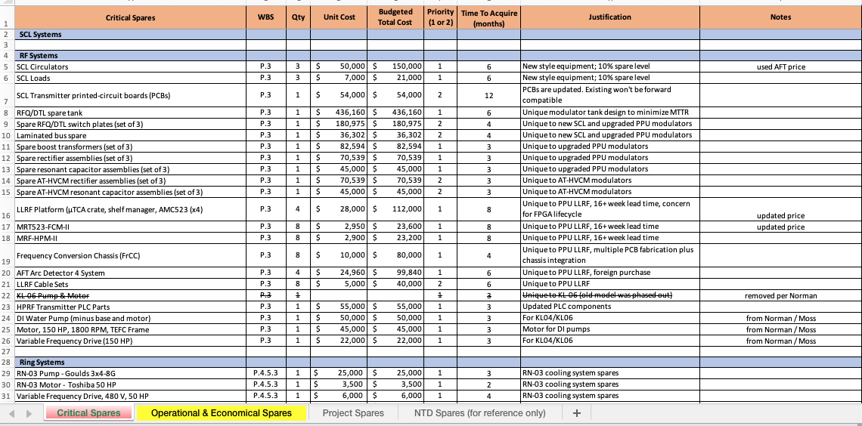
PPU has a contingency spend list
Lists contingency spend choices
  Input from across the directorate
  Includes acquisition time, justification, priority
  ~ $44M identified (beyond project spares)
  “Living” list
See “Contingency spend plan spreadsheet” on review website under project documents

Slide 12
Contingency spending opportunities
Retrofit the existing Linac with the PPU low-level RF control system
  Improved performance and obsolescence mitigation
  >$2M
Purchase the critical spares listed on the contingency spend plan spreadsheet
  Highest priority spares that support completion of PPU commissioning and early operations
  $2.2M
Additional items, including:
  PPU operational/economical spares totaling $10.2M
  NTD requests totaling $8.5M
  NSD requests totaling $1.8M
  RAD requests totaling $19M
The above-listed items total ~$44M

Slide 13
Summary
Matrixed approach for PPU within NScD is working well
  Survived ORNL re-organization unscathed
Project progress reported to ORNL management regularly
  Communicate more regularly with new NScD Director
Regular communications within the IPT
PPU has a well defined contingency spend process

