Slide 1




Cost and Schedule
DOE/SC Independent Project Review of the Proton Power Upgrade Project
Wayne Steffey
NScD Project Management Group Leader
September 14-17, 2021

Slide 2
Cost and Schedule – Charge Questions
4a) Are the cost, schedule and performance metrics being properly collected and reported?
4b) Are major cost and schedule assumptions, resource constraints and project risks, as well as COVID-19 uncertainties being adequately addressed? K
B8-3 Greenwood

Slide 3
Outline
Project Controls Background
Summary Changes since CD 2/3
Project Status
Earned Value Management
  Performance Status Collection
  Distribution / Communication
  Change Control
Prior Recommendations
Summary

Slide 4
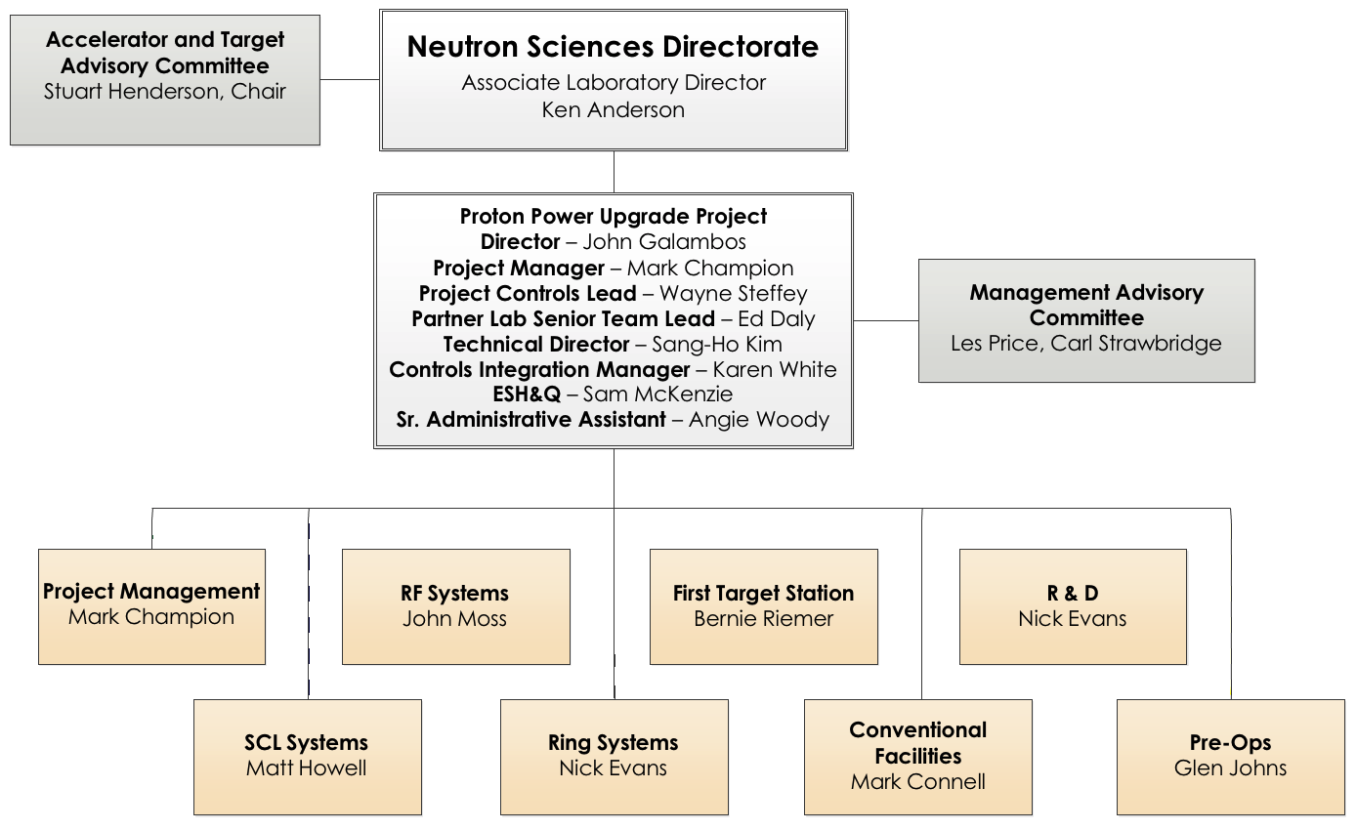
PPU Project Organization
Project Management Office (PMO)
Group Leader for NScD Project Management

Slide 5
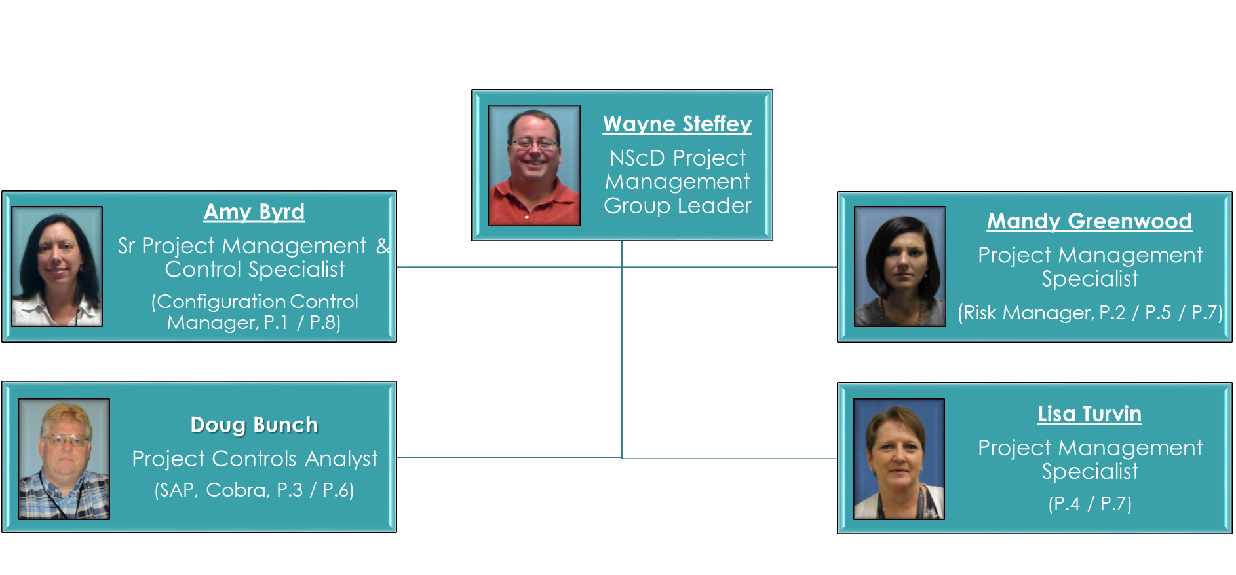



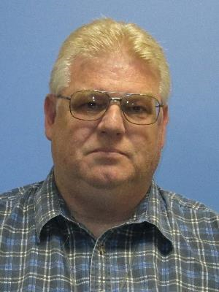

Skilled Project Controls Team
PPU has 4 Project Controls Analysts (PCAs) dedicated to the PPU project
PCAs are assigned to specific WBS L2 systems and serve as the point of contact between the technical team and the project controls office

Slide 6
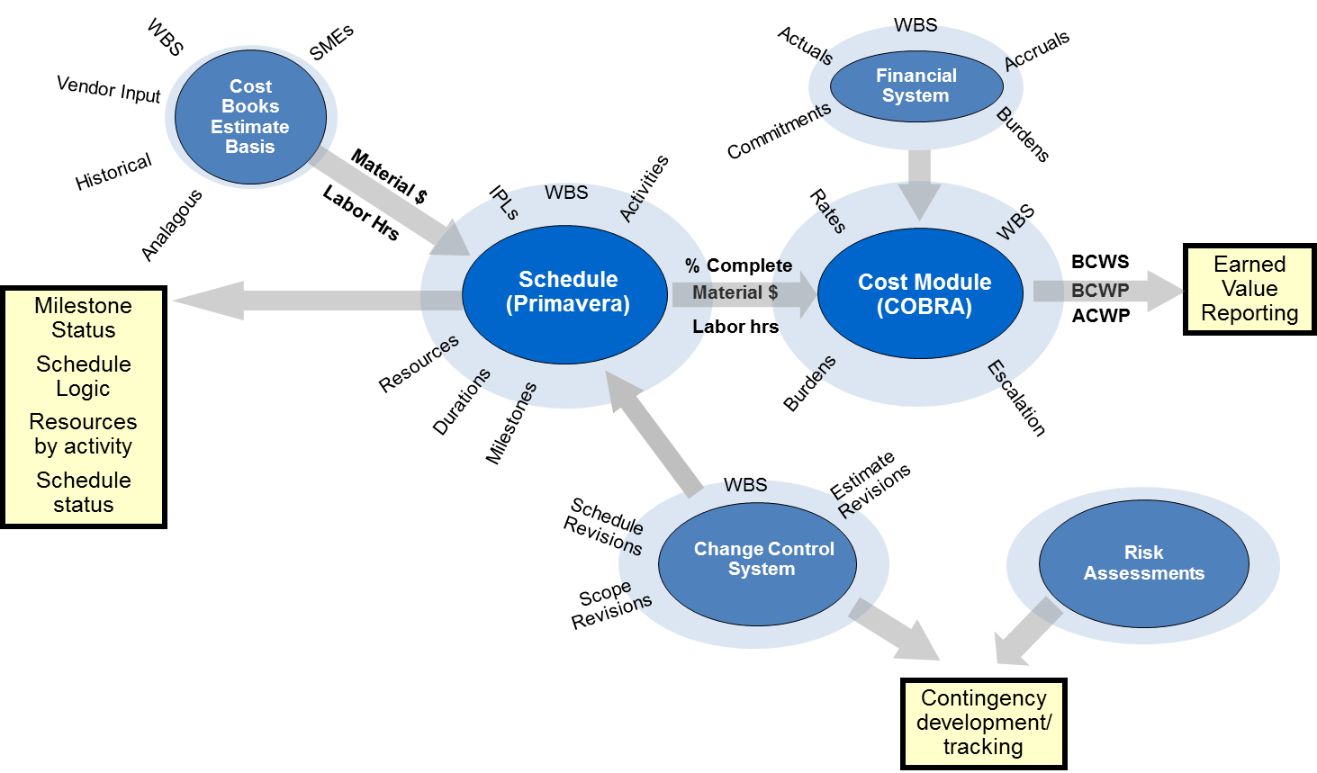
Project Control Systems
SAP
CEDB
PARS II
Acumen Risk

Slide 7
Work Breakdown Structure encompasses all work scope
P
PPU
P.1
Project Management
P.2
SCL Systems
P.3
RF Systems
P.7
R&D
P.8
PreOps
P.2.1
Management and System Integration
P.2.2
Cavities
P.2.2.1
Mngt & Sys Int
P.2.2.2
Cavity Procurement
P.2.2.2.4
Installation
P.2.2.2.2
Design
P.2.2.2.3
Procure/Fab
P.9
Pre-CD1
P.4
Ring Systems
P.5
Target Systems
P.6
CF Systems
P.1 – P.6, P.10 = TEC
P.7 – P.9 = OPC
P.10
LLPs
Generally symmetric structure
  Level 2: Major System
  Level 3: Subsystems
  Level 4: Components
  Level 5: Phase
    .01= Management & Integration
    .02= Design
    .03= Procure/Fab
    .04= Installation
Control Accounts

Slide 8
WBS Dictionary defines the total project scope

Slide 9
Project Schedule is well constructed
Logically tied, Resource loaded
Earliest possible finish that
  Ensures outage-depended activities are completed in an operational or maintenance outage
    Aligns with the current operating schedule of outages
    Assumes one long outage beginning in early FY23 (8.5 months)
  Constructs the RTBT stub during the long outage, concurrent with installation of ring components and 3 cryomodules
Assumes funding and resources are available, as needed by the project (no constraints)
Schedule quality meets industry standards/metrics (Acumen Fuse)

Slide 10
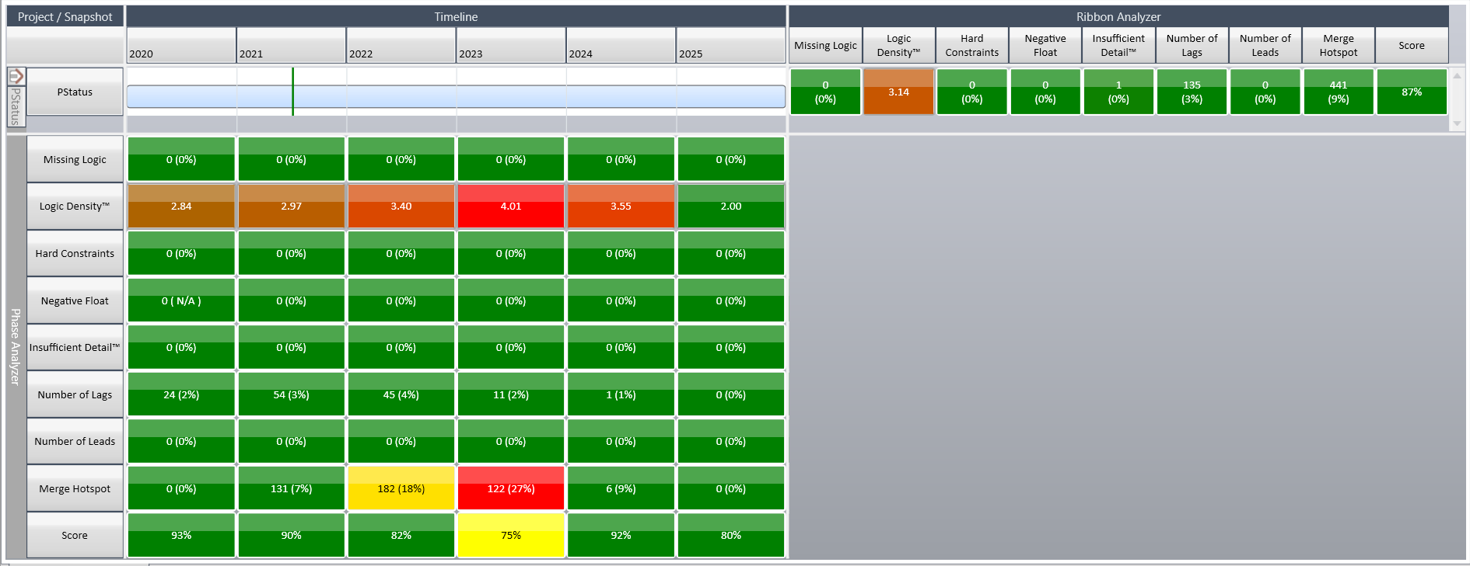
Schedule Quality is good per Acumen Fuse report

Slide 11
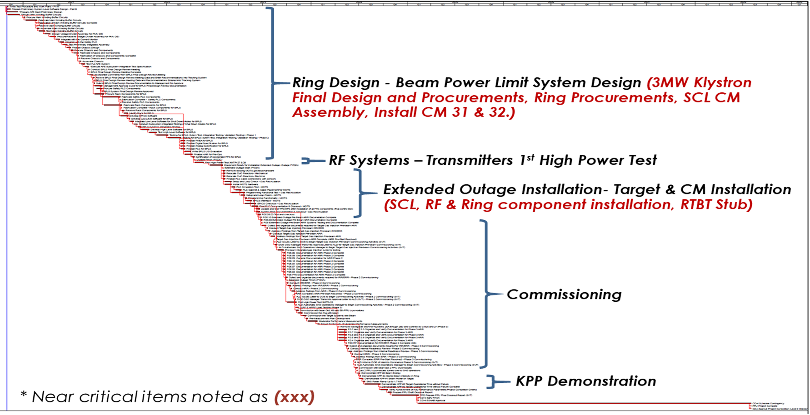
Critical Path (Near Critical: <10 weeks float)

Slide 12
Progress since CD 2/3 has been good

Slide 13
Project Change Requests exist for all schedule and estimate changes since CD 2/3

Slide 14
Project Performance to date is very good

Slide 15
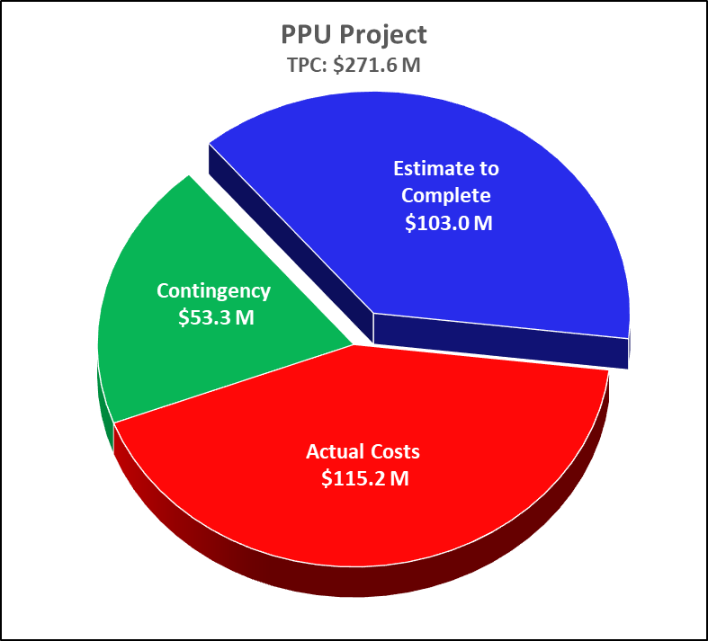
Summary Project Performance

Slide 16
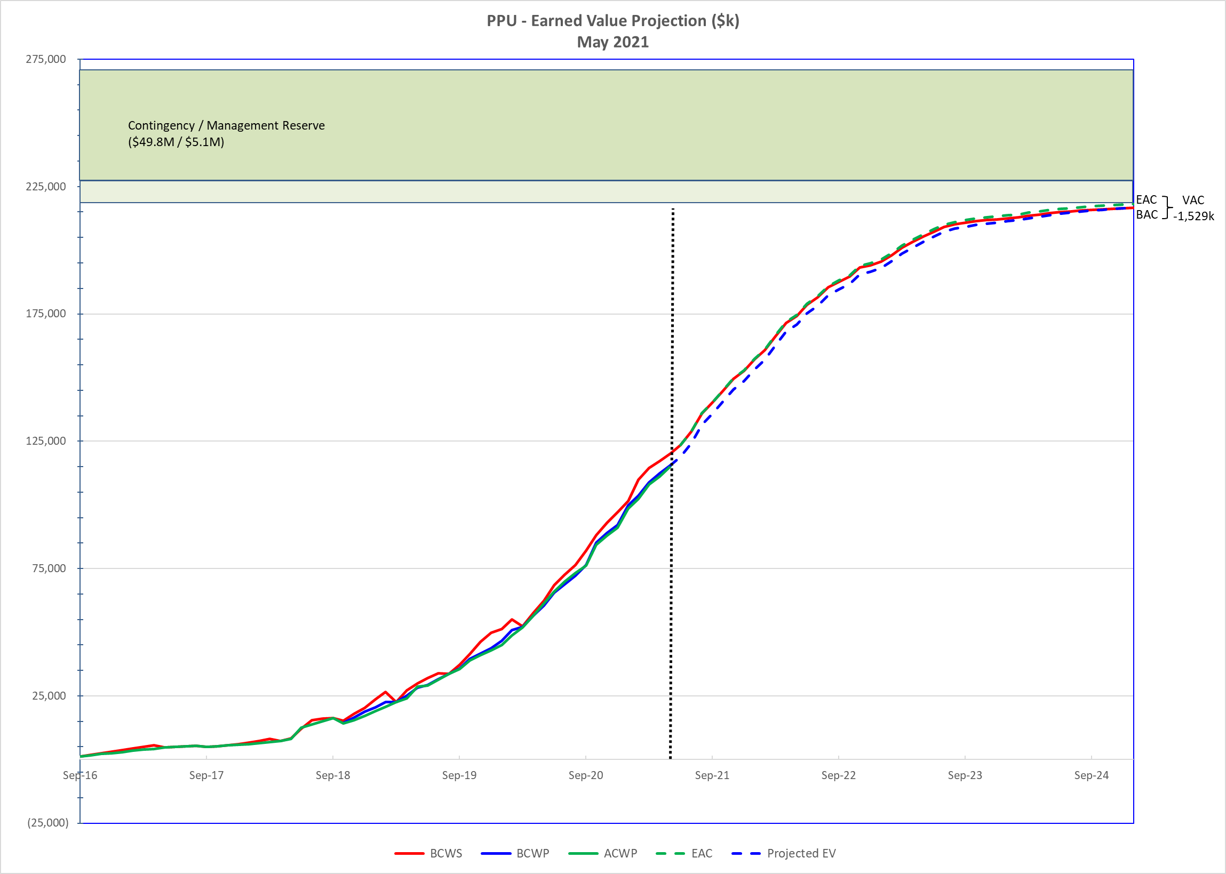
Life Cycle - Performance Projection

Slide 17
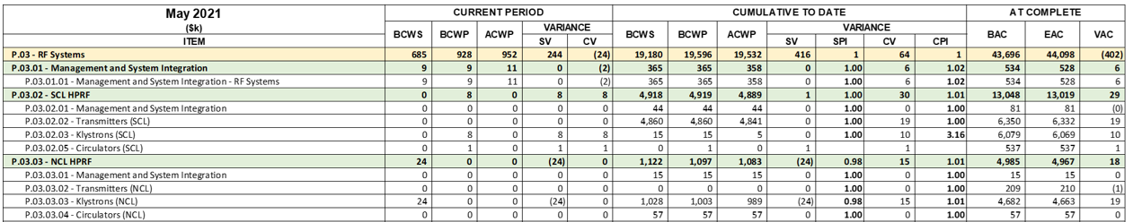
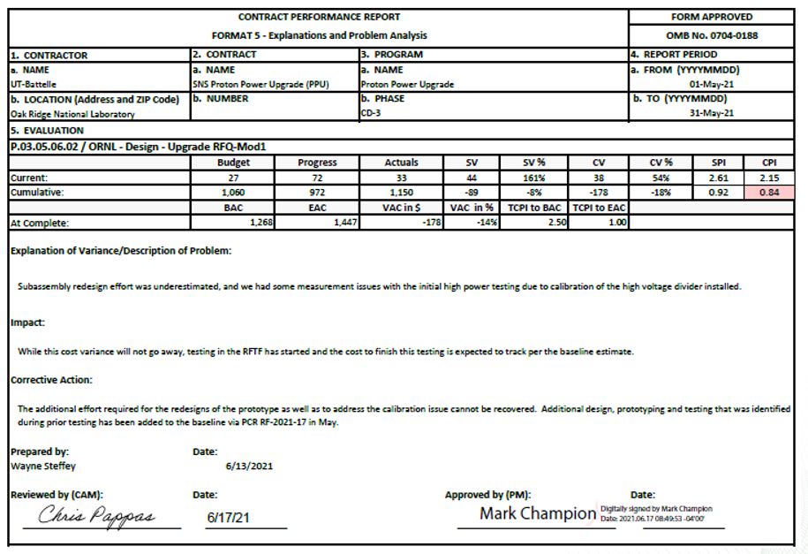
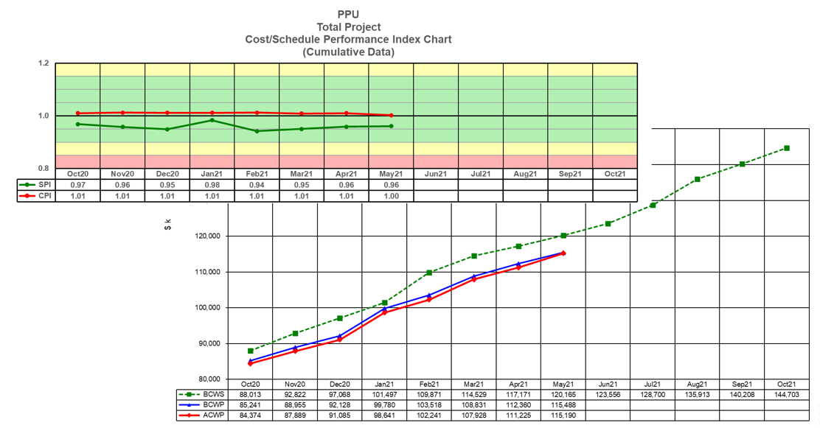
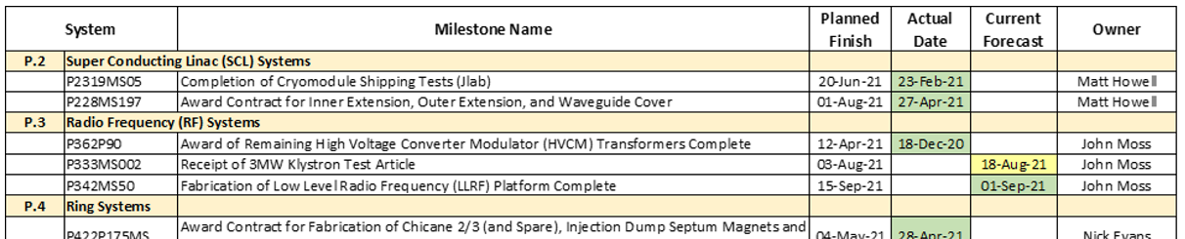
PPU EV Reports are generated monthly

Slide 18
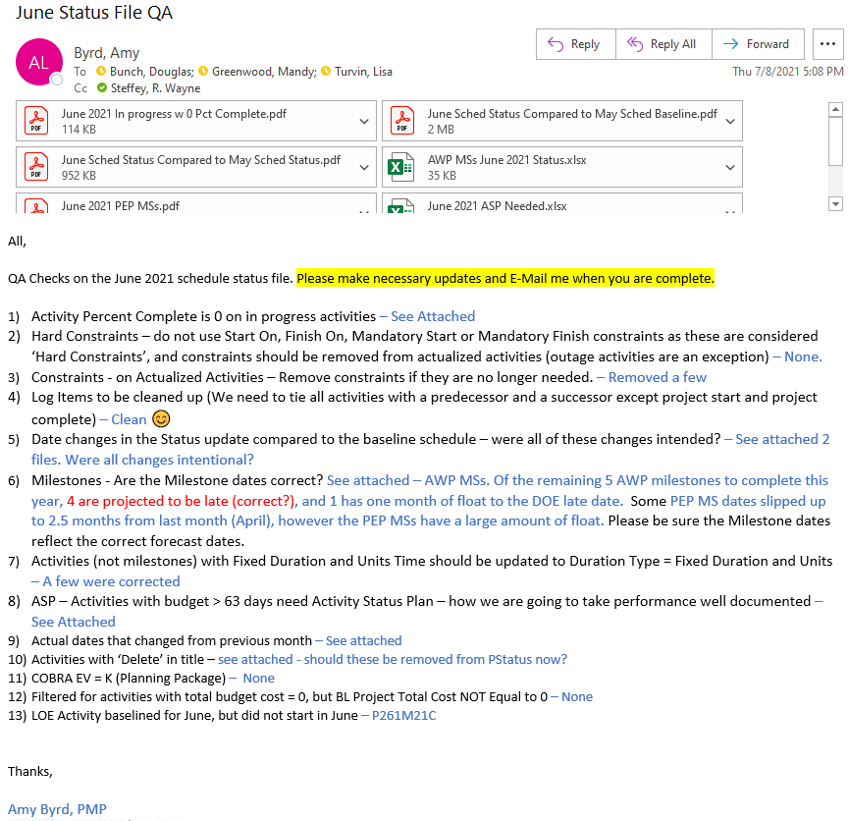
Monthly Project Control Routine
Schedule status updated by PCAs and Technical Teams
Receive schedule status and costs from JLab
EAC items collected and incorporated
Input is QA checked and report distributed to PCAs
PCRs incorporated into Cobra
Performance data generated by Cobra
Charts are developed and packaged

Slide 19
Monthly Reporting Calendar

Slide 20
Performance Metrics Distribution
Metrics package assembled and distributed for technical team input
  Variance Analysis reporting
  Changes to current risk status
  Documenting of new emerging risks
  Issues needing attention
  Key activities for next 90 days
Monthly metrics meetings conducted with CAMs, L2 Managers, Project Management team and the Federal Project Director

Slide 21
Communication of Project Performance

Slide 22
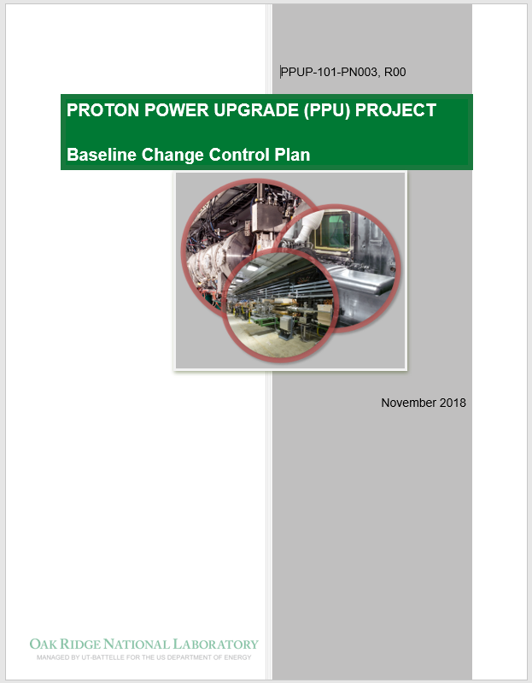
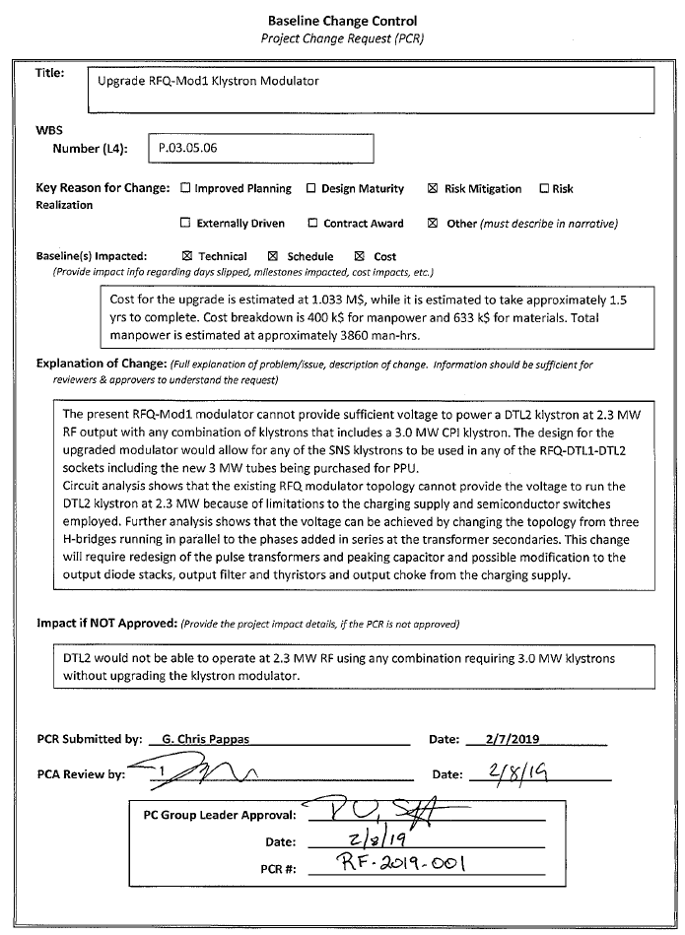
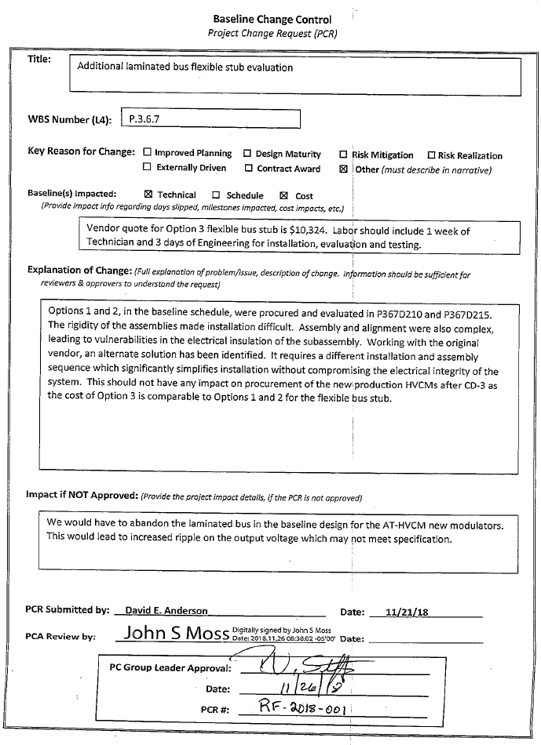
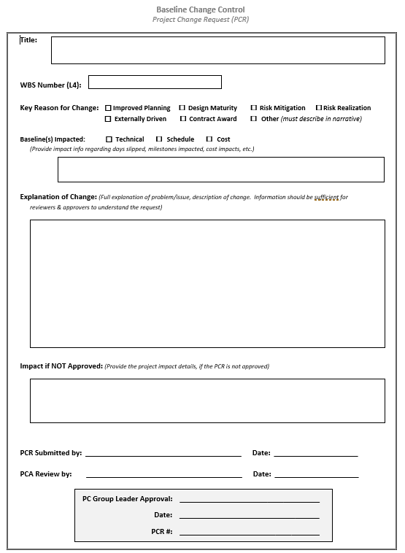
Change control
A Change Control process has been used on the PPU project since 2018
Change control guidance is provided in the PPU Baseline Change Control Plan (BCCP)
Upon approval of the PPU Baseline, a formalized change control process was implemented
Project Change Requests (PCRs) have been processed and approved per the BCCP guidance
Detailed documentation is processed with each PCR providing before/after data for analysis
Freeze period rules are followed which prevents PCRs from modifying performance data in the current two months, except for specific exceptions documented in the Project Controls Manual

Slide 23
Responses to recommendations
None received from CD 2/3 IPR
No outstanding recommendations from other DOE reviews

Slide 24
Summary
  Project Control systems and processes are fully established
  Monthly performance data is accurately captured, reviewed and processed
  Project has demonstrated the ability for monthly EV metrics reporting over the past several years
  Project performance information is being distributed to the project stake-holders in a routine and timely manner

