Slide 1
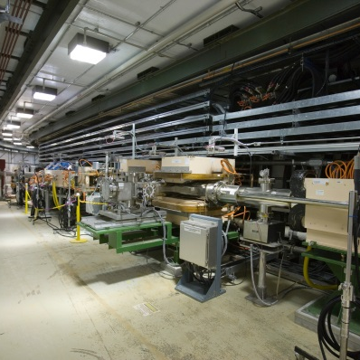
Procurement
DOE/SC Independent Project Review of the Proton Power Upgrade Project
Markus Camfield
Procurement Manager
September 14-17, 2021

Slide 2
Procurement Staffing
Current Staff
Markus Camfield, Procurement Manager
Barbara Shaw, Procurement Officer
Stacey Johnson, Procurement Officer
Liz Lynch, Procurement Officer
Additional support is provided by other procurement groups in the ORNL Contracts Division for lower $ value commercial purchases, construction subcontracts, and partner lab agreements.

Slide 3
Procurement Strategy and Delivery Methods
PPU Procurement staff follow ORNL Procurement Operating Practices (copy on Indico site) that are approved by DOE and in accordance with UT-Battelle Prime Contract.
Various procurement strategies and delivery methods are available to be utilized consisting of:
Subcontract/Purchase Order* - Fixed Price*
Basic Ordering Agreement - Time and Materials
Task Order - Cost-Reimbursement
Standardized Items/Bulk Purchase - Incremental Funding*
Subcontract/PO with Options*
*primary types
Fixed price agreements place the responsibility to perform within the stated price on the subcontractor and have been used at every opportunity.

Slide 4
Procurement Strategy and Delivery Methods
Most competitive procurements use a Best Value approach with evaluation criteria and an evaluation team to score offers.
Typical Evaluation Criteria includes
Offeror’s understanding of the Technical Requirements (often request manufacturing plan and schedule)
Offeror’s Relevant Experience
Offeror’s Quality Assurance Program
For early project procurements, the procurement process started prior to ESAAB approval in order to be ready for award when approval was received.

Slide 5
Procurement Tracking
86% of procurements (>$150k) have been awarded as planned in the baseline schedule.
Phase | Late | On-Time | Total
CD-1 | 1 | 9 | 10
CD-3 | 5 | 10 | 15
CD-3a |  | 1 | 1
CD-3b |  | 16 | 16
Grand Total | 6 | 36 | 42
Notes:
Again, are these prime or burdened dollar figures?
For Jefferson Lab, is this just the CD-3B figure for procurement of cryomodule parts?
Where is Research Instruments, the cavity provider?

Slide 6
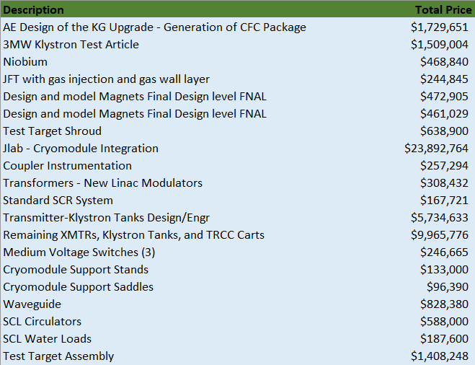
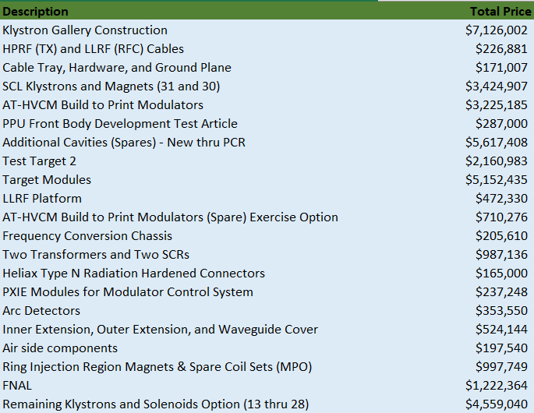
Procurement Status
Total funded value for all PPU project procurements to date = $106M
includes partnership agreements, Marketplace orders, construction, small dollar PO’s placed by the Rapid Purchasing Group, and PO’s placed by PPU Procurement
(42) procurements awarded (>$150K) for a total funded value of = $87M / 86%
Note: all costs shown are unburdened.

Slide 7
Procurement Status
Total Number of Procurements >$150K Awarded to date = $87M (86%)
Top 10 by dollar value:
Jefferson Lab -$23.8M
L3 Applied Technologies $15.7M
CPI - $10M
Metalex- $9.6M
FM Sylvan Inc. $7.1M
Research Instruments $5.6M
Alpha Omega- $3.9M
Fermi Lab - $3.1M
Cannon Design - $1.7M
10.Dynapower - $1.4M
Note: all costs shown are unburdened.
Notes:
Again, are these prime or burdened dollar figures?
For Jefferson Lab, is this just the CD-3B figure for procurement of cryomodule parts?
Where is Research Instruments, the cavity provider?

Slide 8
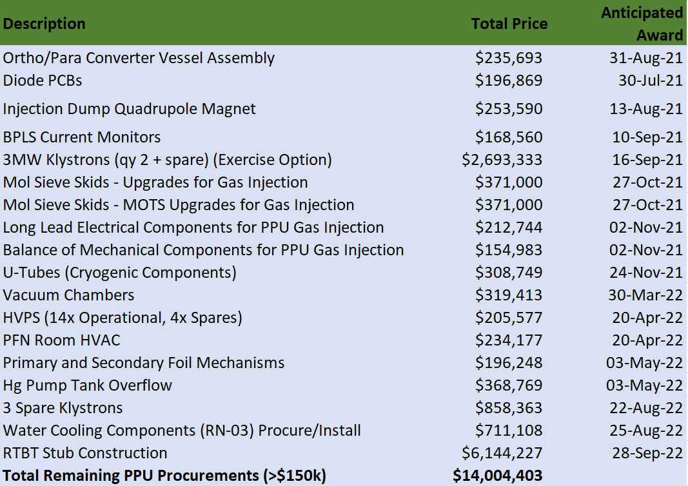
(18) Remaining major PPU Procurements (>$150K) = $14M / 14%
Note: all costs shown are unburdened.

Slide 9
Response to COVID-19
ORNL immediately identified the on-site subcontractors whose work was deemed essential to remain on-site. Non-essential subcontractors continue to work remotely.
Procurement staff have effectively worked from home.
Subject matter experts from other laboratories assisted with: superconducting cavities at Research Instruments, high voltage converter modulators at Alpha-Omega, and fast current transformers at Bergoz.
Each subcontract is being handled on an individual basis and Company response is being worked through Procurement Compliance and ORNL Office of General Counsel if needed.
No major vendor delays due to COVID.

Slide 10
Summary
PPU Procurement Group is appropriately staffed to complete the remaining procurements.
Procurement Procedures and Approved Purchasing System in Place.
Procurements have progressed well and 86% ($87M) of procurements (>$150k) have been awarded.
86% of procurements (>$150k) have been awarded as planned in the baseline schedule.
Procurement staff will continue working with the PPU technical staff to prioritize procurements upon completion of Procurement Readiness Reviews

