Slide 1




P.1 Project Management & Installation Plans
DOE/SC Independent Project Review of the Proton Power Upgrade Project
Mark Champion
Project Manager
Level 2 Manager for P.1 Project Management
September 14–17, 2021

Slide 2
Outline
P.1 Project Management
  Scope
  Organization
  Cost
  Risk register
Installation status and plans
Summary

Slide 3
Scope of P.1 PPU Project Management
Charge: 5
Project management
  Management
  Project reviews
Project support
  Project controls
  Finance
  Procurement
  Human resources
  Communications
  Systems engineering
  Technical director
  Installation coordination
ESH&Q
  Environment, safety, and health
  Quality assurance
See the WBS Dictionary for descriptions
  Available under Project Controls tab of the Indico site

Slide 4
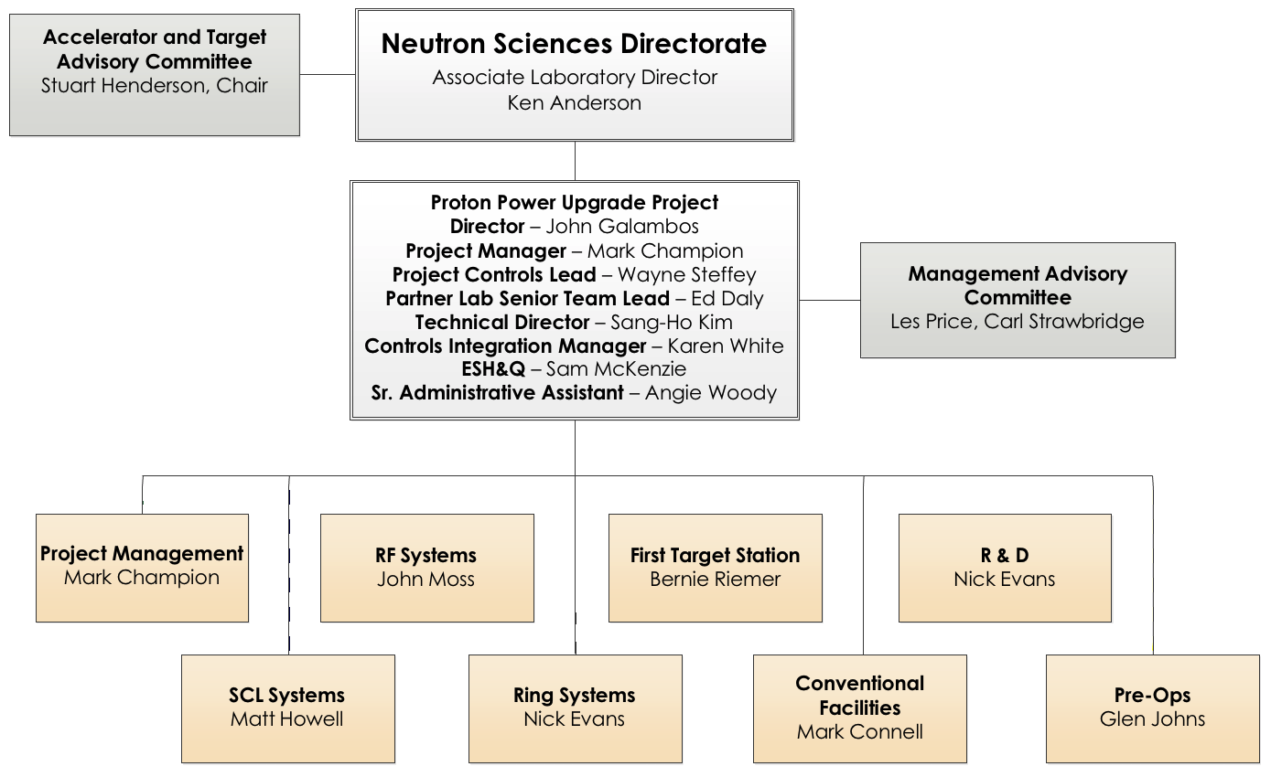
PPU Project Organization
Charge: 5
Talented, experienced team
Many team members participated in the SNS construction project and have extensive operations experience
P.1 team members

Slide 5
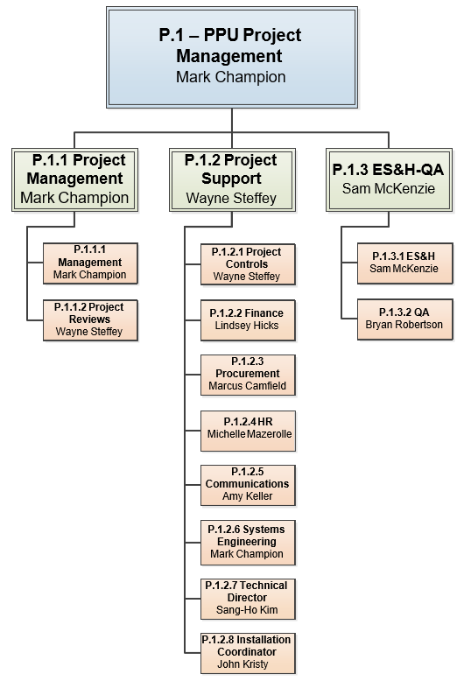
P.1 Project Management
Organization
Charge: 5
Talented team has many years of experience at SNS
Supported SNS during construction and operations

Slide 6
P.1 Progress since CD-2/3
Charge: 4
Project management advanced to 40% complete by cost (was 19% at CD 2/3)
BAC changed very little since CD 2/3 baseline (0.4% increase)
Good performance metrics

Slide 7
Project management costs are 10% of project
Estimate at Completion
Charge: 4
~80% of cost is in these three elements

Slide 8
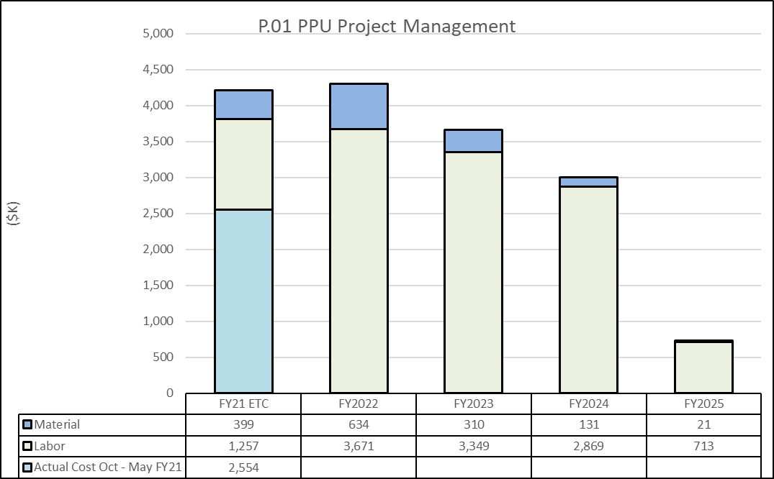
P.1 Cost estimate by fiscal year
Charge: 4
Dominated by labor costs

Slide 9
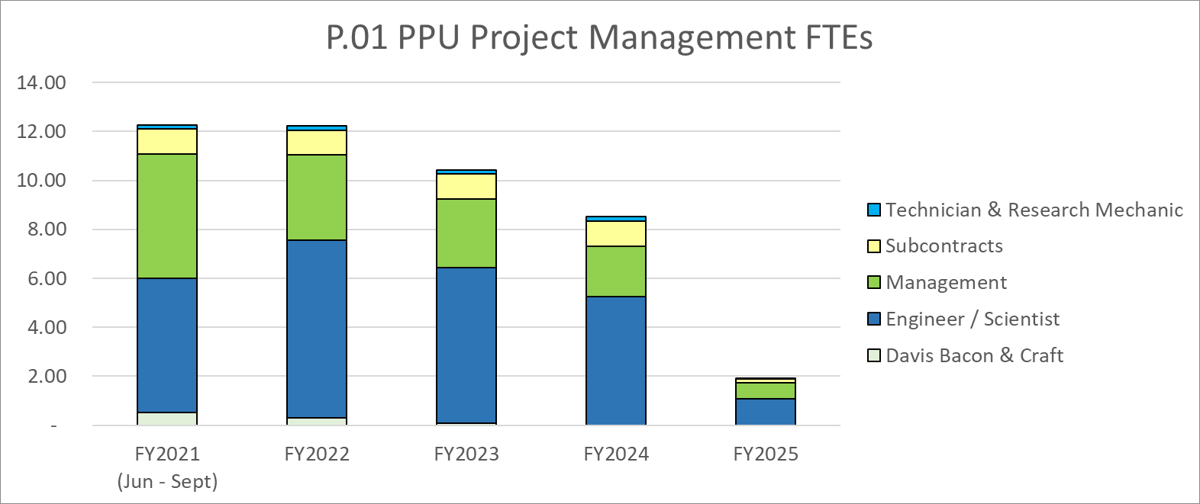
P.1 Labor profile by fiscal year
Charge: 4
Labor peaks in FY21-22 and then begins to taper off

Slide 10
P.1 Risks are identified and tracked
Twelve risks
  Pre-Mitigated Ranking: 1 Low, 9 Medium, 2 High
  Post-Mitigated Ranking: 1 Low, 10 Medium, 1 High
High risk items
  COVID-19 Impacts Project Cost or Schedule
    Mitigation: Frequent vendor communication, use of alternate vendors if needed, vendor oversight by local experts, vaccinations, masking, social distancing, and work-from-home

Slide 11
P.1 Risks are identified and understood
Risk ID | L3 WBS | Risk Title | Expiration Date | Mitigation | Pre- Mitigation Rank | Post Mitigation Rank
T-P.1-030 | P.01 | COVID-19 Impacts Project Cost or Schedule | 2/12/2025 | Frequent vendor communication, use of alternate vendors if needed, vendor oversight by local experts, vaccinations, masking, social distancing, and work-from-home. | 20 | 20
T-P.1-004 | P.01 | Difficulty in finding/retaining staff (does not apply to Davis-Bacon or UT-B craft) | 10/1/2025 | Monitor staffing plans vs actual staffing; start the recruiting of professional staff at least 4 months before needed hire data; start the recruiting of technician staff at least 1 month in advance. Utilize contractors and ORNL staff from other directorates when necessary. Establishment of BOA for staff augmentation. | 16 | 12
T-P.1-007 | P.01 | SNS operating schedule changes delays project by 6 months | 10/1/2025 | Ensure a member of the PPU team is on the NScD scheduling committee to represent the PPU needs. Communicate PPU requirements well and often throughout the directorate. Ensure PPU priorities are NScD priorities. | 12 | 12
T-P.1-018 | P.01 | Critical SNS component failure delays PPU by at least 12 months or delays KPP demonstration | 10/1/2025 | Maintain good communication between PPU, SNS Operations, and NScD management team. Conduct periodic Vulnerability Workshops to assess vulnerabilites within the SNS neutron production systems. (recent workshop conducted March 11, 2021). PPU personnel participate in these workshops. Include identified mitigations in the SNS operations plans, including annual budget allocations. | 10 | 10
T-P.1-028 | P.01 | Standing Army Cost for Schedule Contingency | 7/31/2028 | PPU management will monitor progress and will seek to minimize early-finish delays. | 10 | 10
T-P.1-016 | P.01 | Operations tasks required for PPU not complete when required | 10/1/2025 | Maintain good communication with RAD and NTD to minimize risk. | 12 | 9
*
*
*
*
*
*
*Included on project list of top ten risks

Slide 12
P.1 Risks are identified and understood Continued
Risk ID | L3 WBS | Risk Title | Expiration Date | Mitigation | Pre- Mitigation Rank | Post Mitigation Rank
T-P.1-015 | P.01 | Actual funding profile received by project does not match profile used for planning | 10/1/2025 | Maintain good communication with BES to make sure PPU funding needs are clearly understood. Promptly respond to requests for information from BES and congress regarding project funding needs. Ensure field work proposals and project data sheets are completed promptly and reflect project funding needs. | 8 | 8
T-P.1-020 | P.01 | Equipment experiences infant mortality resulting in not meeting KPP | 10/1/2025 | Develop and maintain critical spares list for PPU and include in the project baseline. | 10 | 8
T-P.1-006 | P.01 | Safety incident occurs on project | 10/1/2025 | ESH oversight during all installation activities; JHA process implemented; daily 'tool box' meetings and constant reinforcement of safety principles and basics. | 9 | 6
T-P.1-022 | P.01 | Emergent operational event requires matrixed staff | 10/1/2025 | Succession planning results in broadening of work force during the project | 12 | 6
T-P.1-029 | P.01 | Craft Resource Availability During Installations | 3/31/2024 | Plan ahead to ensure needed personnel are available when needed. Engage with NScD Chief Operating Officer if needed to bring in additional craft from ORNL Facilities & Operations. Utilize subcontract craft personnel when feasible (GEM Tech or similar). | 9 | 6
T-P.1-021 | P.01 | Outage dependant task causes or reveals damage to a system | 10/1/2025 | Safety and technical training; SNS supervision of external labor; Monitoring of system condition in advance of outage. | 3 | 2

Slide 13
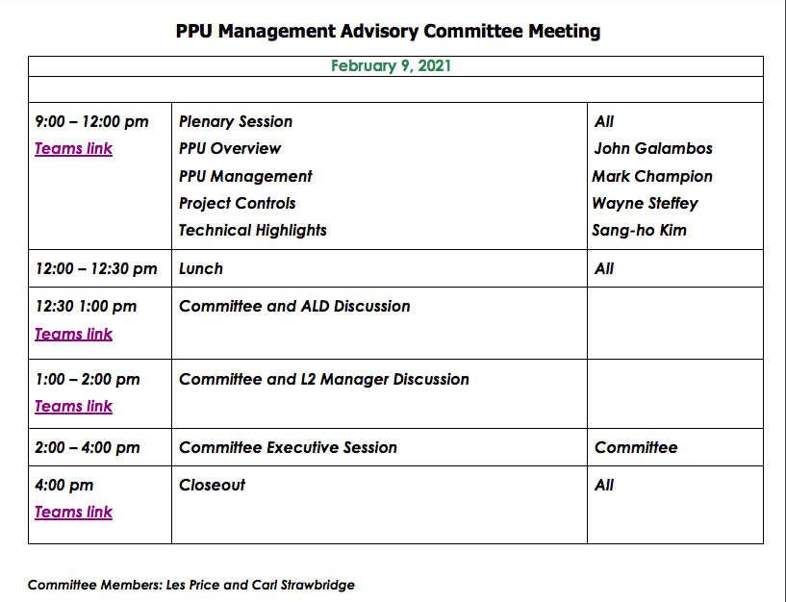
Project management advisory committee meeting was conducted in February 2021
Charge: 5
Management Committee: Les Price and Carl Strawbridge
Four presentations as shown
on agenda
Good discussions – key topic
was contingency spending as
risks are retired
  Contingency spend plan and
  spreadsheet developed as result
  of this meeting
Nine recommendations have
all been addressed and closed

Slide 14
Installation Scope
Installation refers to the installation of technical systems and components within each Level 2 WBS area
  Superconducting Linac
  RF Systems
  Ring Systems
  First Target Station Systems
Conventional Facilities scope is not included
Outage-dependent installation is planned during scheduled maintenance outages, including the PPU long outage
  For example, installation of cryomodules in the accelerator tunnel
Non-outage-dependent installation will occur during operations
  For example, installation of 28 new RF stations in the klystron gallery

Slide 15
Installation Fundamentals
Each Level 2 team is responsible for its installation planning
Technical oversight and technical equipment costs are included in the Level 2 work plans
Maintenance outages are managed and coordinated by Research Accelerator Division Integration and Planning Group
  Work is planned and scheduled using Primavera P6
  Work is executed in accordance with ORNL/NScD ES&H requirements
Labor for installation work is provided by:
  Time & materials (T&M) contractor
  SNS Research Mechanics*
  SNS Technicians
  ORNL Facilities and Operations craft workers*
PPU Installation Coordinator manages the T&M contract
*bargaining unit employees

Slide 16
Time & materials contractor is well known to SNS
GEM Technologies of Knoxville
NScD has a T&M contract with GEM
GEM provides craft labor and supervision and has performed many jobs across the SNS site
  Familiarity with the SNS site and ESH&Q expectations
  Presently supporting PPU installation and neutron instrument construction/upgrades
GEM presently has ~17.5 FTEs working on PPU installation
This arrangement conveniently provides for workforce augmentation, as needed, for installation of PPU equipment

Slide 17
Installation Management resides in P.1 Project Management
Charge: 5
John Kristy is the Installation Coordinator
  Many years of experience in this capacity at SNS and the Advanced Photon Source at Argonne National Laboratory
  Manages the GEM time and materials contract
Rod Thomas is the Building Information Modeling (BIM) Coordinator
  Supported the klystron gallery construction
  Has transitioned to installation support

Slide 18
Installation coordination responsibilities are documented in the WBS dictionary
Includes:
Installation coordinator - to manage installation efforts across all systems
Building Information Modeling coordinator – installation support and verification
Management of the service request orders (SROs) with the T&M contractor
Allocation of craft across several concurrent SROs (in coordination with contractor superintendent)
Level of Effort support craft (e.g., laborers, carpenters)
Management of all the material assets required for installation (e.g., tools, forklifts, consumables)
General tools and equipment rental that cannot be associated with subprojects (project wide)
Equipment transportation on site
Does not include:
Effort for technical oversight of the installation tasks
Costs for the technical components being installed

Slide 19
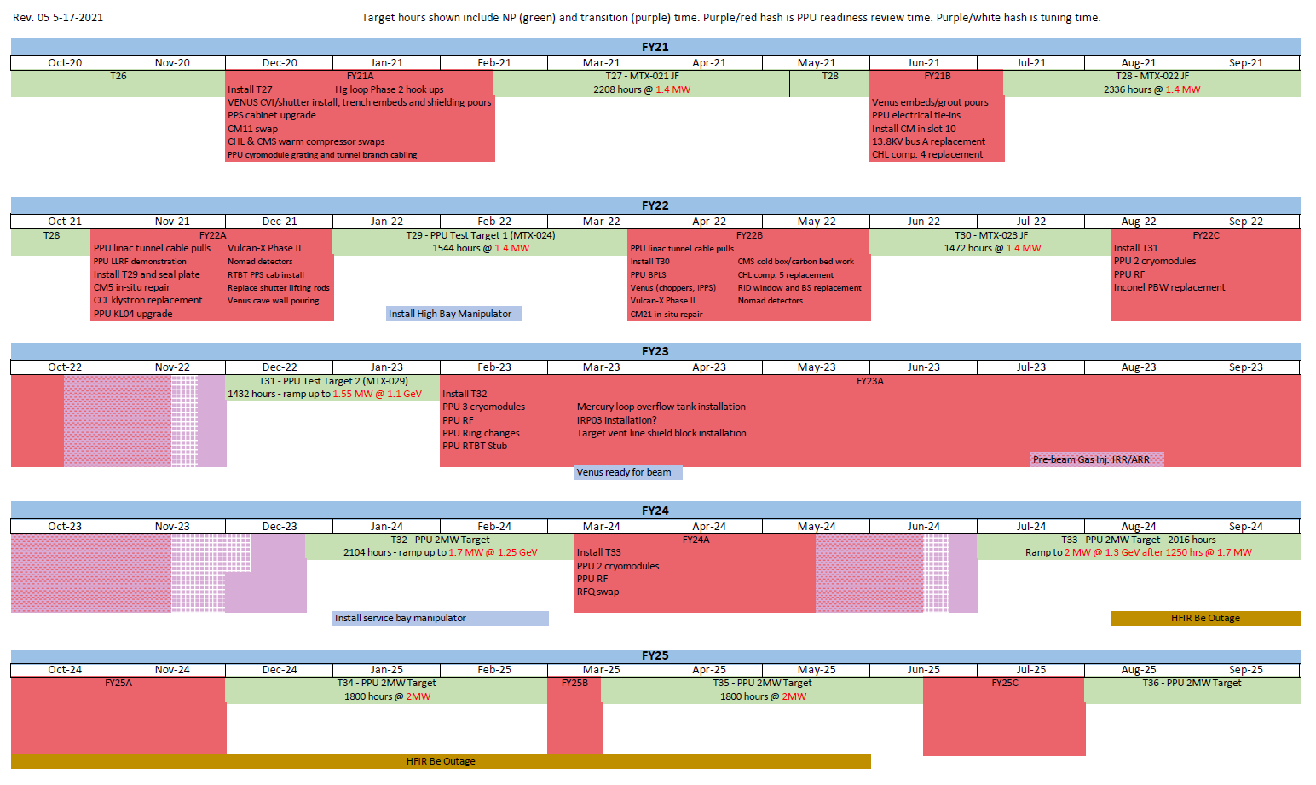
Installation plans mesh with five-year operations plan
Charge: 5
Complete
Complete
External Readiness Review
FTS high gas flow equipment
Accelerator Readiness Review
External Readiness Review
KPP Demonstration
PPU Early Finish

Slide 20
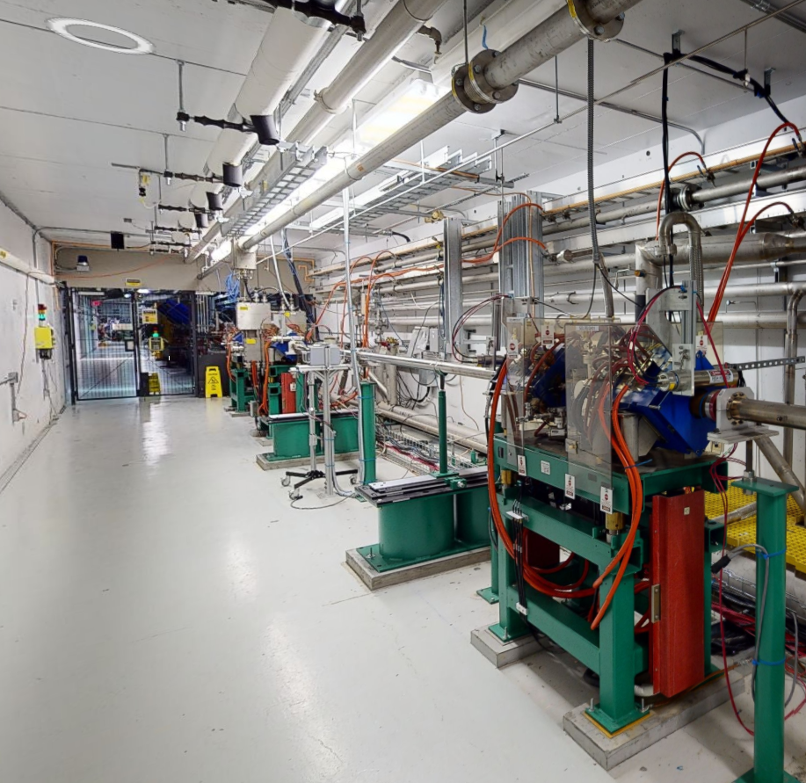
Superconducting Linac cryomodule stands and cable tray installation is complete
Charge: 1
Work performed by T&M contractor during maintenance outage
Location for first PPU cryomodule at end of Linac tunnel

Slide 21
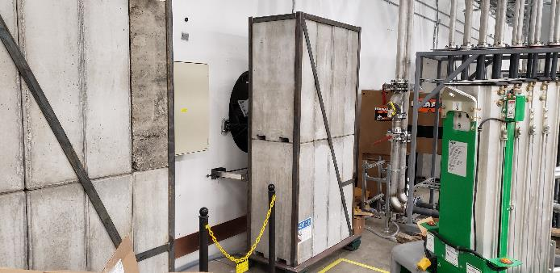
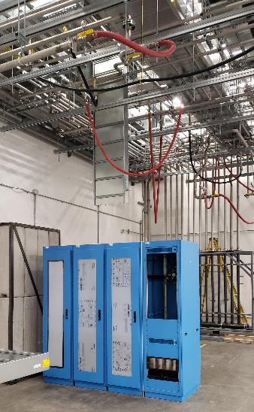
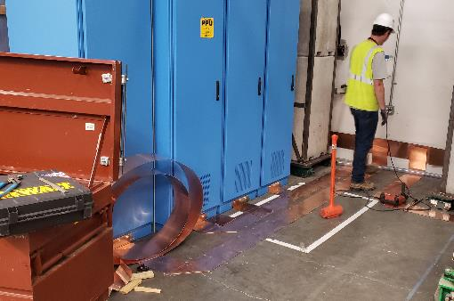
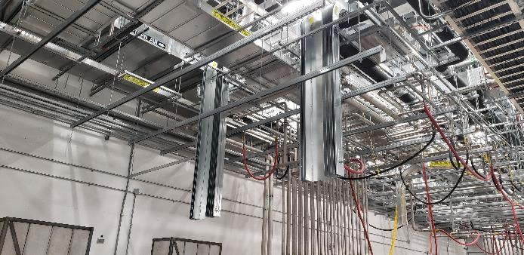
RF Systems installation being performed by T&M contractor
Charge: 1
B3-2 Moss
Waveguide chase shield blocks mounted on rollers for quick reconfiguration to support installation over multiple outages
Installation of ground plane to equipment racks
Installation of cable tray drops to equipment racks

Slide 22
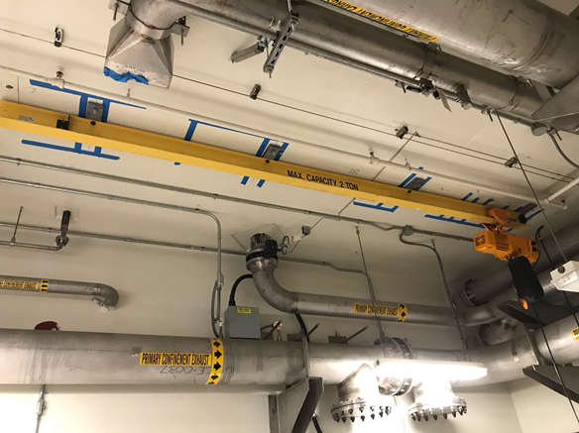
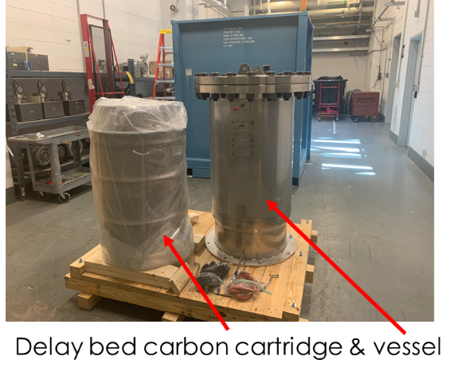
FTS Mercury Off-gas Treatment System (MOTS) installation progress
Charge: 1
Mercury Off-gas Treatment System delay bed vessel and shielding installation completed in July
Gold amalgamation room (GAR) overhead crane was installed previously (needed for delay bed installation)
GAR piping modifications for PPU delay bed completed and inspected
Performed by SNS research mechanics and Facilities & Operations craft workers
GAR overhead crane
B2-8 Stephens

Slide 23
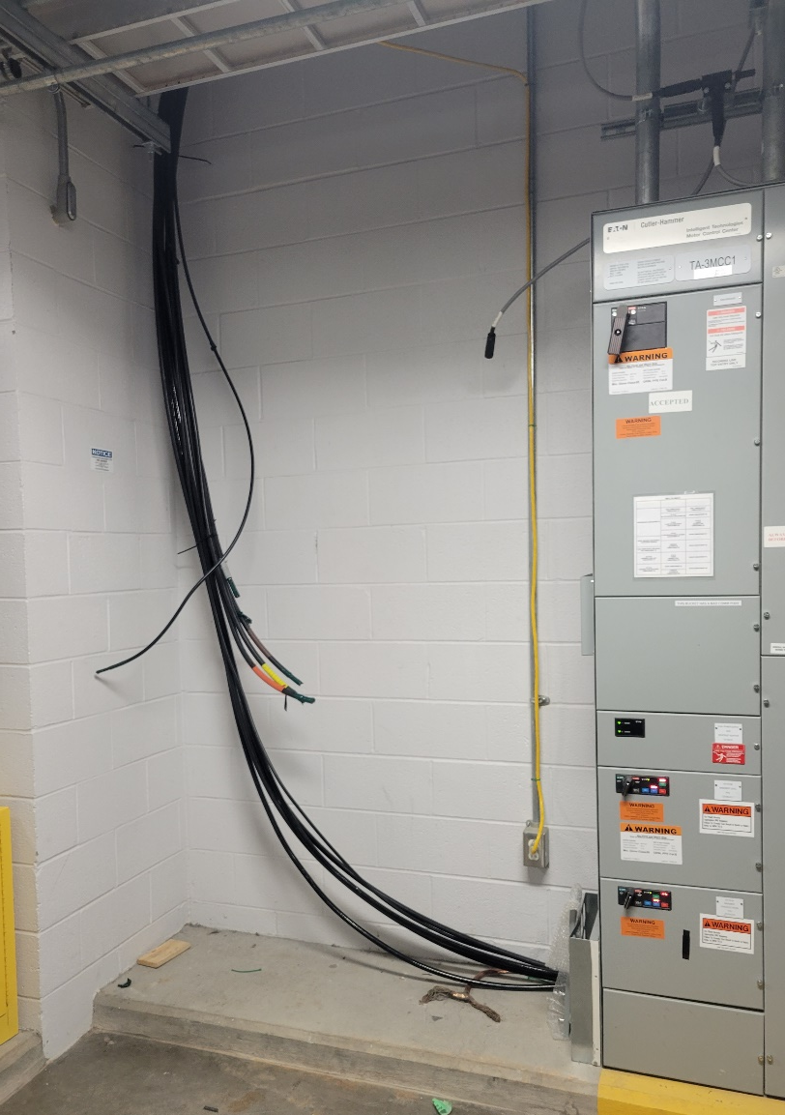
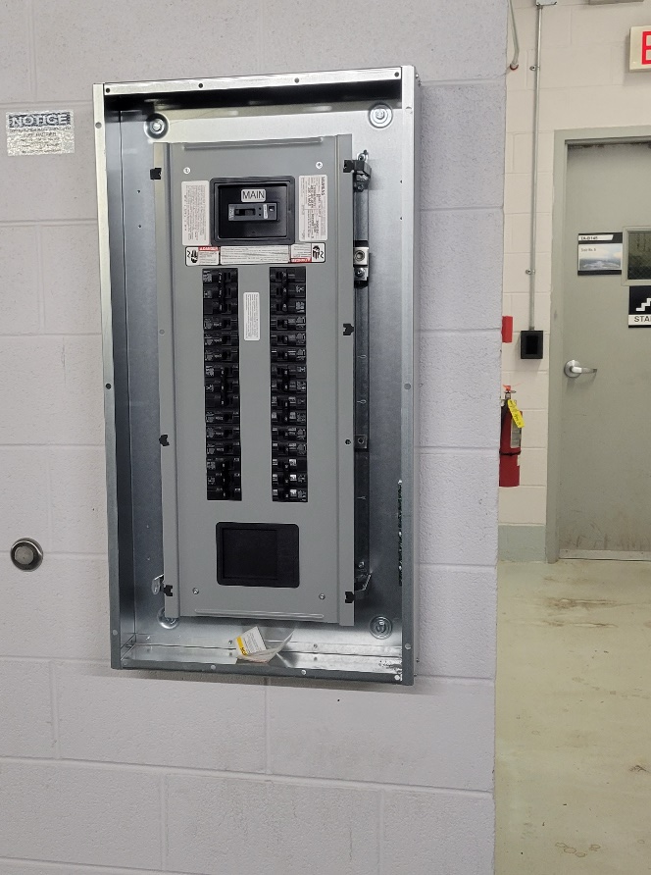
FTS Electrical upgrade installation underway
Charge: 1
New electrical cables from floor above
Basement Electrical Upgrade
  Procurement started April 2021
  Installation began June 2021
    Building 8700 power outage to allow for electrical tie into transformer occurred June 2021
  Installation expected to be complete August 2021
Performed by T&M contractor
New electrical panel in 8700 Basement
B2-7 Ahlschwede

Slide 24
Summary
The project management team is fully staffed and successfully executing project responsibilities
Management systems and processes are in place
Cost and schedule metrics are good
  Need to maintain cost and schedule performance without sacrificing safety or quality
Risks and action items are tracked and updated appropriately
  No open action items for P.1 Project Management
The project is baselined, and construction is underway
Installation of technical equipment is underway
Thank you for your attention. Questions?

Slide 25
Extra Material

Slide 26
Systems engineering
Engineering design is nearly complete (98%) and follows the NScD engineering process (next slide)
Matrixed staff key to success
  PPU engineering staff owns the existing systems and will own the PPU systems
  Experienced team understands the accelerator and target systems through years of operations/maintenance/upgrades experience and applies this knowledge to PPU design
  In many cases, we are adding to existing systems and utilizing the same or similar technologies
Technical oversight from the project manager, technical director, and project director
Design reviews, procurement readiness reviews facilitated by the project office

Slide 27
Project Execution – Engineering
Guided by NScD engineering process – NScD-ENG-PR-001
  Assign responsibilities
  Define the requirements and interfaces
  Develop a solution that efficiently meets the requirements and is sustainable, safe, and environmentally benign
    Abide by application codes and regulations
    ORNL: Standards Based Management System (SBMS)
    Incorporate value engineering, best practices, SNS corporate knowledge and lessons learned
  Utilize the peer-review process
  Maintain configuration control
    In collaboration with Research Accelerator and Neutron Technologies divisions
  Own the work, from inception through operations/maintenance
  Communicate
All work is executed within the existing
framework of SNS procedures and policies

Slide 28
Project resides in a mature organization
‒ SNS has been operating since 2006
PPU project team is largely matrixed from operations divisions
  Research Accelerator Division
  Neutron Technologies Division
Project team has extensive operations experience and owns the technical systems being upgraded
PPU utilizes existing procedures, policies, and business systems
  Engineering process
  Configuration control
  Document control
  Procurement, finance, human resources
  Environment, Safety, Health and Quality Assurance
Provides for efficient project execution

Slide 29
NScD Engineering Program Manager
For the future, the NScD Engineering Program Manager position was created and filled in June 2021
  Provides leadership to drive continual improvement of NScD asset management and conduct of engineering
  Engineering program
    Configuration management
    Policies, procedures and tools
    Design change
    Engineering documentation
    Design authority for SNS
  Asset Management
    Workflow
    Stores and kitting
    Work control
    High value spares

Slide 30
The PPU project is being managed to deliver a high-quality upgrade while ensuring employee safety
ORNL Integrated Safety Management System applies to all work at SNS
Construction/Installation contractors abide by the Chestnut Ridge Facilities ES&H plan
  With daily oversight from Jim Goodpasture, SNS ES&H, Luke Santee, construction field representative, John Kristy, installation coordinator
SNS staff work according to established procedures and utilize the SNS work control system; similar for Jefferson Lab staff
Project and line management emphasize safety and conduct walkthroughs
  Don’t sacrifice safety for schedule
SNS quality assurance staff is engaged throughout project
Good communication is key

Slide 31
Project Execution - Meetings
Weekly
Project management
  Project office, Level 2 managers, ESH&Q, Procurement, Finance
Project office
  Project director, project manager, technical director, project controls manager
Level 2 team meetings; project controls meetings; others as needed
Bi-weekly
Federal Project Director (FPD) status meeting
  Project office, FPD, Research Accelerator Division Director
L2 managers meet 1-on-2 with project director and project manager
Monthly
Metrics meeting
All-staff project meeting
Conference call with DOE Basic Energy Sciences, including Office of Project Assessment
Mid-month call with DOE Program Manager
Regular communication with division directors for Research Accelerator Division and Neutron Technologies Division

Slide 32
Project Execution - Meetings
As Needed
Risk register
Action tracking
Procurement readiness reviews
Change control board

Slide 33
Project Execution – Reviews
Preliminary and Final design reviews with external reviewers
Internal technical reviews
Procurement readiness reviews
Accelerator and Target Advisory Committee meetings
  November 2021, April 2019, May 2018
Review | Date Conducted | Date Approved | Notes
CD-1 | 5/17 | 4/18
CD-3A | 8/18 | 10/18
CD-3B | 6/19 | 9/19
Director’s Review | 6/20 | -- | Confirmed readiness for CD-2/3
CD-2/3 | 7/20 | 10/20
ICE/ICR | 7/20 | 10/20
Director’s Review | 8/21 | --
OPA Status Review | 9/21 |  | Sep. 14-17, 2021

