Slide 1




P.08 Transition to Operations
DOE/SC Independent Project Review of the Proton Power Upgrade Project
Glen D. Johns
Level 2 Manager for Pre-Ops
September 14 – 17, 2021

Slide 2
Outline
Charge: 5
Scope
Progress since CD-2/3
Phased approach
Phase 1, 2, and 3
12-month look-ahead
Summary

Slide 3
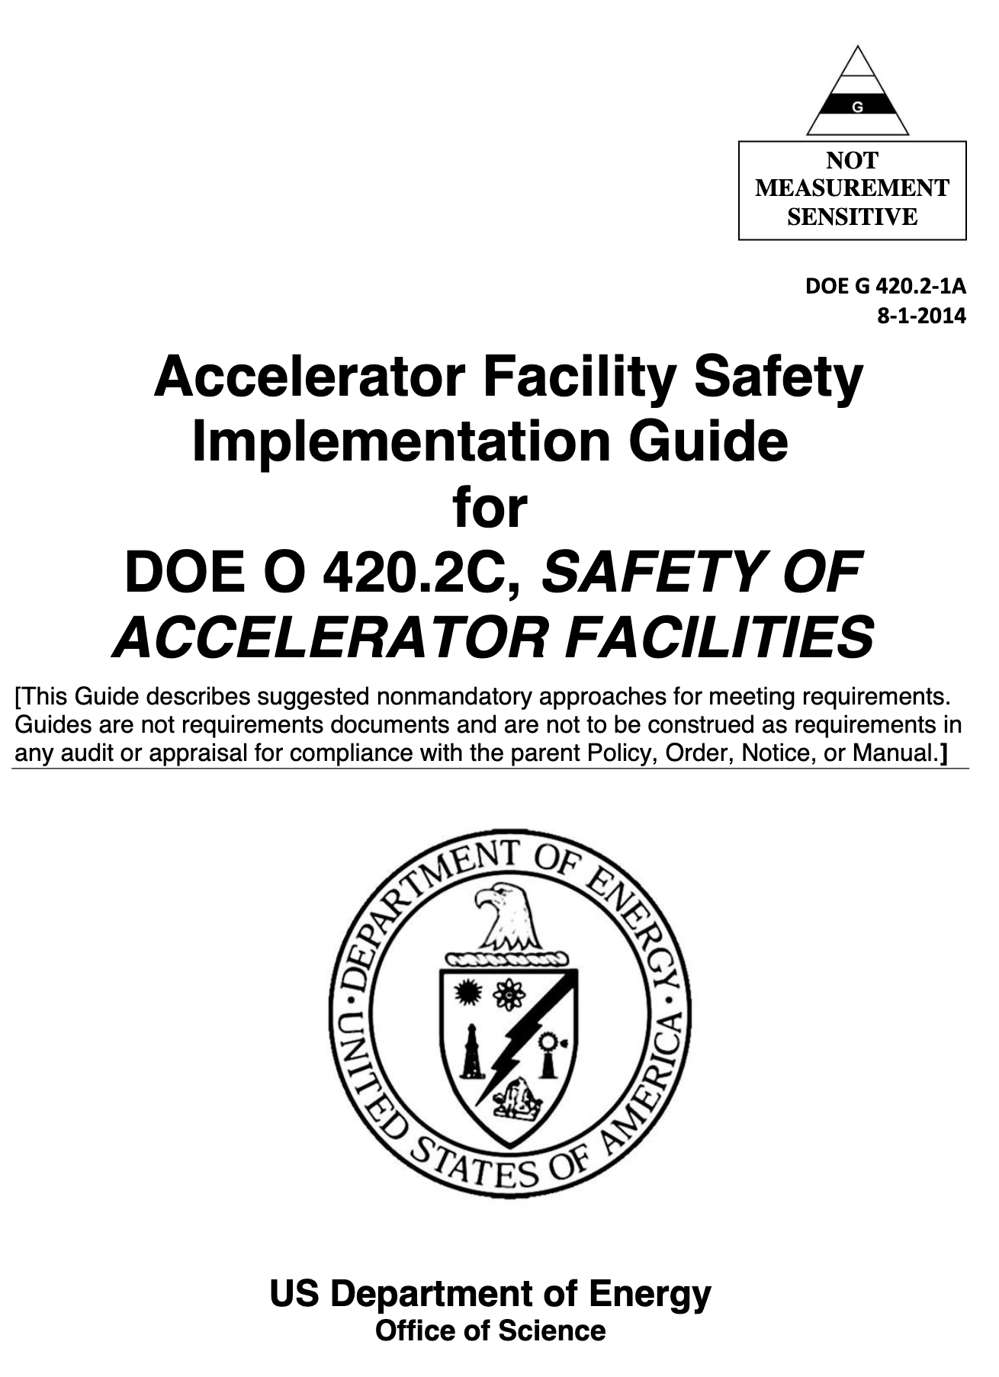
P. 8 Pre-ops scope is well-defined
Define process and identify the activities required to obtain approval from DOE for commissioning newly installed PPU equipment with beam
Defines plan for commissioning with beam
Assumes the following are ready to begin beam commissioning activities
  Hardware
  Documentation
  People
B8-9 Peters

Slide 4
CD-2/3 12-Month Look-Ahead (how have we done?)
Refine readiness review process in concert with local DOE personnel
  Updated readiness review durations and verified proper logic in schedule
  Explicitly added review and beam commissioning time to 5-year plan
Continue development of the Transition to Operations document in accordance with DOE Guide 413.3-16A, Project Completion/Closeout Guide
  Updated document to reflect new 5-year plan
Continue development of the beam commissioning plan
  Assigned beam commissioning leader
  Revised beam commissioning plan

Slide 5
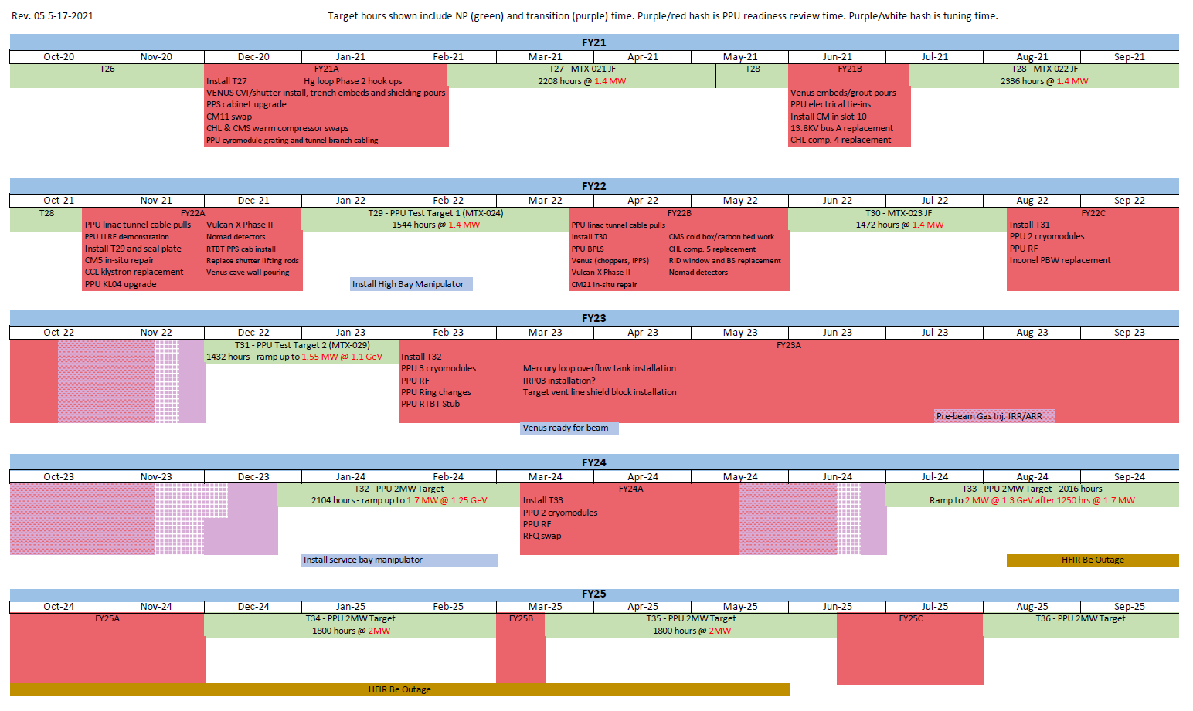
Revised 5-year plan aligns SNS ops and PPU schedules
Readiness review and tuning periods called out explicitly
Plan will be adjusted as progress evolves
Better handle on readiness review durations after FY22C
4 main outages related to the approval process
  FY22B
  FY22C
  FY23A
  FY24A
Outage 1
Outage 2
Outage 3
Outage 4

Slide 6
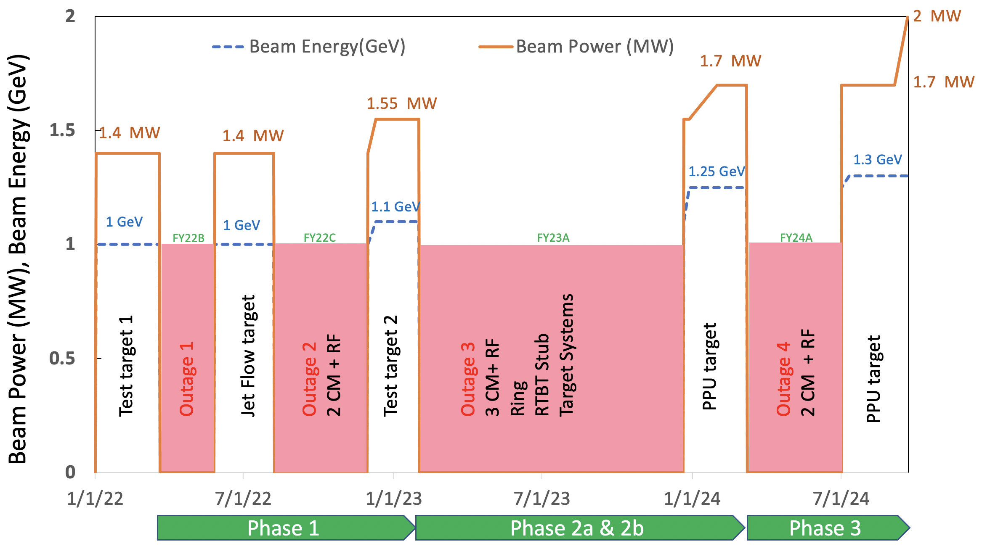
Three-phase approach to commissioning and operations approval

Slide 7
Initial steps to approval are common across the phases
Equipment installation and checkout
Hardware installed
Documentation
Procedures for operating and maintenance
Personnel ready
Qualification plans updated
Internal Readiness Review
Review conducted
Pre-starts corrected
Ready for External Readiness Review (ERR) or full Accelerator Readiness Review (ARR)
Training complete and documented
Component and subsystem testing complete
System readiness review complete
Integrated system test complete
Training materials ready
Control screens ready
Final approved drawings stored properly
Documented results of integrated system tests
Documentation showing compliance with Quality Assurance process
Design Reviews
Calculations
Acceptance tests
Specifications
Each WBS has time allocated for this
Detailed approval steps vary depending on the phase

Slide 8
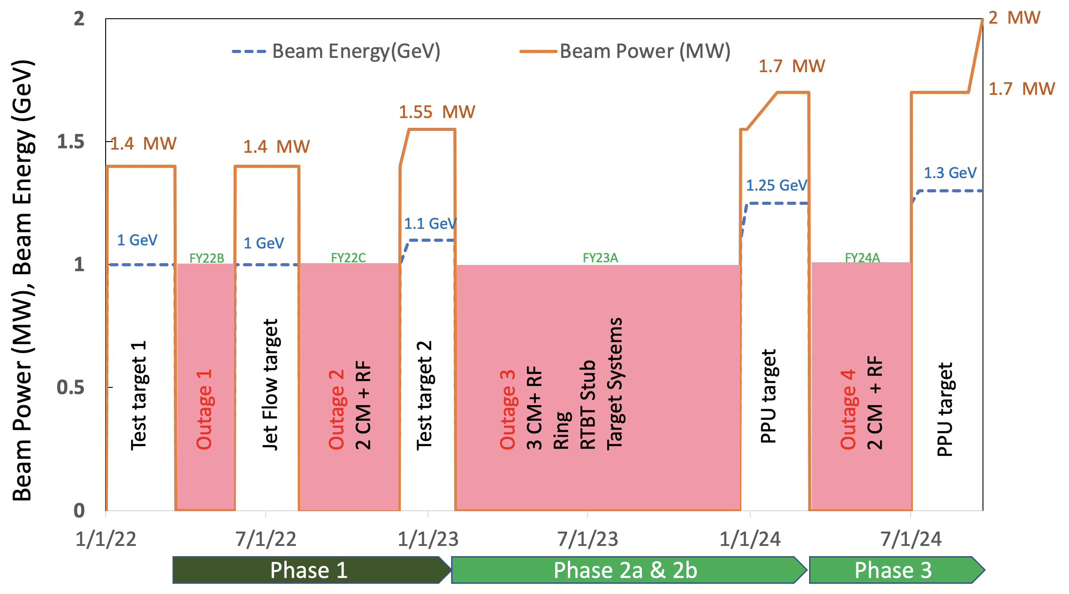
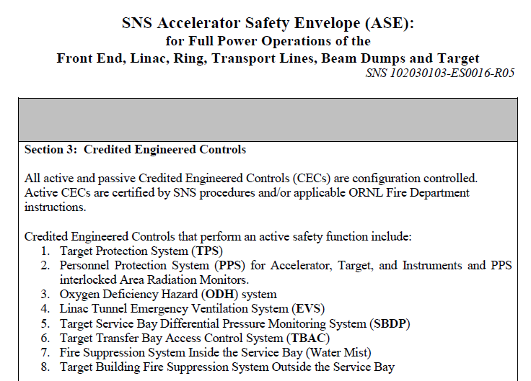
Phase 1 scope and assumptions
Scope
PPU Test Target 1 installed in FY22A
Beam Power Limiting System (BPLS) installed in FY22B outage
  Test and operate at 1 GeV and 1.4 MW as a non-credited control during the following run
Install first 2 cryomodules and all supporting systems including RF and PPU Test Target 2 during FY22C outage
Assumptions coming out of FY22C
BPLS testing successful
BPLS certification during FY22C
Approved Final Safety Assessment Document (FSAD)
in place
Draft Accelerator Safety Envelope (ASE) ready to
incorporate new credited control
Draft Operations Envelope (OE) ready

Slide 9
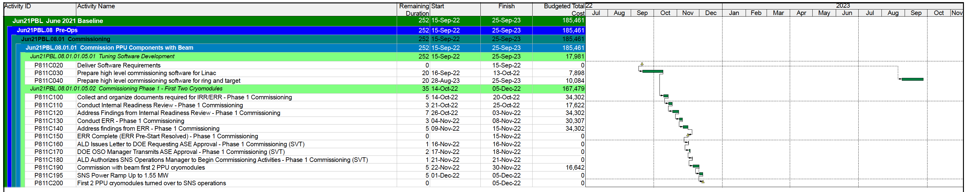
Phase 1 approval path
Collect documentation (5 days)
Conduct Internal Readiness Review (IRR) and resolve pre-start actions (10 days)
Conduct ERR and resolve pre-start actions (8 days)
Associate Laboratory Director (ALD) requests ASE approval and notifies of commissioning/ops (4 days)
  DOE transmits approved ASE
Commissioning with beam in accordance with commissioning plan begins (5 days)
Ramp up to 1.55 MW (5 days)
Continued operations at 1.1 GeV and 1.55 MW until next outage (FY23A)

Slide 10
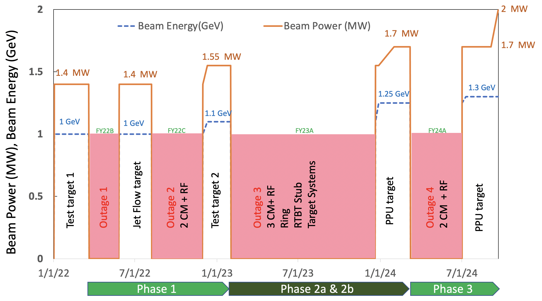
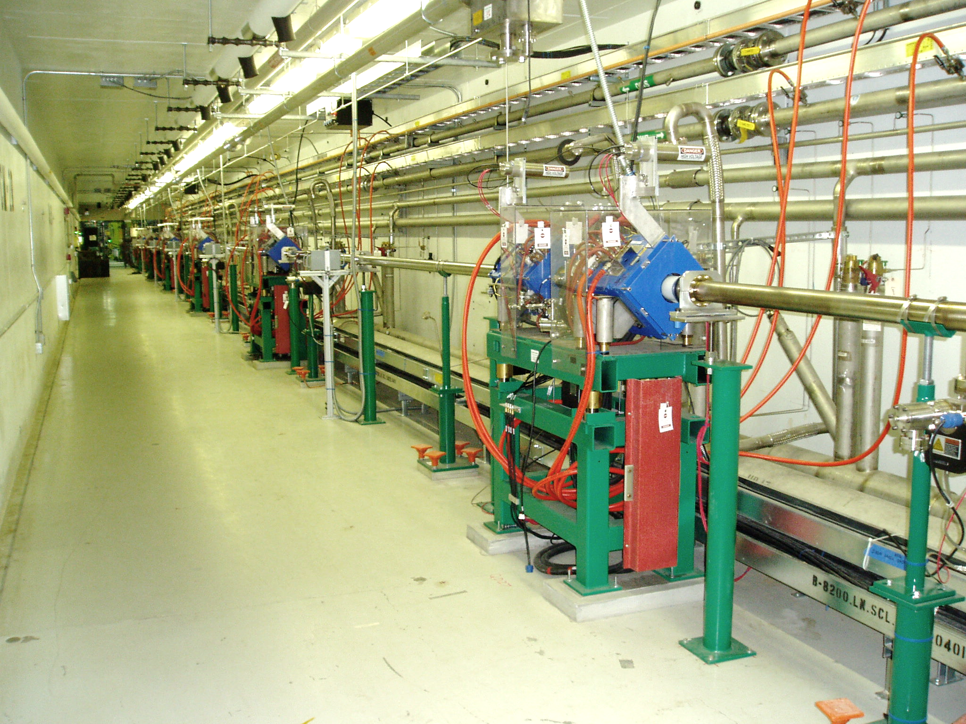
Phase 2 scope and assumptions
Scope (FY23A)
Install 3 cryomodules and all supporting systems including RF
Install Ring systems – injection, injection dump, extraction
Install Target systems – mercury pump, gas injection system, cryogenic moderator system
Modify Ring to Target Beam Transport (RTBT) – new stub-out
Install PPU Target 1
Assumptions
Gas injection hardware ready for commissioning during outage
Draft ASE ready to incorporate new gas injection controls
ASE approval received and no-beam gas injection commissioning successful during outage
Draft OE ready
Empty cryomodule slots

Slide 11
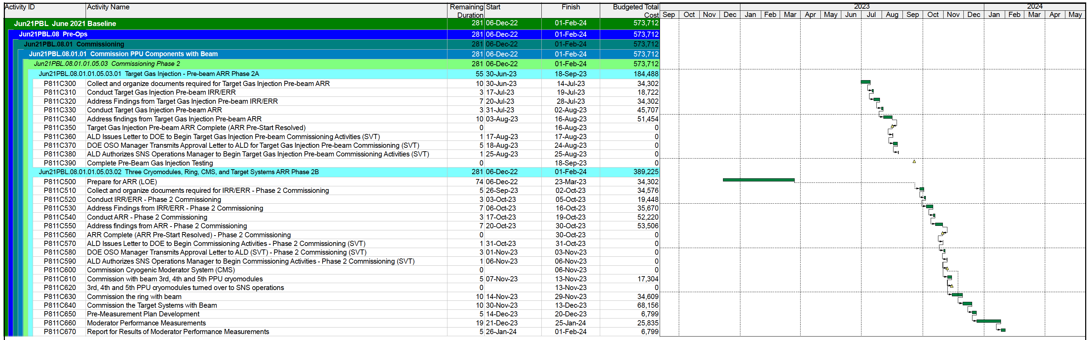
Phase 2a&b approval path
Part A – pre-beam gas injection (GI)
Collect documentation (10 days)
Conduct GI IRR and resolve pre-start actions (10 days)
Conduct Accelerator Readiness Review (ARR) and resolve pre-start actions (13 days)
ALD requests and receives ASE approval and permission to perform pre-beam gas injection commissioning from DOE (7days)
Perform pre-beam gas injection activities per approved procedure
Part B – remainder of scope
Collect documentation (5 days)
Conduct IRR for remaining scope and resolve pre-start actions (10 days)
Conduct Accelerator Readiness Review (ARR) and resolve pre-start actions (10 days)
ALD requests and receives approval for commissioning and operations from DOE (5 days)
Commissioning with beam in accordance with commissioning plan begins (25 days)
Operations at 1.25 GeV and 1.7 MW continues until next outage (FY24A)

Slide 12
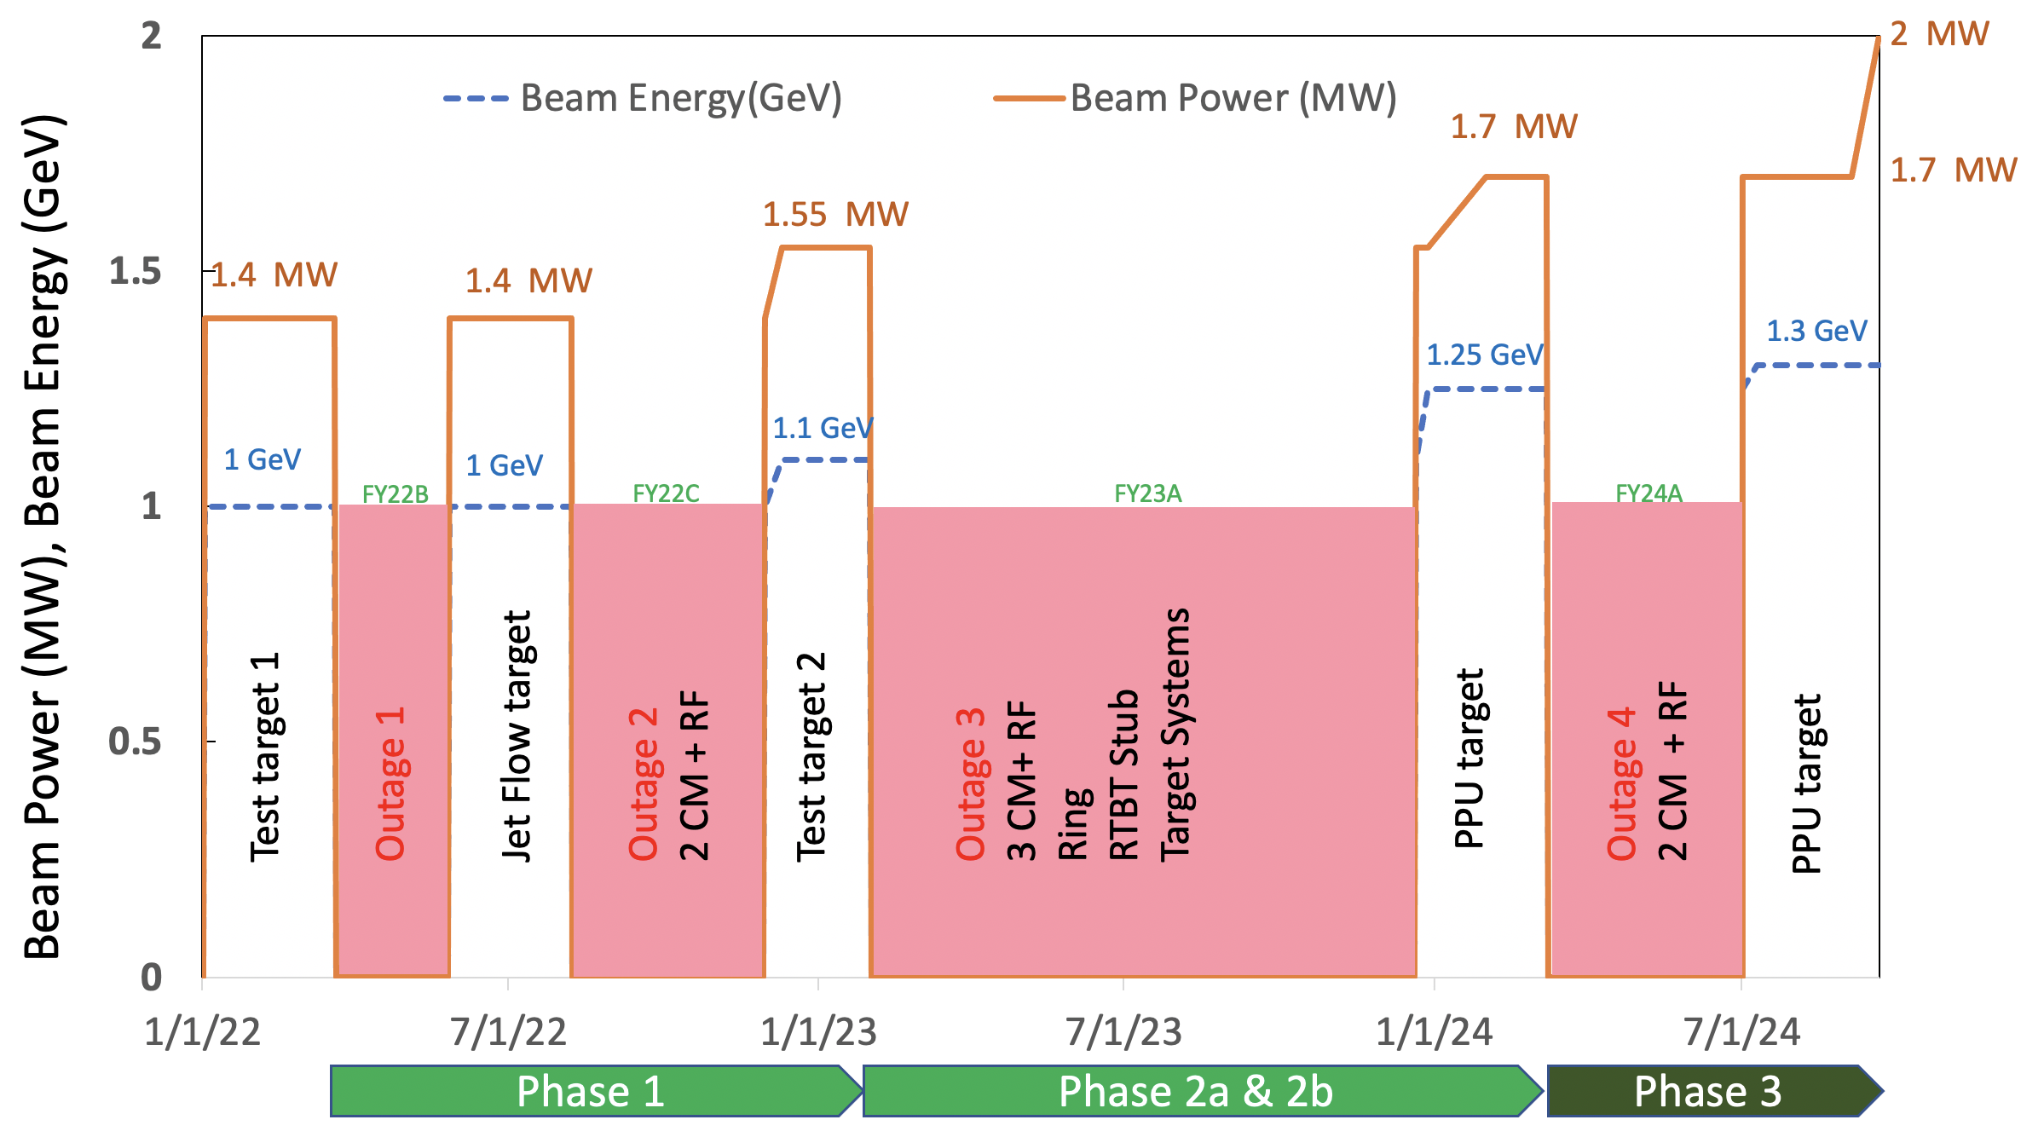
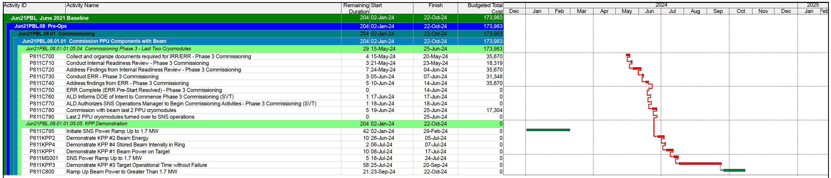
Phase 3 scope and approval
Install last 2 cryomodules, PPU Target 2 and all supporting systems
including RF during FY24A outage
Collect documentation (4 days)
Conduct IRR and resolve pre-start actions (10 days)
Conduct ERR and resolve pre-start actions (8 days)
ALD notifies DOE of intent of commissioning and routine operations (2 days)
Commissioning with beam in accordance with commissioning plan begins (5 days)
Operations at 1.3 GeV and 1.7 MW continues until KPP goal of 1250 hours is reached
Power ramp up to 2 MW begins

Slide 13
12-Month Look-Ahead
Confirm readiness review process in concert with DOE
Keep Transition to Operations document up to date
Prepare for first readiness reviews in Oct/Nov 2022
  Solicit review committee members and chair
  Logistics – website, document readiness process, travel
  Develop detailed agenda and charge questions

Slide 14
Summary
Aligned PPU and SNS operations outage periods
  5-year plan updated
  Readiness review and beam tuning durations made explicit
Updated readiness review schedule in PPU schedule
Appointed beam commissioning leader
  Detailed beam commissioning plan developed
Continue close communications with operations as main PPU installation outages near

Slide 15
Backup Material

Slide 16
Accelerator and Target Advisory Committee
Stuart Henderson, Chair
Neutron Sciences Directorate
Associate Laboratory Director Ken Andersen
Proton Power Upgrade Project
Director – John Galambos
Project Manager – Mark Champion Project Controls Lead – Wayne Steffey Partner Lab Senior Team Lead – Ed Daly Technical Director – Sang-Ho Kim
Controls Integration Manager – Karen White
ESH&Q – Sam McKenzie
Sr. Administrative Assistant – Angie Woody
Management Advisory Committee
Les Price, Carl Strawbridge
Project Management Mark Champion
SCL Systems
Matt Howell
RF Systems
John Moss
Ring Systems
Nick Evans
First Target Station
Bernie Riemer
Conventional Facilities Mark Connell
R & D
Nick Evans
Pre-Ops
Glen Johns
Project Support Wayne Steffey ESH& Q
Sam McKenzie
Cavities
John Mammosser
Cryomodules Ed Daly Cryogenics Brian Degraff Utility Systems Chris Stone
System Integration John Mammosser SCL Controls Karen White
SCL HPRF
John Moss
NCL HPRF
John Moss
LLRF
Mark Crofford Existing Linac Modulators Chris Pappas
New Linac Modulators David E. Anderson Utilities
Greg Norman RF Controls Karen White Global Controls
Karen White
Injection Region Robert Saethre Injection Dump Charlotte Barbier Extraction Region Robert Saethre Utilities
Greg Norman
Ring Control Systems
Karen White RTBT Stub Nick Evans
Accelerator Physics
Nick Evans
Neutronics Franz Gallmeier Mercury Process Makayla Edwards
Moderator Cryogenic Systems
Bernie Riemer(Interim) Vessel and Shielding Systems
Oscar Martinez
Target Utility Erica Ahlschwede Instrument Systems
Oscar Martinez
MOTS
Greg Stephens 2 MW Target Kevin Johns
Safety, Controls and Operations
Charlotte Barbier Gas Injection Development Charlotte Barbier
Building Modifications
Mark Connell
Gas Injection Development Charlotte Barbier Foil Development Nick Evans
Commissioning Glen Johns Regulatory Compliance Glen Johns

Slide 17
P.8 Budget and Estimate to Complete

Slide 18
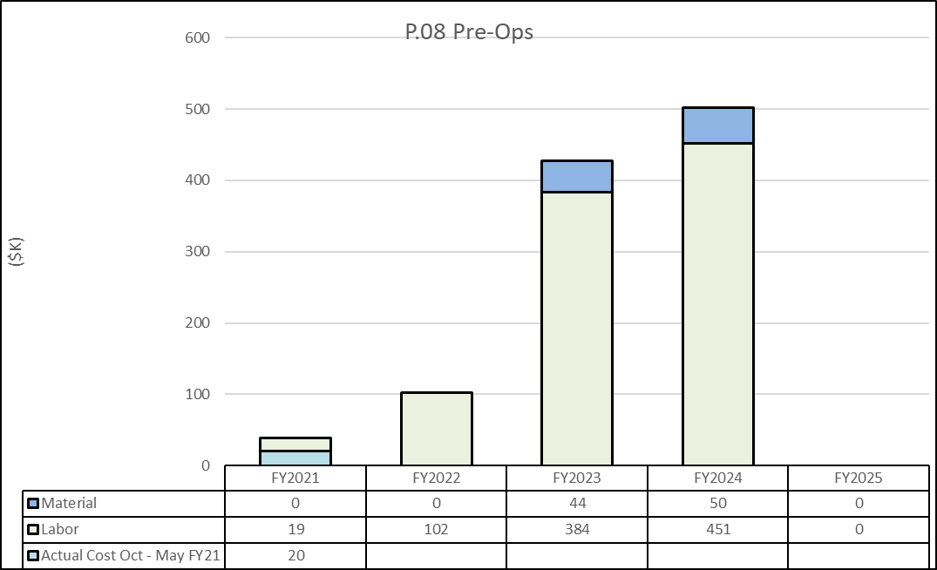
P.08 Material/Labor Charts with FY21 Actual Cost Oct – May

Slide 19
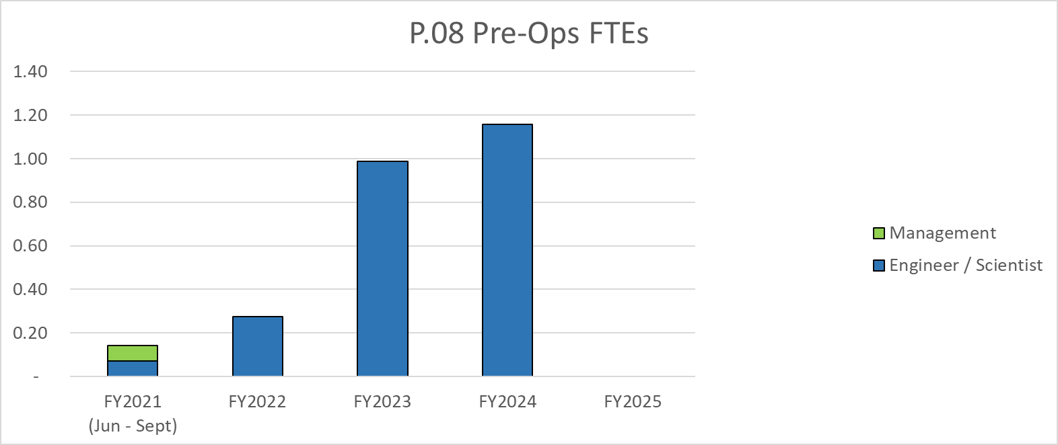
Labor Profile

