Slide 1
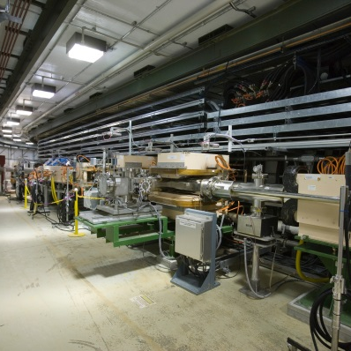
P.08.01 Beam Commissioning
DOE/SC Independent Project Review of the Proton Power Upgrade Project
Charles Peters
Beam Commissioning Leader
September 14 – 17, 2021

Slide 2
Outline
Charge: 5
Scope
Beam Commissioning Process
Superconducting Cavity Linac (SCL) Beam Commissioning
Ring Magnet Beam Commissioning
High Level Tune Up Details
Ways to Limit Beam Power
Summary

Slide 3
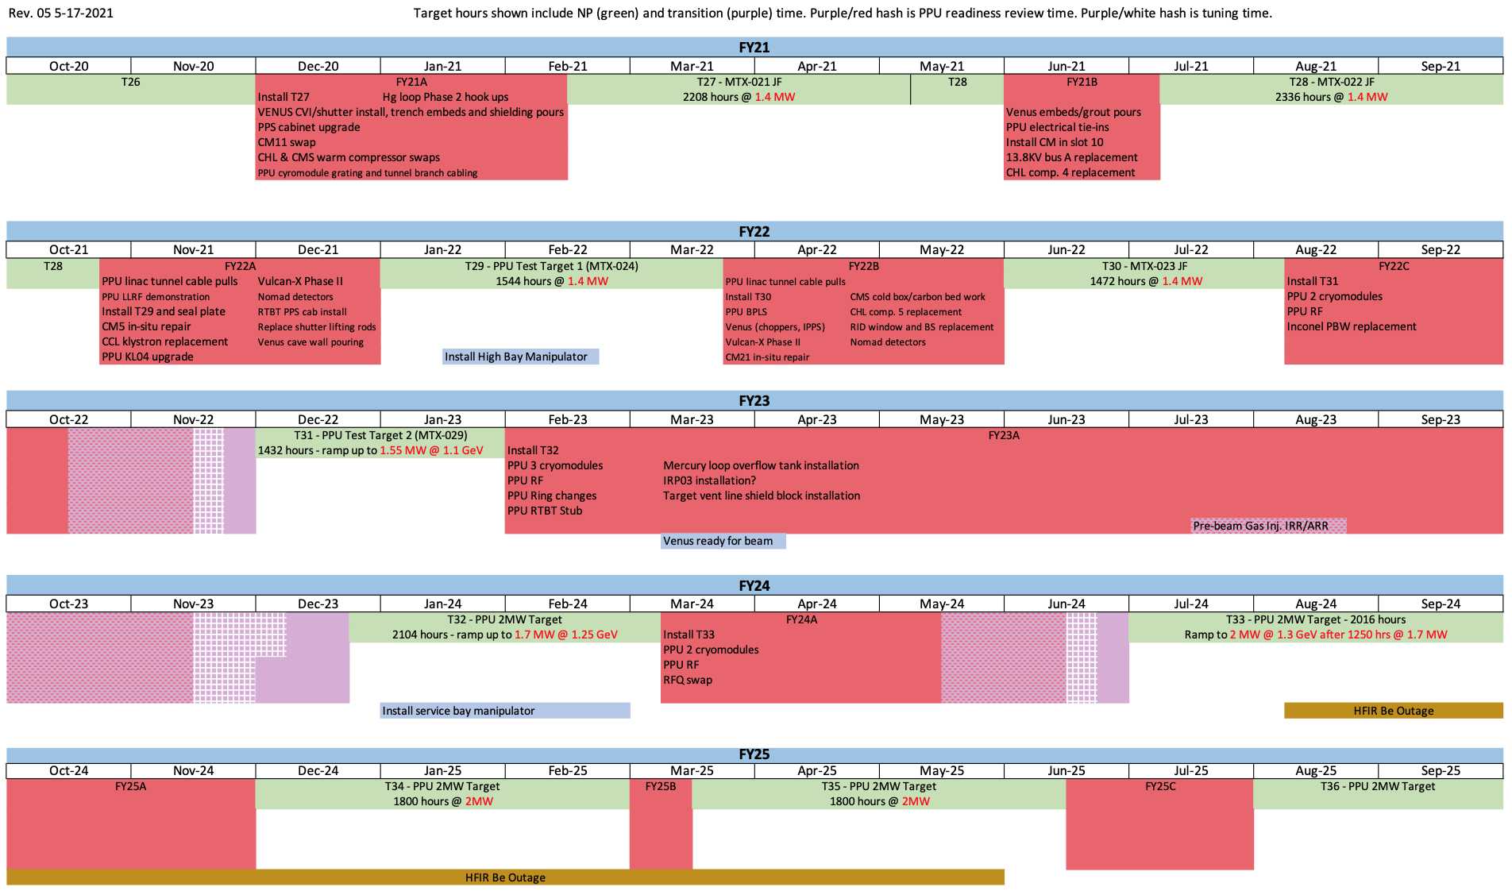
Scope
Safely perform beam commissioning following each PPU outage
FY22B outage (June 2022, 2 days)
Beam Power Limiting System (BPLS) commissioning and 1.4 MW production tune up
FY22C outage (October 2022, 10 days)
Cryomodules 31-32 commissioning and 1.55 MW production tune up
FY23A outage (October 2023, 25 days)
Cryomodules 28-30, ring magnets chicanes, injection dump septum and quad, and 1.7 MW production tune up and target commissioning
FY24A outage (May 2024, 10 days)
Cryomodules 26-27 and 2.0 MW production tune up
Notes:
BPLS beam commissioning will be scanning beam energy, beam charge, interlock to the MPS, interlock to the PPS, compare with BCMs in the RTBT (BCM25I, 25, 02, 14)
Beam Power Limiting System

Slide 4
Beam Commissioning Six-Step Process
Beam commissioning following each PPU equipment installation outage will be a six-step process
SCL Beam Setup to the Linac Dump
Ring Beam Setup to the Extraction Dump
Production Documentation of Beam to the Extraction Dump
Target Strain Measurements
Production Documentation of Beam to the Target
Foil Conditioning
The commissioning process will be approximately the same with variation only in the final beam output parameters and ring injection checkout following the FY23A outage
Production documentation will serve as validation of completion of beam commissioning
Personnel performing commissioning will be the same that perform the beam setup process now

Slide 5
Significant Experience with Cryomodule Commissioning
SCL beam setup to the linac dump is performed after every extended maintenance outage
Cryomodule removal and replacement has occurred multiple times during outages
Application used for beam setup is well established
Only thing required is to update the database with new Process Variables (PVs) for the new Superconducting Radio Frequency (SRF) cavities

Slide 6
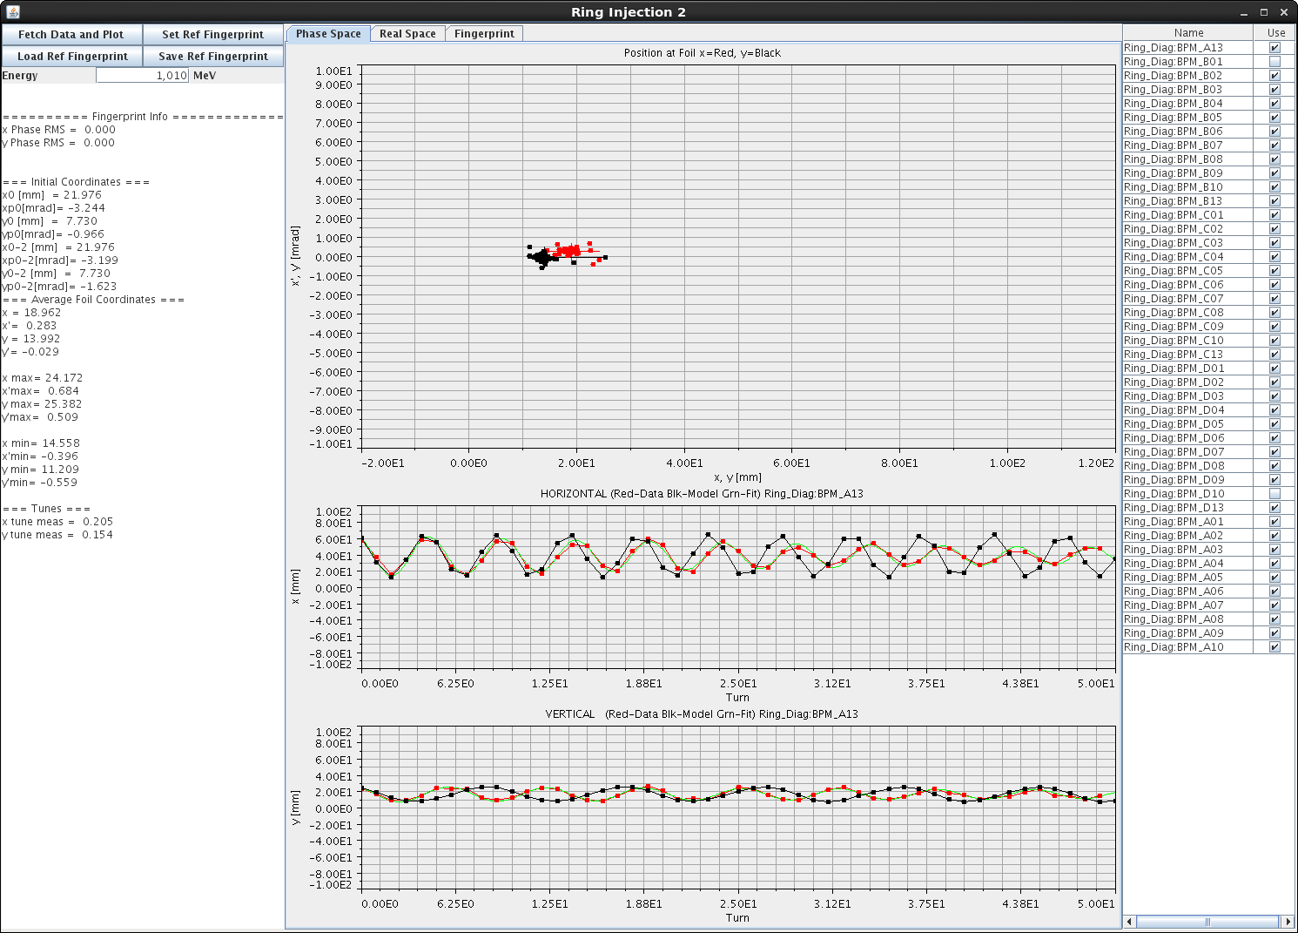
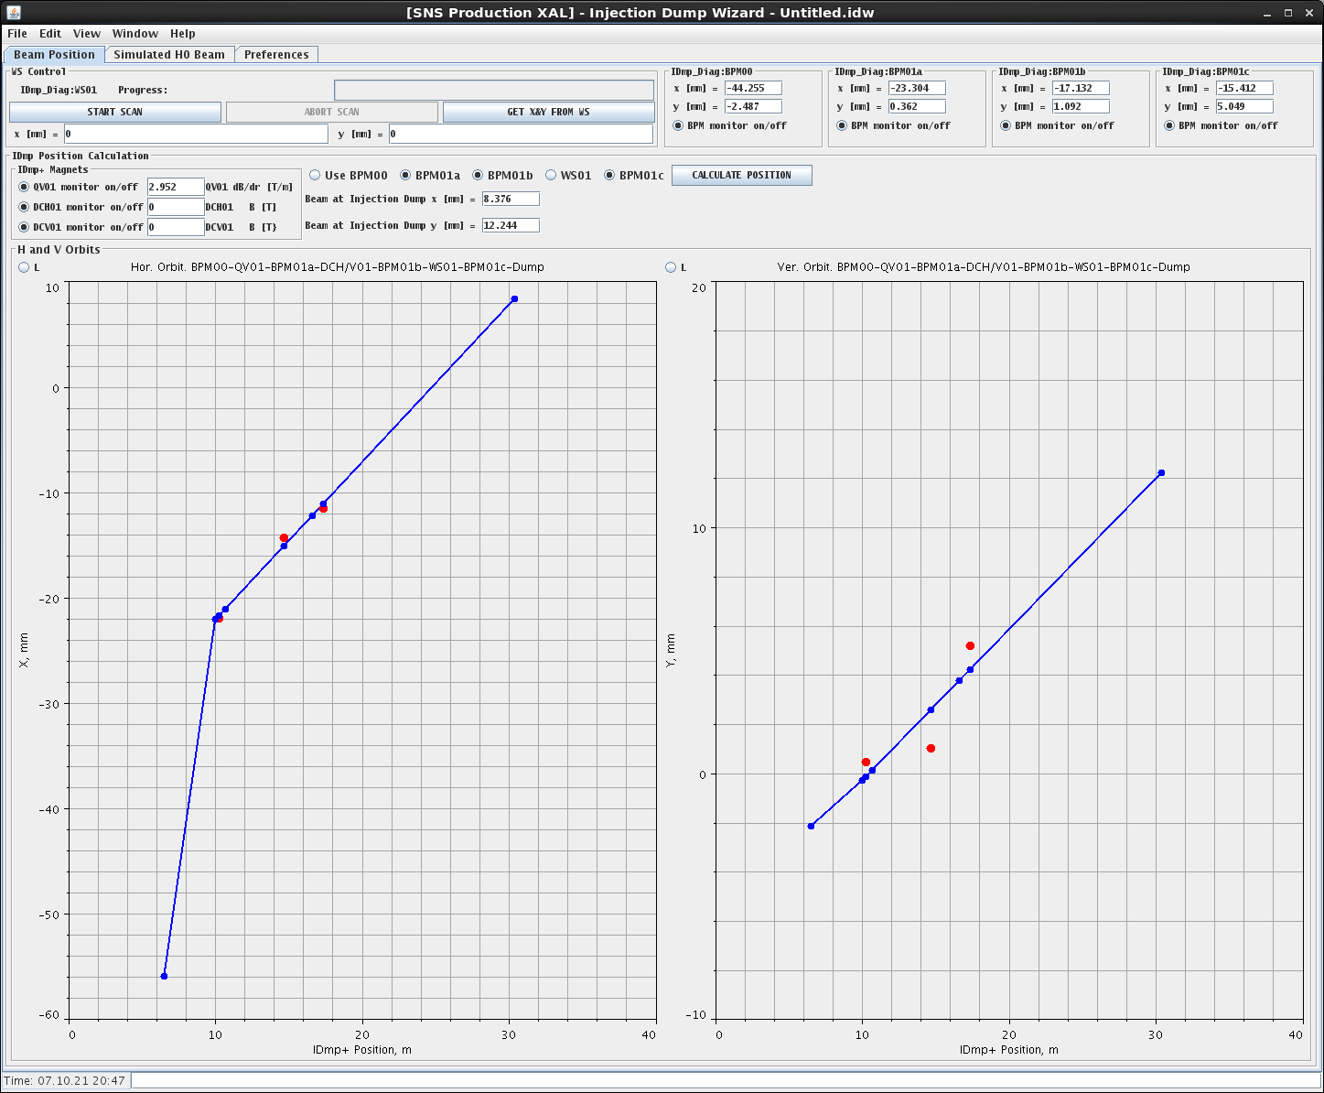
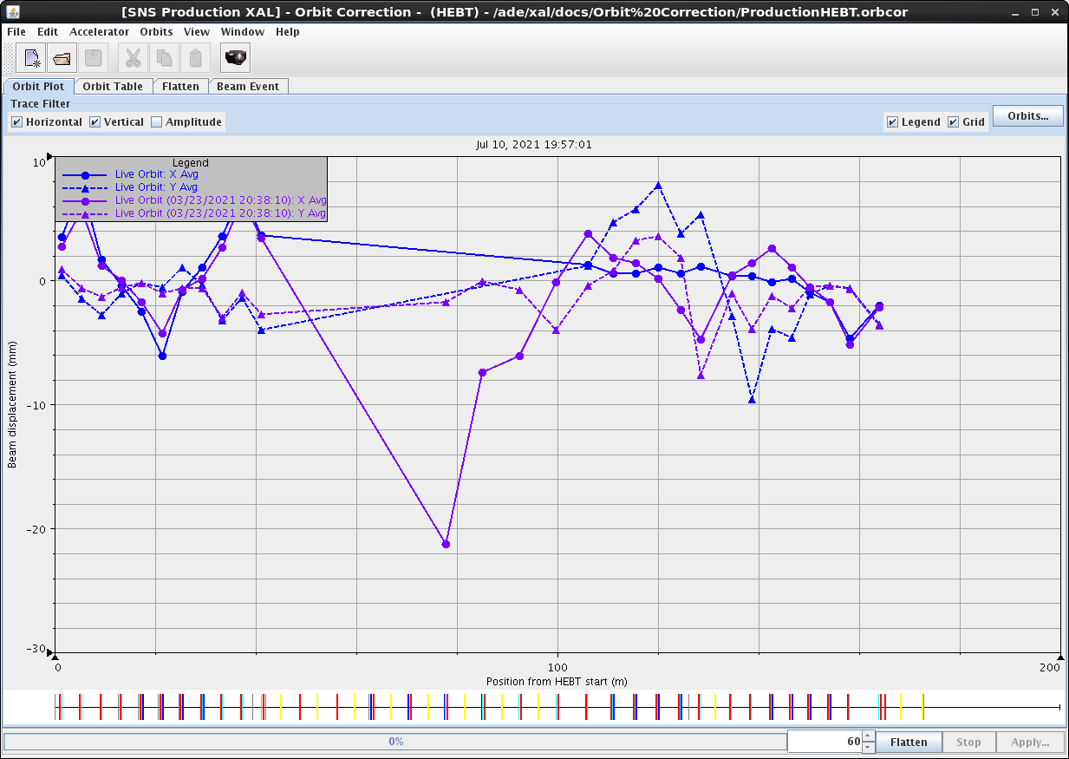
Ring Magnet Setup Process is Well Understood
Have established processes for verifying beam trajectories to the injection dump and through the ring
Restore to saved orbits to easily reproduce previous beam setups
Applications are already built
Orbit correction, injection dump wizard, and ring injection wizard
All PVs and power supplies are the same except for the addition of the new quad magnet in the injection dump line
Orbit correction
Injection dump wizard
Injection position and angle

Slide 7
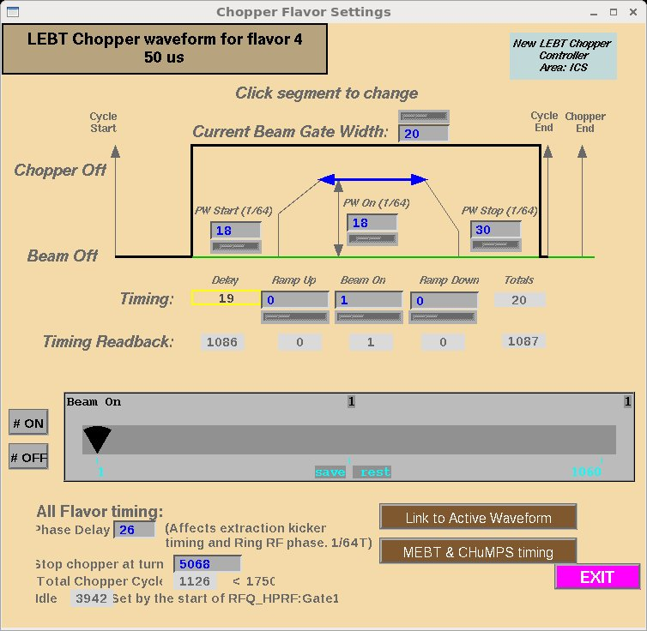
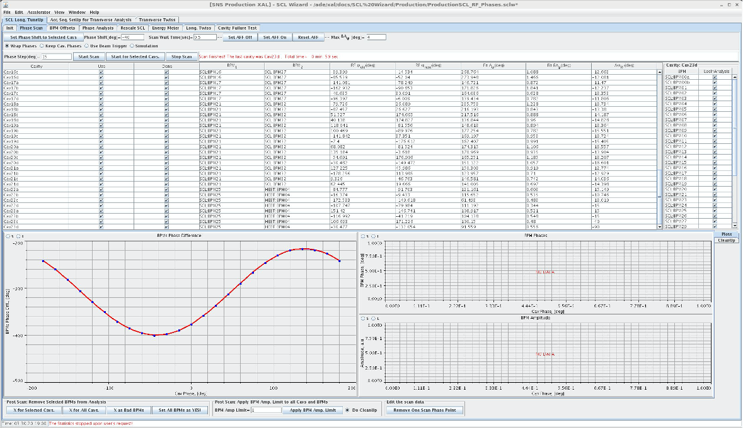
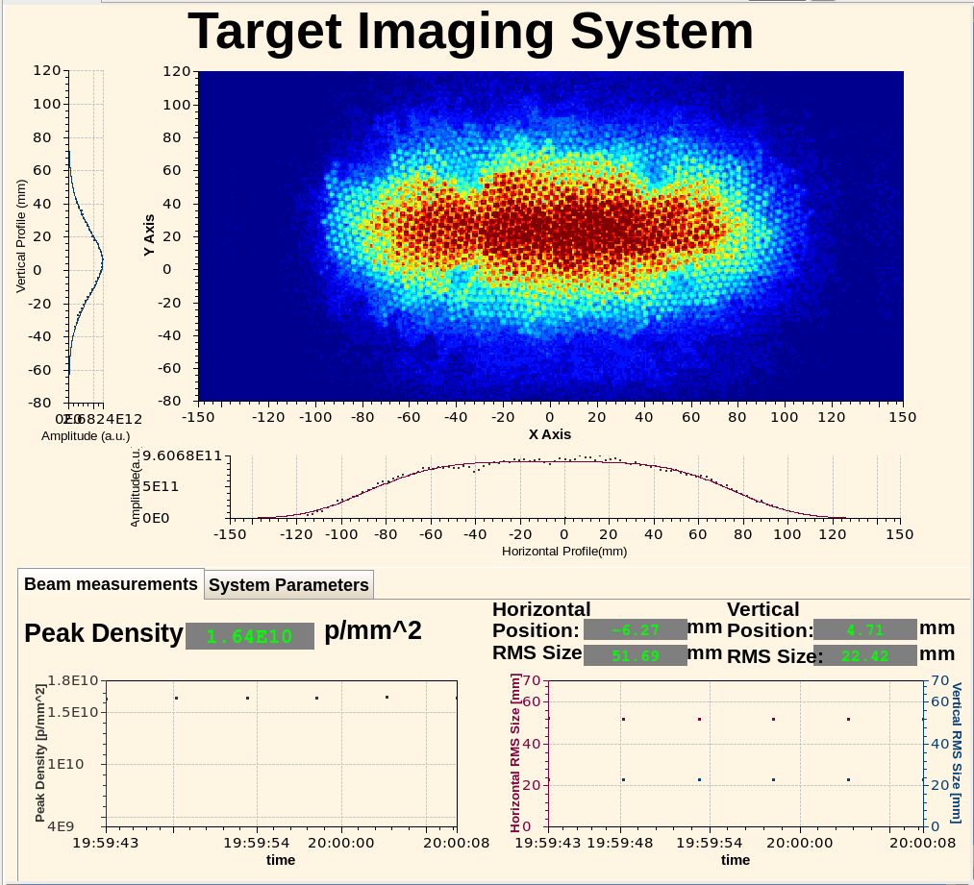
High Level Steps for the Tune-Up Process
LEBT chopper
Set up 1 microsecond low current (5 mA) beam
Scan SCL cavity phases (automated)
Measure the beam energy using SCL and High Energy Beam Transport (HEBT) BPMs (must have previously saved BPM offsets)
Also assumes maintenance was not performed on BPMs
Scale magnets in the HEBT, Ring, and Ring to Target Beam Transport (RTBT)
Insert primary stripper foil and measure the beam energy using the Ring
Set Ring RF cavities phases
Retract primary stripper foil and verify beam transport to the Ring injection dump
Slowly increase beam charge while monitoring beam losses
Measure beam size on the target
Phase scans

Slide 8
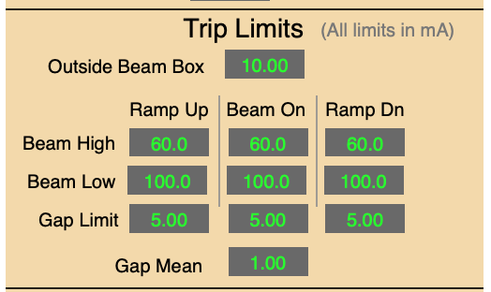
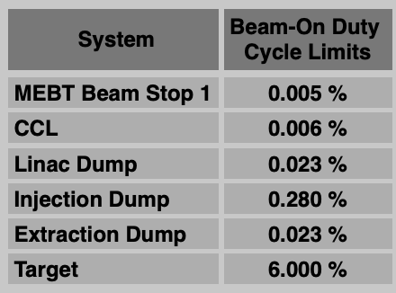
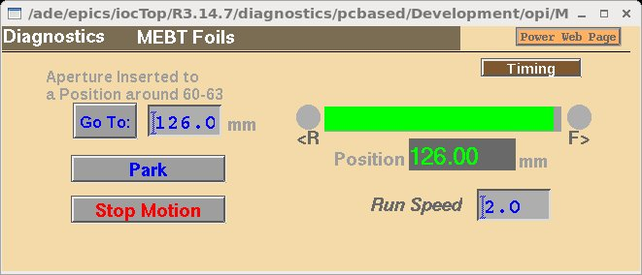
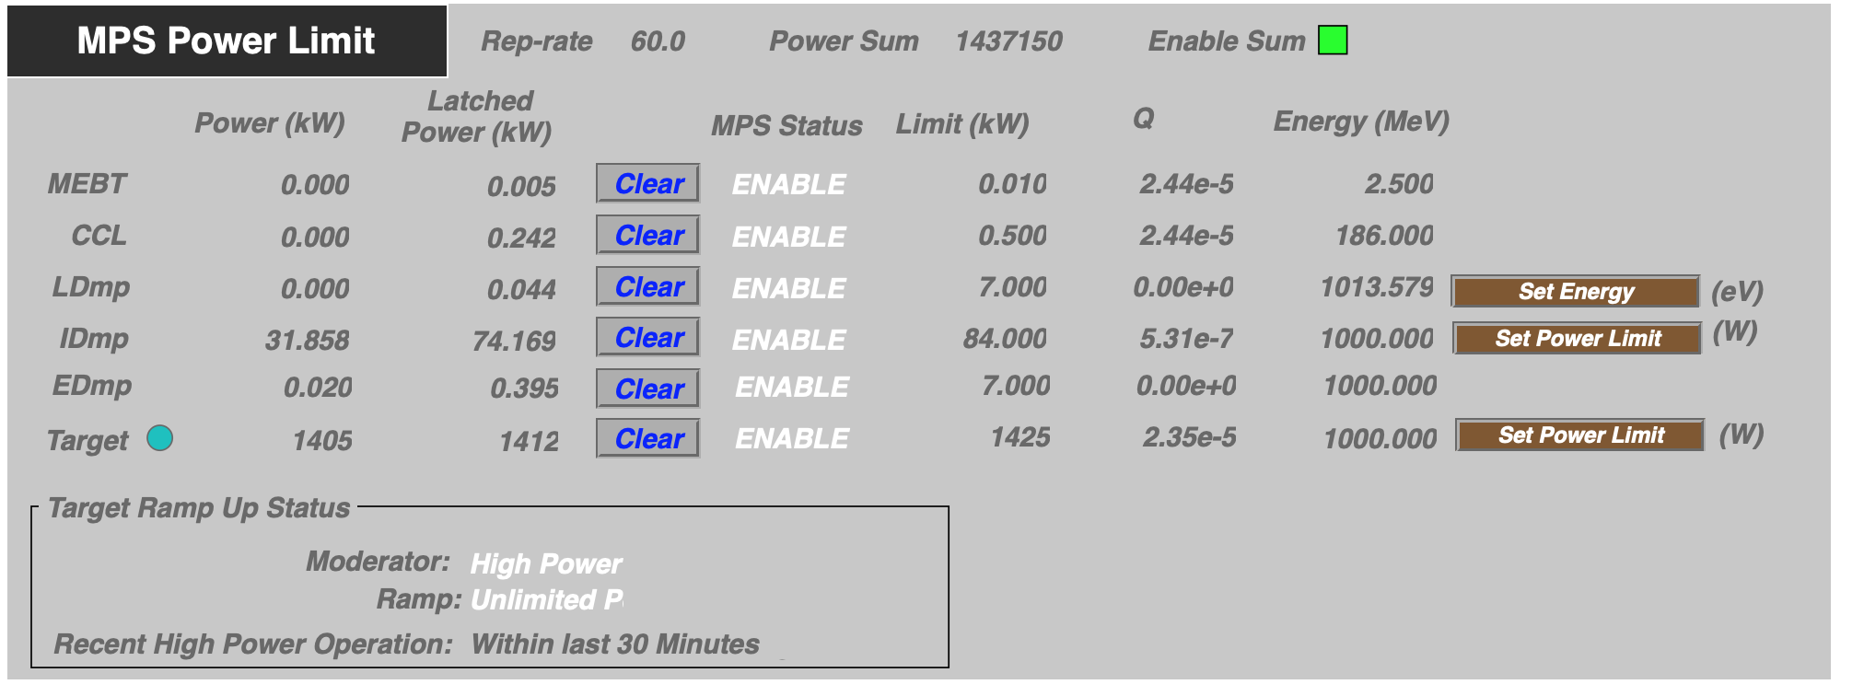
Practices for Limiting Beam Power are Well Established
Hardware limits
Digital delay and pulse generator (DG535) limits beam rep rate and pulse width
Chopper und Machine Protection System (ChuMPS) system limits beam current in the Medium Energy Beam Transport (MEBT)
Insertable aperture reduces current and when inserted the Machine Protection System (MPS) limits maximum pulse width to 50 microseconds
BPLS once installed in FY22B
Software limits
Duty cycle limit
Dump power limit 10 second average (Linac dump, injection dump, extraction dump, target)
ChuMPS interlock levels
MEBT aperture

Slide 9
Summary
Charge: 5
Already have experience using the beam commissioning process during each turn on after extended maintenance periods
Have significant experience commissioning cryomodules
Have even performed target strain measurements at 1.7 MW equivalent beam pulses
Have all necessary software (only need to update database with new PVs)
Have all necessary beam diagnostics needed for limiting beam power except for the BPLS which will be commissioned prior to the first PPU cryomodule installations

