Slide 1




P.5.10.3 First Target Station Controls
DOE/SC Independent Project Review of the Proton Power Upgrade Project
Angel Berrocal
FTS Controls Integration
September 14-17, 2021

Slide 2
P.5.10.3 Scope
Control System is based on existing EPICS architecture
Architecture remains the same for PPU
EPICS architecture is scalable and extensible
Adding more network nodes, IOCs, PLCs
Modifying systems to support additional hardware for Target controls integration

Slide 3
P.5.10.3 Design Phases
Control Integration design are managed in Phases
  Phase 1 (Conceptual)
  Phase 2 (Preliminary)
  Phase 3 (Final)

Slide 4
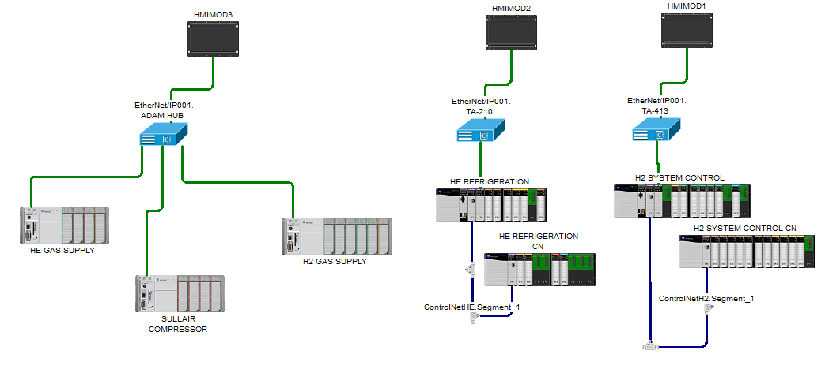
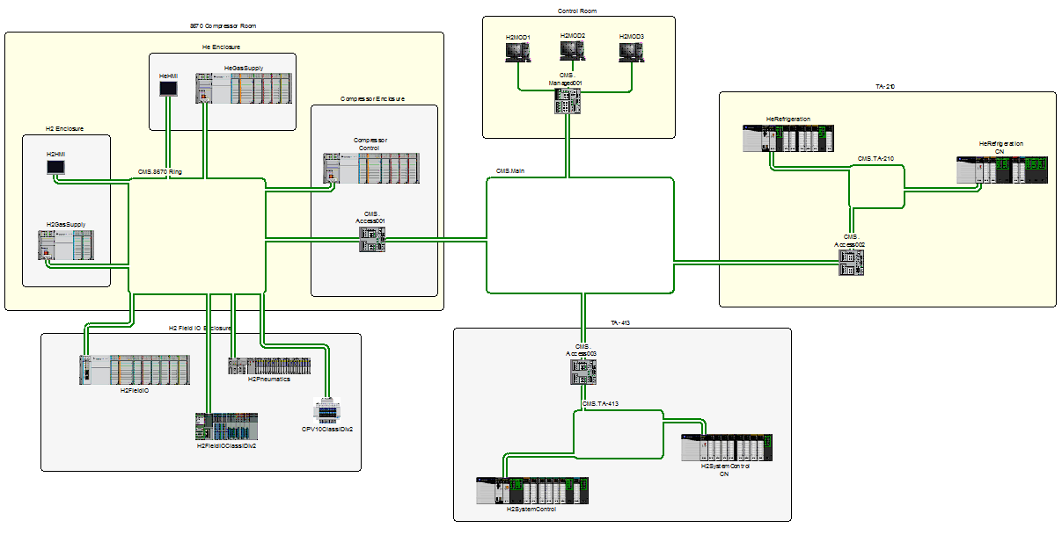
P.5.10.3 Scope
Charge: 1,4
Diverse types of signals will be provided as deemed necessary to ensure reliability of the system
Signals critical to beam production will be redundant to ensure reliability and ensure uptime is maximized
Target Controls will be distributed to SNS standard PLCs/IOC pairs for each target subsystem to facilitate maintenance
PPU FTS control integration scope includes controls integration up to connectivity to instrumentations, Allen Bradley Control/Compact Logix PLC, Ethernet IP Ring topology architecture for redundancy, and operator interface (EPICS)
Ethernet IP Star Configuration
Ethernet IP Ring Configuration
Ethernet IP Multiple Ring Configuration

Slide 5
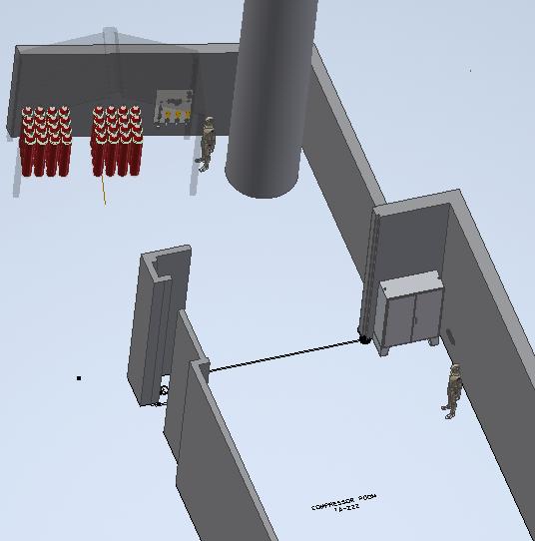
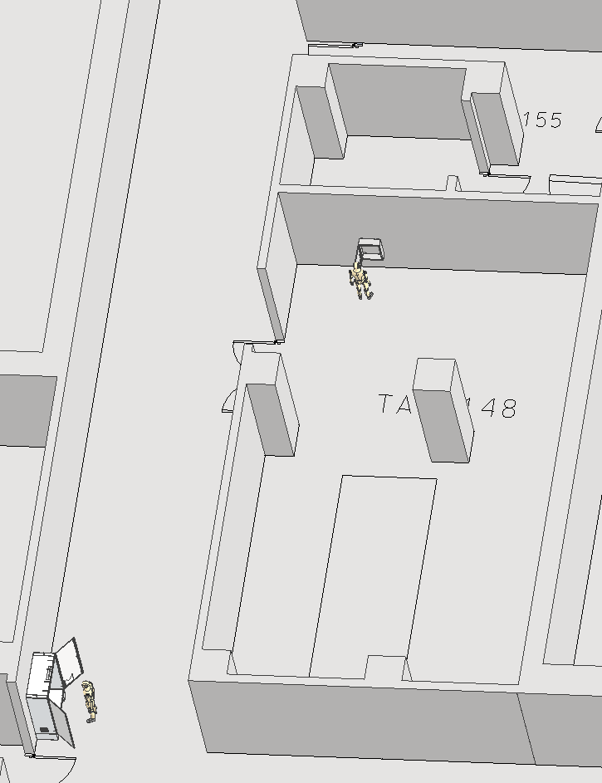
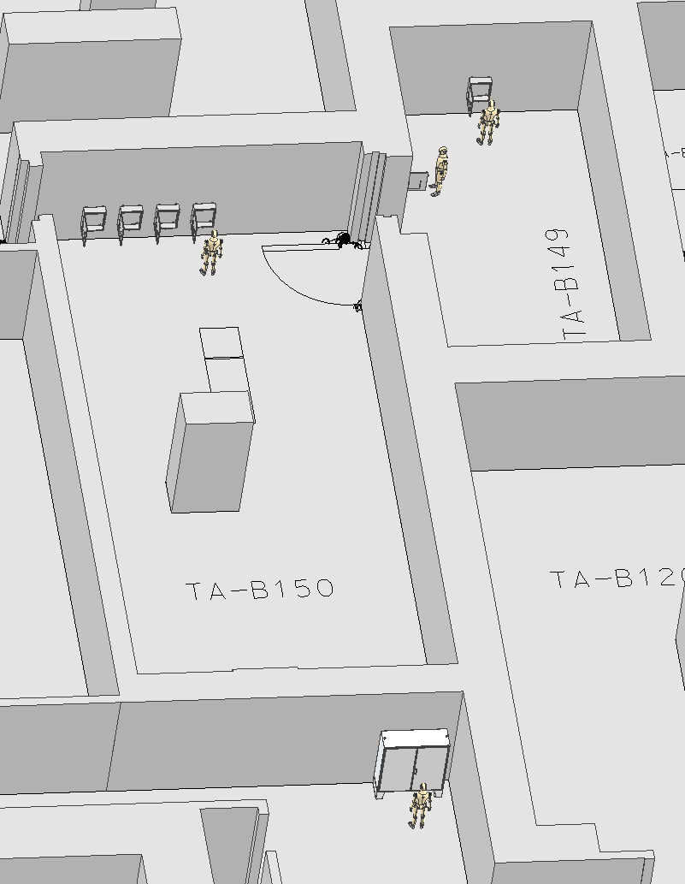
P.5.10.3 Scope
Charge: 1,4
Hydrogen Refill System (HRS)
  New PLC enclosure to control
  Monitor CMS Hydrogen supply
  Control cabinet will be in building 8760 compressor room
Mercury Off-Gas Treatment System (MOTS)
  New PLC enclosure to control
  Monitor Tritium and Xenon removal systems
  Control Cabinet will be in building 8700 baseman
Gas Recirculation (GR)
  New PLC enclosure to control and monitor Target Gas Injection
  Include a Molecular Sieve as a subsystem.
  Control Cabinet will be in building 8700 baseman
Hydrogen Refill System
Mercury of Treatment System
Gas Recirculation

Slide 6
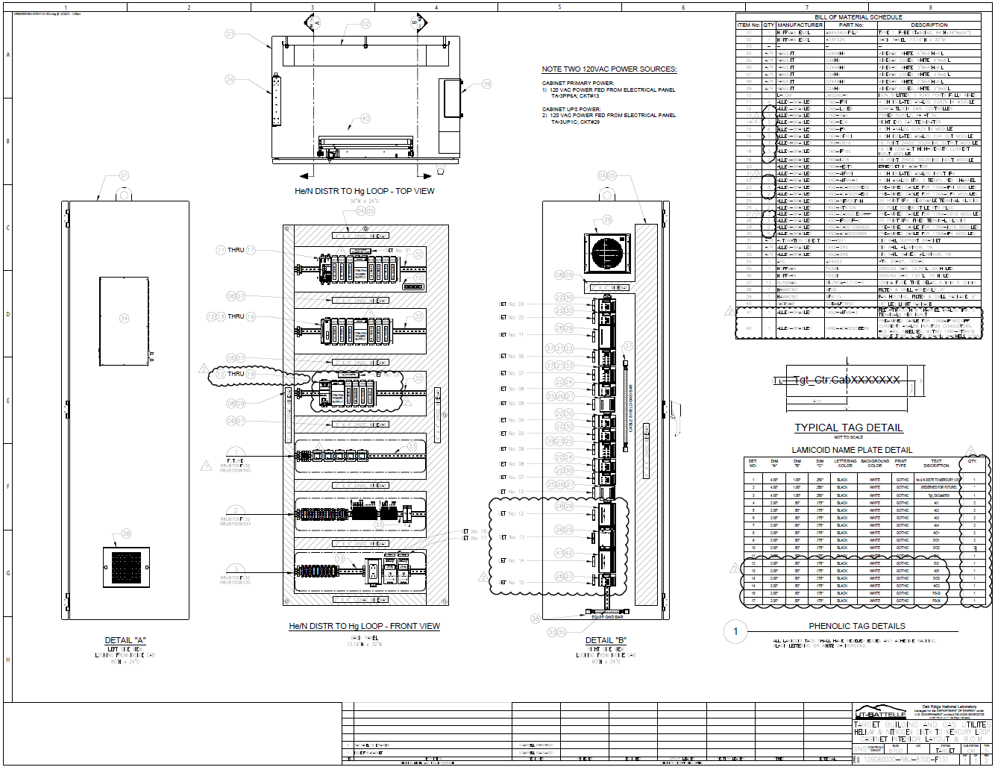
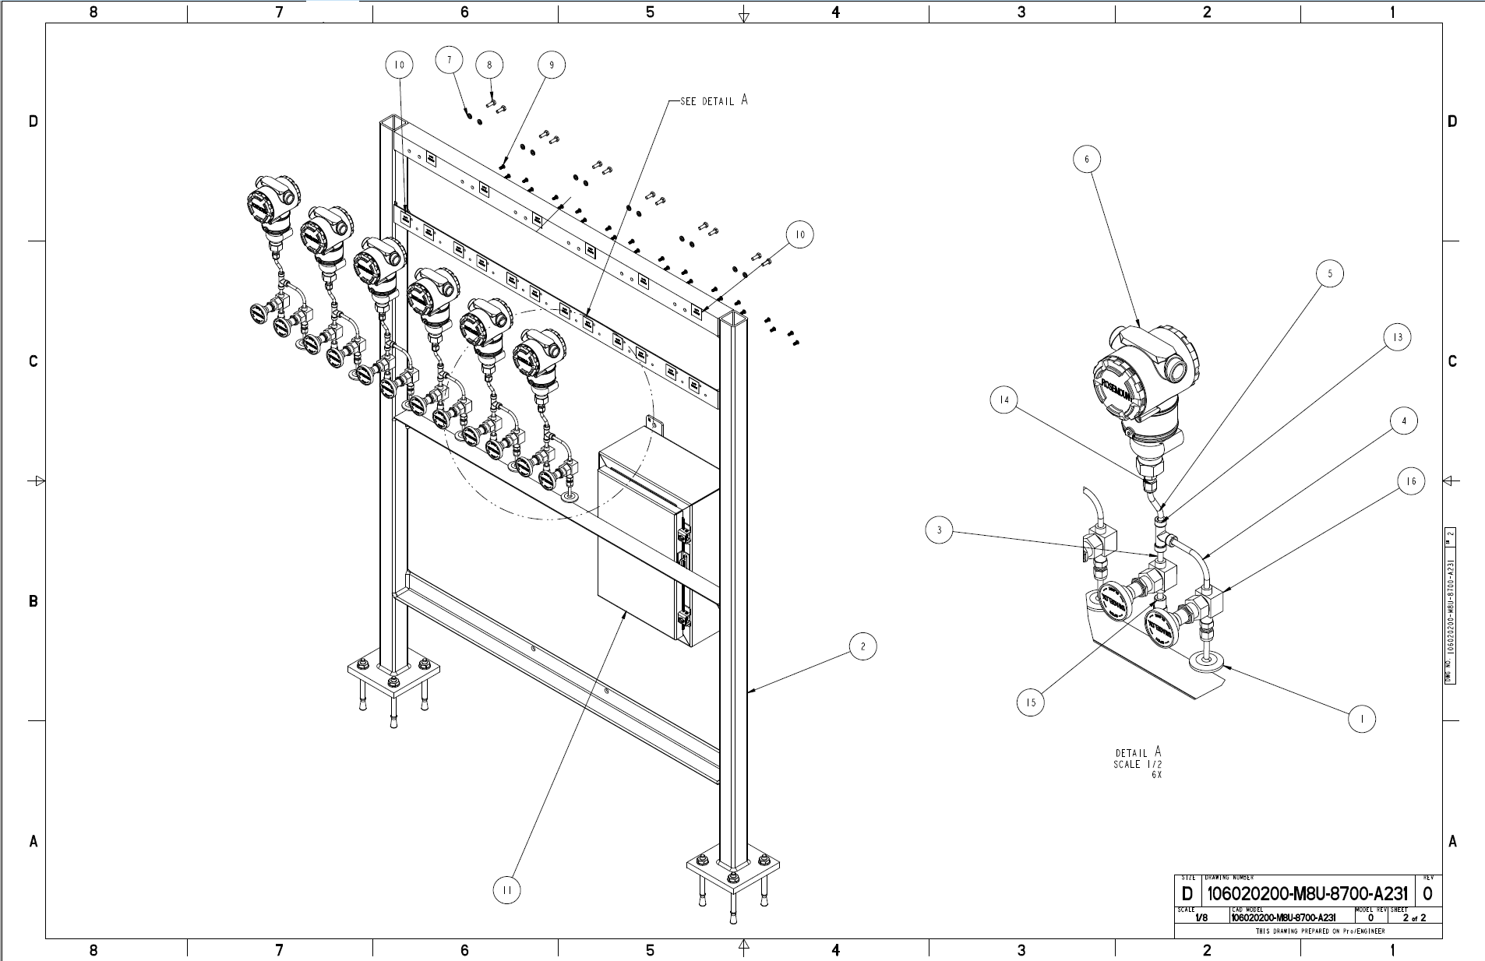
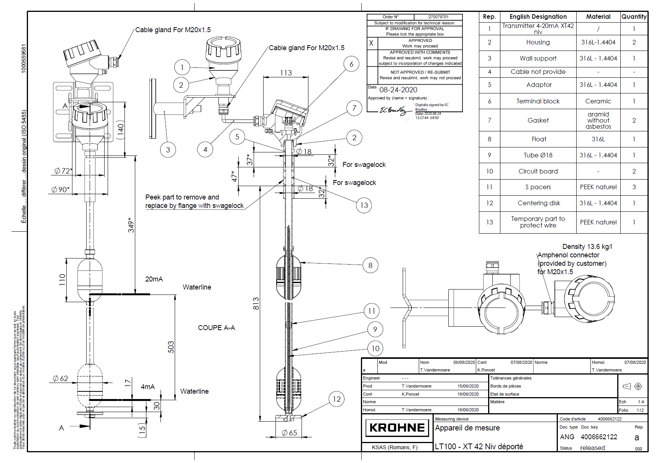
P.5.10.3 Scope
Charge: 1,4
Gas Panel 10 (GP10)
  Control cabinet 8780 upgrade
  Additional PLC in the Mercury Loop Recovery
Catalyst
  Adding six Pressure Transmitters and six Temperature Transmitters in existing CMS circulator system
  Drawings will be upgraded
Mercury Process System (MPS)
  Adding Level Sensor for the Mercury Pump Overflow Tank
  Cabinet 8530 drawings will be upgraded
  The preferred design concept is to make use of the existing Rocket GLS penetration and junction boxes
Gas Panel 10
Catalyst
Mercury Process System

Slide 7

















































P.5.10.3 Organization
Charge: 5
P.5 First Target Systems
Bernie Riemer
P.5.1
Management
and System Integration Bernie Riemer
P.5.2
Neutronics
Franz Gallmeier
P.5.3 Mercury Process Systems Makayla Edwards
P.5.4
Moderator
Cryogenic Systems Bernie Riemer
P.5.5 Vessel and Shielding
System
Oscar Martinez
P.5.6 Target Utility Systems
Erica Ahlschwede
P.5.7
Instrument System
Oscar Martinez
P.5.8 MOTS
Greg Stephens
P.5.9 2 MW Target
Kevin Johns
P.5.10 Safety, Controls and Operations
Charlotte Barbier
P.5.11
Gas Injection Development
Charlotte Barbier
P.5.1.1
Management and System Integration Bernie Riemer
P.5.2.1
Management and System Integration
Franz Gallmeier
P.5.3.1
Management and System Integration Makayla Edwards
P.5.4.1
Management and System Integration Bernie Riemer
P.5.5.1
Management and System Integration
Oscar Martinez
P.5.6.1
Management and System Integration
Erica Ahlschwede
P.5.7.1
Management and System Integration
Oscar Martinez
P.5.8.1
Management and System Integration
Greg Stephens
P.5.9.1
Management and System Integration
Kevin Johns
P.5.10.1
Management and System Integration Charlotte Barbier
P.5.11.1
Management and System Integration Charlotte Barbier
P.5.2.2 Evaluation at 1.3 GeV
Franz Gallmeier
P.5.3.2
Evaluations at 1.3 GeV
Makayla Edwards
P.5.4.2 Ortho-Para Hydrogen Converters Bernie Riemer
P.5.5.2
Evaluations at 1.3 GeV
Oscar Martinez
P.5.6.2
Evaluations at 1.3 GeV
Erica Ahlschwede
P.5.7.2
Evaluations at 1.3 GeV
Oscar Martinez
P.5.8.2 Additional MOTS delay bed Greg Stephens
P.5.9.2 Target Module
Kevin Johns
P.5.10.2 System Integration for
Safety
Jacob Platfoot
P.5.11.2
Gas Injection
Charlotte Barbier
P.5.2.3 System Design Support Franz Gallmeier
P.5.3.3 Hg Pump Tank Overflow Makayla Edwards
P.5.4.3 Ortho-Para Hydrogen
Converter Diag.
Bernie Riemer
P.5.6.3 Upgrades for 1.3 GeV Systems
Erica Ahlschwede
P.5.8.3 Upgrades for Gas Injection Greg Stephens
P.5.9.3 Supporting Hardware Kevin Johns
P.5.10.3 Controls Integration Karen White
P.5.2.4 FTS Source
Performance
Franz Gallmeier
P.5.3.4 Hg Return GLS
Makayla Edwards
P.5.4.4 Hydrogen Refill System Bernie Riemer
P.5.6.4 Upgrades for Gas Injection Erica Ahlschwede
P.5.8.4 MOTS Cold Trap and Shielding
Greg Stephens
P.5.9.4 PPU Test Target
Drew Winder
P.5.10.4 Operating Procedures and
Training
Greg Stephens
P.5.2.5 FTS Facility Support Franz Gallmeier
P.5.3.5 In-Cell Target Gas Supply
Hardware
Makayla Edwards
Supporting contributors
P.5.10.3 (Controls Integration): Doug Campbell, Terry Kennedy, and Tony Dao

Slide 8
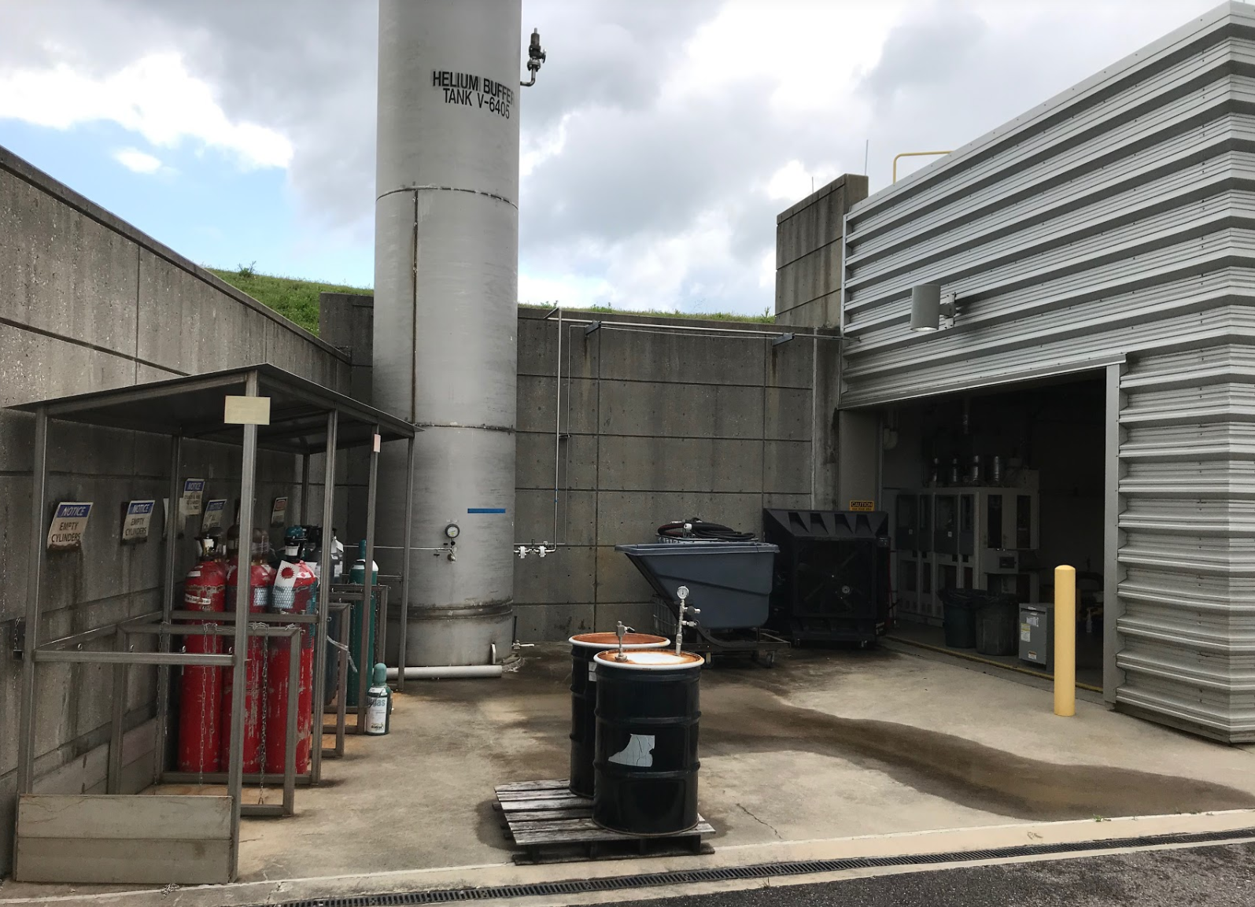
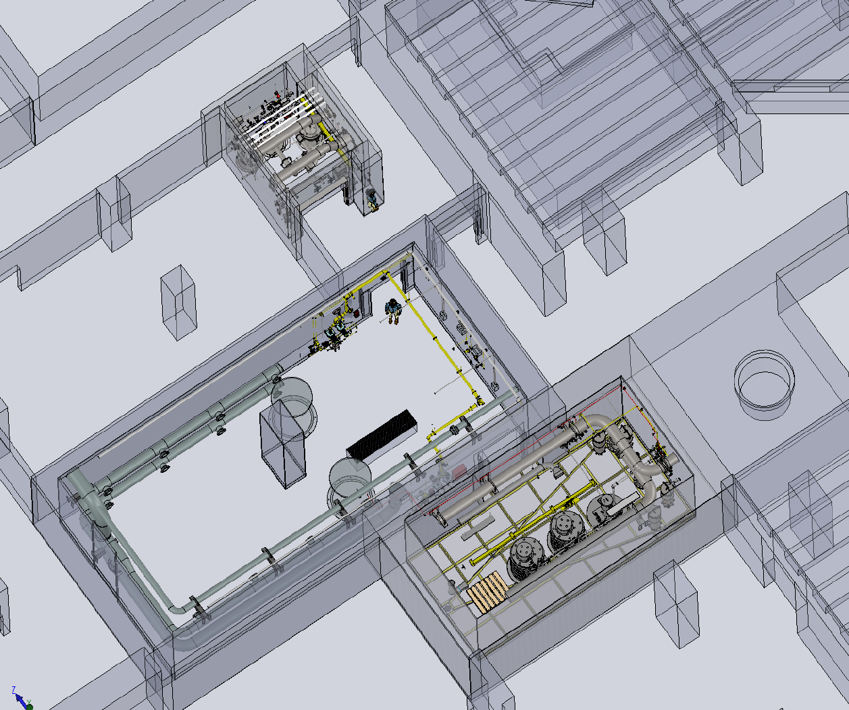
P.5.10.3 Progress since CD-2/3
Charge: 1,3,4
HRS
  Phase 2 Schematic Design 100% completed
  Phase 3 Schematic Design 98% completed
  FDR Completed
MOTS
  Phase 1 Design 100% Completed
GR
  Phase 2 Schematic Design GR 100% completed
  Phase 2 Schematic Design Mol Sieve 100% completed
  Phase 3 Schematic Design 10% completed
New inventory location
Current HRS location (at capacity)
Hydrogen Refill System
Mercury of Treatment System
Gas Recirculation
Mercury of Treatment System & Gas Recirculation

Slide 9
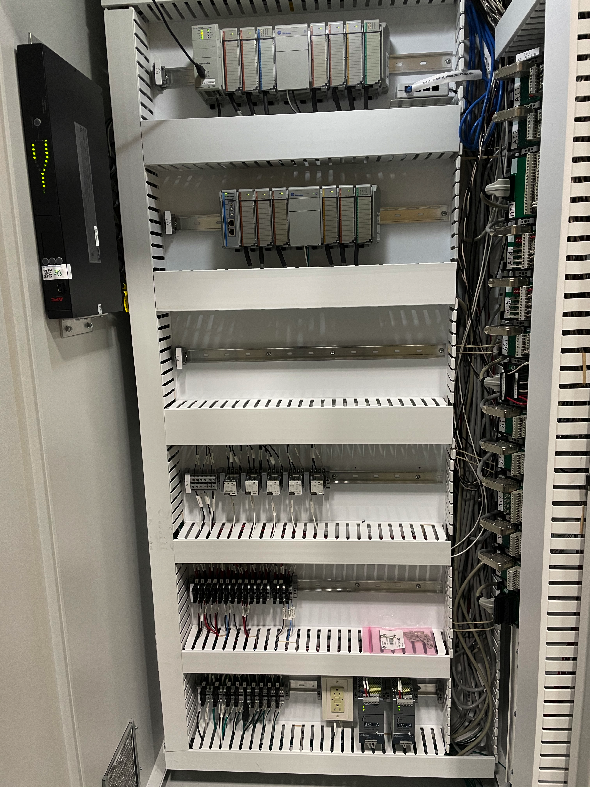
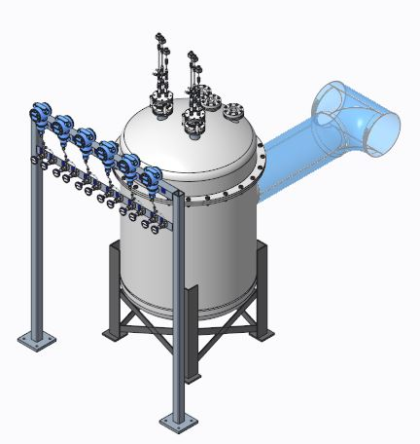
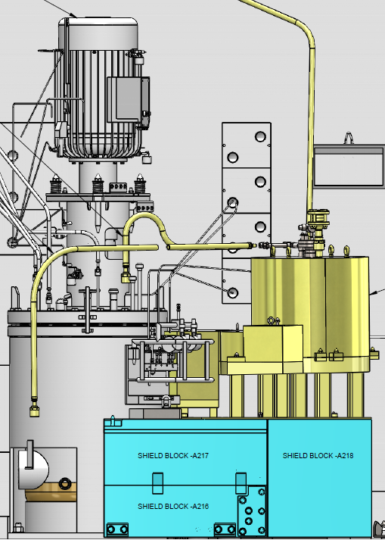
P.5.10.3 Progress since CD-2/3
Charge: 1,3,4
GP10
  Phase 2 Schematic Design 100% completed
  FCSR document completed
  Phase 3 Schematic Design 100% completed
  FDR Completed
Catalyst
  Phase 1 & Phase 2 Design 100% completed
MPS
  Phase 1 Design 64% completed
Gas Panel 10
Catalyst
Mercury Process System

Slide 10
P.5.10.3 Challenges
Charge: 1,3,4,5
HRS
  Waiting on vendor BOM to complete Phase 3 schematics
  Instrumentation to be rated for Class 1 Div. 2 Group B using nonincendive fields wiring methods or equivalent
  Will need to work with new ME to finalized design and installation efforts
MOTS
  Phase 2 delayed due to changes in design
  Molecular Sieve P&ID and PCD are not finalized at this time
GR
  P&ID & PCD were not finalized which impacted revisions and rework on design

Slide 11

P.5.10.3 Challenges
Charge: 1,3,4,5
GP10
  Resources working on other WBS
Catalyst
  Resources working on other WBS
Target Control Systems progress has been delayed because predecessors have been delayed
  Additional resources are working to recover schedule
PCR was approved for Gas Recirculation and MOTS due to mechanical design changes
  This increased the controls scope

Slide 12
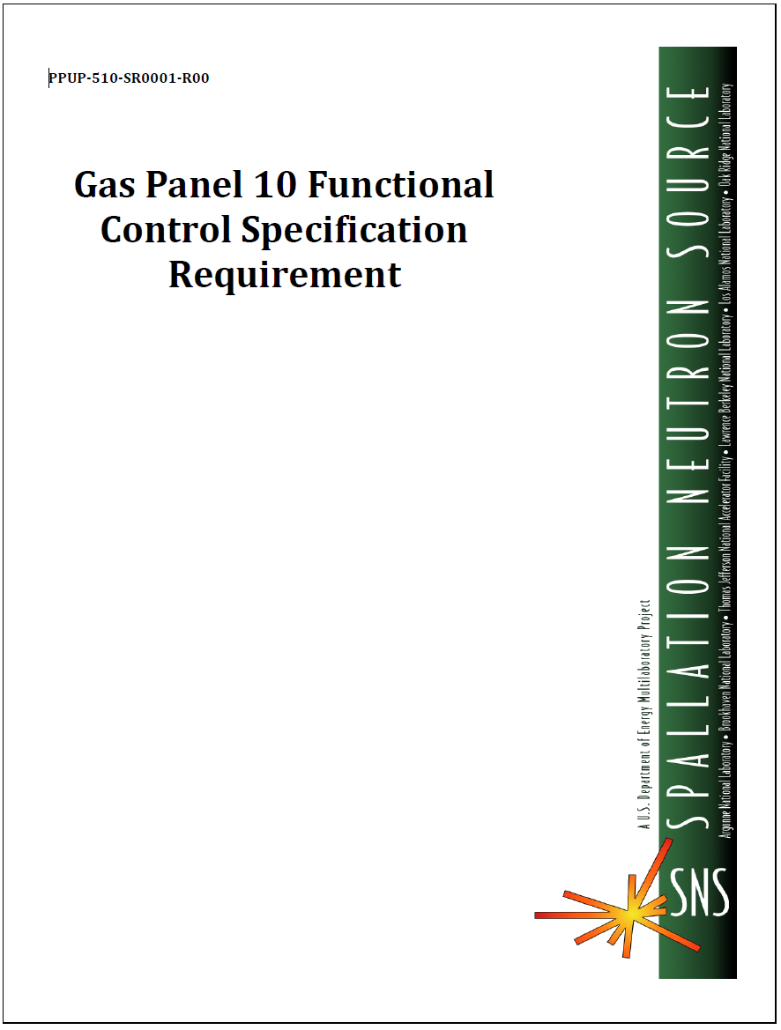
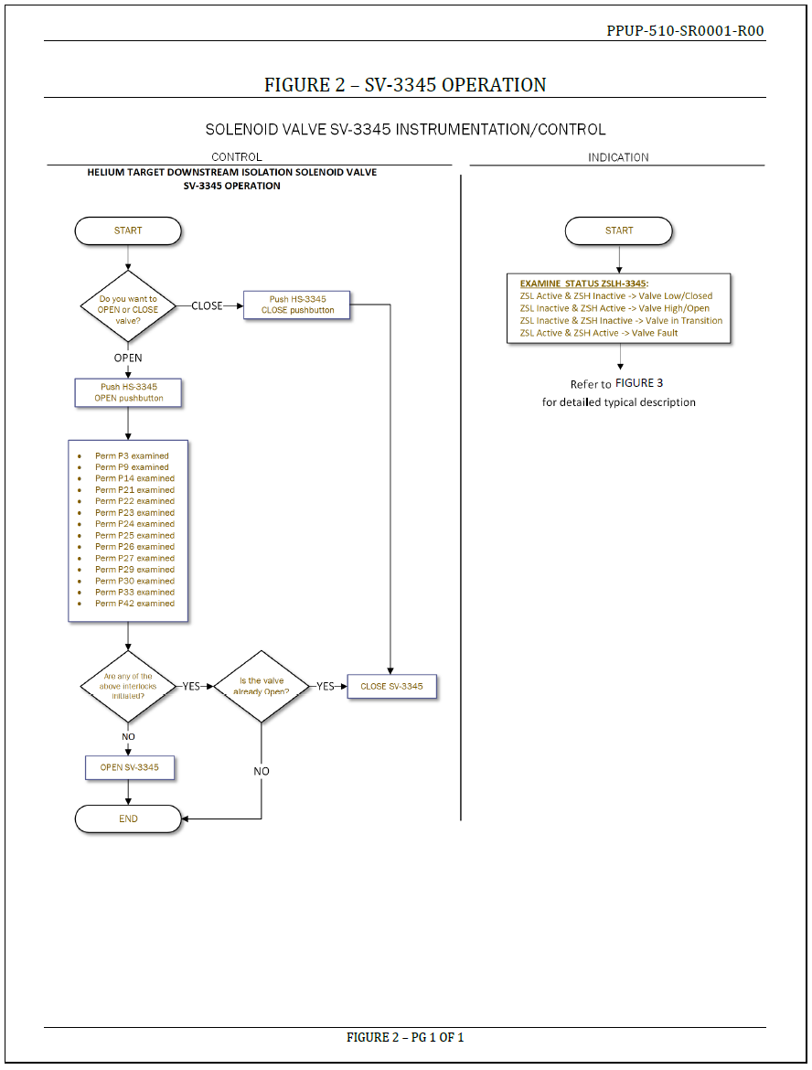
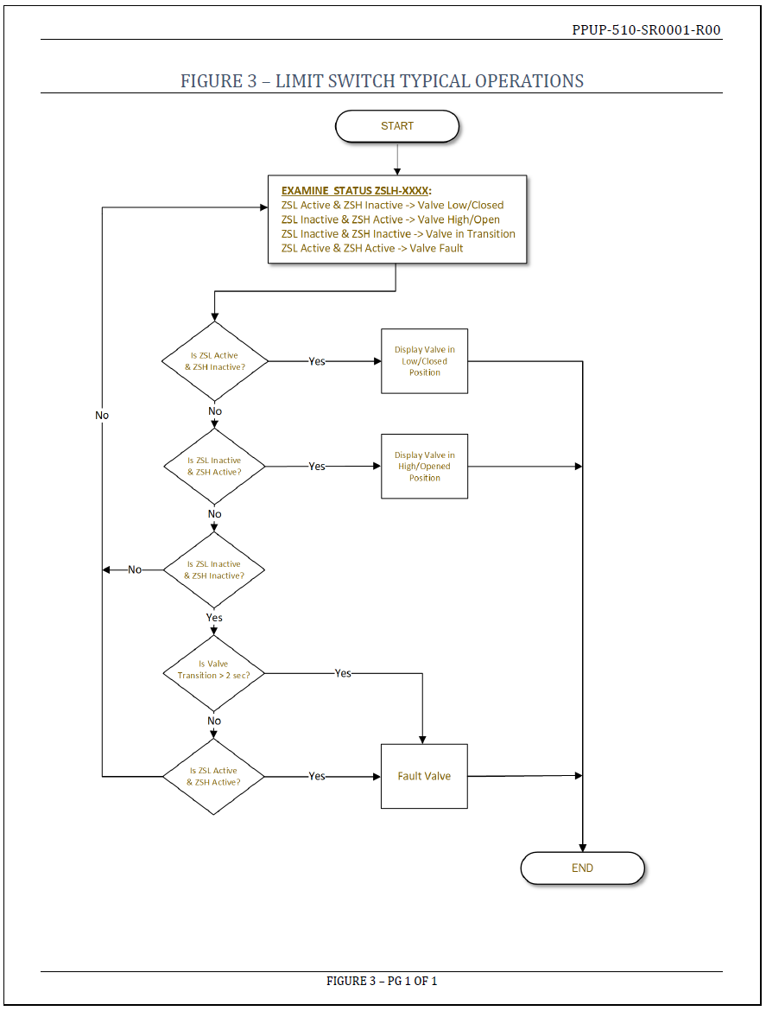
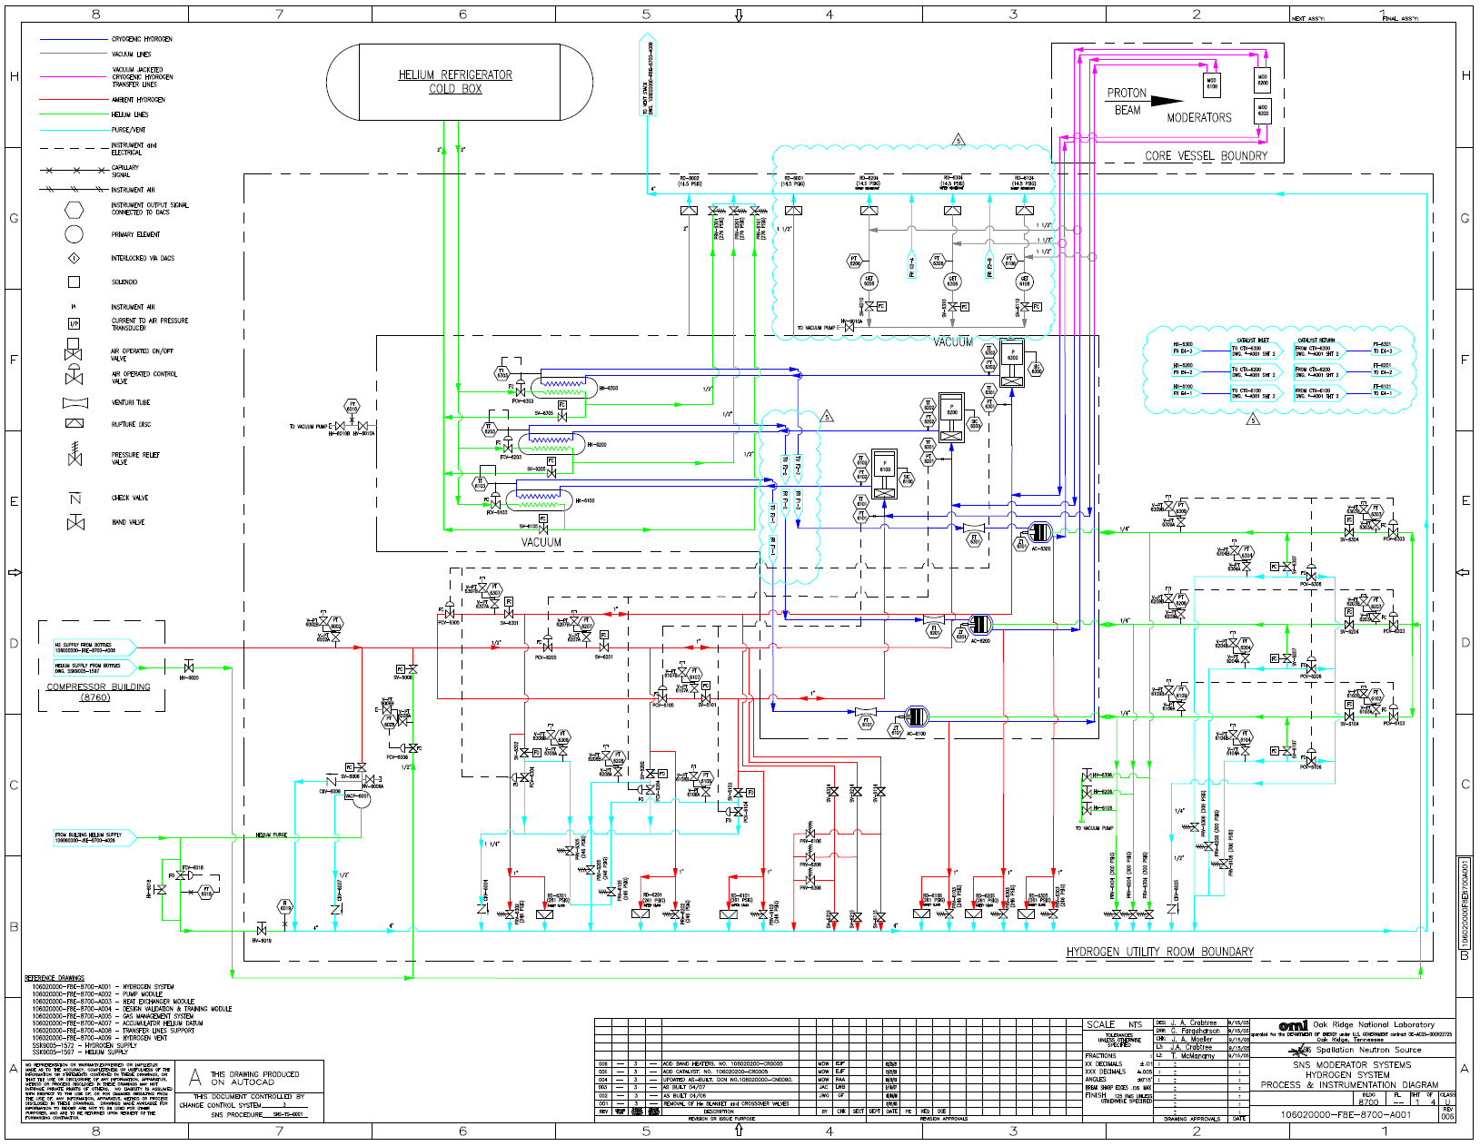
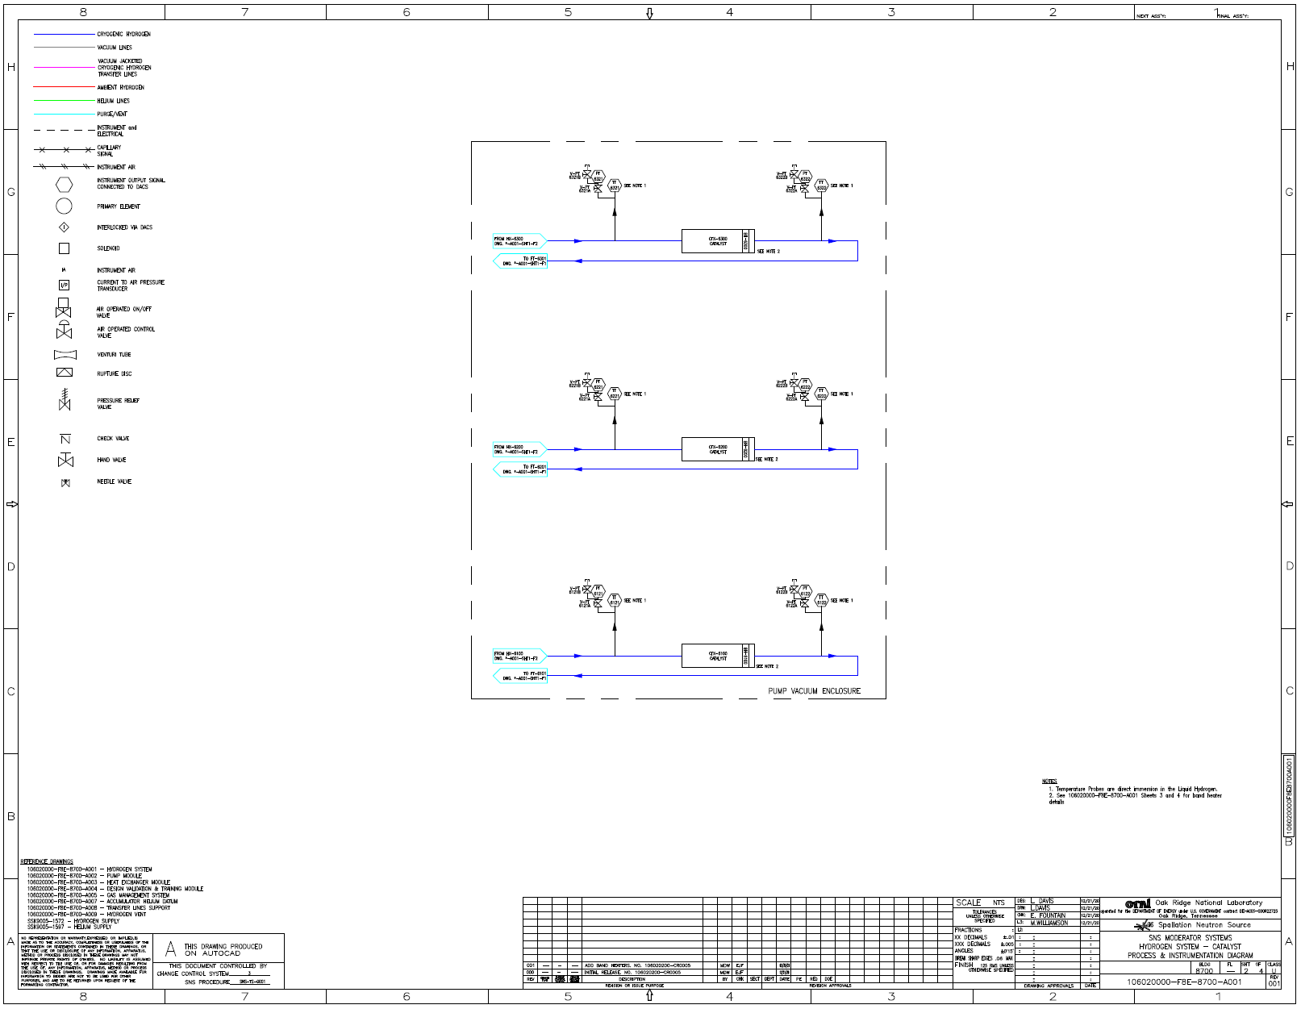
P.5.10.3 Final Design Status
Charge: 1,3,4
HRS and GP10 Final Design Review(FDR) completed
  Tracking recommendations, procurement in progress
Catalyst design in progress. MPS is delayed due to resources
  Additional resources can be hire for design
GR and MOTS design currently ongoing
  PCD & P&ID finalized
PLC programming and configuration is getting pushed and will overlap with other activities
  Additional resources can be hire for PLC programming and configuration

Slide 13
P.5.10.3 Installation Plans
Charge: 1,2,3
Equipment will be procured from external suppliers and control hardware will be assembled by external panel fabricators
Installation of Target Controls hardware will be performed primarily by craft labor with supervision/oversite from FTS Engineers
Testing and commissioning will be performed by FTS engineers and technicians
Work will be performed consistent with QA & Safety requirements

Slide 14
P.5.10.3 Installation Plans
Charge: 1,2,3
HRS
GP10
GR
MOTS
CAT
MPS
HRS Fabrication
GP10 Procurement,
HRS Installation and Programming
HRS Installation and Programming
Gas Recirculation PLC Cabinet & Cable Placement
GP10 Installation & Programming
GP10 Programming
Catalyst Procurement
Gas Recirculation Procurement
MOTS Procurement
MPS Procurement
MOTS Programming
Gas Recirculation Programming
MOTS PLC Cabinet & Cable Placement
Catalyst PLC Cabinet Update, Cable Placement, Programming
MPS PLC Cabinet Update, Cable Placement, Programming

Slide 15
P.5.10 Cost and Schedule
Charge: 4
P.5.10 is dominated by Control Integration
March PCR resulted in $716K increase
Overall progress in 26% completed

Slide 16
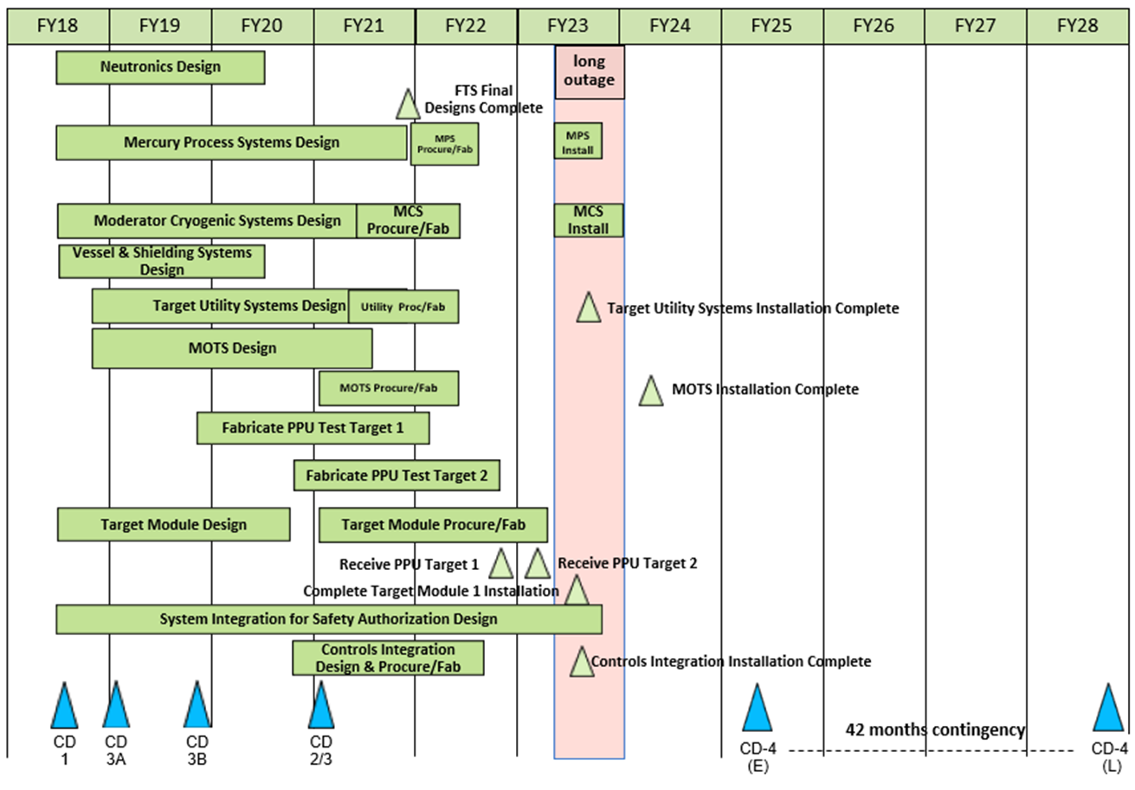
P.5.10 Cost and Schedule
Charge: 4
Cost are dominated by labor

Slide 17
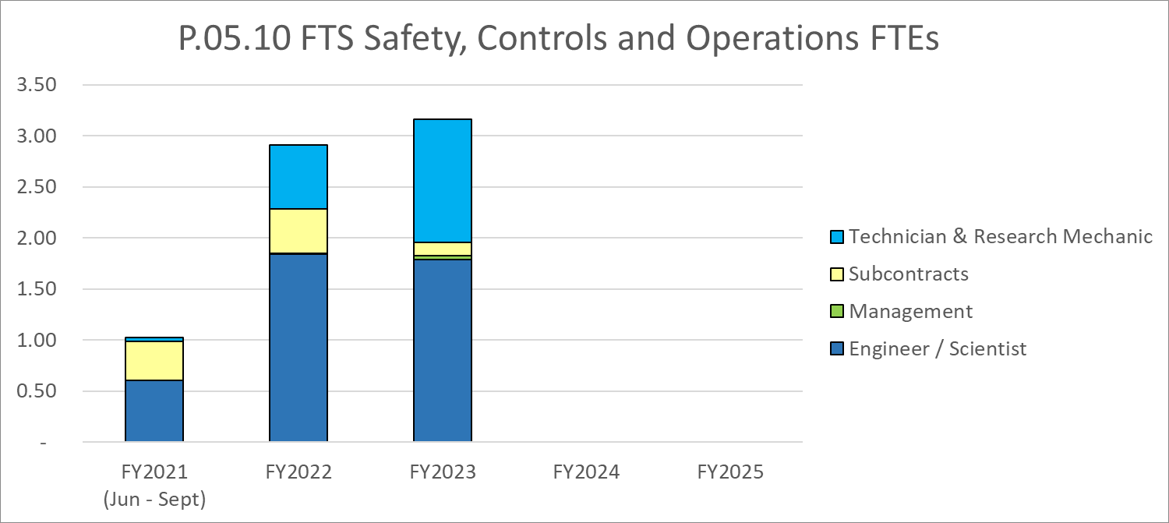
P.5.10 Labor Profile
Charge: 5

Slide 18
P.05.10 Safety, Controls and Operations Risk Register
Risk ID | L3 WBS | Risk Title | Expiration Date | Mitigation | Pre-Mitigation Rank | Post Mitigation Rank
T-P.5-024 | P.05.10 | Analysis reveals additional controls and/or protection system requirements for 2 MW target. | 11/1/2022 | Ensure analysis is completed well in advance of CD-2 so proper estimates for target control and protection systems can be developed and included in the project baseline. | 12 | 6
T-P.5-016 | P.05.10 | Failed certification for safety or controls during last outage | 12/1/2023 | Leverage the lessons learned in GI3 to develop a reasonable schedule and make sure some time is in the planning to address any potential failure in any certification. | 12 | 4
Two active risks identified
  One risk retired
  Pre-mitigated ranking: 2 Medium
  Post-mitigated ranking: 1 Low, 1 Medium
High Risks
  No high risks identified
Key risk categories analyzed
  Controls requirements
  Safety
Risks are reviewed on a regular basis
B2-10 Platfoot

Slide 19
P.05.10 Responses to Recommendations
Charge: 6
No recommendations from the CD-2/3 review

Slide 20
P.05.10.3 ESH&Q and COVID-19 Impacts
Charge: 3
Hydrogen Refill System
  Compliant with fire protection engineer
  Compliant with Class 1 Div.2 Group B
COVID-19 impacts
  Due to quarantines, meetings and schedules were delayed
  Project interaction was a challenge with requirements and design, progress move at slower pace
  Despite COVID-19 challenges, project aimed for milestones

Slide 21
P.05.10.3 12-Month Look-Ahead
Charge: 1-5
Hydrogen Refill System
  Procurement and cabinet fabrication
  Phase 2 & 3 for PLC and HMI configuration and programming
MOTS
  Phase 2 & 3 schematics design
  Phase 2 & 3 for PLC configuration and programming
  Procurement and cabinet fabrication
Gas Recirculation
  Phase 3 GR schematics design
  Phase 2 & 3 for PLC configuration and programming
  Procurement and cabinet fabrication

Slide 22
P.05.10.3 12-Month Look-Ahead
Charge: 1-5
Gas Panel 10
  Procurement and cabinet upgrade
  Phase 2 & 3 for PLC configuration and programming
Catalyst
  Phase 3 for schematics design
  Phase 2 & 3 for PLC configuration and programming
  Procurement and cabinet upgrade
Mercury Process System
  Phase 2, & 3 for schematic design & PLC configuration and programming
  Procurement and cabinet upgrade

Slide 23
Summary
Target Control Systems has progress well to further develop the design
Scope is understood and meets FTS performance requirements
Interfaces for Target Controls are well defined for this stage of the project
Activities and cost are well developed and will be refined as the Target Systems design evolves
Schedule is integrated with Target Systems design schedule to support project completion dates
Thank you for your time!
Questions?

