Slide 1




P.05.9 2MW Target
DOE/SC Independent Project Review of the Proton Power Upgrade Project
Kevin Johns
Level 3 Manager for 2MW Target
September 14-17, 2021

Slide 2
Outline
Scope
Organization
Progress since CD-2/3
Challenges
Final design status
Installation plans
Cost and schedule
Labor profile
Risk register
Responses to recommendations
ESH&Q and COVID-19 impacts
12-month look-ahead
Summary

Slide 3
Scope
Charge: 4
Management and System Integration (P.5.9.1)
  Fabrication oversight and management
Fabrication of three (3) 2 MW targets (P.5.9.2)
  First three targets to operate after PPU long outage
Supporting hardware (P.5.9.3)
  Target utilities supplied via jumpers
Fabrication of two (2) Test Targets (P.5.9.4)
  Early deployment of PPU target features such as swirl bubblers prior to long outage to gain operational experience
Notes:
P5.9 scope includes the following four elements
Test Targets help gain early operational and fabrication experience prior to production targets

Slide 4
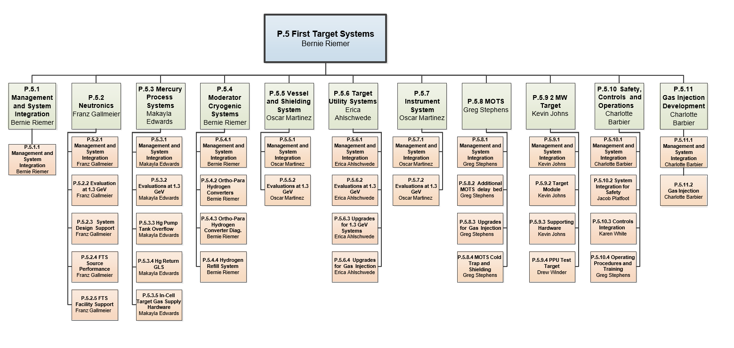
Organization
Charge: 4
Notes:
Drew remained CAM for Test Targets while the target team continued to develop the 2 MW target design

Slide 5
Progress Since CD-2/3 (July 14-17, 2020)
Award contract for Test Target 2
  Completed 9/2020
Award contract for 3 target modules (subject to CD-3)
  Completed 10/2020
  First milestone complete, all material received
Receive Front Body Development Test Article
  Completed 2/2021
  Incorporated into Test Target #2 Scope
Test Target 1 EB Welding and NDT Verification
  Completed 7/2021
Notes:
3 production targets ordered after CD-2/3 approval.
TT2 and 3 production targets being fabricated together improves fabrication time
Front body development piece ordered 6/1 ~ 8-month development

Slide 6
Current Status
All PPU targets are being fabricated at Metalex Manufacturing.
  Metalex has successfully built 23 target modules to date
Weekly virtual meetings are held to discuss progress
Monthly on-site visits have resumed by manufacturing and engineering
  Visits for oversight of Test Target #1 were lost due to Covid
New 2MW target fabrications progressing well
  PPU Target 2 recently damaged during machining of front body
Notes:
Virtual meetings provide scheduling updates, answer vendor questions, and resolution to any challenges during fabrication
Worked through TT1 issues virtually, many issues would have been easier to resolve in person. Required additional time or shipments for inspection to resolve.
Ability to travel recently has increased oversight and ability to address issues better

Slide 7
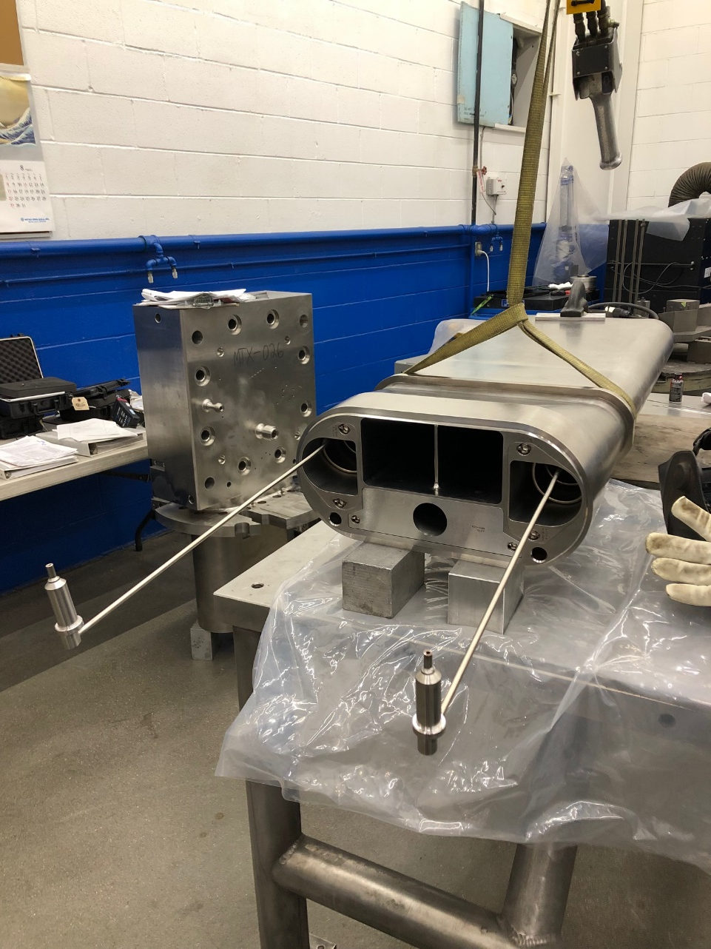
PPU Test Target 1
Charge: 3
MTX-024
  Planned operation at 1.4 MW and gas injection up to 10 SLPM thru swirl bubblers
    Completion: September 2021
    Operation: January 2022
  Includes new PPU features such as
    Swirl bubblers
    Transition center baffle
    Insert and new jet-flow supply
  Front body is a previous design
    modified to remove corners.
Notes:
New swirl bubbler design passed all pre-installation testing. With the elimination of small orifices at the bubbler, reduced risk of gas rate degradation during operation

Slide 8
PPU Test Target 2
Charge: 3
MTX-029
  Planned operation up to 1.55 MW and gas injection up to 10 SLPM thru swirl bubblers and nose injection
    Completion: March 2022
    Operation: December 2022
  Target design is identical to that of 2 MW targets. Operated prior to long outage
  Test target #2 utilizes the front body development piece used to prove out fabrication process of new target design
Notes:
Single supply of gas injection due to new VLSB not being installed yet
Target is further along than other production targets due to use of FB. Inner window EB weld already completed.
The new outer window to FB EB weld will up next.

Slide 9
PPU 2MW Targets
Charge: 3, 4
MTX-030 thru MTX-032
  Planned operation up to 2 MW at 1.3 GeV after KPP is met
  Fabrication underway
    Parts are making excellent progress; exception: MTX-031
  Gas injection up to 20 SLPM via swirl bubblers and nose injection
  MTX-030
    completion: May 2022
    ramp to 1.7 MW
  MTX-031
    completion: July 2022*
    achieve KPP then ramp to 2MW
  MTX-032
    completion: August 2022
    project spare
KPP:
*Change anticipated

Slide 10
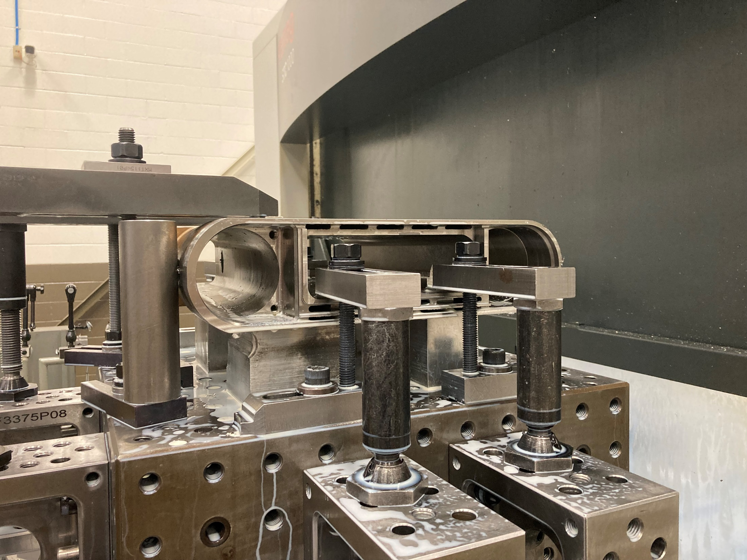
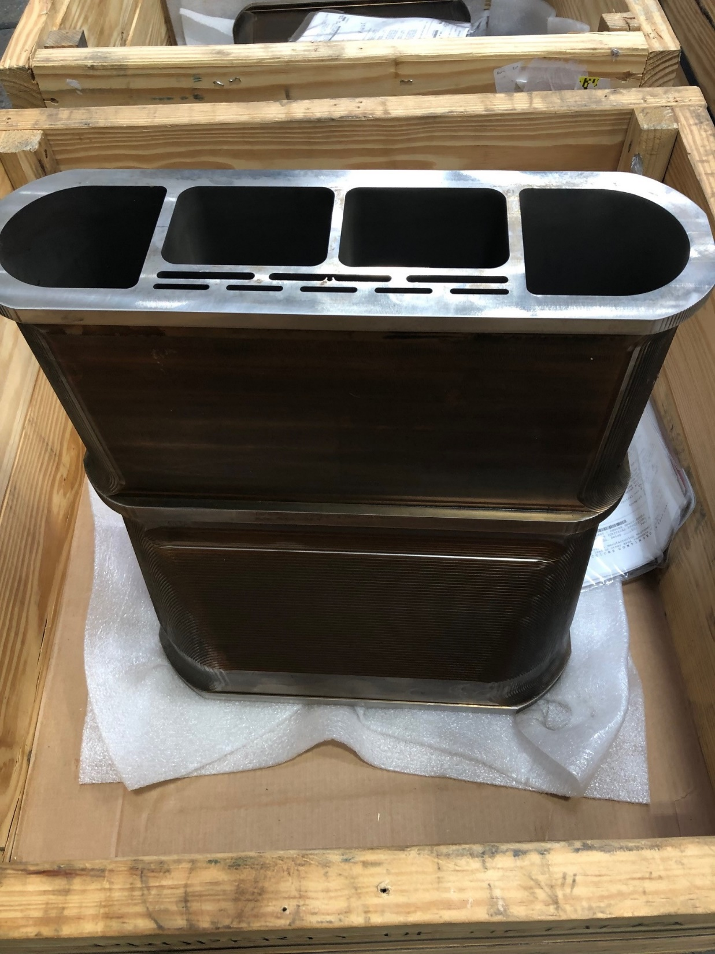
PPU 2MW Targets

Slide 11
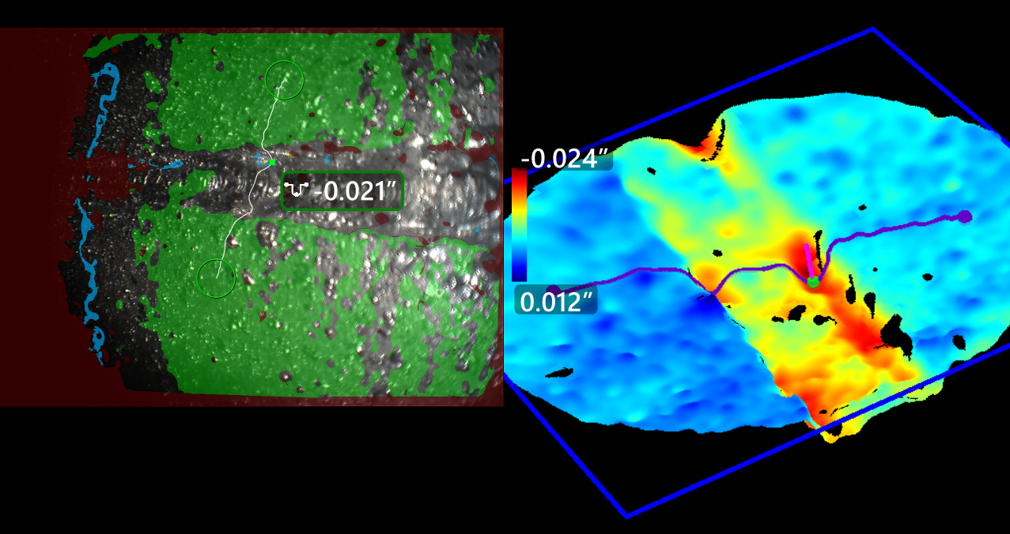
Challenges
Charge: 1
Test Target #1 Water-Cooled Shroud (WCS) has had several weld rejections
  Minor changes made for PPU, none which relate to fabrication difficulties to date
  Multiple EB weld repairs have successfully been completed
Activities in progress to determine root cause of recent EB weld issues and correct before future welds are made
  Further oversight of EB welding
  Engineering review of NDE techniques
  Further weld development if needed
Notes:
Shroud repair have caused delays in overall schedule. Delivery still expected before need by date. Tracking closely.
Have had to develop new inspection techniques to resolve restrictions in previous techniques.

Slide 12
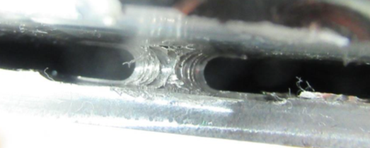
Challenges
PPU Target #2 (MTX-031) front body recently damaged
  Significant enough part had to be scrapped
  Wrong tool loaded into machine
Two previous front bodies (MTX-029 and MTX-030) had been successfully completed already
Waiting on schedule impact of replacement part
MTX-030 Complete
MTX-031 Damage
Notes:
Float in schedule should not impact operation date
These issues occasionally are dealt with

Slide 13
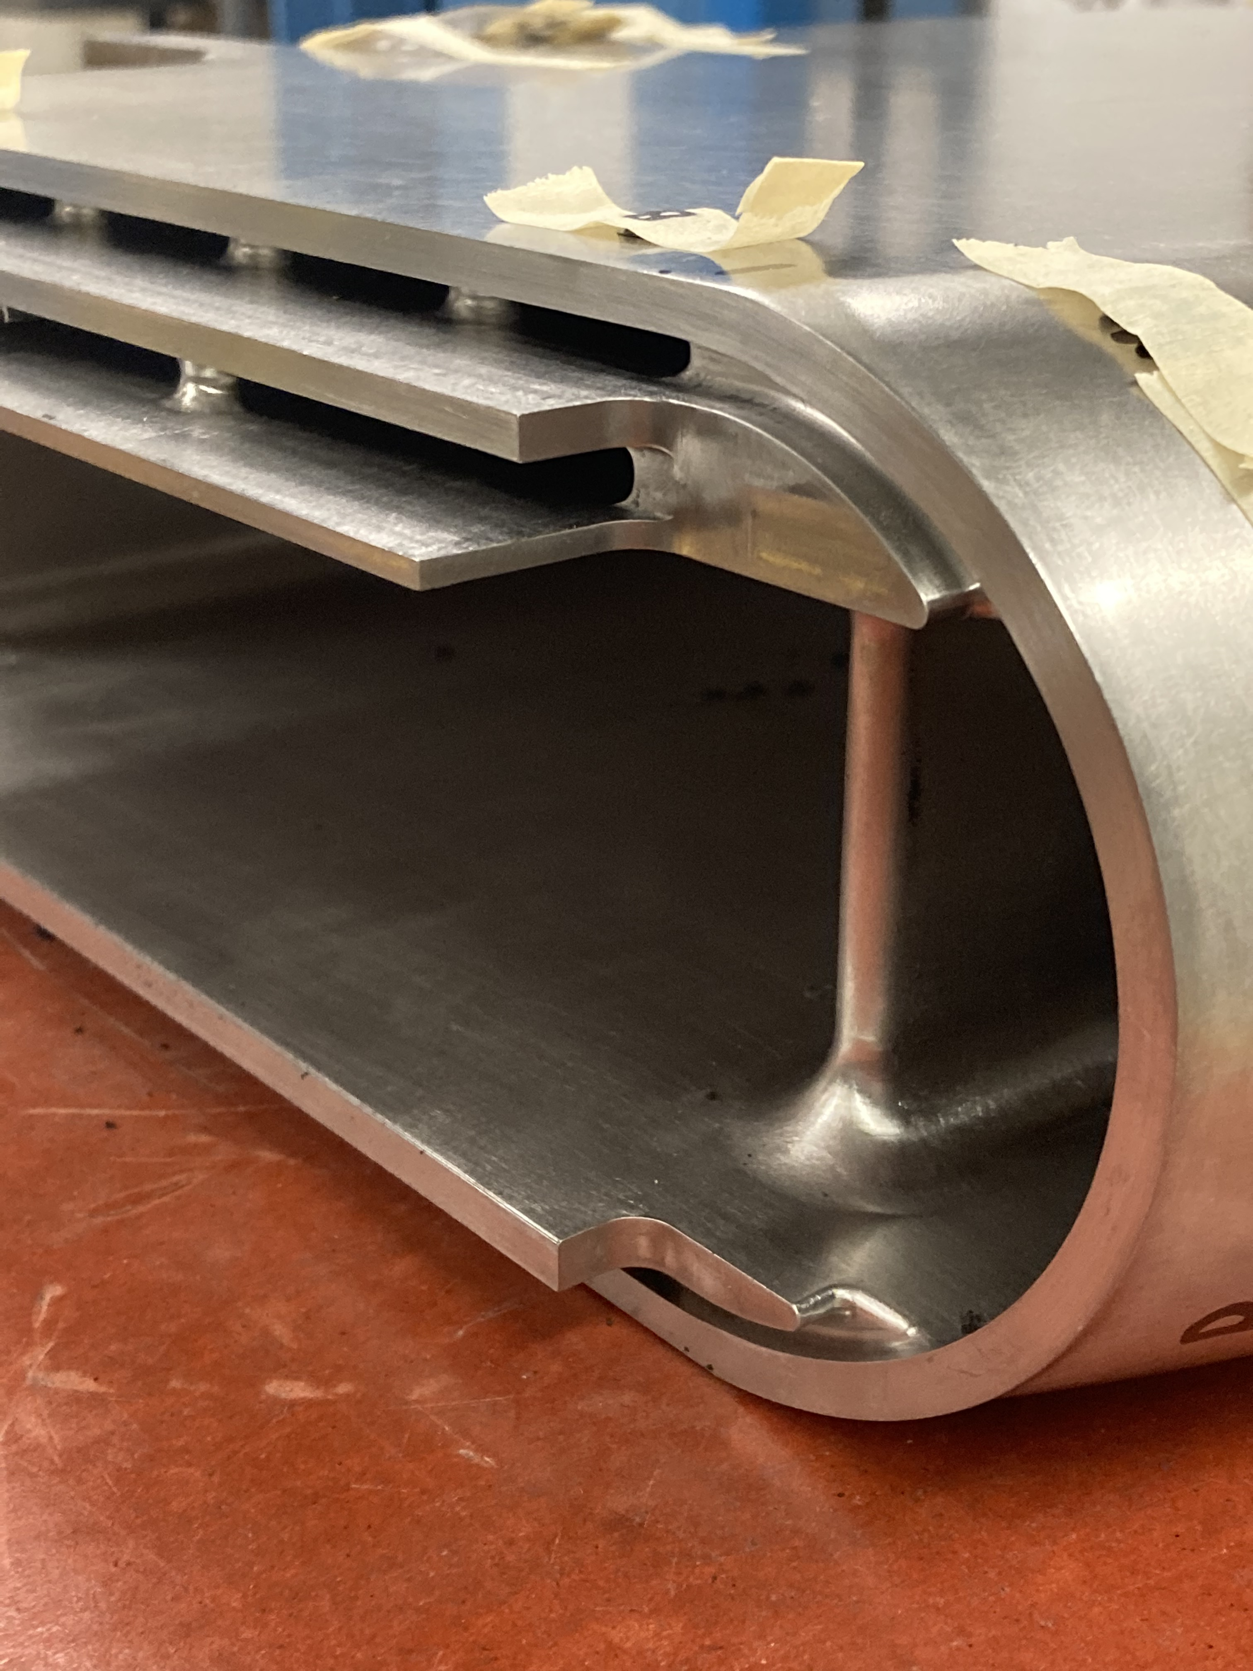
Final Design Status
Final Design has been completed
Design was unaffected by T27 leak
  Corner which led to leak was removed during initial design of target module in response to T22 leak

Slide 14
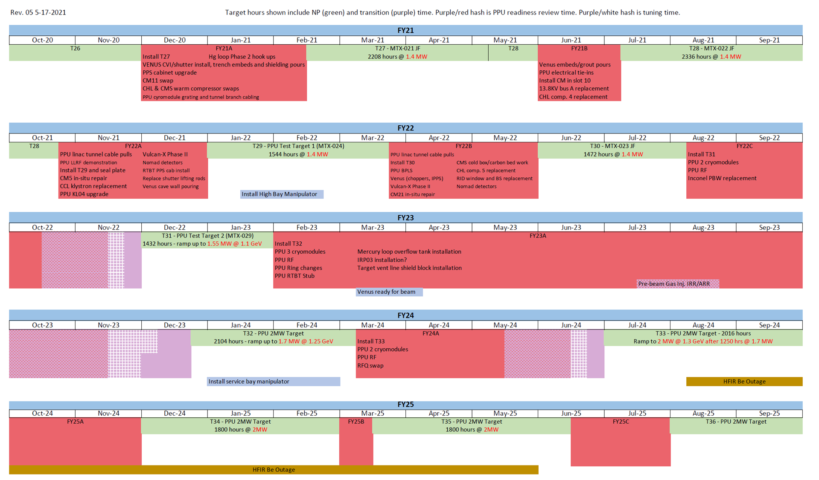
Installation Plans
Charge: 2
TT# 1
All targets are scheduled for delivery prior to the long outage
Target installation process is the same as current
TT# 2
PPU# 1
PPU# 2
PPU# 3
Notes:
Delivery dates shown are vendors current completion date, tracking ahead of project schedule.
Installation of T32 during long outage after all new gas injection hardware is installed and tested.
Work with operations for installation of new equipment needed outside of PPU scope (new VLSB)

Slide 15
Budget and Estimate to Complete
Charge: 2
P.05.09.01 Difference is from restricted travel due to Covid.
Notes:
5.9.1 ETC high due to restricted travel during Covid
About halfway through for test targets and production targets
Order of jumpers left for supporting hardware. New VLSB design

Slide 16
Cost Estimate by FY

Slide 17
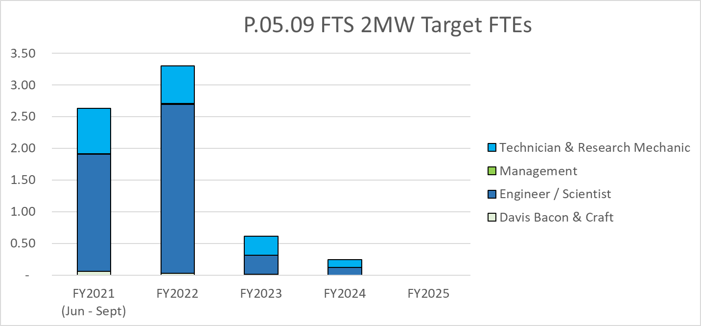
Labor Profile
Charge: 4
Notes:
Break down of labor
Engineering/manufacturing support/oversight throughout fabrication
Technician/research mechanic support for final testing and installation preparation

Slide 18
P.05.09 2 MW Target Risk Register
Risk ID | L3 WBS | Risk Title | Expiration Date | Mitigation | Pre-Mitigation Rank | Post Mitigation Rank
T-P.5-005 | P.05.09 | Late delivery of target module | 6/30/2023 | Continue to maintain good communication with the target vendor, including frequent vendor visits, so that schedule challenges can be discovered early and mitigated to the extent possible. | 6 | 6
T-P.5-032 | P.05.09 | Late delivery of test targets | 1/31/2022 | Continue to maintain good communication with the target vendor, including frequent vendor visits, so that schedule challenges can be discovered early and mitigated to the extent possible. | 2 | 2
Two active risks identified
  Five risks retired
  Pre-mitigated ranking: 1 Low, 1 Medium
  Post-mitigated ranking: 1 Low, 1 Medium
High Risks
  No high risks identified
Test Target #1 Delivered
Key risk categories analyzed
  Fabrication
  Delayed target delivery
  Limited Vendors
Risks are reviewed on a regular basis
Notes:
Currently production targets on track to be delivered well ahead of need by date.

Slide 19
Responses to Recommendations
Charge: 6
Recommendations from CD2/3 Director’s Review
  Recommendation: Quantify the potential impacts of the Target Module opportunity and any strategies to enhance its probability. Incorporate it into the PPU Risk Analysis prior to the IPR
  Response: A new opportunity has been created in the Risk Register: "O-P.5-007" is valued at a potential $200k savings
    Front body development piece was used with TT#2 and an additional front body did not need to be purchased
    This recommendation has been closed
  Recommendations from prior DOE reviews are closed
Notes:
This was a risk which wasn’t realized rather than opportunity for savings.

Slide 20
Fabrication and COVID-19 Impacts
Charge: 5
New design has led to different fabrication processes needed
  Changes were rolled out in pieces through the implementation of Test Targets. This has minimized difficulties with the 2MW target fabrication
Several non-conformances and repairs were needed on PPU TT#1 shroud
  Repairs have all been successful thanks to many people
Damage to PPU Target 2 will cause schedule delay
  Due to float in schedule, it will not impact scheduled operation cycle
No Covid-19 delays recorded during fabrication to date.
  Travel restrictions for target oversight

Slide 21
12-Month Look-Ahead
Charge: 2,4,5
Successful operation of PPU Test Target #1
Delivery of PPU Test Target #2
  Preparation for installation prior to PPU long outage
Delivery of all production targets
  Vendor schedule tracking ahead of project schedule. Final target delivery currently forecasted for August 2022

Slide 22
Summary
PPU Test Target #1 recently delivered. Target to be operated at the beginning of CY22
  First deployment of swirl bubblers in SNS target module
Resumed travel and oversight for PPU TT#2 and production targets
  Expect this to improve fabrications going forward
Production 2MW target design going well
  Benefited from roll out of features in Test Targets

