Slide 1




P.6 Conventional Facilities
DOE/SC Independent Project Review of the Proton Power Upgrade Project
Mark Connell
Level 2 Manager for Conventional Facilities
September 14-17, 2021

Slide 2
Outline
Scope
Organization
Progress since CD-2/3
Challenges
Final design status
Installation plans
Cost and schedule
Labor profile
Risk register
Responses to recommendations
ESH&Q and COVID-19 impacts
12-month look-ahead
Lessons Learned
Summary

Slide 3
Session Agenda: B5 Conventional Facilities
Tuesday
1:00 pm B5-1 Conventional Facilities Overview Mark Connell
1:25 pm B5-2 Klystron Gallery Construction Luke Santee
1:50 pm Discussion All
Wednesday
10:30 am B5-3 RTBT Stub Design and Construction Mark Connell
10:55 am B5-4 Controls Derrick Williams
11:20 am Discussion All
1:15 pm Discussion All
Thursday
10:30 am Discussion if needed All

Slide 4
Scope
Charge: 1,5
P.6.1 Conventional Facilities (CF) Management
P.6.2 Conventional Facilities Building Modifications
  P.6.2.1 moved to P10.6 Klystron Gallery Building Modifications
  P.6.2.2 Ring-to-Target Beam Transport (RTBT) Modifications
  P.6.2.3 Heating, Ventilation and Air Conditioning (HVAC) Controls
P10.6 Long Lead Procurement Klystron Gallery Building Modifications
B5-1 Connell
B5-2 Santee
B5-3 Connell
B5-4 Williams

Slide 5
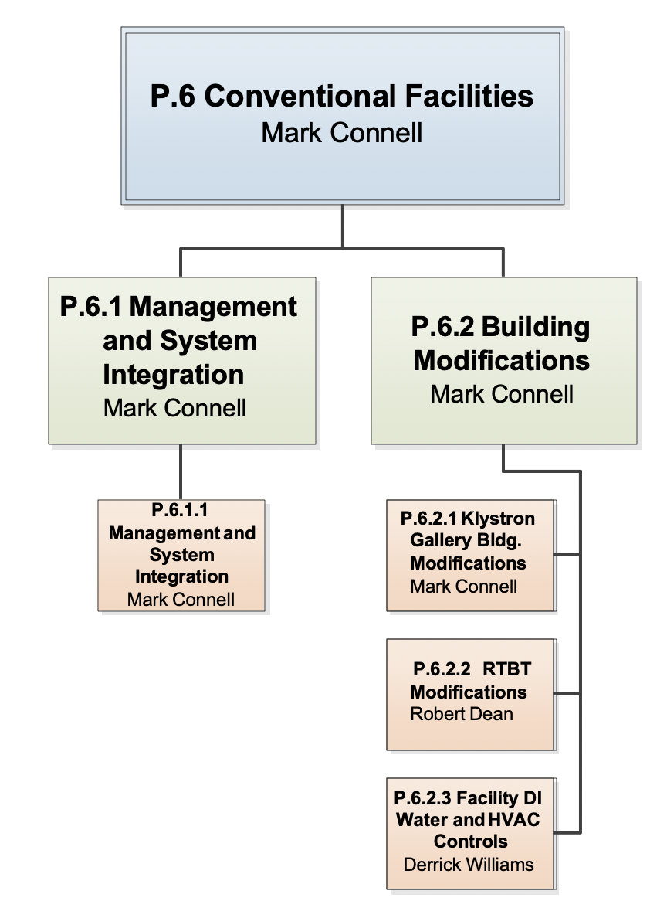
Work Breakdown Structure
Charge: 5
Moved to P.10.6.2.1 Long-Lead Procurement
Luke Santee
Moved to P.10.6.2.3 LLP

Slide 6
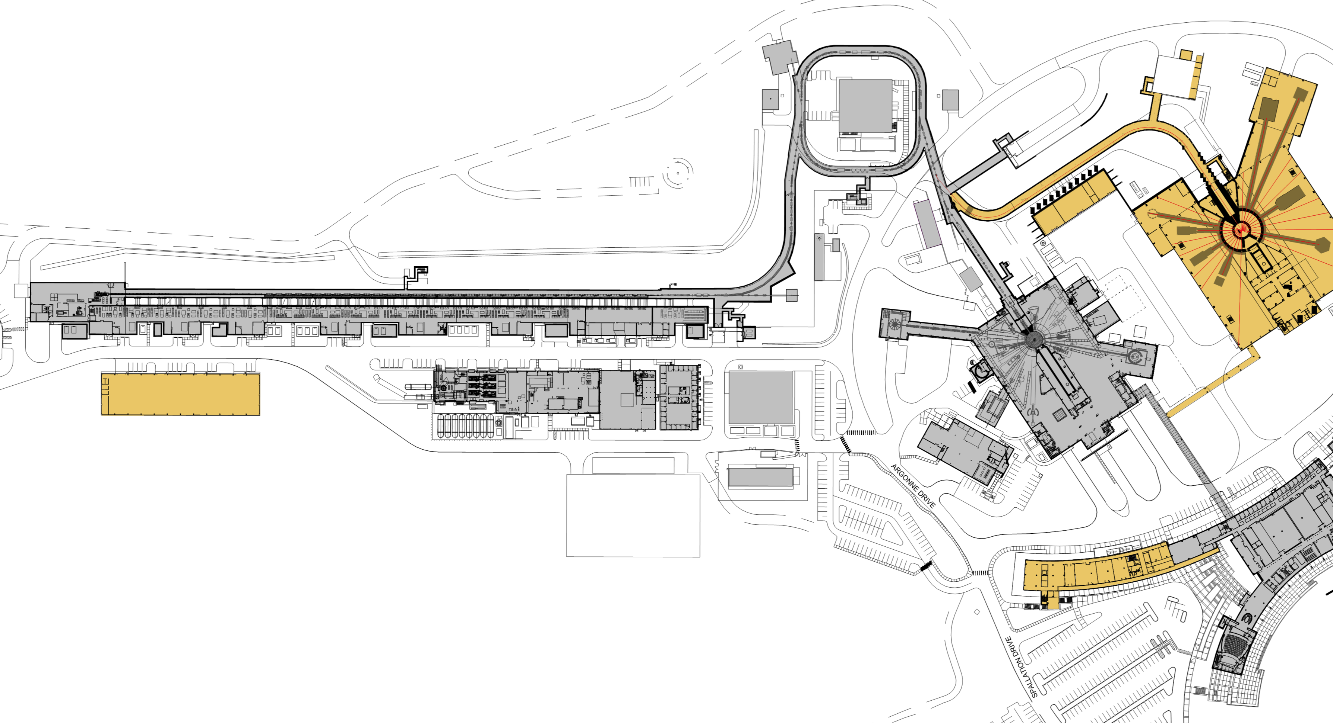
SNS Site – CF Scope Areas
Charge: 1
RTBT Stub
P.6.2.2
Klystron Gallery – CD-3B
P.10.6.2.1
P.10.6.2.3

Slide 7
Scope – Klystron Gallery
Charge: 1
Conventional Facilities
  New pump room with siding and roll up door
  Concrete drives, sidewalks and transformer slabs
  13.8kV switchgear and building electrical services to power panels
  New HVAC unit, piping and ductwork
Accelerator Cooling
  (2) 150 HP pumps, pump bases and header piping installed to (5) Transmitter Rack Cooling Carts (TRCC)
  DI Water polishing loop
  Branch piping from TRCC’s to technical equipment hose connections
  Hydrostatic testing, flushing and drying of piping
Radio Frequency
  Installed hanger grid system down to ~14’ above finished floor

Slide 8
Scope – Klystron Gallery
Charge: 1
Controls
  DI water system controls
  HVAC system controls
B5-4 Williams

Slide 9
Scope RTBT Stub Design
Charge: 1
Provide comprehensive design for the construction of the Stub out to the Second Target Station (STS) connection point
  Structural design for connection to existing structure and STS tie-in point
  Geotechnical evaluation and settlement analysis to minimize differential settlement
  Constructability reviews to ensure work could be completed as designed and within the schedule constraints
  Radiation shielding analysis incorporated into design and construction milestones
  Minimal electrical for lights and receptacles
  HVAC system downstream of shield wall for humidity control

Slide 10
Scope RTBT Stub Construction
Charge: 1
Construction to be completed in 6-months from SNS outage start date with a Fixed Price Subcontract (FPSC)
Excavation boundaries for pre-outage work and final grade prior to SNS start-up are specified on the drawings based on neutronics study
Project is staged for pre-outage work, outage dependent work and post-outage work
Mitigations have been put in place to minimize adverse weather impacts- multiple drainage systems, shotcrete slopes, and sheet piles to minimize excavation
Schedule developed by Construction Management firm Barton Malow under Cannon Design contract
Personnel Protection Systems (PPS) by ORNL

Slide 11
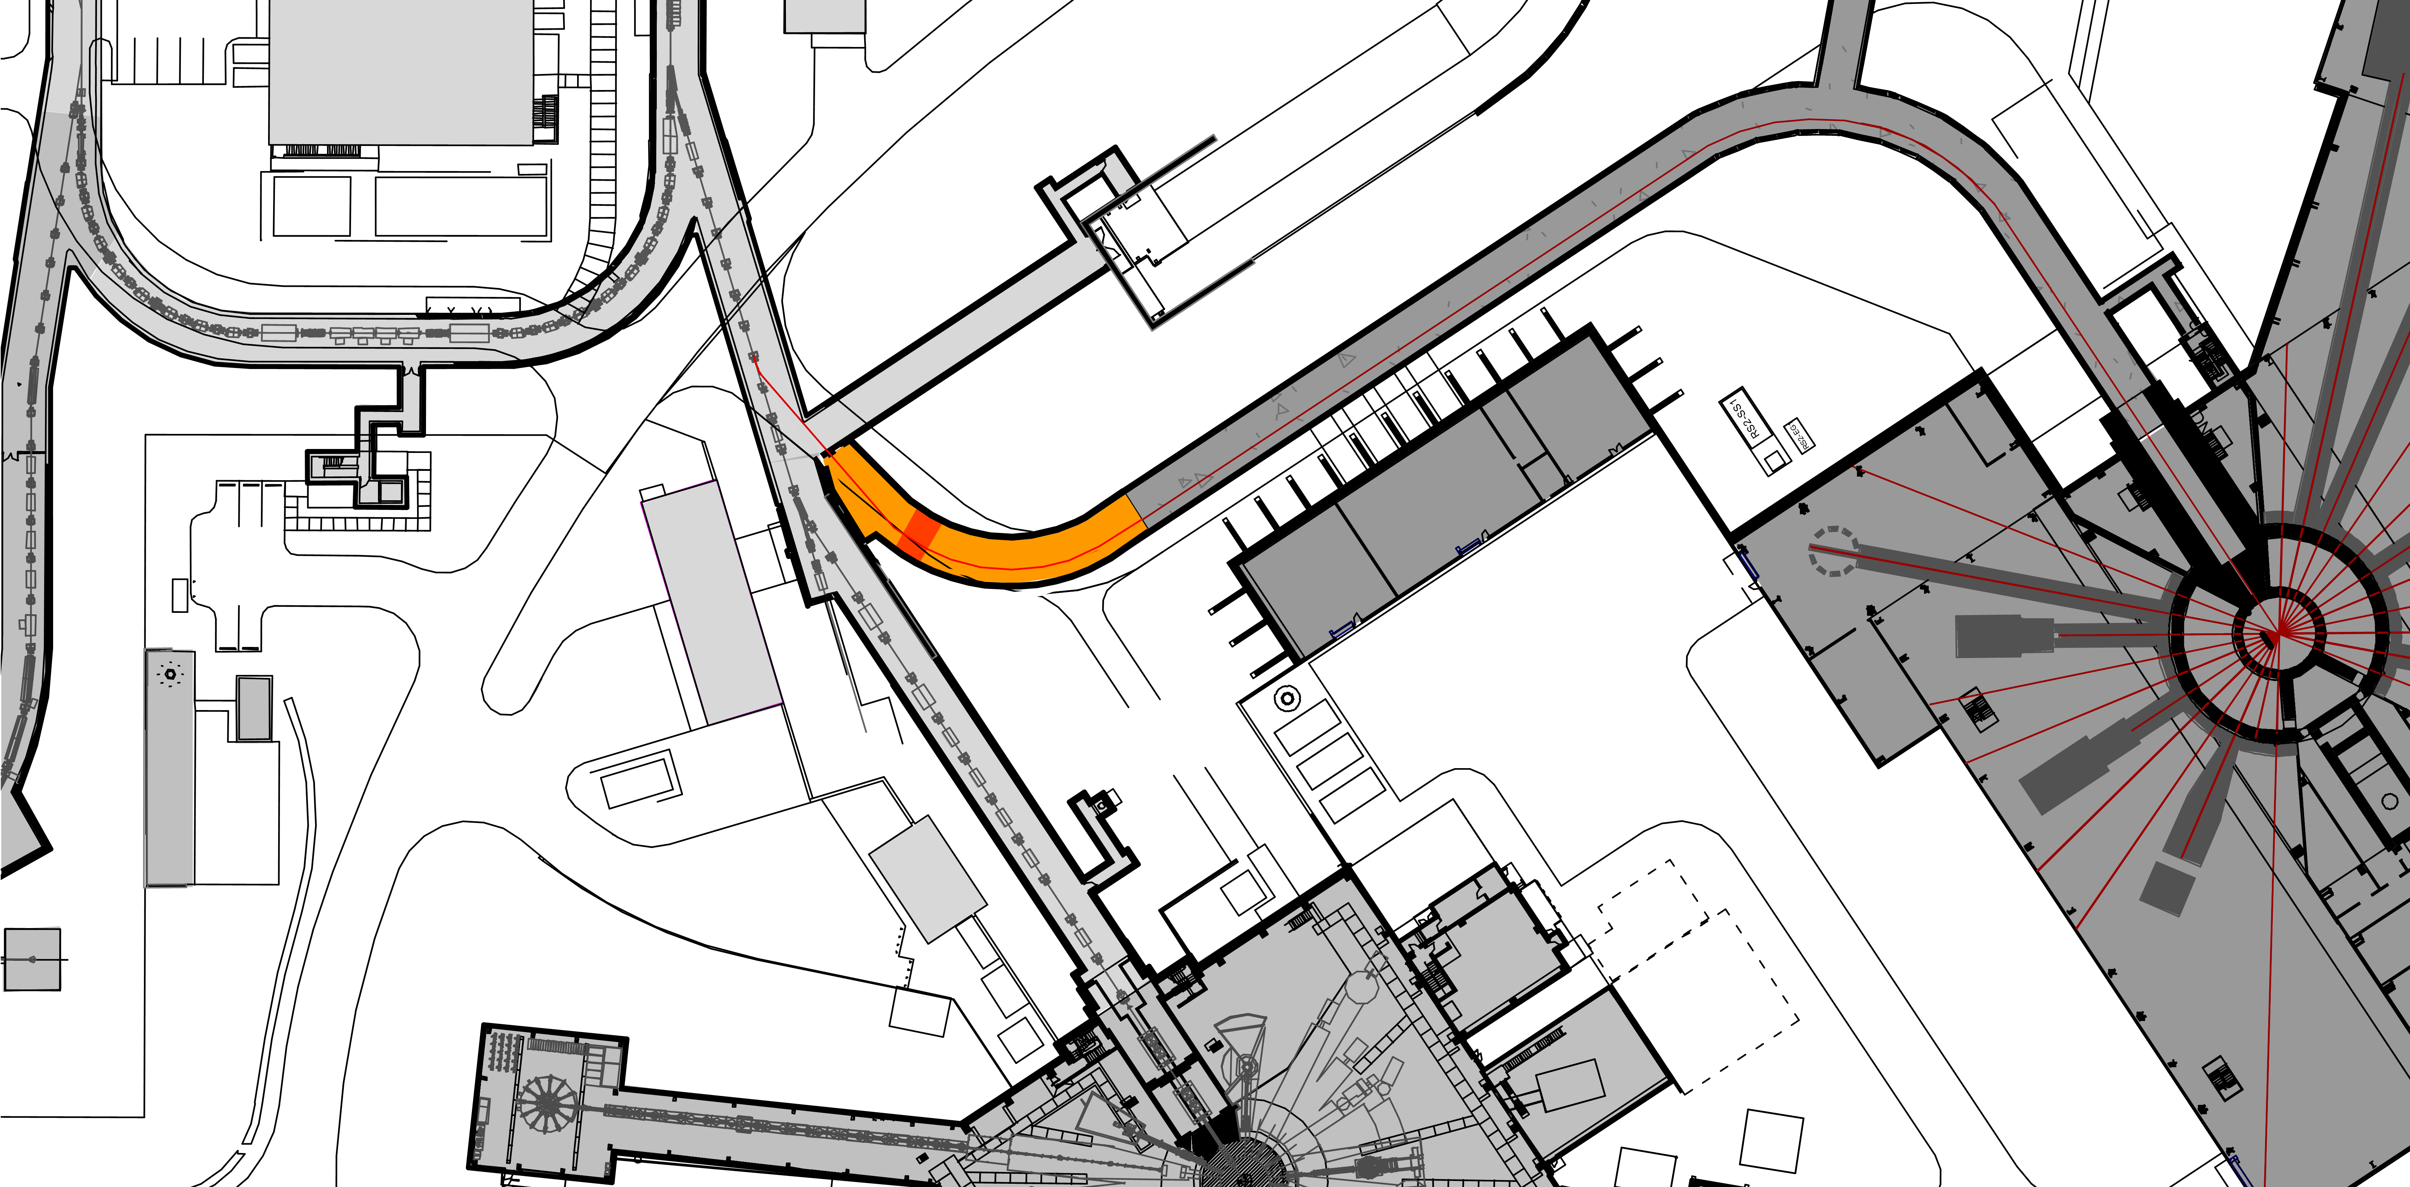
RTBT Stub Overview – Existing/New/Future
Charge: 2
RTBT Tunnel
Truck Access Tunnel
Future RTST Tunnel
Future Proton Beam
RTBT Proton Beam
Temporary Stacked Shielding
RTST Service Building
RTBT Service Building
RTBT Stub
Second Target Station
First Target Station

Slide 12

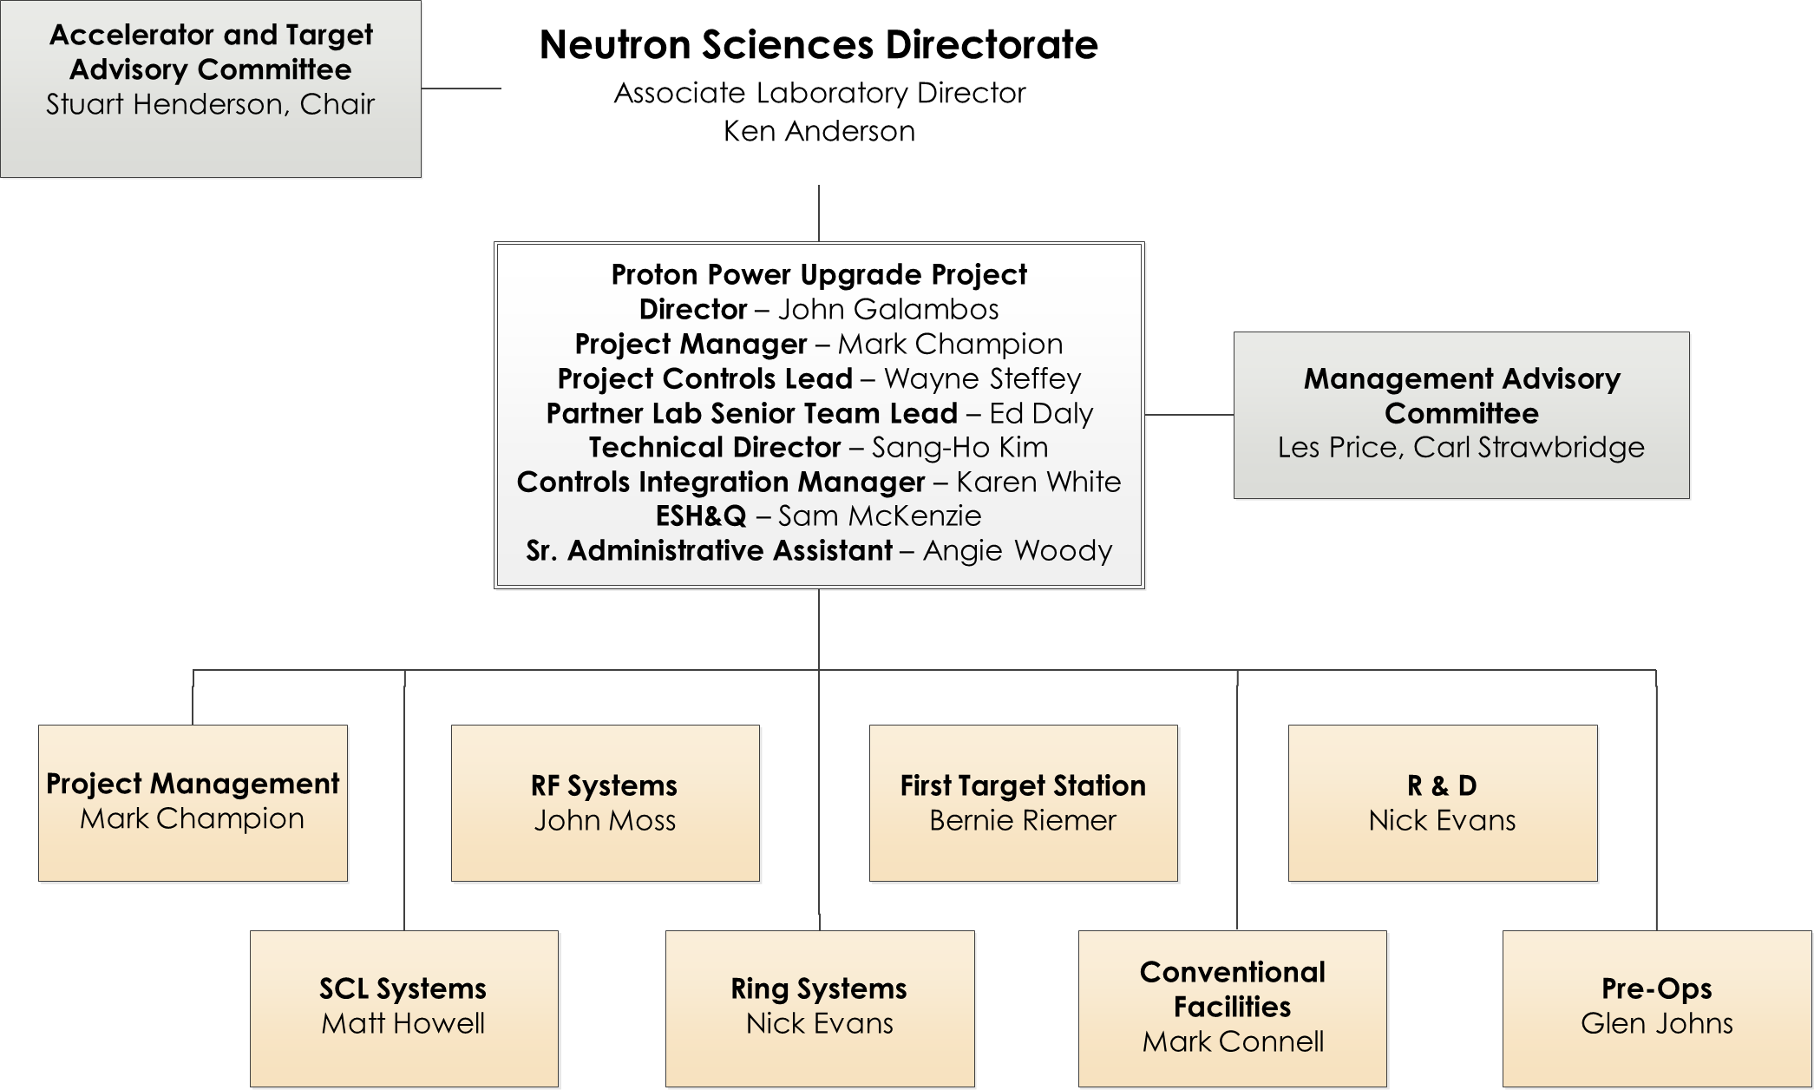
Organization- Level 2
Charge: 5

Slide 13
Progress since CD-2/3
Charge: 4
Klystron Gallery
  Klystron Gallery Construction complete and turned over to installation subcontractor
  DOE Klystron Gallery ready for installation milestone met with Substantial Completion April 6, 2021
  As built drawings and project close-out in progress
RTBT Stub
  No field work scheduled or performed
  Reviewing plans for change of SNS operations outage schedule
  Coordinating technical and schedule with Second Target Station and Beamline 13 External Building-2

Slide 14
Challenges
Charge: 5
Klystron Gallery
Performing construction during COVID-19
Utilizing BIM for the first major construction project- design model versus construction model expectations and use
Managing multiple scopes for design and construction
RTBT Stub
Completing construction and restoring shielding to allow beam operations within 6-month schedule with weather uncertainties
Potential for changes from STS during design development
Potential for STS and Beamline 13 EB-2 concurrent construction

Slide 15
Final Design Status
Charge: 1
Final designs are complete for Klystron Gallery Building Modifications and RTBT Stub
  Changes to RTBT Stub requested by STS may be considered by PPU management as design moves from conceptual to preliminary

Slide 16
Installation Plans
Charge: 1
Klystron Gallery Construction Complete
RTBT Stub
  Construction is scheduled for SNS FY 23A outage beginning February 2023
  Stacked shielding by the installation subcontractor concurrent with stub construction
  ORNL PPS group will install equipment during stub construction

Slide 17
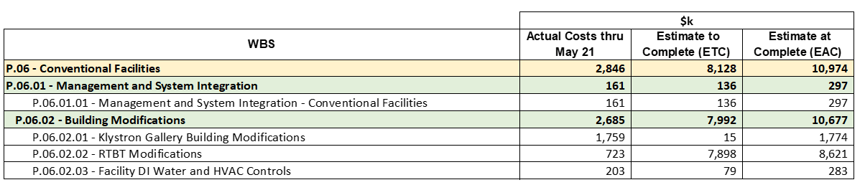
Cost and Schedule- Management and RTBT Stub
Charge: 4

Slide 18
SPI and CPI – P.06

Slide 19
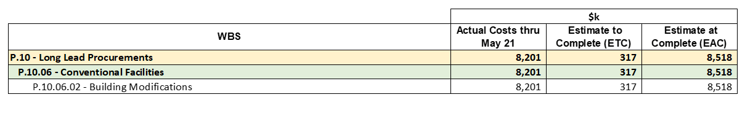
Cost and Schedule- Klystron Gallery Construction
Charge: 4

Slide 20
SPI and CPI – P.10.06
Final CPI 0.99 July 2021

Slide 21
Project Change Requests since CD-2/3

Slide 22
Klystron Gallery FPSC Change Orders
Charge: 4
Change order requests from the FPSC totaled $808,651
Change orders approved by UTB $644,222
9.94% of Subcontract Value
Categories of changes and associated costs:
  COVID and OT $236,036
  Accelerator Cooling $131,483
  Design changes UTB Directed $ 77,849
  BIM Design Adds $ 75,186
  Differing Field Conditions $ 48,592
  Scope Additions UTB Requested $ 46,604
  GC Coordination $ 22,310

Slide 23
Klystron Gallery Construction Schedule Changes
Original subcontract completion date February 6, 2021
COVID-19 direct impact of 35 calendar days moved end date to March 11, 2021. Processed under CFCO 9
Technical issues with the roof curb caused delays to critical path activities of 20 calendar days. Contract end date moved to March 31, 2021. Processed under CFCO 12
The electrical tie-in for the project to go onto permanent power was dictated by operations to be performed on a full maintenance day which occurred on April 6, 2021, marking substantial completion of the project
The subcontract end date was extended to 6/30/21 with a no- cost modification to allow for completion of punch list items and close-out submittals

Slide 24
Cost Estimate by FY- Management
Charge: 4

Slide 25
Cost Estimate by FY- RTBT Stub

Slide 26
Cost Estimate by FY- Klystron Gallery Construction
Charge: 4

Slide 27
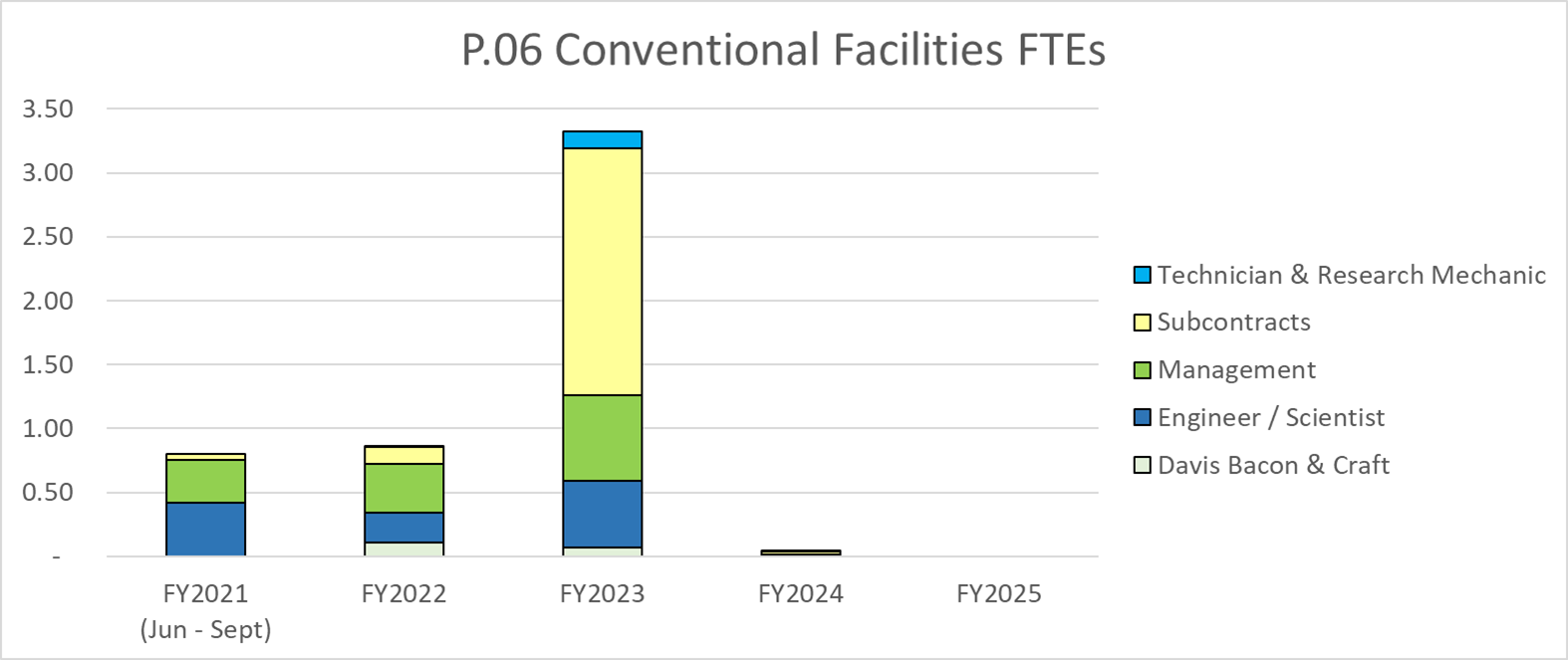
Labor Profile- Management and RTBT
Charge: 4

Slide 28
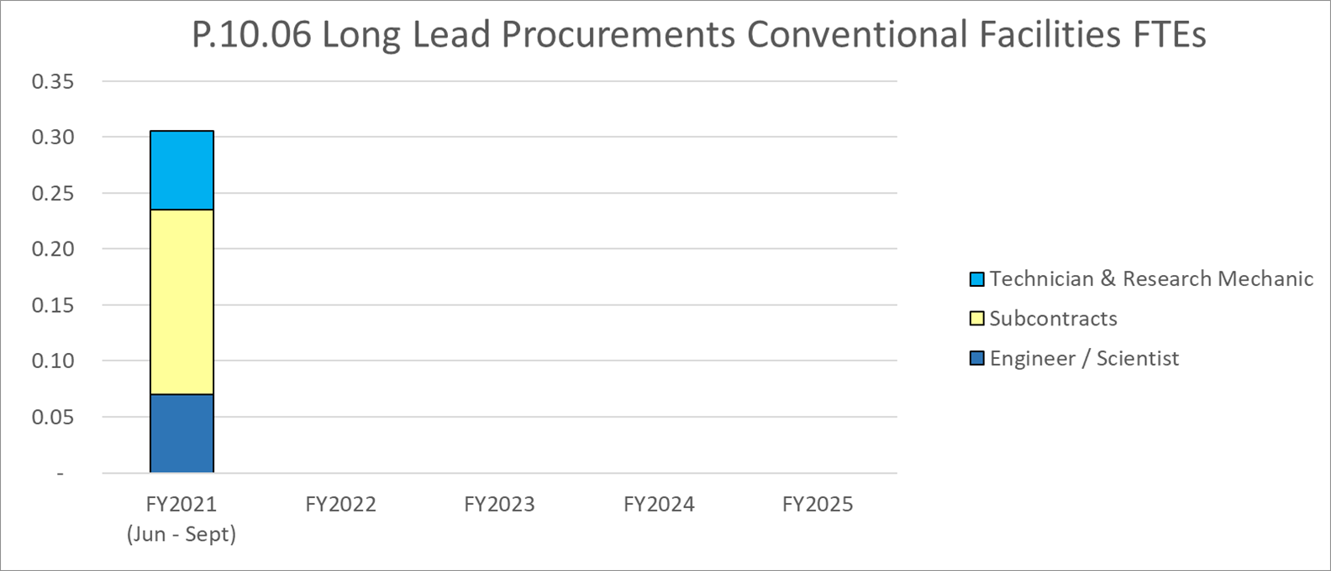
Labor Profile- Klystron Gallery Construction
Charge: 4

Slide 29
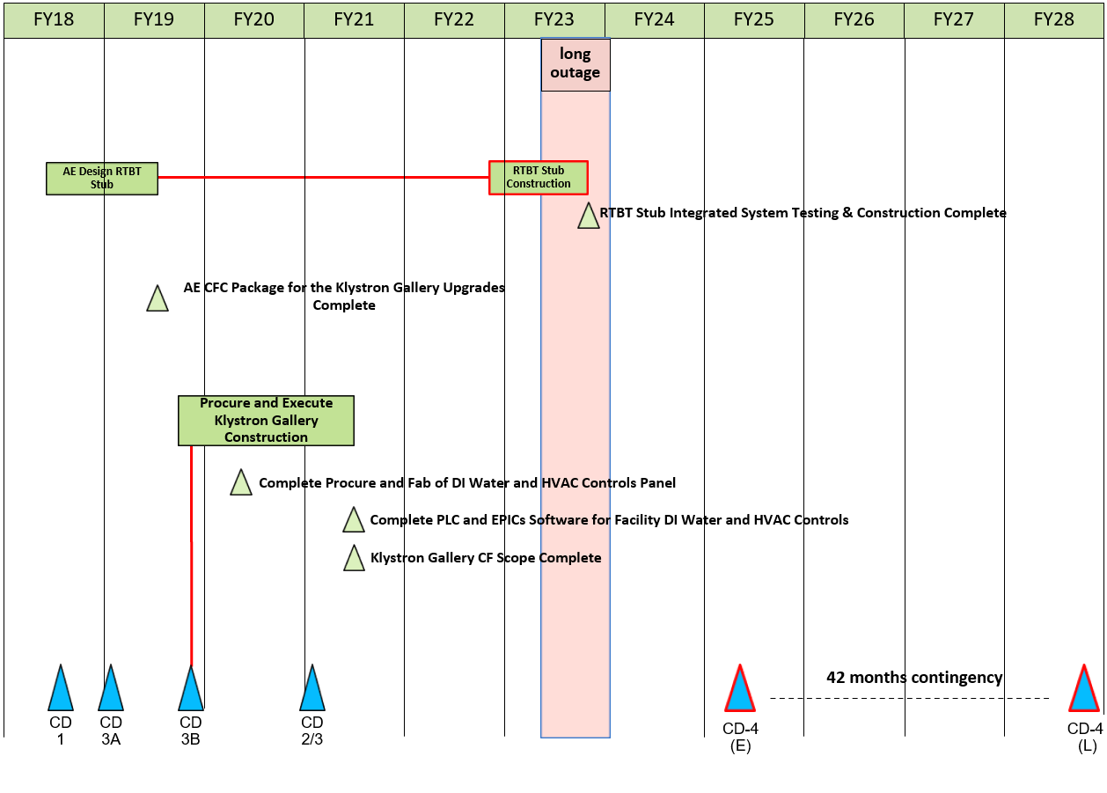
P.6 – CF May 2021 Status Summary Schedule
Charge: 4

Slide 30
Risk Register
Charge: 5
5 Risks
  Pre-mitigated ranking: 5 Medium
  Post-mitigated ranking: 2 Low, 3 Medium
High Risk Items
  None
Risks realized:
  PPU KG Construction concurrent with Installation Subcontractor
    Risk was realized with slip of construction schedule, but impact was mitigated by coordination of work allowing both entities to perform scheduled work in the same space without delays or cost impacts

Slide 31
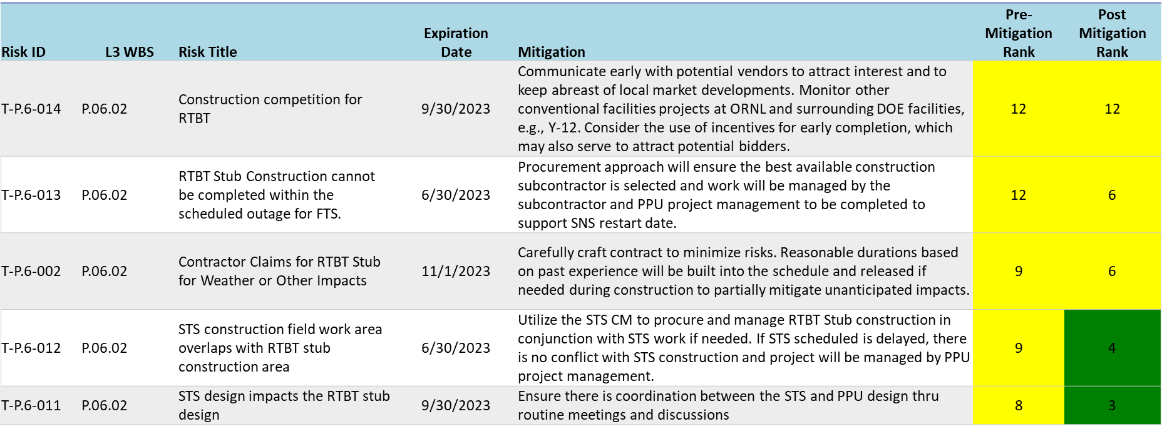
Risks are Identified and Monitored
Charge: 5

Slide 32
Responses to Recommendations
Charge: 6
No recommendations from the CD-2/3 review
Review | Type | Recommendation | Status
Director’s Review | Recommendation | Develop a procurement approach, prior to the CD 2/3 IPR, to award the Tunnel Stub contract to a qualified construction contractor capable of meeting the required schedule for construction completion during the long outage. | Closed. Meeting held with STS and procurement and plan outline generated.

Slide 33
ESH&Q and Covid-19 Impacts
Charge: 3
PPU project was deemed mission critical by UTB/DOE
Subcontractor performed 58,300 manhours without a recordable incident
Construction delayed 5 weeks due to field and shop crews quarantined with COVID
Working to “Guidelines” rather than “Rules” created unique situations to manage. UTB policy flow down to subcontract without contract language is difficult to enforce
Construction material procurements and deliveries were largely unaffected early in the project but were more prevalent as the project progressed
Remote management by FPSC, subcontractors and UTB staff contributed to minor schedule delays

Slide 34
12-Month Look-Ahead
Charge: 4
Klystron Gallery
  Closeout activities including as-built drawings
  Lessons learned
RTBT Stub
  Demolition planning and execution of building 8940
  Coordination with STS design development and Beamline 13 EB-2 development
  Procurement for Construction will begin

Slide 35
Lessons Learned
Charge: 1
Klystron Gallery
BIM- Project team did not have a good understanding of the design model accuracy and completeness. BIM process took much longer than scheduled to get completed model to field
Existing Conditions- Project could have benefitted by scanning prior to subcontractor mobilization to validate all existing features were captured
Labor- Project support costs were more than anticipated due to schedule elongation and daily smoke detector outages
Procurement- Lack of competition limited choices on bidders
Bid Market- FPSC was inexperienced as a General Contractor and did not have adequate qualified and assigned personnel to perform lower tier subcontractor oversight, project engineering and project management
Operations- All electrical and mechanical tie-ins were required to be on SNS full maintenance days resulting unforeseen schedule constraints
B4-2 Santee

Slide 36
Summary
KG Construction completed supporting project schedule
  Quality infrastructure constructed to support RF equipment
  Met DOE milestone despite COVID impacts
  Overlapped RF installation with FPSC to support schedule
  First significant use of BIM in SNS construction project showed benefits and created issues
  Achieved zero recordable incidents in 58,300 hours worked
RTBT Stub planning will resume
  Applicable Lessons Learned will be integrated into RTBT Stub project

