Slide 1




P.6.2.2 RTBT Modifications
DOE/SC Independent Project Review of the Proton Power Upgrade Project
Mark Connell
Level 3 Manager for RTBT Stub
September 14-17, 2021

Slide 2
Outline
Scope
Lessons Learned
Organization
Progress since CD-2/3
Challenges
Final design status
Installation plans
Cost and schedule
Labor profile
Risk register
Responses to recommendations
ESH&Q and COVID-19 impacts
12-month look-ahead
Summary

Slide 3
Scope
Charge: 1
  Ring-to-Target Beam Transport (RTBT) Stub facilitates future accelerator tunnel connection for Second Target Station (STS)
P.6.2 Conventional Facilities Building Modifications
  P.6.2.1 Klystron Gallery Building Modifications
  P.6.2.2 RTBT Modifications Scope in this presentation
  P.6.2.3 HVAC Controls
B4-1 Connell
B4-2 Santee
B4-4 Williams

Slide 4
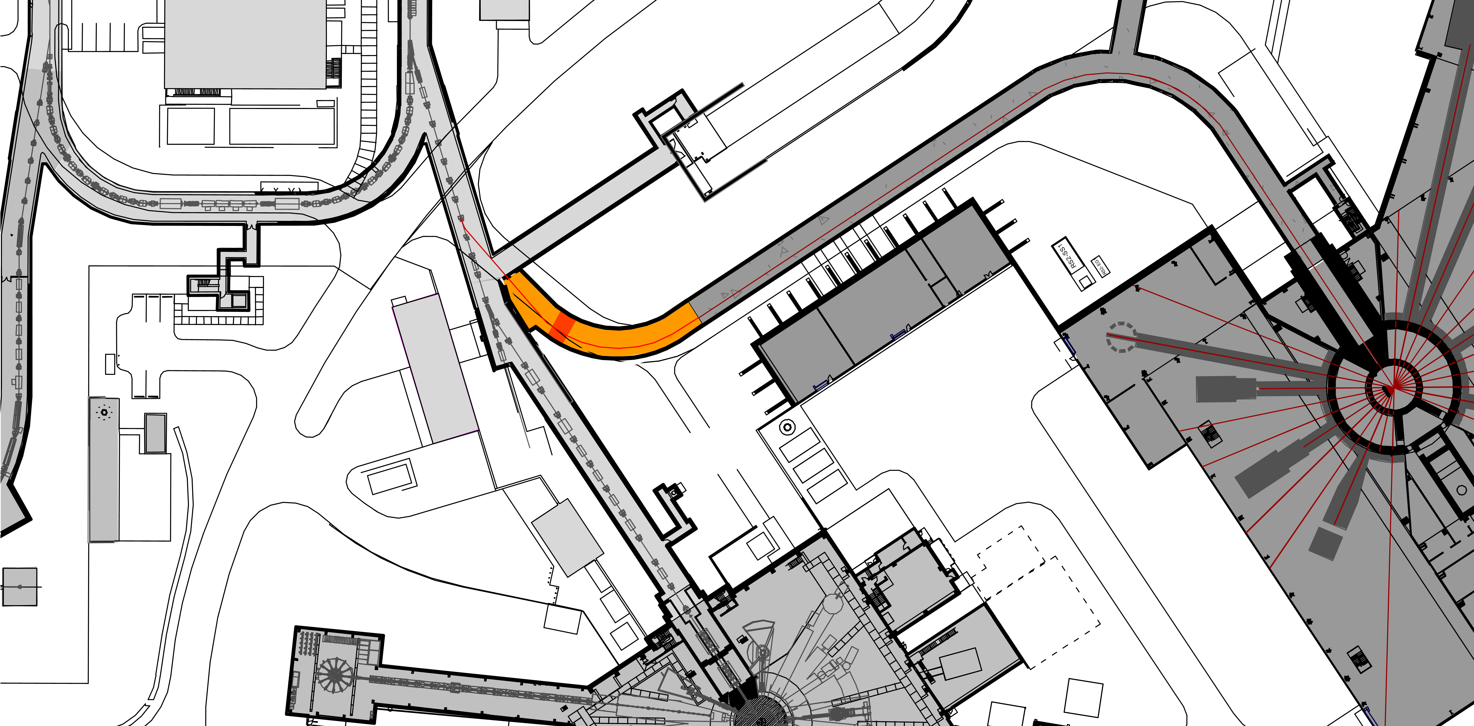
RTBT Stub Overview – Existing/New/Future
Charge: 1
RTBT Tunnel
Truck Access Tunnel
Future RTST Tunnel
Future Proton Beam
RTBT Proton Beam
Temporary Stacked Shielding
RTST Service Building
RTBT Service Building
RTBT Stub
Second Target Station
First Target Station

Slide 5
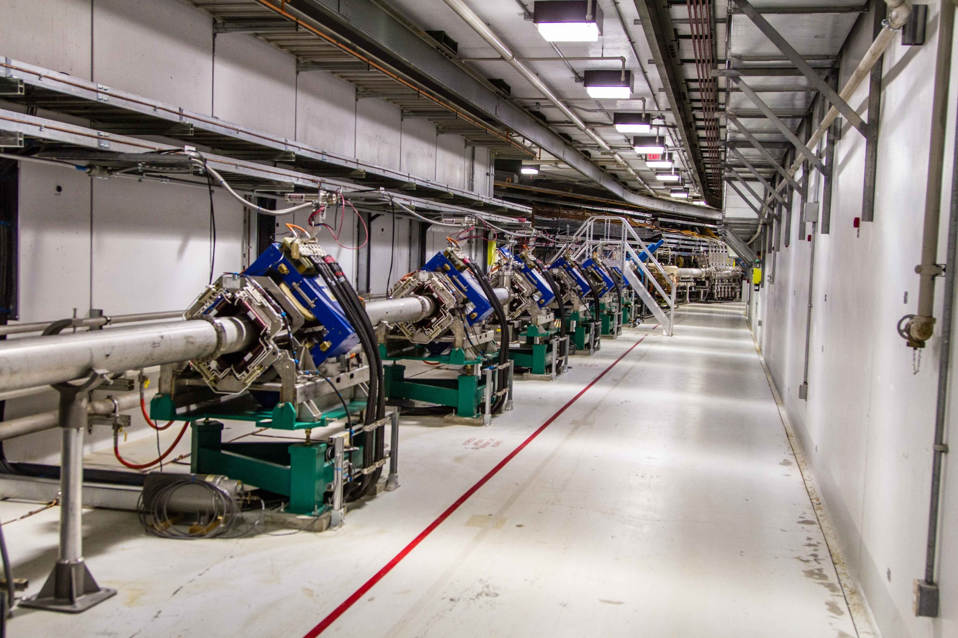
RTBT Beamline – Similar to Future RTST beamline
Charge: 1

Slide 6
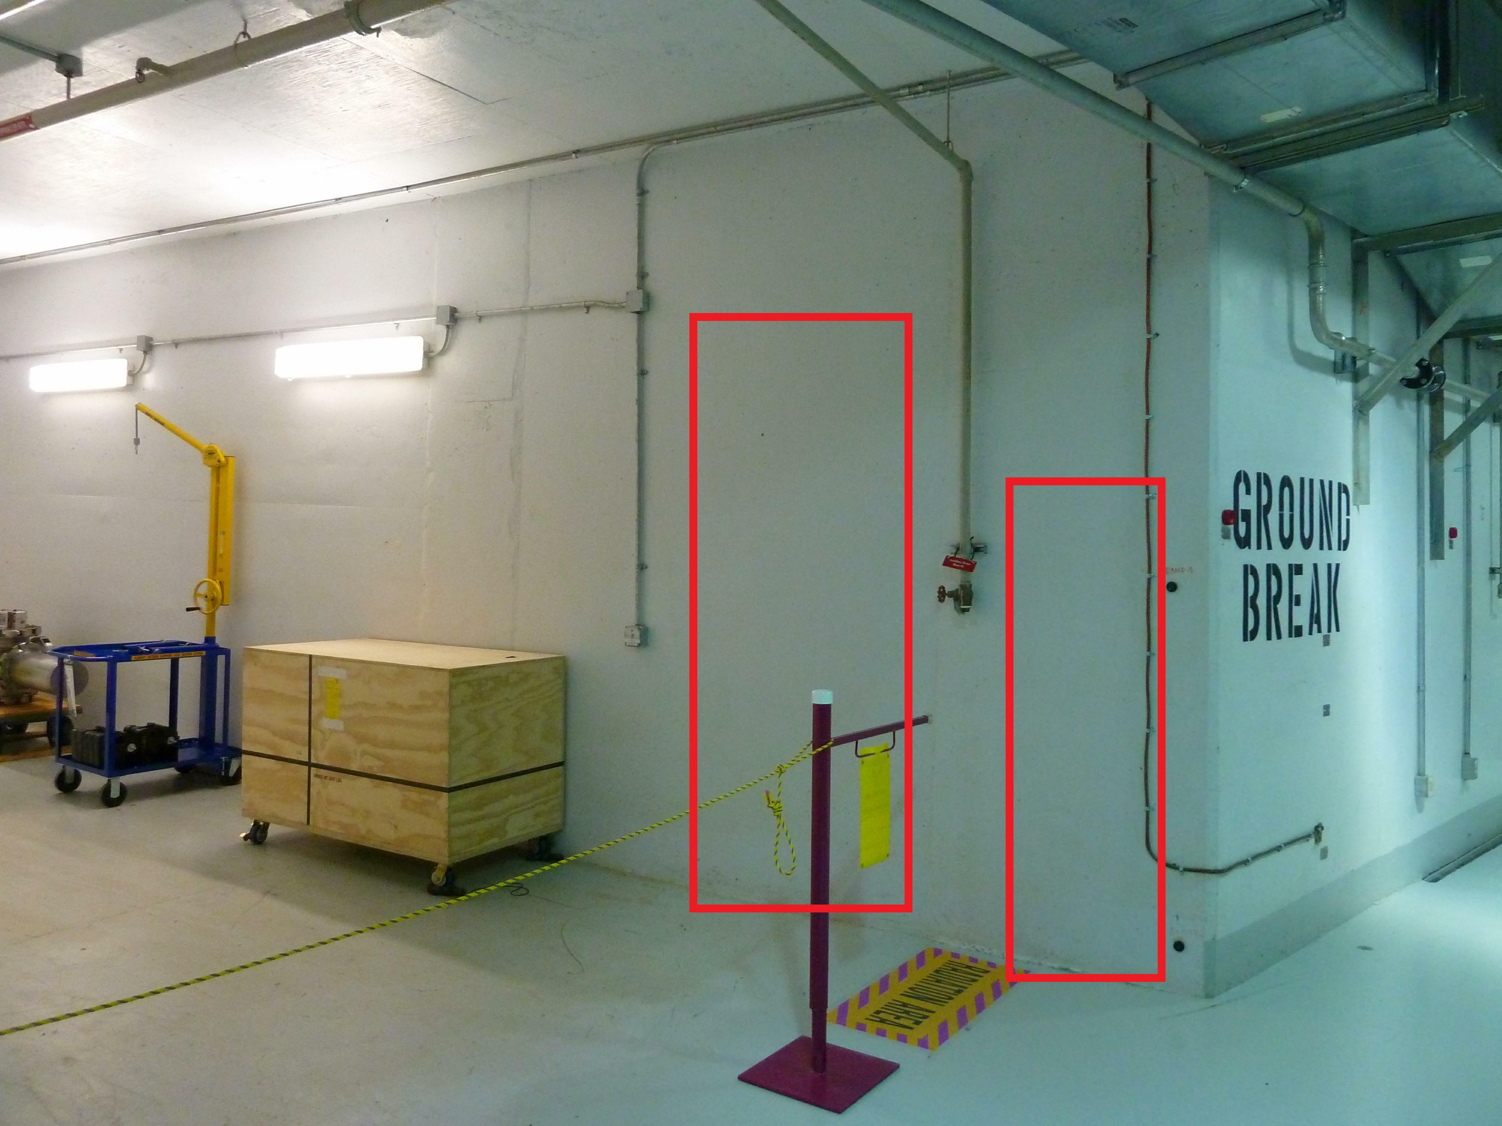
Future Doorway (Left) & Beam Penetration (Right)
Charge: 1

Slide 7
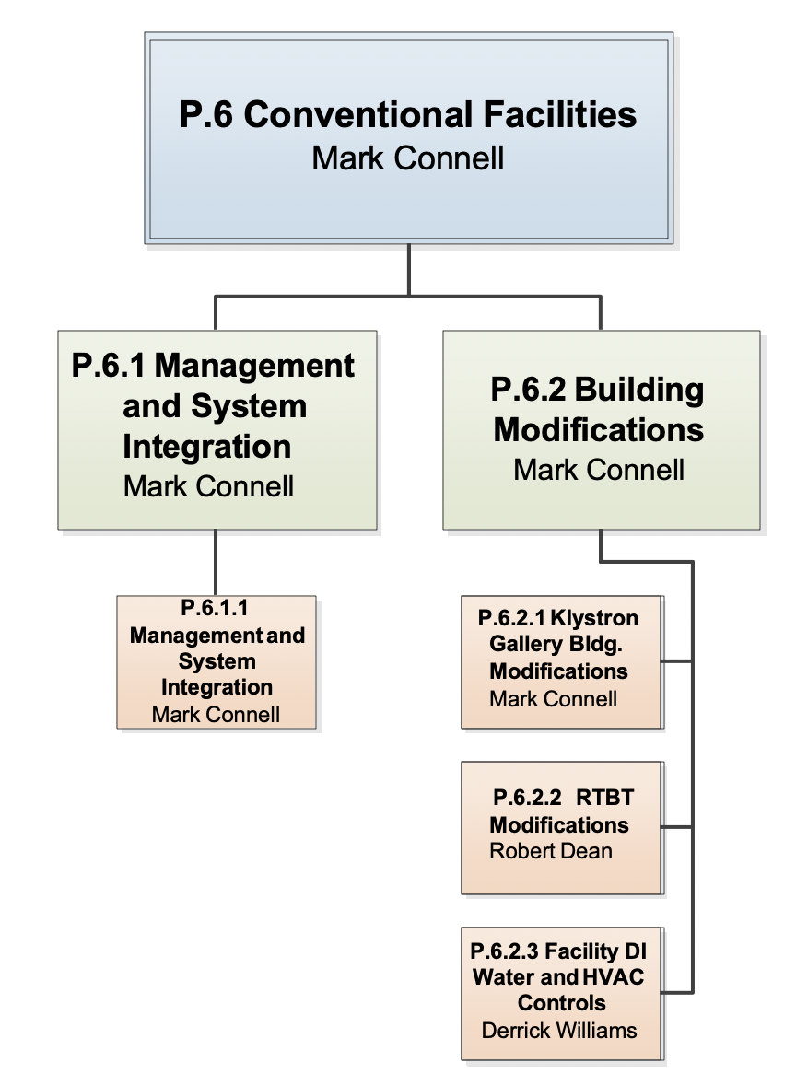
Work Breakdown Structure
Charge: 5
Luke Santee

Slide 8
Design
Charge: 1
Provided minimum RTBT Stub length with earth cover and stacked shielding configuration to ensure adequate Proton Beam Shielding during beam operations which allows Second Target Station construction to tie-in with minimal outage number and duration
3D structural analysis completed ensuring integrity of existing RTBT tunnel during all stages of construction – design limits amount of earth to be removed
Geotechnical and structural analysis show acceptable levels of differential settlement along RTBT Stub
Storm water management is provided for disturbed area during and after construction with maintainable slopes to enable construction to continue as quickly as possible after adverse weather conditions

Slide 9
Design Interface Coordination
Charge: 1,5
Beam and magnet configuration coordination
  Accelerator personnel provided beam layout and shielding calculations
  STS personnel are actively involved in planning
Design coordinates with Temporary stacked shielding design including utility pass-through design
Construction coordination per proposed STS CD-1 schedule. Current STS schedule impacts will be assessed when available

Slide 10
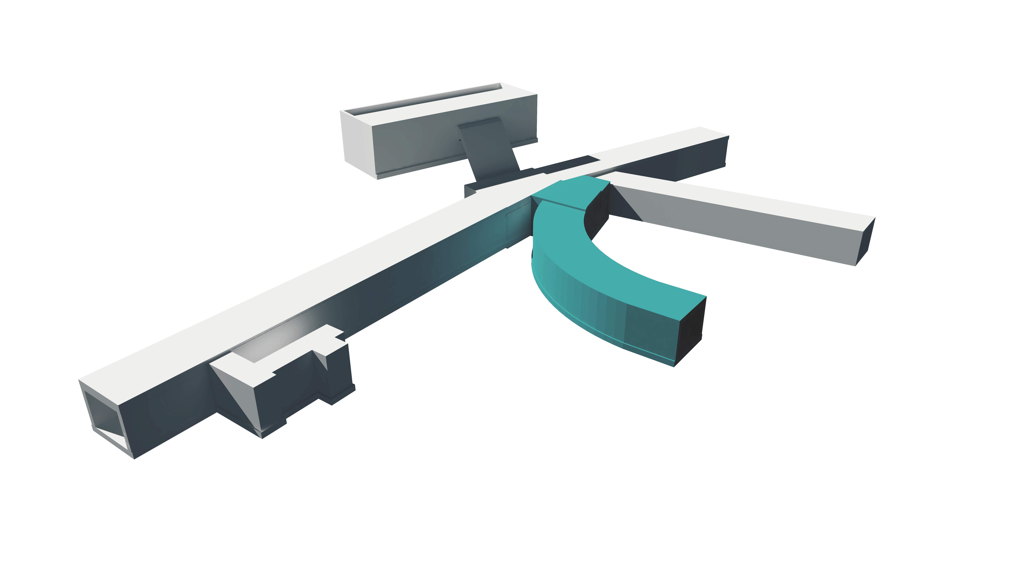
3D Rendering of RTBT and New Stub
Charge: 1
RTBT Service Building
RTBT Truck Tunnel
RTBT Tunnel
New Stub

Slide 11
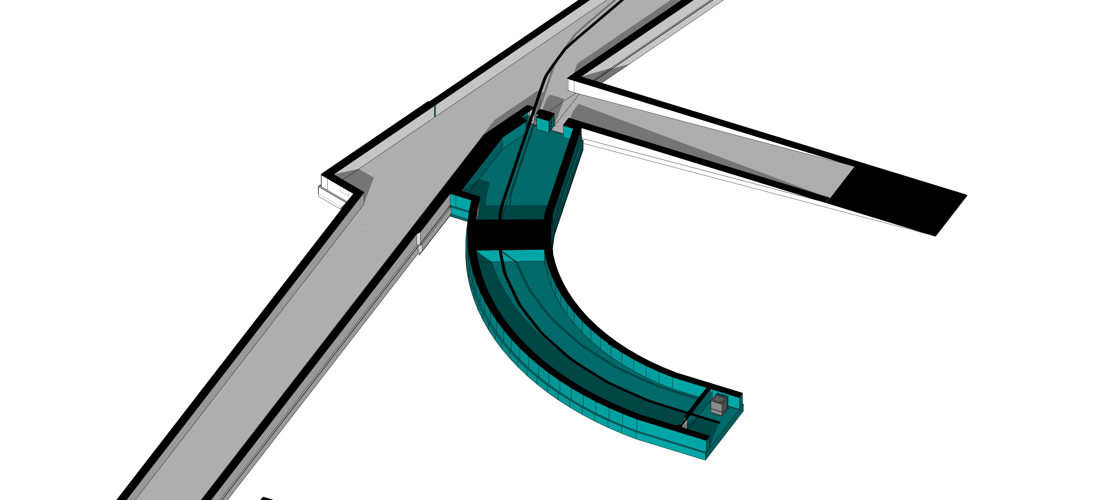
Tunnel Sections Showing Future Beam Routing
Charge: 1
Temporary Stacked Shielding
Future Beam to STS
New Stub

Slide 12
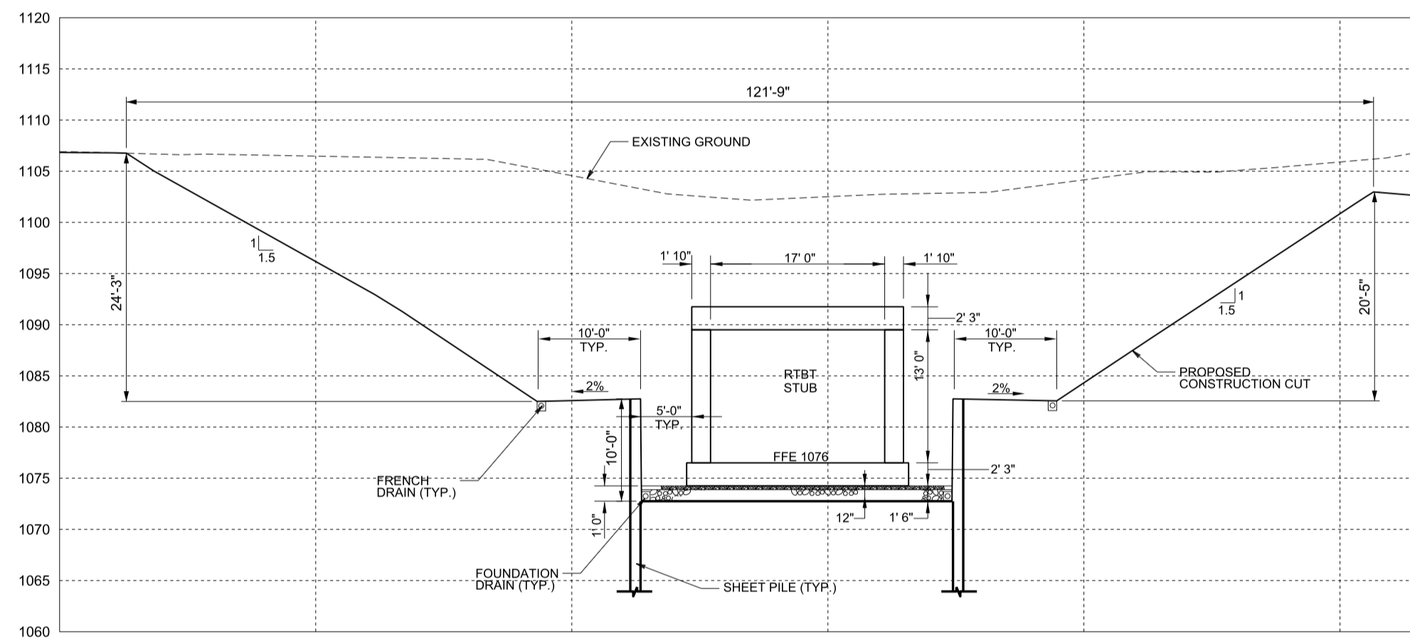
Stub Construction – Excavation Management
Charges: 1,5
Shotcrete to manage slopes and runoff
Uses Sheet Piles to Manage Excavation

Slide 13
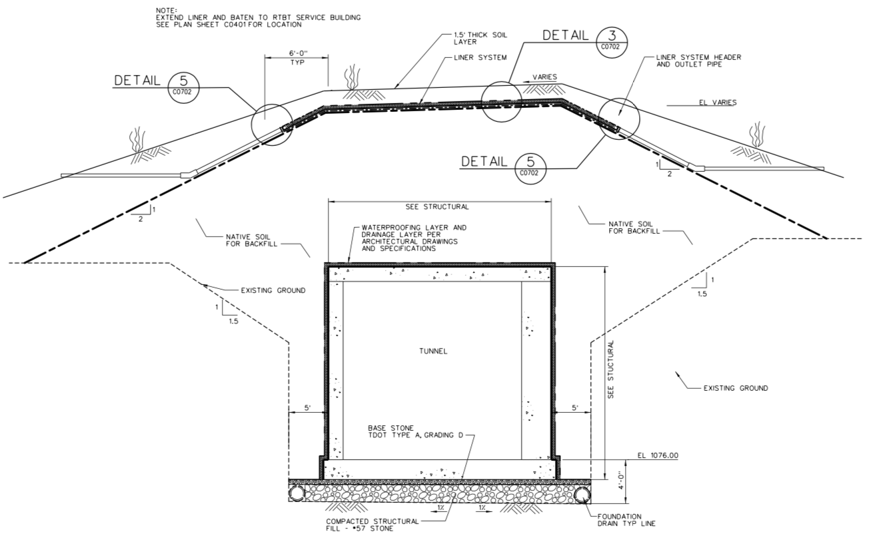
Stub Cross-Section – Water Management
Charges: 1,5
Water Managed by:
Membrane near surface
Waterproofing on tunnel
Foundation drains

Slide 14
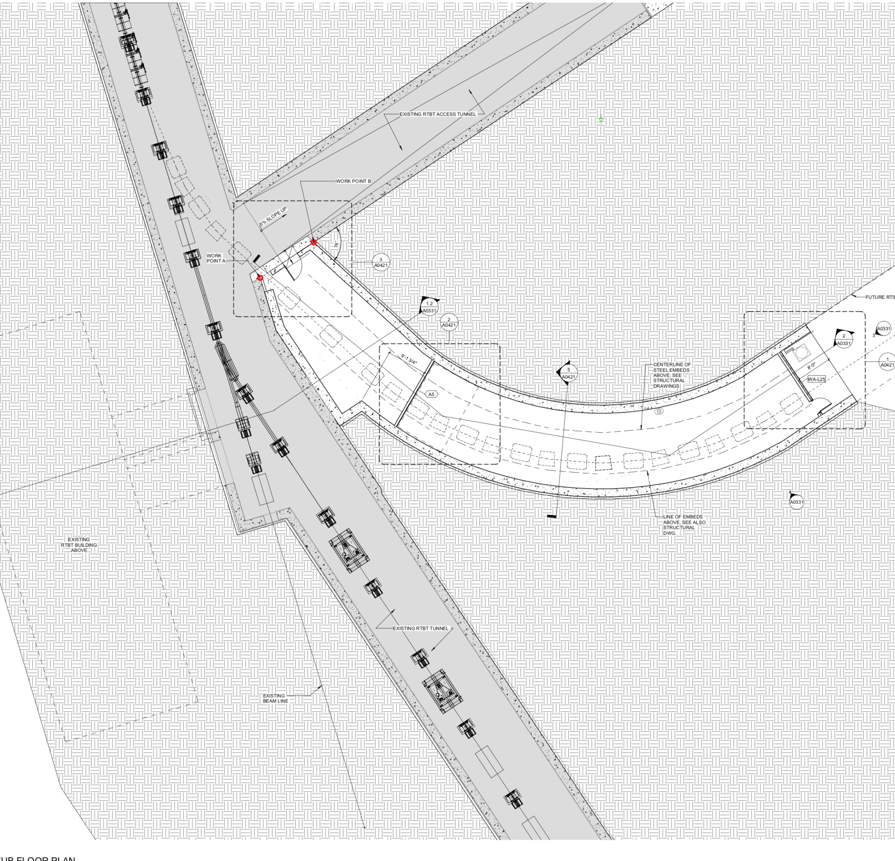
Stub – Coordinated with STS Beamline Routing
Charge: 1
Future beamline routing
Including magnets

Slide 15
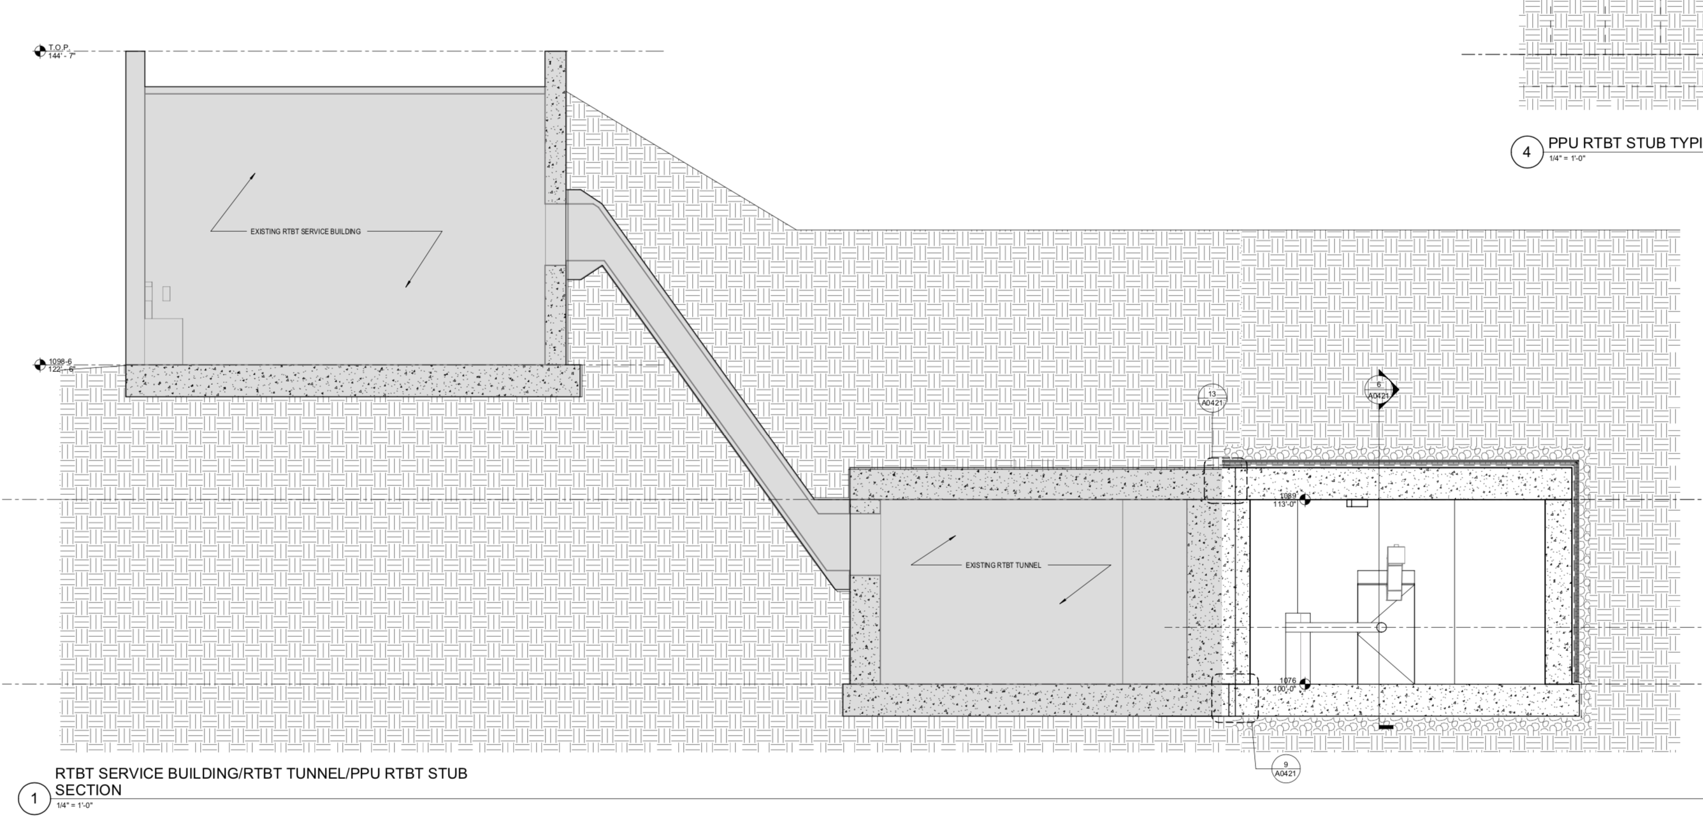
Stub Interface to RTBT
Charge: 1
Cross-section at RTBT Service Building

Slide 16
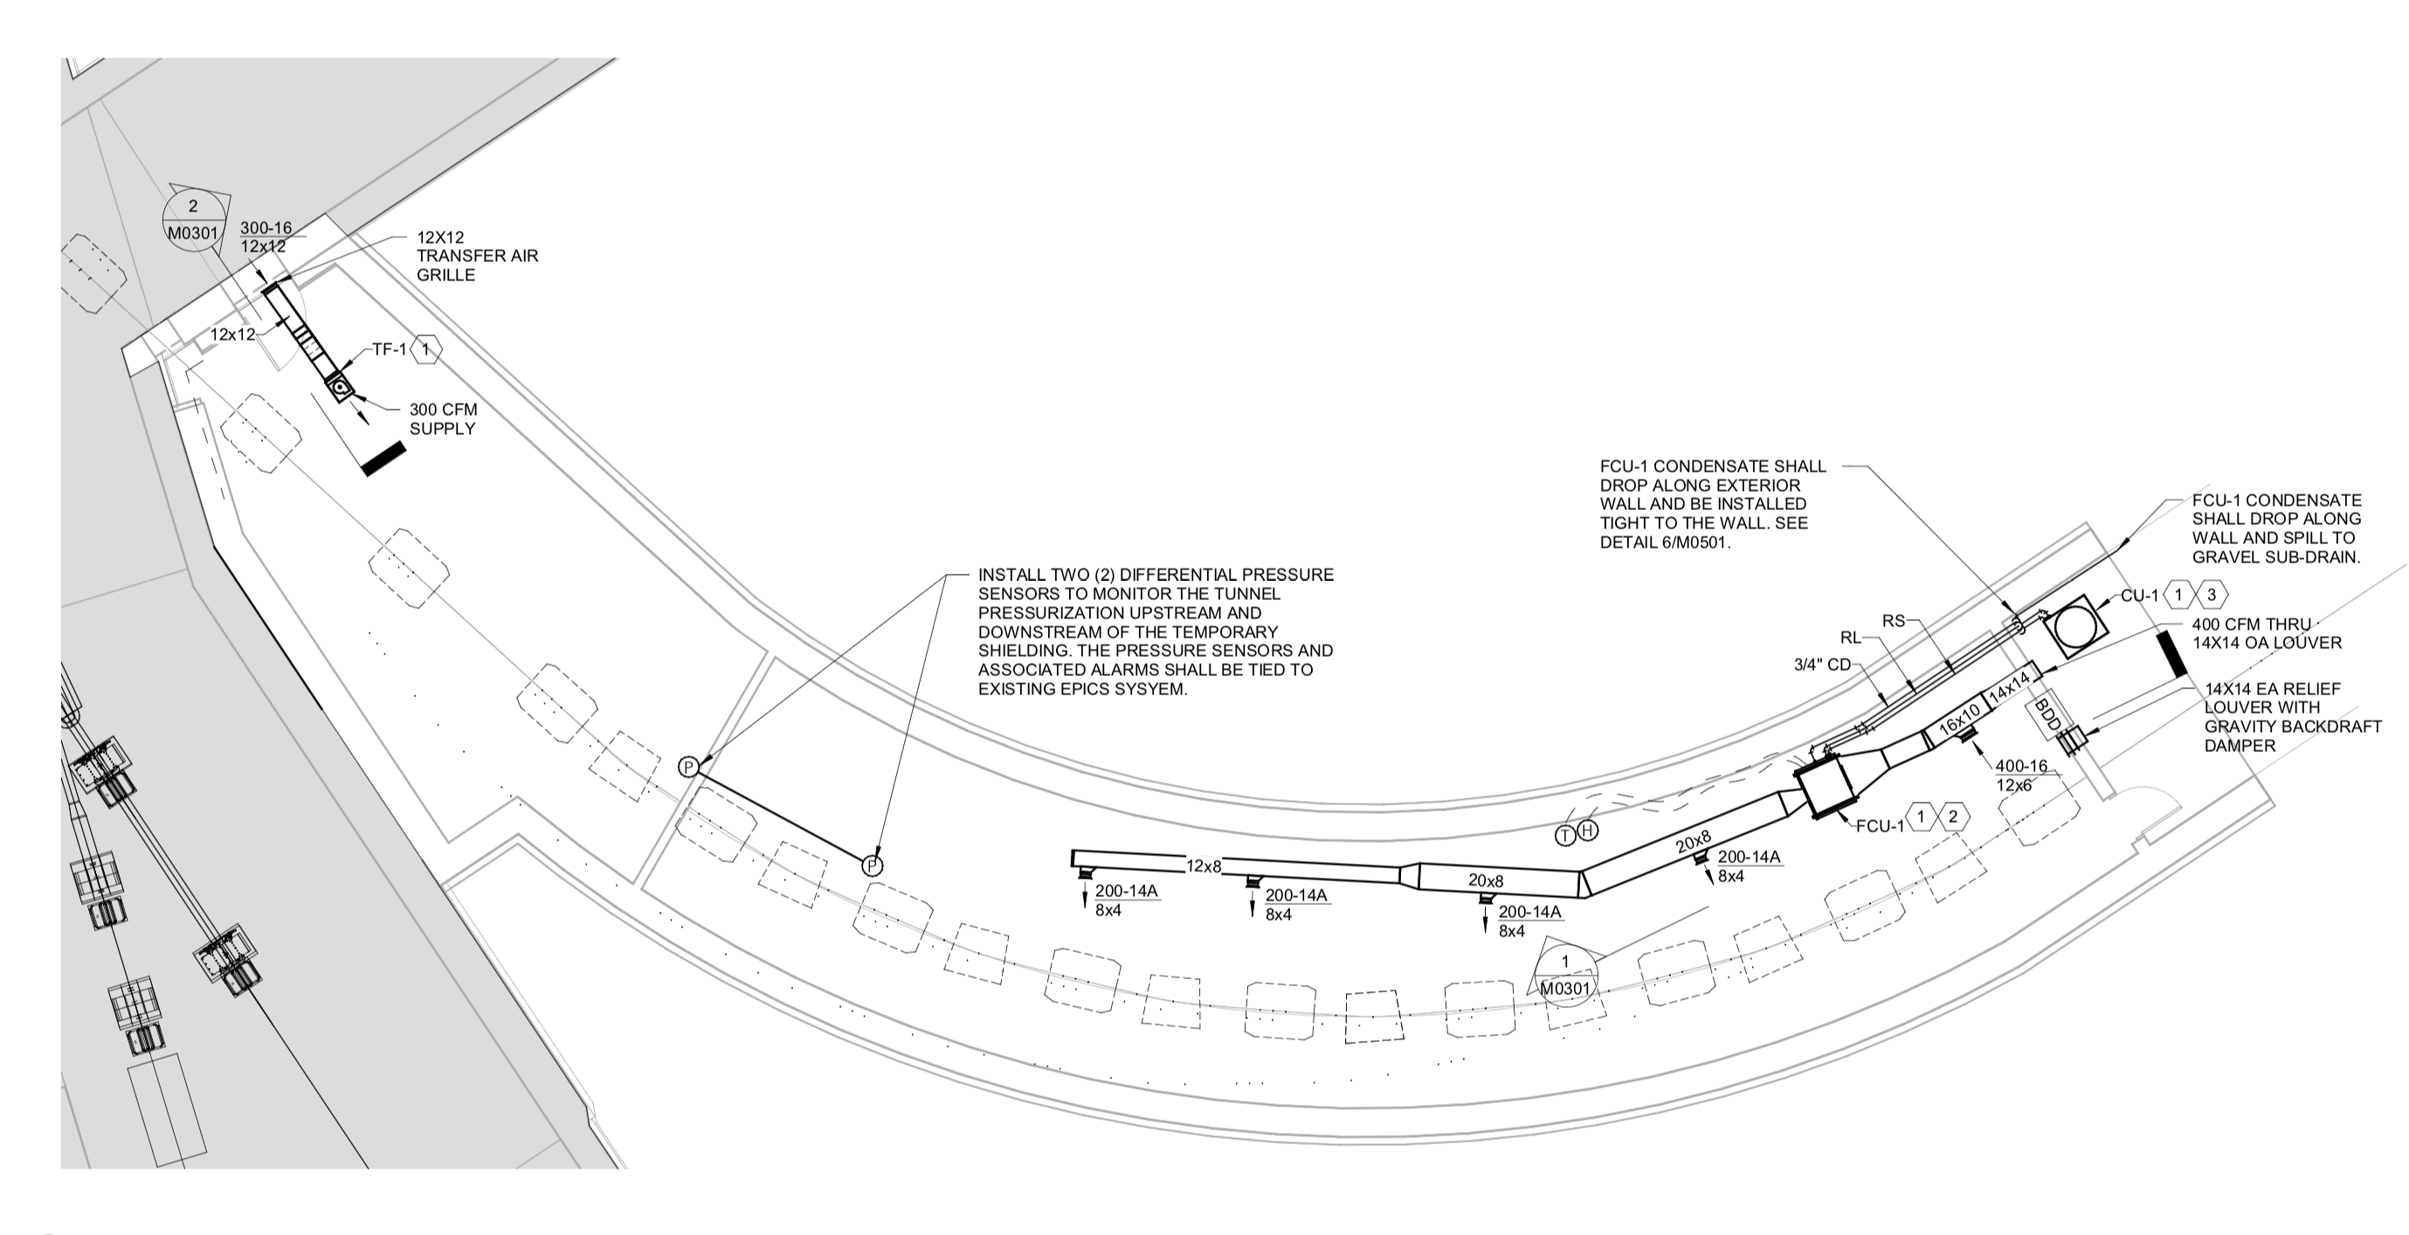
Stub Mechanical
Charge: 1
HVAC and Ventilation Provided to minimize chance of mold or mildew as well as positive pressure downstream of stacked shielding

Slide 17
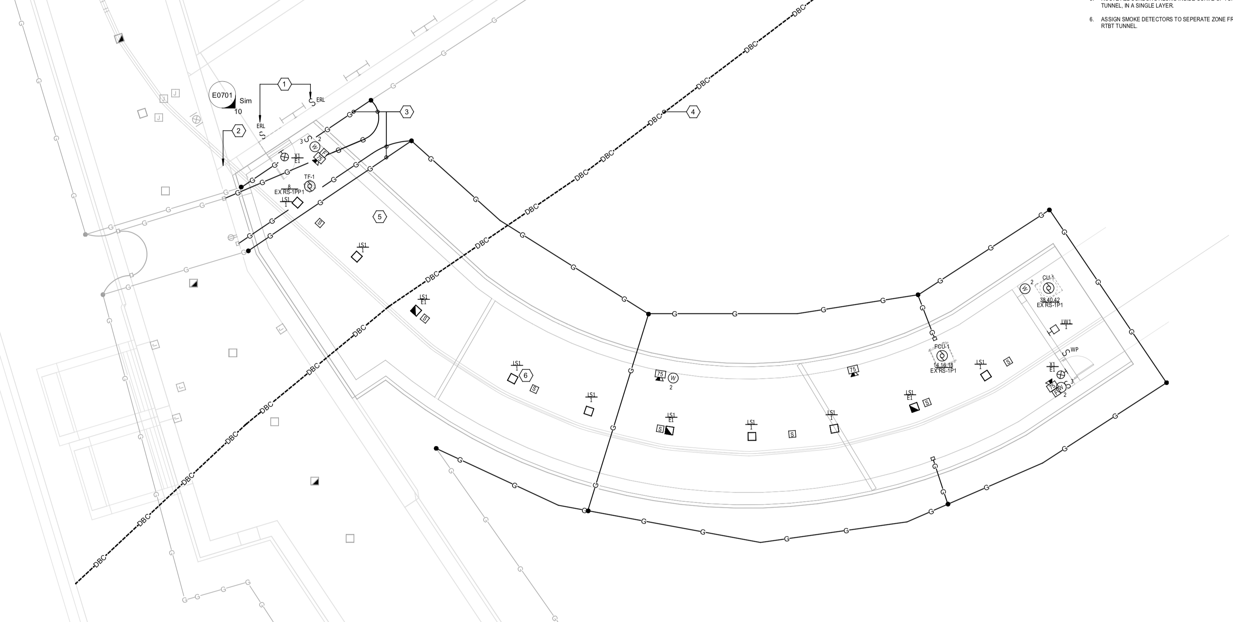
Stub Electrical
Charge: 1
Power
Grounding
Lighting
Heat Detection
Fire Alarm
PPS Conduit

Slide 18
Lessons Learned from KG Construction
Charge: 5
Reevaluate Support Costs and Closeout Period
New procurement strategy needed to improve competition
  Scope Differences from KG Construction that may improve subcontractor participation
    Stub primarily Civil/Structural without mechanical and electrical complication in tight envelope
    Stub not using BIM which may have limited subcontractors

Slide 19

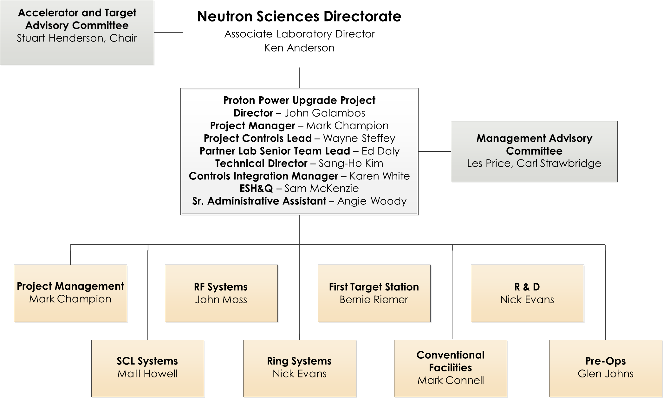
Organization- Level 2
Charge: 5

Slide 20
12-Month Look-Ahead From CD-2/3 Review
Charge: 4
Field Work on hold until PPU extended outage
Initiate discussions with STS CM and/or start bidder outreach
Start developing demolition package for Building 8940- October 2021

Slide 21
Progress since CD-2/3
Charge: 4
Project has been on hold since CD-2/3 review as planned
SNS operational schedule extended outage has moved start date to February 2023 so execution will move to match
The impacts to the outage schedule move will be evaluated this calendar year but no major issues apparent
STS schedule has been moved out to where concurrent STS and RTBT Stub construction is unlikely
The project team will continue to coordinate with STS and evaluate opportunities or potential negative impacts as STS design and schedule mature

Slide 22
Challenges
Charge: 5
Subcontractor willingness to bid and execute work at ORNL in current strong construction economy in East Tennessee
Availability of labor in competition with Y-12 and TVA incentivized programs
Completing construction and restoring shielding to allow beam operations within 6-month schedule despite weather uncertainties
STS design iterations from conceptual to preliminary and potential changes that could impact tie-in point or geometry of RTST or RTBT Stub
STS schedule uncertainty for start of site work
Beamline 13 External Building 2 concurrent construction

Slide 23
Final Design Status
Charge: 1
Final design for RTBT Stub is complete

Slide 24
Installation Plans
Charge: 1
Fixed price subcontract (FPSC) construction to occur during SNS operations extended outage starting February 2023
Stacked shielding by installation subcontractor will be integrated into construction schedule
SNS PPS Group will install chipmunks during stub construction

Slide 25
Schedule Development
Charge: 4
Required AE to engage Construction Manager to assist in constructability
  Ensured schedule-friendly design choices
  Provided detailed schedules using normal and extended working hours
Resulted in a credible schedule for completion in outage window
  Based on 7 day/week 8 hours per day
  36 days allowed for adverse weather
Phased construction to allow for work outside outage
8940 building demo to be complete outside of FPSC
Moving outage from December to February improves probability of favorable weather for exterior work

Slide 26
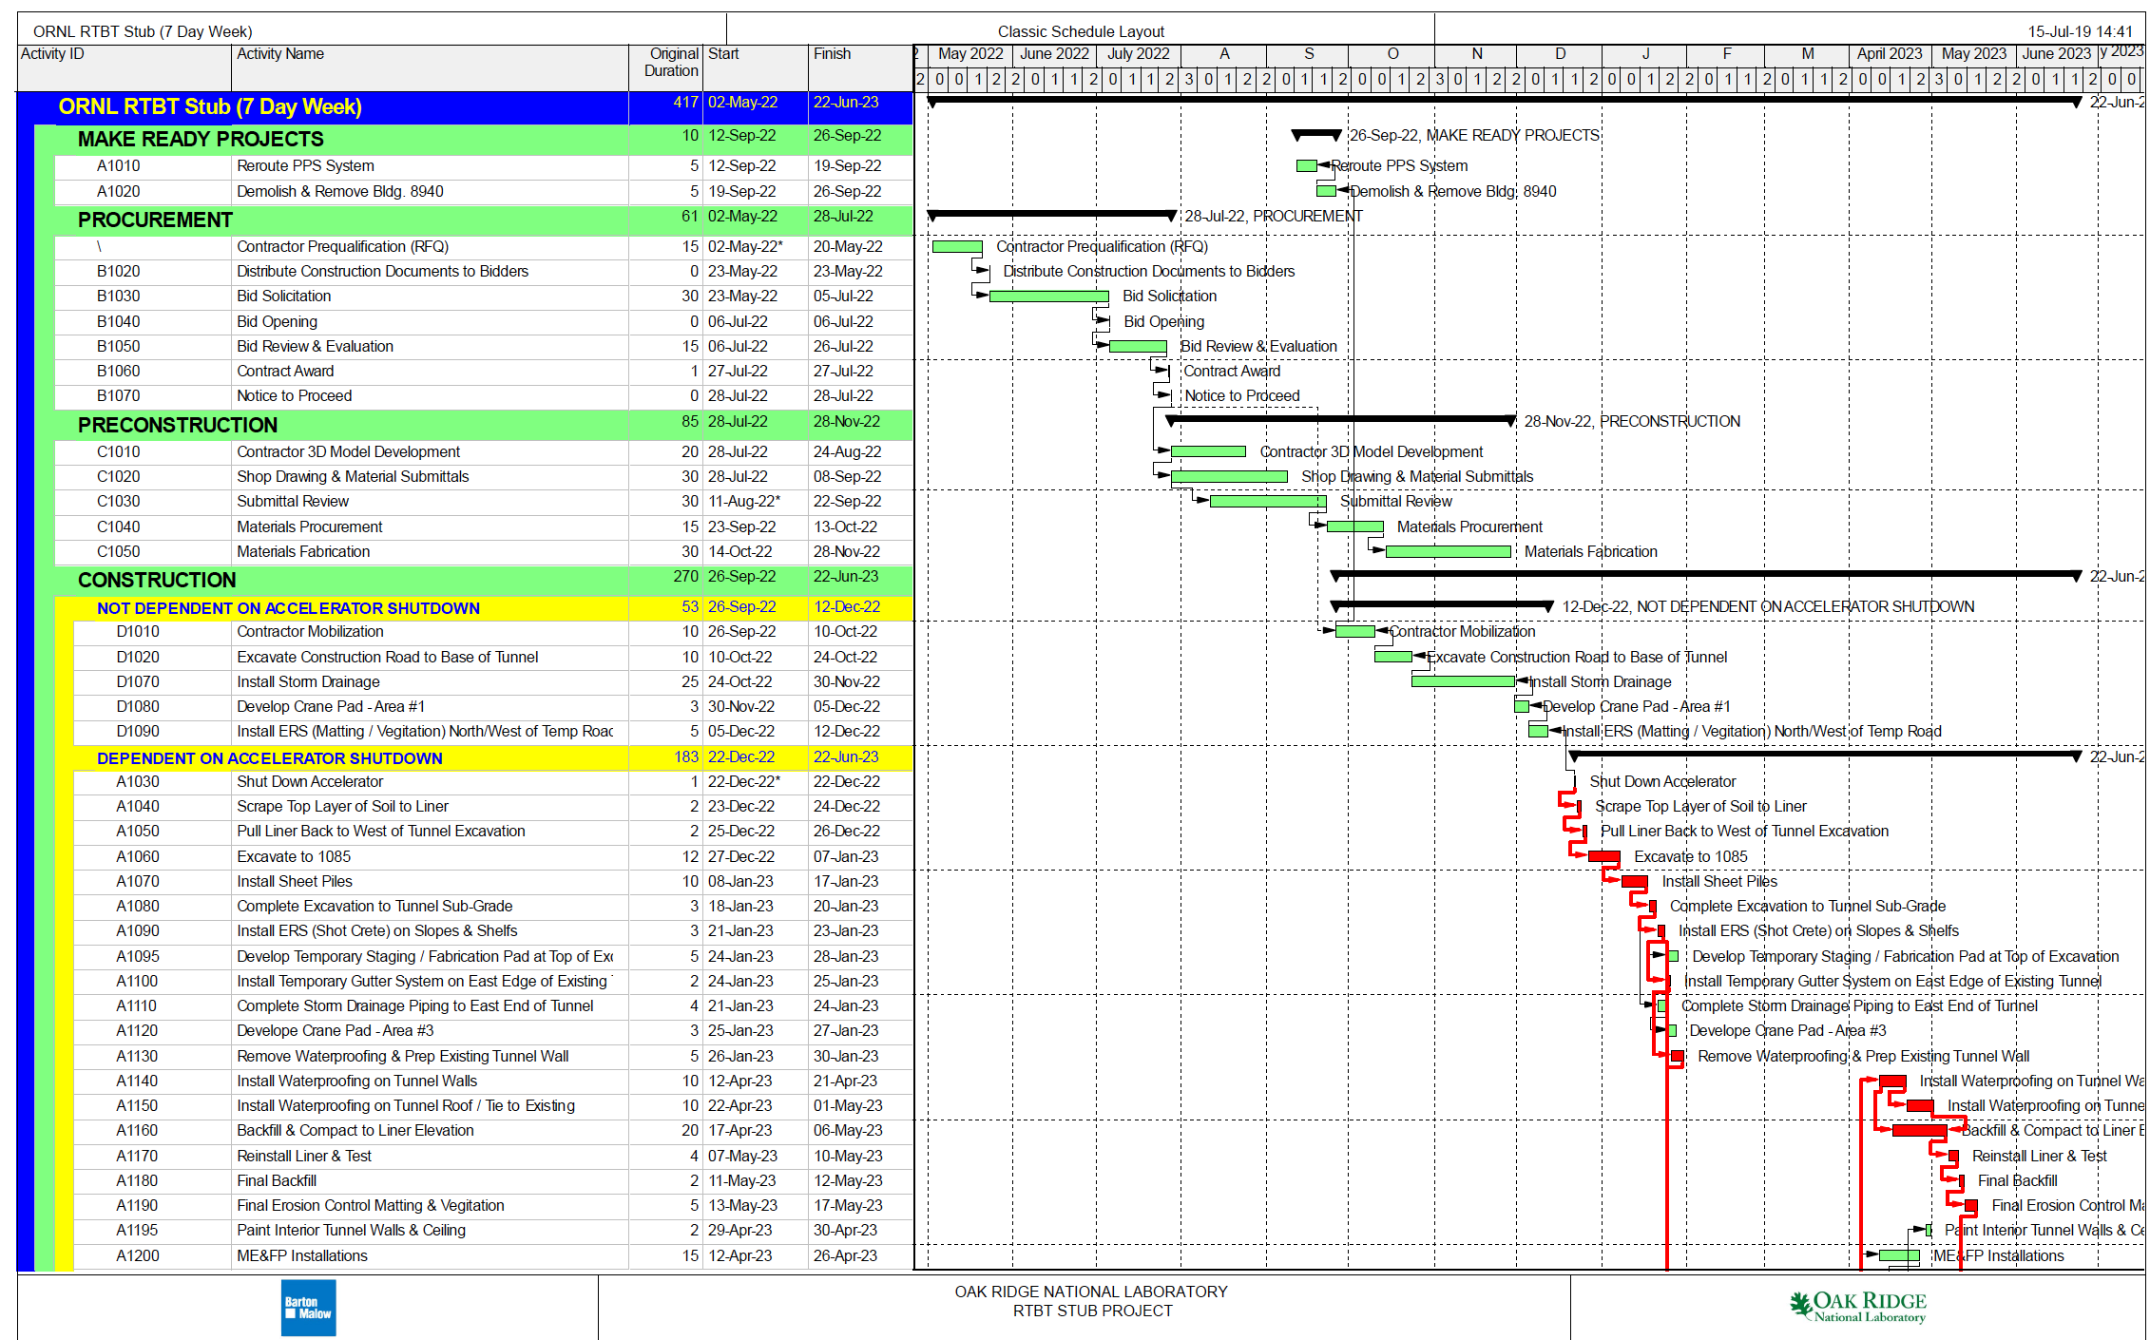
Stub Schedule Achieving 6 Month Duration – Page 1

Slide 27
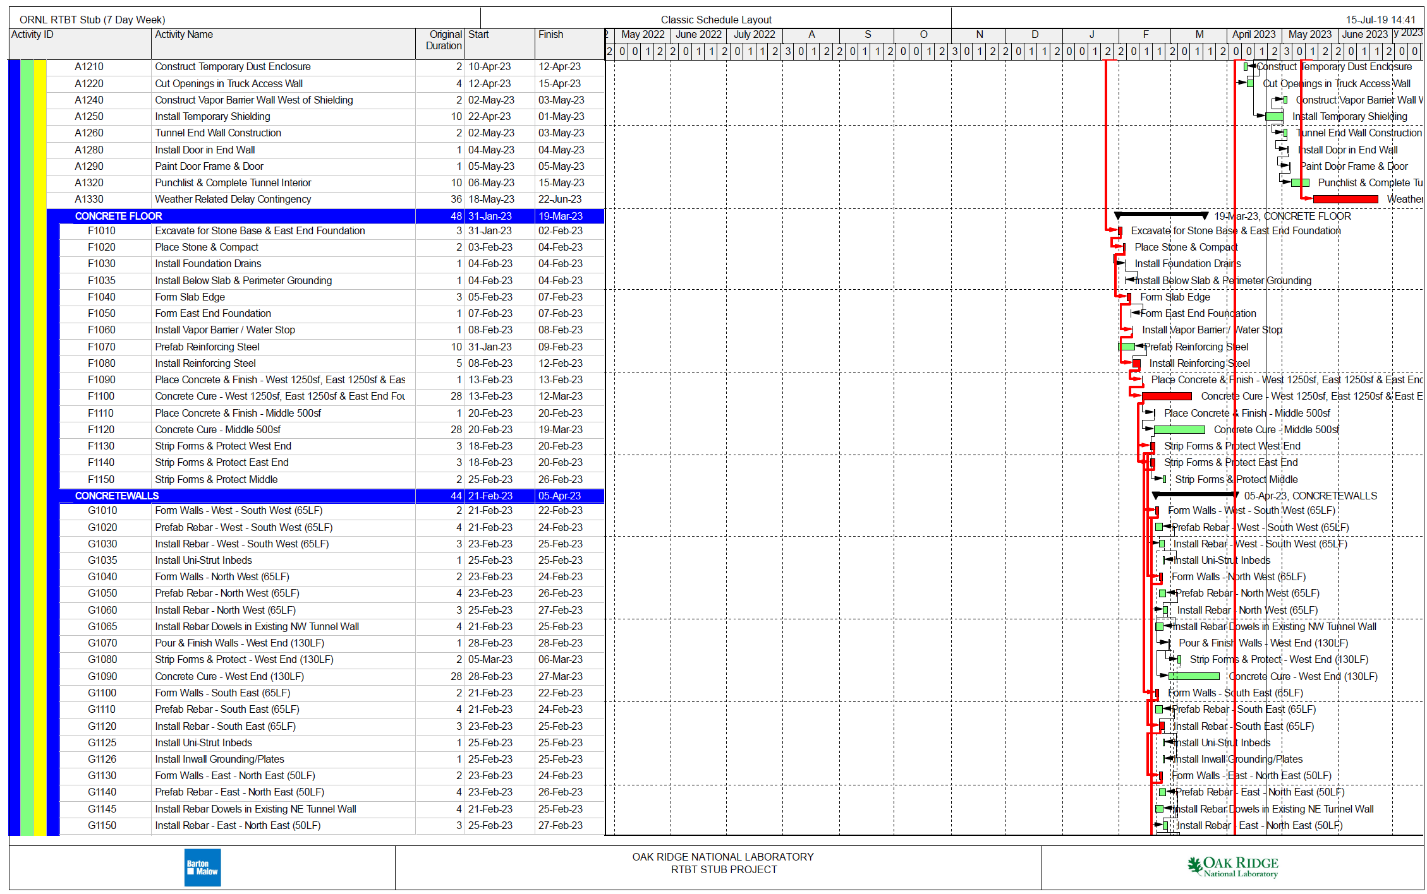
Stub Schedule Achieving 6 Month Duration – Page 2

Slide 28
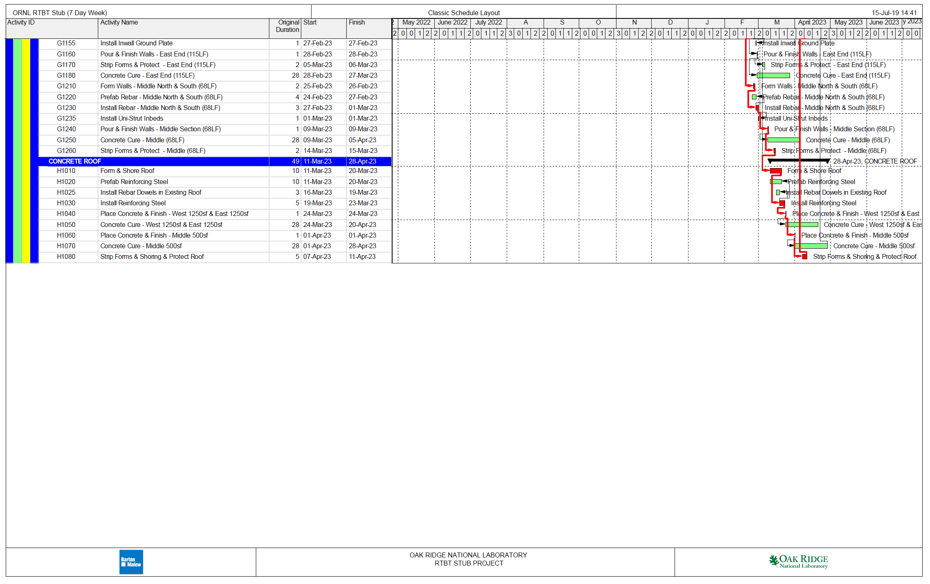
Stub Schedule Achieving 6 Month Duration – Page 3

Slide 29
Phase 1 – Pre-Shutdown Activities
Charges: 1,4
Demolish Building 8940 – Demolition Contractor
FPSC Planning, Submittals, and Procurement- September 2022
  Prepare/submit receive approval for submittals
  Procure components needed for construction
Pre-Outage Construction – Work not affecting shielding- December 2022
  Mobilize to site, set office trailer
  Remove and dispose of fence
  Site layout
  Set up erosion control
  Improve drainage from site
  Minor excavation not impacting shielding
  Pre-tie rebar
  Start building forms

Slide 30
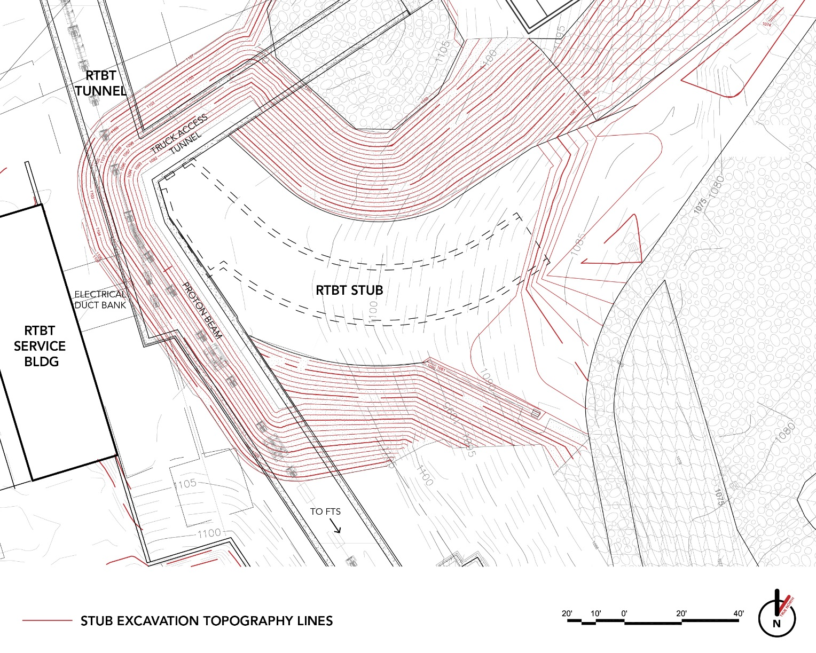
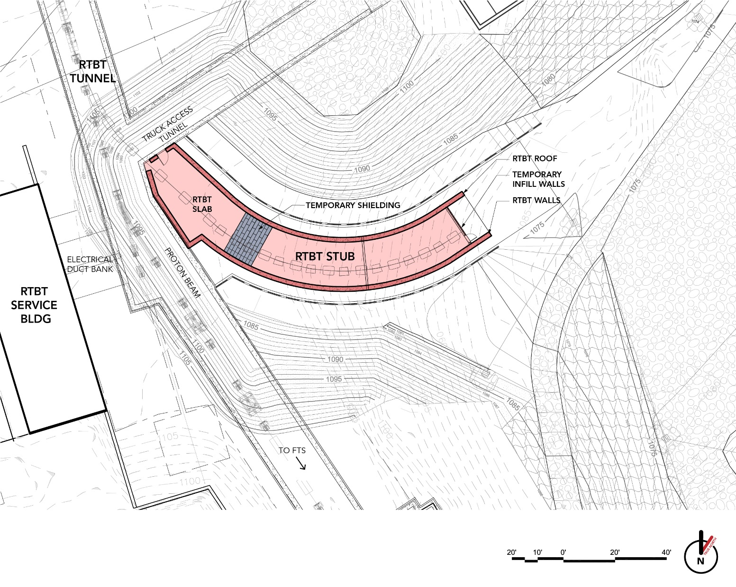
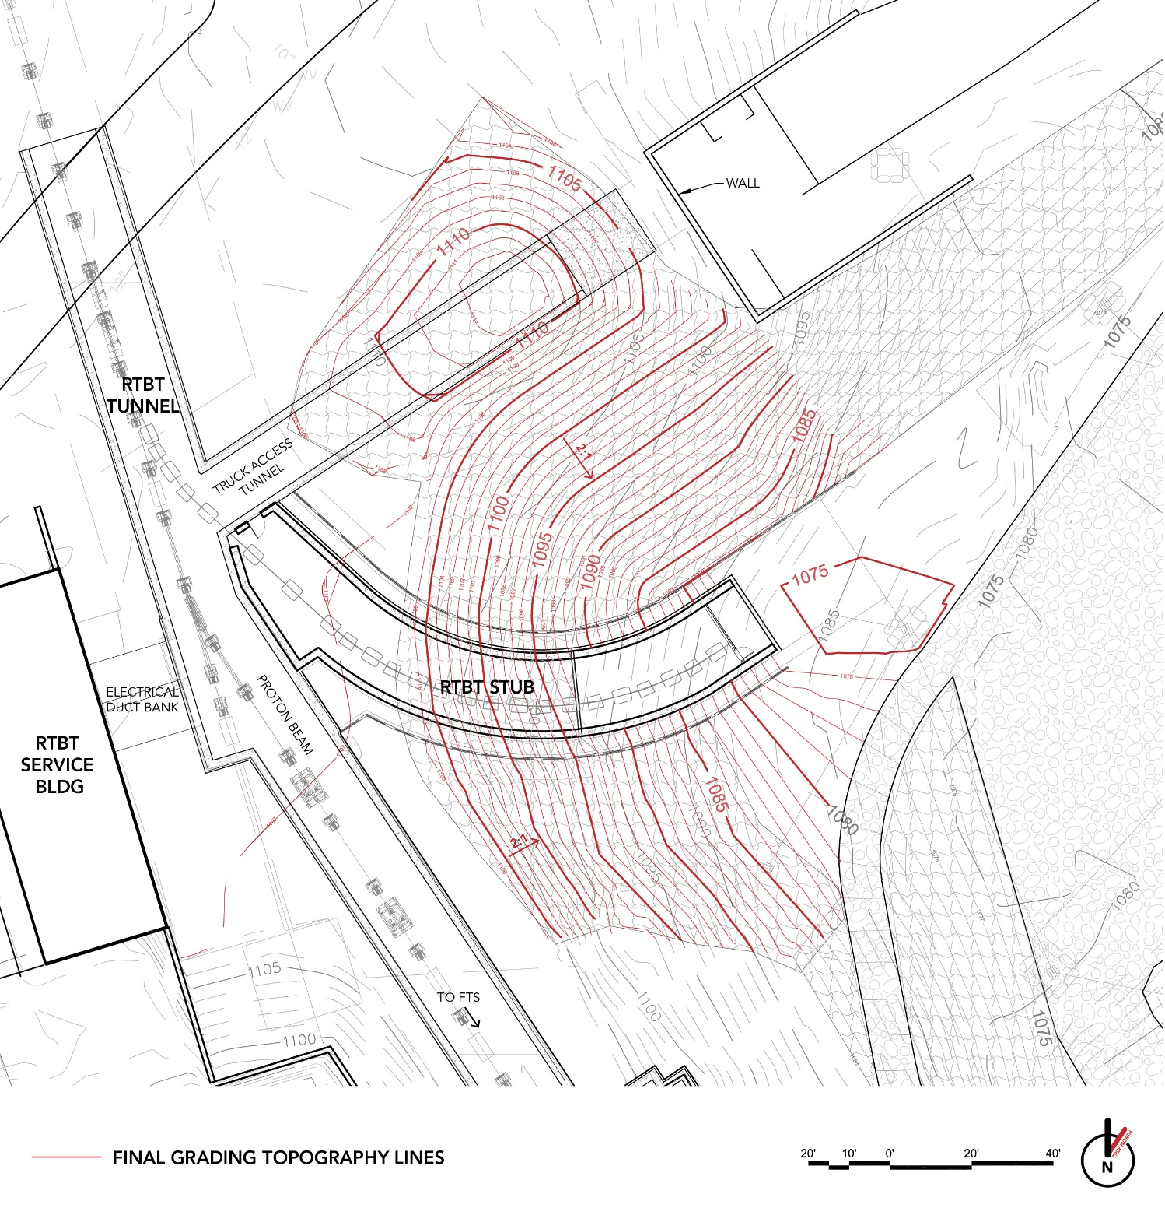
Phase 2 Shutdown Work
Charges: 1,4
Initial Excavation
Final Excavation & Stub Construction
Final Grading

Slide 31

Phase 3 - Post Outage Work
Topsoil installation, final grading, seed and straw above liner
PPS conduit installation
Site restoration
Demobilization, as-builts, and close-out submittals
PPS installation by others

Slide 32
Estimate Development for FPSC
Charge: 4
AE provided estimate which was reviewed by project staff, subcontracted CM and ORNL Engineering
Experience with Klystron Gallery bids led to updating AE estimate as follows:
  Added markups to subcontractors
  Increased markups on FPSC to match Klystron Gallery bid
Estimate includes an allowance for tight schedule risk as suggested in prior reviews
Estimate and support costs consider extended work week

Slide 33
Cost and Schedule
Charge: 4

Slide 34
Cost and Schedule
Charge: 4

Slide 35
Cost and Schedule
Charge: 4

Slide 36
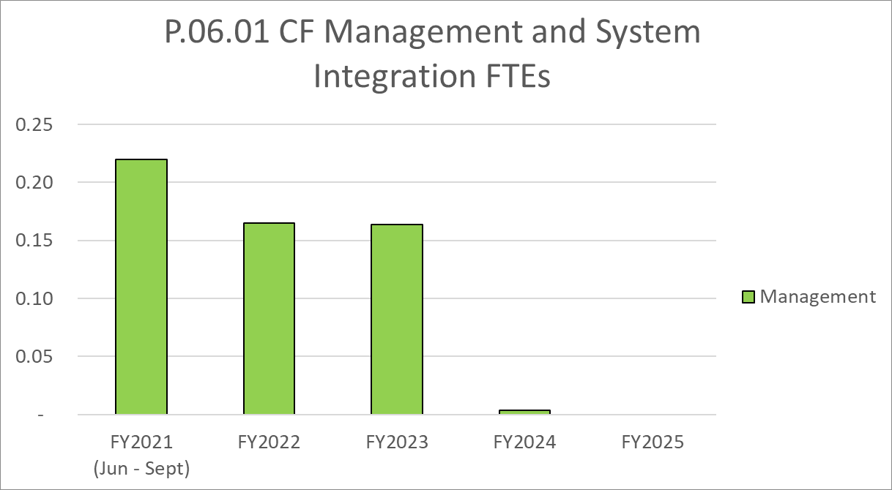
Labor Profile
Charge: 4

Slide 37
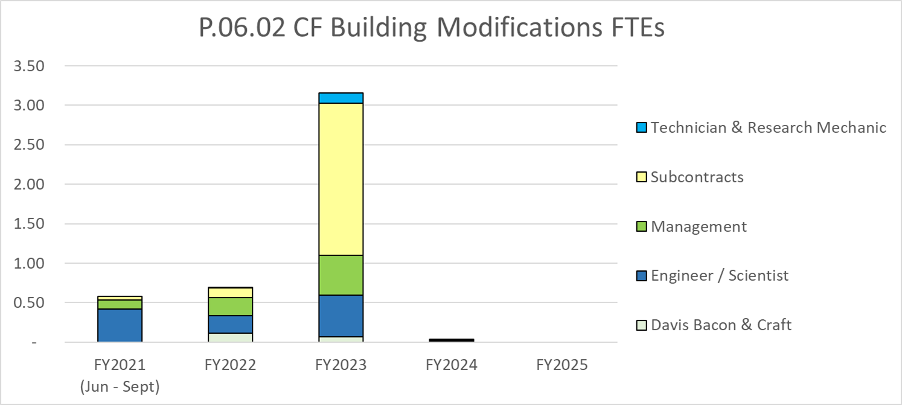
Labor Profile
Charge: 4

Slide 38
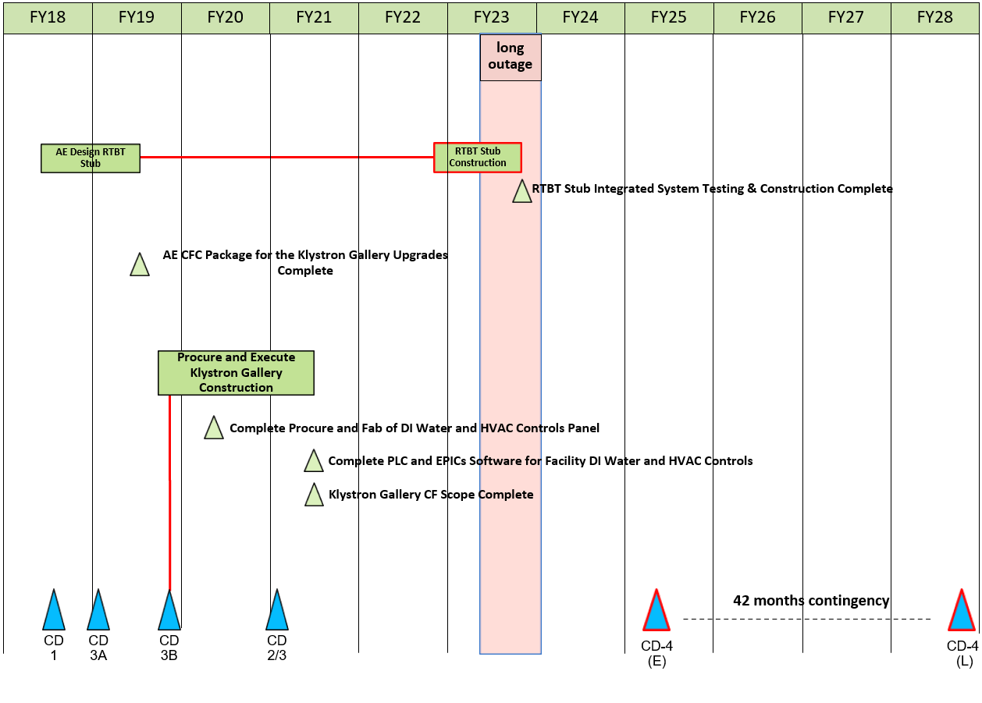
CF Systems May 2021 Status Summary Schedule
Charge: 4

Slide 39
FPSC Procurement Approach
Charge: 2
Timing of STS CM availability is uncertain
BASELINE- PPU to provide Project and Construction Management
  Initiate contractor outreach including visits to qualified contractors to obtain appropriate bidders- February/March 2022
  Consider available options for incentives or liquidated damages with procurement
  Issue Solicitation - May 2022; Submissions June 2022
  Select best value contract with the following key award criteria in descending order of importance: 1. Schedule approach including schedule mitigation, 2. Technical qualifications, and 3. Cost- Evaluate July 2022, Award Contract August 2022
ALTERNATE- STS Construction Management (CM) with PPU PM
  STS CM (estimated June 2022 award) will bid, award and execute the RTBT Stub construction contract
    STS CM to perform outreach to ensure appropriate resources are utilized
    STS CM will provide detailed planning to ensure schedule will be met
Decision point for procurement approach will be first quarter of FY 22

Slide 40
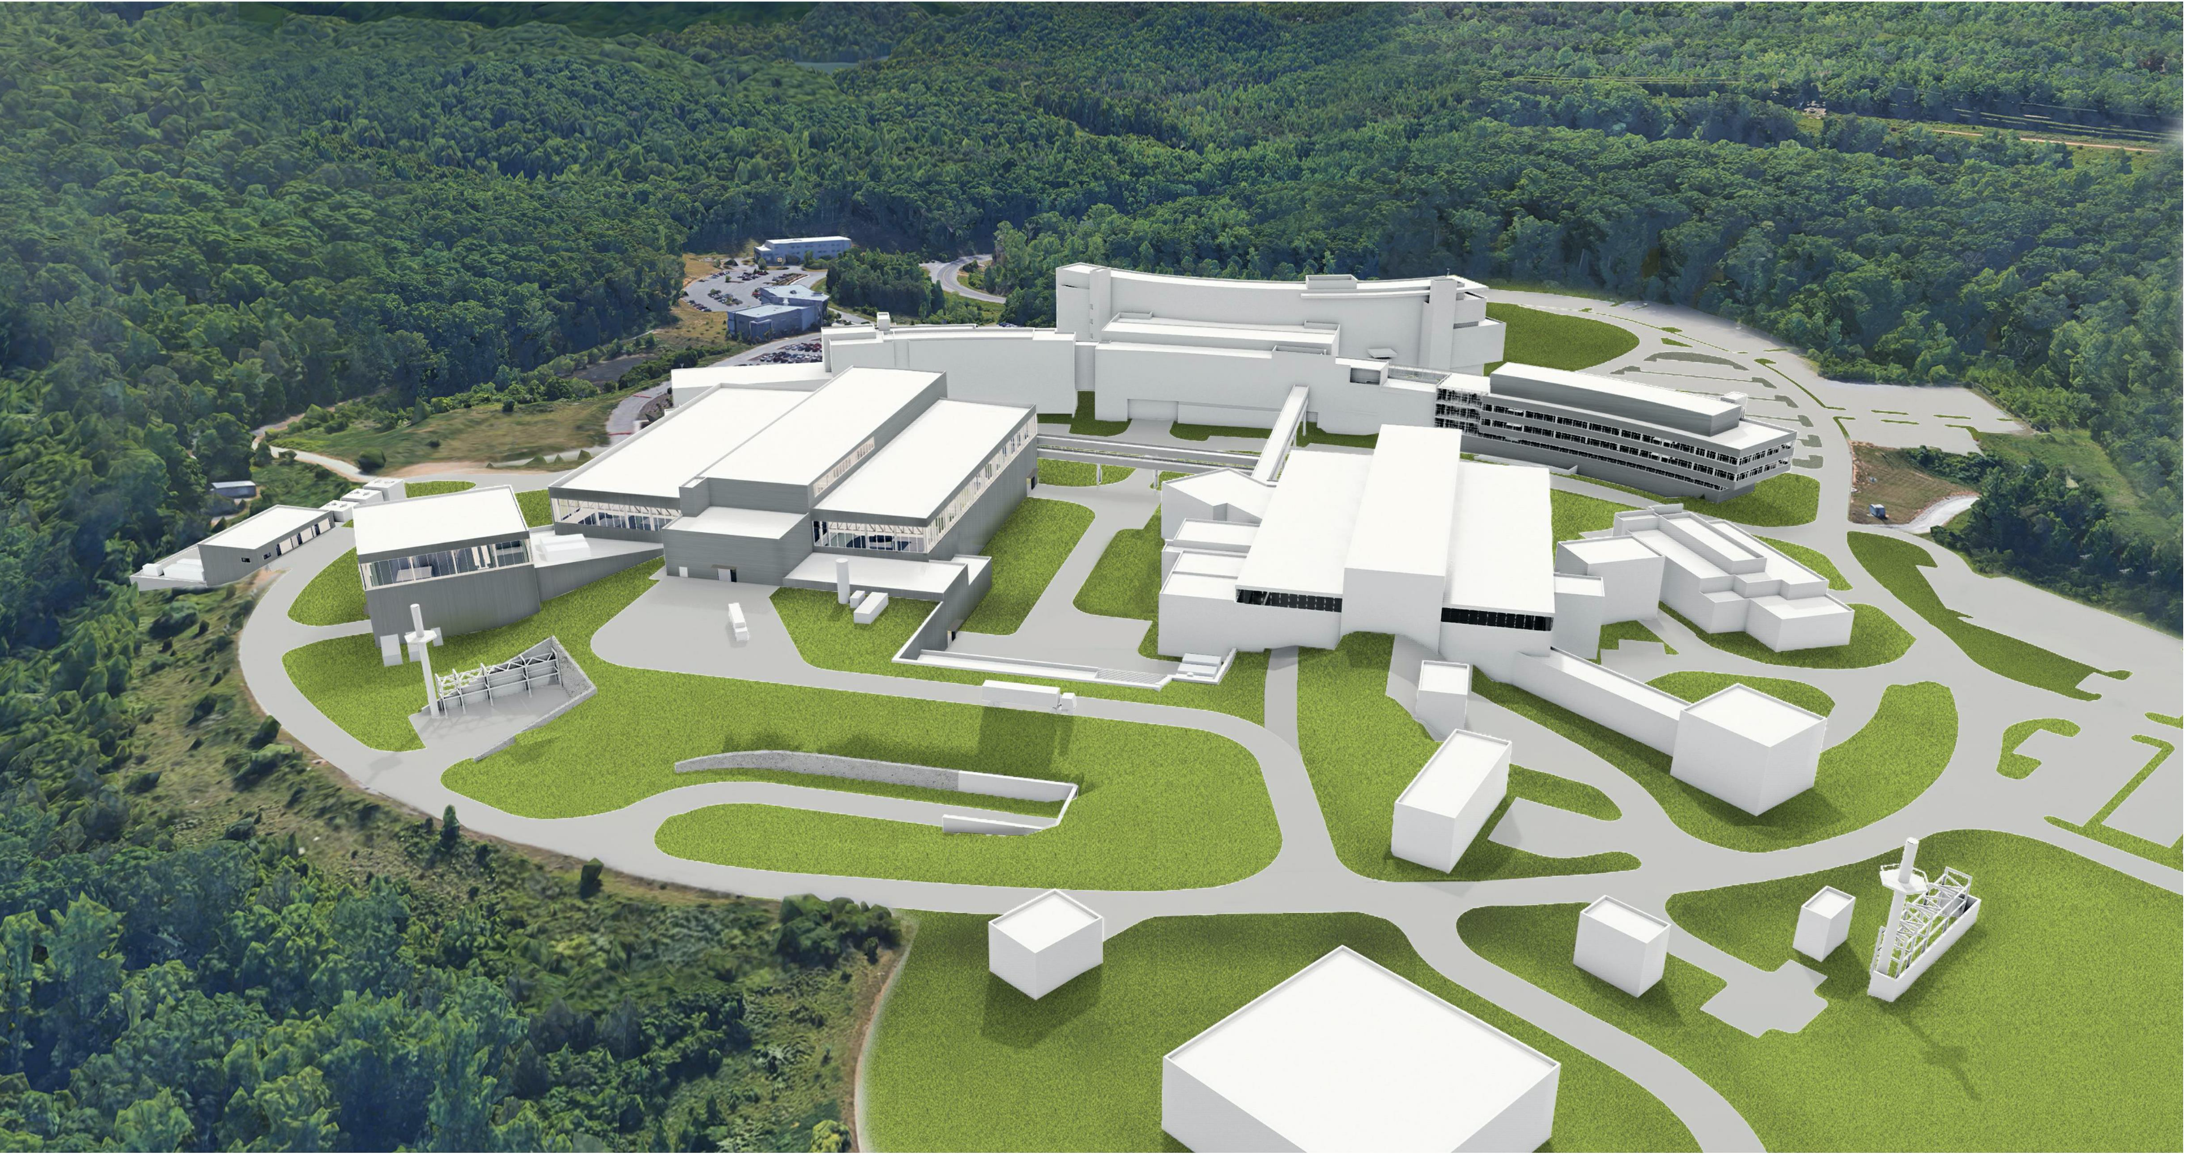
STS/RTBT Stub Site Overlaps
Charges: 1,4
STS
Stub Stockpile
RTBT Stub

Slide 41
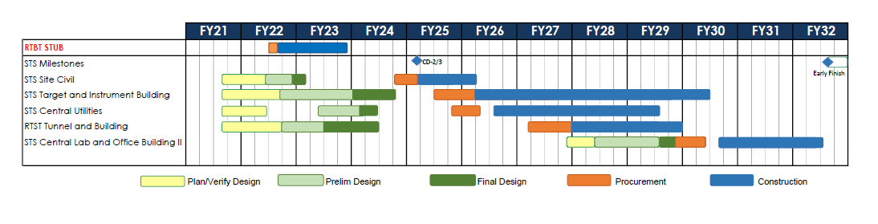
RTBT Stub and STS Schedule (6/22/2021)
Charge: 4
RTBT Stub and STS field activities do not currently overlap

Slide 42
P.06.02 Building Modifications Risk Register
Charge: 5
Risk ID | L3 WBS | Risk Title | Expiration Date | Mitigation | Pre-Mitigation Rank | Post Mitigation Rank
T-P.6-014 | P.06.02 | Construction competition for RTBT | 9/30/2023 | Communicate early with potential vendors to attract interest and to keep abreast of local market developments. Monitor other conventional facilities projects at ORNL and surrounding DOE facilities, e.g., Y-12. Consider the use of incentives for early completion, which may also serve to attract potential bidders. | 12 | 12
T-P.6-013 | P.06.02 | RTBT Stub Construction cannot be completed within the scheduled outage for FTS. | 6/30/2023 | Procurement approach will ensure the best available construction subcontractor is selected and work will be managed by the subcontractor and PPU project management to be completed to support SNS restart date. | 12 | 6
T-P.6-002 | P.06.02 | Contractor Claims for RTBT Stub for Weather or Other Impacts | 11/1/2023 | Carefully craft contract to minimize risks. Reasonable durations based on past experience will be built into the schedule and released if needed during construction to partially mitigate unanticipated impacts. | 9 | 6
T-P.6-012 | P.06.02 | STS construction field work area overlaps with RTBT stub construction area | 6/30/2023 | Utilize the STS CM to procure and manage RTBT Stub construction in conjunction with STS work if needed. If STS scheduled is delayed, there is no conflict with STS construction and project will be managed by PPU project management. | 9 | 4
T-P.6-011 | P.06.02 | STS design impacts the RTBT stub design | 9/30/2023 | Ensure there is coordination between the STS and PPU design thru routine meetings and discussions | 8 | 3
Five active risks identified
  Two risks retired; Two risks realized
  Pre-mitigated ranking: 5 Medium
  Post-mitigated ranking: 2 Low, 3 Medium
High Risks
  No high risks identified
Key risk categories analyzed
  Resource availability
  Construction delays
  Design Changes
  Contractor Claims
Risks are reviewed on a regular basis

Slide 43
Responses to Recommendations
Charge: 6
One open recommendation from 2021 Director’s Review
PPU Director’s Review August 2021 | Develop a plan with procurement and PPU management to ensure the award of the RTBT Stub contract to a qualified contractor that can meet the 6-month outage schedule. The procurement plan needs to be developed as soon as possible after the IPR, the solicitation is scheduled to be issued by May 1, 2022. | Activity added to schedule for planning and development October-December 2021.

Slide 44
ESH&Q and COVID-19 Impacts
Charge: 3
ESH&Q staff were involved in final design reviews resulting in the following
  RTBT Stub core samples obtained and found to not be radioactively contaminated showing low likelihood of encountering activated concrete or soil
  Confirmed shielding adequacy of soil and stacked shielding
  Developed shielding QA requirements
  PPS developed strategy for stub including sweep of tunnel
An Unreviewed Safety Issue (USI) has been completed for this work
There have been no COVID-19 impacts
Quality requirements for concrete density, soil density, and alignment of the structure are built into the specifications

Slide 45
12-Month Look-Ahead
Charge: 4
Demolition planning and execution for Building 8940
Develop a procurement plan to ensure that qualified subcontractors are willing to bid the work
Subcontractor outreach by Project Management and Procurement
Document review, scope of work review, develop procurement package and procurement readiness review
Set up regular meetings for coordination with STS to review potential design or schedule impacts
Active participation by Level 2 and 3 managers in STS planning and design meetings

Slide 46
Summary
Design is complete and FDR is complete
Six-month construction duration is credible within the outage window
Recommendations from previous reviews have been addressed
STS design and schedule to be analyzed for opportunities and impacts to RTBT construction
Cost Estimate has been updated to reflect current market conditions and lessons learned from KG Construction

Slide 47
Back-up Slides

Slide 48
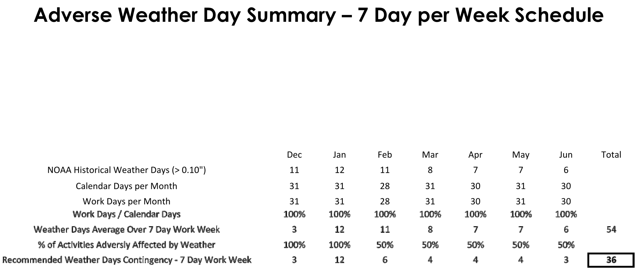
Assessing Likely Weather Delays
Charge: 4

