Slide 1
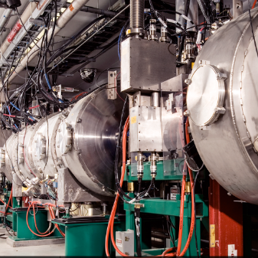
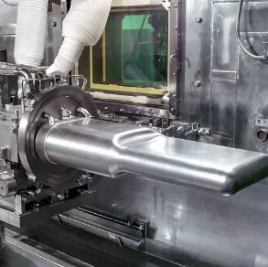
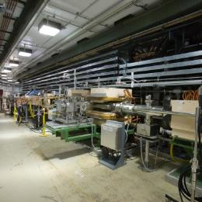

P.2.3 Cryomodule Integration
DOE/SC Independent Project Review of the Proton Power Upgrade Project
Edward Daly for the JLab Team
Level 3 Manager for Cryomodule Integration
@ Jefferson Lab
September 14-17, 2021

Slide 2
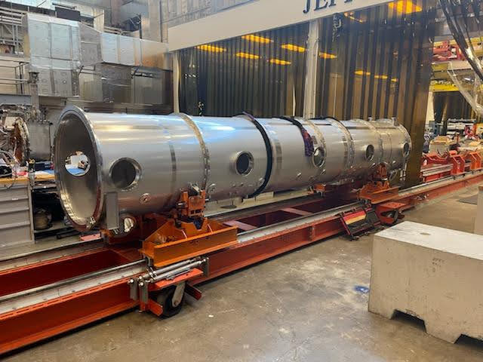
Outline
Scope
Organization & WBS
Progress since Last Review
Cost
Schedule
Labor Profile
COVID Impacts
Risk Register
12-month Look-ahead
Summary
First Vacuum Vessel Installed on Tooling

Slide 3
Scope – P.2.3 Cryomodules Integration
Charge: 1
Original procurement scope was included in CD-3B
Scope changed to include an additional 8th cryomodule
Design high-beta cryomodule and associated tooling
  Includes assembly and shipping tooling
Procure components
  Entire cryomodule bill of materials except for cavities and couplers
Receive and inspect components
Qualify (32) cavities; install helium vessels
Assemble (8) cavity strings
Assemble and test (8) cryomodules
Ship (8) cryomodules from JLab to ORNL / SNS

Slide 4

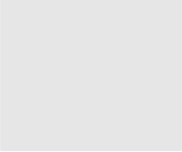
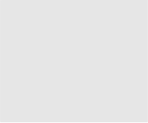


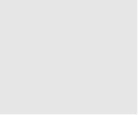


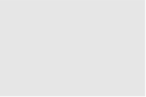
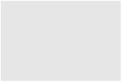


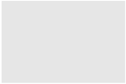

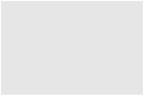
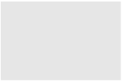











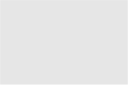




Work Breakdown Structure
Charge: 5
P.2 – SCL
Matt Howell
P.2.1
Management and System Integration Matt Howell
P.2.2 Cavities
John Mammosser
P.2.3
Cryomodules Integration Ed Daly
P.2.4
Cryogenics
Brian DeGraff
P.2.5 Utility Systems Chris Stone
P.2.6 System Integration
John Mammosser
P.2.7 SCL Controls Karen White
P.2.1.1
Management and System Integration
Matt Howell
P.2.2.1
Management and System Integration
John Mammosser
Partner Lab
P.2.4.1
Management and System Integration
Brian Degraff
P.2.5.1
Management and System Integration
Chris Stone
P.2.6.1
Management and System Integration
John Mammosser
P.2.7.1
Management and System Integration
Aaron Coleman
P.2.2.2 Cavity Procurement
John Mammosser
P.2.4.2 Cryogenic Components Brian Degraff
P.2.5.2 Beamline Vacuum
Chris Stone
P.2.6.2 Completed Cryomodule
Testing
John Mammosser
P.2.7.2 Linac Beamline Vacuum
Controls
Derrick Williams
P.2.2.4 Cavity Reprocessing
John Mammosser
P.2.4.3 Cryogenics System Testing
Brian Degraff
P.2.5.3 Insulating Vacuum System
Chris Stone
P.2.6.3
Cryomodule in Tunnel
John Mammosser
P.2.7.3 Linac Insulating Vacuum System Controls
Derrick Williams
P.2.2.5 Coupler Acquisition Yoon Kang
P.2.5.4 Water Systems Klent Pope
P.2.6.4
Cryomodule Testing in Tunnel John Mammosser
P.2.7.4
Cryomodule Controls Aaron Coleman
P.2.2.7 HTA Testing
Brian Degraff
P.2.6.5 Plasma Process MB Cryo. John Mammosser
P.2.2.8 Coupler Waveguide Transition Yoon Kang

Slide 5
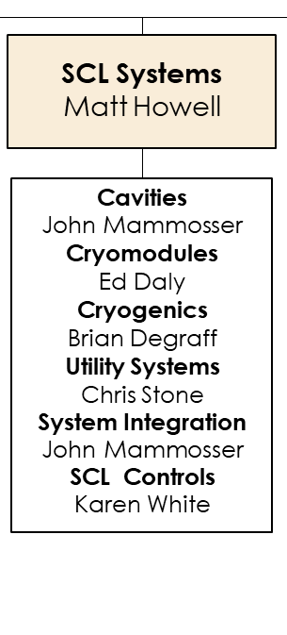
Organization @ L3
Charge: 5
Cryomodules is a WBS element in SCL Systems

Slide 6
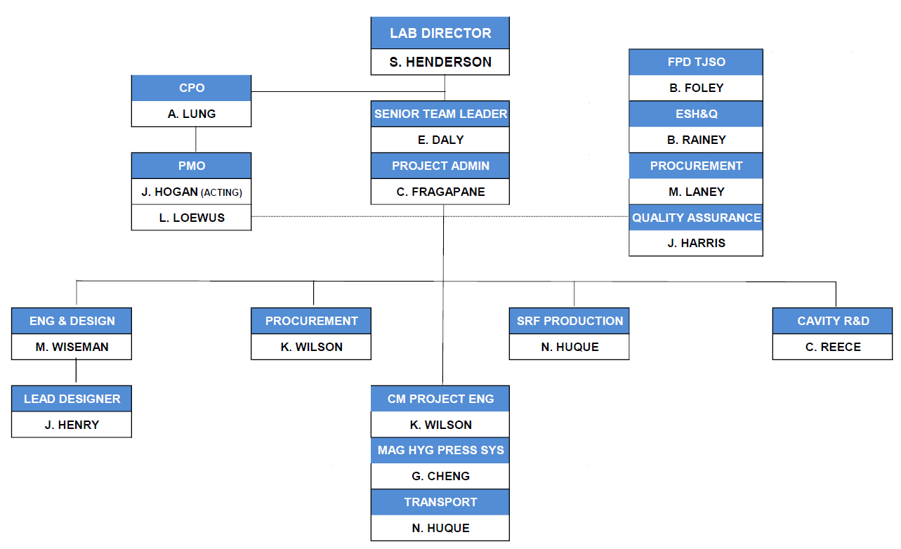
Organization @ Jefferson Lab – SNS PPU Project Team
Charge: 5
JLab Project Team in place since August 2018
B. Foley joined as FPD-TJSO
J. Hogan joined as Project Controls Group Lead
J. Harris joined as Quality Assurance Representative
CAM Hand-Off at start of FY21
  K. Wilson successfully led Procurement effort
  N. Huque leading Assembly, Test and Shipping phases

Slide 7
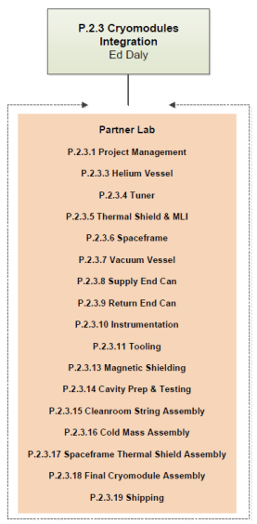
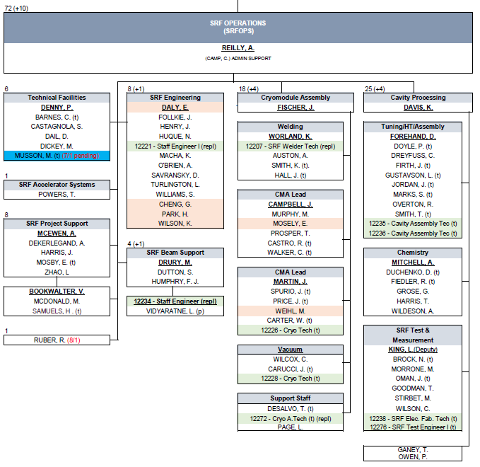
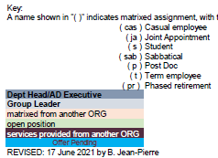
Organization @ Jefferson Lab – SRF Operations
Charge: 5
Accelerator Division provides:
  Production leadership
  Total Staff – 72
  10 additional staff (in progress)
Engineering Division provides:
  Design Lead Engineer
  Matrixed Engineers
  Designers
  Survey & Alignment
ESH&QA Division provides:
  ESH & QA Lead
  SMEs

Slide 8
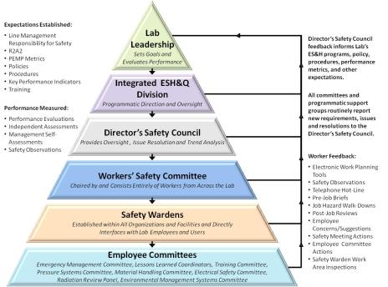
Requirements – Safety
Charge: 3
  49 Work observations conducted by Accelerator Ops / R&D in FY20
  6 different observers from the Accelerator Division conducted these interactions
  2 unsafe issues found that were addressed on the spot
ISM – Integrated Safety Management applies for all work.
Observation & Management Discussion example:
On-floor discussion with employee who was re-threading SS bolts These are custom bolts used on U-tubes with long lead time and expense, and rework is needed to keep work on schedule
Discussed reasons for this work and the PPE in use on the job
Discussed problems with safety glasses fogging up due to his mask, and recommended some possible solutions
Notable Event example:
Issue: Employee Hurts Their Right Shoulder Performing Lapping Activities (repetitive motion injury - DART Case)
Immediate Action: Work was stopped until there was an investigation to understand the circumstances and issues
Full investigation was performed by DSO with Performance Assurance Office (new process)
All corrective actions are complete

Slide 9
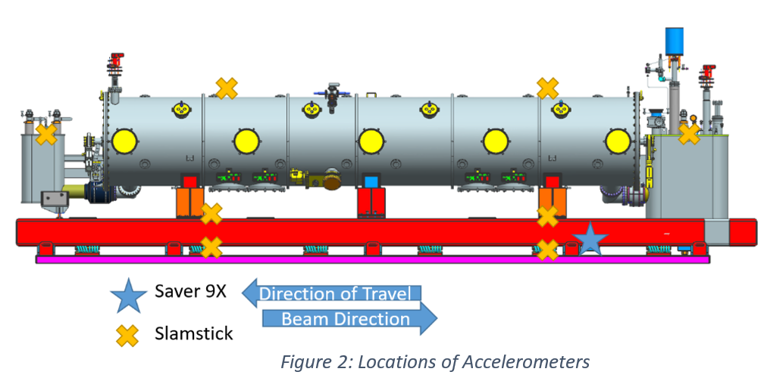
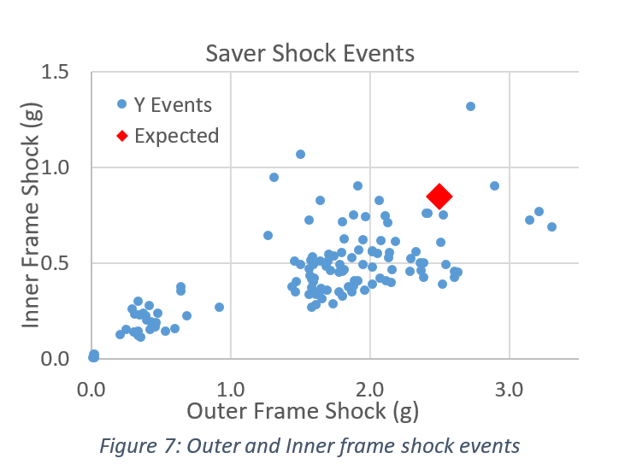
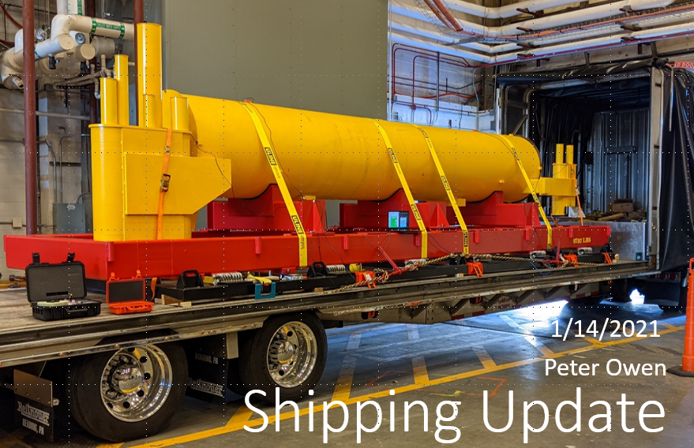
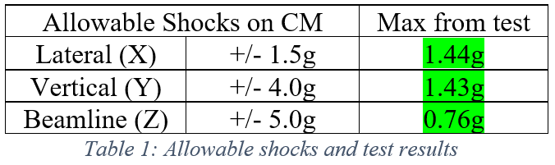
Shipping Studies Successfully Completed
Charge: 1
Goal – Confirm that shipping system provides acceptable cryomodule transportation loads
Requirements: <4g vertical, <5g longitudinal, <1.5g transverse
Data Collected on January 14th
  Saver 9X accelerometers - on inner and outer frame; Triggered by large shock events
  Slamsticks (SSX) - 8 throughout the frame and dummy cryomodule with continuous recording of acceleration, shocks; Measure max shocks throughout dummy cryomodule
  Amcrest GPS - live tracking of truck’s location
  GoPro - record first part of trip, ensures no loose parts
Results indicate > 2X damping between frame and dummy cryomodule
  Sufficient to meet requirements

Slide 10
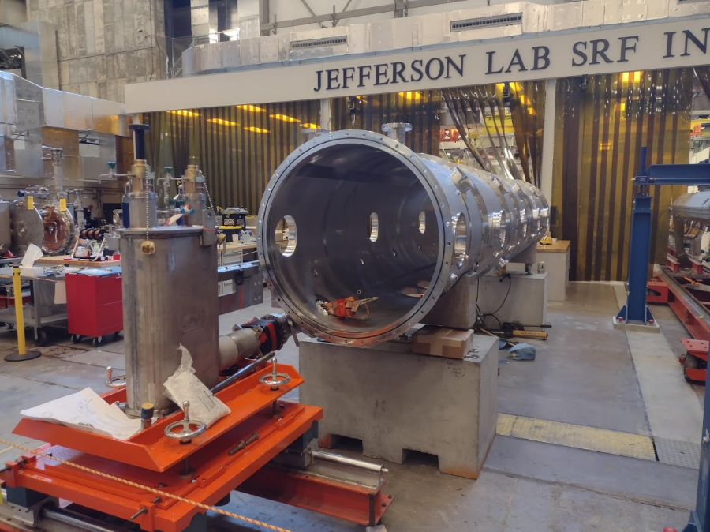
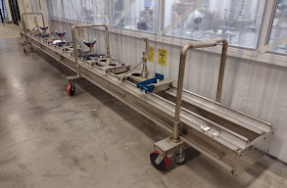
Production Planning Complete
Charge: 5
Tooling and Infrastructure for assembly
  Planning for parallel CM assembly lines on multiple projects
  All major tooling designs procured and tested
Production assembly efforts
  Receipt inspection on-going
  Assembly procedures completed
  Traveler system in place including reporting
  Staffing needs are well understood
Preparing for CM Testing
  Limited testing at JLab prior to shipment to ORNL for full high-power testing

Slide 11
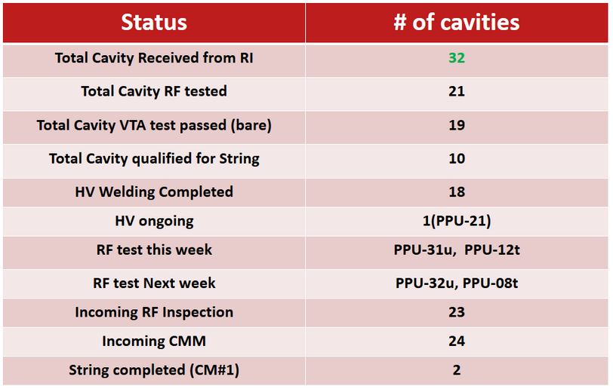
Cavity Status (26-AUG-2021)
Charge: 1
Overall progress is very good
Qualification rate for first test from vendor (~50%)
Retaining performance after tanking has been challenging
  Tanking effort with development cavities showed good results
  Production tanking has been inconsistent
Plans adjusted to re-test tanked cavities prior to string assembly

Slide 12
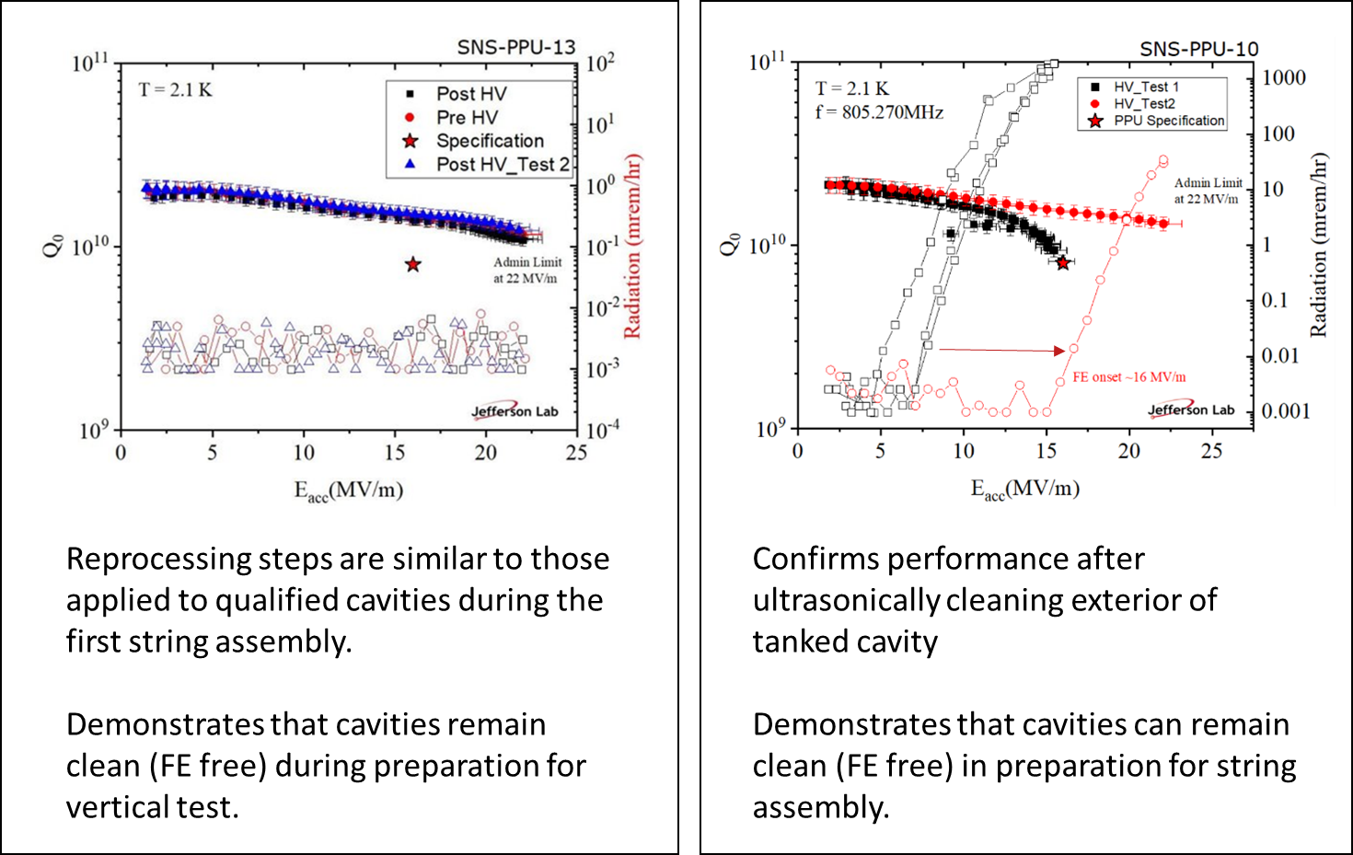
Recent Tanked Cavity Performance (P. Dhakal)
Charge: 2

Slide 13
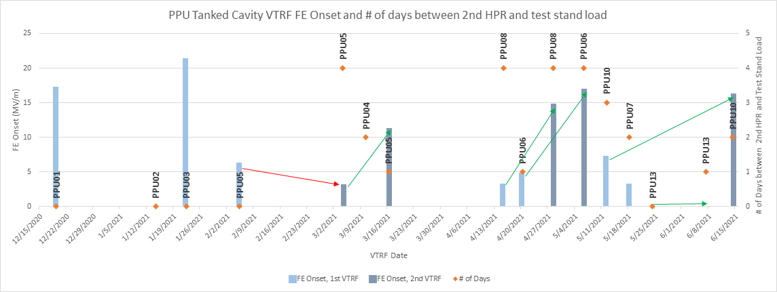
Vertical Test Results for Tanked Cavities (T. Ganey)
Investigating causation and correlation related to FE Onset
  Ineffective/incomplete cleaning of cavity/HV assembly
Observe that second tests improve (push out) FE Onset
  Partial removal of particulate during VTA testing (helium cleaning)
  PPU-05 outlier – likely due to HPR cabinet pump diaphragm failure
Charge: 1

Slide 14
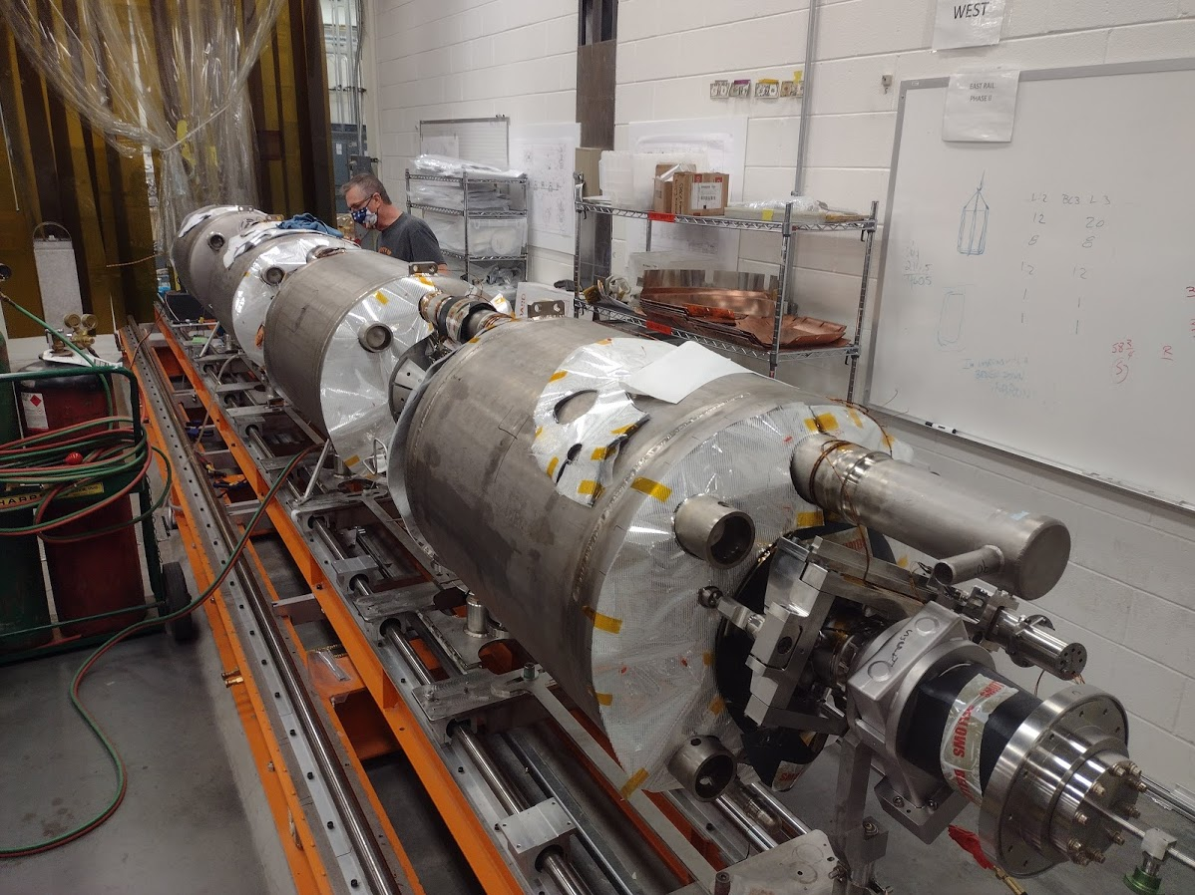
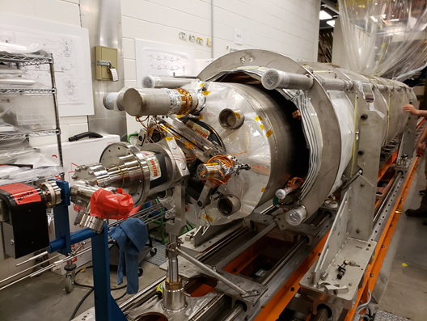
CM Production Area
Charge: 1
CM-01 Cold Mass Assembly in Progress
CM-01 Space Frame Assembly Test-Fit

Slide 15
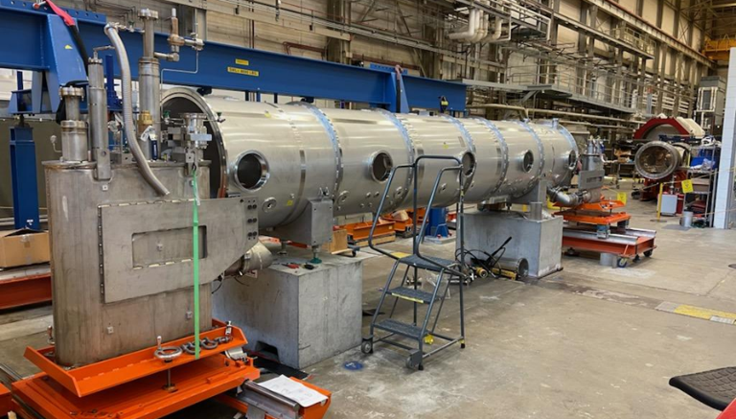
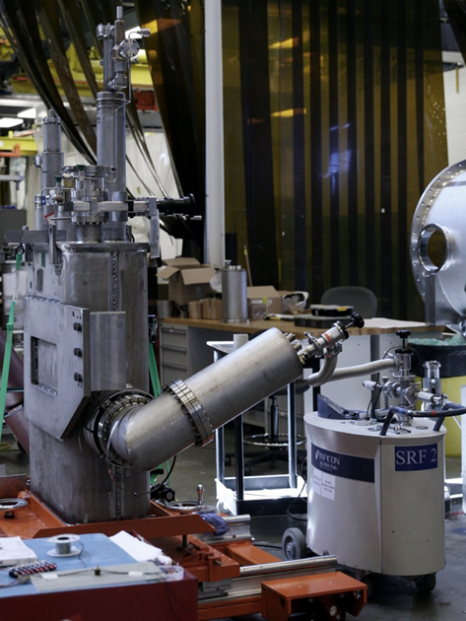
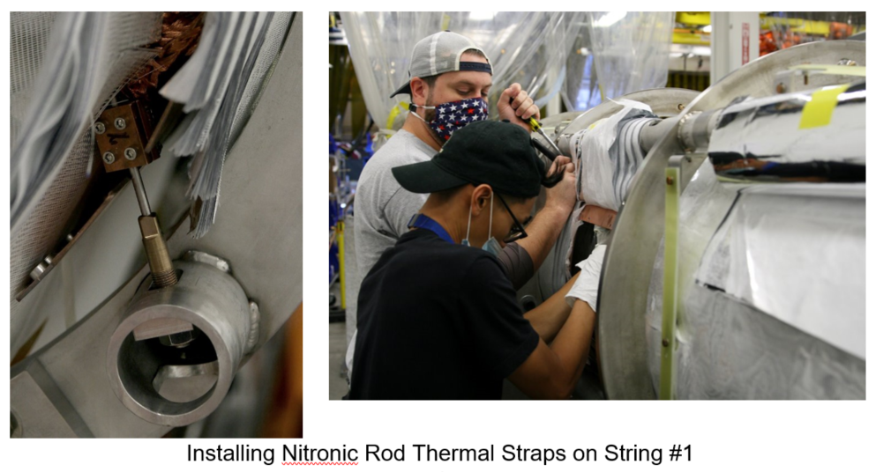
CM Production Area
Test-Fit of End Cans onto the Vacuum Vessels
REC-02 Leak Check
Installing support rods between string and spaceframe

Slide 16
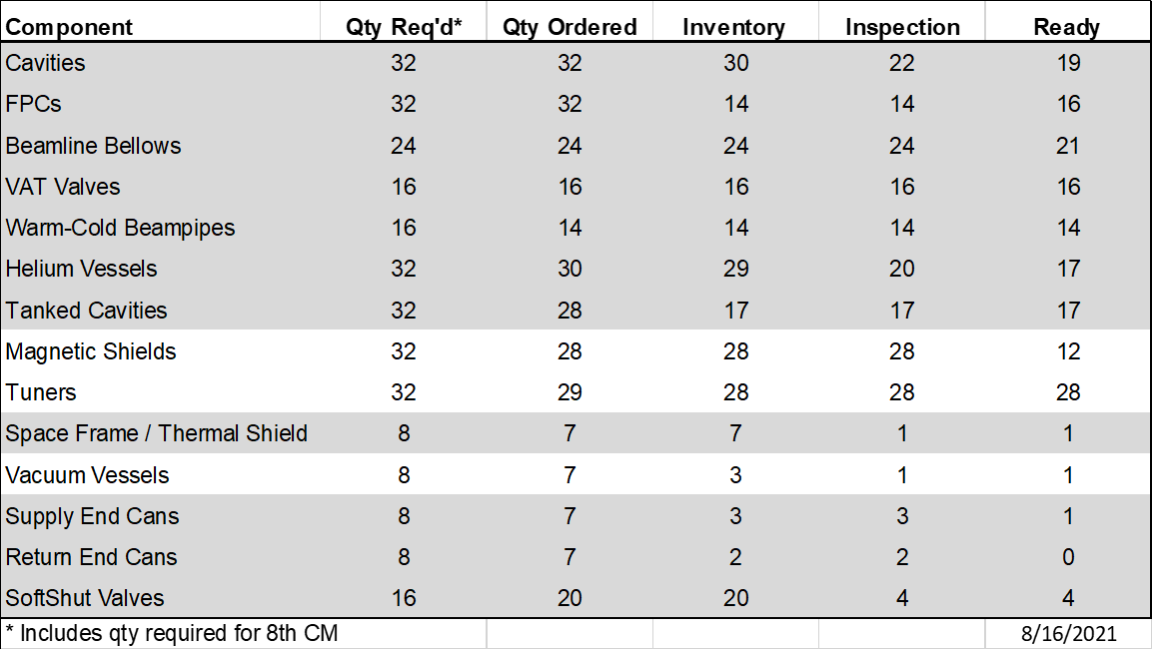
Status of Major Components (16-AUG-2021)
Charge: 2
Components on-hand and ready to complete first CM except return end can pending favorable inspection results
Cavity string
Cold Mass
* First return end can received from vendor on 6/25

Slide 17
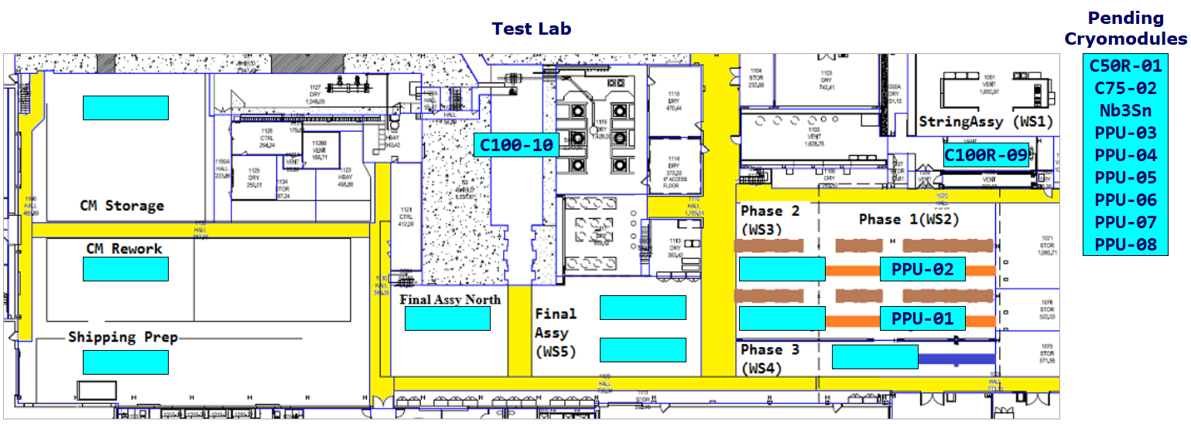
CM Production Area (28 AUG 2021 Status)
Charge: 4
C75-01 and P1 CMs delivered to CEBAF in mid-June 2021
C75-02 and C100-9R are in refurbishment (cavity re-qualification)
PPU-01 at SF/TS Assembly (WS3); PPU-02 at Cold Mass Assembly (WS2)

Slide 18
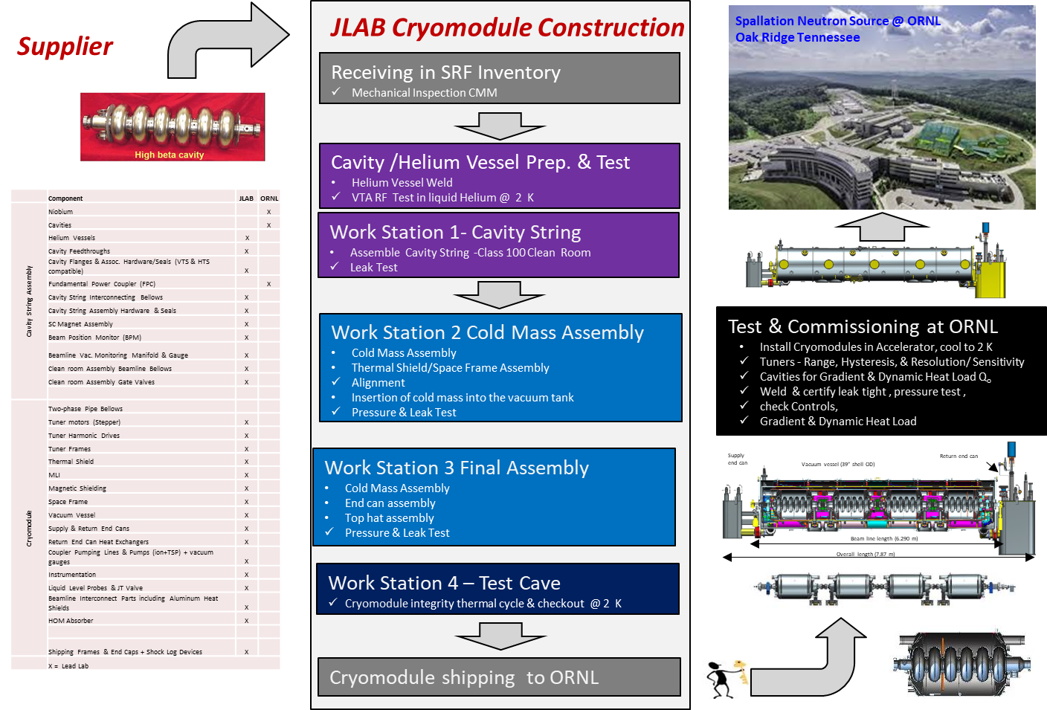
Production – Well-Defined Process Flow
Charge: 1

Slide 19
Processes, Procedures and Travelers
Charge: 1
Finalized list of procedures and travelers for CM production based on CM assembly processes
  Leveraged recent LCLS-II experience
Procedures are a composite of SNS, C100 and LCLS-II experience folding in ORNL procedures and techniques used on HB prototype CM
  Assembly travelers for cavity string assembly
  Assembly travelers for CM assembly
  Procedure development in collaboration with ORNL team
Implemented receiving and inspection travelers for the production CM components
  JLab TRs led these efforts for continuity from design to procurement
Continuing to refine production procedures and travelers based on SNS HB prototype CM experience and lessons learned during production

Slide 20
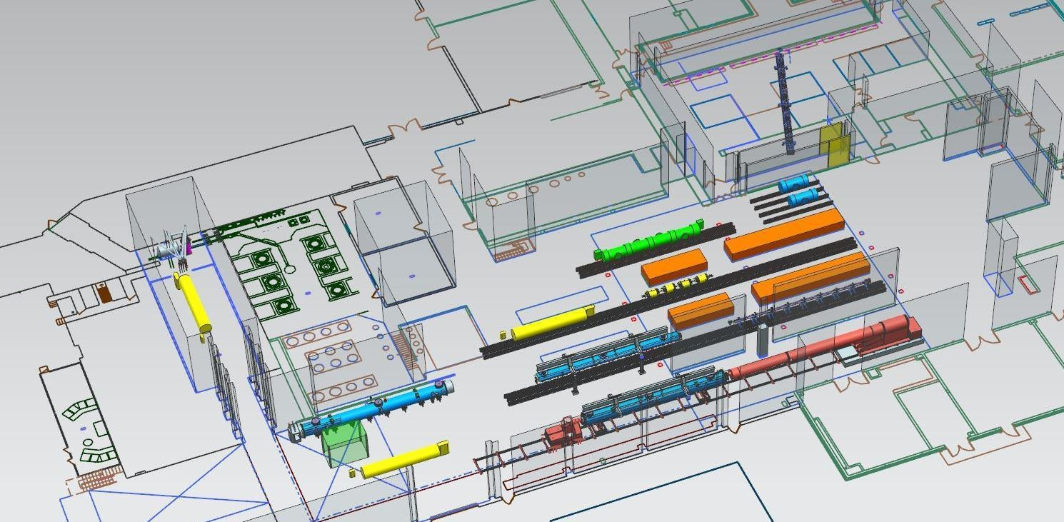
Test Lab – CM Production Area Layout (FY2022)
Charge: 5
Cavity & Cryomodule Assembly / Testing activities are integrated on a routine basis
Projected layout includes CEBAF, SNS PPU and LCLS-II-HE CMs
Clean Room
CM Testing
(CMTF)
Cavity Testing (VTA)
Cold Mass Assembly
Cryomodule Assembly

Slide 21
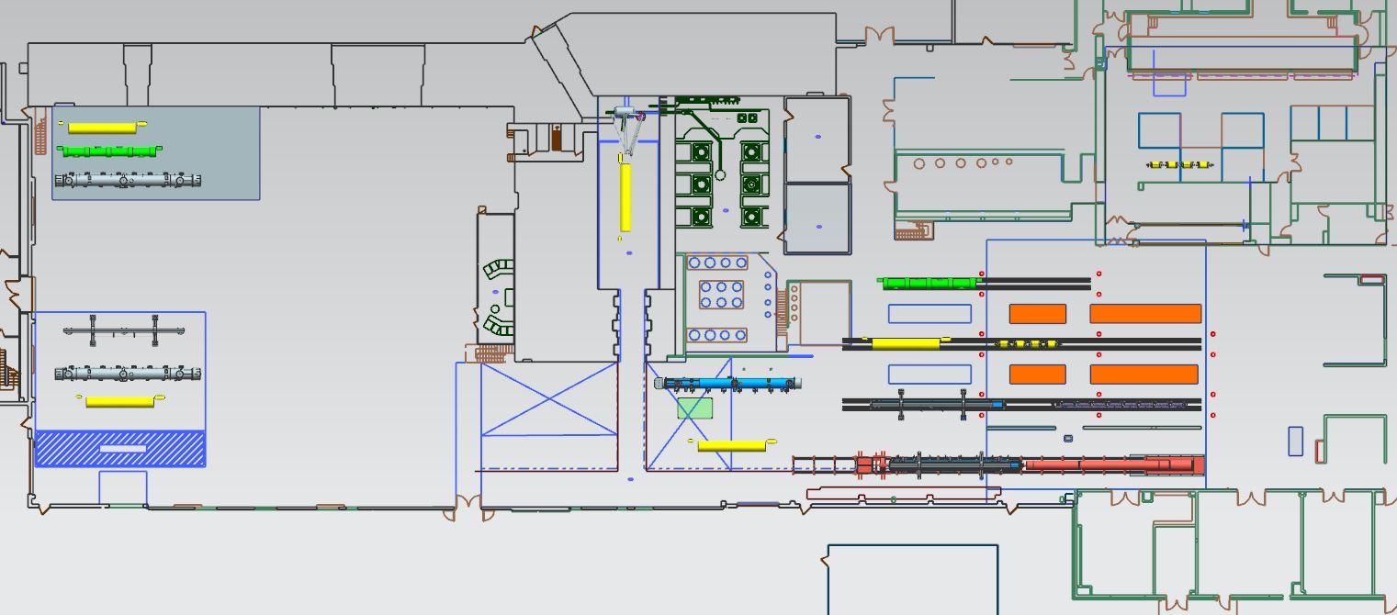
Test Lab – Overall Layout (FY2022)
Charge: 5
CM Testing
(CMTF)
Cavity Testing (VTA)
Clean Room
Storage on UITF roof
Cold Mass Assembly
Shipping / Receiving
Preparation
Cryomodule Assembly

Slide 22

Lessons Learned vs Lessons Applied
Charge: 3
Cold Mass Assembly
Failure Mode Effects Analysis completed for:
  Receiving / Inventory / Issuance
  Cavity Processing and Vertical Test
  Cavity String Assembly
  Cold Mass Assembly
  He Tanking
  Space Frame/Thermal Shield
Receiving
Inventory
Issuance
Cavity Processing
Vertical Test
He Tanking
Space Frame
Thermal Shield
Cavity String Assembly
Vacuum Vessel
Cryomodule Shipping
Cryomodule Test
Final Assembly
27 Failure Modes with RPN >100
21 Recommended Actions identified
Changes made to work control documents
Cavity Helium Tanking
Process Function | Failure Mode | Potential Effects | Causal Mechanism | Current Process Control(s) | S | O | D | RPN | Recommended Action
Previous Travelers completed | Components not checked for NCR status | Dependent on nature of NCR, use of non-cleared part could have impacts on performance or downstream assembly | Physical tag falls off and database not checked | Canned NCR report available | 7 | 6 | 4 | 168 | Potential use of personnel verification that no NCRs are open
Adjust FPC head and tack weld to cavity end dish | Improperly clocked head | Additional work/issues installing piping | Drawing interpretation, not following procedures | Reference drwg's contained in Traveler/Proc | 5 | 5 | 6 | 150 | Devise engineered solution (tooling)
Hold point to ensure cavity is secure (cleared only by SMEs) | Clearance step missed or disregarded | Dependent on what is wrong | Distraction, complacency | Traveler contains instructions for SME to reference | 8 | 3 | 5 | 120 | Further detail the traveler list (itemize)
Remove coupler lollipop | Inspection of cavity in prior step not conducted correctly or thoroughly | Fallen cavity | Inattention, or perhaps lack of sufficient training | Tooling has an engineered control to allow visual load release | 8 | 3 | 3 | 72 | SME to remain and witness lollipop removal

Slide 23
Project Change Requests since CD-2/3
Charge: 4,5
Baseline changes are managed smoothly between JLab and SNS Project Controls Teams
JLab BCRs are inputs for PPU PCRs

Slide 24
Cost – Partner Lab Scope (P.2 & P.10)
Charge: 4
P.2.3 is primarily labor for CM assembly, test and shipment effort
P.10.02.07 is primarily component procurement effort

Slide 25
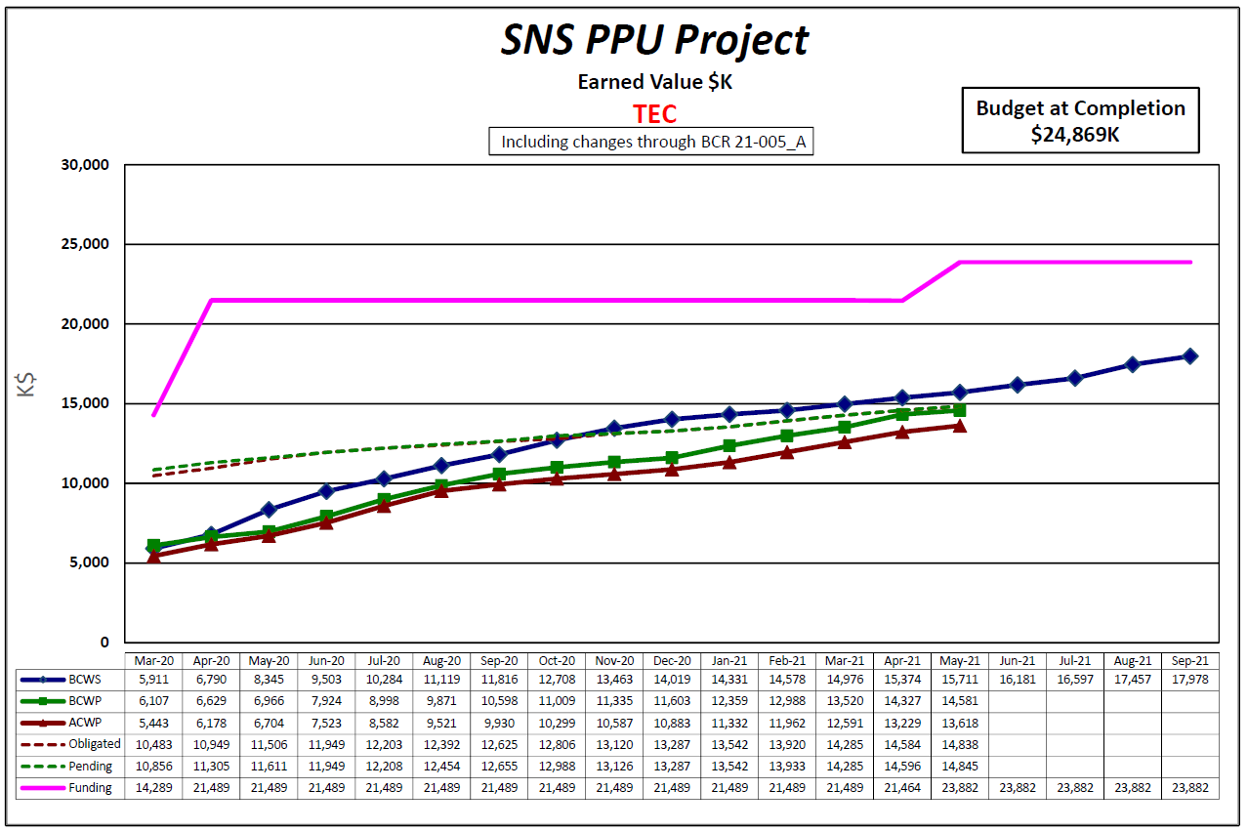
Cost – Partner Lab Scope (58.6% Complete)
Charge: 4,5
JLab Project Management Office (PMO) ensures that SNS PPU project is managed using JLab’s EVMS program
Currently funded to complete CM scope, except assembly labor for additional 8th CM
Combined Scope (P.2 & P.10)
Received funding for additional CM procurements in May

Slide 26
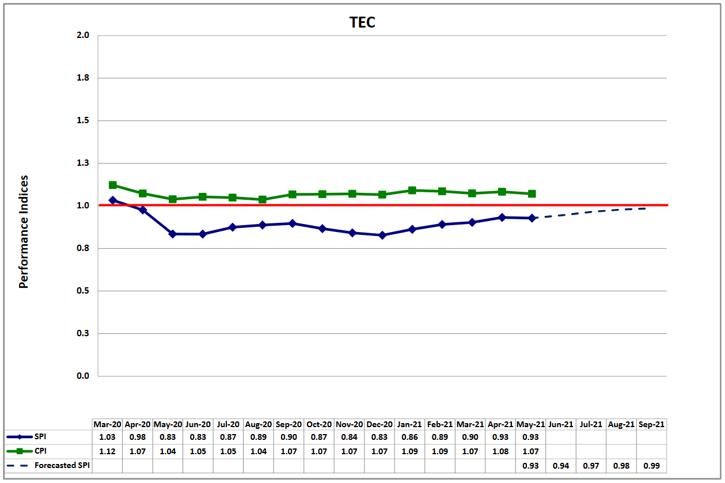
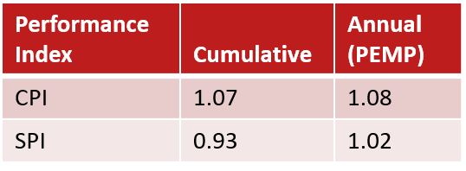
Overall Performance (31-MAY-2021) – 58.6% Complete
Primary Schedule Variance Drivers are Vacuum Vessels and End Cans – ($1,137K)
Receipt of major components in remainder of FY21 will improve overall SV
Assembly progressing well – tanking and re-testing cavities; offsets delivery SV
Charge: 4,5

Slide 27
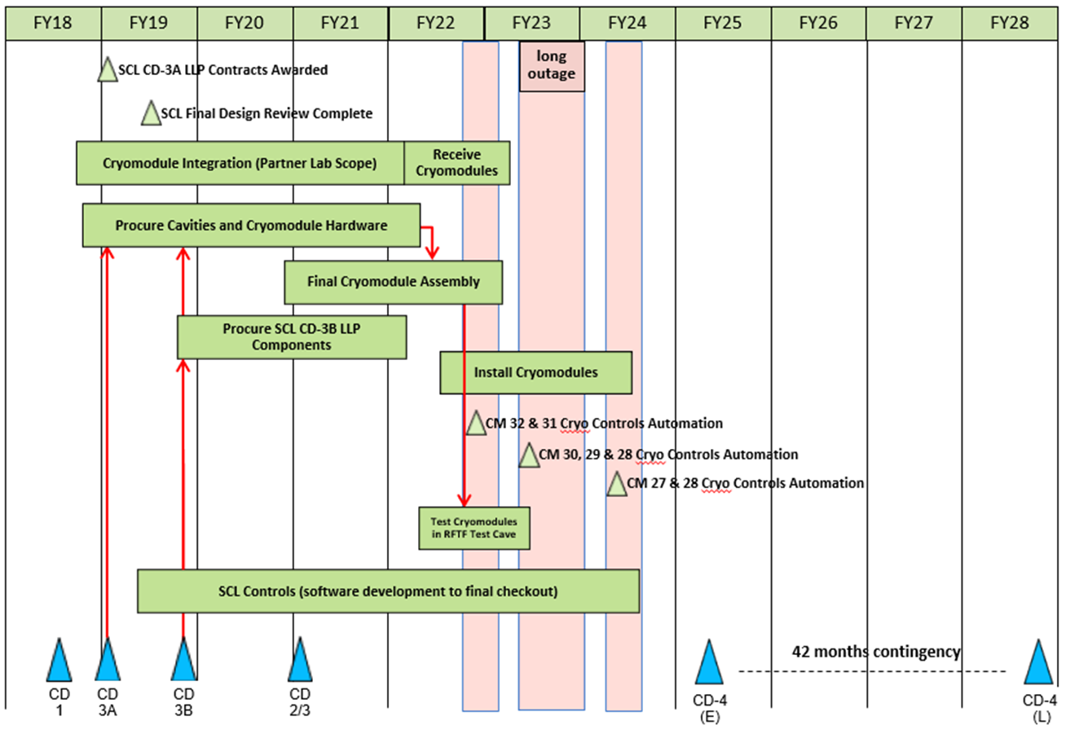
P.03 & P.10.03 – SCL May 2021 Status Summary Schedule
Charge: 4

Slide 28
Schedule Milestones – Partner Lab Scope
Charge: 4
Advance CM deliveries as risk mitigation for installation
3 CMs delivered to ORNL ready for testing prior to 1st down and 3 CMs prior to 2nd down

Slide 29
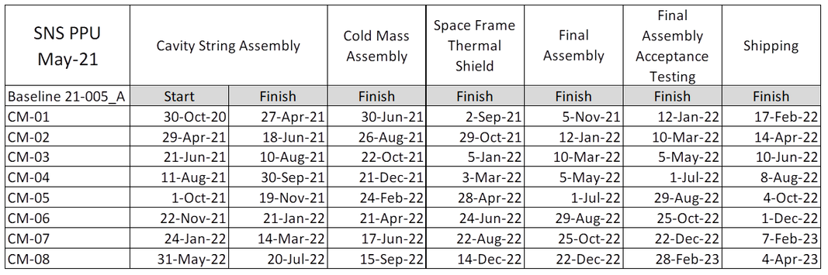
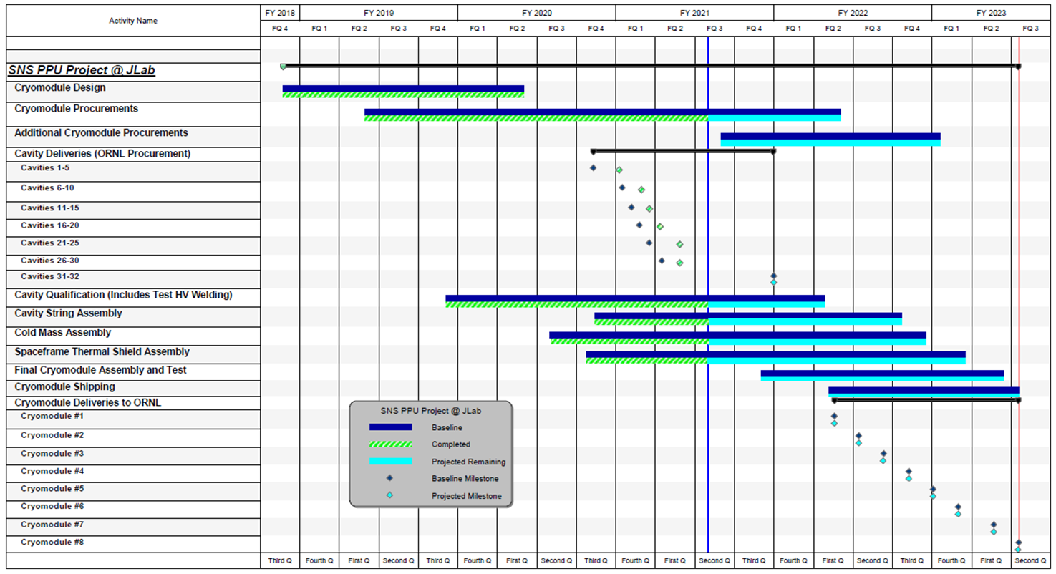
Overall Schedule
Charge: 4
On track to deliver CMs next year with first delivery in Feb 2022
JLab added 8th CM to baseline schedule via BCR in April 2021

Slide 30
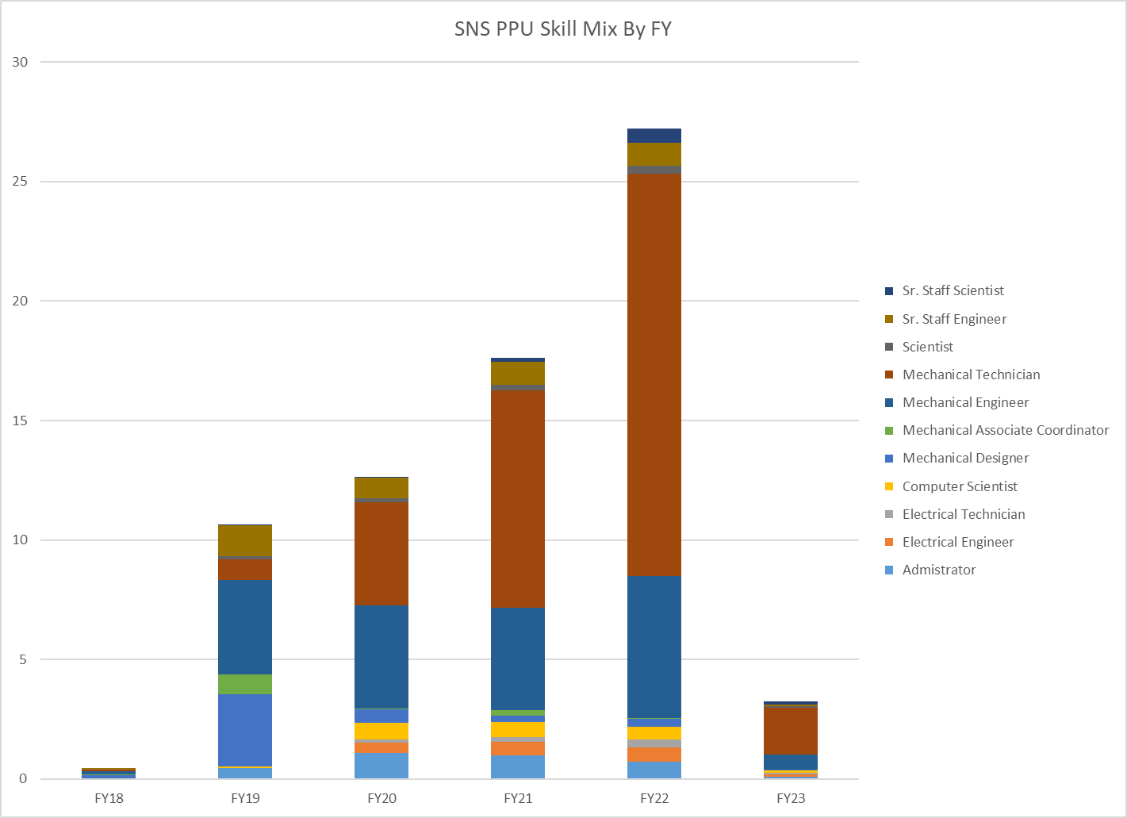
Labor Profile – Peaks at 27 FTEs during FY 22
Charge: 4,5
For comparison, LCLS-II (21 CMs, 4 yrs) averages 45 FTEs during full production
CM Assembly
Cavity Qual
Procurement
Design

Slide 31
Schedule Impact due to COVID-19 at JLab
Charge: 4,5
Procurement phase progressed quite well
  Tracked impacts to delivery schedules for Vacuum Vessels and End Cans
  Managing vendors via telecons, emails, VCs as usual; No site visits in the last year
  Only two vendors reported COVID-related interruptions to operations
Jefferson Lab shutdown operations on 17-March-2020 (MEDCON6)
  Entire PPU team is working remotely on procurements and production preparations
  Procedures modified in order to receive components
Select staff returned to work as operations resumed – 15-June-2020 (MEDCON5)
  Lab management executed plans for PPE and social distancing
  PPU team reviewed and defined work requiring PPE related to cavity test & CM assembly
  Essential workers that handle, inspect, assemble and test hardware allowed on-site
More staff returned to work consistent with State Directives - 7-JUNE-2021 (MEDCON4)
  Users, visitors and students allowed on-site in addition to essential workers
  Staff who can effectively work remotely will continue to do so

Slide 32
P.02.03 Cryomodule Integration (Partner Laboratory Scope) Risk Register
Charge: 5
Risk ID | L3 WBS | Risk Title | Expiration Date | Mitigation | Pre-Mitigation Rank | Post Mitigation Rank
T-P.2-014 | P.02.03 | First 2 Cryomodule Delivery Is Late | 5/15/2022 | Negotiate with SNS operations to adjust maintenance outage schedule to accommodate actual CM delivery dates | 12 | 2
T-P.2-020 | P.02.03 | Partner Laboratory Priorities | 1/31/2023 | Add SNS personnel or contract labor at partner laboratory to meet production schedule, as needed | 6 | 3
T-P.2-017 | P.02.03 | Second delivery of 3 Cryomodules Is Late | 10/1/2022 | Negotiate with SNS operations to adjust maintenance outage schedule to accommodate actual CM delivery dates | 6 | 2
T-P.2-016 | P.02.03 | Final 2 Cryomodule Delivery Is Late | 1/31/2023 | Negotiate with SNS operations to adjust maintenance outage schedule to accommodate actual CM delivery dates | 6 | 2
T-P.2-040 | P.02.03 | Cryostat component (spaceframe) is dimensionally out of tolerance | 3/1/2022 | Maintain good communication between PPU and cryomodule component vendors so that nonconformances can be discovered and mitigated early. Perform inspections promptly upon receipt of materials. Perform vendor visits as needed to ensure quality. | 4 | 4
T-P.2-013 | P.02.03 | Cryomodule Shipment | 1/31/2023 | Conduct shipping tests on Cryomodule shipping fixture to measure g-loading and adjust fixture or re-route truck along different roads to minimize impact to Cryomodule | 4 | 2
Six active risks identified
  Three retired, two realized
  Pre-mitigated ranking: 2 Low, 4 Medium
  Post-mitigated ranking: 6 Low
High Risks
  No high risks identified
Key risk categories analyzed
  Late delivery of components or deliverables
  Competing partner lab priorities
Risks are reviewed on a regular basis

Slide 33
Risk Mitigation for Cryomodule Shipments
Charge: 5
Applying lessons learned from previous projects including SNS and LCLS-II including early testing and active monitoring
Conducted analysis on new components (e.g., FPCs) in order to verify acceptable stress levels during shipping
Shipped ~16 fundamental power coupler (FPC) to JLab without incident
Addressed shipping as part of the cryomodule production readiness review
Performed shipping tests with dummy cryomodule
Perform shipping test with first production cryomodule

Slide 34
12-Month Look-Ahead (SEP-2022)
Charge: 4
Smooth return to working onsite at JLab
Continue executing contracts for procured components
Receive majority of components for 8th cryomodule
Receive and test remainder of cavities
Assemble 8 cavity strings
Assemble and deliver 4 cryomodules to ORNL

Slide 35
Summary
The partnership between SNS and JLab is working well
The division of responsibilities and scope is well understood
  Shipping tests have been completed successfully
  Procurement effort for the first 7 CMs is nearly complete
  Procurement effort for the 8th CM has kicked off
  Cavity qualification is more than 50% complete
  Cryomodule assembly effort has ramped up

Slide 36
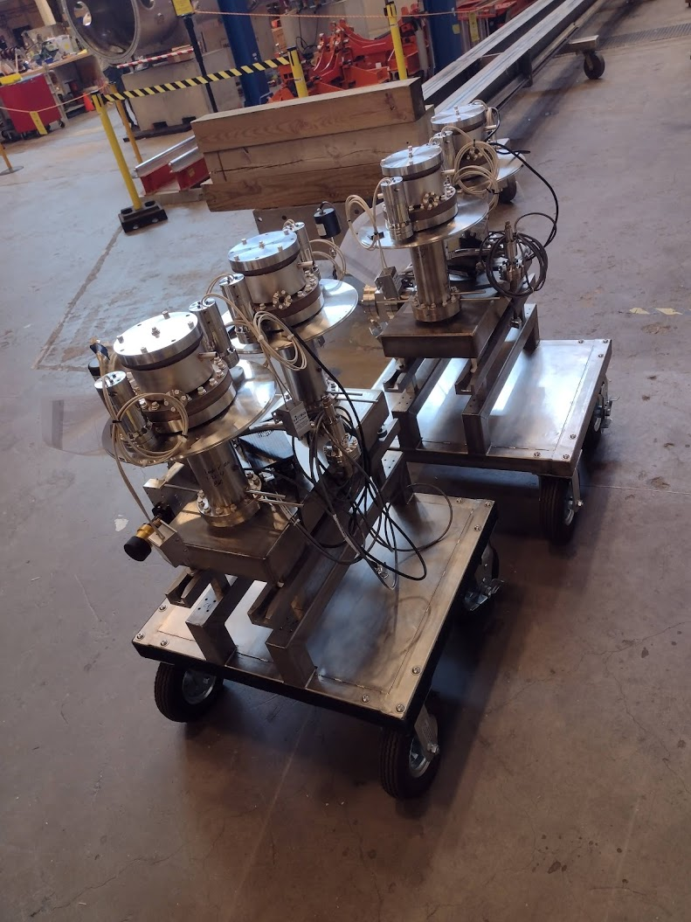
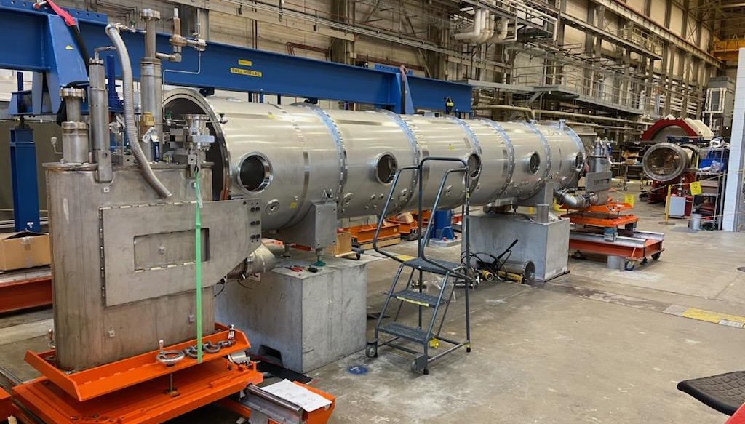
Acknowledgements
Special Thanks – M. Wiseman, K. Wilson, N. Huque, T. Reilly, L. Loewus, P. Dhakal, T. Ganey
JLab colleagues
SNS PPU Project Team at ORNL

Slide 37
Questions?

Slide 38
Sub-Contracting Officer’s Technical Representative (TR)
Charge: 5
Important Role / Responsibility
  “Glue” between design, prototyping, procurement and assembly phases
  Technical expertise for sub-system components
  Achievable for “moderate sized” projects
Design Phase
  Develops technical specifications from higher level requirements
  Prepares drawings and supporting technical documents
Prototyping Phase
  Procures prototypes from industry/partner labs
  Participates in prototype development and testing
  Feeds forward experience into production process
Production Procurement Phase
  Provides technical leadership and point of contact with manufacturer
Assembly/Integration
  Provides sustaining engineering during manufacturing
  Technical judgment to resolve non-conformances

Slide 39
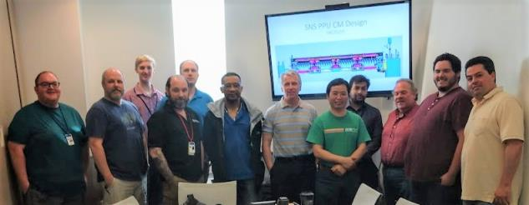
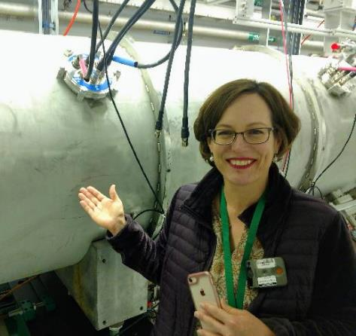
JLab CM Design Team Completed Their Work!
Charge: 1
Mark Wiseman, Senior Staff Engineer, led the design team comprised of engineers and designers and production staff that have contributed to cryomodule designs for SNS, CEBAF, 12 GeV, APS-U, FRIB and LCLS-II.
Katherine Wilson, Staff Engineer on the design team, led the procurement efforts
  Engineers develop specifications and statements of work for procurement
  Provide technical leadership during procurement process (TRs)

Slide 40
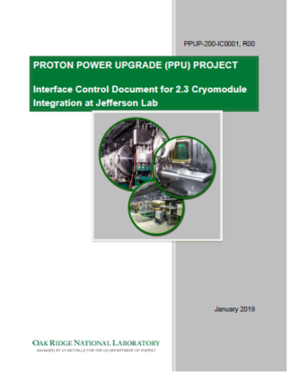
Requirements – FDR, SOWs & ICD
Charge: 1
SNS PPU Final Design Report, Chapter 3
SNS PPU Cryomodule Statement of Work, 104110000-SW008-R00
  Delivery of (8) PPU HB CMs; PPU/JLab responsibilities
SNS PPU CM Design SOW – PPU-P02-SW0001-R00
  Deliverables for Design include: 3-D model and drawing package for PPU cryomodule, assembly and testing methodology and shipping procedure
  Basis for Design includes: existing HB spare CM and SNS staff assembly experiences, HB spare CM as-built drawings and existing CM CAD models at ORNL
Interface Control Document approved

Slide 41



Design – Details from Final Design Report
Charge: 1
No HOM couplers; RRR End groups
HV is ASME Code Compliant
End cans - ASME Code Compliant
FPC Inner Conductor wall is 4 mm thicker & 1.5 mm shorter

Slide 42
Design – Incremental Improvements
Charge: 1
As the design effort progressed, a comprehensive list of changes, modifications and improvements was maintained
Driven by the new requirements for the PPU HB CM
  Eliminating features associated with HOMs – connectors and ports
  Removing holes in magnetic shielding for piezo actuators
Improving components (examples)
  Upgraded to CERNOX temperature sensors
  ASME code-compliant relief valves
Improving assembly methods
  Modified warm to cold bellows and warm beam pipe assemblies to accommodate installation in cleanroom and improved clean assembly
  Added bellows and additional rotatable flanges in end cans to allow position adjustment of the bayonets at final assembly

Slide 43


Design – Cavities and FPCs
Charge: 1
805 MHz Cavities, FPC inner conductor with window, and FPC outer conductor are provided by SNS
30 Cavities will arrive from the vendor ready for VTA testing
The FPC inner and outer conductor will be RF vacuum conditioned at SNS and delivered to JLab ready to install in a cavity string
High Beta cavity with flanges assembly from vendor
104211800-M8U-8330-A001
J. Mammosser TTC presentation

Slide 44



Design – Space Frame & Thermal Shield Assembly
Charge: 1
Thermal shield installed in spaceframe
MLI (not shown)
Cavity string aligned in space frame using nitronic rods
Warm magnetic shield around space frame
Spaceframe
Thermal shield
Nitronic rods
Magnetic shield

Slide 45


Clean Room Assembly
Charge: 1
1.29 m
Cavities are installed in helium vessel at JLab
Four Cavity with helium vessel to a string
  One with liquid level probes
FPC assembly
Field Probes
Beamline bellows between cavities
Metal seal gate valves at ends
Warm to cold transition bellows
  Temporary vacuum pumping on the return end (not shown)
Field Probe
Cavity in helium vessel (24” OD)
Gate valve
Warm to cold beam line bellows
Beam line bellows
Warm to cold beam line bellows w Ion pump
FPC assembly

Slide 46

Helium Circuits (P&ID 109100501-R8U 8200 P001)
Charge: 1
Simplified Version
Primary Supply
2K Return
FPC circuit control valve
Cool down valve
185 PSIG
17 PSID
Primary JT valve
60 PSIA
Shield Circuit

Slide 47



Cold Mass Assembly
Charge: 1
2K header bellows and lower liquid level flex hoses between helium vessels
~5k coupler circuit + HX supply and return lines
FPC vacuum vessel bellows
Tuners
MLI (not shown)
Cold magnetic shielding
Tuner
Flex lines
Header bellows
Coupler circuit
FPC vacuum bellows
Magnetic shield
HX supply and return helium lines

Slide 48


Design – Cryomodule Assembly
Charge: 1
Vacuum Vessel
Supply and Return End Cans
Finish helium circuit piping with valves
Add thermal shield, warm magnetic shields and MLI to both ends inside vacuum vessel
Beam pipes with valves and vacuum pump
Exterior coupler tubing
Supply end view with internal piping
Supply end can
Vacuum vessel (39” shell OD)
Return end can
Beam line length (6.291 m)
Overall length (~7.87 m)

Slide 49



Cryomodule Installation
Charge: 1
Cryomodule on stands and saddles in tunnel
Air side FPC couple and waveguide installed
Warm girders between cryomodules
All supplied by SNS
Warm girder between CMs (from ICD)
Saddle
Air side FPC extensions, doorknobs and waveguides
FPC exhaust manifold (installed at JLab)
Stand

Slide 50

Proposed CM Acceptance Criteria @ JLab prior to shipment
Charge: 1

