Slide 1




P.6.2.3 Facility CF Controls
DOE/SC Independent Project Review of the Proton Power Upgrade Project
Derrick Williams
Level 3/4 Manager for CF Controls
September 14-17, 2021

Slide 2
Outline
Scope
Organization
Progress since CD-2/3
Challenges
Final design status
Installation plans
Cost and schedule
Labor profile
Risk register
Responses to recommendations
ESH&Q and COVID-19 impacts
12-month look-ahead
Summary

Slide 3
Scope
Charge: 1
CF Controls scope include a new PLC enclosure to control and monitor both klystron DI water system “KL06” and Air Handler Unit 06 “AHU06”
The control enclosure location is in the Klystron Gallery and is similar to other CF control systems
RTBT stub out controls will use Application Specific Controllers (ASCs) to control and monitor the HVAC unit and differential pressure across the tunnel shield wall

Slide 4
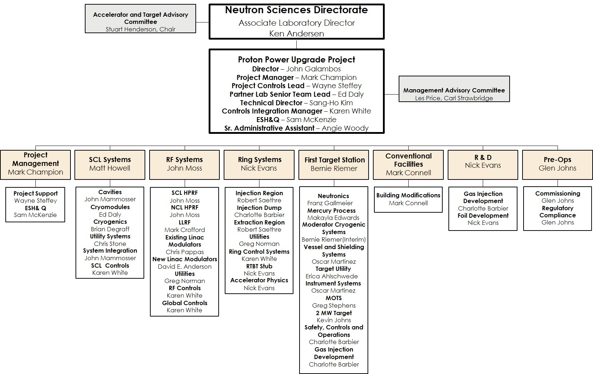
Organization
Charge: 5
P.6 Conventional Facilities

Slide 5





Organization WBS breakdown
Charge: 5
P.6.2.3 CF controls for Klystron Gallery DI water/HVAC and RTBT HVAC systems
P.6 Conventional Facilities
Mark Connell
P.6.1 Management and System Integration
Mark Connell
P.6.2 Building Modifications
Mark Connell
P.6.1.1 Management and System Integration
Mark Connell
P.6.2.1 Klystron Gallery Bldg. Modifications
Mark Connell
P.6.2.2 RTBT
Modifications
Mark Connell
P.6.2.3 Facility DI Water and HVAC Controls
Derrick Williams

Slide 6
Control System is based on existing EPICS architecture
Architecture remains the same for PPU
EPICS architecture is scalable and extensible
Adding more network nodes, IOCs, PLCs
Modifying systems to support additional hardware for P6.2.3 controls

Slide 7
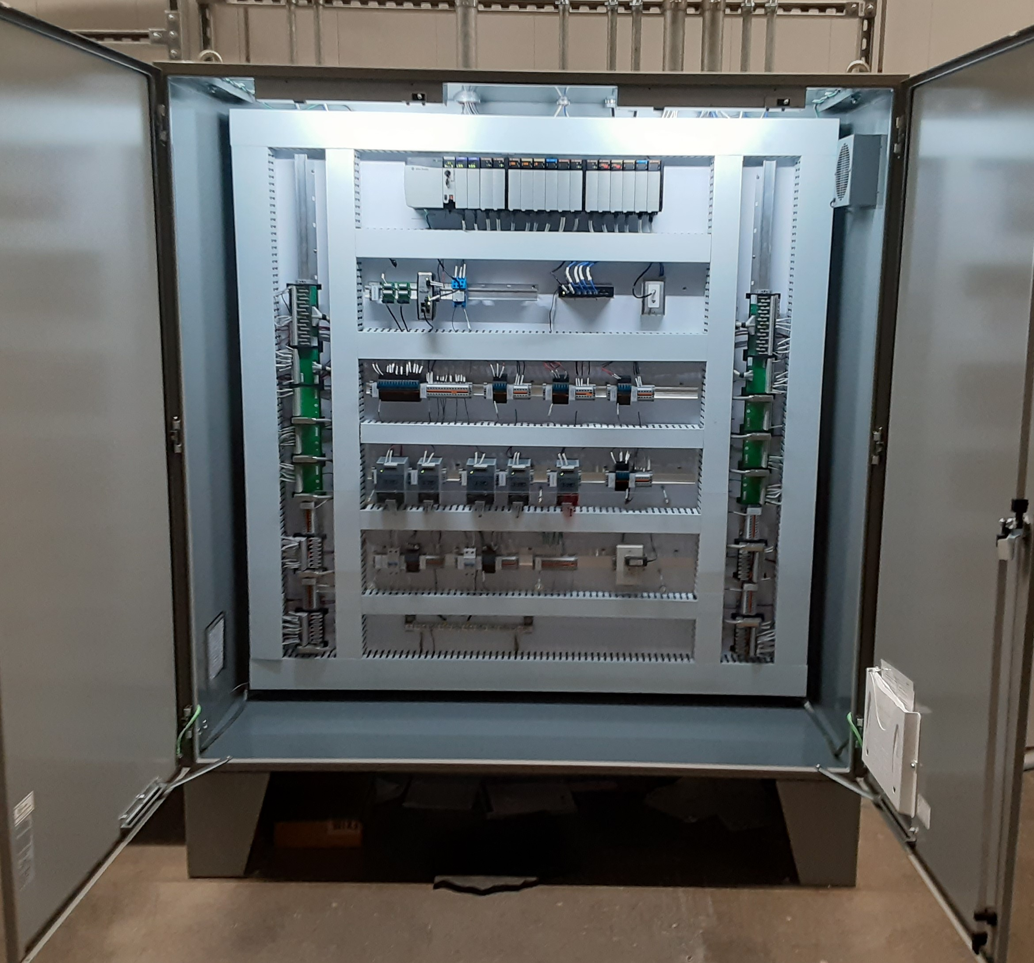
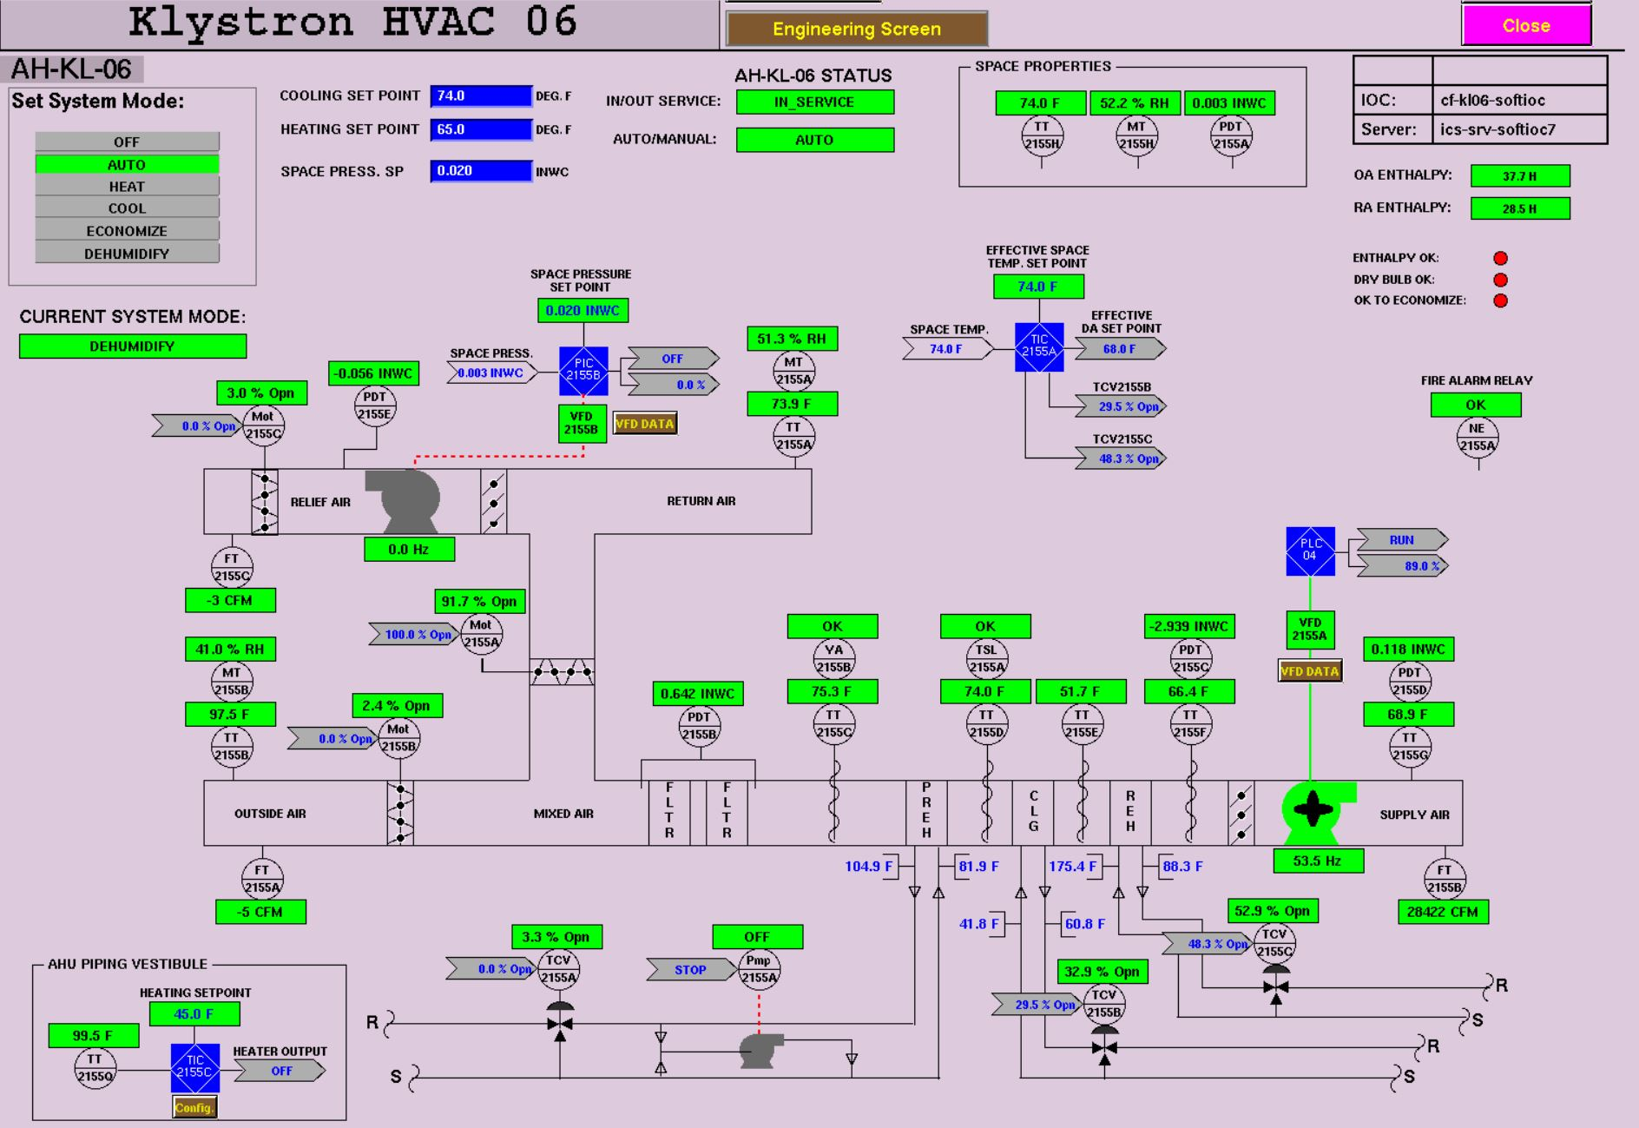
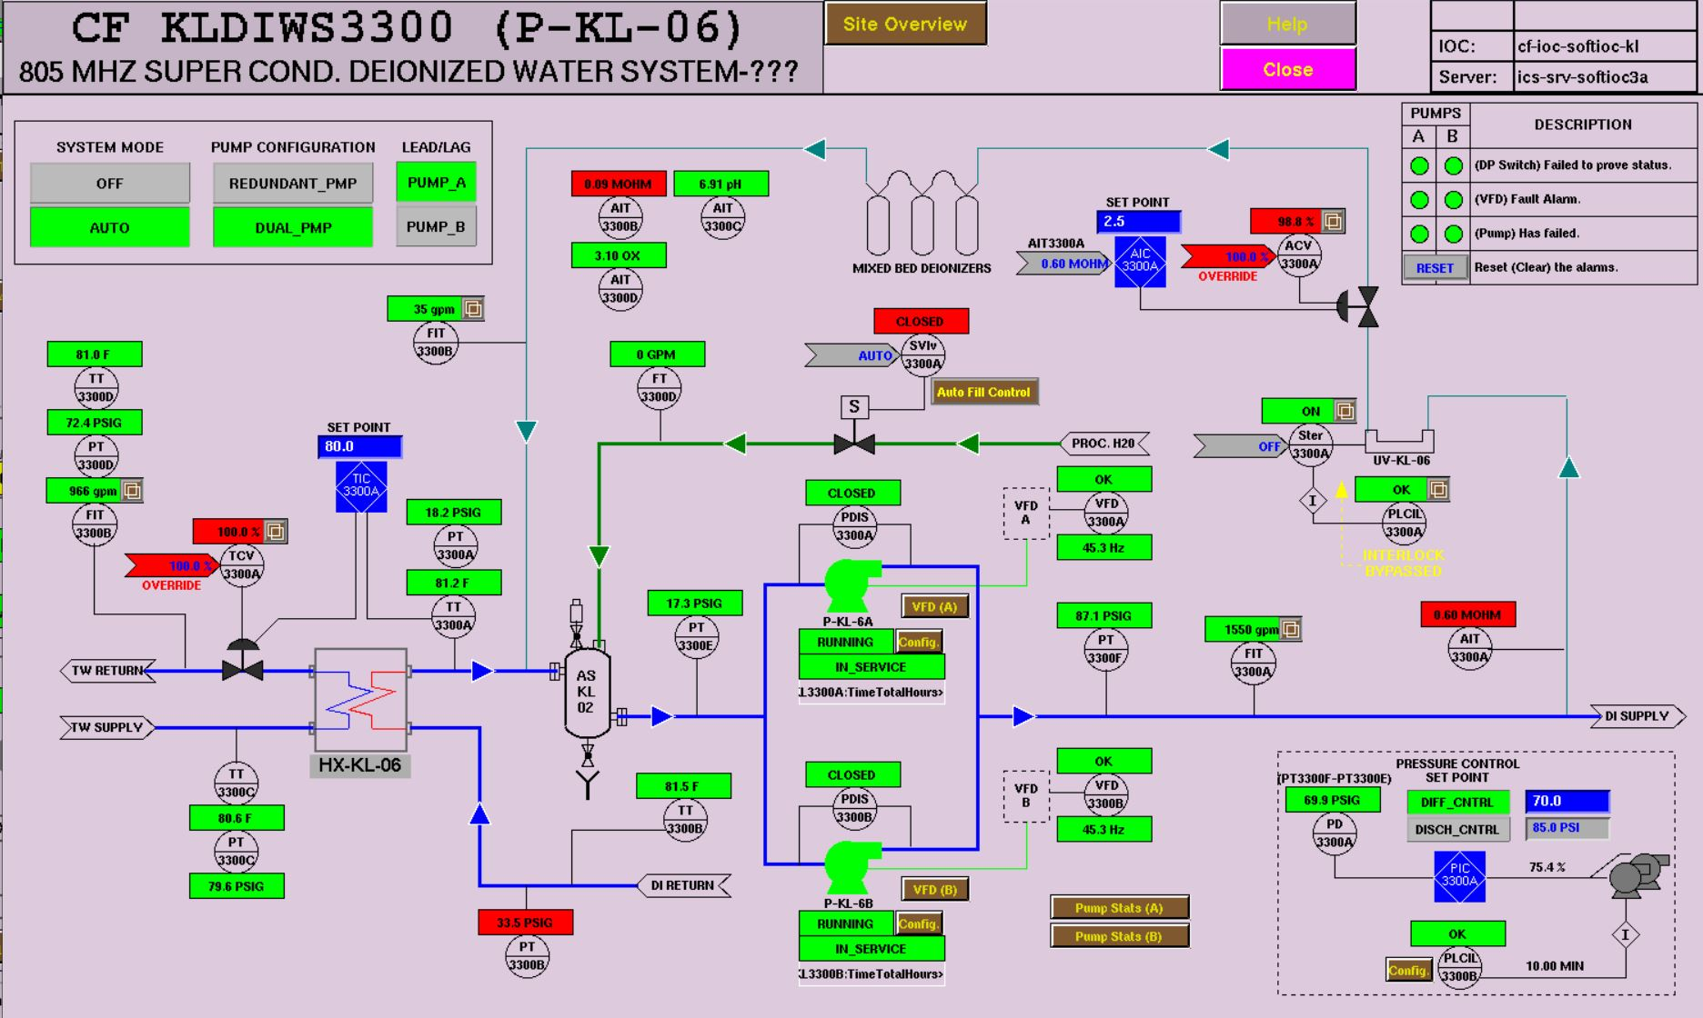
Progress since CD-2/3
Charge: 1
KL06 PLC enclosure
CF Klystron Gallery completed work
  Installed and commissioned the KL-06 PLC enclosure for DI water and HVAC systems
  Wrote the PLC and EPICS code for CF systems
  Commissioned EPICS control screens
DI water control screen
HVAC control screen

Slide 8
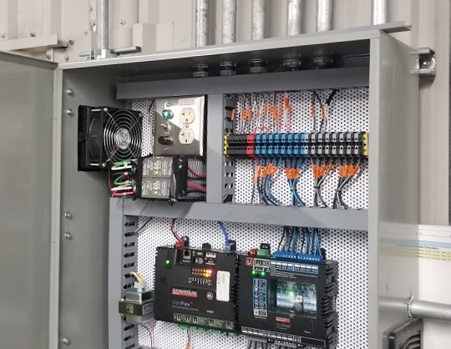
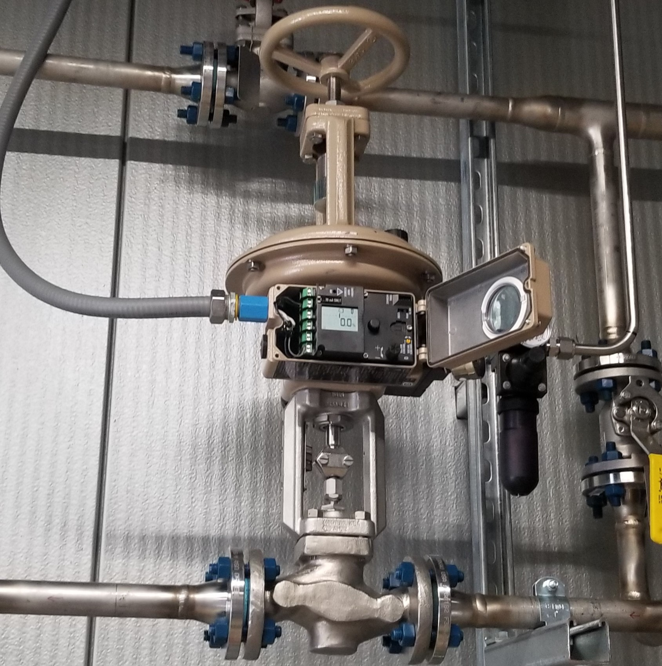
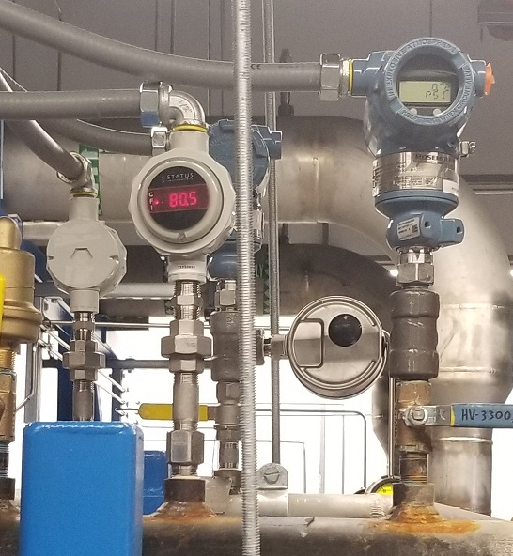
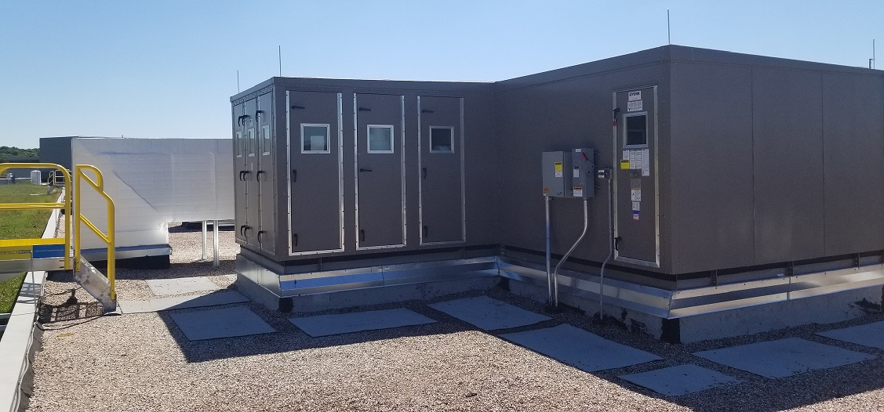
Progress since CD-2/3
Charge: 1
CF Klystron Gallery completed work
  Installed and commission the DI pump room exhaust control system
  Commissioned DI water and HVAC instrumentation and pumps
  Commissioned VFD drive for both systems (total of 4 VFDs)
  As-built documentation changes are ongoing
DI pump room exhaust controls (AutomatedLogic)
Temperature control valve with electronic actuator
Pressure and temperature instrumentation
KL06 rooftop HVAC unit

Slide 9
Challenges
Charge: 1, 4, 5
The installation of the KL06 DI water and HVAC system had several challenges mostly with handoff of the control’s design package from the main subcontractor to the installation contractor
  Cable section and color codes were not followed, wrong instrumentation installed in the field, many components wired wrong
Lack of project management by the subcontractor
  The installer subcontractor did not have knowledgeable oversight
Mitigations and impacts
  SNS control engineers helped manage the installation subcontractor, helped select the proper instrumentation, and corrected the wiring errors
  Impact resource cost: engineering hours increased more than estimate
  Impact to documentation: all drawings will have to be redlined

Slide 10
Final Design Status
Charge: 1
KL06 DI water & HVAC
  The control design was completed to perform installation and commissioning of KL06 water and HVAC systems is year
  Redline drawings are being updated now
RTBT stub out controls
  Controller has been selected for RTBT HVAC (AutomatedLogic)
  Statement of work being developed for control design

Slide 11
Installation plans for Klystron Gallery
Charge: 1
KL06 DI water & HVAC
  Once the technical equipment is connected to KL06 DI water system, adjustments will be made to the PLC PID gains for temperature control, flows and pressure requirements
  Any additional instrumentation will be commissioned once installed in the field

Slide 12
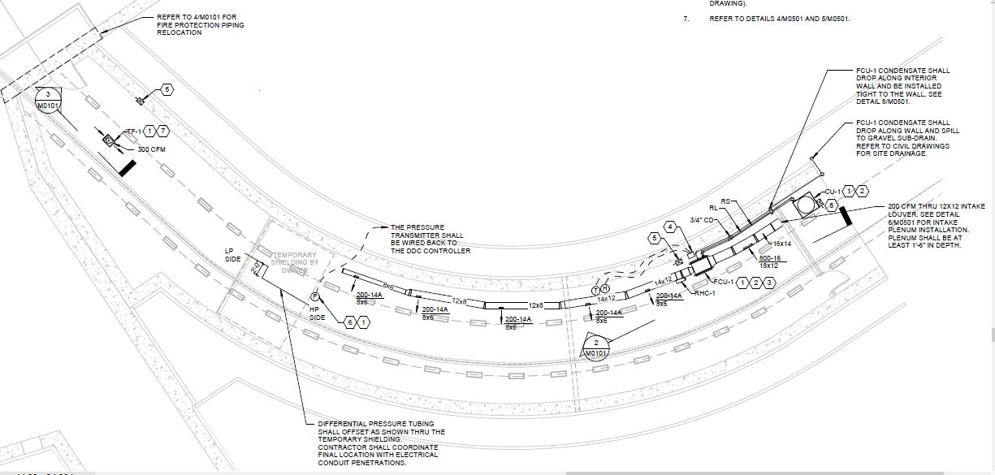
Installation plans for RTBT stub out Air Handling Unit (AHU)
RTBT stub out AHU
  Use subcontractor to produce installation drawings, write logic code for AutomatedLogic controller
  EPICS integration will be SNS control engineers
  Commissioning will be both SNS and subcontractor
Charge: 1
Both the HVAC and DP sensors will be controlled by AutomatedLogic controller
HVAC unit located in stub out tunnel
Differential pressure across shield wall

Slide 13
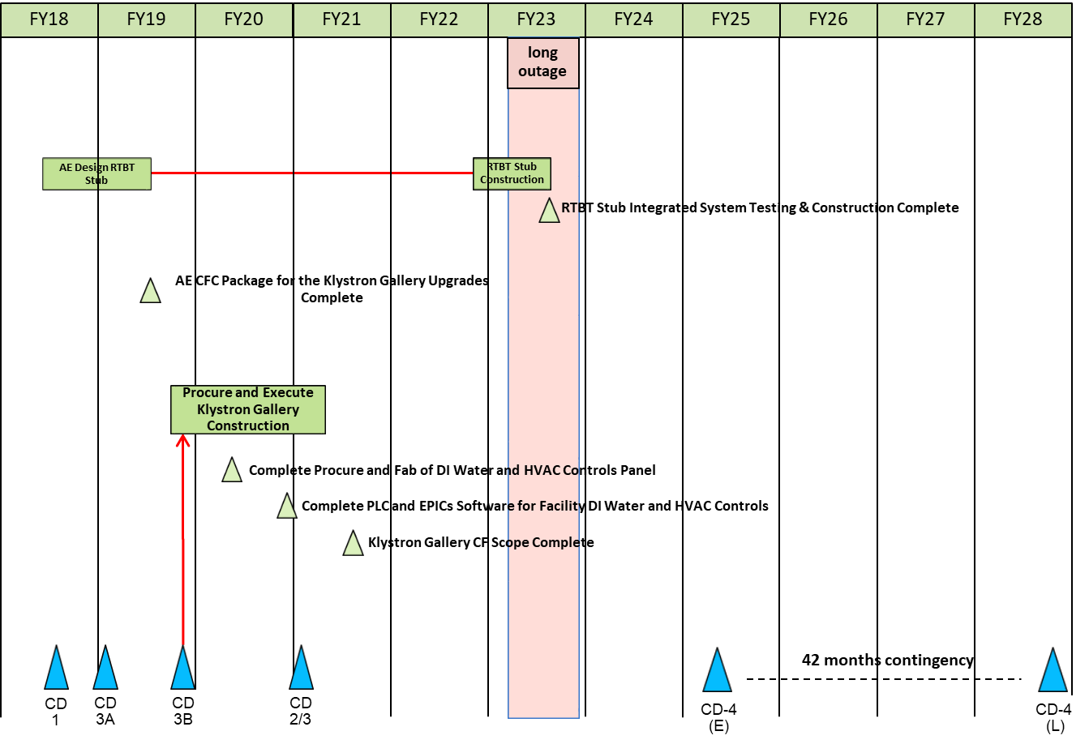
Summary Schedule
Charge: 2
Controls scope for RTBT to be completed
Controls scope for Klystron Gallery is completed

Slide 14
P.06 Cost Performance Report
Charge: 4

Slide 15
Risk
Charge: 5
None identified for controls

Slide 16
Responses to Recommendations
Charge: 6
No recommendations from the CD-2/3 review

Slide 17
ESH&Q and COVID-19 Impacts
Charge: 3
ESH&Q
  Controls installation and commission occupied same areas as overhead work in the Klystron Gallery
    Daily coordination with subcontractor activity and establishing a designated area to work safely near construction activities worked well with commissioning task
COVID-19 impacts
  Impact on installation schedule with subcontractor
    Delayed start date for controls commissioning of KL06 water & HVAC
    SNS controls engineers worked extra hours to meet milestone for completion but were able to meet completion milestone

Slide 18
12-Month Look-Ahead
Charge: 1, 4
Complete redline drawings for KL06 controls and enter them in Document Control Center (DCC)
Develop statement of work for RTBT stub out AHU control system for subcontractor to place order
Develop order of operations for RTBT AHU and establish alarm setpoints for differential pressure across the shield wall

Slide 19
Summary
P6.2.3 Facility DI Water and HVAC Controls
  CF controls for KL06 DI water & HVAC systems are complete; redline drawings documenting installation changes in progress
  CF controls for RTBT stub out AHU final design review held on 9/2019 and is well understood
    AutomatedLogic controller selected to control AHU and monitor differential pressure across shield wall
    Statement of work for RTBT AHU controls will be written soon for contractor
  Experience staff to complete the remaining CF controls for PPU

