Slide 1
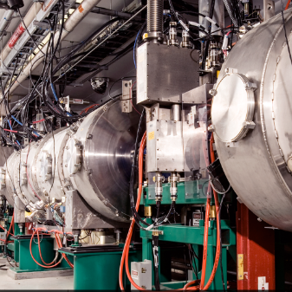
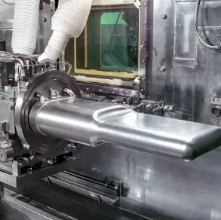
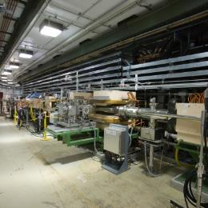

Jefferson Lab
Project Management
DOE/SC Independent Project Review of the Proton Power Upgrade Project
Edward Daly for the JLab Team
Senior Team Lead @ Jefferson Lab
September 14-17, 2021

Slide 2
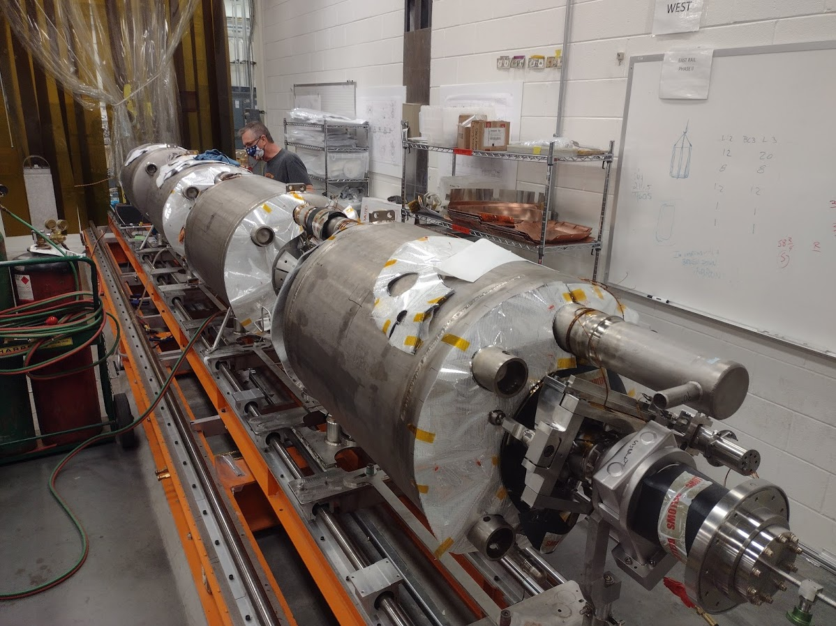
Outline
Introduction
Scope
Organization / Reporting
Integrated Safety Management
Major Accomplishments
Cost
Schedule
Lab Operations / COVID-19
Risks
Looking Ahead
Summary
CM-01 Cold Mass Assembly in Progress

Slide 3
Scope – P.2.3 Cryomodules Integration
Charge: 1
Original procurement scope was included in CD-3B
Scope changed to include an additional 8th cryomodule
Design high-beta cryomodule and associated tooling
  Includes assembly and shipping tooling
Procure components
  Entire cryomodule bill of materials except for cavities and couplers
Receive and inspect components
Qualify (32) cavities; install helium vessels
Assemble (8) cavity strings
Assemble and test (8) cryomodules
Ship (8) cryomodules from JLab to ORNL / SNS

Slide 4
WBS – JLab Scope is mapped to SNS PPU WBS
Charge: 5
Product-oriented structure
  Components contain design, procurement with parts inspected and ready for assembly
  Assembly activities contain design, procurement and assembly steps in order to complete phase of assembly

Slide 5


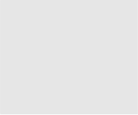


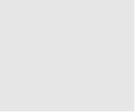


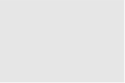
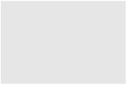


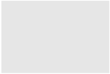

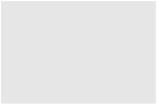
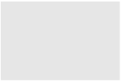




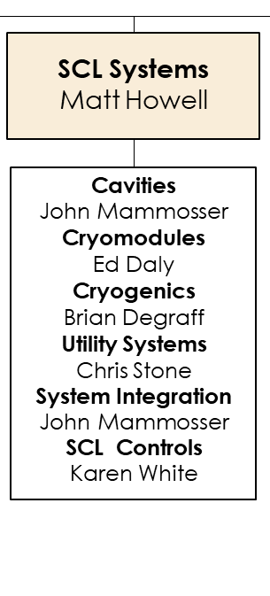







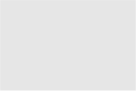




Work Breakdown Structure
Charge: 5
P.2 – SCL
Matt Howell
L3 Technical Leadership Role
Report to L2 SCL leader for Cryomodule Integration
Execute Cryomodule Integration at JLab
P.2.1
Management and System Integration Matt Howell
P.2.2 Cavities
John Mammosser
P.2.3
Cryomodules Integration Ed Daly
P.2.4
Cryogenics
Brian DeGraff
P.2.5 Utility Systems Chris Stone
P.2.6 System Integration
John Mammosser
P.2.7 SCL Controls Karen White
P.2.1.1
Management and System Integration
Matt Howell
P.2.2.1
Management and System Integration
John Mammosser
Partner Lab
P.2.4.1
Management and System Integration
Brian Degraff
P.2.5.1
Management and System Integration
Chris Stone
P.2.6.1
Management and System Integration
John Mammosser
P.2.7.1
Management and System Integration
Aaron Coleman
P.2.2.2 Cavity Procurement
John Mammosser
P.2.4.2 Cryogenic Components Brian Degraff
P.2.5.2 Beamline Vacuum
Chris Stone
P.2.6.2 Completed Cryomodule
Testing
John Mammosser
P.2.7.2 Linac Beamline Vacuum
Controls
Derrick Williams
P.2.2.4 Cavity Reprocessing
John Mammosser
P.2.4.3 Cryogenics System Testing
Brian Degraff
P.2.5.3 Insulating Vacuum System
Chris Stone
P.2.6.3
Cryomodule in Tunnel
John Mammosser
P.2.7.3 Linac Insulating Vacuum System Controls
Derrick Williams
P.2.2.5 Coupler Acquisition Yoon Kang
P.2.5.4 Water Systems Klent Pope
P.2.6.4
Cryomodule Testing in Tunnel John Mammosser
P.2.7.4
Cryomodule Controls Aaron Coleman
P.2.2.7 HTA Testing
Brian Degraff
P.2.6.5 Plasma Process MB Cryo. John Mammosser
P.2.2.8 Coupler Waveguide Transition Yoon Kang

Slide 6
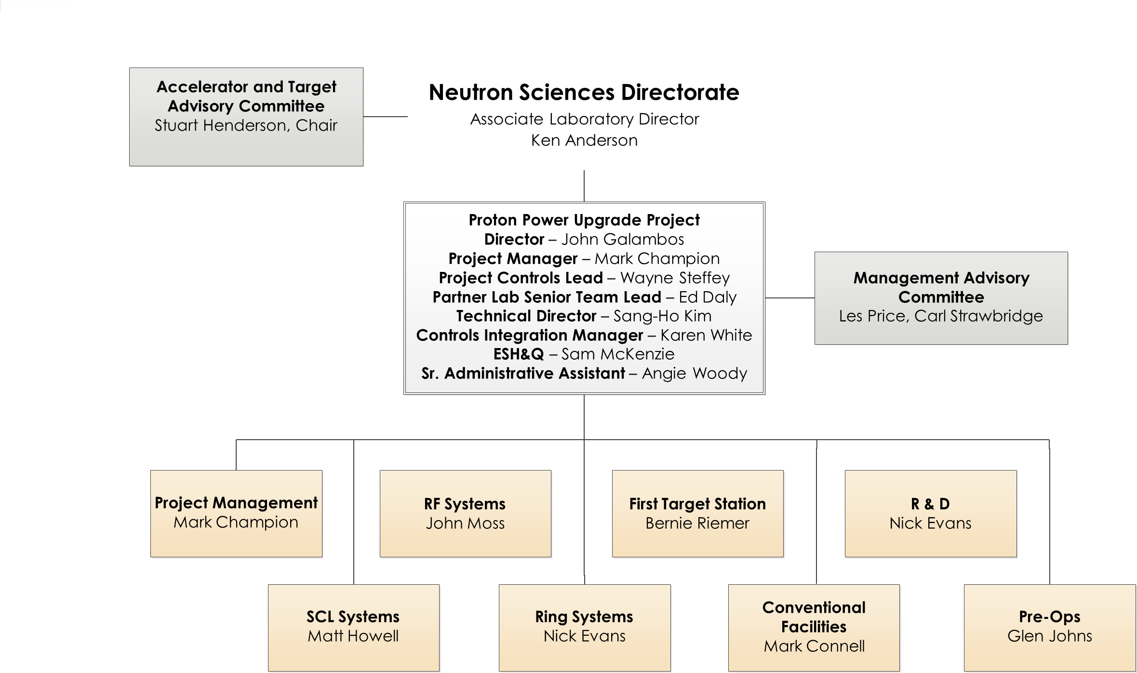
Senior Team Leadership Role
Charge: 5
Ensure communication between PPU Project Director and Jefferson Lab Director

Slide 7
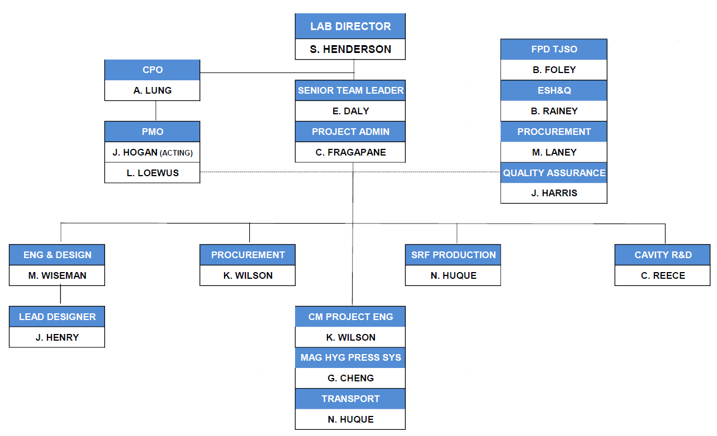
Organization @ Jefferson Lab – SNS PPU Project Team
Charge: 5
JLab Project Team in place since August 2018
B. Foley joined as FPD-TJSO
J. Hogan joined as Project Controls Group Lead
J. Harris joined as Quality Assurance Representative
CAM Hand-Off at start of FY21
  K. Wilson successfully led Procurement effort
  N. Huque leading Assembly, Test and Shipping phases

Slide 8
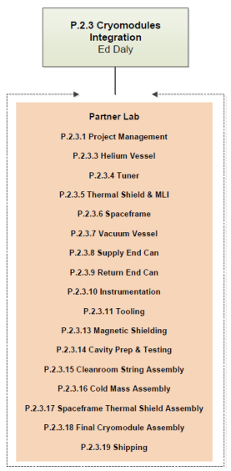
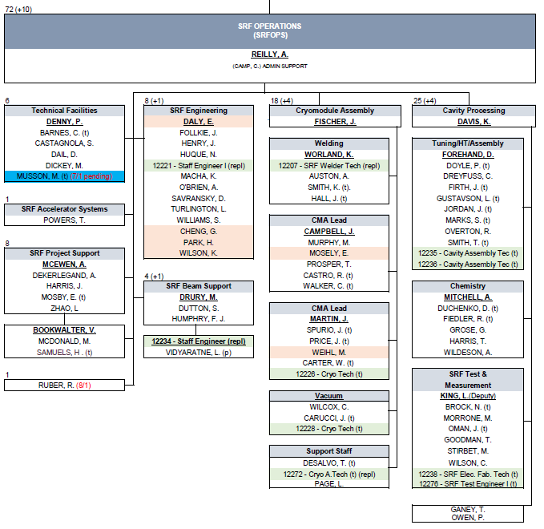
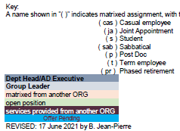
Organization @ Jefferson Lab – SRF Operations
Charge: 5
Accelerator Division provides:
  Production leadership
  Total Staff – 72
  10 additional staff (in progress)
Engineering Division provides:
  Design Lead Engineer
  Matrixed Engineers
  Designers
  Survey & Alignment
ESH&QA Division provides:
  ESH & QA Lead
  SMEs

Slide 9
Integrated Project Plans & Communication
Charge: 5
Integration at Jefferson Lab
Jefferson Lab’s agenda sets direction and defines priorities
  Supporting DOE’s other areas including focus on PPU as part of the agenda
Strategic partnership projects have well-developed schedules used as part of planning process
  Labor estimates and staffing profiles are provided
Staffing needs are reviewed, discussed and integrated in the laboratory’s work planning as required
  Lab leadership holds monthly planning and coordination meetings
Monthly Director’s Status Review
One-on-One with Lab Director twice a month
Communication with ORNL SNS PPU Project
JLab STL attends Project Director’s weekly meetings, Monthly Metrics meetings and BES Monthly Update meetings
SCL L2 & Partner Lab team meets once per week
Project Controls Lead & JLab PMO “tag-up”
JLab team provides weekly and monthly reports, and JLab Director’s Review presentations
JLab PMO provides monthly project data (“flat file”)

Slide 10
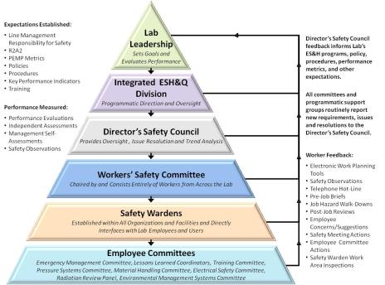
Requirements – Safety
Charge: 3
  49 Work observations conducted by Accelerator Ops / R&D in FY20
  6 different observers from the Accelerator Division conducted these interactions
  2 unsafe issues found that were addressed on the spot
ISM – Integrated Safety Management applies for all work.
Observation & Management Discussion example:
On-floor discussion with employee who was re-threading SS bolts. These are custom bolts used on U-tubes with long lead time and expense, and rework is needed to keep work on schedule
Discussed reasons for this work and the PPE in use on the job
Discussed problems with safety glasses fogging up due to his mask, and recommended some possible solutions
Notable Event example:
Issue: Employee Hurts Their Right Shoulder Performing Lapping Activities (repetitive motion injury - DART Case)
Immediate Action: Work was stopped until there was an investigation to understand the circumstances and issues
Full investigation was performed by DSO with Performance Assurance Office (new process)
All corrective actions are complete

Slide 11
Major Accomplishments
Charge: 1
Actively managing project baseline since September 2018
  via JLab’s Project Management Office
Acceptance Criteria are well-defined in approved documents
Design efforts completed on schedule
  FDR conducted 10-11 June 2019 → Proceeded to Procurement Phase
Procurement activities are progressing very well
  98% of procurement budget has been obligated in contract awards
  83 of 92 procurements are complete
Production has ramped up very well and on schedule
  Qualified 17 of 30 cavities
  Field Emission in tanked cavities is a point of focus
  First two strings complete
  First cold mass assembly complete
Funding availability has been excellent from ORNL
  Request-to-Receipt, typically 1 month
  Enables access to staffing and resources to execute project plans
More details on CM Production Progress in the Break Out Talk
B1-3 Daly

Slide 12
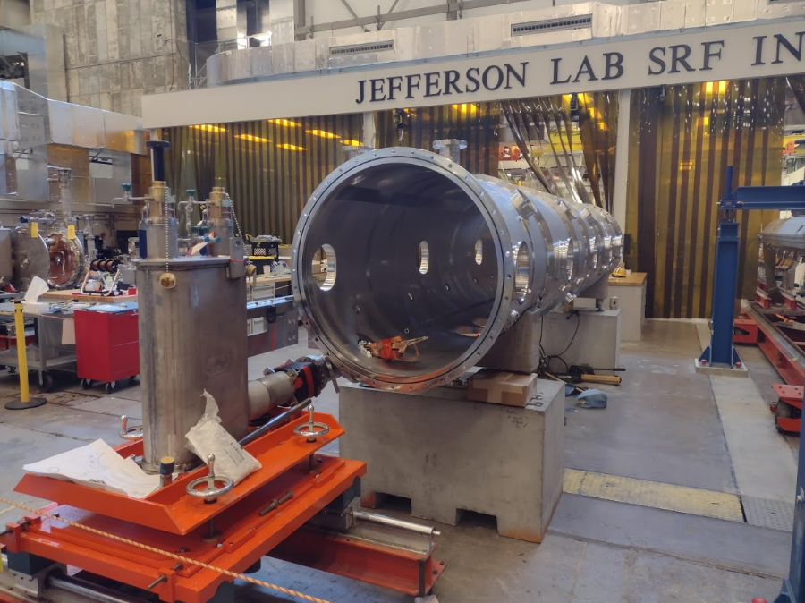
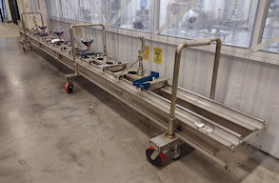
Production Planning Complete
Charge: 5
Tooling and Infrastructure for assembly
  Planning for parallel CM assembly lines on multiple projects
  All major tooling designs procured and tested
Production assembly efforts
  Receipt inspection on-going
  Assembly procedures completed
  Traveler system in place including reporting
  Staffing needs are well understood
Preparing for CM Testing
  Limited testing at JLab prior to shipment to ORNL for full high-power testing

Slide 13
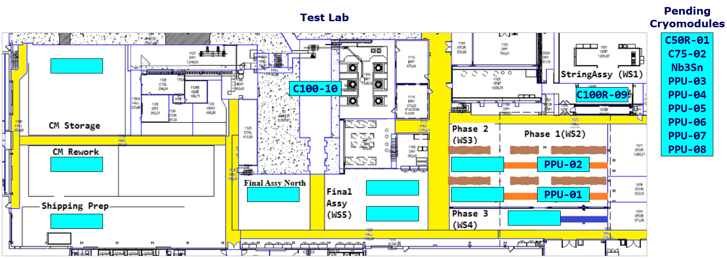
CM Production Area (28 AUG 2021 Status)
Charge: 4
C75-01 and P1 CMs delivered to CEBAF in mid-June 2021
C75-02 and C100-9R are in refurbishment (cavity re-qualification)
PPU-01 at SF/TS Assembly (WS3); PPU-02 at Cold Mass Assembly (WS2)

Slide 14
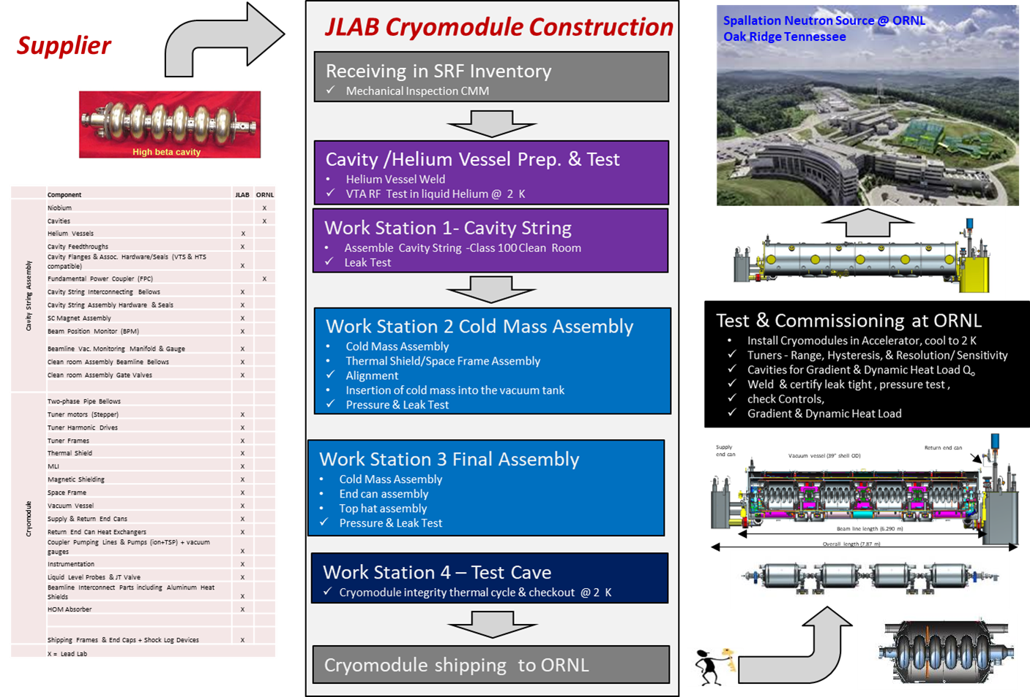
Production – Well-Defined Process Flow
Charge: 1

Slide 15
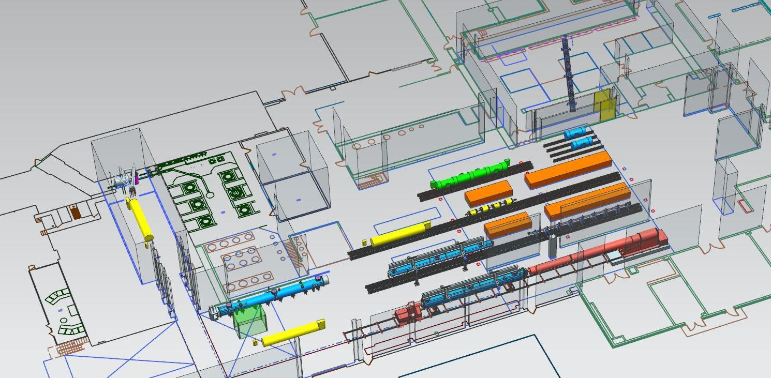
Test Lab – CM Production Area Layout (FY2022)
Charge: 5
Cavity & Cryomodule Assembly / Testing activities are integrated on a routine basis
Projected layout includes CEBAF, SNS PPU and LCLS-II-HE CMs
Clean Room
CM Testing
(CMTF)
Cavity Testing (VTA)
Cold Mass Assembly
Cryomodule Assembly

Slide 16

Lessons Learned vs Lessons Applied
Charge: 3
More details on JLab QA in the Break Out Talk
Receiving
Inventory
Issuance
Cavity Processing
Vertical Test
Cold Mass Assembly
He Tanking
Space Frame
Thermal Shield
B6-4 Harris
Cavity String Assembly
Failure Mode Effects Analysis completed for:
  Receiving / Inventory / Issuance
  Cavity Processing and Vertical Test
  Cavity String Assembly
  Cold Mass Assembly
  He Tanking
  Space Frame/Thermal Shield
Vacuum Vessel
Cryomodule Shipping
Cryomodule Test
Final Assembly
27 Failure Modes with RPN >100
21 Recommended Actions identified
Changes made to work control documents
Cavity Helium Tanking
Process Function | Failure Mode | Potential Effects | Causal Mechanism | Current Process Control(s) | S | O | D | RPN | Recommended Action
Previous Travelers completed | Components not checked for NCR status | Dependent on nature of NCR, use of non-cleared part could have impacts on performance or downstream assembly | Physical tag falls off and database not checked | Canned NCR report available | 7 | 6 | 4 | 168 | Potential use of personnel verification that no NCRs are open
Adjust FPC head and tack weld to cavity end dish | Improperly clocked head | Additional work/issues installing piping | Drawing interpretation, not following procedures | Reference drwg's contained in Traveler/Proc | 5 | 5 | 6 | 150 | Devise engineered solution (tooling)
Hold point to ensure cavity is secure (cleared only by SMEs) | Clearance step missed or disregarded | Dependent on what is wrong | Distraction, complacency | Traveler contains instructions for SME to reference | 8 | 3 | 5 | 120 | Further detail the traveler list (itemize)
Remove coupler lollipop | Inspection of cavity in prior step not conducted correctly or thoroughly | Fallen cavity | Inattention, or perhaps lack of sufficient training | Tooling has an engineered control to allow visual load release | 8 | 3 | 3 | 72 | SME to remain and witness lollipop removal

Slide 17
Managing the Baseline – Coordinating with ORNL
Schedule Information
JLab and ORNL maintain independent but related P6 files
  Not working concurrently in the same P6 file as was done with LCLS-II
JLab P6 baseline and forecast files are transmitted to and kept by ORNL in stand alone files each month
ORNL P6 contains a series of summary activities that are updated subsequently in two WBS areas
  P.02 captures all of the management, design, and assembly work for the original 7 cryomodules, as well as the procurement and assembly for the 8th cryomodule
  P.10 captures all of the procurement for the original 7 cryomodules
Cost Information
Format 1 and “flat file” information provided by JLab
  Used for reference during ORNL status cycle
  Contains cost data (monthly, cumulative) at level 5 based on JLab WBS

Slide 18
Project Change Requests since CD-2/3
Charge: 4,5
Baseline changes are managed smoothly between JLab and SNS Project Controls Teams
JLab BCRs are inputs for PPU PCRs

Slide 19
Cost – Partner Lab Scope (P.2 & P.10)
Charge: 4
P.2.3 is primarily labor for CM assembly, test and shipment effort
P.10.02.07 is primarily component procurement effort

Slide 20
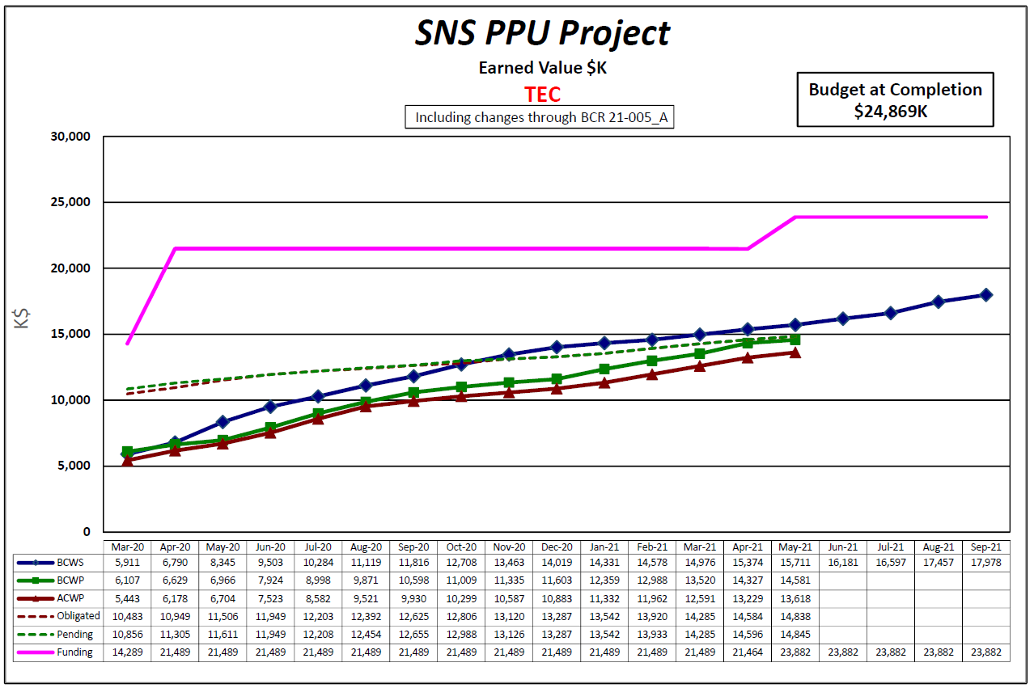
Cost – Partner Lab Scope (58.6% Complete)
Charge: 4,5
JLab Project Management Office (PMO) ensures that SNS PPU project is managed using JLab’s EVMS program
Currently funded to complete CM scope, except assembly labor for additional 8th CM
Combined Scope (P.2 & P.10)
Received funding for additional CM procurements in May

Slide 21
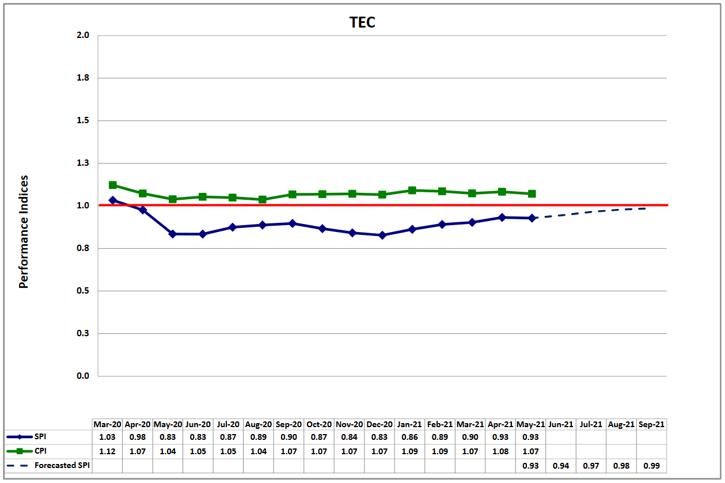
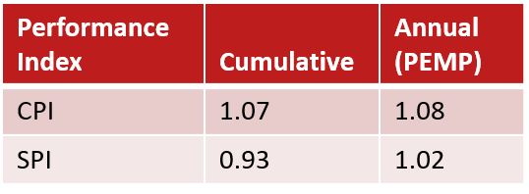
Overall Performance (31-MAY-2021) – 58.6% Complete
Primary Schedule Variance Drivers are Vacuum Vessels and End Cans – ($1,137K)
Receipt of major components in remainder of FY21 will improve overall SV
Assembly progressing well – tanking and re-testing cavities; offsets delivery SV
Charge: 4,5

Slide 22
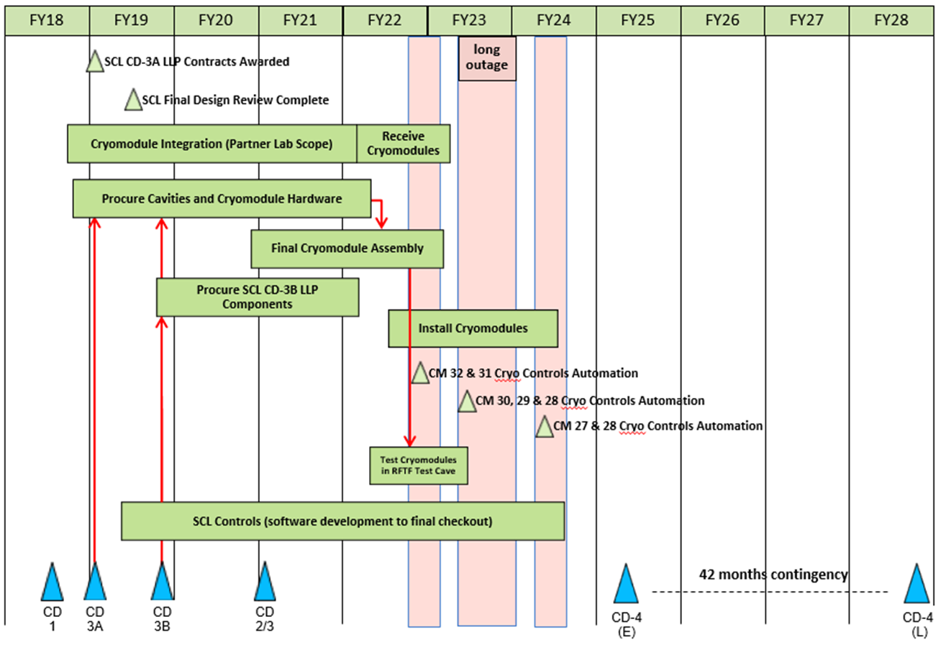
P.03 & P.10.03 – SCL May 2021 Status Summary Schedule
Charge: 4
Coordinated with JLab’s AccDiv/SRF Operations
Advanced CM deliveries by about 1 year to improve flexibility and better align laboratory’s SRF strategic partnership commitments
“3 + 3 + 2” includes 8th CM
3 CMs in time for first outage
3 CMs in time for long outage

Slide 23
Schedule Milestones – Partner Lab Scope
Charge: 4
Advance CM deliveries as risk mitigation for installation
3 CMs delivered to ORNL ready for testing prior to 1st down
3 CMs prior to 2nd down
2 CMs prior to 3rd down

Slide 24
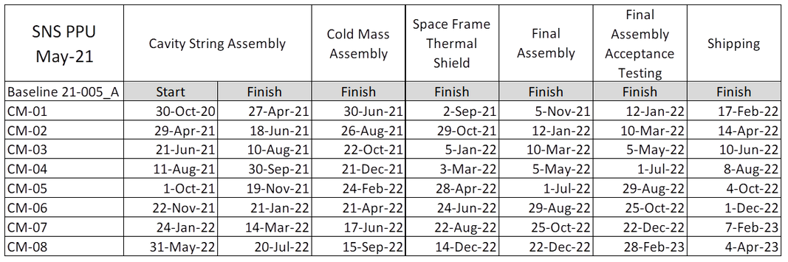
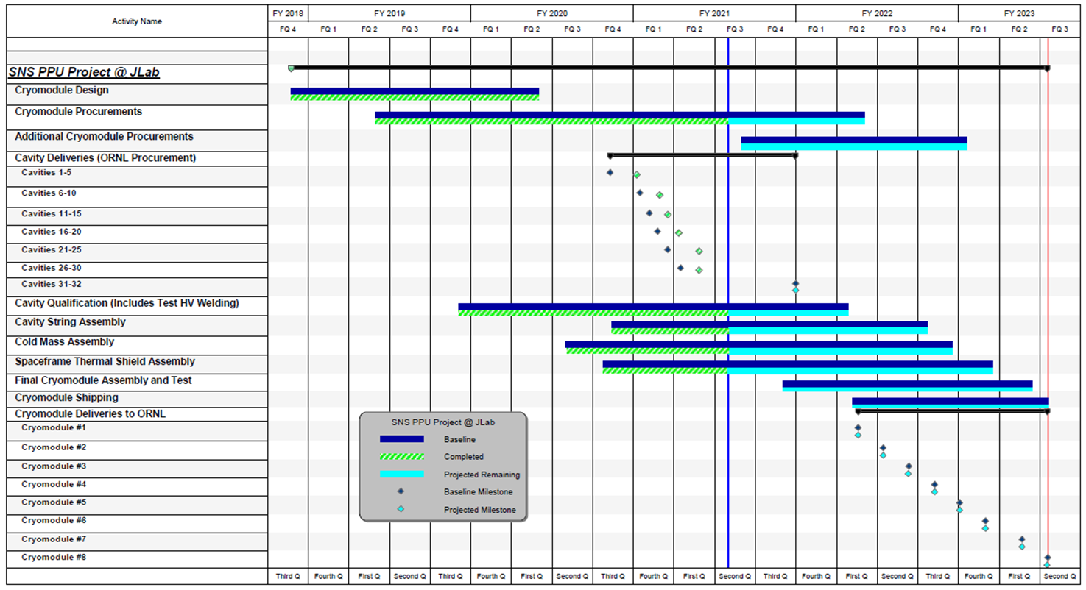
Overall Schedule
Charge: 4
On track to deliver CMs next year w/ first delivery in Feb 2022
JLab added 8th CM to baseline schedule via BCR in April 2021

Slide 25
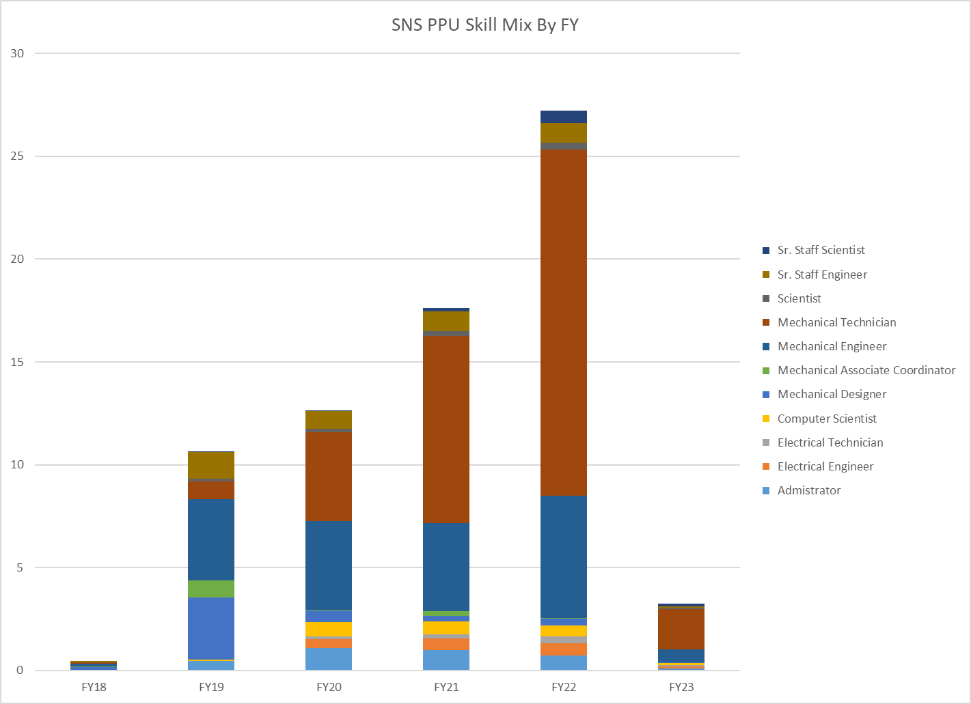
Labor Profile – Peaks at 27 FTEs during FY 22
Charge: 4,5
For comparison, LCLS-II (21 CMs, 4 yrs) averages 45 FTEs during full production
CM Assembly
Cavity Qual
Procurement
Design

Slide 26
Schedule Impact due to COVID-19 at JLab
Charge: 4,5
Procurement phase progressed quite well
  Tracked impacts to delivery schedules for Vacuum Vessels and End Cans
  Managing vendors via telecons, emails, VCs as usual; No site visits in the last year
  Only two vendors reported COVID-related interruptions to operations
Jefferson Lab shutdown operations on 17-March-2020 (MEDCON6)
  Entire PPU team worked remotely on procurements and production preparations
  Procedures modified in order to receive components
Select staff returned to work as operations resumed – 15-June-2020 (MEDCON5)
  Lab management executed plans for PPE and social distancing
  PPU team reviewed and defined work requiring PPE related to cavity test & CM assembly
  Essential workers allowed on-site who handled, inspected, assembled and tested hardware
More staff returned to work consistent with State Directives - 7-JUNE-2021 (MEDCON4)
  Users, visitors and students allowed on-site in addition to essential workers
  Staff who can effectively work remotely continue to do so

Slide 27
Status of Major Components (24-JUN-2021)
Charge: 2
Components on-hand and ready to complete first CM except return end can pending favorable inspection results
Cavity string
Cold Mass
* First return end can received from vendor on 6/25

Slide 28
P.02.03 Cryomodule Integration (Partner Laboratory Scope) Risk Register
Charge: 5
Risk ID | L3 WBS | Risk Title | Expiration Date | Mitigation | Pre-Mitigation Rank | Post Mitigation Rank
T-P.2-014 | P.02.03 | First 2 Cryomodule Delivery Is Late | 5/15/2022 | Negotiate with SNS operations to adjust maintenance outage schedule to accommodate actual CM delivery dates | 12 | 2
T-P.2-020 | P.02.03 | Partner Laboratory Priorities | 1/31/2023 | Add SNS personnel or contract labor at partner laboratory to meet production schedule, as needed | 6 | 3
T-P.2-017 | P.02.03 | Second delivery of 3 Cryomodules Is Late | 10/1/2022 | Negotiate with SNS operations to adjust maintenance outage schedule to accommodate actual CM delivery dates | 6 | 2
T-P.2-016 | P.02.03 | Final 2 Cryomodule Delivery Is Late | 1/31/2023 | Negotiate with SNS operations to adjust maintenance outage schedule to accommodate actual CM delivery dates | 6 | 2
T-P.2-040 | P.02.03 | Cryostat component (spaceframe) is dimensionally out of tolerance | 3/1/2022 | Maintain good communication between PPU and cryomodule component vendors so that nonconformances can be discovered and mitigated early. Perform inspections promptly upon receipt of materials. Perform vendor visits as needed to ensure quality. | 4 | 4
T-P.2-013 | P.02.03 | Cryomodule Shipment | 1/31/2023 | Conduct shipping tests on Cryomodule shipping fixture to measure g-loading and adjust fixture or re-route truck along different roads to minimize impact to Cryomodule | 4 | 2
Six active risks identified
  Three retired, two realized
  Pre-mitigated ranking: 2 Low, 4 Medium
  Post-mitigated ranking: 6 Low
High Risks
  No high risks identified
Key risk categories analyzed
  Late delivery of components or deliverables
  Competing partner lab priorities
Risks are reviewed on a regular basis

Slide 29
Risk Mitigation for Cryomodule Shipments
Charge: 5
Applying lessons learned from previous projects including SNS and LCLS-II including early testing and active monitoring
Conducted analysis on new components (e.g., FPCs) in order to verify acceptable stress levels during shipping
Shipped ~16 fundamental power coupler (FPC) to JLab without incident
Addressed shipping as part of the cryomodule production readiness review
Performed shipping tests with dummy cryomodule
Perform shipping test with first production cryomodule

Slide 30
12-Month Look-Ahead (SEP-2022)
Charge: 4
Smooth return to working onsite at JLab
Continue executing contracts for procured components
Receive majority of components for 8th cryomodule
Receive and test remainder of cavities
Assemble 8 cavity strings
Assemble and deliver 4 cryomodules to ORNL

Slide 31
Summary
The partnership between SNS and JLab is working well
The division of responsibilities and scope is well understood
  Shipping tests have been completed successfully
  Procurement effort for the first 7 CMs is nearly complete
  Procurement effort for the 8th CM has kicked off
  Cavity qualification is more than 50% complete
  Cryomodule assembly effort has ramped up

Slide 32
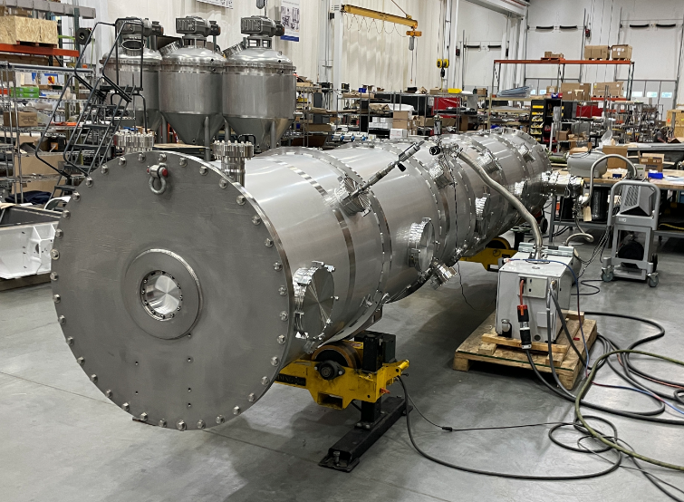
Acknowledgements
Special Thanks – M. Wiseman, K. Wilson, N. Huque, T. Reilly, L. Loewus, P. Dhakal, T. Ganey
JLab colleagues
SNS PPU Project Team at ORNL

Slide 33
Questions?

Slide 34
Sub-Contracting Officer’s Technical Representative (SOTR)
Important Role / Responsibility
  “Glue” between design, prototyping, procurement and assembly phases
  Technical expertise for sub-system components
  Achievable for “moderate sized” projects
Design Phase
  Develops technical specifications from higher level requirements
  Prepares drawings and supporting technical documents
Prototyping Phase
  Procures prototypes from industry/partner labs
  Participates in prototype development and testing
  Feeds forward experience into production process
Production Procurement Phase
  Provides technical leadership and point of contact with manufacturer
Assembly/Integration
  Provides sustaining engineering during manufacturing
  Technical judgment to resolve non-conformances
Charge: 5

Slide 35
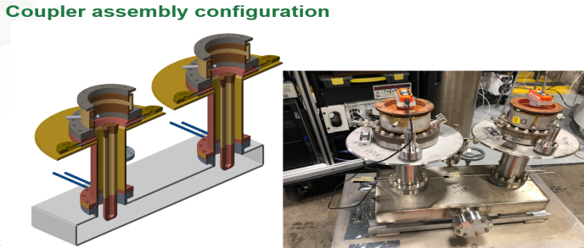
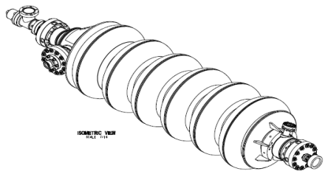
Design – Cavities and FPCs
Charge: 1
805 MHz Cavities, FPC inner conductor with window, and FPC outer conductor are provided by SNS
30 Cavities will arrive from the vendor ready for VTA testing
The FPC inner and outer conductor will be RF vacuum conditioned at SNS and delivered to JLab ready to install in a cavity string
High Beta cavity with flanges assembly from vendor
104211800-M8U-8330-A001
J. Mammosser TTC presentation

Slide 36
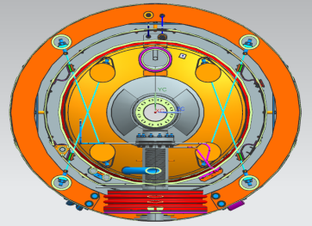
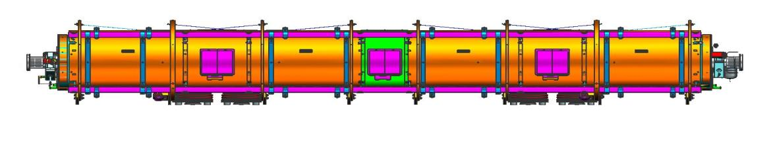
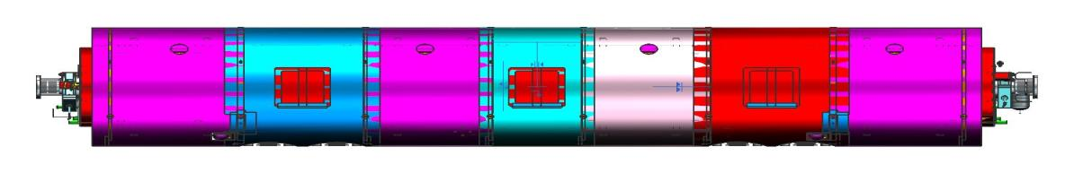
Design – Space Frame & Thermal Shield Assembly
Charge: 1
Thermal shield installed in spaceframe
MLI (not shown)
Cavity string aligned in space frame using nitronic rods
Warm magnetic shield around space frame
Spaceframe
Thermal shield
Nitronic rods
Magnetic shield

Slide 37
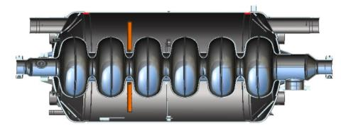
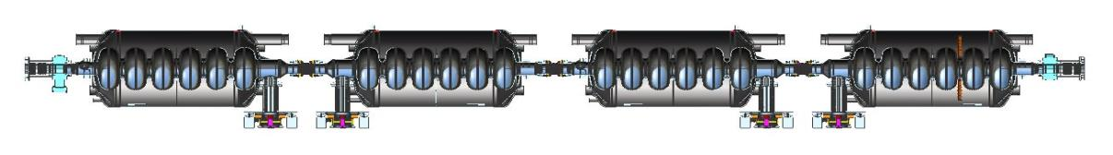
Clean Room Assembly
Charge: 1
1.29 m
Cavities are installed in helium vessel at JLab
Four Cavity with helium vessel to a string
  One with liquid level probes
FPC assembly
Field Probes
Beamline bellows between cavities
Metal seal gate valves at ends
Warm to cold transition bellows
  Temporary vacuum pumping on the return end (not shown)
Field Probe
Cavity in helium vessel (24” OD)
Gate valve
Warm to cold beam line bellows
Beam line bellows
Warm to cold beam line bellows w Ion pump
FPC assembly

Slide 38
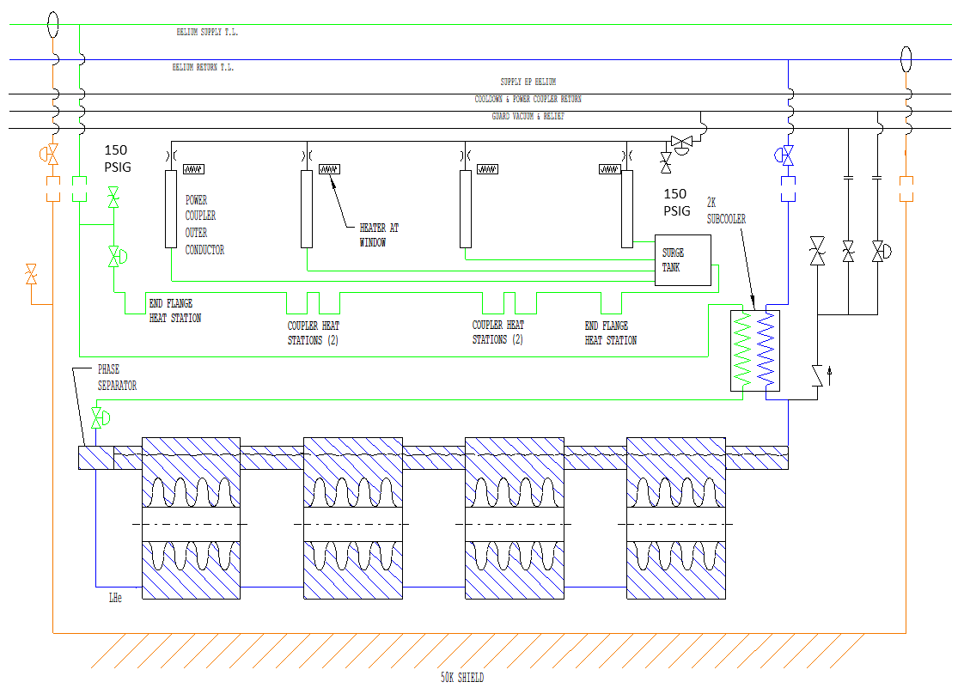
Helium Circuits (P&ID 109100501-R8U 8200 P001)
Charge: 1
Simplified Version
Primary Supply
2K Return
FPC circuit control valve
Cool down valve
185 PSIG
17 PSID
Primary JT valve
60 PSIA
Shield Circuit

Slide 39
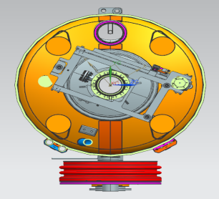
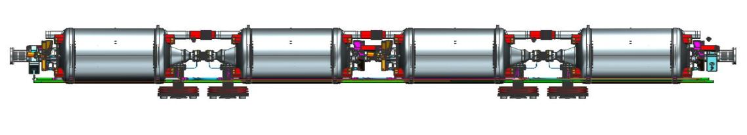
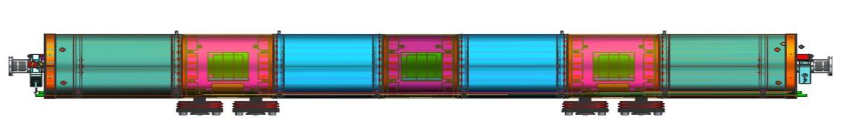
Cold Mass Assembly
Charge: 1
2K header bellows and lower liquid level flex hoses between helium vessels
~5k coupler circuit + HX supply and return lines
FPC vacuum vessel bellows
Tuners
MLI (not shown)
Cold magnetic shielding
Tuner
Flex lines
Header bellows
Coupler circuit
FPC vacuum bellows
Magnetic shield
HX supply and return helium lines

Slide 40
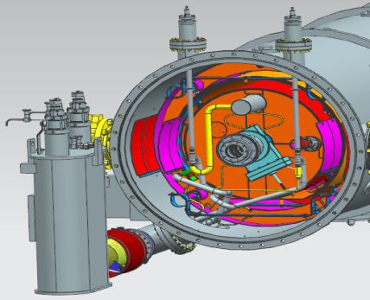
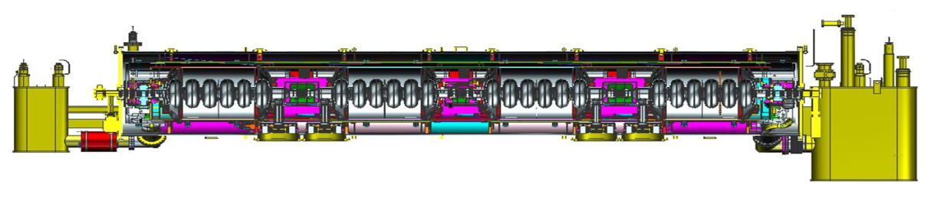
Design – Cryomodule Assembly
Charge: 1
Vacuum Vessel
Supply and Return End Cans
Finish helium circuit piping with valves
Add thermal shield, warm magnetic shields and MLI to both ends inside vacuum vessel
Beam pipes with valves and vacuum pump
Exterior coupler tubing (shown on next slide)
Supply end view with internal piping
Supply end can
Vacuum vessel (39” shell OD)
Return end can
Beam line length (6.291 m)
Overall length (~7.87 m)

Slide 41
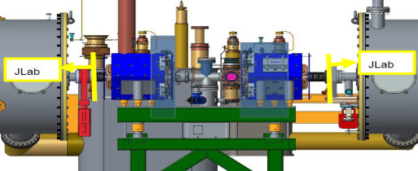
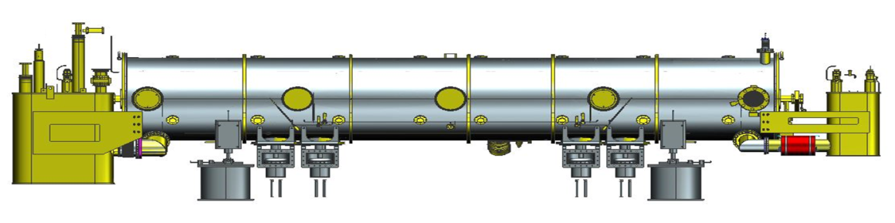

Cryomodule Installation
Charge: 1
Cryomodule on stands and saddles in tunnel
Air side FPC couple and waveguide installed
Warm girders between cryomodules
All supplied by SNS
Warm girder between CMs (from ICD)
Saddle
FPC exhaust manifold (installed at JLab)
Air side FPC extensions, doorknobs and waveguides
Stand

Slide 42
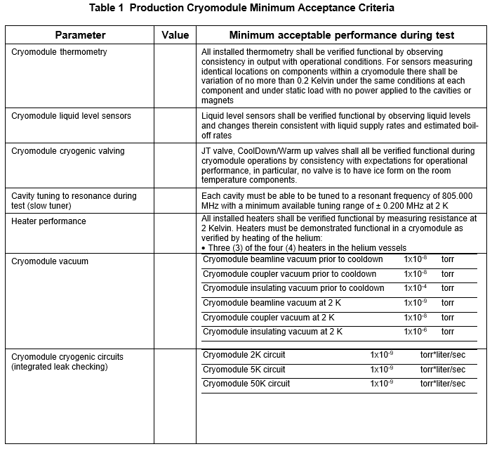
Proposed CM Acceptance Criteria @ JLab prior to shipment
Charge: 1

Slide 43
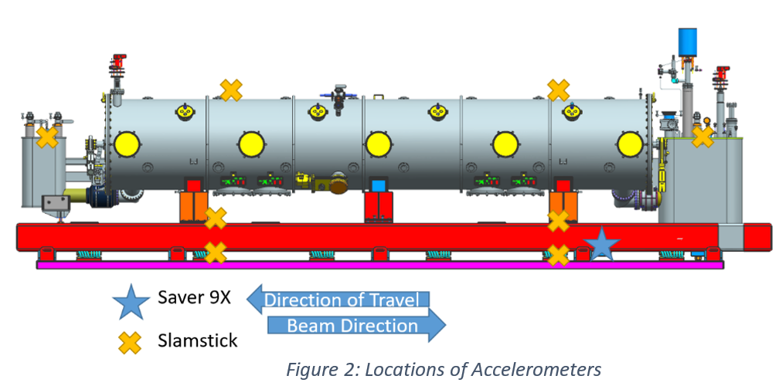
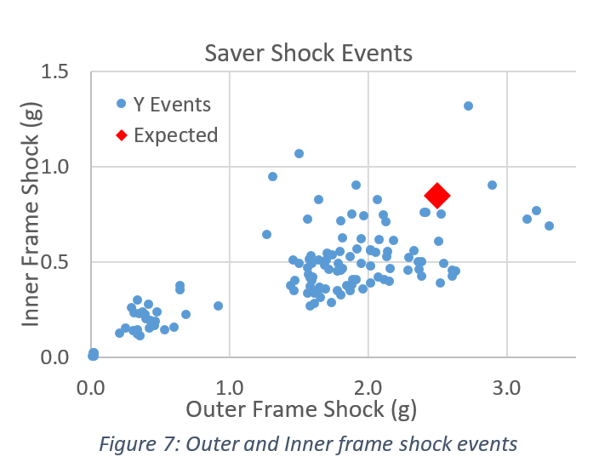


Shipping Studies Successfully Completed
Goal – Confirm that shipping system provides acceptable cryomodule transportation loads
Requirements: <4g vertical, <5g longitudinal, <1.5g transverse
Data Collected on January 14th
  Saver 9X accelerometers - on inner and outer frame; Triggered by large shock events
  Slamsticks (SSX) - 8 throughout the frame and dummy cryomodule with continuous recording of acceleration, shocks; Measure max shocks throughout dummy cryomodule
  Amcrest GPS - live tracking of truck’s location
  GoPro - record first part of trip, ensures no loose parts
Results indicate > 2X damping between frame and dummy cryomodule
  Sufficient to meet requirements

