Slide 1




Risk Analysis
DOE/SC Independent Project Review of the Proton Power Upgrade Project
Mandy Greenwood
Risk Manager
September 14-17, 2021

Slide 2
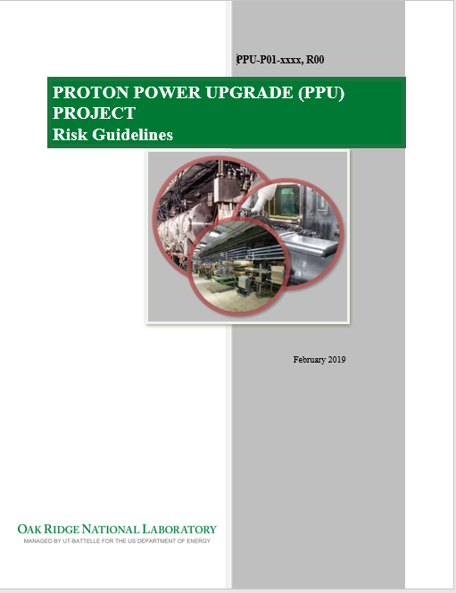
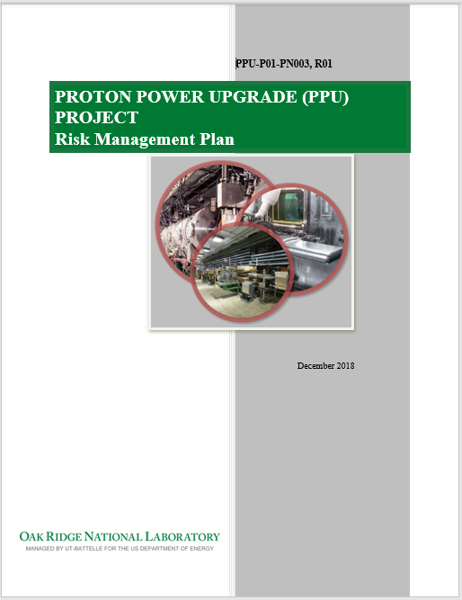
PPU Risk Management System
Risk management has been implemented on the project since prior to CD-1
PPU has utilized the services of Dr. Keith Molenaar (Professor, University of Colorado) to assist the project in better understanding and identifying associated risks
Project has a pro-active approach to risk management that focuses on continual evaluation and monitoring
Risk manager is responsible for working closely with project CAMs to review the risks and uncertainty to ensure a complete contingency needs analysis

Slide 3
Contingency Development

Slide 4
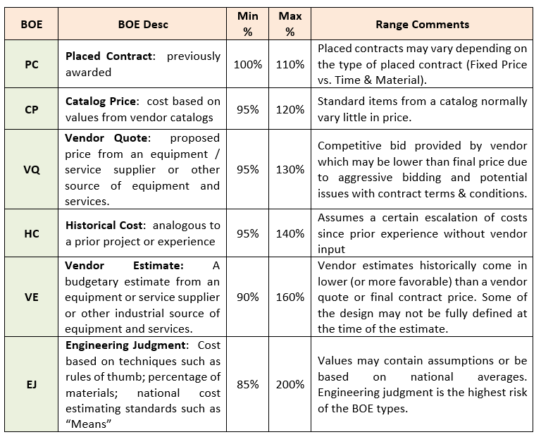
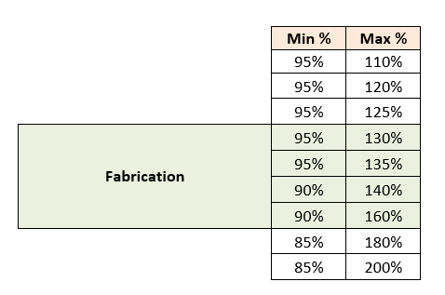
Templates guide the Monte Carlo analysis
Suggested ranges are provided to assist the project team in determining appropriate 3-point ranges for their work scope

Slide 5
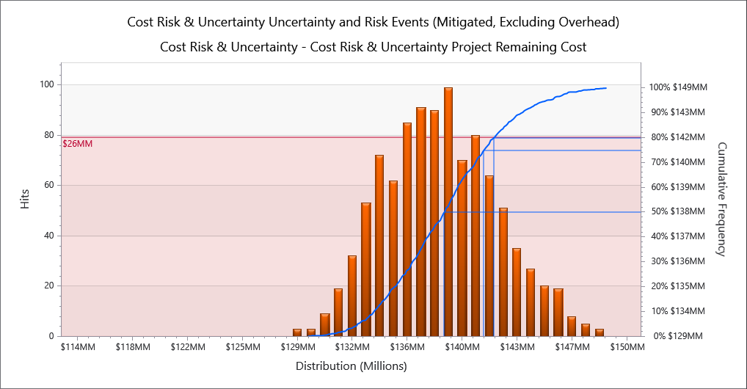
Monte Carlo Cost Uncertainty at P80
Cost Uncertainty and Risk Exposure - Mitigated
80% confidence remain cost will not exceed $142M
100% confidence remain cost will not exceed $149M

Slide 6
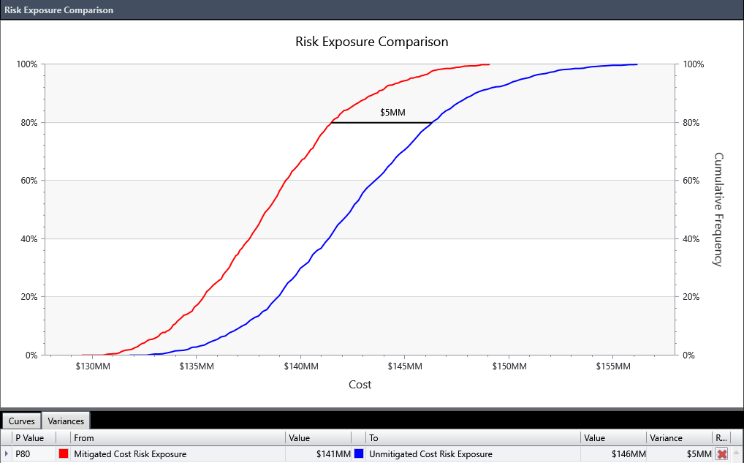
Cost Risk Exposure Decreases with Mitigation
Charge: 5c
Mitigations cost ~$900K and reduce cost risk exposure by $5M

Slide 7
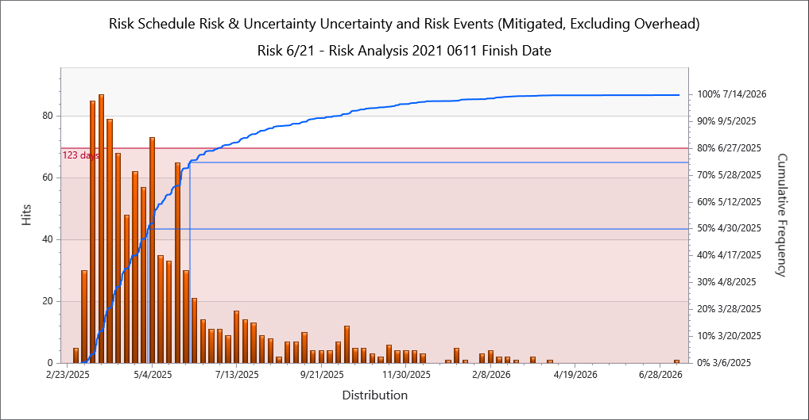
Monte Carlo Schedule Uncertainty at P80
Duration Uncertainty and Risk Exposure - Mitigated
80% confidence: schedule EF will not exceed 6/27/25
100% confidence: schedule EF will not exceed 7/14/26
Baseline EF: 2/12/25
Baseline LF: 7/31/28

Slide 8
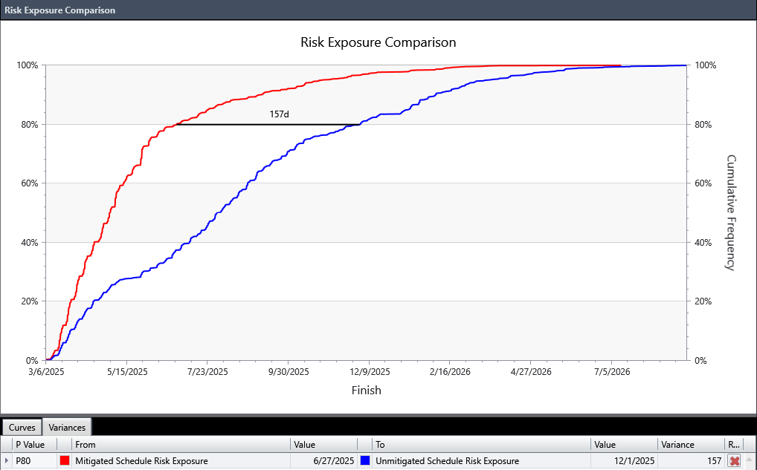
Schedule Risk Exposure Decreases with Mitigation
Charge: 5c
Mitigations cost ~$900K and reduce schedule risk exposure by 5 months

Slide 9
Risks are identified and understood
Charges: 5c, 5d
Risk register populated by PPU team members (CAMs, SMEs, technical staff and L2 Managers)
All risks are approved by the Risk Advisory Board
Includes project and operations risks
Mitigation costs associated with the event risks are included in the baseline estimate, as needed
Risks are continually evaluated and monitored

Slide 10
Risk Register
Charges: 4b, 5c
8 New Risks identified since CD-2/3
Forty-nine risks
  80 Threats and 16 Opportunities have been retired. 6 Threats and 3 Opportunities have been realized
  Pre-Mitigated Ranking: 11 Low, 34 Medium, 4 High
  Post-Mitigated Ranking: 24 Low, 23 Medium, 2 High
High Risks
  COVID-19 Impacts Project Cost or Schedule
    Mitigation: Frequent vendor communication, use of alternate vendors if needed, vendor oversight by local experts, vaccinations, masking, social distancing, and work-from-home
  Fermilab has competing projects or resource issues
    Mitigation: Maintain good communication between PPU and Fermilab so that schedule challenges can be discovered early and mitigated. Engage project management and Fermilab management as needed to ensure this work receives adequate priority. Perform periodic visits to Fermilab to assess progress
Key risk categories analyzed
  Vendor delivery delays
  Budget cycle
  Resource availability

Slide 11
Risk Identification
Charge: 4b
Risks are reviewed monthly in Metrics Meetings

Slide 12
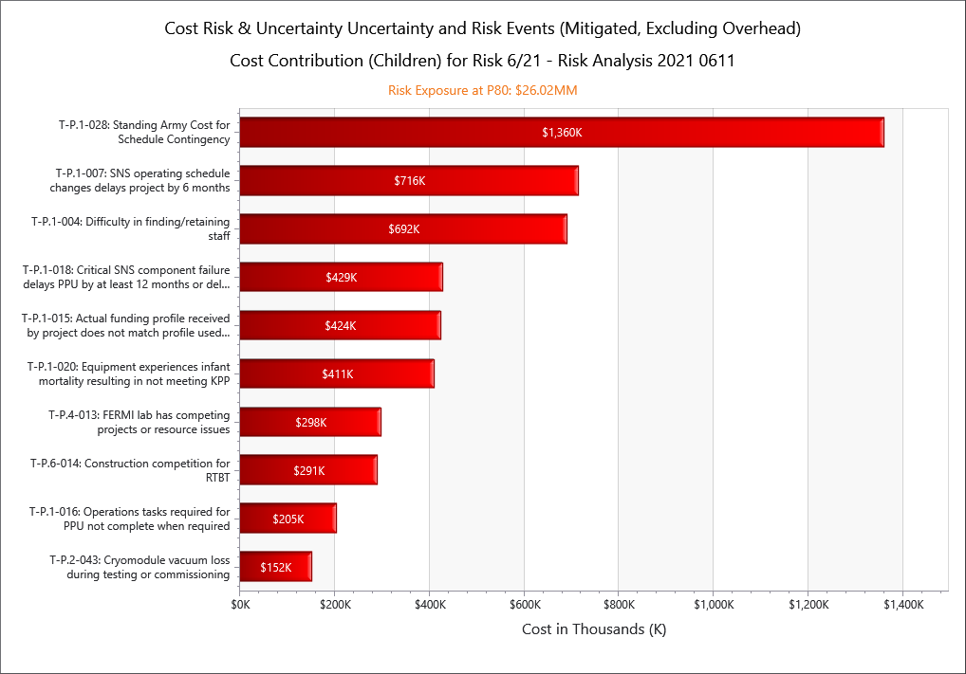
Cost Risk Drivers at P80
Cost Uncertainty and Risk Exposure - Mitigated
Cost risk drivers are risk events contributing significantly to cost risk exposure
Risk drivers for cost risk exposure are reasonable and appropriate

Slide 13
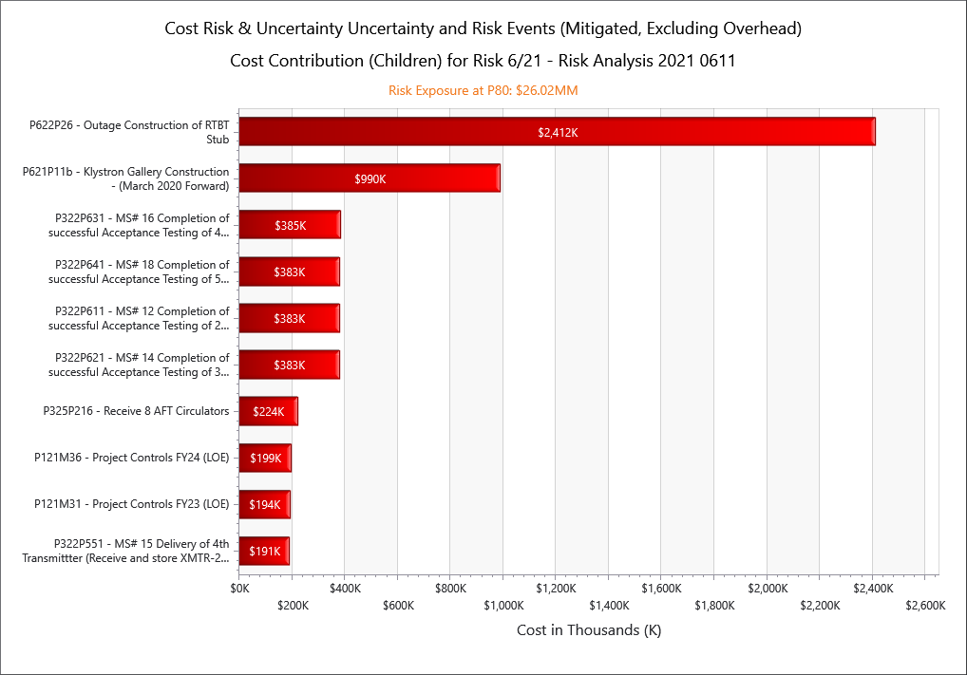
Cost Activity Drivers at P80
Cost Uncertainty and Risk Exposure - Mitigated
Cost activity drivers are activities contributing significantly to cost risk exposure
Activity drivers for cost risk exposure are reasonable and appropriate

Slide 14
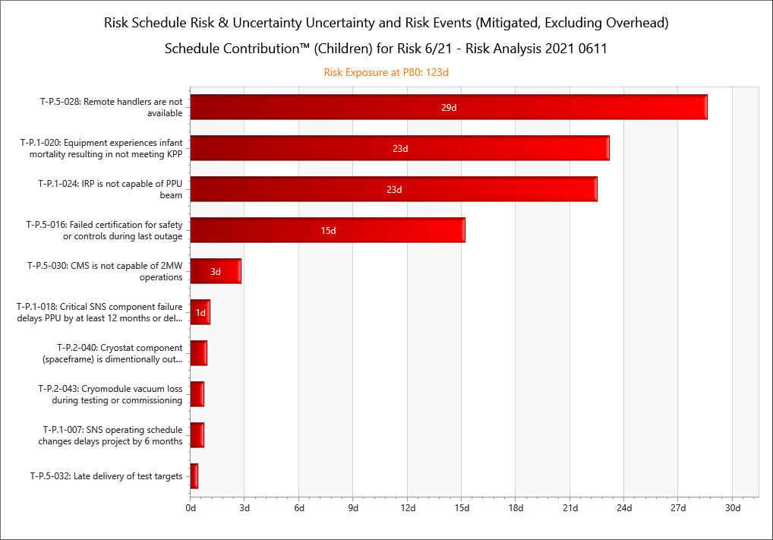
Schedule Risk Drivers at P80
Duration Uncertainty and Risk Exposure - Mitigated
Schedule risk drivers are risk events contributing significantly to schedule risk exposure
Risk drivers for schedule risk exposure are reasonable and appropriate

Slide 15
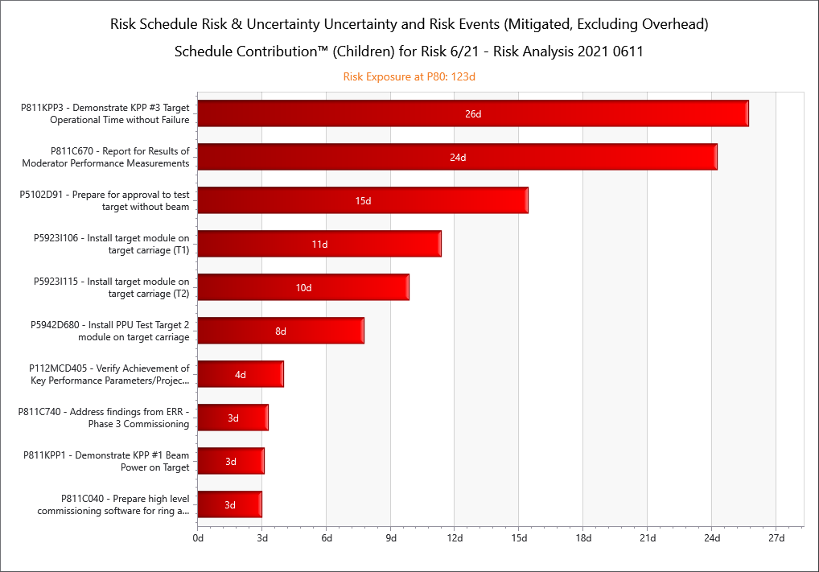
Schedule Activity Drivers at P80
Duration Uncertainty and Risk Exposure - Mitigated
Schedule activity drivers are activities contributing significantly to schedule risk exposure
Activity drivers for schedule risk exposure are reasonable and appropriate

Slide 16
Contingency development by WBS
Charge: 4b
Schedule Contingency:
~ 4.5 months per Monte Carlo analysis
~ 12 months by Management Assessment due to COVID-19
~ 22 months by Management Assessment due to 1250hr Target KPP
Baseline Values:
~ $53M Contingency
~ 42 months schedule contingency

Slide 17
Monte Carlo Simulation Compared to Expected Value

Slide 18
Risk Burn-down
Contingency is adequate to cover remaining risks based on risk analysis

Slide 19
Contingency is sufficient for the project
Charge: 4b
Monte Carlo analysis, using cost & schedule uncertainty with event risks, was performed to define the project contingency needs
Acumen Risk P80 analysis showed an overall contingency need of ~30%
After assessment by management, the value was increased to 47%, providing a high confidence level
Contingency based on:
“Bottom-up“ cost and schedule uncertainty analyses and identified risk events by the CAMs
Management Assessment contingency included to address unidentified project impacts.

Slide 20
Summary
Charge: 5d
  Project is pro-active in risk management and has been actively performing risk analysis since prior to CD-1
  Project is 53% complete with an ETC of ~$103M and an available contingency of ~$53M
  52% contingency on work to go
  PPU has a Contingency Spend Plan that the project will utilize for making contingency usage decisions per the PEP.
B8-7 - Champion

Slide 21
End

Slide 22
Backup
3 Realized Opportunities
  O-P.1-001 PPU is considered LI project
  O-P.1-003 On-site ORNL provided storage becomes available
  O-P.4-001 Extraction kicker system does not need new magnets
6 Realized Threats
  T-P.2-005 Cavity Delivery Is Late
  T-P.2-018 End Can Delivery Is Late
  T-P.2-021 Vacuum Vessel Delivery Is Late
  T-P.6-010 Construction competition for Klystron Gallery
  T-P.6-008 Delay in Tie-Ins to Klystron Gallery Utilities
  T-P.6-009 Schedule pressure requires Klystron Gallery installation to be concurrent with CF Construction

