Slide 1
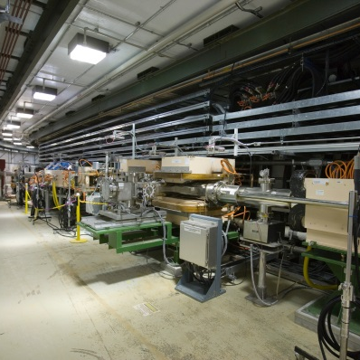
P.03.05.06 Existing Linac Modulators
DOE/SC Independent Project Review of the Proton Power Upgrade Project
Chris Pappas
Level 3 Manager for Existing Linac Modulators
September 14 - 17, 2021

Slide 2
Outline
B2 - Pappas
Scope
Organization
Progress since CD-2/3
Challenges
Final design status
Installation plans
Cost and schedule
Labor profile
Risk register
Responses to recommendations
ESH&Q and COVID-19 impacts
12-month look-ahead
Summary

Slide 3
Scope
Charge: 1
The scope is to upgrade the RFQ and DTL High Voltage Converter Modulators (HVCMs) to support a 25% RF power margin for PPU operation.
Three modulators need upgrading, RFQ-Mod1, DTL-Mod3, DTL-Mod5
HVCMs being upgraded

Slide 4
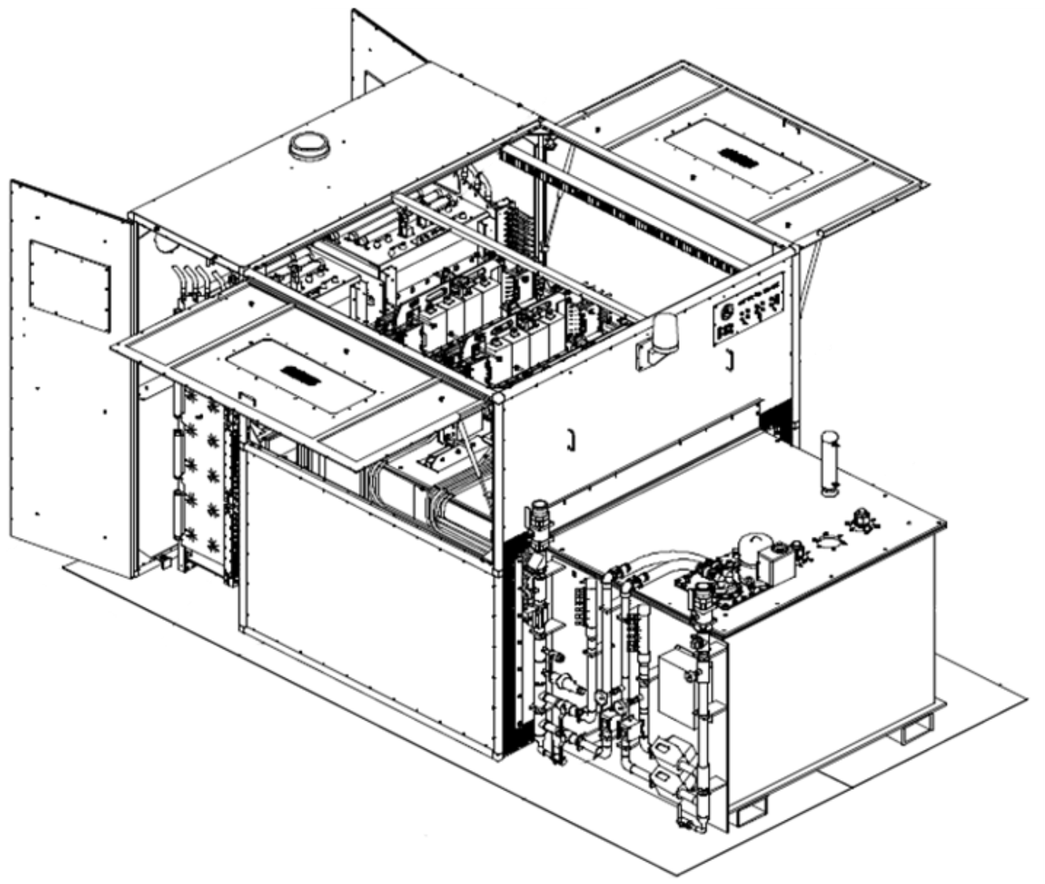
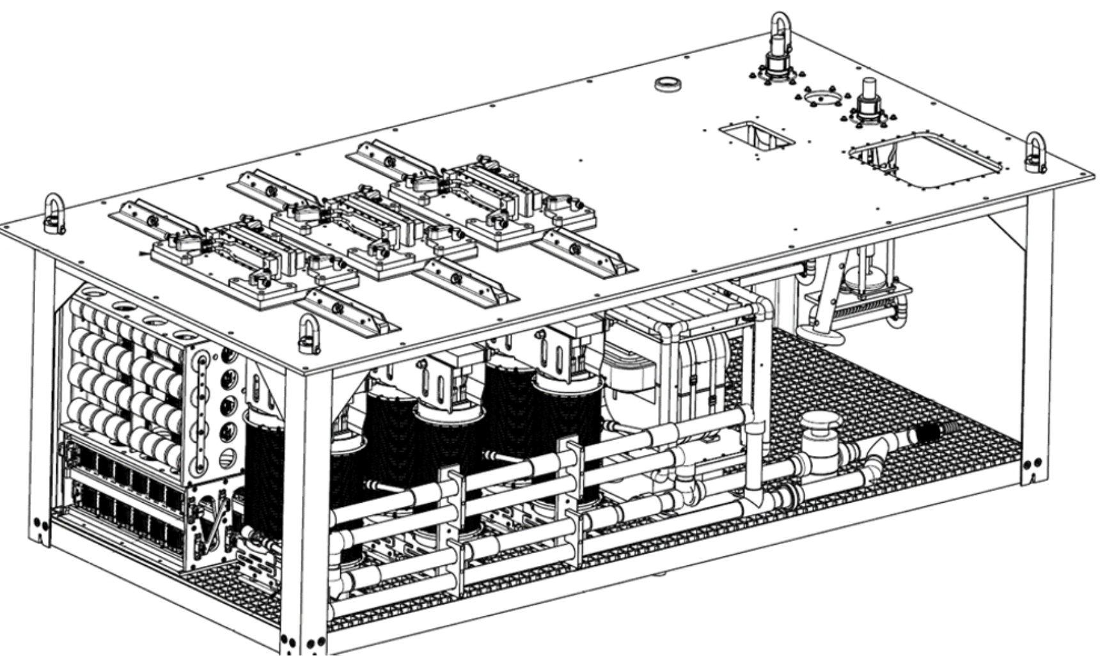
RFQ/DTL Upgrade Impacted Subsystems
Original HVCM subsystem
AT-HVCM subsystem
Unique RFQ/DTL upgrade
Mechanical systems impacted by RFQ-DTL modulator upgrades are the storage capacitor, switch plates, pulse transformers, resonant capacitor assy., rectifier assy. and the oil cooling loop.
Major variation for RFQ-DTL
Minor variation for RFQ-Mod1

Slide 5
RFQ-DTL HVCM Scope
Parameter | Value | Units
 | Peak Voltage
RFQ-Mod1 * | 123 | kV
DTL-Mod5 * | 128 | kV
 | Peak Current
RFQ-Mod1 * | 122 | A
DTL-Mod5 * | 84 | A
 | Allowable Klystron
All | CPI, e2v, Thales
 | Pulse Width
All | 1.5 | ms
 | Repetition Frequency
All | 60 | Hz
* Peak voltage or current allowing for 25 % RF power margin

Slide 6
RFQ-DTL Modulator Layout
Laminated bus assy.
IGBT switch plate assy.
Storage capacitor assy.
HV oil tank
Safety enclosure
Output connectors
Pulse Transformer
Resonant capacitor assy.
Rectifier assy.

Slide 7
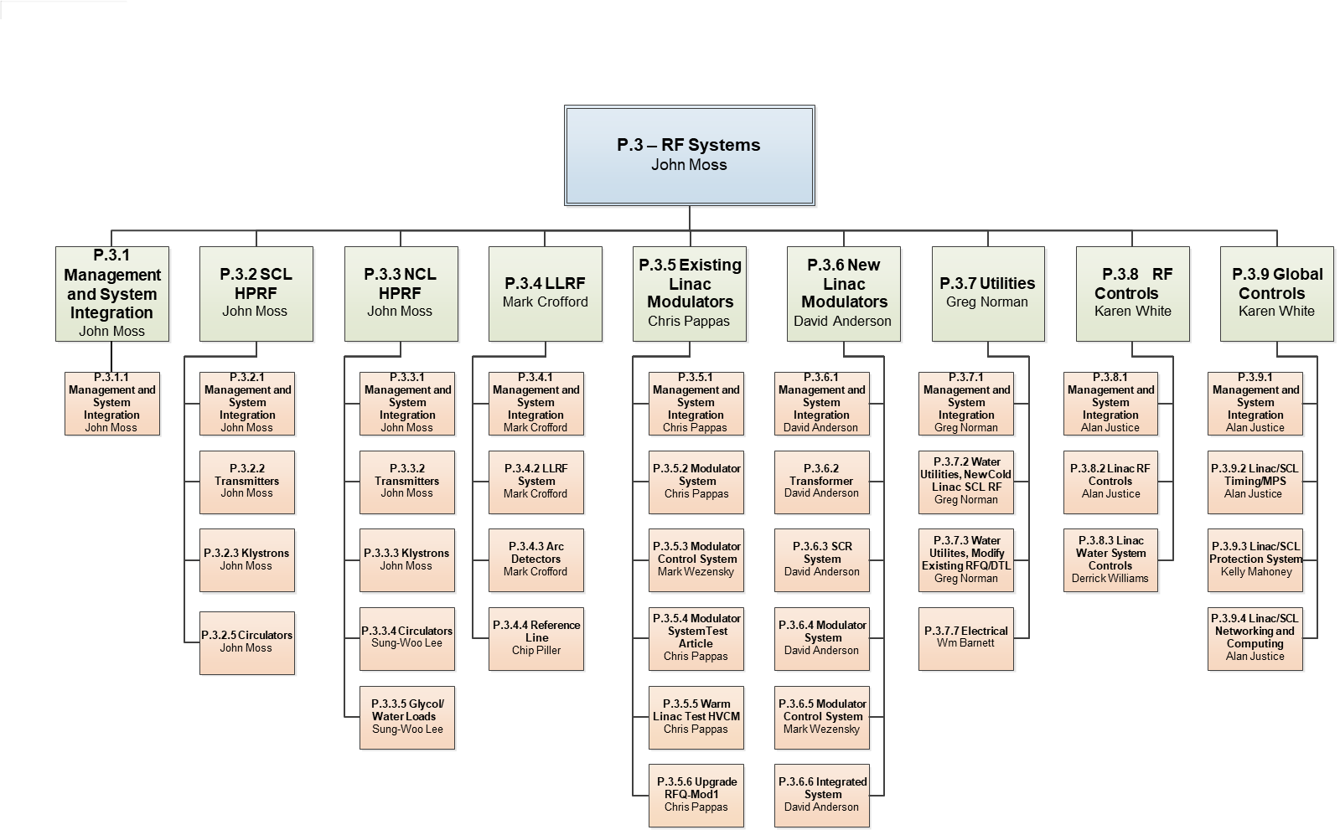
Organization
Charge: 5
P3.5 Team
Engineering
C. Pappas
Technicians
A. Bullman
J. Singleton
Designer/
Contractor
S. Roy

Slide 8
12-Month Look-Ahead from CD2/3
Charge: 1, 2
CD 2/3 was combined with the new SCL HVCMs. Only first two bullets apply to the RFQ-DTL upgrade.
Complete prototype testing of RFQ/DTL modulator upgrade
Begin procurement of RFQ/DTL upgrade components & assemblies
Prototype was fabricated and tested at full power for the DTL configuration.
Awaiting 3 MW klystrons for RFQ testing.
Testing with resistive load, and circuit modeling indicate transformer does not meet spec and will prevent full peak power for RFQ-Mod1.
Electrical design of new transformer secondary baskets and an optional series choke complete.
Procurement of production components has begun.

Slide 9
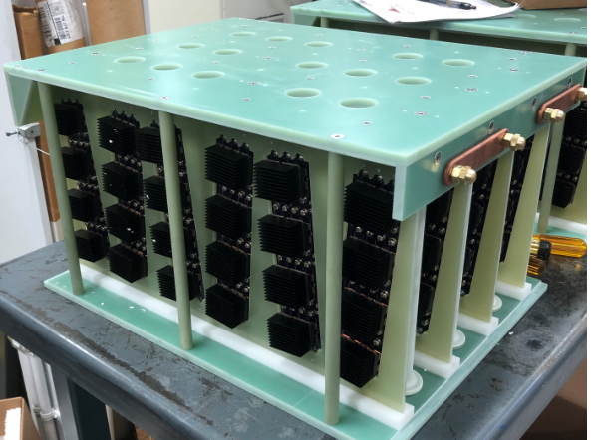
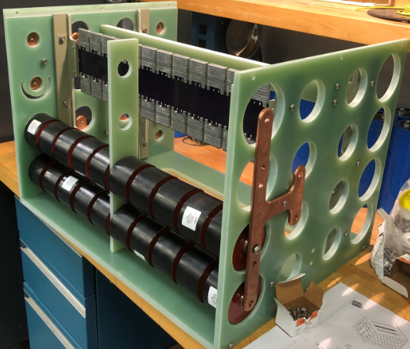
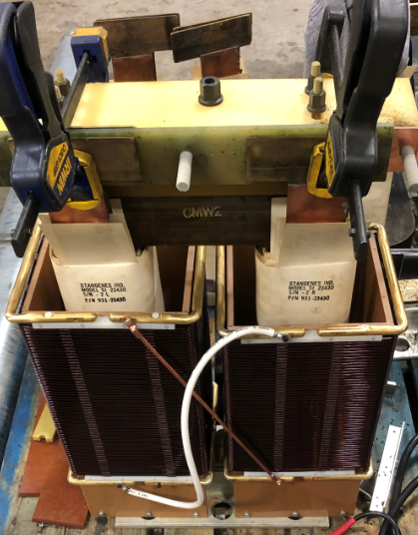
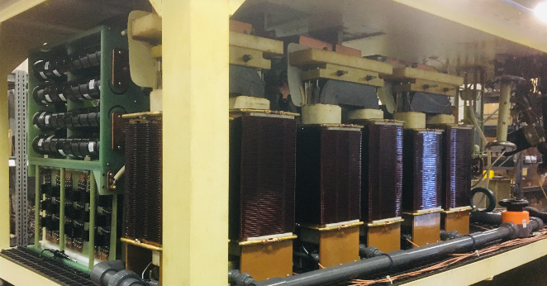
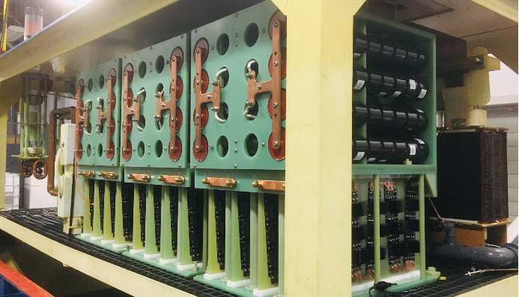
RFQ-DTL HVCM Prototype Assembly
Pulse Transformer Assembly
Rectifier Assembly
Resonant Capacitor Assembly
High Voltage Oil Basket Assembly, ready to drop into HV tank

Slide 10
Full Power Testing with Two 2.5 MW Klystrons
Full power testing of prototype HVCM running since final week of May. There have been multiple trips caused by klystron arcing and cooling faults, without a single internal fault.

Slide 11
Challenges
Charge: 1, 4
The prototype pulse transformer has a leakage inductance less than optimal, preventing full power into the worst case klystron configuration for RFQ-Mod1. Solution are:
Add a 1.2 μH choke in series with the transformer primaries.
Design new secondary winding baskets with the optimal leakage inductance.
Both options are being pursued and drawings are being detailed.
Imbalances in resonant capacitor values are cause of 20 kHz ripple seen.
Approximately 1 month delay in delivery of resonant capacitors and 1st prototype transformer secondary baskets due to Covid-19.
Approximately 1 month delay due to measurement errors during resistive load testing from a defective HV divider used to monitor output voltage.

Slide 12
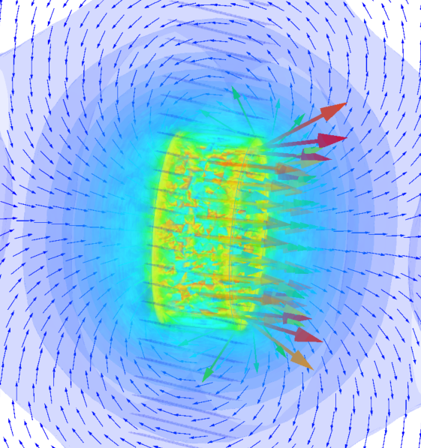
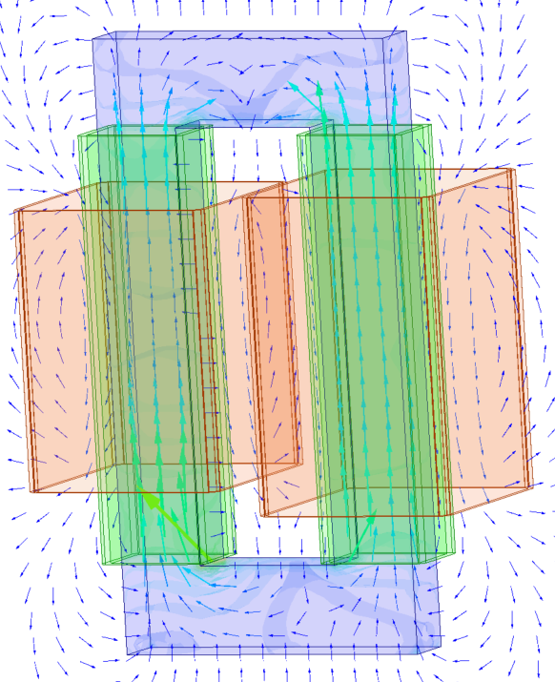
Final Design Status
1.2 μH series choke and mounting hardware is designed (to be used with the winding on the prototype transformers in the test stand now).
Electrical design of new pulse transformer secondary baskets to increase the leakage inductance for the production transformers is complete, Drawing packages are complete and procurement of both has commenced.
Series Choke B Field
Pulse Transformer B Field due to flux leakage

Slide 13
Series Primary Choke Mounting
1.2 μH series choke.
New busing for series choke and mounting hardware to prevent movement during pulsing.

Slide 14
Clamp Failure
Buses were bent and discovered when the tank was removed to investigate 20 kHz ripple.
Busing from the IGBT switch plates to the pulse transformer primary windings was bent due to the Lorentz forces. The forces also either sheered off or backed out the bolts clamping the buses to the primary causing the 20 kHz ripple shown earlier. New clamps and mounting is designed to prevent the buses from moving when pulsed.
Bolts were sheered off or backed out due to Lorentz forces on the buses.

Slide 15
Final Design Status
Charge: 1, 4, 6
FDR was completed on 09/22/2020. Recommendations have been addressed and closed.
Several issues were identified during high power testing.
Currently addressing challenges identified earlier.
The new secondary basket design will eliminate prohibiting use of 2.5 MW klystrons in the DTL2 socket.
Scheduled for delivery of production windings on Mar. 24, 2022. There is no impact on modulator installation. Cost impact of design and testing new windings is approximately $100k.
Procurement of long lead production items has begun.

Slide 16
Installation Plan
Charges: 4,5
Plan to reuse most components of existing modulators. This requires removing existing modulators sequentially due to manpower limitations, beginning Feb. 1, 2023. with RFQ-Mod1.
Subassemblies will be prefabricated and tested before installation.
We are scheduled to be ready for commissioning by Jul. 19, 2023.

Slide 17
PPU Changes Since CD-2/3
Since CD-2/3, the percent completed has increased by 17% and there has been an increase of $904 k in PCRs.

Slide 18
Project Change Requests since CD-2/3
PCRs related to redesign of transformer and design of series choke, IGBTs for RFQ-MOD1 not included in original estimate.
Some costs rolled into other PCRs.

Slide 19
Estimate to Complete/at Completion
Estimate of approximately $1.82 M to complete.

Slide 20
Estimated Cost to Complete by FY23
Charges: 4
Most procurement cost to take place in FY22.
Installation cost for manpower to take place in FY23

Slide 21
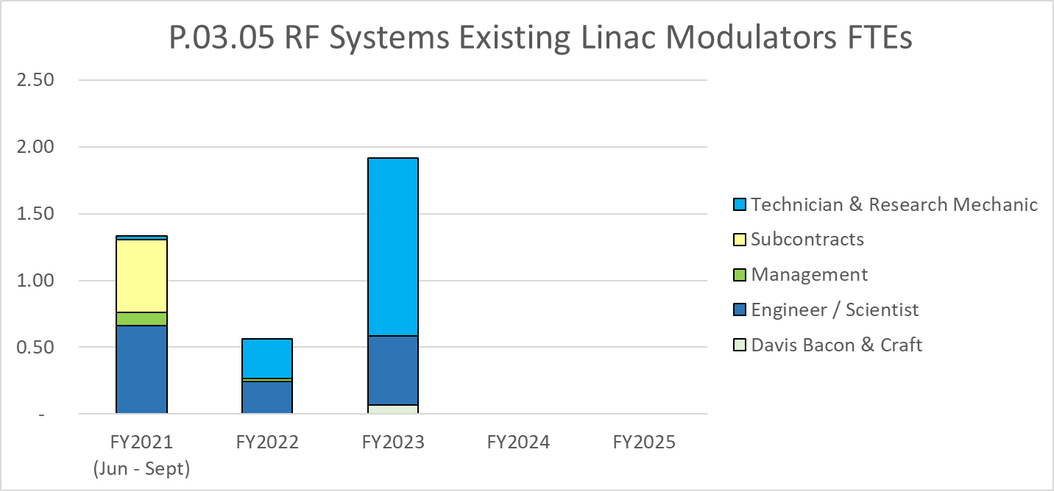
Labor Profile
Subcontractor is mechanical designer for redesign of prototype assemblies.
Labor cost in FY23 are for installation.

Slide 22
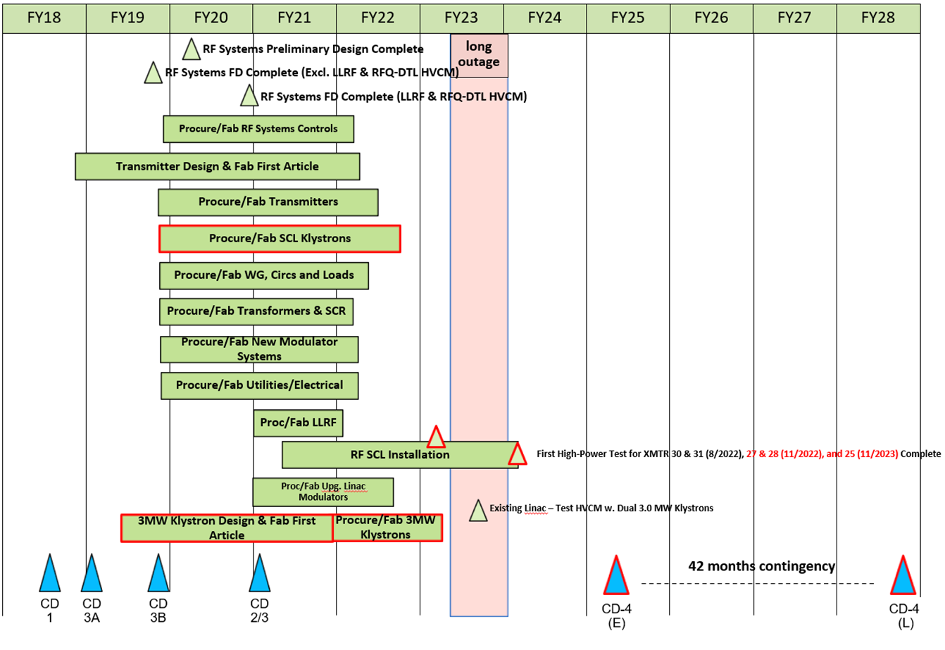
Schedule

Slide 23
P.03.05 Existing Linac Modulators Risk Register
Charges: 5
Risk ID | L3 WBS | Risk Title | Expiration Date | Mitigation | Pre-Mitigation Rank | Post Mitigation Rank
T-P.3-034 | P.03.05 | Prototype results require redesign of subsystem(s) for upgrades of the existing linac modulators | 11/29/2021 | Perform testing as early as possible to allow time for an additional design iteration if necessary. | 6 | 6
Cost and schedule have increased due to new transformer design and additional testing.
One active risk identified
Five risks retired
Pre-mitigated ranking: 1 Medium
Post-mitigated ranking: 1 Medium
High Risks
No high risks identified
Key risk categories analyzed
Vendor risks
Equipment vulnerabilities
Risks are reviewed on a regular basis

Slide 24
Responses to Recommendations
Charge: 6
FDR Recommendations, all closed.
R1) For the 12 mH choke design, consider the effect of the large gap on fringing field losses.
R2) Make a thermal analysis of the transient temperature change from start to end of 1.3 ms pulse and compare to manufacturers data on lifetime, in particular rectifier diodes and 1500 A IGBT
R3) There should be some specific component values in the testing plan at the full power level to determine component success or failure.
FDR Responses
R1) The effect of the stray field due to the large cap in the core of the output choke is negligible.
R2) Transient thermal calculations result in acceptable rate of predicted IGBT and diode failure are similar to those experienced at the SNS, 104010200-TD0021, R00.
R3) Tables of component and test values is complete and released, 104010203-TA0001, R00.

Slide 25
ESH&Q and COVID-19 Impacts
Charge: 4, 5
Minor issues with fabrication of prototype subassemblies requiring rework.
Some hardware was not delivered from the vendor and had to be ordered resulting in minor delays and cost.
Minor delays in delivery of the prototype secondary winding baskets and resonant capacitors from vendors, approximately 1 month.
Final assembly of the prototype HVCM was still mostly on schedule, and vendor performance has yet to impact installation.

Slide 26
12-Month Look-Ahead
Charge: 4, 5
Complete mechanical design of series choke, improved transformer primary bus clamps and new secondary baskets.
Retest modulator with resistive load matching the RFQ-Mod1 worst case klystron configuration.
Continue testing at RFAX and begin testing with new 3 MW klystrons at full peak power if possible.
Complete fabrication of upgrade storage capacitor rack and, new switch plate clamps laminated bus assembly, and upgrade SCR rack fuses and output cabling for full average power testing of RFQ-Mod1.
Proceed with procurement of subassemblies for PPU production HVCMs.

Slide 27
Summary
All recommendations from past reviews are closed.
Prototype HVCM was built and tested with both a resistive and klystron load at full peak and average power for DTL-Mod3 and DTL-Mod5.
Testing with resistive load matching the RFQ-Mod1 worst case showed the output voltage was low due to the prototype transformer leakage inductance.
Electrical design of transformer primary series chokes and new secondary baskets is complete, and mechanical design for both is in progress.
High power testing has been ongoing since May without a failure of the prototype HVCM, and has shown it can withstand repeated load faults at full power.
Procurement of long lead items has begun.

Slide 28
Thank you for your time.
Questions.

