Slide 1
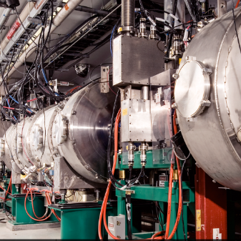
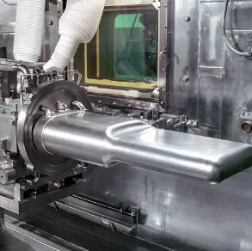
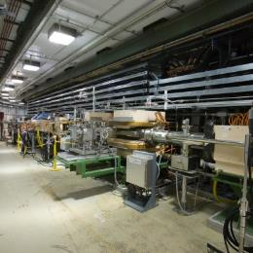

PPU Project Overview
DOE/SC Independent Project Review of the Proton Power Upgrade Project
John Galambos
Director
September 14–17, 2021

Slide 2
Agenda: focus on break-out / executive sessions
Executive sessions
Plenary
Sub-committee breakout sessions

Slide 3
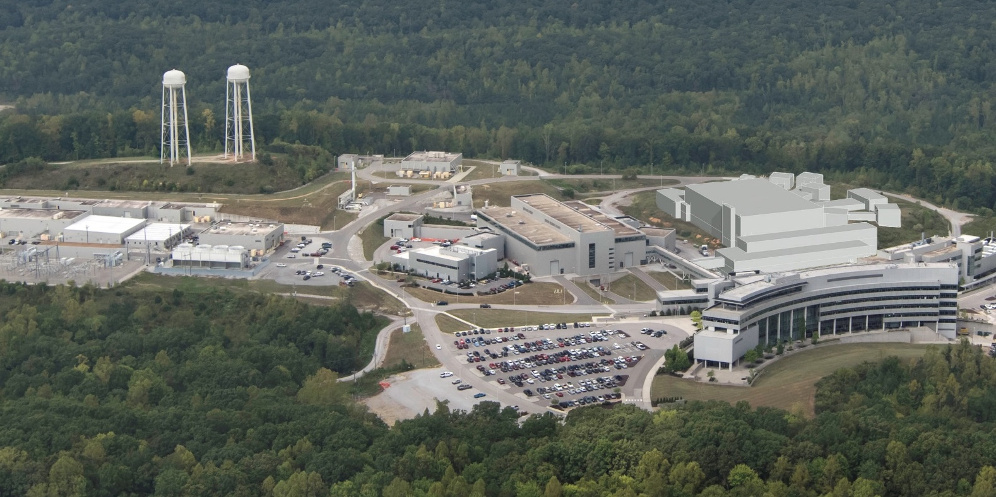
PPU overview
PPU doubles Spallation Neutron Source (SNS) power capability from 1.4 MW to 2.8 MW
  30% beam energy increase, 50% beam current increase
2 MW to First Target Station
Future
Second Target Station (STS)
Accumulator Ring
First Target Station (FTS)
Linac
PPU scope is in blue areas

Slide 4
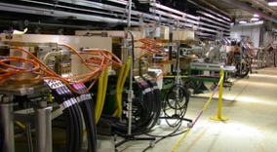
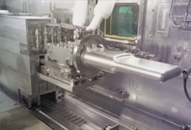
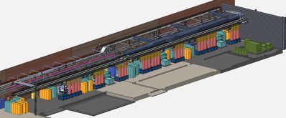
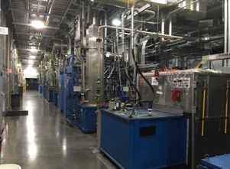
Proton Power Upgrade project scope
Charge: 2
Includes scope across much of the neutron source
Collimators
Ring system upgrades
Primarily injection and extraction
Extraction
7 new superconducting linac cryomodules
Front-End
LINAC
Upgrade
Radio Frequency (RF) system upgrades
Additions for new cryomodules
Upgrades for existing systems
Conventional facility upgrades
Target system upgrades

Slide 5
PPU has been busy the past 3 years: LLPs + CD-2/3
CD-1 approved
CD-3A approved
CD-3B approved
CD-2/3 approval
Jan
2018
Jan
2019
Jan
2020
Jan
2021
$36M FY18 enacted
$60M FY19 enacted
$60M FY20 enacted
$55M FY21 enacted
FY 19: Tailored strategy leveraging use of proven designs
  CD-3A: ~$10 M for superconducting RF cavities
  CD-3B: ~ $53 M for superconducting cryomodules, RF and klystron gallery buildout
FY 20: Combined CD-2/3 review
  Final design was > 90% complete mid 2020
FY 21: Execute LLPs + CD-3 scope

Slide 6
Project baseline parameters
KPPs require upgrades to be fully functional
Key Performance Parameter | Thresholds | Objectives
Beam power on target | 1.7 MW at 1.25 GeV | 2.0 MW at 1.3 GeV
Beam energy | 1.25 GeV | 1.3 GeV
Target operational time without failure | 1,250 hours at 1.7 MW | 1,250 hours at 2 MW
Stored beam intensity in ring | > 1.6x10¹⁴ protons at 1.25 GeV | > 2.24x10¹⁴ protons at 1.3 GeV
Baseline TPC is $272M
CD-4 is Q4 FY2028

Slide 7
The past year we made good progress
Dodged bullet for initial COVID impact
Generally maintained overall schedule
  Procurements
  Component fabrication
  Construction
Close to predicted cost estimate
 | 1 year ago (July 2020) | Now (July 2021)
% complete (earned value) | 33% | 57%
Contingency relative to ETC | 45% | 59%
Early finish* | 1/24/2025 | 2/12/2025
B8-2 Steffey
* CD-4 (late finish) is July 31 FY2028

Slide 8
Integrated Project Team has new members
Harriet Kung
Linda Horton
Kurt Fisher
Linda Horton
Hannibal Joma
(Ed Stevens previously)
Johnny Moore
Wendy Cain
(James Barnard previously)
Thomas Zacharia
John Galambos
Mark Champion
Sang-Ho Kim
Wayne Steffey

Slide 9
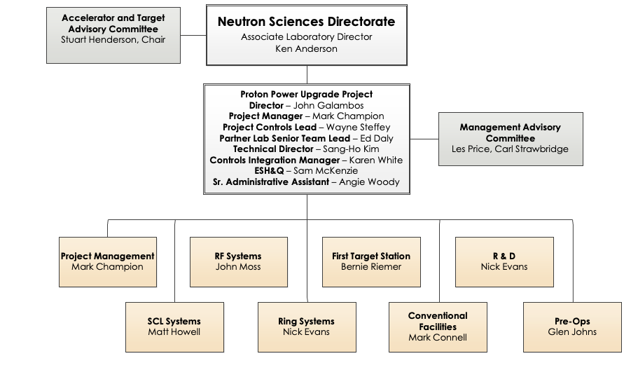
PPU project organization is largely stable
Currently being reconstituted
Ken Andersen replaced Paul Langan
Nick Evans replaced Charlotte Barbier

Slide 10
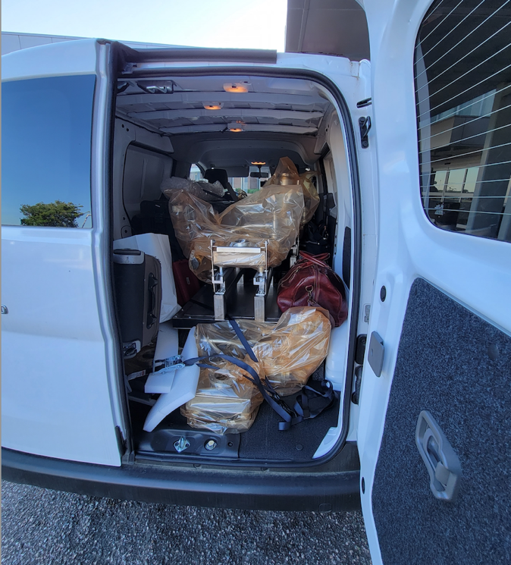
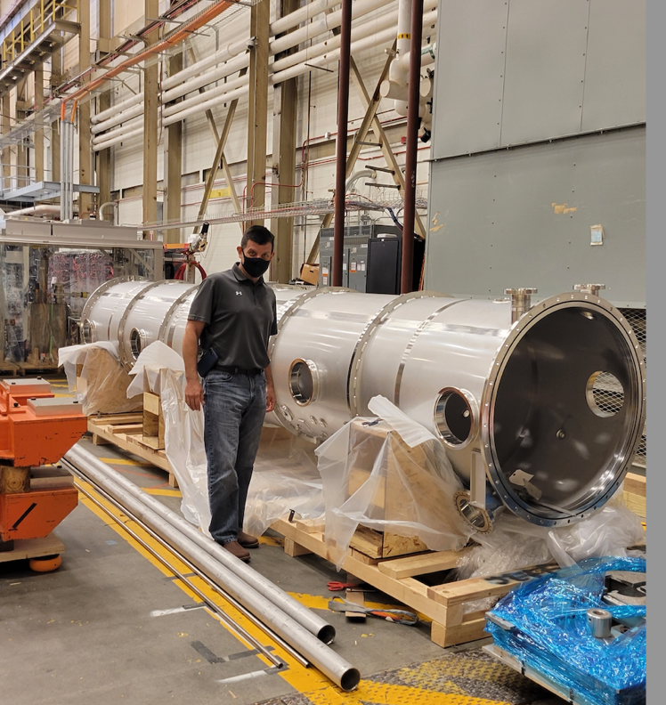
Partner lab coordination is going well
B8-6 Daly
We have resumed in person visits to JLab
  COVID prevented travel until May 2021
Regular video conference updates, weekly/monthly status reports
  Longstanding positive relationship between JLab and SNS

Slide 11
Cost contingency is healthy at > 50% on Estimate to Complete
A2 - Champion
B8-1 - Galambos
+ and – cost changes balance
Net negative draws on contingency (COVID ?)
Have a contingency spend plan and process for allocating contingency

Slide 12
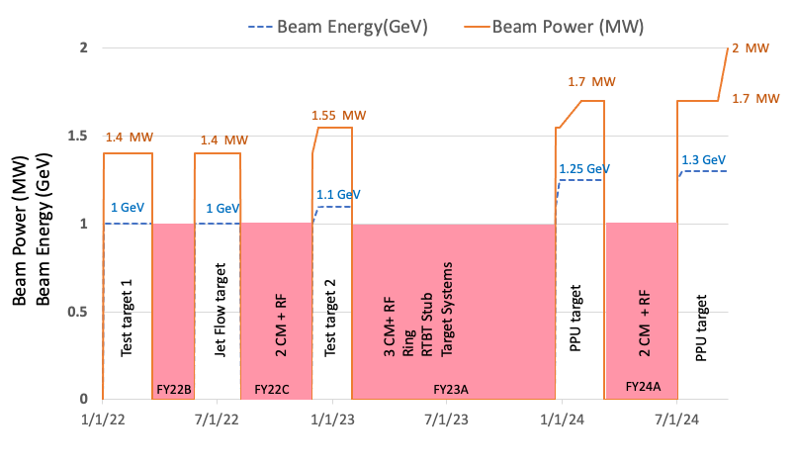
Gradual power ramp-up over 2023-2024 drives schedule
Incorporates new equipment as it arrives – red shaded areas indicate downtimes
One 10 month extended outage in 2023
B8-7 Champion
B8-8 Johns
B8-9 Peters

Slide 13
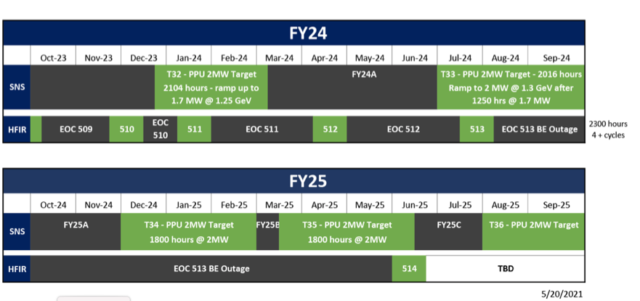
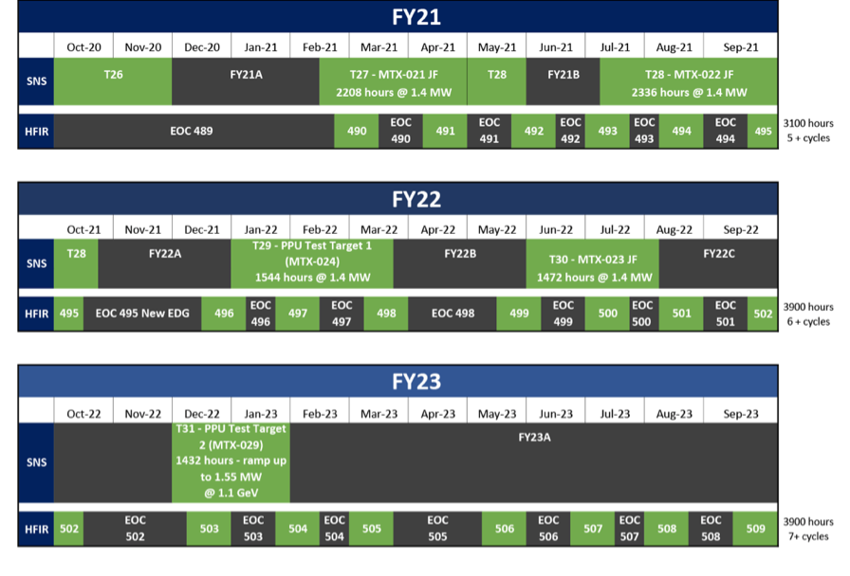
PPU plans are integrated in the “5-year” NScD directorate plan
See https://neutrons.ornl.gov/hfir/hfir-sns-5-year-working-schedule
Tradeoffs communicated with our BES sponsor

Slide 14
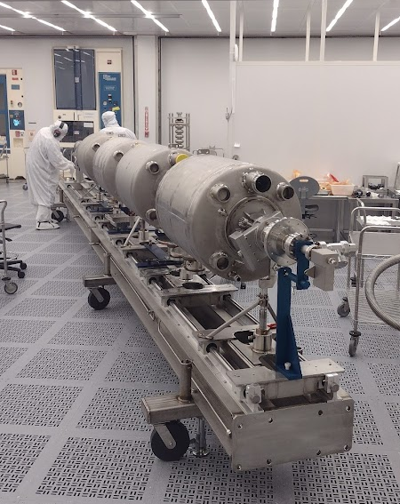
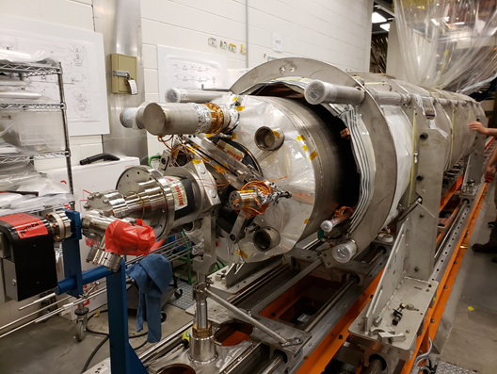
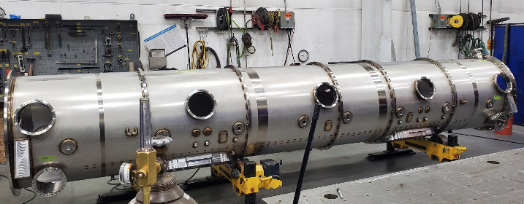
SCL systems: cryomodule production ramping up
Cavities received in good shape
Cryomodule production proceeding well at JLab
  84 of 93 procurements at JLab
  2 string assemblies complete
  Spare cryomodule added
String assembly
Cold mass assembly
Cryomodule vacuum vessel

Slide 15
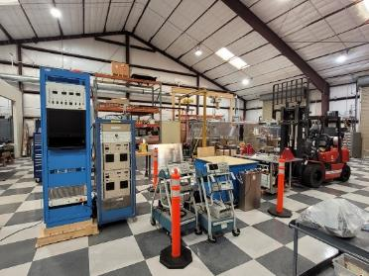
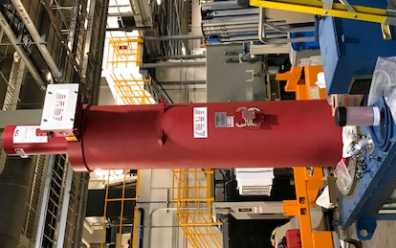
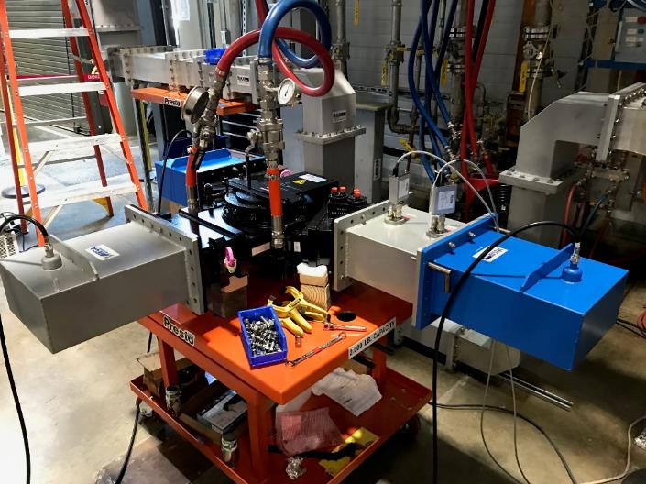
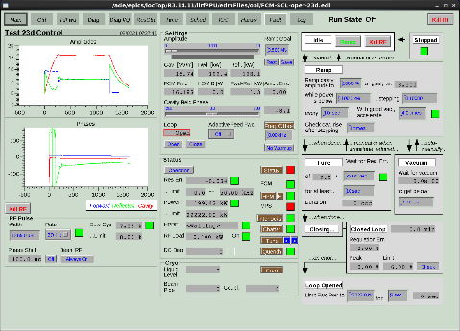
RF Systems: Procurements on track for power ramp-up
Transmitter cooling cart at vendor
HVCM fabrication at vendor
Klystrons being received on site (working too!)
1st article circulator received
LLRF test operation on SNS

Slide 16
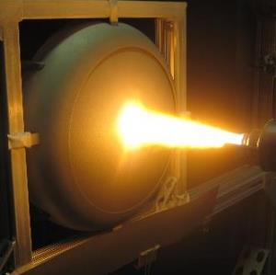
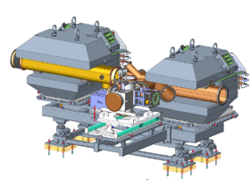
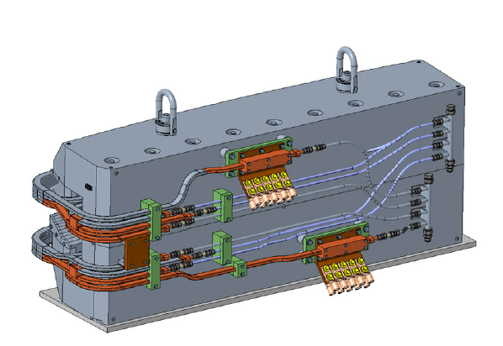
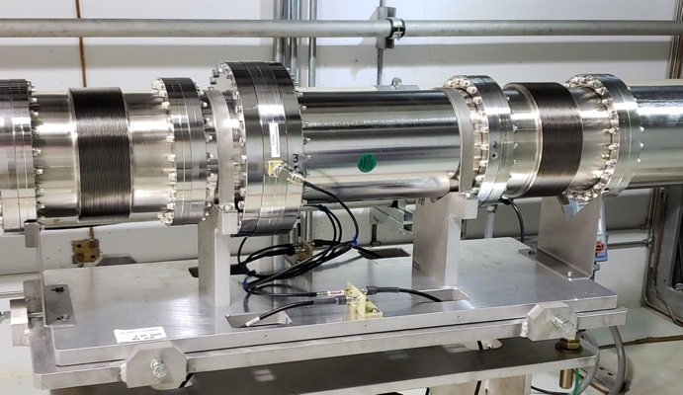
Ring systems: magnet final designs complete, focus on fabrication
Injection dump imaging system: on track for install in FY22
FNAL is fabricating new injection magnets
Current pickups in tunnel for beam power limiting system

Slide 17
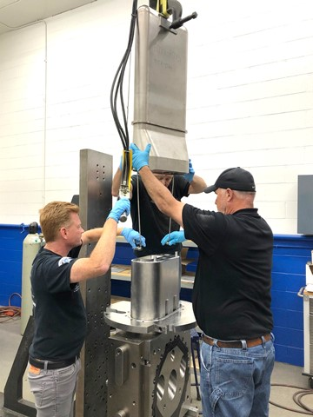
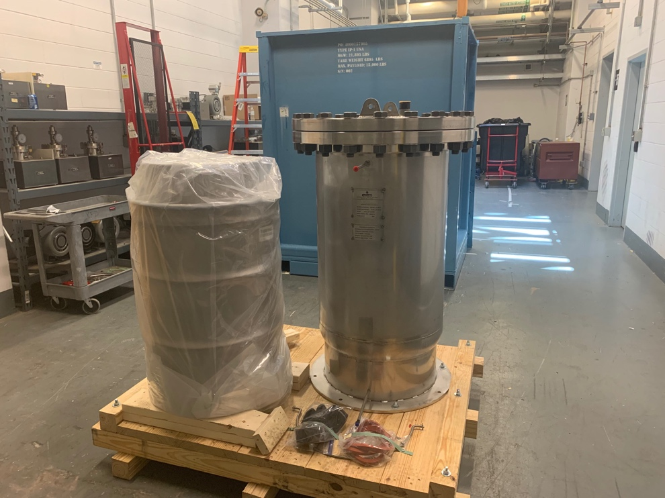
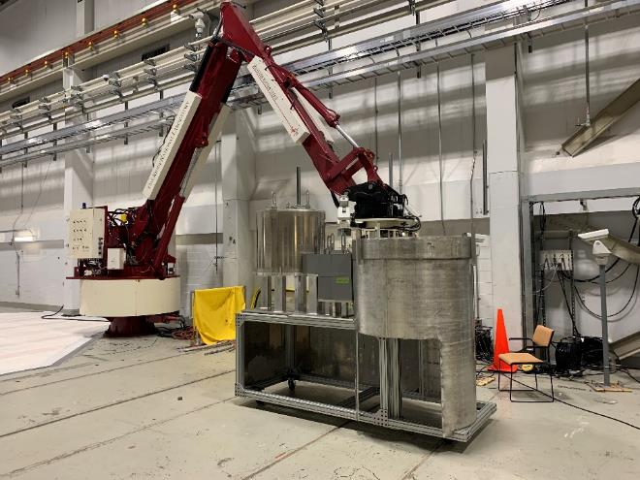
Target systems: target manufacture and sub-system component fabrication going well
Test target 1 assembly
Delay bed carbon cartridge and vessel
Mercury pump overflow tank mockup test

Slide 18
Conventional facilities: klystron gallery buildout is complete: BIM helped
Complicated piping sections are fabricated offsite
And lifted / positioned into place:
easier than fabricating in place
B5-2 Santee
(BIM = Building Information Modeling)
See: https://neutrons.ornl.gov/klystron-virtual-tour

Slide 19
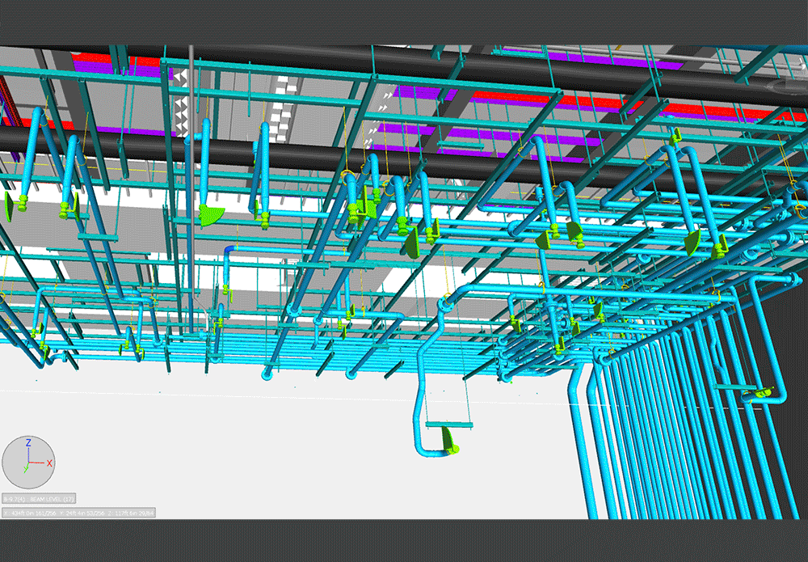
BIM transformation from virtual to reality

Slide 20
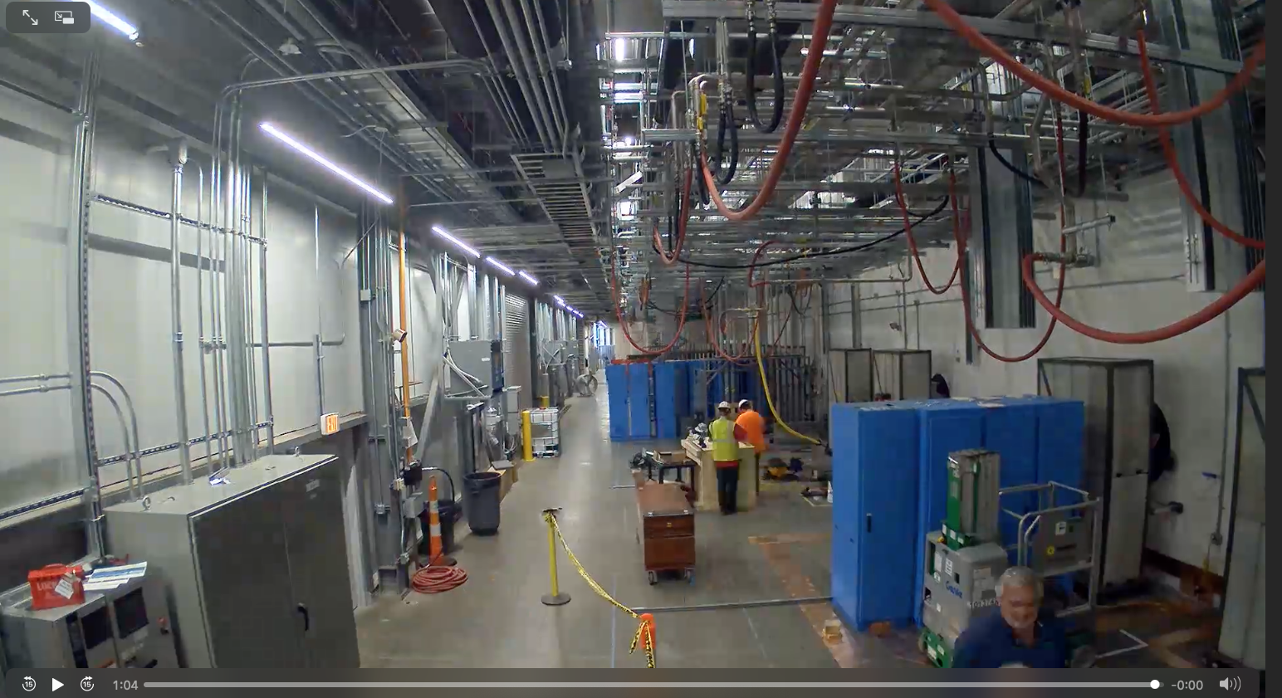
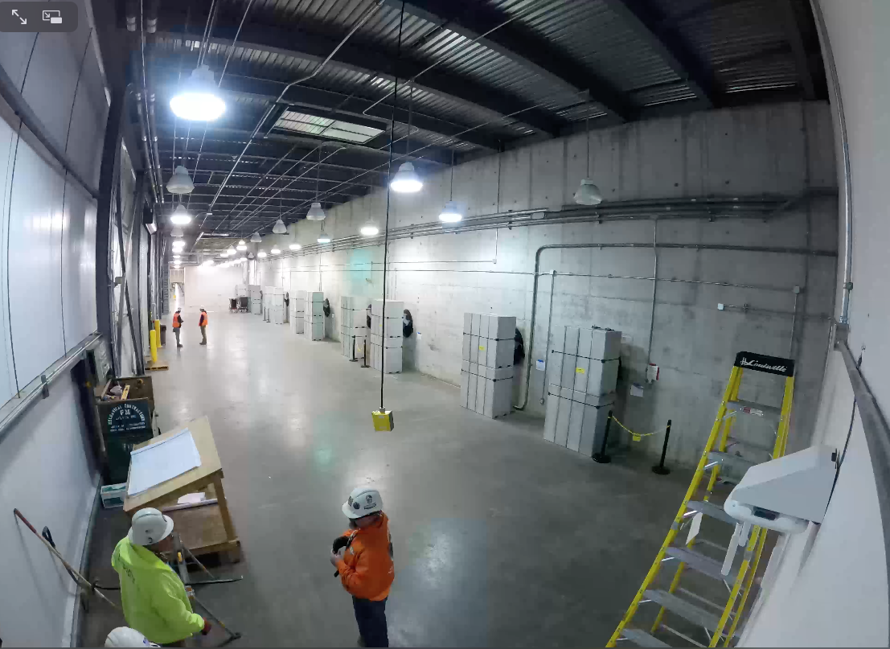
Klystron gallery activity videos
February 2020
August 2021
Under Project Information - Klystron gallery construction video
Under Project Information - Klystron gallery Installation Video

Slide 21
ESH&Q
B8-4 McKenzie
COVID: impacted on on-site activities (e.g. klystron gallery construction)
QA: heavy involvement in procurement activities and acceptance
PPU is using the same work control practices as operations
Safety: continuous presence on CF and installation activities

Slide 22
COVID impacts have not been severe … so far
Critical PPU staff were permitted on site throughout COVID
  E.g. klystron gallery construction
  There was a schedule impact – but we worked around this
ORNL return to full onsite presence on hold
  (84% staff vaccinated)
JLab site access has been more restrictive than ORNL
  Onsite presence has permitted equipment acceptance and cryomodule fabrication
Vendor performance
  Initially not many direct COVID related delays, but over the past months we are starting to get more delay requests
But there are some indications of potential issues
  Recent trend of change requests: cost increases
  Issues finding resources
B8-6 Daly

Slide 23
Installation has begun and outage planning is refined
PPU Installation is ongoing
  Klystron gallery equipment is being installed
  Electrical tie-ins are occurring in outages
Outage plans include more refined estimates
  ARR execution durations are increased
Coordination with operations
  E.g. RFQ swap delayed to after the long outage
B8-7 Champion
B8-8 Johns

Slide 24
What worries me (1 year ago at CD-2/3)
COVID impact on vendor deliveries
  Survived initial impact, but still have concerns
CD-3B activities, moving beyond procurements
  The project mentality has switched to “fabrication/construction”
Targets: manufacturing / schedule for power ramp-up
  Target manufacturing is going well
  Power ramp-up schedule is maintained
Long outage: coordinating activities
  More realism is now included
  Better coordination / communication with operations and sponsor

Slide 25
What worries me (looking forward)
Maintaining equipment delivery schedules
COVID secondary impacts
  Cost/schedule, resource availability, staff returning to campus
Target stub planning

Slide 26
Summary
PPU has transitioned from “design” to “construction” mode
We survived COVID in relatively good shape
Now concerns are shifted to equipment delivery, installation and outage coordination

Slide 27
Backup

