Slide 1




P.05.08 Mercury Off-gas Treatment System
DOE/SC Independent Project Review of the Proton Power Upgrade Project
Greg Stephens
Level 3 Manager for P.05.08
September 14 – 17, 2021

Slide 2
Outline
Scope
Organization
Progress since CD-2/3
Challenges
Final design status
Installation plans
Cost and schedule
Labor profile
Risk register
Responses to recommendations
ESH&Q and COVID-19 impacts
12-month look-ahead
Summary

Slide 3
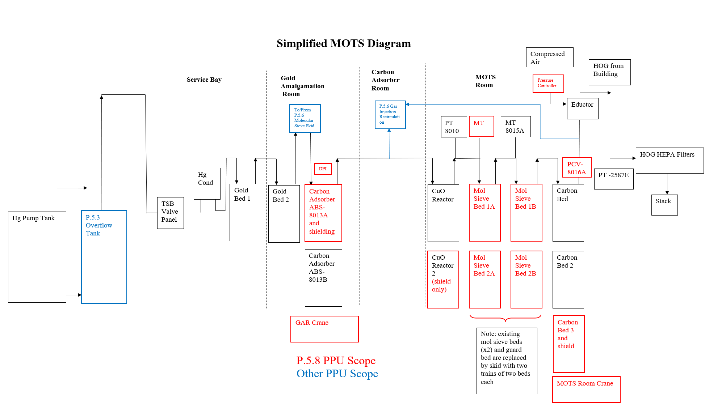
Mercury Off-Gas Treatment System (MOTS) Scope
P.5.8.1- Management & System Integration
P.5.8.2- Additional MOTS Delay Bed and Shielding
  Differential pressure transmitter
  Monorail crane
P.5.8.3- MOTS Upgrades for Gas Injection
  Molecular sieve beds and shielding
  Pressure controller for Compressed Air (CA) to eductor
  Back-pressure controller
  CuO reactor shielding
P.5.8.4- MOTS Cold Trap and Shielding
  MOTS Room monorail crane
B2-7 Ahlschwede

Slide 4
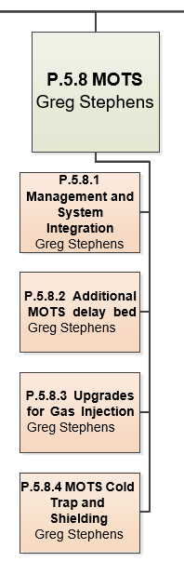
Organization
Charge: 5

Slide 5
Post CD-2/3 12-Month Look-Ahead
Final, detailed design work
  Drawings
  Calculations
  Specifications/Data Sheets
  Installation Plans/Statements of Work
  MOTS room modeling
Final Design Reviews
  Molecular sieve beds
  MOTS Room crane
  Cold trap and shielding
Installation package preparation
Procurement, fabrication and installation phase

Slide 6
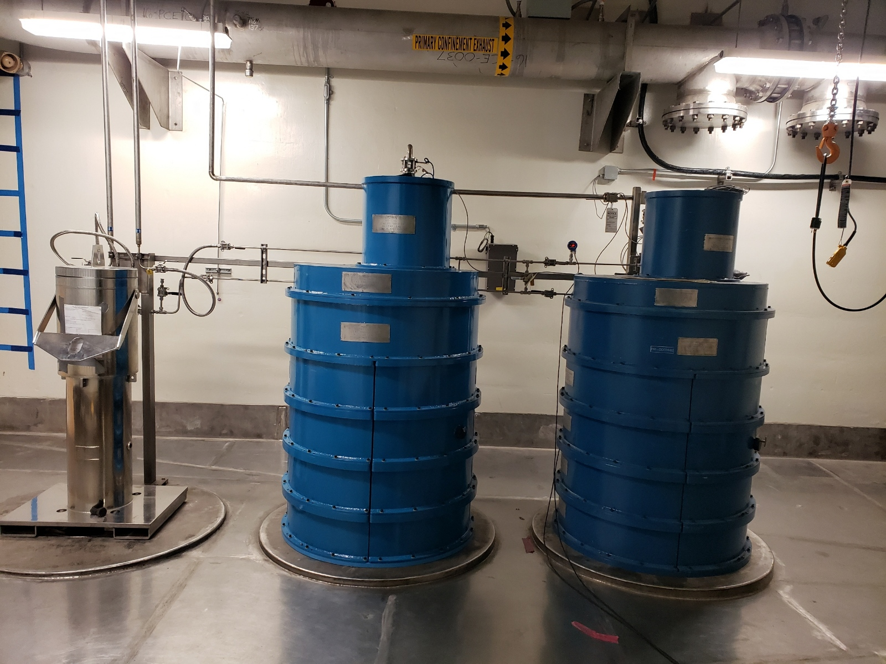
Progress since CD-2/3
Charges: 1,2 & 5
Mol Sieve PDR (October 2020)
Delay bed and shielding PRR/PO Awarded (November 2020)
  Delivered May 2021 (Project milestones scheduled for August 2021)
  GAR Crane installed June 2021
  Installed Aug 2021
  Nuclear grade DP transmitter purchased and received
Delay Bed

Slide 7
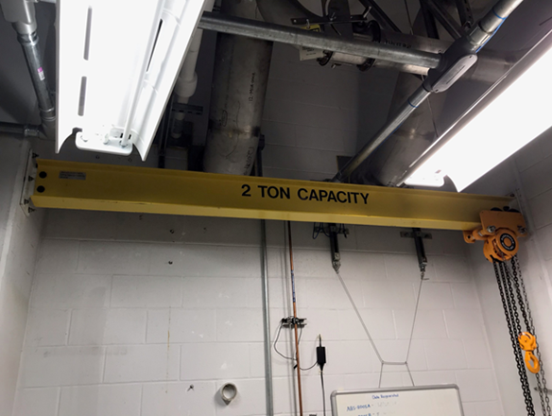
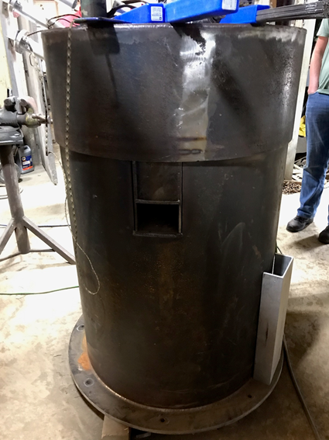
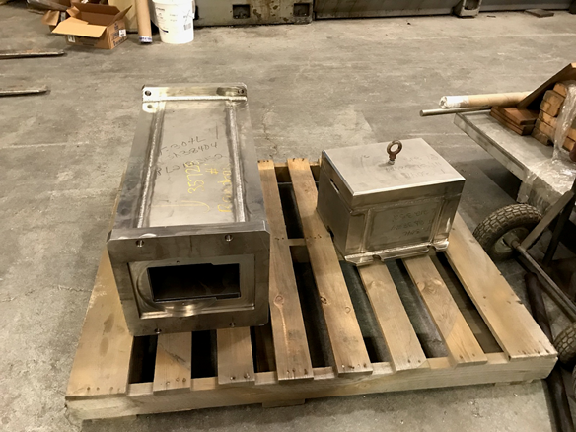
Progress since CD-2/3
Charges: 1,2 & 5
MOTS Cold Trap, Shielding and Crane FDR (January 2021)
  Cold trap PO awarded May 2021
    Second sub-assembly purchased to retrofit existing cold trap
      Provides redundancy for system reliability
  Crane installed March 2021
  Shielding fabricated and awaiting lead pour
CuO Reactor Shielding Fabrication Complete
MOTS Room Crane
CuO Reactor Shielding
Cold Trap Shielding

Slide 8
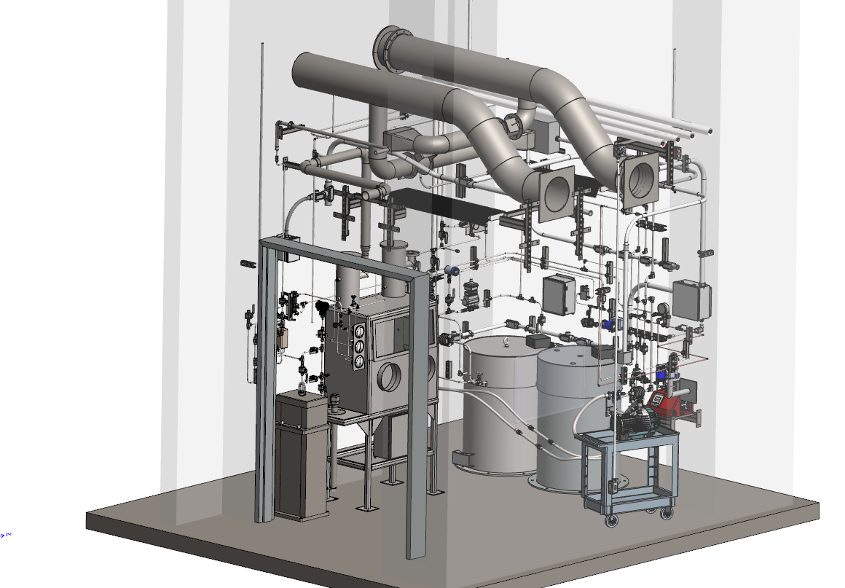
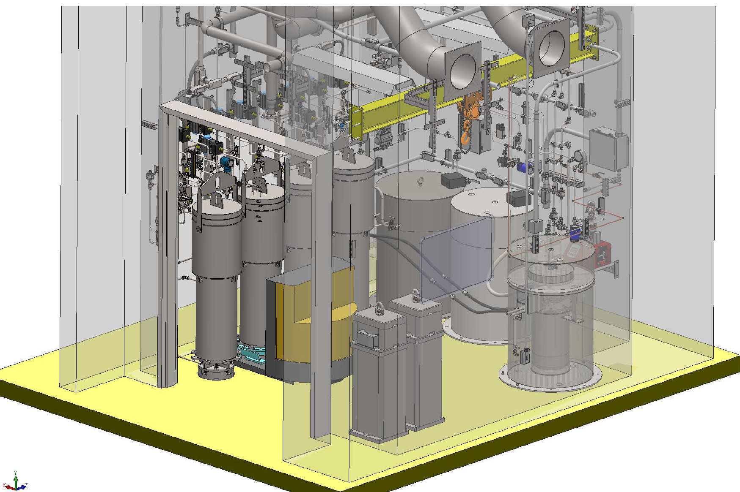
Progress since CD-2/3
Charges: 1,2 & 5
3D Modeling of MOTS equipment room
  Pre-PPU equipment
  PPU equipment installed
    Glovebox removed
    CuO reactors relocated
    Additional cold trap
    MOTS Room crane
    MOTS molecular sieves and valve panels
  New equipment fits
Demo/Installation Drawings
P&ID
Process Controls Description
MOTS Room Model Pre-PPU
MOTS Room with PPU Equipment

Slide 9
Completed Documentation
Charges: 1,2 & 5
Document Number | Title
PPUP-508-CN0005 | MOTS Cold Trap ABS-8016 Isolation Valve Installation
PPUP-508-VS0002 | NUCON International Vendor Submittals for ABS-8013A Cartridge and Vessel (PO# 4000184571)
PPUP-508-CN0003 | Installation of ABS-8013A
PPUP-508-VS0001 | TruSkill Machining Vendor Submittals for ABS-8013A Shielding (PO# 4000184352)
PPUP-508-CN0004 | 2-Ton Monorail Crane Installation in Bldg 8700, TA-B149
PPUP-508-CN0002 | 2-Ton monorail crane installation in Bldg 8700, TA-B156
PPUP-508-CR0001 | Upgrades for Mercury Off-gas Treatment System - Proton Power Upgrade, WBS P.5.8
PPUP-508-DE0004 | Final Design Review Report MOTS Cryogenic Carbon Adsorber (ABS-8016) and Crane
PPUP-508-CA0004 | MOTS ABS-8016 Trapped Volume Relief Capacity Calculation
PPUP-508-DA0003 | 2-Ton Monorail Crane (TA-B156) Design Analysis and Calculations
PPUP-508-QA0002 | P0508-A Ambient Temperature Carbon Adsorber Shielding GAMAC Form
PPUP-508-QA0001 | P0508-A Ambient Temperature Carbon Adsorber GAMAC Form
PPUP-508-TD0001 | PPUP-508-TD0001, R01 Technical Review of Cold Adsorber Design
PPUP-508-EQ0001 | Specification for Refrigerated Carbon Adsorber ABS-8016
PPUP-508-CA0003 | Shielding for MOTS Cryogenic Carbon Adsorber ABS-8016 Design Analysis and Calculations
PPUP-508-DA0002 | MOTS and Gas Injection Recirculation Volume Determination
PPUP-508-DA0001 | Source Terms and Dose Calculations for the PPU-Modified Mercury Offgas Treatment System
PPUP-508-DC0002 | PPU Mol Sieve Design Basis
PPUP-506-DA0001 | Helium Gas Molecular Sieve Dryer Assemblies' Rupture Disks Sizing Calculations
PPUP-508-TR0002 | MOTS Process Flow Diagram Material Balance
106060000-TD0006 | Mercury Target Gas Injection Pre-PPU System Process Control System Description

Slide 10
Completed Drawings
Charges: 1,2 & 5
Document Number | Title
108030700-M8U-8700-A024 | Vacuum Vessel Assembly ABS-8012 & ABS-8016
108030700-M8U-8700-A038 | Ambient Carbon Adsorber Assembly Instructions
108030700-M8U-8700-A084 | Tritium Removal Room 2-Ton Monorail Crane Assembly Instructions
108030700-M8U-8700-A085 | Cryogenic Carbon Adsorber Subassembly
108030700-M8U-8700-A086 | Cryogenic Carbon Adsorber ABS-8016 Vessel Weldment
108030700-M8U-8700-A087 | ABS-8016 Subassembly Brazement Piece Detail
108030700-M8U-8700-A088 | Adsorber ABS-8016 Subassembly Brazement Clamp
108030700-M8U-8700-A089 | Adsorber ABS-8016 Subassembly Coldhead Flange Detail
108030700-M8U-8700-A090 | Adsorber ABS-8016 Subassembly Vessel Flange Detail
108030700-M8U-8700-A091 | ABS-8016 Shield Lid
108030700-M8U-8700-A092 | ABS-8016 Shield Body
108030700-M8U-8700-A093 | ABS-8016 Shield Plug
108030700-M8U-8700-A094 | Refrigerated Carbon Adsorber Assembly ABS-8016
108030700-M8U-8700-A095 | BLDG 8700, RM TA-B149 2-TON MONORAIL CRANE ASSEMBLY INSTRUCTIONS AND DETAILS
108030700-J8U-8700-A368 | TRITIUM AND XENON REMOVAL SYSTEM PIPING AND INSTRUMENTATION DIAGRAM

Slide 11
In Progress/Outstanding Work
Completion of final detailed modeling
  Equipment positioning
  Piping layouts
Detailed demo/installation drawings
  Glovebox demo
  CuO reactor installation
  Molecular sieve and valve panel installation
Molecular sieve regeneration source term
Equipment specification for molecular sieves
Seismic analyses

Slide 12
Challenges
Charges: 1 & 5
Mercury loop overpressure event of 2019 and recovery
  Was priority for most of FTS team
  Resulted in water in Hg off-gas stream, thus the late addition of molecular sieves upstream of carbon delay beds to the PPU scope (P.5.6)
In-house designer moved to STS
  Staff position has not been filled
  Hired subcontract designer (shared with P.5.6)
Original molecular sieve shielding design was found to be inadequate (rad and heat resistant paint not available)
  Leveraged existing gold amalgamation bed shielding design
Early PPU completion schedule selected

Slide 13
Final Design Status
Charge: 1
P.5.8.2 Delay bed, shielding and crane FDR held April 2019
  Installed June-August 2021
P.5.8.4 Cold trap, shielding and crane FDR held January 2021
  Crane installed March 2021
  Cold trap and shielding to be installed FY22A outage
  Upgrade of existing cold trap to be after extended outage to allow for radioactive decay
P.5.8.3 MOTS Upgrades for Gas Injection (except molecular sieve) presented as final at CD-2/3.
  Higher capacity flow transmitter and back pressure controller
  Pressure controller for air to eductor
P.5.8.3 Molecular Sieves
  Design effort combined with P.5.6
  FDR target date in Fall 2021
B2-7 Ahlschwede

Slide 14
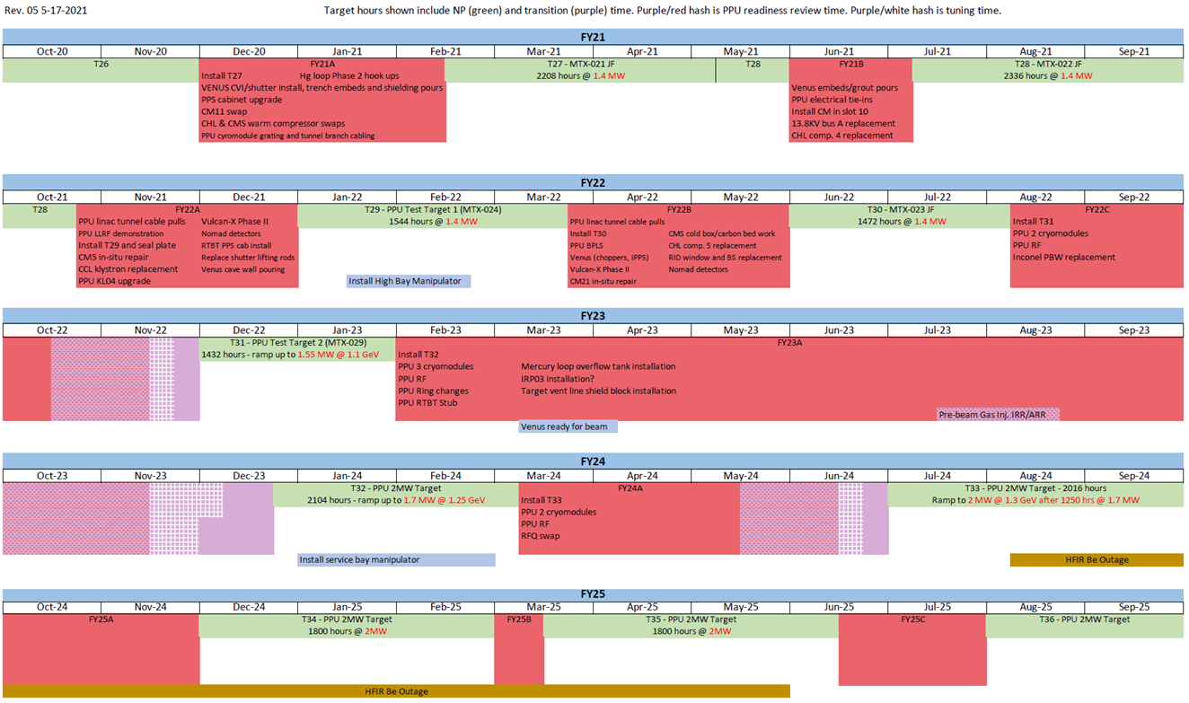
5-Year Plan
Charge: 4
Cold Trap
MOTS Molecular Sieves
Upgrade Existing Cold Trap

Slide 15
Installation Plans
Charges: 1,4 & 5
FY22A Outage
  Cold trap
FY23A Outage (extended outage)
  Relocate CuO reactors
  Demo MOTS glovebox
  Install molecular sieves
  Delay bed DP transmitter
Post-FY23A
  Upgrade existing cold trap

Slide 16
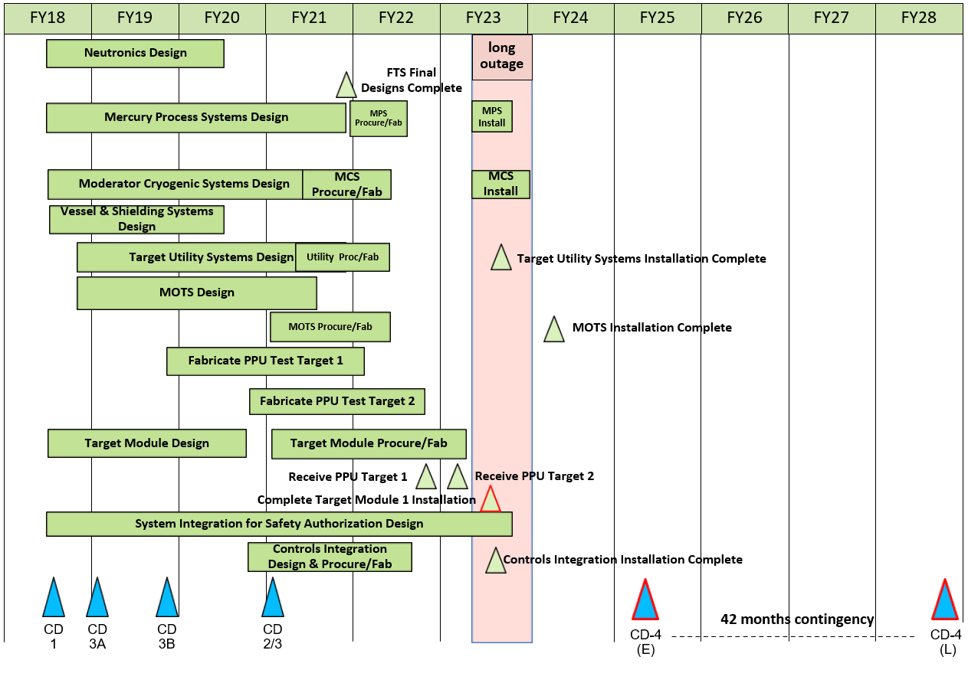
Cost and Schedule
Charge: 4
MOTS to be rated for PPU conditions coming out of long outage
Final MOTS installation in FY24 is upgrade of existing cold trap
  PPU cold trap to be installed in FY22A outage
  Ample time needed for radioactive decay prior to modifications
FTS Summary Schedule

Slide 17
PPU Changes since CD-2/3
Charges: 4, 5

Slide 18
Estimate at Complete
Charges: 4,5

Slide 19
Estimate to Complete by FY
Charge: 4
Notes:
FY21 includes actual costs through May

Slide 20
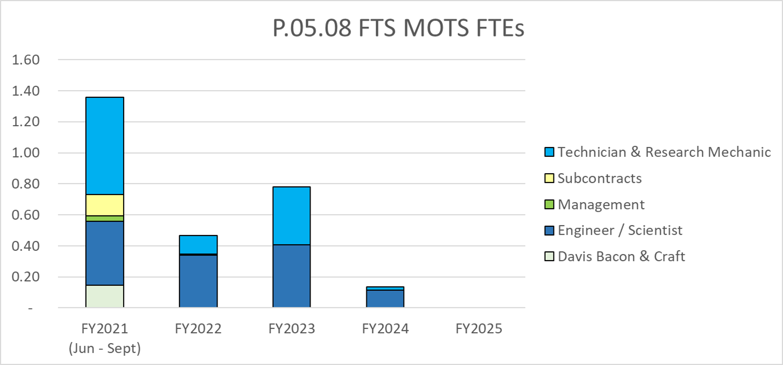
Labor Profile
Charge: 4,5

Slide 21
P.05.08 MOTS Risk Register
Charge: 5
No active risks identified
  One risk retired
High Risks
  No high risks identified
Key risk categories analyzed
  Moisture in MOTS
Risks are reviewed on a regular basis

Slide 22
Responses to Recommendations
Charge: 6
No recommendations from the CD-2/3 review
No recommendations for P.5.8 from DOE reviews
No recommendations from previous Director’s Reviews

Slide 23
ESH&Q and COVID-19 Impacts
Charge: 3
Delay Bed QA review revealed a nonconformance issue
  Faceplate was not installed IAW drawings
  Issue was promptly corrected by vendor
No COVID-19 impacts for P.5.8 to date
  Delay bed and shielding delivered 3 months early
  Vendors have indicated they are starting to see longer lead times for materials

Slide 24
12-Month Look-Ahead
Charge: 5
Molecular sieves
  Finish design
  FDR
  PRR
  Procurement
  Delivery
Cold trap
  Delivery
  Installation

Slide 25
Summary
PPU MOTS upgrades are progressing well
  Delay bed and GAR crane installed ahead of schedule
  MOTS Room crane installed
  CuO reactor shielding fabricated and awaiting installation
  Cold trap fabrication is on schedule
  Molecular sieve design is approaching completion
Thank you for your time

