Slide 1




PPU Quality Assurance
DOE/SC Independent Project Review of the Proton Power Upgrade Project
Bryan Robertson
Quality Representative

Slide 2
PPU Procurement Flow & QA Tools
Project Oversight
Financial Oversight
Environmental Oversight
Safety Oversight
Quality Oversight
Define what we want
Ensure we get what we want
Design Development
Design verification
Procurement
Monitor vendor performance
Installation /
Design validation
Develop Drawings
Design Reviews
Develop Statement of Work
Track with ACL
(Acceptance Criteria Listing)
Acceptance Testing
Develop Specifications
Qualify vendors
Site Surveillance
ACL Final Check
Compete the work
Nonconformances Deviations
Risk Analysis
Acceptance Criteria Listing
Verification of ACL Items
Graded Approach/ Minimum Acceptance Criteria
Vender Qualification

Slide 3
PPU QA Program Responsibilities
QA has provided input to all transactions listed below to date:
  Nonconformances - vendor action plans to correct issues
    Tracking these in ACTS – 14 so far of which 11 are closed
  All Procurement Competitions – research vendors according to manufacturing capabilities, previous experience, and QA Program (40 contracts so far)
    Development of database tracking vendor performance
  Vendor Meetings – interpreting PPU QA requirements
  Onsite visits / site surveillances
    Jlab, Metalex (3), Alpha Omega, GMW/Bergoz in October
    Keller, Metalex (also DCS, L3 Technologies)
    Working on ability to do virtual audits and site surveillances
  All Procurement Readiness Reviews
  All Final Design Reviews
  All QA Tools – Risk Analysis (FMEA), Graded Approach, Minimum Acceptance Criteria, Acceptance Criteria Listings

Slide 4
Graded Approach / Minimum Acceptance Criteria (GAMAC) and Risk Analysis
Use of these tools has allowed QA to provide better feedback on understanding mitigating risk for development of Statements of Work/Tech Specs
GAMAC determines the level of rigor for each procurement
GAMAC & Risk Analysis together provide the ability to focus on being preventive – especially important for procurements on the critical path
Identified mitigations are captured in the contract, statement of work, technical specifications, etc.
The Acceptance Criteria Listing captures the vendor’s deliverables that must be provided to assure risk mitigations are proven
Multi-disciplined approach to reviewing all these documents has resulted in a better understanding of the risks and the mitigations for PPU and for PPU vendors

Slide 5
JLab Interaction
Initial visit - trained their QA personnel and their equivalent Technical Project Officers on our QA system & they provided insight on their process
Developed a SQAP which was approved based on our QA system
Joint review of their risk analyses
Involved in cavities and cryomodule meetings
Review and approval of “non-standard” NCRs
Multiple discussions on previous shipping issues – agreement to use the current shipping fixture for testing and possibly ultimate use
Good rapport and regular contact w/JLab QA

Slide 6
Fermilab
Reviewed Quality Management Program Manual
Reviewed their Quality Assurance Plan for PPU Ring Systems
Reviewed their Engineering risk assessment
Involvement in Fermilab weekly meetings with PPU Project

Slide 7
RTBT Stub Construction Project
Klystron Gallery construction project was a Grade 3 – Routine
RTBT Stub will be a higher grade due to radiation shielding
Grade 1 or 2 requires:
  Stronger risk analysis and mitigations
  Acceptance Criteria Listing or equivalent which defines vendor deliverables
  Vendor NCRs are approved by PPU personnel

Slide 8
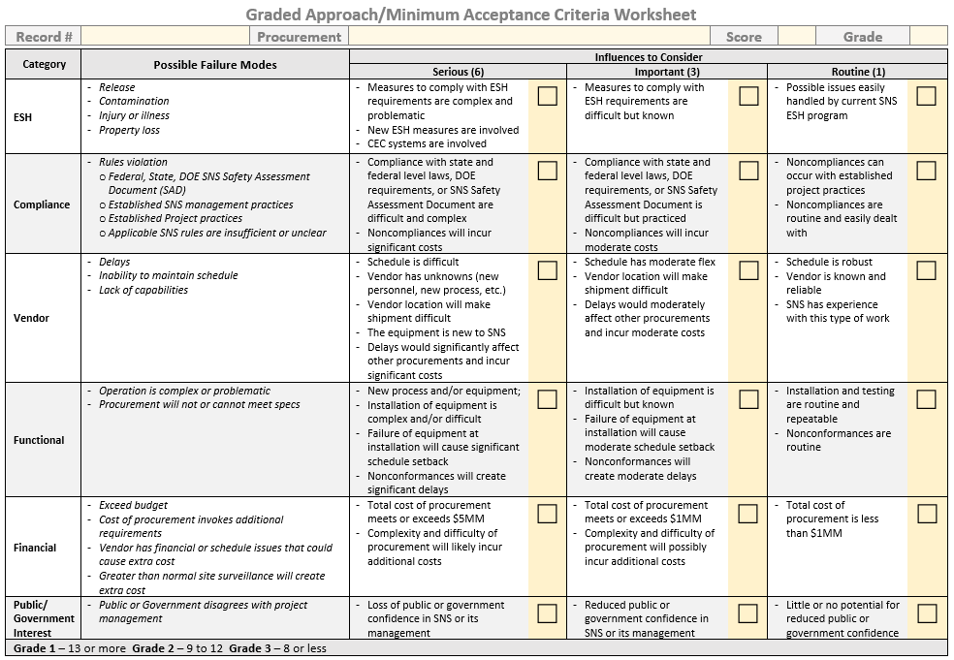

Slide 9
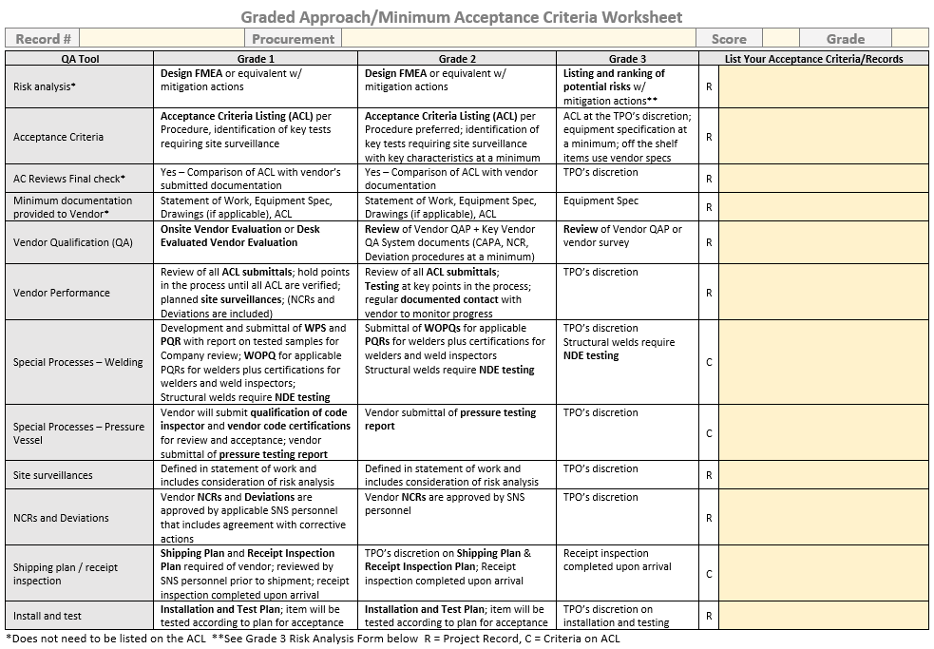

Slide 10
Acceptance Criteria Listing (ACL)
The ACL is a requirement for Grade 1 procurements and preferred for Grade 2
The ACL is a summary of the tangible deliverables (i.e., proof) we need to receive from the vendor to provide us with confidence of a conforming product
  It lists the QA/Manufacturing records to be part of the procurement record package
  Utilizes hold points to help ensure that ORNL approvals are being obtained before the vendor moves forward
Multi-discipline approach in developing the ACL to ensure (1) acceptable vendor performance and (2) records of that performance are adequately defined

Slide 11
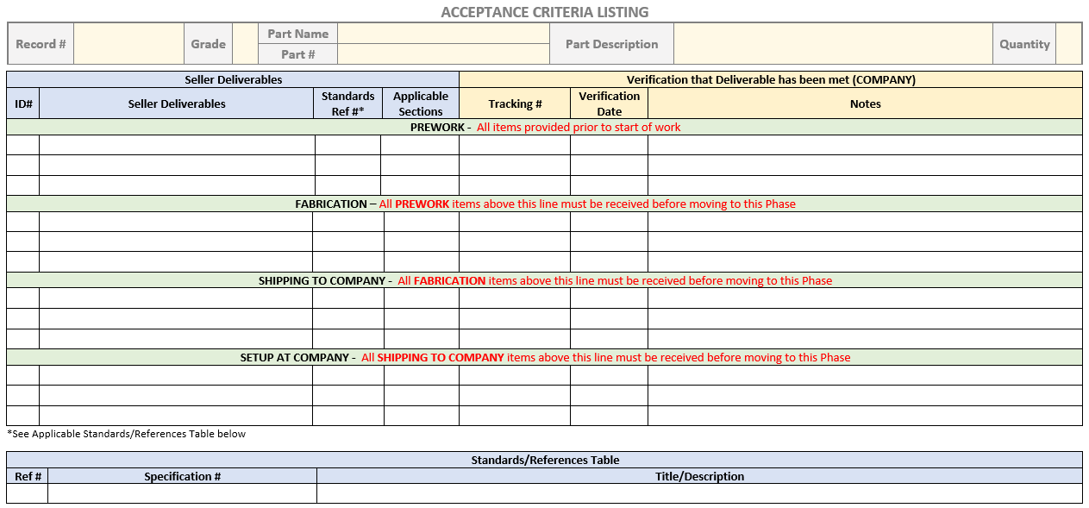

Slide 12
Procurement Grading
*15 procurements were completed before the current grading system was implemented
  Long lead procurements
    (200) Niobium Sheets & Cavities – Test Plan & Incoming Inspection Plan
    (200) Fundamental Power Coupler – Test Plan, Incoming Inspection Plan, Conditioning
    (300) Transformers – New LINAC Modulators

Slide 13
Critical and Important Procurements
Grade 1 Critical Procurements
Category 400 – Ring Systems
  P0402-B Ring Injection Region Magnets & Spare Coil Sets (Fermilab 2008,14 POs)
  P0402-B1 Injection Dump Quadrupole Magnet (Not awarded yet)
  P0406-A BPLS Current Monitor (GMW 2000, 328 POs)
Category 500
  P0509-B Test Target Shroud (Metalex 2019, 75 POs)
  P0509-C Test Target Assembly (Metalex)
    MTX-024 (Test Target #1) 8/22
  P0509-C PPU Production Targets (Metalex)
    MTX-029 (PPU 2M@ Test Target #2) 3/22
    MTX-030 (PPU 2MW) 5/22
    MTX-031 (PPU 2MW) 7/22
    MTX-032 (PPU 2MW) 10/22
Grade 2 Important Procurements
Category 200 – SCL Systems
  P0201-A Cryomodule Support Stands and Saddles (KELLER – 2009, 71 POs)
  P0205-A Cryomodule Integration (JLab)
Category 300 – RF Systems
  P0302-D SCL Circulators Design (FERRITE MICROWAVE TECHNOLOGIES 2007, 5 POs)
  P0303-B 3MW Circulators (CPI 2004, 14 POs)
  P0306-C AT-HVCM Build to Print Modulators (Alpha Omega)
  P0306-C AT-HVCM Build to Print Modulators (Spare) (Alpha Omega)
Category 400 – Ring Systems
  P0406-A In-Flange & In-Air Fast Current Transformers (Not awarded yet)
Category 500 – First Target Station Systems
  P0509-A PPU Front Body Development Test Article (Metalex)

Slide 14
Critical Item Example – Metalex Targets
P0509-C PPU Production Targets
  MTX-029 (PPU 2MW) 3/22
  MTX-030 (PPU 2MW) 5/22
  MTX-031 (PPU 2MW) 7/22
  MTX-032 (PPU 2MW) 10/22
$58M in contracts including multiple targets
Good working relationship
Multiple hold points including onsite visits/surveillances built into contracts
Fabrication and Engineering/QA review vendor submittals
Recently completed assessment

Slide 15
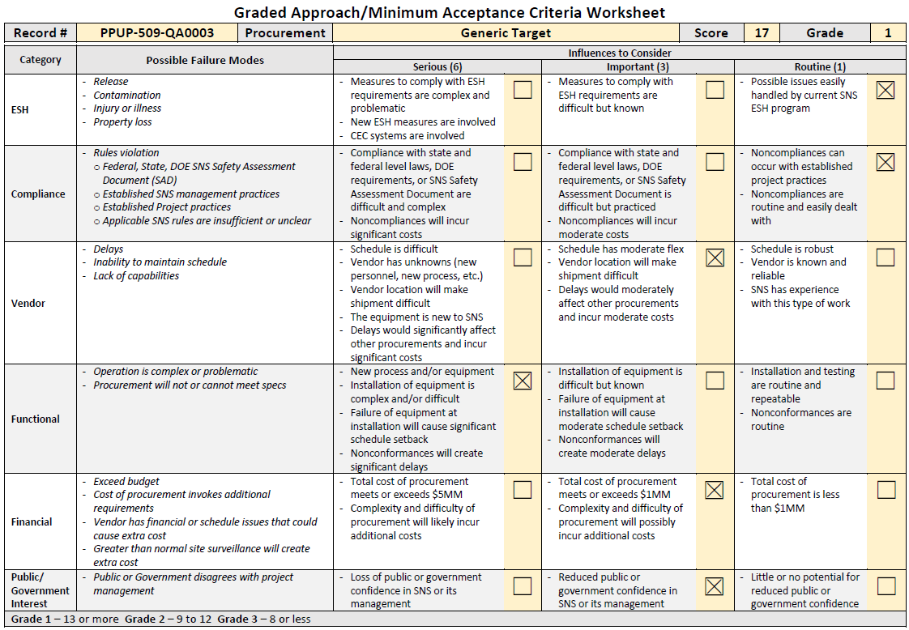

Slide 16
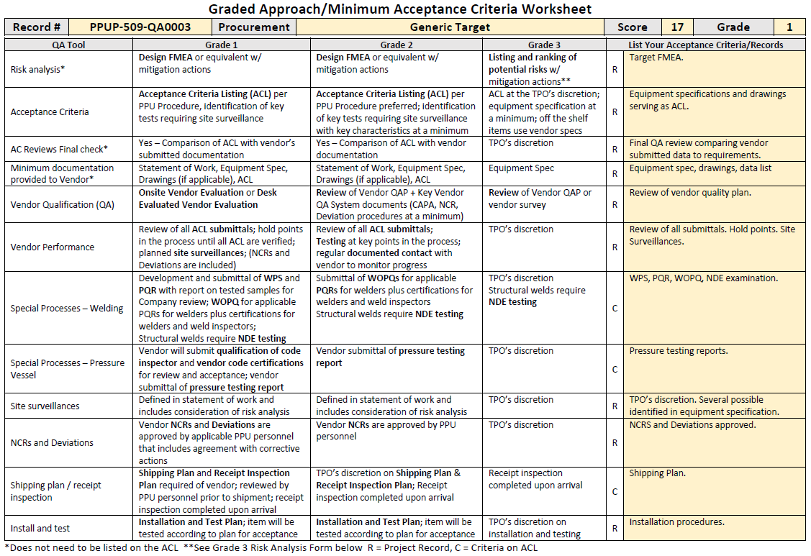

Slide 17
Target Risk Analysis
Every target undergoes thorough analysis after removal to understand the failure mode and determine mitigations
Most issues have been performance-related and not due to fabrication – design changes to correct are introduced immediately
This cycle has been repeated for every target meaning that there is no “low hanging” fruit left
Risk mitigations are included in the current ACL
Target ACL is translated into a BOM by Metalex

Slide 18
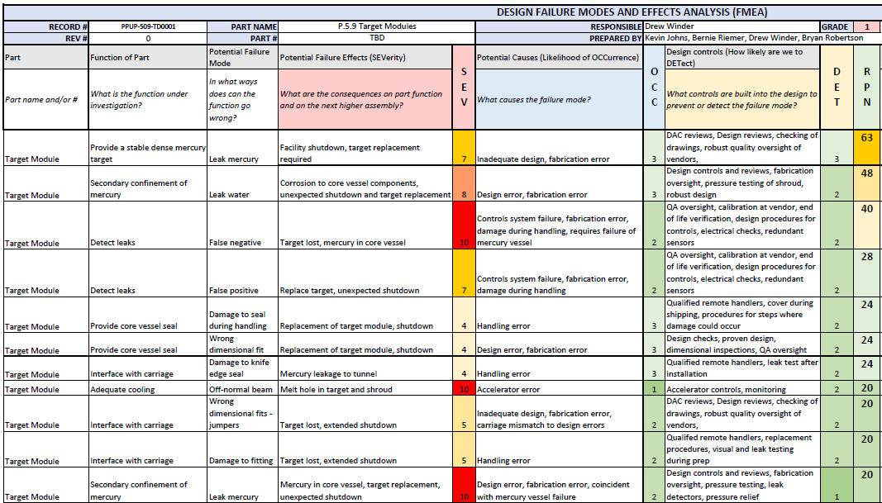
*Partial document – mitigation section is cut off

Slide 19
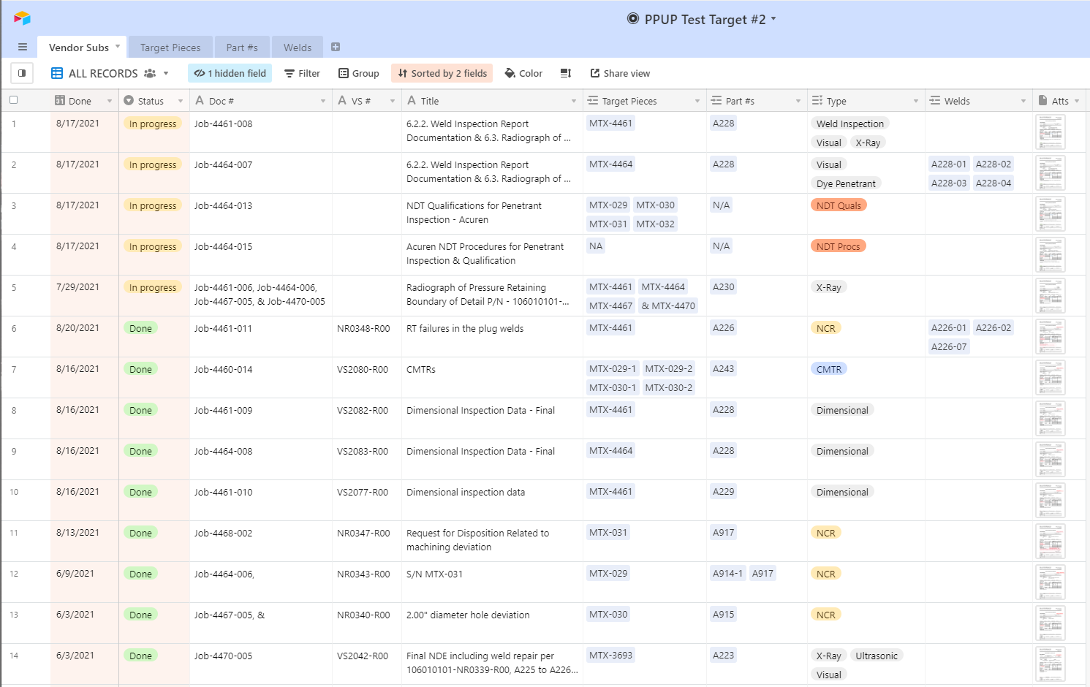
*Partial view

Slide 20
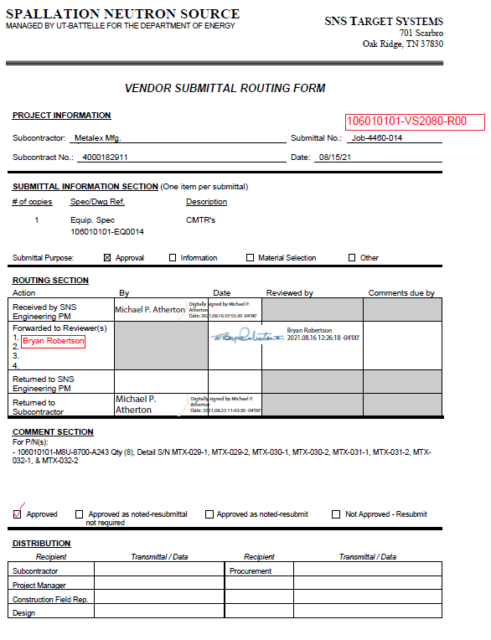
Vendor Submittal
Cover Sheet

Slide 21
QA Program Pending Improvements
Fabrication Tracking Database for complex procurements
  Definition of the ACL
  Storage and Tracking of vendor submittals for the ACL
  Automated workflow/approval process for vendor submittals
  Integrated w/vendor’s workflow for targets
  First Project to use database will be this month – PPU Target
Vendor Performance Database
  Tracks “events” for each vendor – fabrication ratings, contract ratings, NCRs, Deviations, delays
  Work in progress
  Developing Fabrication Evaluation & Overall Contract Evaluation
  Will help in future risk mitigation

Slide 22
Questions?

Slide 23
Non-applicability of 10 CFR 830 / PAAA
PAAA consists of two rules that have the force of law:
  10 CFR 830, which includes the QA Rule and the Nuclear Safety Rule – Not applicable to SNS
  10 CFR 835, the Rad Protection Rule – SNS is subject to enforcement under this rule
830.3, Definitions, “Non—reactor Nuclear Facilities” – exempts accelerators from the 830 rule: “..does not include accelerators and their operations”
  Internal white paper stating our case that was accepted by DOE
SNS is under the DOE orders, DOE-O-414.1D for QA and the Accelerator Safety Order
The words in DOE-O-414.1D are almost identical to the QA rule in 10 CFR 830. So the exemption only means that we’re not subject to enforcement of the QA Rule under PAAA.
All of ORNL is subject to DOE’s industrial safety rule, 10 CFR 851

