Slide 1




ESH&Q
DOE/SC Independent Project Review of the Proton Power Upgrade Project
Sam McKenzie
PPU ESH&Q Manager

Slide 2
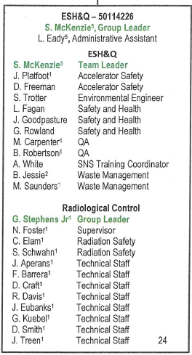
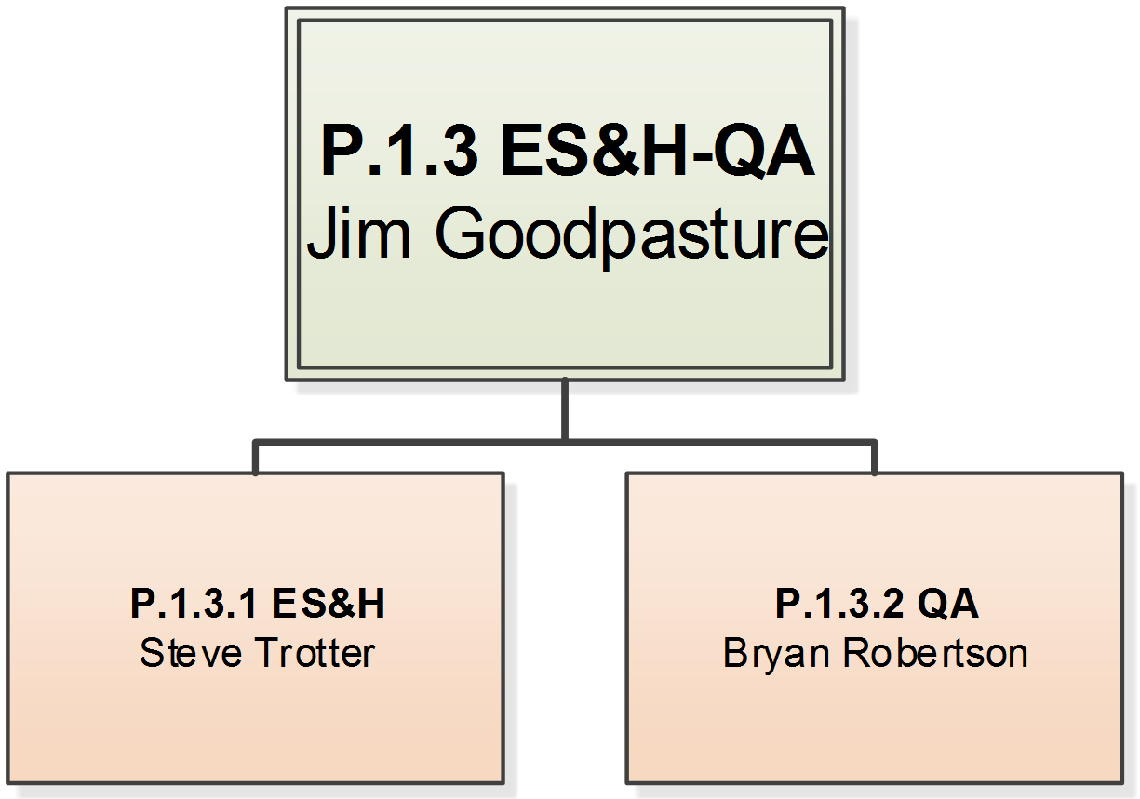
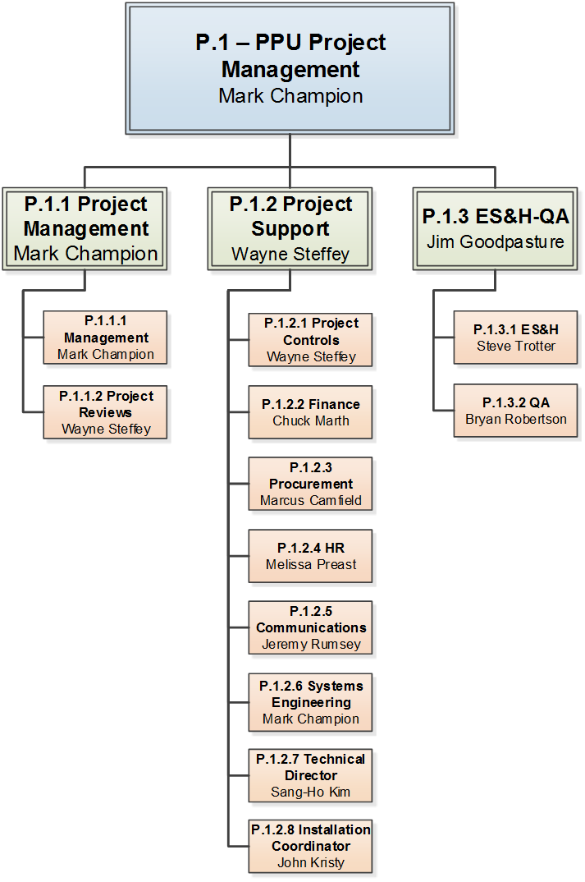
PPU ESH&Q Organization
PPU S&H personnel sub-set of SNS Accelerator Organization
P.1 PPU
Project Management
Mark Champion
P.1.1
Project Management
Mark Champion
P.1.2
Project Support
Wayne Steffey
P.1.3
Environmental,
Safety & Health– Quality
Sam McKenzie
P1.1.1
Management
Mark Champion
P.1.2.1
Project Controls
Wayne Steffey
P.1.2.5
Communications
Amy Keller
P.1.3.1
Environmental, Safety & Health
Jim Goodpasture
P.1.1.2
Project Reviews
Wayne Steffey
P.1.2.2
Finance
Lindsey Hicks
P.1.2.6
Systems Engineering
Mark Champion
P.1.3.2
Quality
Bryan Robertson
P.1.2.3
Procurement
Marcus Camfield
P.1.2.7
Technical Director
Sang-Ho Kim
P.1.2.4
Human Resources
P.1.2.8
Installation Coordinator
John Kristy

Slide 3
PPU ESH&Q Organization
PPU S&H personnel sub-set of SNS
Accelerator Organization
ESH&Q – 50114226 E. Griffis, Leader
ESH&Q
S. McKenzie | Team Leader
J. Platfoot | Accelerator Safety
D. Freeman | Accelerator Safety
M. Balanky | Safety and Health
L. Fagan | Safety and Health
J. Goodpasture | Safety and Health
G. Rowland | Safety and Health
T. Graben-Galyon | Quality
B. Robertson | Quality
A. White | SNS Training Coordinator
B. Jessie | Waste Management
Radiological Control
G. Stephens Jr. | Team Leader
J. Davis | Supervisor
C. Elam | Radiation Safety
S. Schwahn | Radiation Safety
J. Aperans | Technical Staff
F. Barrera | Technical Staff
D. Craft | Technical Staff
R. Davis | Technical Staff
J. Eubanks | Technical Staff
G. Kuebel | Technical Staff
D. Smith | Technical Staff
J. Treen | Technical Staff
P.1.3
Environmental,
Safety & Health– Quality
Sam McKenzie
P.1.3.1
Environmental, Safety & Health
Jim Goodpasture
P.1.3.2
Quality
Bryan Robertson

Slide 4
PPU ESH&Q Requirements
ORNL Safety Management System
defined by the DOE Integrated Safety Management System (ISMS)
Define Work Scope
Analyze Hazards
10 CFR 851, Worker Safety and Health Program
Regulatory flowdown
Establishes the worker safety and health
requirements for contractor activities at DOE sites
Project
Description
You can edit this text
Feedback and
Improve
Develop/Implement
Controls
Work
Safely!
Perform Work
ORNL Standard Based Management System (SBMS)
Work Output
Translates external and internal requirements into laboratory-wide policies and procedures to assist staff in achieving the laboratory’s mission in a safe and compliant manner
PPU ESH&Q
Staff and contractors follows ORNL current ISM/SBMS policies. No additional procedure development is required

Slide 5
Safety and Health
DOE/SC Independent Project Review of the Proton Power Upgrade Project
Jim Goodpasture CIH CSP
NScD ESH Support

Slide 6
Safety and Health Project Support
PPU safety and health oversight is an extension of work conducted in our current facilities under existing laboratory procedures by S&H personnel familiar with the SNS accelerator and ORNL Systems
Organization Structure
01
S&H support is provided by current SNS S&H staff as a seamless extension of current accelerator responsibilities
Requirements Flow-down
02
PPU operations follow the same standards and processes as SNS/ORNL
PPU
Project
03
S&H Support Activities for PPU
S&H staff are familiar with the operations, equipment, facilities and hazards for PPU
04
PPU Contractor Oversight
Subcontractor safety and health is part of the oversight responsibilities from procurement through project completion

Slide 7
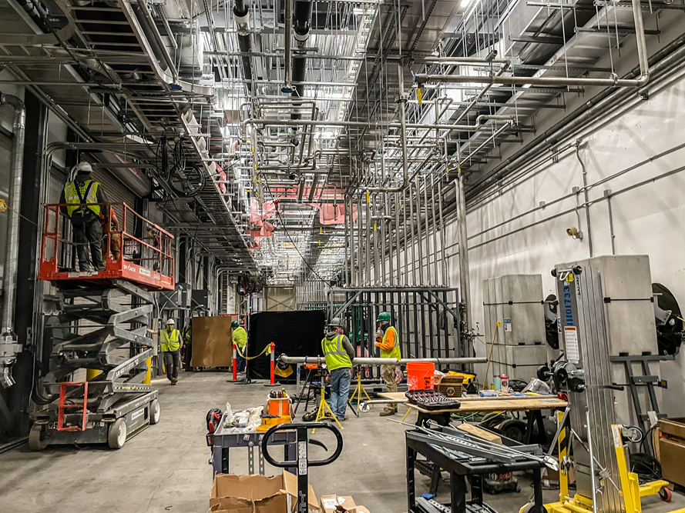
Progress Since CD-2/3
  Construction of Klystron Gallery Buildout
  Contract awarded in 2020 and construction completed April 7, 2021
  Required coordination with accelerator operations without beamtime loss
  Challenges:
    Construction and operation activities during COVID
    Laboratory COVID policies instead of contract requirements
    Operations coordination
      Access to equipment in construction zone
      Road closures
      System shutdowns and utility tie-ins
      Material handling

Slide 8
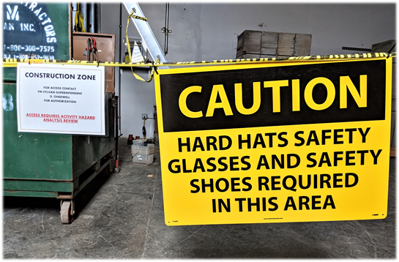
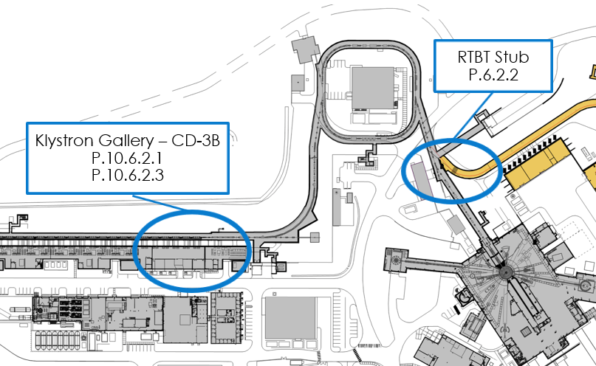
  Continued Project Success
  Construction contractor performed 58,300 work hours without a recordable incident.
  SNS PPU accelerator activities performed with no recordable incidents
  Future Project Support
  Klystron Gallery equipment installation – began in April, 2021
  RTBT Stub Construction – scheduled for FY23

Slide 9
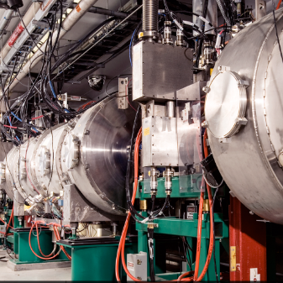
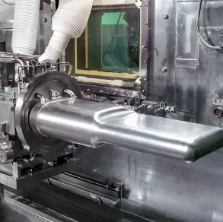
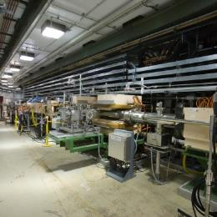

Accelerator Safety
J. Platfoot
September 14-17, 2021

Slide 10
Overview of Accelerator Safety
Preliminary Hazard Analysis Report was written to support CD-1
  Evaluated 9 PPU related changes for safety impacts
Hazard Analysis Report was written to support CD-2/3 review
  Focused on 7 topics requiring detailed analysis
    All analysis is complete
  Identified need for 3 new Credited Controls
    Beam Power Limiting System
    Rad Protection Program control of Gold Amalgamation Room access
    Moderator Cryogenic System ortho-para catalyst module retention elements
Now the focus is on ensuring proper implementation of Credited Engineered Controls (CEC) requirements and translating analysis into operational documents (FSADs and ASE)

Slide 11
Beam Power Limiting System (BPLS)
B4-7 - Bong
System has passed Preliminary Design
Development of revised wording for First Target Station (FTS) requirement document
  Clarified the intent of the proposed limits
Draft Unreviewed Safety Issue Evaluation (USIE) being worked in parallel to establish language for easy insertion into Final Safety Assessment Document for Proton Facilities (FSAD-PF)

Slide 12
Miscellaneous evaluations
Second Carbon Delay Bed USIE
  Supported early installation
  Allows characterization of system before increasing gas injection rate
RTBT Stub USIE
  Describes analytical work supporting safe construction and operation
  Evaluates potential Radiation Hazards at increased Beam Energy
  Focus areas
    Personnel Protection System modifications
    Shielding design, QA and verification
    Construction hazard management including radiological sampling
Off-normal (HAZOP) for mercury process
  Opportunity for systematic scrub of potential scenarios
  Supported update to target system interlocks
B2-8 - Stephens
B5-3 – Connell

Slide 13


Look Ahead
USIE for installation of PPU Test Target #1 with swirl bubbler
  January 2022
  Supports characterization of new bubbler technology at lower gas flow
Finalize FSAD-PF revision for BPLS installation
  March 2022 (dependent on completion of BPLS design)
  BPLS will be installed and tested for an operational cycle
  Validation of system design capability to perform CEC safety function
ASE Revision to implement BPLS as CEC
  October 2022
  Implements the BPLS as a CEC following installation of first 2 Cryomodules

Slide 14
Accelerator Safety Summary
Planned safety analysis is complete.
Safety analysis conclusions are being implemented in credited controls.
Operational safety documents are being developed.

Slide 15
ESH&Q – Quality Introduction
DOE/SC Independent Project Review of the Proton Power Upgrade Project
Bryan Robertson
PPU Quality Manager

Slide 16
Outline
QA Requirements Flowdown
PPU QA Goals and Organization
PPU Project/QA Flow and Tools

Slide 17
QA Requirements Flowdown
DOE Order 414.1D – QA Standard
ISO 9001:2015 – Labwide consensus standard
ORNL QA Plan (SBMS)
Standards-Based Management System (SBMS) – Labwide documents
SNS QA Plan
  PPU QA Plan
Integrated Document Management System (IDMS) – NScD Directorate Level
OPM and PCS - Organization Level

Slide 18
QA Organization/Background
Performance Analysis & Quality
SNS Research Accelerator Division (RAD)
Group Leader, QA Programs/Field Services
ESH&Q Group Leader
ISO 9001:2015-based
SNS QA Plan
SNS QA Program
Quality Representative
PPU QA Plan
PPU Project
Quality Oversight
Quality Representative
  - Designated role within ORNL requiring qualification
  - Combined 60+ years of QA

Slide 19
PPU Procurement Flow & QA Tools
Project Oversight
Financial Oversight
Environmental Oversight
Safety Oversight
Quality Oversight
Define what we want
Ensure we get what we want
Design Development
Design verification
Procurement
Monitor vendor performance
Installation /
Design validation
Develop Drawings
Design Reviews
Develop Statement of Work
Track with ACL
(Acceptance Criteria Listing)
Acceptance Testing
Develop Specifications
Qualify vendors
Site Surveillance
ACL Final Check
Compete the work
Nonconformances Deviations
Risk Analysis
Acceptance Criteria Listing
Verification of ACL Items
Graded Approach/ Minimum Acceptance Criteria
Vender Qualification

Slide 20
Summary
Experienced QA Staff
Good QA Involvement
Working on improving the process
QA Process focus on being preventive – Identify and mitigate risk upfront

