Slide 1
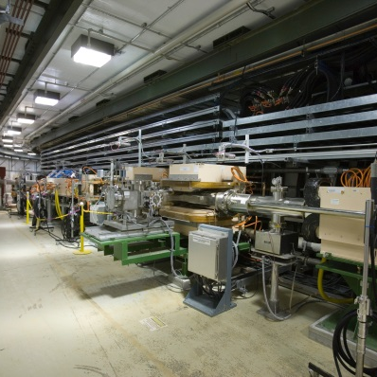
P.2.3 Cryomodules Integration
DOE/SC Independent Project Review of the Proton Power Upgrade Project
Jacob Harris
JLab Quality Assurance Representative
September 14 – 17, 2021

Slide 2
Outline
Charge: 3
Scope
Organization & WBS
Three Keys to JLab QA Success
SNS PPU and JLab QA
Lessons Learned vs Lessons Applied
JLab’s Data-Driven Approach
12-month look-ahead
Summary
SNS PPU and JLab QA
Lessons Learned / Lessons Applied
Data- Driven Approach

Slide 3
Scope – P.2.3 Cryomodules Integration
Charge: 5
Original procurement scope was included in CD-3B
Scope changed to include an additional 8th cryomodule
Design high-beta cryomodule and associated tooling
Includes assembly and shipping tooling
Procure components
Entire cryomodule bill of materials except for cavities and couplers
Receive and inspect components
Qualify (32) cavities; install helium vessels
Assemble (8) cavity strings
Assemble and test (8) cryomodules
Ship (8) cryomodules from JLab to ORNL / SNS

Slide 4
Work Breakdown Structure
Charge: 5
P.2 – SCL
Matt Howell
P.2.1
Management and System Integration Matt Howell
P.2.2 Cavities
John Mammosser
P.2.3
Cryomodules Integration Ed Daly
P.2.4
Cryogenics
Brian DeGraff
P.2.5 Utility Systems Chris Stone
P.2.6 System Integration
John Mammosser
P.2.7 SCL Controls Karen White
P.2.1.1
Management and System Integration
Matt Howell
P.2.2.1
Management and System Integration
John Mammosser
Partner Lab
P.2.4.1
Management and System Integration
Brian Degraff
P.2.5.1
Management and System Integration
Chris Stone
P.2.6.1
Management and System Integration
John Mammosser
P.2.7.1
Management and System Integration
Aaron Coleman
P.2.2.2 Cavity Procurement
John Mammosser
P.2.4.2 Cryogenic Components Brian Degraff
P.2.5.2 Beamline Vacuum
Chris Stone
P.2.6.2 Completed Cryomodule
Testing
John Mammosser
P.2.7.2 Linac Beamline Vacuum
Controls
Derrick Williams
P.2.2.4 Cavity Reprocessing
John Mammosser
P.2.4.3 Cryogenics System Testing
Brian Degraff
P.2.5.3 Insulating Vacuum System
Chris Stone
P.2.6.3
Cryomodule in Tunnel
John Mammosser
P.2.7.3 Linac Insulating Vacuum System Controls
Derrick Williams
P.2.2.5 Coupler Acquisition Yoon Kang
P.2.5.4 Water Systems Klent Pope
P.2.6.4
Cryomodule Testing in Tunnel John Mammosser
P.2.7.4
Cryomodule Controls Aaron Coleman
P.2.2.7 HTA Testing
Brian Degraff
P.2.6.5 Plasma Process MB Cryo. John Mammosser
P.2.2.8 Coupler Waveguide Transition Yoon Kang

Slide 5
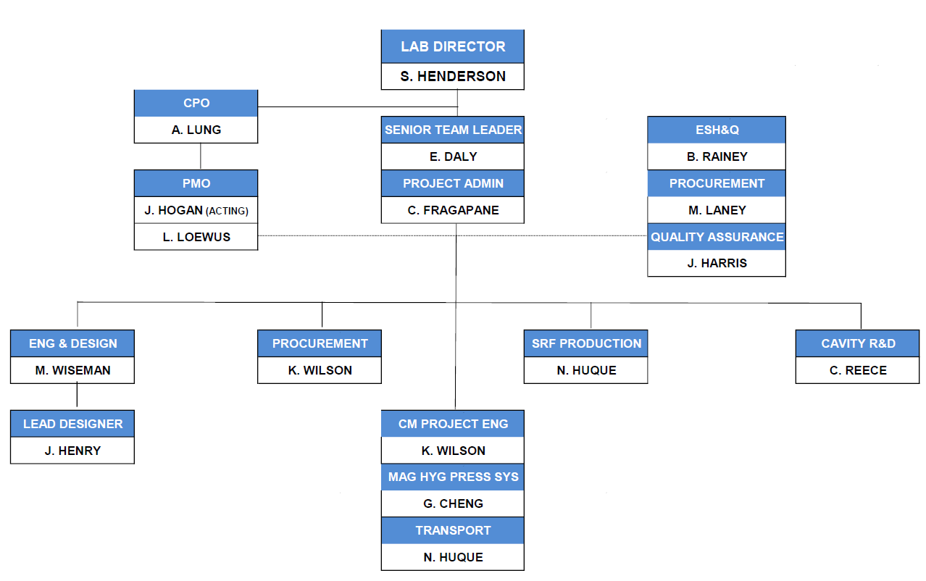
Organization @ Jefferson Lab – SNS PPU Project Team
Charge: 5
JLab Project Team in place since August 2018
J. Harris joined as Quality Assurance Representative

Slide 6
Jefferson Lab Quality Assurance
Charge: 3
SRF Operations Quality Policy
Quality is our commitment to deliver world-class SRF products and services that are worthy of our customers trust by
Enabling and empowering our people to build safety, reliability, quality, and compliance into our products, technologies, and services
Delivering products to plan that support system reliability, availability, and that yield a great customer experience
Measuring our quality objectives and driving systemic continual improvement
Proactively and transparently engaging our customers

Slide 7
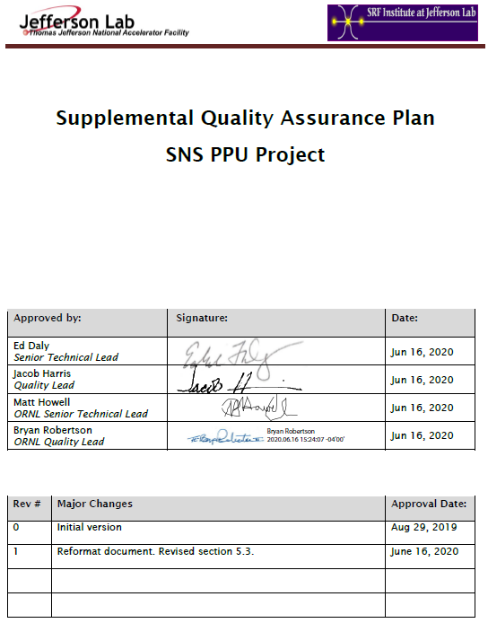
Jefferson Lab Quality Assurance
Charge: 3
JLab Supplemental Quality Assurance Plan
SNS PPU Quality Assurance Plan
JLab Quality Assurance Plan
JLab SNS PPU SQAP
Satisfies SNS PPU QA and JLab QA requirements
Approved by SNS PPU Project Team
Describes unique SNS PPU QA requirements
e.g. standard vs non-standard NCRs

Slide 8
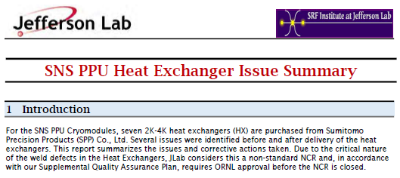
SNS PPU and JLAB QA Interface
Charge: 3
Standard NCR. Nonconformance Reports resolved through standard practices such as high-pressure rinse, lapping, or product replacement, and the final disposition results in an acceptable product.
Non-Standard NCR. Failure to meet PPU High Beta Cavity and Cryomodule Performance Requirements and Minimum Acceptance Criteria documents. Other conditions which are likely to lead to a critical failure in fit, form, or function, or which require non-routine repairs.
Example of a recent Non-Standard NCR
Vendor #1 fabricated heat exchangers (HX) and sent them to Vendor #2 for installation into end cans.
Vendor #2 inspected HXs under JLab contract, and informed JLab of defects to the HXs.
JLab investigated and proposed a solution to SNS PPU in a written report.
SNS PPU approved the written report.
JLab generates NCRs and includes the report.

Slide 9
Lessons Learned vs Lessons Applied
Charge: 3
PFMEA Methodology
Facilitated by JLab Performance Assurance.
Work Center Leads and technicians provide input based on traveler steps and experience.
RPN calculated. Focus is on scores >100.
Current Status
27 Failure Modes with an RPN >100
21 Recommended Actions identified
Changes made to work control documents
Receiving
Inventory
Issuance
Cavity Processing
Vertical Test
Cold Mass Assembly
He Tanking
Space Frame
Thermal Shield
Cavity String Assembly
Vacuum Vessel
Cryomodule Shipping
Cryomodule Test
Final Assembly
Cavity Helium Tanking
Process Function | Failure Mode | Potential Effects | Causal Mechanism | Current Process Control(s) | S | O | D | RPN | Recommended Action
Previous Travelers completed | Components not checked for NCR status | Dependent on nature of NCR, use of non-cleared part could have impacts on performance or downstream assembly | Physical tag falls off and database not checked | Canned NCR report available | 7 | 6 | 4 | 168 | Potential use of personnel verification that no NCRs are open
Adjust FPC head and tack weld to cavity end dish | Improperly clocked head | Additional work/issues installing piping | Drawing interpretation, not following procedures | Reference drwg's contained in Traveler/Proc | 5 | 5 | 6 | 150 | Devise engineered solution (tooling)
Hold point to ensure cavity is secure (cleared only by SMEs) | Clearance step missed or disregarded | Dependent on what is wrong | Distraction, complacency | Traveler contains instructions for SME to reference | 8 | 3 | 5 | 120 | Further detail the traveler list (itemize)
Remove coupler lollipop | Inspection of cavity in prior step not conducted correctly or thoroughly | Fallen cavity | Inattention, or perhaps lack of sufficient training | Tooling has an engineered control to allow visual load release | 8 | 3 | 3 | 72 | SME to remain and witness lollipop removal

Slide 10
Jefferson Lab’s Data-Driven Approach
Charge: 3
Inventory Travelers
Inspection Travelers
Production Travelers
Components Delivered
Parts Received
Shipping data
Inspection and test results
Vendor data
Part Assembly
In-progress testing
Serialization
PRIMeS system for Inventory Travelers
Pansophy system for other Travelers and work control documents.
NCR/D3 Travelers
Digital segregation
Calibration Tracking Module

Slide 11
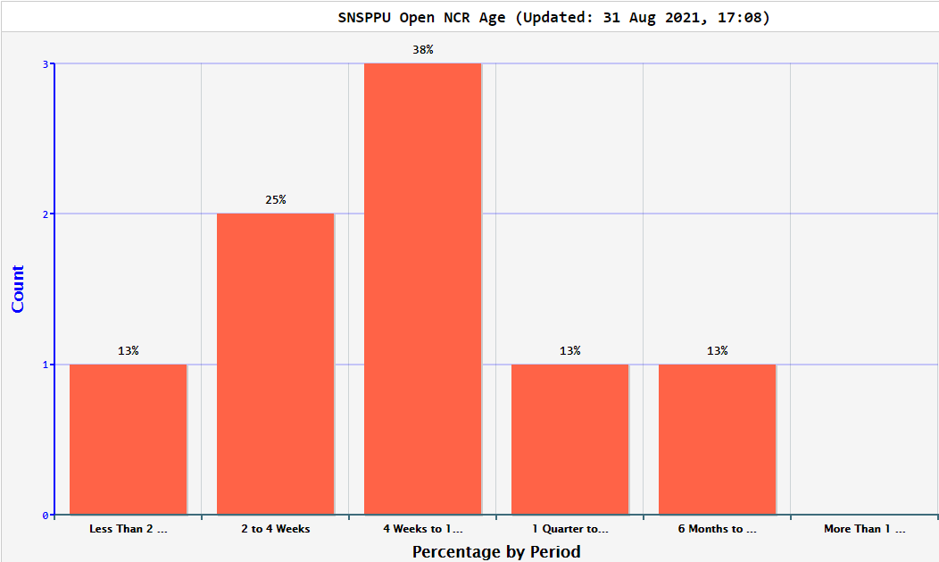
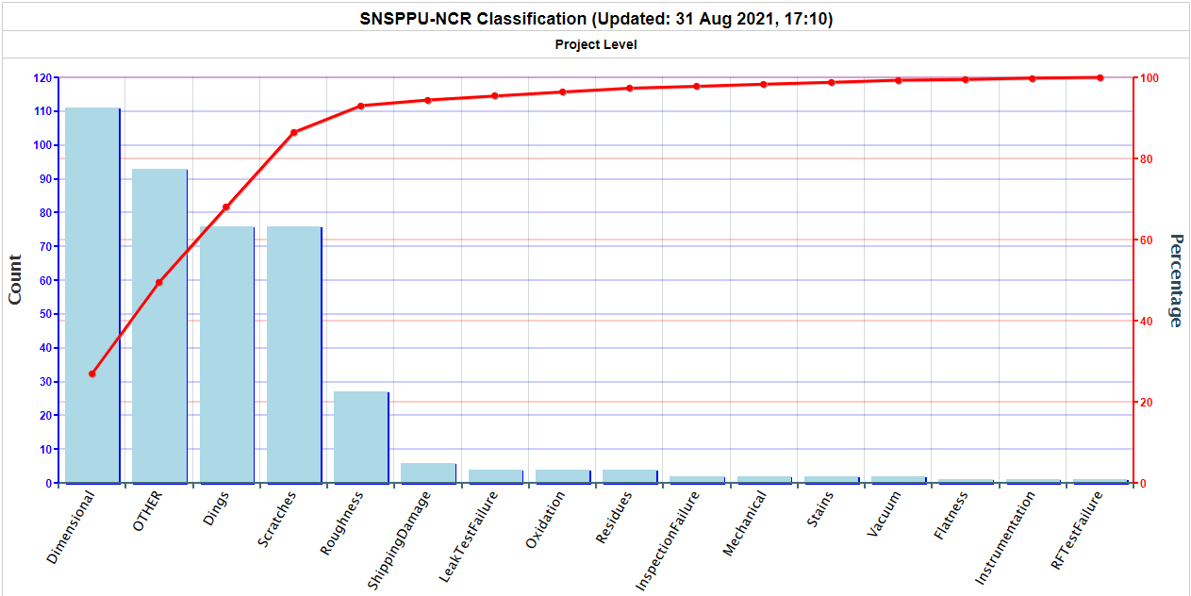
Jefferson Lab’s Data-Driven Approach
Charge: 3
Quality Reports
Age of Open NCRs
Monitored regularly.
Timeliness discussed in SRF project meetings.
Histogram of NCR Categories
Monitored regularly.
Outliers quickly identified and evaluated.

Slide 12
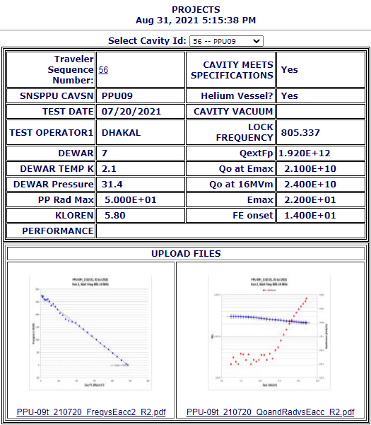
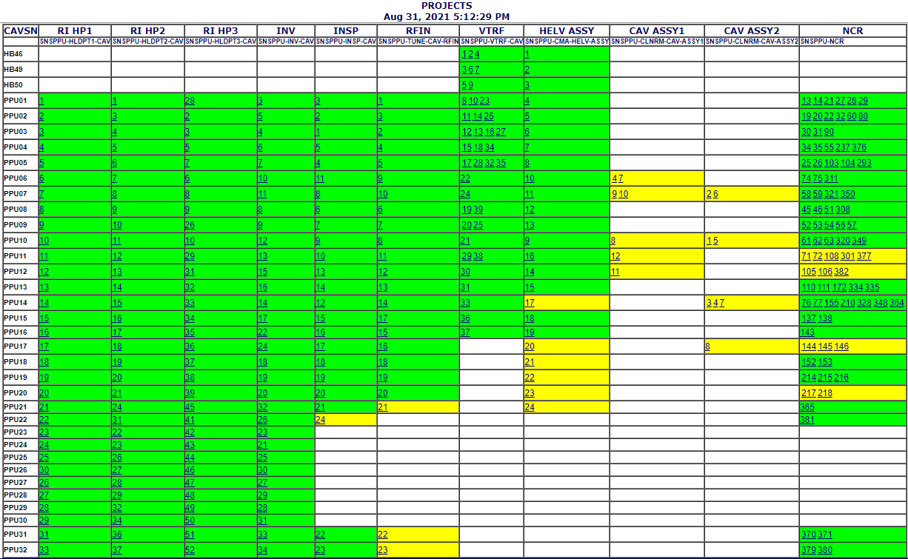
Jefferson Lab’s Data-Driven Approach
Charge: 3
Quality Reports
Cavity Status Board
Status of key travelers, including NCRs, for each cavity.
Cavity Performance

Slide 13
12-Month Look-Ahead
Charge: 3
Complete the PFMEA and implement risk mitigation steps into work control documents.
Continue to develop QA Reports and make them available to SNS PPU.
Finalize the data packet to be delivered with each Cryomodule.
Continually improve the JLab Quality Management System

Slide 14
Summary
Charge: 3
Jefferson Lab’s SQAP is aligned to SNS PPU QA Plan, resulting in effective interaction and mutually agreed upon results.
Lessons learned are applied through a PFMEA which results in improved travelers and lower risk.
A data-driven process approach is pervasive through all aspects of work performed at Jefferson Lab. This rich dataset allows for critical self-inspection and transparency to SNS PPU.

