Slide 1
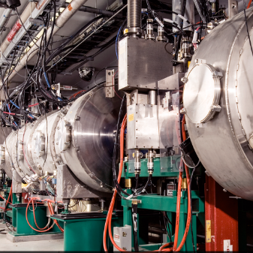
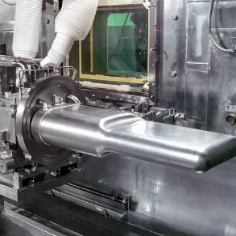
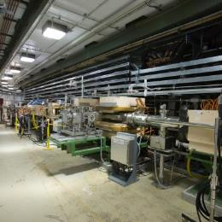

P.02.07 SCL Controls
DOE/SC Independent Project Review of the Proton Power Upgrade Project
Aaron Coleman
Level 4 Manager for SCL Controls
September 14-17, 2021

Slide 2
Outline
Scope
Organization
Progress since CD 2/3 review
Challenges
Final design status
Installation plans
Cost and schedule
Labor profile
Risk register
Responses to recommendations
ESH&Q and COVID-19 impacts
12-month look-ahead
Summary

Slide 3
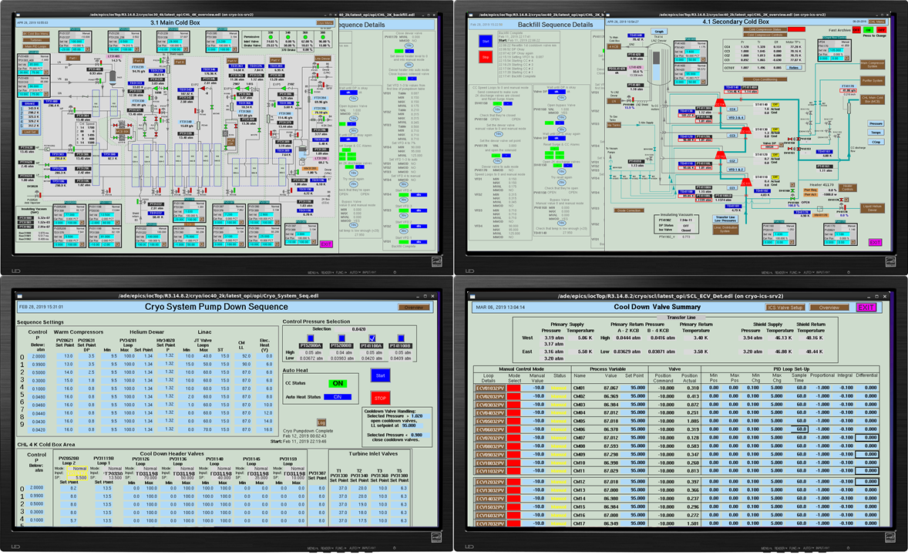
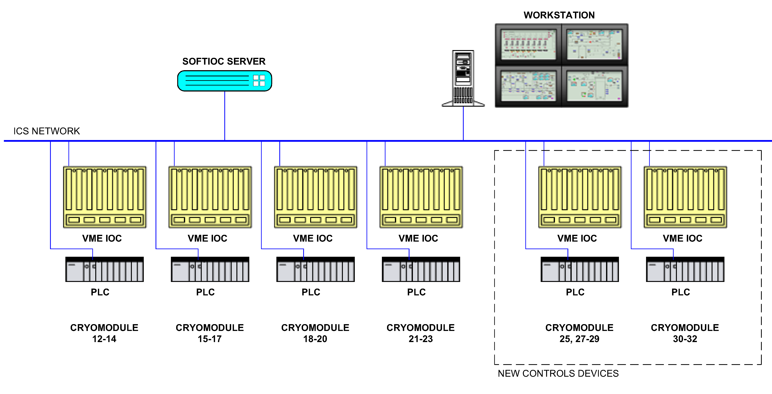
Scope - Controls Integration for new PPU SCL devices
P.2.7 SCL Controls
  P.2.7.2 Linac Beamline Vacuum Controls
    Replication of existing Programmable Logic Controller (PLC)/Input Output Controller (IOC) based controls
    Interfaces to Low Level RF (LLRF) and Machine Protection System (MPS)
  P.2.7.3 Linac Insulating Vacuum Controls
    Replication of existing PLC/IOC based controls
  P.2.7.4 Cryomodule Controls
    Replication of existing cryomodule controls with adjustments for obsolescence
Charge: 1
Cryomodule Controls Layout

Slide 4
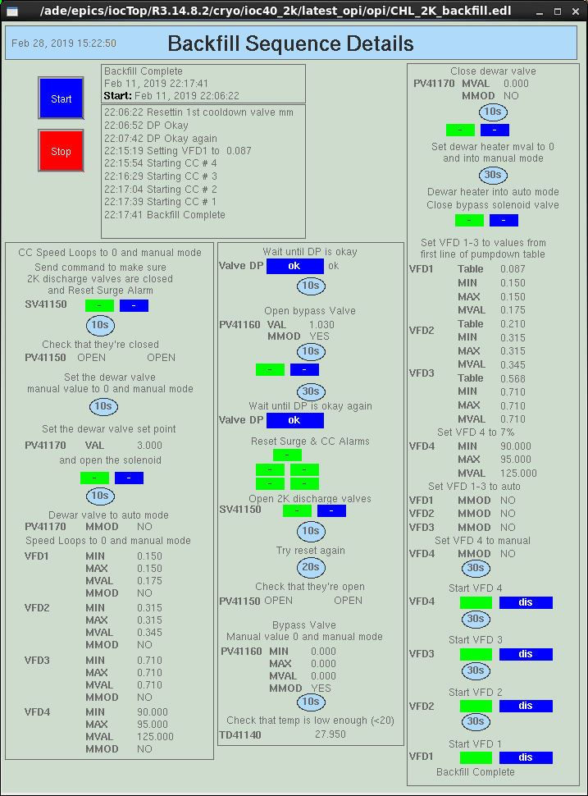
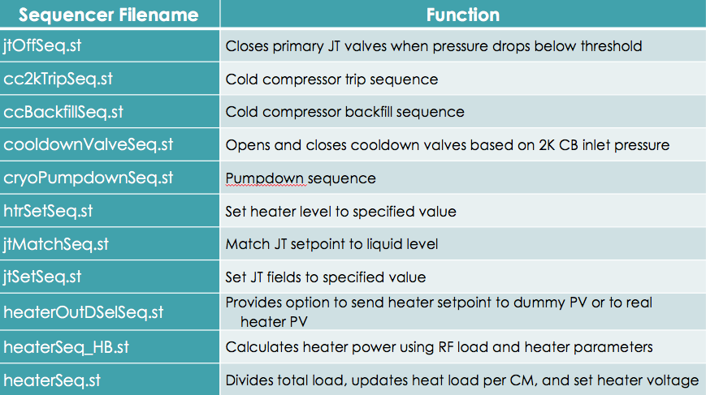
Scope
Charge: 1
SCL Controls scope outside of 2.7
P.2.4 Cryogenics System Testing and Development
  P.2.4.3 Cryogenics System Testing and Development
    Modify controls sequences which automate system functions such as pump downs, heater management
    Sequences will be updated to match the total number of installed cryomodules following each installation period
B1-4 DeGraff
Cryogenic Controls Sequence Interface

Slide 5
































Work Breakdown Structure
P.2 – SCL
Matt Howell
P.2.1
Management and System Integration Matt Howell
P.2.2 Cavities
John Mammosser
P.2.3
Cryomodules Integration Ed Daly
P.2.4
Cryogenics
Brian DeGraff
P.2.5 Utility Systems Chris Stone
P.2.6 System Integration
John Mammosser
P.2.7 SCL Controls Karen White
P.2.1.1
Management and System Integration
Matt Howell
P.2.2.1
Management and System Integration
John Mammosser
Partner Lab
P.2.4.1
Management and System Integration
Brian Degraff
P.2.5.1
Management and System Integration
Chris Stone
P.2.6.1
Management and System Integration
John Mammosser
P.2.7.1
Management and System Integration
Aaron Coleman
P.2.2.2 Cavity Procurement
John Mammosser
P.2.4.2 Cryogenic Components Brian Degraff
P.2.5.2 Beamline Vacuum
Chris Stone
P.2.6.2 Completed Cryomodule
Testing
John Mammosser
P.2.7.2 Linac Beamline Vacuum
Controls
Derrick Williams
P.2.2.4 Cavity Reprocessing
John Mammosser
P.2.4.3 Cryogenics System Testing
Brian Degraff
P.2.5.3 Insulating Vacuum System
Chris Stone
P.2.6.3
Cryomodule in Tunnel
John Mammosser
P.2.7.3 Linac Insulating Vacuum System Controls
Derrick Williams
P.2.2.5 Coupler Acquisition Yoon Kang
P.2.5.4 Water Systems Klent Pope
P.2.6.4
Cryomodule Testing in Tunnel John Mammosser
P.2.7.4
Cryomodule Controls Aaron Coleman
P.2.2.7 HTA Testing
Brian Degraff
P.2.6.5 Plasma Process MB Cryo. John Mammosser
P.2.2.8 Coupler Waveguide Transition Yoon Kang

Slide 6
Planned12-Month Look-Ahead from CD 2/3 review
Insulating Vacuum
  Receive and test new racks (2)
  Cleanup existing cables
Beamline Vacuum
  Receive and test new rack (1)
  Develop PLC code
Cryomodule Controls
  Ensure any lessons learned in test cave are folded into cryomodule controls construction
  Procure hardware under CD 3
  Develop PLC code
All
  Develop EPICS interface code and configuration
Charge: 1,5

Slide 7
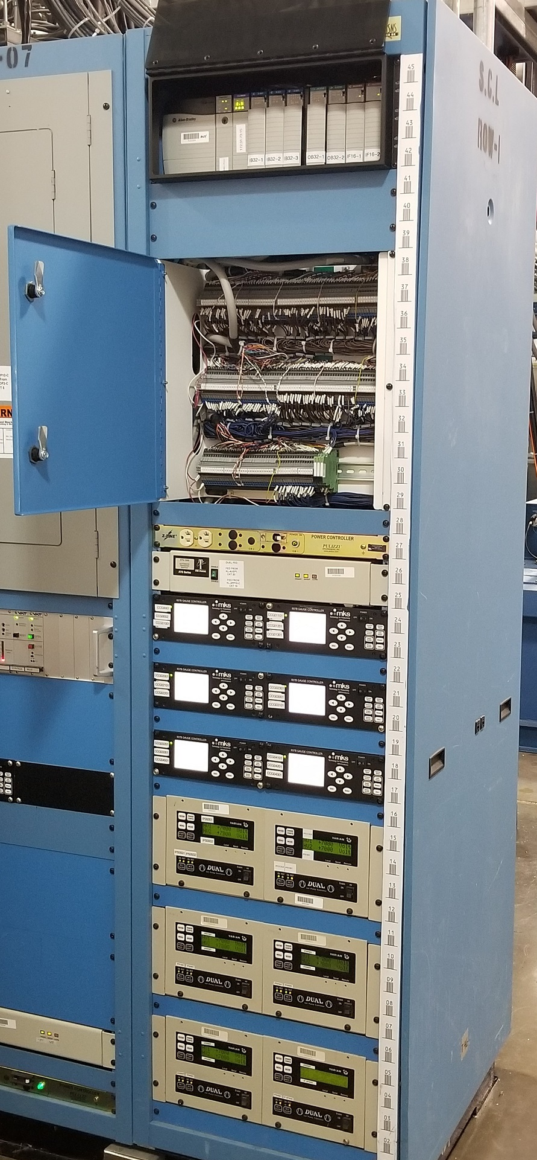
Progress since CD 2/3 review
Charge: 2,5
P.2.7.2 Linac Beamline Vacuum Controls
  Received 1 beamline vacuum rack
  PLC code is written for Zone 9 (CM31, 32, HEDP)
  Test procedures are written
  EPICS screens are being developed
P.2.7.3 Linac Insulating Vacuum Controls
  Received 2 insulating vacuum rack
  PLC code for both system is written and tested in lab with rack hardware
  Test procedures are written
  EPICS screen are being developed
Linac Beamline Vacuum Rack

Slide 8
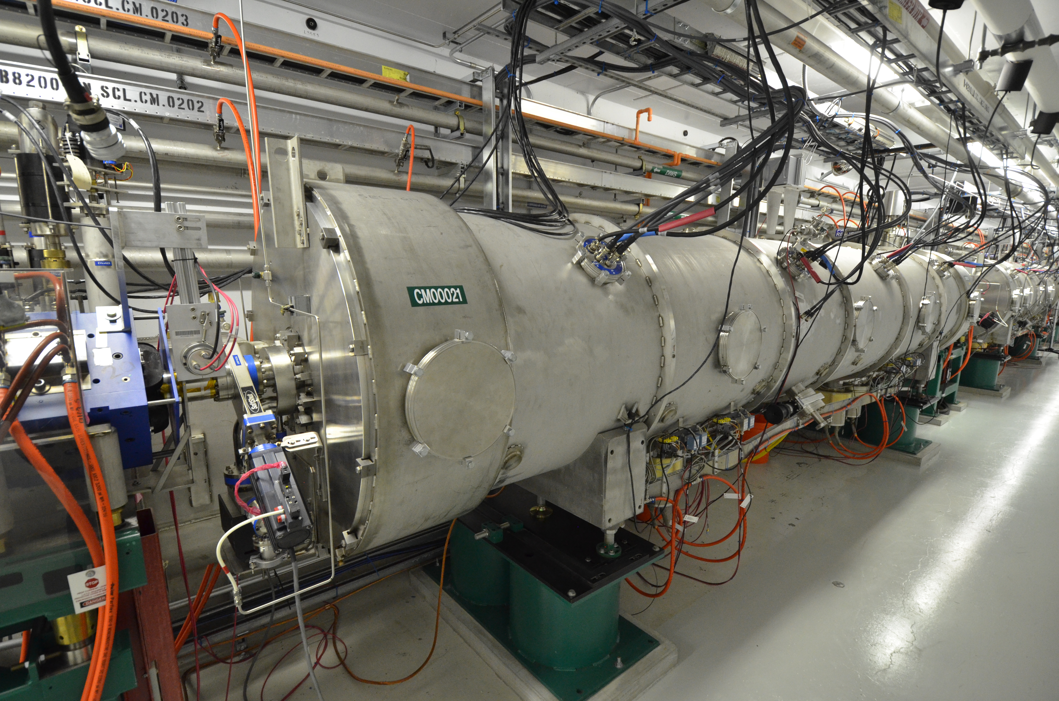
Progress since CD 2/3 review
Charge: 2,5
Cryomodule Controls
  Pressure sensors for all the new CM were procured
  Approximately 90% of the branch cables for CM31 & CM32 have been procured
    These are the field cables from the beam line interface (BLI) to cryomodule sensor connectors

Slide 9
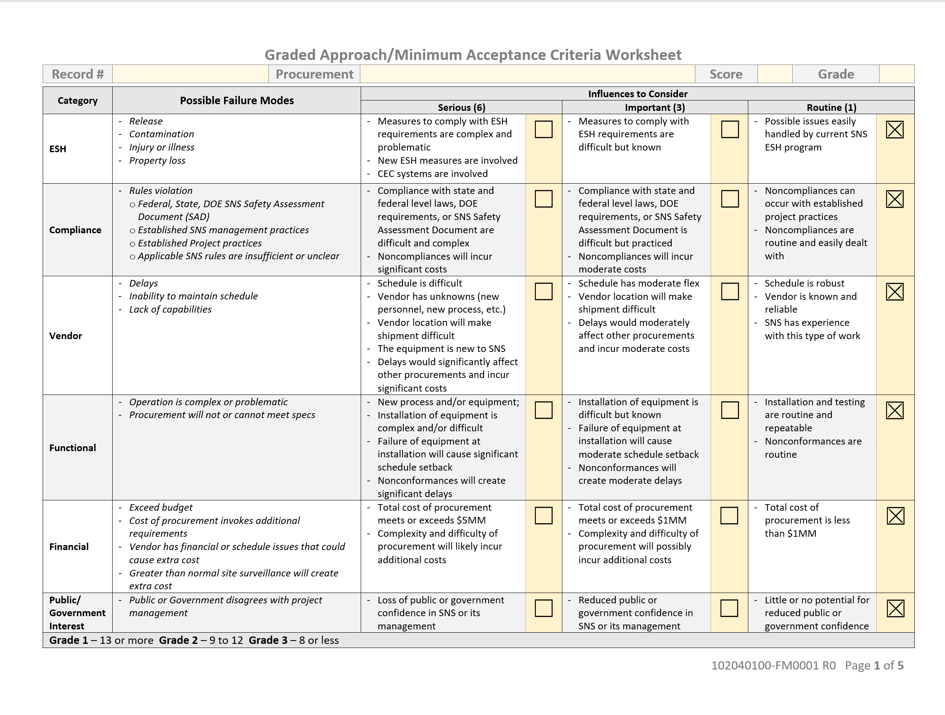
Progress since CD 2/3 Cryomodule Controls continues
  Procurement Readiness Review was completed May 10th ,2021 for the procurement of the cryomodule controls cabinets
    Established acceptance criteria with our QA personnel and others
    Presented procurement components and procurement plan to a senior level PPU panel
    The first four cabinets for the first three cryomodules are now on order. Should receive them December 2021
  Made editorial correction to control cabinet drawings
    Changes of wire tag numbering and changes to some part number on bill of materials (BOM)
Charge: 2,5

Slide 10
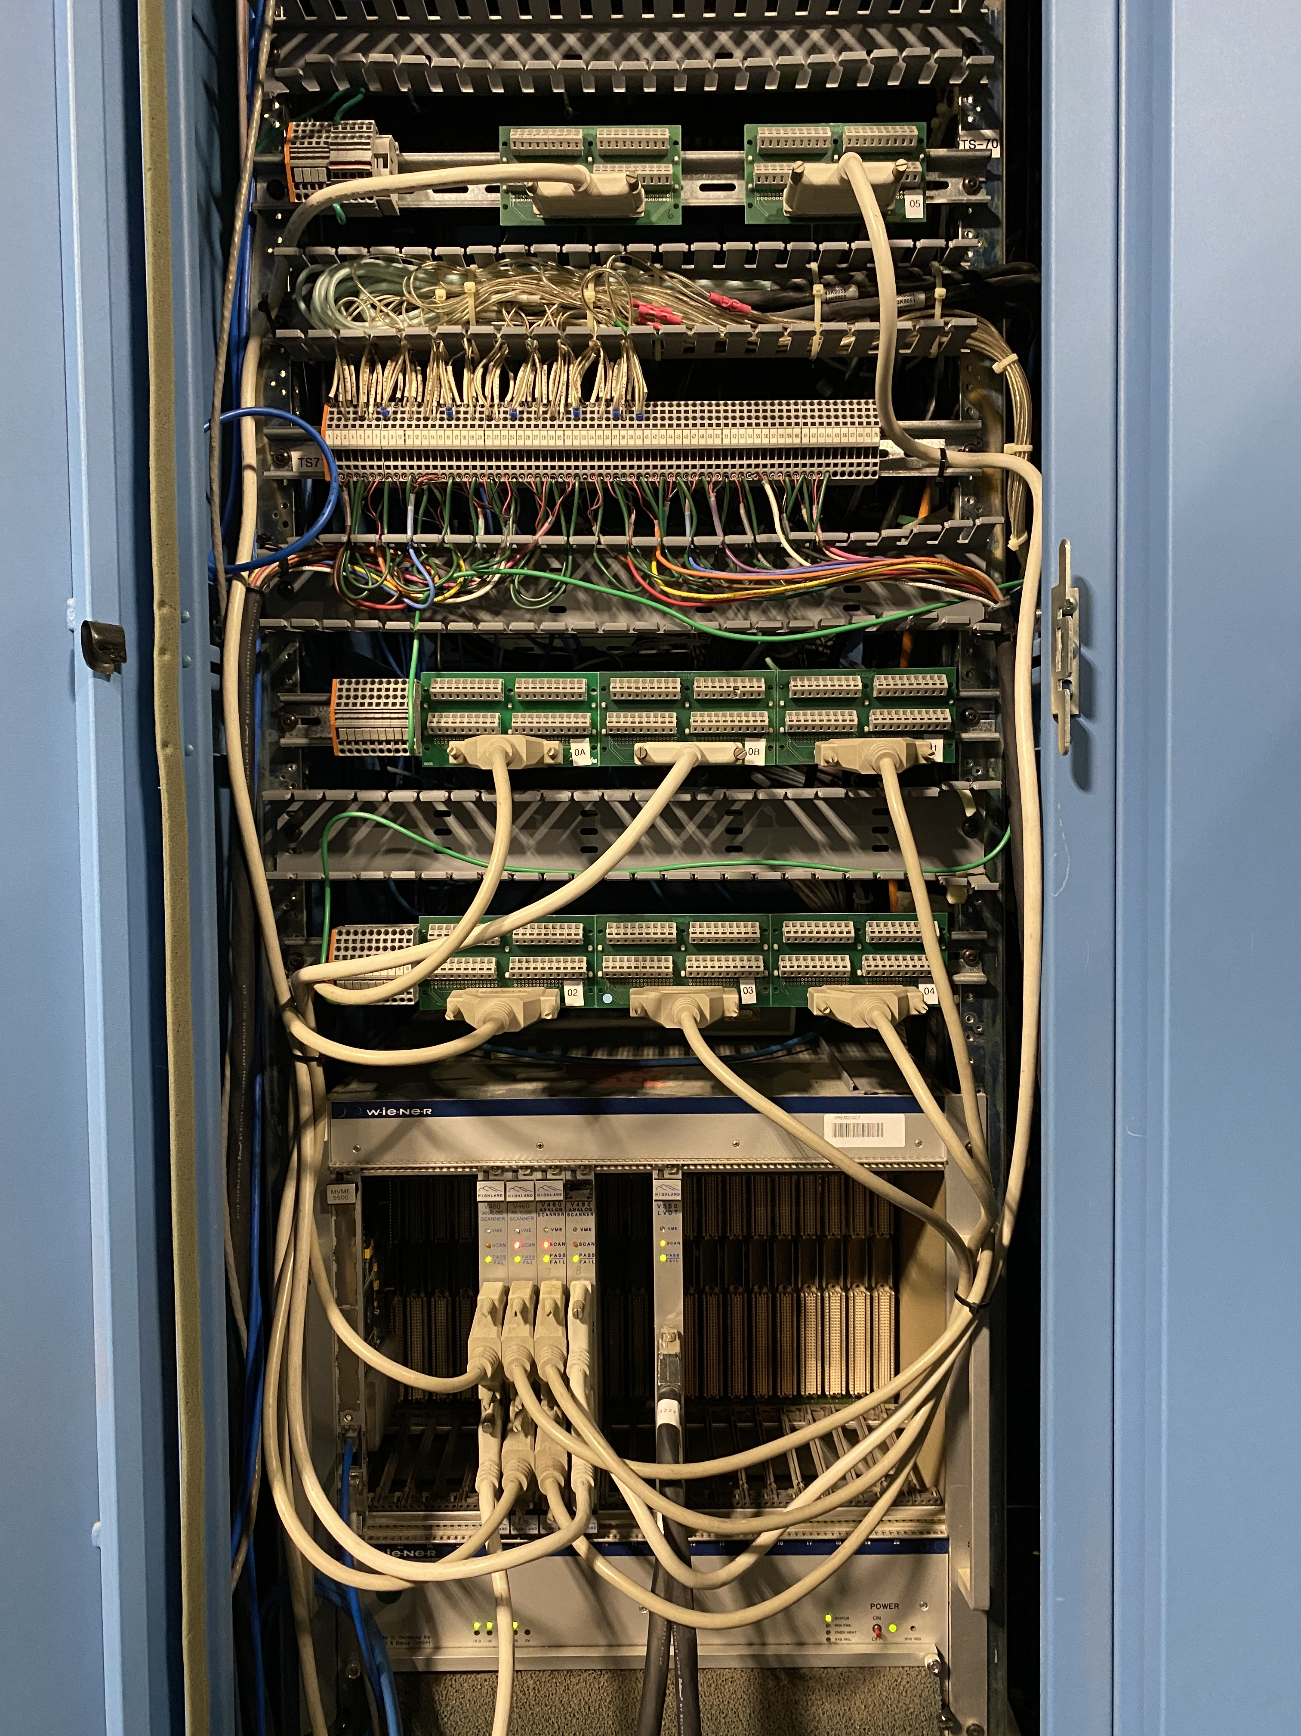
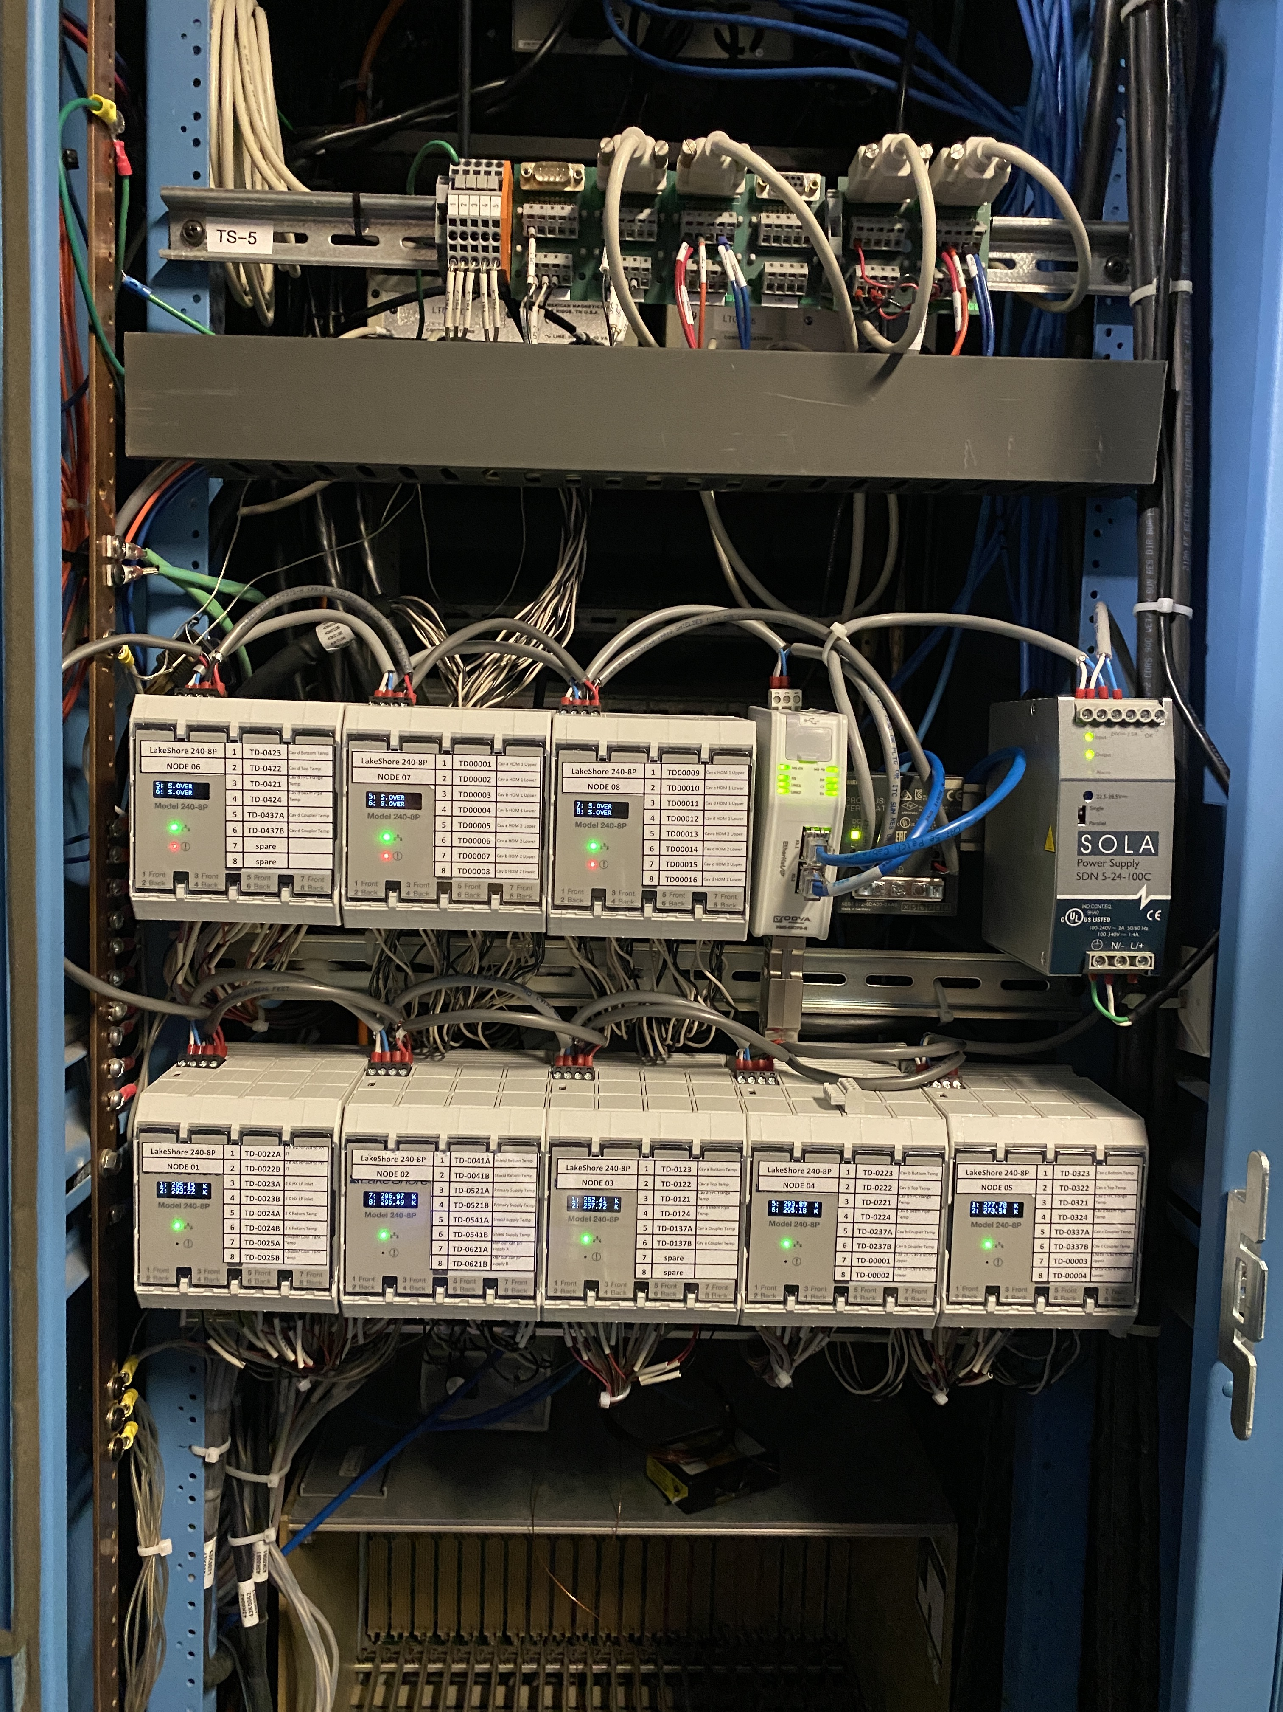
Progress since CD 2/3 Cryomodule Controls continues
  Installed new cryogenic temperature sensor input module in the RFTF test cave
    This is the new design for PPU which allows us to measure cernox or diode temperature sensors
    We tested one of our spare cryomodules using this enhanced control architecture
    This will allow us to test the new PPU cryomodules in the test cave before installing them in the Linac
Charge: 1
BEFORE
After

Slide 11
Progress since CD 2/3 Cryomodule Controls continues
We plan to start PLC programming for the transfer line controls located in the HEBT, programming for CM32 and CM31at the end of July 2021

Slide 12
Challenges
Charge: 5
We recently loss the partial drafting support we had for updating red line changes
  We will require an experienced controls centric drafter to support our efforts as field and fabrication changes are introduced
  Controls is looking to hire a new drafter; part of this person's time will be in support of cryomodule controls
A recent PCR covering changes to when the cryomodule control cabinets are fabricated will have some minor schedule impact on control cabinets inspection and testing activities

Slide 13
Final Design Status
Charge: 1
Final design for SCL controls has been completed for some time now. We are in the procurement and acceptance testing phase within this WBS

Slide 14
Installation Plans
Cryomodule controls installation plan for CM32, CM31, and transfer line devices
  Support field wire termination for cryomodules’ field devices and transfer line devices
  Download and configure PLC program in processor
  Loop check new control system for first two cryomodules and transfer line
  Download and configure EPICS configuration in IOC processor
  Perform integration test between field devices and HMI screens
Charge: 5

Slide 15
PPU Changes since CD 2/3
Charge: 4

Slide 16

Estimate at Complete

Slide 17
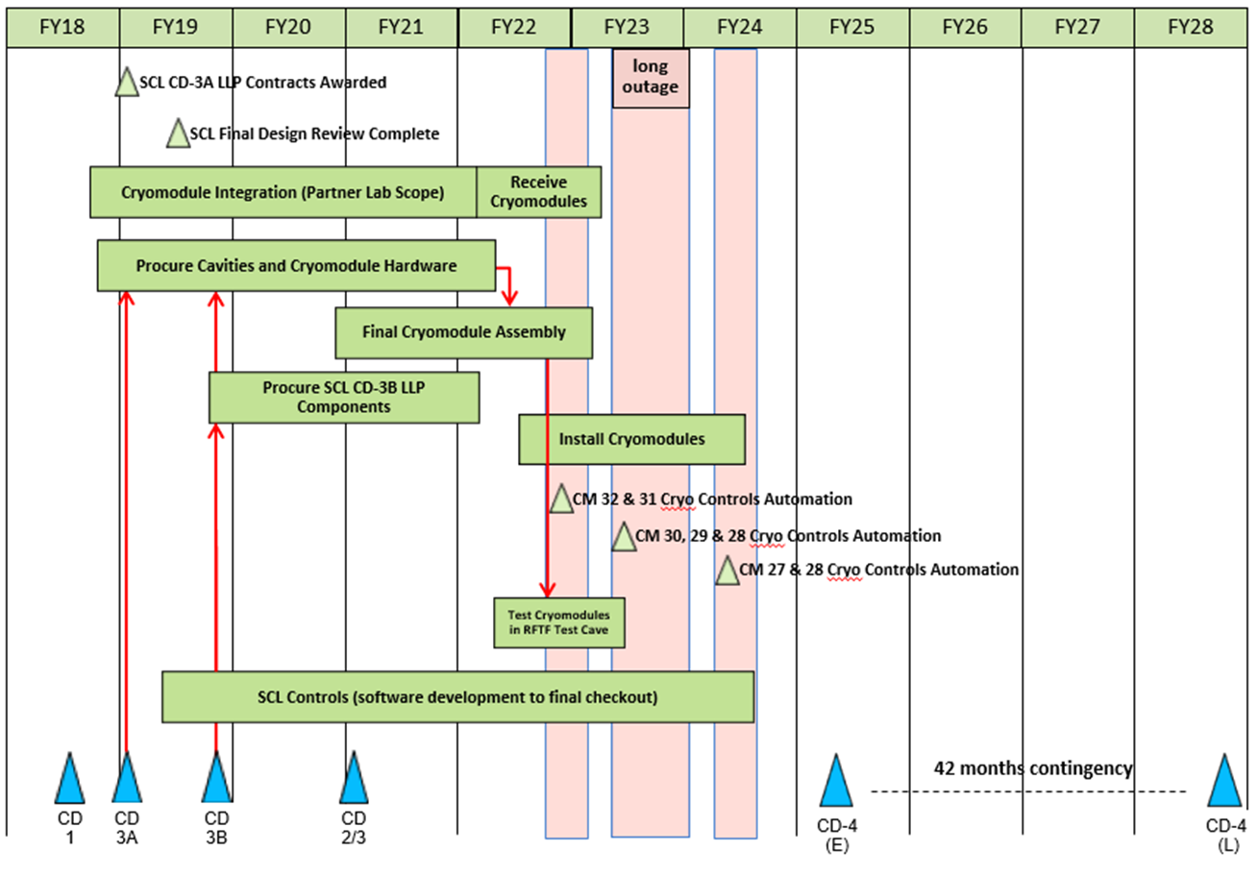
SCL May 2021 Status Summary Schedule

Slide 18
Cost Estimate by FY
Charge: 4,5
Our labor profile will be greatest during FY22

Slide 19
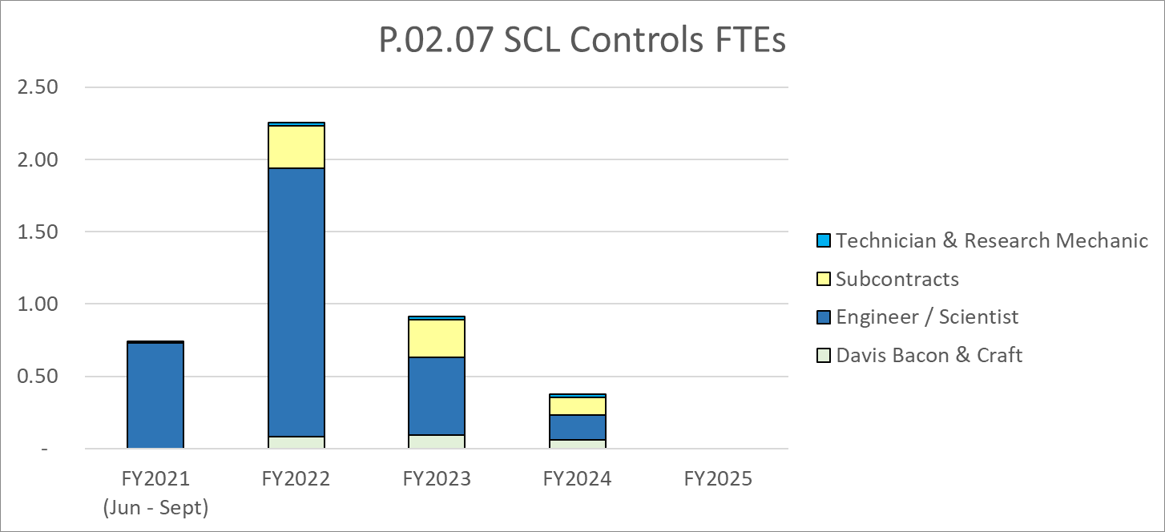
Labor Profile
Charge: 4,5
FY22 majority of efforts:
Control cabinets installation support and software programming

Slide 20
P.02.07 SCL Controls Risk Register
No active risks identified
  One retired
High Risks
  No high risks identified
Key risk categories analyzed
  Software requirements
Risks are reviewed on a regular basis

Slide 21
Responses to Recommendations
Charge: 6
There were no recommendations from the CD 2/3 review

Slide 22
ESH&Q and COVID-19 Impacts
Charge: 3
We currently have not experienced any significant ESH&Q considerations or impacts in our scope of work
COVID-19 impacts in our scope
  Control cabinet fabricator has been able to continue working during the pandemic
  Some of our cabinet devices/components have longer than usual delivery times; however; this has not stopped the fabricator’s progress

Slide 23
12-Month Look-Ahead as of Today
Charge: 5
P.2.7.2 Linac Beamline Vacuum Controls
  Complete EPICS screens and vertical test with rack hardware in lab
  Install rack in klystron gallery
  Connect vacuum cabling for CM31, 32, and HEDP
  Commission vacuum system minus CM31, 32
P.2.7.3 Linac Insulating Vacuum Controls
  Complete EPICS screens and vertical test with rack hardware in lab
  Install both racks in klystron gallery

Slide 24
12-Month Look-Ahead
Charge: 5
Cryomodule Controls look-ahead
  Procure four control cabinets for phase 1 installation
  Start and complete PLC programming for first two cryomodules
  Start and complete EPICS programming for first two cryomodules
  Fabricate adapter boxes for first two cryomodules
  Commission new control system for first two cryomodules

Slide 25
Summary
Beamline vacuum and insulating vacuum control cabinets have been procured and being tested
Four of the cryomodule control cabinets have been ordered.
Upgraded RFTF test cave control system. Now we are able to read the PPU cryomodule temperature sensor types
Cost and schedule are in line with project completion dates
We have the heaviest labor effort during FY22

Slide 26
Back Up Material if needed

Slide 27
Equipment layout drawing for reference

