Slide 1




P.02.05 Utilities
DOE/SC Independent Project Review of the Proton Power Upgrade Project
Chris Stone
Level 3 Manager for Utilities
September 14 – 17, 2021

Slide 2
Outline
Scope
Organization
Progress since CD 2/3
Challenges
Final design status
Installation plans
Cost and schedule
Labor profile
Risk register
Responses to recommendations
ESH&Q and COVID-19 impacts
12-month look-ahead
Summary

Slide 3
Scope
P.2 Superconducting LINAC
  P.2.5 Utilities – Chris Stone
    P.2.5.1 Management and System Integration – Chris Stone
      Management oversight of WBS elements
    P.2.5.2 Beamline Vacuum Systems – Chris Stone
      Design
      Procurement/Fabrication
      Installation
    P.2.5.3 Insulating Vacuum Systems – Chris Stone
      Design
      Procurement/Fabrication
      Installation
    P.2.5.4 Water Systems – Klent Pope
      Procurement/Fabrication
      Installation

Slide 4
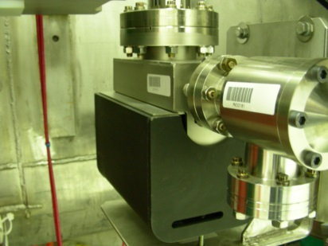
Scope – P.2.5.2 Beamline Vacuum
Charge: 1
The beamline vacuum systems for PPU will very closely mimic those of the existing SCL systems
The system shall consist of the following:
  45 L/s Ion Pump on each cryomodule identical to those already in use in the SCL. A manual all-metal angle valve will be mounted to the ion pump for “break-in”. These items to be supplied by the partner lab
  Electro pneumatic gate valves on the fore and aft of each cryomodule identical to those already in use in the SCL. These items to be supplied by the partner lab
  Ion Pump on each warm section between cryomodules identical to those already in use in the SCL
  The addition of a cold cathode vacuum gauge on each warm section
45 L/s Ion Pump

Slide 5
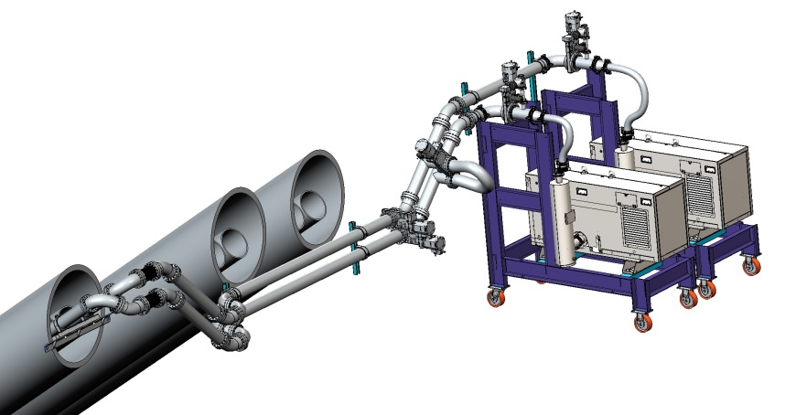
Scope – P.2.5.3 Insulating Vacuum
Charge: 1
The original cryomodule design for SNS did not include an insulating vacuum system However, operational experience has led to the inclusion of an IVS to account for potentially high gas loads in individual cryomodules
The design concept for IVS closely mimics the approach taken in the upgrade of the vacuum systems for the DTL and CCL portions of the accelerator
IVS will consist of a turbomolecular pump mounted directly to each new cryomodule, along with an electro-pneumatic gate valve on the turbo inlet and the appropriate vacuum pressure instrumentation and controls
Each turbo pump will exhaust into a common foreline manifold which will run overhead down the length of the new CM installation
The klystron gallery will house an appropriately sized dry screw pump to maintain the foreline manifold at an acceptable pressure along with a backup pump in case of a pump failure
The foreline manifold will traverse from the tunnel to the klystron gallery via the chase at CM slot 26, which has been reserved for this purpose
Klystron Layout for Foreline Pumps

Slide 6
Scope – Water Systems
The seven (7) new cryomodules have four (4) FP couplers each that require a minimum of 1 gpm cooling flow per cryomodule to remove a maximum of 200 Watts. The (4) FP couplers on each HB cryomodule are connected in series
The QMCS was tested with additional flow of 14 gallons per minute to simulate the addition of the 7 new cryomodules. Testing was performed in June 2016. There were no adverse effects to the QMCS skid or the equipment cooled by the QMCS. There is adequate capacity in the QMCS skid heat exchanger (HX) and pump flow
Each cryomodule will be connected with RAD hard hoses, (4) thermocouples (TC) and (1) flow switch (FS) prior to testing in the RFTF test cave and will be transported to the tunnel on the cryomodule assembly (the design & all components are identical to the existing installation). Temperatures and flow switch will be monitored and alarmed in EPICS by the FP coupler system

Slide 7





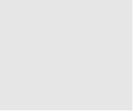


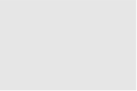
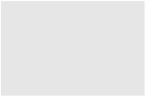


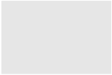


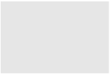


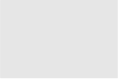













Organization
P.2 – SCL
Matt Howell
Charge: 5
P.2.1
Management and System Integration Matt Howell
P.2.2 Cavities
John Mammosser
P.2.3
Cryomodules Integration Ed Daly
P.2.4
Cryogenics
Brian DeGraff
P.2.5 Utility Systems Chris Stone
P.2.6 System Integration
John Mammosser
P.2.7 SCL Controls Karen White
P.2.1.1
Management and System Integration
Matt Howell
P.2.2.1
Management and System Integration
John Mammosser
Partner Lab
P.2.4.1
Management and System Integration
Brian Degraff
P.2.5.1
Management and System Integration
Chris Stone
P.2.6.1
Management and System Integration
John Mammosser
P.2.7.1
Management and System Integration
Aaron Coleman
P.2.2.2 Cavity Procurement
John Mammosser
P.2.4.2 Cryogenic Components Brian Degraff
P.2.5.2 Beamline Vacuum
Chris Stone
P.2.6.2 Completed Cryomodule
Testing
John Mammosser
P.2.7.2 Linac Beamline Vacuum
Controls
Derrick Williams
P.2.2.4 Cavity Reprocessing
John Mammosser
P.2.4.3 Cryogenics System Testing
Brian Degraff
P.2.5.3 Insulating Vacuum System
Chris Stone
P.2.6.3
Cryomodule in Tunnel
John Mammosser
P.2.7.3 Linac Insulating Vacuum System Controls
Derrick Williams
P.2.2.5 Coupler Acquisition Yoon Kang
P.2.5.4 Water Systems Klent Pope
P.2.6.4
Cryomodule Testing in Tunnel John Mammosser
P.2.7.4
Cryomodule Controls Aaron Coleman
P.2.2.7 HTA Testing
Brian Degraff
P.2.6.5 Plasma Process MB Cryo. John Mammosser
P.2.2.8 Coupler Waveguide Transition Yoon Kang

Slide 8
Progress since CD 2/3
Charge: 2
Initial Procurements for Utilities have begun
The vacuum manifold through the chase at Slot 26 have been installed

Slide 9
Challenges
Charge: 2
We have begun the procurement phase for utilities a few months early to ensure that our procurements arrive on time
  Based on recent procurement efforts for normal operations
Ion Pump Controller (Beamline Vacuum) Obsolescence

Slide 10
Final Design Status
Charge: 1
Final design for P.2.5 Utilities is complete

Slide 11
Installation Plans
Charge: 1
Utility installation will essentially parallel the installation schedule for the cryomodules
Some IVS manifold installation work can be done during semi-weekly maintenance days leading up to the cryomodule installations

Slide 12
Estimate at Complete
Charge: 4

Slide 13
Cost Estimate by FY
Charge: 4

Slide 14
Labor Profile
Charge: x
Labor slides to be provided by Project Controls
  Should indicate profile through project completion
  Address staffing challenges and future hires

Slide 15
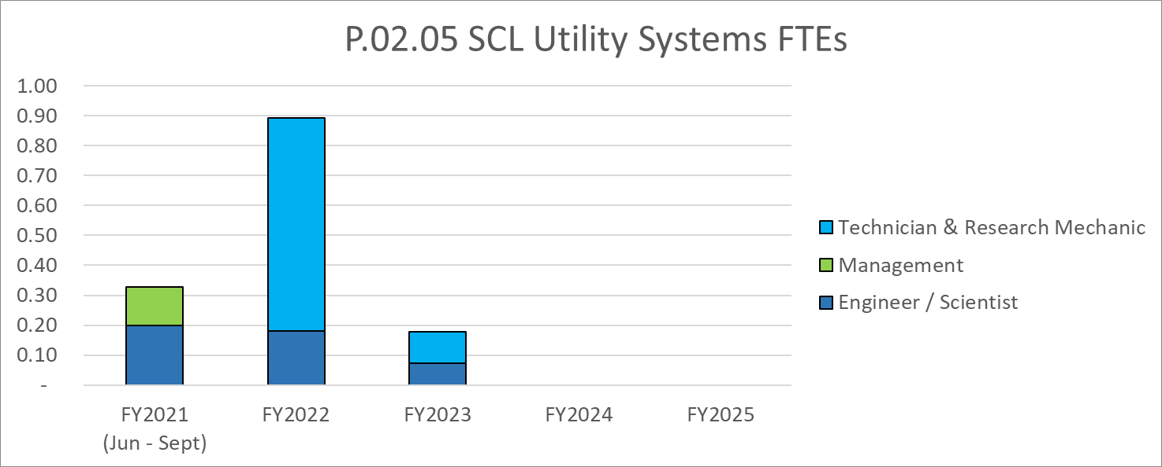
Labor Profile
Charge: 4

Slide 16
P.02.05 Utility Systems Risk Register
No active risks identified
  No risks retired
Risks are reviewed on a regular basis

Slide 17
Responses to Recommendations
Charge: 6
P.2.5 has participated in and successfully completed all project reviews to date
No recommendations for P.2.5 were generated from these reviews

Slide 18
ESH&Q and COVID-19 Impacts
Charge: 3
P.2.5 has thus far had negligible impacts due to ESH&Q or COVID-19
The bulk of P.2.5 scope is in the future

Slide 19
12-Month Look-Ahead
Charge: 2
Preparation
  Procurements in late 2021
  Installation in mid 2022

Slide 20
Summary
The status for P.2.5 Utilities is commensurate with the project schedule:
The design is complete, and documentation is in place
The risks are well understood and documented
The cost & labor needs are well defined

