Slide 1




P.04.02.02 Injection Region
  Magnet Production
DOE/SC Independent Project Review of the Proton Power Upgrade Project
David Harding (FNAL)
Fermilab Magnet Systems Department
September 14-17, 2021

Slide 2
Outline
Scope
Organization
Progress since CD-2/3
Challenges
Final design status
Installation plans
Cost and schedule
Labor profile
Risk register
Responses to recommendations
ESH&Q and COVID-19 impacts
12-month look-ahead
Summary

Slide 3

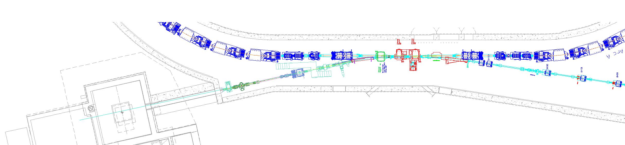
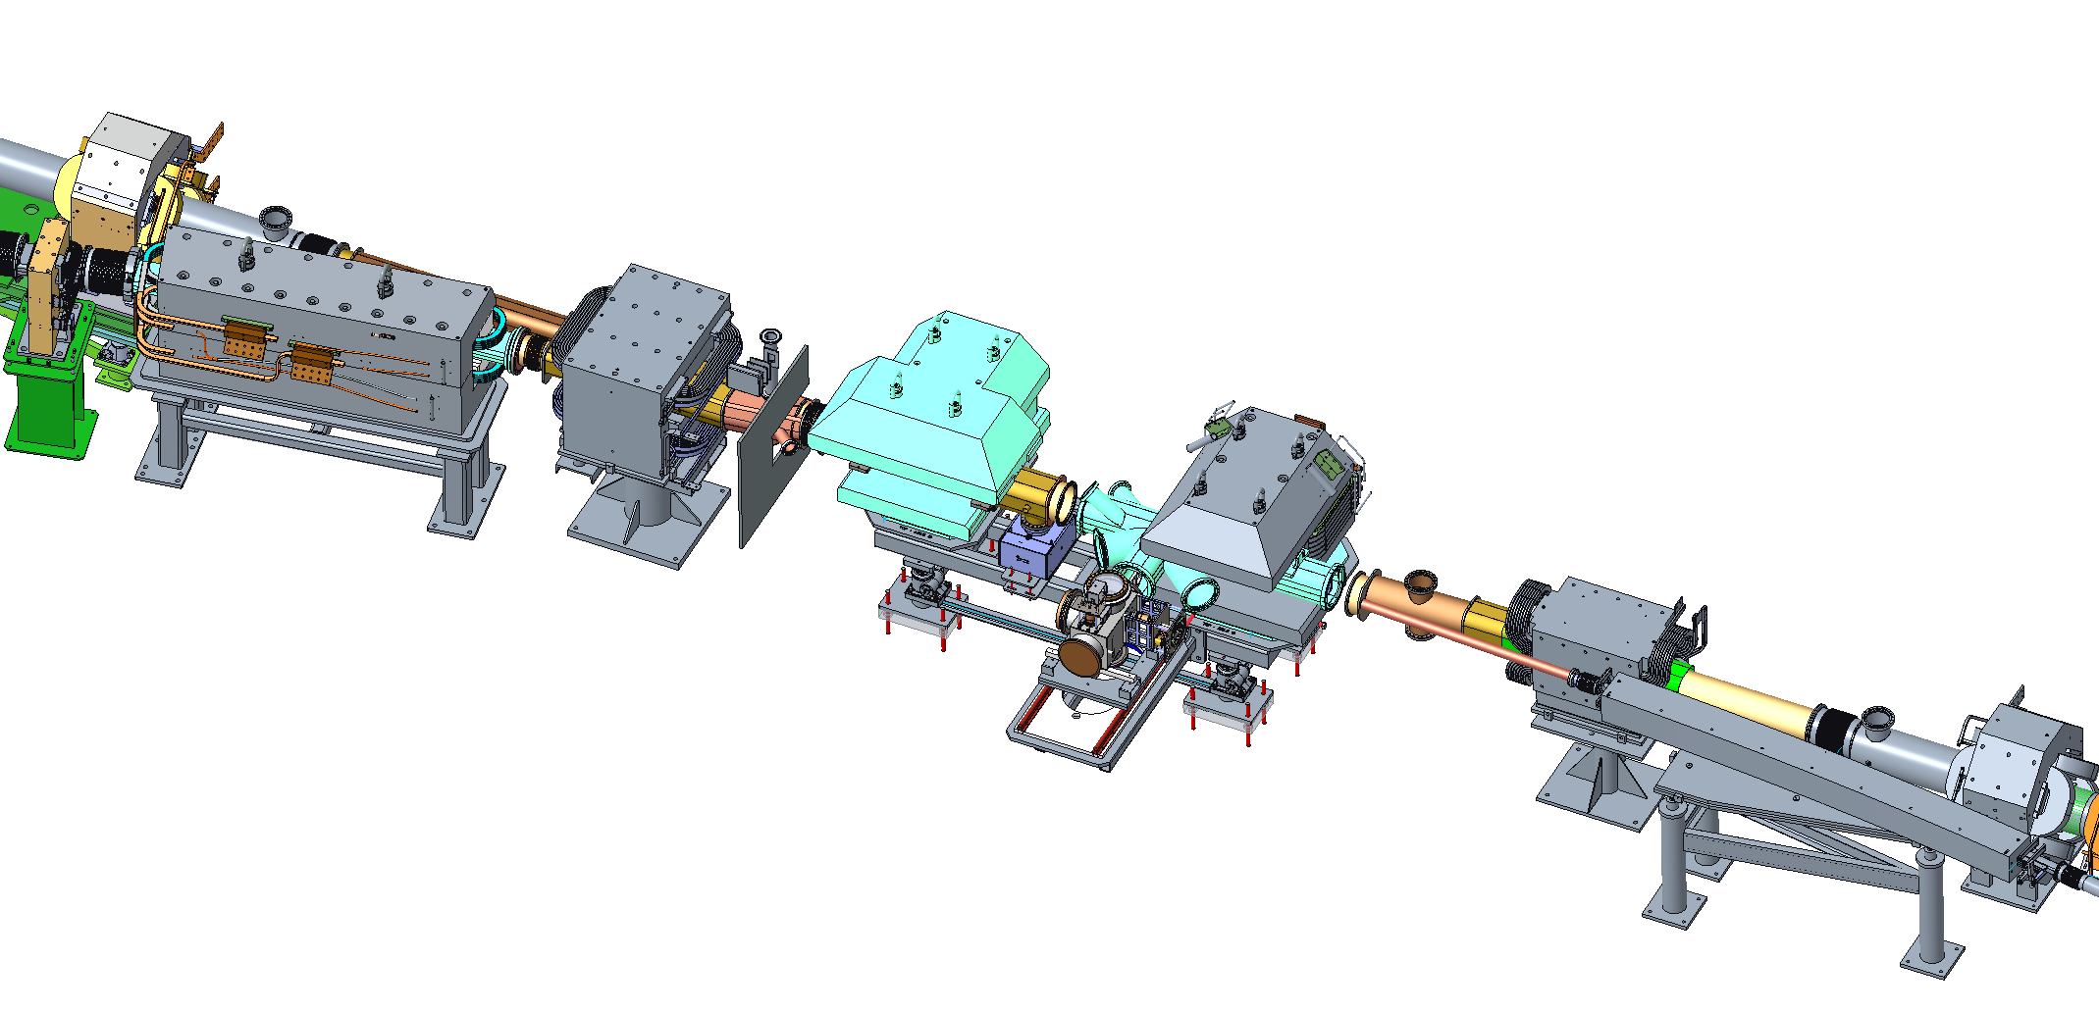
Ring Injection Region Scope detail (WBS P.4.2)
P.4.2.3 Upgrade injection kicker power supplies (8 total)
Charge: 1
P.4.2.2 Add injection dump quadrupole magnet and power supply
P.4.2.2 New injection dump septum magnet designed by FNAL (Harding)
Beam direction
P.4.2.2 Two new magnets designed by FNAL
Chicane #3 and Chicane #2 (Harding)
P.4.2.2 Move chicane #1 ~30 cm upstream
Chicane #4 does not change
P.4.2.5 Primary and Secondary Foil Strippers
(Charlotte Barbier)
P.4.2.4 New vacuum chambers, TiN coating of adapters, ion pumps, and gauges
(Charlotte Barbier)

Slide 4
Scope
Design, fabricate, and deliver for installation
  Chicane #2 dipole magnet
  Chicane #3 dipole magnet
  Injection dump septum magnet
Also
  Spare chicane dipole magnet (flavor to be determined)
  Rollover fixture and necessary parts for changing flavor of spare chicane dipole magnet
  Spare coil for injection dump magnet
Magnetic measurements
  Each magnet individually (including recirculating beam region outside injection dump magnet)
  Chicane #2 and #3 together

Slide 5

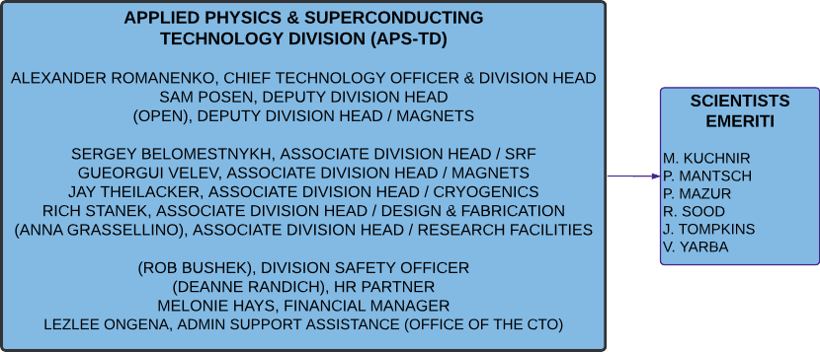

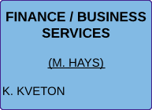
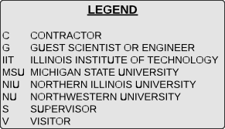

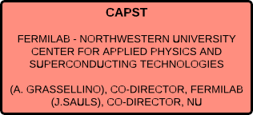
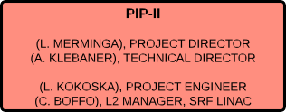
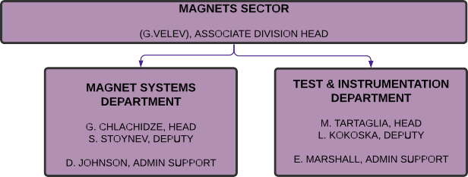
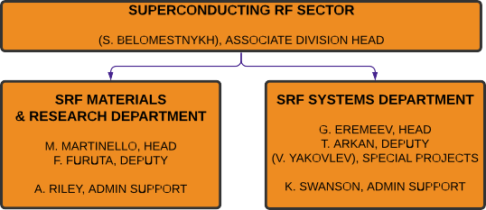
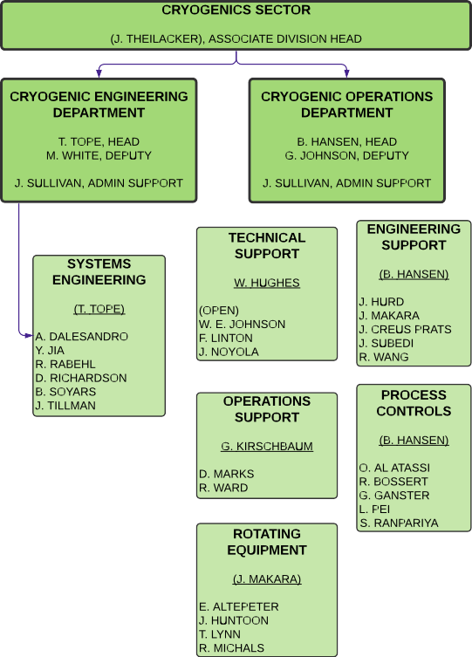
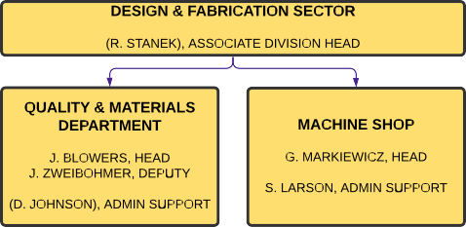
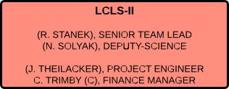
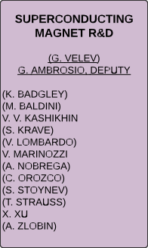
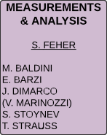
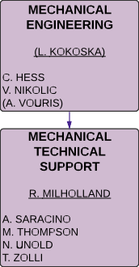
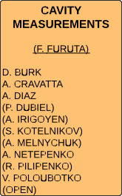
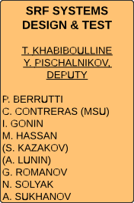
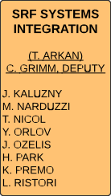
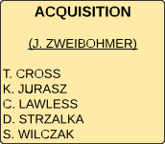
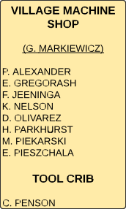
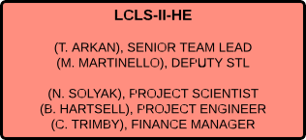
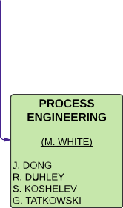
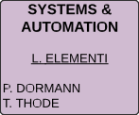
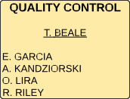
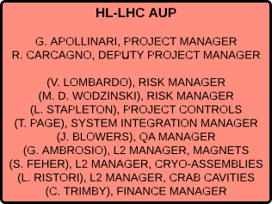
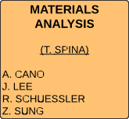
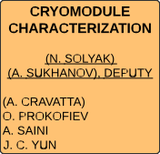
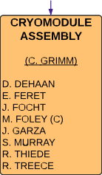
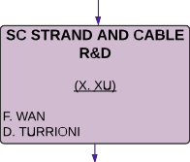
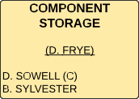
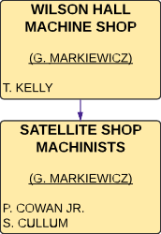
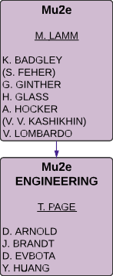
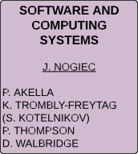
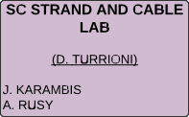
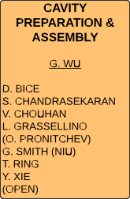
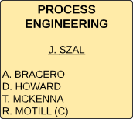
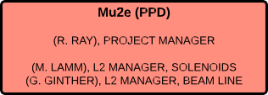
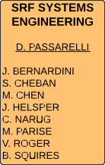
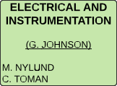
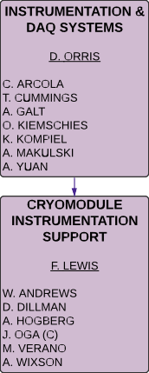
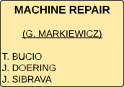
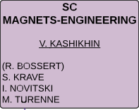
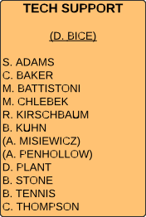

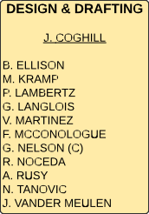
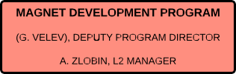
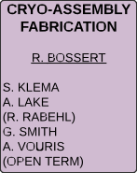
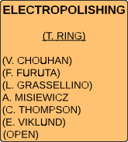
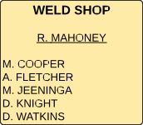
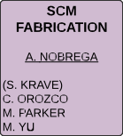
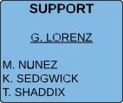






Charge: 5
Fermilab Procurement
Outside machine shops

Slide 6
Progress since CD-2/3
Charges: 1, 2, 4
Last July we were planning to
  Conduct a production readiness design review
  Enter into agreements for magnet fabrication
  Start procurement of components
  Start detailed design of unique features of magnet measurements
Since then, we have
  Completed the detailed drawings and had a successful readiness review
  Signed SOWs and MPOs for magnet fabrication
  Started procurements
  Reduced the scope of the magnet measurements

Slide 7
Challenges
Charges: 4, 5
Maintaining focus, especially on procurements
  Things have not been moving as rapidly as we would like to see.
  The lead engineer and I talk with the Acquisitions Group regularly.
  The head of Acquisitions sits in on our weekly meetings with PPU.
  We expect frequent visits from PPU once there is some action.
Dealing with statistical fluctuations in technician availability
  It’s a small group, so illnesses, vacations, etc. can add up quickly.
  We are currently hiring two more technicians and expect two more term hires for the duration of this project (and two following projects).
Succession planning
  See above.
Potential supply chain disruption
  No problems yet, but we are just getting started.
  We will order all the small parts soon to avoid surprises later.

Slide 8
Final Design Status
Charges: 1, 4
Charge: x
Magnet and tooling designs are complete.
Drawings are released for procurement.
Design work remains on some measurement system details.
  The hardware and software are not needed until the first magnet is fabricated, so we will have appropriate time to finish before the components are needed.

Slide 9

P.4 Ring May 2021 Status Summary Schedule
Charge: 4
Bulk of Ring Systems work takes place during the long outage in FY23

Slide 10

Schedule
Now
Dec 2022
Charges: 2, 4, 5
Procurement
First coil
Assemble first magnet
More coils
Measure first magnet
Assemble more magnets
Measure more magnets
Procurement
First coil
Assemble magnet
Second coil
Measure magnet
Dump dipole Chicane Dipoles

Slide 11

Early component procurements
Charges: 2, 4
 | Estimate | Contract
Chicane Dipole
Steel | $ 117 K | $ 147 K
Core machining | $ 80 K | Closes 9/17
Conductor | $ 25 K | $ 33,727
Glass and Kapton tape | $ 16 K
Winding tooling | $ 15 K | $ 10,910
Potting tooling | $ 25 K | $ 23,708
Dump Septum Magnet
Steel | $ 60 K | $ 100 K
Core machining | $ 115 K | Closes 9/17
Conductor | $ 10 K | $15,807
Glass and Kapton tape | $ 17 K
Winding tooling | $26 K | $ 38,875
Potting tooling | $ 52 K | $ 45,480
January 2019
August 2019

Slide 12

Labor Profile
Charges: 4, 5
Charge: x
Fabrication technicians by month
  Blue are available today
  In the process of hiring two more
  Will add two more term technicians around December
0 1 2 3 4 5
Oct Nov Dec Jan Feb Mar Apr May Jun Jul Aug Sep Oct Nov Dec

Slide 13
Risk Register
Charges: 4, 5
Charge: x
We recognize that the magnets are the highest schedule risk to the project.
My group is committed to get the job done.
We meet with PPU managers weekly and expect visits as soon as it seems useful.

Slide 14
Responses to Recommendations
Charges: 5, 6
Charge: x
No recommendations from the CD-2/3 review
Two comments
  The PPU scope to fabricate magnets at FNAL for the SNS Ring, while of limited dollar value, is quite impactful to the success of the PPU project and is currently identified as the top risk rating on PPU. The risk mitigation strategy should consider all possible avenues, including alternate sources. With a number of larger projects with competing resources on-going at a lab (FNAL) that is managed by another DOE program (OHEP), PPU and ORNL should consider establishing effective communications at multiple levels (technical staff, project management, laboratory management, DOE FPD and site offices), a possible PEMP goal and when possible, a consistent on-site presence, to ensure good capability exists to monitor and deliver to the PPU baseline.
  PPU management is starting to see vendor delays and cost increases associated with COVID control measures. This risk will need to be closely managed and mitigated going forward, along with the identified risk associated with construction of the target building stub in the tight local labor market.

Slide 15
ESH&Q and COVID-19 Impacts
Charges: 3, 4, 5
Charge: x
ESH&Q
  Just design and procurement so far, so few hazards.
  Fabrication and measurements will use standard operations.
  Detailed travelers (work instructions) under development incorporate job hazard analyses.
  Worked with project on design of rollover tooling and procedure for spare chicane.
  No exotic materials.
Little COVID-19 impact so far
  Remote design, procurement work
  Strict compliance with COVID-19 guidelines
  No supply chain issues yet
  COVID-19 protocols in place on the production floor

Slide 16
12-Month Look-Ahead
Charges: 2, 4, 5
Charge: x
Nov 2021 – Chicane coil winding starts
Feb 2022 – Dump dipole coil winding starts
May 2022 - First chicane magnet complete
July 2022 – Dump dipole magnet complete

Slide 17
Summary
Magnet and tooling designs are complete
Procurement is under way
Some magnet-specific measurement components are still to be designed
No serious technical or ESH&Q issues
The schedule is very tight
Technician resources will need careful management
Charges: 1, 4
Charges: 1, 2
Charges: 1, 2, 4
Charges: 1, 3
Charges: 4, 5, 6
Charges: 5, 6

Slide 18
Backup

