Slide 1




P.4 Ring Systems
DOE/SC Independent Project Review of the Proton Power Upgrade Project
Nicholas Evans
Level 2 Manager for Ring Systems and R&D
September 14-17, 2021

Slide 2
Outline
Scope
Organization
Progress since CD-2/3
Challenges
Final design status
Installation plans
Cost and schedule
Labor profile
Risk register
Responses to recommendations
ESH&Q and COVID-19 impacts
12-month look-ahead
Summary

Slide 3
Scope
P.4 Ring Systems
  P.4.1 System management
  P.4.2 Injection Region
    P.4.2.2 Magnets
    P.4.2.3 Power supplies
    P.4.2.4 Vacuum
    P.4.2.5 Stripper foils
  P.4.3 Injection Dump
    P.4.3.2 Imaging system
    P.4.3.3 Engineering review
  P.4.4 Extraction Region
    P.4.4.2 Magnets
    P.4.4.3 Power supplies
P.4 Ring Systems
  P.4.5 Utilities
    P.4.5.2 Electrical
    P.4.5.3 Water
    P.4.5.4 PFN room cooling
  P.4.6 Ring Control Systems
    P.4.6.2 Beam power limit
    P.4.6.3 RTBT Stub PPS
    P.4.6.4 Ring inj controls
    P.4.6.5 Ring extr. controls
  P.4.7 RTBT Stub
    P.4.7.2 Temporary shielding
    P.4.7.3 Berm neutronics calcs
  P.4.8 Accelerator Physics
B4-4 Norman
B4-2 Saethre
B4-3 Harding
B4-6 Mahoney
B4-7 Bong
B4-5 Willis
B4-1 Evans
B4-2 Saethre
B4-1 Evans

Slide 4
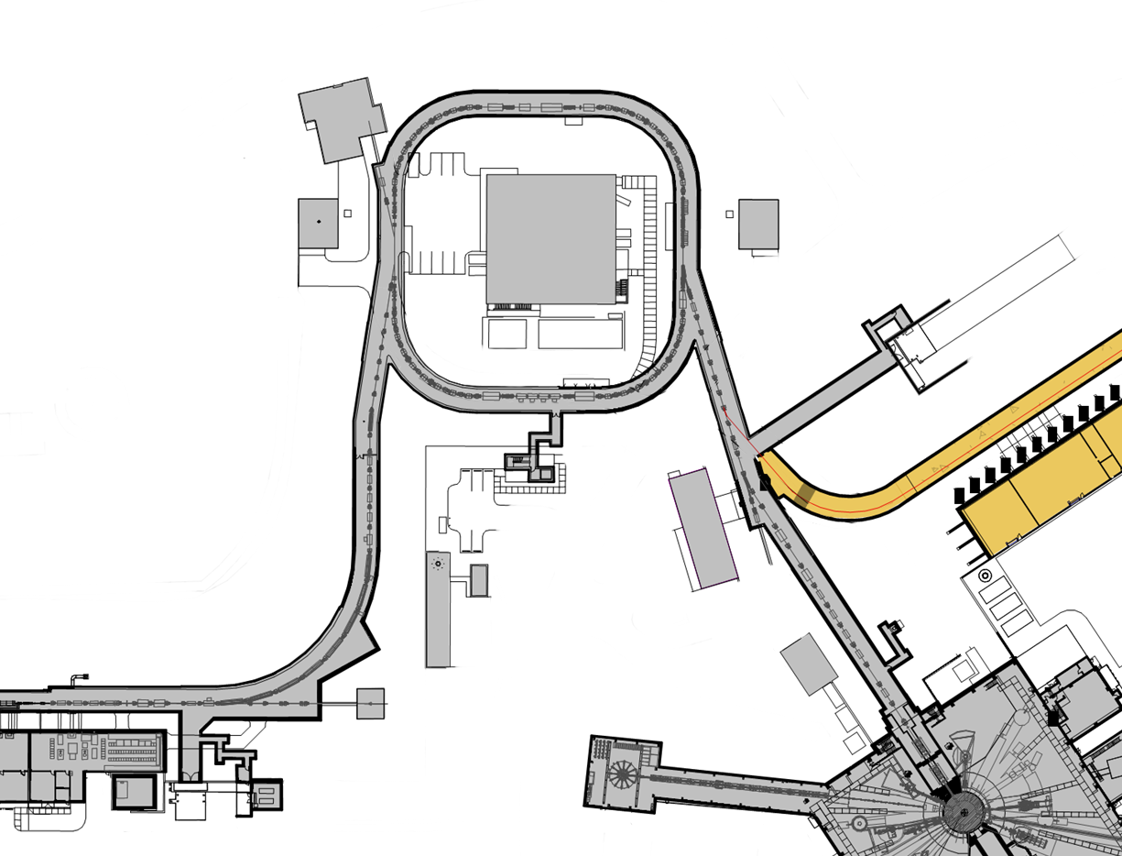
PPU Ring – Technical Scope
Charge: 1
Re-evaluate injection dump power limit
Install imaging system
  Upgrade charging power supplies to 45kV
  Replace shims in extraction septum magnet
Ring
Service Building
Replace two chicane magnets
Upgrade injection kicker power supplies
Replace injection dump septum magnet
Move chicane magnet #1 upstream ~30 cm
Add quad magnet to IDmp beamline
Add diag. to IDmp beamline
2D Pyrometer for foil temperature measurements*
  Neutronics and shielding calculations for RTBT to RTST tunnel stub
  PPS for stub
  Power limit system for
  2 MW operation of FTS
  Upgrade water cooling system for the power supplies in the Ring service building
  Cooling fan kit for the main ring dipoles substation power transformers
  Install air conditioning in PFN Room

Slide 5
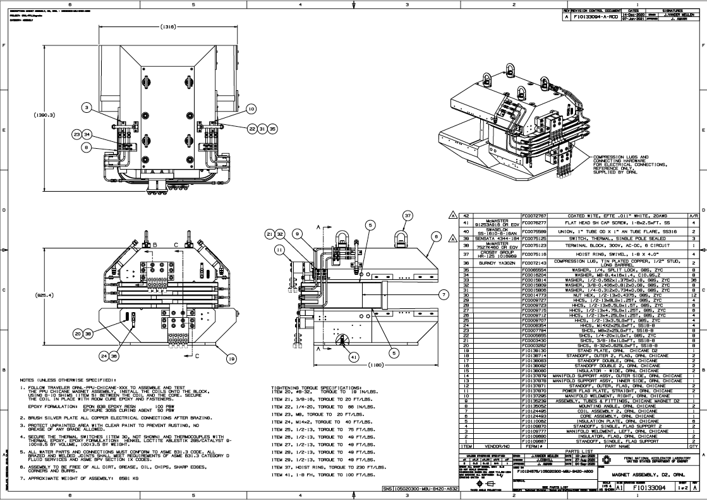
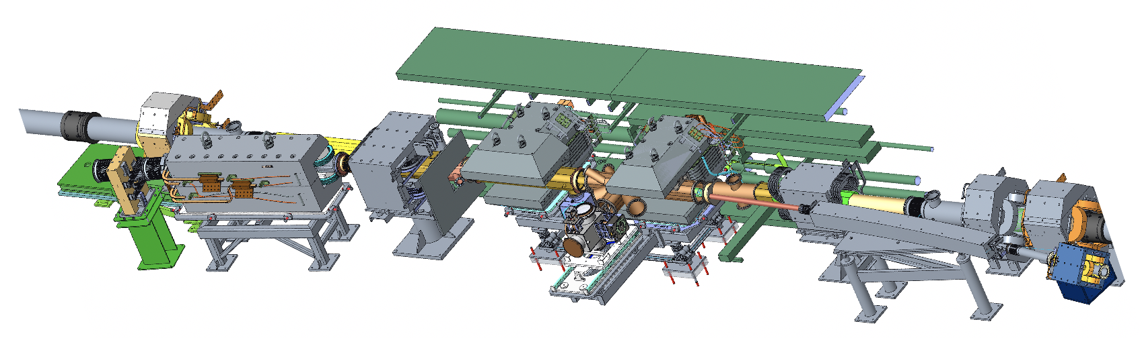
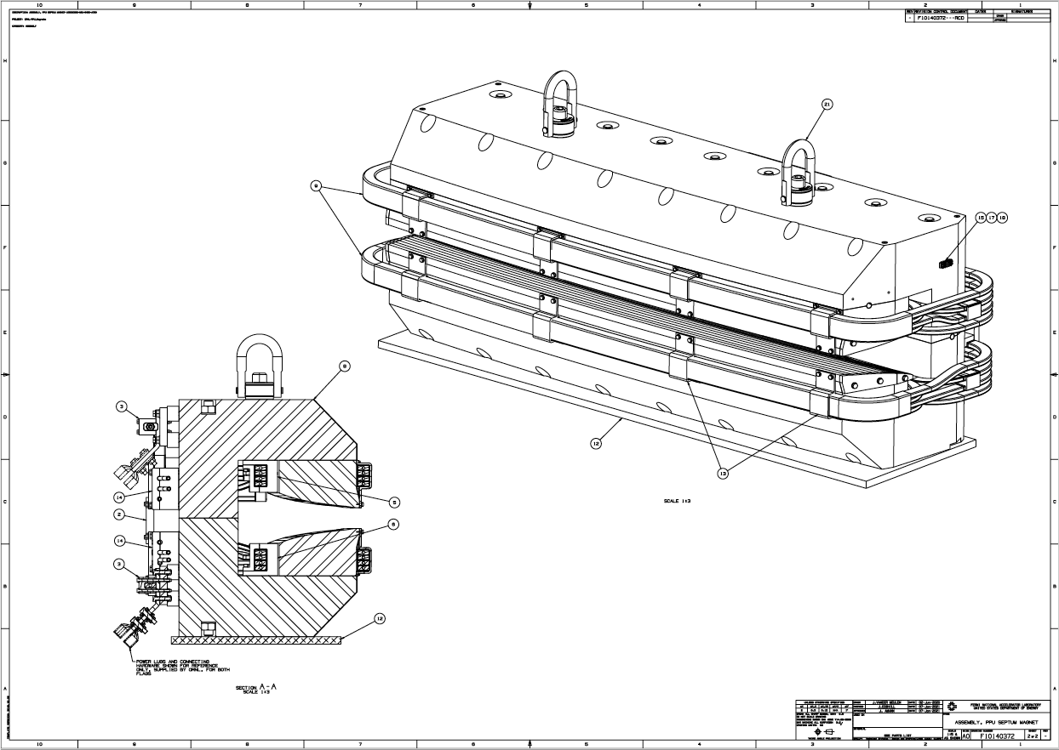
P.4.2 Injection Region
B4-2 Saethre
P.4.2.2 Magnets
P.4.2.3 Power Supplies - complete
P.4.2.4 Vacuum
P.4.2.5 Stripper Foil Changers
Injection region: chicanes 2,3 and dump septum,
vacuum chambers, and foil changers will be replaced.
Chicane 1 will be moved upstream.

Slide 6
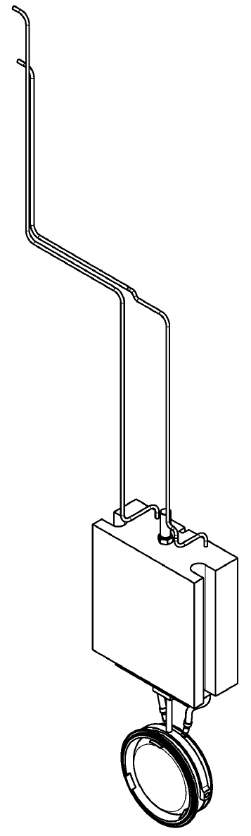
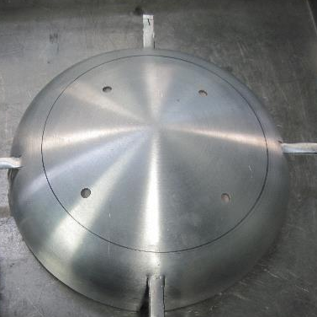
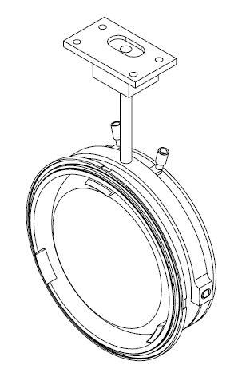
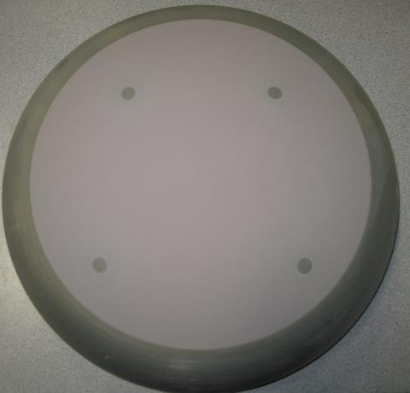
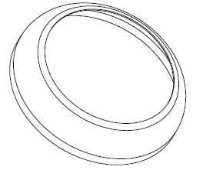
P.4.3 Ring Injection Dump - scope
B4-5 Willis
P.4.3.2 Thermal Modelling – complete (106090200-TR0001-R00, 106090200-TR0004-R00, Kumar et al.)
P.4.3.3 RID-IS – window, optics in fabrication, installation planning on-going
Window components for the RID-IS
Fiducial Mask
Coated Window
Coating mask
Window/Flange Weldment

Slide 7
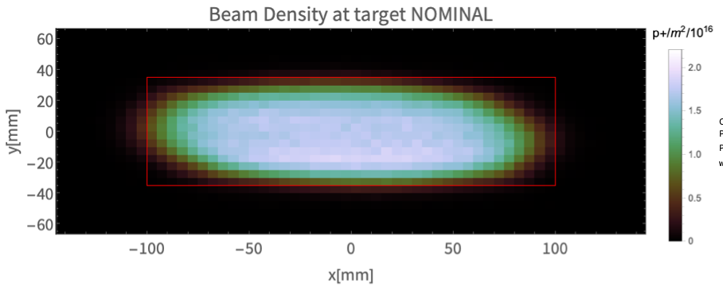
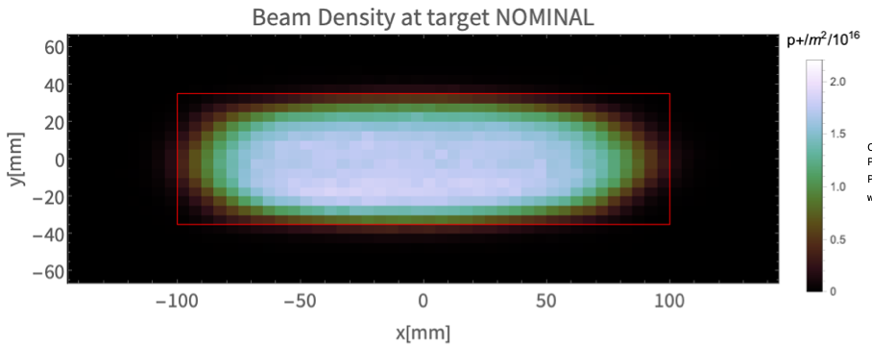
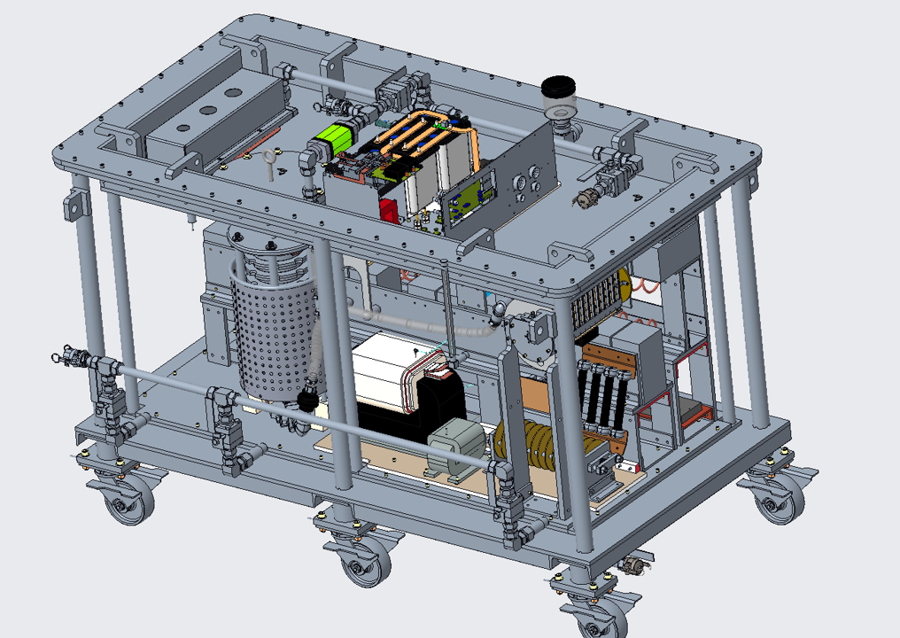
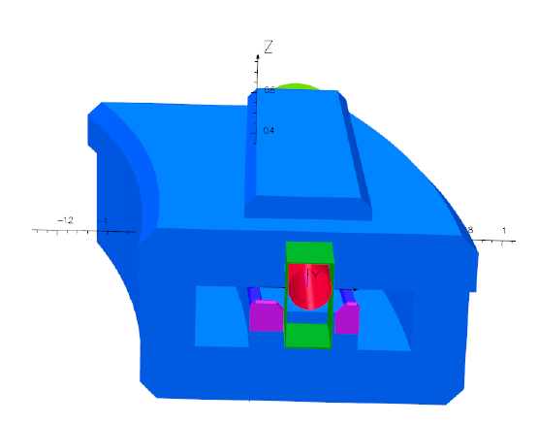
P.4.4 Extraction Region
ORBIT simulation of nominal target distribution at 1.3 GeV using 3D field map
B4-2 Saethre
Existing Magnet
P.4.4.2 - Magnets
P.4.4.3 – Power Supplies
PFN
With new shims
RCPS
Existing pole shims require splitting magnet to replace
new shims install on front face of magnet yoke
Transformer
Upstream end of Extraction Lambertson in SNS tunnel, and FNAL simulation

Slide 8
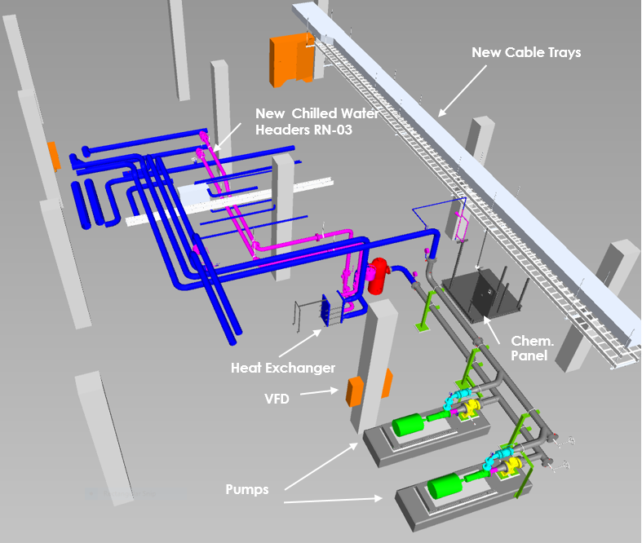
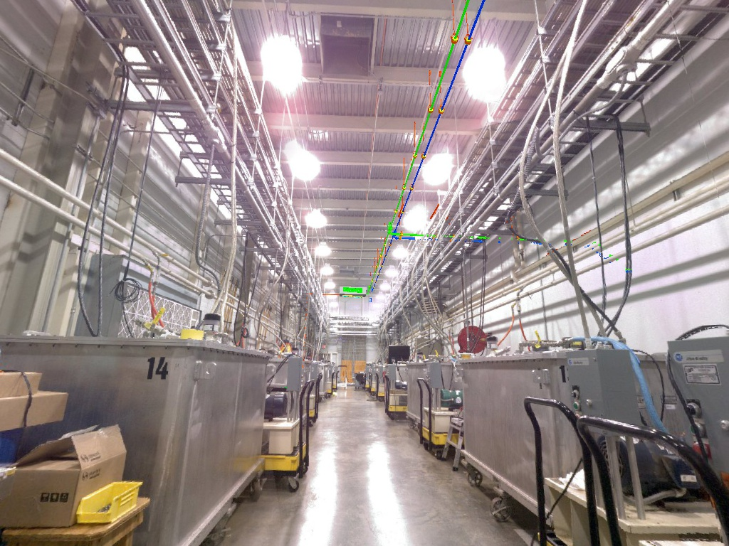
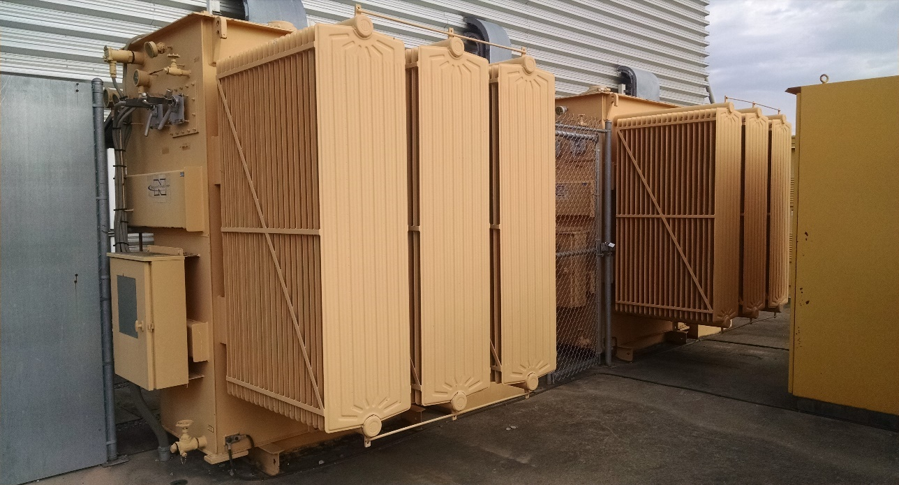

P.4.5 Utilities
B4-4 Norman
P.4.5.2 Main Ring Dipole Transformer Upgrade
P.4.5.3 RN-03 Magnet Power Supply DI Water Cooling Upgrade
P.4.5.4 PFN Room HVAC
Cooling fans will be added
to dipole transformers
HVAC will be added to PFN room
RN-03 cooling system will be upgraded

Slide 9
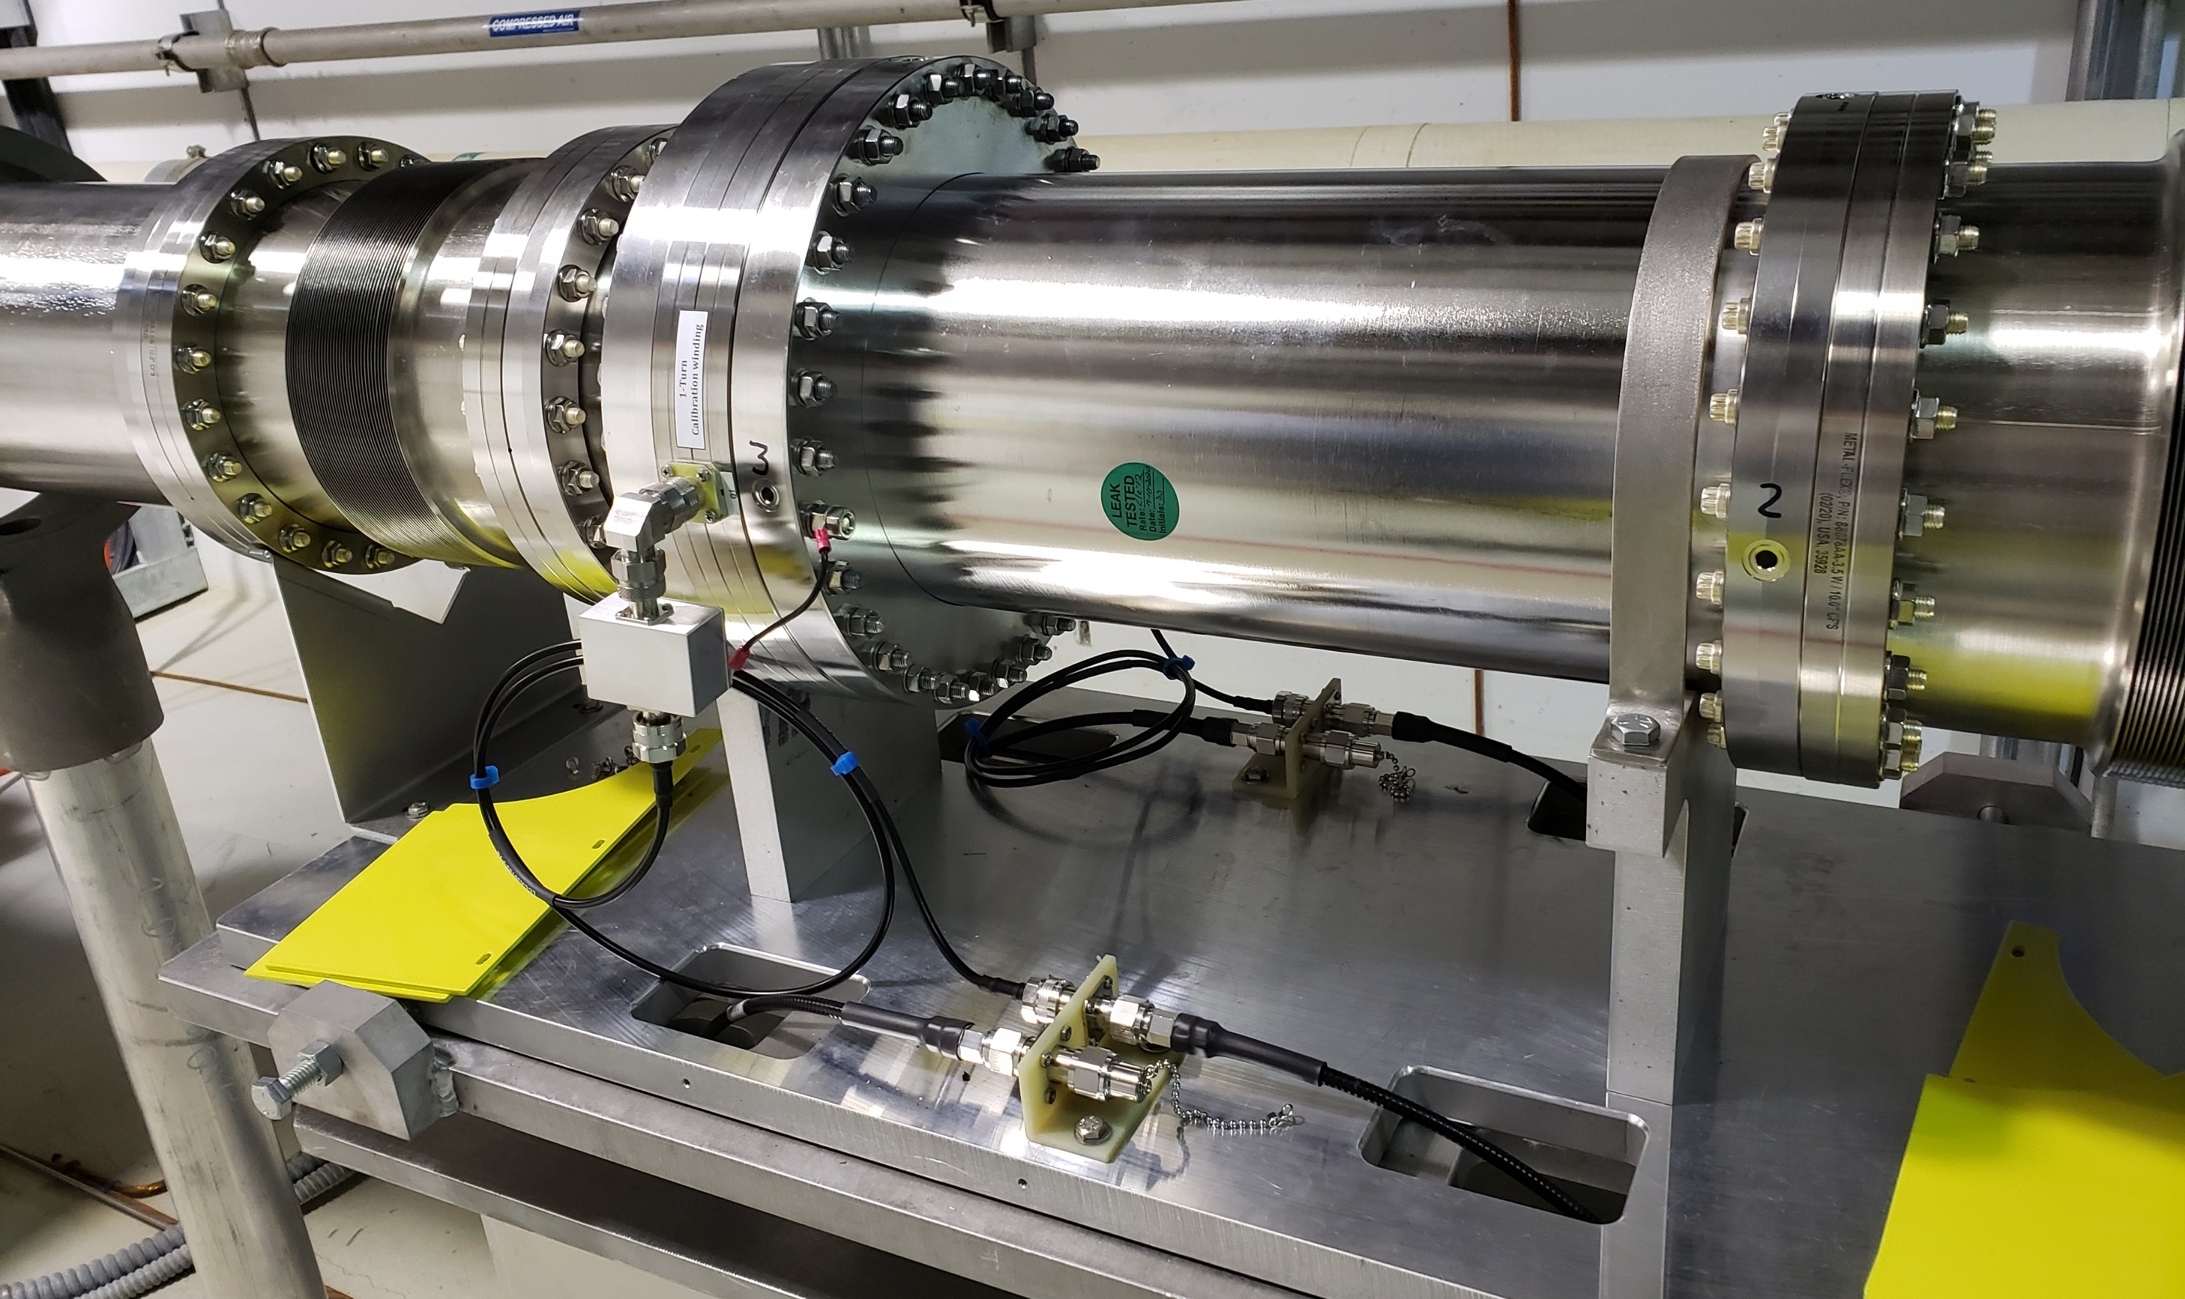
P.4.6 Ring Control Systems
B4-6 Mahoney
B4-7 Bong
P.4.6.2 Beam Power Limiting System (BPLS)
P.4.6.3 RTBT Stub PPS
P.4.6.4 Ring injection controls
P.4.6.5 Ring extraction controls
BPLS test article tunnel installation

Slide 10
P.4.7 RTBT Stub and P.4.8 AP - Scope
P.4.7 RTBT stub
  Calculations are complete (SNS-106100200-DA0113-R0, SNS-106100200-DA0110-R00)
  Shield stacking will occur near end of long outage in FY23 – ring systems is covering shield stacking, will piggyback on conventional facilities contract
P.4.8 Accelerator Physics – entirely LOE
  Evaluate beam physics risks – e-P, foils
  Consult on designs – RTBT stub, vacuum chambers, injection region, extraction region
  Commissioning - injection region, RID-IS, kickers, BPLS

Slide 11
Accelerator and Target Advisory Committee
Stuart Henderson, Chair
Neutron Sciences Directorate
Associate Laboratory Director Ken Andersen
Proton Power Upgrade Project
Director – John Galambos
Project Manager – Mark Champion Project Controls Lead – Wayne Steffey Partner Lab Senior Team Lead – Ed Daly Technical Director – Sang-Ho Kim
Controls Integration Manager – Karen White
ESH&Q – Sam McKenzie
Sr. Administrative Assistant – Angie Woody
Management Advisory Committee
Les Price, Carl Strawbridge
Project Management Mark Champion
SCL Systems
Matt Howell
RF Systems
John Moss
Ring Systems
Nick Evans
First Target Station
Bernie Riemer
Conventional Facilities Mark Connell
R & D
Nick Evans
Pre-Ops
Glen Johns
Project Support Wayne Steffey ESH& Q
Sam McKenzie
Cavities
John Mammosser
Cryomodules Ed Daly Cryogenics Brian Degraff Utility Systems Chris Stone
System Integration John Mammosser SCL Controls Karen White
SCL HPRF
John Moss
NCL HPRF
John Moss
LLRF
Mark Crofford Existing Linac Modulators Chris Pappas
New Linac Modulators David E. Anderson Utilities
Greg Norman RF Controls Karen White Global Controls
Karen White
Injection Region Robert Saethre Injection Dump Charlotte Barbier Extraction Region Robert Saethre Utilities
Greg Norman
Ring Control Systems
Karen White RTBT Stub Nick Evans
Accelerator Physics
Nick Evans
Neutronics Franz Gallmeier Mercury Process Makayla Edwards
Moderator Cryogenic Systems
Bernie Riemer(Interim) Vessel and Shielding Systems
Oscar Martinez
Target Utility Erica Ahlschwede Instrument Systems
Oscar Martinez
MOTS
Greg Stephens 2 MW Target Kevin Johns
Safety, Controls and Operations
Charlotte Barbier Gas Injection Development Charlotte Barbier
Building Modifications
Mark Connell
Gas Injection Development Charlotte Barbier Foil Development Nick Evans
Commissioning Glen Johns Regulatory Compliance Glen Johns

Slide 12
Progress since last year – CD 2/3 look-ahead
 | CD-2/3 Est. | Actual/Est. | Comments
Ring Systems Final Design Review (September 2020) | Sept 2020 | N/A | No systemwide design review
Chicane – begin fab | Dec. 2021 | April 2021 | Place contracts with FNAL
Dipole – begin fab | Jan. 2021 | April 2021 | Place contracts with FNAL
Inj. Region Vac. – complete design | Dec. 2020 | ongoing | Loss of lead engineer – COVID impact
Inj. Region Vac. – begin fab | April 2021 | Current Jan 2022 (expected sooner) | Delayed by design
Inj. Dump Window – install | Sept 2021 | Summer 2022 | Install delayed by ops. – new date preferred by PPU
BPLS tunnel test of FCT | Fall 2020 | Fall 2020
BPLS calibration procedures | - | ongoing
BPLS PDR | Feb 2021 | Feb 2021 | Reviewers requested DPU specific review
BPLS FDR | Aug 2021 | Feb 2022
We are still on track for the power ramp up.

Slide 13
Progress since CD-2/3
Charge: 4
We’ve accomplished a lot in the last year
Cost has gone up about 15%
Almost half of increase is due to refining the BPLS scope
Unanticipated design work, and fabrication contract with FNAL also cause

Slide 14
Remaining Final Design Activities
Charge: 1
Injection Region
  Loss of key engineers to COVID, attrition, set us back on vacuum chamber, electron catcher, foil changers
  Plan to have have vacuum vessel designs out for fabrication early 2022
  Electron catcher – new design simplifies vacuum chambers, decouples catcher from chamber
  Foil changer scope has been reduced
BPLS – FDR is not scheduled until Feb 2022, DPU-centric design review early Sept. 2022
Risk associated with final design activities is schedule, largely related to timely fabrication, possible BPLS post-FDR activities

Slide 15
Schedule/Procurement Challenges
Charge: 4
B4-2 Saethre
Magnet Fabrication – delivery date is just before long outage
  Mitigation: reduced the development time for magnet measurement system, regularly scheduled meetings with FNAL during procurement, regular site visits during production
Vacuum chamber design is not complete – COVID impact
  Mitigation: Contractor enlisted to help with chamber design and analysis
Primary/Secondary Foil changer designs behind schedule – consequence of slip in vacuum chamber
  Mitigation: reduction of scope, additional engineering resource enlisted
BPLS schedule is very tight, FDR could result in additional activities
  Currently no procurement issues, but some longer lead items are being ordered now
  Mitigation: Met with review committee post-PDR to discuss responses to recommendations, discuss final review documentation,
  Mitigation: ops, ESH&Q are developing a plan for administrative control of beam to allow power ramp-up to continue w/o BPLS
Currently no impact on power ramp-up
B4-2 Saethre
B4-2 Saethre
B4-6 Mahoney
B4-7 Bong

Slide 16
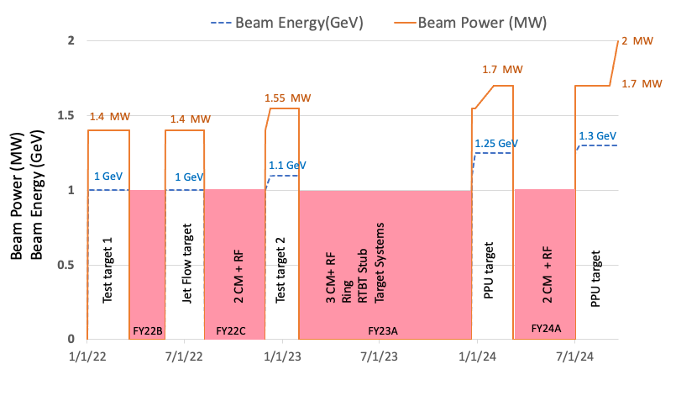
Power Ramp-up and BPLS Certification
Charge: 4
Full BPLS testing during ops
B4-7 Bong
BPLS runs certified
for PPS (baseline)
Baseline plan has BPLS certified for PPS before power goes above 1.4 MW in FY23
We have developed a plan for administrative control of beam power (provides >1 year schedule)

Slide 17
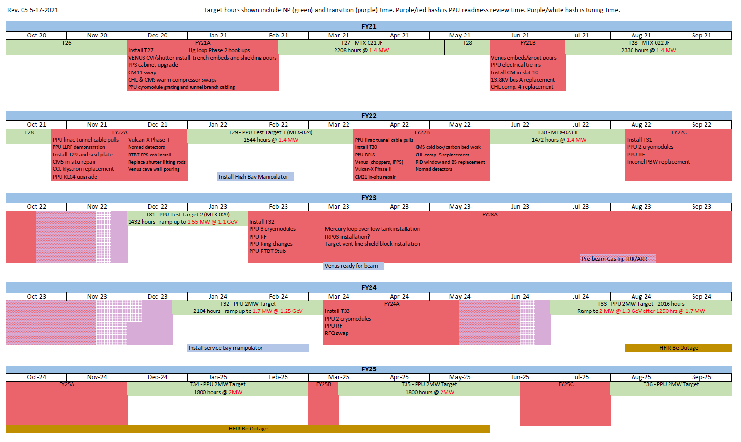


PPU Ring Work and the Outage Schedule
Charge: 4
Installations
begin this calendar year and continue through FY23
Neutron Prod.
Outage
Transition
Tuning
PPU Readiness
Review

Slide 18
Installation Plans
B4-2 Saethre
B4-5 Willis
B4-4 Norman
B4-6 Mahoney
Fall FY2022 (FY22A outage)
  RTBT PPS cabinet
  Main Ring Dipole transformer fans
Summer FY2022 (FY22B outage – Spring 2022):
  Ops will install coated RID window – work planning in progress
  PPU will install optics in tunnel – work planning in progress
  Install second Fast Current Transformer for BPLS
Long outage FY23:
  All magnets – chicane, dipole, idump quad, extraction shims – work planning in progress
  PFN HVAC, and RN-03 upgrade
B4-7 Bong
Charge: 4

Slide 19
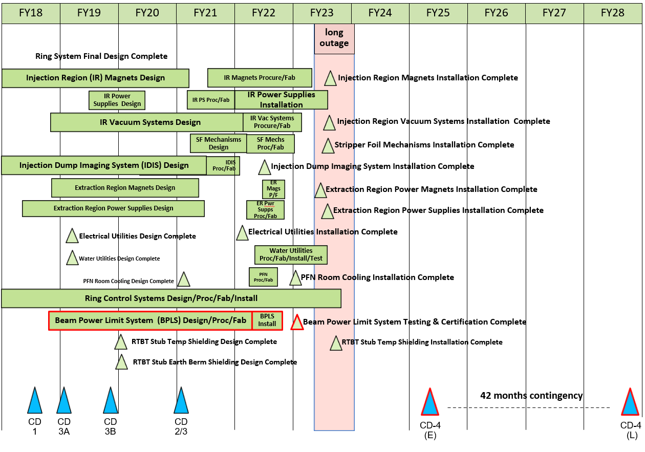
P.4 Ring May 2021 Status Summary Schedule
Charge: 4
Bulk of Ring Systems work takes place during the long outage in FY23

Slide 20
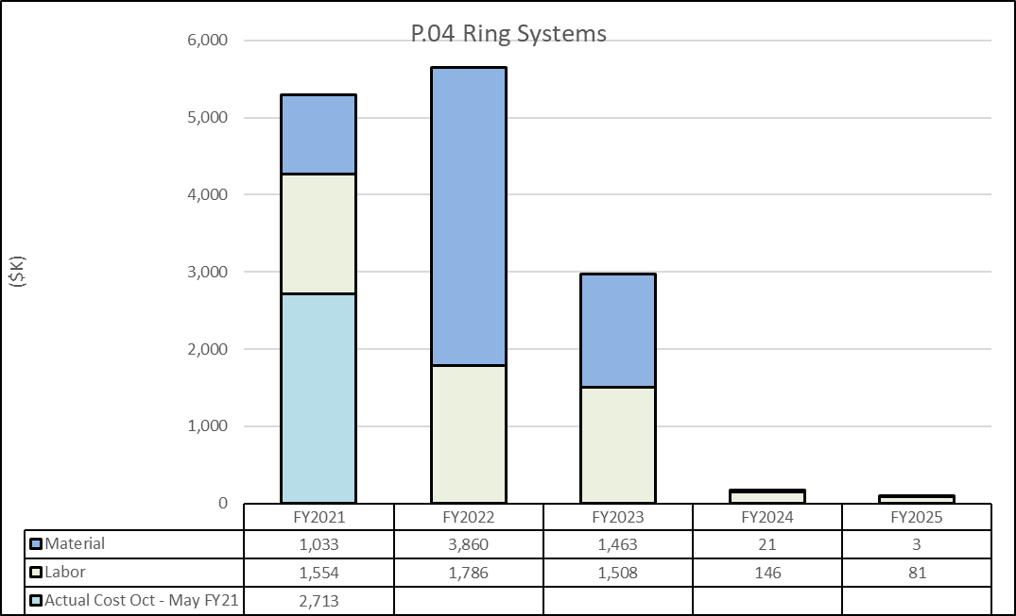
P.04 Material/Labor Charts with FY21 Actual Cost
Oct – May
Charge: 4
FY22 is dominated by the procurement of materials that will be installed over the next two year. Labor is fairly steady.

Slide 21
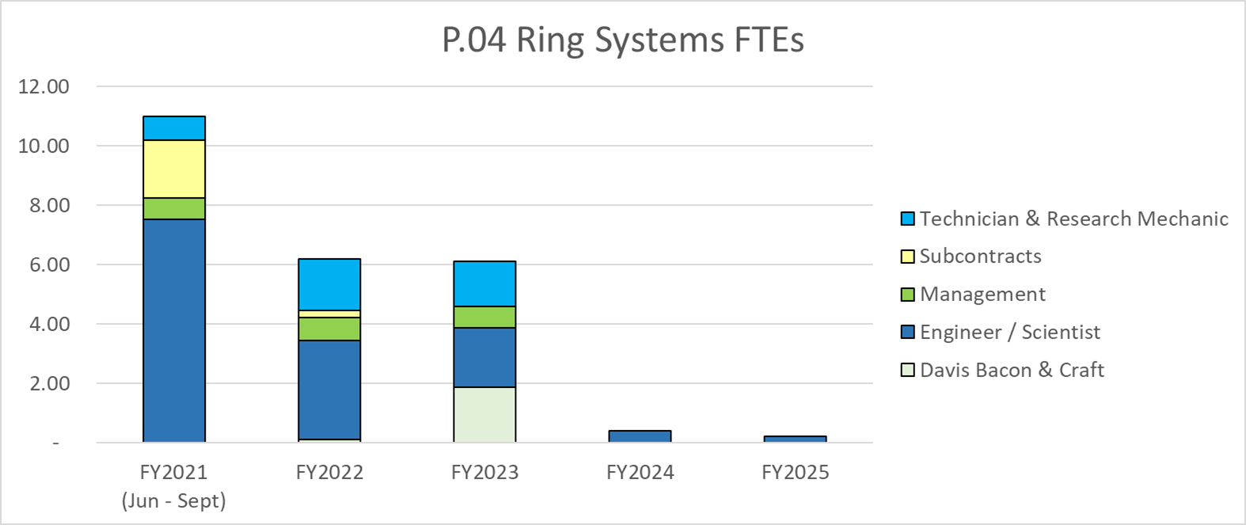
Labor Profile
Charge: 4
Labor profile also reflects the shift from design to procurement and installation over the next two years, with support for power ramp up extending into FY25.

Slide 22
Estimate to Complete
Ring Systems is just under halfway done in terms of spending
Almost all of our procurements are coming up in FY22
FY23 will be dominated by installation activities

Slide 23
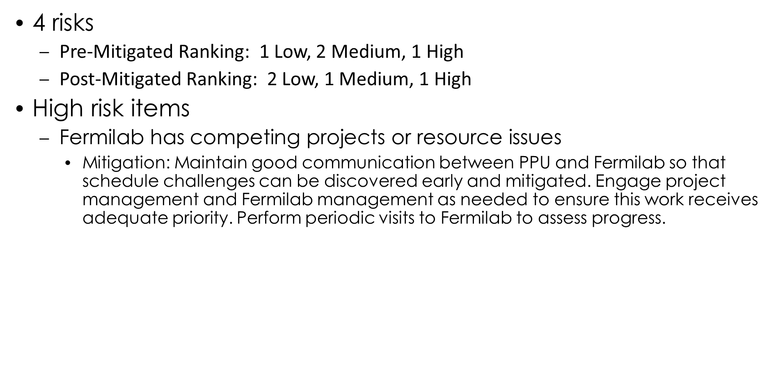
Risk Register
Charge: 5

Slide 24
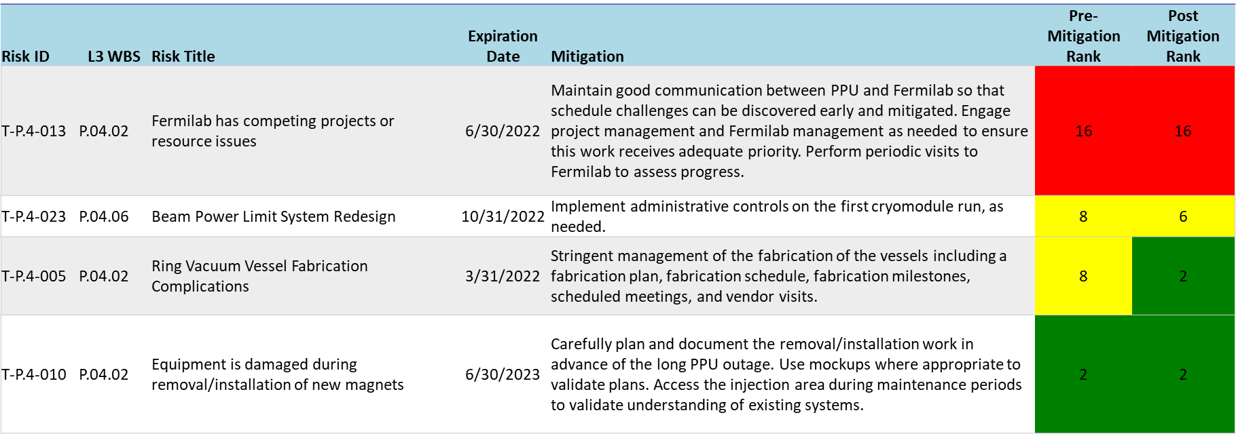
Risks are Identified and Monitored
Charge: 5

Slide 25
Responses to Recommendations
Charge: 6
No recommendations from 2020 Director’s Review
One from CD 2/3 review :
  “By the next DOE IPR, evaluate adding a Risk Registry entry for the Beam-Power Limiting System.”
  evaluated schedule and cost impact of slip in BPLS schedule, mitigation, included in risk register
Three recommendations from 2021 Director’s Review:
  To closely manage the high risk associated with the delivery of injection region magnets from FNAL, establish communication at the Laboratory level as soon as possible.
  Finalize plans for measurements of injection region magnets and monitoring the progress bi-weekly by OPA review.
  Finalize plan for administrative control of beam power as a mitigation in beam power limiting system by OPA review.

Slide 26
12-Month Look-Ahead
Charge: 4
Activity | Finish Date
Install RTBT PPS CAB Replacement | 25-Oct-21
Utilities - Install Substation XFMR Fans | 04-Nov-21
Conduct BPLS Final Design Review Meeting* | 15-Nov-21
Release Drawings and Prepare Fab Package for Vacuum Chambers & Components 100%* | 03-Dec-21
Dump Dipole Production Readiness Review | 04-Feb-22
Utilities - Award contract for PFN Room Cooling Components | 19-Apr-22
Injection Dump Imaging System Installation Testing Complete | 13-May-22
Receive RCPS transformer and diode - 14x Operational | 20-May-22
Receive Injection Dump Quadrupole Magnet | 01-Jun-22
Chicane Magnet Meas - Measure First Chicane Magnet | 03-Aug-22
*will change w/ upcoming PCR

Slide 27
Summary
We’ve made a lot of good progress, but we still have a long way to go
We are transitioning to installations and procurement over the next year
Some setbacks due to COVID, but we have a plan – currently no impact to the power ramp up

Slide 28
Backup Slides

Slide 29
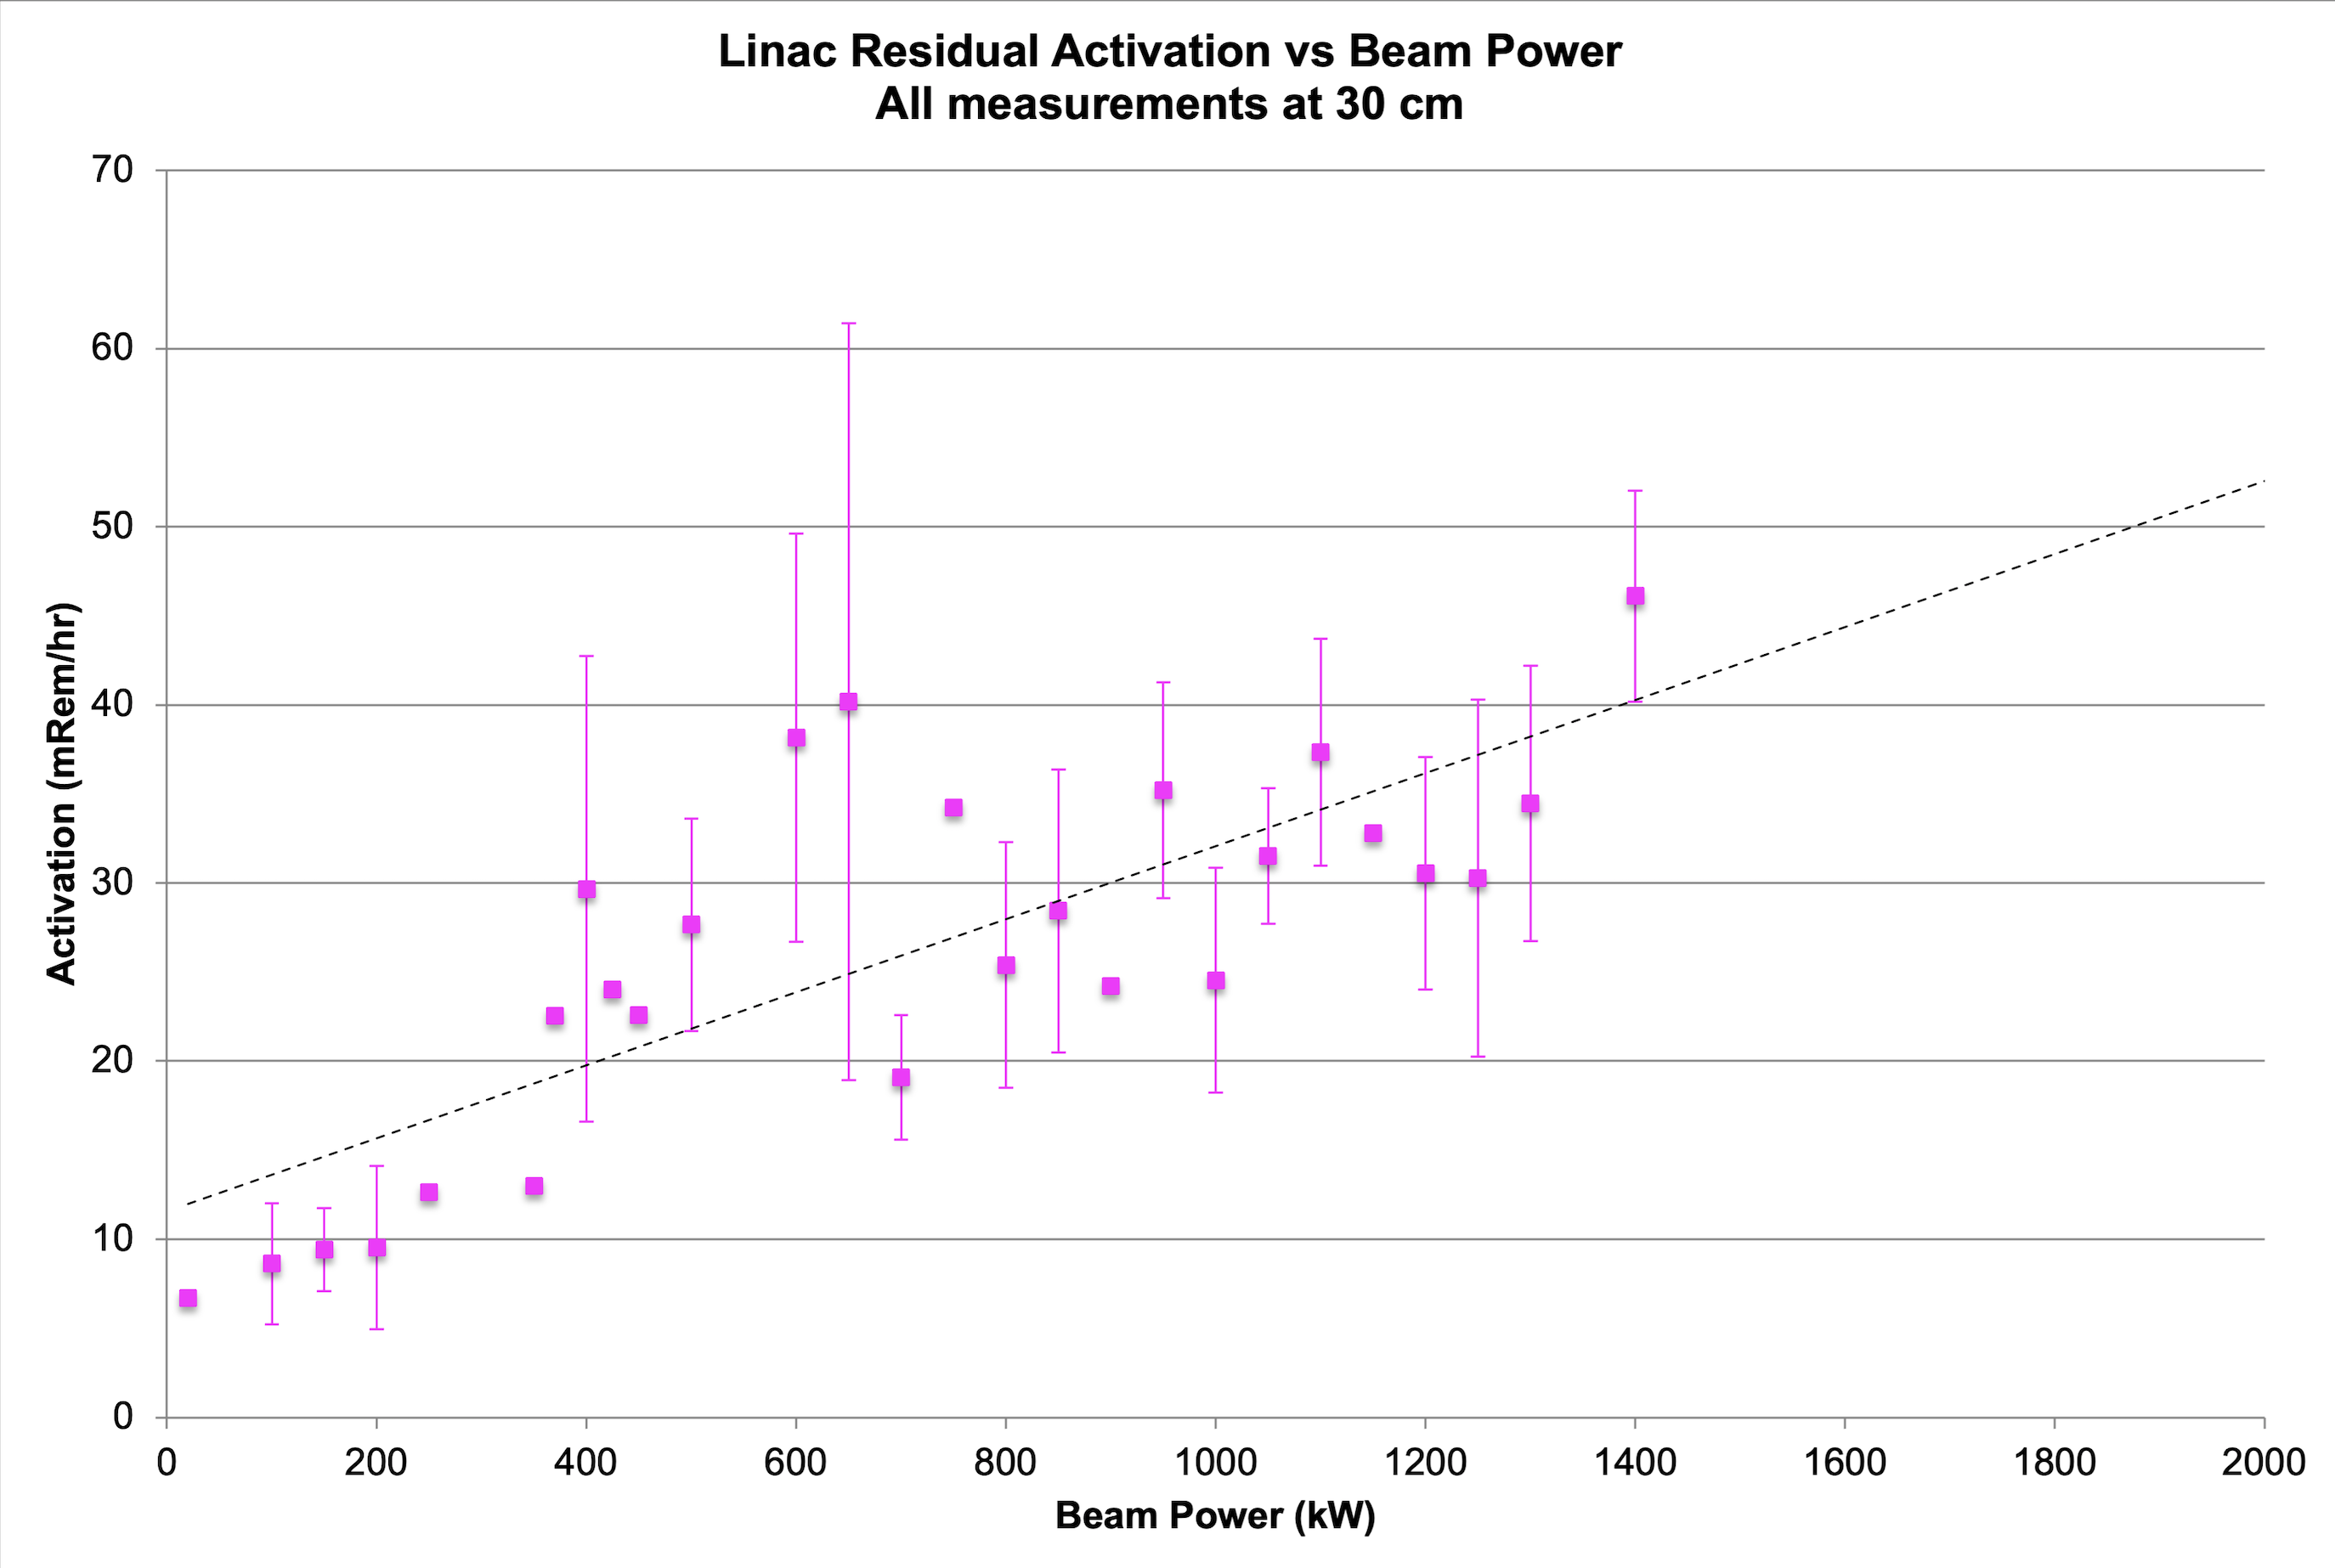
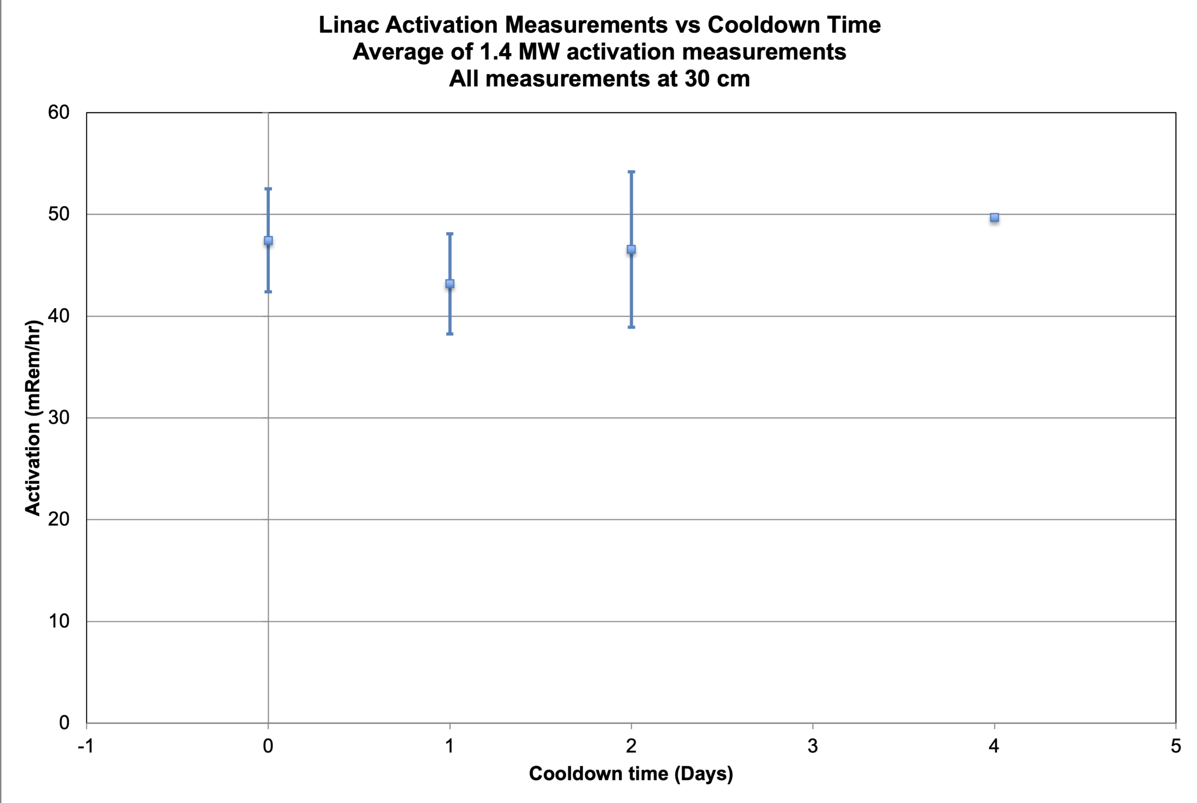
Linac Activation and Cooldown - SNS Historical Data

Slide 30
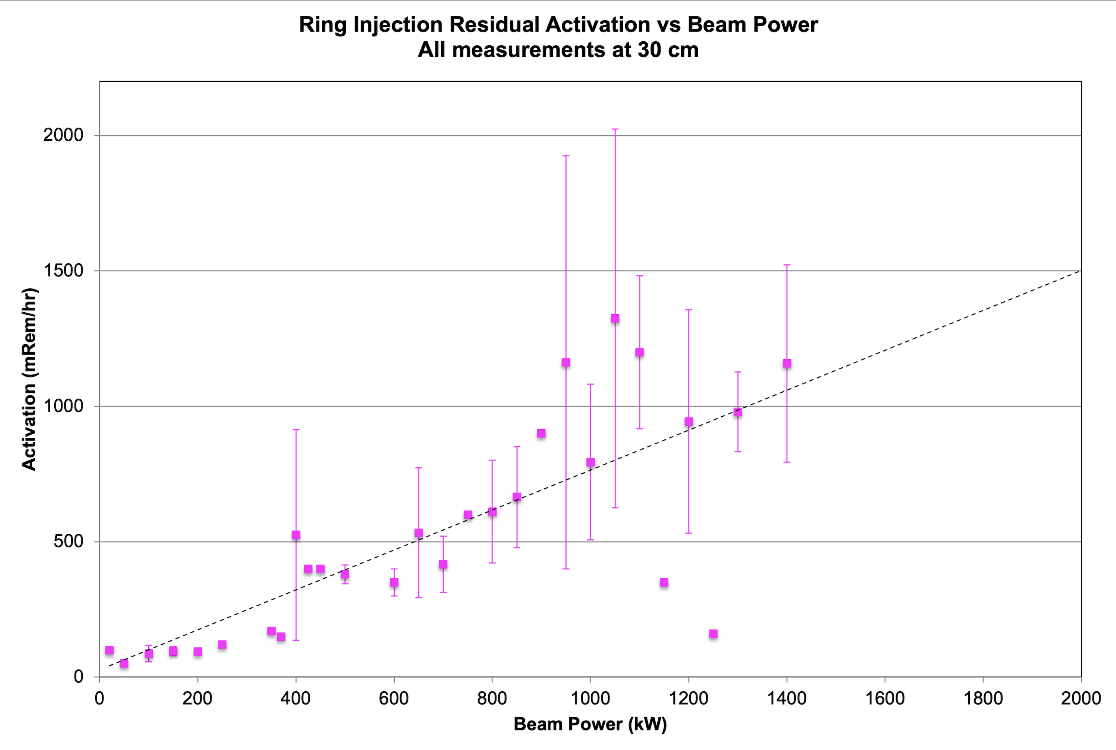
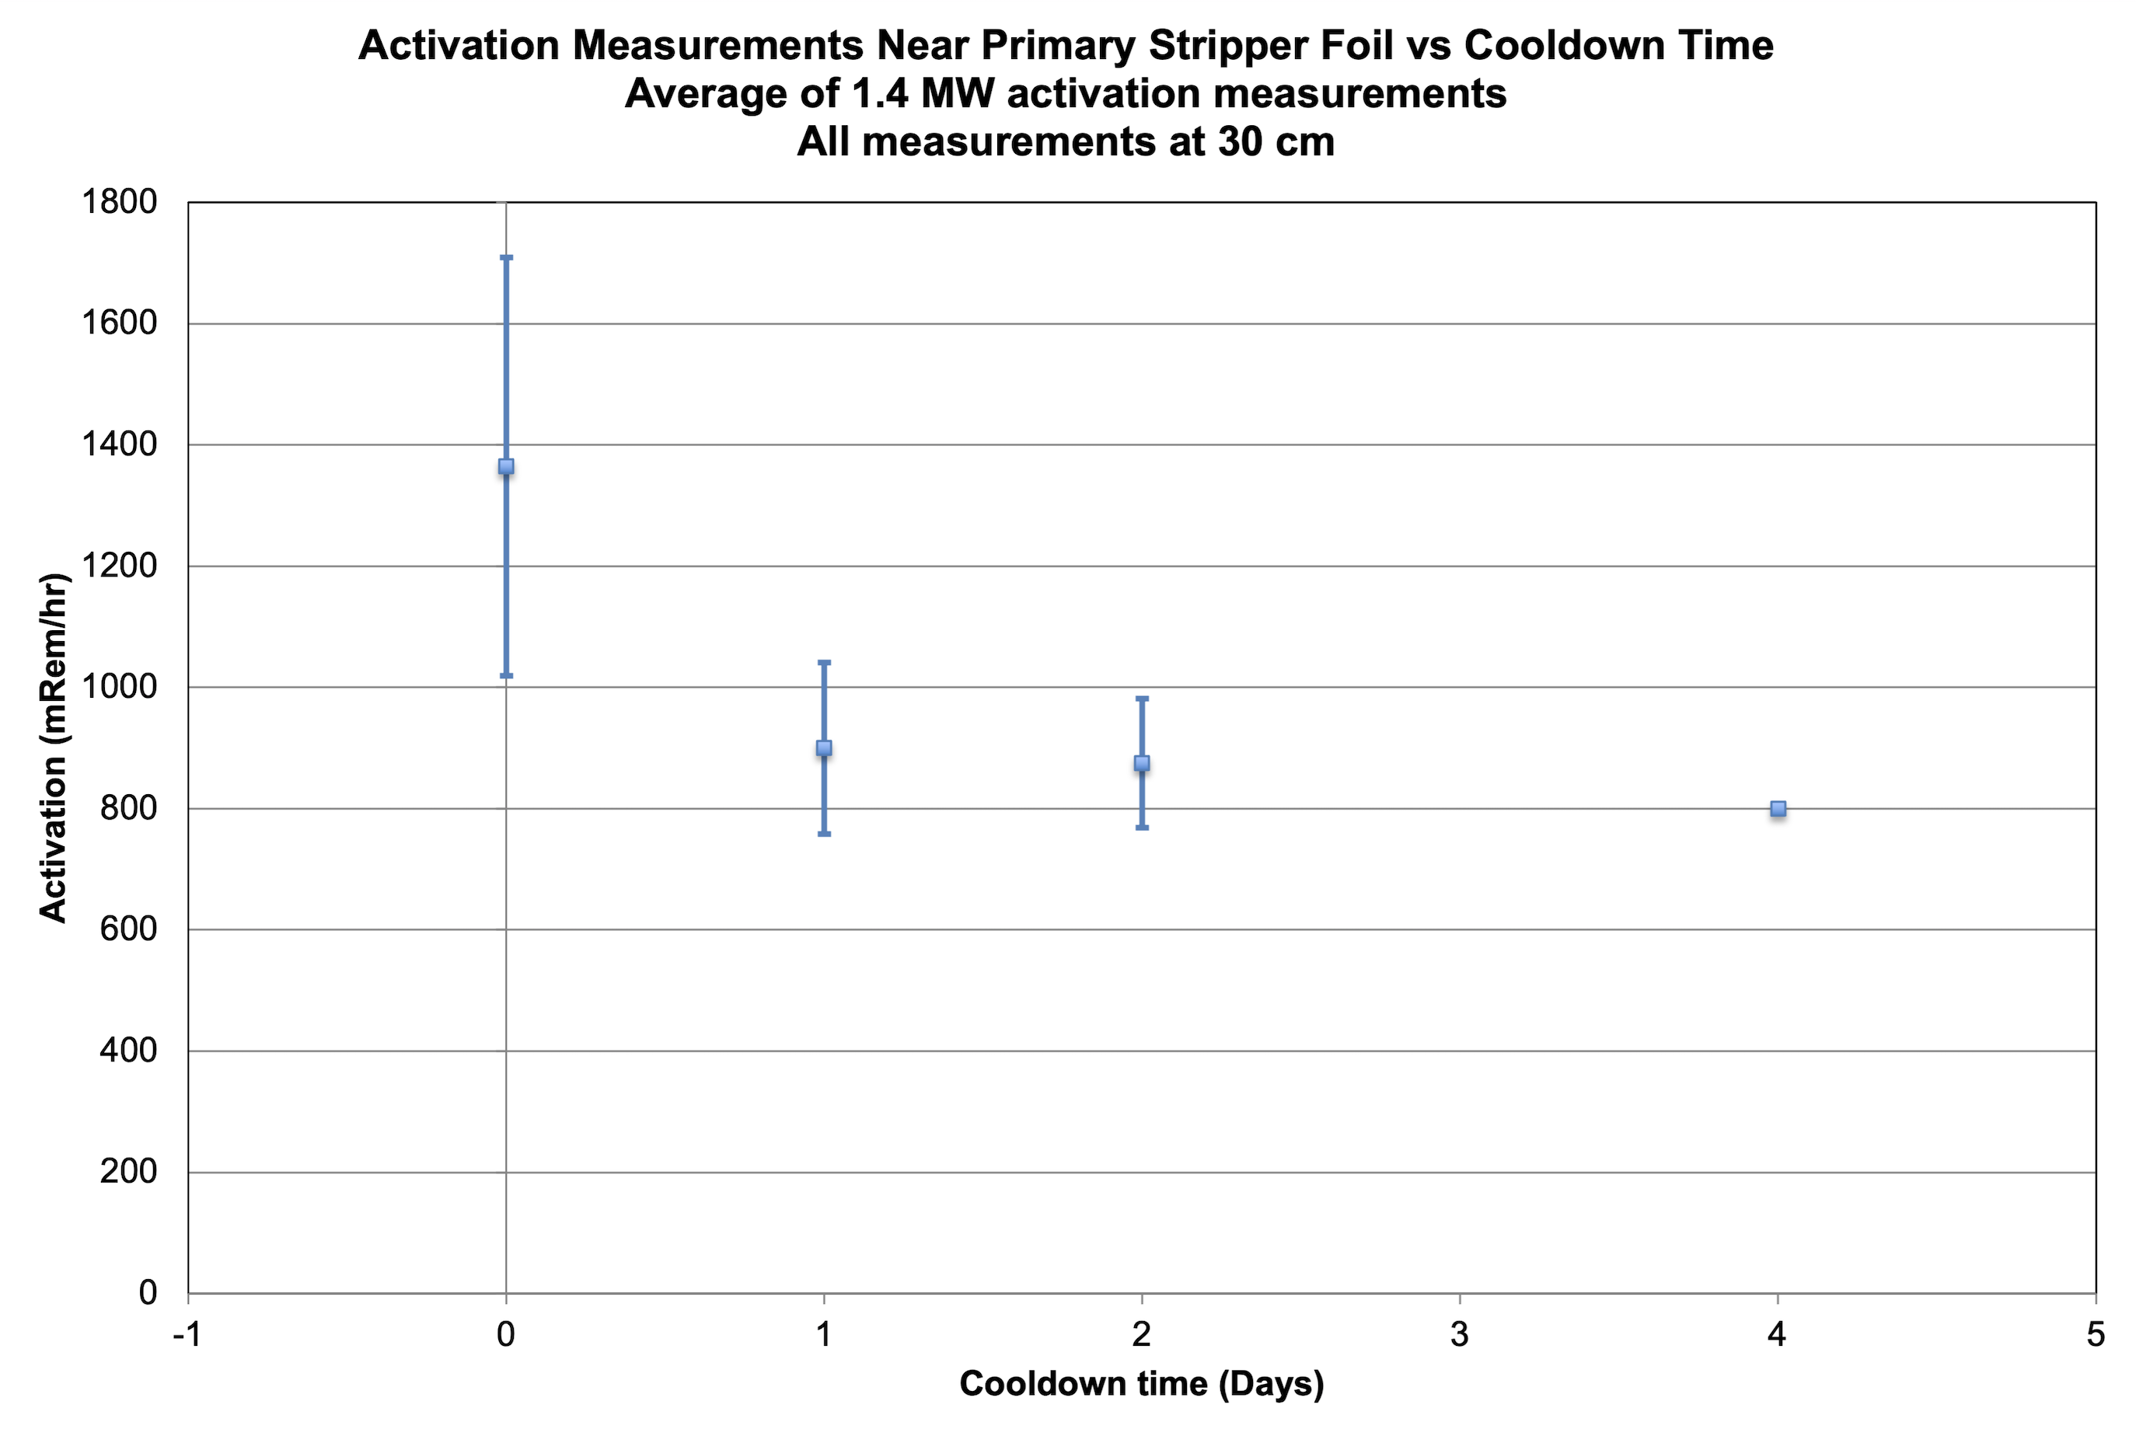
Ring Activation and Cooldown - SNS Historical Data

Slide 31
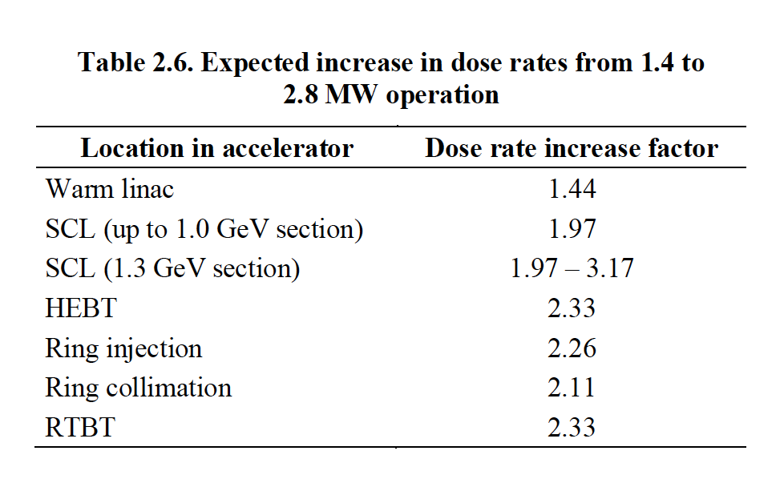

Radioactivation
Mike Plum analyzed activation for PPU in
the CDR. Takeaways:
  SCL losses <1.6x current losses
  Dose rate due to Coulomb scattering at foil
  only ~1.63x higher at 2.8 MW
  Dose rate due to Nuclear scattering at foil ~2.5x higher at 2.8 MW
  Assuming roughly equal contributions currently, dose rate will be ~2.26x at 2.8 MW (or 1.56x higher at 1.3 GeV, 2.0 MW)
We are planning some improvements to the injection region to reduce the time spent working in that area, as well as reducing some of the work done to document foils in the tunnel – a significant source of worker dose
We’re also always trying to bring losses down
*

Slide 32
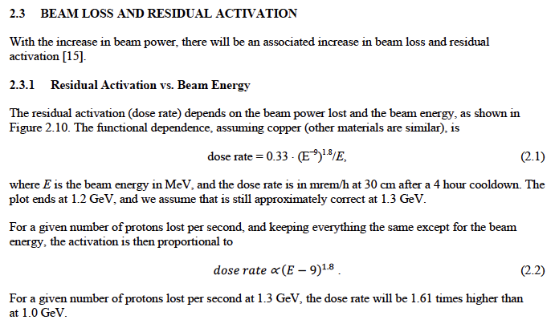
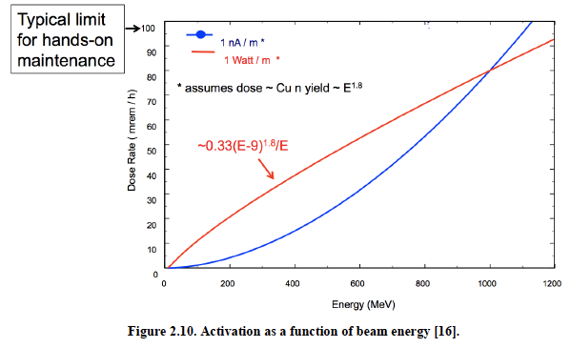

Slide 33
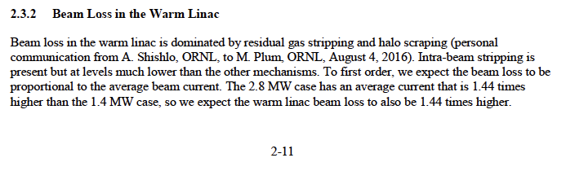

Slide 34
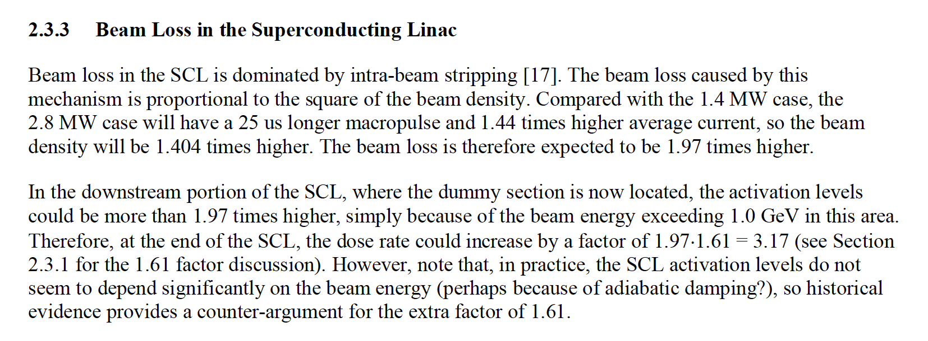
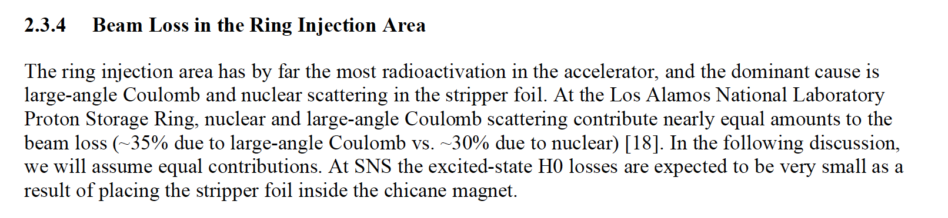

Slide 35
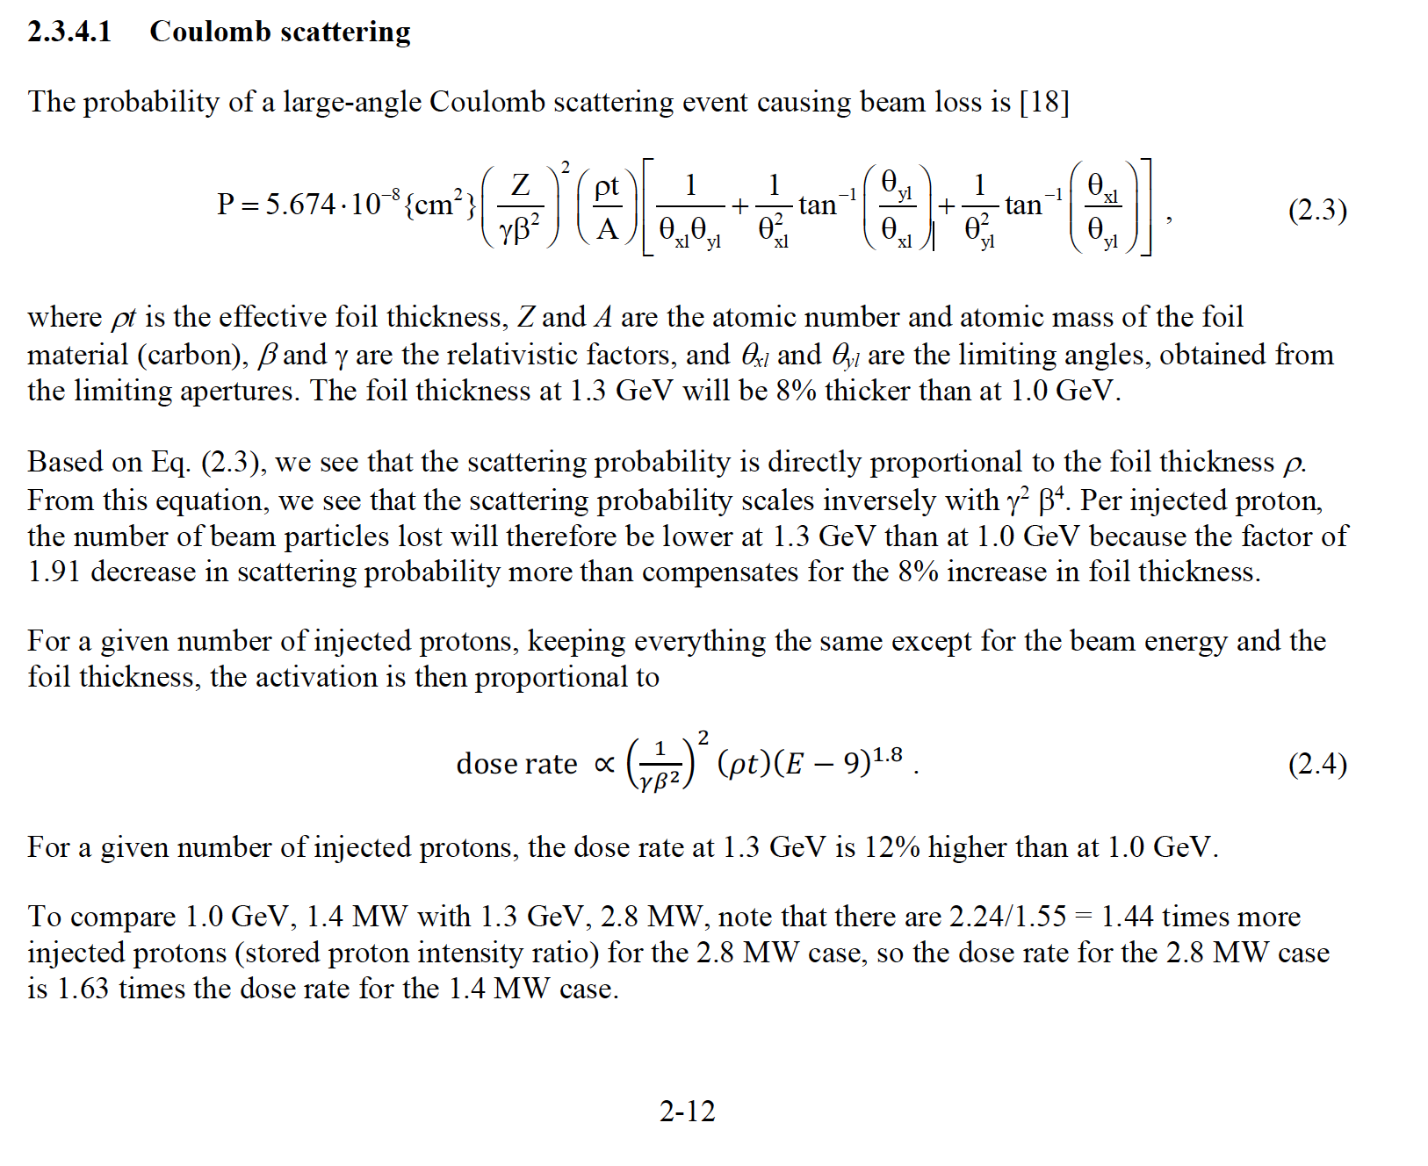

Slide 36
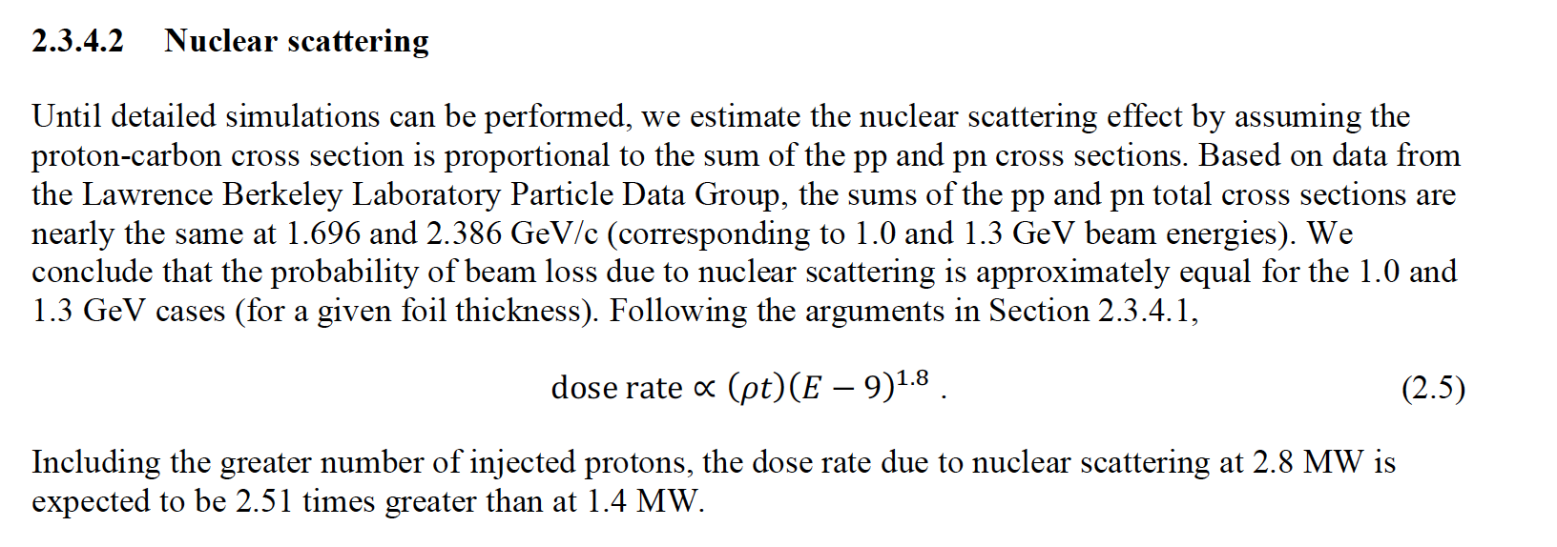
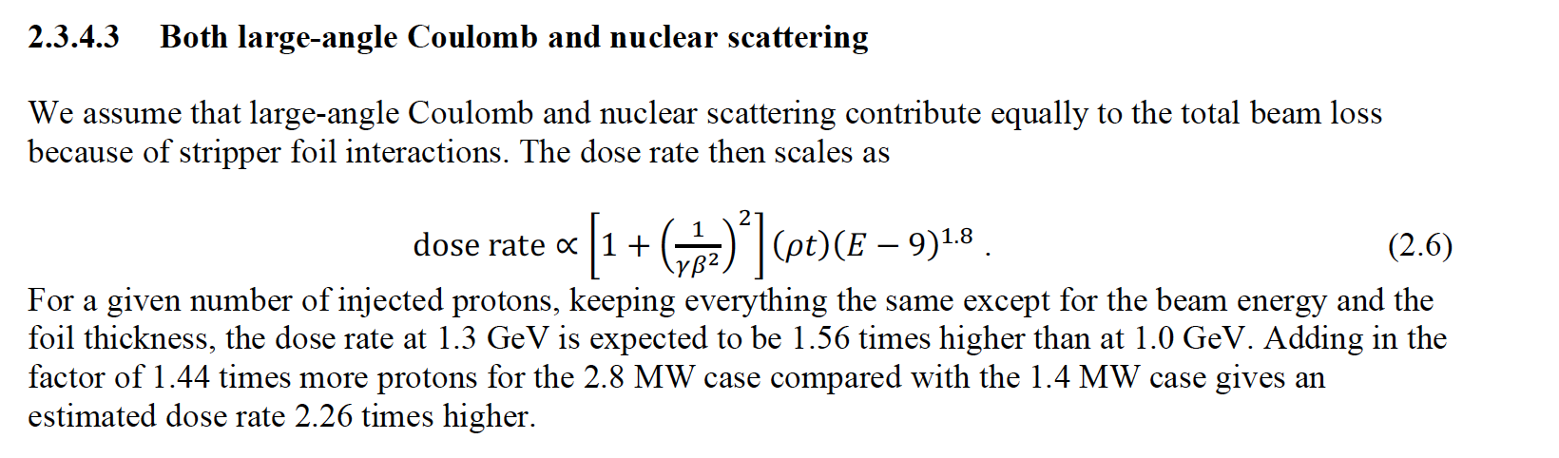

Slide 37
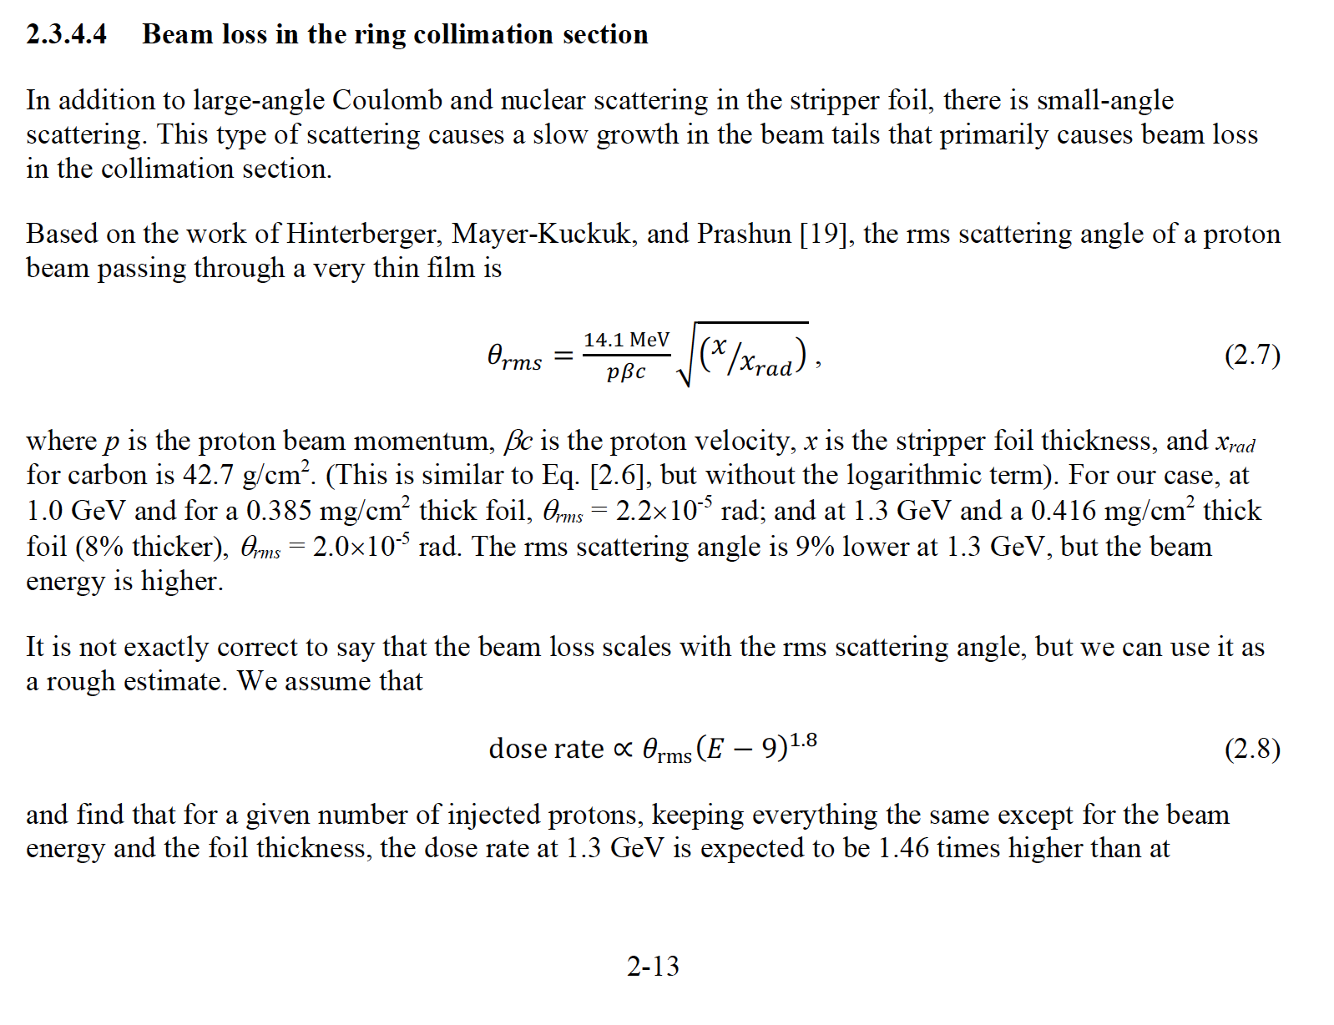

Slide 38
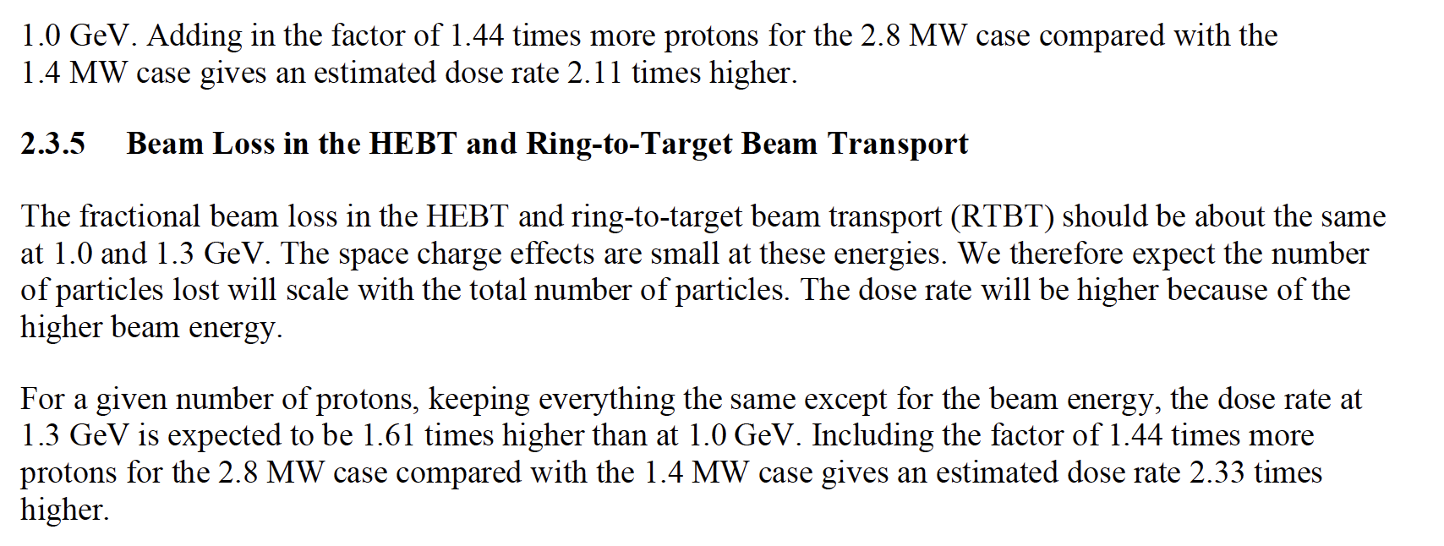

Slide 39
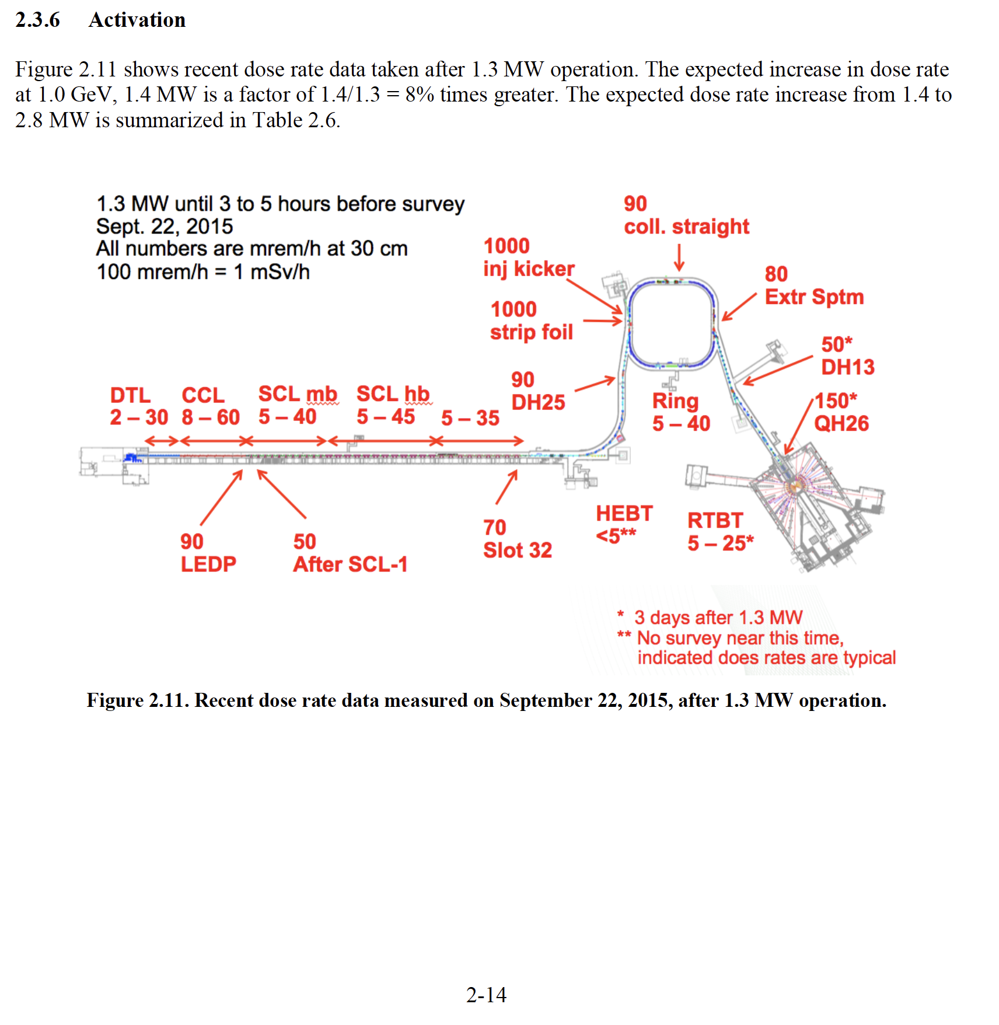

Slide 40
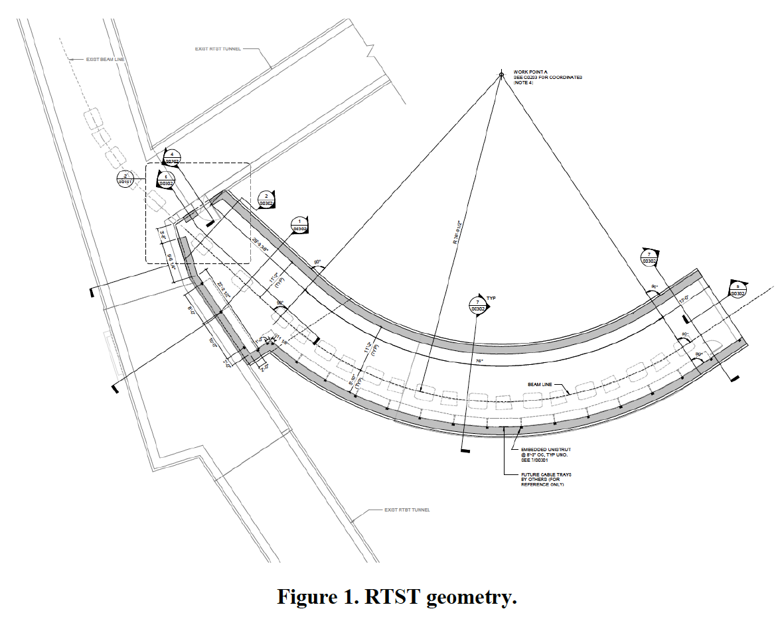
RTBT Stub - Earth Berm is Sufficient
Charge: 1
Calculations to verify that the earth berm above the RTBT stub is sufficient for 2.8 MW operation in the STS era complete (SNS-106100200-DA0110-R00)
Limits:
  0.25 mrem/h at 30 cm from the top of the soil during normal operation
  <10 rem/h for accident cases.
Assumptions:
  2.8 MW operation for accident case
  <1.0W/m losses
  68.58 cm concrete roof
  Min. 495.30 cm of soil

Slide 41
RTBT Stub - Plug Thickness Increased
Charge: 1
Calculations to determine required thickness of stub plug during PPU FTS 2.0 MW operation complete (SNS-106100200-DA0113-R0)
Limits:
  0.25 mrem/h at 30 cm from the top of the soil during normal operation
  <20 rem/h for accident cases
Assumptions:
  2.0 MW operation for accident case
  <1.0W/m losses
540 cm of concrete required
Stacking this shielding during 2023 long outage is included in P.4.7 scope

Slide 42
Accelerator Physics – e-P is not a problem
Charge: 1
Recent 29 uC, 972 MeV, 1.7 MW equivalent test (2.3 MW equivalent at 1.3 GeV)
Tuning up as usual:
collimation losses were observed well in excess of normal operations
Longitudinal bunch profile was more peaked than normal
Rebalancing ring RF to flatten the bunch brought losses back to levels consistent with 1.4 MW operations
We still have plenty of headroom on RF, unused sextupoles and octupoles if the last 16% or so of charge is troublesome during STS era
Bunch Flattened with RF
Ring Losses - Collimation
No flattening attempted
Longitudinal Profile

