Slide 1




P.4.3.2 Injection Dump Imaging System
DOE/SC Independent Project Review of the Proton Power Upgrade Project
Dave Willis
Level 3 Manager for Injection Dump Imaging System
September 14 – 17, 2021

Slide 2
Outline
Scope
Organization
Progress since CD-2/3
Challenges
Final design status
Installation plans
Cost and schedule
Labor profile
Risk register
Responses to recommendations
ESH&Q and COVID-19 impacts
12-month look-ahead
Summary

Slide 3
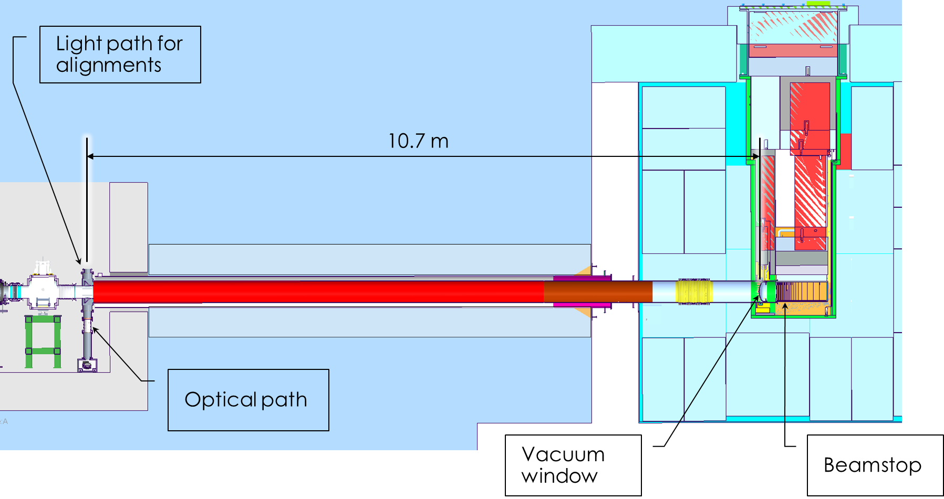
Scope
Charge: 4
Ring Injection Dump (RID) Imaging System
  Design and implement an Imaging System to provide necessary understanding of the steering of beams to the RID. Existing Target Imaging System (TIS) provided foundation for design

Slide 4


































Organization
Charge: 5
P.4 Ring
Nick Evans
P.4.1
Management and System Integration Nick Evans
P.4.2 Injection Region
Robert Saethre
P.4.3 Injection Dump
Charlotte Barbier
P.4.4
Extraction Region Robert Saethre
P.4.6 Ring Control Systems Karen White
P.4.7 RTBT Stub
Nick Evans
P.4.8
Accelerator Physics Nick Evans
P.4.5 Utilities
Greg Norman
P.4.1.1
Management and System Integration
Nick Evans
P.4.2.1
Management and System Integration Robert Saethre
P.4.3.1
Management and System Integration
Dave Willis
P.4.4.1
Management and System Integration Robert Saethre
P.4.5.1
Management and System Integration
Greg Norman
P.4.6.1
Management and System Integration Derrick Williams
P.4.7.2 RTBT Stub Temporary Shielding
Nick Evans
P.4.8.1 Accelerator Physics
Nick Evans
P.4.1.2
Design
Nick Evans
P.4.2.2 Magnets
Robert Saethre
P.4.3.2 Injection Dump Imaging
Dave Willis
P.4.4.2 Magnets
Robert Saethre
P.4.5.2 Main Ring Dipole XFMR
Upgrade
Greg Norman
P.4.6.2 Beam Power Limit
Systems
Patrick Bong
P.4.7.3 RTBT Stub Earth Berm Shielding
Nick Evans
P.4.2.3 Power Supplies
Robert Saethre
P.4.3.3 Injection
P.4.4.3 Power Supplies
Robert Saethre
P.4.5.3 RN-03 DIW
Cooling Upgrade
Greg Norman
P.4.6.3 Personnel Protection System
Kelly Mahoney
Dump Engineering
Review
Melissa Harvey
P.4.2.4 Vacuum Systems
Charlotte Barbier
P.4.5.4
PFN Room HVAC
Greg Norman
P.4.6.4 Ring Injection Section
Controls
Derrick Williams
P.4.2.5 Primary and Secondary
Stripper Foil
Charlotte Barbier
P.4.6.5 Ring Extraction Section
Controls
Derrick Williams

Slide 5
Progress since CD-2/3
Charges: 1,2
12-month Look-Ahead from the CD-2/3 Review (July 2020)
    Complete design
    Initiate all procurement and fabrication
    Plan implementation
We are at 63% complete
There was an increase in BAC of $258k
Added cost driven primarily by going to higher performance telescope and low estimates on cost of goods

Slide 6
Project Change Requests since CD-2/3
Charge: 4
These are the PCRs associated with the change to budgets
Injection Dump Imaging System portion of $1.8M is $150k

Slide 7
Progress since CD-2/3 (cont’d)
Charges: 1,2
Technical and milestone achievements
  Redesigned many of the imaging system components to accommodate larger telescope design and increased aperture.
  Completed design and drawings of imaging system and shielding
  Contracts in place for RID window assemblies, custom telescope, custom mirrors (due late Sept)
  All off-the-shelf components have been received
  All vacuum boundary components ordered (last one to ship 9/28)
  All other fabricated parts are ordered (due Sept)
  Have started discussing work planning with groups that will be involved during installation

Slide 8
Challenges
No significant challenges have been identified that would need mitigation, everything is progressing smoothly
There are no known risks associated with having completed the final design

Slide 9
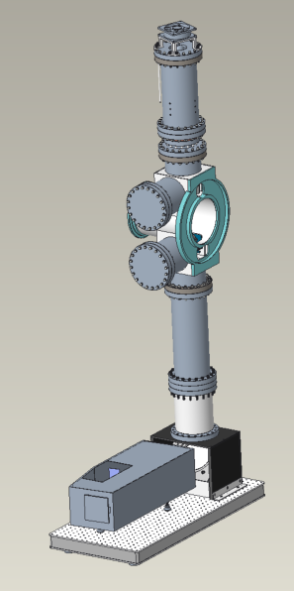
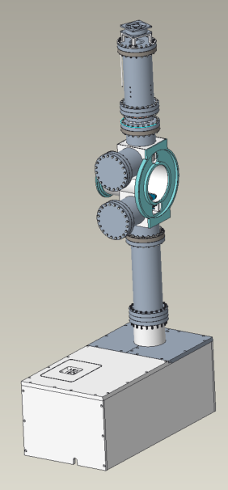
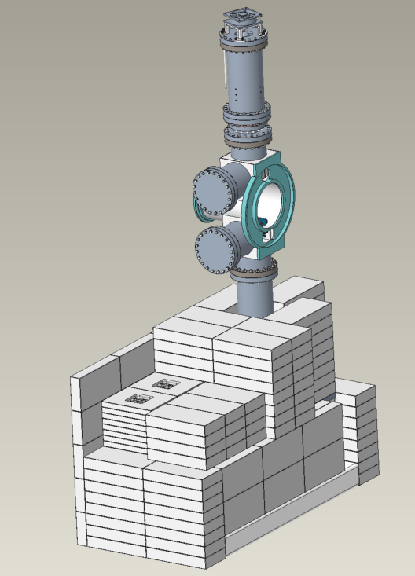
Final Design Status
Charge: 1
Final design is complete

Slide 10
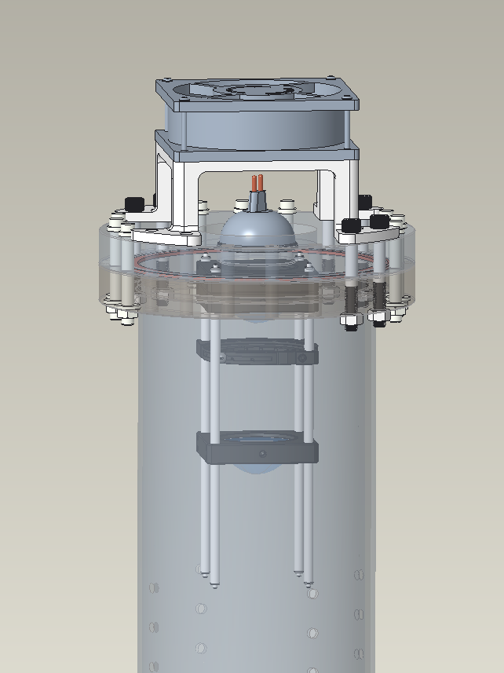
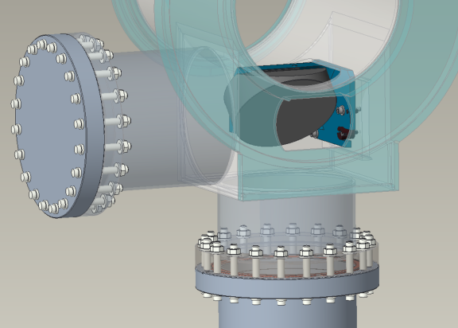
Final Design Status (cont’d)
Custom Turning Mirror
Light Source Assembly

Slide 11
Final Design Status (cont’d)
Original On-Axis Cassegrain Telescope Concept
Off-Axis Schmidt-Cassegrain Telescope
Ray Tracing of Off-Axis Telescope

Slide 12
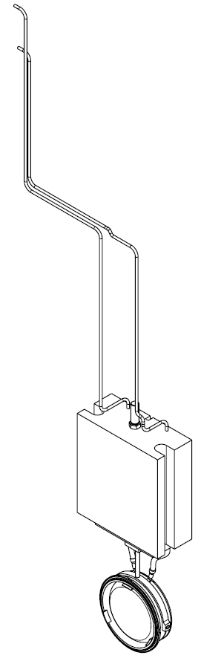
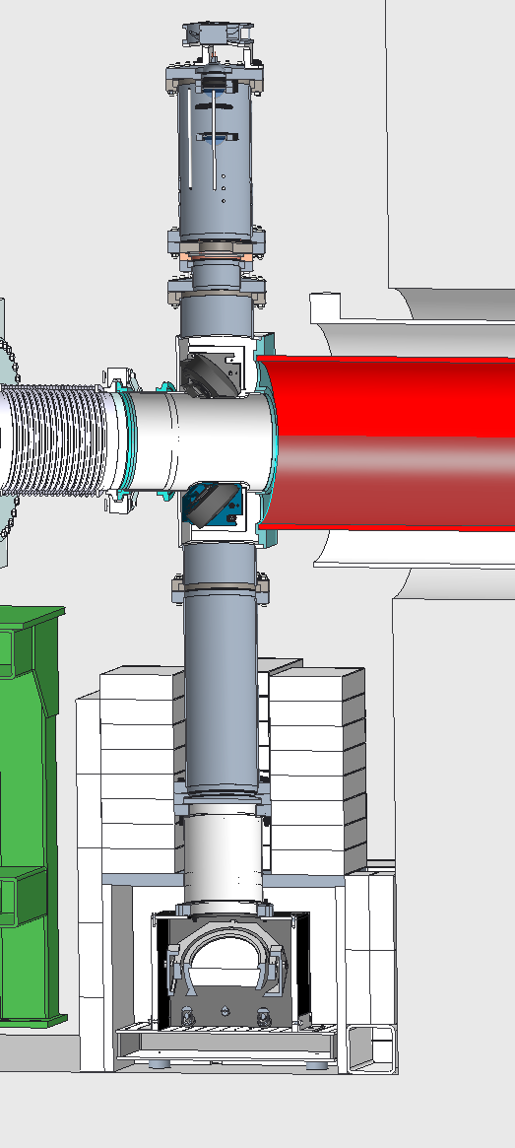
Installation Plans
Charges: 2,5,6
Installation during Spring 2022 outage when RID window and beamstop are replaced, this removes significant radiation source; drives logic ties in schedule
20” outer pipe will be cut back.
Existing flight path (14” pipe) will be cut and a pre-fabricated vacuum vessel welded in place. Coordination with Radiation Safety, Bargaining Unit/Weld Coordinator, Operations, Instrument Engineer
Window assembly to be installed with remote tooling by operations

Slide 13
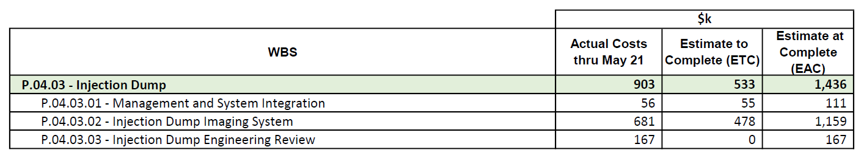
Estimate to Complete
We are at 63% complete based on spending
A lot of the remaining funds are already committed and will accrue this FY

Slide 14
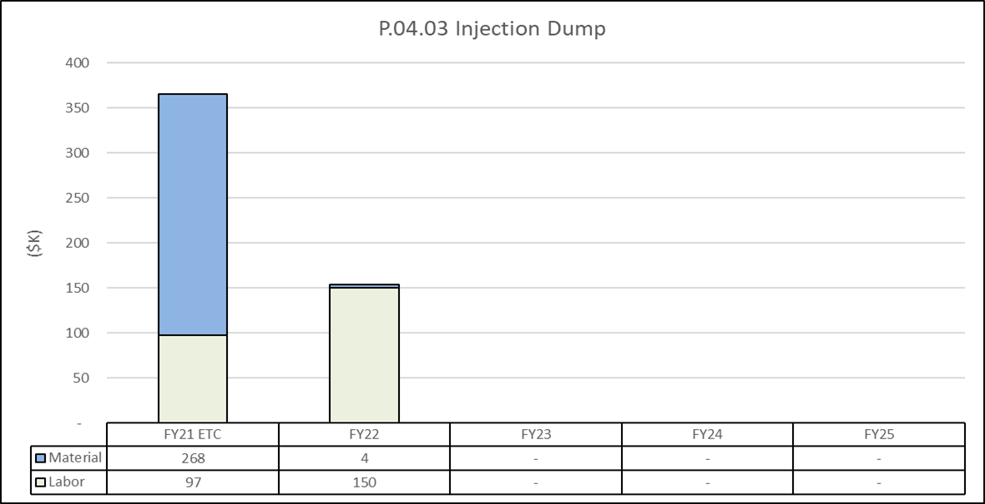
Estimate to Complete by FY
Lots of procurements this fiscal year
Installation and testing labor will dominate next fiscal year

Slide 15
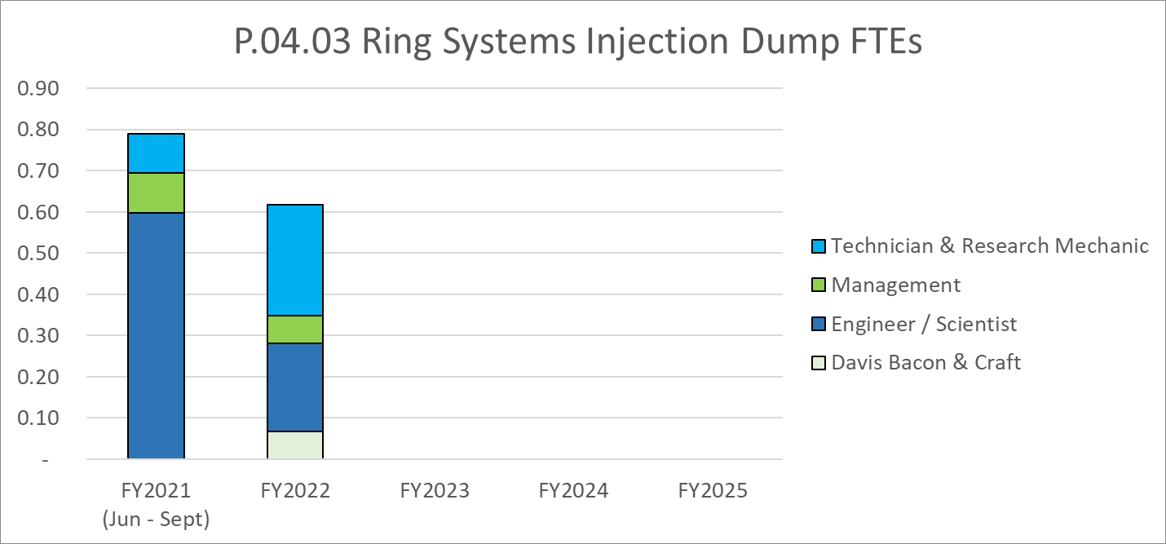
Labor Profile
Less than one FTE for total labor budget
System design (and drawing creation) dominated this fiscal year
Installation and testing will be primary next fiscal year

Slide 16
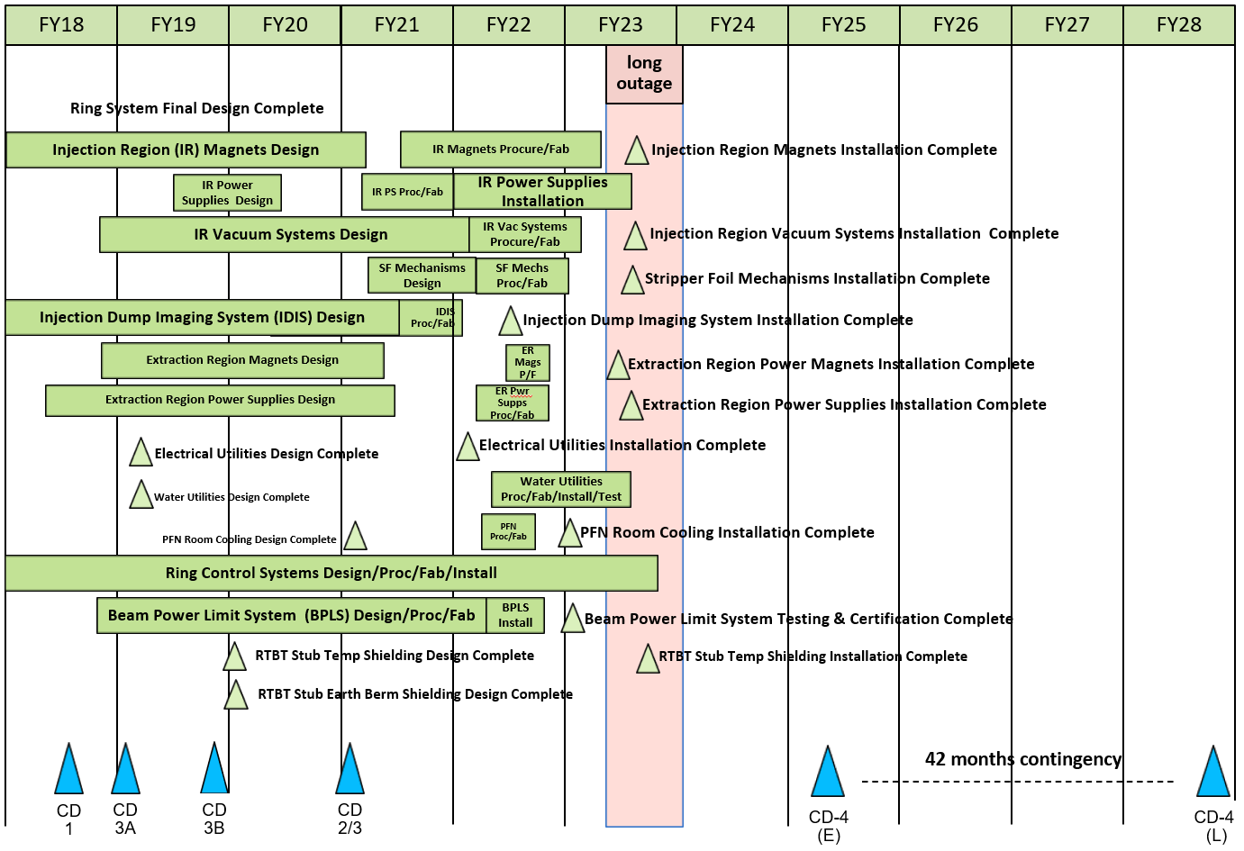
P.4 Ring May 2021 Status Summary Schedule

Slide 17
P.04.03 Injection Dump Risk Register
No active risks identified
  Two risks retired
High Risks
  No high risks identified
Key risk categories analyzed
  Equipment requirements
Risks are reviewed on a regular basis

Slide 18
Responses to Recommendations
Charge: 6
No recommendations from the CD-2/3 review
Recommendations from prior DOE reviews are closed

Slide 19
ESH&Q and COVID-19 Impacts
Charge: 3,4,5
One team member contracted Covid (serious case)
There were some vendor delays, but none of consequence to overall project schedule
Project would have been ready for installation during Winter 2021 outage (original plan)

Slide 20
12-Month Look-Ahead
Charge: 1,4
Receipt of all remaining system components and coated windows
Testing of telescope and mirrors in optics lab
Preparation and finalization of work plans for installation
Installation of coated RID window and Imaging System
Testing of installed Imaging System
Imaging System used to steer the proton beam to the desired position on the RID window

Slide 21
Summary
Charge: x
Design of the Imaging System is complete, all drawings have been completed and released
Contracts are in place for RID windows, custom telescope, and custom mirrors. All are on schedule to be received in August/September 2021
Long lead vacuum boundary components are on order and due by August 2021
Custom fabricated components are on order
All “off the shelf” items have been received
Work planning has begun for late Spring 2022 outage
Thank you for your time. Are there any questions?

Slide 23
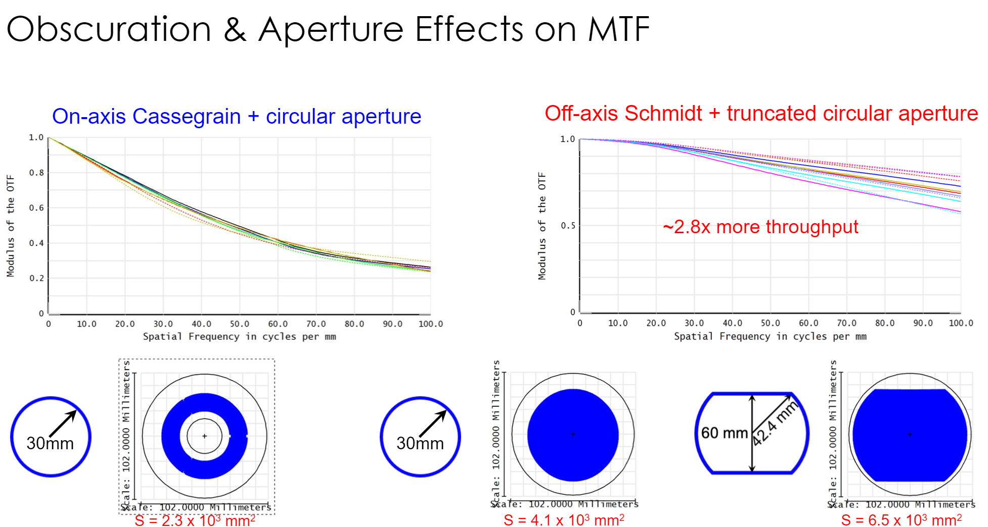
Optical Performance, Modulation Transfer Function Data

