Slide 1
Warm and cold SNS LINAC commissioning
Test Beams at SNS
A. Aleksandrov
9/25/2021
Spallation Neutron Source,
Oak Ridge National Laboratory, TN USA

Slide 2
Outline
SNS accelerator overview
Test beam options at SNS accelerator
  Linac Dump
  Momentum Dump
  Injection Dump
  Extraction Dump
SNS Beam Test facility

Slide 3
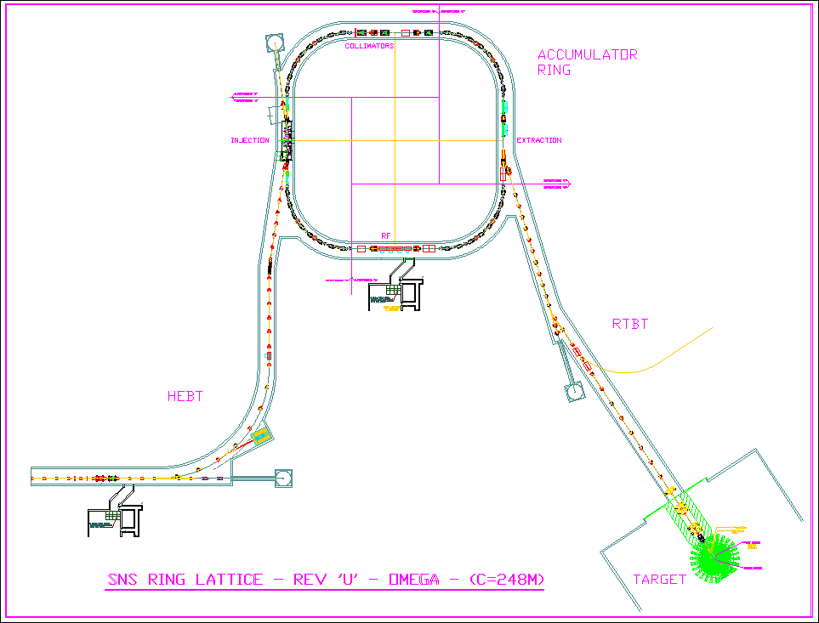
SNS Accelerator Complex
Front-End: Produce a 1-msec long, chopped, low-energy H- beam
LINAC: Accelerate the beam to 1 GeV
Accumulator Ring: Compress 1 msec long pulse to 700 nsec
H- stripped to protons
Deliver beam to Target
2.5 MeV
86.8 MeV
186 MeV
387 MeV
1000 MeV
Ion Source
RFQ
DTL
CCL
SRF, β=0.61
SRF, β=0.81
P beam on target : 1.44MW
I beam average: 1.44mA
Maximum Beam energy: 1 GeV
Duty factor: 6%
Rep. rate: 60Hz
Pulse width: 1ms
Current
1ms

Slide 4
SNS linac beam pulse temporal structure
Macro-pulse
structure (made by the Ion Source)
16.7ms (1/60 Hz)
~50mA
15.7ms
1ms
Mini-pulse
modulation (made by the chopper)
945 ns (1/1.059 MHz)
645 ns
300 ns
260 micro-pulses
Micro-pulse
structure
(made by the RFQ)
2.4845 ns (1/402.5 MHz)
~40mA

Slide 5
SNS ring and target beam temporal structure
Beam pulse structure in accumulator ring
Current
1ms
Beam pulse structure at neutron target
16.7ms (1/60 Hz)
~33A
700ns
~33GW
peak power
~23kJ per pulse

Slide 6
Beam access opportunities
Injection Dump
Momentum Dump
Extraction Dump
2.5 MeV
86.8 MeV
186 MeV
387 MeV
1000 MeV
Ion Source
RFQ
DTL
CCL
SRF, β=0.61
SRF, β=0.81
Linac Dump
Very dense equipment placement
no access

Slide 7
Beam modes
Neutron production
  4500 – 5000 hours per year
  Beam parameters and trajectory strictly controlled
    Small beam fraction can be diverted at several locations
Beam study
  <800 hours per year
  Beam parameters are variable
  Bam can be sent to different destinations

Slide 8
Linac Dump beam line
7.5kW average beam power
Any temporal structure
  40mA, 1ms , .3Hz
  40mA, 5us, 60Hz
Passively cooled
Beam energy
  .2-1. GeV in beam study mode
  1 GeV in production mode
Can be used during production
  laser stripper to divert beam

Slide 9
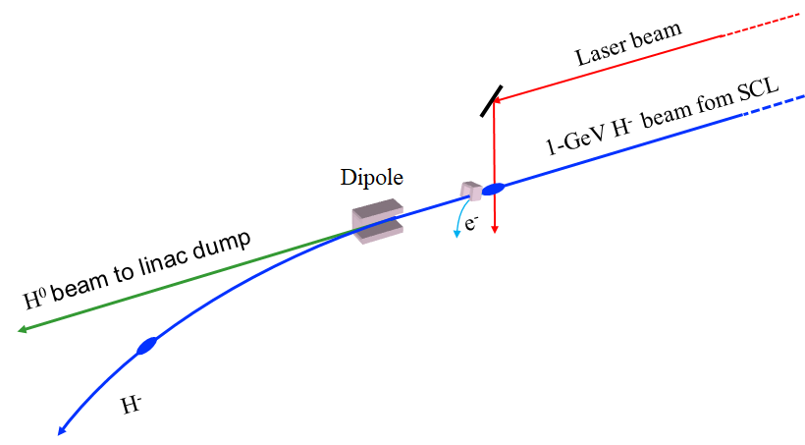
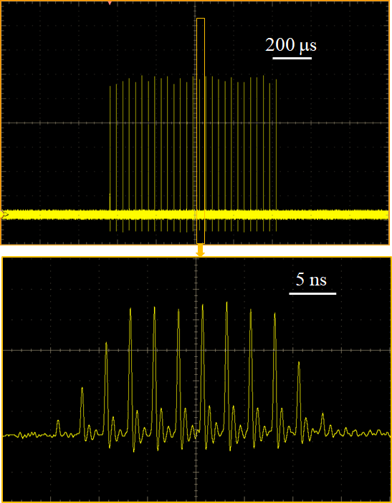
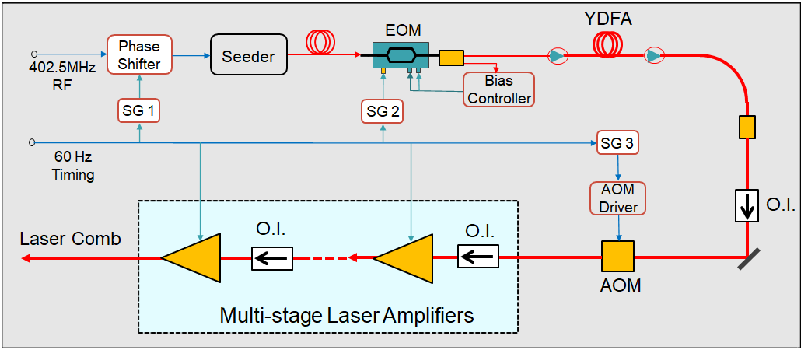
Nonintrusive 1-GeV H⁰/p⁺ beam extraction at the SNS linac dump
1-GeV/1.3-GeV H⁰ beam can be extracted to the linac dump using laser beam
Beam extraction can be conducted at 1 Hz to 60 Hz
Temperal structure of H⁰ beam is variable from a few micro bunches to the entire macropulse
Estimated extraction charge is 5 nC per macropulse with the current laser system and can be increased by an order of magnitude with more amplifiers or power recycling setup. (300W – 3kW)
Courtesy Yun Liu
Example of temporal structure
Laser-based beam extraction scheme
Developed laser system

Slide 10
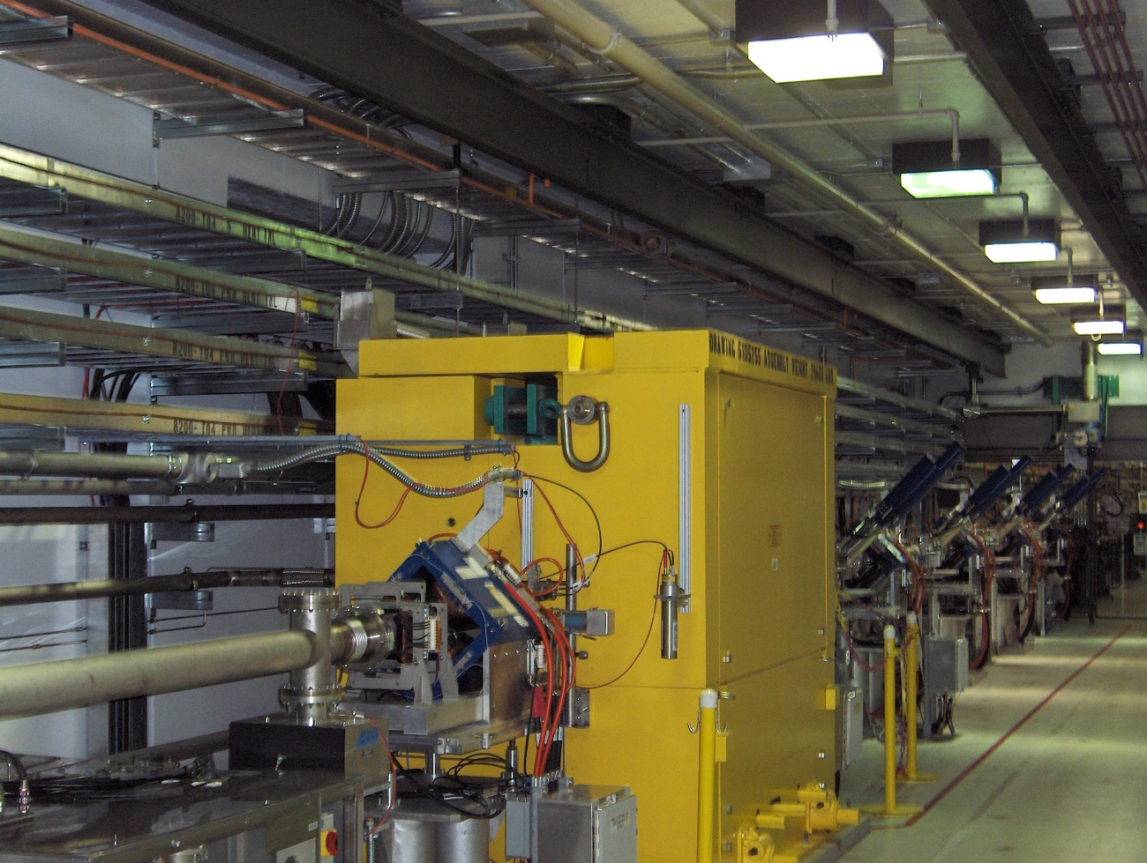
1GeV, 2kW shielded beam absorber
~ 6’ x 6’ x 6’
Closed loop water cooling

Slide 11
Momentum Dump
5kW average beam power
Any temporal structure
  40mA, 1ms , .2Hz
  40mA, 3us, 60Hz
Forced air cooled
Beam energy
  .2-1. GeV in beam study mode
  1 GeV in production mode
Can be used during production
  Foil stripper to divert beam

Slide 12
Injection Beam Dump
150kW average beam power
Any temporal structure
  40mA, 1ms , 6 Hz
  40mA, 100us, 60Hz
water cooled
Beam energy
  .2-1. GeV in beam study mode
  1 GeV in production mode
Can be used during production
  ~1mA peak current

Slide 13
Extraction Beam Dump
7.5kW average beam power
Short pulse temporal structure
  40mA-40A
Passively cooled
Beam energy
  .8-1. GeV in beam study mode
Can not be used during production

Slide 14
Current BTF layout in RFTF Annex building (8320)
Particles | H⁻ | H⁻,p
Energy | 2.5 MeV | 2.5MeV
Current | < 50 mA | <50mA
Pulse width | < 1 ms | <50us
Rep rate | < 60 Hz | <10Hz
Beam Power | < 7.5 kW | <65W
High Power
mode
Low Power
mode

Slide 15
BTF beam line straight line layout
High power
beam stop
FODO
HDR
emittance
6-D scan
Moderator Test Stand (MTS)

Slide 16
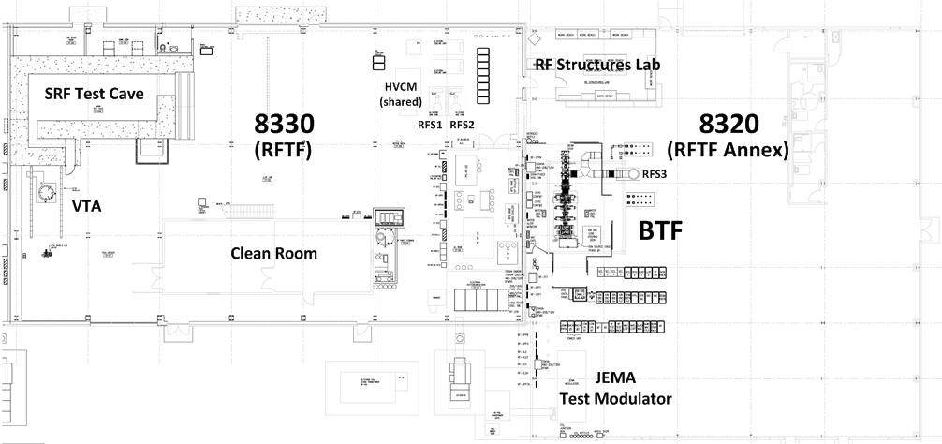
Feasibility of BTF upgrade for higher energy, more high-power test stations
Pros
  Significant infrastructure available: RF power, cooling water, cryogenics
Cons
  Radiation shielding will be required for whole facility

Slide 17
Summary
High energy test proton beam can be available for experiments at several locations in SNS accelerator tunnel
  There is no existing infrastructure for test stations
Low energy test proton beam can be available for experiments at Beam Test Facility

