Slide 1
ADS Workshop Introduction and Goals
ADS Workshop
September 24, 2021
Fulvia Pilat

Slide 2
New science and application opportunities at the SNS To be discussed at the NScD Neutron Advisory Board, Oct 1 2021
At 1.4 MW the SNS linac is the highest power proton accelerator in the word. The facility will be capable of 2.8 MW after the execution of the PPU upgrade
A high power linac is the optimal driver for applications such as:
irradiation facility (SEEMS)
intense muon source (muSR)
accelerator driven system (ADS)
material testing for nuclear fusion
Existing accelerator-driven neutron facilities (ISIS, J-PARC, SINQ) have leveraged their capabilities (existing muSR facilities, ADS test targets, etc.), and the ESS is planning too
Dedicated ADS facilities are being
built in Europe and China

Slide 3
Overview Strategic Applications for the SNS Facilities
Application | Beam Energy Required | Method | New Conventional Facilities Y/N | New Conventional Facilities Y/N | Status
SNS Production Accelerator
muSR / SEEMS facility | 1 GeV | Laser strip diversion of pulse from H⁻ linac | Yes |  | Proposal
Fusion materials testing | 1 GeV | New target surrounding mercury target | No |  | Concept proposal
Nuclear data for ADS? | 1 GeV | Utilize beam from linac injection dump ? | Yes - Minimal |  | Being studied
Beam Test Facility
Moderator Test Facility | 2.5 MeV | Divert beam from BTF | No |  | Proposed AIP

Slide 4
Accelerator Driven Systems
Spallation Neutrons
High-power proton accelerator
~1-2 MW for demonstration
10+ MW for industrial scale system
Applications:
Transmutation of nuclear fuel
Energy generation
Expertise on accelerators
and reactor at ORNL
Subcritical reactor
chain reaction sustained by spallation neutrons

Slide 5
Workshop Goals
Participation from FFESD, NScD, STS
GOALS:
Surveying history and status of ADS
Identifying realistic test activities and program at ORNL
Planning future activities
Exploring future funding opportunities

Slide 6
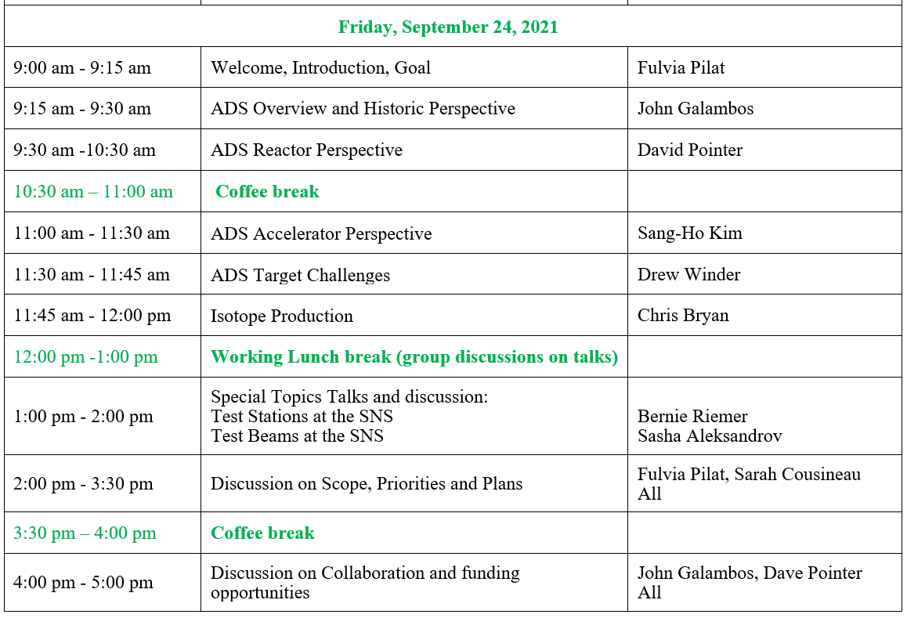
AGENDA

