Slide 1
Accelerator Perspective for ADS (internal use only)
Presented at the
ADS Workshop 2021
ORNL
September 24, 2021
Sang-ho Kim
Accelerator Systems Section
Research Accelerator Division, NScD

Slide 2
Outline
High power hadron machines
State of the art is superconducting linear accelerator (SCL)
Beam power/beam energy for ADS
Achievable with existing technologies
Beam trip frequency requirement for ADS
Need more studies and assessment
What are the ‘REAL’ benefits of accelerator driven sub-critical reactors?
May need separate assessment for strong case(s)
Summary

Slide 3
High power hadron machines
Fusion Material Irradiation
ADS
Neutron scattering
High energy physics

Slide 4
Modern high power linacs
Most (all) of high-power machines under construction/design are based on Superconducting RF (SRF) technology
Higher efficiency (grid power to beam)
Smaller beam loss (large bore)
Operational flexibility (large energy acceptance)
Shorter linac length (high gradient)
Availability/reliability is machine (application) specific
Most of machines aims at > 90 % availability
ADS requirement is tougher (will discuss later)
Notes:
One of kind…

Slide 5
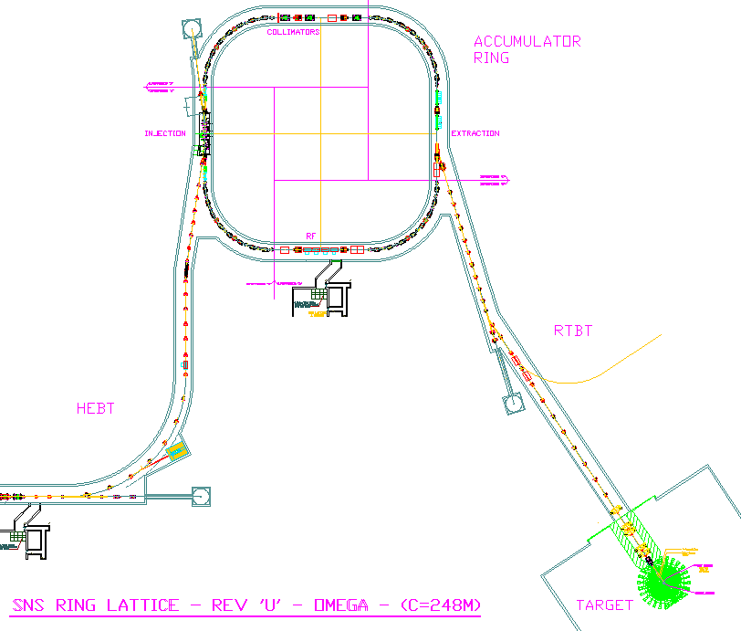
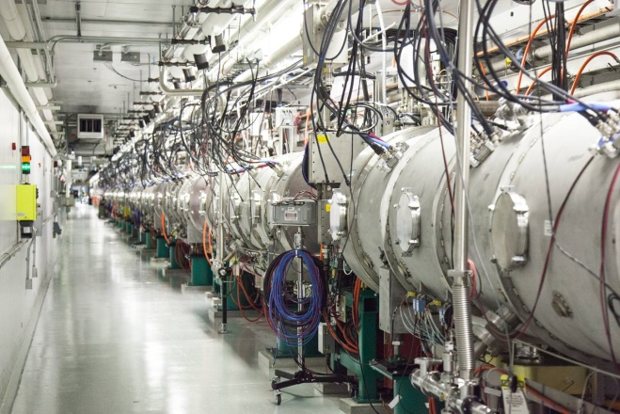
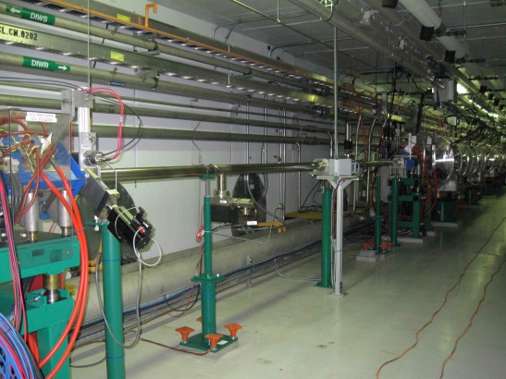
SNS Superconducting Linac (SCL)
Accumulator Ring
SNS SCL is the world first mega-watt class hadron linear accelerator using SRF technology
Successful deployment of SRF technology and highly reliable operation of SNS SCL encouraged other high power accelerator projects around world to adopt SRF technology
259 m
1300 MeV
157 m (SCL)
71 m
FE
DTL
CCL
SRF, β=0.61
SRF, β=0.81
upgrade
Liquid Hg Target
186 MeV
1000 MeV
Empty slots
for upgrade
SNS SCL system (including all supporting systems) is routinely running at 98 % availability
Cryomodules
in the tunnel

Slide 6
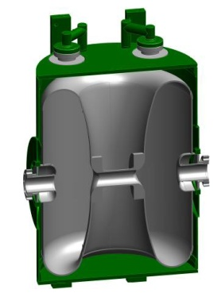
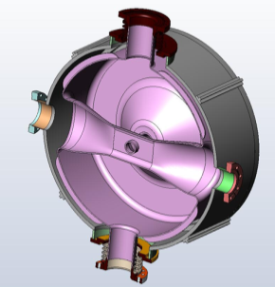
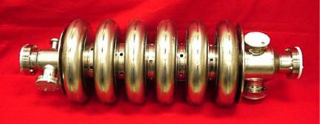
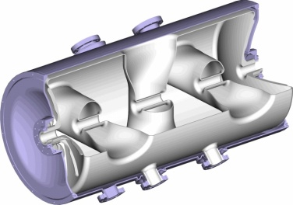
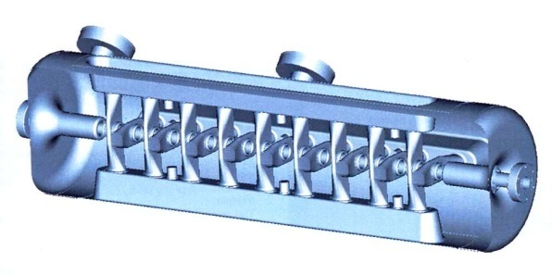
SRF accelerating structures
SRF applications are expanding to lower beam velocities (β =v/c)
β=0
β=1
0.05
0.1
0.25
0.5
0.8
SNS SCL range

Slide 7
High-power hadron SCLs under development
ESS: pulsed (4% beam duty), proton, 14 Hz, 2 GeV, 62.5 mA peak, 2.5 mA average, 5 MW
PIP-II: CW capable, H-, 0.8 GeV, 2 mA chopped, > 1 MW capable
FRIB: CW, p to U, >200 MeV/u, 0.7 emA (U-238), 0.4 MW

Slide 8
High power CW proton accelerator for ADS
Beam power (at 1 – 2 GeV), $P_{b}\sim \frac{1}{2}\left(1−k_{eff}\right)P_{th}$, P_{th}: reactor thermal power
Cyclotron
A few MW is limit: multiple cyclotrons for high beam power
Beam energy is limited to 500 ~ 600 MeV
Linac
Accelerator design for ADS in 1990s: based on normal conducting structures
Recent advances in superconducting RF cavities
SCL is the generally accepted technology of choice for ADS accelerator
Some variations under study, e.g. recirculation concept (new LDRD)

Slide 9
Comparisons of NC based linac with SCL
 | ATW-1 | ATW-2 | SNS old design | SNS | PIP-II
Structure type | All normal conducting | All normal conducting | All normal conducting | NC + SC | All SC except RFQ
Beam energy | 1.6 GeV | 0.8 GeV | 1.0 GeV | 1.0 GeV 1.3 GeV | 0.8 GeV
Beam mode | CW | CW | pulse | pulse | Pulse to CW
Linac length | 1900 m | 1000 m | 465 m | 260 m 330 m | 215 m
Notes:
Just to give an idea….

Slide 10
ADS roadmap
Summary from White paper ‘Accelerator and Target Technology for Accelerator Driven Transmutation and Energy Production’ (2010)
Demonstration/
Experiment
-Tech./comp. test/development
-Fuel studies
-System Avail. >50%
Industrial scale transmutation
-Transmutation of minor Actinide, Am
-Use process heat
-System Avail. >70%
Industrial scale power generation w/ energy storage
-Deliver power to the grid
-System Avail. >80%
Industrial scale power generation w/o energy storage
-System Avail. >85%
1 – 2 MW beam
0.5 – 3 GeV
10 – 75 MW beam
1 – 2 GeV (CW)
10 – 75 MW beam
1 – 2 GeV (CW)
10 – 75 MW beam
1 – 2 GeV (CW)
Test/prototype/demo.
Dedicated demo machine (e.g. MYRRAH) will provide a real proof
Some test can be done utilizing existing machines (e.g. JPARC TEF)
Industrial scale
CW proton beam: 10 to 30 MW (e.g. JAEA, EFIT, C-ADS)
Notes:
TEF: Transmutation Experimental Facility
EFIT: European Facility for Industrial Transmutation of Minor Actinides
MYRRAH:

Slide 11
General remark on beam energy and beam power for CW operation
All critical aspects of physics and technologies for accelerator have been demonstrated but not collectively
No showstopper regarding beam energy and beam power
Next slides will discuss about beam trip requirements

Slide 12
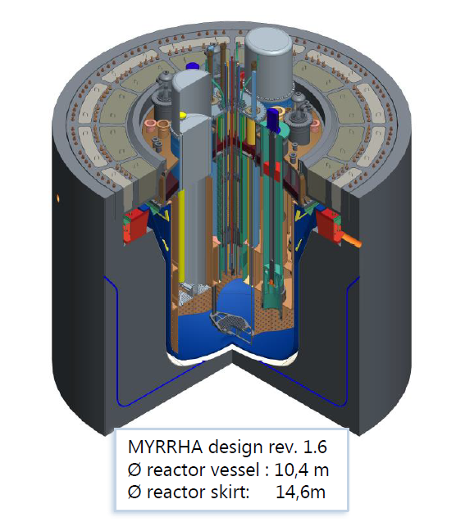
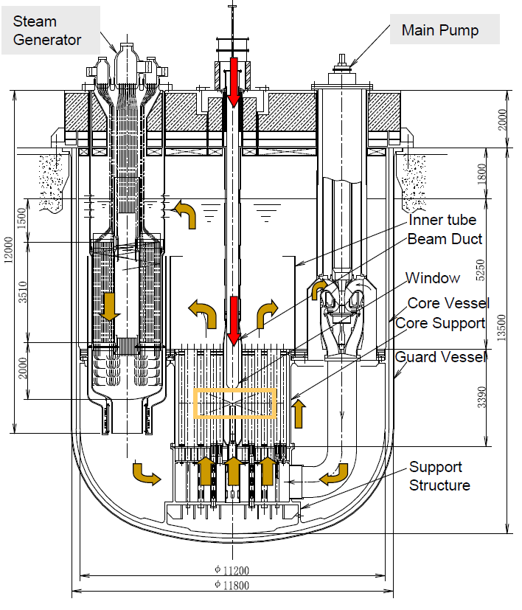
Beam trip frequency requirement
Data from MYRRAH, JAEA (both LBE Target/coolant)
Mechanical integrity: thermo-mechanical, fatigue, interaction with LBE
System availability
MYRRAH reactor
JAEA reactor

Slide 13
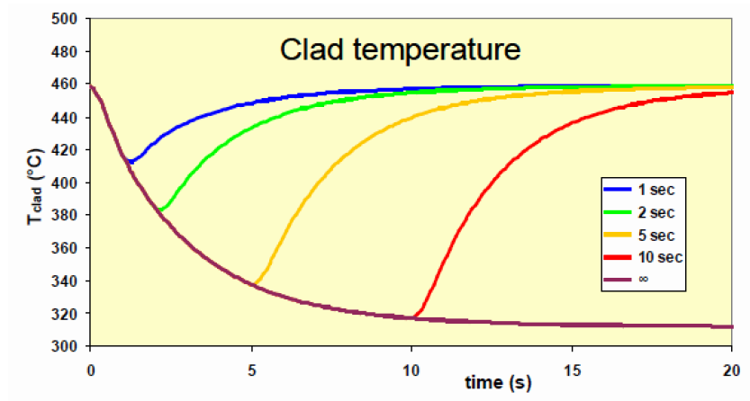
Beam trip frequency requirement – MYRRHA
T. Junquera, Accelerator Reliability requirements for ADS: the MYRRHA project goals, presented at 4th international workshop on ADSR systems and Thorium, 8/31 – 9/2, 2016
Mechanical integrity issues on window, fuel cladding, reactor structure, etc.
Long beam interruption causing reactor shutdowns: restart will take 20~40 hours
Beam trip > 3 sec: 10 times during 3-month of operating cycle ~ about 0.1 trips/day
cf. FY20 SNS 95% availability:
No. of trips > 3 s: 14.3 trips/day
(SNS data from Charles Peters)

Slide 14
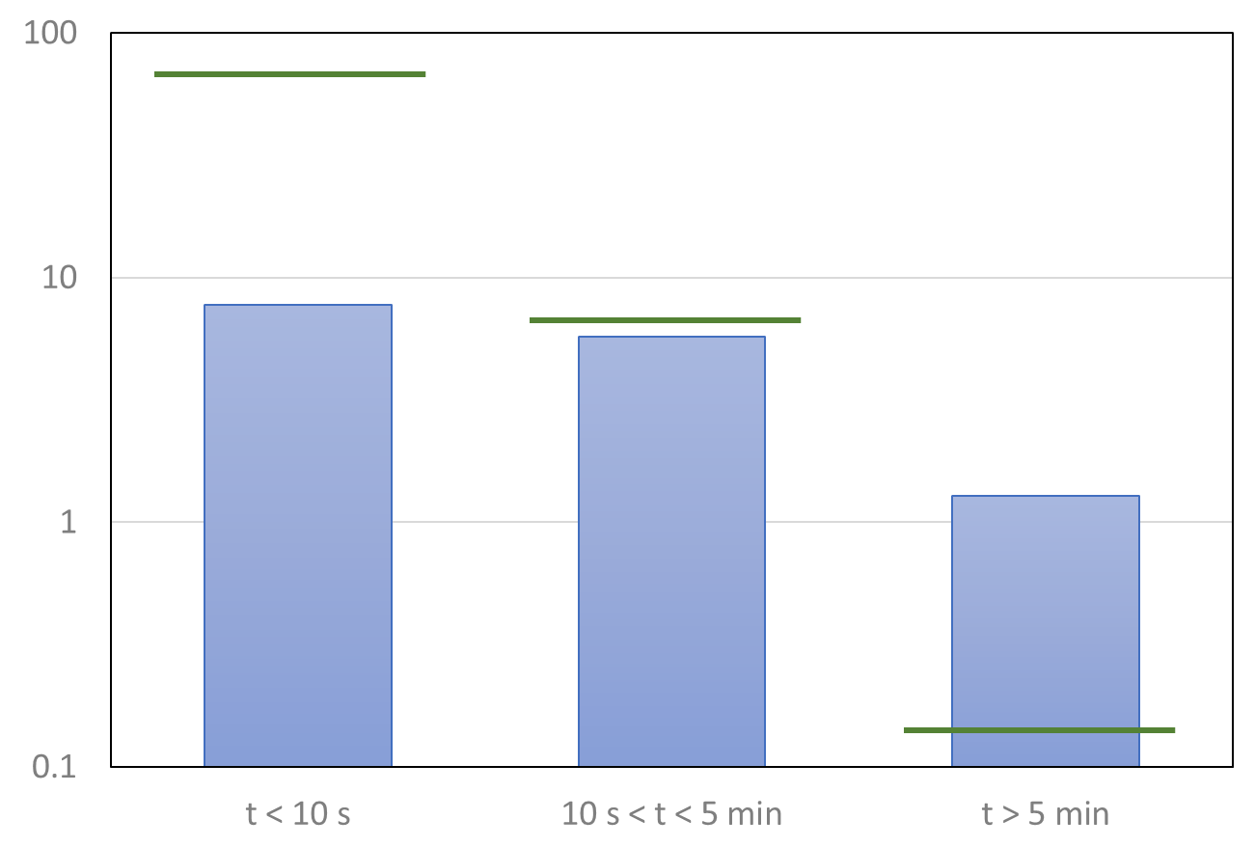
Beam trip frequency requirement - JAEA
H. Takei, et. al, Estimation of acceptable beam-trip frequencies of accelerators for accelerator-driven systems and comparison with existing performance data, J. Nucl. Sci. Tech., Vol 49, No. 4, April (2012), pp. 384 – 397
t < 10 s: 20,000/yr (beam window)
10 s < t < 5 min: 2,000/yr (Inner barrel)
T > 5 min: 42/yr (system availability)
0.14 times/day
Plant restart (20 hours / trip)
70% yearly system availability or 85% during run
JAEA requirement
SNS FY20
(Charles Peters)
No. of trips per day

Slide 15
Remark on beam trip requirement
It is THE major challenge!
Need balanced and goal-oriented machine philosophy. General approach should include
Simple design (less parts/equipment, more passive)
Over design/LARGE margin
Highly modular design
Redundant design (serial and/or parallel)
Or Innovative breakthroughs
SNS provides one of best opportunities for this study/analysis (New LDRD program started this year)
ADS community has been analyzing SNS statistics with positive feedbacks
Other important challenge for industrial ADS
Number of staff
Notes:
One of kind… R&D nature….

Slide 16
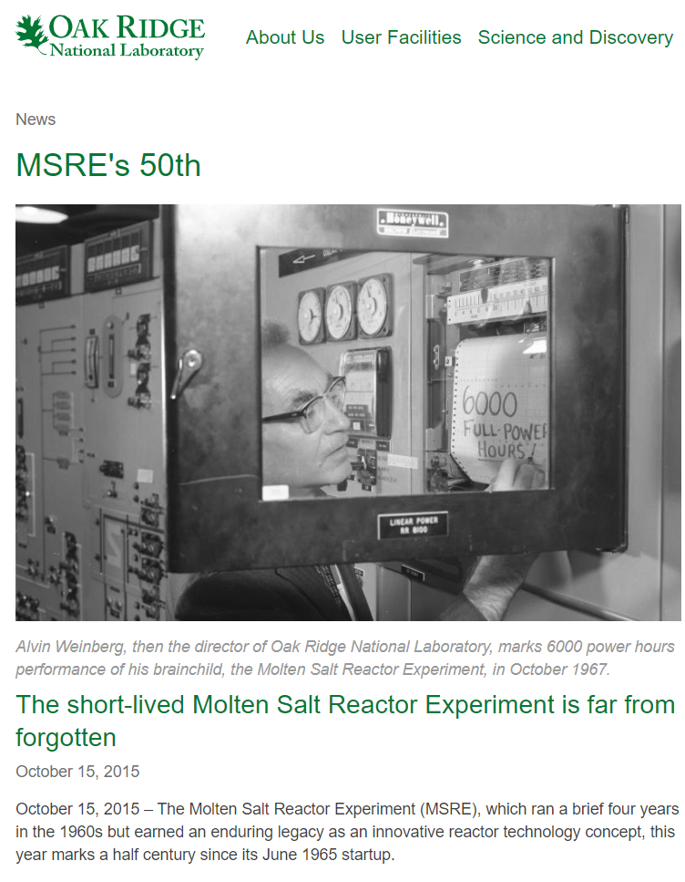
Molten salt reactor for Minor Actinide (and W-Pu) transmutation
ORNL has a long history and unique experience with molten salt reactor
Molten salt reactor may relax beam trip requirement
???
Transmutation: More interest than energy production in US
Electricity production can be the next goal, which requires more reliable and highly available system

Slide 17
What are the ‘REAL’ benefits of accelerator driven sub-critical reactors?
ADS is mainly driven by accelerator community so far….
Turning-off accelerator will immediately shut reactor down, which is true, but argument seems weak
safety?: maybe good for public acceptance
Notes:
Three mile island (human-computer interaction, human error, etc), Chernobyl (design obsolete), Fukushima Daiichi (due to decay heat)….
May not be technical solution for the previous incidents.

Slide 18
Are we on the same page?
Perspectives can be different

Slide 19
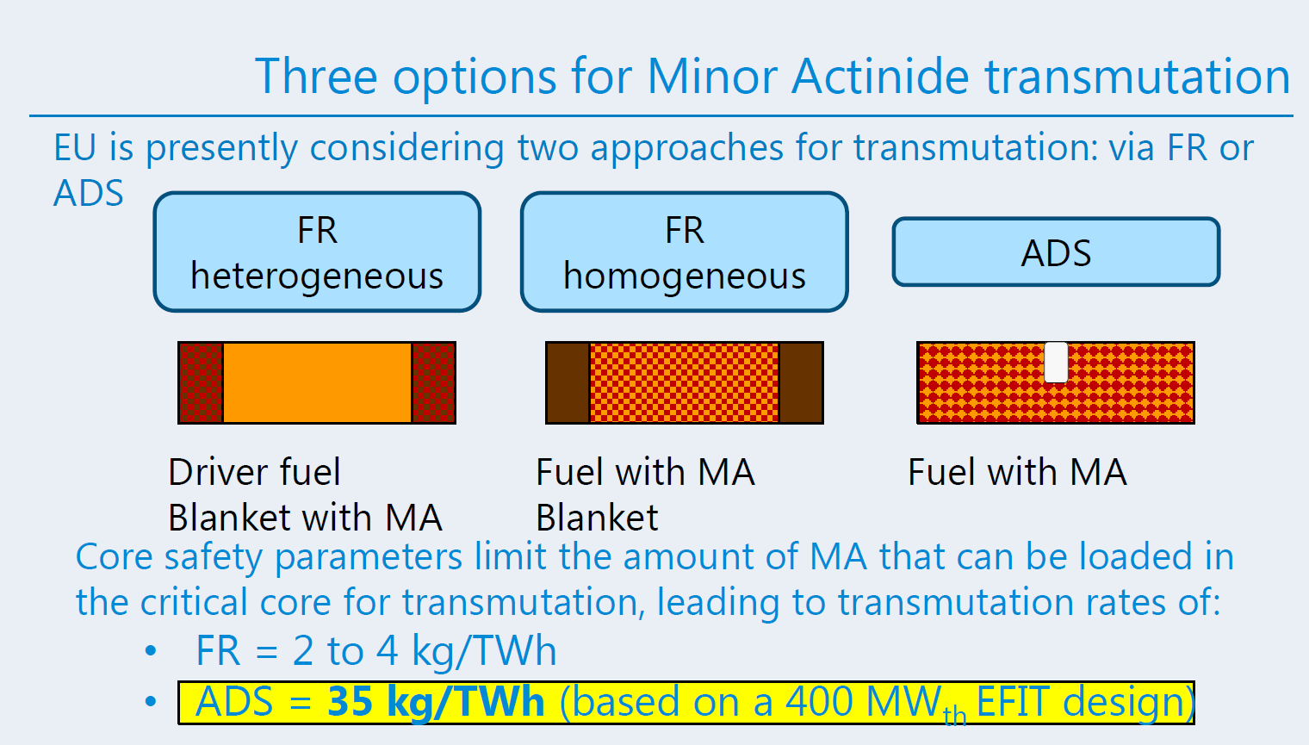
Minor Actinide burning rate?
From H. Abderrahim presentation at 4th international workshop on ADS & Thorium
*EFIT: European Facility for Industrial Transmutation of Minor Actinides
If so, would be strong case for ADS

Slide 20
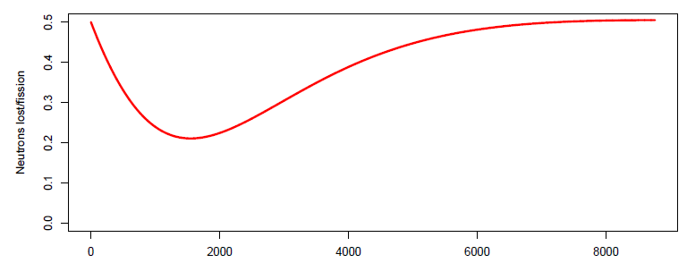
Is accelerator really needed for breeder reactor?
For self-contained breeder reactors (n_{f}=n_{b}=1), operation of breeder reactor with just control rod is difficult
R. Barlow presentation at 4th international workshop on ADS & Thorium
Time (hours)

Slide 21
Summary
High power hadron machines
Technology of choice is superconducting linear accelerator (SCL)
Beam power/beam energy for ADS
Achievable with existing technologies
Beam trip frequency requirement for ADS
Accelerator: Need studies for Large-scale INDUSTRIAL accelerator
Reactor: Need assessment for molten-salt reactor
Benefits of accelerator driven sub-critical reactors
Need separate assessment for strong case(s)

