Slide 1
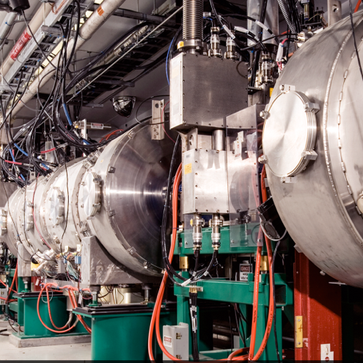
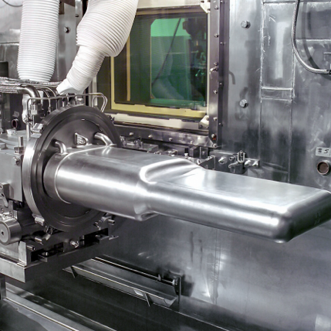
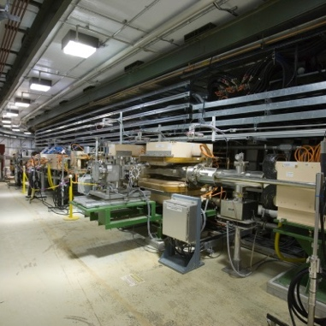
ADS Comments
ADS Workshop
ORNL
John Galambos
Sept 27, 2021

Slide 2
ADS: brief history
Use of an accelerator as part of a fissile material breeding scheme:
Materials Test Accelerator at LLNL circa 1950s
Energy Research and Development Administration, Proceedings of an Information Meeting on Accelerator-Breeding, CONF-770107, held at Brookhaven National Laboratory, January 18-19 (Upton, New York, 1977).
"The Second Nuclear Era" (1984), Alvin M. Weinberg et al., (1984) https://www.osti.gov/servlets/purl/5122774
Accelerator driven breeders
Energy production
Rubia energy amplifier, ~1993: https://cds.cern.ch/record/256520/files/at-93-047.pdf
Tritium production
“Accelerator Production of Tritium Conceptual Design Report”, LA-UR-96-4847 (March, 1997).
Waste burners
Bowmann et al., 1992, Nucl. Instrum. Methods, A320, 336.
Comparison of ADS and Fast reactor burners:Accelerator-driven Systems (ADS) and Fast Reactors (FR) in Advanced Nuclear Fuel Cycles – A Comparative Study, OECD Nuclear Energy Agency (2002), available on the NEA webpage on Accelerator-driven Systems (ADS) and Fast Reactors (FR) in Advanced Nuclear Fuel Cycles ( http://www.nea.fr/html/ndd/reports/2002/nea3109.html)
Accelerator needs:
H. Aït Abderrahim et al., 2010, Accelerator and Target Technology for Accelerator Driven Transmutation and Energy Production , http://staff.ustc.edu.cn/~qunwang/temp/ADS_White_Paper_final.pdf

Slide 3
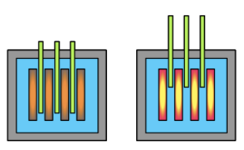
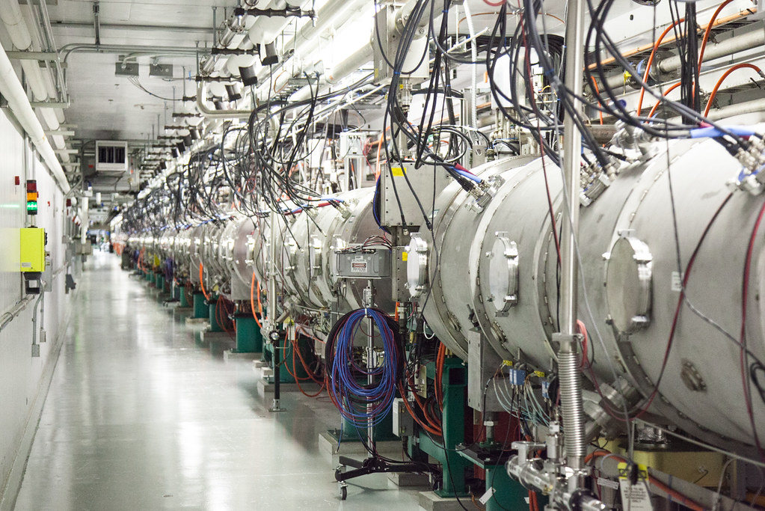
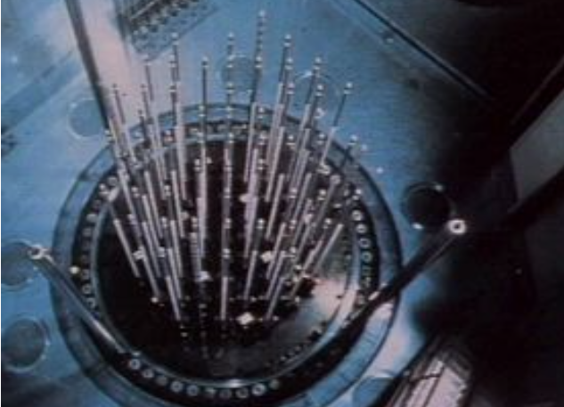
ADS challenge: convince folks (including ourselves) that it’s a good idea to replace:
Control rods
High power ~ GeV proton accelerator
With
3.3 Provide Effective and Efficient Communications and Responsiveness

Slide 4
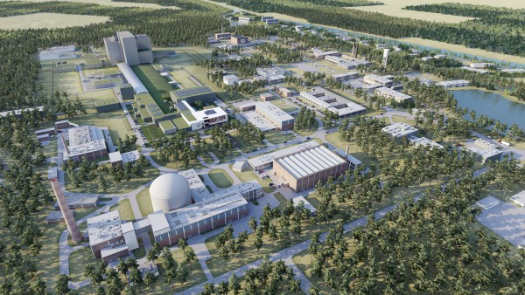
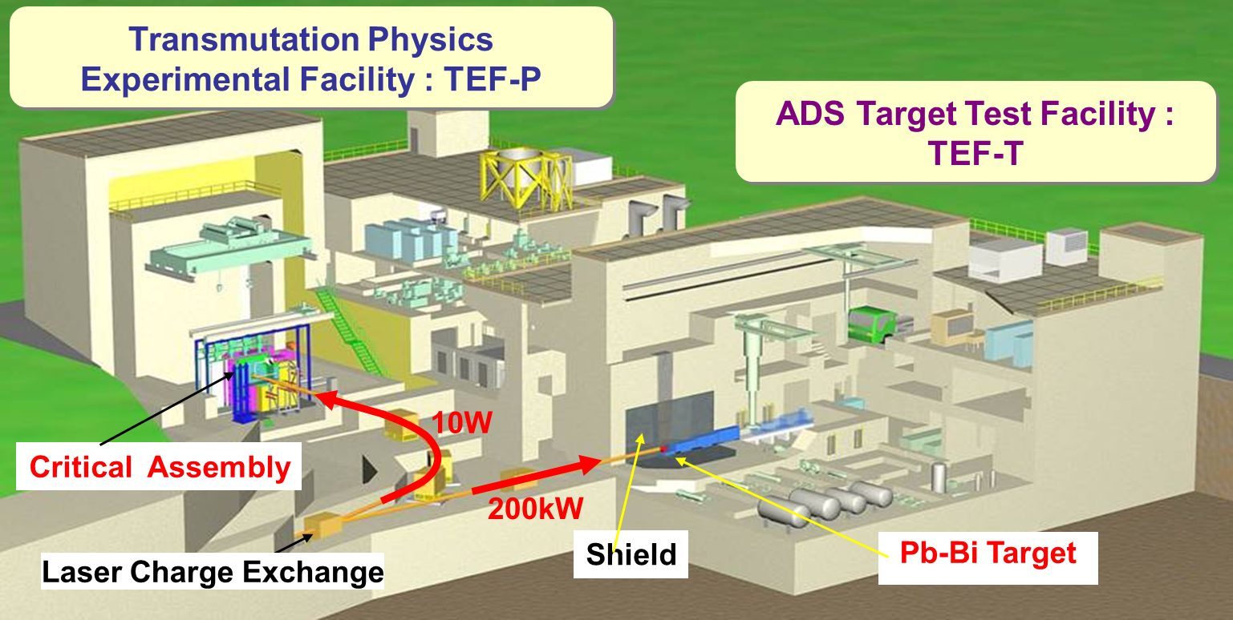
Ongoing efforts
MYRRHA project in Belgium
Demonstration project (600 MeV p linac)
https://myrrha.be/myrrha-project/
J-PARC transmutation experimental facility
10 W irradiation facility, 200 kW systems test facility
https://j-parc.jp/Transmutation/en/index.html
China ADS (ADANES) http://english.imp.cas.cn/Work2017/CI2017/
20 year plan to commmercialization
MYRRHA

Slide 5
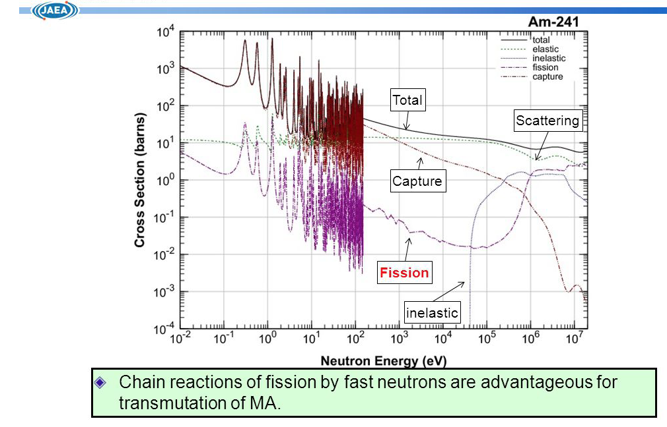
Need a clear / natural advantage for ADS
Long lived minor actinide (MA) nuclear waste transmutation requires fast neutrons
Cross section advantage
Fast reactors have more control challenges than ”thermal neutron” reactors
Fewer delayed neutrons

Slide 6
ADS economic / operational reliability issues are always a concern
Minor actinide burning (not selling power) application may help
Long-term nuclear waste disposal keeps not happening
There are pots of $$ collected for this purpose
Molten salt reactor technology reduces sensitivity to accelerator trips
ORNL has history here
Getting attention recently

Slide 7
What is new / why ADS now?
High power p beam (> 1MW) superconducting RF linac (~1 GeV) is demonstrated
Somewhat attractive path to higher availability
Multi-MW p beam operation is less daunting
Public resistance to nuclear power seems to be wanning
Not a carbon emitter
Long term spent fuel disposal keeps not happening
Another 2 decades have slipped by with no substantial progress

Slide 8
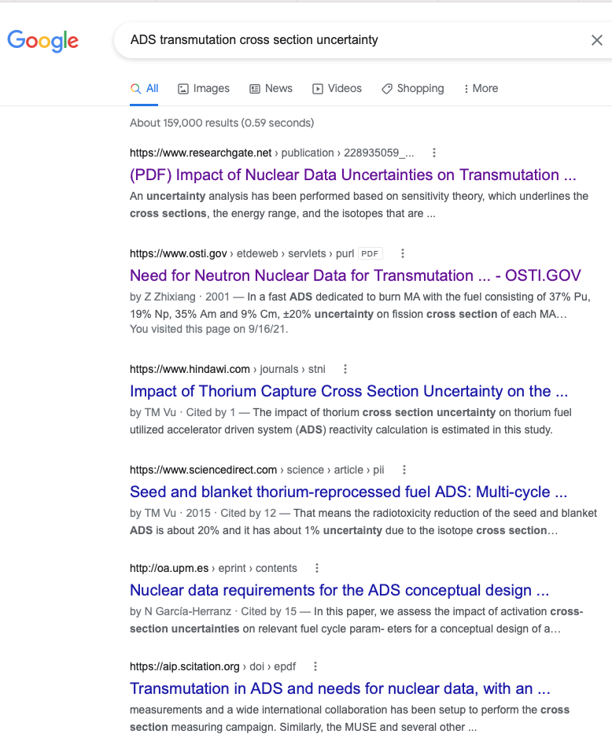
What can we do short term?
Can we put together a quick setup for cross section analysis?
E.g. in linac dump section?
Use PD $$ to study?

Slide 9
Longer term
Need a (potential) funding stream
Will be necessary as part of LDRD proposal
Monitor funding opportunity announcements
NE
DARPA
Can we influence FOAs?

