Slide 1




Test Stations at the SNS
Bernie Riemer
Accelerator Driven Systems Workshop
ORNL
September 24, 2021
Notes:
30 minutes included Q&A

Slide 2
Test stations … for what purposes?
What are the development needs to address vs.
What can be done somewhere at the SNS
Example target test facilities
The SEEMS target station concept for the SNS
  Missions, capabilities, opportunities for broader test applications
  Low power and no impact to neutron scattering at FTS and STS
  Possibilities to accommodate ADS tests
Test facility capabilities and safety basis
  Fissile materials – can avoid nuclear facility category if mass does not exceed limits (700 g?) without beam
  With beam – any amount of fissile material – likely a nuclear facility
Notes:
What does SNS/ORNL bring to the ADS development needs table?
Staff expertise and experience (engineering and physics of high-power targets, liquid metal targets, material science,
A pulsed H⁻ accelerator with plenty capacity beyond serving the FTS and STS

Slide 3
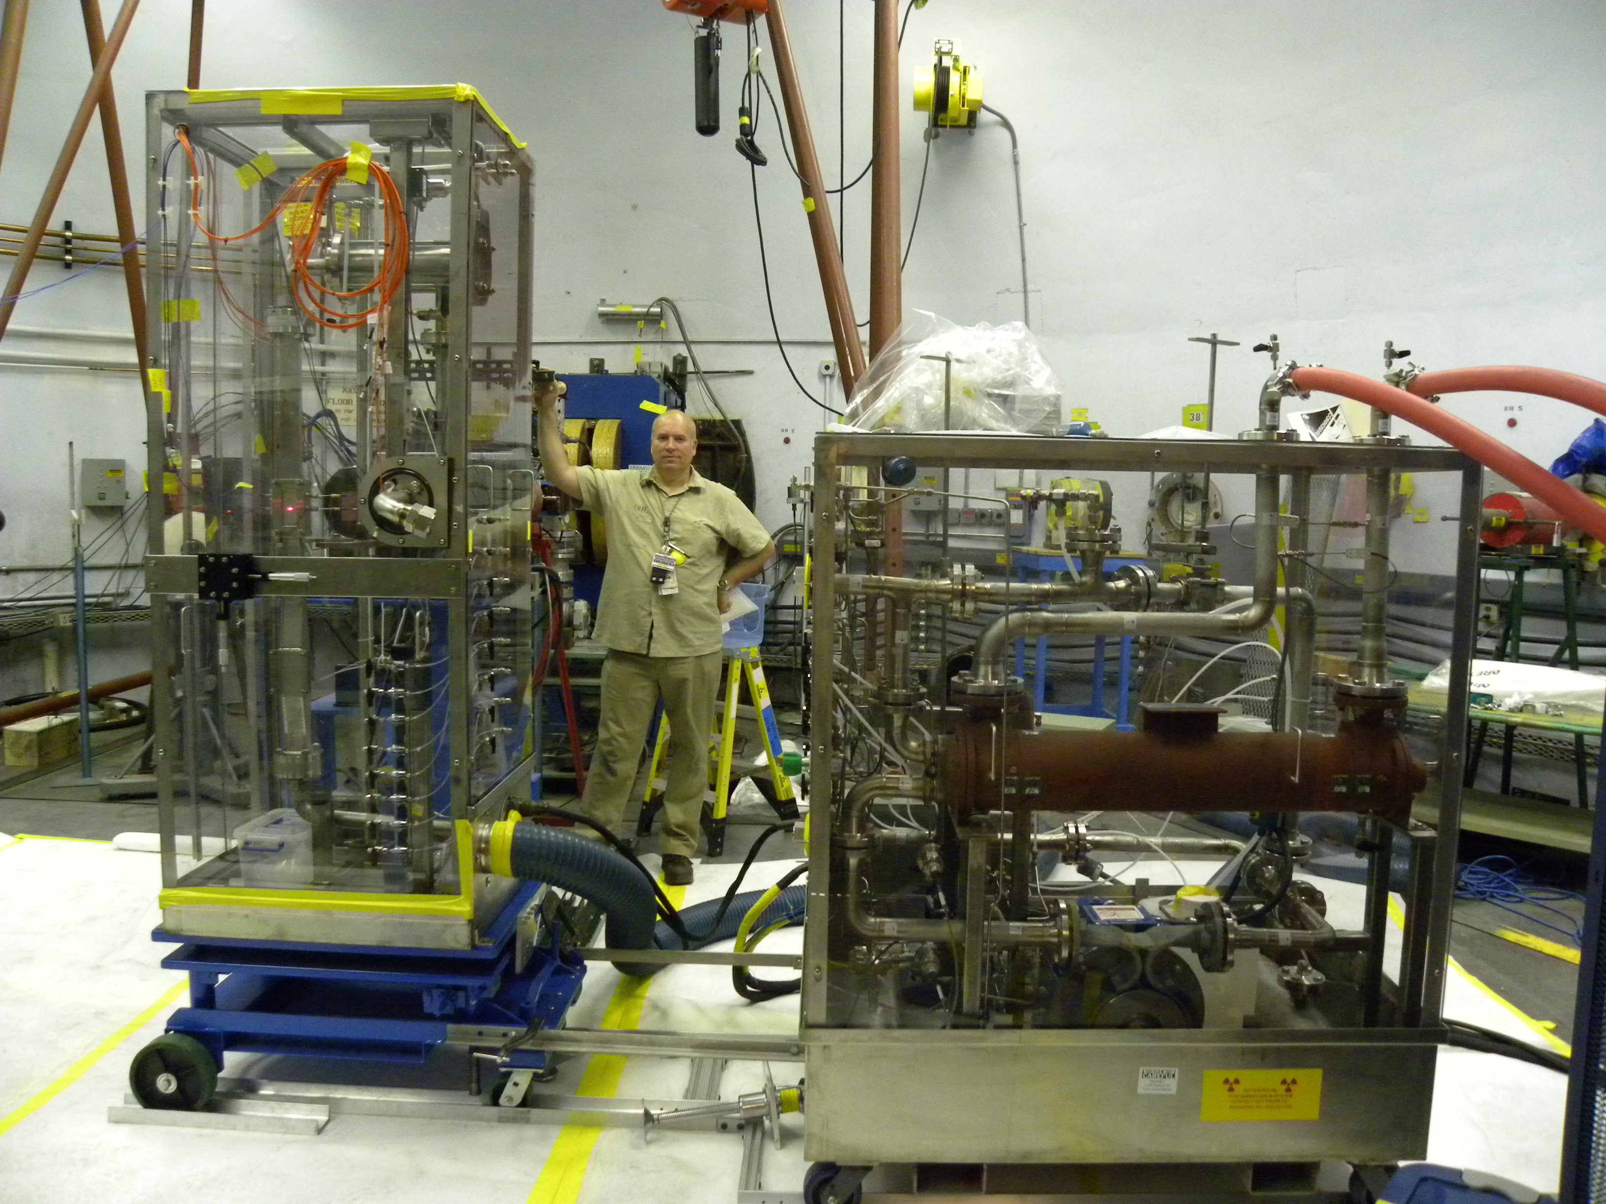
SNS in-beam target development largely was done in the LANSCE-WNR Blue Room (1997-2011)
Hugely beneficial testing for SNS target pulse response and cavitation R&D
800 MeV p, short-pulse, mx rep rate 2 p/m
Max 1000 pulses on a single target
At the limit of
  Hands-on target handling
  Allowed fluence into the Blue Room
Target types: mercury, tungsten, zirconium, tantalum, graphite, lead-bismuth eutectic
We also used proton radiography
Notes:
Large room with useful test infrastructure
Run as a user program with supportive staff
Accommodated complex experiments, safety challenges were managed
Max beam intensity eq. ca. 2.5 MW SNS
We consistently got lots of beam – always got things done
If you want more fluence or higher rep rates – start getting into remote handling

Slide 4
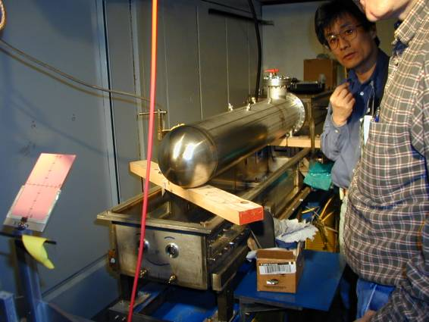
AGS Spallation Target Experiments at BNL (ASTE)
2000~2002
Collaboration between SNS, JParc, FZJ-Jülich (ESS)
Large Hg target
24 GeV pulsed beam
Small beam spot
Not hands-on
Less than satisfying pulses
Not a user program

Slide 5
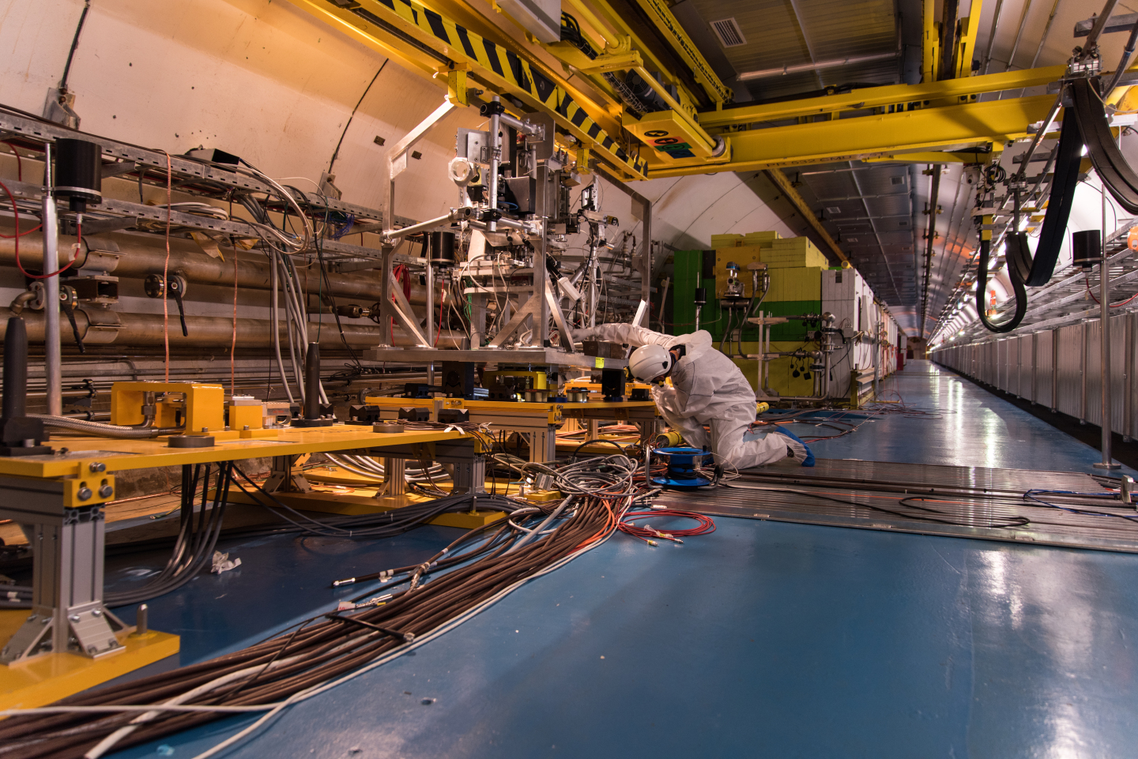
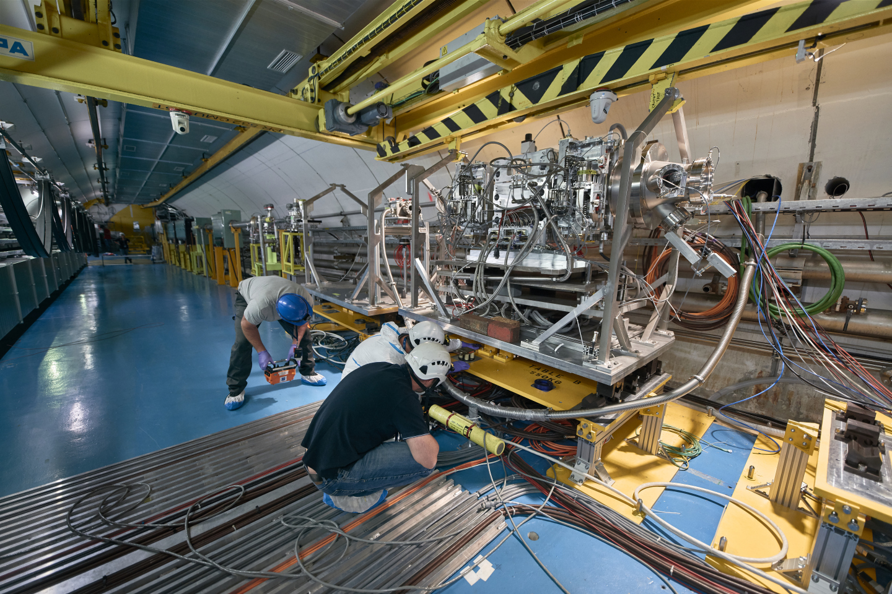
HiRadMat at CERN user facility at CERN providing high-intensity pulsed beams to a large test area
440 GeV/c … protons, heavier ions from the SPS
Intended for high-intensity pulse effects on targets, beam-intercepting devices, material samples
  Not for high fluence – not for material radiation damage
  Very good infrastructure for user support
Notes:
Small beam spot ~ 1mm
Supports CERN programs and outside users
Run time availability is not huge, but sufficient for current demands
I’m the chair of the HRM Scientific Board

Slide 6
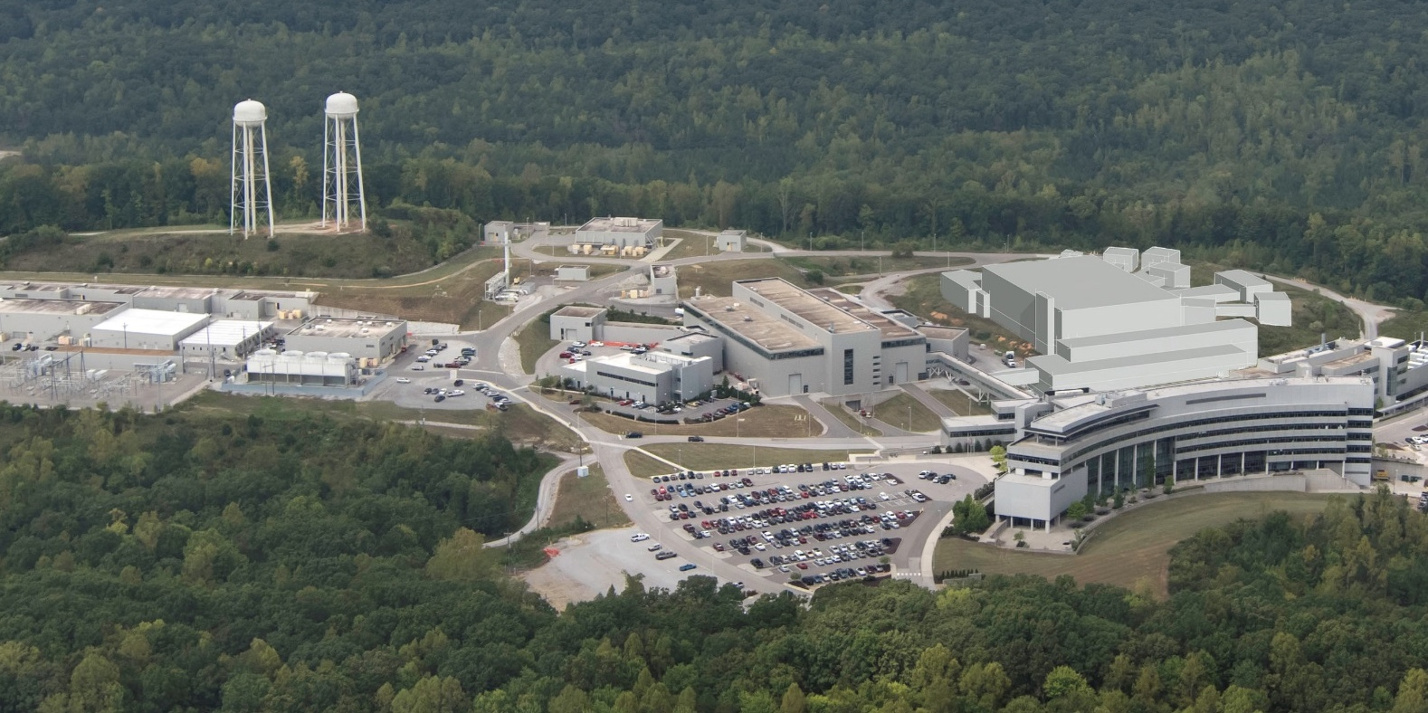
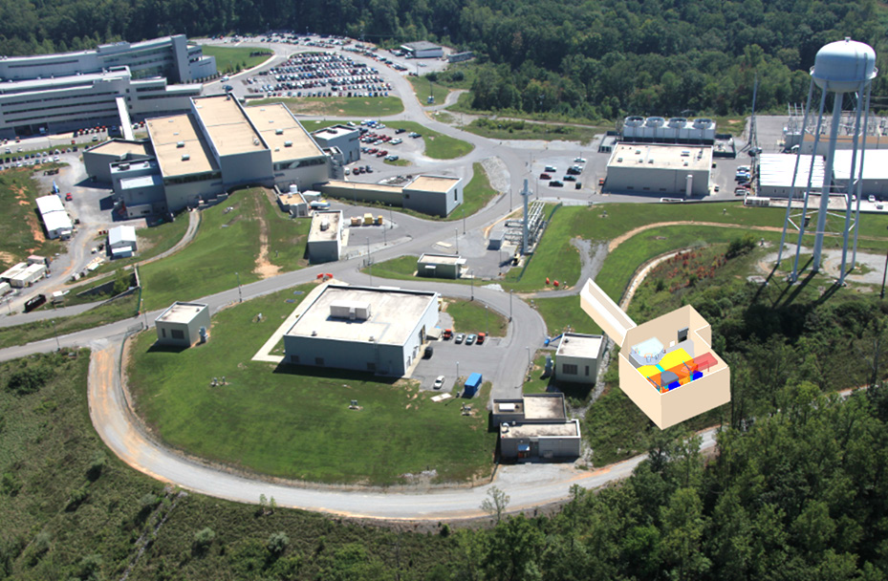
SEEMS is a modest size target station with low power requirements
Accumulator Ring
Future
Second Target Station (STS)
First Target Station (FTS)
Linac
FTS
SEEMS
Operating & being upgraded
STS project scope – CD-1 approved
SEEMS – future
Notes:
SEEMS is not a test station. It is a dual mission user facility.
Adding a test station may be possible … it depends
The beam diversion for SEEMS is such that the impact to FTS and STS operations is insignificant

Slide 7

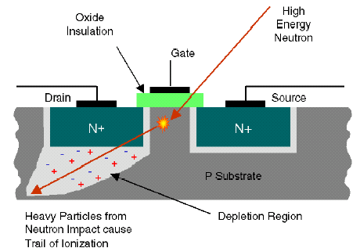
ORNL could become a premiere site for US radiation effects testing of microelectronics
Radiation effects can have catastrophic consequences on system behavior
  Natural radiation – terrestrial and in space
  Man-man radiation
Example – Single Event Effects (SEE)
SEE can take on many forms, e.g.
  Soft errors – transient, non-destructive
  Hard errors – latch ups
  Gate rupture, frozen bits, burnout
Source: IBM, Journal of Research & Development
Terrestrial Cosmic Rays and Soft Errors
Source: Honeywell, Laura Dominik
Atmospheric Radiation Testing, 2012 NUFO Meeting
Notes:
There are other categories of radiation effects on electronics – it’s diverse.
ORNL is well positioned to provide high-energy and thermal neutron beams, proton beams, and heavy ions to serve national testing needs
This is done at BNL, ISIS, CERN, CSNS, MSU, TAMU …

Slide 8
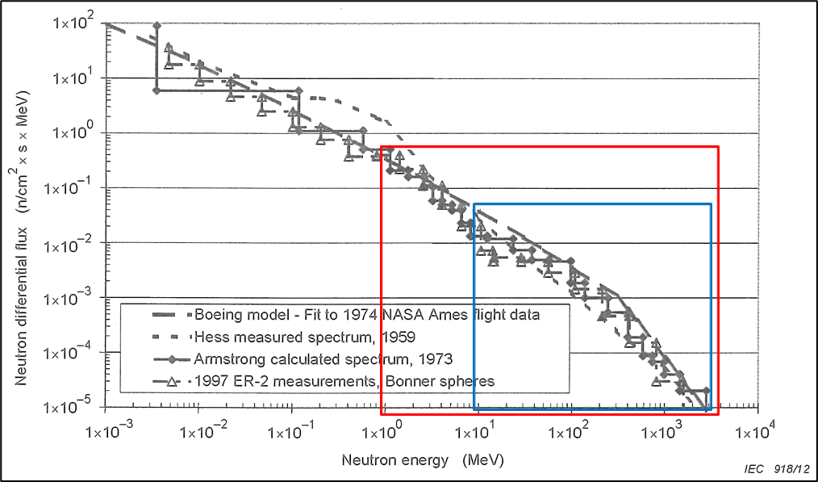
The atmospheric neutron energy spectrum is well characterized and can be matched with a spallation neutron source
Atmospheric neutron energy spectrum
We are experts at this
We have the accelerator
We have a facility concept: SEEMS
Dual mission of SEEMS
  Single Event Effects:
    high-energy & thermal neutrons, high-energy protons, muons
  Muon spectroscopy:
    μSR materials characterization techniques that compliment neutron scattering
Operation of SEEMS will have insignificant impact on SNS neutron scattering operations
Notes:
Muons also of interest for electronics radiation effects testing, HEP

Slide 9

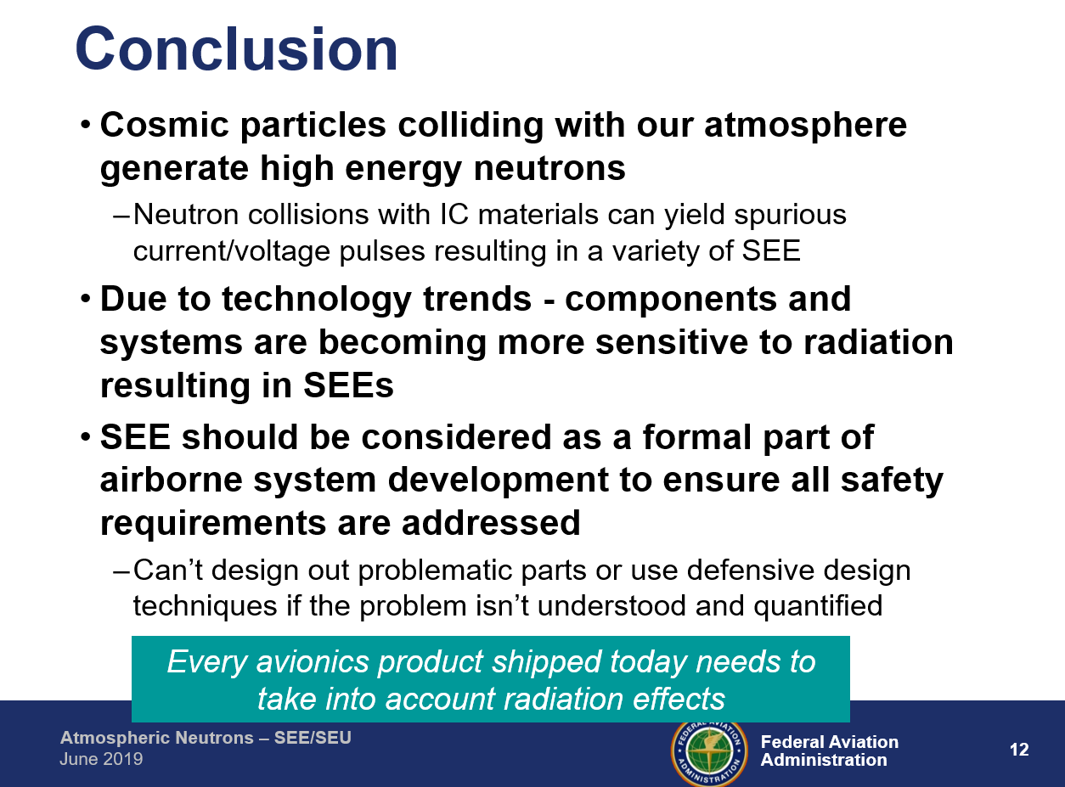
Commercial aircraft are an example SEE test application
Aircraft certification requires sellers to show robustness against SEE in critical electronic systems
Neutrons are the primary cause for SEE in avionics
Basis of a SEE evaluation is test data
  error rates on devices
G. Horan – FAA
Not enough radiation effects test capacity or capability in the US!
Quantas Airways in-flight excursion attributed to SEE in air data inertial reference unit (2008)
Notes:
Here addressing one sector within radiation effects on microelectronics.
SEE testing – this means actively collecting information while devices or systems are being irradiated.
SEE testing is not about accumulated dose effects.
Accumulated dose is a key parameter in other rad effects applications

Slide 10
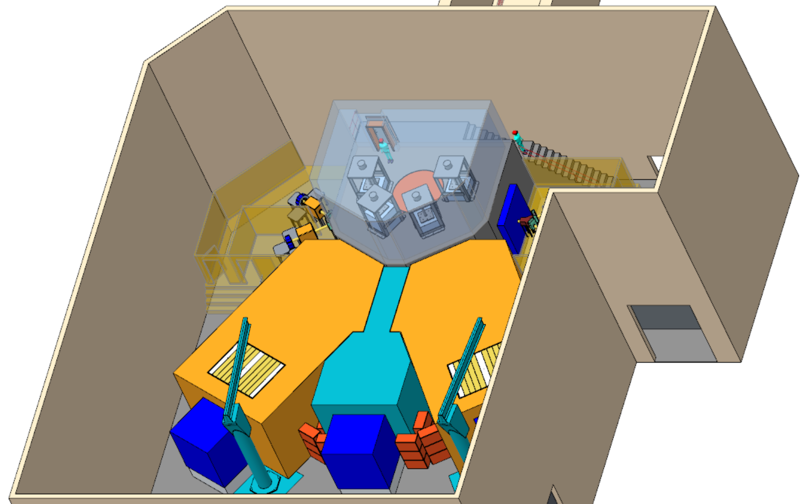
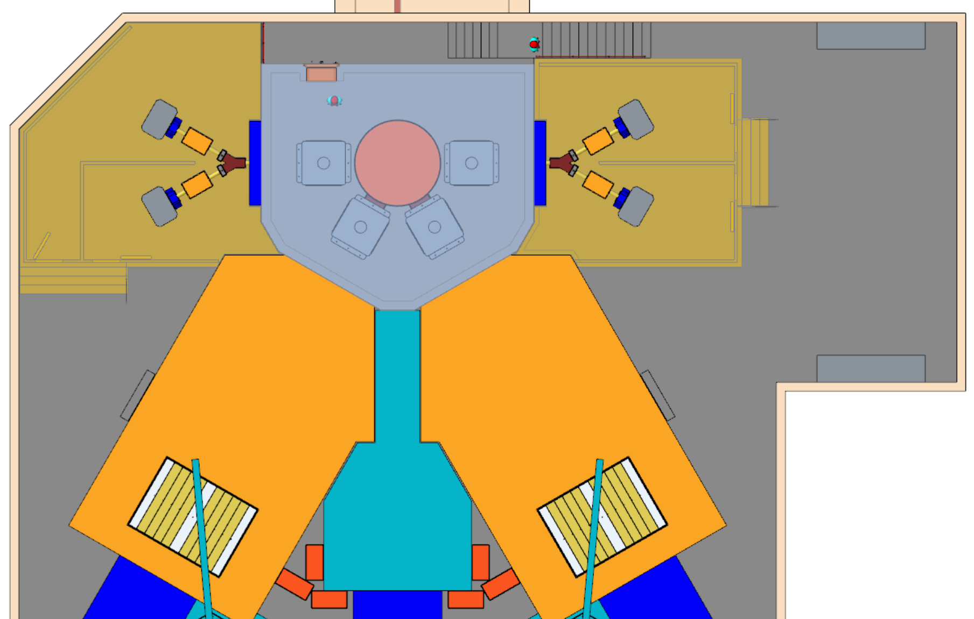
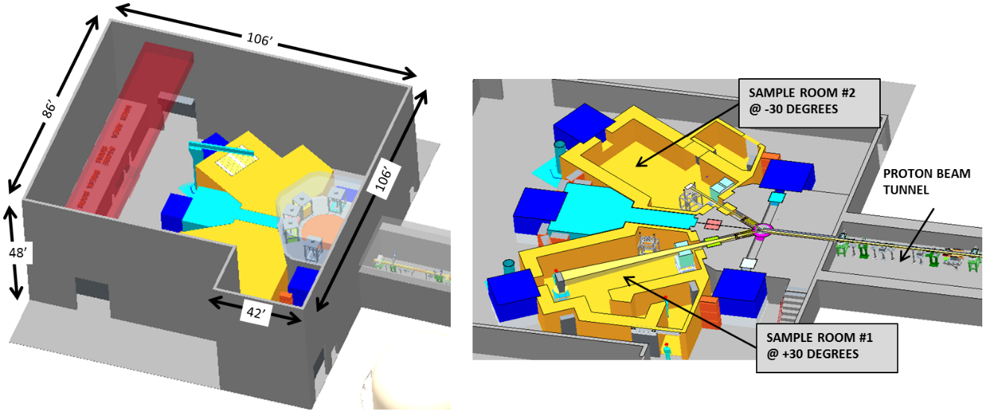
SEEMS facility layout accommodates large SEE test areas
Device or system test capable
Two neutron test cells
One proton test cell
Four muon beamlines
1.3 GeV protons
Target monolith
µSR 1 & 2
µSR 3 & 4
Proton irradiation
Neutron SEE Testing 1 & 2
Notes:
SEEMS is not so large as the neutron scattering science target stations, but it is substantial, with a large target monolith and substantially shielded test areas.
Direct proton irradiation is possible by several methods. A leading choice is in the space between the neutron test areas

Slide 11
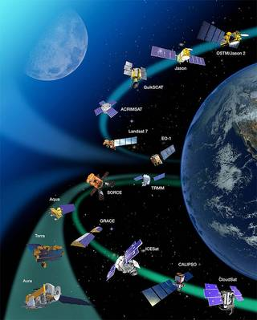
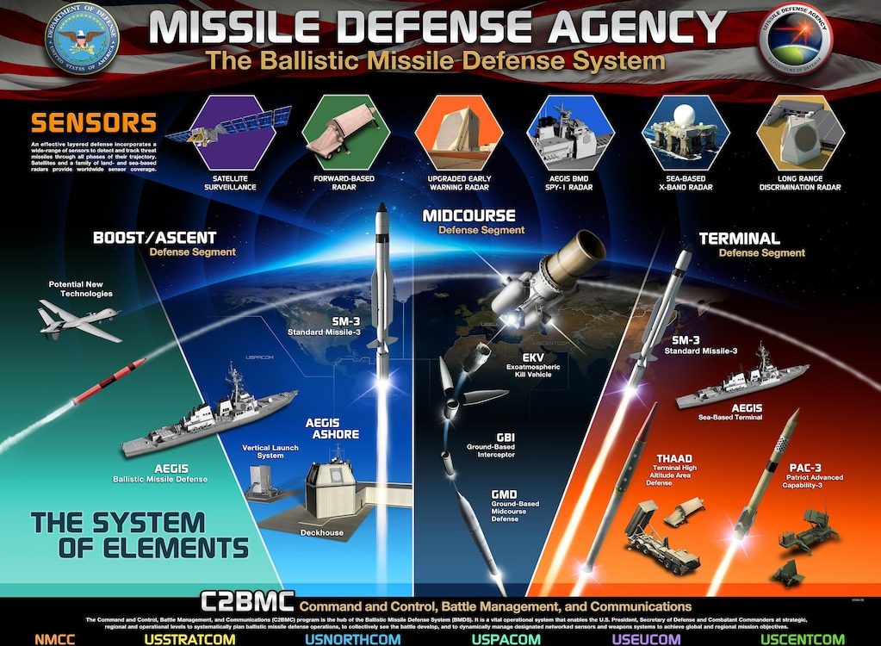

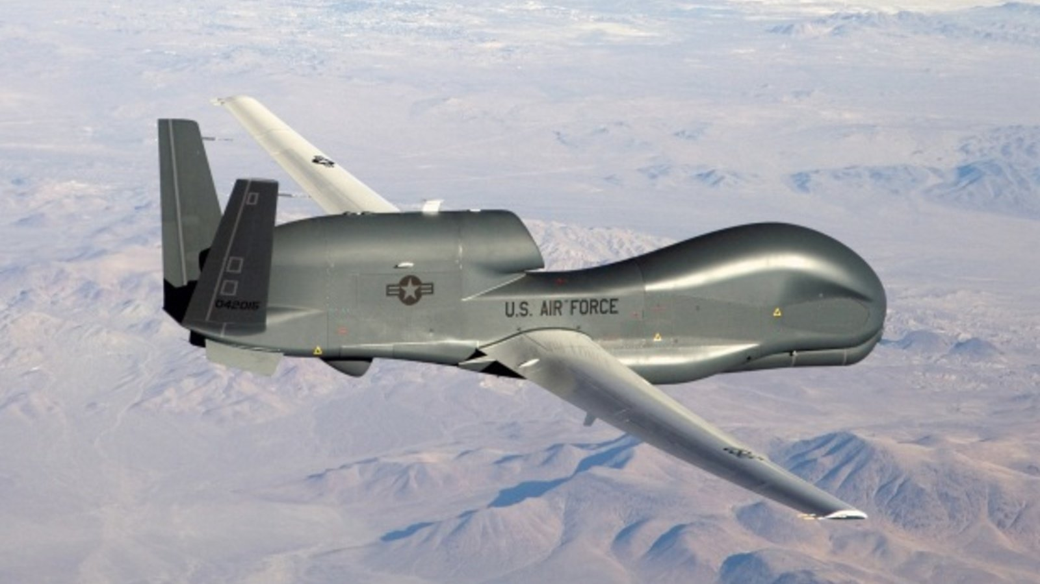

Other sectors of radiation effects to microelectronics where SEEMS capabilities can make a difference
Source: NASA
Autonomous cars, drones
NASA and commercial spacecraft
Defense applications
Supercomputing
Source: SingularityHub
Source: PYMNTS.com
Source: Reuters
Notes:
Cars have become rolling computer platforms. Self driving technologies are rapidly advancing. Automakers will need test data.
A similar story for drones – military or commercial. The FAA is trying to figure out the latter.
I’ve started dialogue with NASA (Goddard) and the MDA ( Huntsville AL )

Slide 12





Muon spectroscopy (µSR)
Vancouver, Canada
Didcot, United Kingdom
Villigen, Switzerland
Tokai, Japan
μSR originated in the US, operating at the Los Alamos Meson Physics Facility, USA (1972-1995)
The technical and scientific complementarity with neutrons are why they usually co-exist
Facility | Source Type | Flux (μ⁺/sec) | Pulse Width (ns) | Co-located Neutrons?
TRIUMF | Continuous | 5.0 x 10⁶ | - | No
ISIS | Pulsed | 1.5 x 10⁶ | 70 | Yes
PSI | Continuous | 2.0 x 10⁸ | - | Yes
J-PARC | Pulsed | 1.8 x 10⁶ | 100 | Yes
SEEMS (proposed) | Pulsed | 4.3 x 10⁸ | 50 | Yes
  They have overlapping research themes and share a user base
Courtesy Travis Williams - NScD

Slide 13
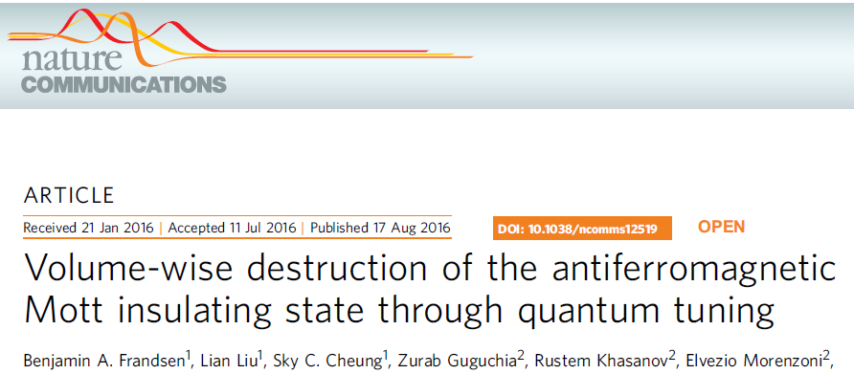
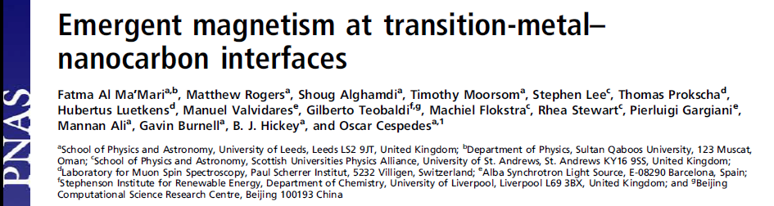
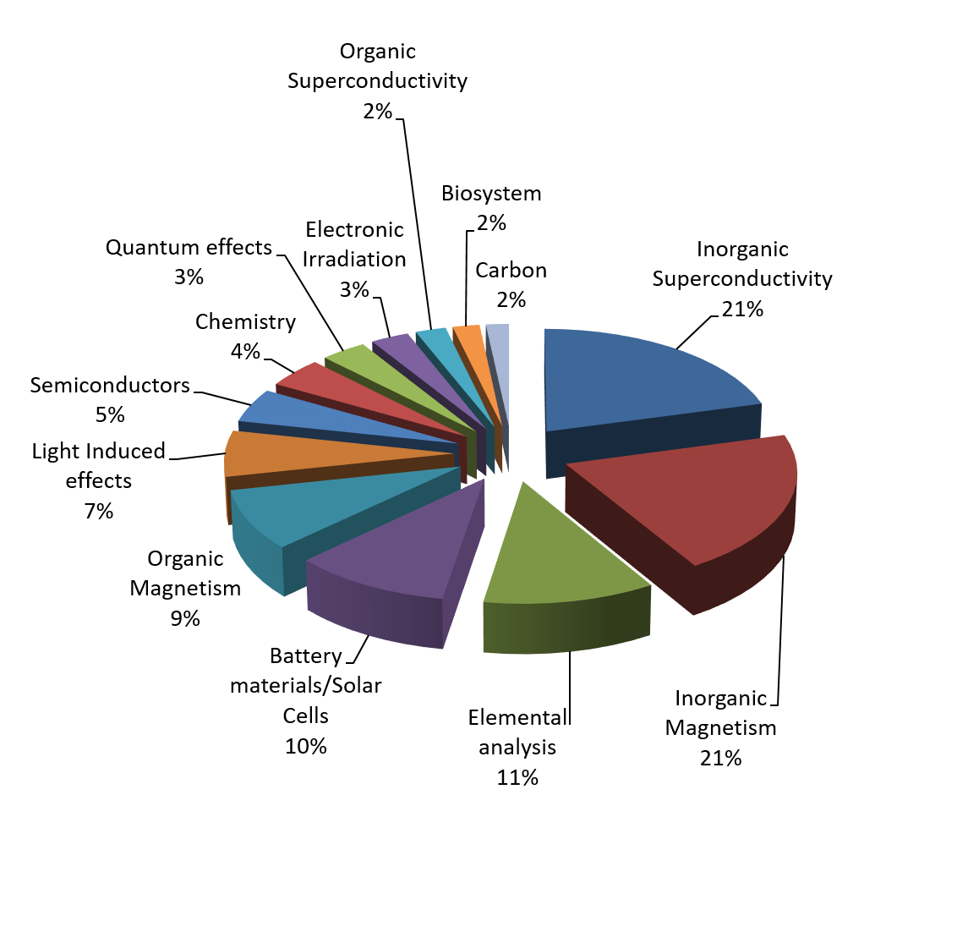
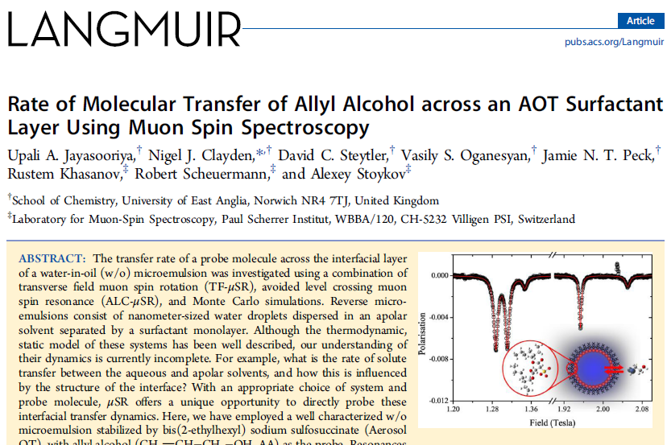
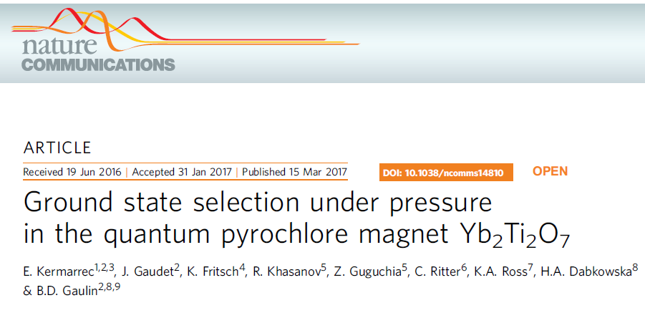
Scientific Impact
Variants of μSR are making meaningful contributions to the areas of:
    Magnetism
    Superconductivity
    Molecular systems
    Quantum diffusion
    Hydrogen storage
    Battery materials
    Semiconductors
    Radical chemistry
    Thin films and heterostructures
User base of ISIS facility,
courtesy of A. Hillier, (2016)
Notes:
muSR has a well-established history, producing high-impact science in areas that ORNL already specializes in, particularly with neutrons and materials science.
SEEMS will have the potential for new capabilities, meaning we can open up new areas of science.

Slide 14
µSR capabilities at SEEMS
World-leading muon flux
    Faster measurements, greater resolution, smaller samples, innovative beam technologies
Low-energy muon beams
    High flux means more low-energy muons, which are in high demand.
    Ability to study thin films, surface effects, topological states and depth-dependent phenomena
    Noted by the scientific community as the biggest need for the field
Opportunities for innovation
    Muon microscopy: focused beams for device measurements
    Integration with high-performance computing for simulation of complex data
Courtesy Travis Williams - NScD

Slide 15

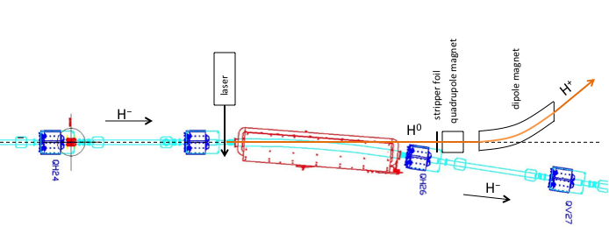
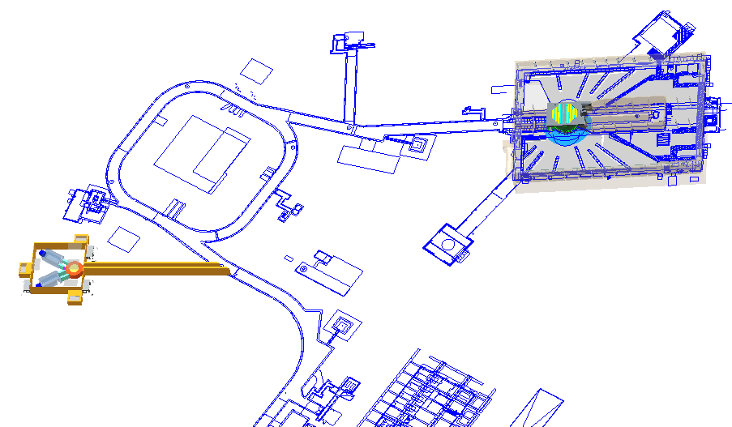
SEEMS does not employ a parasitic target as in other muon / spallation neutron sources
Instead, kW-level proton beam is extracted by laser stripping diverting a small fraction of SNS H⁻ beam upstream of accumulator ring
Proton beam intensity is tunable by laser beam intensity and duty factor
No impact to the primary target station operation
H⁺
Laser strips electron from H⁻ beam to H⁰
H⁰ and H⁻ beam components are separated by transverse magnetic field
H⁰ beam is stripped to protons by a foil
H⁺
H⁻
Notes:
SEEMS has its own, dedicated tungsten target. Helium gas cooled
Laser stripping was successfully tested with the required time structure:
30 ns pulses at 50 kHz
Needed intensity improvements not especially difficult

Slide 16
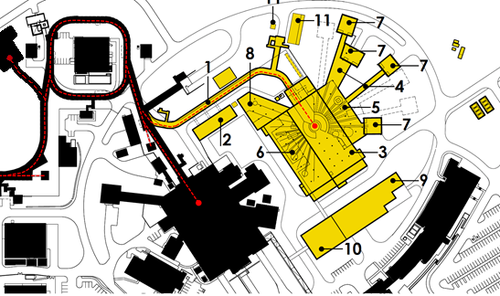
SEEMS facility location at the SNS
Between the injection dump and water tower
  Final position to be determined
Usable land is limited due to terrain & existing infrastructure
FTS
SEEMS
STS
SEEMS
FTS
B. Riemer and F.X. Gallmeier. ORNL/TM-2014/553
Notes:
The SEEMS facility would be placed on the opposite side of the accumulator ring from the target building.
All services required at available at the SNS site, and the extra beam line is minimal.

Slide 17
What testing – outside of its primary missions – could the SEEMS facility accommodate?
Direct proton irradiation with 1.3 GeV pulsed protons onto ADS test assemblies – perhaps ~10 kW
Proton test area – if not more of SEEMS
Use of fissile materials would have to be approved
Alternatively, another proton beamline off the SEEMS extraction line could be constructed to a separate, dedicated test station
Proton irradiation
Notes:
Possibly changing from an accelerator to a nuclear facility --- an expensive burden

Slide 18
Other SNS possibilities?
Ring injection dump
Momentum dump
Linac dump
Notes:
RID – reconfiguration needed. Risk to operations
MD, LD – don’t know. Expect capabilities would be limited

Slide 19
There are possibilities for test stations at SNS to support ADS development – need to understand the requirements better
Summary points for discussion
  What physics and/or technology issues do we want to address?
  What are the beam & facility requirements to address these?
  Question of nuclear facility rating should be resolved early
  Usable real estate at the SNS accelerator complex capable of transporting beams to is limited
Leveraging SEEMS to add testing capabilities seems feasible … need to answer these and other questions

Slide 20
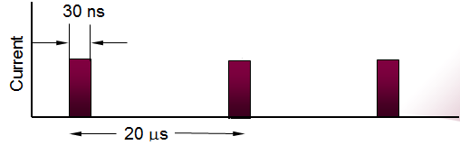
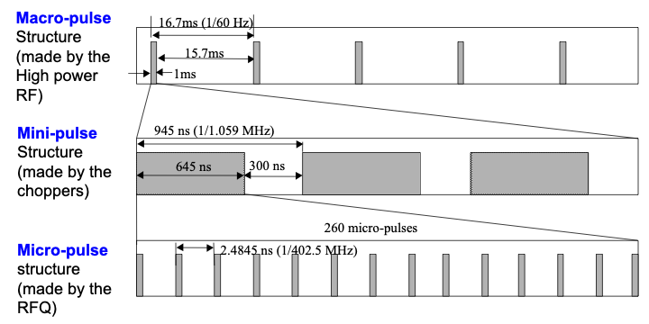
Backup
SNS LINAC pulse structure
SEEMS high-resolution laser stripping mode for muons
Superposes with LINAC beam
Other laser modes are possible
Notes:
This graphic is idealized is several respects:
This would be at the end of the accelerating cavities
The micro pulses are Gaussian and not square
By the point of extraction in the HEBT for SEEMS, there will be some lengthening of the micro pulse length (maybe a bit more than 2.5 ns).

