Slide 1
Isotope Production using Accelerator-Driven Systems
ORNL ADS Workshop
September 24th 2021
Chris Bryan

Slide 2
⁹⁹Mo/^{99m}Tc is Driving Isotope ADS Development
Why?
While many isotopes can be produced in ADS, short-lived isotopes benefit from the ability to easily turn the ADS on and off for target retrieval.
There is a perception that ADS, particularly driving subcritical assemblies have a simpler approval path from the NRC.
Mo-99 QUICK FACTS
SPECT Imaging unit
Discovered in 1938 by Seaborg and Segre
⁹⁹Mo (66 hours) decays to ^{99m}Tc (6 hours)
U.S. Pioneered the use of ^{99m}Tc in the 1980s when Cinichem produced generators in NY state.
Prior to 2016 80% Supplied from Canada and Netherlands using aging reactors
Historically produced from HEU targets (in HEU reactors)
US administers 40,000 ^{99m}Tc nuclear diagnostic procedures per day
In 2009 THERE WAS NO U.S. PRODUCER OF ⁹⁹Mo
Example SPECT Image
Notes:
Cintichem reactor – 5MW light water RR in Tuxedo, NY

Slide 3
⁹⁹Mo from LEU targets in an accelerator-driven subcritical assembly
Lansing, MI
Well-funded
NRC Construction and Operating application being prepared
DOE Cooperative Agreement Partner
First products were superconducting LINACs (SDI).
Still involved in component sales and consulting expertise with Superconducting LINACs.
Primary business is now Isotopes (primarily Medical)
Alpha-Emitters (Ac-225)
Beta-Emitters (Lu-177)
Gamma-Emitters (Mo-99)
Notes:
ORNL assisting niowave with U3O8 pellet pressing and neutronics verification

Slide 4
Niowave Mo-99 Production Concept
Superconducting Electron Linear Accelerator
Uranium Target Assembly (UTA)
Grimm, et.al., 2015, Commercial Superconducting Electron Linac for Radioisotope Production, DOE-NP SBIR Phase II Technical Report

Slide 5
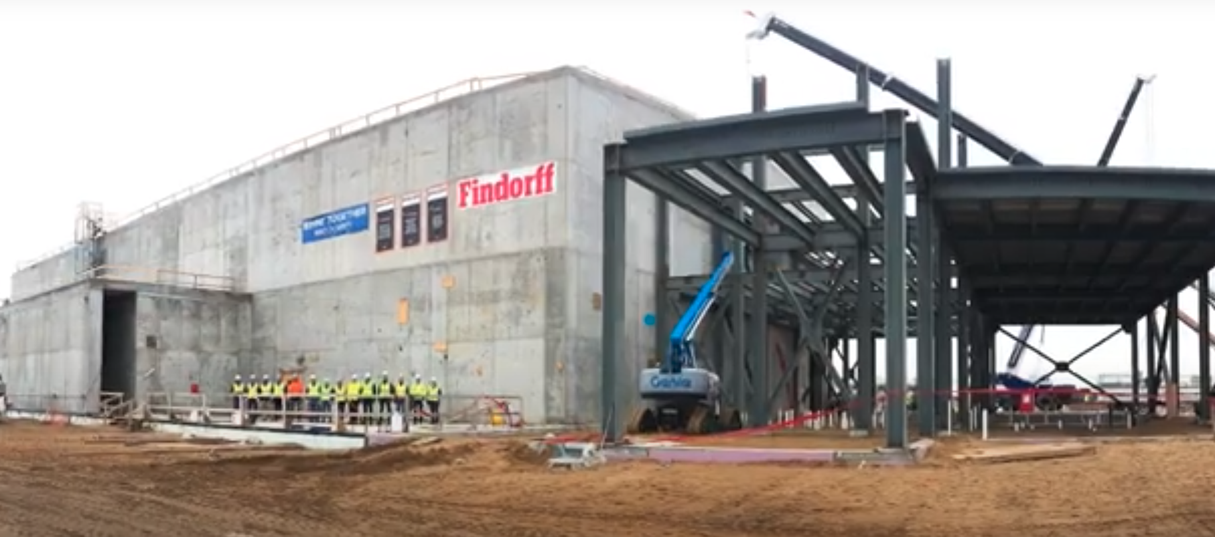
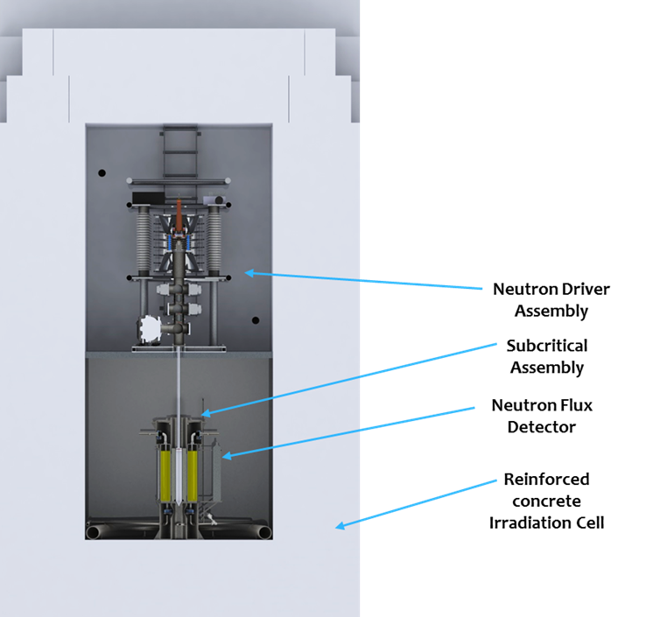
⁹⁹Mo from an accelerator-driven subcritical assembly
Janesville, WI
Well-funded
NRC Construction application approved
NRC Operating application submitted
DOE Cooperative Agreement Partner
Neutron Driver Assembly
Subcritical Assembly
Neutron Flux Detector
Reinforced concrete Irradiation Cell
Notes:
What is ORNL doing? Materials research of the subcritical assembly vessel (zirc, recently changed to SS)

Slide 6
⁹⁹Mo from two distinct production methods
Natural and enriched disk production
Disk irradiation (MURR)
Disk dissolution, cleanup and mo-99 shipping
Refill Generator at Radiopharm
Once consumed, remaining waste unused generator liquid returned to NorthStar
Recycled liquid cleaned and converted back to powder form
Disk irradiation at NorthStar
Disk dissolution, cleanup and mo-99 shipping
Refill Generator at Radiopharm
Once consumed, remaining waste unused generator liquid returned to NorthStar
Recycled liquid cleaned and converted back to powder form
(n,𝛾) Reactor production from ⁹⁸Mo
(𝛾,n) Accelerator production from ¹⁰⁰Mo
Notes:
ORNL assisting with powder processing AND additive target manufacturing for both neutron capture and accelerator production

Slide 7
NorthStar Medical Radioisotopes
Beloit, WI
Well-funded
State-regulated (since no uranium is used)
Control entire supply chain (targets to Generators)
DOE Cooperative Agreement Partner
Completed Accelerator Facility in Beloit, WI
Already operate reactor-based production facility for Mo-99.

Slide 8
Recommend a Configurable/Flexible ADS System
Flexibility could include:
Changeable converters
Changeable or removable subcritical assemblies
Changeable accelerator or accelerator operating parameters
Isotope Benefits could include:
Isotope specific configurations
Fast handling/removal times for short-lived isotope research
Direct production via beam, or converted production via converter or subcritical assembly.
Converter
Subcritical Assembly
Accelerator

Slide 9
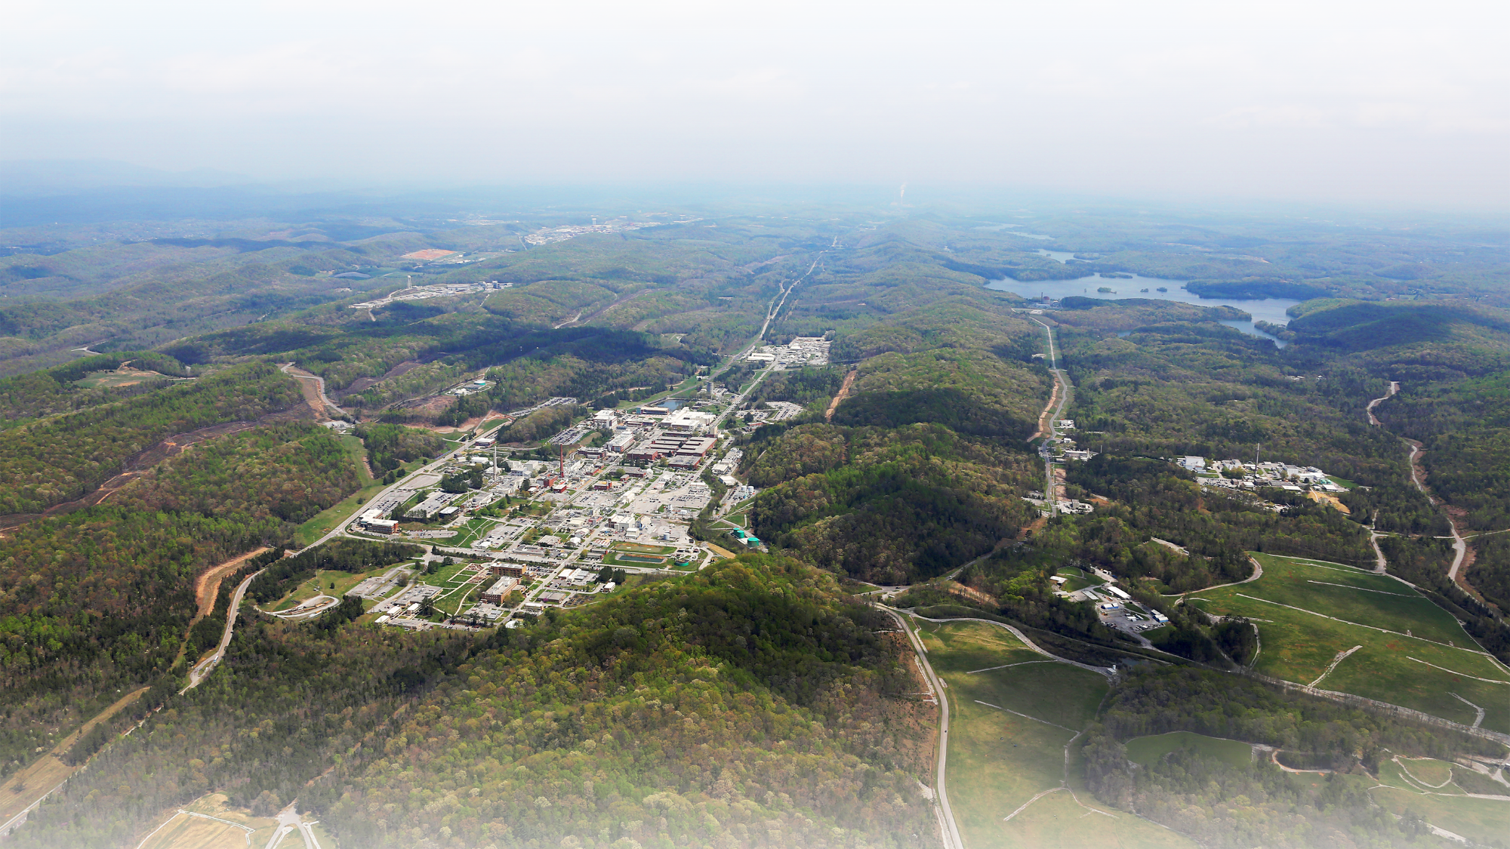
Questions?

