Slide 1
Nuclear Reactor Basics
Benjamin Collins, Ph.D.
Power Reactor Physics
Nuclear Energy and Fuel Cycle Division
Oak Ridge National Laboratory
Aug. 23, 2021
Not for Public Release

Slide 2
How a power plant works
Heat Source
Boils water
Turns turbine
Generates electricity

Slide 3


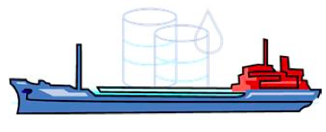
A nuclear plant is different because of the fuel
Nuclear power plants use the energy stored in the nucleus of large atoms rather than the energy stored in weaker chemical bonds.
To Power 1000 Homes
150 Tons of Uranium
2,100,000 Tons of Coal
Coal (C): C + O₂ -> CO₂ + 4 eV
Natural Gas: CH₄ + O₂ -> CO2 + 2H2O + 8 eV
Nuclear: ²³⁵U + n -> ⁹³Rb + ¹⁴¹Cs + 2n + 200 MeV
10,000,000 Barrels of Oil

Slide 4
To effectively generate electricity…
We need to fission many atoms
We establish a self-sustaining chain reaction
Notes:
This is how it works in principle, but in reality, there are many types of atoms in a reactor – not just uranium.

Slide 5
Not all neutrons fission Uranium…
Some are absorbed by other types of atoms in the core
Some “leak” out of the core and are absorbed elsewhere

Slide 6
A reactor designer must balance
Absorption in Fuel
Fission
Absorption in Structure
Radioactive Decay
Leakage
Neutron Production
Neutron Loss

Slide 7
A reactor designer must balance
Absorption in Fuel
CRITICAL = BALANCED
Fission
Absorption in Structure
Radioactive Decay
Leakage
Neutron Production
Neutron Loss

Slide 8
What’s so CRITICAL?
CRITICAL → k=1
  # of Neutrons Produced = # of Neutrons Absorbed
SUB-Critical → k<1
  # of Neutrons Produced < # of Neutrons Absorbed
SUPER-Critical → k>1
  # of Neutrons Produced > # of Neutrons Absorbed

Slide 9
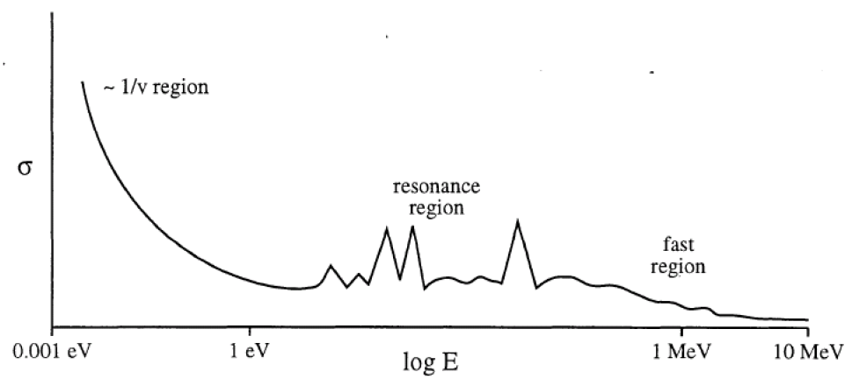
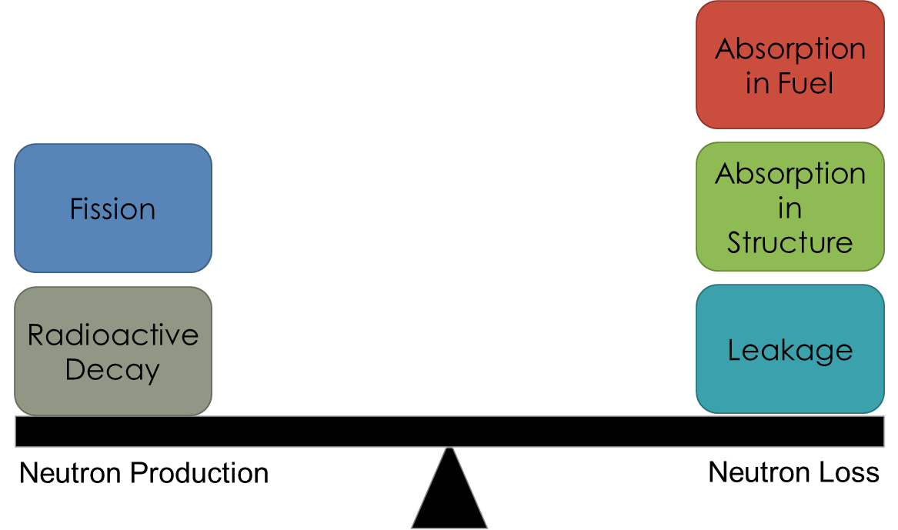
How fast were you going?
Cross-section of nucleus is strongly dependent on neutron speed

Slide 10
Let’s Build a Nuclear Power Plant

Slide 11
Let’s Build a Nuclear Power Plant
First, ceramic fuel pellets are manufactured from uranium ore
Notes:
Emphasize that fuel is dense, solid, hard and a strong container.

Slide 12
Let’s Build a Nuclear Power Plant
The ceramic fuel pellets are stacked in a column
And sealed inside a metallic alloy case, called the cladding, to form a fuel rod

Slide 13
Let’s Build a Nuclear Power Plant
The fuel rods are grouped together in a regular array or fuel assembly

Slide 14
Let’s Build a Nuclear Power Plant
The fuel rods are grouped together in a regular array or fuel assembly
The fuel assemblies are arranged in a larger regular array or reactor core

Slide 15
Let’s Build a Nuclear Power Plant
The fuel rods are grouped together in a regular array or fuel assembly
The fuel assemblies are arranged in a larger regular array or reactor core
The reactor core is contained inside a heavy steel reactor pressure vessel (RPV)

Slide 16
Let’s Build a Nuclear Power Plant
Turbine/
Generator
Condenser
Pump
In a nuclear power plant, the reactor core replaces the burning fossil fuel as the energy source

Slide 17
Let’s Build a Nuclear Power Plant
Turbine/
Generator
Condenser
Pump
Control rods absorb neutrons and are used to stop/start the reaction

Slide 18
Let’s Build a Nuclear Power Plant
Turbine/
Generator
Condenser
Pump
Control rods absorb neutrons and are used to stop/start the reaction

Slide 19
Boiling Water Reactor (BWR)
Turbine/
Generator
Condenser
Pump
39 of the 104 nuclear power plants in the U.S. look like this
They’re called BWRs or Boiling Water Reactors

Slide 20
BWR Containment
Turbine/
Generator
Condenser
Pump
The entire reactor sits inside a large concrete and steel containment building

Slide 21
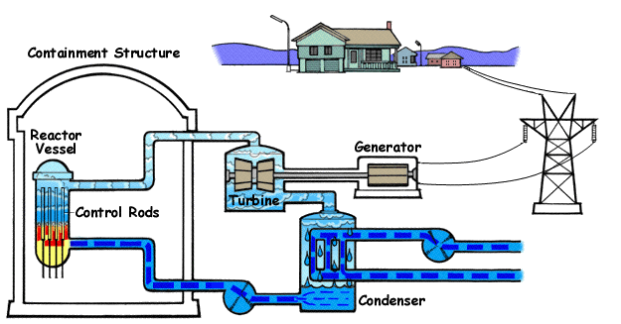
Boiling Water Reactor

Slide 22
Pressurized Water Reactor (PWR)
Turbine/
Generator
Condenser
Most U.S. nuclear power plants are PWRs or Pressurized Water Reactors
Pump
Steam is made in a steam generator rather than directly in the reactor core
Pump

Slide 23
PWR Containment
Turbine/
Generator
Condenser
Pump
Pump
The entire reactor sits inside a large concrete and steel containment building

Slide 24
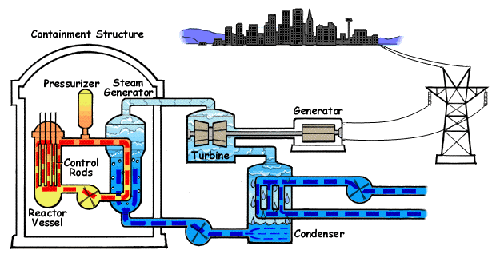
Pressurized Water Reactor

Slide 25

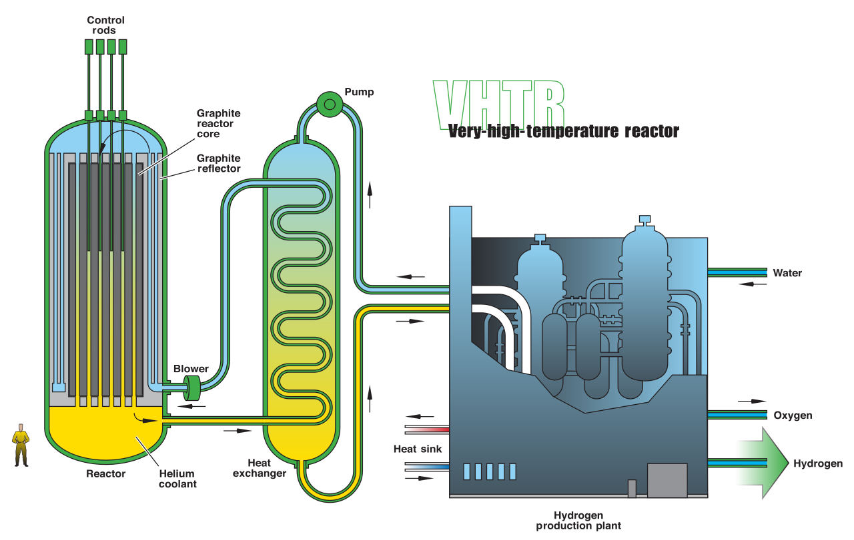
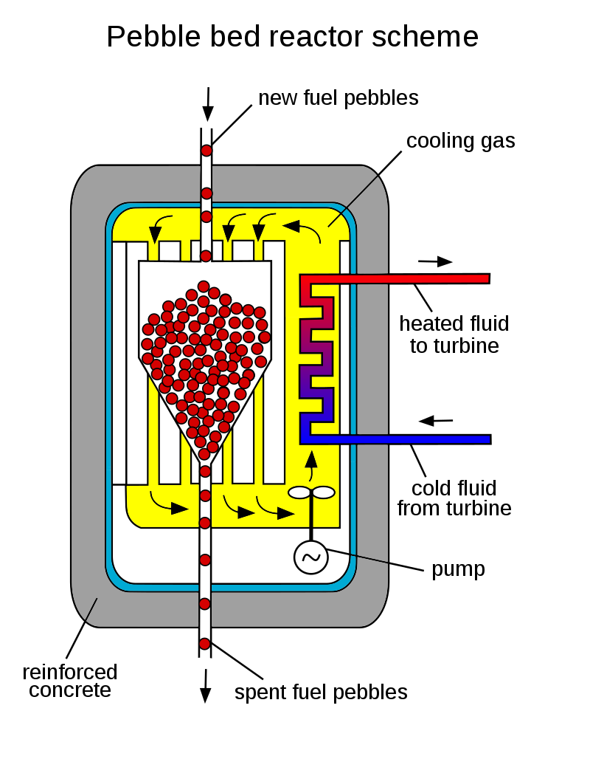
Advanced nuclear plants – High Temperature Gas Cooled Reactor

Slide 26
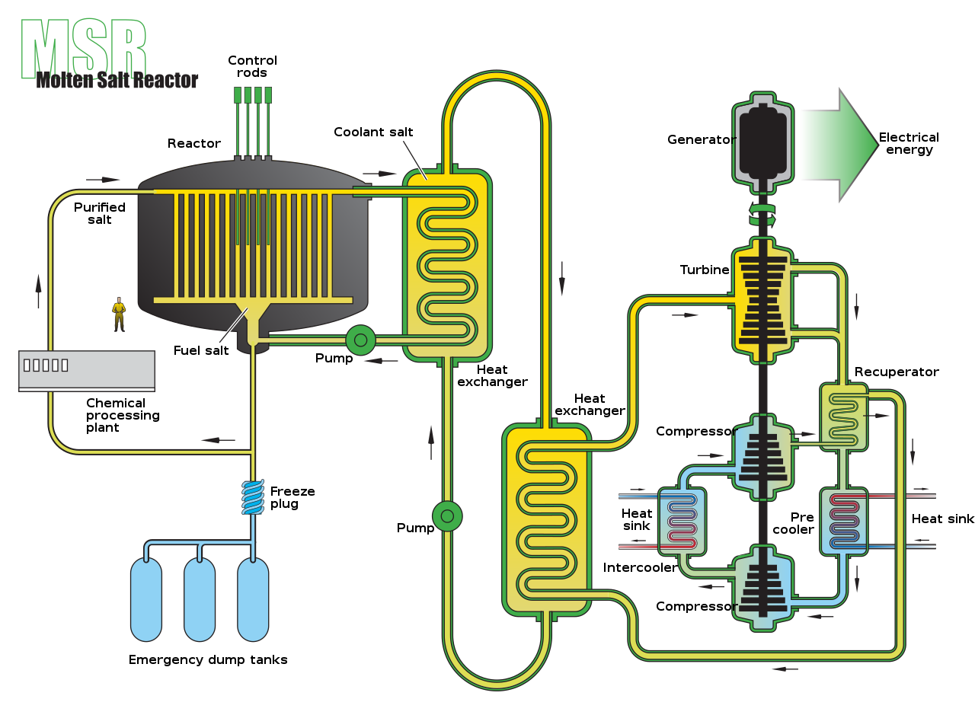
Advanced nuclear plants – Molten Salt Reactors
Liquid fuel flows through primary loop

Slide 27
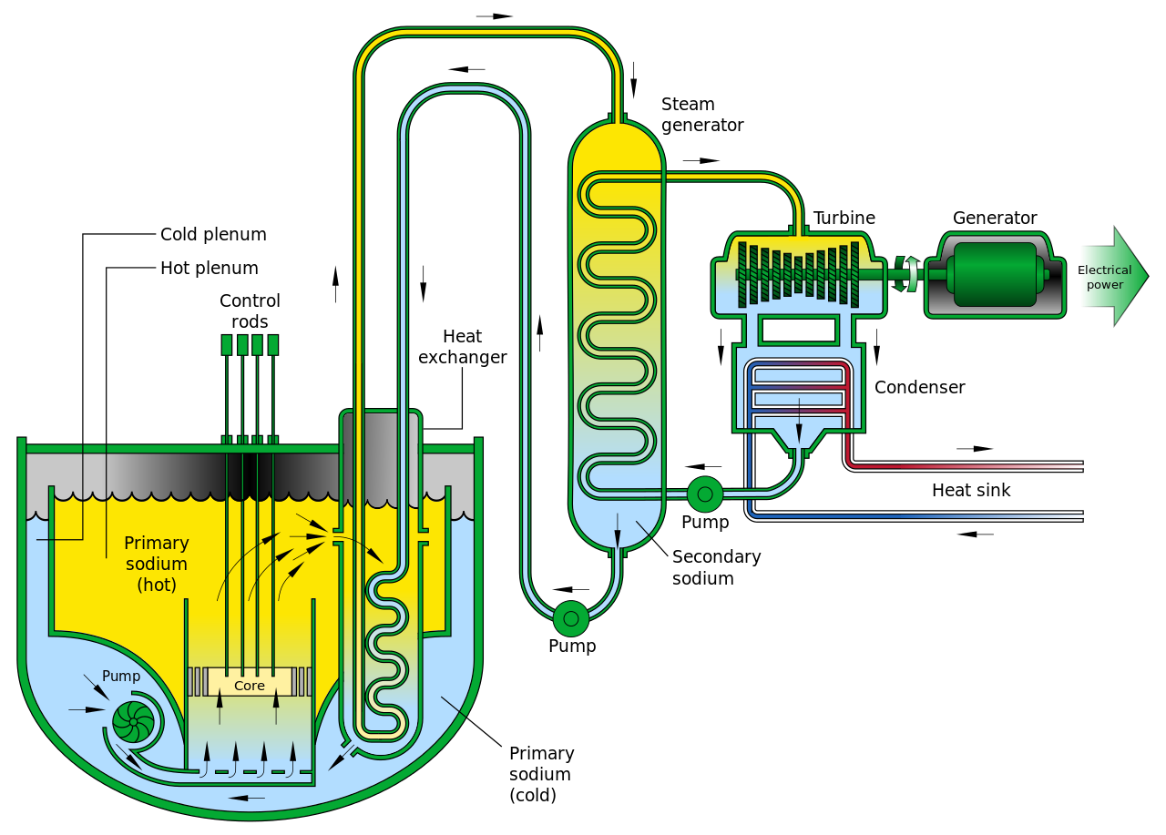
Advanced nuclear plants – Sodium-cooled Fast Reactor

Slide 28
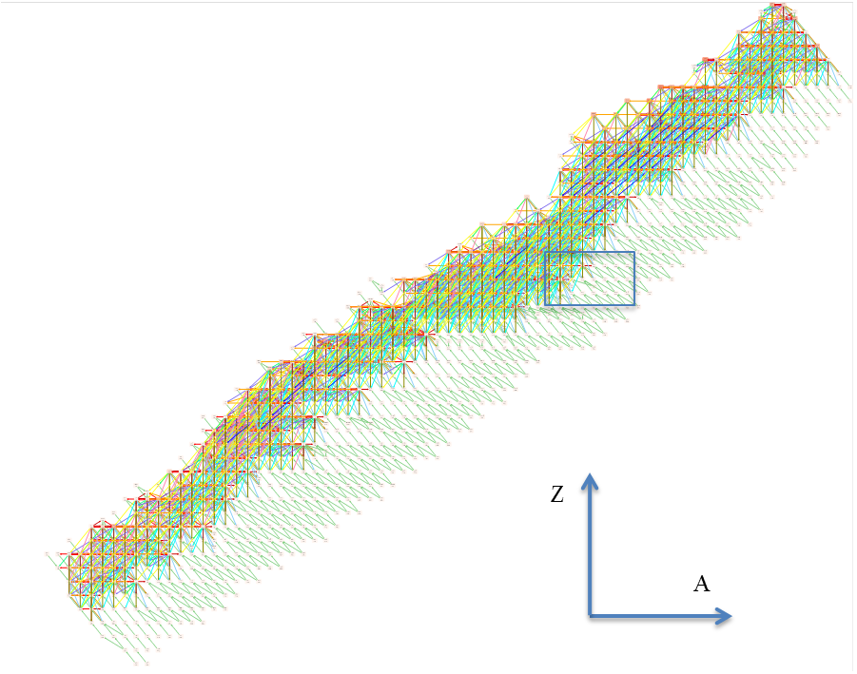
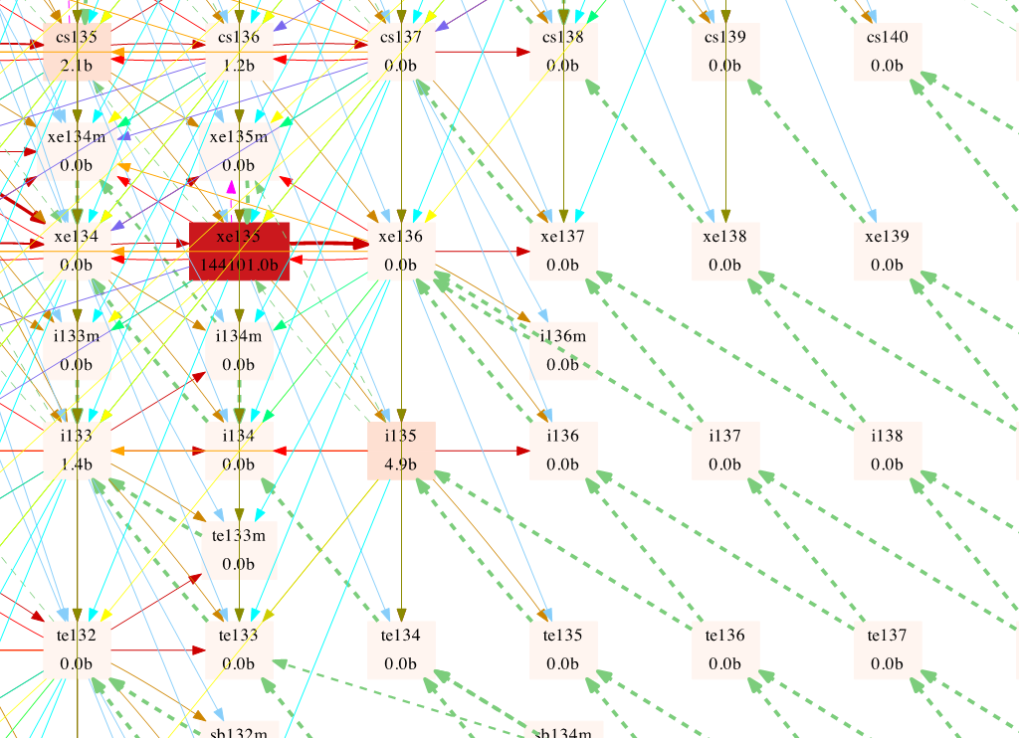
Impacts of irradiation
As fuel is irradiated, it produces many other isotopes as well as decreasing fissile mass

Slide 29
A reactor designer must balance as fuel is irradiated
Absorption in other isotopes increases
Absorption in Fuel
Fissile mass decreases
Fission
Absorption in Structure
Radioactive Decay
Leakage
Neutron Production
Neutron Loss
Must find a way to maintain balance over time

Slide 30
How can an accelerator help?
Additional source can offset losses in the system
Accelerator can provide additional source of neutrons
External Source
Absorption in Fuel
Fission
Absorption in Structure
Radioactive Decay
Leakage
Neutron Production
Neutron Loss

Slide 31
ADS Reactor Designs, Considerations and Motivations
W. David Pointer
Advanced Reactor Engineering and Development
Nuclear Energy and Fuel Cycle Division
September 24, 2021
Not for Public Release

Slide 32
Outline
Development timeline
Liquid Metal Cooled, Metallic-Fueled, Fast Spectrum ADS
Molten Salt Fueled ADS
Mythology of enhanced safety and improved reactor control
Why consider ADS?

Slide 33
Development timeline
1940 - E.O. Lawrence (USA) and W.N. Semenov (USSR) purse accelerator driven neutron sources
1941 – Seaborg (USA) proposes plutonium production using accelerator driven neutron sources
1985 – In “The Second Nuclear Era” Alvin Weinberg describes the general concept of an energy amplifier
1980s – H. Takahashi proposes accelerator driven actinide transmutation
1993 – Nobel Laureate C. Rubbia revived the energy amplifier concept with focus on Thorium fuel cycle

Slide 34
Early 2000s
Focus on simplification of Reactor/Accelerator Interface
  Windowless targets
  Integration of SCM and target thermal management
International efforts
  Lead Bismuth target & SCM coolant
    US – Nuclear Test Facility and Material Test Station
    Europe – MegaPIE (PSI) / GUINEVERE (SCK-CEN) / MYRRHA (SCK-CEN)
    Japan – KUCA Subcritical Assembly Experiment
    China – VENUS-II zero power facility
    India
  Molten salt fueled SCM with solid U target
    US – GEM*STAR (Virginia Tech – Bowman, Haghighat & Vogelaar)

Slide 35
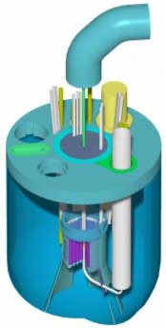
Why LBE-cooled ADS?
Supports operation of subcritical multiplier with a fast spectrum
  Virtually transparent to neutrons
  Highly desirable for transmutation of problematic minor actinides
  Enables use of alternate fuel cycle strategies including MOX
Great thermal hydraulic characteristics for passive cooling of both fuel and target
  Wide operating temperature range
    low melting point (125 ºC) compared with components (lead 327 ºC, bismuth 271 ºC)
    boils above 1670 ºC
  Excellent thermal conductivity at low pressure
  Huge heat capacity means that nothing happens fast
Can serve as both coolant and spallation target material
Excellent gamma radiation shielding (although activation/spallation products may erode this benefit)
Strong desire to eliminate need for a metallic beam window exposed to high radiation damage
  The vapor pressure of lead and lead bismuth eutectic at the operating temperatures of about400 ºC is low, on the order of 10⁻⁴ Torr.

Slide 36
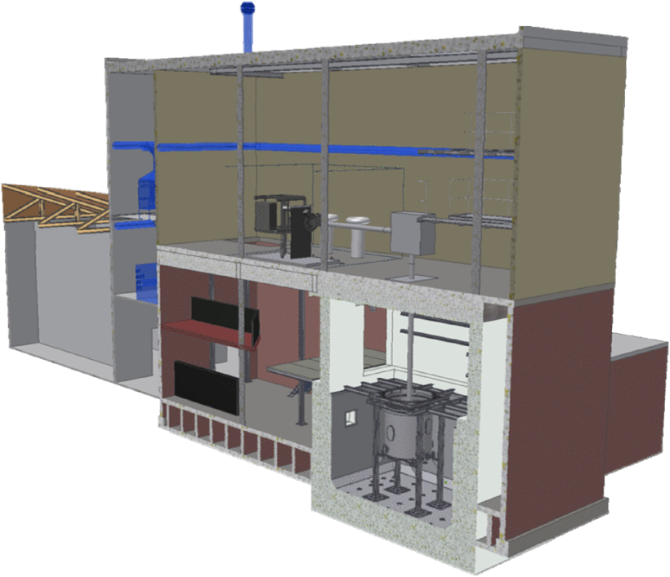

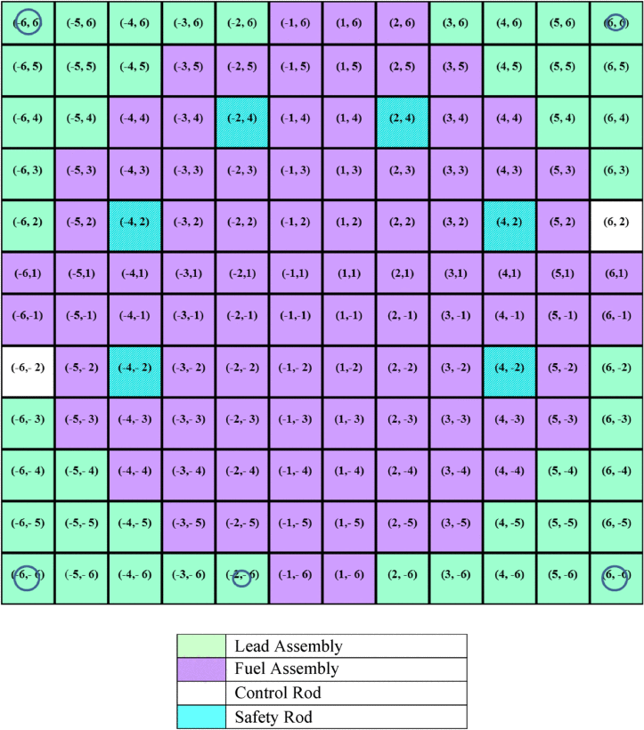
GUINEVERE (EU – SCK-CEN
Modified existing VENUS reactor at SCK-CEN to a lead reflected fast spectrum core
  Zero-power fast-spectrum sub-critical SCM
  30% enriched ²³⁵U metallic fuel in Pb matrix
  Deuteron GENEPI-3C accelerator operating in pulsed and continuous mode
  Ti3H target producing 14.1 MeV neutrons
Operates in both critical and subcritical mode
Focus on qualification of instruments and tools
  Demonstrate in-core measurement of reactivity
  Time dependent neutron spectra measurements after beam interruptions
  Validate predictions of control rod worth
Prepare for scale up to MYRRHA

Slide 37
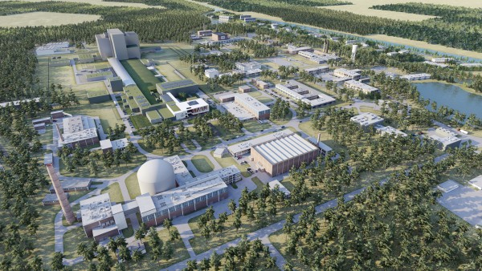
MYRRHA (Multi-purpose hYbrid Research Reactor for High-tech Applications)
Demonstrating
Advanced Linear Accelerator
Lead Bismuth Eutectic Cooled Fast Spectrum Reactor (and SCM)
Proton Target Facility
Fusion Target Station
Scheduled to be commissioned in 2036

Slide 38
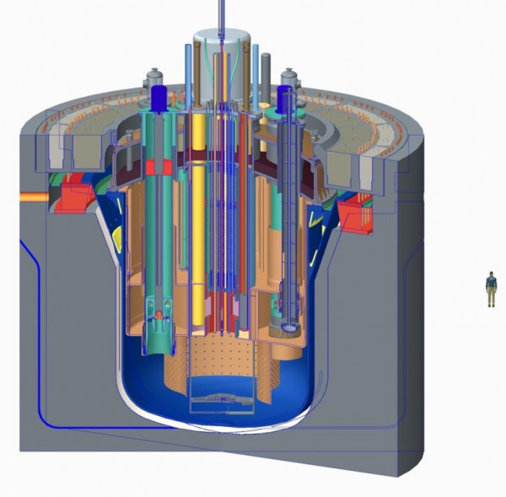
MYRRHA Reactor & SCM
Pool type reactor
100 MW_{th}
MOX fuel
Cooled by 7,800 tons of Lead Bismuth Eutectic
  High thermal capacity
  Very slow transient responses
Strong density gradient in response to temperature
  Decay heat load removable by natural convection
Demonstrates GenIV LBE reactor technology

Slide 39
LBE challenges
Cross-section libraries require development
Turbulence in confined flow → Erosion
Stratification and striping in unconfined flow
Flow induced vibration in fuel assemblies
Activation product transport in steam generators → double wall heat exchangers
Control rod hydrodynamics
Hot/cold pool interactions
Sloshing
Fuel cycle requires separate, or at least adjacent, recycle facilities

Slide 40
Why Molten Salt ADS?
Benefits of Molten Salt Fuel and Coolant
  Molten fuel
    No fuel melting accidents
    Potential for continuous addition of fuel stock and removal of undesirable fission products
  Great thermal hydraulic characteristics
    Wide operating temperature range
      Melting point around 450 ºC
      High boiling point above 1400 ºC
    Can operate at atmospheric pressure
    High heat capacity results in slowly evolving transients
    Fuel salt can serve dual role as solid target coolant

Slide 41
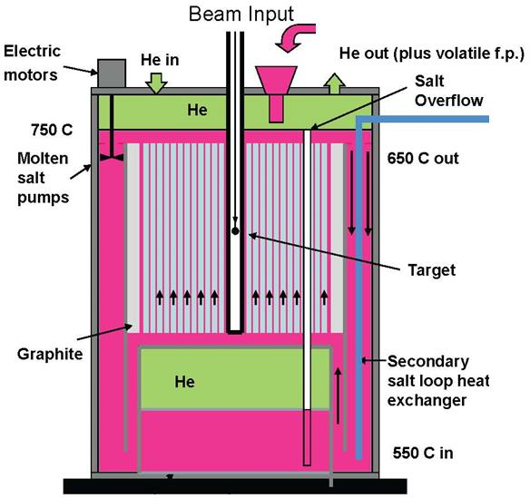
GEM*STAR
Concept developed by Charles Bowman, Bruce Vogelaar, and Ali Haghighat at Virginia Tech
(LiF)2 UF4 fuel salt
High temperature operation
  Nominally 1000 ºK
  High efficiency thermal conversion for power production
Graphite moderated
Thermal Spectrum
Fresh fuel (or LWR spent fuel) added and fission products removed at fixed intervals
Equilibrium fuel cycle established after ~ 2 years

Slide 42
Molten Salt Reactor Experiment (MSRE)
Design, development and construction completed in about 5 years, starting in 1960
  Updated and altered Aircraft Reactor Experiment facilities
Initially loaded with unfueled salt
Fuel slowly added through sampler-enricher to bring the reactor critical
Full power operation at 7.4 MW
  Limited by heat rejection capacity
Early 1962
Start of “Construction”
June 1, 1965
Initial Criticality (U-235 Core)
May 1966
Full Power Operation (7.4 MW)
October 2, 1968
Initial Criticality (U-233 Core)
December 1969
Shutdown
Notes:
Rosenthal, Murray W. "An account of Oak Ridge National Laboratory’s thirteen nuclear reactors." ORNL/TM 181 (2009).
Aircraft Reactor Experiment was a 2.5 MW molten salt reactor demonstration, operated November 8-12,1954.

Slide 43
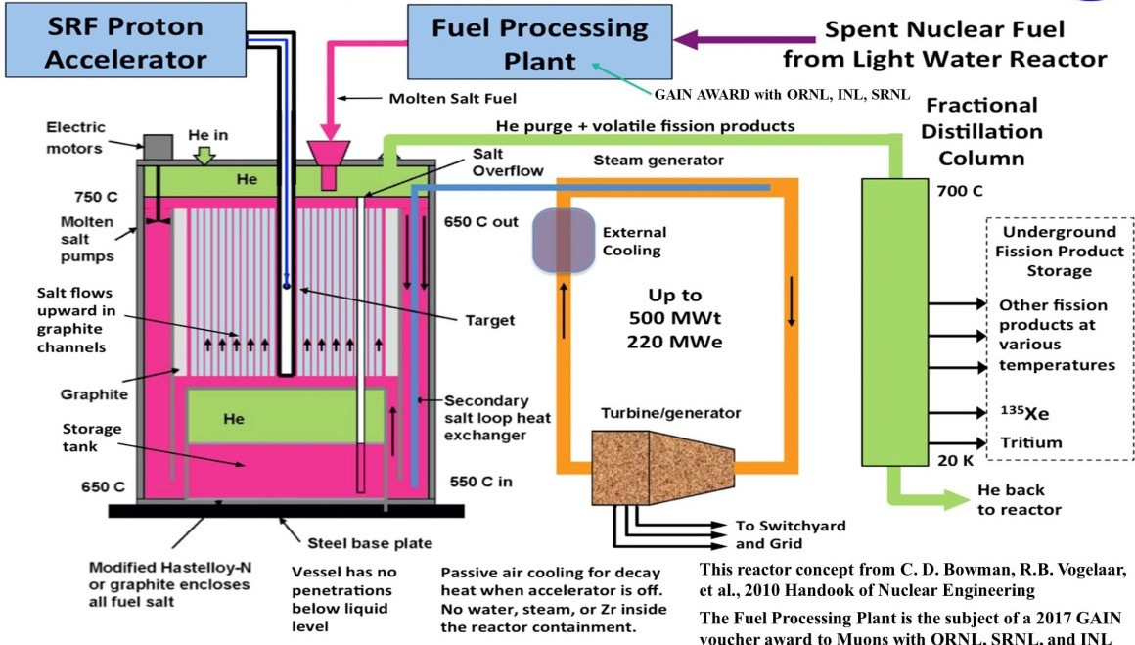
Mu*STAR

Slide 44
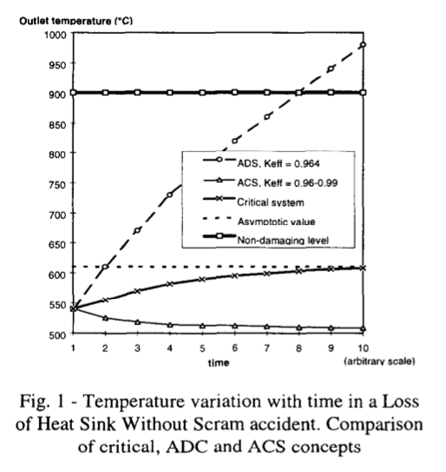
Myths and truths of safety enhancement
In 2001, Salvatores et al. evaluated the role of subcriticality in mitigation of accident scenarios
Considered two impacts of the degree of subcriticality
  Optimization of accident tolerance
  Minimization of the proton beam power
Found that subcritical systems have a definite advantage in comparison to critical systems for rapid transients such as Transient Over Power Without Scram (TOPWS)
For slow transients, such as the thermal hydraulic transients like Loss of Flow Without Scram (LOFWS) or Loss of Heat Sink Without Scram (LOHSWS) the subcritical system does not have any of the favorable natural feedbacks found in critical systems, and it is essential that the accelerator shut down.
For more common transients, such as station blackout transients, where the system scrams and the accelerator shuts down, the safety considerations are nearly identical to a critical reactor system. The system must provide adequate pathways for removal of the decay heat presented by the fission, spallation, and activation products

Slide 45
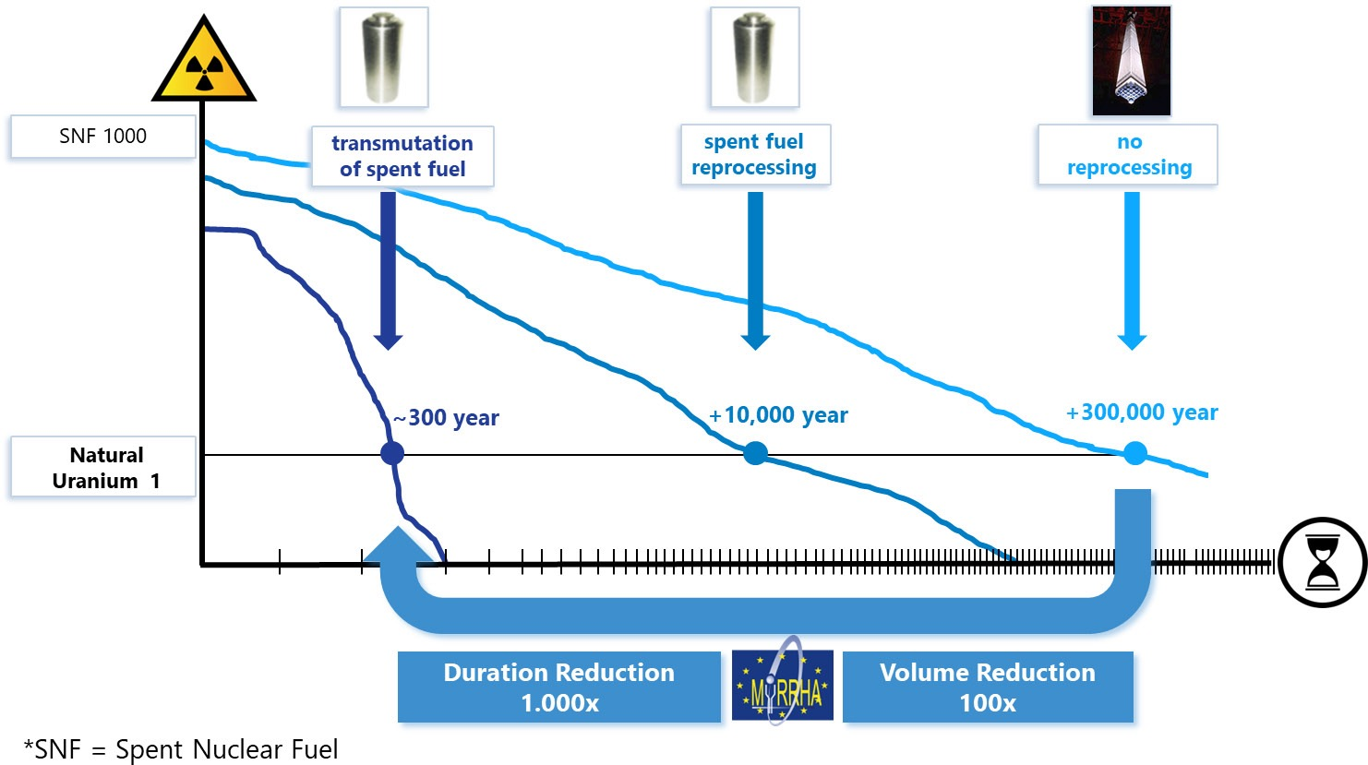
So why consider an ADS?

Slide 46
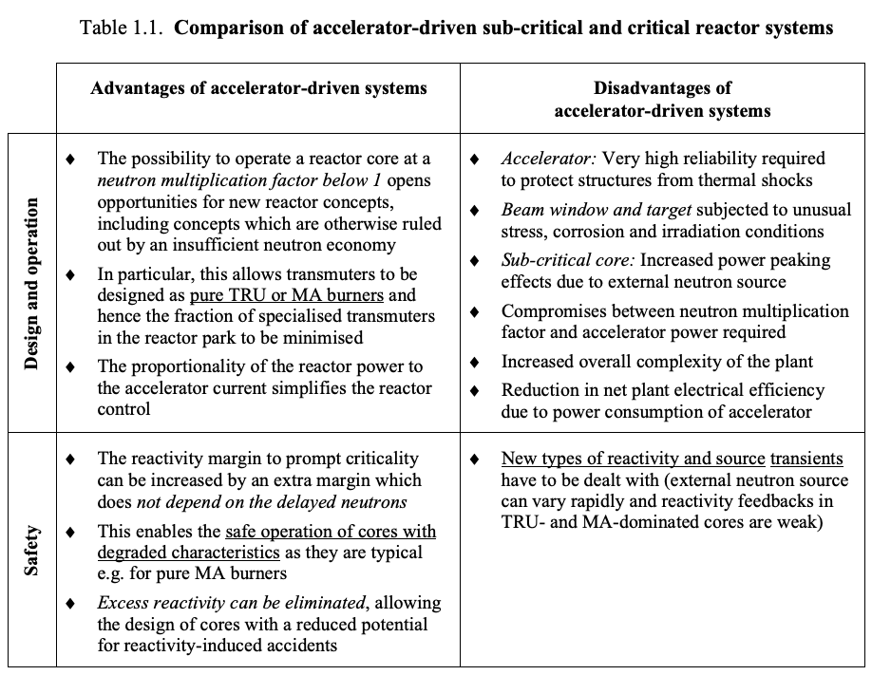
So why consider ADS?
From: “Accelerator-driven Systems (ADS)
and Fast Reactors (FR) in
Advanced Nuclear Fuel Cycles:
A Comparative Study, OECD/NEA-3109, 2002.

Slide 47
Major conclusions of OECD/NEA study
Potential reductions in actinide inventory and long-term radiotoxicity are very similar for deployment of ADS versus fast reactor fleets with integral recycle
Recycle of plutonium without minor actinide transmutation reduces plutonium specific radiotoxicity but is not as effective as fuel cycles including minor actinide transmutation
The consideration of different neutron spectra for ADS operations opens interesting degrees of freedom in the core design that enable consideration of very different fuel cycles
Subcritical operation introduces tolerance of the system for degradations of the safety features, especially reactivity feedbacks of the core.

Slide 48
R&D gaps
Accelerator and target system technology has evolved substantially since the early 2000s
Molten salt fueled concepts are under-developed in comparison to liquid-metal cooled systems using conventional solid fuel
  Safety considerations
  Fuel utilization considerations
  Control implications
Comparative studies for evaluation of ADS impacts focus on liquid metal cooled fast-spectrum systems with companion recycle facilities. Impacts of continuous feed and fission product removal in liquid fueled systems – on both the ADS and reactor fleet sides – have not been given adequate consideration
The sensitivity of potential molten salt designs to potential disruptions in accelerator operation has not been adequately considered
Salt-cooled metallic U target is inadequately developed to support consideration of tradeoffs between subcriticality, safety, fuel utilization, and accelerator performance demands
Modeling has been somewhat simplistic
  Little consideration of more exotic concepts and configurations such as tunable accelerator performance or multi-pack systems of ADS facilities driven by a common accelerator

