Slide 1
Target Team Progress Report
Application of ML to the Liquid Mercury Target
Lianshan Lin, Hoang Tran, Majdi I. Radaideh
Apr 21st, 2022

Slide 2
Outline
Task background and overall progress (Lianshan Lin)
Model calibration (Hoang Tran)
Bayesian inverse uncertainty quantification (Majdi I. Radaideh)

Slide 3
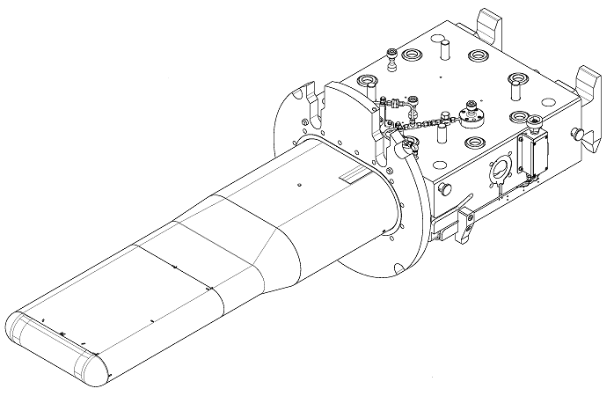
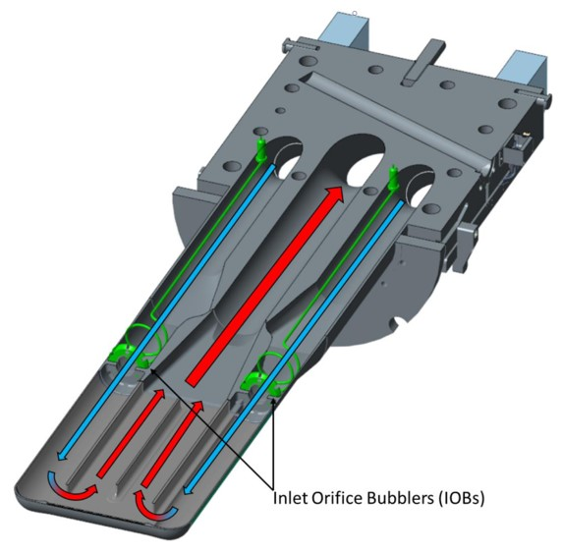
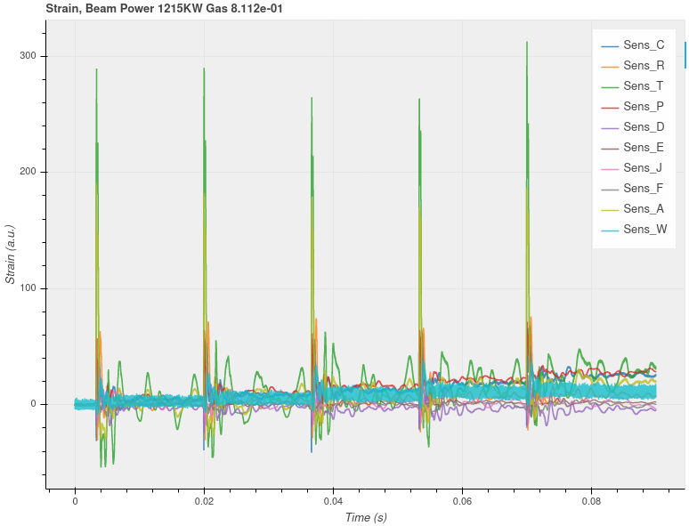
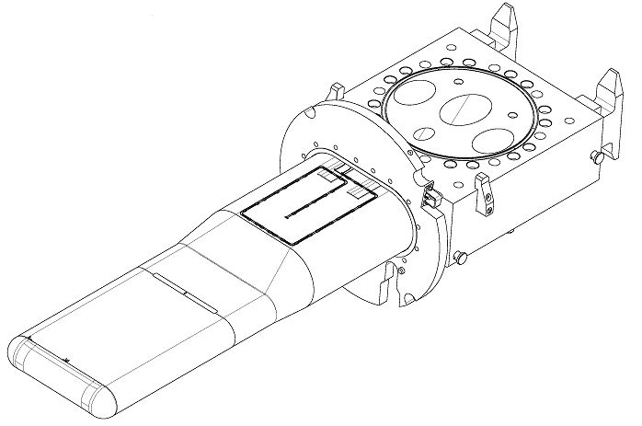
Current Mercury Target Design and Strain Sensors
Target vessel (Top)
Zone 3
Zone 1
Zone 2
Arrows represent the flow of mercury, blue for low temperature and red for high temperature.
J
K
Z
L
A
B
C
D
F
Target vessel (Bottom)
Zone 2
Zone 1
Proton
pulse
→ used to inject helium gas to reduce pressure and cavitation damage
S
R
P
N
Q

Slide 4
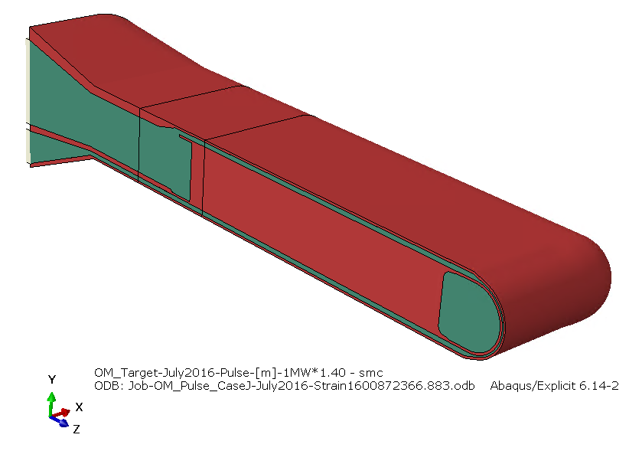
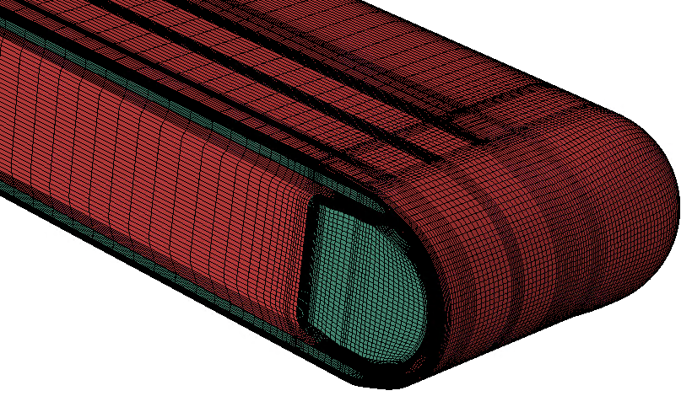
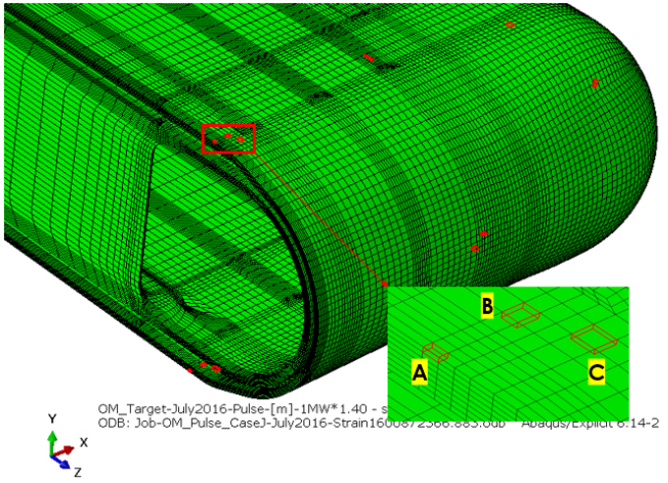
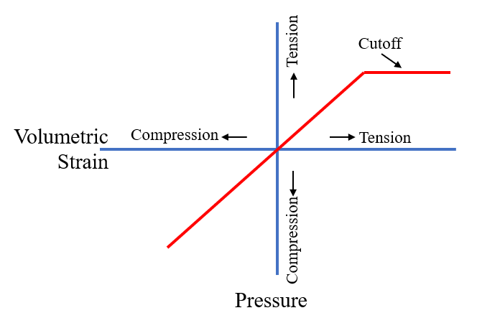
Mercury Target Pulse Simulation Model
8
7
5
6
Target in Hex Mesh
Steel
4
3
Mercury
1
2
Mercury
EOS
Sensor Elements

Slide 5
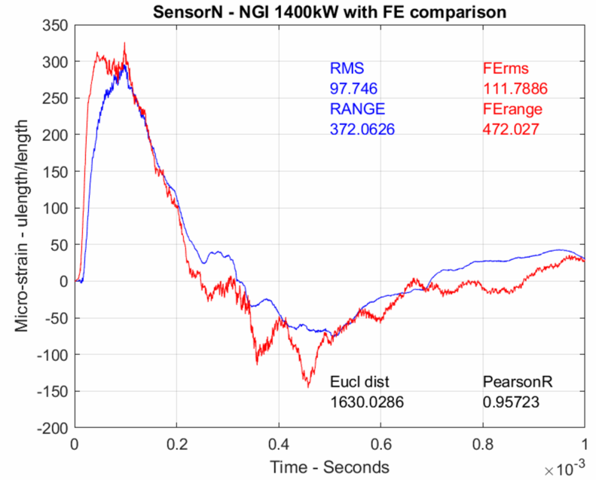
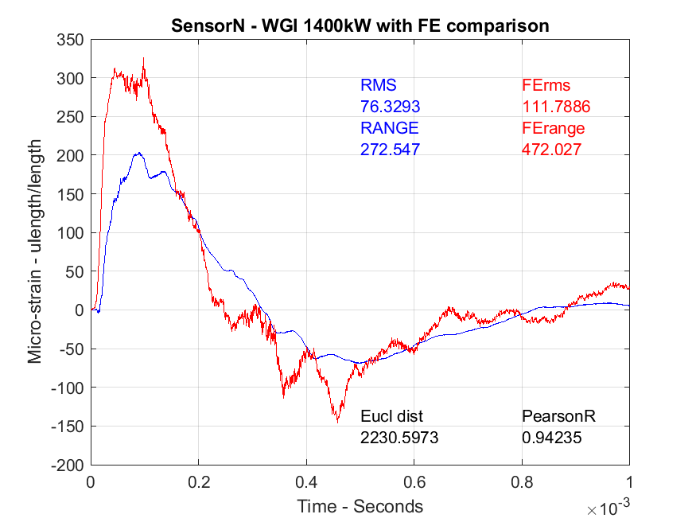
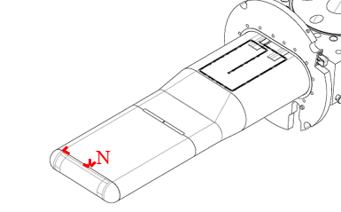

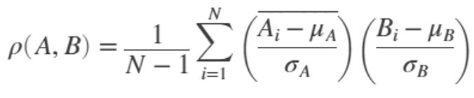
Discrepancy between Test and Simulation Strain Data
Measured Sensor Strain
Finite Element Strain
No Gas Injection Comparison, 1400KW
With Gas Injection Comparison, 1400KW
RMS
97.746
RANGE
372.063
FErms
111.789
FErange
472.027
RMS
76.329
RANGE
272.547
FErms
111.789
FErange
472.027
Microstrain
Microstrain
Eucl dist
1630.03
PearsonR
0.957
Eucl dist
2230.60
PearsonR
0.942
Time - Seconds
Time - Seconds
RMS: root-mean-square of strain values
RANGE: Max strain – Min strain
Eucl dist: Euclidean distance
Pearson R: Pearson Correlation Coefficient
Target Bottom

Slide 6
Methods to Improve Simulation for Gas Injection Case
Challenges
  Expensive FE model simulation with some unknown parameters
  Data noises and model biases
Modelling
  Tune Candidate Parameters in EOS mercury model
    Mercury density, sound speed in mercury, and mercury tensile cutoff threshold
  Include Bubbles Behavior in mercury model
    Rayleigh-Plesset model
Machine Learning & HPC
  Train surrogate models to identify unknown key parameters in mercury models
  Utilize HPC to improve the efficiency of time-consuming full target finite element simulation

Slide 7
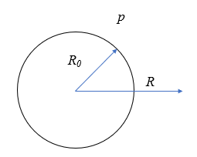
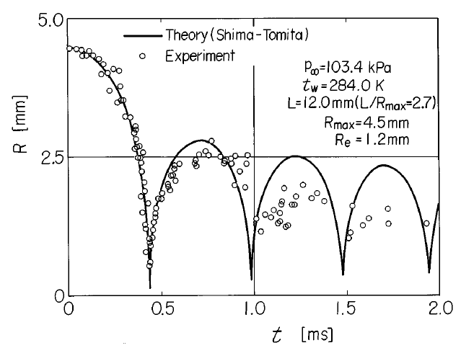
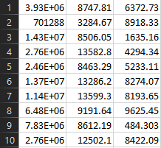
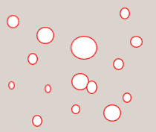


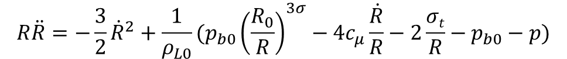
Parameterized EOS and Rayleigh-Plesset Models
$$R\ddot{R}=−\frac{3}{2}{\dot{R}}^{2}+\frac{1}{ρ_{L0}}(p_{b0}{\left(\frac{R_{0}}{R}\right)}^{3σ}−4c_{μ}\frac{\dot{R}}{R}−2\frac{σt}{R}−p_{b0}−p)$$
Mercury
EOS
$$∆p_{R_increment}=\frac{4}{3}πK∗Nb∗(R^{3}−R_{old}^{3})$$
Parameters
Cutoff Density Sound Speed
Variation with time of the bubble radius*
p_{b0} pressure in the bubble at time zero
ρ_{L0} initial liquid density
c_{μ} specific heat
σ adiabatic index
σ_{t} surface tension
K liquid bulk modulus
Nb number of bubbles per cubic volume
.
.
.
Bubble families in Mercury
*A. Shima, Studies on bubble dynamics, Shock Waves, 1997 7:33-42.

Slide 8
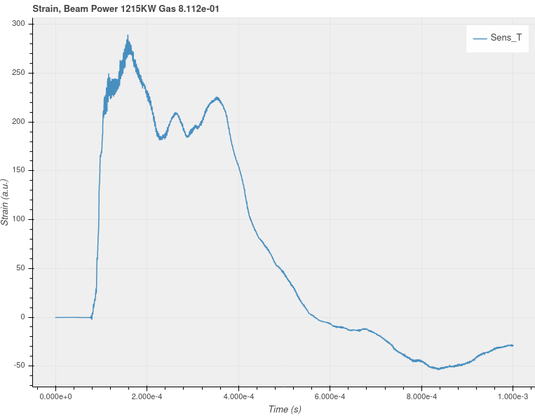
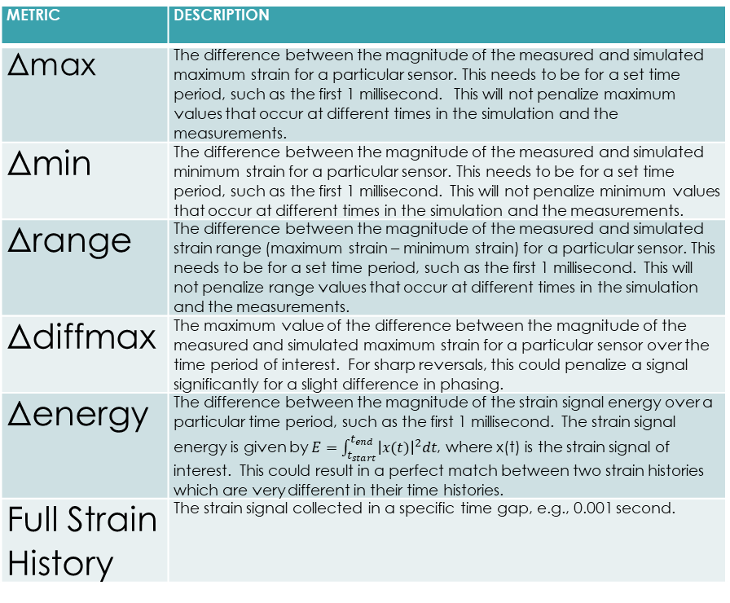
Metric of Strain
Metric | Description
Δmax | The difference between the magnitude of the measured and simulated maximum strain for a particular sensor. This needs to be for a set time period, such as the first 1 millisecond. This will not penalize maximum values that occur at different times in the simulation and the measurements.
Δmin | The difference between the magnitude of the measured and simulated minimum strain for a particular sensor. This needs to be for a set time period, such as the first 1 millisecond. This will not penalize minimum values that occur at different times in the simulation and the measurements.
Δrange | The difference between the magnitude of the measured and simulated strain range (maximum strain – minimum strain) for a particular sensor. This needs to be for a set time period, such as the first 1 millisecond. This will not penalize range values that occur at different times in the simulation and the measurements.
Δdiffmax | The maximum value of the difference between the magnitude of the measured and simulated maximum strain for a particular sensor over the time period of interest. For sharp reversals, this could penalize a signal significantly for a slight difference in phasing.
Δenergy | The difference between the magnitude of the strain signal energy over a particular time period, such as the first 1 millisecond. The strain signal energy is given by $E=\int_{t_{start}}^{t_{end}}{{\left|x(t)\right|}^{2}dt}$, where x(t) is the strain signal of interest. This could result in a perfect match between two strain histories which are very different in their time histories.
Full Strain History | The strain signal collected in a specific time gap, e.g., 0.001 second.
max
range
energy
energy
min

Slide 9
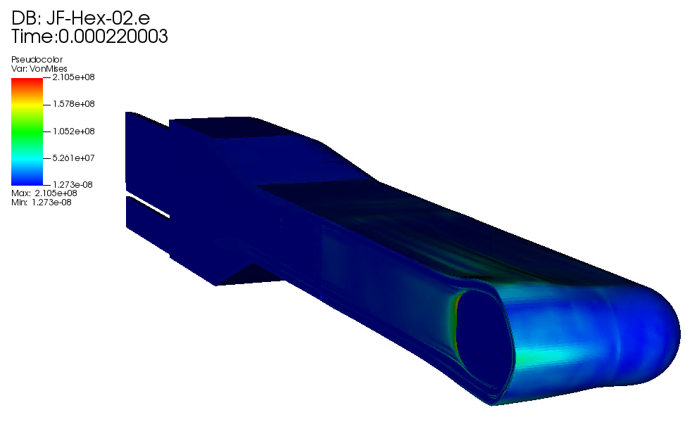
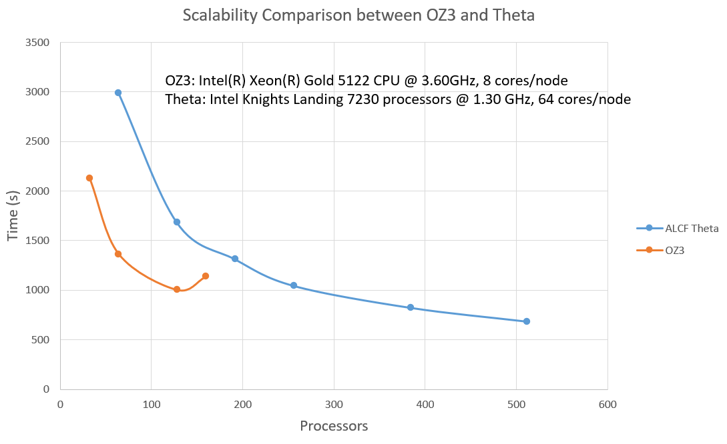
Apply ML method on Full Target Model
Hex Mesh Jet-Flow Target in Sierra
OZ3 : Local Cluster
Theta: Argonne Leadership Computing Facility (ALCF) machine
Full model, Hex mesh
Total time: 1 millisecond
Displacement scale = 100
Number of nodes: 3,971,356
Number of elements: 3,650,454
Number of frames in output database: 51
Processors: 96
Wall time: 24hr:56min:27sec
Mass scaling: disabled
Silent boundary: included
Output time interval: 20 microseconds
HPC nodes are needed to generate enough number of machine learning strain datasets from large scale finite simulations.

Slide 10
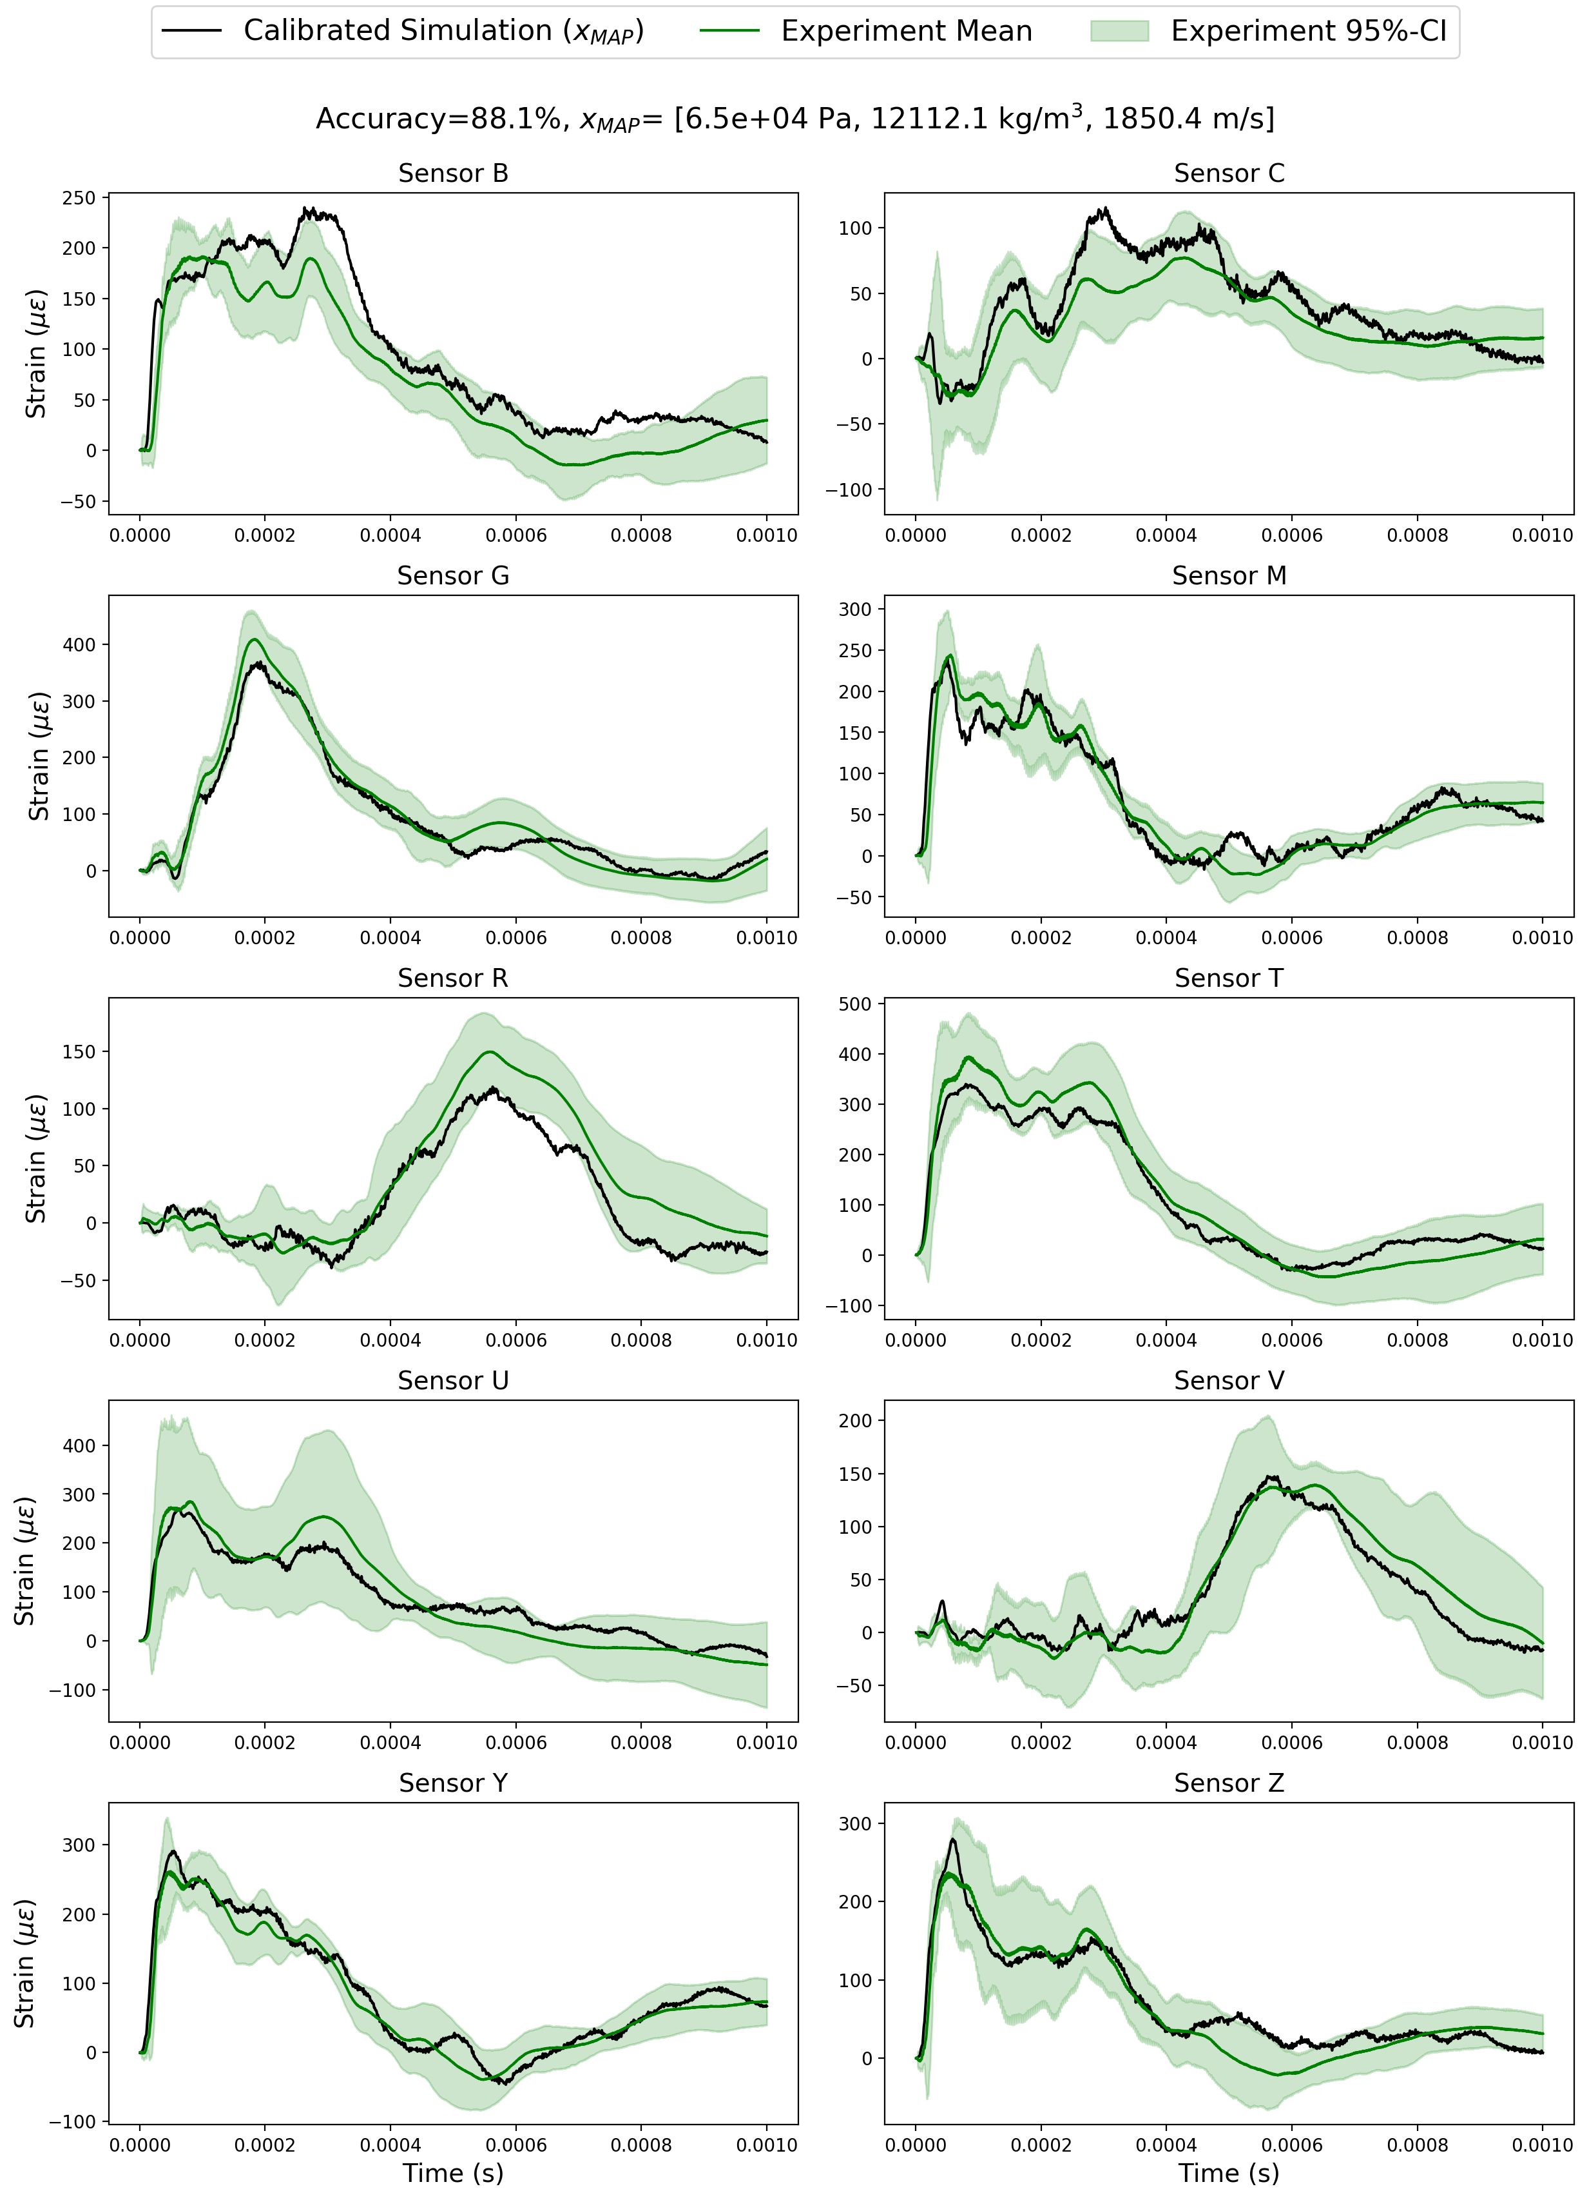
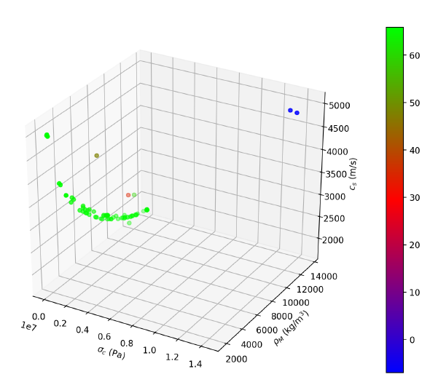
Progress of EOS and R-P Models
Parameterized EOS model for no gas injection case
R-P Model for gas injection case
Experimental sensor strain data curated.
R-P model user subroutine in Sierra is ready to use.
Exploring the initial parameters space by varying at bubbles size and bubbles family.
Small scale simulations are running.
Optimized three parameters in EOS model
Calibrated sensor strains*
Bubble families in Mercury
*Radaideh, M. I., et al. “Bayesian Inverse Uncertainty Quantification of the Physical Model Parameters for the Spallation Neutron Source First Target Station”. https://arxiv.org/abs/2202.03959, Under review in Results in Physics

Slide 11
Model calibration of the Liquid Mercury Spallation Target using Evolutionary Neural Networks and Sparse Polynomial Expansions
Hoang Tran
Radaideh, M. I., Tran, H., Lin, L., Jiang, H., Winder, D., Gorti, S. Zhang, G., Mach, J. & Cousineau, S. (2022). Model calibration of the Liquid Mercury Spallation Target using Evolutionary Neural Networks and Sparse Polynomial Expansions, submitted to Nuclear Instruments and Methods in Physics Research Section B.

Slide 12
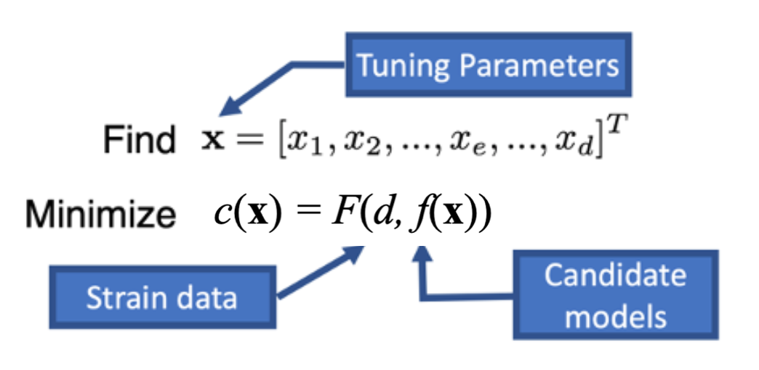
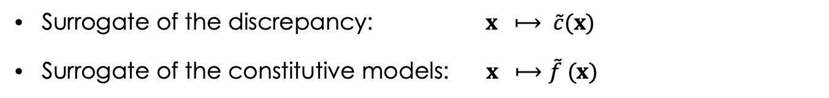
A surrogate modeling-based optimization is used to overcome the challenges of learning a large, complex model
The inverse ML problem
Equation of State (EOS) Model for cavitation in mercury (3 unknown parameters)
Rayleigh-Plesset Model for general bubble dynamics (8 parameters)
Key idea:
Learn surrogate models from the simulation data and perform optimization on the surrogate
Significantly reduce the number of simulations of the constitutive model
Enable parallel tuning on HPC
Two types of surrogates:
Surrogate of the discrepancy: $x ⟼ \tilde{c}(x)$
Surrogate of the constitutive models: $x ⟼\tilde{f} (x)$
Notes:
To address those challenges, we will exploit the scalable DNN-based optimization capability that has been developed under the support of the ORNL AI Initiative. The key idea is to build surrogate models of the loss function and then use the cheap-to-evaluate surrogates to tune the candidate models. We will consider two strategies, constructing either 1) a single DNN-based surrogate defined globally on the parameter domain, or 2) a sequence of local surrogate models of the loss function, where each surrogate will cover a segment of the search path, for example, 50 iterations. For models with few number of tuning parameters (PID), we lean toward global approach, so that we do not need to train multiple DNN models. Obtaining an accurate global surrogate for constitutive models with high number of parameters may be infeasible, in which case we rely on local approach. Since the data for training the surrogates can be generated by running FE/CFD simulations in parallel, and the DNNs can be trained using multiple nodes on HPC, it is almost equivalent to say that we can perform all iterations covered by the surrogate in parallel. Even considering the training cost, the time reduction is very significant compared to the sequential optimization. The approach has been tested using a topology optimization problem for additive manufacturing, where the goal is to design a 3D printable square plate using two materials to achieve a prescribed thermal conductivity property. The red represents the material with good conductivity and the blue represents the material with poor conductivity. The proposed method used 32 nodes on SUMMIT to achieve 85% time reduction as well as maintain good accuracy.

Slide 13
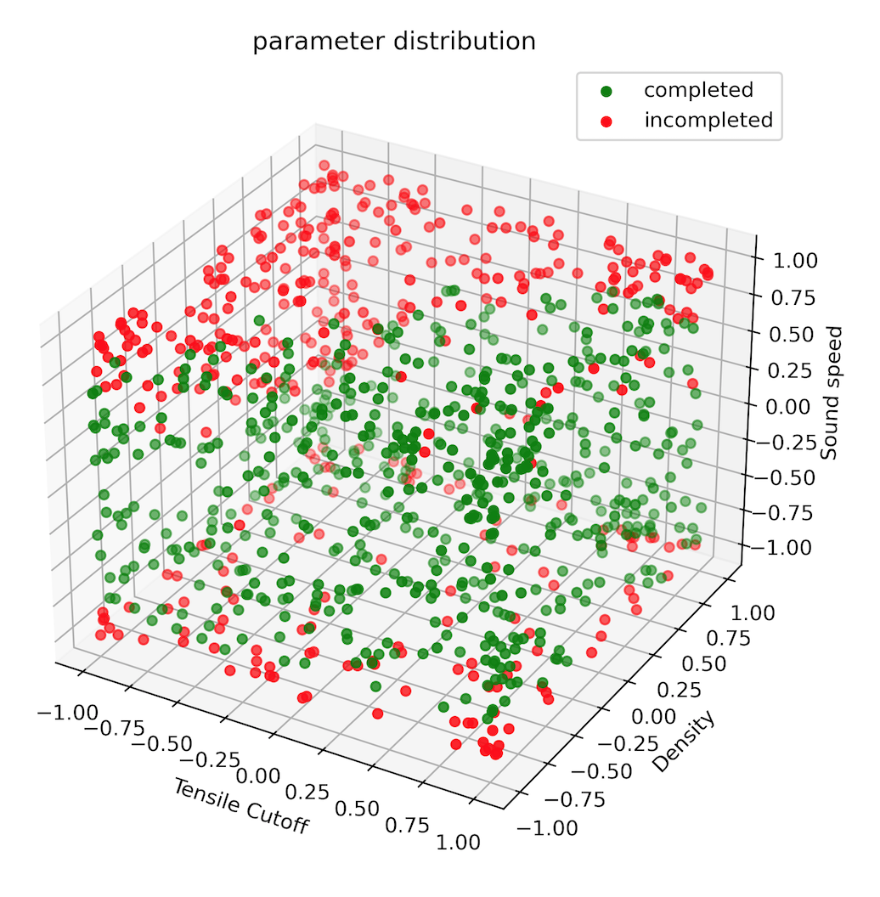
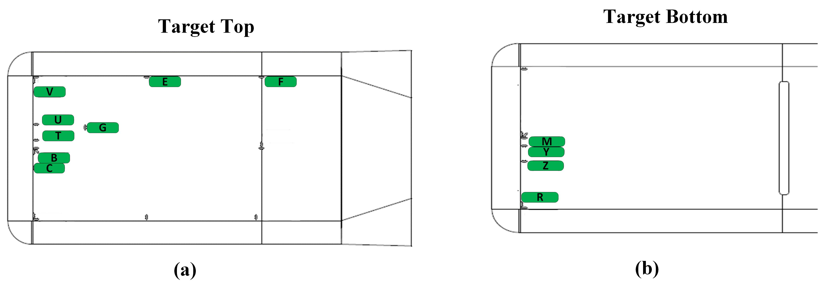
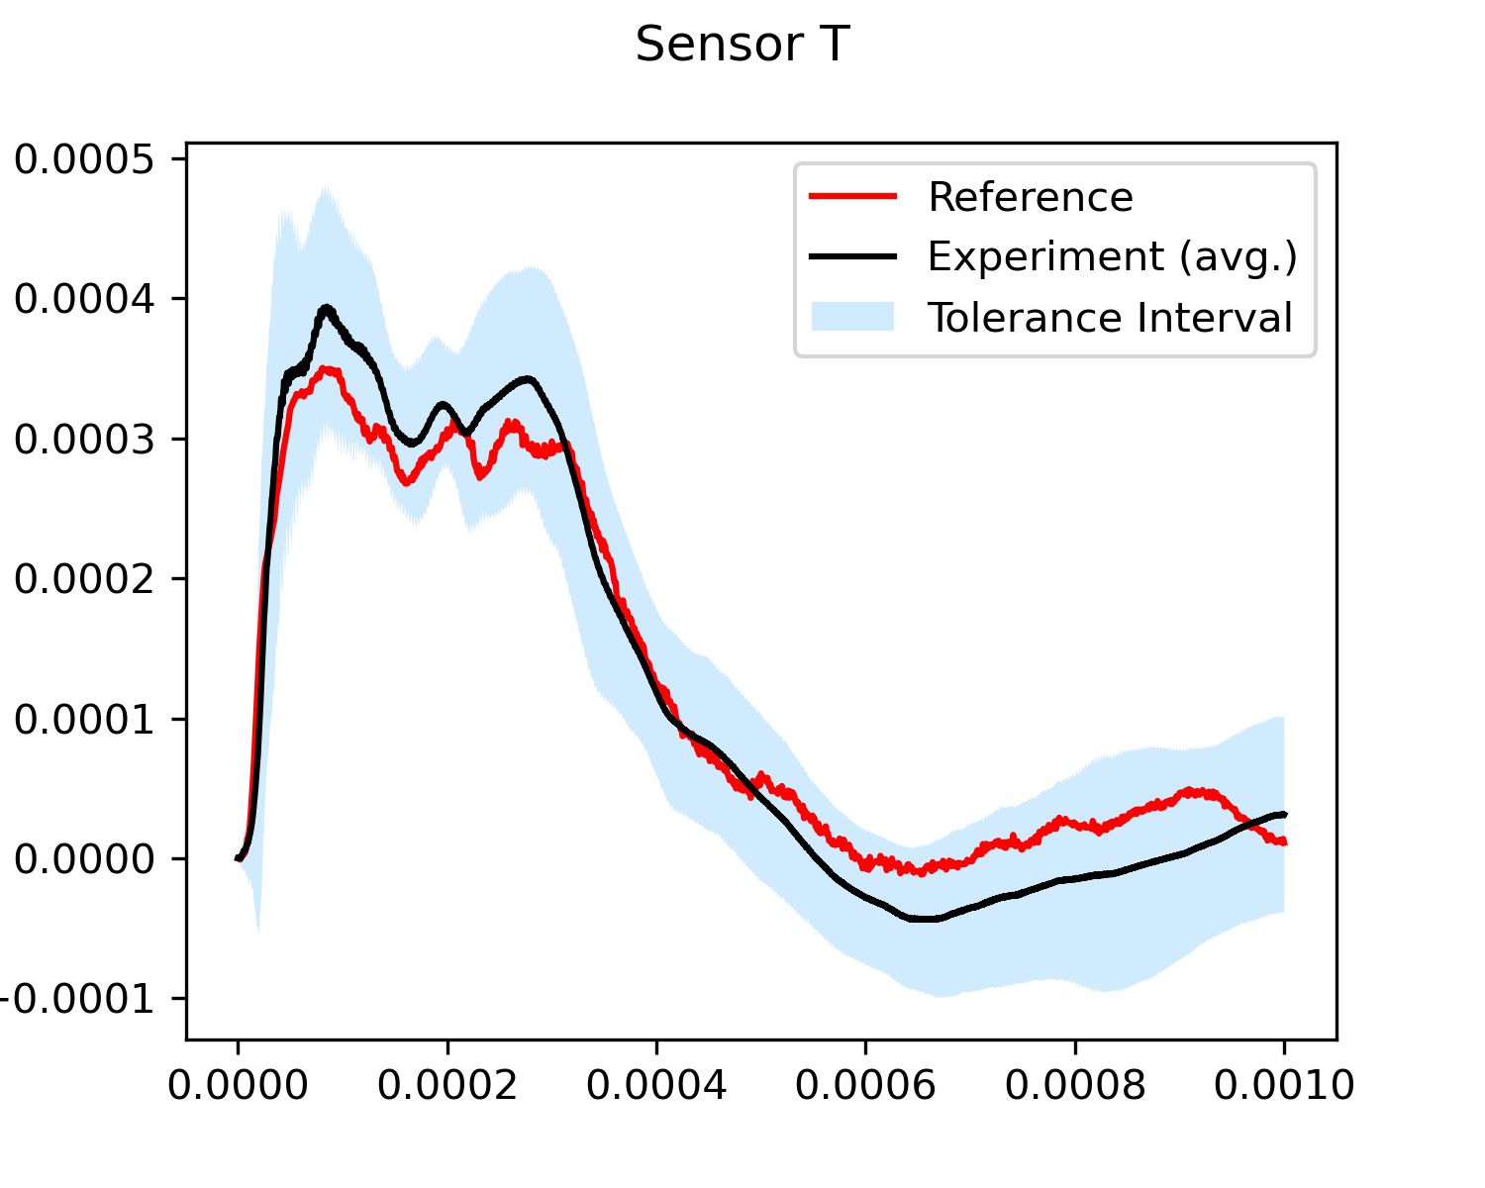
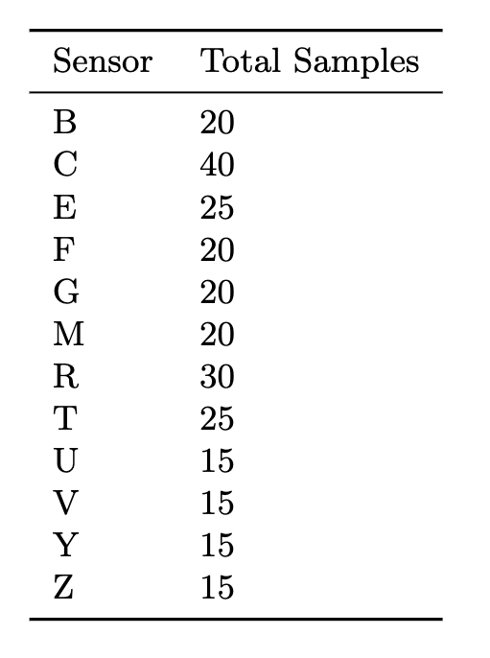
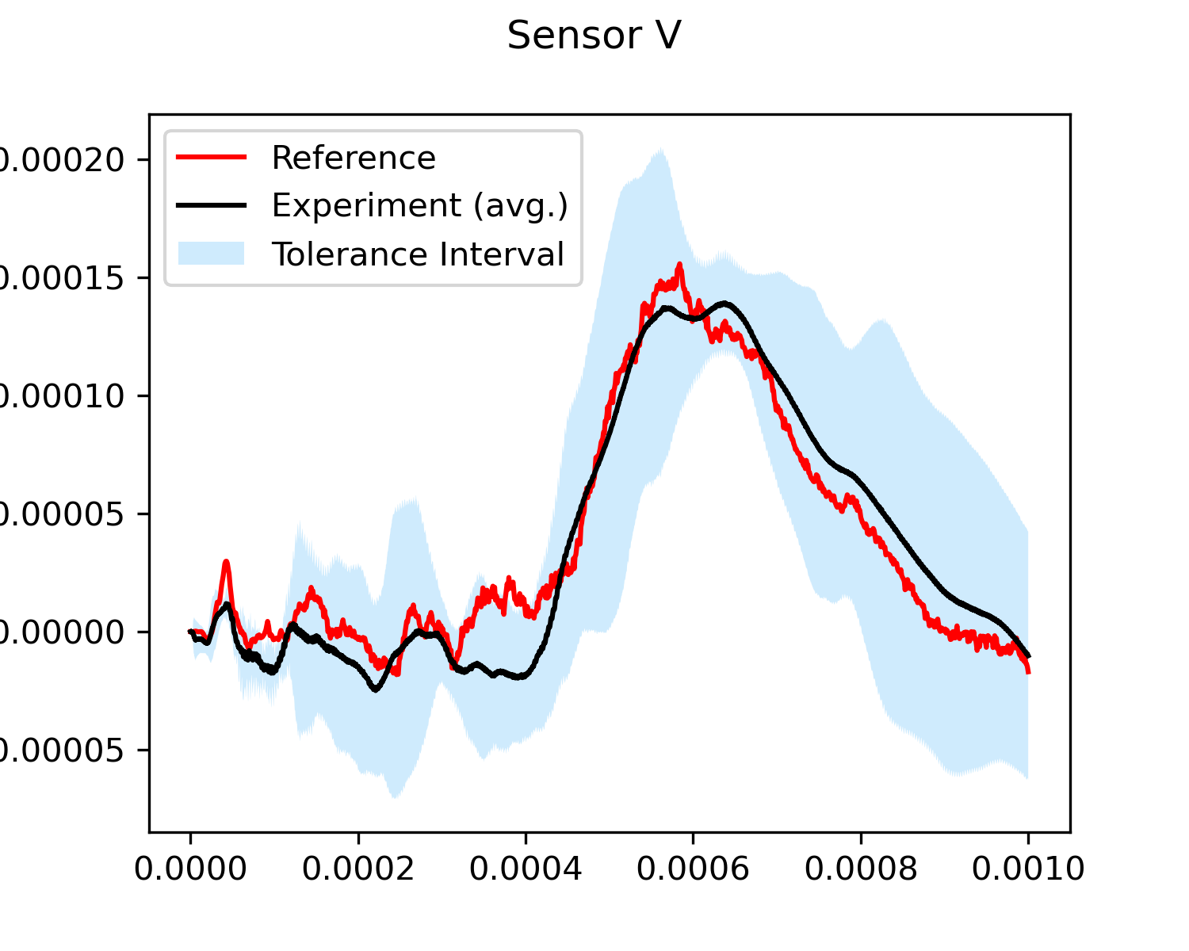
Experimental and simulation data
Location of the sensors on the target vessel (a) top and (b) bottom
Number of measured strain for all sensors in this study
Dataset: 603 Samples
Training: 483
Testing: 120

Slide 14
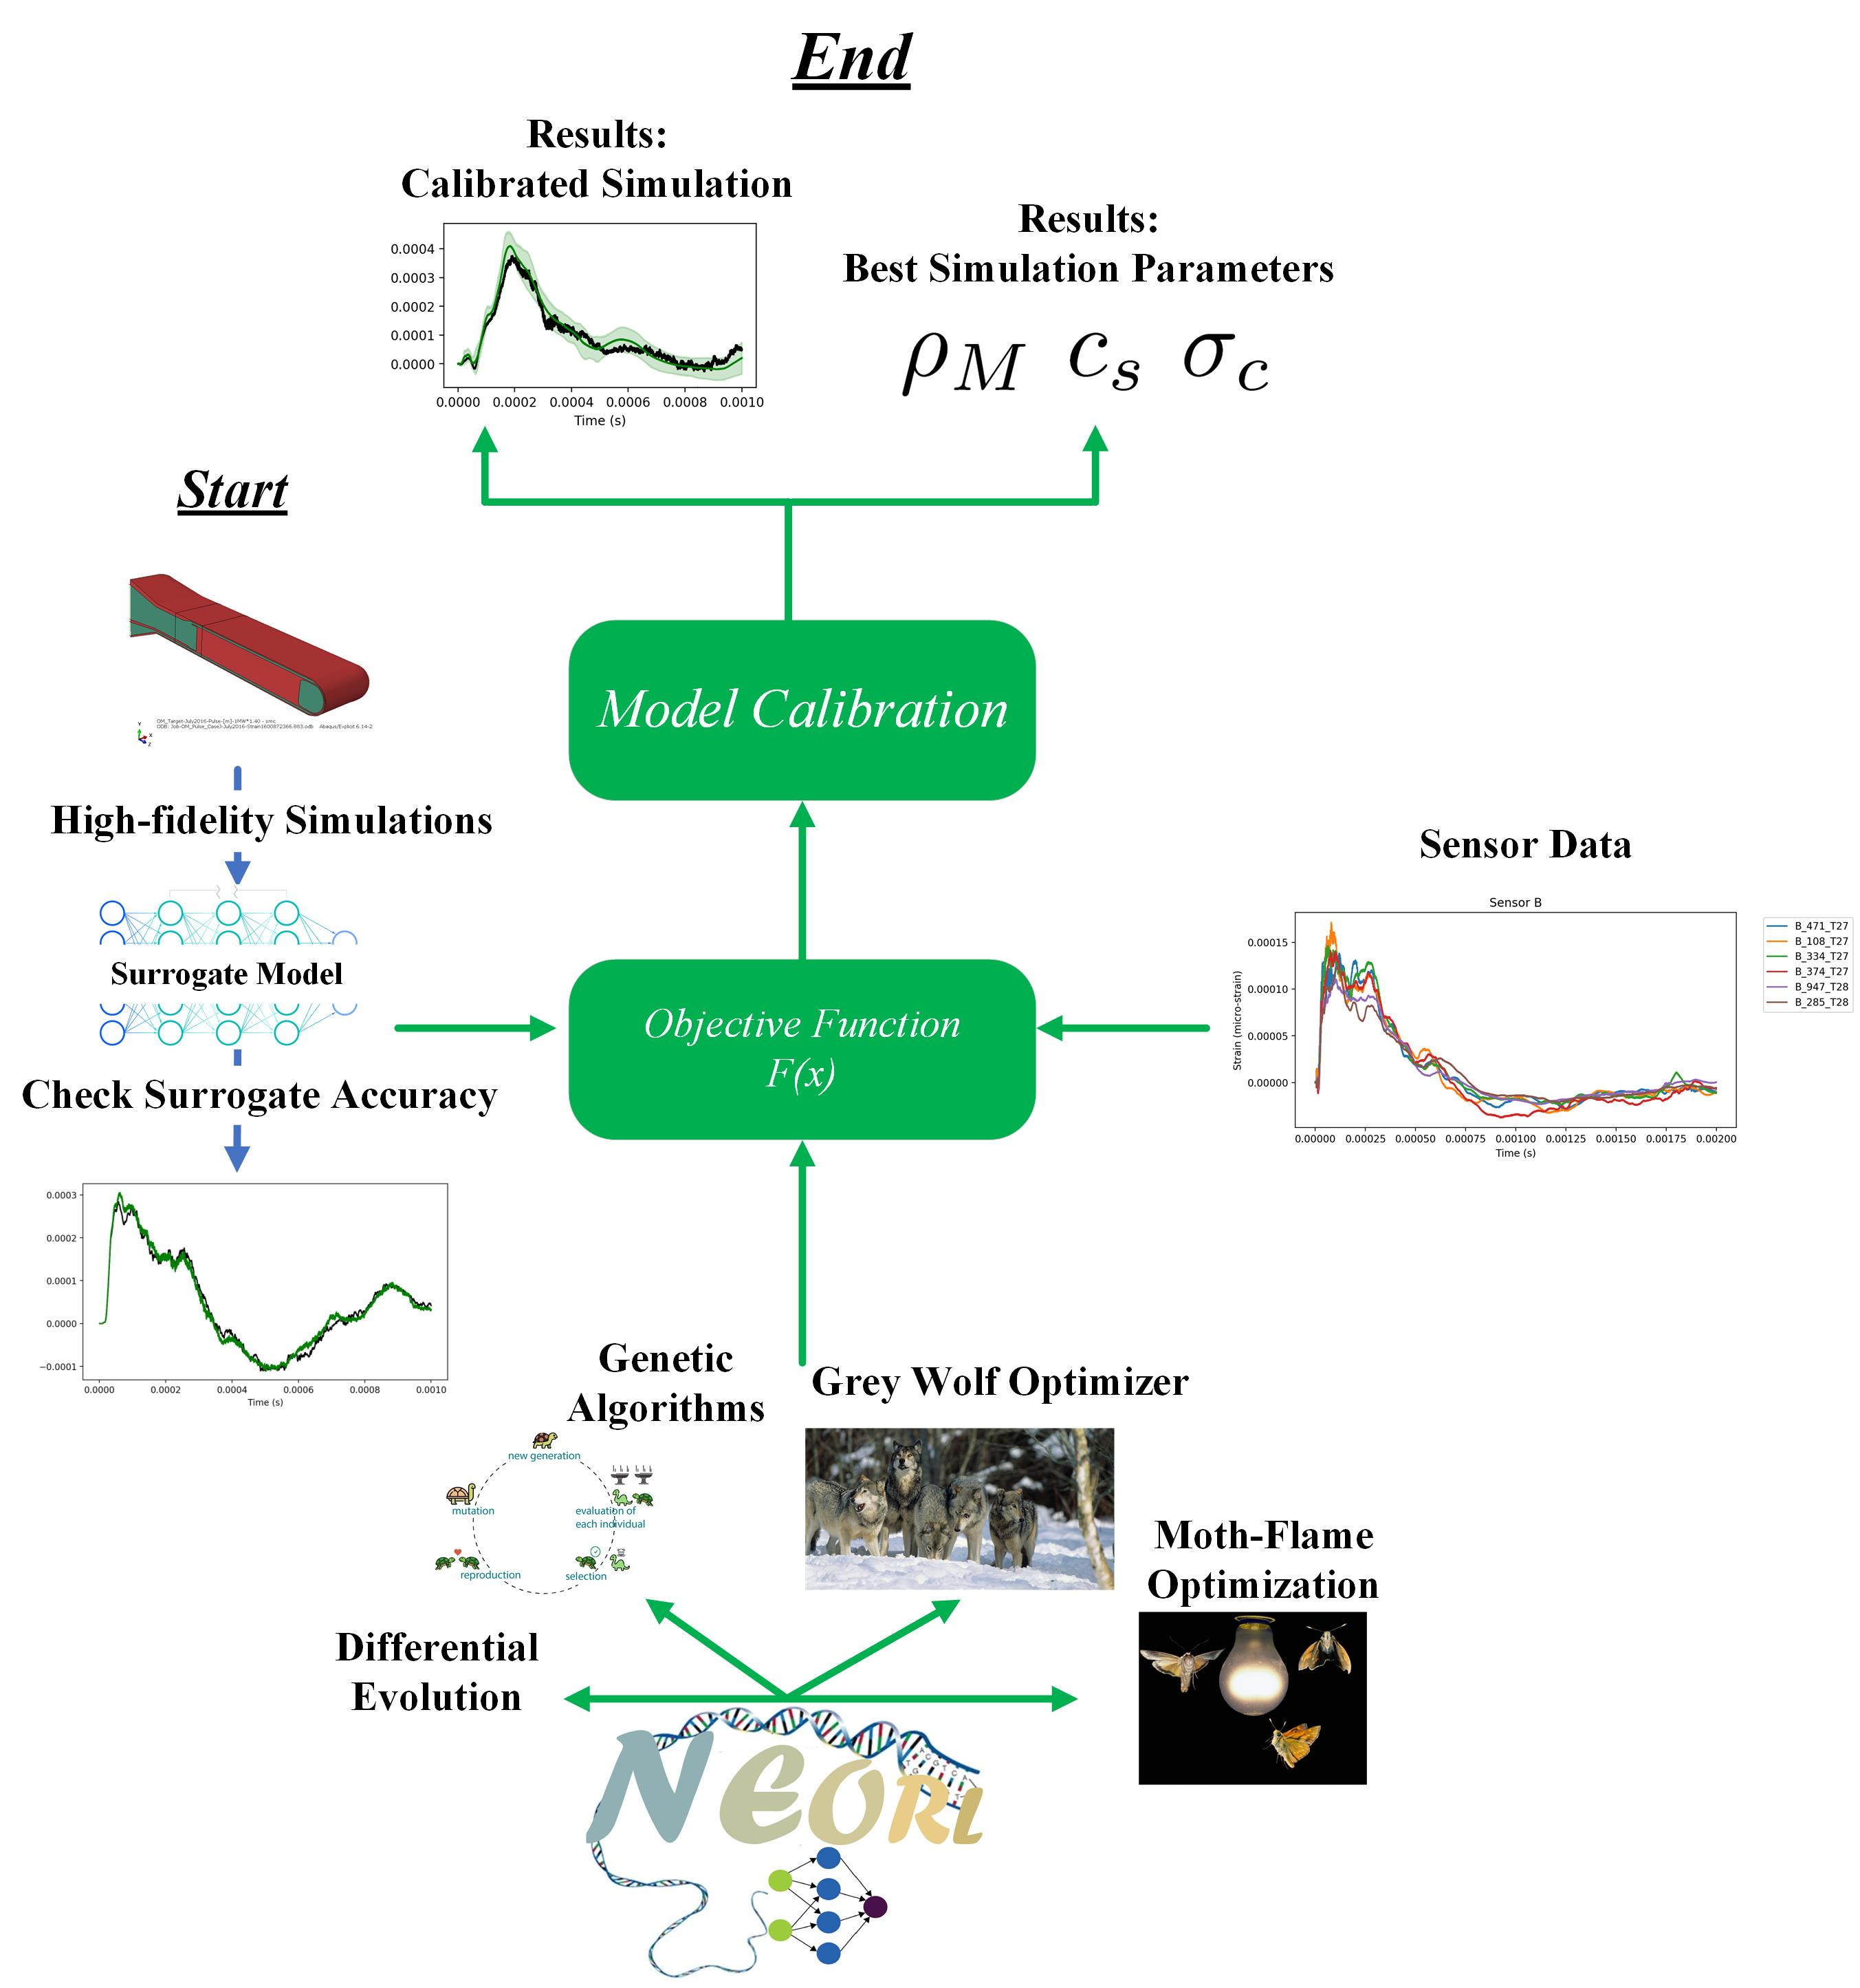
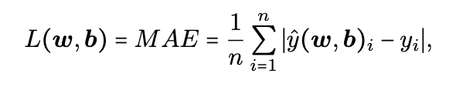
Evolutionary Neural Calibration (ENC)
Construct neural network surrogate from high-fidelity simulations
Gradient-free evolutionary optimization to search for the optimal parameters
Connect the above two steps in an objective function to perform model calibration

Slide 15
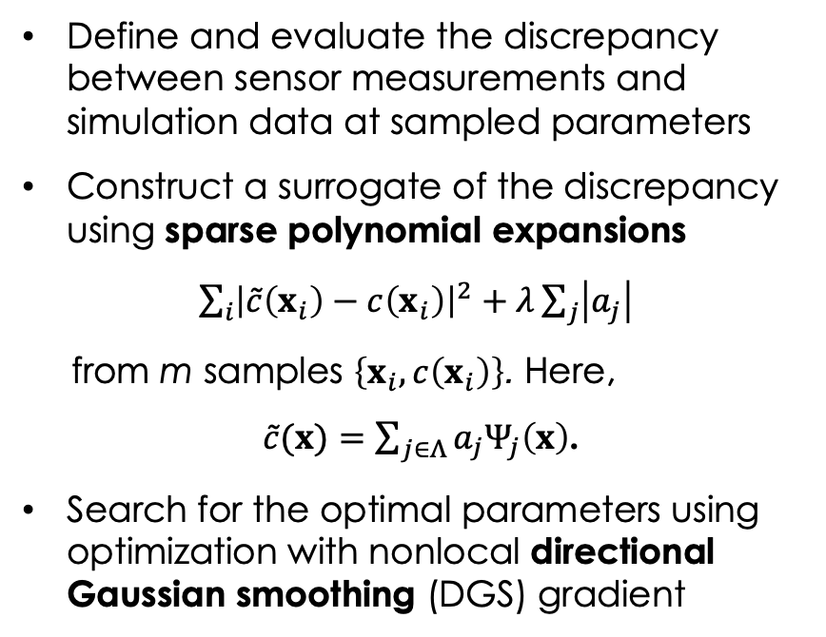
Sparse polynomial expansions (SPE)
Define and evaluate the discrepancy between sensor measurements and simulation data at sampled parameters
Construct a surrogate of the discrepancy using sparse polynomial expansions
$\sum_{i}{{\left|\tilde{c}\left(x_{i}\right)−c\left(x_{i}\right)\right|}^{2}}+λ\sum_{j}{\left|a_{j}\right|}$
from m samples $\left\{x_{i}, c\left(x_{i}\right)\right\}$. Here,
$\tilde{c}(x)=\sum_{j∈Λ}{a_{j}Ψ_{j}\left(x\right)}$.
Search for the optimal parameters using optimization with nonlocal directional Gaussian smoothing (DGS) gradient
Illustration of the nonlocal exploration of the DGS gradient. The blue arrow points to the
conventional gradient direction and the red arrow points to the DGS gradient direction. The top and right plots show the directionally smoothed functions along the two axes.

Slide 16
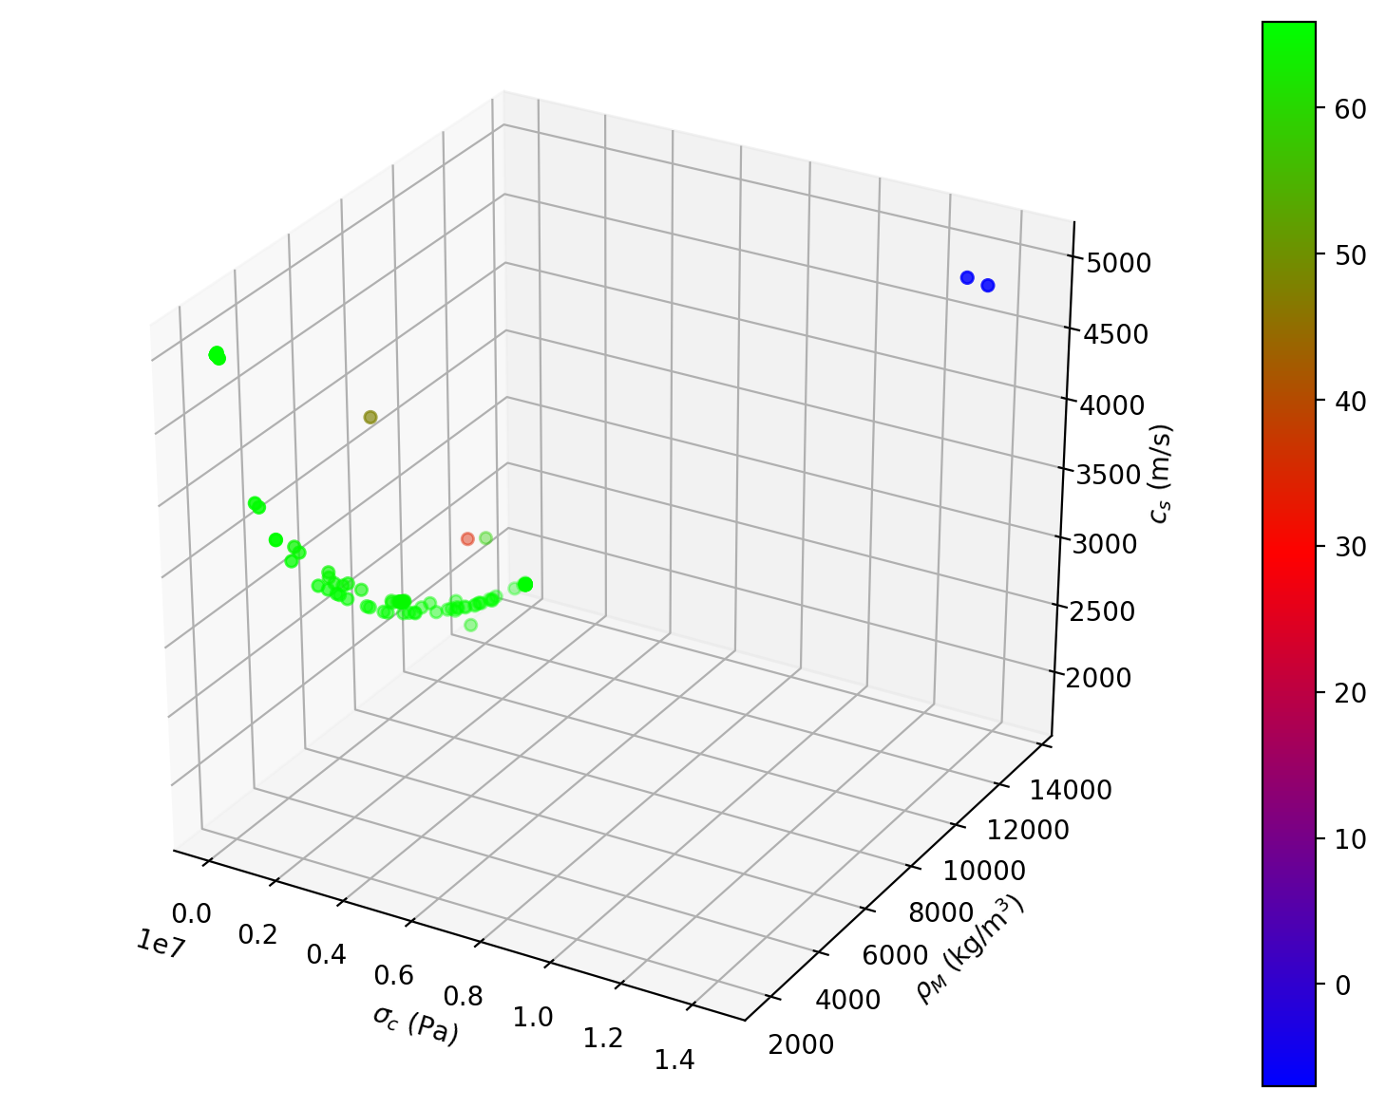
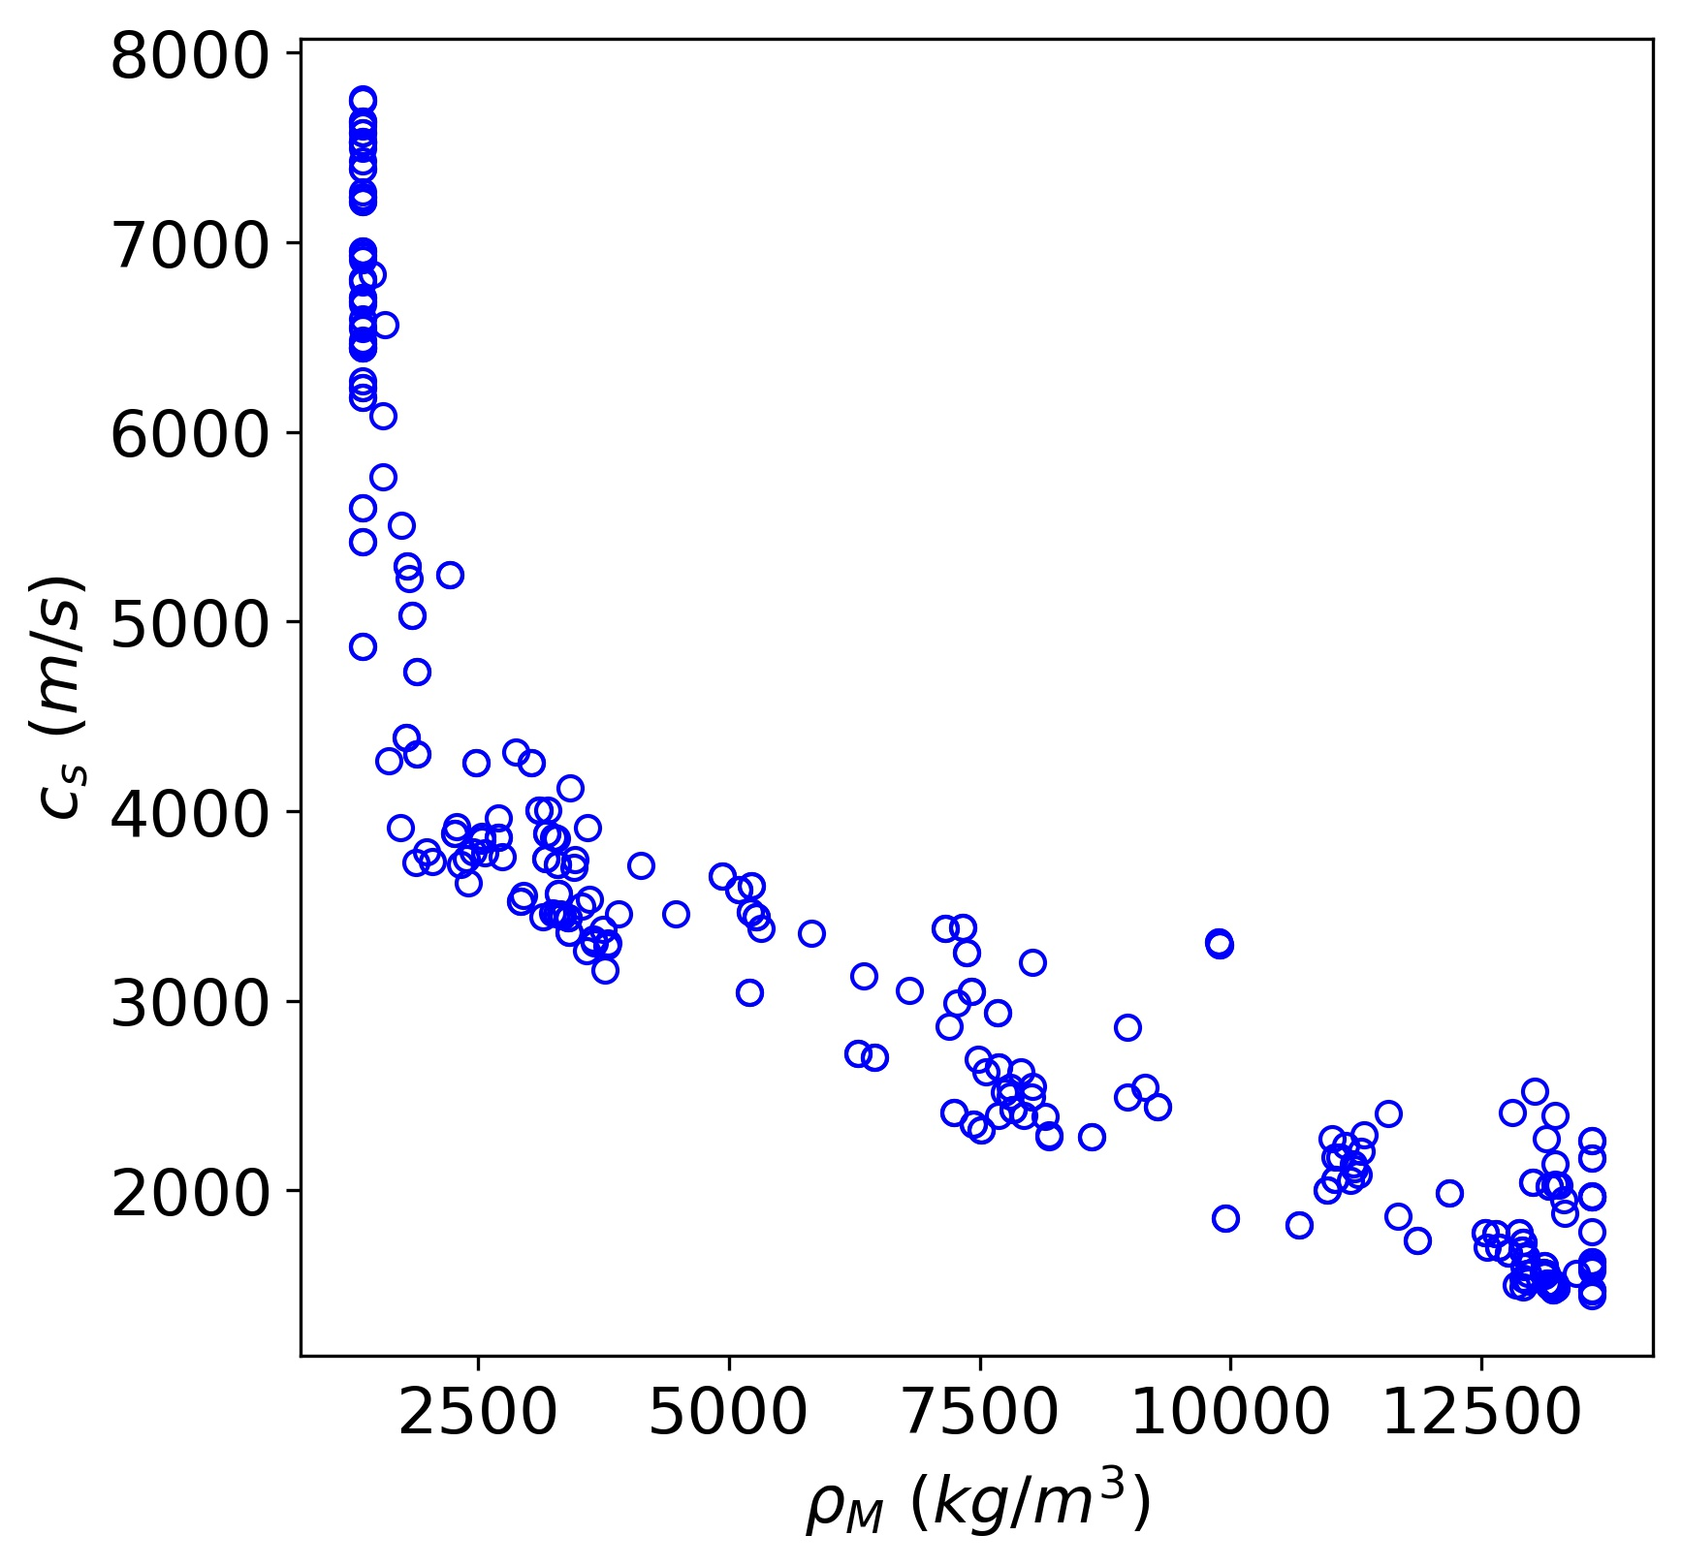
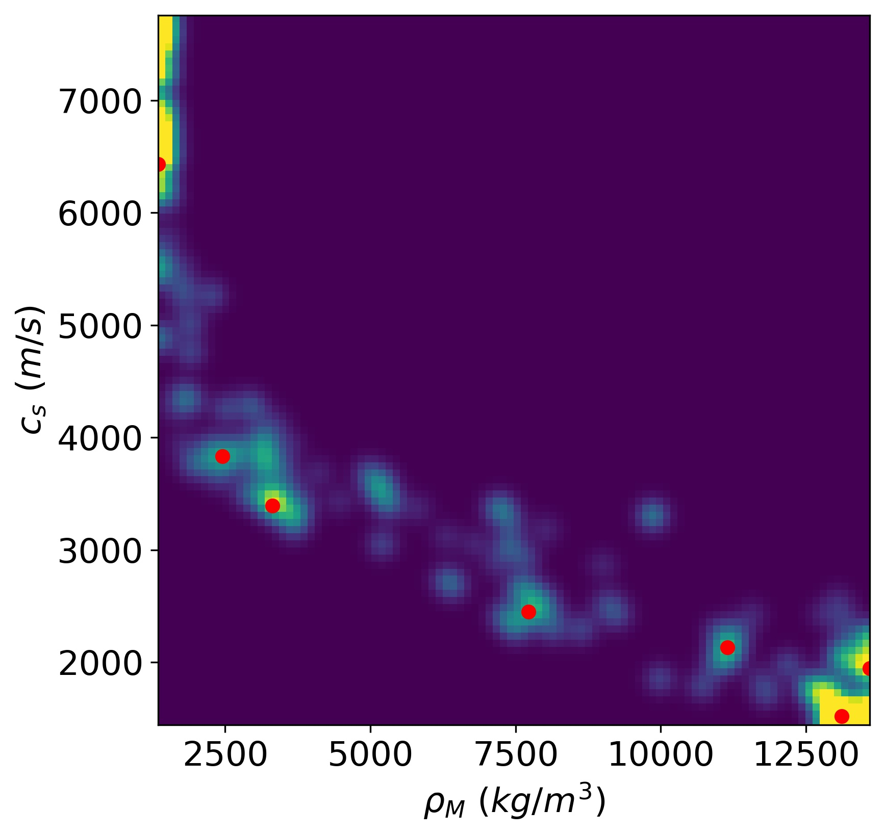
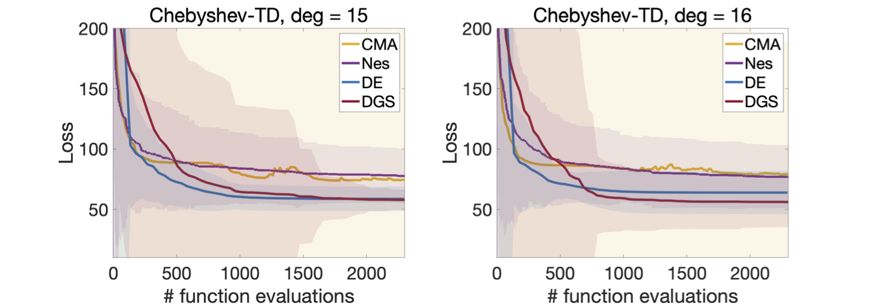
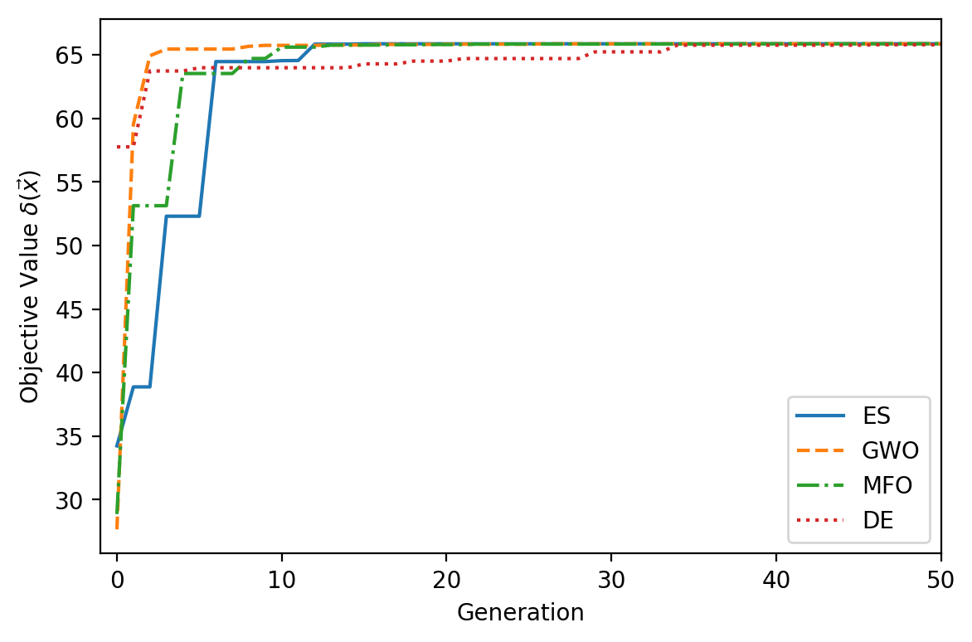
Calibrated parameters
Best calibrated parameters by ENC
Distribution of candidate parameters by SPE surrogates
Convergence of the ENC optimization algorithms
Convergence of the DGS algorithm on SPE surrogates, compared to other baselines.
Notes:
This approach is developed with the support from ORNL AI Initiative. Unlike previous works, DGS gradient applies the smoothing directionally instead of globally, and in doing so, significantly reduces the required number of function evaluations. This allow DGS gradient to smooth out and explore in a larger area than other approaches, being a truly nonlocal search direction.

Slide 17
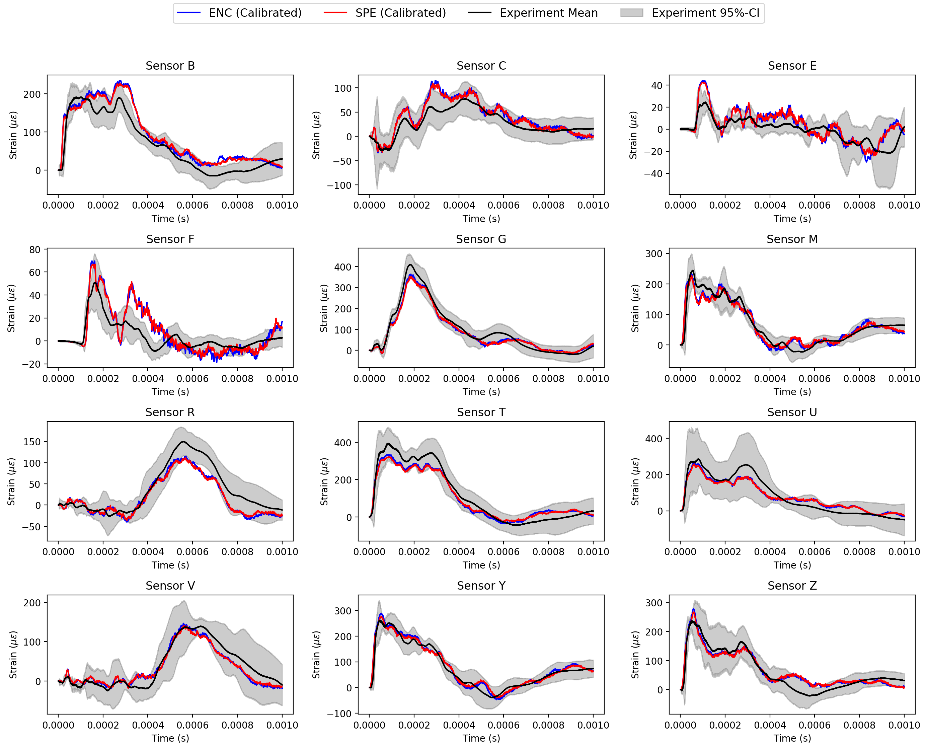
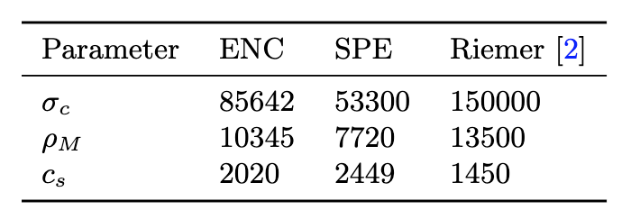
Methodology validation
Best calibrated parameters found by ENC and SPE
[2] B. Riemer, Benchmarking dynamic strain predictions of pulsed mercury spallation target vessels, Journal of nuclear materials 343 (1-3) (2005) 81–91.
It is possible to find nonphysical parameters that can improve the simulation accuracy
Need more advanced two-phase flow model to capture the full physics
The results of the calibrated simulation against the sensor experimental data using the ENC and SPE methods.

Slide 18
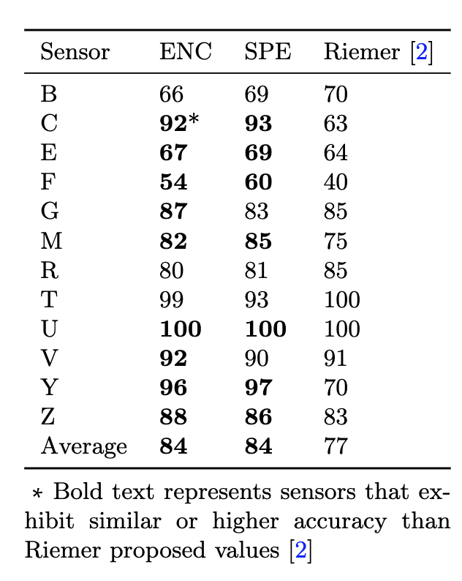
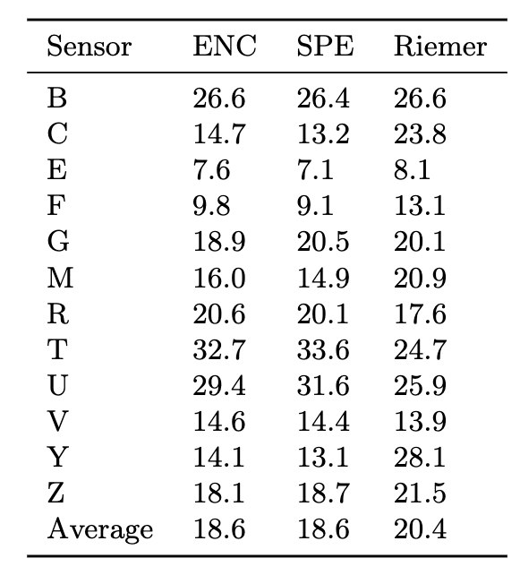
Methodology validation
Comparison of sensor accuracy (%, left) and mean absolute error (με, right) by ENC, SPE, and reference against experimental data

Slide 19
Bayesian inverse uncertainty quantification of the physical model parameters for the spallation neutron source first target station
Majdi I. Radaideh
Radaideh, M. I., Lin, L., Jiang, H., & Cousineau, S. (2022). Bayesian inverse uncertainty quantification of the physical model parameters for the spallation neutron source first target station. Results in Physics, 105414.

Slide 20
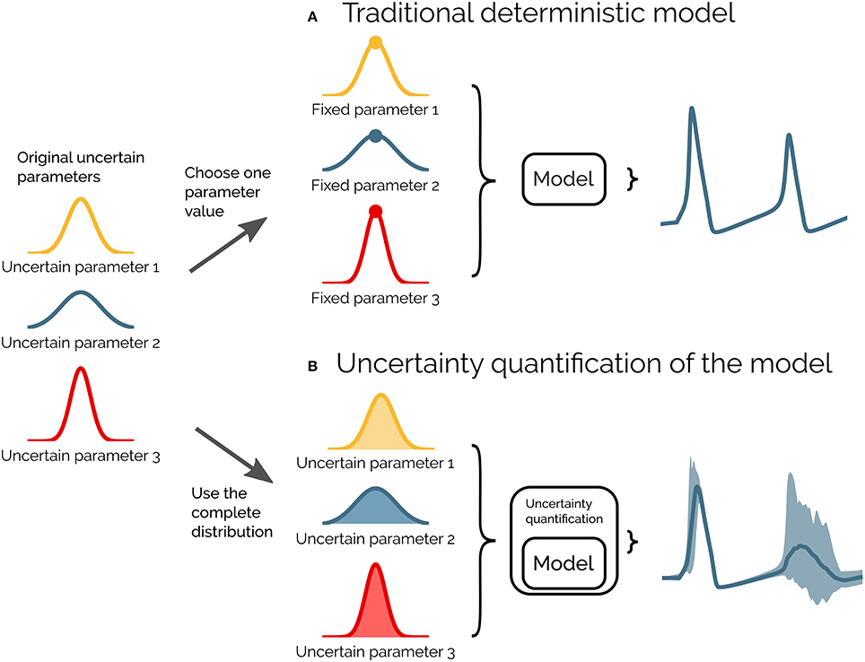
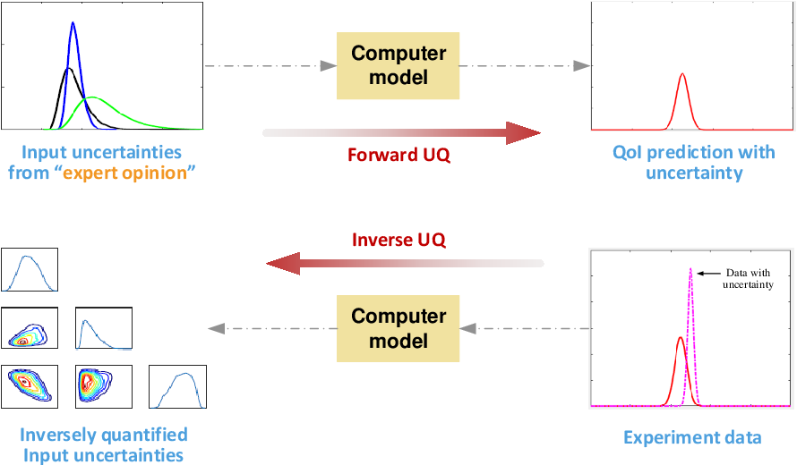
Uncertainty Quantification (UQ)
Wu, X, et al. "A comprehensive survey of inverse uncertainty quantification of physical model parameters in nuclear system thermal–hydraulics codes." Nuclear Engineering and Design 384 (2021): 111460.

Slide 21
The Target inverse problem
Can we use an accurate calibrated simulation to carry fatigue analysis and estimate target life and maintenance times?
Mach, Justin, et al. "Fatigue analysis of the Spallation Neutron Source 2 MW target design." Nuclear Instruments and Methods Section A 1010 (2021): 165481.
The inverse problem
Equation of State (EOS) Model for cavitation in mercury (3 unknown parameters)
Rayleigh-Plesset Model for general bubble dynamics (8 parameters)
Today, we will focus on the EOS 3-parameter model
x₁: Tensile cutoff threshold (Pa)
x₂: Mercury Density (kg/m3)
x₃: Mercury Speed of Sound (m/s)
Radaideh, M. I., et al. “Bayesian Inverse Uncertainty Quantification of the Physical Model Parameters for the Spallation Neutron Source First Target Station”. https://arxiv.org/abs/2202.03959, Under review in Results in Physics
Notes:
To address those challenges, we will exploit the scalable DNN-based optimization capability that has been developed under the support of the ORNL AI Initiative. The key idea is to build surrogate models of the loss function and then use the cheap-to-evaluate surrogates to tune the candidate models. We will consider two strategies, constructing either 1) a single DNN-based surrogate defined globally on the parameter domain, or 2) a sequence of local surrogate models of the loss function, where each surrogate will cover a segment of the search path, for example, 50 iterations. For models with few number of tuning parameters (PID), we lean toward global approach, so that we do not need to train multiple DNN models. Obtaining an accurate global surrogate for constitutive models with high number of parameters may be infeasible, in which case we rely on local approach. Since the data for training the surrogates can be generated by running FE/CFD simulations in parallel, and the DNNs can be trained using multiple nodes on HPC, it is almost equivalent to say that we can perform all iterations covered by the surrogate in parallel. Even considering the training cost, the time reduction is very significant compared to the sequential optimization. The approach has been tested using a topology optimization problem for additive manufacturing, where the goal is to design a 3D printable square plate using two materials to achieve a prescribed thermal conductivity property. The red represents the material with good conductivity and the blue represents the material with poor conductivity. The proposed method used 32 nodes on SUMMIT to achieve 85% time reduction as well as maintain good accuracy.

Slide 22
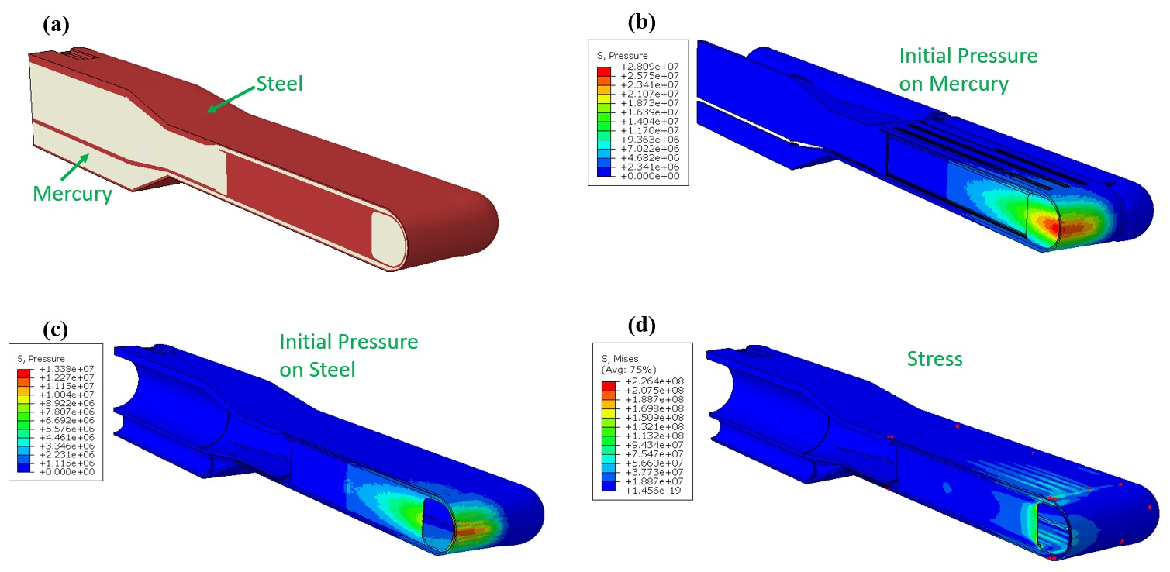
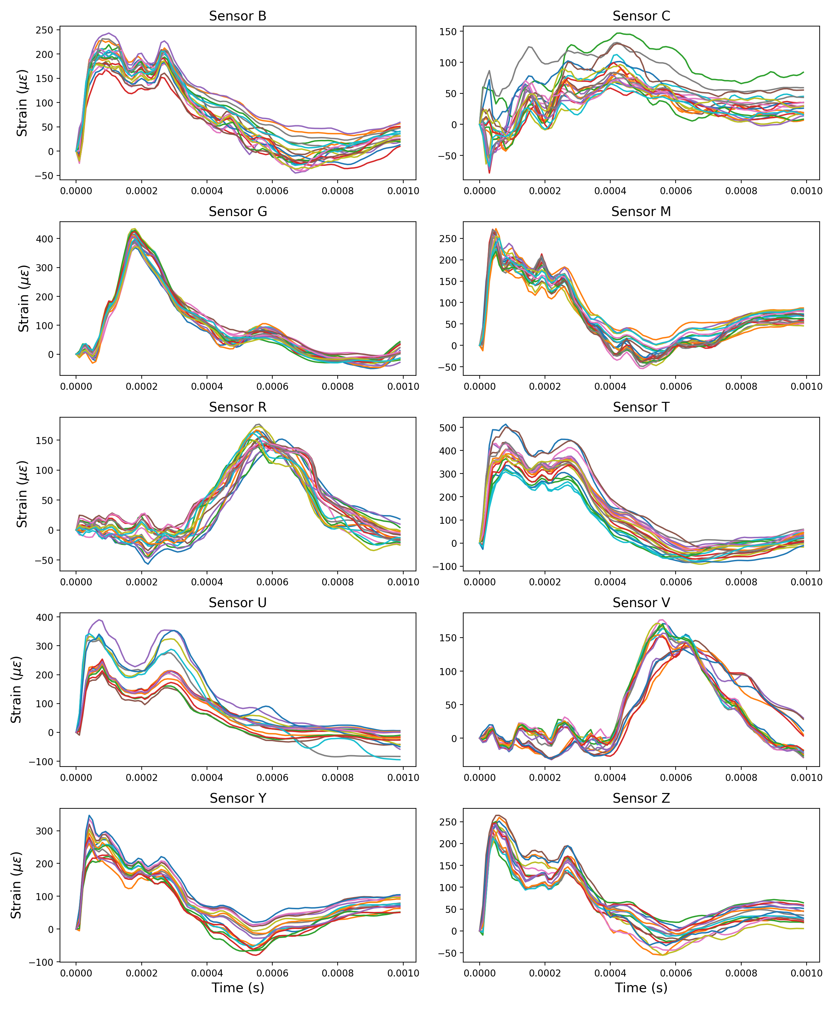
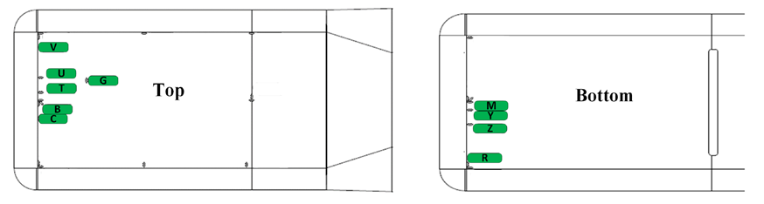
Solid Mechanics Simulation and Measured Strain Data
via Sierra/Solid Mechanics from
Sandia National Lab
via experimental pulses sent to real target models in ORNL

Slide 23
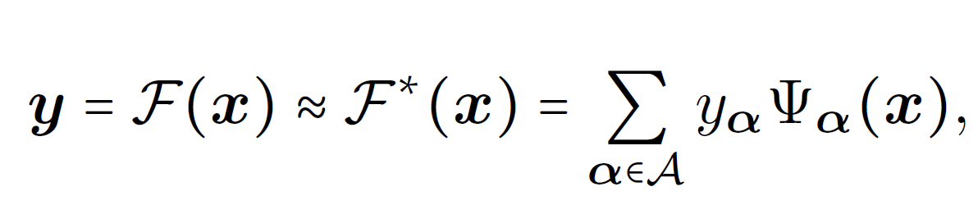
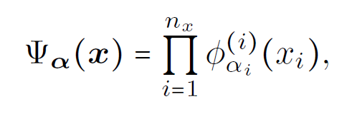
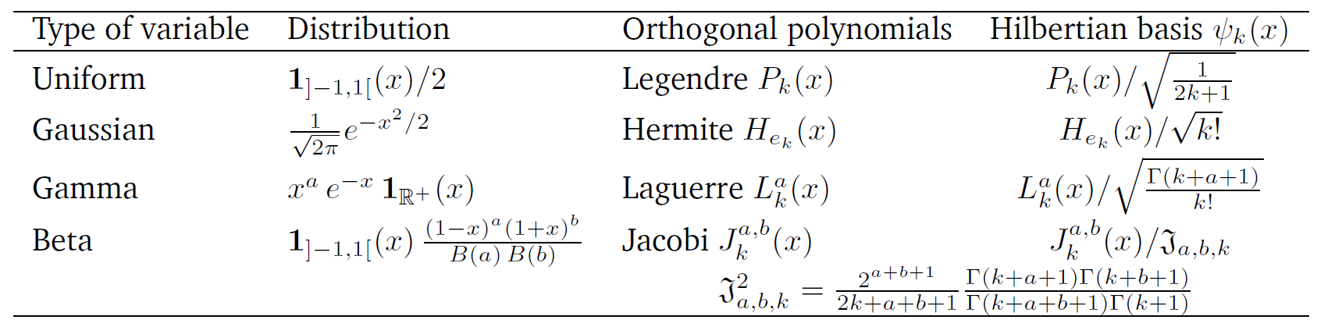
Surrogate Modeling for Sierra
Each surrogate model execution is of order of 1ms.
Each Sierra execution is of order of 8 hours

Slide 24




Bayesian Framework
θ: parameters to be estimated
D: observation/data point
Likelihood
or
or
Prior
Posterior
Marginal Likelihood (constant)
Marginal Likelihood (constant)
Proportional Form

Slide 25



Bayesian Statistics
(The Posterior distribution)
Radaideh, M. I., et al. “Bayesian Inverse Uncertainty Quantification of the Physical Model Parameters for the Spallation Neutron Source First Target Station”. https://arxiv.org/abs/2202.03959, Under review in Results in Physics
Markov Chain Monte Carlo
Skipping all math, the posterior distribution looks:
Priors
Measured Strain
Sierra/Surrogate model
Residual Variance
Marginal Likelihood (Biggest Problem)
How to sample from this distribution???

Slide 26

MCMC Diagnostics

Slide 27





Posterior Results
Radaideh, M. I., et al. “Bayesian Inverse Uncertainty Quantification of the Physical Model Parameters for the Spallation Neutron Source First Target Station”. https://arxiv.org/abs/2202.03959, Under review in Results in Physics
Upper bound of 32 micro-strain as the optimal discrepancy between model and data
On average, the sensor and model can be off by about 32 micro-strain in average.
[23] B. Riemer, Benchmarking dynamic strain predictions of pulsed mercury spallation target vessels, Journal of nuclear materials 343 (1-3) (2005) 81–91.

Slide 28





Bayesian vs Frequentist
Item | Bayesian | Frequentist (ENC/SPE)
Cost | High (because of MCMC sampling) | Low (SPE) to moderate (ENC)
Complexity | Difficult to implement | Easy to implement
Robustness | Robust | Depends on the problem
Correlation | Inherently captured by sampling | Not captured directly
Parameter Estimation | Both point-estimate and random distribution | Point-estimate only
Priority:
Comprehension: Bayesian > ENC > SPE
Simplicity: SPE > ENC > Bayesian

Slide 29
Thank You!
The task team is grateful for support from the Neutron Sciences Directorate at ORNL in the investigation of this work. This work was supported by the DOE Office of Science under grant DE-SC0009915 (Office of Basic Energy Sciences, Scientific User Facilities program). This research used resources of the Compute and Data Environment for Science (CADES) at the Oak Ridge National Laboratory, which is supported by the Office of Science of the U.S. Department of Energy under Contract No. DE-AC05-00OR22725. This research also used resources of the Argonne Leadership Computing Facility, which is a DOE Office of Science User Facility supported under Contract DE-AC02-06CH11357.

