Slide 1
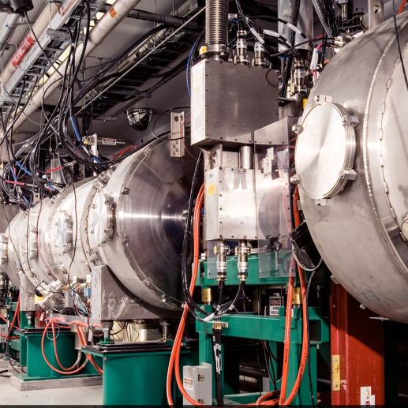
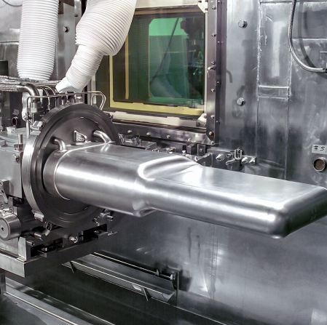
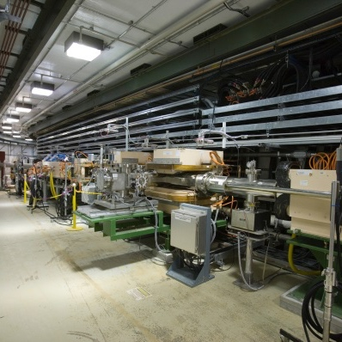
All Team Meeting
Sarah Cousineau
April 21st 2022

Slide 2
Welcome to SNS! (… finally)

Slide 3
Goals of Workshop
Develop end-game plan for each use case.
Decide what makes sense to do and what we can drop
Try to leave a “working product” behind
Answer the following questions (discussion on Friday):
What lessons have we learned about applying ML to accelerators that we didn’t know before the project?
How sustainable is an ML implementation on an accelerator, e.g., how often does it require maintenance or retraining? How black box are these application?
In order to utilize ML, do we need to hire dedicated ML staff in the future?
Where is the “bang for the buck” in ML applications – what kind of system lends itself best to this?

Slide 4
Logistics
You should have internet access on the ORNL-visitor wifi. It is restricted.
If you need a quiet space for a phone call or short meeting, we can provide you an office space (ask me or Wim)
Restrooms are just down the hall, and emergency gathering point is in parking lot outside of lobby.
Wim and I both have espresso machines if you need a ”boost” – let us know
There should be time during breaks and at the end of the day for email catch up
Submit your presentation ASAP so we can upload to event for later access​
- ML location on Teams, Rebecca, Majdi & Yigit for ML discussion​
Lunch is provided and is buffet style: C-150, eaten in our meeting room C-156
Dinner will be at Aubrey’s in Oak Ridge (unfortunately, not paid by workshop). Menu has a good variety (including vegetarian): signup sheet

Slide 5
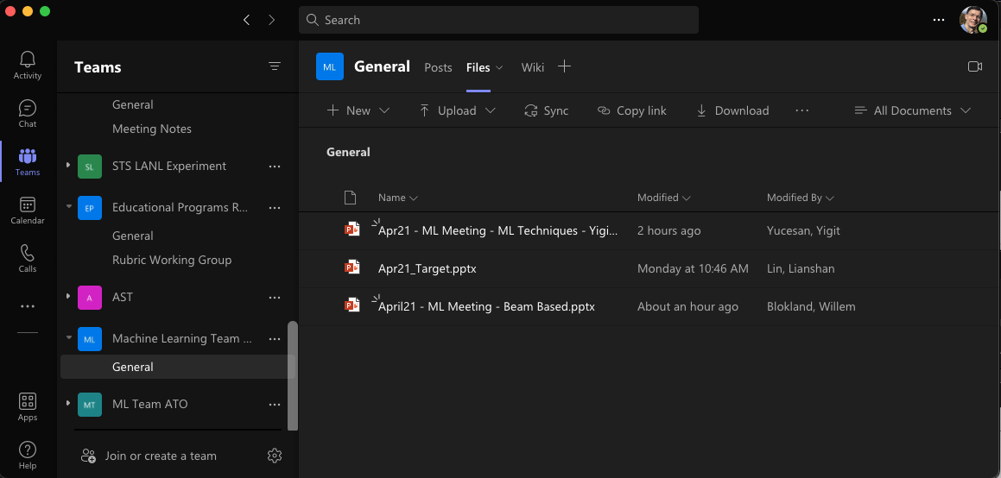
Logistics
Upload in teams
Website:
https://conference.sns.gov/event/331/

