Slide 1
Overview of Methods
Method | Advantage | Drawback | SNS Use Case | Comments
Non-NN ML | More interpretability | Poor performance on large dataset | BB/Target
Gaussian Process | Easy implementation | Non-scalable | BB/Target
Multi-layer Perceptrons | Simple input-output mapping | Structural redundancy | BB/Target
Convolutional Neural Networks | Automatic feature extraction | Data hungry | BB/HVCM
Recurrent Neural Networks | Ability to model time-series | Vanishing/exploding gradient | BB/HVCM/ CMS
AutoEncoders | Data representation in reduced dimension | Destroys interpretability of data | BB/HVCM
Siamese Networks | Can work with imbalanced data | Sensitive to input variations | BB
Generative Adversarial Networks | Useful when more data needed | Unstable training | HVCM
Customized Neural Networks | Customizable | Specific models | HVCM
Physics-informed Neural Networks | Reduced data need | Some physics needed | CMS
Reinforcement Learning | Dynamic control adaptation | Expensive training | All

Slide 2
Multi-layer Perceptron

Slide 3
Multi-layer Perceptrons (MLPs)
How it works:
$$b$$
Sigmoid
Single neuron: linear regression
$$w$$
$$wx+b=y$$
$$x$$
$$y$$
$$b$$
$$w_{1}$$
Activation function: introduce nonlinearity
$$f(w_{1}x+w_{2}x+b)=y$$
$$x$$
$$f$$
$$y$$
Rectified Linear Unit (ReLU)
$$w_{2}$$
$$…$$
Fully connected multi-layered neural networks
$$x_{1}$$
$$y_{1}$$
$$…$$
$$…$$
$$…$$
$$…$$
$$…$$
$$x_{i}$$
$$y_{i}$$
$$…$$

Slide 4
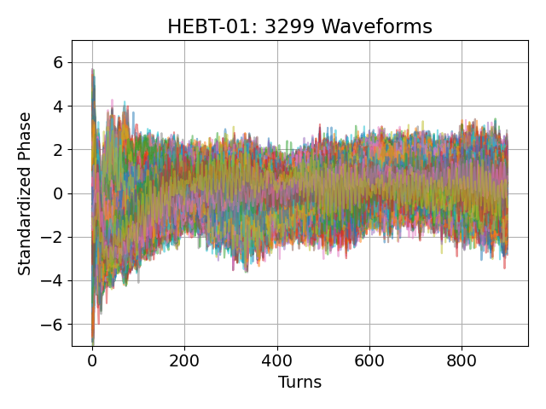
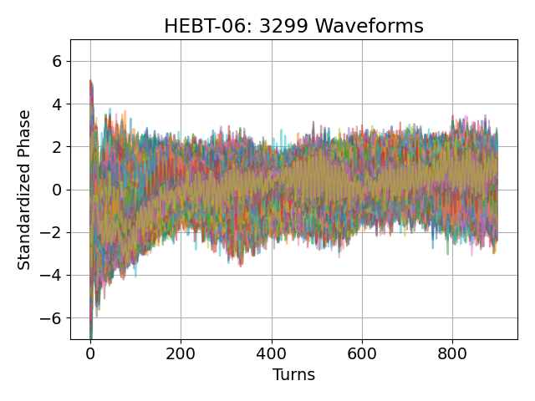
Multi-layer Perceptrons (MLPs)
Advantages:
Simple input-output mapping
Customizable with a wide range of non-linear activation functions to model complex relations
Drawbacks:
Pure black-box model
Redundancy due to fully-connected framework
Architecture selection (Neural Architecture Search)
Application Fields:
Data visualization
Data compression
Encryption
Image/text/speech recognition
Machine translation
Jack of all trades, master of none!
SNS Use Cases:
Anomaly detection using BPM phase data
Upstream BPM
…
Downstream BPM
MLPs were a popular machine learning solution in the 1980s
…
…
…
…

Slide 5
Recurrent Neural Networks

Slide 6
Recurrent Neural Networks (RNNs)
How it works:
Model sequences (time-series) through repeated cells
Structure:
$$y_{t}$$
Unrolled RNN:
$$y_{0}$$
$$y_{1}$$
$$y_{t}$$
Cell
Cell
Cell
Cell
…
$$x_{t}$$
$$x_{0}$$
$$x_{1}$$
$$x_{t}$$
Math behind:
Popular cell designs:
$$y_{t}=f(x_{t},y_{t−1})$$
$$x→inputs$$
$$y→states$$
$f→cell$ transition

Slide 7
Recurrent Neural Networks (RNNs)
Advantages :
Ability to learn from long sequences
Mitigate vanishing-gradient problem in deep networks
Drawbacks :
Suffers from short sequences
Require state value at each timestamp for efficient training
Application Fields:
Failure prognostics
Market (financial) predictions
Text/speech recognition
Semantic parsing
SNS Use Cases:
Equipment prognosis using beam-based signals
HVCM failure prediction
LSTMs include “Forget Gates” that decides whether a previous state should be used

Slide 8
Customized Neural Network Architectures

Slide 9
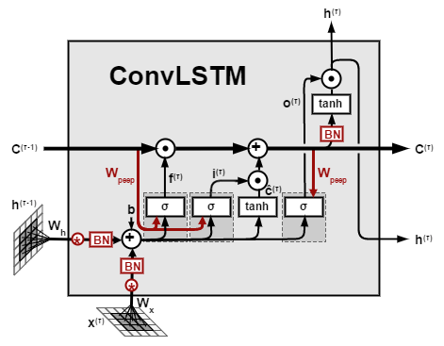
Convolutional LSTM (ConvLSTM)
Classical LSTM architecture
Tailored to discover spatiotemporal pattern in data
ConvLSTM: matrix multiplication of inputs and states replaced by convolution operation
CNN-LSTM: two layers stacked
Application Fields:
Predict next-frame in a video
Precipitation nowcasting
SNS Use Cases:
ConvLSTM-AutoEncoders for High Voltage Converter Modulators (HVCM) anomaly detection
Convolution operation applied to inputs and states @ each timestamp

Slide 10
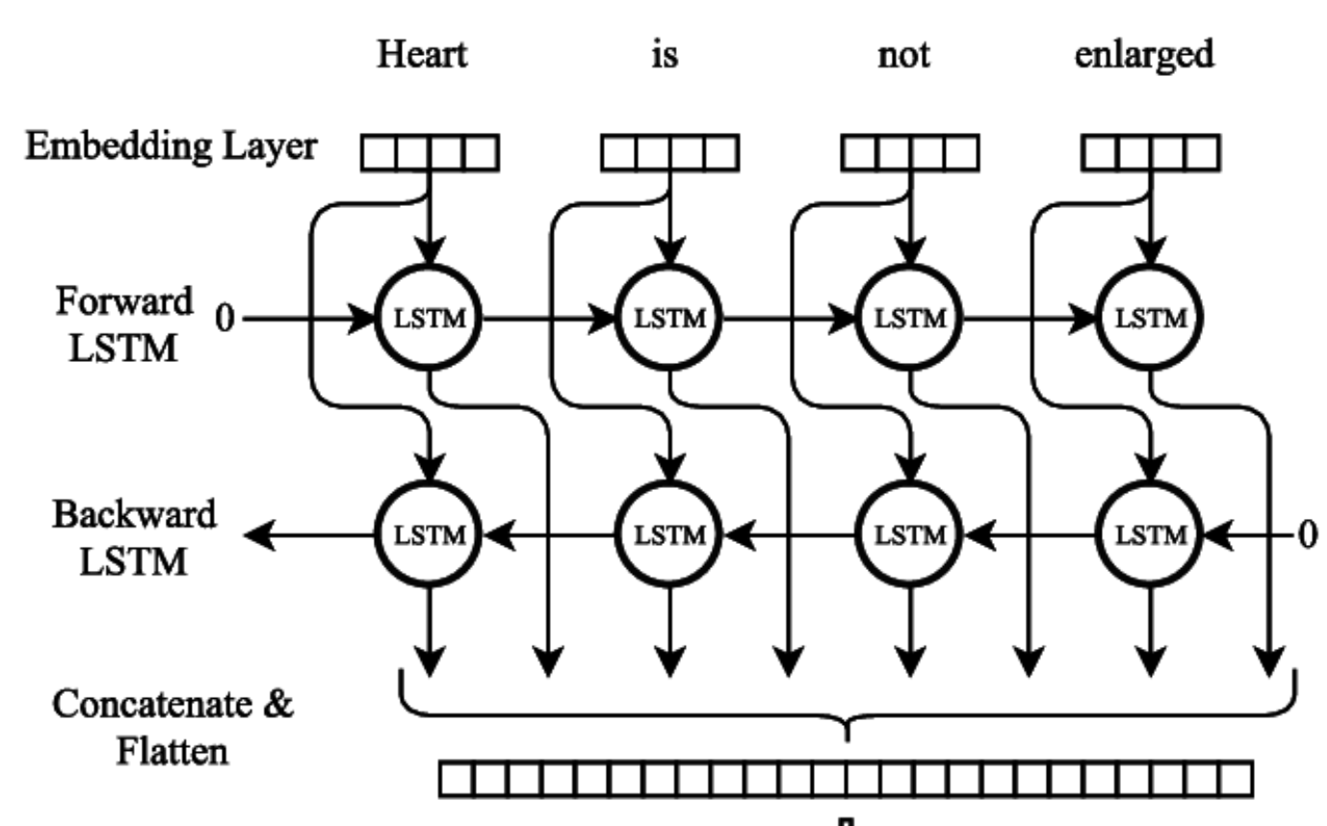
ConvLSTM AutoEncoders
Seq2Seq model
Machine translation
Text summarization
ConvLSTM
MaxPool
ConvLSTM
MaxPool
SNS Use Cases:
HVCM/Beam-based anomaly detection
Conv
LSTM
Conv
LSTM
UpSample
Conv
LSTM
UpSample
ConvLSTM
Bi-directional LSTM
Process sequences in both directions
Speech recognition
Semantic parsing
SNS Use Cases:
Prediction with time-series data
HVCM
Beam-based

Slide 11
Physics-informed Neural Networks

Slide 12
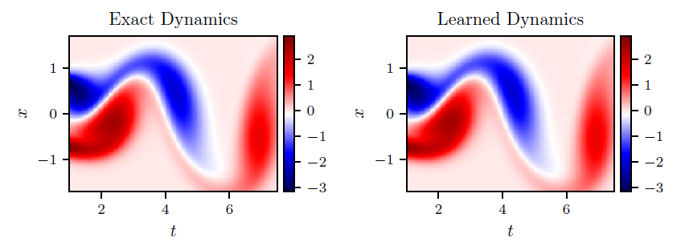
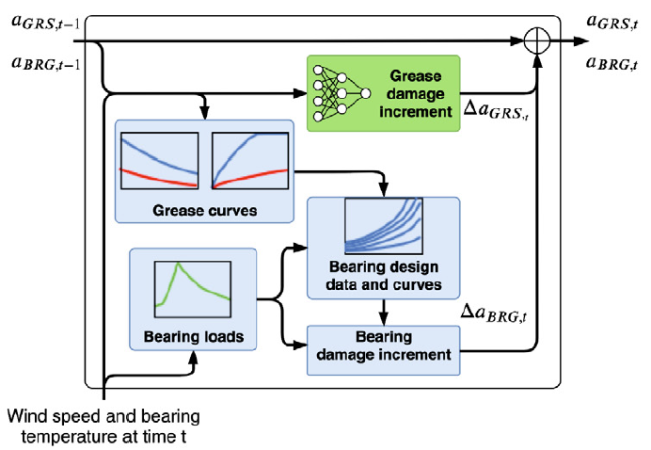
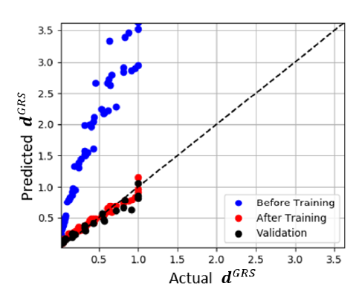
Physics-informed Neural Networks (PINNs)
Underlying physics guides data-driven nodes
Reduce need for data greatly
Collocation methods:
PDEs to constrain NN solution
Hybrid methods
Graph models where physics and data-driven kernels coexist
$$a_{GRS}$$
Raissi, M. (2018). Deep hidden physics models: Deep learning of nonlinear partial differential equations. The Journal of Machine Learning Research, 19(1), 932-955.
$$a_{GRS}$$
F. A. C. Viana, R. G. Nascimento, A. Dourado, and Y. A. Yucesan (2021), "Estimating model inadequacy in ordinary differential equations with physics-informed neural networks," Computers and Structures, Vol. 245, pp. 106458, 2021. (DOI: 10.1016/j.compstruc.2020.106458).
SNS Use Cases:
Multi-fidelity modeling for CMS

Slide 13
Collocation Methods
https://developer.nvidia.com/modulus
Raissi, M., Perdikaris, P., & Karniadakis, G. E. (2019). Physics-informed neural networks: A deep learning framework for solving forward and inverse problems involving nonlinear partial differential equations. Journal of Computational physics, 378, 686-707.

Slide 14
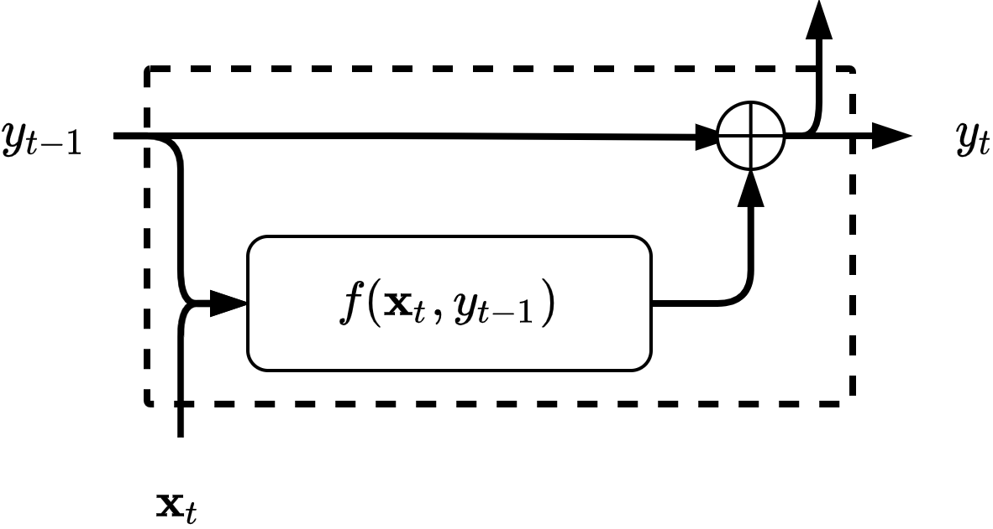
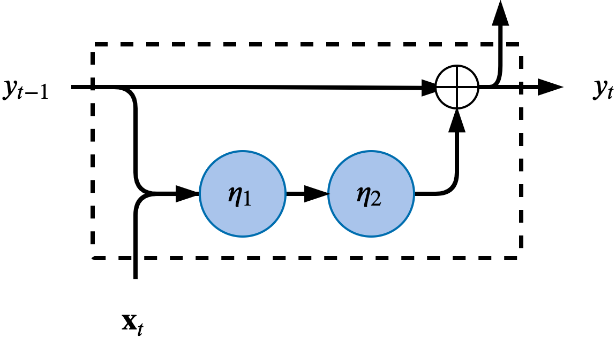
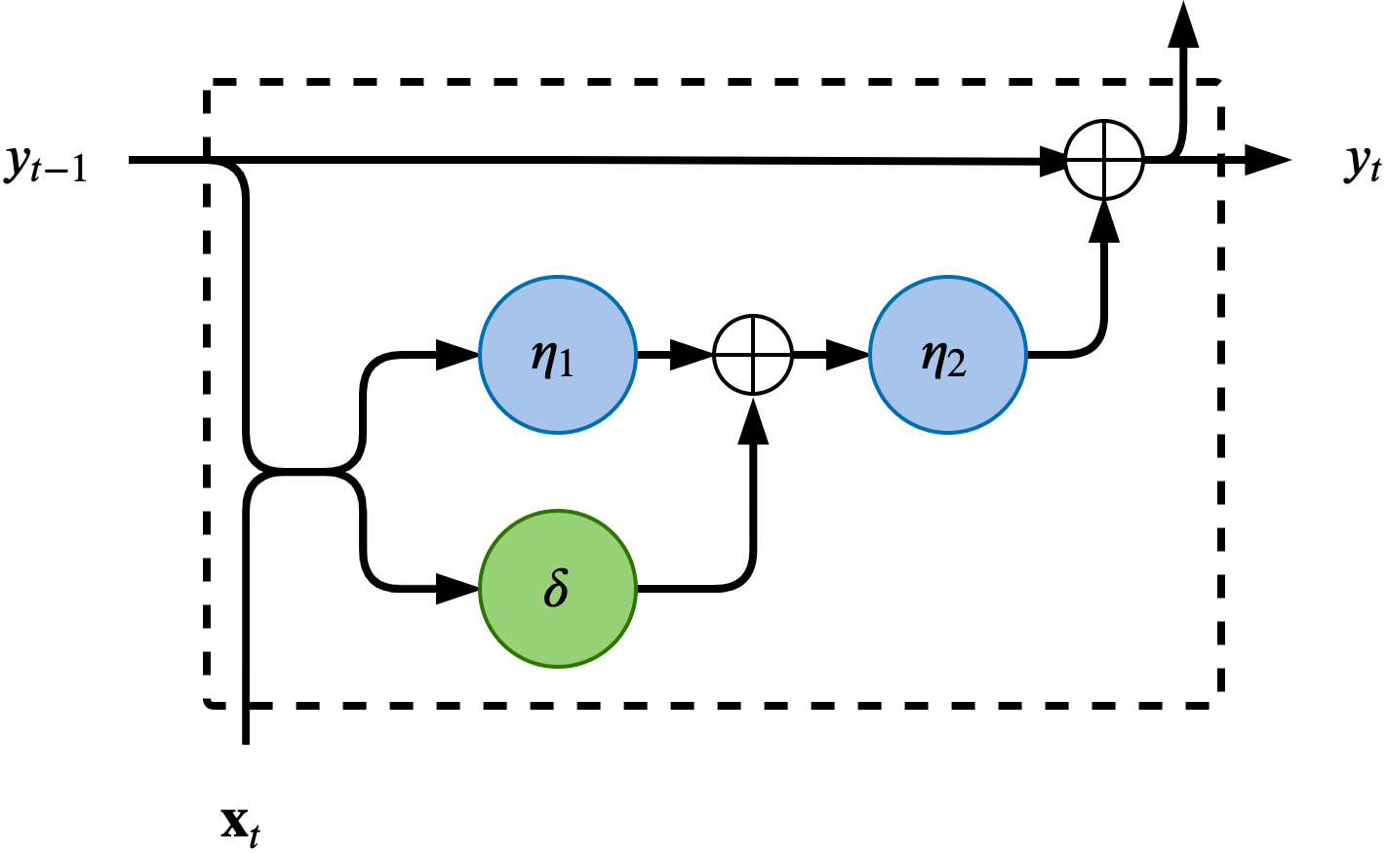
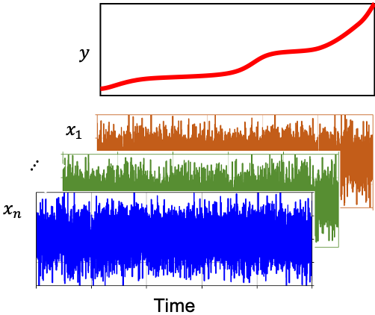
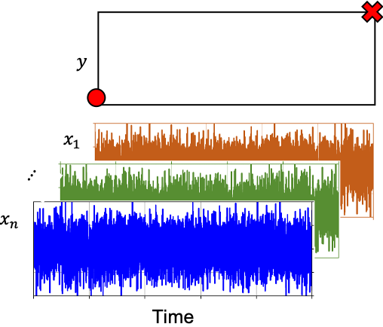
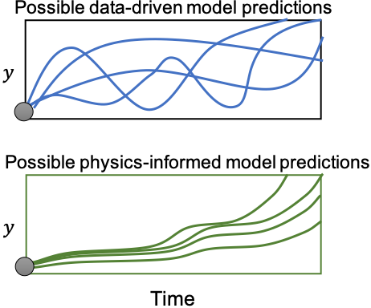
Hybrid Physics-informed Neural Networks (PINNs)
Euler Cell
Physics-based Cell
Hybrid Cell
Physics kernels
Data-driven kernels
Actual Output
Available Data
Predictions

Slide 15
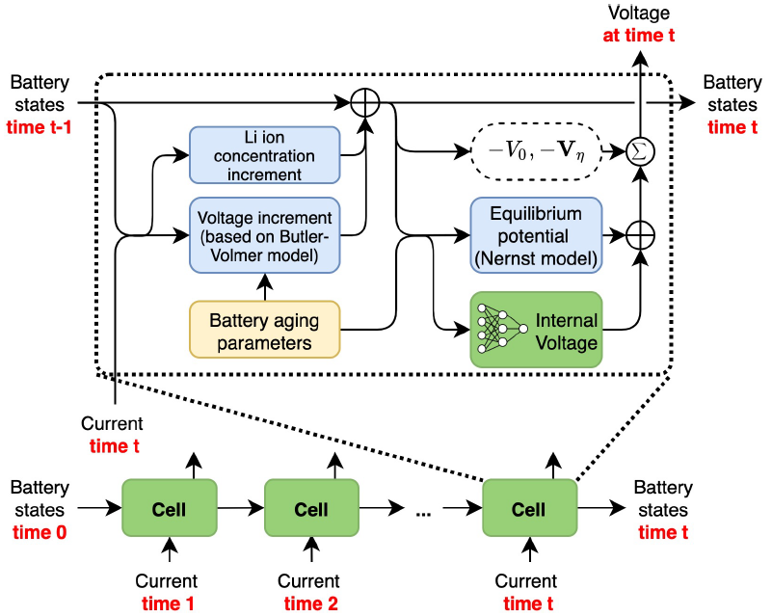
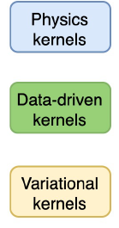
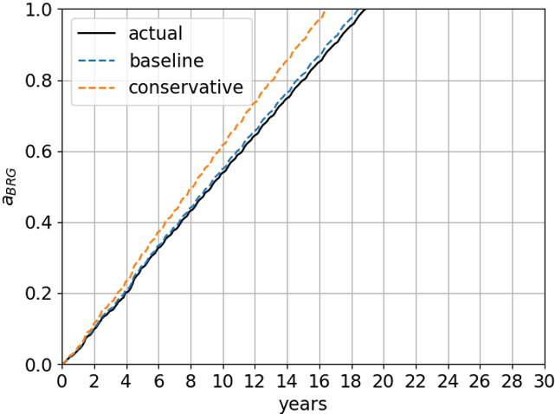
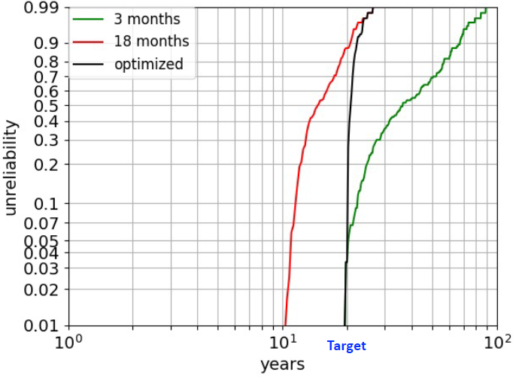
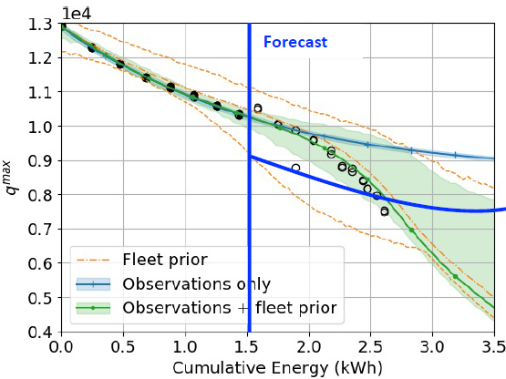
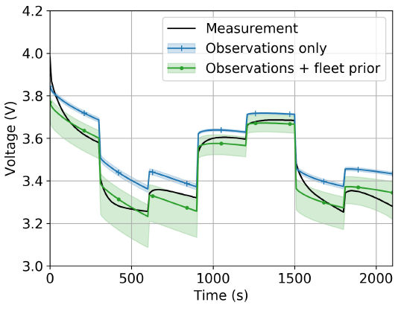
Hybrid Physics-informed Neural Networks (PINNs)
Application Fields:
Wind Turbine Main Bearing Fatigue
(Prognosis)
Lithium-ion Battery Aging Model
(Prognosis)
Model:
Model:
Challenge
Unbalanced data
Calibrated with visual inspections
Small subset of farm sampled
Data
Load history of 30 years of 100 turbines
Visual grease inspections once a month for 6 months
Challenge
Prognosis models depend on several empirically adjusted factors
Results:
Results:
Y. A. Yucesan and F. A. C. Viana, "Hybrid physics-informed neural networks for main bearing fatigue prognosis with visual grease inspection," Computers in Industry, Vol. 125, pp. 103386, 2021. (DOI: 10.1016/j.compind.2020.103386).
R. G. Nascimento, M. Corbetta, C. S. Kulkarni, and F. A. C. Viana, "Hybrid physics-informed neural networks for lithium-ion battery modeling and prognosis," Journal of Power Sources, Vol. 513, pp. 230526, 2021. (DOI: 10.1016/j.jpowsour.2021.230526).

Slide 16
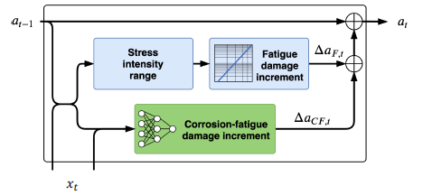
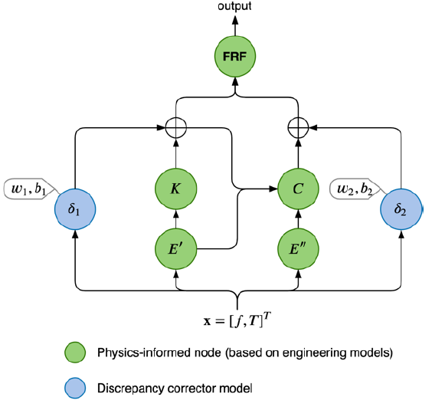
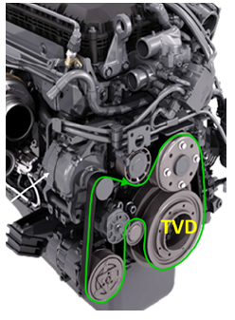
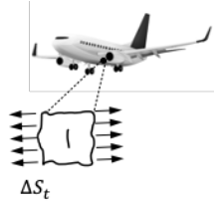
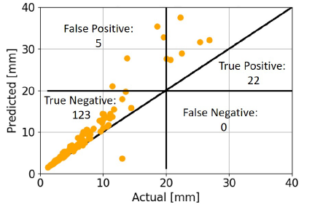
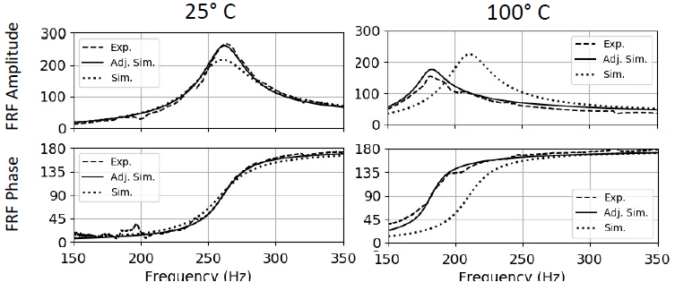
Hybrid Physics-informed Neural Networks (PINNs)
Application Fields:
Model-form uncertainty in corrosion fatigue (Prognosis)
Torsional vibration damper
(System ID)
Model:
Model:
Results:
Challenge
Assumed: pure mechanical fatigue
Reality: Corrosion-fatigue
Data
Load history of 5 years of 150 aircraft
Crack length of 15 aircraft @ 5th year.
Results:
A. Dourado and F. A. C. Viana, “Physics-informed neural networks for missing physics estimation in
cumulative damage models: a case study in corrosion fatigue,” ASME Journal of Computing and Information Science in Engineering, Vol. 20 (6), 10 pages, 2020.
Y. A. Yucesan, F. A. C. Viana, L. Manin, and J. Mahfoud, "Adjusting a torsional vibration damper model with physics-informed neural networks," Mechanical Systems and Signal Processing, Vol. 154, pp.107552, 2021. (DOI: 10.1016/j. ymssp.2020.107552).

