Slide 1
Beam-based Use Case

Slide 2
Objectives and Methodologies in the Proposal
Objectives
Determine accuracy and timeliness of the equipment failure predictions as a function of
Equipment, accelerator setup parameters, and beam-based data types
Determine the time horizons needed for timely and reliable predictions,
Identify potential of finding new and previously unidentified signatures of failing equipment.
Estimate expected improvements in beam availability for SNS
Inform the accelerator community which diagnostics and ML methods are most useful for predicting failures.
Methodology
Use time-frequency analysis and modal analyses methods
Possibly apply Independent Component Analysis and Empirical Mode Decomposition)
Apply time-series prediction approaches (GPR and Bayesian LSTM)
Augment the time-series model structures to embed both short-term and long-term dynamics
Specifically, we will use knowledge of the relevant timescales to develop a multi-scale Bayesian LSTM model for accurate prediction at relevant timescales.
Use the condition indices and causal analysis to determine:
Whether failure precursors exist in the data
Which individual failing equipment can be identified from beam-based measurements.
Notes:
ALCF

Slide 3
Objectives and Methodologies in the Proposal
Found precursors far enough ahead to abort
Objectives
Determine accuracy and timeliness of the equipment failure predictions as a function of
Equipment, accelerator setup parameters, and beam-based data types
Determine the time horizons needed for timely and reliable predictions,
Identify potential of finding new and previously unidentified signatures of failing equipment.
Estimate expected improvements in beam availability for SNS
Inform the accelerator community which diagnostics and ML methods are most useful for predicting failures.
Precursors far enough ahead to abort without significantly lowering beam power
Started analysis of BPM data, equipment classification
Uncertainty aware Siamese Model
Analyzed potential improvement in availability and reduction in SCL beam loss
In progress as we are evaluating different techniques and data sources
Notes:
ALCF

Slide 4
Objectives and Methodologies in the Proposal
Methodology
Use time-frequency analysis and modal analyses methods
Possibly apply Independent Component Analysis and Empirical Mode Decomposition)
Apply time-series prediction approaches (GPR and Bayesian LSTM)
Augment the time-series model structures to embed both short-term and long-term dynamics
Specifically, we will use knowledge of the relevant timescales to develop a multi-scale Bayesian LSTM model for accurate prediction at relevant timescales.
Use the condition indices and causal analysis to determine:
Whether failure precursors exist in the data
Which individual failing equipment can be identified from beam-based measurements.
We have not gone here yet:
GPR scales poorly, used approximation instead. Miha found no real improvements with PCA applied to RF.
Using deep learning methods instead to extract features
Not pursued
Using similarity of Siamese Model.
Using MPS data to analyze classification
Notes:
ALCF

Slide 5
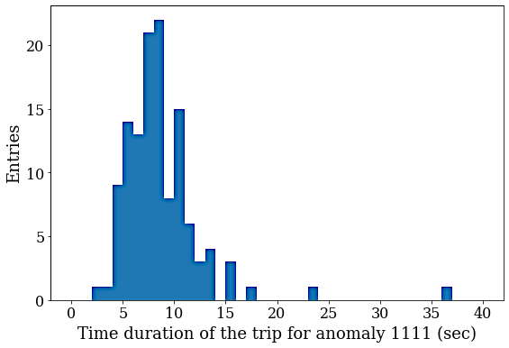
Errant Beam Metrics
The DCM archives data:
When (Downstream – Upstream) > threshold
Beam loss in the SCL: 1111 events
When the pulse is truncated
Beam loss upstream or aborted by another device: 1100 events
Metrics: How well should ML perform
March 2021, production was 26.4 days, 1.5% beam lost
0.22% beam lost due to SCL beam loss
1.30% beam lost due to truncated beam
We need to predict a fraction of the errant pulses: TPR ≈ 50%
We shouldn’t add much down-time due to false positives
An insignificant amount would be 0.2% of beam pulses
but penalty is 4 pulses per abort
→ we want to achieve a FPR ≈ 0.05%
Trip statistics derived from DCM data
Started analysis of BPM data, equipment classification
Very small amount of beam wrongly aborted and ~50% reduction of SCL losses
Notes:
:

Slide 6
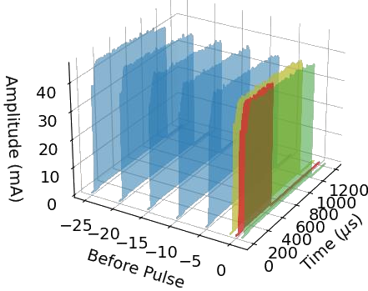
Beam-based: Current Efforts
Approaches
Beam Position Monitor phase data:
Map upstream to downstream to detect abnormal pulses. If mapped version differs from measured, then we have an abnormal condition
Differential Current Monitor data:
Identify the faulty equipment using labeled Machine Protection System (MPS) data
Siamese twin model to detect abnormal beam pulses
This model looks at similarities of two inputs and provides you with a similarity value
BPM phase turn-by-turn data
Use before pulse as abnormal
Beam current waveform

Slide 7
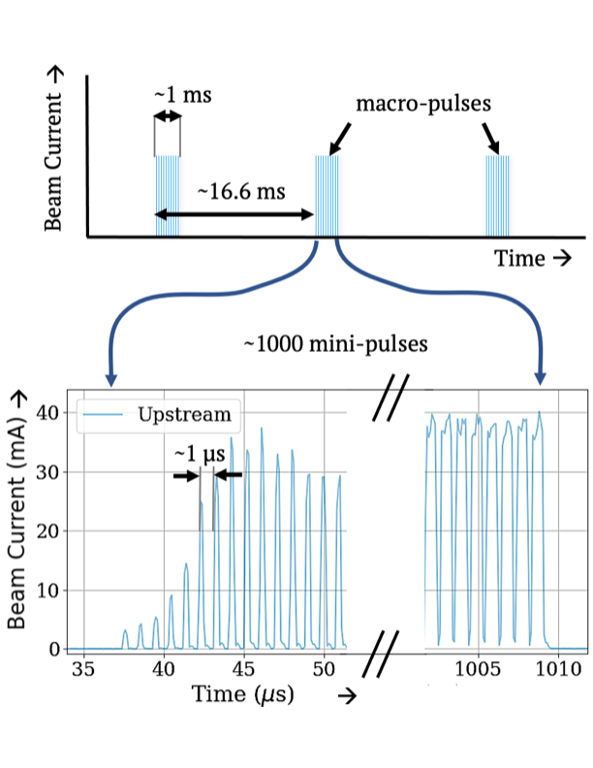
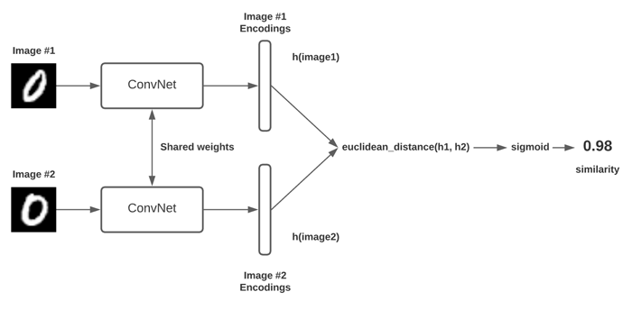
Beam-based: Siamese model
Siamese Model:
By using a reference pulse from the training set, we can compare a normal pulse to a normal reference pulse to see if they are still similar (if not, retrain)
We can run multiple inferences of same pulse versus multiple references to majority vote
Similarity allows to classify pulses not seen before
DCM data: 60 Hz pulses sampled at 100 MS/s

Slide 8
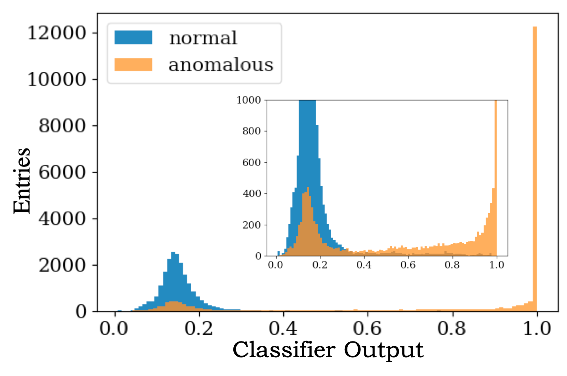
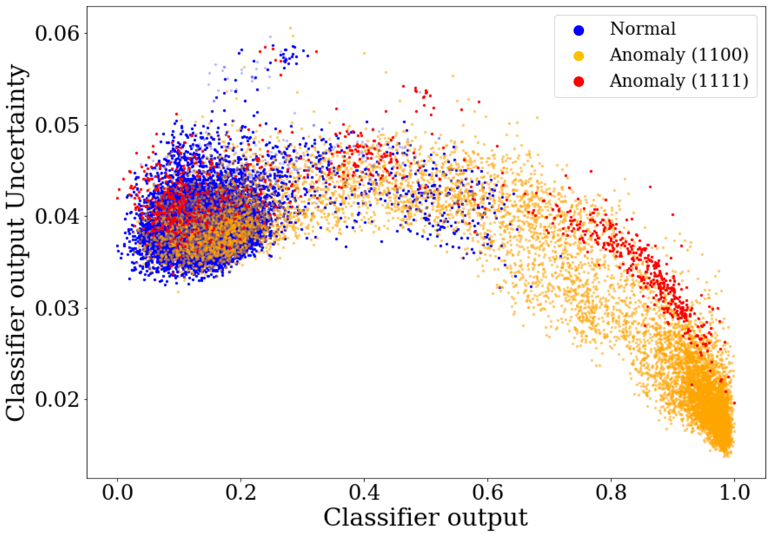
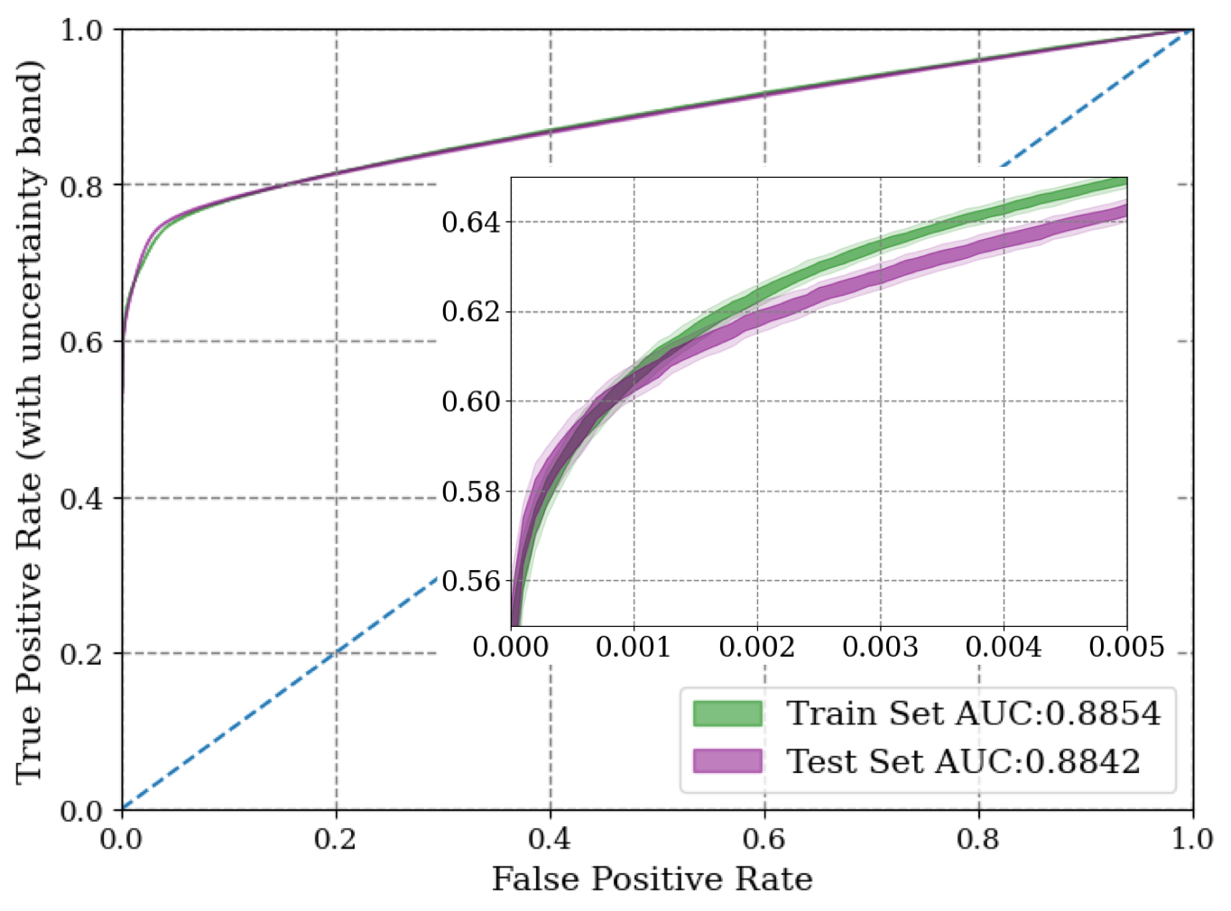
Beam-based: Siamese Model
Probabilistic model (Gaussian Approximation) adds uncertainty to similarity predictions
Anomaly, red 1111, that has not been part of training set, is identified correctly but has higher uncertainty
Deterministic Model
Probabilistic Model
1100 events
→ We can have very low FPR, e.g. 0.05% aka 0.2% of beam wrongly aborted, with ~50% of abnormal beam predicted*
*Blokland, W., Ramuhalli, P., Peters, C., Yucesan, Y., Zhukov, A., Schram, M., ... & Jeske, T. (2021). Uncertainty aware anomaly detection to predict errant beam pulses in the SNS accelerator. arXiv preprint arXiv:2110.12006.

Slide 9
Beam-based: Siamese Model

Slide 10
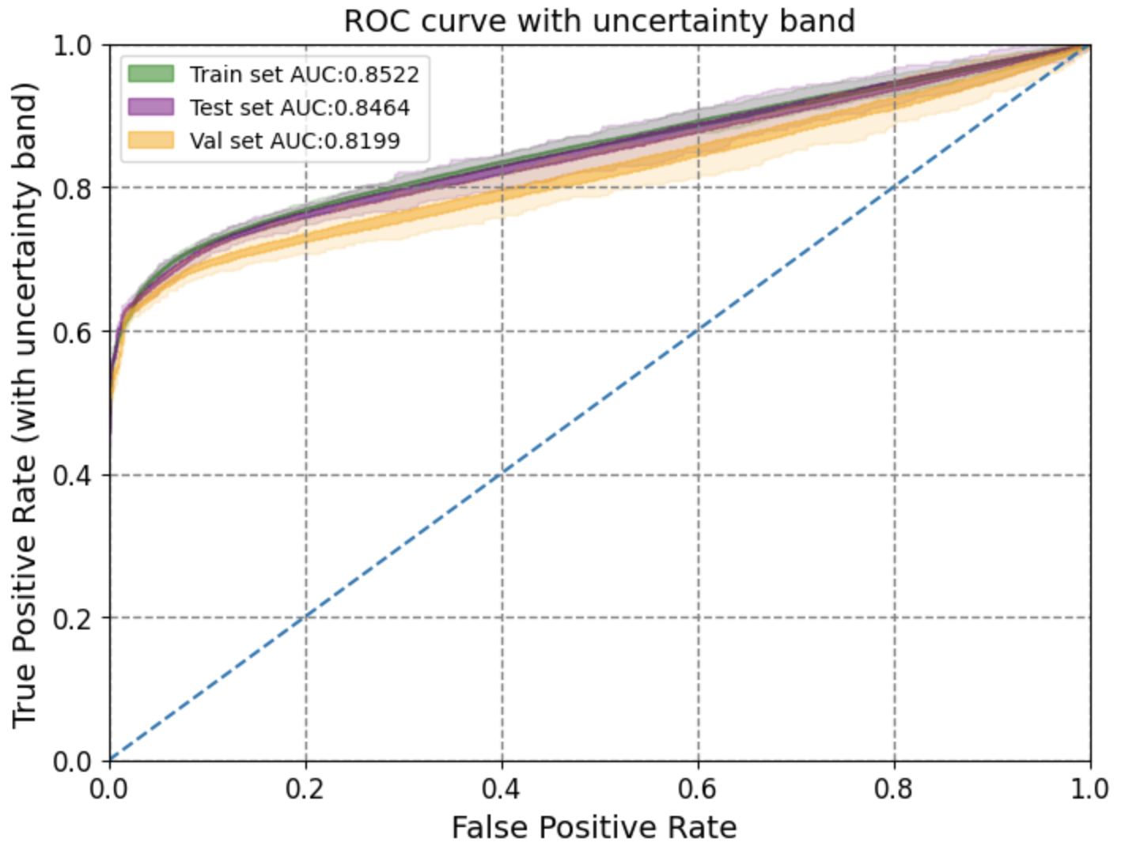
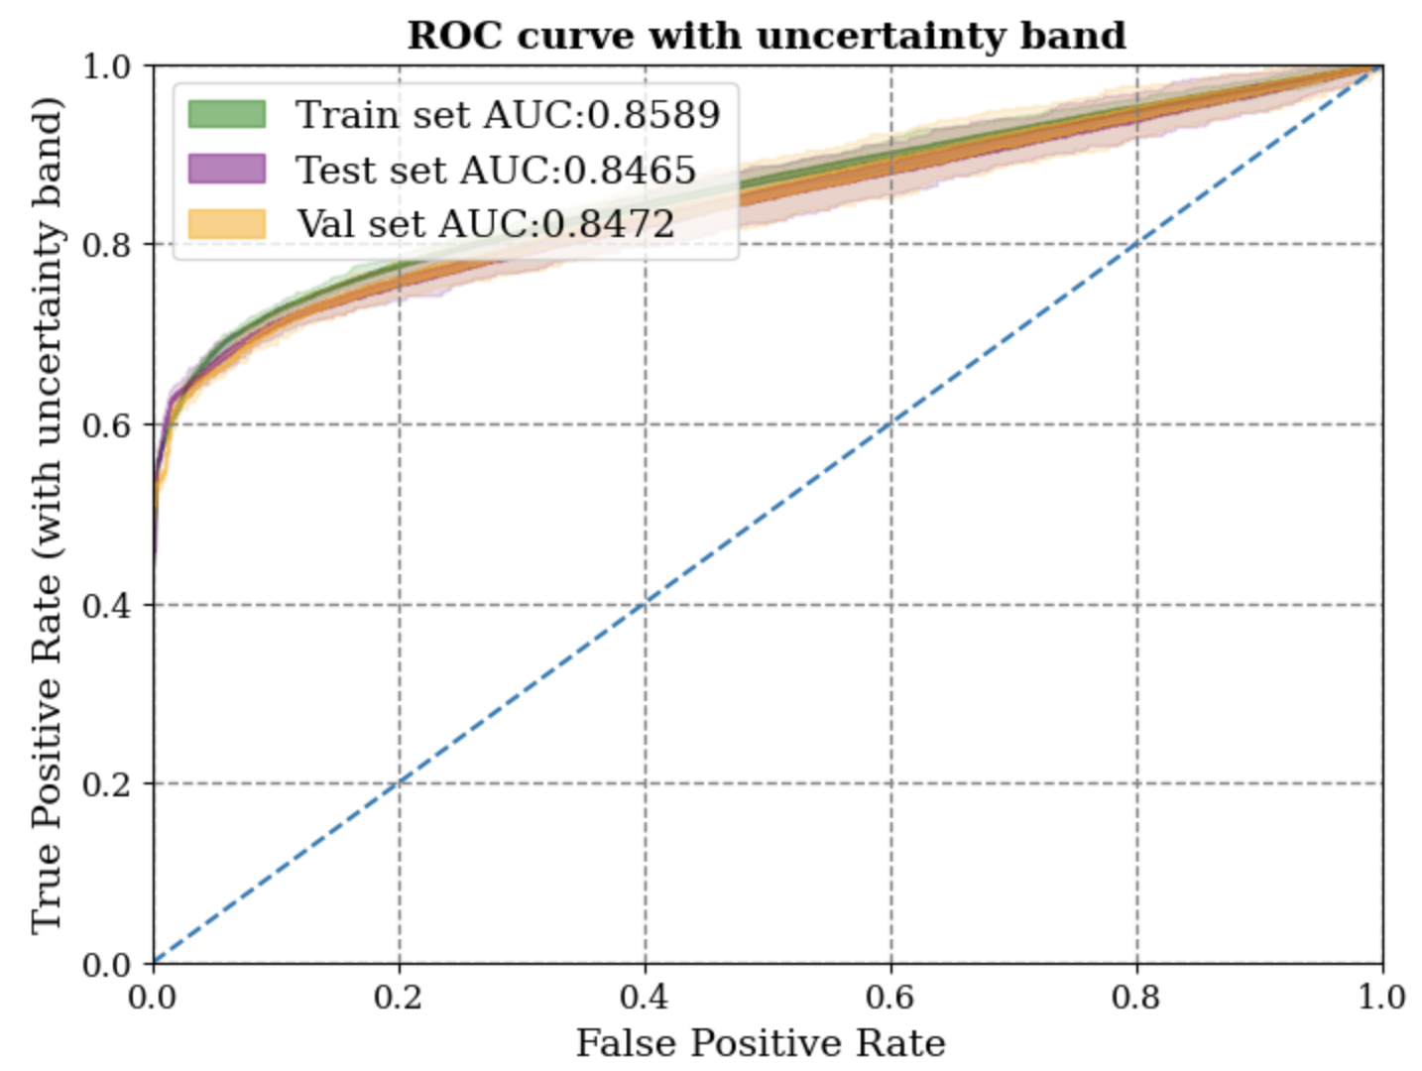
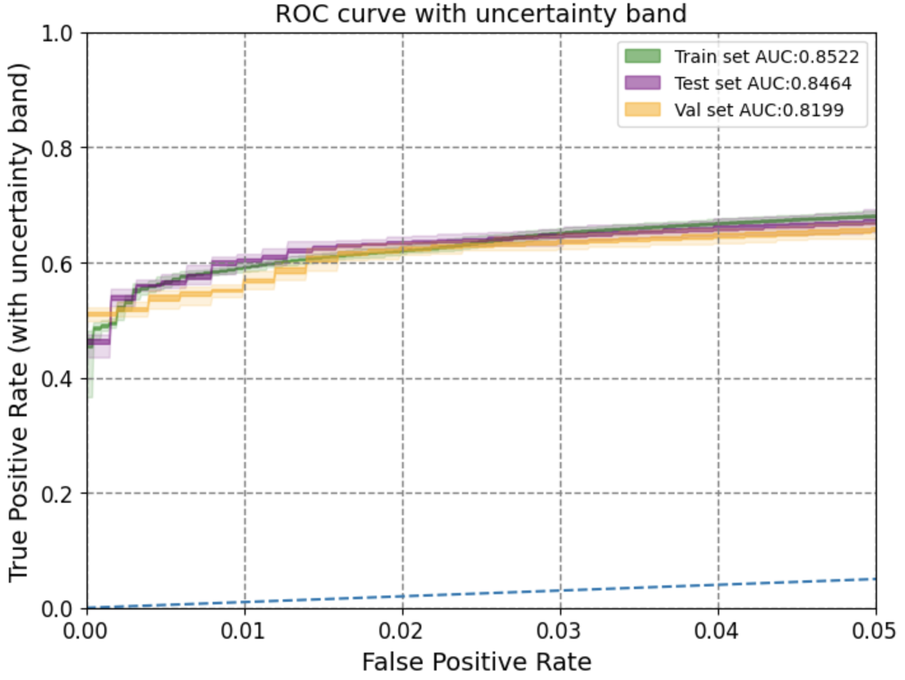
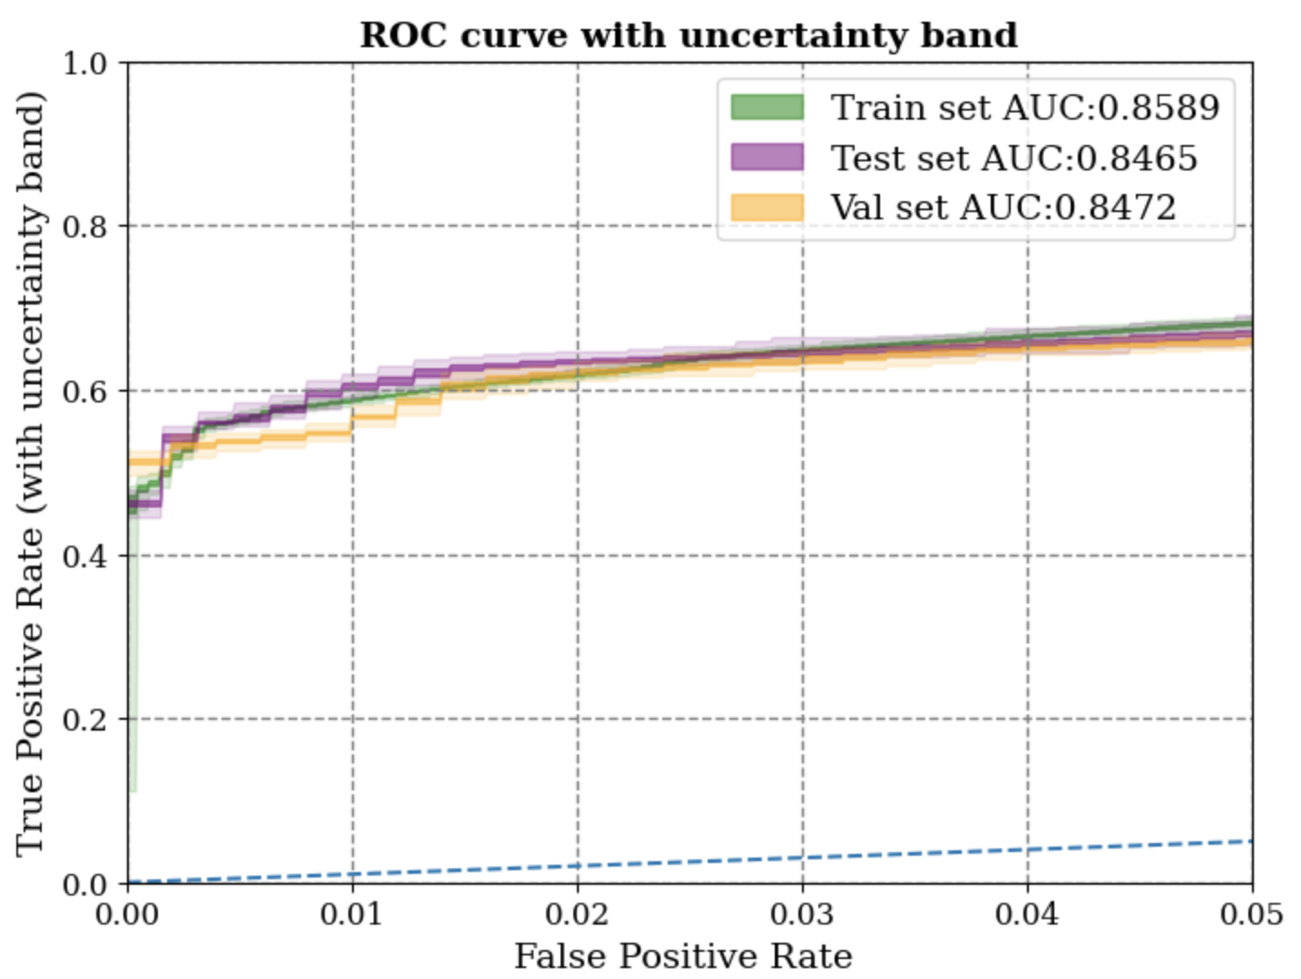
Before-n Analysis
Beam-based: Siamese Improvements
Implemented a data generator to increase the number of combinations without memory bottleneck
All the models now on will be trained with the generator
Before-1
Before-25
ROC on before-1 and before-25 looks visually the same → Similar performance!

Slide 11
Beam-based: Siamese Model and GradCAM

Slide 12
Beam-based: Siamese Model and GradCAM

Slide 13
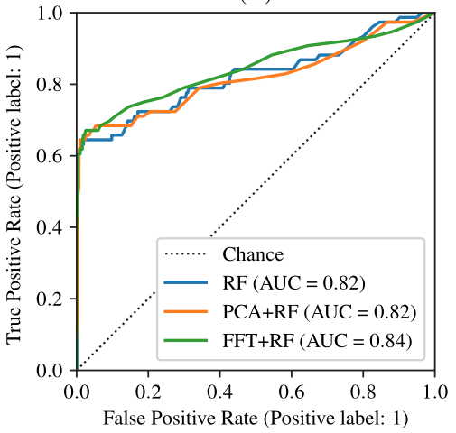
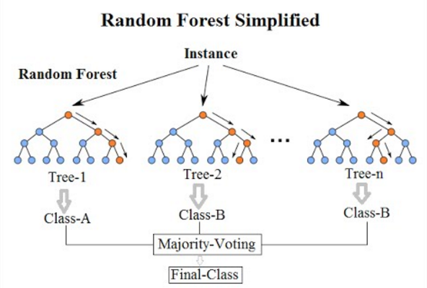
Beam-based: Errant Beam RF Work by Miha*
Method
Random Forest classifier with 100 estimators
Improvements: PCA, FFT, Voting, different dataset sizes
Results
No SCL beam loss: 40/233 predicted trips, 6531 false alarms
SCL beam loss: 20/27 predicted trips, 4133 false alarm
(~5,184,000 pulses per day)
We predict 75% of SCL beam loss pulses with ~0.2% *4 of good beam aborted.
Credit: Wikipedia
ROC curve with preprocessing
*M. Reščič, R. Seviour, W. Blokland, Improvements of pre-emptive identification of particle accelerator failures using binary classifiers and dimensionality reduction,, NIM-A,Volume 1025, 2022, 166064,ISSN 0168-9002, https://doi.org/10.1016/j.nima.2021.166064.

Slide 14
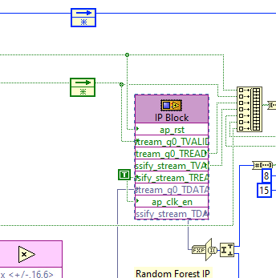
RF FPGA Design Flow
Automated, push button
sklearn model
intermediate
representation
Xilinx software platform
DCML FPGA bitstream
RTL
front-end parser
header
LabVIEW
To Xilinx
vitis
config host interface
Register-Transfer Level: description close to hardware implementation
“cage”
vivado testing DSE …
Adrestea FPGA Design Environment

Slide 15
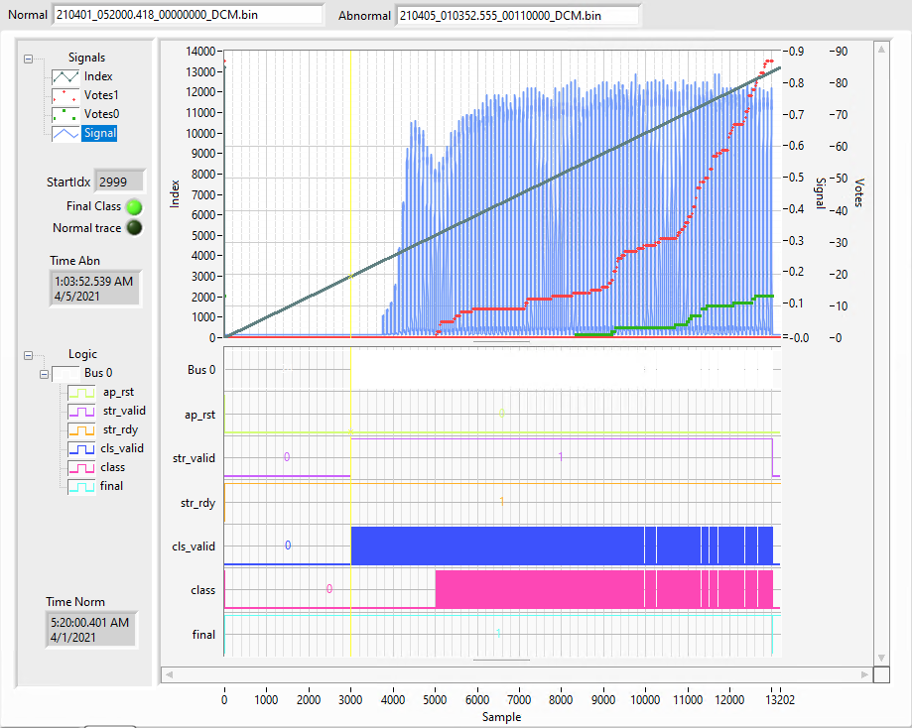
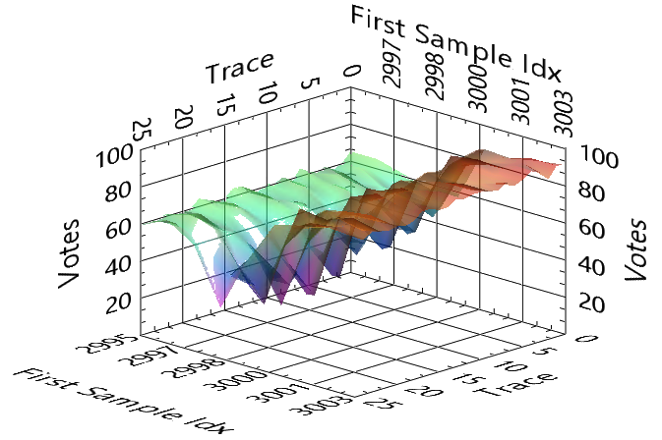
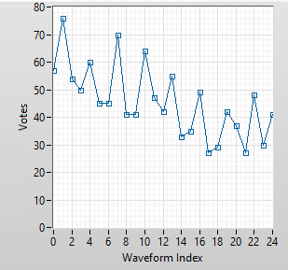
Implementation of ML-DCM with RF and Siamese twin
Hardware
Additional PXI installed
Amp installed
ML
RF integrated using model from Nov data
Deterministic model on RT
Point by point results from RF trees
Scanning over first sample and “before” waveforms

Slide 16
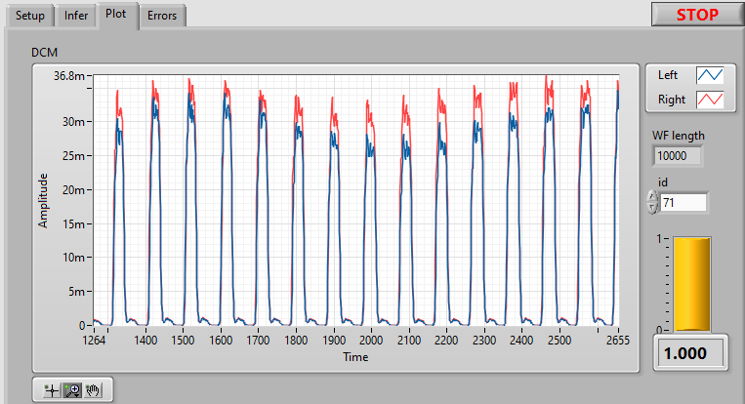
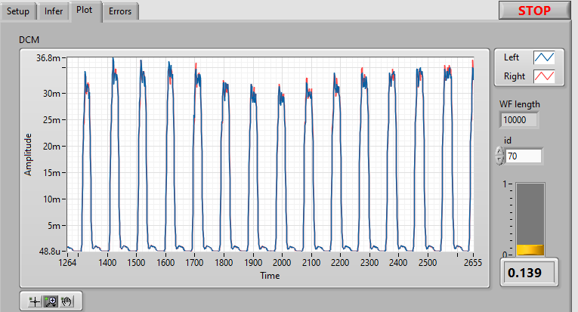
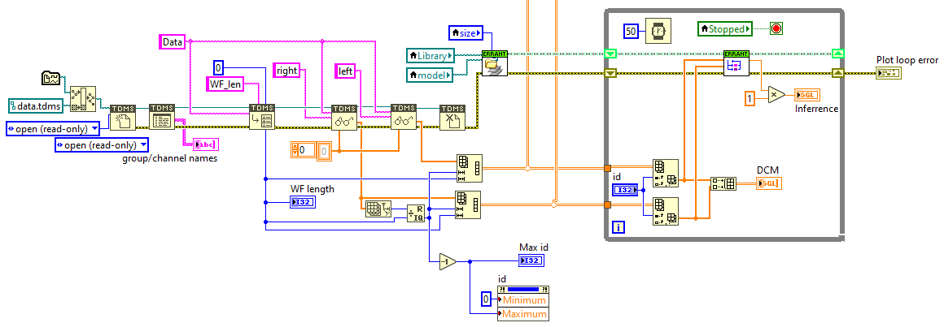
Beam-based and Infrastructure
Implementation of ML-DCM with RF and Siamese twin
Different
Similar
Captured raw DCM waveforms
JLab trained Siamese model with data for model testing in numpy format
Converted to TDMS in python
Load data in LV running on Real Time target
→ Inference with real data takes 0.5 ms on multi-core, well within 16 ms to do ~5 inferences/chan
Testing of Siamese code

Slide 17
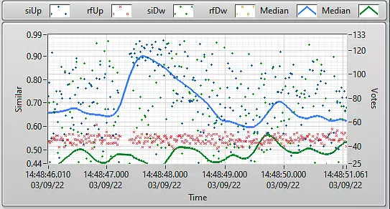
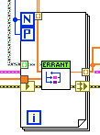
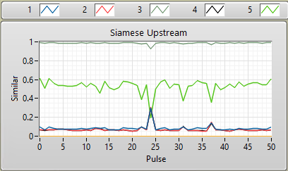
Beam-based: Field Implementation
Implementation in the field
Installed second DCM (DCML) and fed it duplicate analog signals from beam current sensors
Implement Siamese model on DCML RT
Implement RF on FPGA (upcoming paper on development environment)
Analyze all incoming beam current waveforms
Normal_N
Normal_N
Pulse-by-pulse analysis on up/down stream both Siamese and RF
Normal_1
Similar?
Uncertainty
Beam pulse
Similarity
Beam pulse
Siamese model applied to multiple Normal references
→ We see certain events but not yet operational in terms of TP and FP
5 Inferences with different references per beam pulse

Slide 18
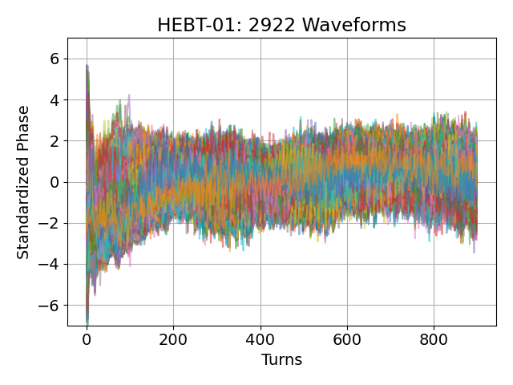
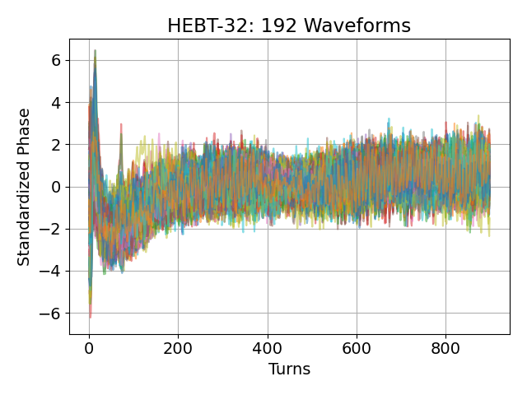
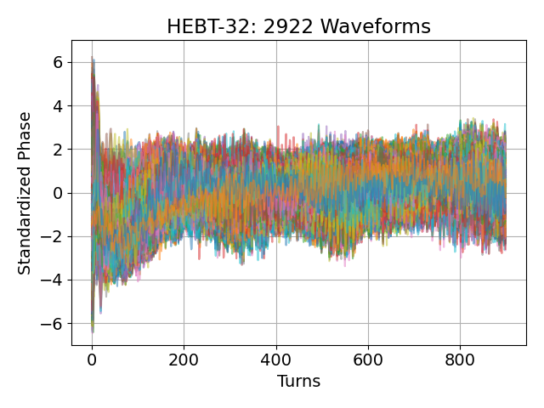
Beam-based: BPM Phase Data
Use normal traces to model mapping from an upstream and downstream BPM
Pass faulty traces from the trained model
Compare error between true phase and predicted phase
Model: Multi-layered Perceptron
Input: HEBT-BPM01 Phase
Output: HEBT-BPM06 Phase
Training: Normal Waveforms
Training
Inference &
Post-processing
Upstream BPM
…
…
Actual Waveforms
…
RMSE
…
…
$$RMSE≥threshold⇒Errant$$
$$RMSE<threshold⇒Normal$$
Downstream BPM
Yucesan, Y., et al. (2022) “A Machine Learning Approach for Errant Beam Detection using Spatial Phase Deviation” Work in Progress.
Model Predictions

Slide 19
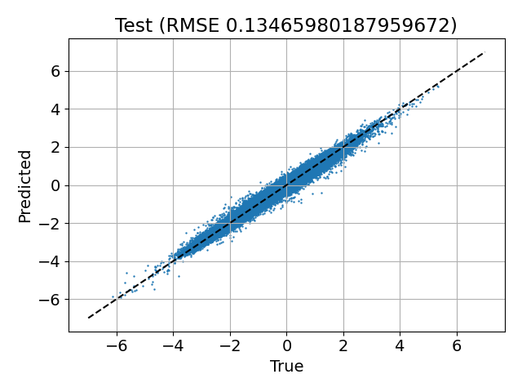
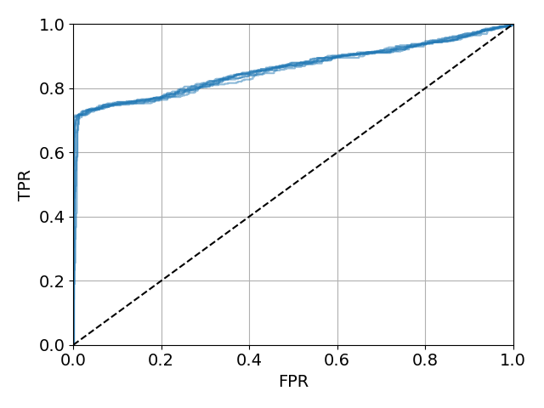
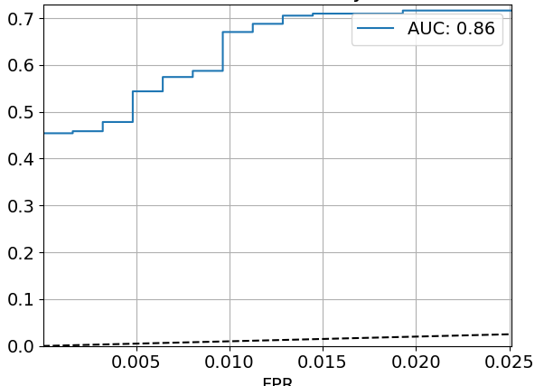
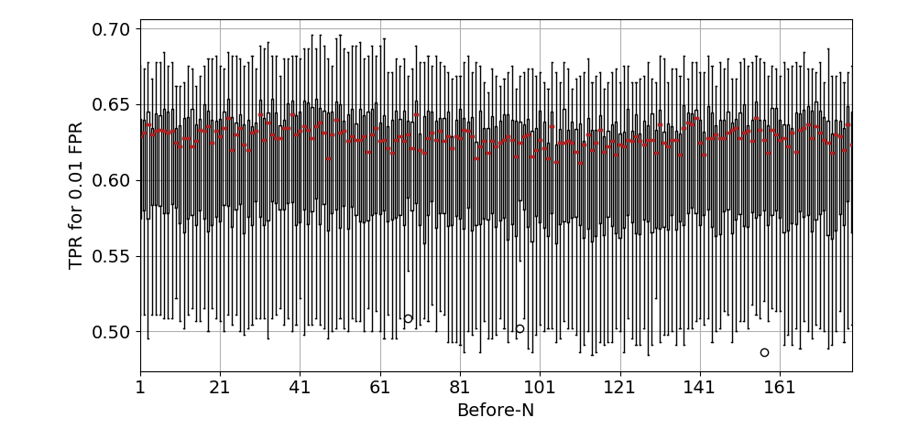
Beam-based: BPM Phase Data
Cross-validated model performance on target FPR
Model validated for normal-to-normal mapping
Analysis on errant pulses indicate distinguishable normal vs errant pulses
Maintained performance on previous pulses
Phase Predicted vs Measured
Precursors on fault 180 pulses before beam trip!
Results:
FPR < 0.25 % while maintaining TPR ~45%
Consistent performance on Before-180 pulses
HEBT01-32 model outperforms HEBT01-06 model

Slide 20
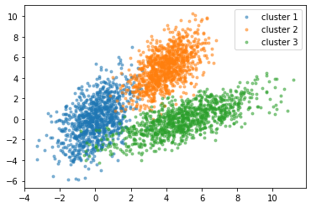
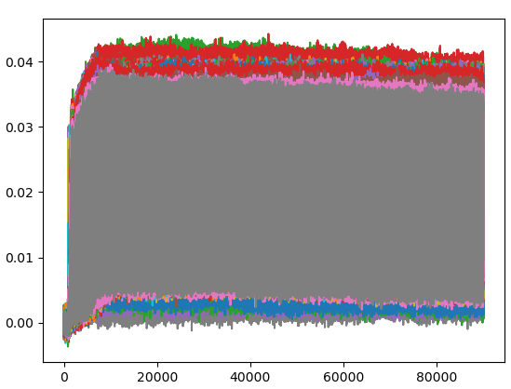
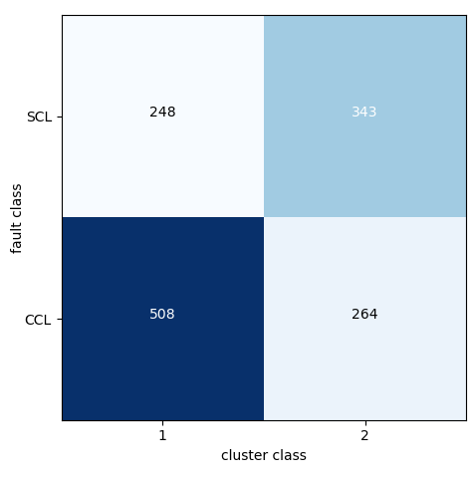
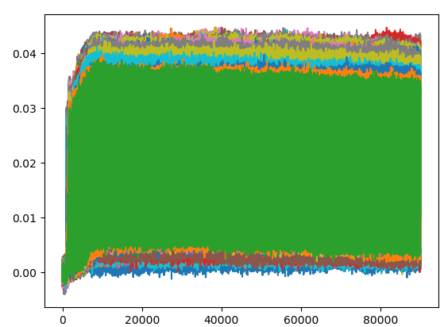
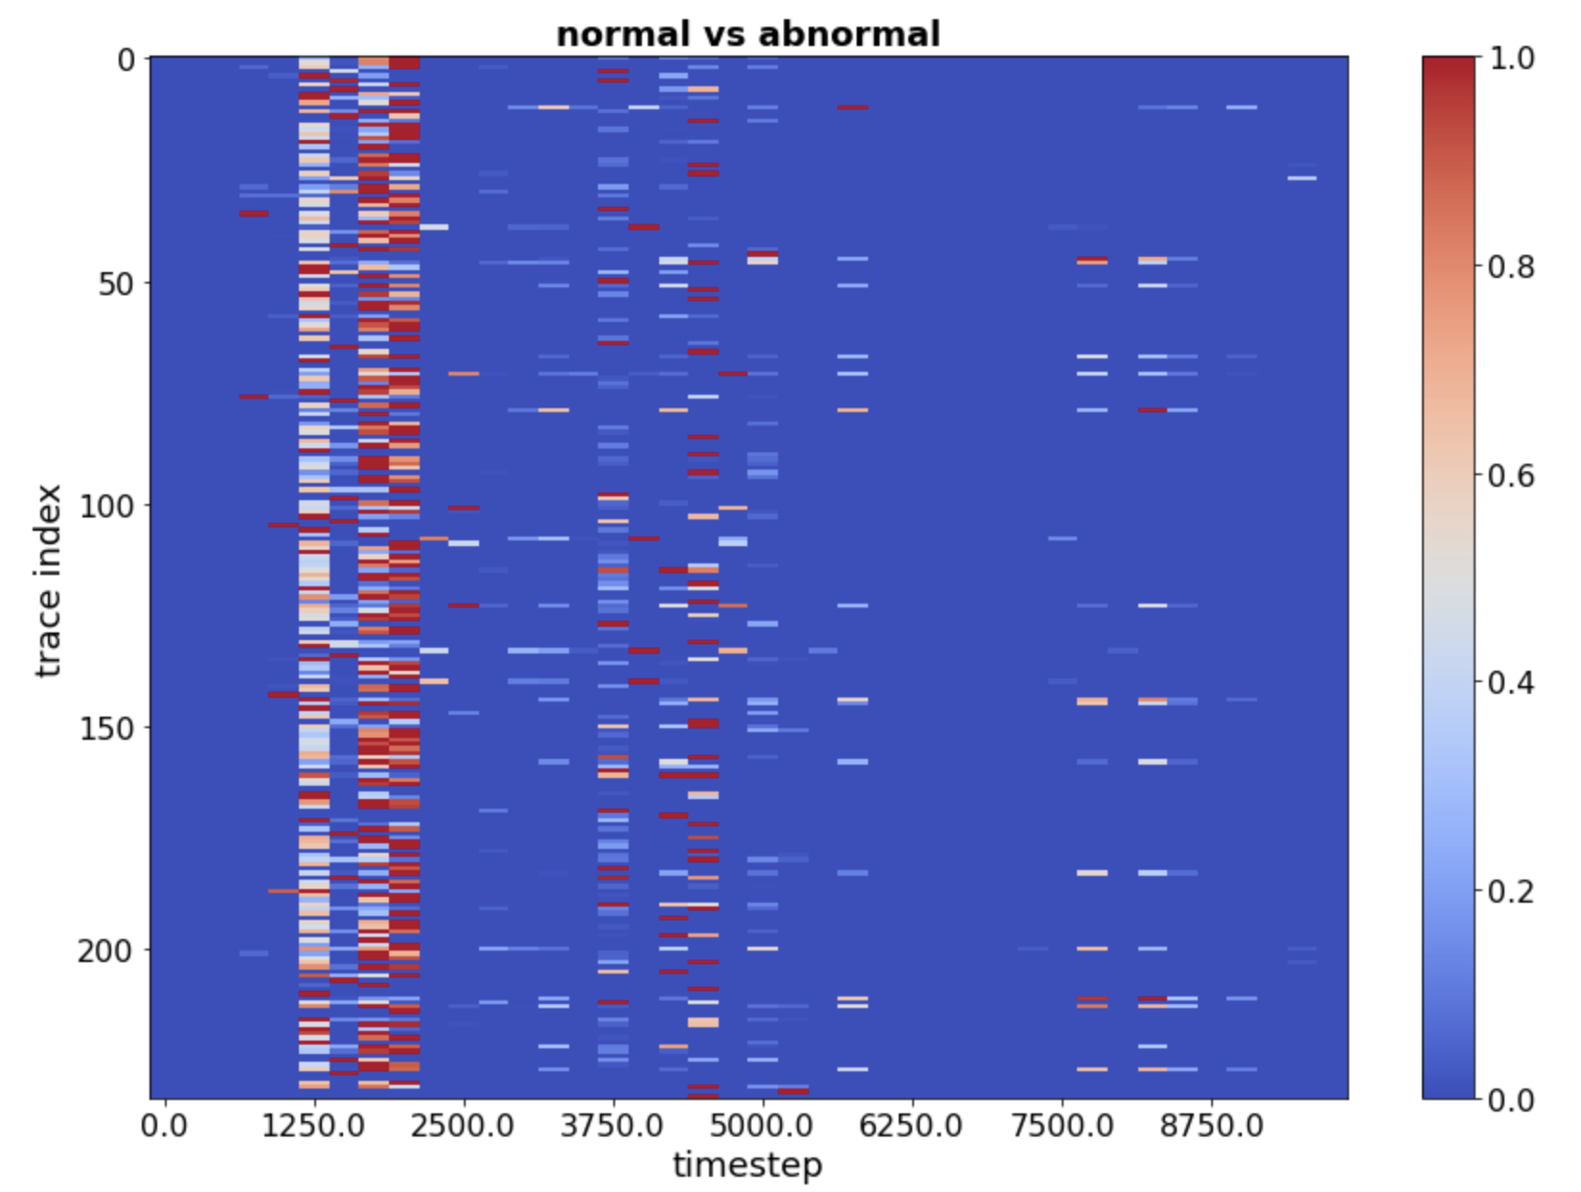
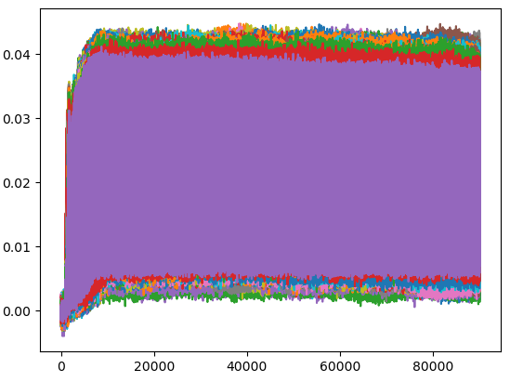
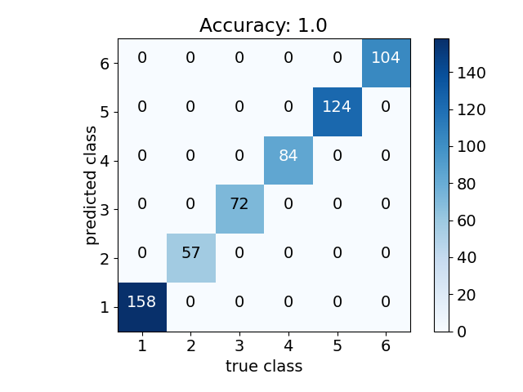
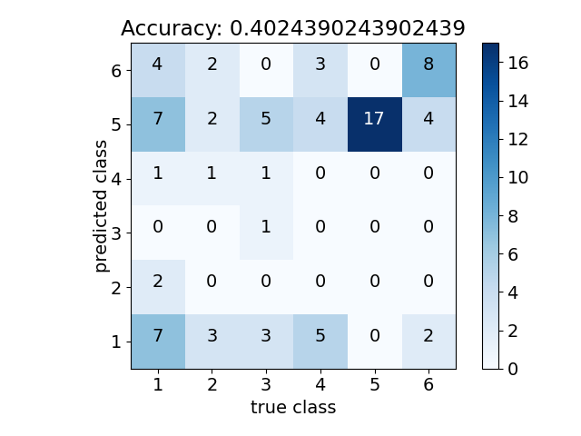
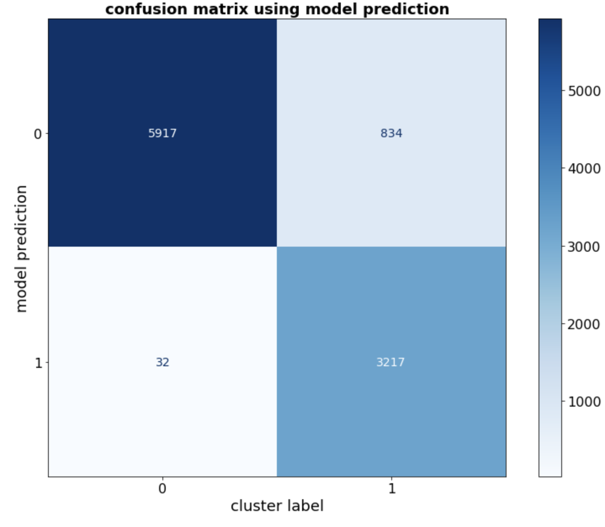
Beam-based: Equipment Fault Classification
Goal: identify the equipment causing errant beam
Siamese model:
Unsupervised Clustering:
Use gradCAM* to generate heatmaps and see if heatmaps are different for different equipment
Confusion Matrix
Signals
246
343
*Gradient-weighted Class Activation Mapping
…
Example of clusters
508
264
Convolutional Neural Networks (CNNs):
Training
Test
In progress:
Ok for finding anomalies → might be ok for equipment classes
In progress:
Weak classification performance
Overfitting
5917
834
32
3217

Slide 21
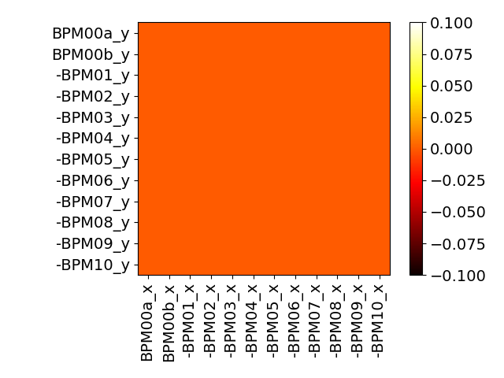
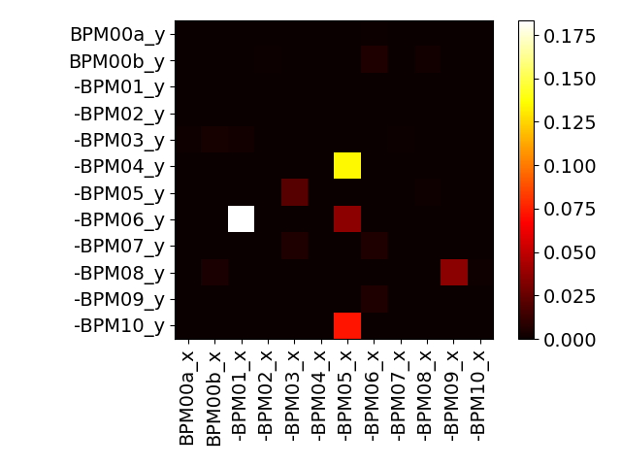
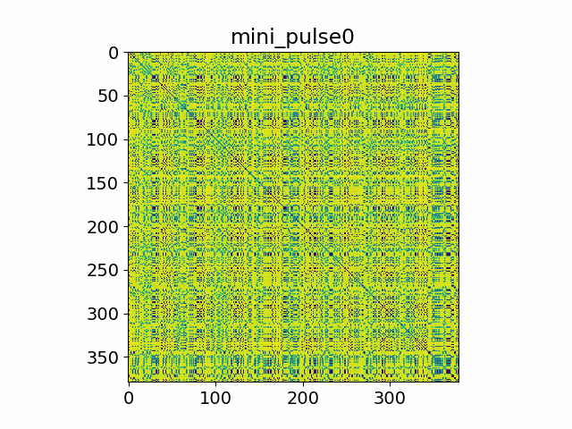
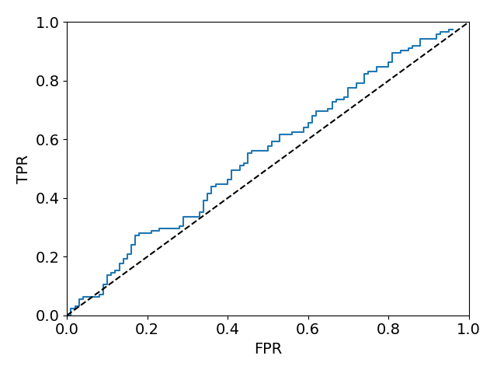
Beam-based: Other techniques tested
Granger Causality Test on BPM data for anomaly detection
Image pattern enhancement for equipment classification
T0
T179
(errant)
Form heatmap for exponential differential within 4 minipulse sequence
Apply conventional image classification methods
SCL BPMs
Neither temporal nor spatial analysis provide predictive power
Poor classification performance

Slide 22
Beam-based: Outputs So Far
Publications
Blokland, W., Ramuhalli, P., Peters, C., Yucesan, Y., Zhukov, A., Schram, M., Rajput, K. & Jeske, T. (2022). “Uncertainty aware anomaly detection to predict errant beam pulses in the SNS accelerator”. Physical Review Accelerators and Beams (Under Review)
“A Machine Learning Approach for Errant Beam Detection using Spatial Phase Deviation” (Work in Progress)
M. Reščič, R. Seviour, W. Blokland, (2022) “Improvements of pre-emptive identification of particle accelerator failures using binary classifiers and dimensionality reduction,”, NIM-A,Volume 1025, 2022, 166064,ISSN 0168-9002, https://doi.org/10.1016/j.nima.2021.166064.
IPAC poster
Talks
Blokland, W., “Machine Learning to Improve the Operation of the Spallation Neutron Source” @ FRIB-MSU
Malachi’s talk @ ANL
Field Implementation
Random Forest Model on FPGA
Siamese Model on DCML
Inference data is collected online for both models historically.

Slide 23
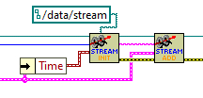
Beam-based: Next Steps
Analysis
Time horizon determination (Expand on Miha’s work)
Improved equipment fault classification model
GradCAM applied to Siamese Model
Leverage spatial distribution of BPMs
Full deployment of anomaly detection models
Uncertainty Aware Siamese Model
DCML or ML Server (performance)
Abort beam once reaching reasonable FP/TP rates
BPM model installed on multiple BPMs
Performance evaluation (statistics collection)
Different techniques vs data sources: deploy multiple models, ensemble voting
Sustainable ML frameworks (MLflow)
Automate (useable by non-ML experts) generation of models
ML Server: 60 Hz streaming and storing of DCML data

Slide 24
Beam-based: Discussion
Classification Methods for equipment classes
Best way to get code from JLAB integrated with SNS
Need to update models quickly or field tests will be limited
ML Analysis on server

