Slide 1
ML Improvement Project Budget Status
March 2022
ML Team Meeting – April 2022
Mike Dayton
4/21/2022

Slide 2
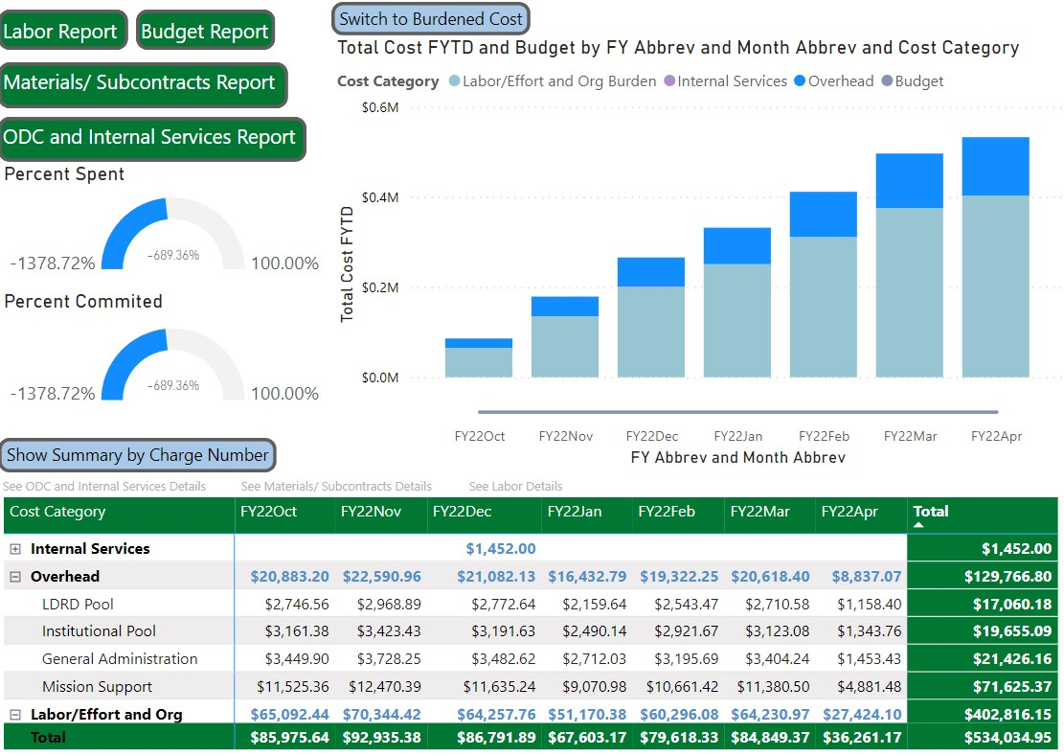
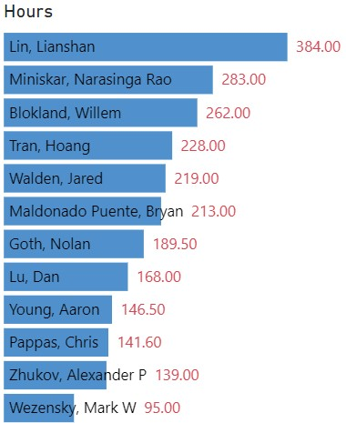
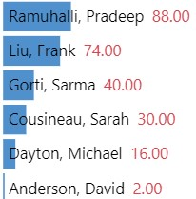
NRML0001 ORNL Labor FY22 Actuals
As of 4/19/2022

Slide 3
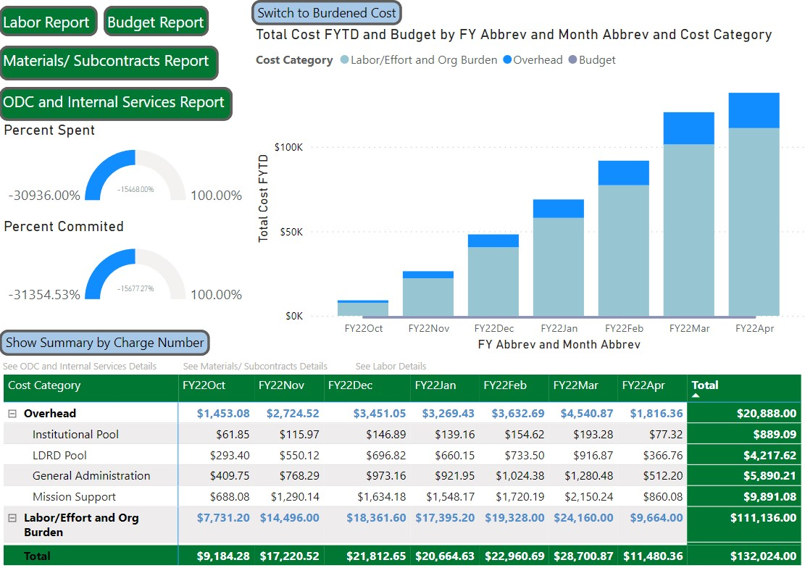
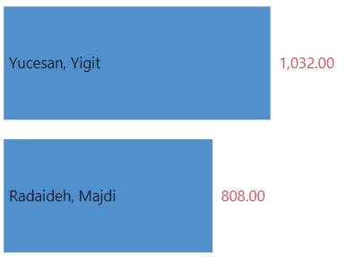
NRML0002 Post-Doc FY22 Actuals
As of 4/19/2022

Slide 4
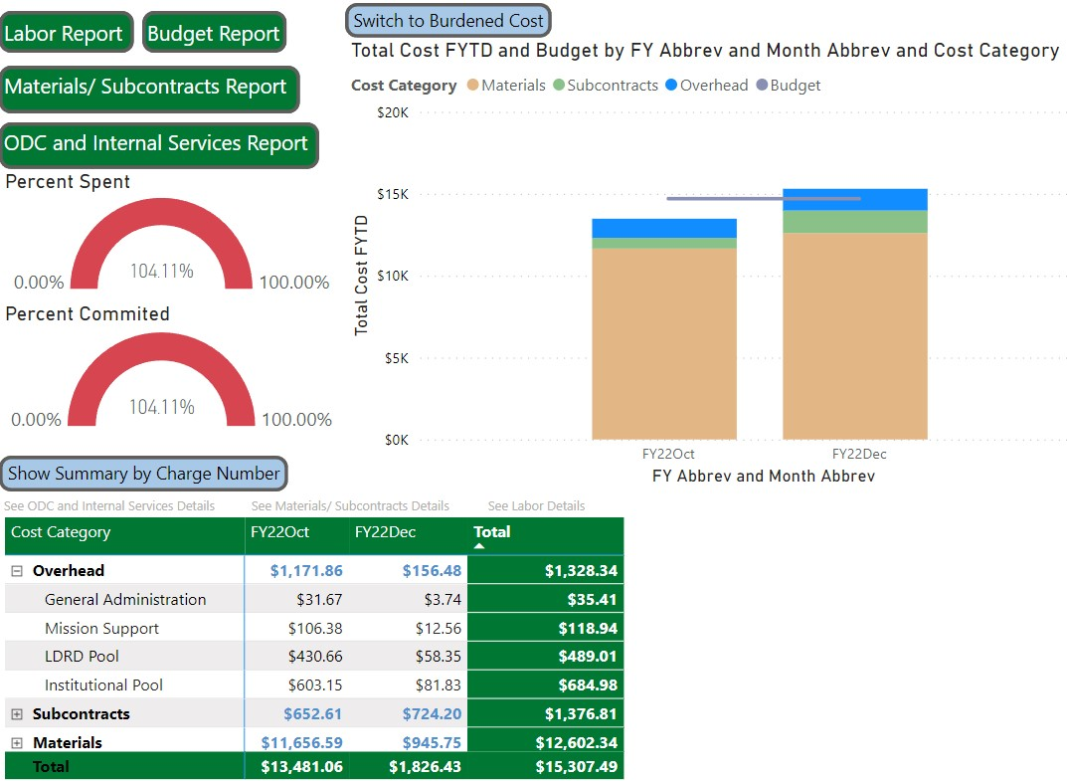
NRML0004 Materials and Supplies FY22 Actuals
As of 4/19/2022

Slide 5
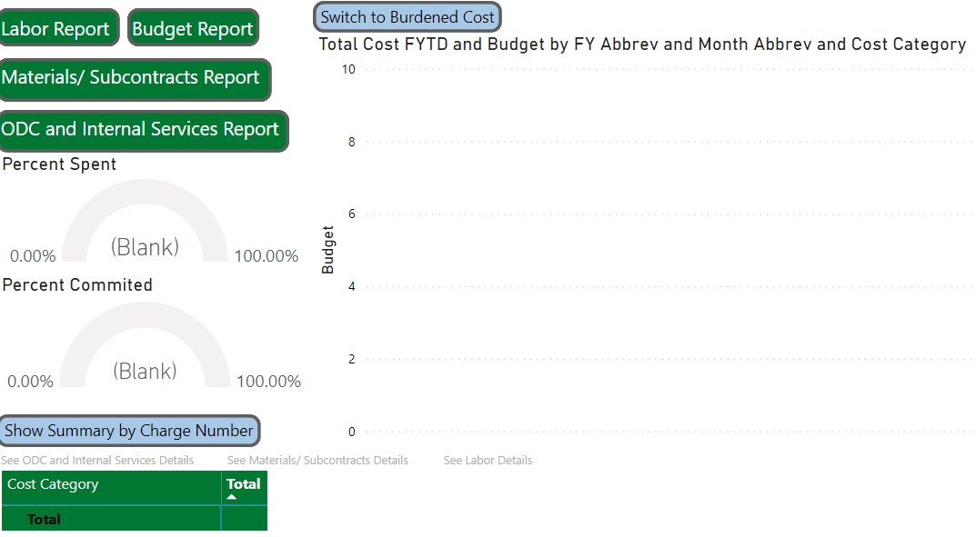
NRML0005 Travel FY22 Actuals
As of 4/19/2022

Slide 6
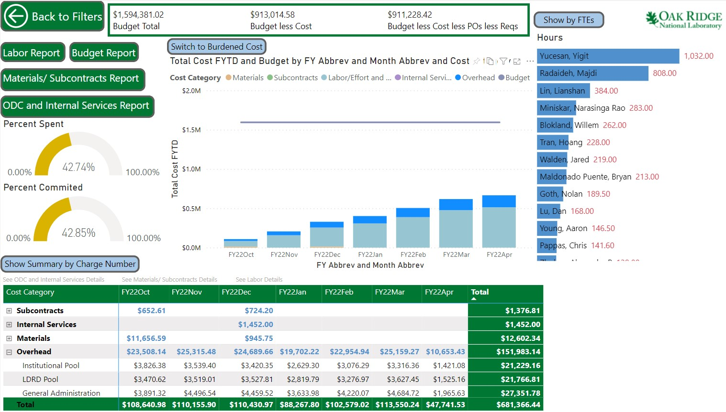
Dashboard Report (Summary)
As of 4/19/2022

