Slide 1
ORNL Machine Learning HVCM Use Case
Task Team
T. Britton, D. Lu, M. Radaideh, C. Pappas, P. Ramuhalli, K. Rajput, M. Schram, L. Vidyaratne, J. Walden

Slide 2
Content
HVCM at SNS
GAN for data Augmentation
RNN autoencoders for anomaly detection
CNN autoencoders for anomaly detection
Modeling of capacitor degradation with CNN
Summary

Slide 3
SNS RF Systems
The SNS uses 15 High Voltage Converter Modulators to power klystrons which provide the RF used to accelerate a proton beam.
There are three basic types of HVCMs
RFQ & Drift Tube Linac
Coupled Cavity Linac
Super Conducting Linac
RFQ-DTL
CCL
SCL

Slide 4
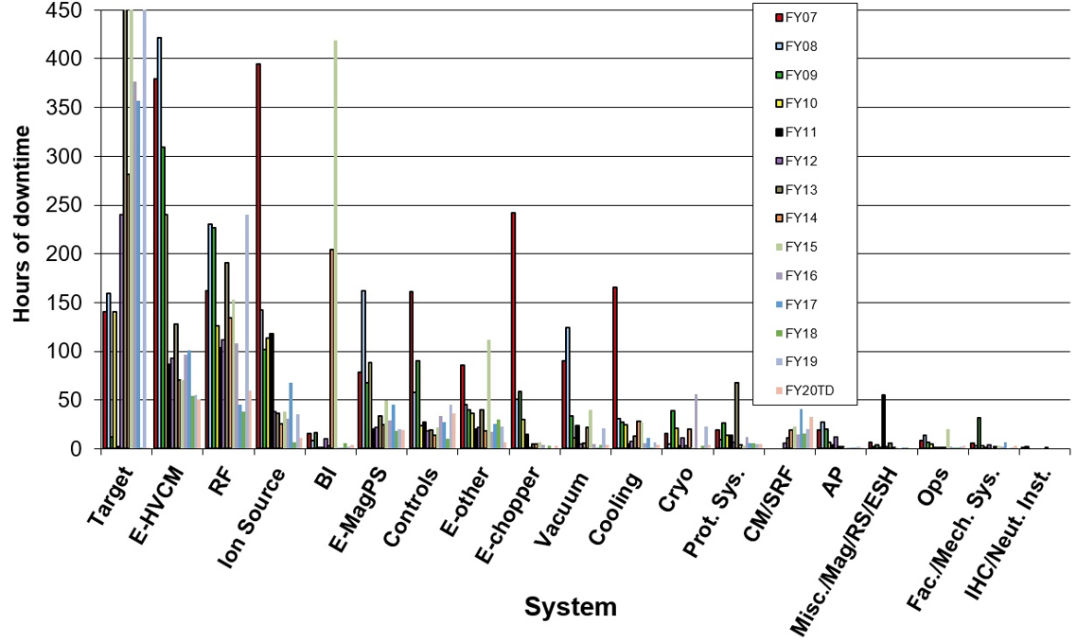
HVCM Reliability

Slide 5
HVCMs at SNS
High Voltage Converter Modulators (HVCMs) are used to convert 13.8 kVAC, 3 φ into a train of up to 135 kV, 1.3 µs pulses at 60 Hz to klystrons which power the accelerating cavities at the SNS.
They consist of
a) AC switch gear and magnetics
b) a controlled rectifier to convert the input AC to 2100 VDC
c) energy storage, chopping of the 2.1 kVDC at 20 kHz, stepping the chopped voltage up to high voltage, and rectifying the filtering the chopped high voltage.
d) HVCM controller

Slide 6
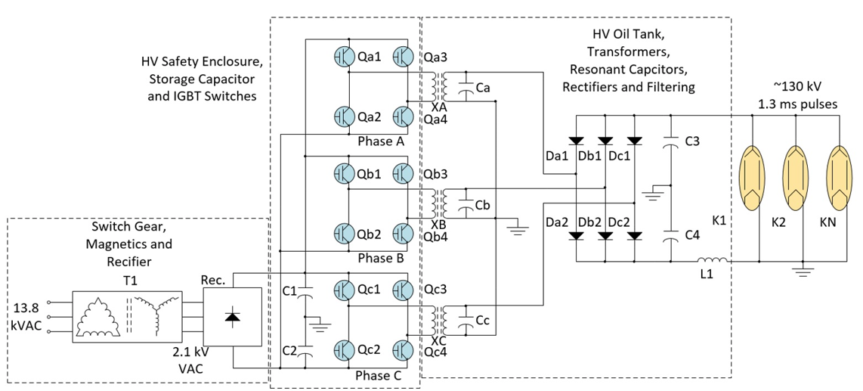
HVCM Schematic
3 phase, full wave rectifiers, 120 kHz apparent switching
Resonant Capacitors
Klystrons
Energy storage capacitors
Output filtering
HV pulse transformers, 20 kHz bipolar pulses
HV power transformer and line filters cabinet, outside
6 pulse, phase controlled rectifier rack
Insulated Gate Bipolar Transistor switches, 20 kHz switching frequency

Slide 7
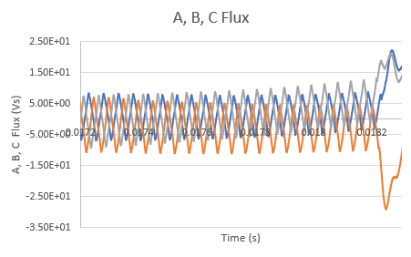
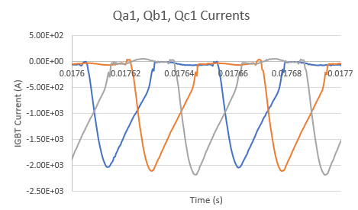
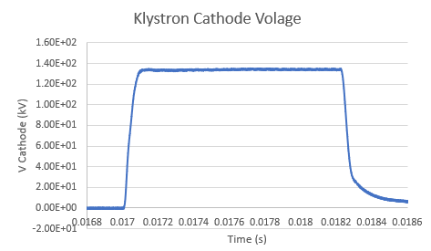
HVCM Waveforms
Each HVCM digitizes 32 waveform channels at 50 MS/s and saves a RUN file, decimated to 2.5 MS/s 30 minutes after start up, or after tuning has occurred.
In addition to the RUN files, two Fault files are saved every time there is a HVCM fault. One with 50 MS/s and a record length of 3.5 ms, and another at 2.5 MS/s and a record length of 36 ms, both centered at the time of the fault.
A SETTINGS file is saved whenever a change is made HVCM settings used for tuning or to set warning and fault levels.
All RUN, Fault and SETTINGS files have been archived since January 2021.

Slide 8
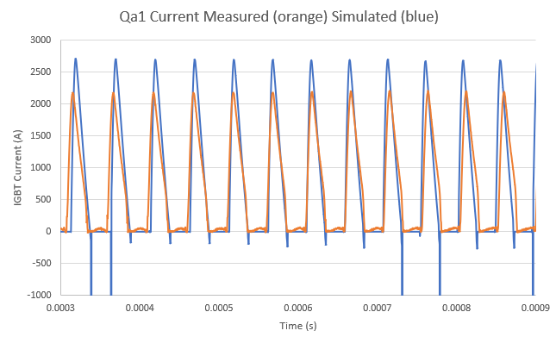
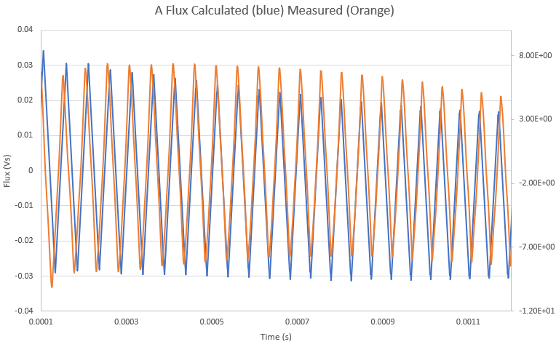
Simulated HVCM Waveforms
SPICE circuit models for the HVCMs have been developed and validated.
Models have been built to also include frequency modulation using MatLab with LTSpice.
MatLab is also being used to sweep ranges of component values to generate SPICE simulations to model degradation of components such as plastic film capacitors.

Slide 9
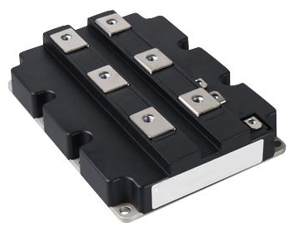
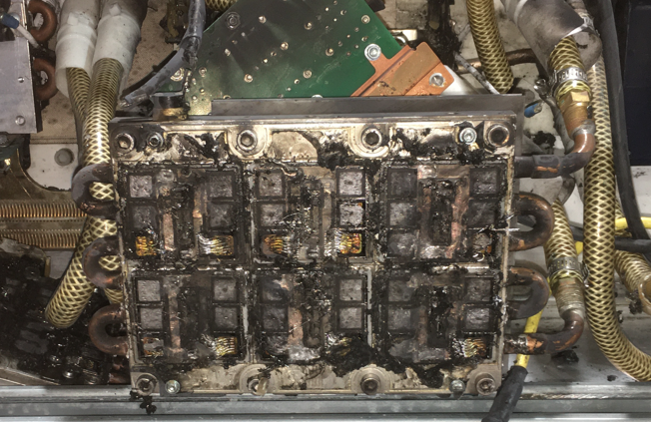
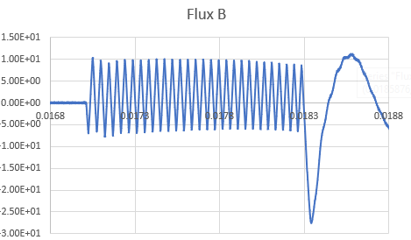
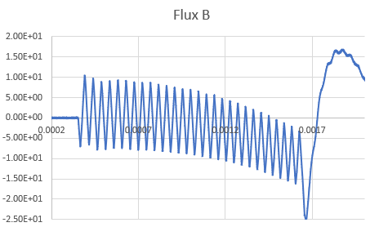
HVCM Faults, IGBT Exploded
Normal IGBT and flux after tuning, several days before event.
Exploded IGBT and flux from shot immediately precent event.

Slide 10
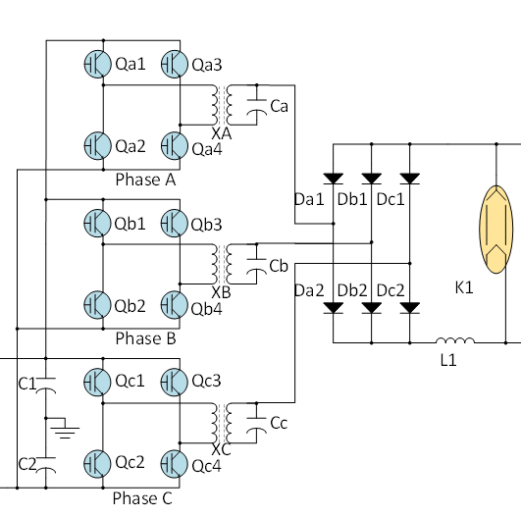
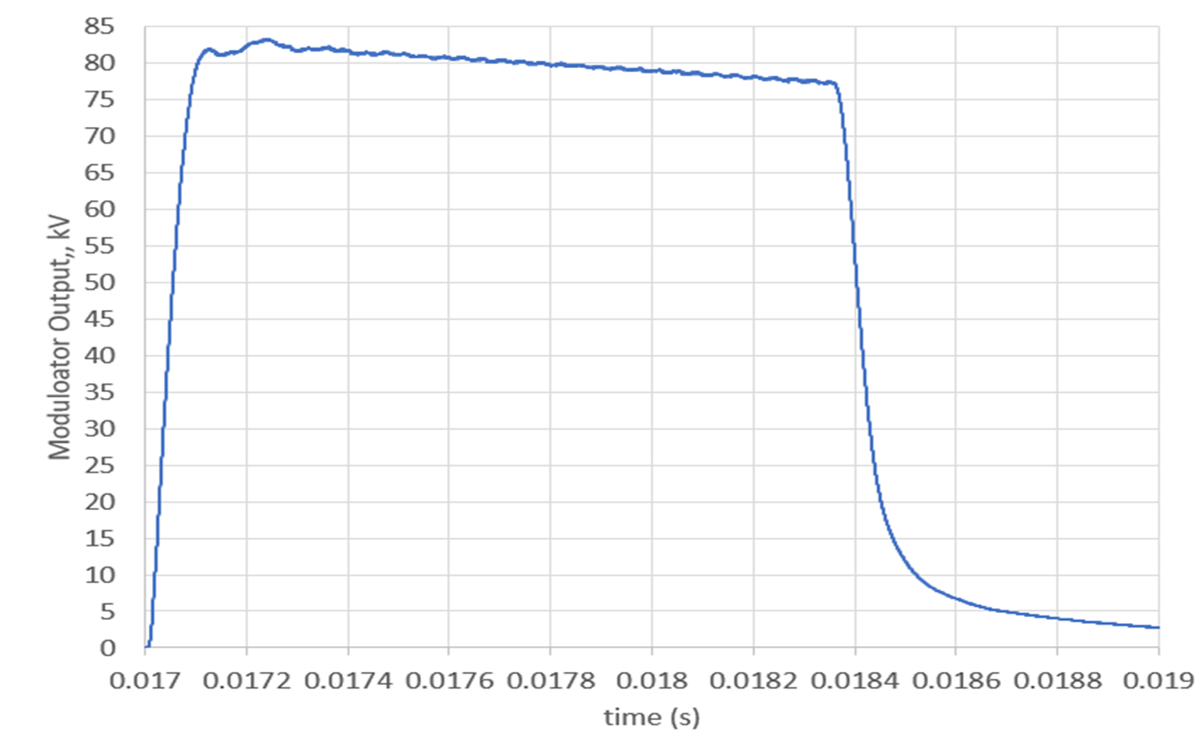
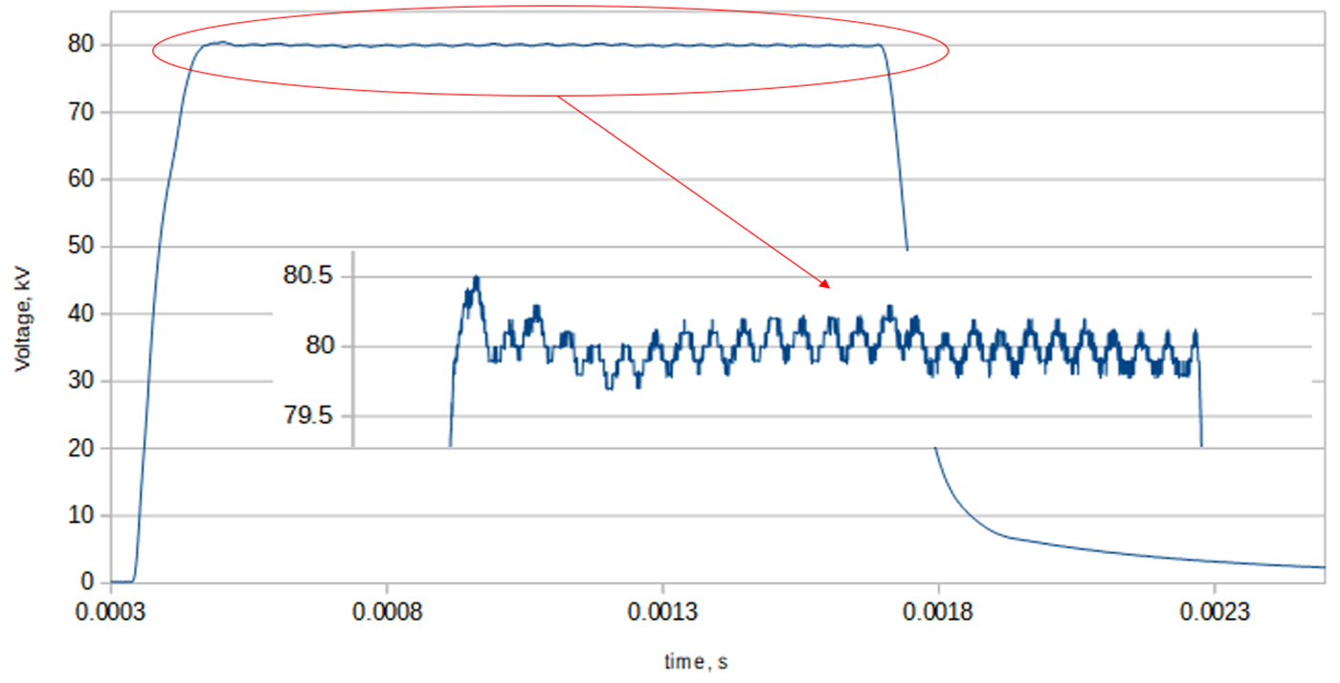
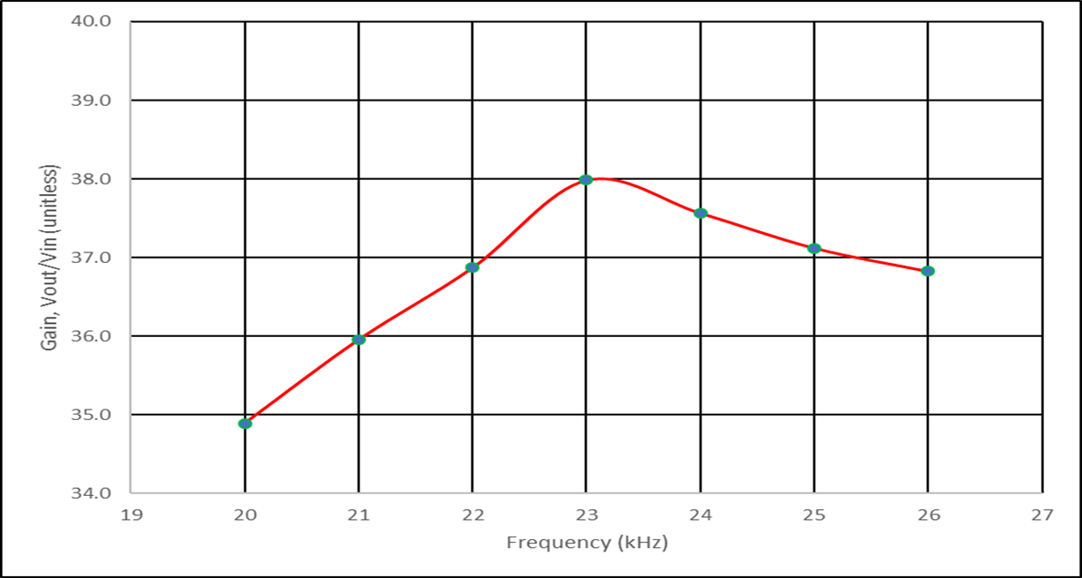
HVCM Tuning
Output voltage droop
20 kHz fixed
Droop compensation by modulating frequency from 20-23 kHz
Modulator Gain
Vs Frequency
HVCM circuit
20 kHz nom. switching
HVCMs are tuned whenever maintenance is performed to optimize pulse flat top and keep waveforms within preset limits.
The knobs used are
the range of frequencies to sweep during the pulse to correct for voltage droop
shortening of the initial pulses to prevent overshoot on the rising edge
biasing of the transformer core to prevent core saturation
Changing the angles of the three phases and small changes in the angles of individual micro-pulses to correct for output voltage ripple.

Slide 11
Content
HVCM at SNS
GAN for data Augmentation
RNN autoencoders for anomaly detection
CNN autoencoders for anomaly detection
Modeling of capacitor degradation with CNN
Summary

Slide 12
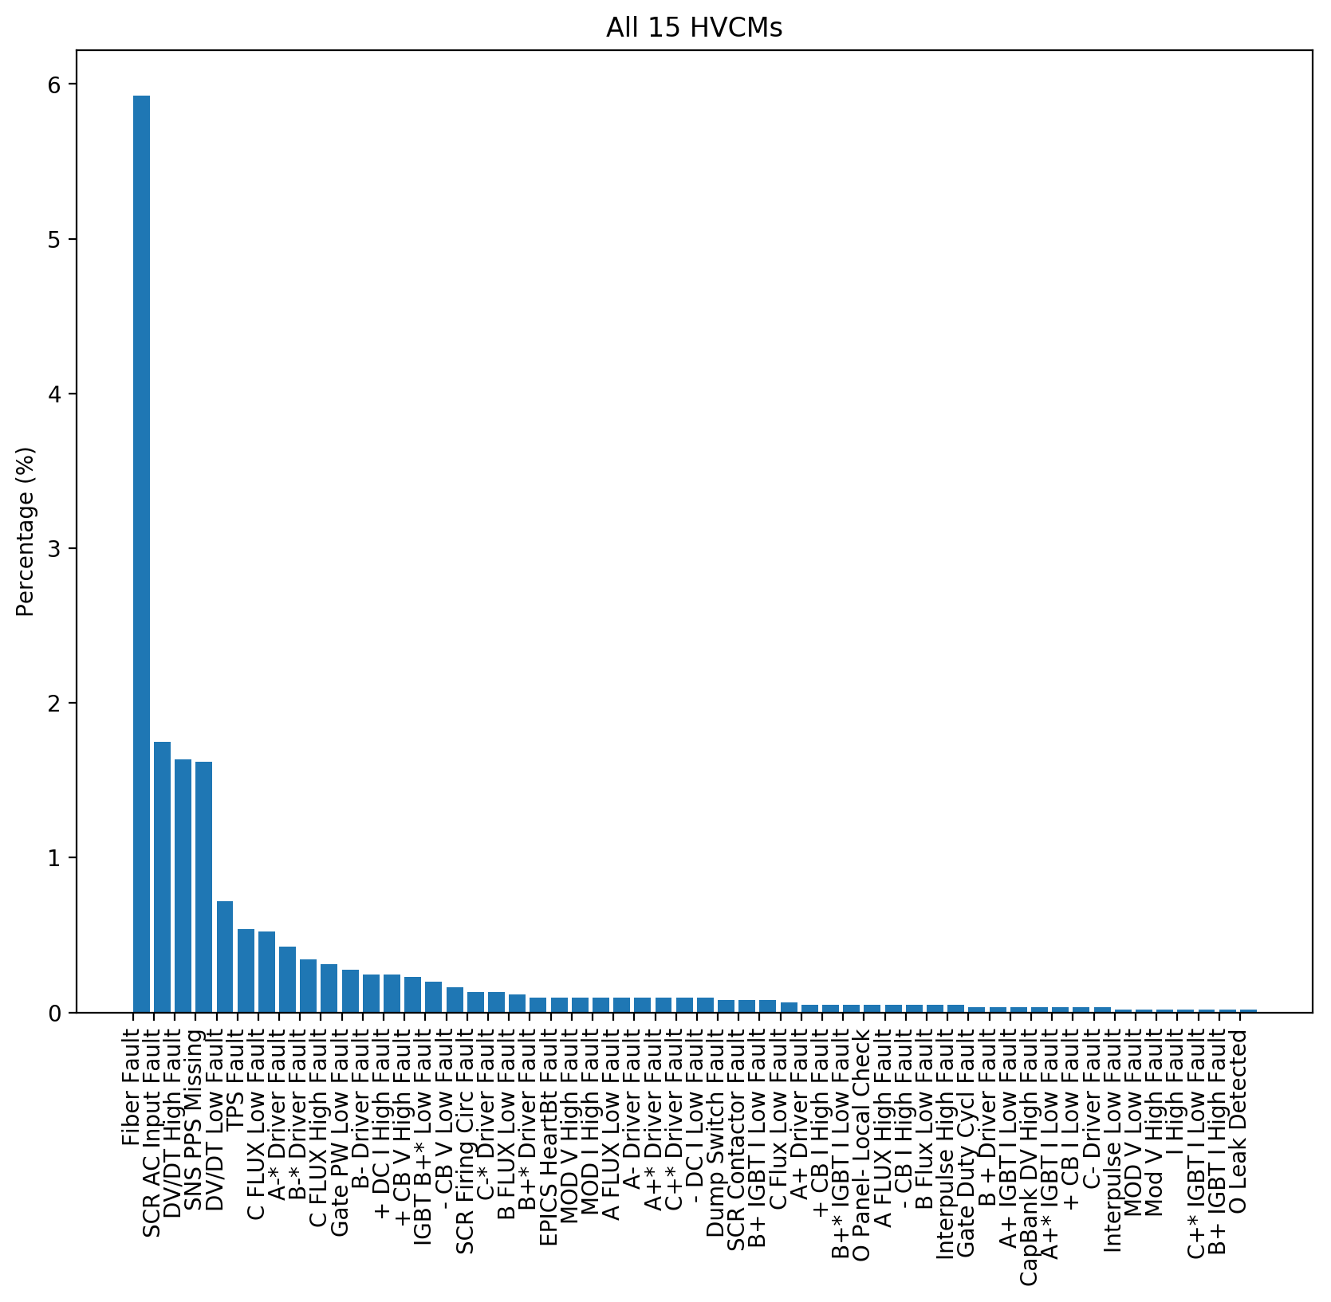
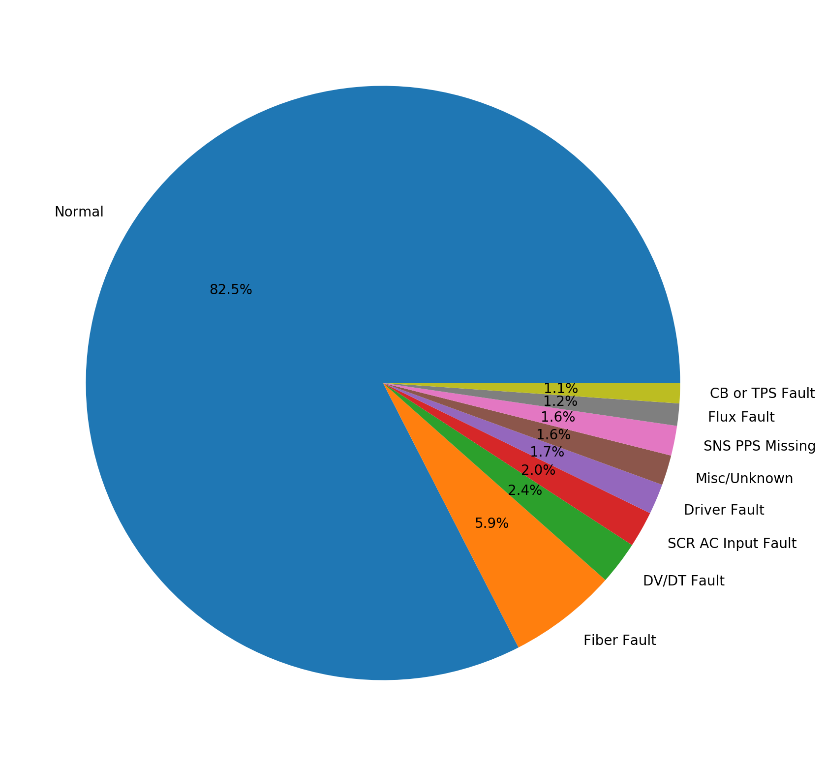
From Anomaly Detection to Fault Classification
Sample size is about ~6000 samples/pulses from all 15 modulators
Data relabeled into 9 major classes: 1 normal, and 8 faulty.
Normal pulse is 82.5% (removed to show better scale)

Slide 13
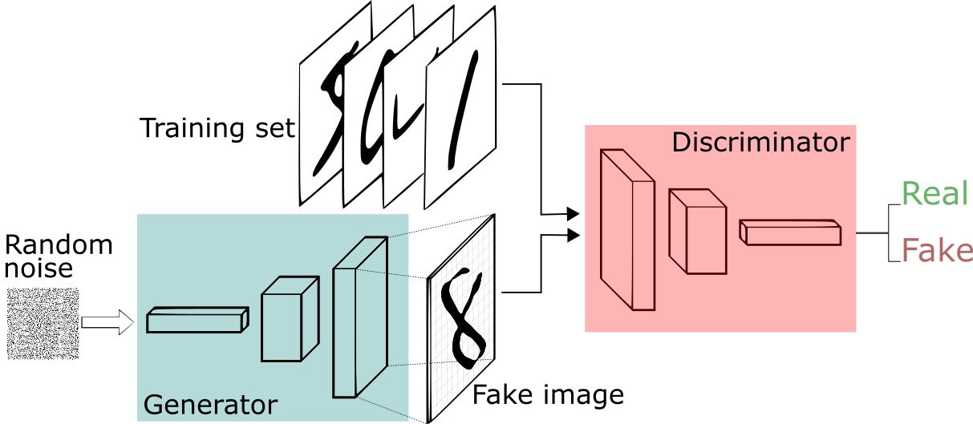
Failure detection with the help of GAN
Due to the unfair split between faulty and normal data, we use generative adversarial networks (GAN) to generate synthetic failure data that mimic real faulty data.
Then a CNN/LSTM model can be used for either binary failure classification or multi-class classification.
Performance of the CNN classifier is very good on normal data, but poor on classifying faulty data.

Slide 14
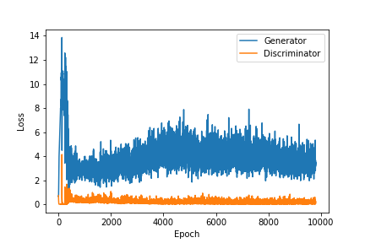
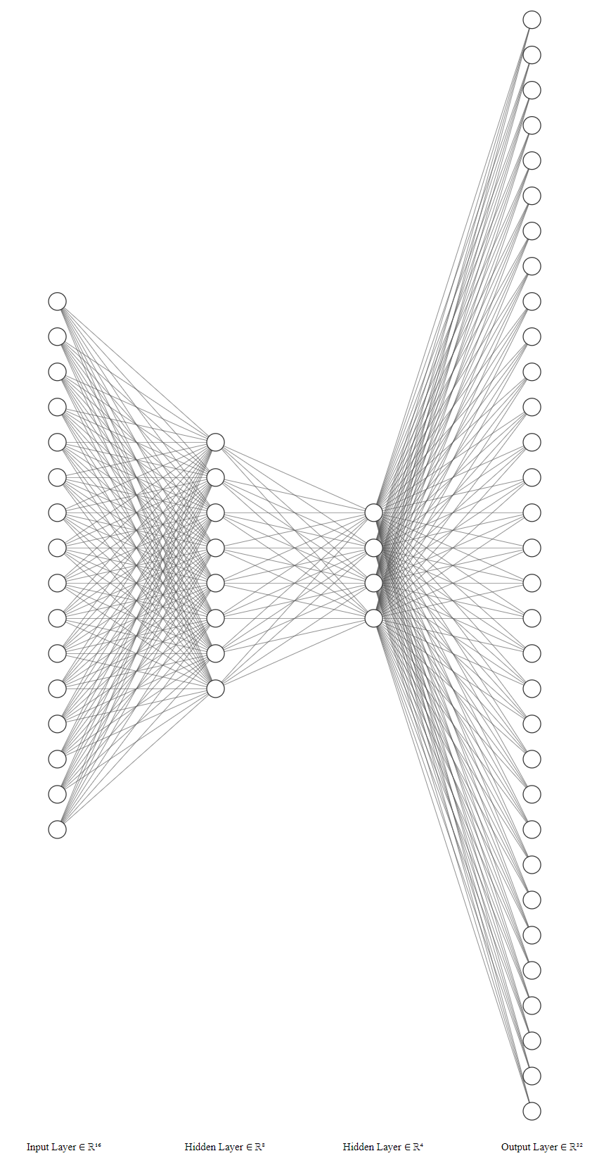
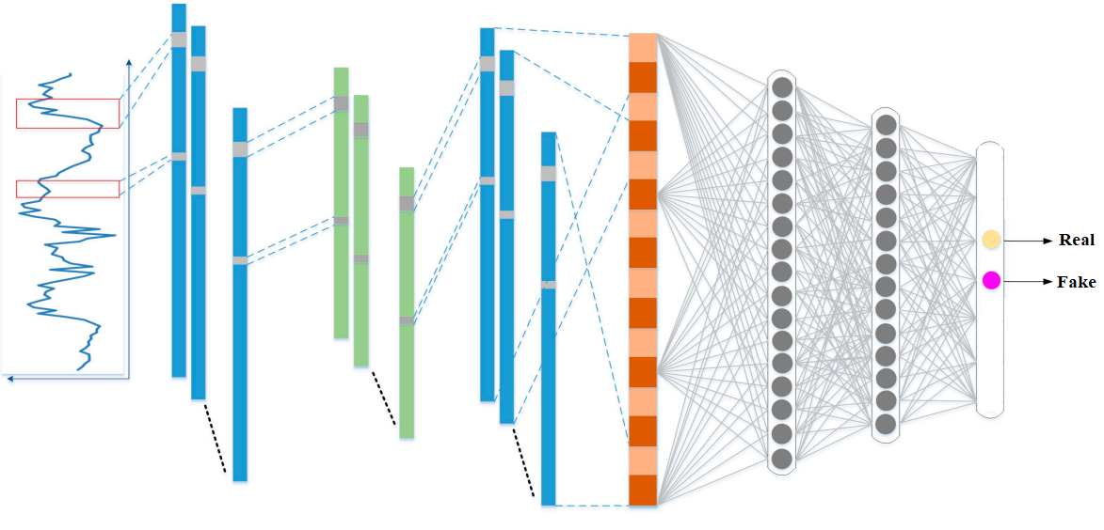
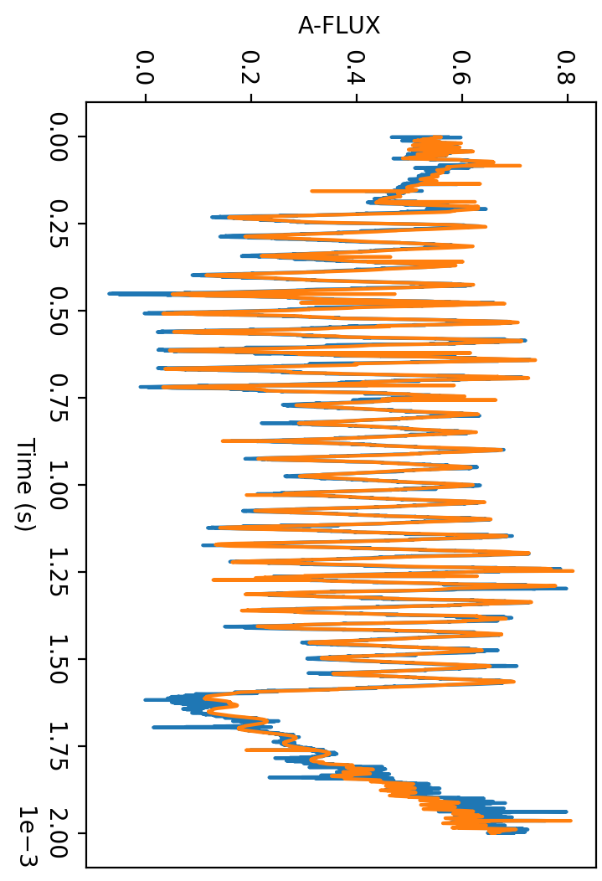
GAN Architecture
Generator
Discriminator
Waveforms
Noise

Slide 15
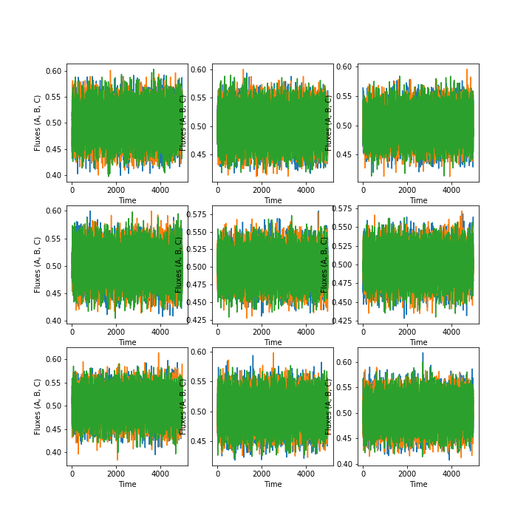
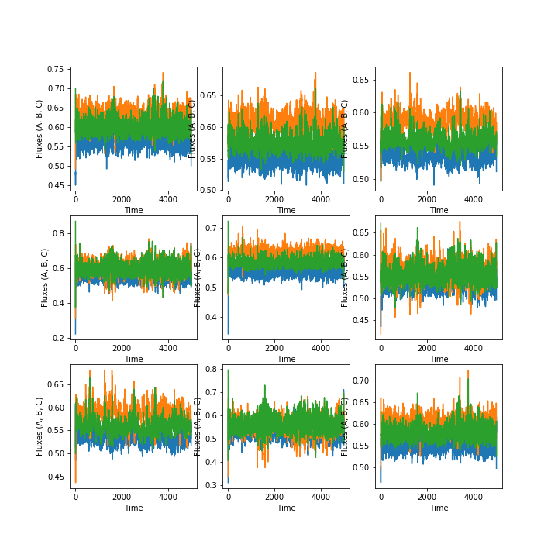
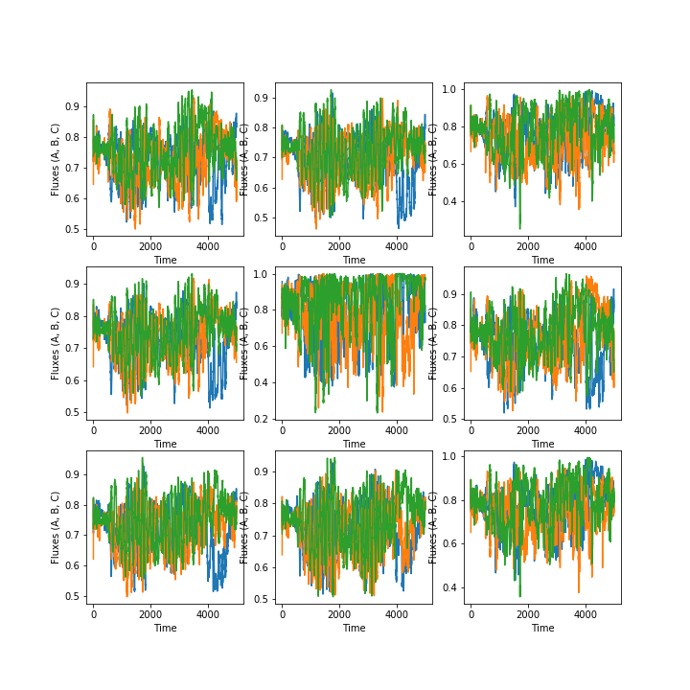
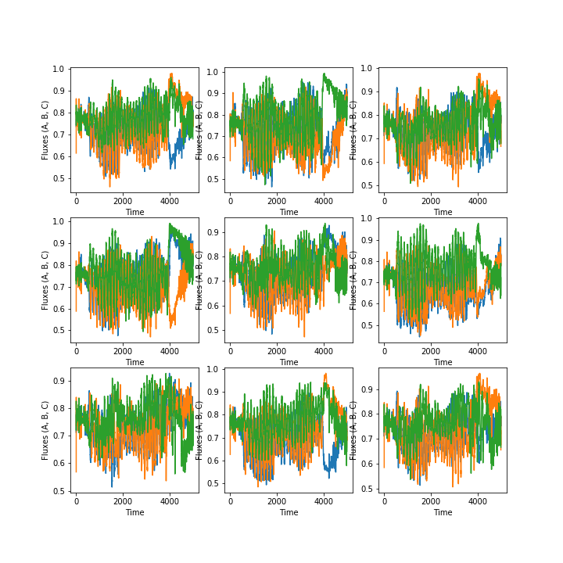
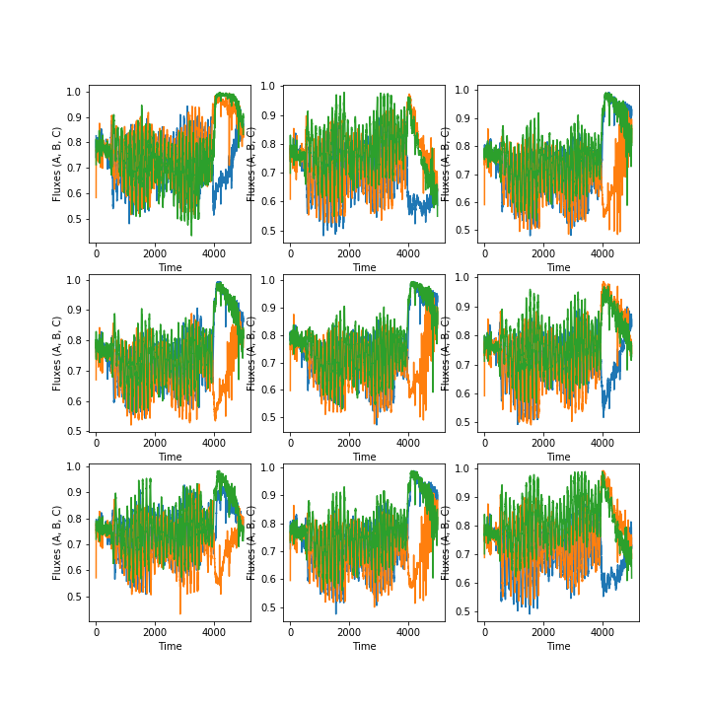
GAN on Normal Data
Epoch = 1
Epoch = 200
Epoch = 1000
Epoch = 5000
Epoch = 10000

Slide 16
GAN on Normal Data

Slide 17
Content
HVCM at SNS
GAN for data Augmentation
RNN autoencoders for anomaly detection
CNN autoencoders for anomaly detection
Modeling of capacitor degradation with CNN
Summary

Slide 18
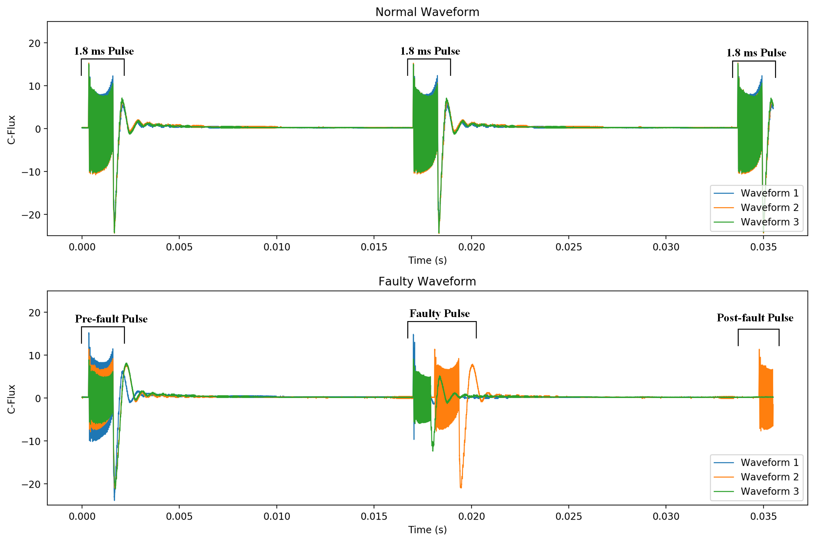
Data (from raw to processed)
Can we develop a model that detects the anomaly at the pre-fault pulse?
1- Cut the 1.8ms pulses from the waveform
2- Get ALL normal pulses
3- Get ONLY first faulty pulse
4- Stack the pulses in a time sequence
5- Apply spectral Fourier transform for signal smoothing
6- Normalize the data between 0 and 1

Slide 19
Recurrent AutoEncoders (RAE)
Recurrent neural networks perform well in time sequences.
Autoencoders are systems used for dimensionality reduction and self-reconstruction.
The logic is: Can we train a system that learns how to accurately reconstruct itself in normal situations?
What would happen if the system experiences an anomalous situation?
GRU: Gated Recurrent Unit
LSTM: Long Short-term memory
ConvLSTM: Convolutional LSTM

Slide 20
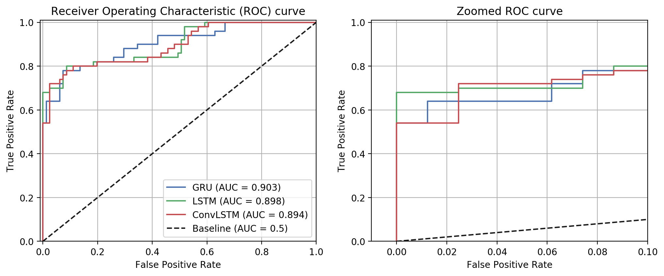
Anomaly Detection Results
Area under the ROC curve (AUC)
AUC=0.5 (Random baseline detector)
AUC=1.0 (Perfect detector)
Radaideh et al. (2022). Time Series Anomaly Detection in Power Electronics Signals
with Recurrent and ConvLSTM Autoencoders. Under ORNL internal Review, to be submitted to Digital Signal Processing.

Slide 21
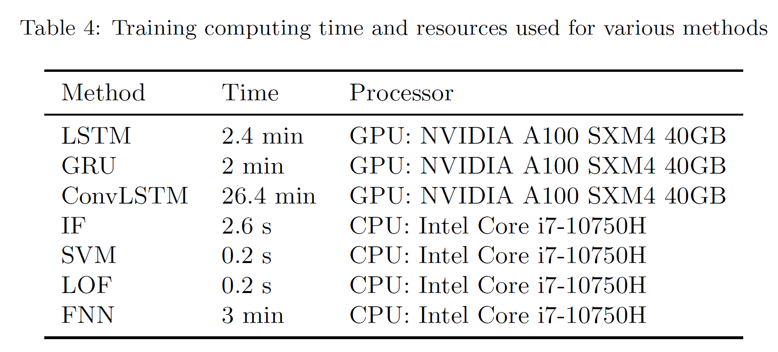
Benchmarking
GRU: Gated Recurrent Unit
LSTM: Long Short-term memory
ConvLSTM: Convolutional LSTM
IF: Isolation forests
SVM: Support vector machine
LOF: Local outlier factor
FNN: feedforward neural network
False Omission rate
>
Radaideh et al. (2022). Time Series Anomaly Detection in Power Electronics Signals
with Recurrent and ConvLSTM Autoencoders. Under ORNL internal Review, to be submitted to Digital Signal Processing.

Slide 22
Content
HVCM at SNS
GAN for data Augmentation
RNN autoencoders for anomaly detection
CNN autoencoders for anomaly detection
Modeling of capacitor degradation with CNN
Summary

Slide 23
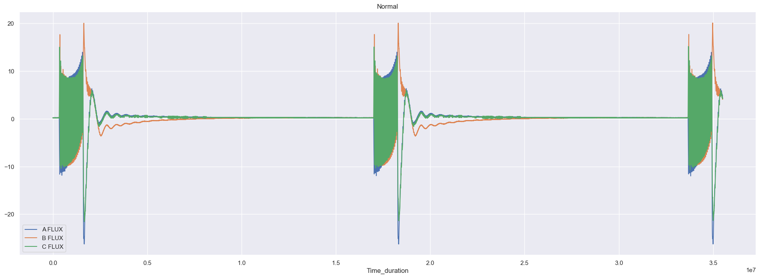
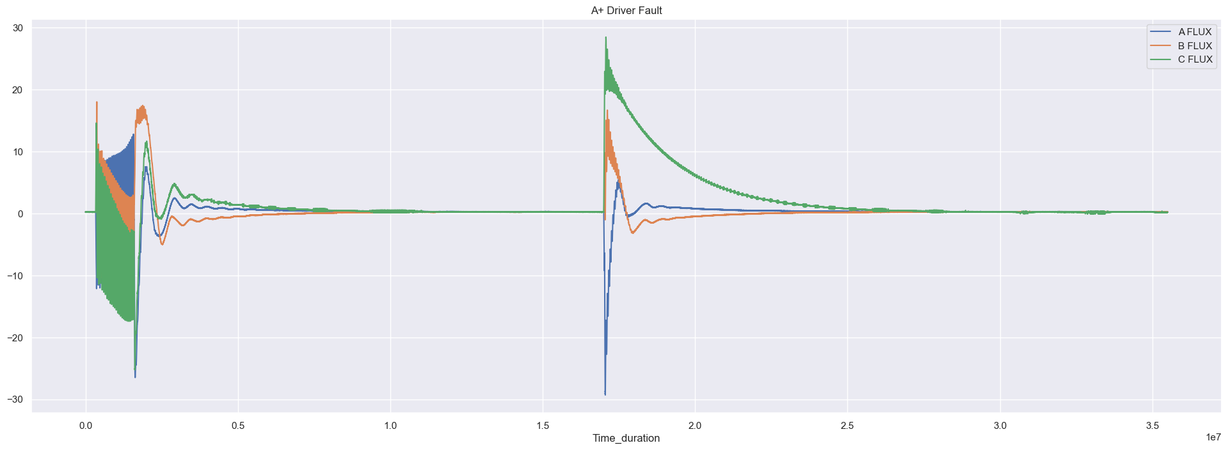
Goal
Detection of anomalous operation in HVCM modules
Looking at the waveforms of HVCM modules in operation to detect anomalous pulses
Given the pulse immediately before the faulted pulse is available, can we predict imminent failure?
Normal Data
Fault Data

Slide 24
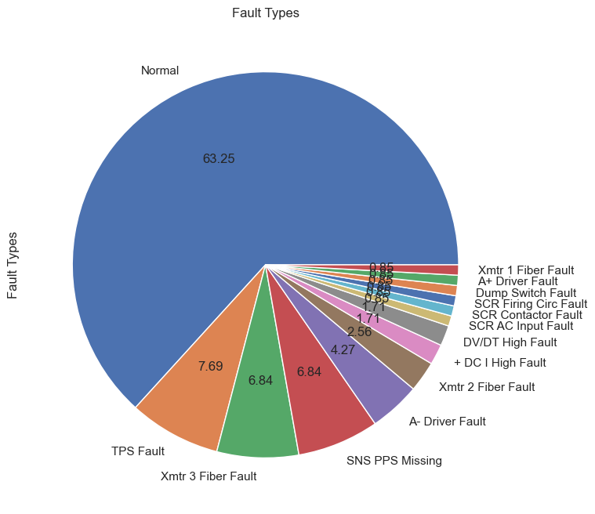
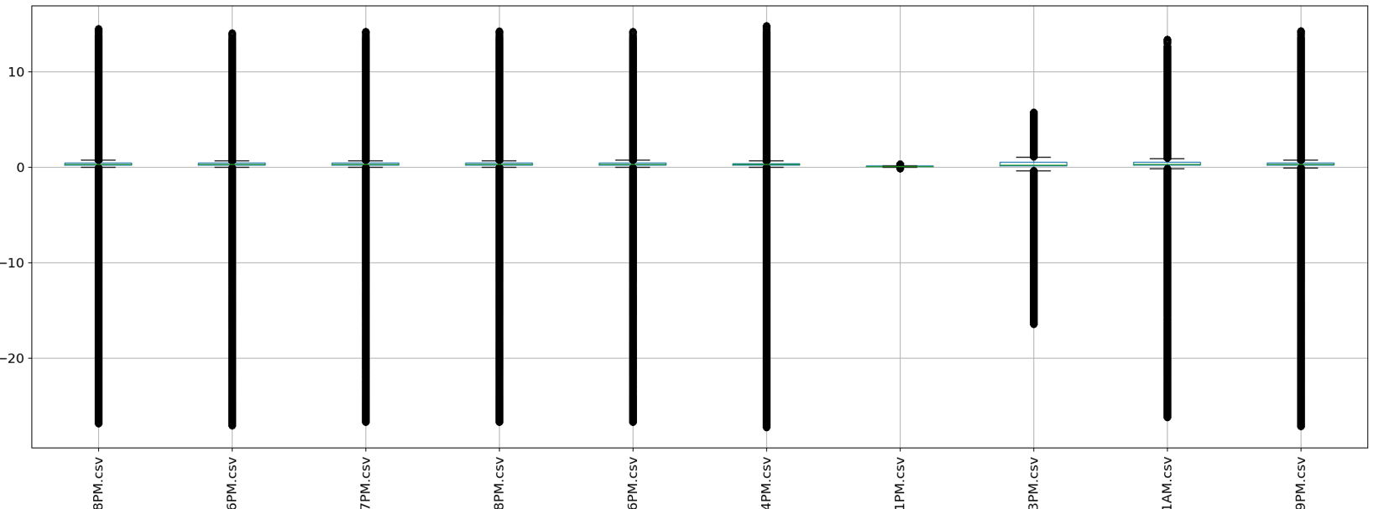
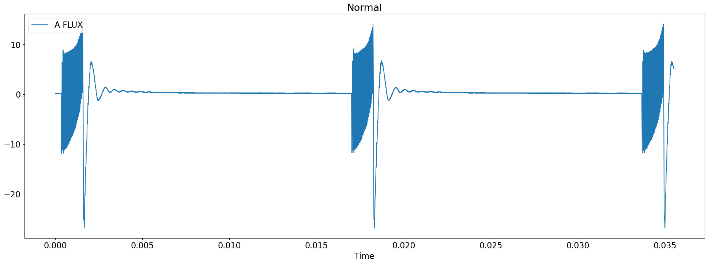
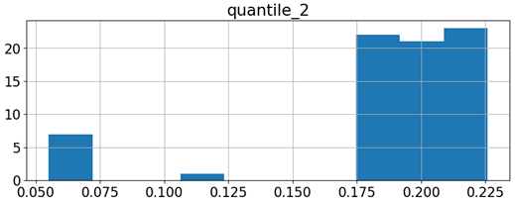
HVCM Anomaly Detection
Data Pre-processing
Extraction of pulses for analysis
Identifying anomalous ‘normal’ data
Distribution of data in a module
normal
Faulty normal
Box plot analysis to identify faulty normal traces
Extract first pulse (impending fault) for analysis
Faulty normal
normal
quantile statistics provide good separation
Threshold

Slide 25
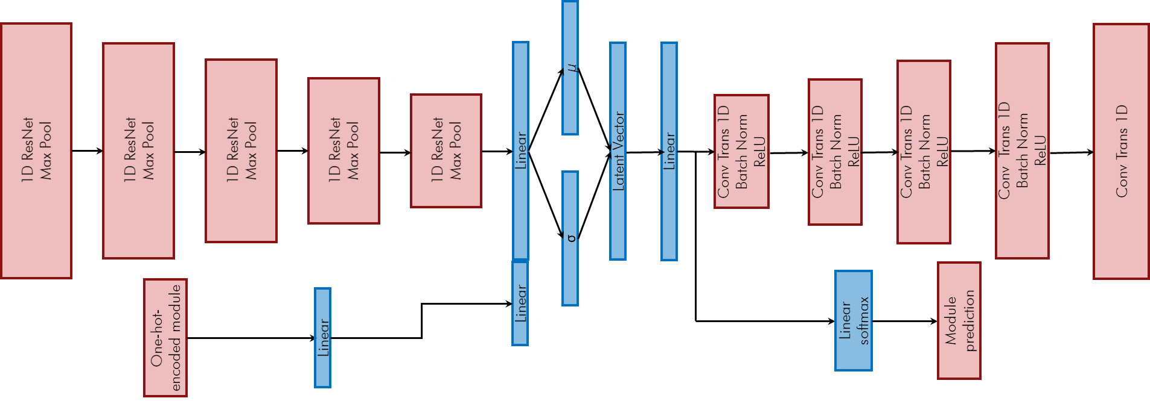
HVCM Anomaly Detection with CNN
Model
Generalized VAE architecture for Anomaly Detection
Applicable for data from multiple Modules
Additional encoder-decoder branch for module ID
1D ResNet blocks in Encoder for improved and stable representation learning

Slide 26
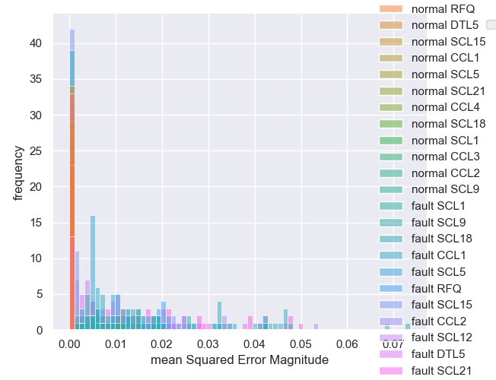
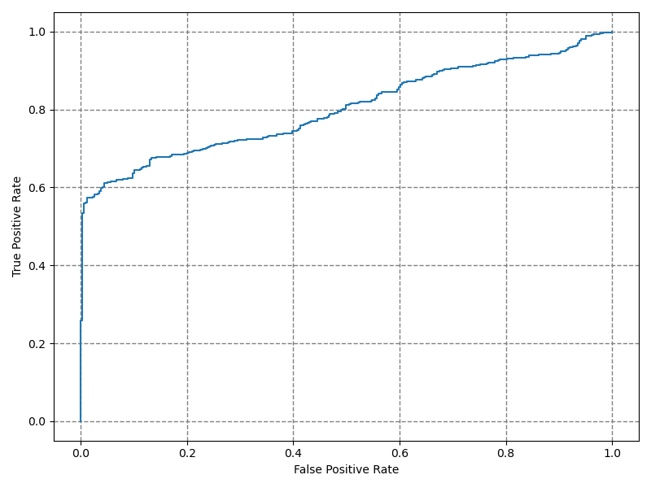
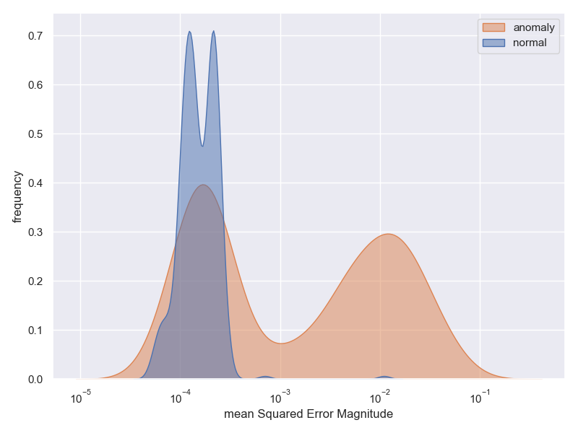
HVCM Anomaly Detection
Results
Dataset using data from 14 HVCM modules
Training with 5-fold cross validation
Anomaly detection by inspecting reconstruction error (MSE) of VAE

Slide 27
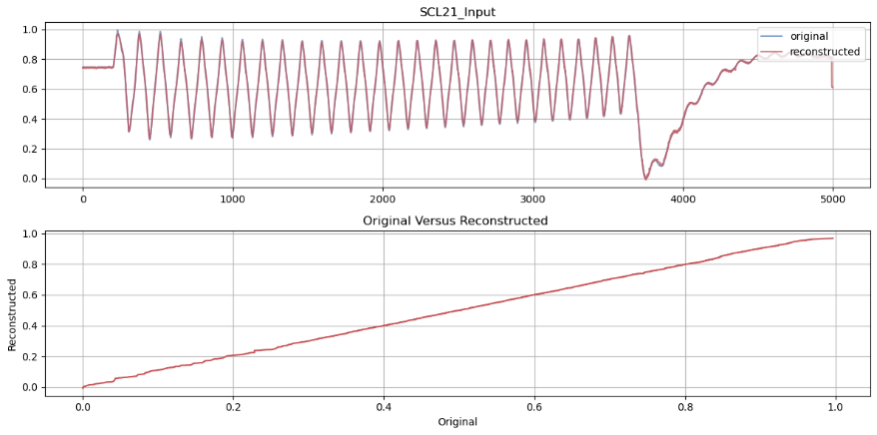
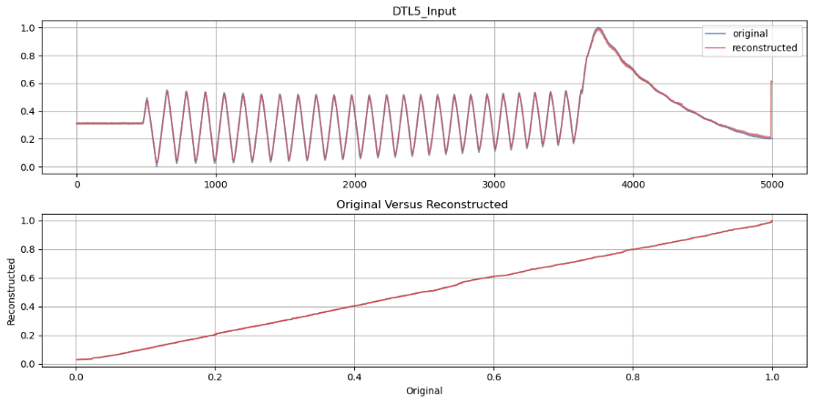
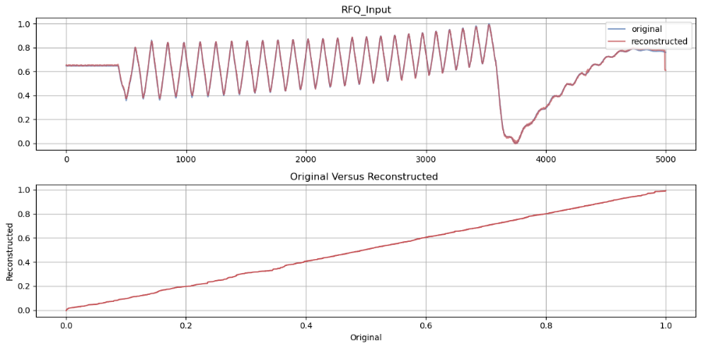
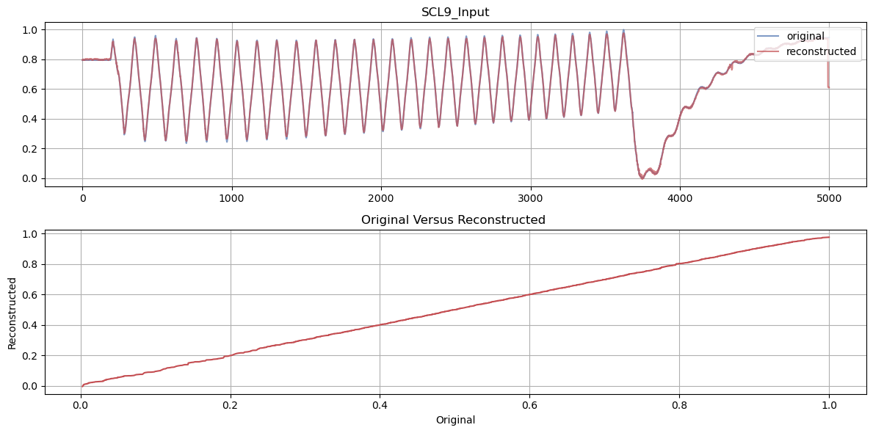
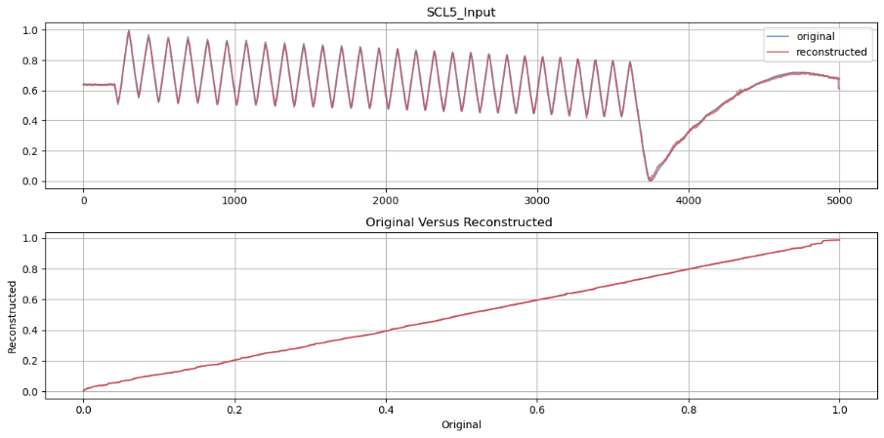
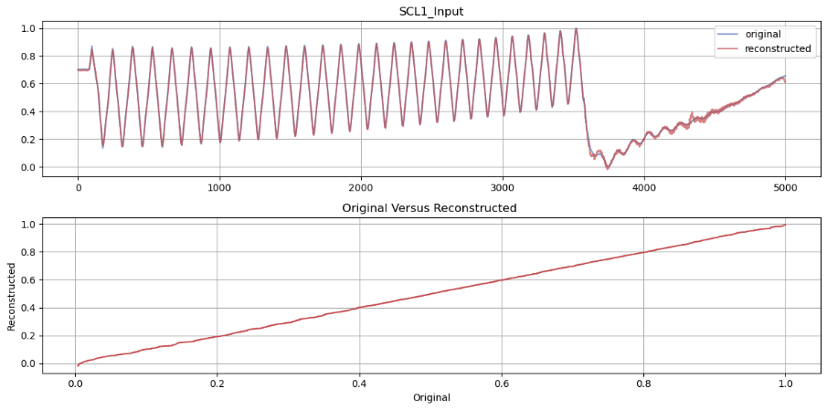
HVCM Anomaly Detection
Example reconstruction results

Slide 28
HVCM Anomaly Detection
Future Work
Revisit pre-processing for data from modules ‘SCL5’ and ‘SCL14’
Data from these modules contain a large variety of ‘normal’ anomalies
Hyper-parameter tuning for VAE
Further improvement in ROC may be obtained by hyper-parameter tuning
Compare performance with other anomaly detection techniques
Experiment on the possibility of leveraging the model for fault type identification

Slide 29
Content
HVCM at SNS
GAN for data Augmentation
RNN autoencoders for anomaly detection
CNN autoencoders for anomaly detection
Modeling of capacitor degradation with CNN
Summary

Slide 30
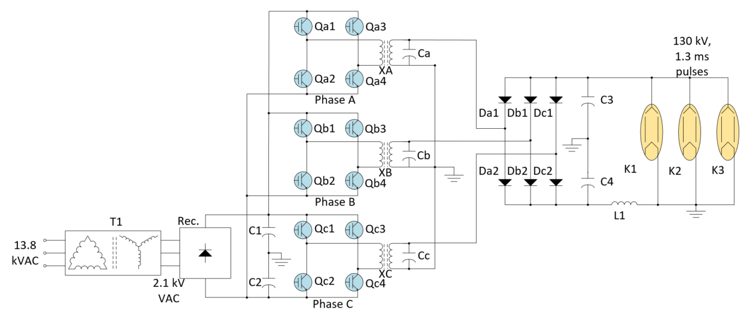
Goal
Ultimately, we want to predict when components will need (preventative) maintenance
Can we look at the waveforms of an HVCM in operation and predict the capacitances of the three phases?
Not a lot of data-measurement correlation. So, we'll start with simulations

Slide 31
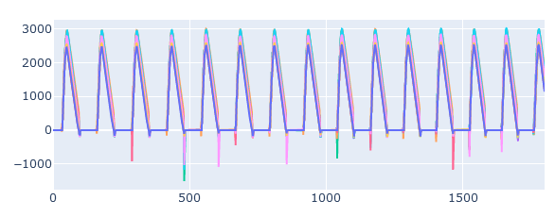
method
We utilized high fidelity simulations (LTspice) of the HVCM
Simulate the 10 traces present in data
VOUT
IAP
IAPS
IBP
IBPS
ICP
ICPS
Aflux
Bflux
Cflux
IAP
Index-600 (the "stable" region)
Current traces contain artifacts from LTspice convergence. They are cleaned before training

Slide 32
model
Conv1D
Basic premise:
Extract/synthesize features
Each Conv1D block also contains Batch normalization, average pooling, and dropout
Use those features to compute the 3 capacitance values
Each MLP block contains 6 nodes connected to an output
There are no connections between MLP blocks, thus no correlated computation of values
Conv1D
Conv1D
Conv1D
Flatten
MLP
MLP
MLP
C_{A}
C_{B}
C_{C}

Slide 33
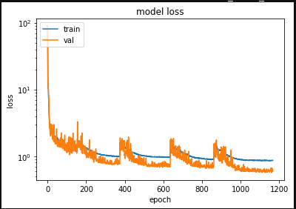
Results
Training performed with 5-fold cross validation
676 samples withheld from training as a test set
Mean absolute percentage error for loss
Run File | CA | CB | CC
CCL1_400ns_Run_8.31.2021-2.54.19PM | 3135.7764 pF | 3369.5867 pF | 3419.5261 pF

Slide 34
Future work
Hyper parameter optimization
Uncertainty quantification
Multi methods
Model validation
Check prediction on real data temporally proximate to when the capacitors are measured
Use these methods to make predictions
RNN?

Slide 35
Content
HVCM at SNS
GAN for data Augmentation
RNN autoencoders for anomaly detection
CNN autoencoders for anomaly detection
Modeling of capacitor degradation with CNN
Summary

Slide 36
Goals of Machine Learning for the HVCM Use Case
The overall goal for machine learning for the HVCM case is improved reliability and the reduction of unscheduled down time of the HVCMs through anomaly detection methods (In a good progress).
Predict degradation of components such as plastic film capacitors which happens slowly with time and schedule HVCM maintenance to prevent catastrophic faults and loss of beam time for SNS (In a good progress).
Automate HVCM tuning to keep it optimal as conditions change such as when components degrade or with temperature variations (Not moving well, Issues with data streaming).

Slide 37
Work in Progress
Testing GAN to generate faulty data. This includes data augmentation by adding noise to current fault data, and generate some fault events from simulation.
Collecting more data from the RFTF test bed.
Capacitor degradation work to be finalized/improved by adding uncertainty bands.
Getting some papers done on anomaly detection, capacitor degradation, ML for HVCM.

