Slide 1
ML Techniques for SNS Part I
ML Team Meeting
April 21, 2022
Majdi I. Radaideh
Oak Ridge National Laboratory
radaidehmi@ornl.gov

Slide 2
Overview of Methods
Method | Advantage | Drawback | SNS Use Case | Comments
Non-NN ML | More interpretability | Poor performance on large dataset | BB/Target
Gaussian Process | Easy implementation | Non-scalable | BB/Target
Multi-layer Perceptrons | Simple input-output mapping | Structural redundancy | BB/Target
Convolutional Neural Networks | Automatic feature extraction | Data hungry | BB/HVCM
Recurrent Neural Networks | Ability to model time-series | Vanishing/exploding gradient | BB/HVCM/ CMS
AutoEncoders | Data representation in reduced dimension | Destroys interpretability of data | BB/HVCM
Siamese Networks | Can work with imbalanced data | Sensitive to input variations | BB
Generative Adversarial Networks | Useful when more data needed | Unstable training | HVCM
Customized Neural Networks | Customizable | Specific models | HVCM
Physics-informed Neural Networks | Reduced data need | Some physics needed | CMS
Reinforcement Learning | Controls modeling | Expensive training | All

Slide 3
Content
Convolutional Neural Networks
Reinforcement Learning
Generative Adversarial Networks
Gaussian Processes
Random Forests

Slide 4
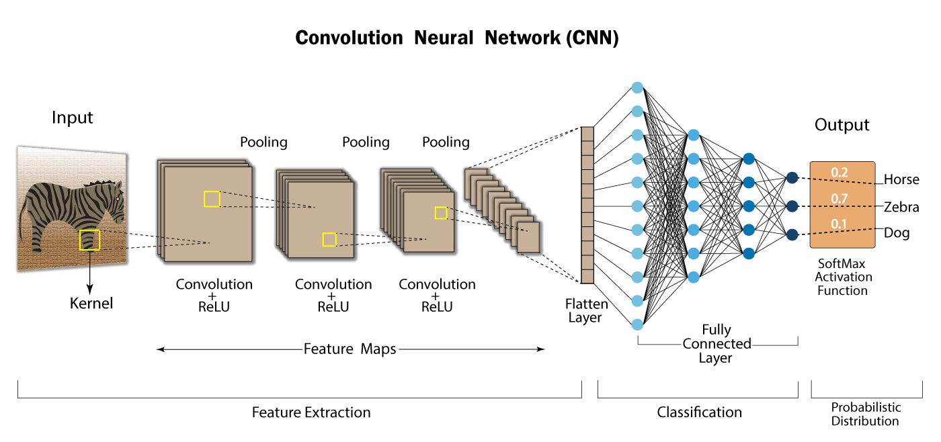
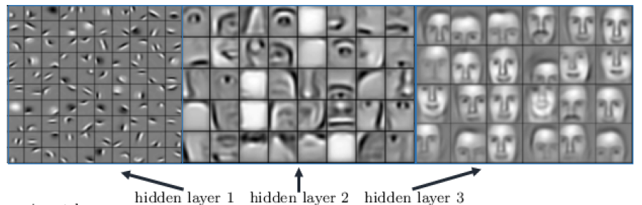
CNN Concept
Initial layers of convolution learn generic information
last layers learn more specific/complex features.
After the final convolutional Layer, the output feature map will be converted into vector: one dimensional flattened array.
Then fully-connected layers convert the flattened array into a classification or regression output depending on the last activation.

Slide 5
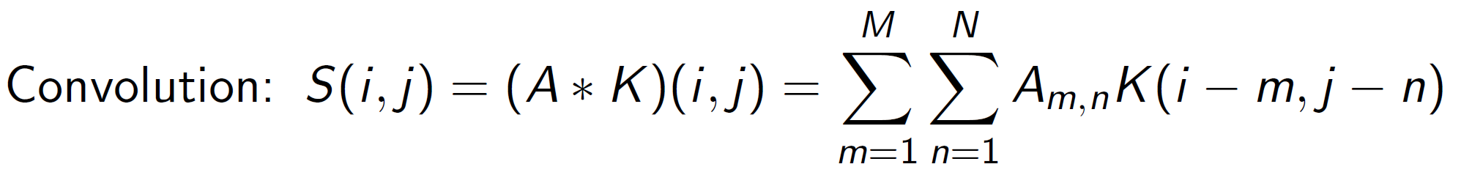
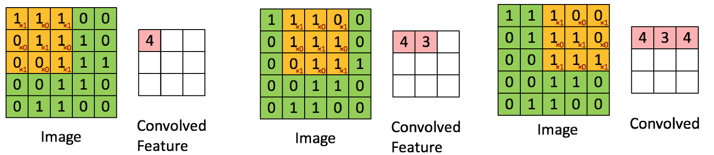

Convolutional Operation on Image
For a two-dimensional image matrix $A$, define convolution by a kernel/filter$KMxN$
Convolution of a 5 x 5 image and a 3 x 3 kernel/filter
1*1 + 1*0 + 1*1 +
0*0 + 1*1 + 1*0 +
0*1 + 0*0 + 1*1 = 4
Confirm this yourself!
Confirm this yourself!

Slide 6
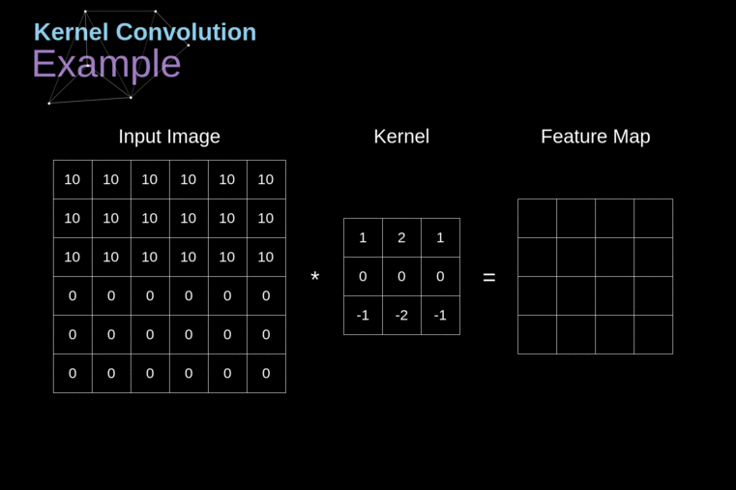
Convolutional Operations on Image
6x6 Image & 3x3 filter/kernel

Slide 7
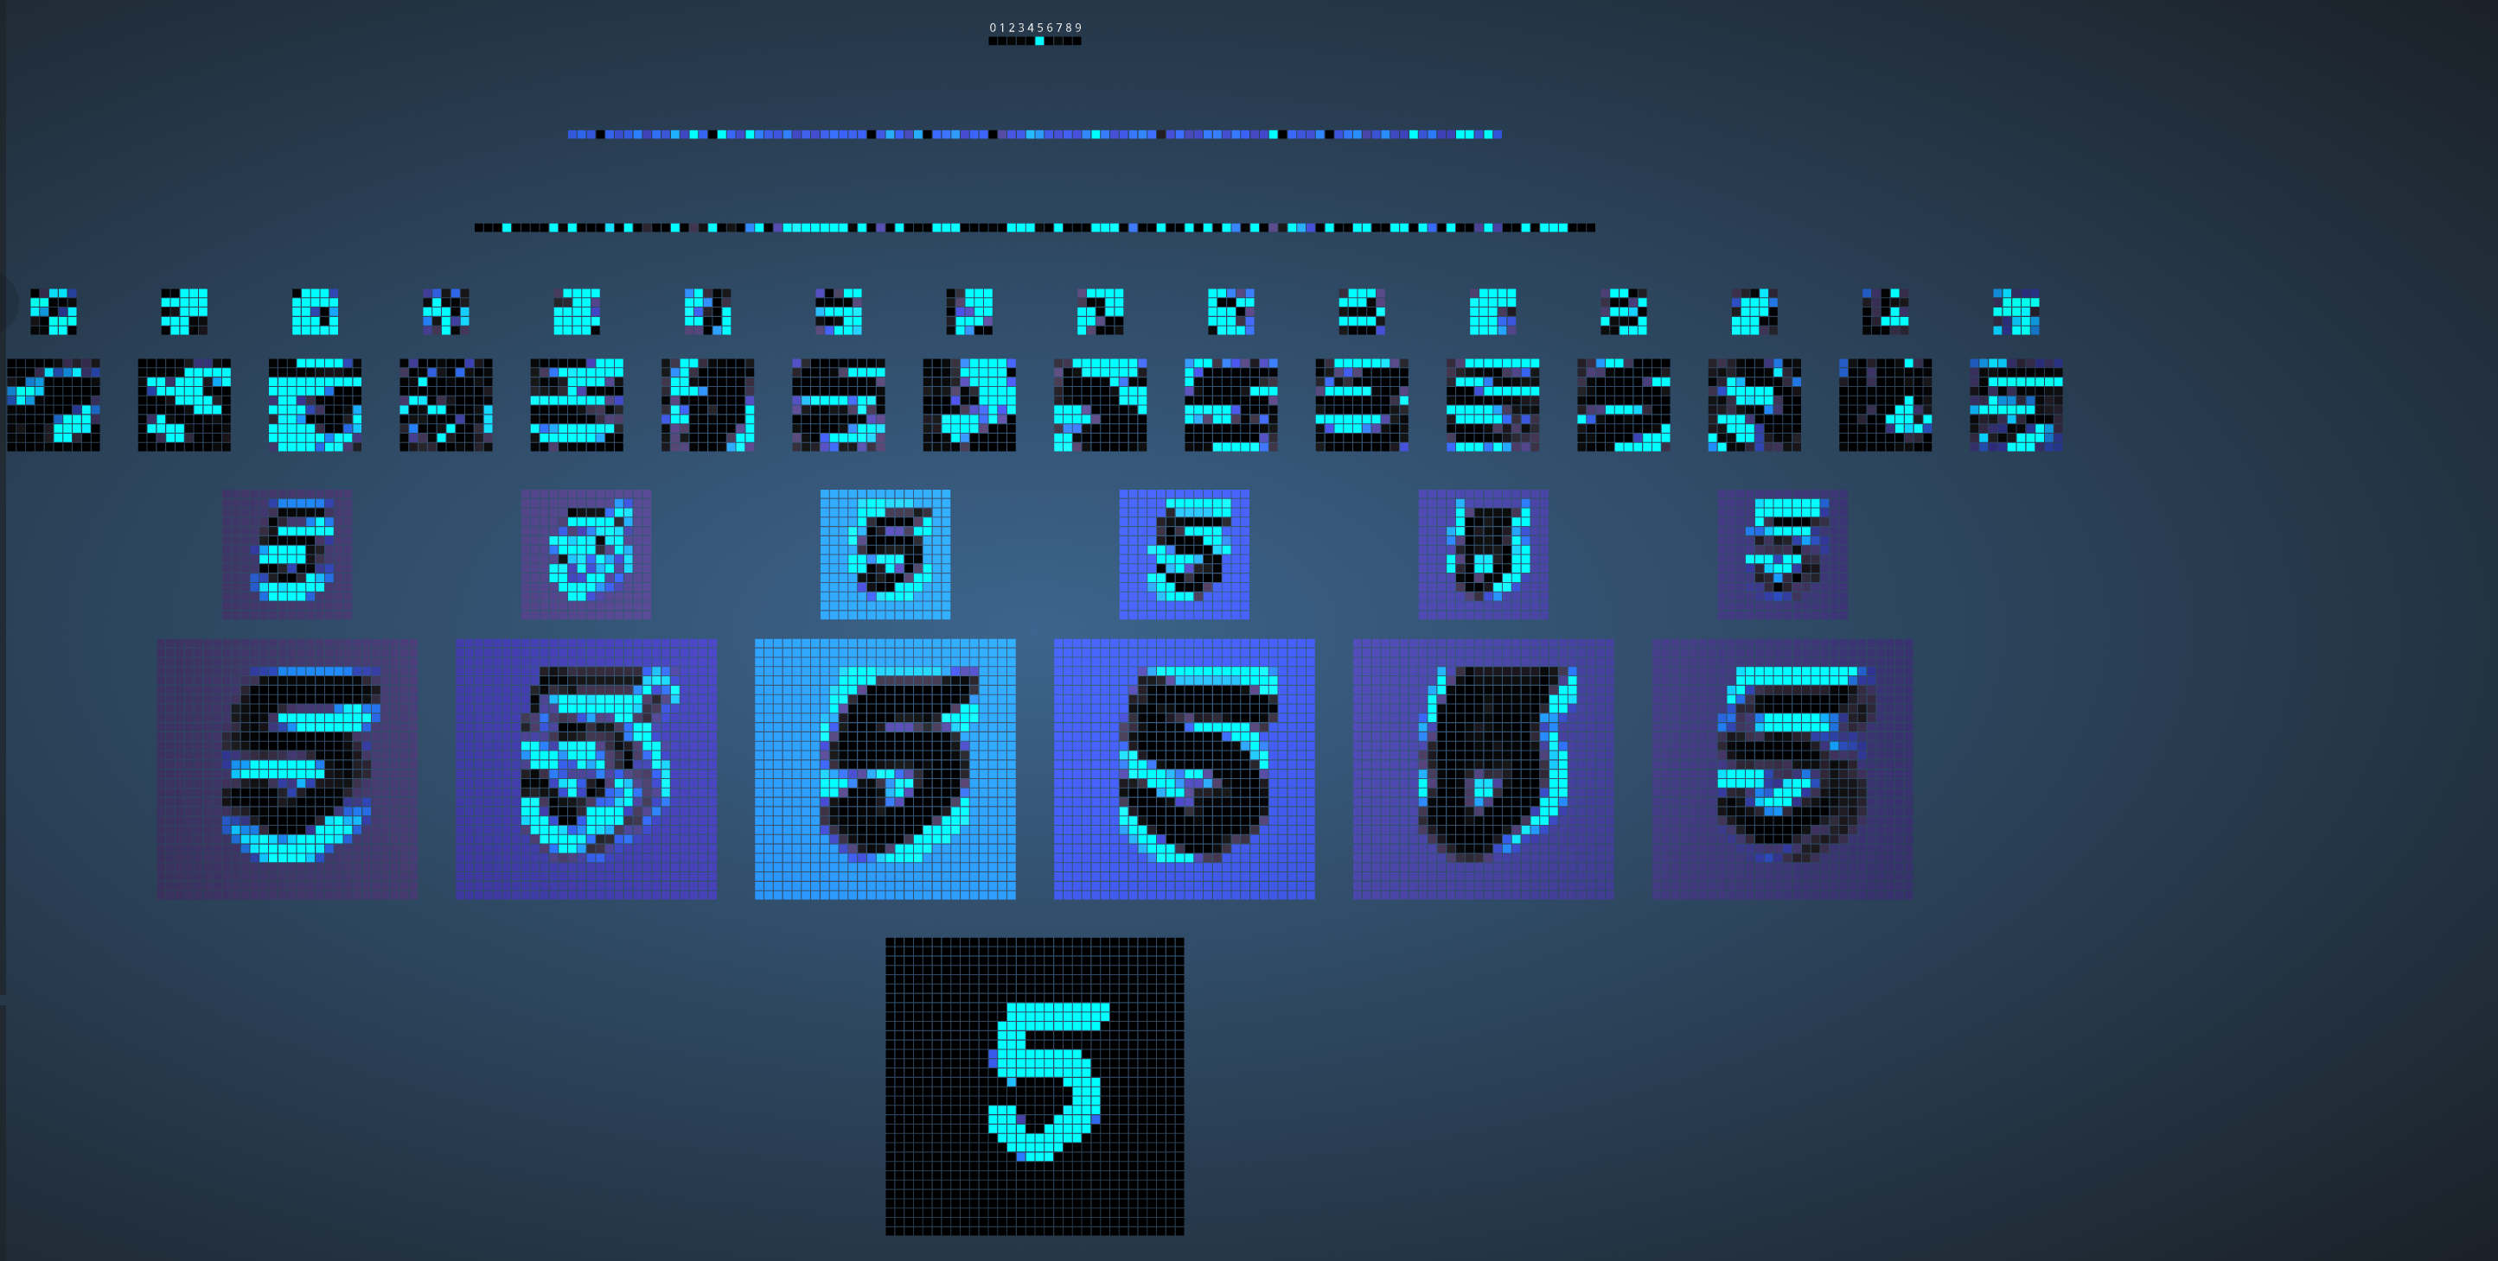


CNN Applications: Handwritten Classification
Output
Fully-connected layer 2
Fully-connected layer 1
Pooling layer 2
Convolution layer 2
Pooling layer 1
Convolution layer 1
My handwritten
Input layer
https://www.cs.ryerson.ca/~aharley/vis/conv/flat.html

Slide 8
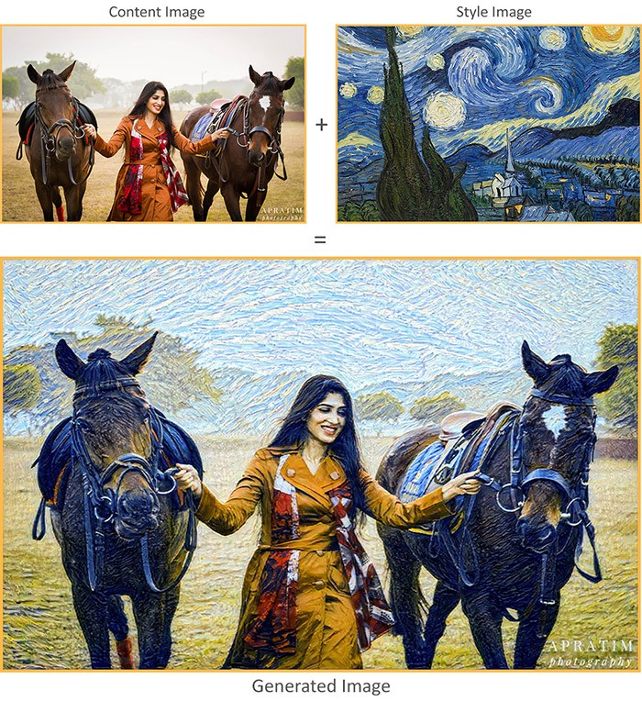
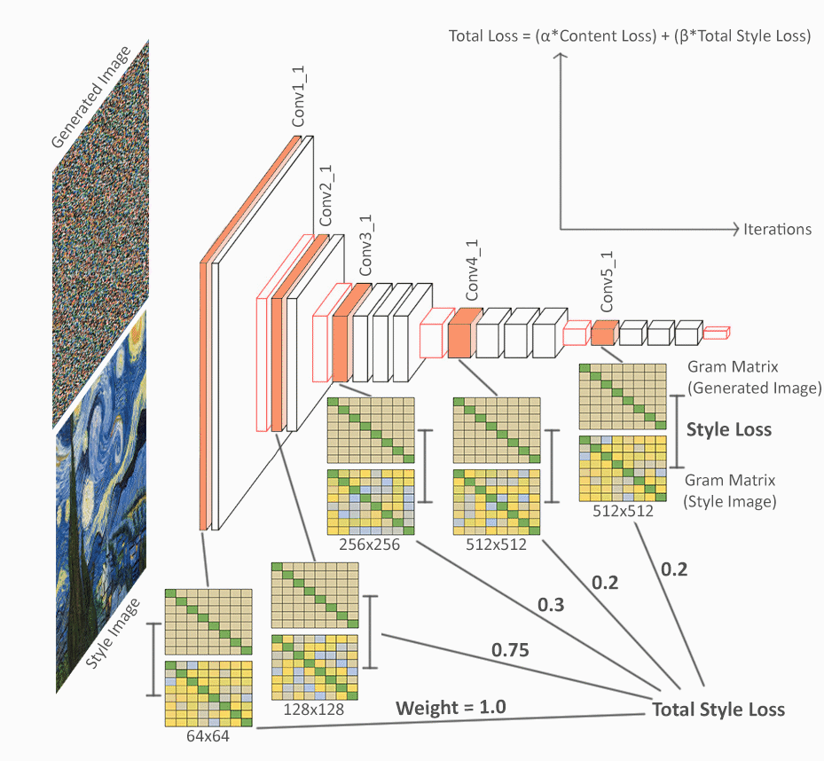
CNN Applications: Neural Paintings
Source: https://towardsdatascience.com/art-with-ai-turning-photographs-into-artwork-with-neural-style-transfer-8144ece44bed

Slide 9
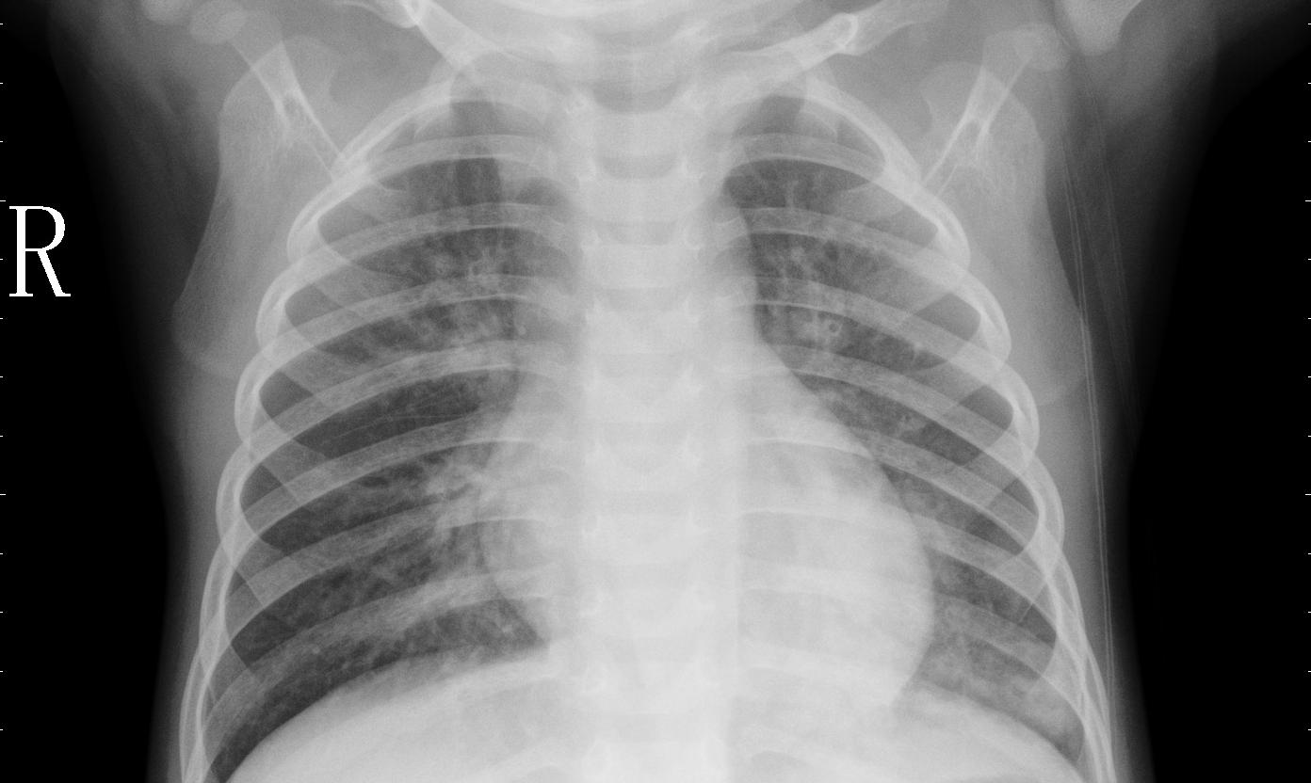
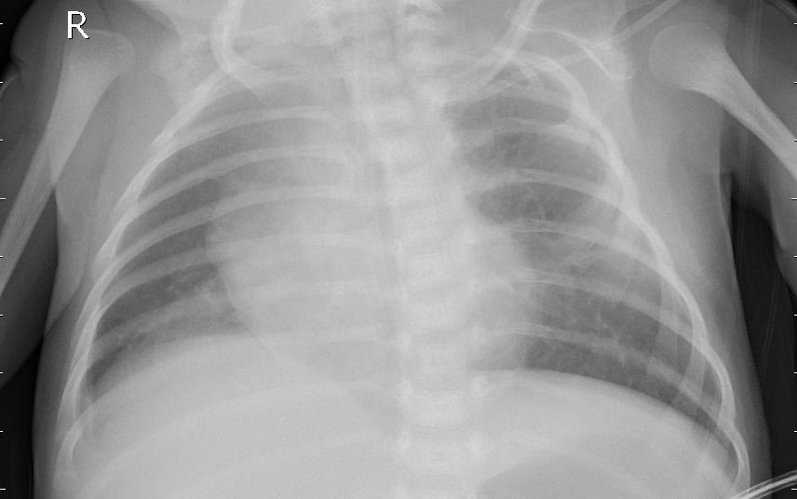
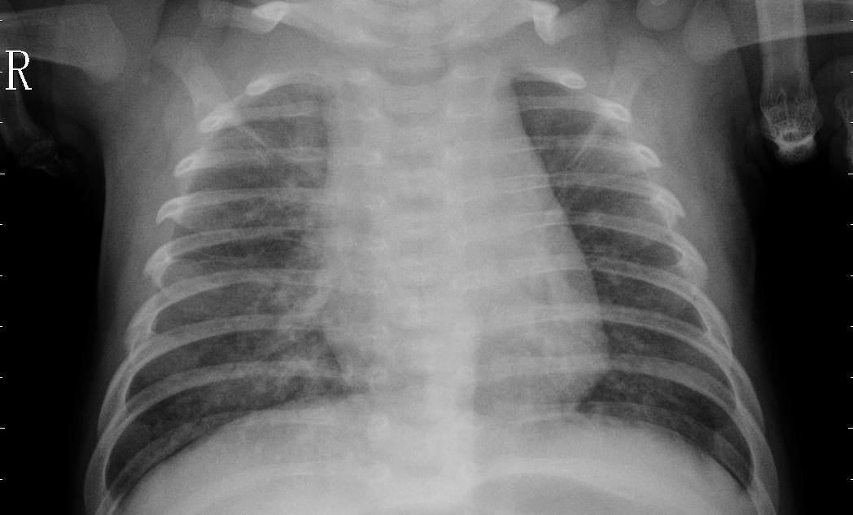
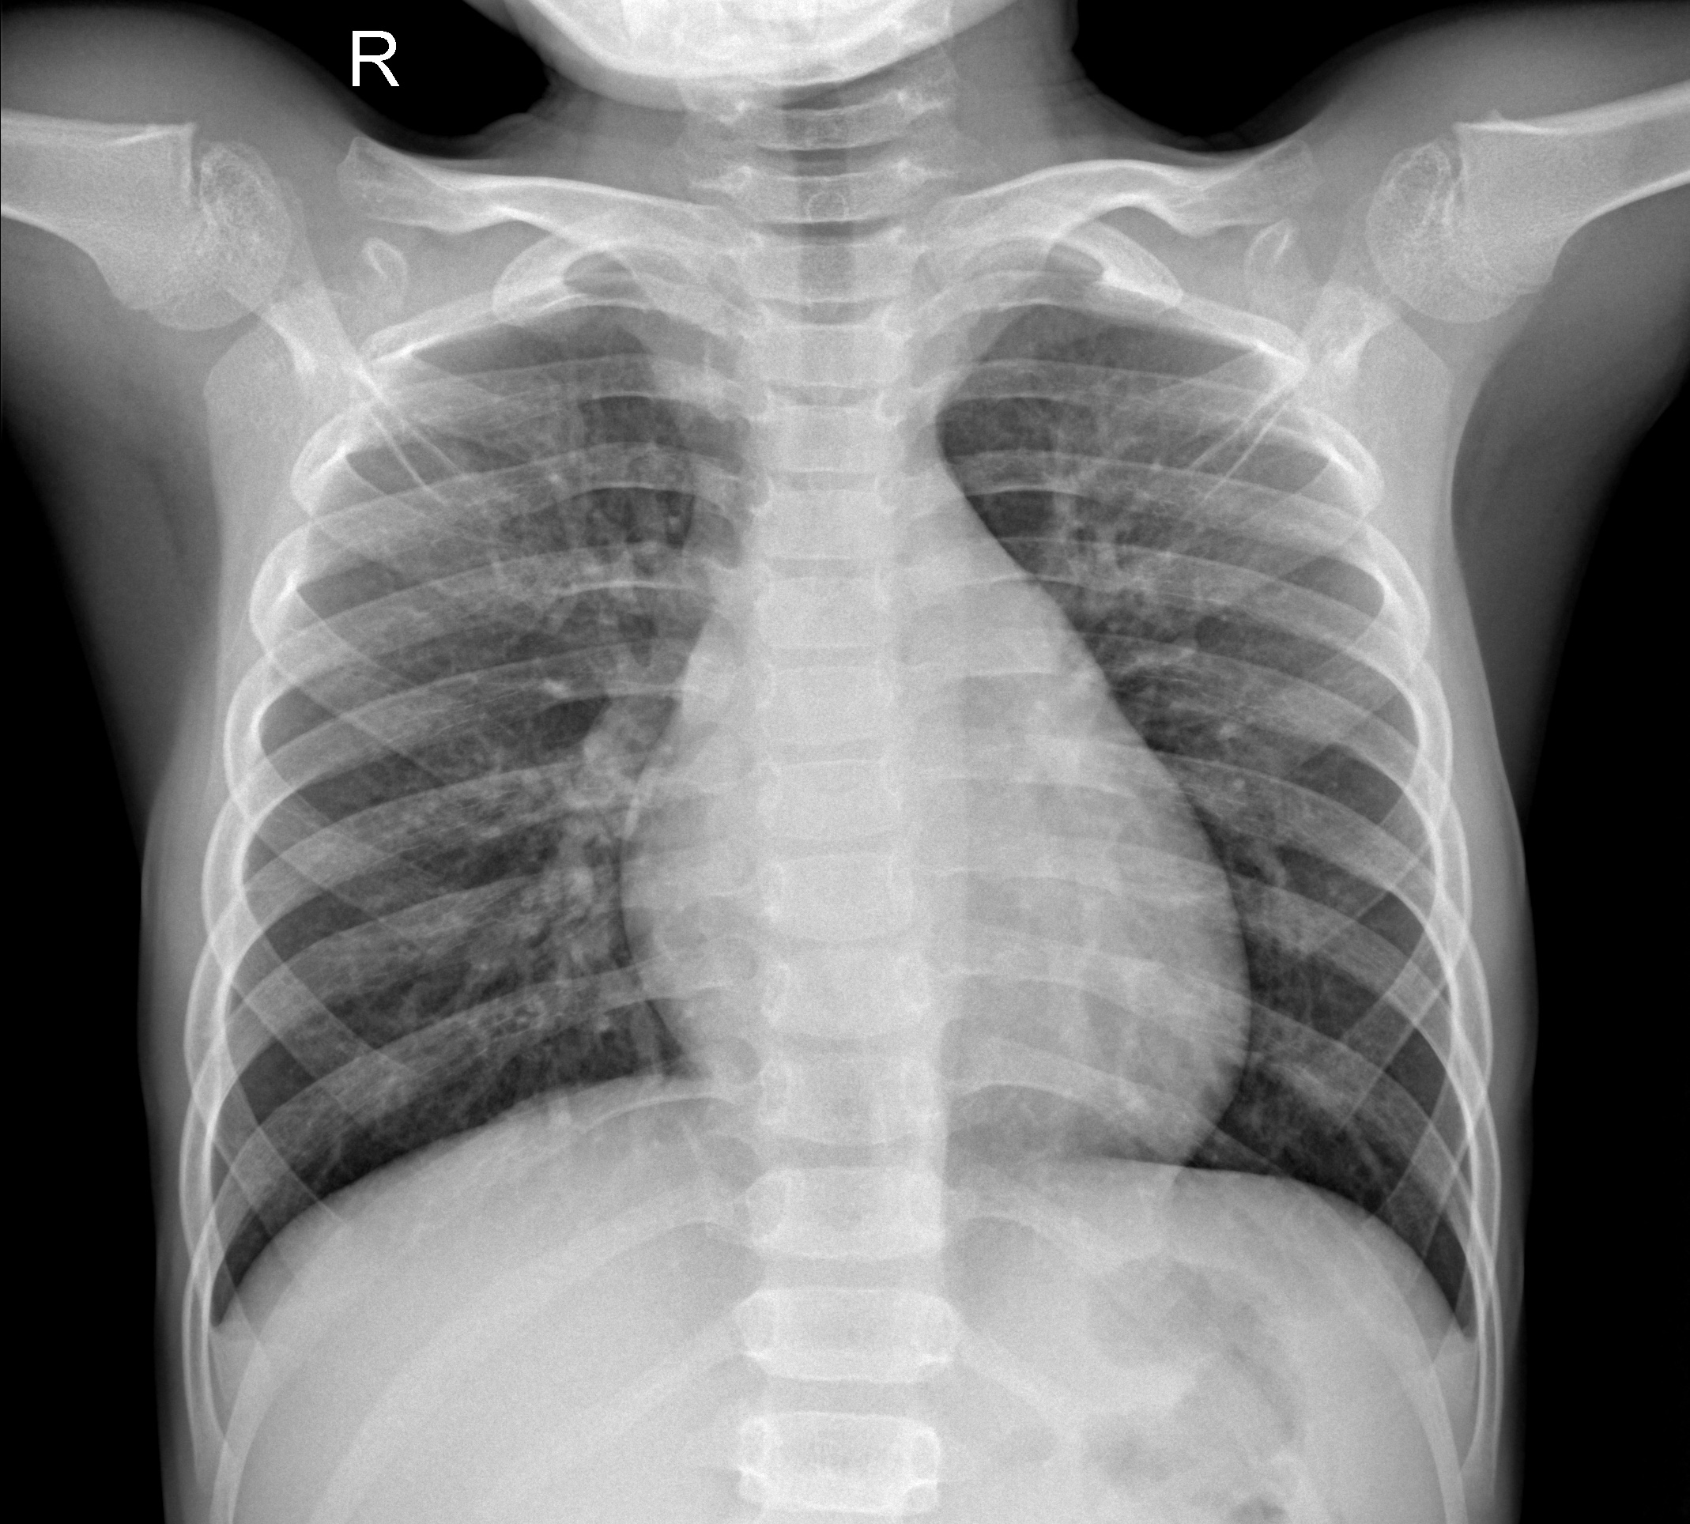
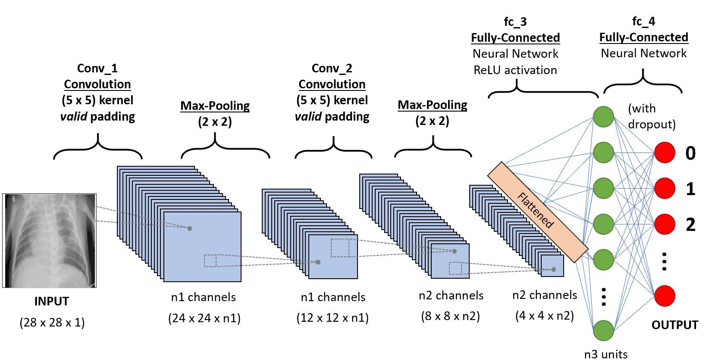
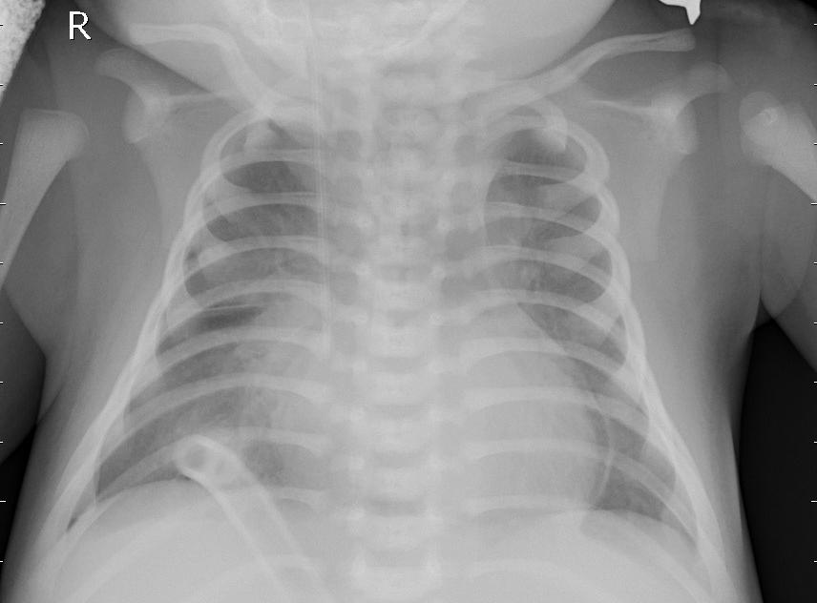
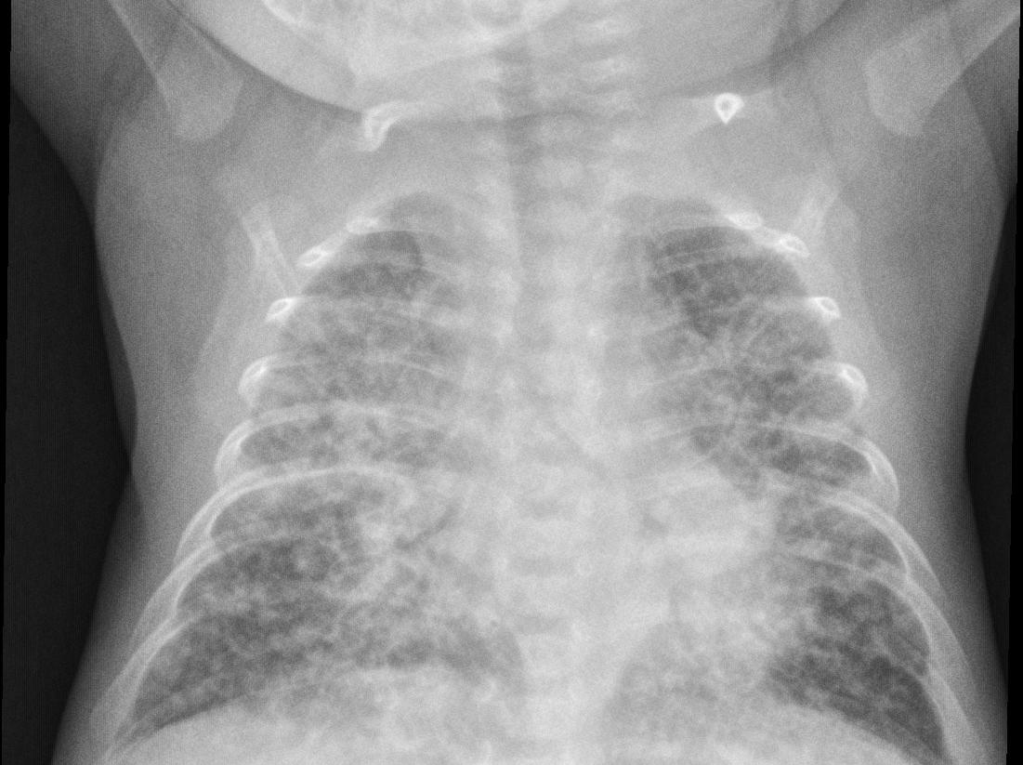
Applications in Radiology: X-ray Image Processing
Classification accuracy 85-87%
Normal ☺
Infected with Bacterial or Viral ☹

Slide 10
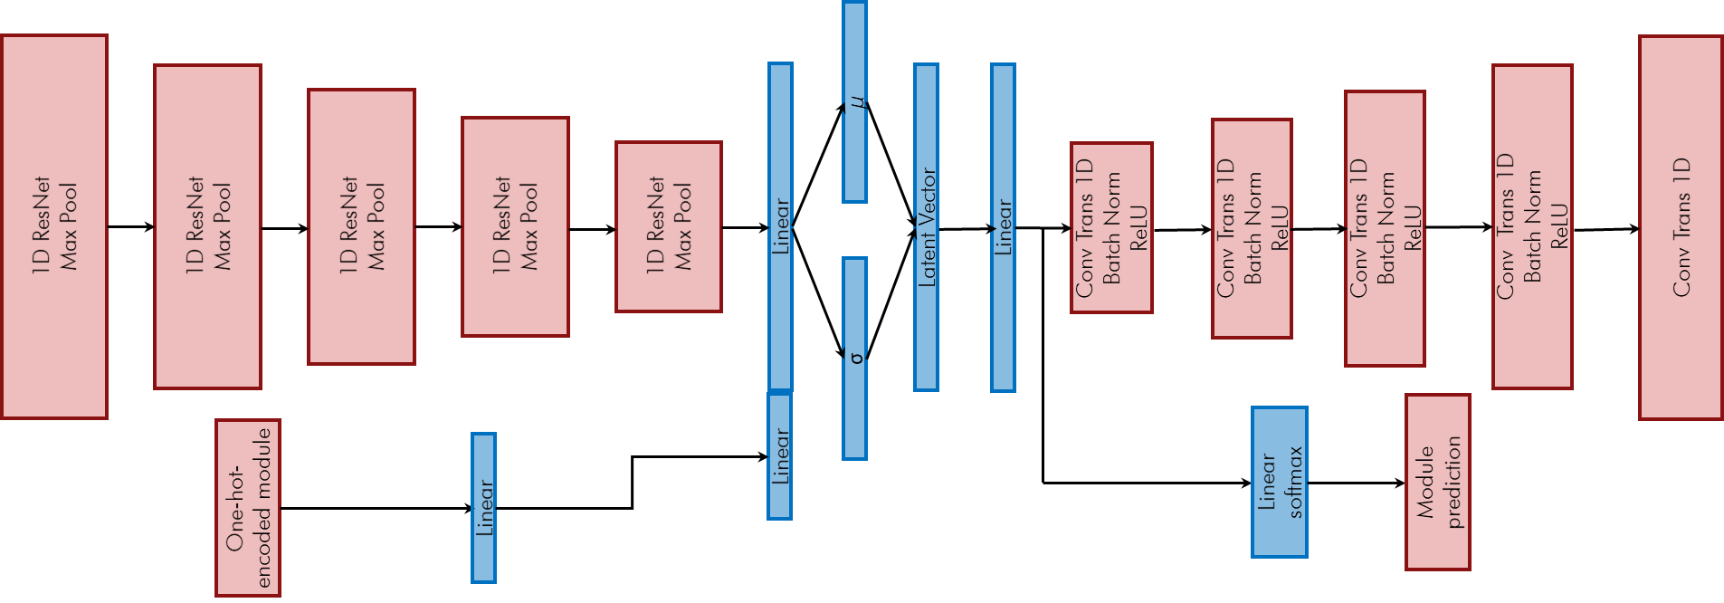
CNN
Advantages :
Capture spatial dependencies like in images.
Useful for automatic feature extraction (using the filters).
Much faster to train than fully-connected networks.
Drawbacks :
Lots of data is needed.
Application Fields:
Image recognition.
Recommender systems
Self-driving or autonomous cars
Object detection
SNS Use Cases:
All use cases
CNN can be used for fault detection, surrogate modeling, signal processing, and in generative models.

Slide 11
Content
Convolutional Neural Networks
Reinforcement Learning
Generative Adversarial Networks
Gaussian Processes
Random Forests

Slide 12
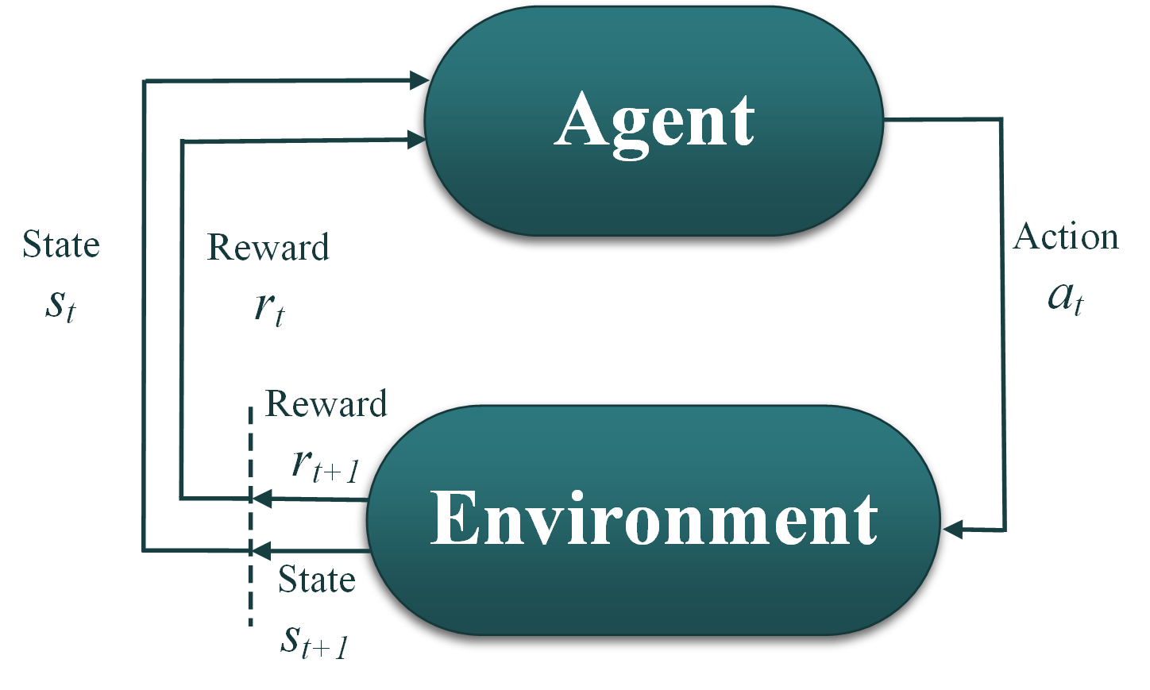
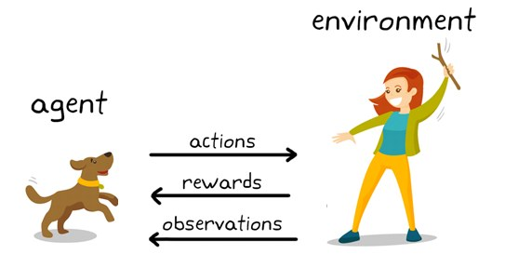
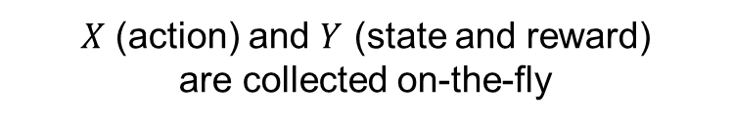
Reinforcement Learning
$X$ (action) and $Y$ (state and reward)
are collected on-the-fly
Learning agents to take actions in an environment to maximize the awards.
Labelled input/output pairs are NOT needed.
Take an action, observe rewards and states, decide next action, repeat.

Slide 13
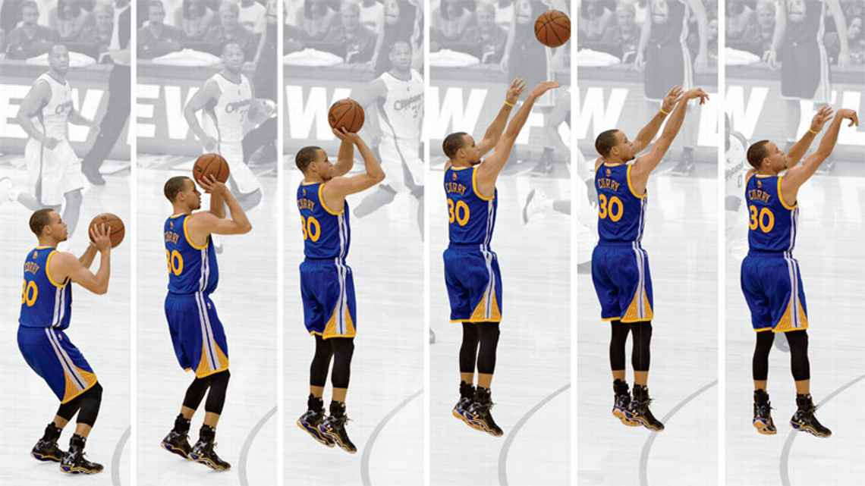
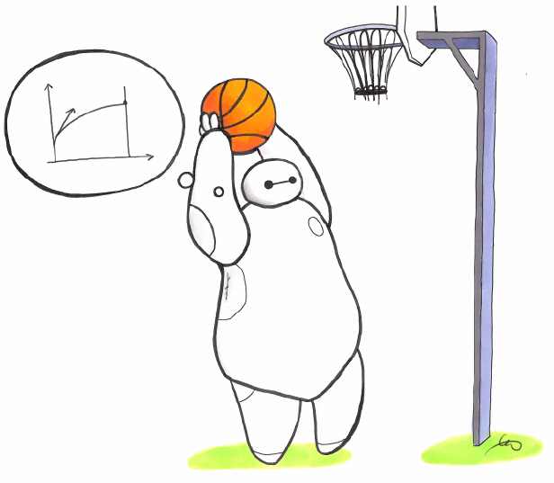


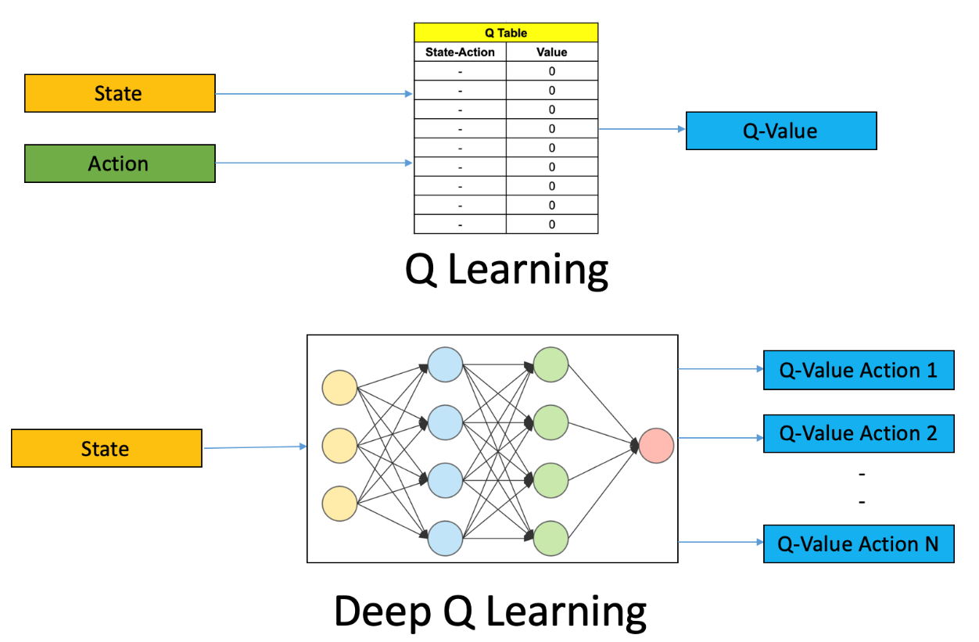
RL: Value-based vs Policy-Based vs Actor-Critic
Stable Baselines
Top libraries for RL
Q-Learning (Value-based): learn a single deterministic action from a discrete set of actions by finding the maximum Q value.
Policy Gradient (Policy-based): learn a map/policy from state to action, which can be stochastic and continuous, without Q-value in the middle.
Actor-Critic (Hybrid of both): Actors learn the policy , and critics produce Q-values for the actions to adjust the policy quality.
Source: https://medium.com/@jonathan_hui/rl-policy-gradients-explained-9b13b688b146

Slide 14
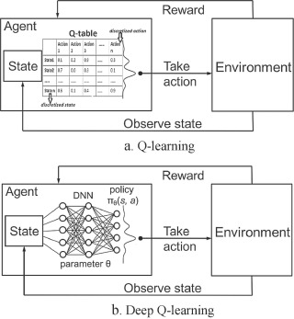
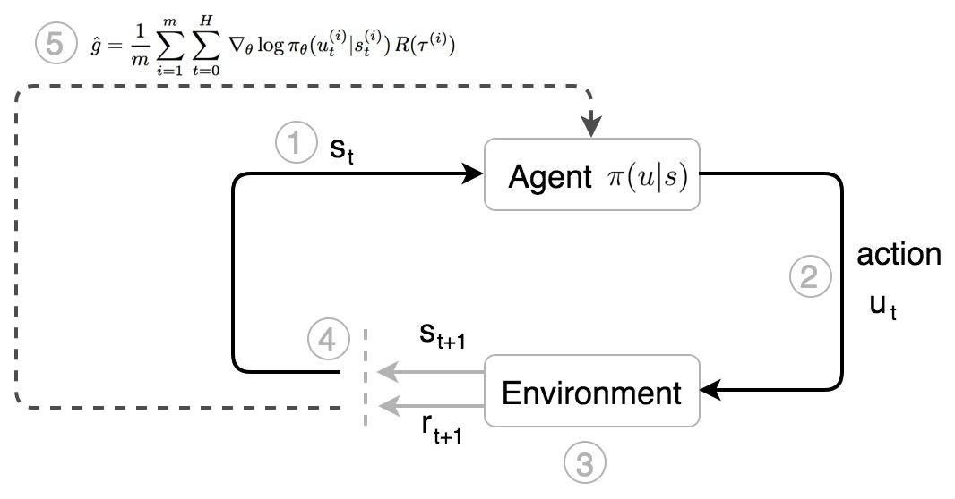
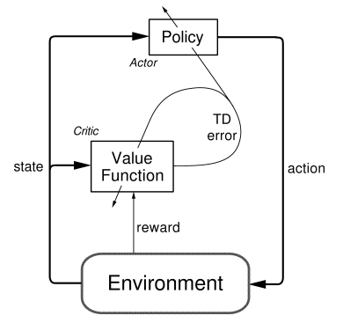
RL Algorthims
Q-Learning → DQN
Policy-gradient → PPO
Actor-Critic → A2C
Notes:
In Q-Learning we learn a Q-function that satisfies the Bellman (Optimality) Equation. This is most often achieved by minimizing the Mean Squared Bellman Error (MSBE) as the loss function. The Q-function is then used to obtain a policy (e.g. by greedily selecting the action with maximum value).
2. With policy gradients, and other direct policy searches, the goal is to learn a map from state to action, which can be stochastic, and works in continuous action spaces.
3. The policy structure is known as the actor, because it is used to select actions, and the estimated value function is known as the critic, because it criticizes the actions made by the actor. Learning is always on-policy: the critic must learn about and critique whatever policy is currently being followed by the actor. The critique takes the form of a TD error. This scalar signal is the sole output of the critic and drives all learning in both actor and critic

Slide 15
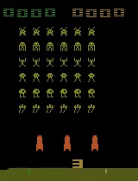
Me Playing Space Invaders with RL

Slide 16
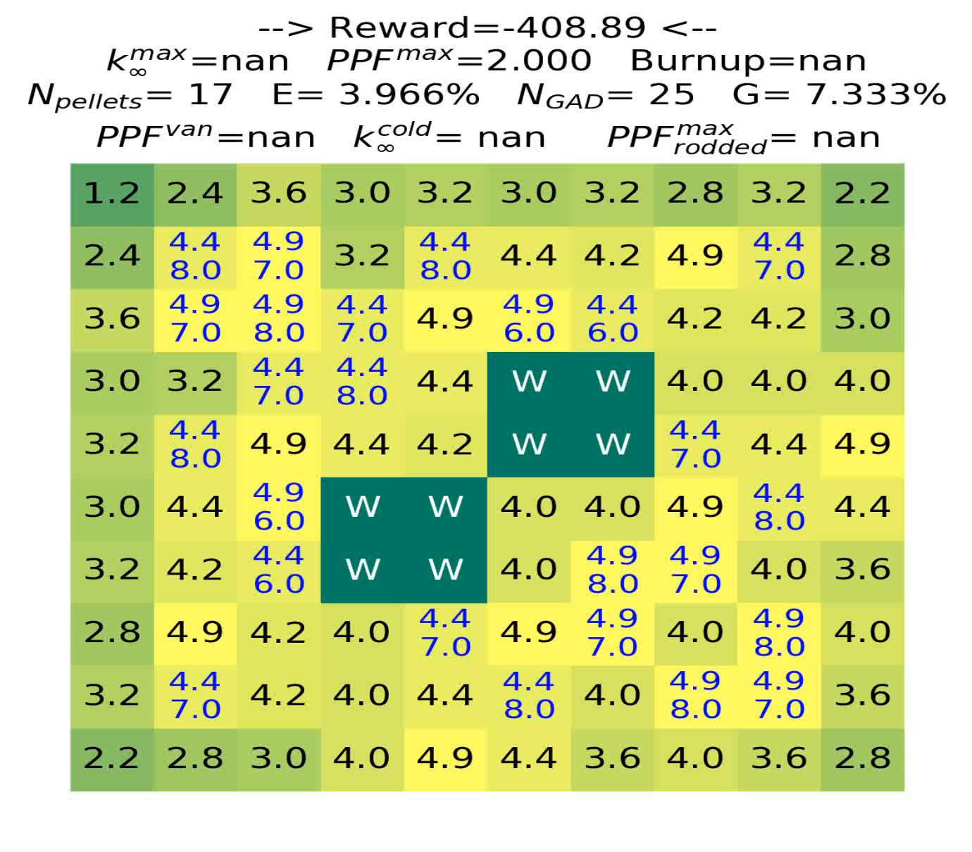









Design Constraints
$$E ε [3.95\%, 4.05\%]\text{✔}$$
$$G ε [7.2\%, 7.6\%]\text{✔}$$
$$N_{GAD} ε [16, 18]\text{✔}$$
$$N_{pellets}≤20\text{✔}$$
$${PPF}^{max}≤1.4\text{✔}$$
$${PPF}_{rodded}^{max}≤1.9\text{✔}$$
$$k_{∞}^{max}≤1.10000 \text{✔} k_{∞}^{cold} ≤1.1\text{7000} \text{✔}$$
Final Objective
Maximize Burnup & Minimize Power Peaking
$$Burnup ⤤⤤$$
$${PPF}^{max}⤦⤦$$

Slide 17
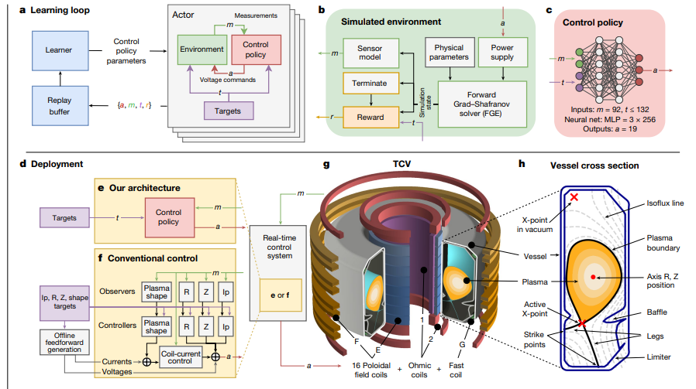
Plasma control with RL
Degrave, Jonas, et al. "Magnetic control of tokamak plasmas through deep reinforcement learning." Nature 602.7897 (2022): 414-419.

Slide 18
Reinforcement Learning
Advantages :
Data collected on-the-fly, no pre-generated data is needed.
Dynamic learning based on state and time.
Human-inspired based on performance and reward maximization.
Drawbacks :
Huge amounts of trial-and-error are needed to learn.
Can be very expensive if the environment is complex (e.g. simulation).
Rigid and sensitive to hyperparameters.
Application Fields:
Autonomous control.
Robotics
Optimization
Game-playing
SNS Use Cases:
HVCM for tuning the settings given a detected fault or system tuning time.
CMS?
BB?

Slide 19
Content
Convolutional Neural Networks
Reinforcement Learning
Generative Adversarial Networks
Gaussian Processes
Random Forests

Slide 20
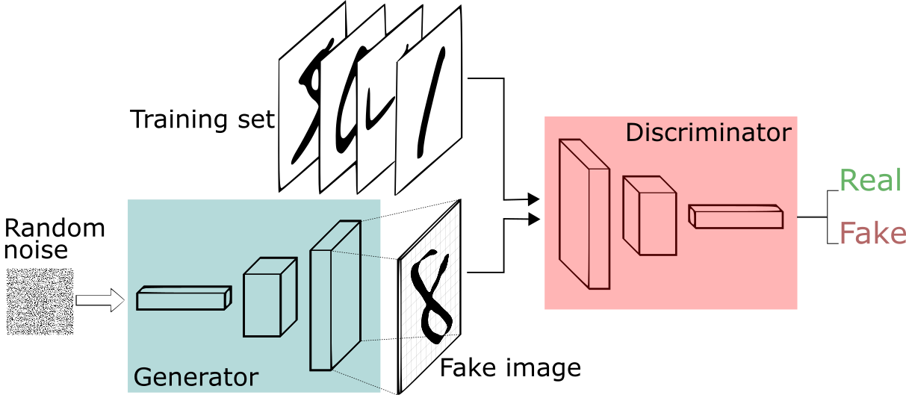
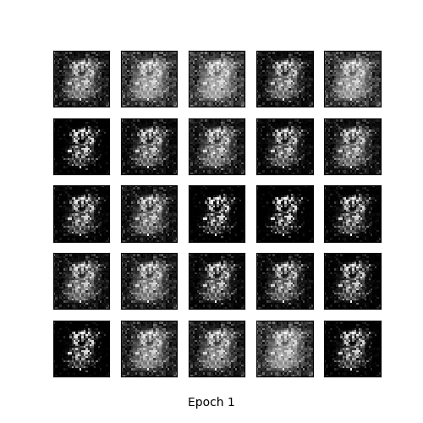
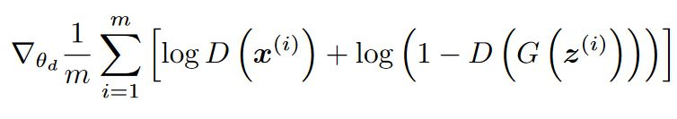
Generate synthetic data with GAN
Due to the data limitation, we use generative adversarial networks (GAN) to generate synthetic data that mimic real data.
Discriminator penalizes itself for misclassifying a real image as fake, or a fake image (created by the generator) as real, by maximizing the below function.

Slide 21
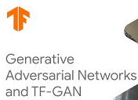

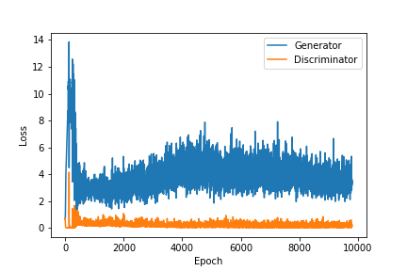
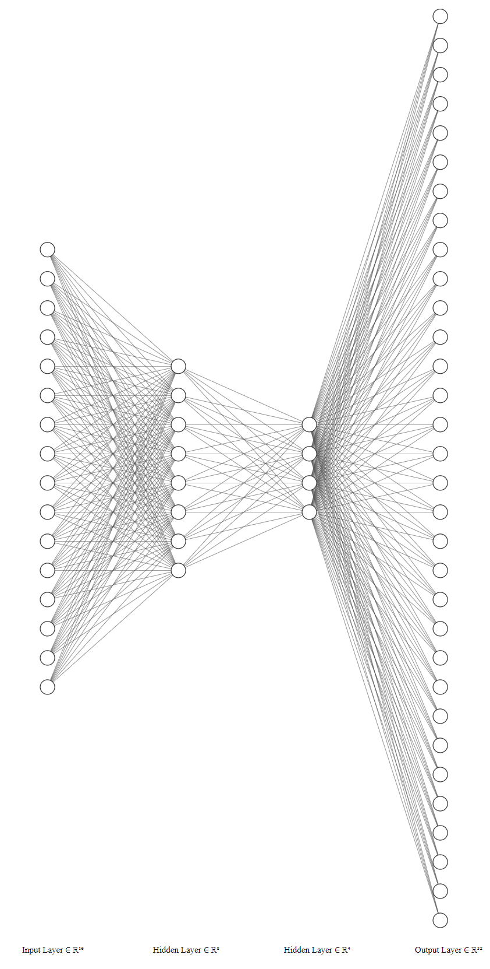
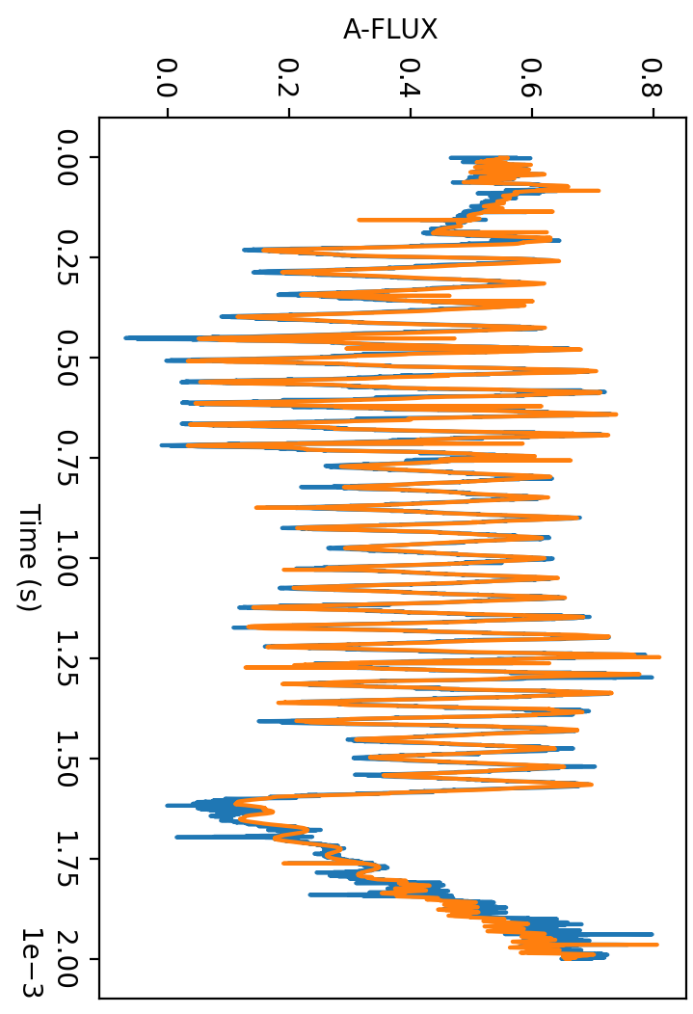
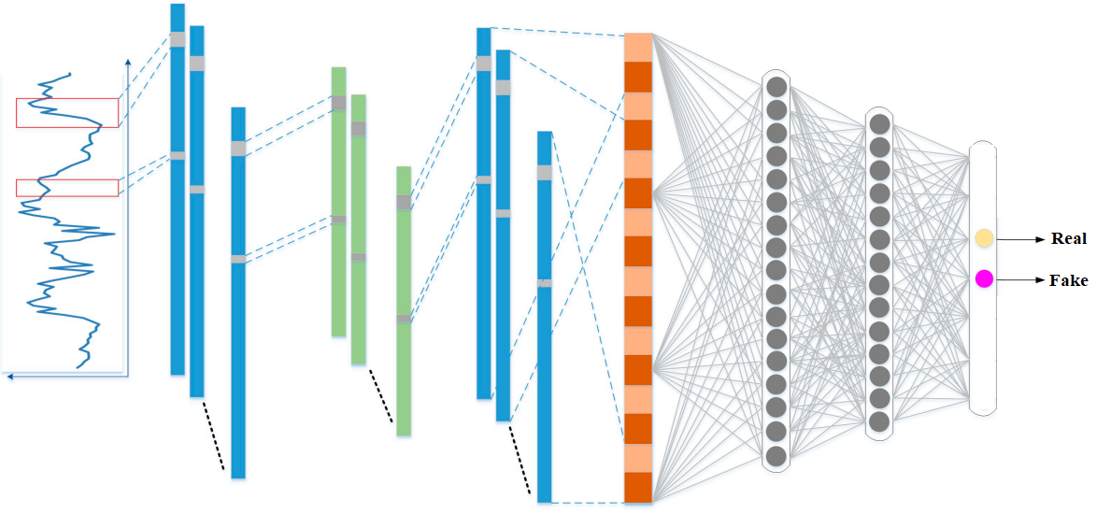
GAN Architecture
Generator
Waveforms
Discriminator
Noise
https://this-person-does-not-exist.com/en

Slide 22
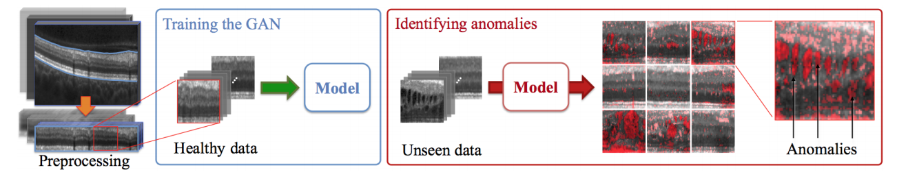
GANs
Advantages :
Generative models that can generate very realistic data.
GAN does not require labelled data.
Drawbacks :
Needs a lot of data to work and to generalize.
Expensive to train (> 50,000 epochs)
Application Fields:
Image recognition.
Anomaly detection.
Image-to-Image Translation
Text-to-Image Translation
SNS Use Cases:
Useful for HVCM & BB for generating synthetic signals.
Useful for HVCM & BB for direct application to anomaly detection.
Xia, Xuan, et al. "GAN-based Anomaly Detection: A Review." Neurocomputing (2022).

Slide 23
Content
Convolutional Neural Networks
Reinforcement Learning
Generative Adversarial Networks
Gaussian Processes
Random Forests

Slide 24
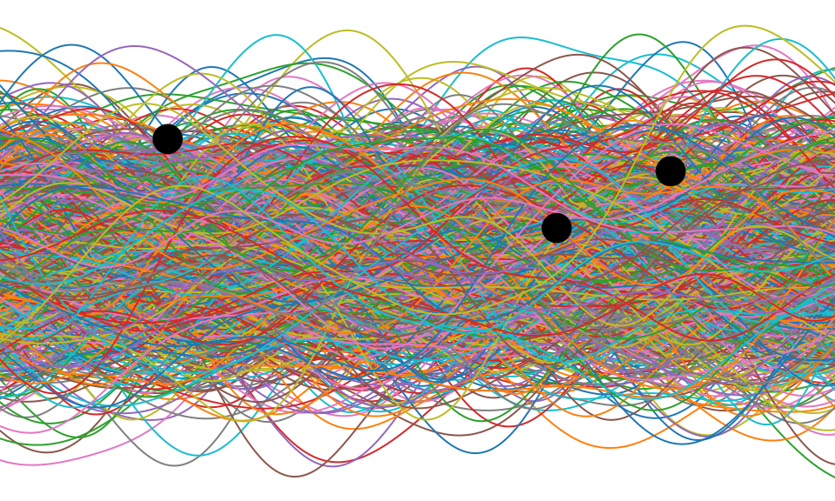
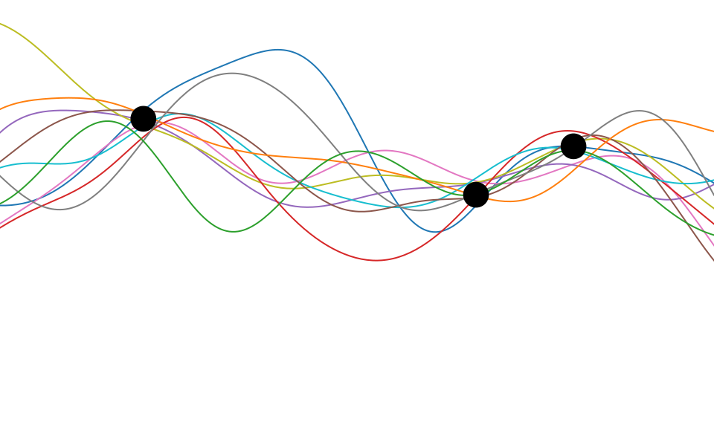
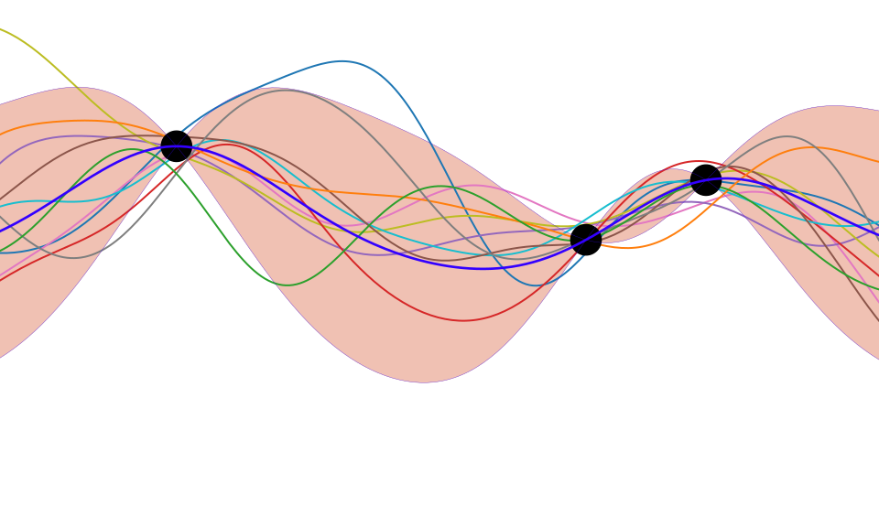
Gaussian Processes
Large number of possible functions
After observing new data, narrow the functions to the best that fits data
Fit a new surrogate (blue line) as the mean and standard deviation (red bars) of these best functions
Get more data

Slide 25
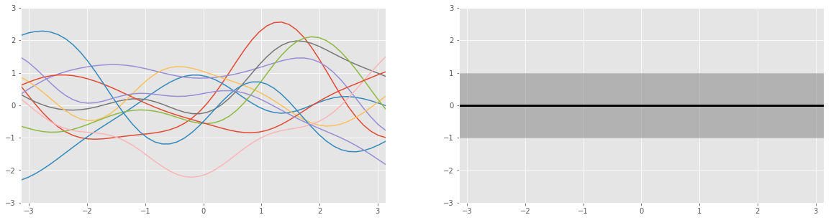
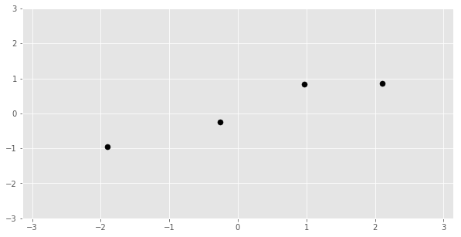
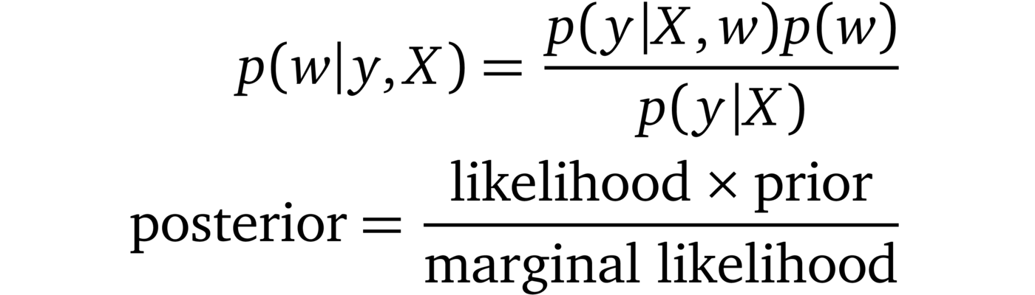
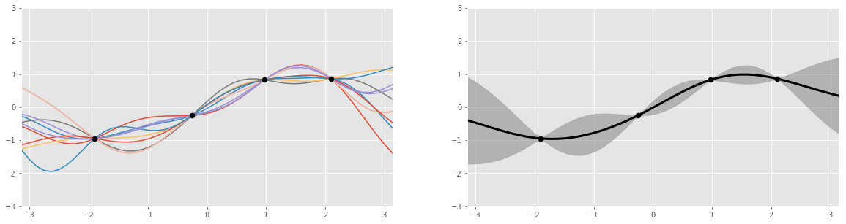
Gaussian Processes
Samples drawn from
Distribution of functions (Prior)
Mean/Std of left
Prior belief about the function
New data
Bayes Rule
Samples drawn from
Distribution of functions (Posterior)
Mean/Std of left
Posterior belief about the function to fit

Slide 26
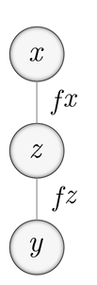

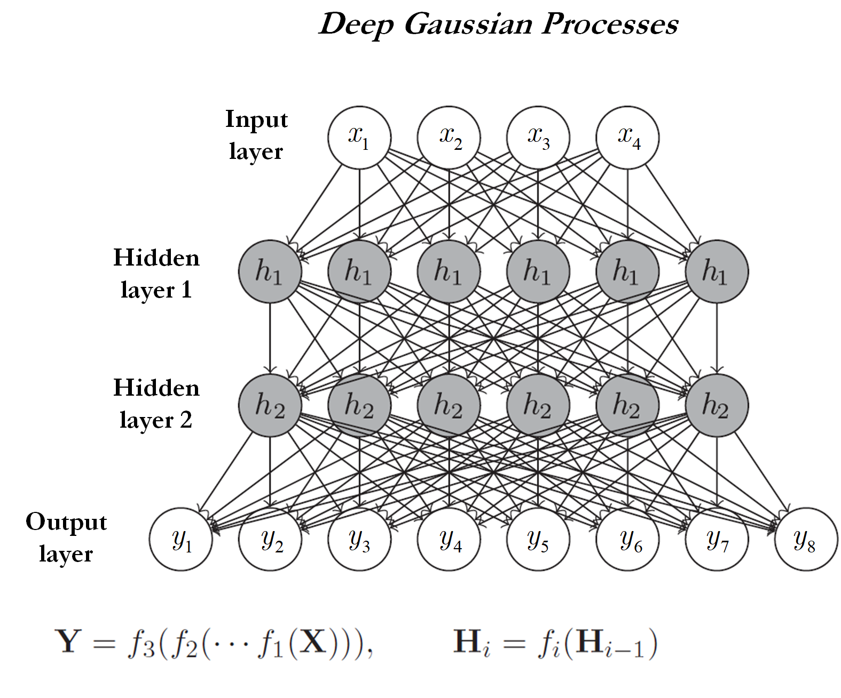

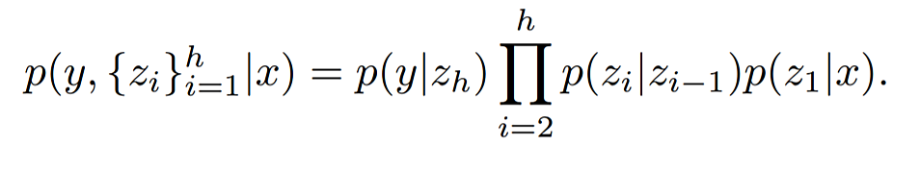
Deep GPs
Deep GP retains the advantage of GP but allowing more depth to capture more complex relationships.
Handles big data.
Can mimic deep neural networks.
DeepGP uses the novelty of variational inference to optimize the deep model architecture
  Number of nodes in hidden layers is automatically determined!
Solve this integration!

Slide 27
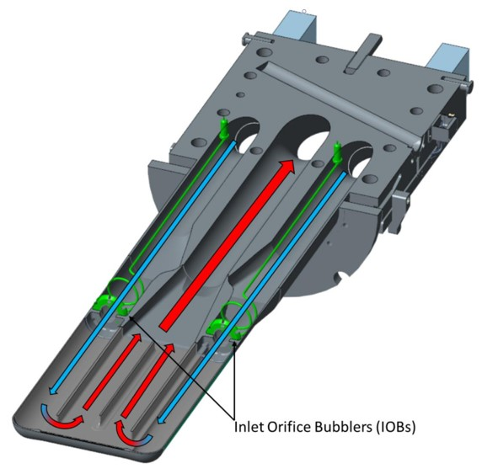
Gaussian Processes
Application Fields:
Surrogate modeling.
Regression problems.
Classification (more limited).
SNS Use Cases:
Can be used for the target given limited data/simulation capacity.
Test the GP surrogate with limited data for the R-P model and compare with neural networks.
Advantages :
Ability to predict with uncertainty.
Use Bayesian and variational inference to infer number of nodes.
Works well with limited data.
Drawbacks :
More expensive to train.
More complex to implement.
Do not scale well with data like neural networks.

Slide 28
Content
Convolutional Neural Networks
Reinforcement Learning
Generative Adversarial Networks
Gaussian Processes
Random Forests

Slide 29
Random Forest
Decision Tree:
Well-established “shallow” ML method
Sequence of decisions at “internal node” based on comparison between “feature” against “split variables”, till a “leaf node” is reached
Random Forest
Ensemble of decision trees
Trained by “bagging” – “boosted aggregating”
Name coined by Leo Breiman and Adele Cutler. Attributed to Tin Kam Ho
Math
Each node is a one-liner
# decision trees = N
max depth = D
aggregation module
Next = Left_{m} if f_{k} < split_{m} else Right_{m}

Slide 30
Technique Name
Advantages :
Easy to train
Less requirement on training data
Good accuracy
(ensemble of trees >> single tree)
Really fast inference (easy but not obvious, see next page)
Drawbacks :
“Shallow” method
Not as powerful as “deep” models
Lose some of the explainable nature
Usually requires some feature engineering
Application Fields:
All over the place. Usually the first choice for ML practitioners
One of the most popular ML methods
SNS Use Cases:
Errant beam prediction based on DCM readings (Rescic et al)
Integrated with DCM on FPGA

Slide 31
Really Fast Random Forest Evaluation
f₆₁₅
N₀
Evaluate based on topological order
From top to bottom
Easy to understand
Need to store all features
f₂₀₃₁
N₂
f₂₁
N₄
“Out-of-order” evaluation
Evaluate by the ordering of
input features
Avoid storing of features
Simpler and faster
Almost instantaneous
Result = N₀ AND N₂ AND N₄
Tree evaluation is a long sequence of logic AND
operations
Commutative and associative
Can be carried out in different orders. The trick is to
avoid storing exponential number of nodes
A simple data structure turns out to do the job

Slide 32
Non-NN (Backup)

Slide 33
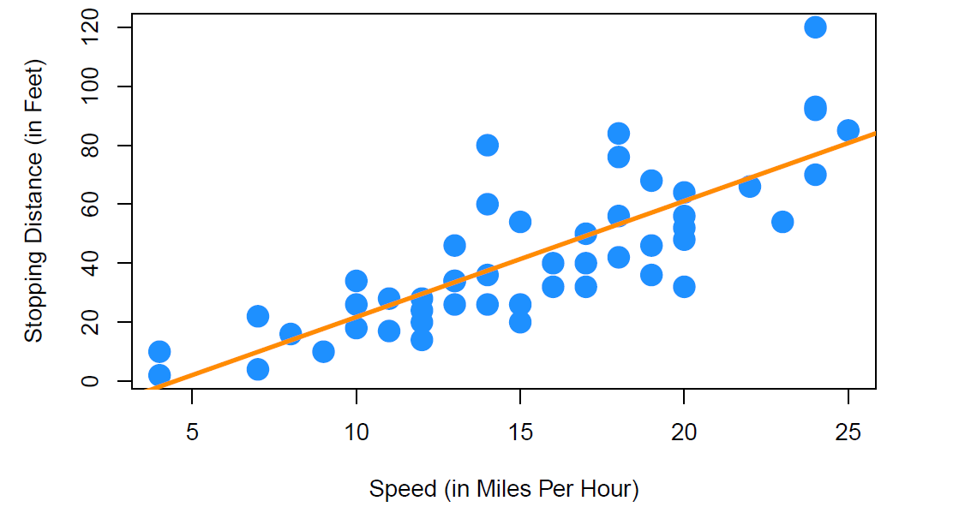




Linear Regression vs Support Vector
Support Vector Regression is similar to Linear Regression in that the equation of the line is $y=β_{0}+β_{1}x$.
In SVR, this straight line is referred to as hyperplane.
The data points on either side of the hyperplane that are closest to the hyperplane are called Support Vectors which is used to distinguish the decision boundary lines.
Unlike other linear regression models that try to minimize the error between the real and predicted values, the SVR tries to fit the best line within a threshold value ($ε$).
For a non-linear regression, the kernel function transforms the data to a higher dimensional space and performs the linear separation.
$$ε$$
$$ε$$
SVM: Support Vector Machines are used for classification problems
SVR: Support Vector Regression are used for regression problems

Slide 34





The Kernel Trick
Polynomial kernel
$$φ(x)=x2$$
One of the genius tricks in Machine Learning to find a linearly separable data in a higher dimensional space.
If the data is not linearly separable in the original, or input space then we apply transformations to the data.
The transformation maps the data from the original space into a higher dimensional feature space.
The goal is that after the kernel transformation to the higher dimensional space, the data is now linearly separable.
We can then fit a decision boundary and hyperplane to separate the classes or to make regression.
1D space
(NOT linearly separable)
2D space
(Linearly separable by red dash line)
Polynomial kernel
2D space
(NOT linearly separable)
3D space
(Linearly separable by the red dash line)
See also for math explanation
https://medium.com/@zxr.nju/what-is-the-kernel-trick-why-is-it-important-98a98db0961d

Slide 35
SVM/SVR Tips
Pros
  SVR can be very efficient, because it uses only a subset of the training data, only the support vectors.
  Works very well on smaller datasets, on non-linear datasets, and high dimensional spaces.
  Maybe effective in cases when number of dimensions/features is greater than the number of samples.
  NOT very sensitive to overfitting.
Cons
  Training time is high for large datasets
  When the data set has noise (i.e. data points are overlapping), SVM doesn’t perform well

Slide 36






DT Cost Function
Find the value of $θ$ that minimizes $G\left(Qm,θ\right)$, call it as $θ^{∗}$
Recurse for subsets $Q_{m}^{left}(θ^{∗})$ and $Q_{m}^{right}(θ^{∗})$ until the maximum allowable depth is reached.
$m$: node index
$$Qm:data in node m with total size$$
$$Q_{m}^{left} :data in node m in the left subset with size N_{m}^{left}$$
$$Q_{m}^{left} :data in node m in the right subset with size N_{m}^{right}$$
What is $H$(.)?
For each candidate split, $θ=\left(j,t_{m}\right), which are model parameters$
$j$: is the feature index
$tm$: threshold value

Slide 37










Impurity/loss function ($H$)
Classification
Regression
If a target is a classification outcome taking on $0, 1,…, k−1$, for node $m$, and a total of $k$ classes, then
If the target is a continuous value, then for node $m$
MSE
is the proportion of class $k$ observations in node $m$
Gini index
MAE
Entropy index
Note that MAE fits much slower than the MSE criterion.

Slide 38


Random Forests
What If a decision tree is not Enough?
Try to make a forest!
The Random Forest Algorithm combines the output of multiple (randomly created) Decision Trees to generate the final output.

Slide 39
Pros/Cons
Advantages to using DT/RF:
  Easy to interpret (DT mainly) and make for straightforward visualizations.
  Can handle both numerical and categorical data.
  Perform well on large datasets
  Are very fast
Disadvantages to using DT/RF:
  Building decision trees is a greedy approach, meaning it makes the most optimal decision at each step, but does not take into account the global optimum.
  DT/RF are prone to overfitting, especially when a tree is particularly deep and the problem has many features.
    The greedy approach leads to smaller sample of events that try to meet the data, but not necessarily enough to generalize to new events.
    This is why max_depth and max_features in are introduced to alleviate the overfitting issue.

Slide 40
GP Intuition
Narrower distribution of functions means more certain degree of belief.
The updated GP process is constrained to the possible functions that fit our training data.
The mean of the (right) goes through all training points, and so does every sampled function (left).
Model uncertainty (Standard deviation) is higher away from the training data, which reflects our lack of knowledge about these areas.

Slide 41
Technique Name
Advantages :
Drawbacks :
Application Fields:
Different fields the method is popularly applied to
SNS Use Cases:
How do (or can) SNS use cases benefit from the method

