Slide 1
Resonance Compensation for High Brightness Beams in the CERN PSB
5th ICFA Mini-Workshop on Space Charge – Oak Ridge 2022
24/10/2022
F. Asvesta
S. Albright, F. Antoniou, H. Bartosik, C. Bracco, G.P. Di Giovanni, T. Prebibaj, D. Zeitz
PSB-OP team

Slide 2
Overview
Motivation
Identification of resonances
Loss maps
Resonance compensation
Resonance-by-resonance
Global settings
Impact on High Brightness Beams
Emittance & profile shape
Summary & Outlook

Slide 3
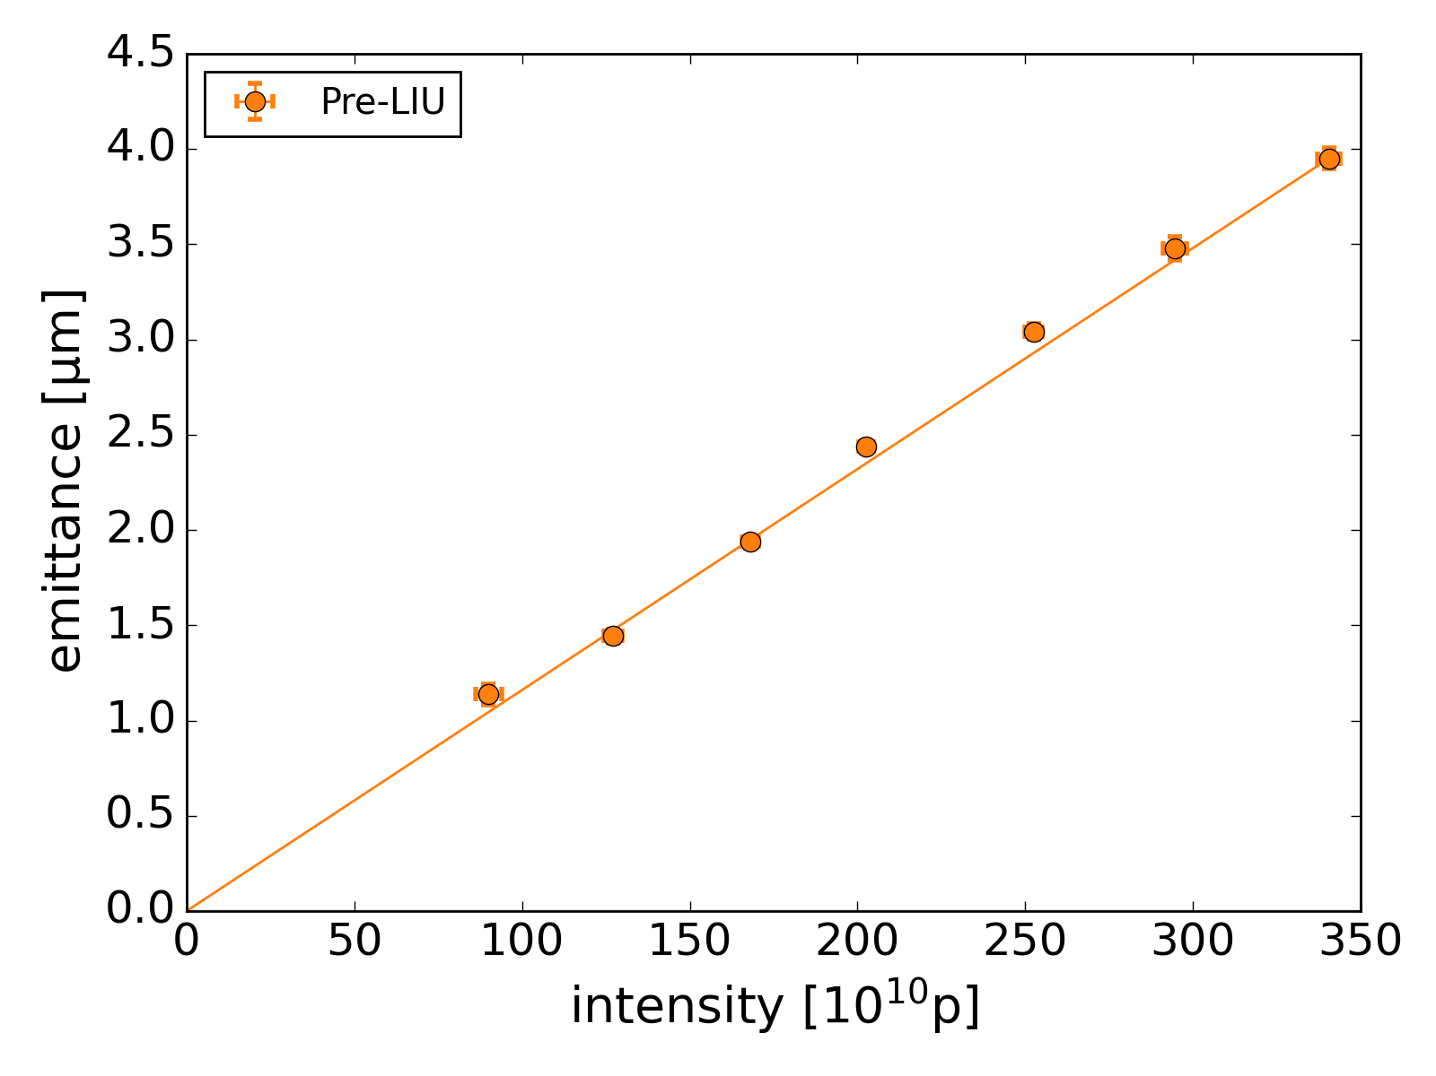
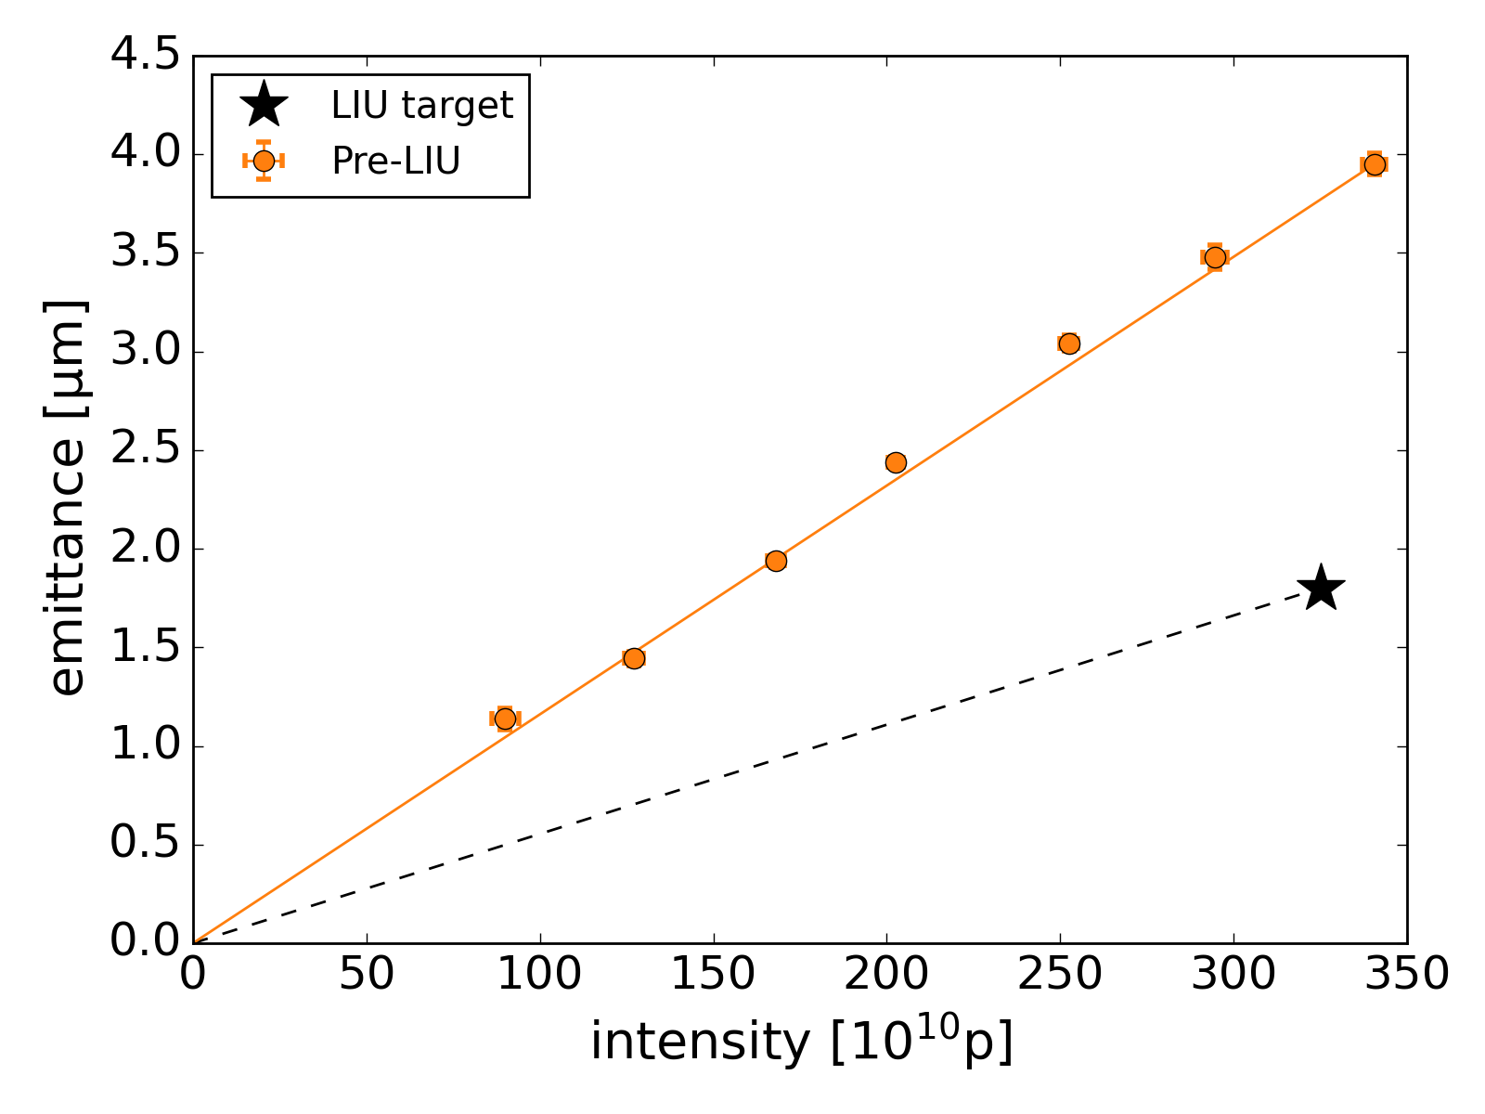
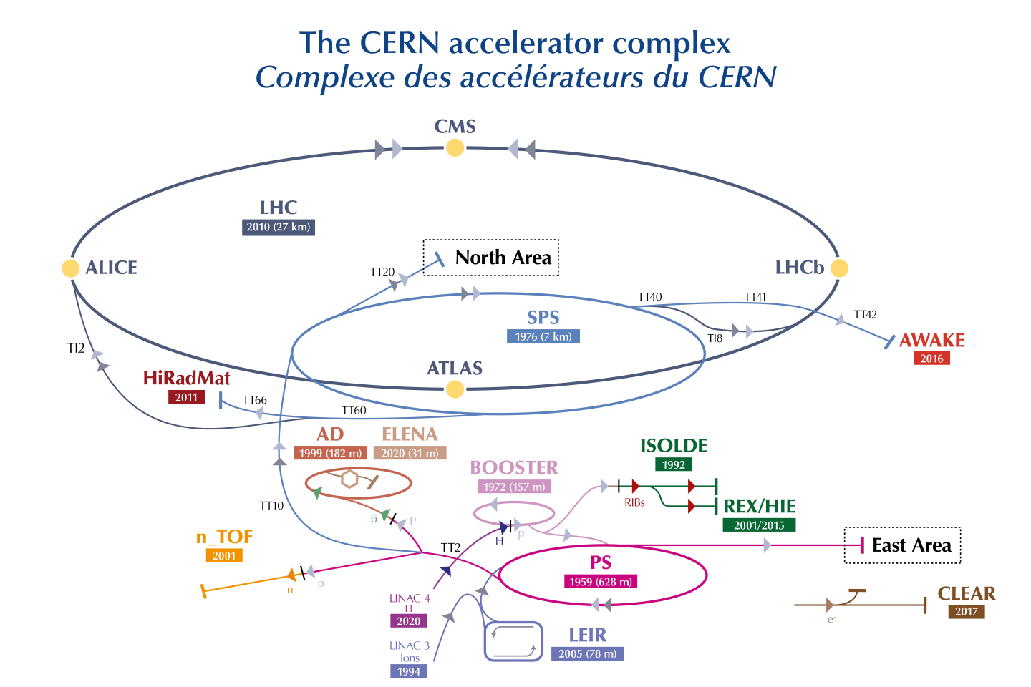
Motivation – LIU Upgrade
PSB is the first synchrotron of the CERN injector chain for protons:
Defines the maximum brightness for the full complex operating with $ΔQ_{x,y}≈−0.5,−0.6$
Aim of the LIU project
Double the brightness
Maintain similar space charge tune shifts
Increased injection energy 50 MeV → 160 MeV with the new LINAC4
Increased extraction energy from 1.4 GeV to 2 GeV

Slide 4
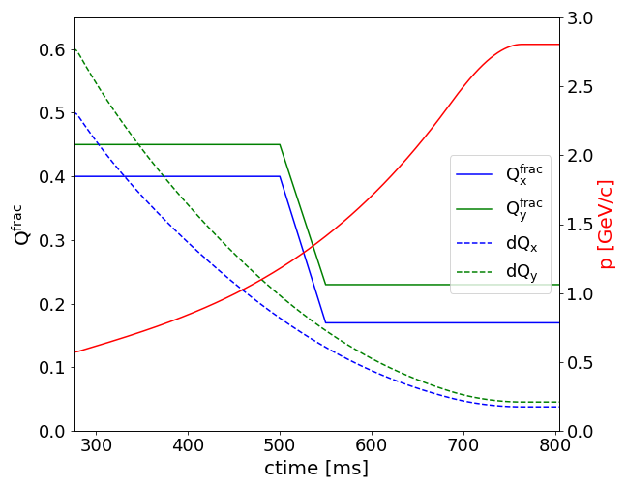
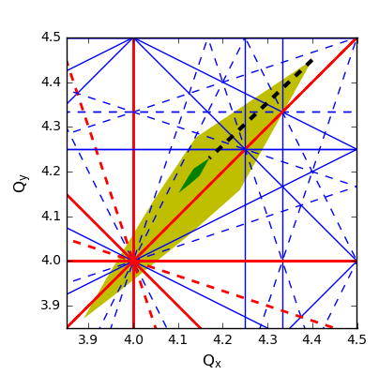
Motivation – Maximize brightness
Space charge remains the main brightness limitation in the PSB – the working point evolution is defined in order to preserve the brightness:
High Injection Tunes (4.4/4.45):
minimizing interaction with integer resonances for low energy that causes: significant emittance blow-up
Ramp to resonance free space (4.17/4.23):
minimizing interaction with higher order resonances that can cause: Losses Emittance blow-up Transverse tails
During the tune ramp, a large variety of resonances are crossed.
At low energy many resonances are overlapped due to space charge
During the tune ramp, the resonances are being crossed
At high energy no impact from resonances & space charge is expected
Resonance identification & compensation studies needed!

Slide 5
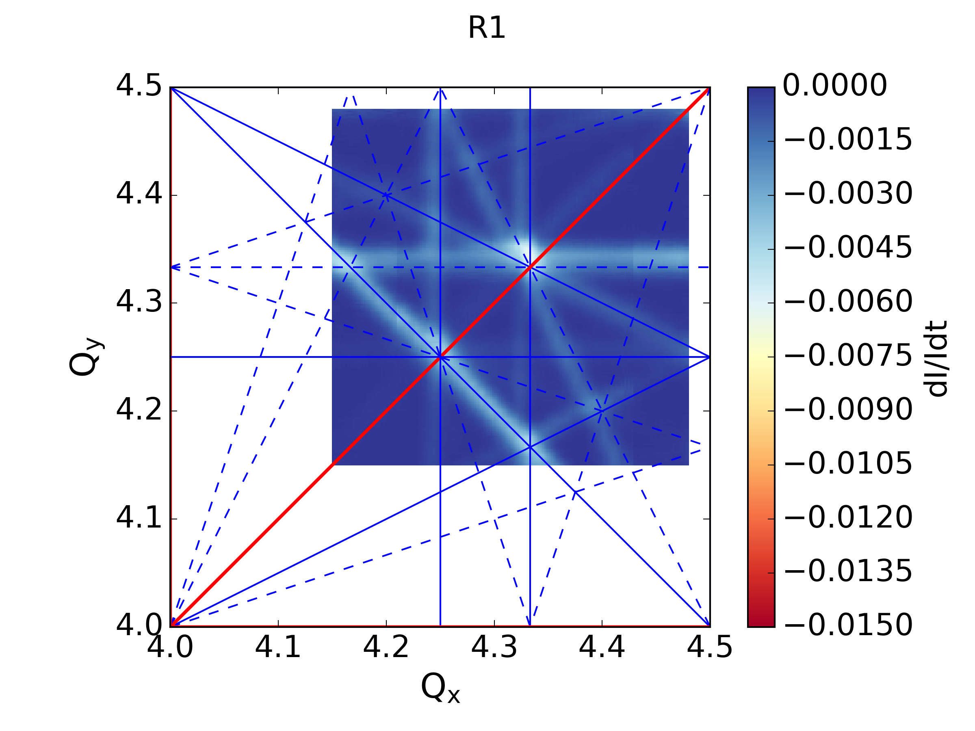
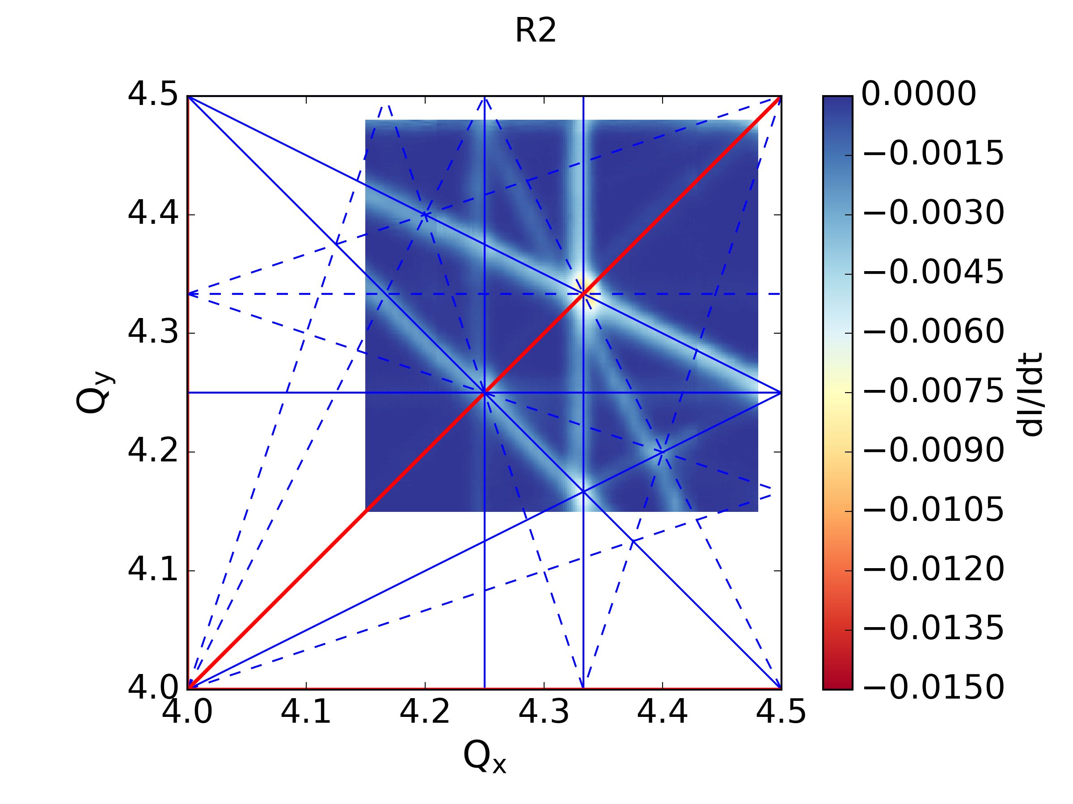
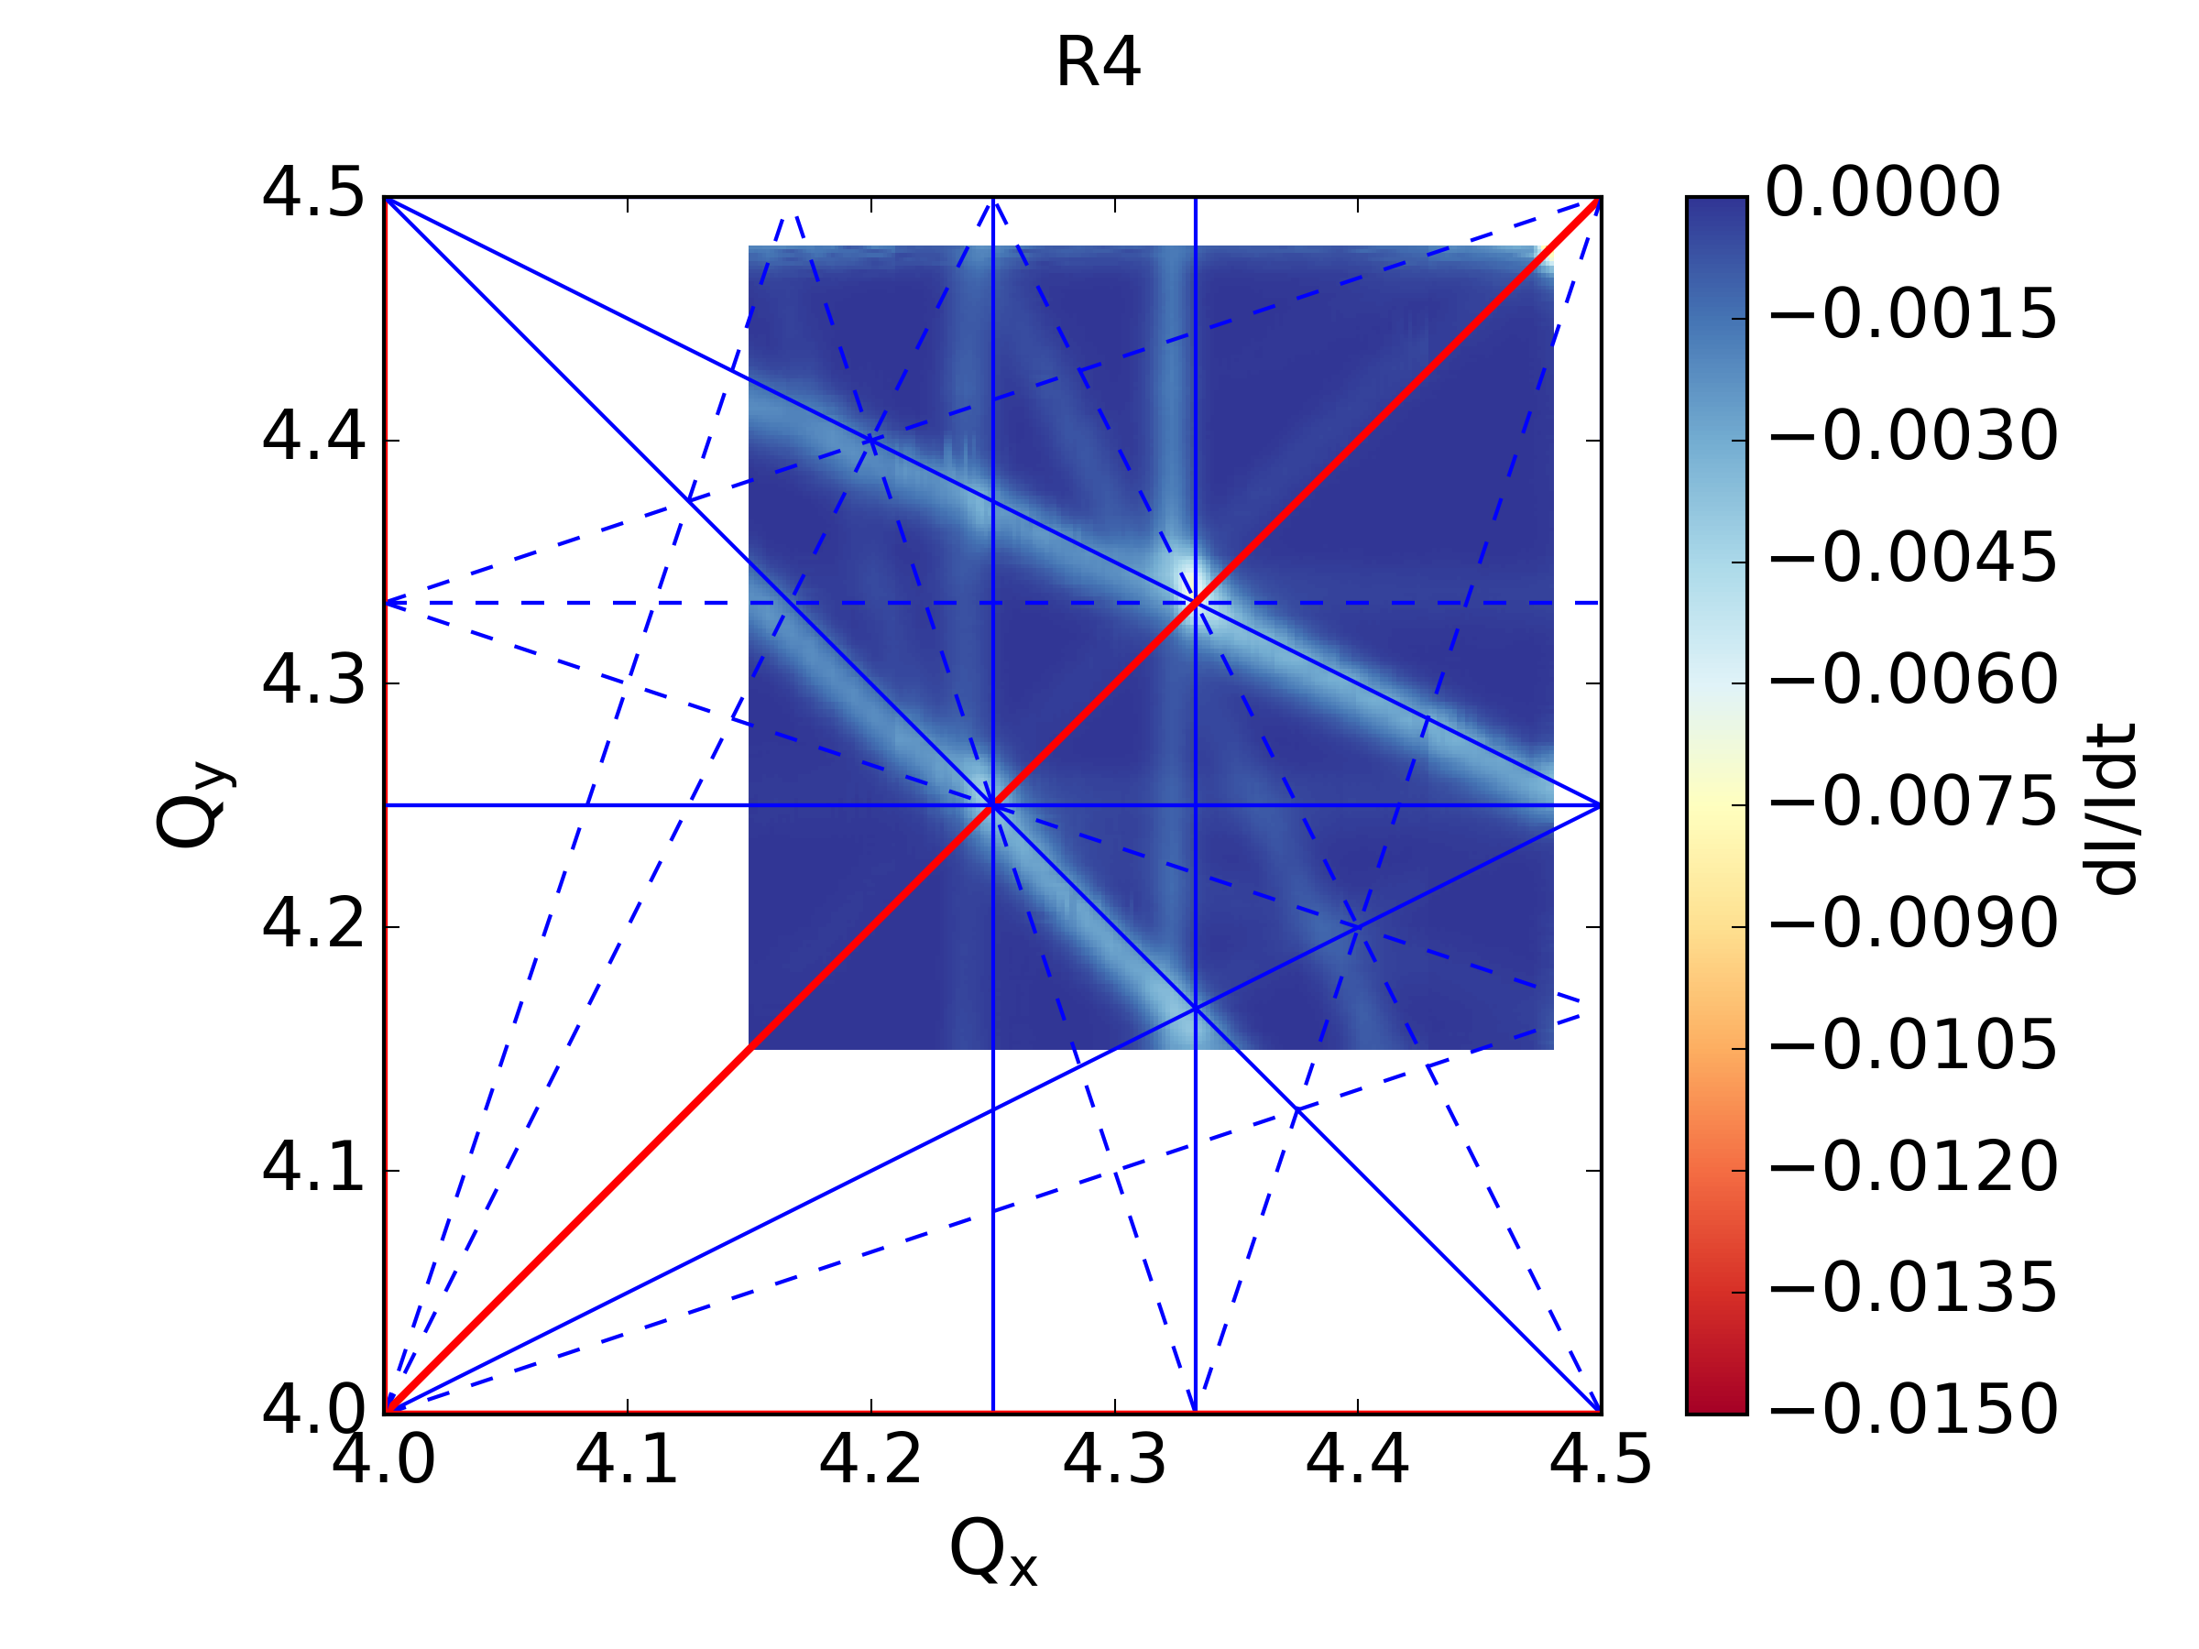
Resonance Identification
One tune ($Q_{x}$ or $Q_{y}$) is being varied during C350-700ms from $[4.15−4.48]$ (and vice versa) while the other is kept constant.
The resonances can be seen through the loss rate calculated from the intensity curve.
The study is done on a flat cycle with a low brightness beam ($ΔQ_{x}≈ΔQ_{y}≈−0.035$)
→ All sextupole & octupole resonances can be seen in all rings
→ Normal sextupole resonances are stronger in R2, R3 & R4
→ Skew sextupole resonances are stronger in R1
→ Octupole resonances are strong in all rings

Slide 6
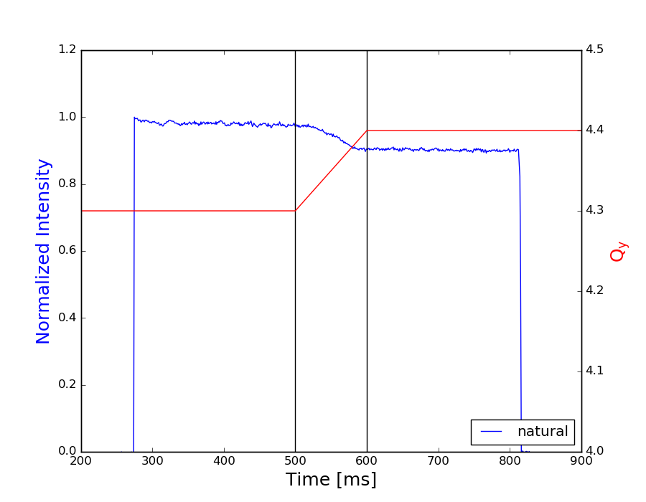
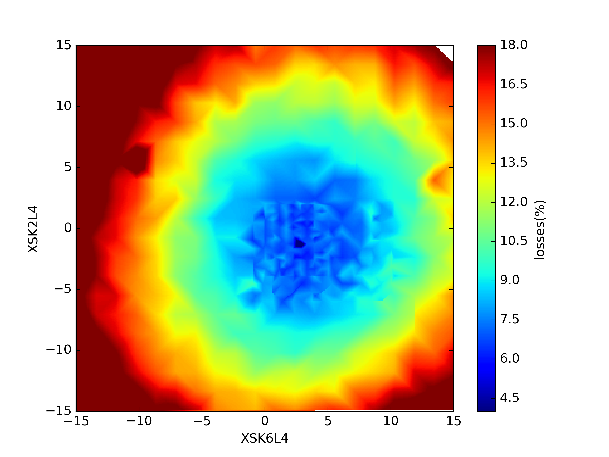
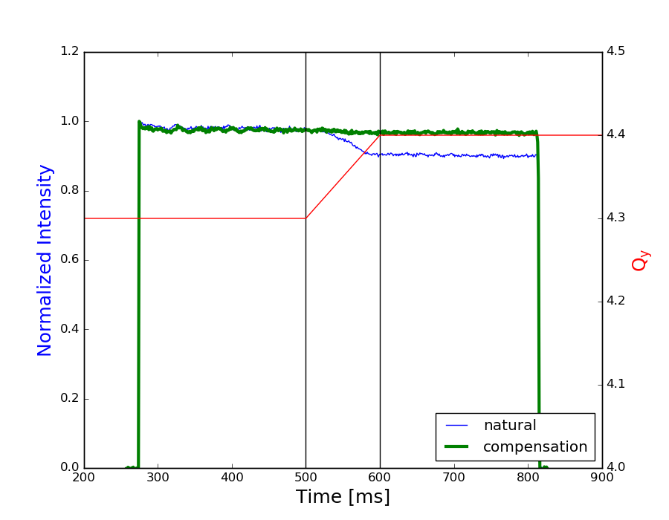
Resonance Compensation – Individually
For each resonance:
Resonances dynamically crossed
Identified suitable correctors
Vary currents while monitoring losses
Verify configuration
2. RDT/MADX-PTC
For every observed resonance, identify (RDT, MADX-PTC) complementary corrector pairs
1. Cross dynamically
3. Vary currents
4. Validation

Slide 7
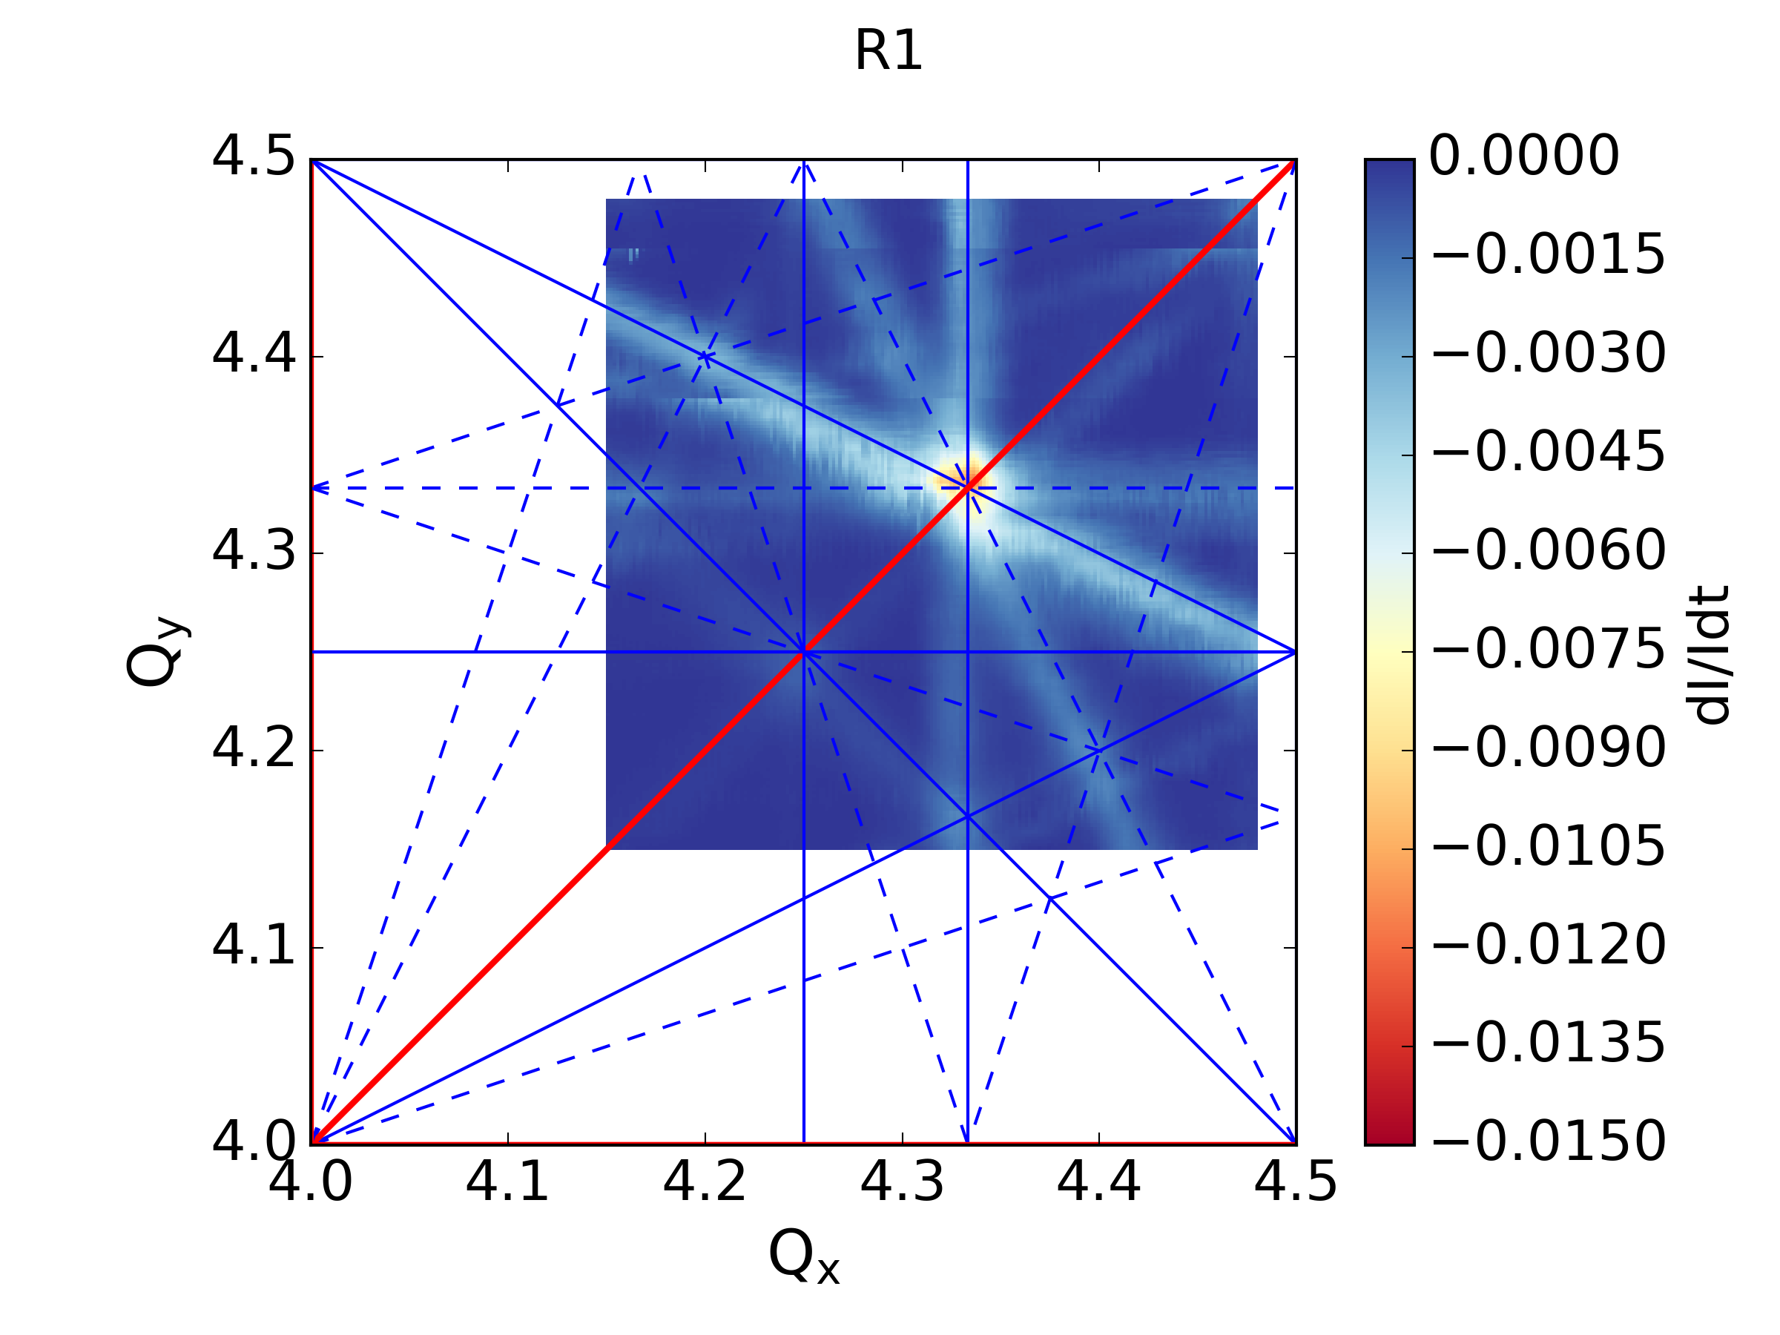
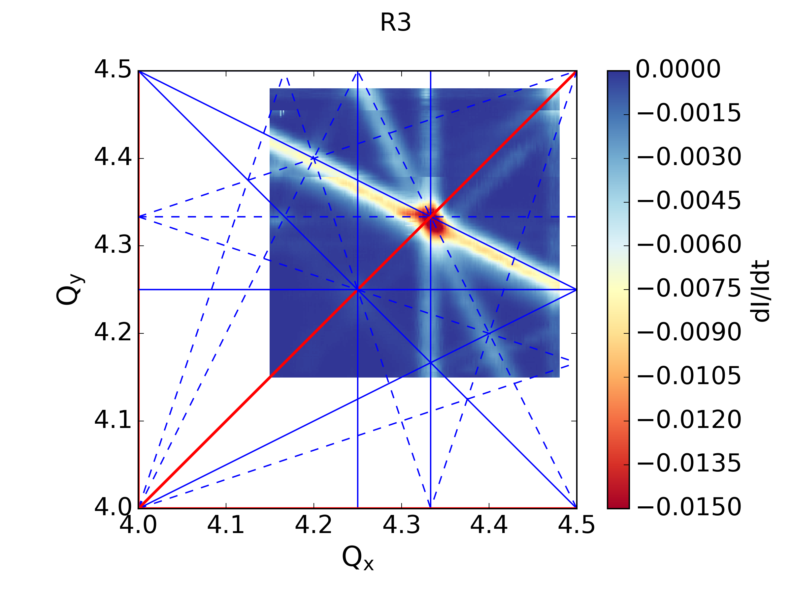
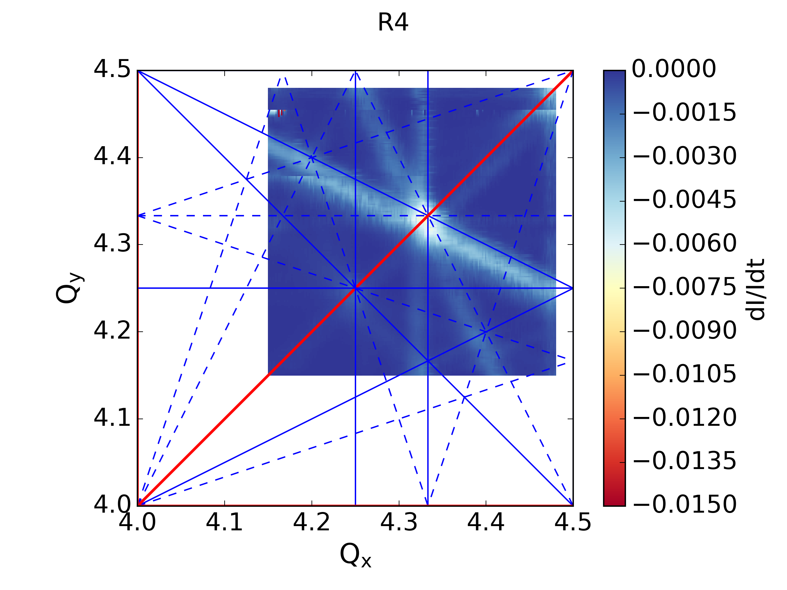
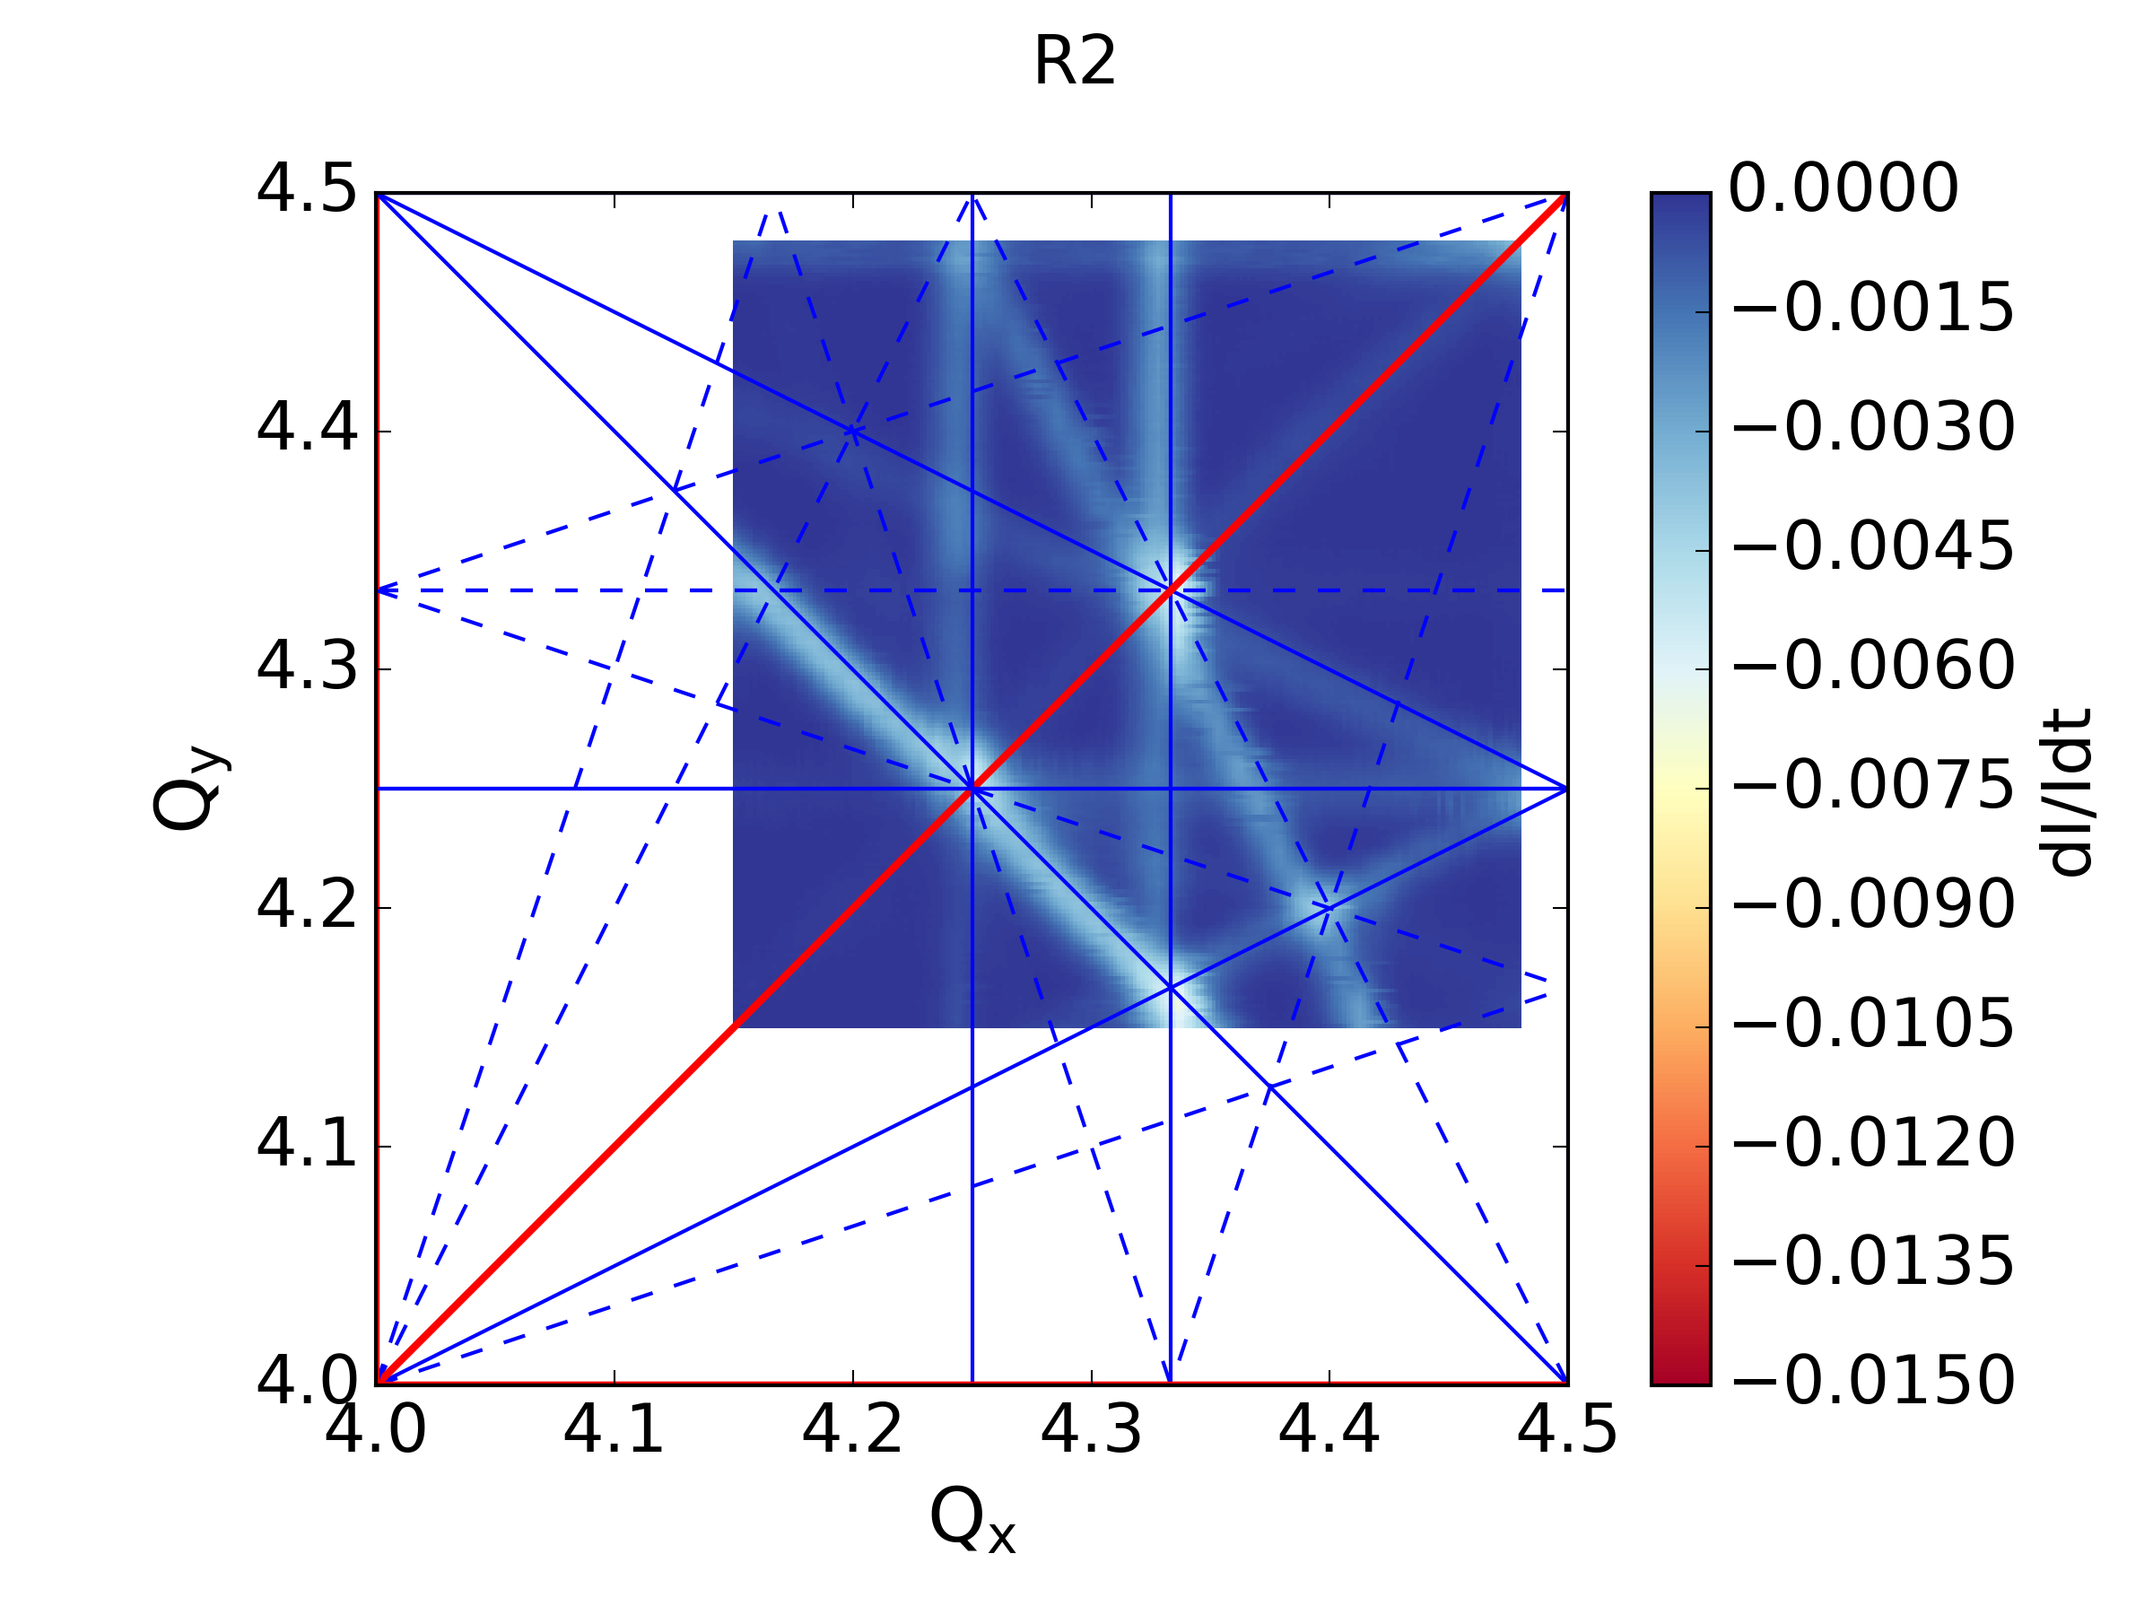
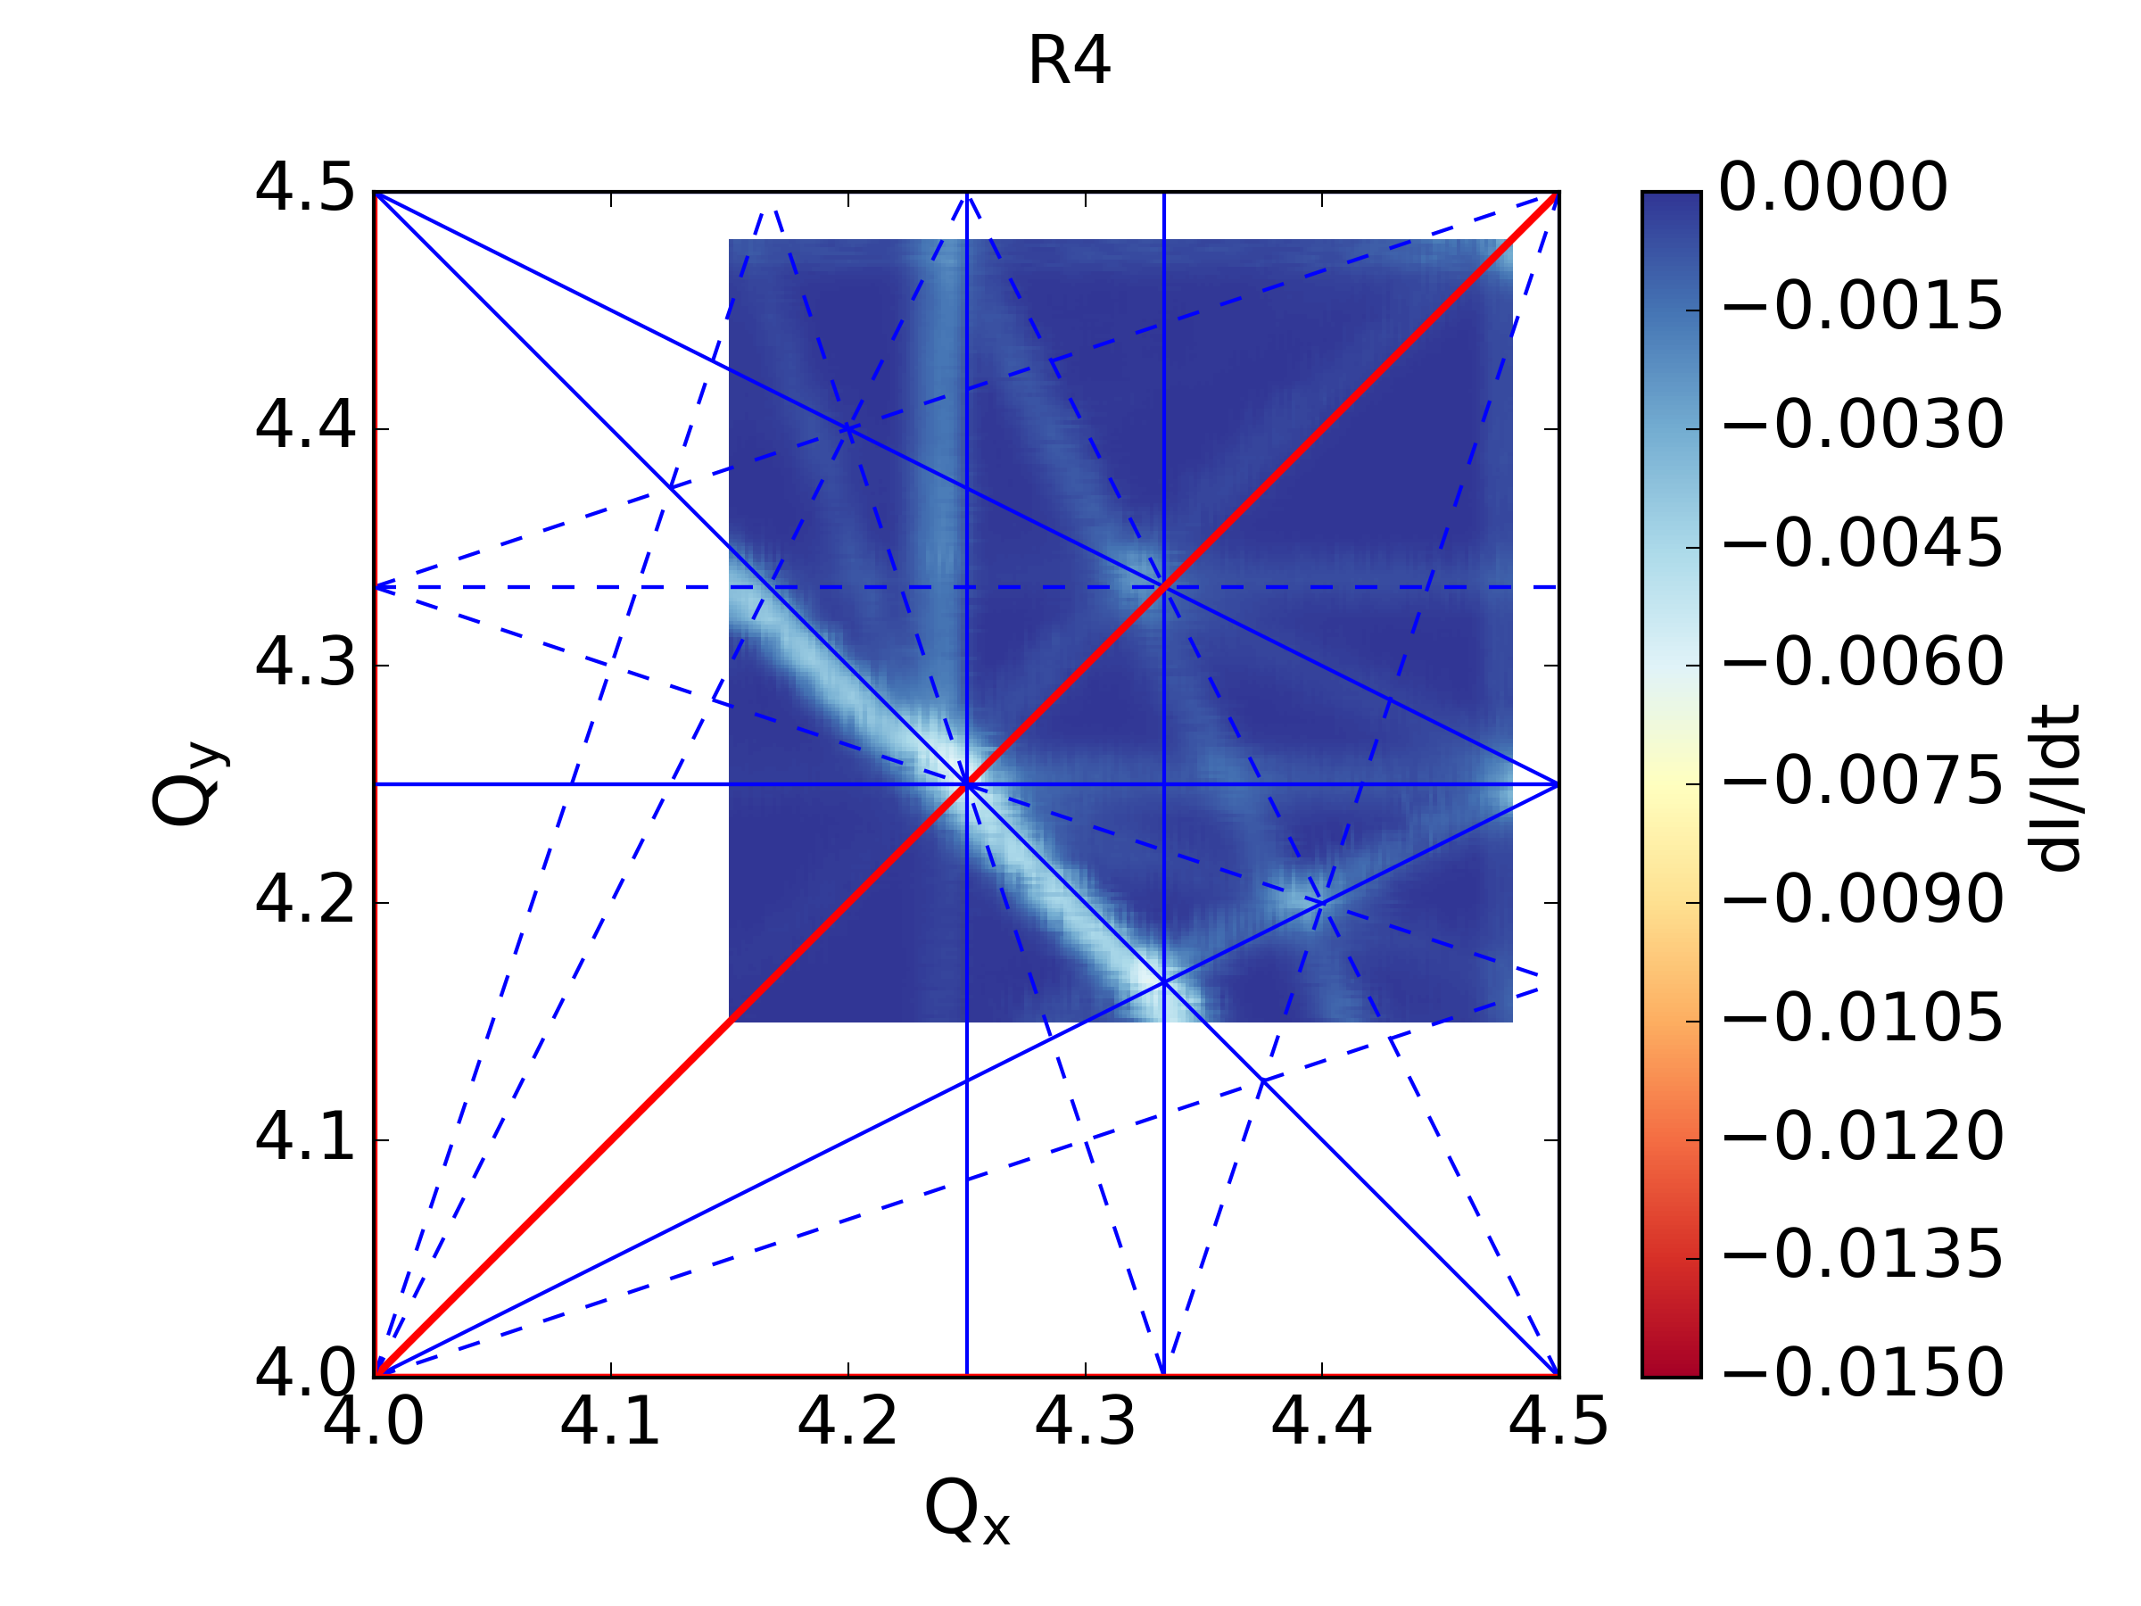
Resonance Compensation – Globally
4th order normal resonances:
The compensation values estimated experimentally seem identical for all resonances
3rd order normal resonances:
Using PTC and the MADX model where the resonances are crossing each other:
Calculate the RDTs of the resonances based on the compensation values
Calculate the RDTs of each available magnet for all resonances of interest
Global solutions estimated
Significant suppression of both resonances in all rings but R2 (current limitation)
3rd order skew resonances not enough correctors…

Slide 8
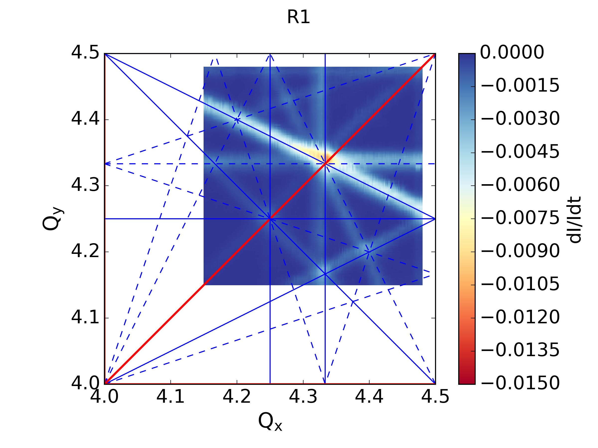
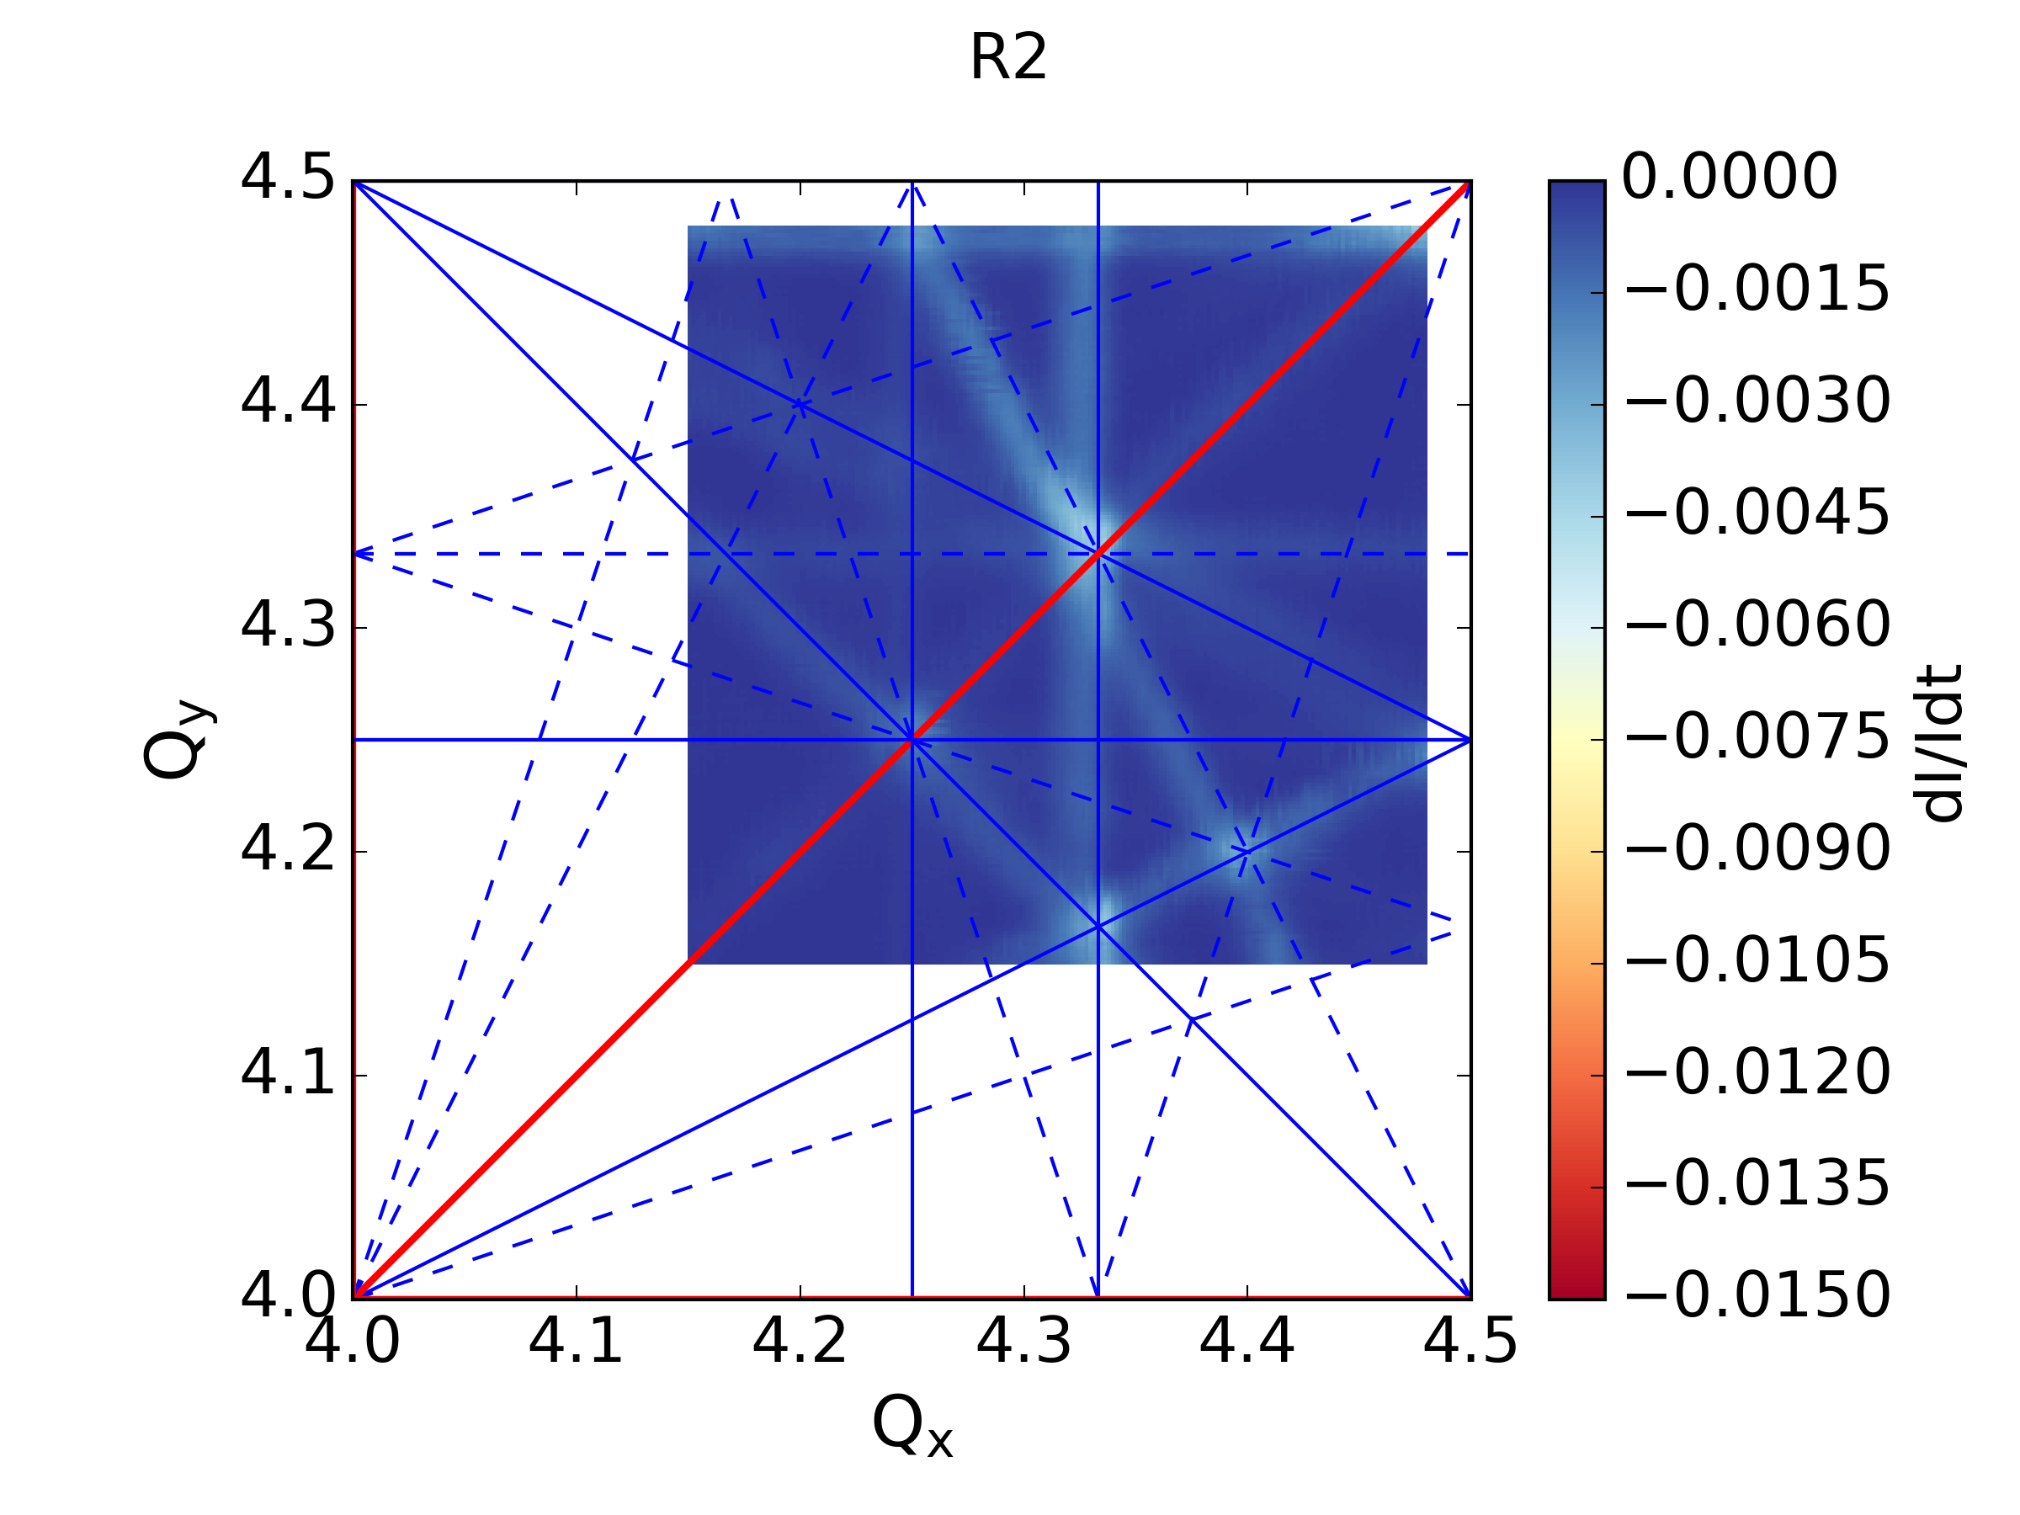
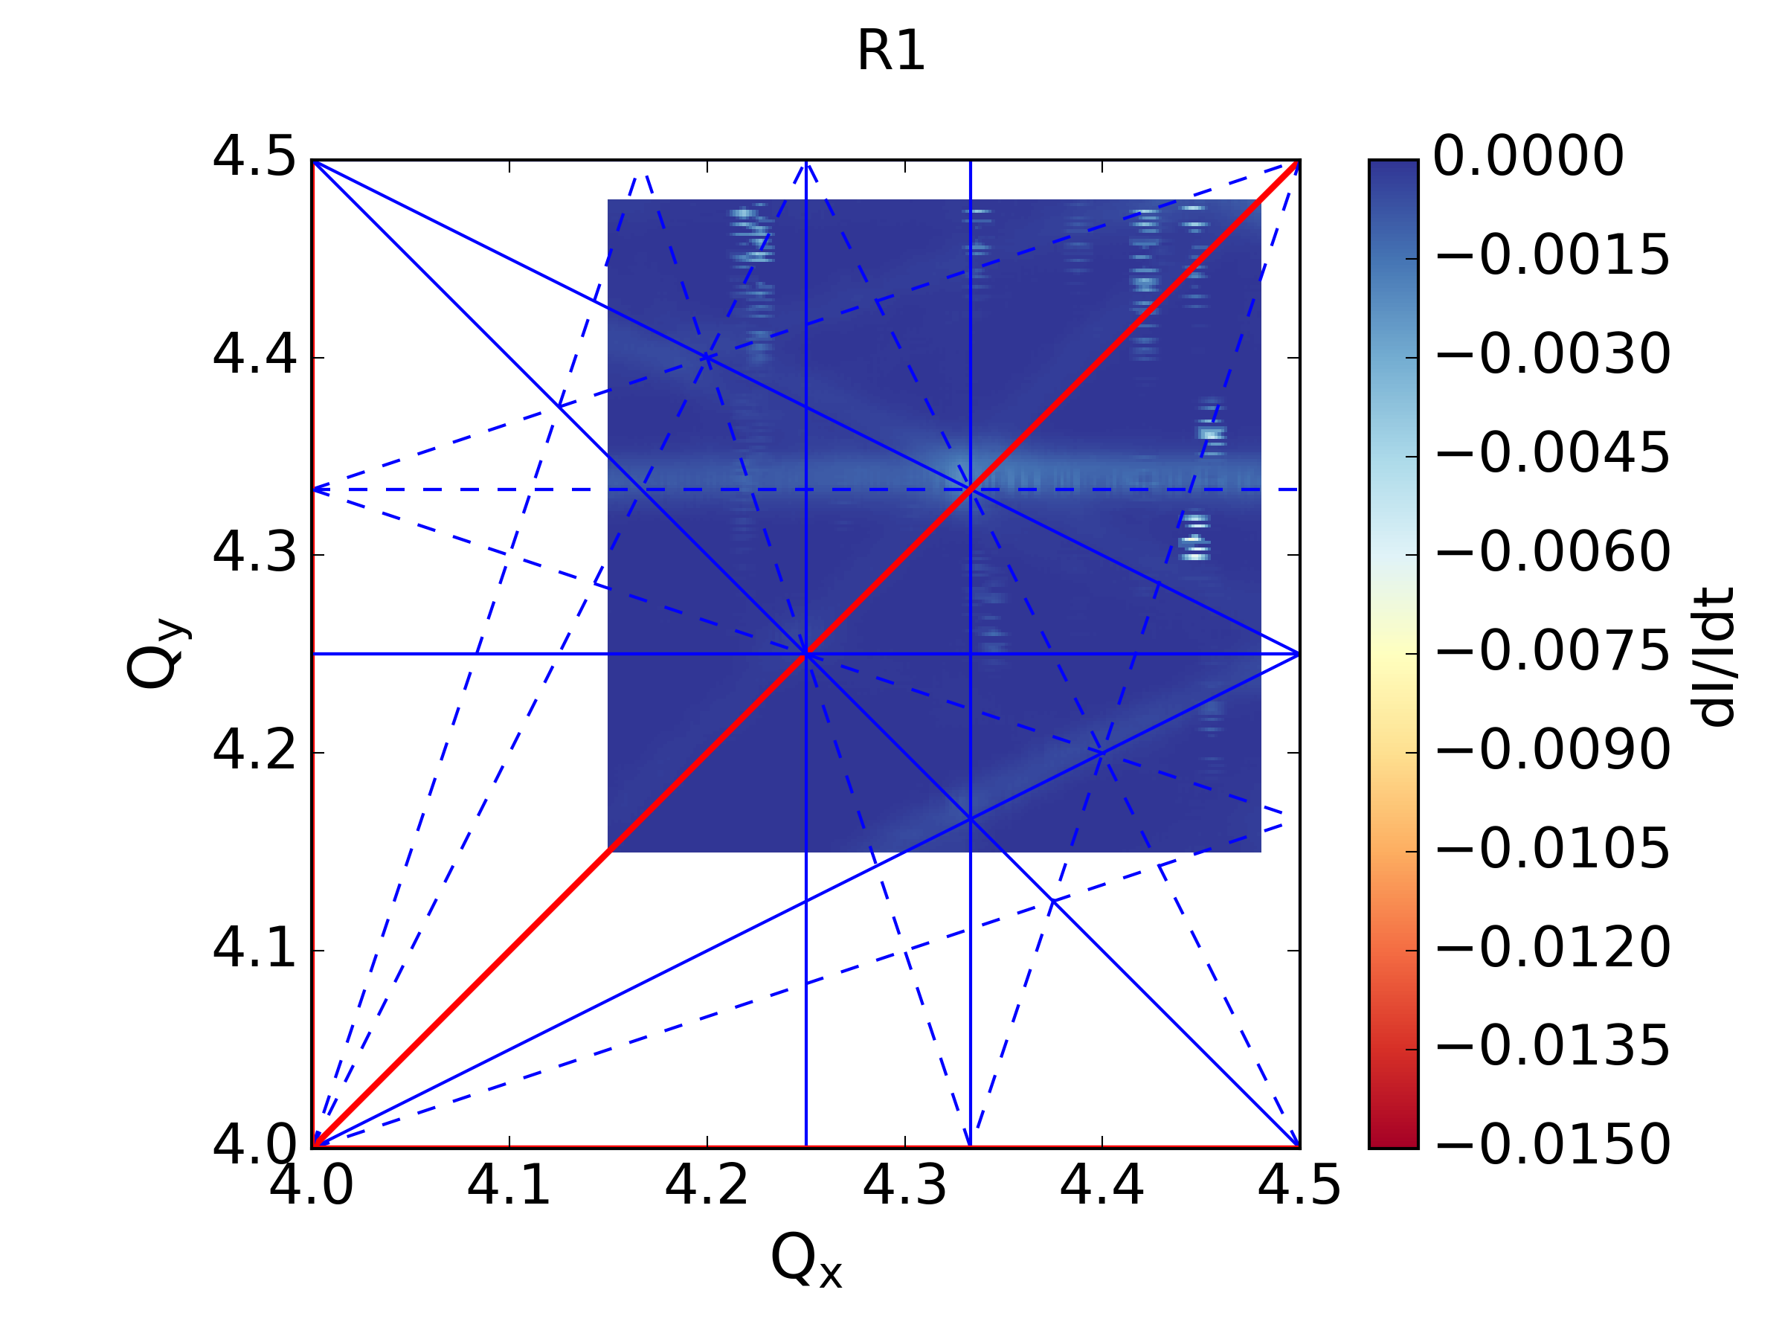
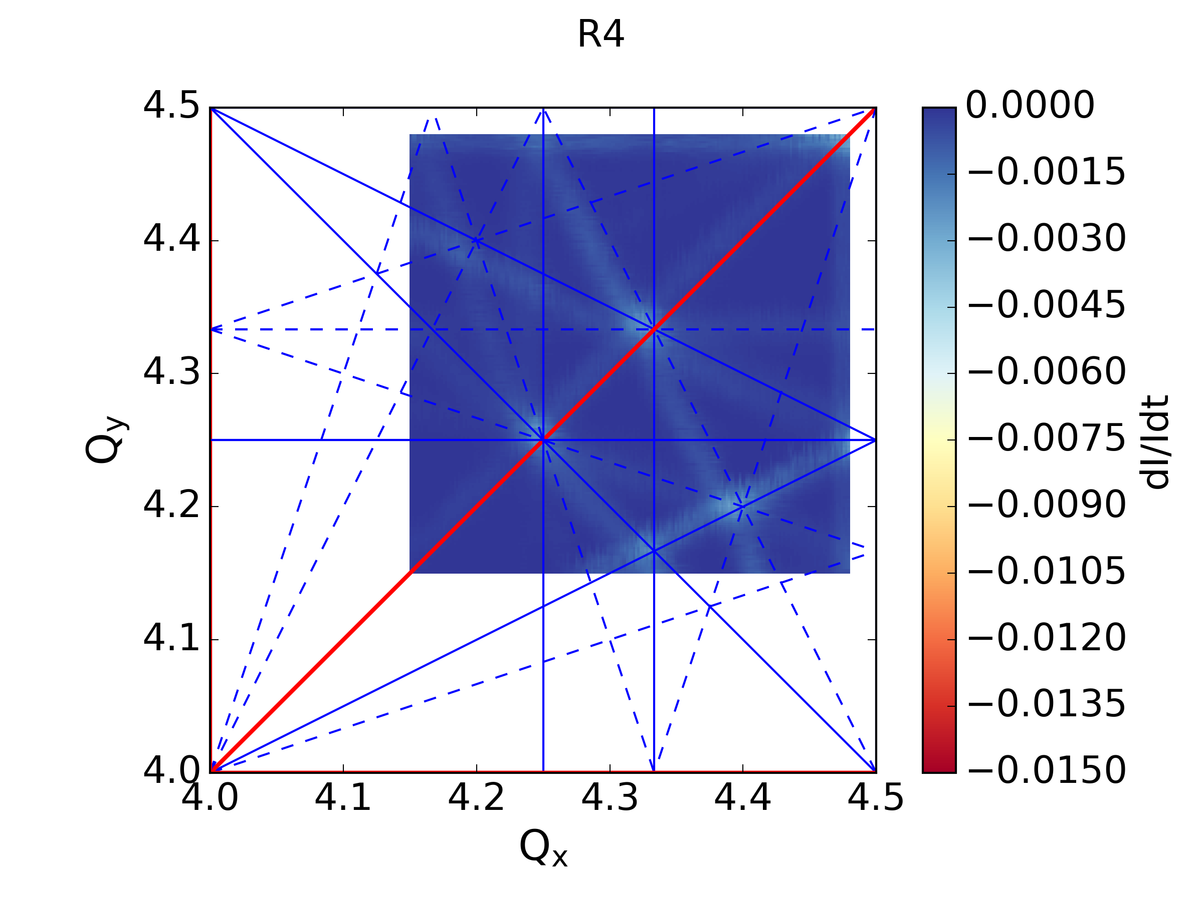
Resonance Compensation – Globally
Testing the global configurations
Significant suppression
current limitations &/or limited # of correctors
Not possible to refine solutions for partially compensated resonances
Significant cross-talk of corrections & resonances – misalignment & FeedDown
Optimization Framework GeOFF
Fast convergence for individual resonances
Flexible to add extra corrector magnets either for investigations of individual resonances or global settings
Better compensation of partially corrected resonances using more correctors
Global settings for all rings (including cross-talks)

Slide 9
Resonance Compensation - Summary
Final configuration
Natural excitation
Analytical estimations
All resonances suppressed in the operational regime
All studies at low energy – global configuration cannot be scaled (corrector current limitations)

Slide 10
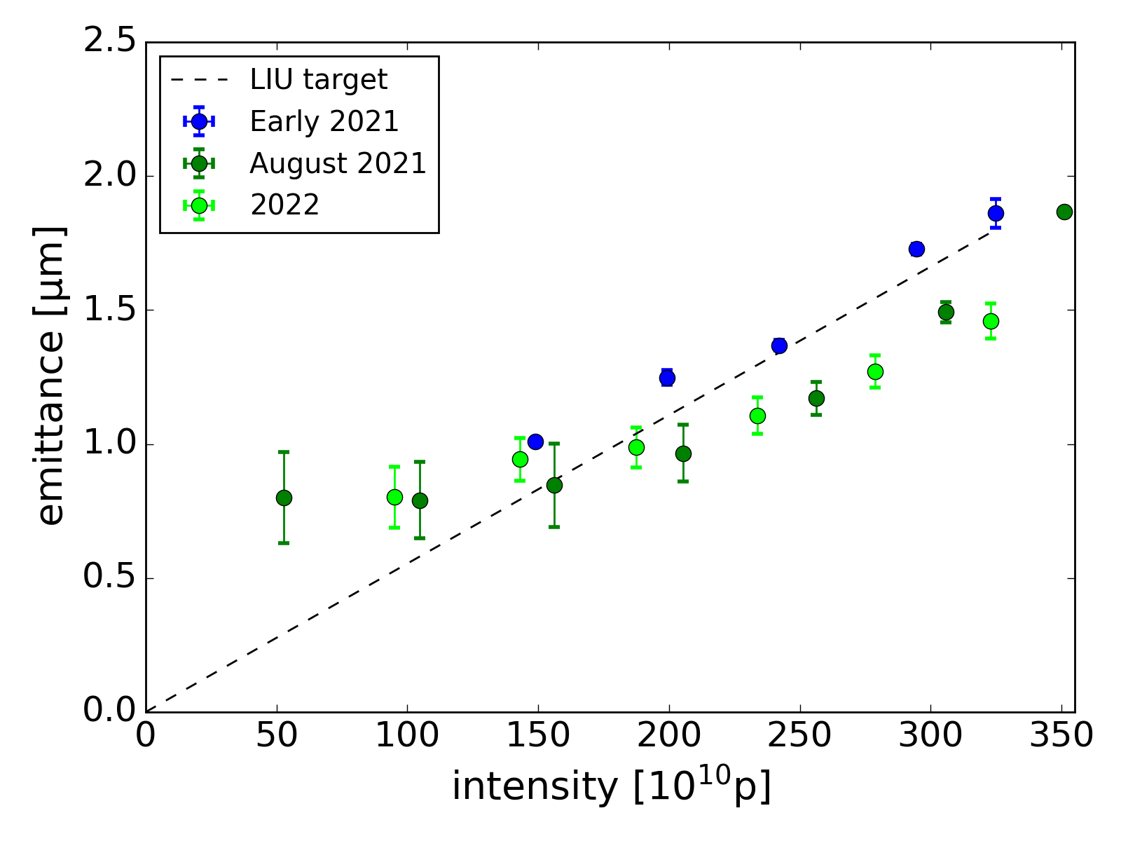
High Brightness beams
LIU target for the LHC brightness already achieved using the individual resonance compensation settings
Changing correctors while crossing resonances
LIU target exceeded when including
global resonance compensation
β-beating correction
applying the design working point evolution
Large transverse tails are observed causing losses at LHC injection – especially for “BCMS” regime
note emittance plateau for the BCMS regime up to ~150e10 (injected emittance & foil scattering)

Slide 11
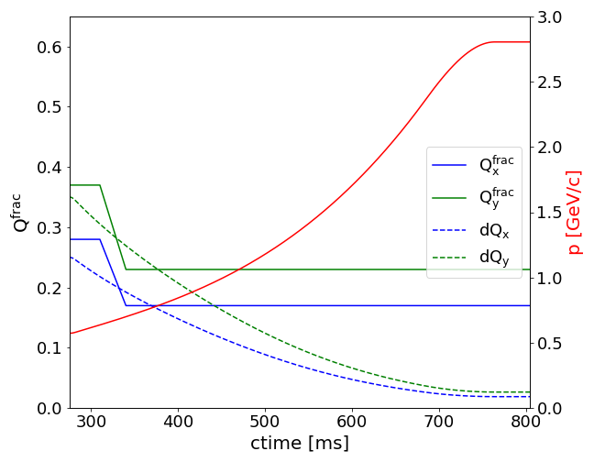
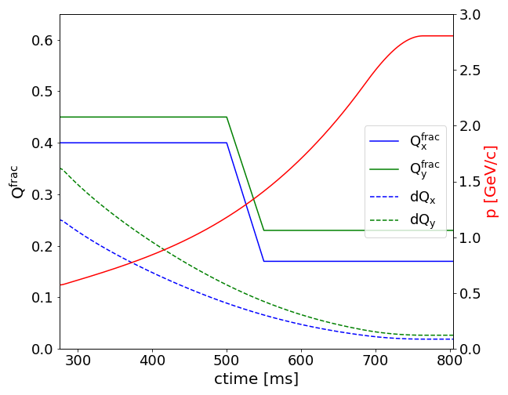
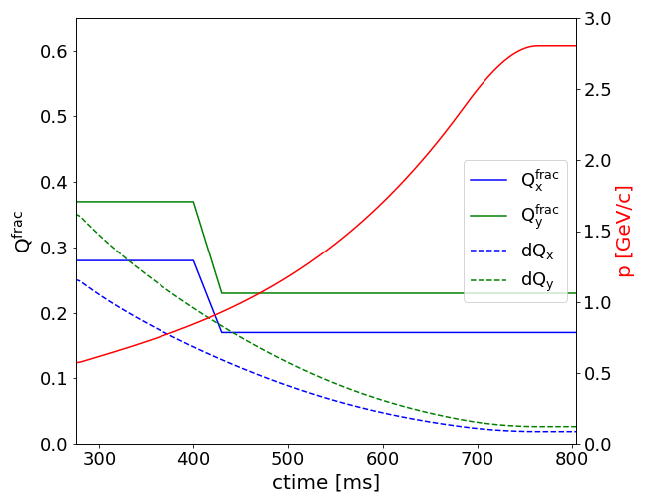
High Brightness beams – Transverse tails
High Injection Tunes (4.4/4.45):
minimizing interaction with integer resonances for low energy that causes: significant emittance blow-up
Ramp to resonance free space (4.17/4.23):
minimizing interaction with higher order resonances that can cause: Losses Emittance blow-up Transverse tails
Nom
note emittance plateau for the BCMS regime up to ~150e10
Smaller space charge tune shift
lower injection tunes (4.37/4.28)
faster ramp down
ramping down even faster - minor blow-up
OptB
OptT

Slide 12
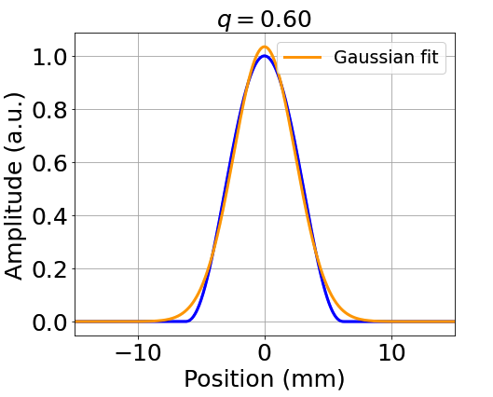
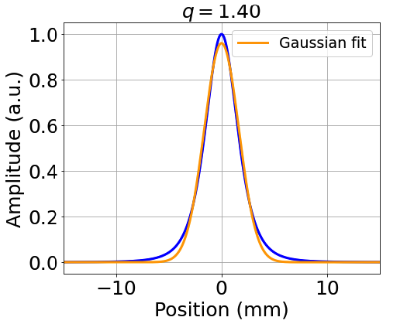
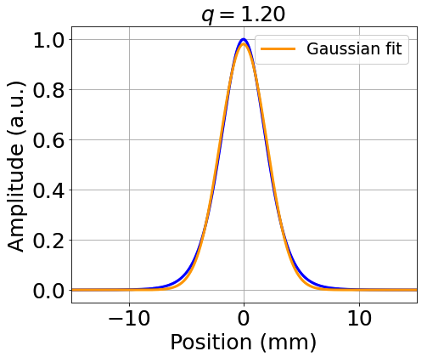
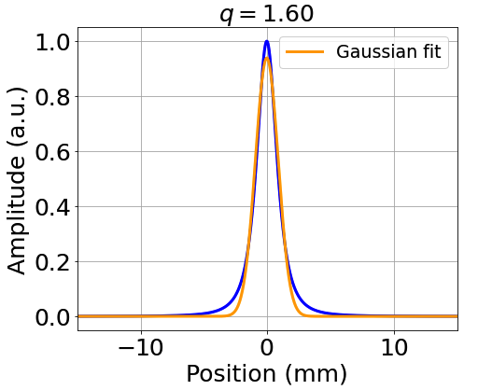
Transverse tails characterization – qGausian
Generalized Gaussian function:
q-factor characterizes the tail population:
$q=1$ : Gaussian tails
$q>1$: overpopulated tails
$q<1$: underpopulated tails
$β$ controls the height/width:
$σ_{QG}=\left\{\begin{aligned}{\left[β\left(5−3q\right)\right]}^{−\frac{1}{2}}, q<5/3 \\ ∞, \frac{5}{3}≤q<2 \\ undefined, 2≤q<3\end{aligned}\right.$
T. Prebibaj et al.: LN4/PSB MPC #66

Slide 13
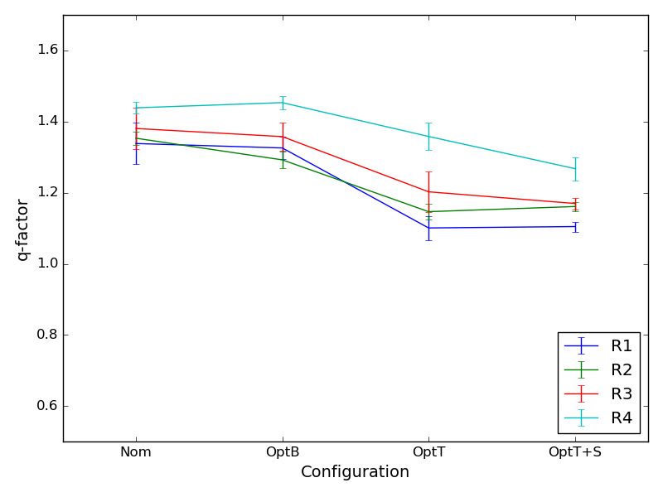
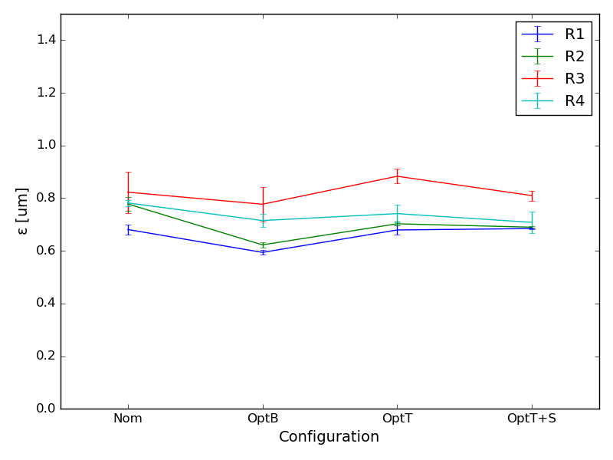
High Brightness beams – Transverse tails (V)
Checking the different configurations (Nom, OptB, OptT, & OptT + Shavers) in the PSB:
Minor impact on emittances (brightness) for the nominal BCMS intensity (~85e10)
Tail content reduces in all rings – from ~1.4 to 1.2
Variation of tail content per ring – R4 seems to always behave worse than the others
Shaving doesn’t give any substantial impact (for rings other than R4)

Slide 14
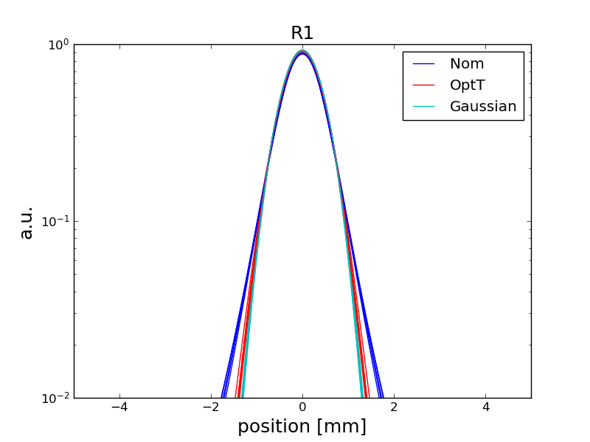
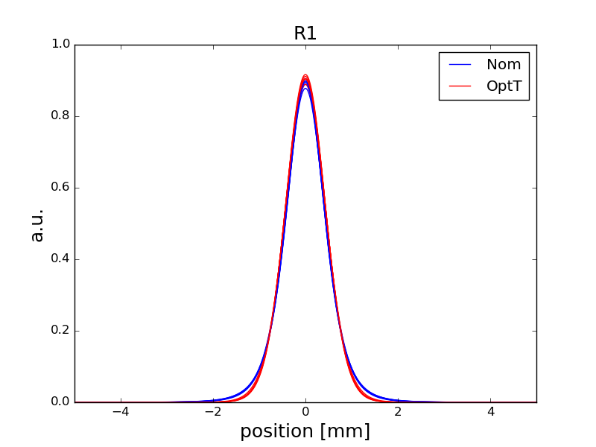
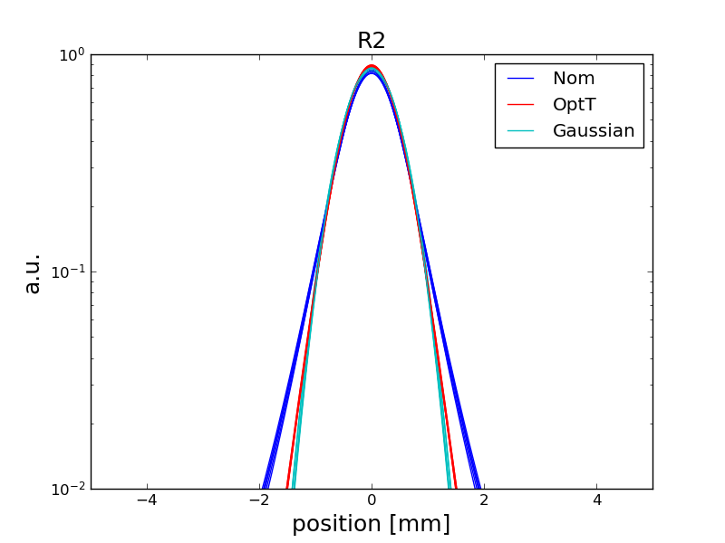
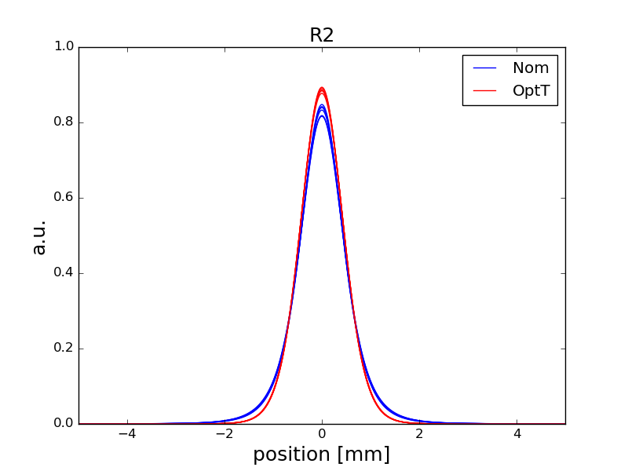
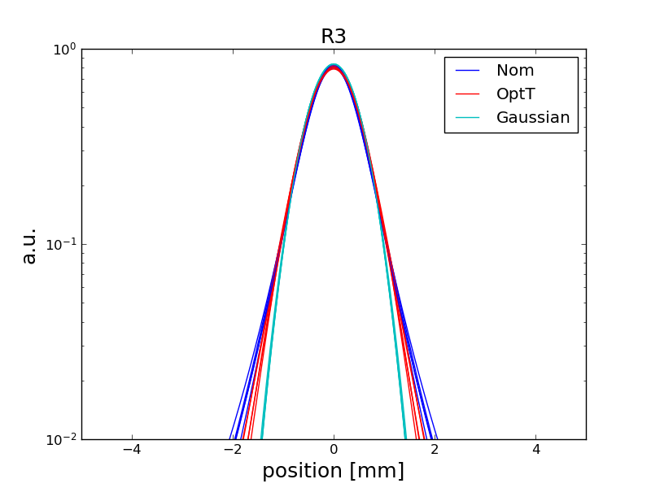
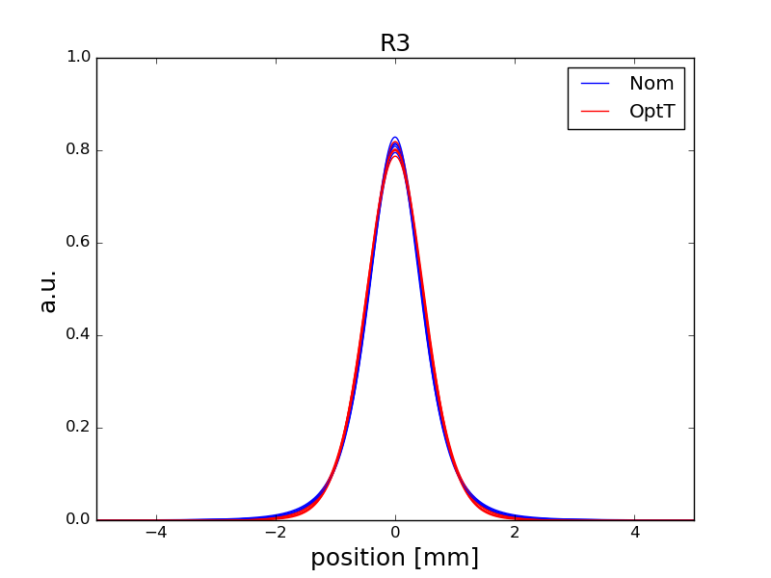
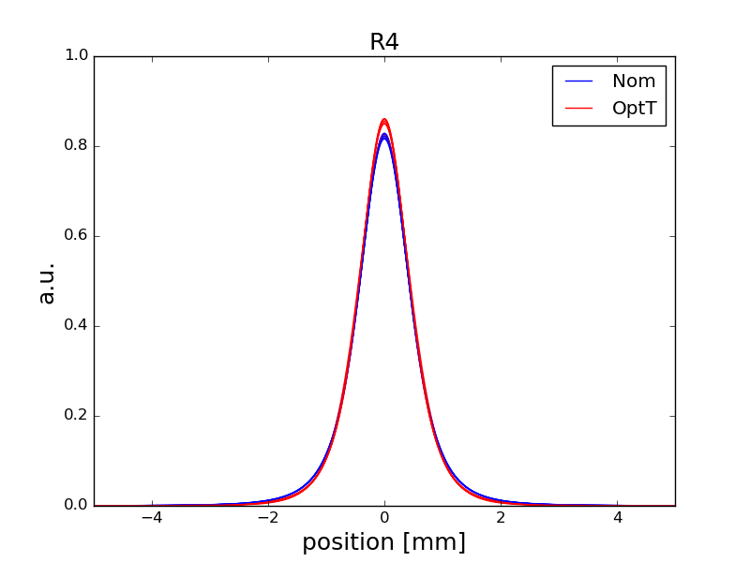
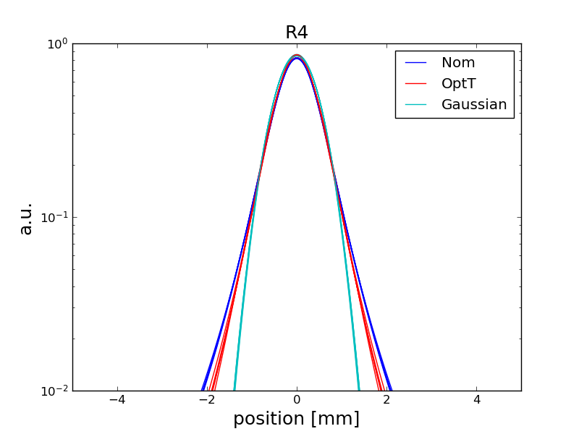
High Brightness beams – Transverse tails (V)
Comparison of the vertical profiles in all rings for the Nominal (Nom) and Optimized Tails (OptT) variants show reduction of the transverse tails
Plotting in logscale to better characterize the tails – Gaussian for reference
R1 & R2 seem to benefit the most showing the largest tail reduction
R3 & R4 show some improvements but less significant.

Slide 15
Summary & Outlook
Studies for resonance identification revealed excited resonances up to 4th order in all PSB rings.
Through compensation studies combining analytical, experimental techniques & the optimizer:
Compensation (full or partial) of all observed resonances
Schemes for the simultaneous compensation of multiple resonances
Target LHC brightness achieved with satisfactory compensation of all observed resonances
Working point & resonance compensation modifications for the LHC beam reduced the transverse tails in all rings (q-factors: 1.4 -> 1.2 still not Gaussian!)
Ring-to-ring variations are observed
Include measured errors (through compensation values) in simulations to improve the model
using the machine model
Refine compensation schemes &
Investigate different configurations for the compensation that can be scaled with energy
Investigate ways for reducing the transverse tails with higher brightness – S. Albright talk

Slide 16
Summary slide, 5th ICFA mini-workshop on Space Charge
Theme: Bridging the gap in space charge dynamics
In 1-2 sentences, summarize the content of this presentation
(If relevant, specify type of facility, species, tune shift):
The CERN PSB defines the maximum brightness for the proton chain while operating on a maximum space charge tune shift of -0.5/-0.6
Identification & compensation of multiple non-linear resonances both individually & globally to maximize brightness
Proposal of alternative operational scenarios to balance brightness & transverse distribution quality
From your perspective, where is the gap regarding space charge effects? (understanding/control/mitigation/prediction/?)
Refining & understanding the modeling of the higher order nonlinearities to better predict (& overcome) limitations imposed from their interplay with the strong space charge effects
What is needed to bridge this gap?
Measurements of the nonlinear components, with independent methods to get the most accurate description (e.g., through induced losses & compensation, beam spectrum, magnetic measurements)
Benchmarking experiments to validate simulation models and characterize the effects
Resources for lengthy space charge simulations

Slide 17
Thank you for your attention!

Slide 18
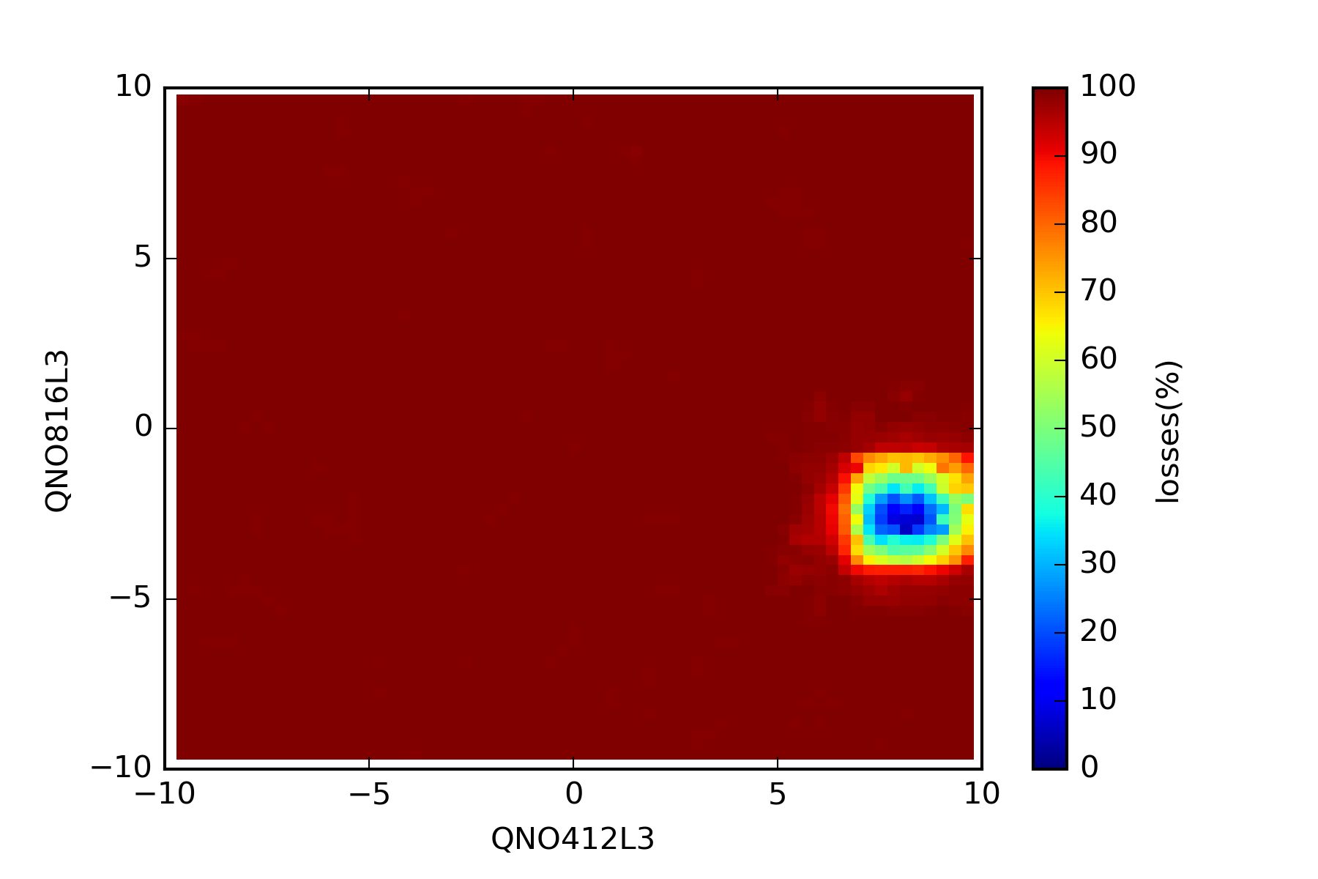
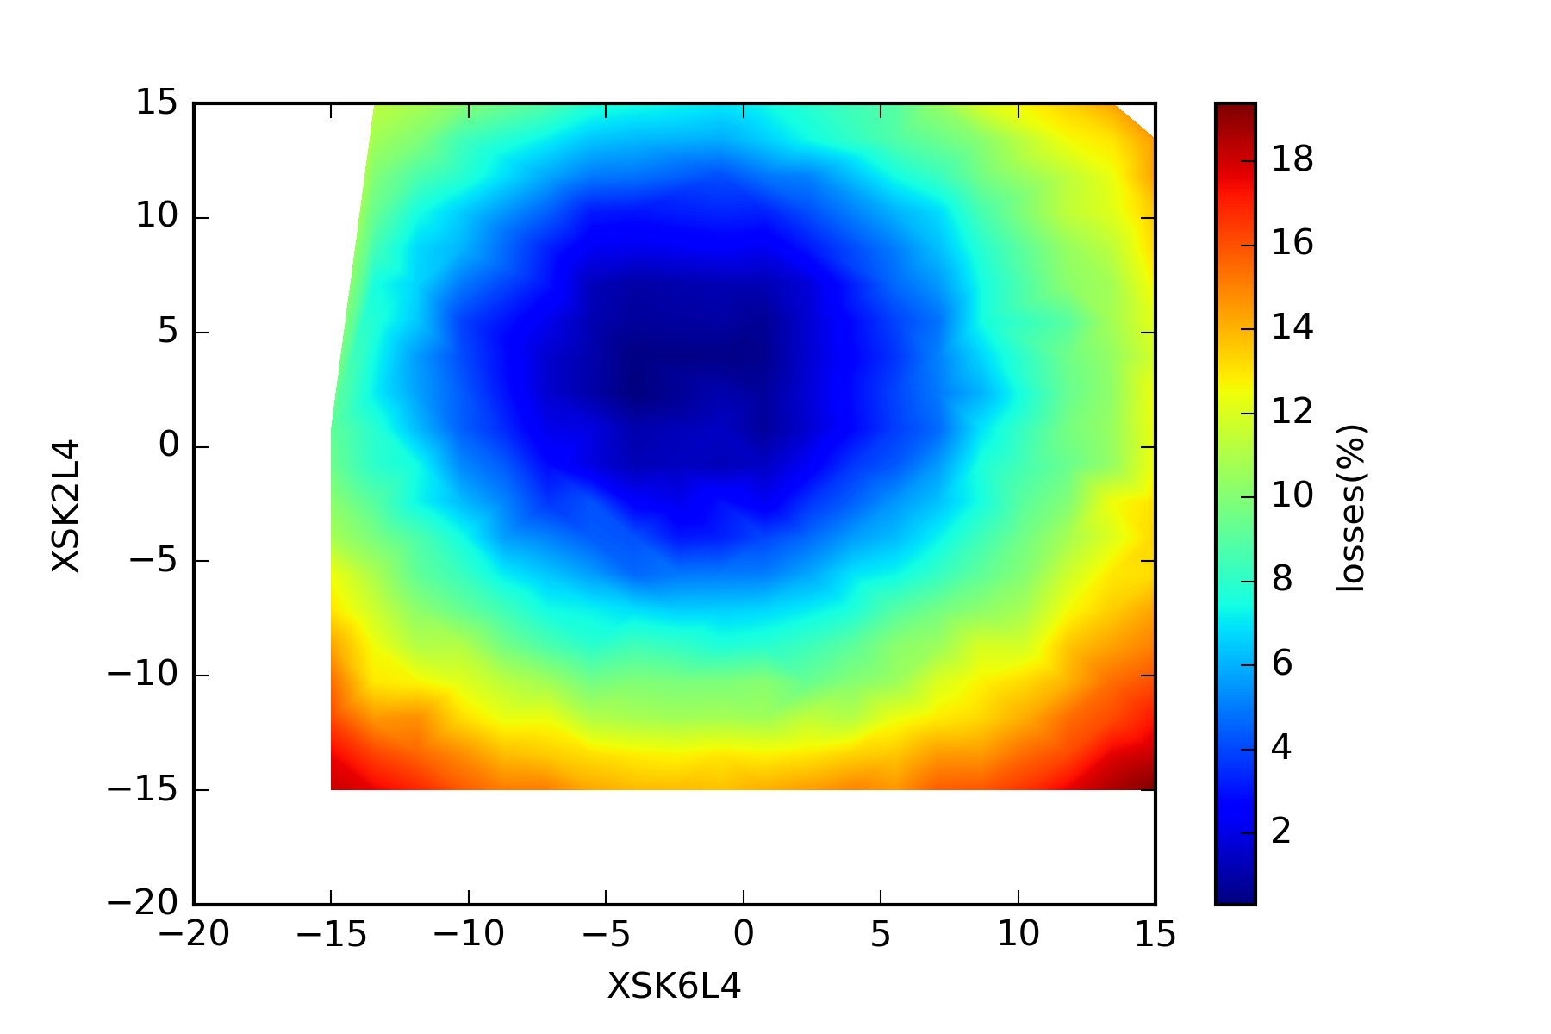
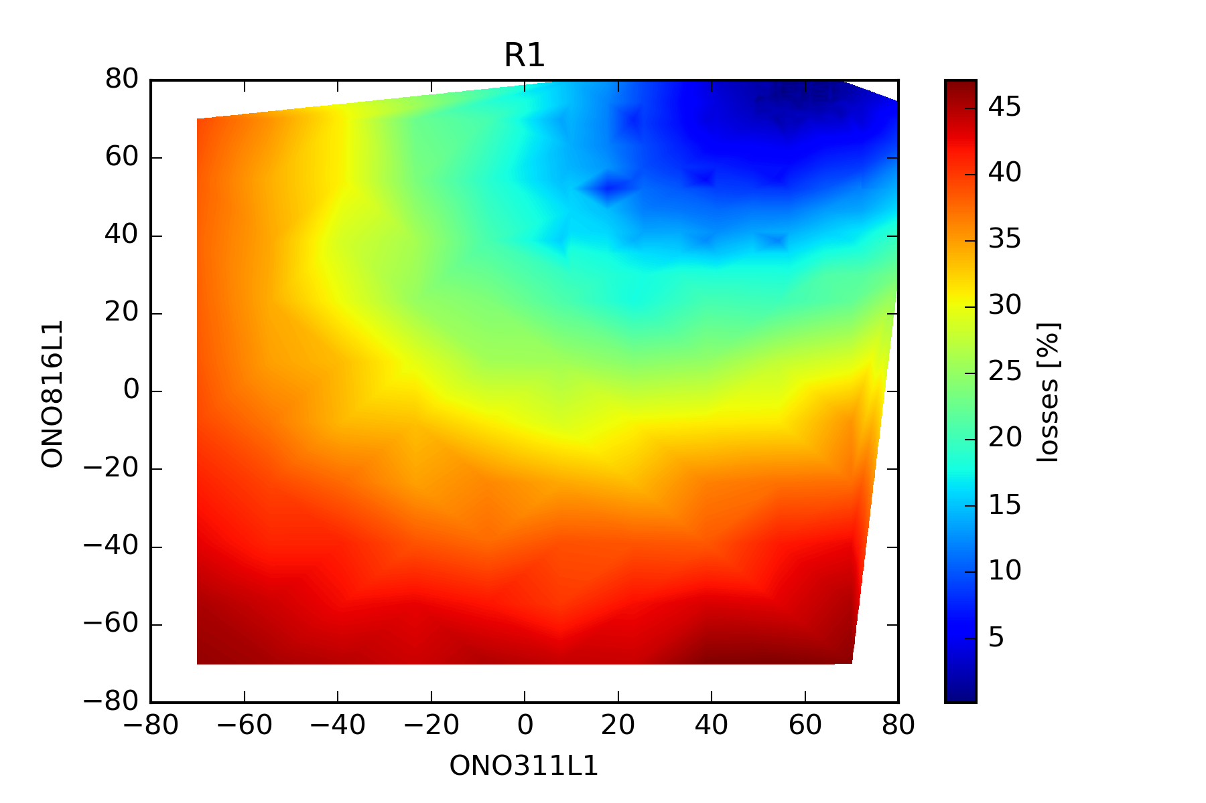
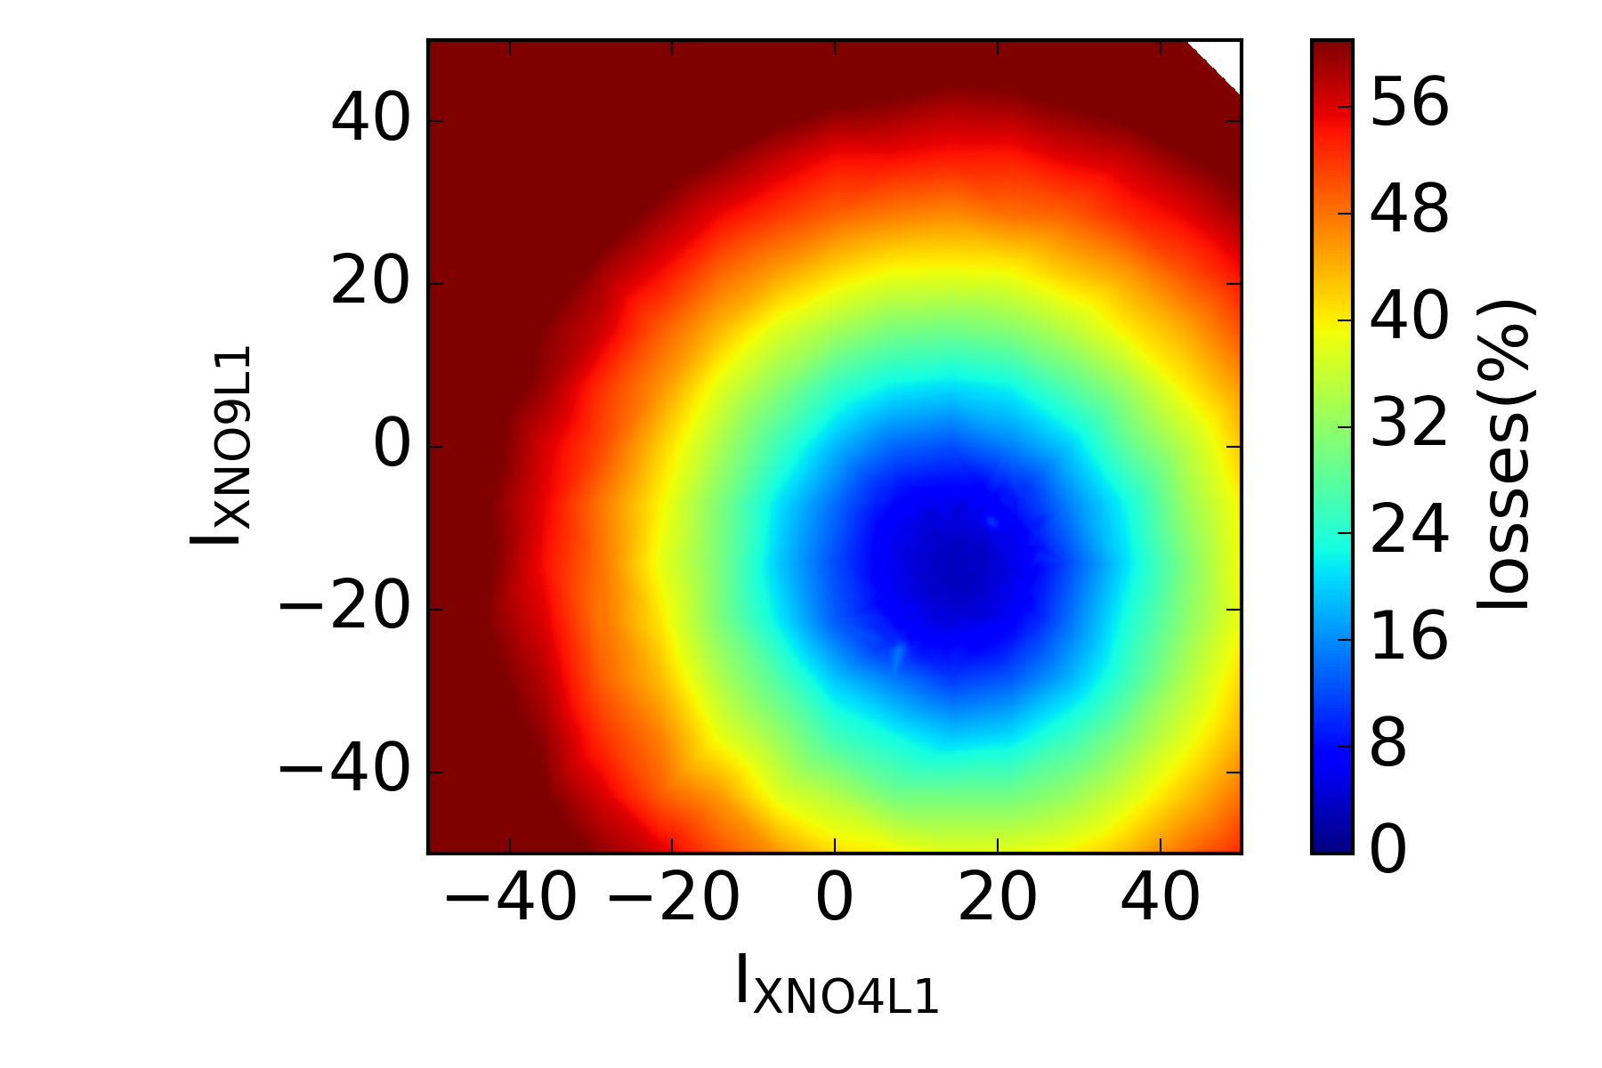
Resonance Compensation – Individually
For each resonance:
Resonances dynamically crossed
Identified suitable correctors
Vary currents while monitoring losses
Verify configuration
Partial compensation of 2Qy
Full compensation of all 3rd order resonances
Partial compensation of 4th order resonances due to current limitations
2nd Normal
3rd
Skew
3rd
Skew
3rd
Normal
4th Normal
Current
limitations

Slide 19
Resonance Compensation
Individual resonance compensation
 |  |  | Normal Sextupole |  |  |  | Skew Sextupole |  |  |  | Octupole
 | 2Qy |  | Qx + 2Qy |  | 3Qx |  | 2Qx + Qy |  | 3Qy |  | 4Qx / 2Qx+2Qy / 4Qy
 | QNO 412L3 | QNO 816L3 | XNO 4L1 | XNO 9L1 | XNO 4L1 | XNO 9L1 | XSK 2L4 | XSK 6L4 | XSK 2L4 | XSK 6L4 | ONO 4L1 | ONO 816L1
R1 | 9.16 | -3.11 | 0 | -10.56 | 8.57 | -20 | -4 | -3.67 | -8 | 2.15 | -44.7 | -49.9(12L1)
R2 | 10.5 | -3.1 | 15 | -12.85 | 25.7 | -34.99 | 4.83 | -1.33 | 0.43 | -1.19 | - 46.66 | 47.77
R3 | 7.83 | -2.9 | 3.58 | -39.99 | 10.9 | -39.64 | 2.37 | -3.95 | -1.33 | 2.78 | -39.5 | -44.7(12L1)
R4 | 9.51 | -2.23 | 15 | -9.44 | 20 | -17.14 | -3 | -4.67 | -2.43 | -1.86 | -49.9 | -49.9(12L1)
Similar to Pre-LS2
Different from Pre-LS2
New resonances
Correctors connected in 2021
All values in Amps

Slide 20
High Brightness beams – Transverse tails
Typical operation, excited resonances are crossed
Normal sextupoles
Skew sextupoles
Normal octupoles
Improved situation only 1 resonance of each sextupole type is crossed:
Less correctors
Lower power
allows ramping corrections to follow the ramp of the main magnets
Better control of resonances

Slide 21
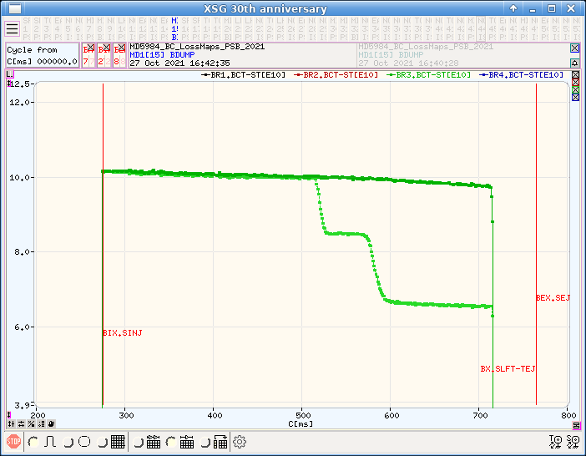
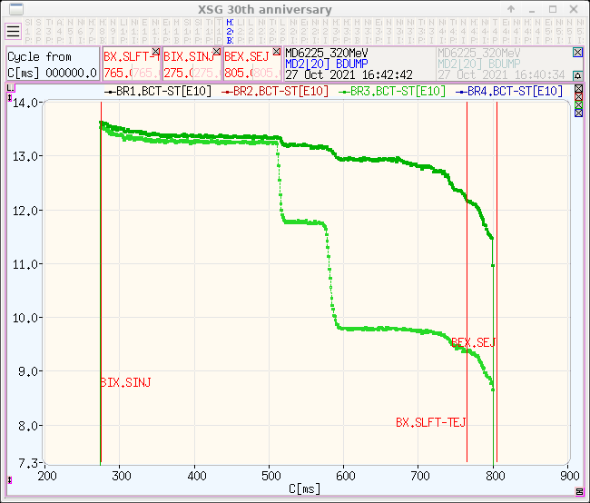
Resonances Along the Cycle
Resonance compensation settings are defined at injection energy
Should the settings scale with energy?
3Qx & Qx+2Qy perfectly compensated @160 MeV
Constant I @ 320 MeV
Partial compensation of the resonance
Constant K @ 320 MeV
Not possible to test due to current limitations
Investigate different options for scaling the compensation

Slide 22
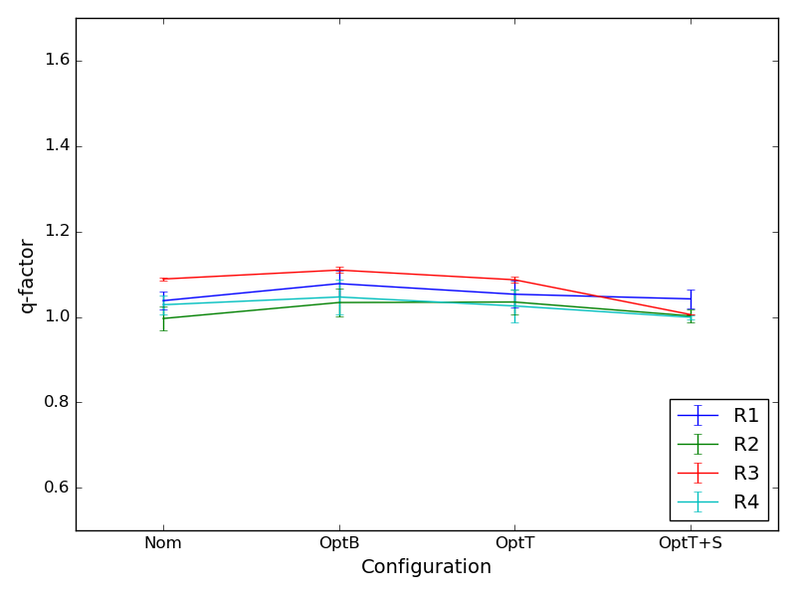
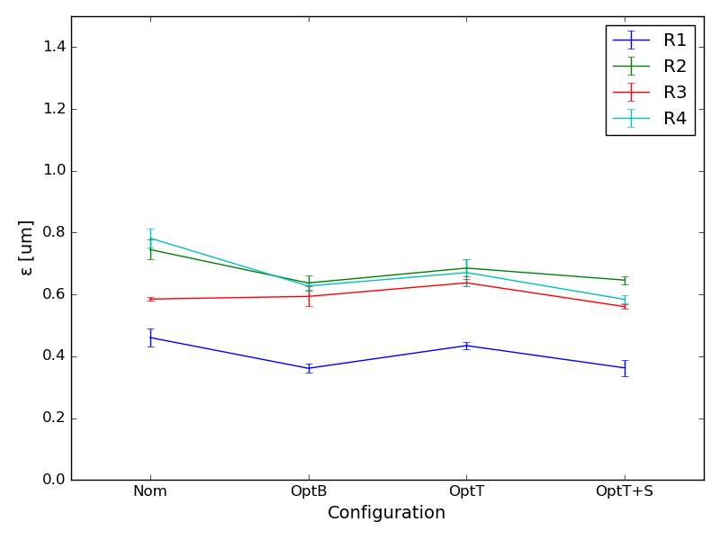
High Brightness beams – Transverse tails (H)
Checking the different configurations (Nom, OptB, OptT, & OptT + Shavers) in the PSB:
Minor impact on emittances (brightness) for the nominal BCMS intensity (~85e10)
No variation of tail content
Tails in the horizontal plane cannot be seen in the PSB due to dispersion & dp/p
Testing with <dp/p again not possible to observe tails

Slide 23
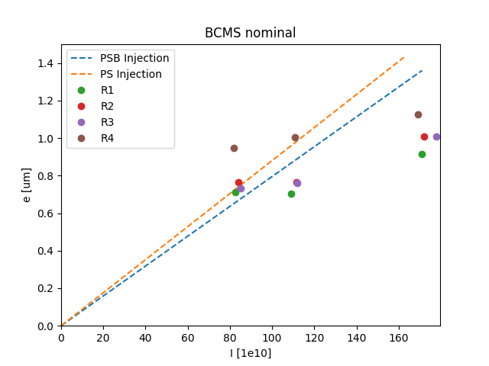
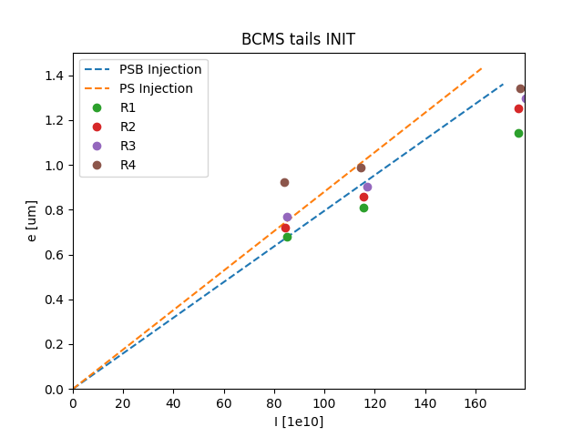
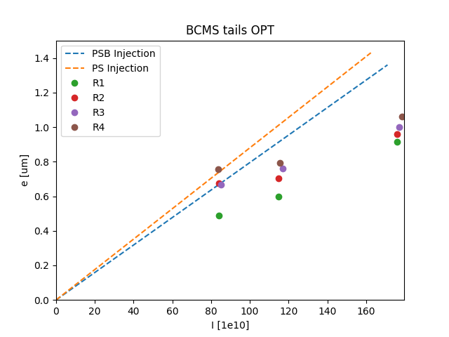

Slide 24
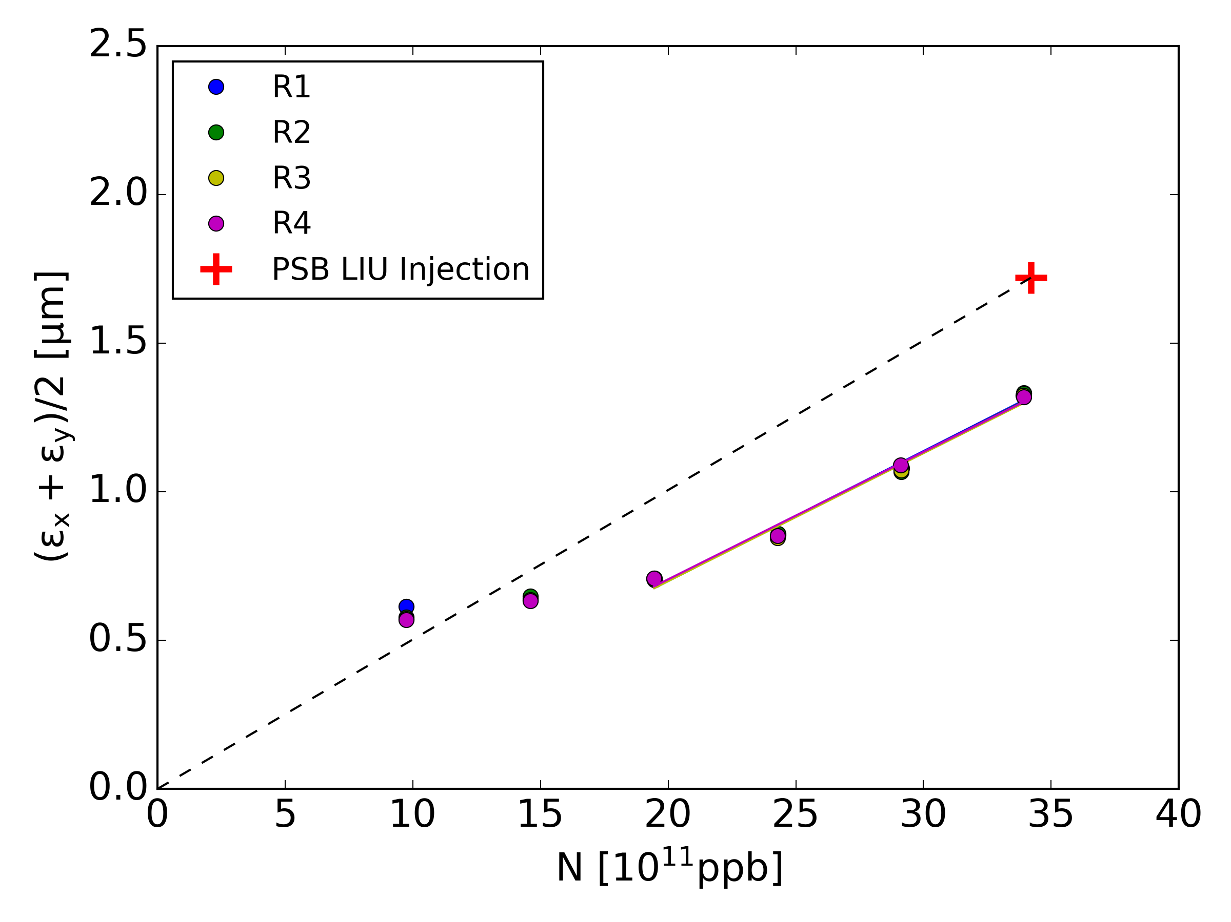
Brightness curve – “realistic” simulations

